Slide 1

ACCSYS Publication Committee
J. G. Weisend II
Deputy Head of Accelerator Projects
September 23, 2015

Slide 2
Introduction
Since the beginning of the ACCSYS Collaboration, a policy regarding publications has been in place (see attached policy)
This has not really been implemented so far but with the increasing amount of work and resulting publications, the goal is to start formally using the policy.
The policy provides for a publication committee consisting of:
  Chair (J. Weisend) and representatives from each collaborating institution.

Slide 3
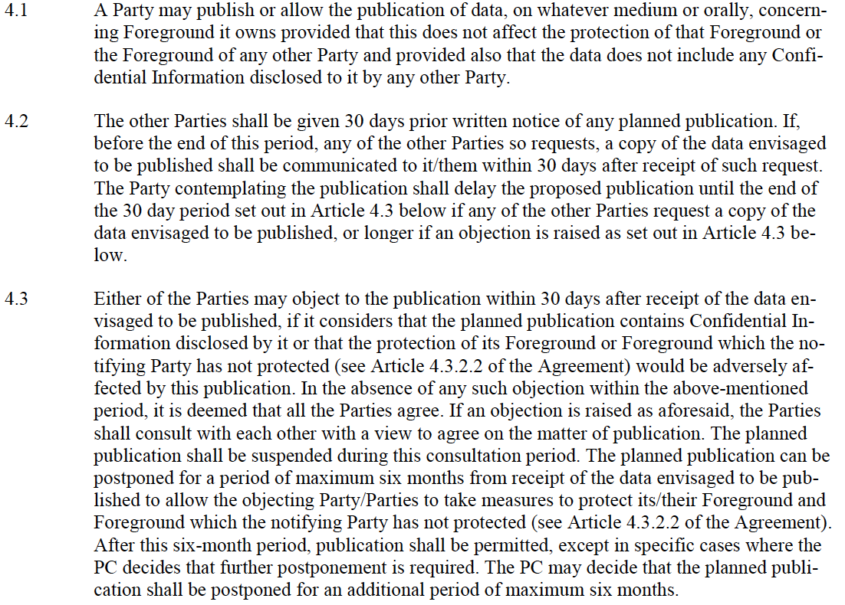
Primary purpose of the publication committee
Is to Implement the policy; in particular

Slide 4
Proposed definition of “Publication”
The proposed definition of publication for this policy is: “Content that is released either orally or in writing to any journal (including online journals) or any formal conference or workshop that involves parties outside the collaboration”
It is proposed that the following activities are not considered “publication” and are not subject to this policy
  Meetings, reviews and reports internal to the collaboration including such items as monthly reports, design and project reviews (even those with external members such as TAC, Annual Review etc.), safety reviews, CCB actions, working groups and discussions.
  Use of information in academic settings: classes, seminars, short courses, webinars etc. Use of good judgment is expected here.
  Use of information in informal discussions with other institutions and vendors including industry days. Use of good judgment is expected here.

Slide 5
Next Steps
Establishment of the committee (email from J. Weisend this week)
Provision of abstracts for items that meet the definition of publication above to J. Weisend (john.weisend@esss.se) for distribution to the rest of the committee.
After some experience is gained, possible alteration of the policy based on lessons learned.
Its expected that the committee will do the bulk of its work via email
Other possible future activities of the committee include:
  Maintaining a bibliography of all project publications
  Helping to advertise upcoming upcoming opportunities for publication ( journals, conferences, workshops) and helping to ensure appropriate representation of ESS
Note that the goal of this work is not to excessively inhibit publication or slow down information transfer

