Slide 1

WP Status & General Issues
J. G. Weisend II
Deputy Head of Accelerator Projects
September 23, 2015

Slide 2
Outline
Work Package Highlights
  Detailed status of all work packages may be found in monthly reports
  Selected highlights are shown today – Many slides contributed by WP Leaders
Work Package Audits and Design Reviews
  Audit on WP2 (Beam Physics)
  DTL CDR (June 22 & 23)
  ACCP PDR-1 (September 1 and 2)
  Component design reviews: IOT, beam instrumentation etc.
  Upcoming Reviews & Audits
Risk Update
Issues

Slide 3
Work Package Highlights
Summary:
ACCSYS is moving into final prototyping and production of actual components.
Major contracts are being placed and the pace of design reviews is increasing.
Significant progress has been made despite summer break.
Hands on work in starting in a number of local labs (Medicon Village, LTH and Utgård)
Numerous papers were presented at summer conferences

Slide 4
Work Package Highlights
WP1 Management
Held Annual Audit on WP2 (Beam Physics)
Held CDR for DTL and PDR-1 for the ACCP
Reorganization of AD (see M.L. talk)
Schedule improvements and setting of Ready for Installation milestones (see L.L. Talk)
WP2 Beam Physics
Baseline MEBT lattice released. This includes the updates and modifications as agreed by WP03
Phase scan studies of DTL with focus on tank 1
Magnet Schedule has been prepared through collaboration with in-kind partner
The method to perform matching to DTL with the tracking was extended from 1D to 3D.

Slide 5
Work Package Highlights
WP3 NCFE
The work on the L4 requirements has continued and more that 95% have been documented in DOORS and agreed to by ESS and the In-kind partners.
L4 interface requirements have been documented in spreadsheets and are being reviewed by ESS and partners.
Request of offer for the HV platform released
Market survey (AAPC) for RFQ completed, analysis on-going.
Production of Drift tube parts for prototyping ongoing

Slide 6
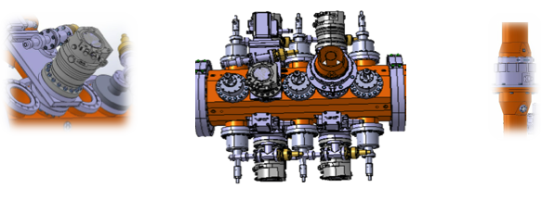
WP3: RFQ
RFQ mechanical assemblies showing the possibility to add gate valves if desired on the left, one fully equipped segment with gate valves (center) and the power coupler (right).

Slide 7
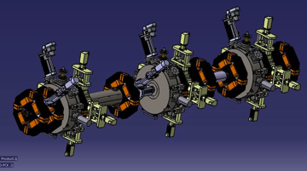
WP3 : MEBT
MEBT mechanical assembly showing currently agreed configuration for quadrupoles, bunchers and scrapers among other elements.

Slide 8
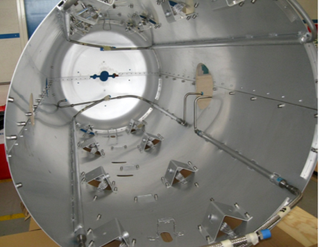
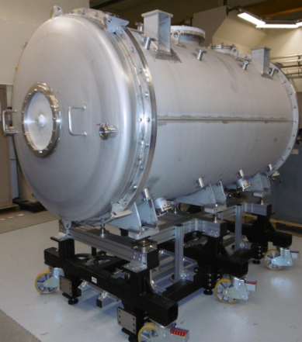
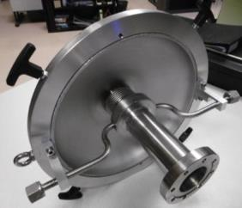
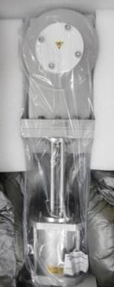
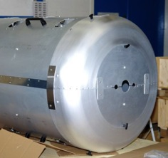
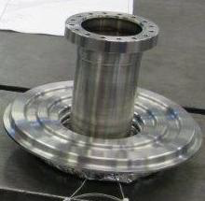
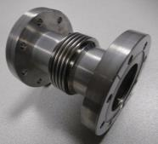
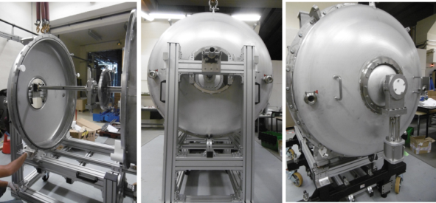
Spoke prototype cryomodule
Most of the parts are fabricated and delivered
Thermal shield
Vacuum vessel & its
Mechanical support
Gate valves
Cold/warm transition
First blank assembly of some parts
Coupler/vacuum vessel interface
Inter-cavity belows

Slide 9
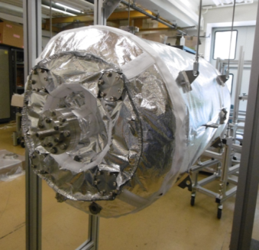
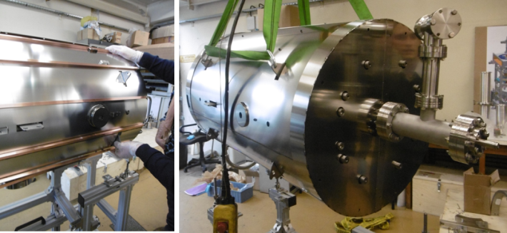
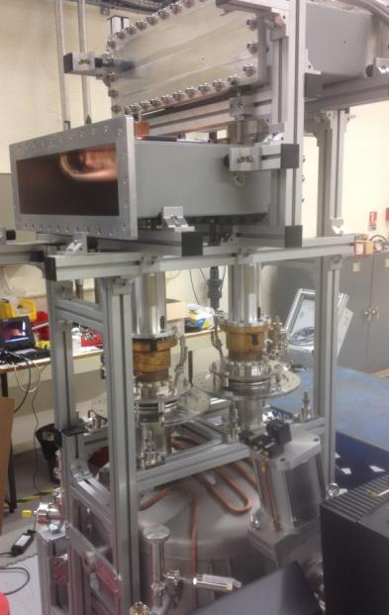
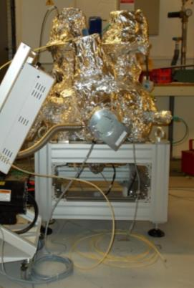
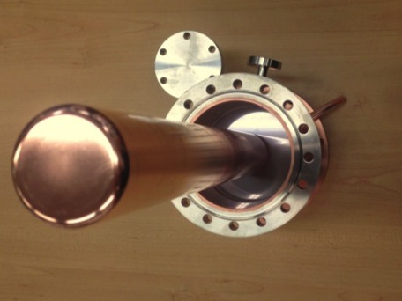
Cavity ancillaries & couplers
Magnetic shield
(2-layer Cryophy, actively cooled)
MLI for the cavity
1/2 height
WR 2300
Coupler baking stand
Power couplers: 4 units fabricated
Doorknob
Power coupler
window
Double-walled
tube
RF conditioning
Cavity with water cooling loop
1st coupler pair assembled on the conditioning stand & ready to be tested with RF at Saclay

Slide 10
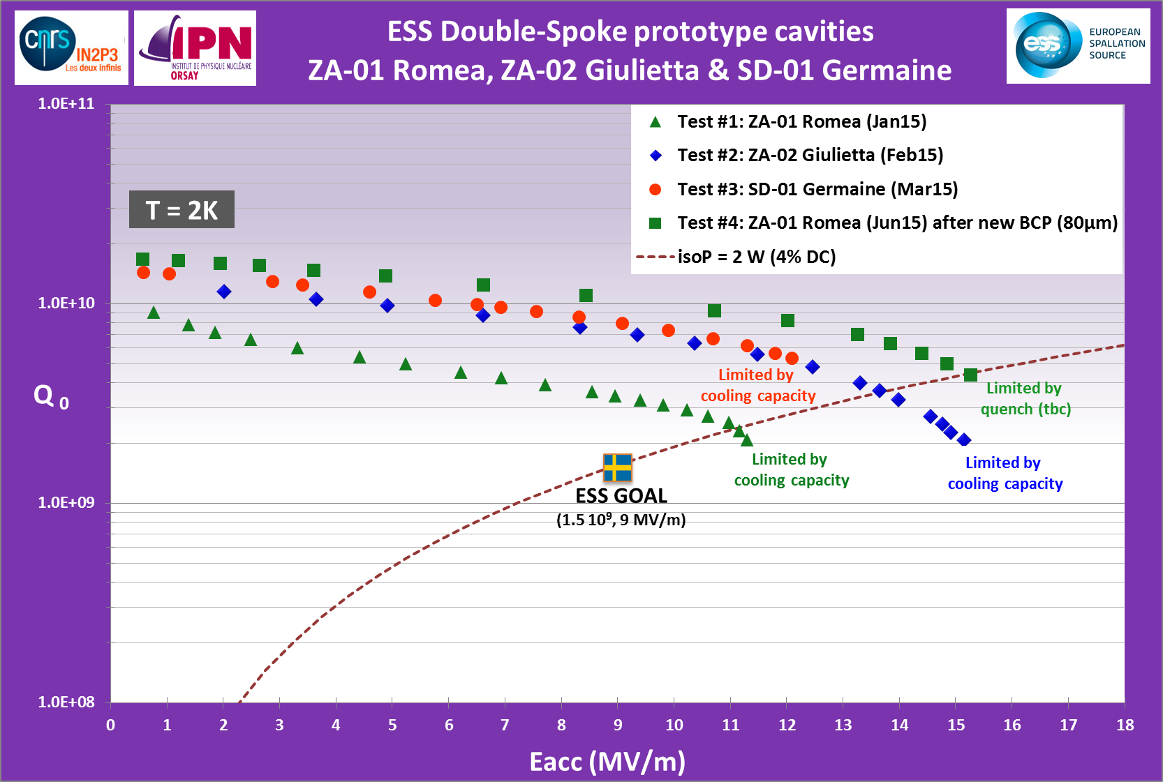
Latest Result (June) on Romea
Qo improved by  T_{acid max}:
30°C (Test #1)
25°C (Tests #2 & #3)
18°C (Test #4)
Improved surface treatment
All prototypes tested within the specs
« Bare results » : NO BAKING, NO HEAT TREATMENT
Lacc=3/2*βλ=0.639 m

Slide 11
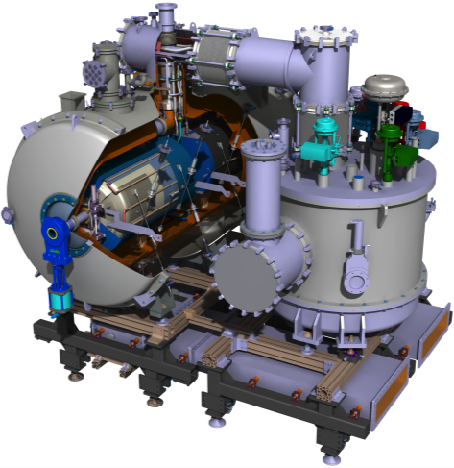
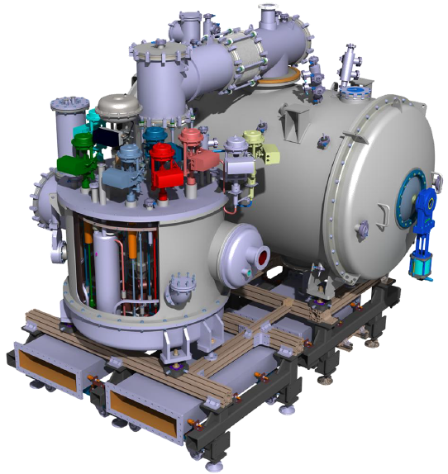
Spoke valve box
Heat exchangers, cryovalves and instrumentation (TT) to be received within 2 weeks. Valve box under fabrication.

Slide 12
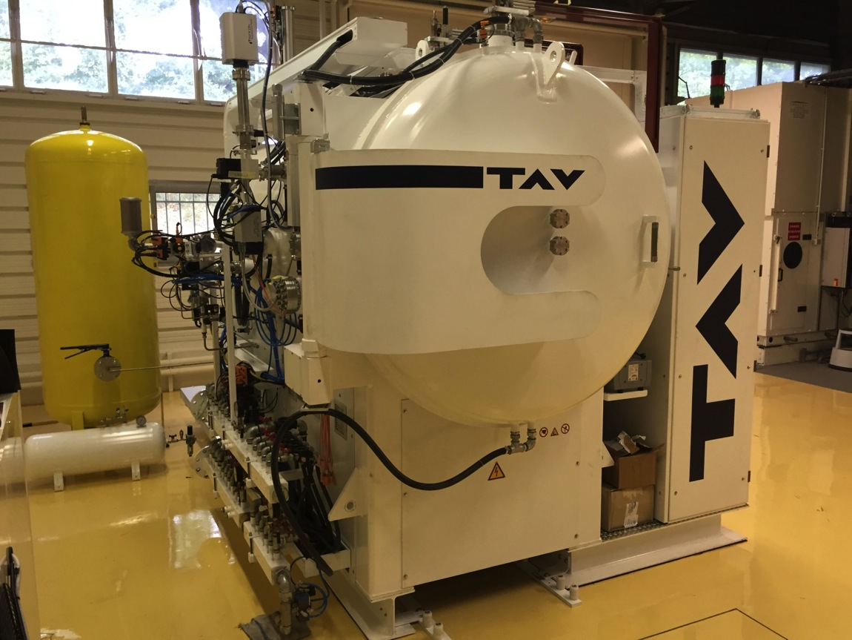
Vacuum Furnace for Cavity H degassing
Just received from TAV company. Installation and heat treatment procedure validation to be done within the next 2 months

Slide 13
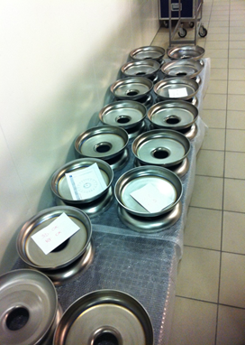
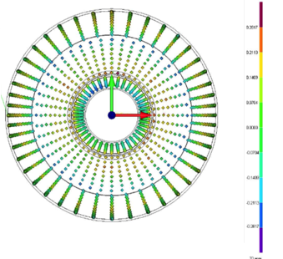
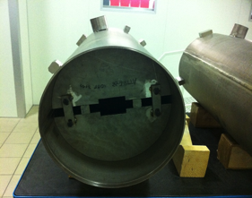
WP5: Elliptical Cavities & Cryomodules
Six medium beta cavities under fabrication at Zanon, A first bare cavity should be delivered to CEA by end of Oct. 2015
Medium beta cavity dumbbells
3D measurements show good shapes within the mechanical required tolerances.
The “only” deviation is the total length of each dumbells that is shorter of about 0.6mm than expected.
Helium tank
prepared for welding

Slide 14
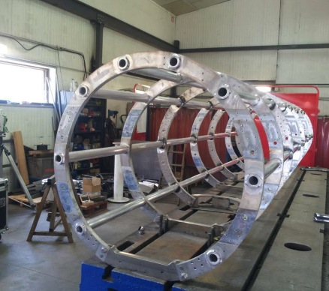
WP5: Elliptical Cavities & Cryomodules
Space frame of M-ECCTD at factory before shipment at CEA

Slide 15
WP6 Beam Delivery Systems
Participation in the Beam Delivery IVDR (June 2015)
Preparation for the Beam Delivery CDR in October

Slide 16
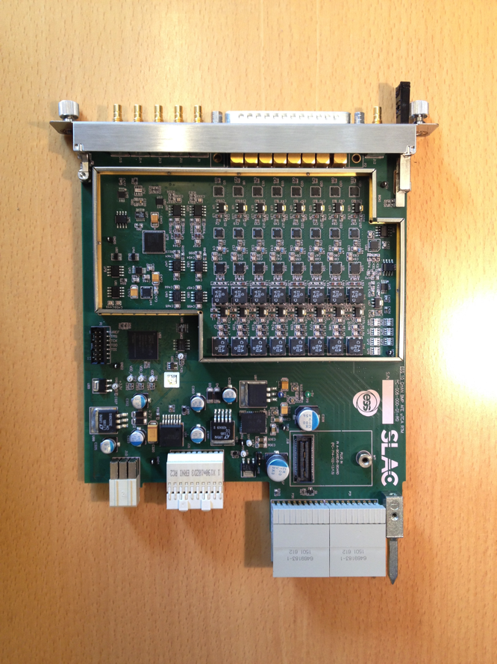
WP7 Beam Instrumentation
MicroTCA Prototype Rear Transition Module (RTM)
For use with BPMs and LLRF
Designed at SLAC, Produced in Lund
Testing with LLRF Systems to start this month

Slide 17
WP8: RF
  L3 IOT design review. Very good progress, L3 now expects to deliver 4-6 month earlier than planned
  Uppsala University has received first spoke RF power station. ESS was present for the first tests, and 405 kW at 352.32 MHz was reached without problems. Uppsala University will now measure all parameters of the power station against the statement of work to determine how well it performs.
  Testing of industry produced waveguide prototypes in ESS Lund RF lab

Slide 18
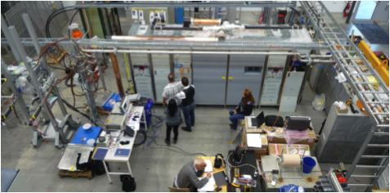
FREIA (Uppsala) First site tests of 352 MHz Power Station
Power Power station seen from above from above
400 kW peak power
352.21 MHz
3.5 ms pulse width, 14 Hz
Based on two tetrodes
Integrated station

Slide 19
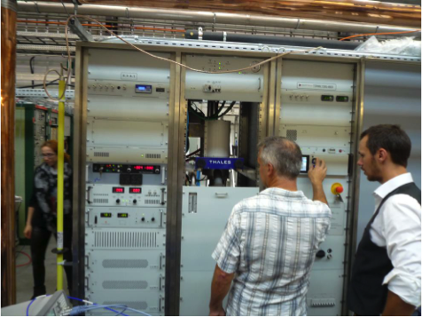
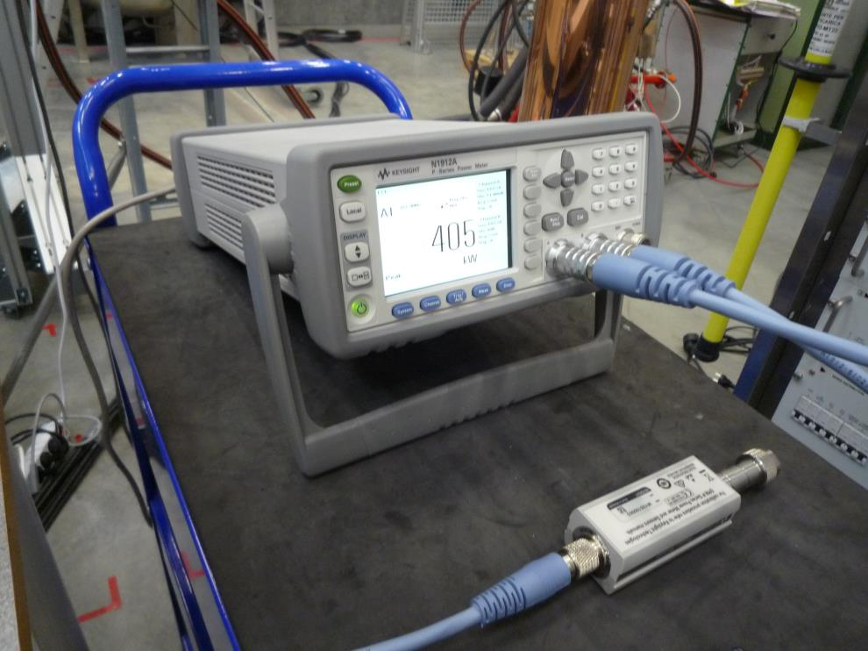
FREIA (Uppsala) First site tests of 352 MHz Power Station
Tetrode and cavity
This was a first test
Detailed measurements to verify performance ongoing
Will give valuable input for design of units in linac (contribution from Elettra)
Enables cryogenic testing of spoke cavities & cryomodules

Slide 20
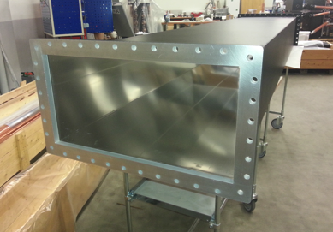
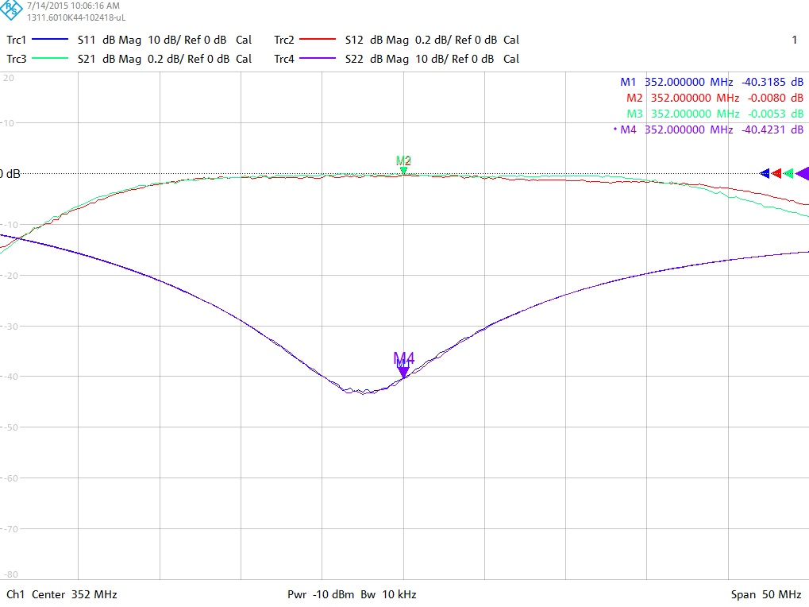
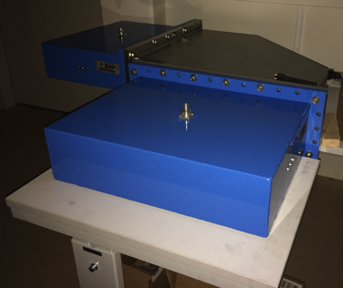
Work done in RF Laboratory at ESS (Tunavagen 24)
ESS needs waveguides in kilometers and elbows in thousands.
Simple to design and with good fabrication drawings
can be easily developed by a metal manufacturer, rather than a RF company.
The development by metal manufacturer will reduce the cost by 20-30 % as compared to the RF companies.
cost saving is expected to be of the order of 2-3 MEUR.
Time spent at ESS < 20 hours
RF Waveguide manufactured
by standard RF company
Failed in visual inspection
ESS Design
Waveguide extends through flanges
Fabrication becomes easy & hence cost effective
Received prototypes developed by two companies: Local Swedish company, Spanish company
H-Elbow
Components by both companies satisfy ESS specifications.
Coax-waveguide
Adapters
S11 > 40 dB
S21 < 0.05 dB

Slide 21
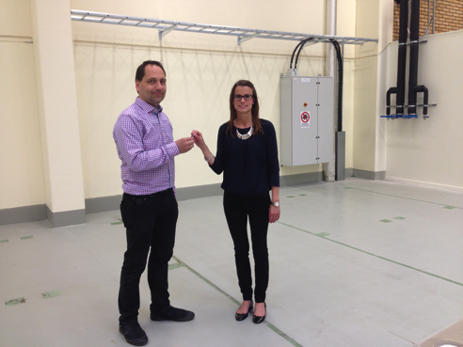
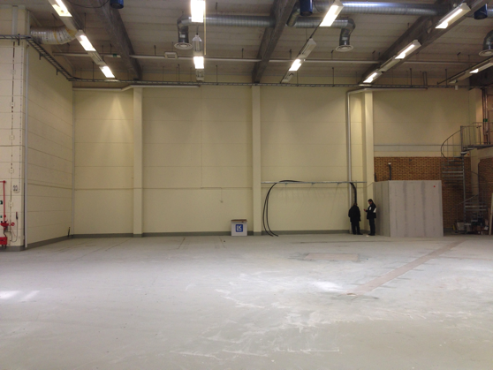
WP10 Test Stands: Lund RF labs
RF Lab in Utgård facility (Lund):
  We have taken possession of this space.
  Schedule and scope of RF use is TBD depending on the activities of the RF Integration lab (LTH)
  Facility is being shared with Detectors and Sample Environment

Slide 22
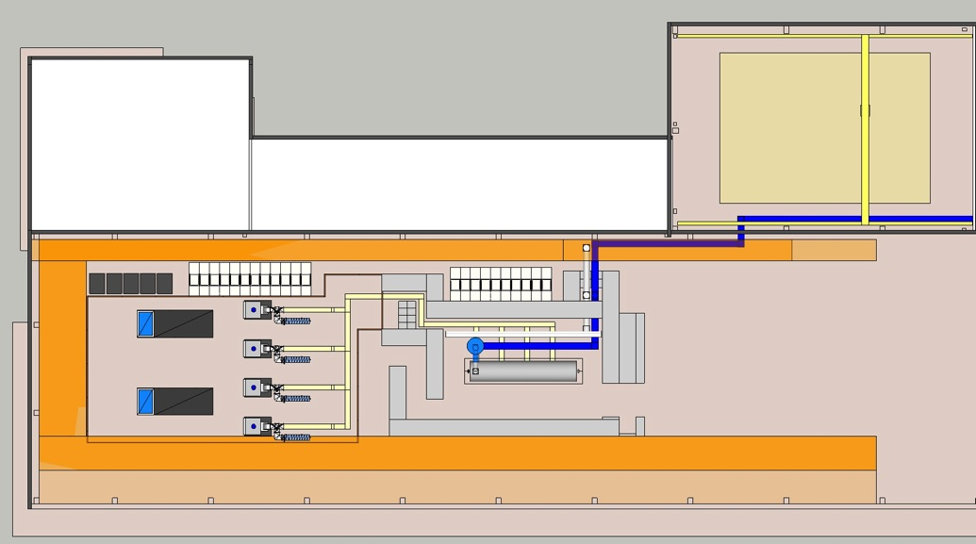
WP10 Test Stand 2 – Lund ( Elliptical CMs)
unloading area
control room
  The Heads of Agreement between ESS and IKC partner IFJ PAN (Krakow, Poland) was signed. This HoA describes the work to be done by IFJ PAN concerning the testing of cryomodules and the level of required resources.
  Shielding Bunker design has started

Slide 23
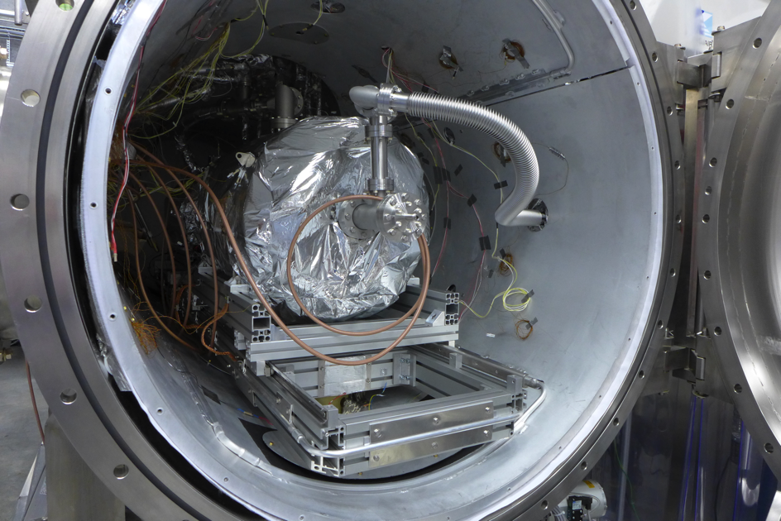
WP10 Progress at FREIA (Uppsala)
Horizontal testing on the “Germaine” spoke cavity has started in the HNOSS facility
The cavity has been cooled down to 2 K and RF measurements have started
Preliminary data is being analyzed

Slide 24
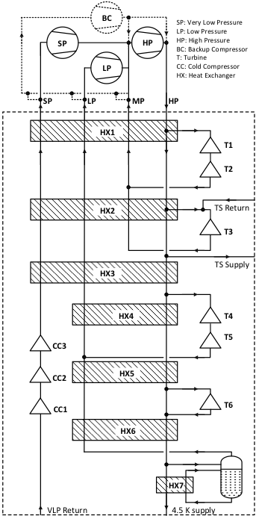
WP11 Cryogenics - ACCP
PDR-1 Held
Allows ordering of long lead items
e.g. Compressors &
Heat Exchangers
Note:
1) No LN₂ Precooling
2) Last stage of subatmospheric
pumping is warm
Notes:
Contract signature pending (expected March 2015), contract value < 20 million EUR (excluding installation, LHe Dewar, warm gas storage etc.)

Slide 25
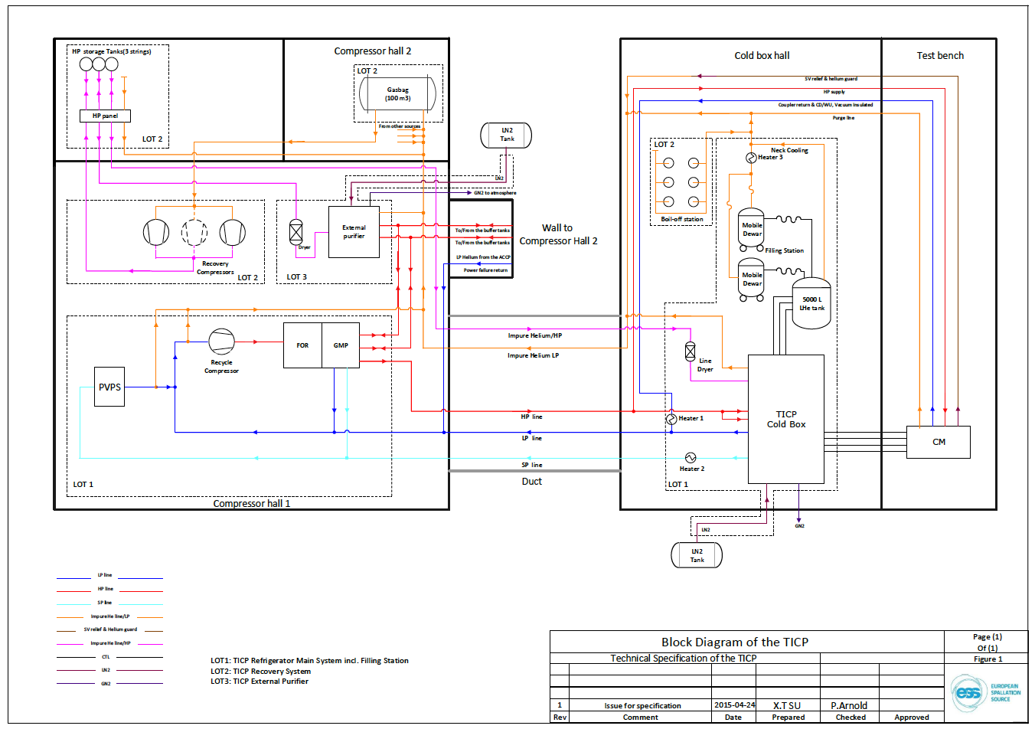
WP 11: Test & Instruments Cryoplant (TICP)
Proposals for Lots 1- 3 due back in September 2015
Selection in November 2015
Orders expected in December 2015

Slide 26
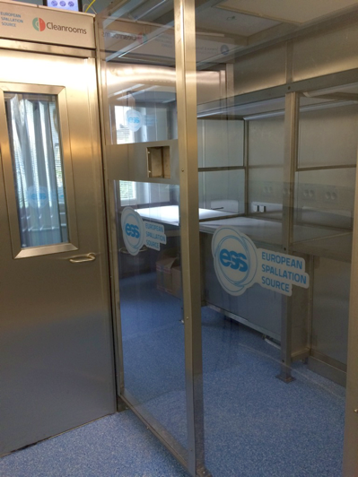
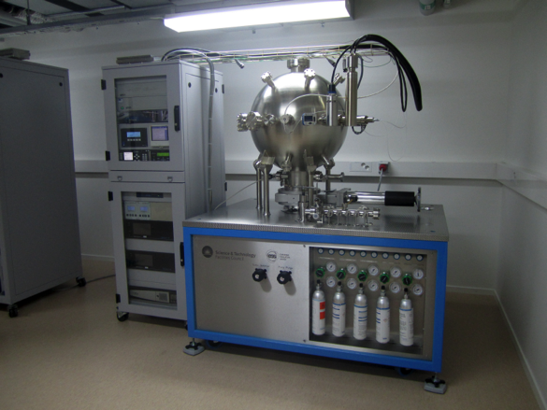
WP12 ESS Vacuum Facilities - Provided by STFC Daresbury
Vacuum Gauge Calibration Facility
Clean Room

Slide 27
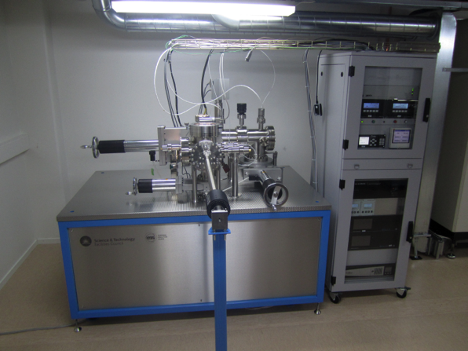
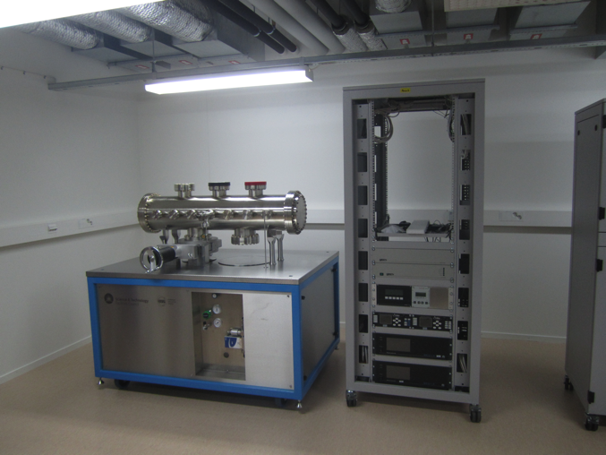
WP12 ESS Vacuum Facilities - Provided by STFC Daresbury
Materials Test Facility (Outgassing Tests)
Vacuum Integration Test Facility

Slide 28
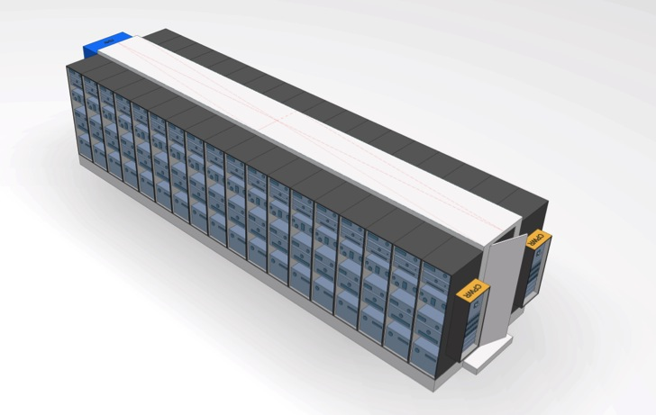
WP15 Rack Cooling Concept
Blocks of racks with shared inline - or roof coolers - supplied from the site water loop(s).
Temperature between 20 – 30°C, ±1°C. Typically, 25°C.
Assumes < 3 kW heat loss per rack (average). Seems to hold.
Main issue is the costs:
  Preliminary requirements were too restrictive for the vendors, driving a non-standardised design.
  Power distribution, needs analysis and optimisation.
  Cooling requirement may be relaxed to “do not add heat into gallery”. Saves recirculation.
  Site water temperatures requires mixing to non-condensing levels.
More / Updated Information at:
https://ess-ics.atlassian.net/wiki/display/AWES/Rack+Task+Force
Notes:
Main Effort is on project re-planning and collection rack requirements from all WP’s. The initial space requirements that Eugene did, appears to be reasonably accurate, the power requirements appear to be a bit over specified and the cooling requirements are coming down also. This is good news; if we can get below 3 kW per rack on average the cooling system is much simpler, according to the rack vendors (Rittal).
Rittal also quoted 2.6 MEUR for 800 racks in blocks – based on 5 kW per rack and under-the-floor cooling (which is not standard solution).
The power distribution is presently a bit expensive, it may be possible to optimise it and use the savings on the racks – making ends meet (or at least move them closer to each other).

Slide 29
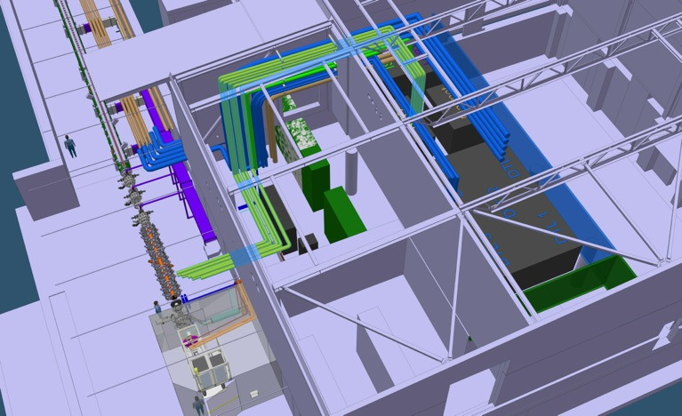
WP16 – Cooling Support
Regular meetings with interface stakeholders, e.g. phone meetings concerning ISS & LEBT, RFQ, etc. Good feedback on the requirements in DOORS!
Started looking into more details regarding the FEB & Tunnel piping layout (including planning for installation)
CFs decision to pause the process design of the CUB and RF gallery has proven to be a big breather. Now there´s more time to gather proper data from all stakeholders.
WP16 scope towards NSS labs are slowly but steadily getting more detailed.
IS/LEBT Cooling SKID
FEB to Tunnel pipe routing

Slide 30
WP17 Reduced Scale modulator prototype
( SML topology status on Sept 2015 )
Electrical schematic
Part I
Part II
Part I – Low Voltage power converter: successfully tested in Feb. 2015 on resistive loads (@1kV);
Part II – HV oil tank assembly: - first HV module prototype built from Feb to June 2015 and successfully tested with a 25kV dummy load in July 2015, in combination with Part I

Slide 31
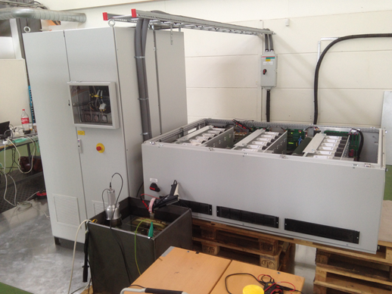
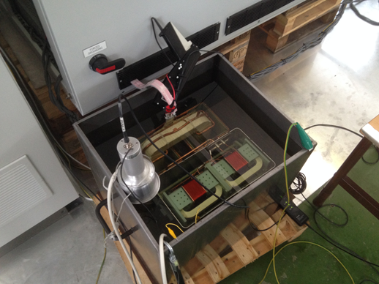
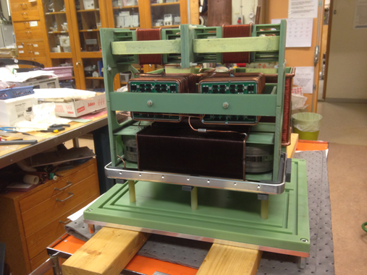
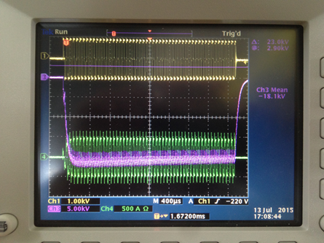
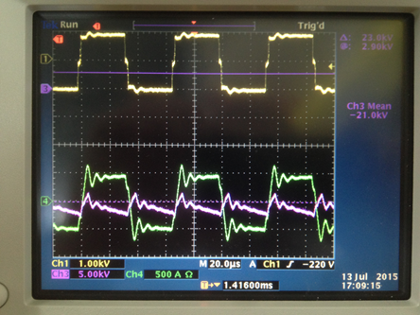
WP17 Integrated test of Low Voltage power converter with High Voltage module #1, at LTH (July 2015)
Part I – Low voltage power converter
Part II – HV module prototype in oil tank
HV module prototype in assembly workshop at LTH
Experimental results at full power: Pulsed at 20kV/20A, 3.5ms/14Hz
(Note: no output filter present; waveforms are as expected)
3.5ms pulse
zoom
Magenta: HV output pulse; Yellow: LV input voltage; Green: LV input current

Slide 32
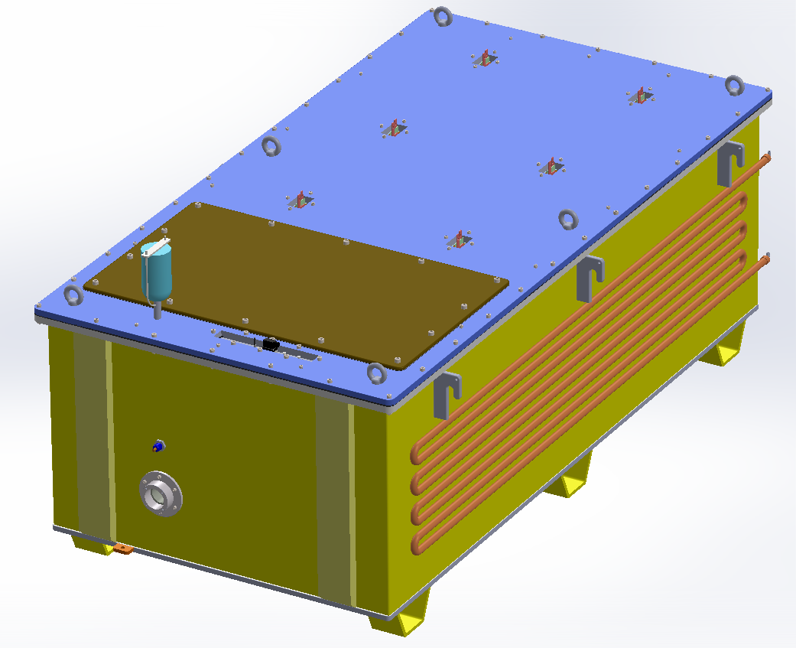
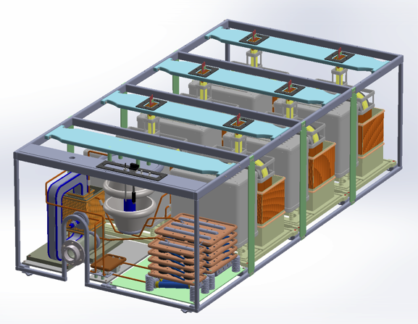
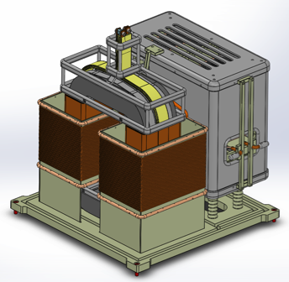

WP17 3D Model of the complete HV oil tank assembly
( containing 6 HV modules and output filter stage )
External view
Internal view
LV feedthroughs
Silica gel breather
Tank lid
HV sensor
Inspection lid
HVHF transformer
HV rectifier box
Water cooling serpentine
HV output connector
Longitudinal cut view
Fiberglass insulation frame
HV module
Design and 3D model started in Feb 2015 and completed in June 2015;
Technical specification for “build to print” contracting ready in June 2015;
Invitation To Tender (ITT) for construction launched on 2nd July 2015;
Offers received on 10th September 2015;
HV modules
HV output filter capacitor banks

Slide 33
WP17 Commercial 330kVA modulator
contract & magnet power converters
Commercial 330 kVA modulator:
Redesign of several components was needed after testing of the prototypes (HVHF transformer, SPRC modules, rectifier bridges);
Additional delay in delivery. New delivery date: May 2016, instead of Feb 2016
Magnet power converters IKC:
Total cost of pulsed power converters + magnets remain the same as for the DC case
  (i.e. higher cost of pulsed power converters compensated by cost reduction in pulsed magnets);
HoA draft document was prepared and reviewed by both parties (Elettra and ESS). Ready for signature;

Slide 34
Work Package Audits
Since the last TB, an Annual Audits was held on Beam Physics (WP2)
No technical showstoppers were found in the work package and it is are on track to meet milestones, however the staff was found to be significantly overworked. This situation is improving with additional hires underway.

Slide 35
Example WP2 Audit Recommendations
  ACCSYS should move to freeze the lattice by end of 2015 and require any additional changes to the lattice to go through the formal ESS change control process. Underway
  ACCSYS should expedite the filling out of Linac Lego to reduce the amount of missing information Underway
  Review the strategy of where to integrate the dipole magnets on stands. Should this be done at Daresbury or does it make more sense to do this at Elletra or ESS?
  ACCSYS management must intervene to actively resolve the issue with the requirements and capabilities of the LLRF system relative to the RF system (WP8) and beam physics (WP2) A decision needs to be made on how best to move forward.

Slide 36
Evolution of Audits
Given the increasing number of detailed design reviews, WP Audits in 2016 will start to be limited to project reporting e.g.:
  EVMS curves,
  Cost and schedule variances
  Risks
  Milestones
  With technical details covered by the ongoing design reviews. This approach will vary by WP status

Slide 37
Work Package Audits in 2015
Work Package | Date
WP15 Electrical Support | March 11
WP16 Cooling Support | April 29
WP10 Test Stands | April 28
WP12 Vacuum (included in cost review) | May 20
WP2 Beam Physics | June 25
WP8 RF | November 16
WP17 Power Convertors | November 24
WP4/5 Cavities & CMs | December
WP3 NCFE | January 2016
WP11 Cryogenics | January 2016

Slide 38
Design Reviews
Since the last TB Meeting the CDR for the DTL was held (June 22 - 23) and the PDR-1 for the ACCP was held (Sept. 2 - 3)
From the DTL CDR Report:
“The design of the DTL is well advanced and the INFN team has created and presented an impressive amount of work on the modeling, simulation and mechanical design of the DTL. With a few exceptions, performance requirements are well understood. Even with the few remaining issues, the INFN beam dynamics and RF design will meet expectations.
Developing and documenting interface requirements remains a significant issue and must be given priority by the project in order for the DTL to operate successfully as a part of the ESS linac.” Underway

Slide 39
Design Reviews
From the ACCP PDR-1 Closeout:
“The Linde team has made important and detailed progress on the design of the ACCP.
The design looks like it will meet the specifications and no technical showstoppers were found”
  Is the design sufficiently mature to allow Linde to move forward on the procurement of long lead time items including: He compressors, cold compressors and heat exchangers ?
  Yes, the procurements can proceed after:
  The remaining details of the cold compressors are provided
  The sizing of the oil skids is verified
  The heat exchanger data sheets are marked to show which are horizontal and which are vertical.
“

Slide 40
Example Review Recommendations
DTL CDR
Define interface in more detail, particularly those related to the installation of the DTL in the tunnel and its connection to services.
Define and prototype sealing and inter-tank approaches.
Provide a list of off normal events with associated mitigation measures and downtime estimations. This should include faults that can turn off the RF and their associated recovery procedures.
ACCP PDR-1
Try to leave enough space in the control boxes for the controls of a future Standby Compressor.
Install a full flow bypass valve is to allow the SP to work as the LP in case of LP compressor trip.
Install a Relief valve or other system so that when the SP is used as the LP the pressure in the 2 K suction line never exceeds 1.3 bar
ESS must rapidly address the issue of whether double safety valves are required or not.

Slide 41
Design Reviews in 2015
(some dates may change)
Component | Date
Ion Source & LEBT (CDR) | February 10
CDS (PDR) | April 20
DTL (CDR) | June 22, 23
ACCP (PDR - 1) | September 2, 3
L3 IOT (CDR) | September 18
Beam Delivery (CDR) | October 8
ACCP HAZOP | October 20, 21
ACCP (PDR-2) | November 17, 18
RFQ (CDR -2) | Week of December 7
LWU (CDR) | Q4 2015
Details of reviews including presentations and final reports are found at
https://ess-ics.atlassian.net/wiki/pages/viewpage.action?spaceKey=ASTR&title=ACCSYS+Technical+Reviews+Home
(Under construction)

Slide 42
Risk and treatment status
No changes to risk status from last TB
The cost impacts of the risks are being improved over the next year (Annual Review Recommendation)

Slide 43
Issues
Costs for installation activities are covered in the work packages. There are however, a few identified gaps:
  Staffing to physically move beam line components into the tunnel, mount and align in place
  Final connection piping connections between CDS and Cryomodules – Solved will be done by WP11, funding exists
  Beam tube connections between NCFE beam line components (Will likely be taken on by WP12)
Costs for at least rudimentary stands exist in all work packages. Gaps identified are:
  Goal of developing standardized stand designs
  Break down of beam based alignment requirements into physical tolerances for installation and alignment
Impact of radiation on sensors (particularly pressure sensors) in tunnel - local shielding may be needed

Slide 44
Issues
Remaining budget and burn rate for WPs as large procurements start.
  Monthly reporting by planners (see L. Lari’s talk)
Connections with and support by ICS
  This is improving.
    D. Piso is the principal ICS contact with ACCSYS.
    High level schedule milestones are being discussed and updated between ICS and ACCSYS
    Dedicated ICS staff have been identified for cryogenics controls, vacuum system controls and parts of the NCFE
  However, addition effort is needed and both ACCSYS and ICS need to carefully manage this issue.

