Slide 1
Survey, Alignment and Metrology
Fiducials Requirements
ACCELERATOR TECHNICAL BOARD
23/09/2015
Fabien Rey
ESS Survey, Alignment and Metrology Group

Slide 2
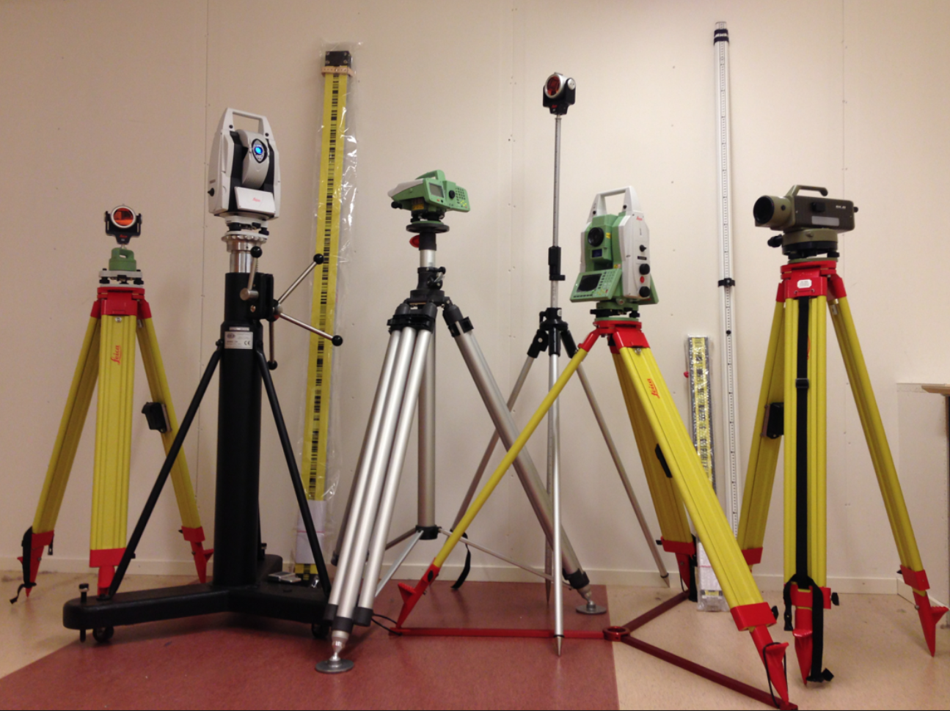
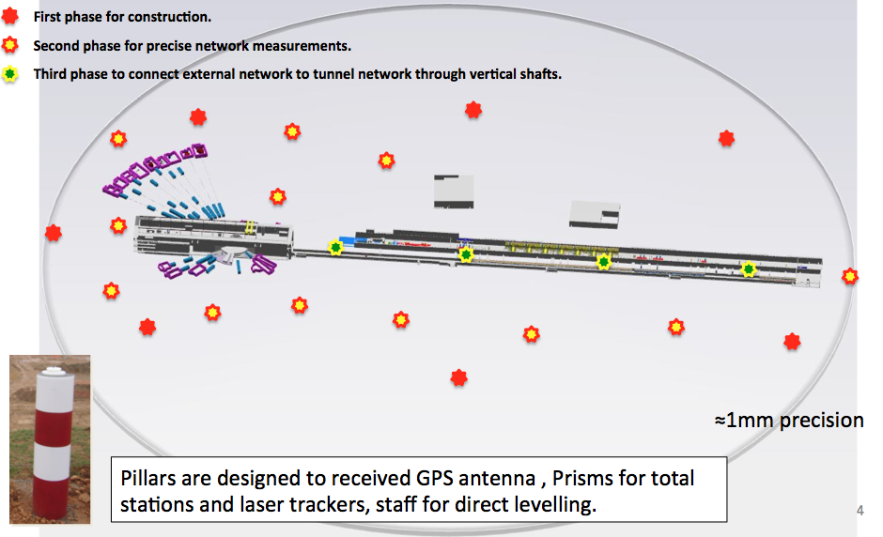
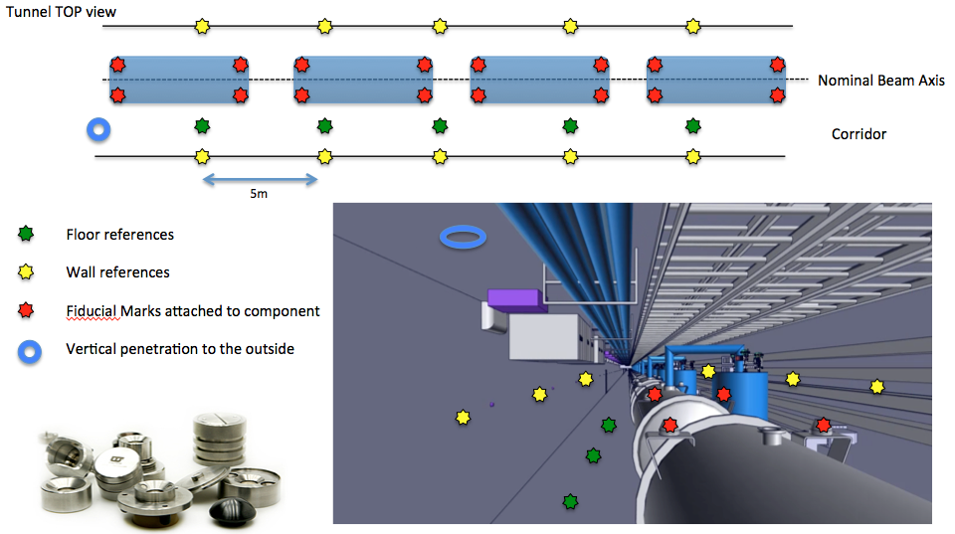
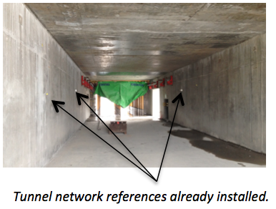
Survey & Alignment Strategy at ESS
Based on 3D free stationing technique with least squares adjustment calculus
Instrumentation: laser tracker, total station, digital and optical levels, 3D Arm, GPS, metrology software.
Two reference networks connected:
- One outside Geodetic Pillar Network (mm accuracy)
Measurements: GPS, Total Stations, Digital Levels.
- One internal reference network (0.1 mm accuracy)
Measurements: Laser Trackers , Total Stations, Digital Levels
2

Slide 3
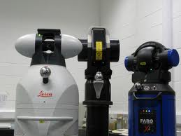
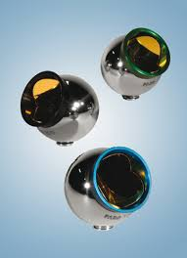
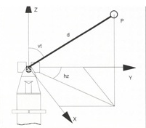
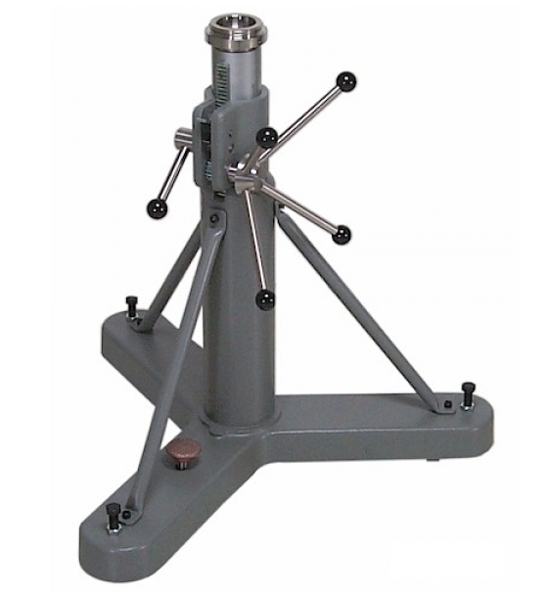
LASER TRACKER
Measure angles in vertical and horizontal planes + distances
some models measure in interferometry mode
1.5” PRISMs
Laser Trackers
10 m diameter
Accuracy below ± 50 micrometres
TRIPOd

Slide 4
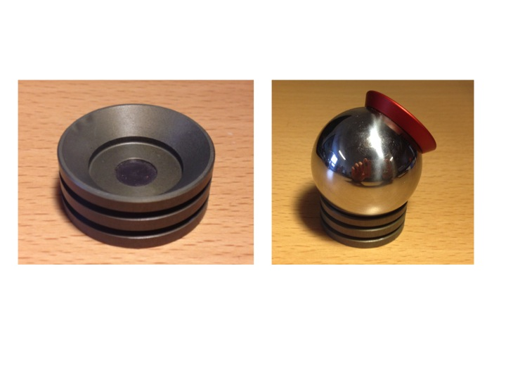
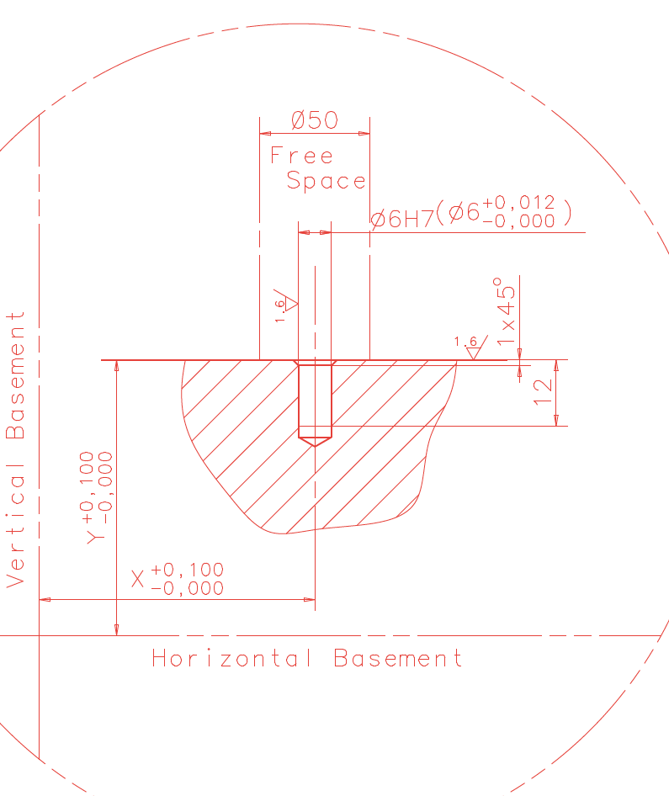
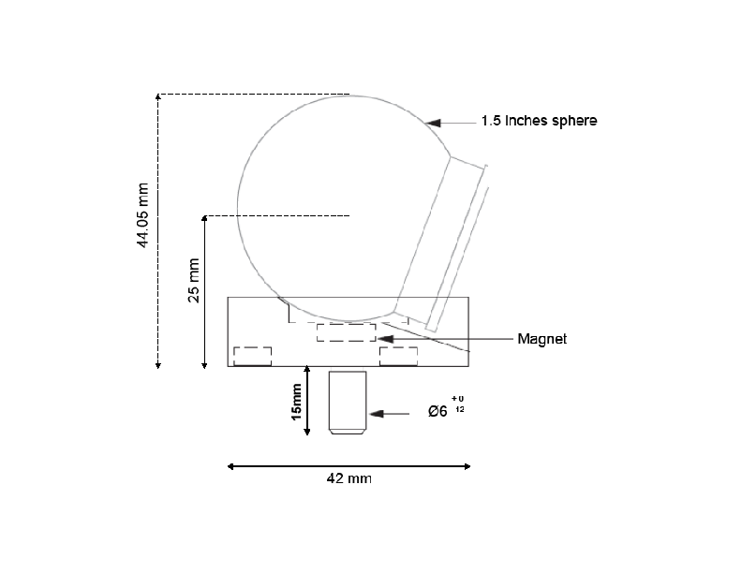
Fiducialization Process
Fiducialization : report the sensitive part or axis of a component to external references used to align the component.
Fiducials to receive prism
Sensitive Axis: magnetic axis, accelerating axis…
Mechanical axis used for construction / assembly
Fiducialization Bench
Laser tracker
4

Slide 5
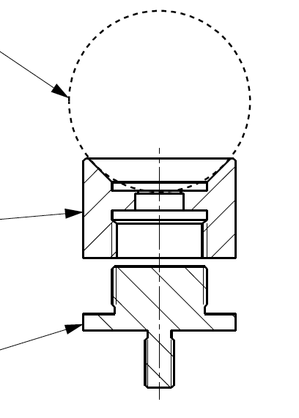
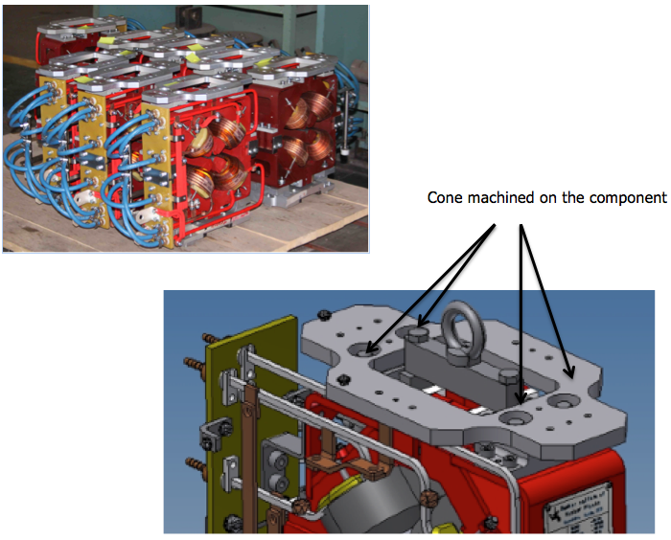
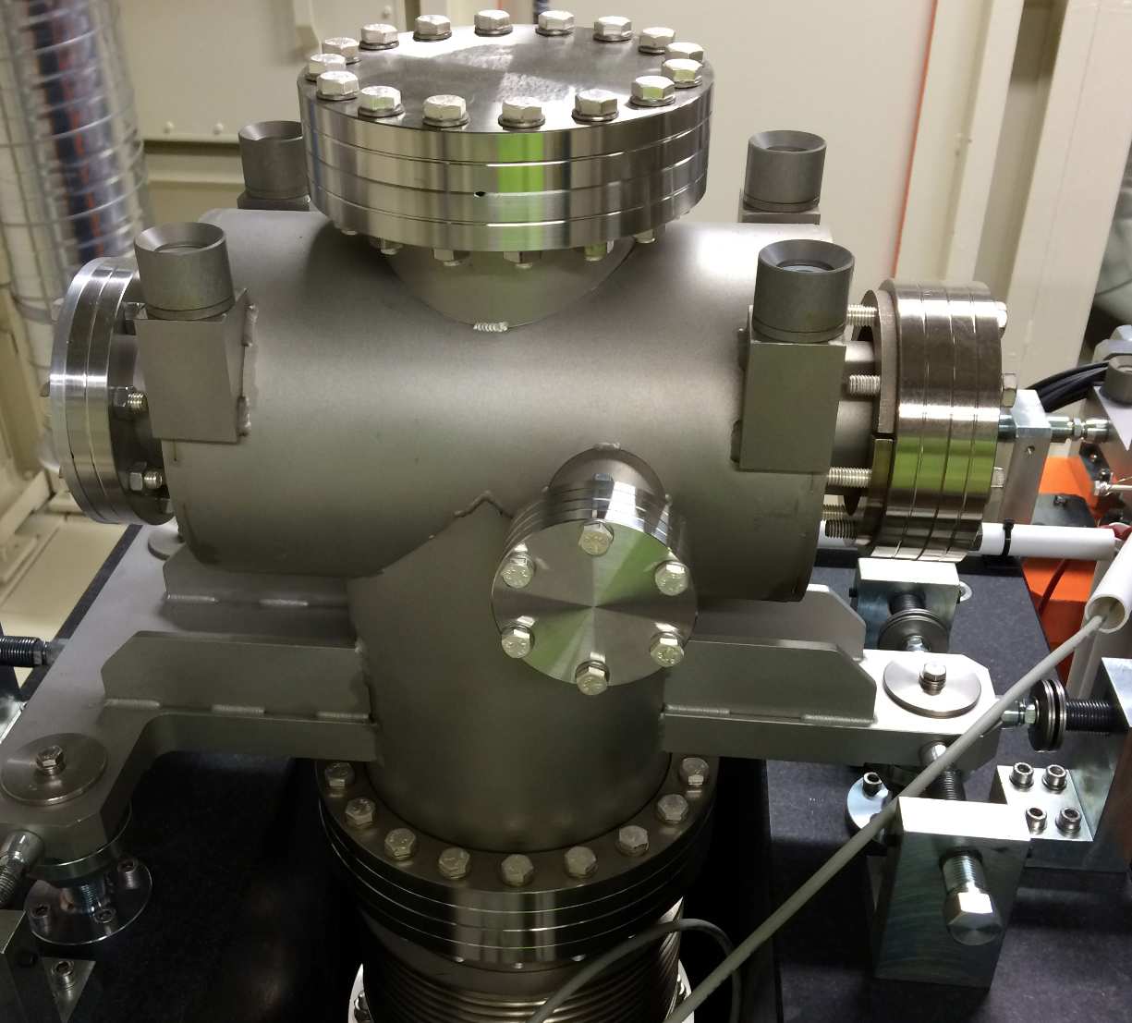
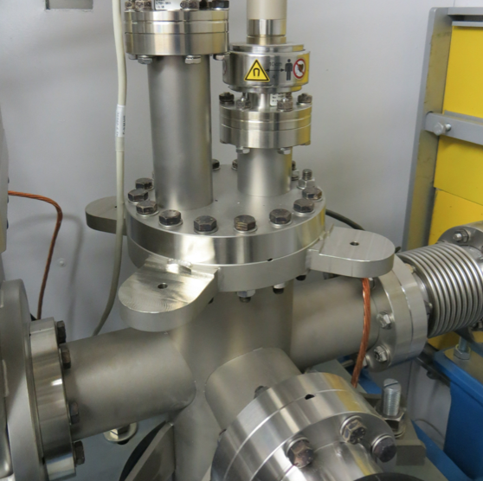
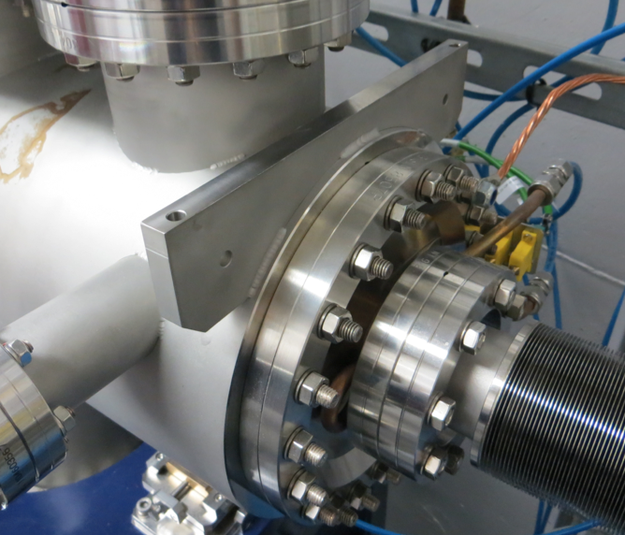
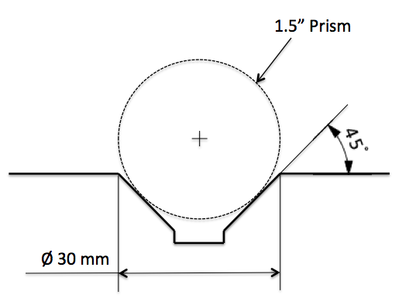
Fiducials
ESS-0012977
6H7 Machined Hole
Assembly glued with M6 Hole
Cone directly machined
on the component
1,5” Prism
Cone Part
M6 Part

Slide 6
Alignment Process
Nominal beam axis
No Forced Centering for instruments
We place the instruments where convenient

Slide 7
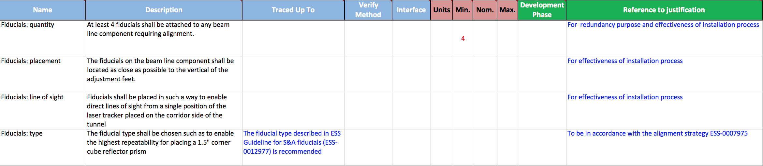
Fiducials REQUIREMENTS
Goal: Get the fiducials implemented in the design
Quantity
Placement
Line of sight
Type

Slide 8
Next Step
Fiducialization Report
Should contain :
Fiducialization Process ( instrument used, sensitive part measured)
Data : 3D coordinates of the fiducials expressed in a defined coordinate system

Slide 9
Thank You

