Slide 1
PBI task force intermediate report
Stephen Molloy

Slide 2
Contents
Mandate of the taskforce
  Authorities
  Deliverables
Assumptions
Tasks
Status
Preliminary conclusions

Slide 3
Mandate
Authorities
Deliverables
The power to define the baseline ACC:TGT interface from the point of view of AD, and to negotiate this with TD.
The power to make changes to the commissioning document (i.e., Marc Muñoz's document: ESS-0010872, Beam Commissioning Planning).
The power to define the baseline locations of the PBI devices in the linac lattice.
The power to decide the core technologies for the core PBI devices.
In order for this task force to operate successfully, and to minimize conflict, the task force leader should endeavor to work towards consensus, and should do his best to ensure that all interested parties are consulted. However, where consensus cannot be achieved the task force leaders decision (as chair-person) is final.
A written report with:
A definition of the ACC:TGT interface. This will allow the task force to concentrate on accelerator diagnostics, and leave aside those that are purely for TGT purposes.
The architecture of an accelerator timeline generator, thereby allowing the task force to discuss the "types" of beam (sometimes called "beam modes") that will be used during commissioning. This will be based on the commissioning documents that have already been produced by Marc Muñoz (e.g. ESS-0010872, Beam Commissioning Planning) and Eugene Tanke (e.g. ESS-0025640, ESS-0032966).
The beam parameters that AD need to measure, and the lattice locations in which AD need to measure them.
The baseline technology for the core PBI devices (that includes e.g. the BCMs, BLMs, BPMs).
The priority in time for the additional PBI proposed in the existing plan from the BD group for PBI at ESS

Slide 4
Mandate
Will not deliver this.
Priorities lie with other deliverables, & time-pressures have pushed this out.
Authorities
Deliverables
The power to define the baseline ACC:TGT interface from the point of view of AD, and to negotiate this with TD.
The power to make changes to the commissioning document (i.e., Marc Muñoz's document: ESS-0010872, Beam Commissioning Planning).
The power to define the baseline locations of the PBI devices in the linac lattice.
The power to decide the core technologies for the core PBI devices.
In order for this task force to operate successfully, and to minimize conflict, the task force leader should endeavor to work towards consensus, and should do his best to ensure that all interested parties are consulted. However, where consensus cannot be achieved the task force leaders decision (as chair-person) is final.
A written report with:
A definition of the ACC:TGT interface. This will allow the task force to concentrate on accelerator diagnostics, and leave aside those that are purely for TGT purposes.
The architecture of an accelerator timeline generator, thereby allowing the task force to discuss the "types" of beam (sometimes called "beam modes") that will be used during commissioning. This will be based on the commissioning documents that have already been produced by Marc Muñoz (e.g. ESS-0010872, Beam Commissioning Planning) and Eugene Tanke (e.g. ESS-0025640, ESS-0032966).
The beam parameters that AD need to measure, and the lattice locations in which AD need to measure them.
The baseline technology for the core PBI devices (that includes e.g. the BCMs, BLMs, BPMs).
The priority in time for the additional PBI proposed in the existing plan from the BD group for PBI at ESS

Slide 5
Structure
Online documentation:
  https://ess-ics.atlassian.net/wiki/display/PBITF/PBI+Taskforce+Home
Roles:
  Stephen Molloy, Chair, Secretary
  Andreas Jansson, Group Leader for Beam Instrumentation
  Mamad Eshraqi, WP Leader for Beam Physics
  Iñigo Alonso, Lead Engineer
  Ryoichi Miyamoto, Beam Physics contact person for BI
  Edgar Sargsyan, Lead Engineer
  Others called in as necessary
Meetings:
  Ad-hoc and based on linac sections
  Typically proceed as follows
    Meeting #1: Discuss the various needs of the section, decide on tasks
    Meeting #2: Present strawman proposal, & review
    Meeting #3: Determine pseudo-final proposal
    Meeting #4: Address remaining issues

Slide 6
Working assumptions (initial)
The region of interest extends from the interface between the ion source and LEBT to the interface between accelerator and target.
  The tuning dump interface is also included in the ACC:TGT definition.
  The mechanical and beam interfaces between the accelerator and target are coincident at the upstream face of the neutron shield wall.
    Note that this implies that target PBI is not part of ACCSYS scope.
The purpose of commissioning is to achieve the L3 requirements.
The purpose of PBI is:
  Measurement of the beam to allow the set-up of component parameters to design values.
    For example, cavity phase scans making use of beam phase monitors.
  Debugging of off-normal beam conditions.
    Specifically those conditions not otherwise communicated to the control system
  Demonstrate achievement of the L3 requirements, including interface requirements, and the ACC:TGT interface requirements.
    Only those requirements related to the beam
    Including subsequent monitoring of those parameters
  Machine optimisation and development.

Slide 7
ACC:TGT interface negotiations
Target Division didn’t agree to the proposed change in the ACC:TGT interface definition
They’re happy to have TGT beam diagnostics taken into the scope of this taskforce
Thus:
  Proton beam diagnostics within the TGT monolith are now part of this taskforce

Slide 8
Working assumptions (current)
The region of interest extends from the interface between the ion source and LEBT all the way to the Target, including the Tuning Beam Dump.
The purpose of commissioning is to achieve the L3 requirements.
The purpose of PBI is:
  Measurement of the beam to allow the set-up of component parameters to design values.
    For example, cavity phase scans making use of beam phase monitors.
  Debugging of off-normal beam conditions.
    Specifically those conditions not otherwise communicated to the control system
  Demonstrate achievement of the L3 requirements, including interface requirements, and the ACC:TGT interface requirements.
    Only those requirements related to the beam
    Including subsequent monitoring of those parameters
  Machine optimisation and development.

Slide 9
Tasks
Split the work amongst four tasks based on the “working assumptions”
Task #1: Nominal operations
Assume that ACCSYS L3 requirements have been achieved, and that the machine is operating as designed.
What PBI is needed to maintain nominal operations?
  This should include debugging of off-normal beam conditions.
Task #2: Demonstration of successful commissioning/restart
Assume the existence of the PBI suite detailed in the response to task #1.
What additional PBI is needed to demonstrate the successful achievement of the L3 beam requirements?
Task #3: Commissioning/restart
Assume the existence of the PBI detailed in the responses to tasks #1 & #2.
Assume that all accelerator systems and components have achieved (or can achieve) their requirements.
What additional PBI is needed to allow set-up of component parameters to their design values?
Of these, which are needed only during commissioning, and which need to be permanently installed?
Task #4: Optimisation & development
Assume the existence of the PBI detailed in the responses to the previous three tasks.
What additional PBI is needed for machine optimisation and development?

Slide 10
Current status & some highlights
Please note:
  The taskforce has not yet finished its work
  The following are not 100% agreed by all members
  There will (almost certainly) be changes made to the following before publication

Slide 11
High-level status
 | LEBT | RFQ | MEBT | DTL
 | 75% | 100% | 75% | 33%
Comments and/or open issues | No discussions yet, but baseline is believed to be adequate | Few diagnostics to discuss | No discussions yet, but baseline is believed to be adequate | Extra BPMs? WS’s in all inter-tanks? FC & ED? Fast BCM’s?
 | SCL & HEBT | A2T | DMP | TGT
 | 75% | 33% | 33% | 50%
Comments and/or open issues | Two BPM’s in first SPK LWU’s? NPM’s? | Errant phase conditions resulting in over-focusing? | Allowable current density on dump? | Lifetime of the luminescent screen? Risk of the grid system?

Slide 12
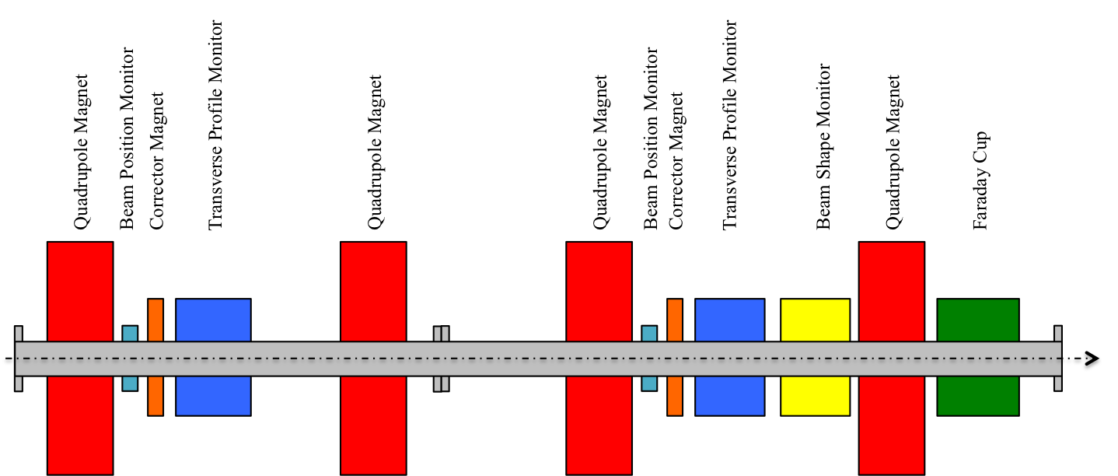
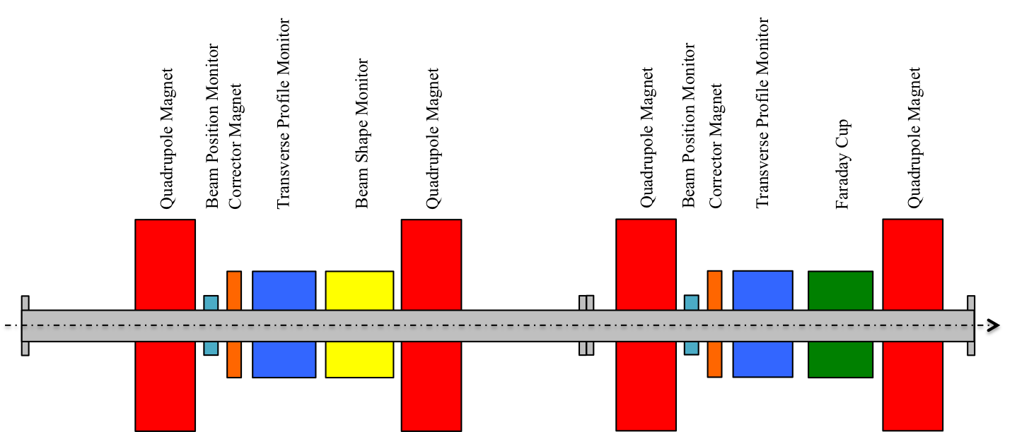
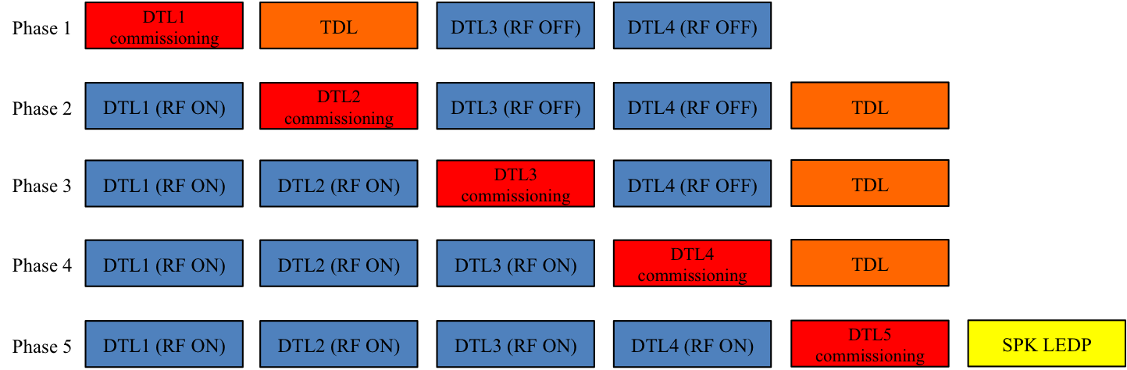
DTL: Commissioning proposal
Temporary Diagnostics Line for DTL commissioning
  Assembled from HEBT LWU’s, so no extra cost
Two alternative configurations shown here
Note that this proposal is consistent with the sequence proposed by Eugene

Slide 13
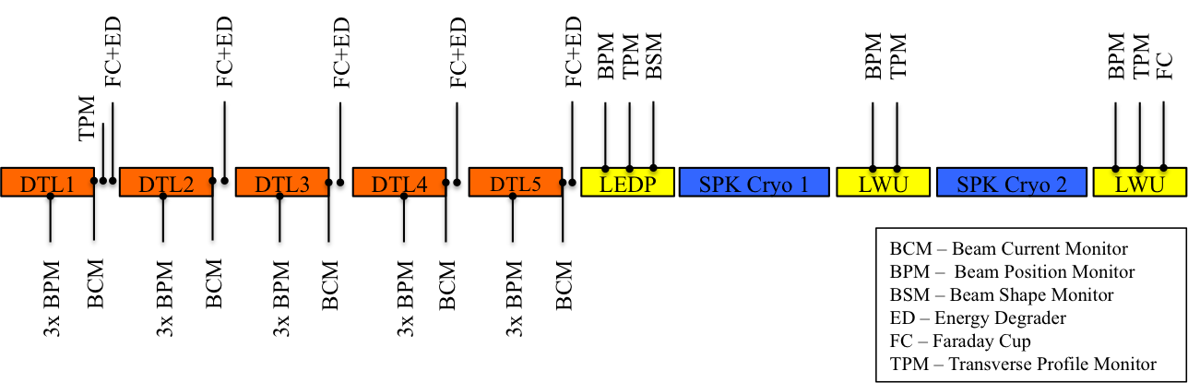
DTL: Permanent diagnostics proposal

Slide 14
SC Linac & HEBT
One BPM per LWU
  An open question is whether this is sufficient for the LEDP & SPK-LWU#1
  Staggered locations within subsequent LWU’s
Transverse emittance measurement stations shall have 3 WS’s
  No singlet scanners
WS stations will be located:
  At the start of the SPK section
    After CM1, CM2, and CM4 (TBD – depends on the phase advance)
    For determination of the dynamics on entry to the SC linac
  At the start of the MBL section
    Location TBD – depends on the phase advance
    For determination of the dynamics at the frequency jump
  At the end of the HEBT
    For determination of the dynamics at the final energy
  Note:
    No WS’s in the HBL
    NPM’s have not yet been discussed, so no comment is made on them here

Slide 15
Plans
Will deliver final results to TAC in October
Will target open questions in a series of meetings
  Intended to have proposals presented and accepted in those meetings
Currently this taskforce does not plan to determine detailed performance requirements
  This will be solved by BP & BI
  May be addressed for some systems to enable discussion on tech choice

