Slide 1
Science meets DMSC
September 3, 2025

Slide 2
Background for this meeting
- UCPH, DTU, ITU organized events to foster collaboration with DMSC
- scope was presented by group members rather than management
- Want to repeat for Science Directorate
    … Science has many new staff members

Slide 3
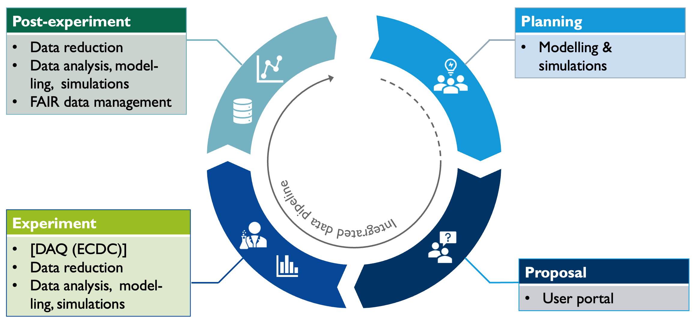
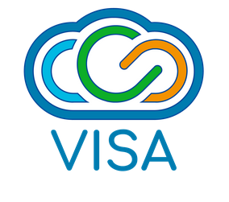

DMSC supports the user journey
with scientific computing and data science solutions and services
Remote access available from acceptance of proposal

Slide 4
DMSC is a Science Division
Science
Large Scale Structures
Diffraction & Imaging
Spectroscopy
NSS
Science Support Division
DMSC

Slide 5

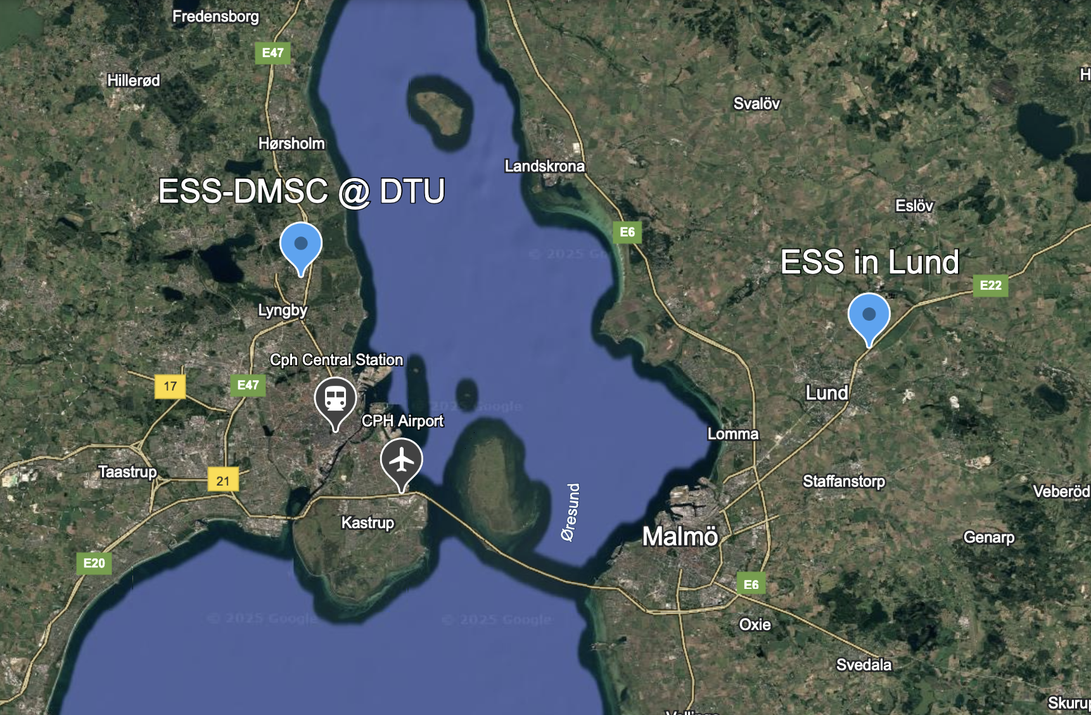


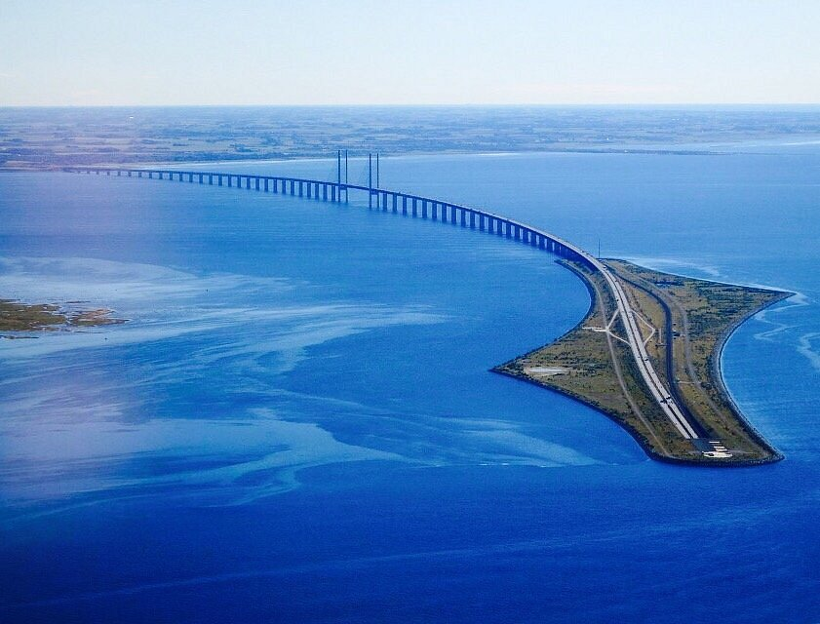
ESS is a dual site facility
With two host nations

Slide 6
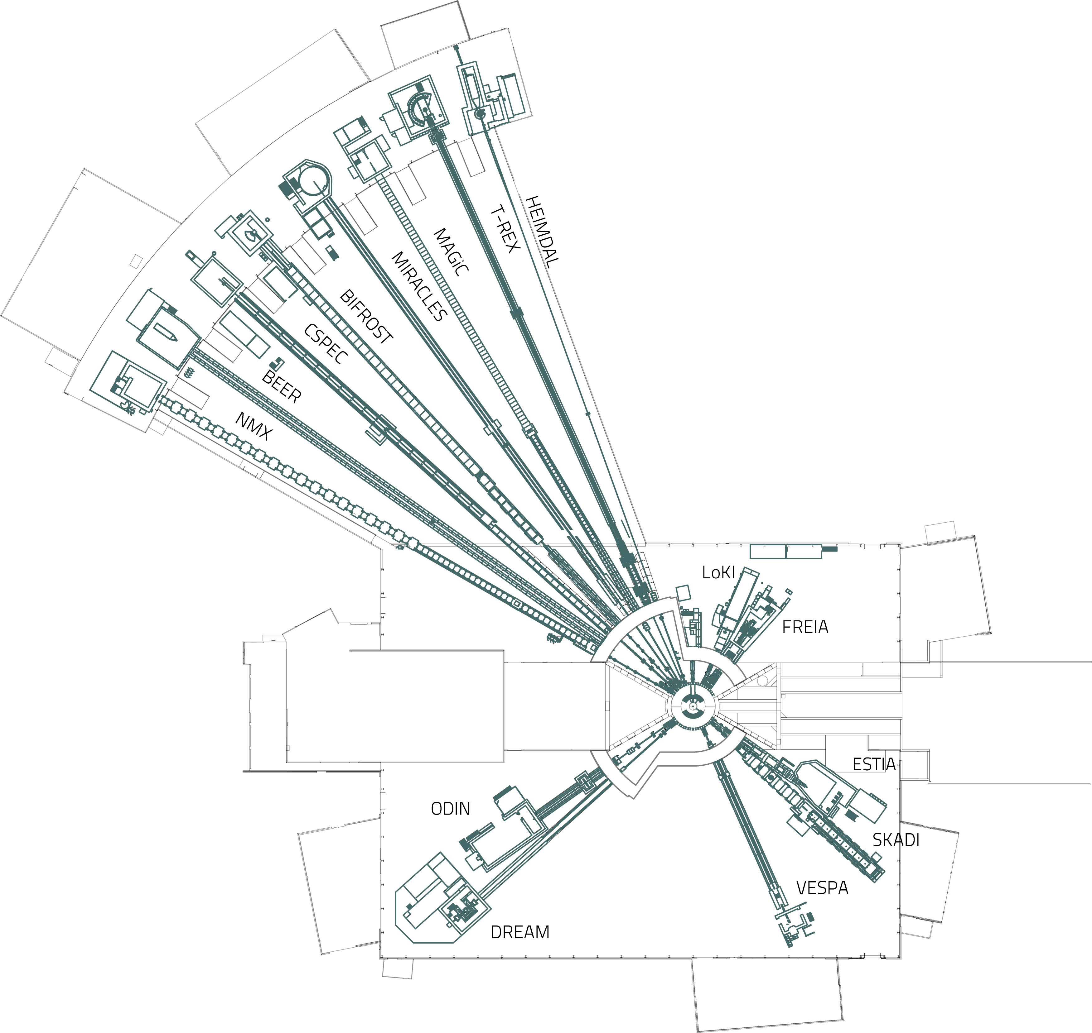
Technology & Science Groups @ DMSC
for supporting users with scientific computing tools and services
User office software / Proposal system
Experiment control & data acquisition
Data processing & analysis
FAIR data management
Jekabs
Morten
Mads
Jekabs

Slide 7
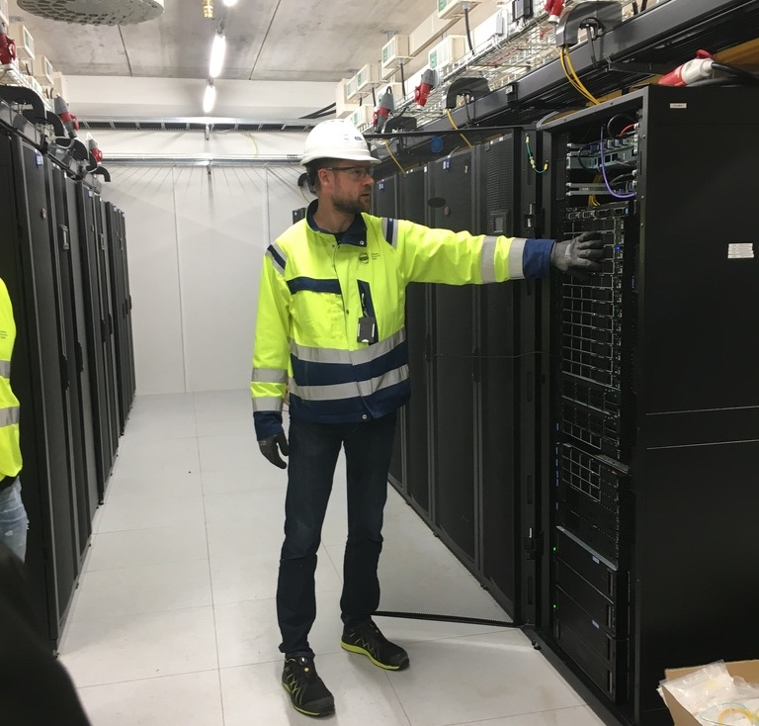
Technology & Science Groups @ DMSC
for supporting users with scientific computing tools and services
Greg
Instrument Data Scientists
User office software / Proposal system
Experiment control & data acquisition
Data processing & analysis
FAIR data management
Data Systems & Technologies
Brian

Slide 8
46 staff members incl. everything
20 nationalities
6 out of 10 has PhD degree
7 affiliated with universities

