Slide 1

Experiment Control & Data Curation?
Experiment Control & Data Acquisition?

Slide 2
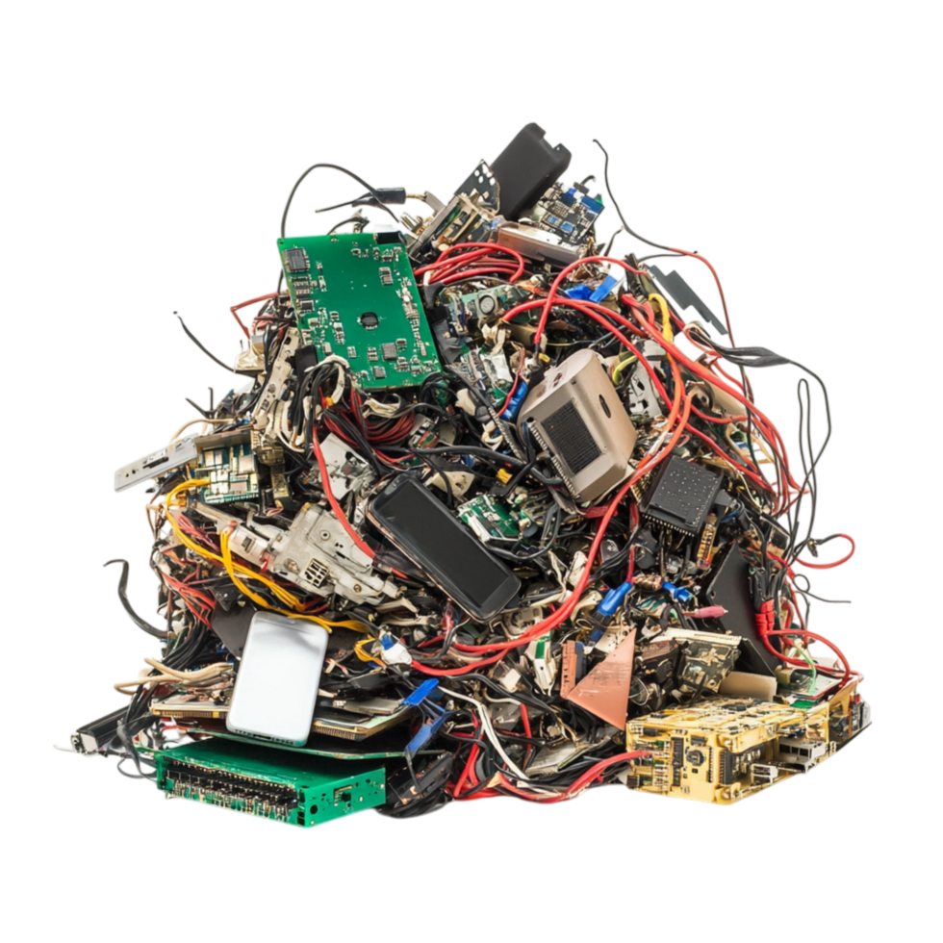
ECDC's role is turning this ...

Slide 3
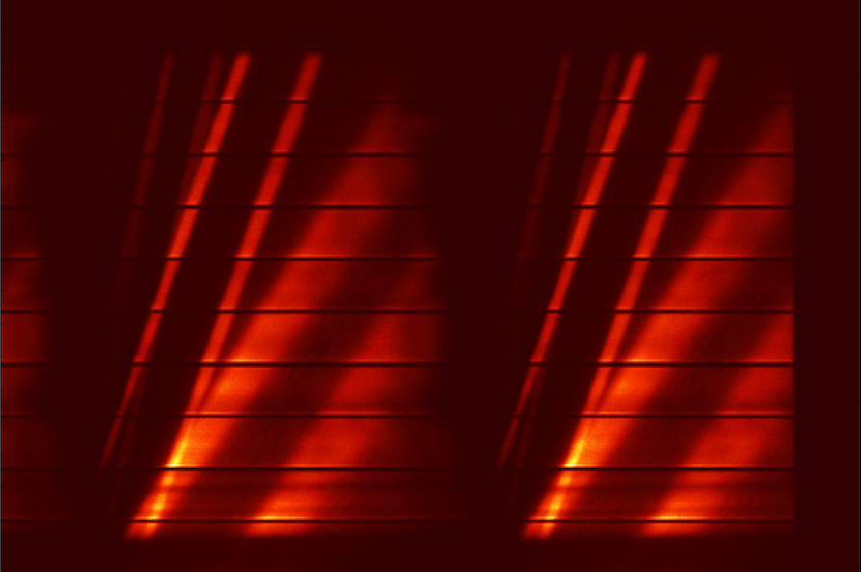
... into this

Slide 4

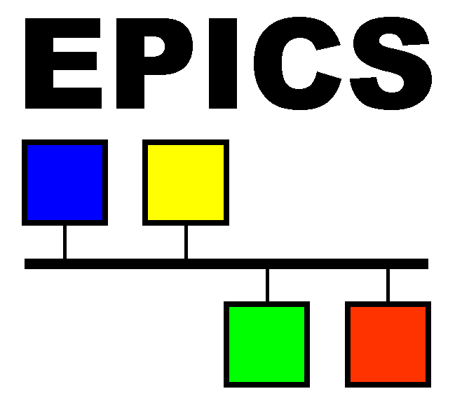



ECDC Responsibilities
  Experiment Control
  Beamline and Device Controls
  Detector Data Readout
  Readout Data Acquisition
  Detector Software Event Formation
  Data Streaming
  Scalable Cloud Storage
  Nexus File Writing

Slide 5
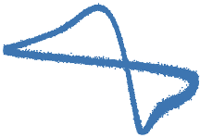
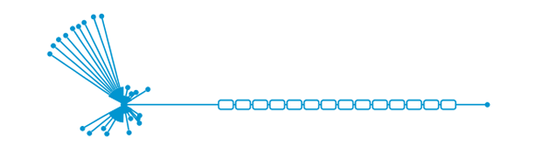




ECDC System Architecture
instrument hardware
site infrastructure
DMSC
AREA
51
detectors
readout
event formation
'RM'
EFU
filewriter
storage
data
controls
Lund - CPH
slits
'EPICS'
EPICS
FW
choppers
...
samp. env
NICOS

Slide 6
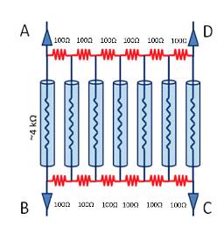
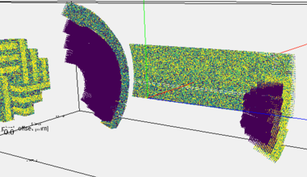
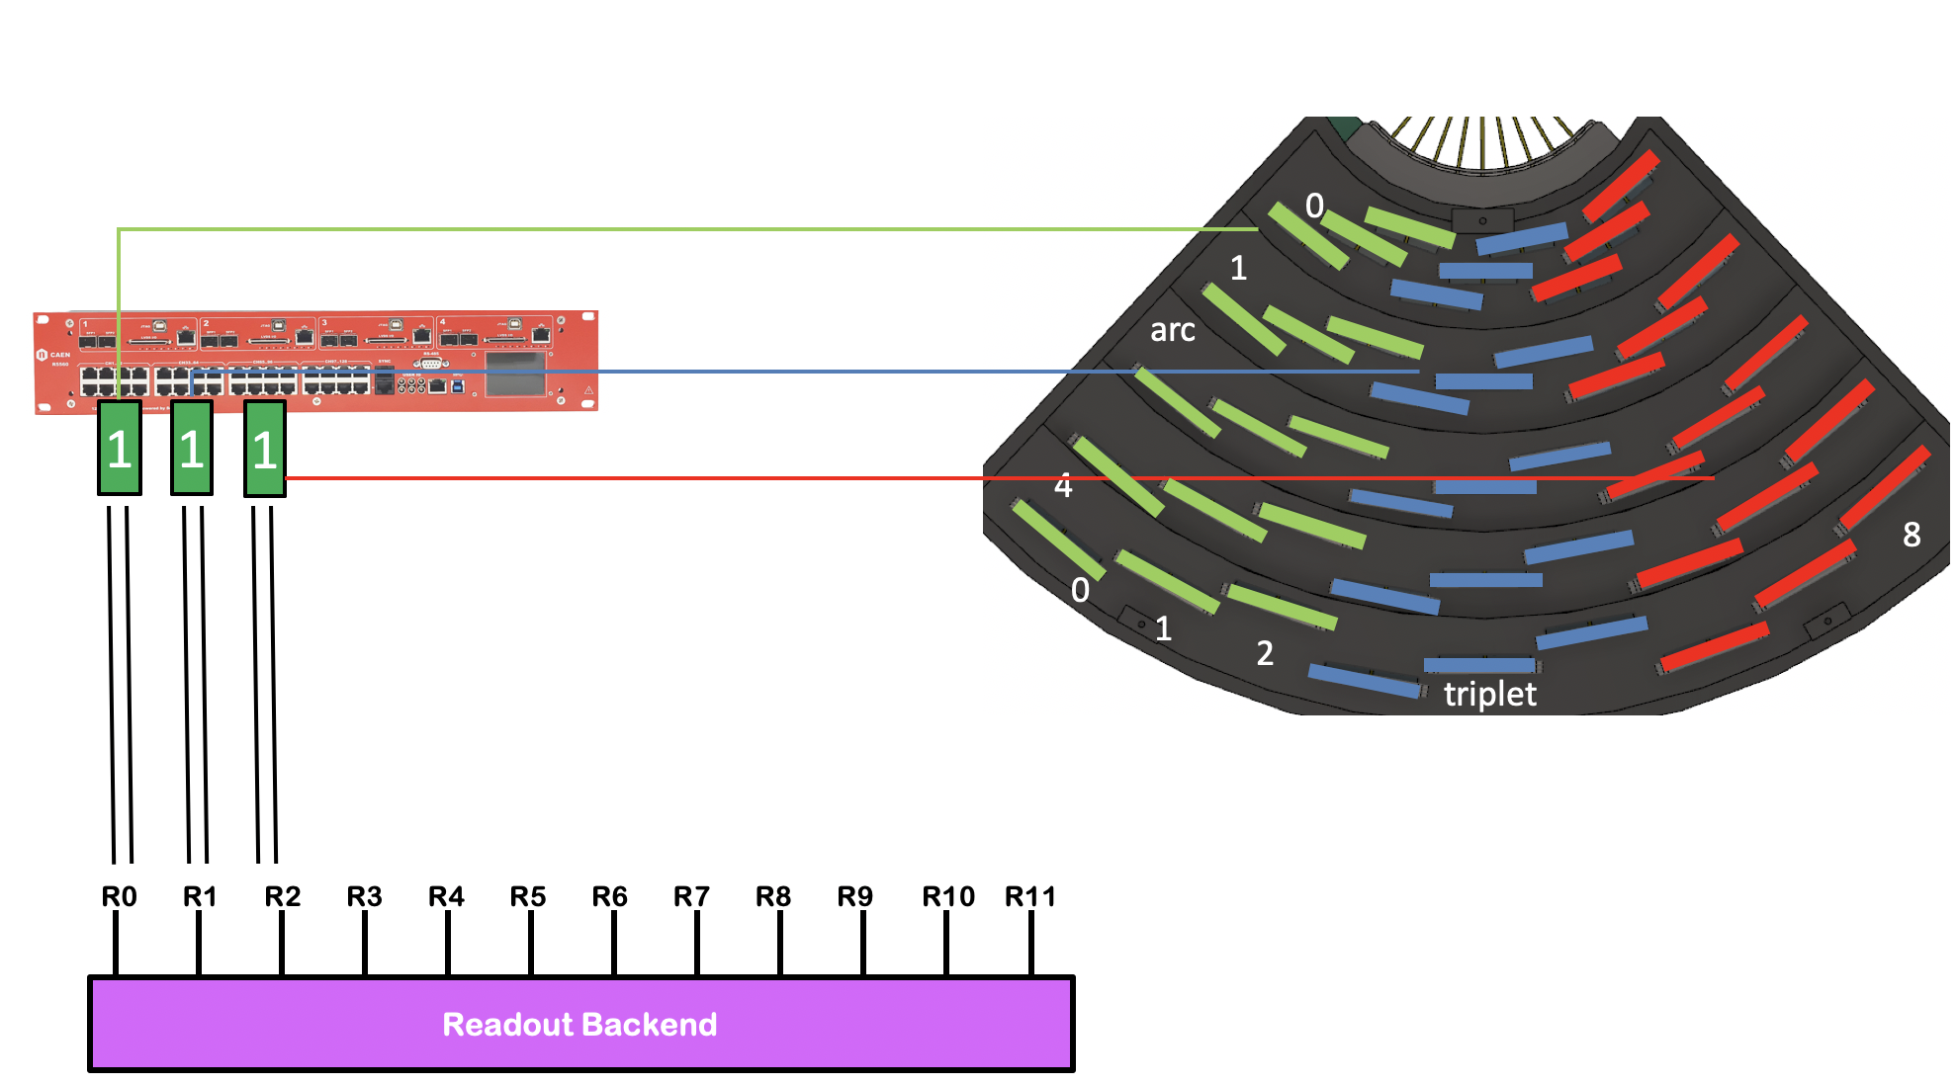
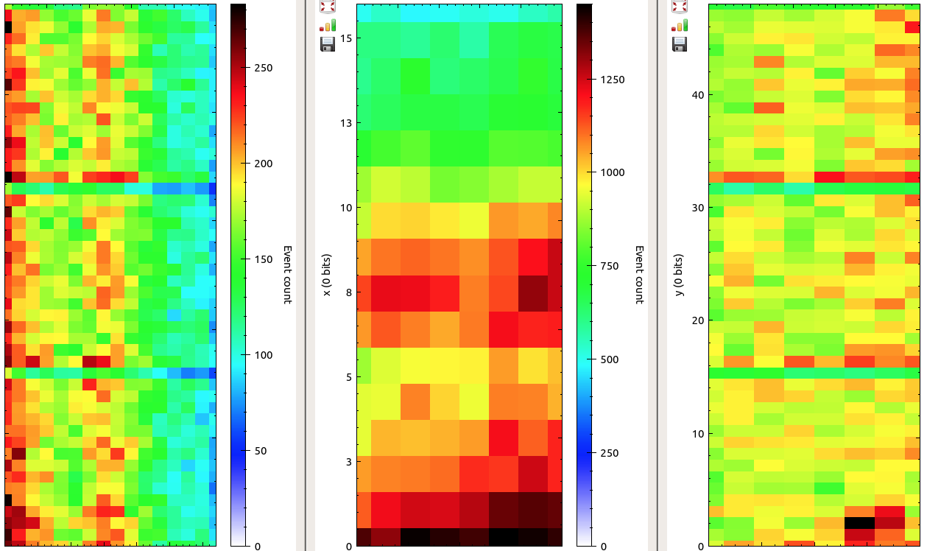
Readout, Event formation and file writing one for each instrument
Analog
Digital
Logical
Physical
(V(t), A(t), Ohm)
(t, FEN, RING, ch, adc)
('tof', pixel)
('tof', r, ϕ, θ)
Readout
Frontend
Readout
Backend
EFU
Scipp & friends
Conversion electronics ultimately measures charge, current or voltages.
Deals with instrument configuration identifiers such as rings and front –end nodes + other digital and digitized values: grids, wires, strips, tubes, amplitudes or ADC values.
This step abstract all information on the left away and provides a 2D (3D) detector surface which can be used for commissio-ning, monitoring and calibration.
Here, pixels are 'connected' with the physical instrument geometry: lengths, angles and detection volumes.

Slide 7
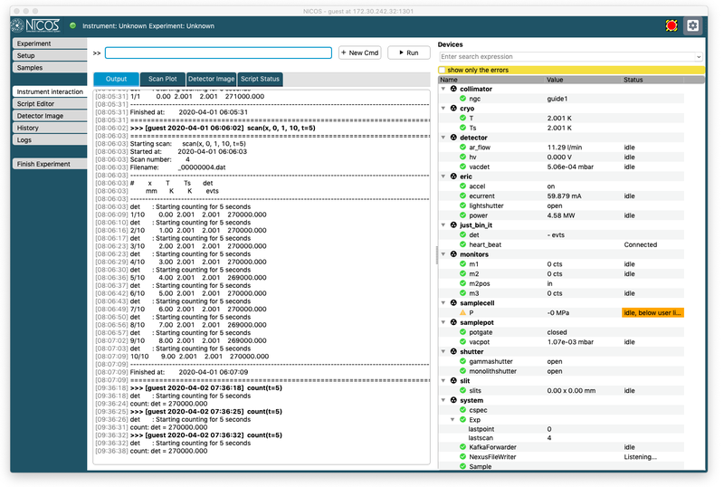
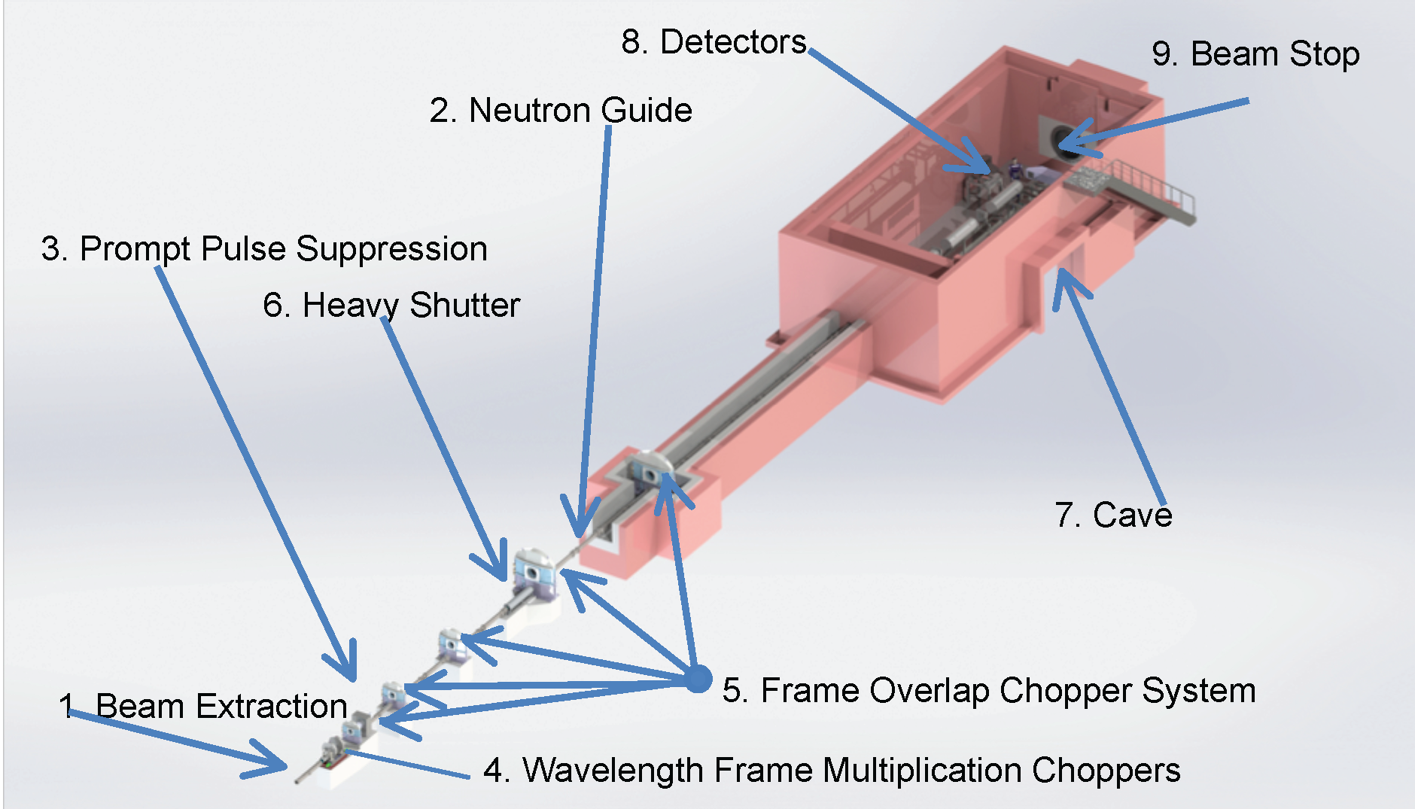
Experiment & Device Control one for each instrument
NICOS
CLI and GUI to control & monitor
Shutters
Slits
Choppers
Sample Movement
Robotics

Slide 8
Architecting all this requires
a tremendeous amount of collaboration
  DRAM, SCIPP, DST, DetG, ICS, chopper group, motion control, sample environment, Instrument scientists, IDS'es, user office, ...
a focus on commonality
  standard interfaces, configuration, calibration, data formats, documentation
a good development toolchain
  automatic sw builds and tests, measurable test coverage, automated deployments
tools for systems monitoring and debug

Slide 9
ECDC Servers – Site
March 2025
efu0632 (?)
filewriter0124
kafka0619
kafka0421
nicos 10.225
efu00534 (?)
filewriter0626 (?)
kafka0621
kafka0423
nicos 10.238
efu0633
filewriter0628 (?)
kafka0521
kafka0425
Graylog 211.187.
bifrost-nicosserver
efu0634
filewriter0625
kafka0523
kafka0427
Grafana 211.93
nmx-nicosserver
efu0635
filewriter0627
kafka0525
kafka0429
efu0533
filewriter0629
kafka0527
kafka0431
Graphite 211.24
tbl-nicosserver
efu0433
filewriter0630
kafka0413
kafka0517
AKHQ 211.94
dream-nicosserver
efu0434
kafka0419
kafka0519
AKHQ 211.85
loki-nicosserver
efu0435
kafka0415
kafka0529
Dashboard 211.156
odin-nicosserver
efu0436
kafka0417
kafka0531
Generator 211.98
efu0437
efu0631
Daqlite 211.41
Daqlite 211.67

Slide 10
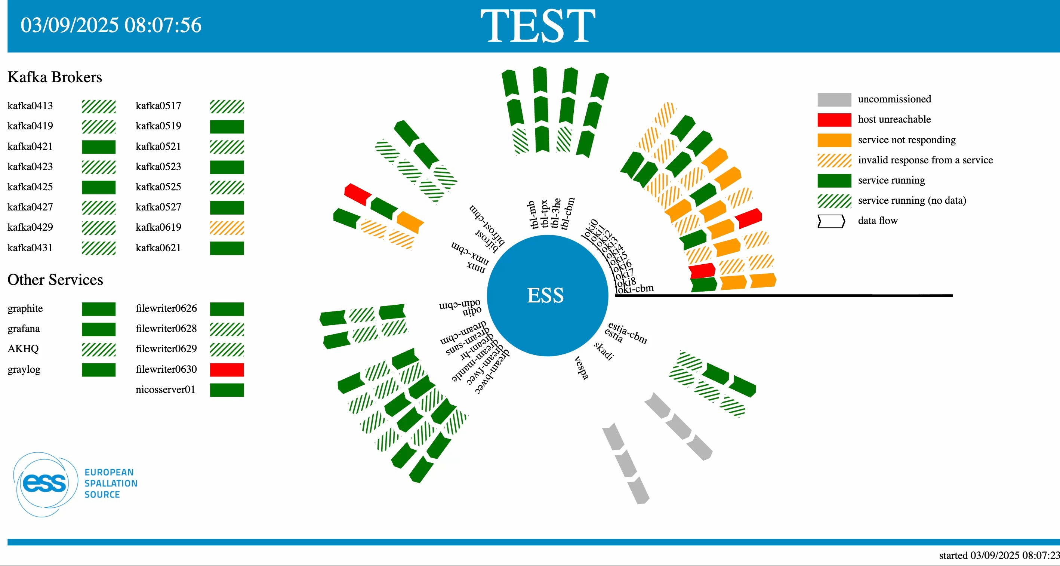
Instrument Infrastructure
ESS

Slide 11
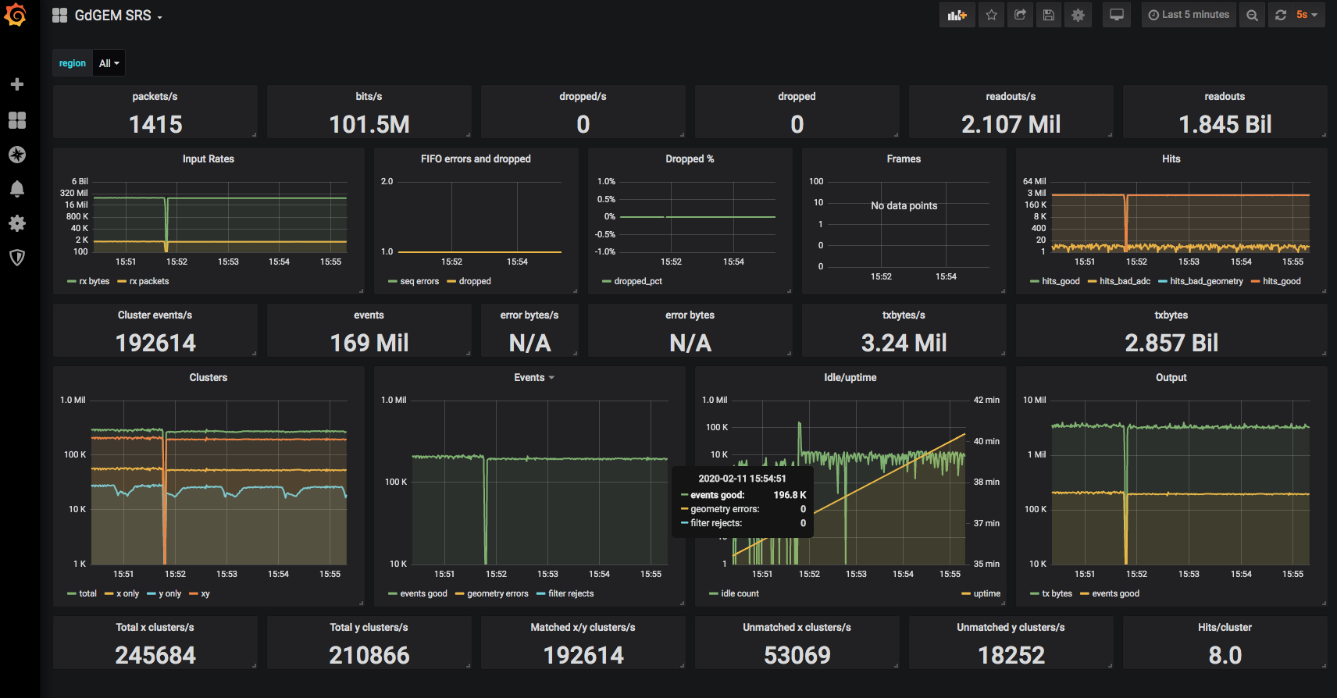
Grafana Runtime Stats

Slide 12
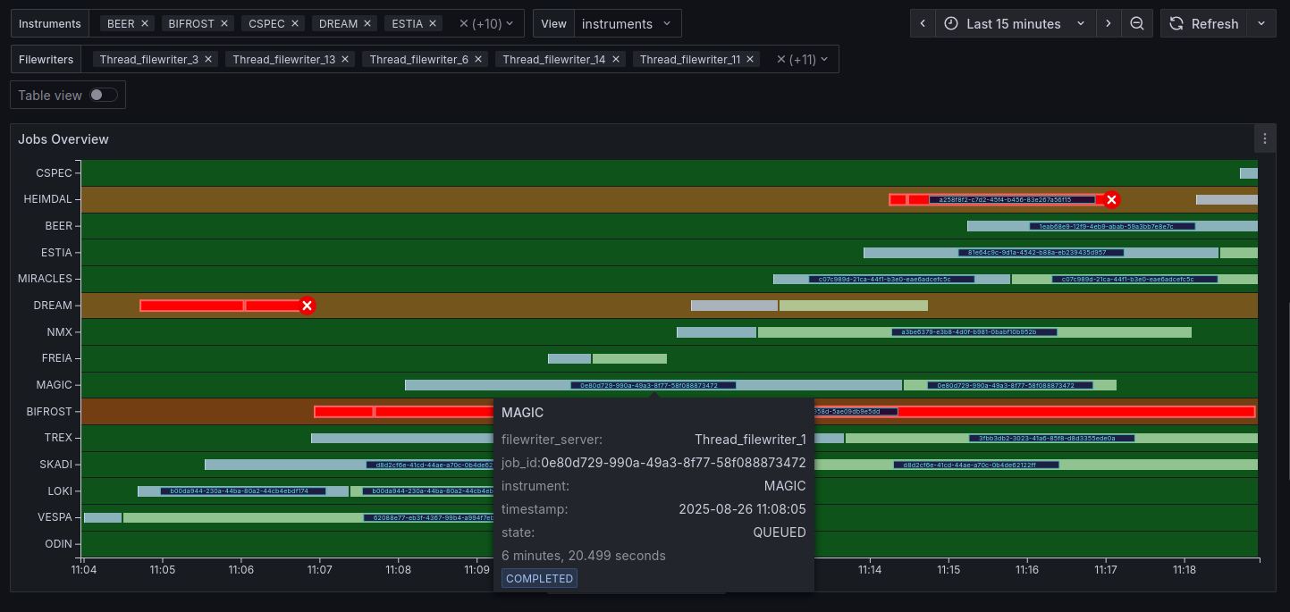
File writing (job) monitor

Slide 13
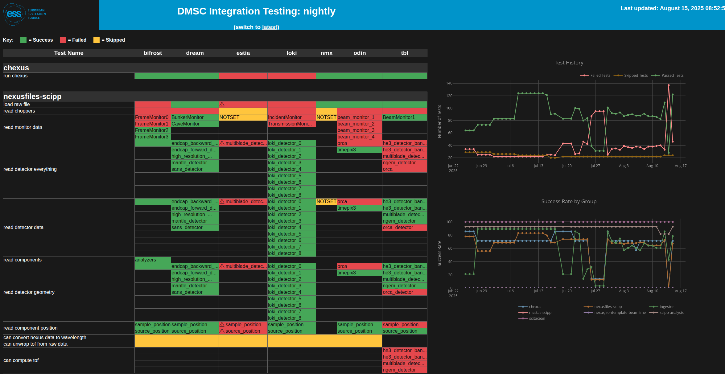
DMSC integration

Slide 14
Event Creation and Data Compression
Experiment Control and Data Collection
Epics Commands and Device Control

