Slide 1
Data Reduction, Analysis, and Modelling (DRAM) group
Group leader: Torben Roland Nielsen
PRESENTED BY Mads Bertelsen

Slide 2






DRAM
Responsibility
Data Reduction, Analysis and Modelling group
?
?
?
Stream events & meta data
Data reduction & visualization
Data analysis & modelling
FAIR Data management
Experiment control
User office software (proposal)
If existing software fulfills our requirements – we embrace it.
If existing software lacks certain features – we embrace it and modify it.
Otherwise – we write our own (in such a way that other facilities can also use it).

Slide 3
DRAM
Modelling subgroup
  Peter Willendrup
  Thomas Kittelmann
  Mads Bertelsen
  Damian Martin Rodriguez

Slide 4

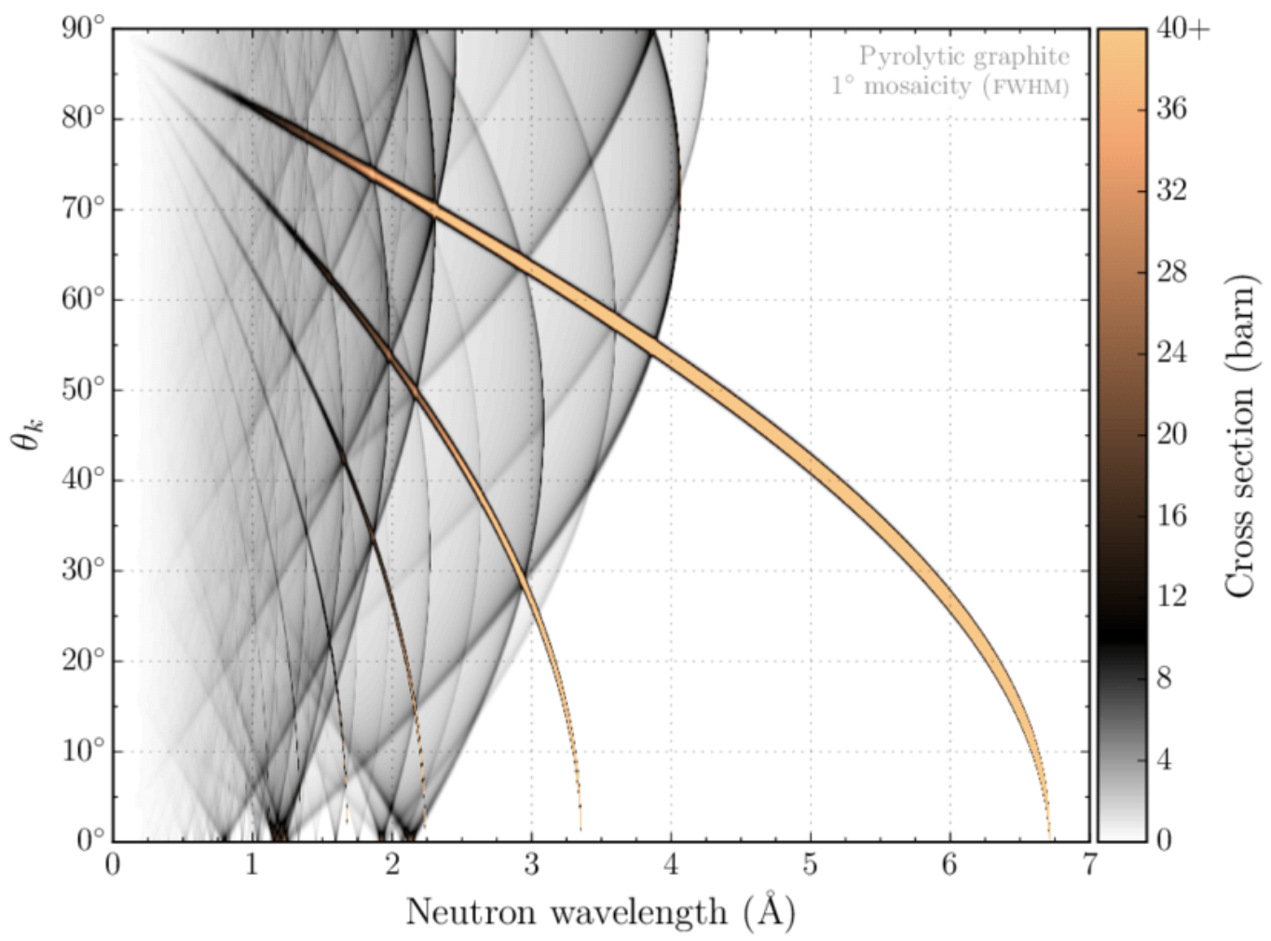
DRAM
Modelling subgroup
Bragg scattering in Pyrolytic graphite
  Peter Willendrup
  Thomas Kittelmann
  Mads Bertelsen
  Damian Martin Rodriguez
  NCrystal scattering kernel library
    Single crystals, powders, gasses, …
    Stand-alone or as plugin, for example GEANT-4
Elastic neutron scattering models for Ncrystal, Thomas Kittelmann and Xiao-Xiao Cai, (2021)
https://github.com/mctools/ncrystal/wiki
https://github.com/mctools/ncrystal-notebooks

Slide 5
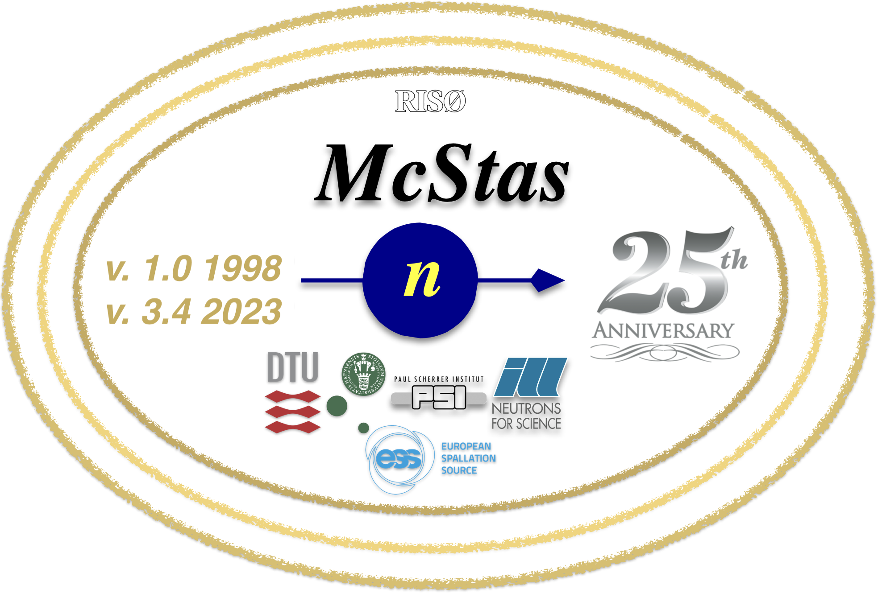

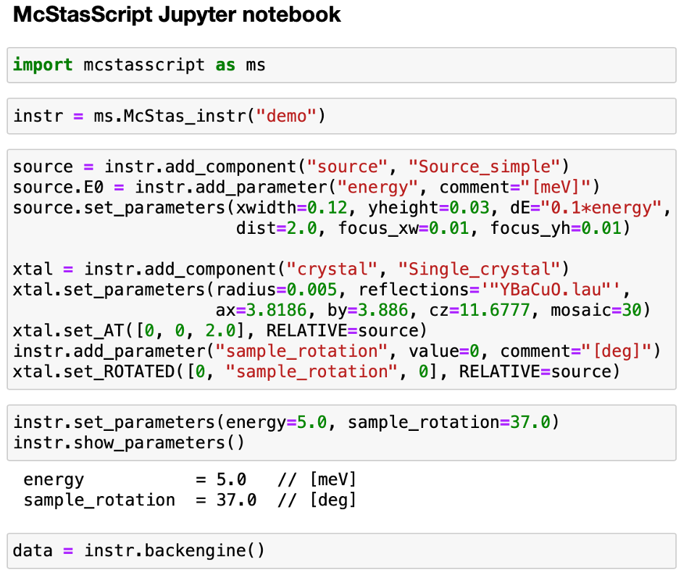
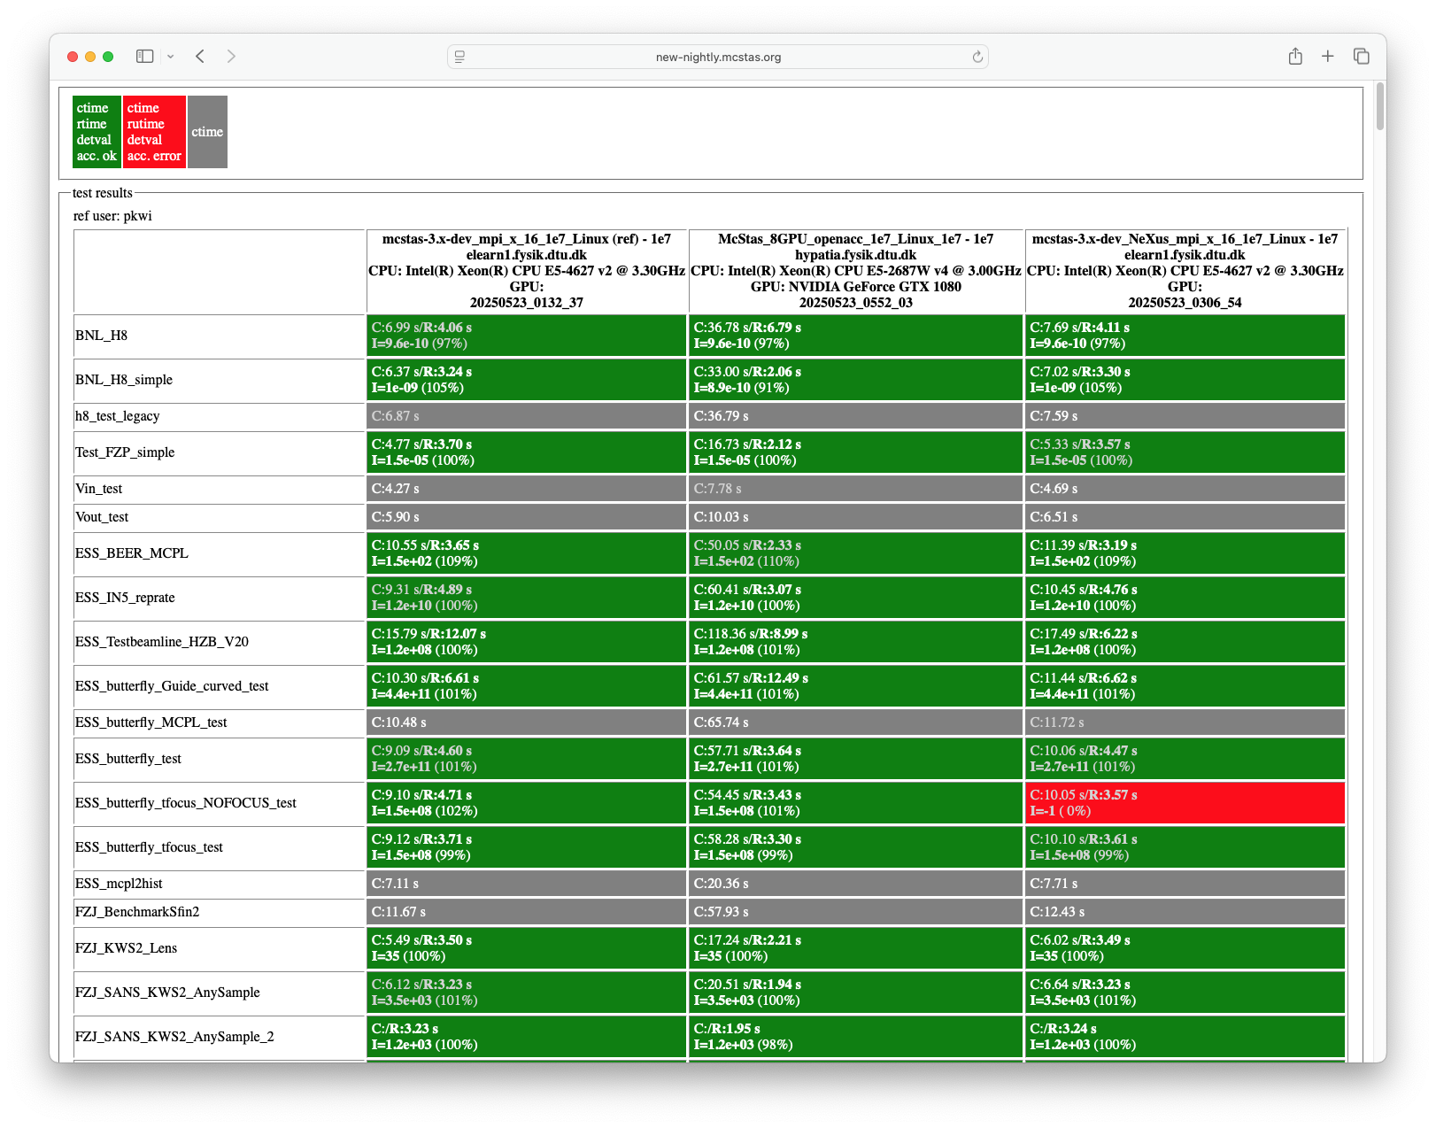


DRAM
Modelling subgroup
  Peter Willendrup
  Thomas Kittelmann
  Mads Bertelsen
  Damian Martin Rodriguez
McStasScript Jupyter notebook

Slide 6
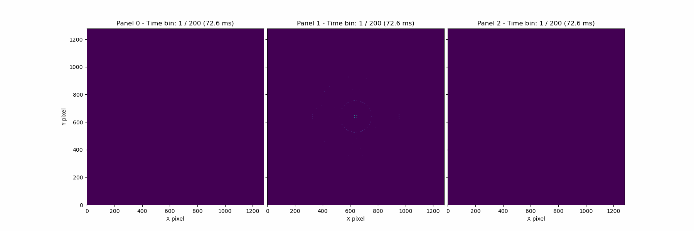
DRAM
Modelling subgroup
  Peter Willendrup
  Thomas Kittelmann
  Mads Bertelsen
  Damian Martin Rodriguez
NMX simulation by IDS Aaron
cytochrome c oxidase (~16M reflections)

Slide 7
DRAM
Reduction subgroup
  Simon Heybrock
  Neil Vaytet
  Jan-Lukas Wynen
  Sunyoung Yoo
  Johannes Kasimir
  Mridul Seth

Slide 8


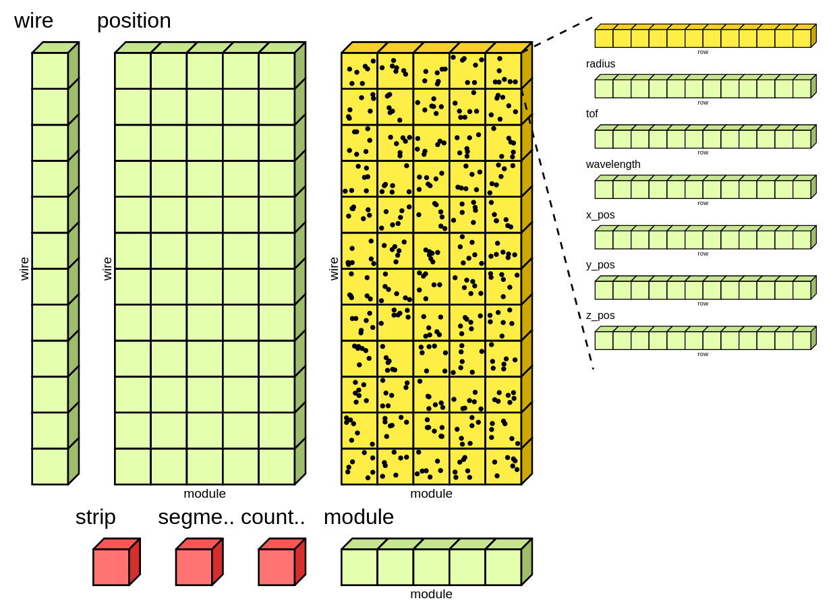
DRAM
Reduction subgroup
  Simon Heybrock
  Neil Vaytet
  Jan-Lukas Wynen
  Sunyoung Yoo
  Johannes Kasimir
  Mridul Seth
Did not find suitable solution for ESS requirements
Had to create that solution
Labeled dimensions
Units
Event data
Binned data
Performant
Readable

Slide 9
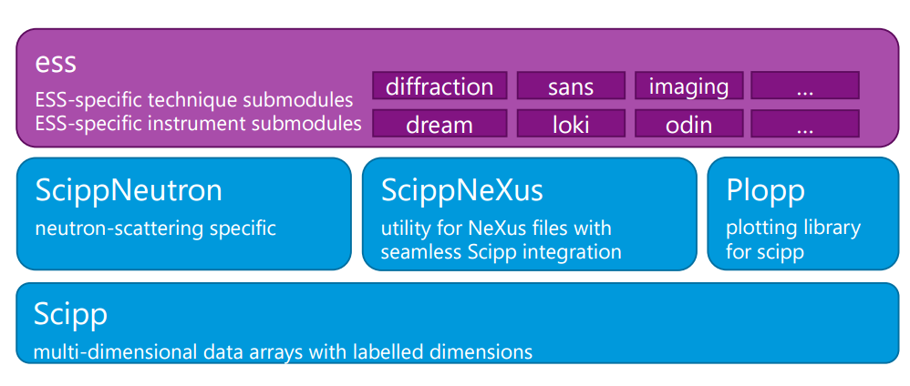
DRAM
Reduction subgroup
  Simon Heybrock
  Neil Vaytet
  Jan-Lukas Wynen
  Sunyoung Yoo
  Johannes Kasimir
  Mridul Seth
Packages built upon the scipp data containers

Slide 10

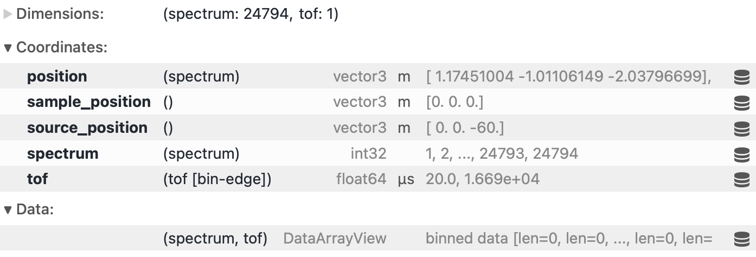
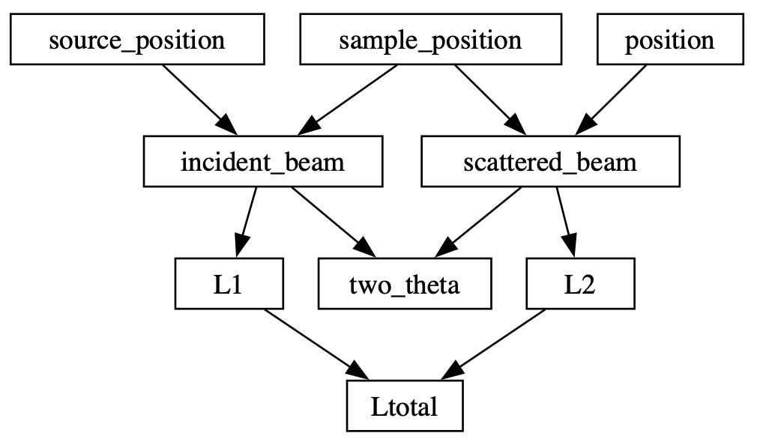
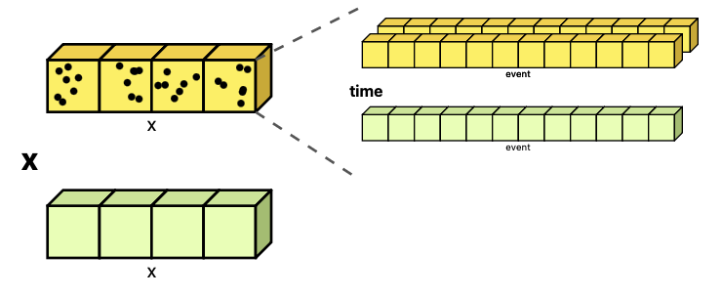
DRAM
Reduction subgroup
  Simon Heybrock
  Neil Vaytet
  Jan-Lukas Wynen
  Sunyoung Yoo
  Johannes Kasimir
  Mridul Seth

Slide 11

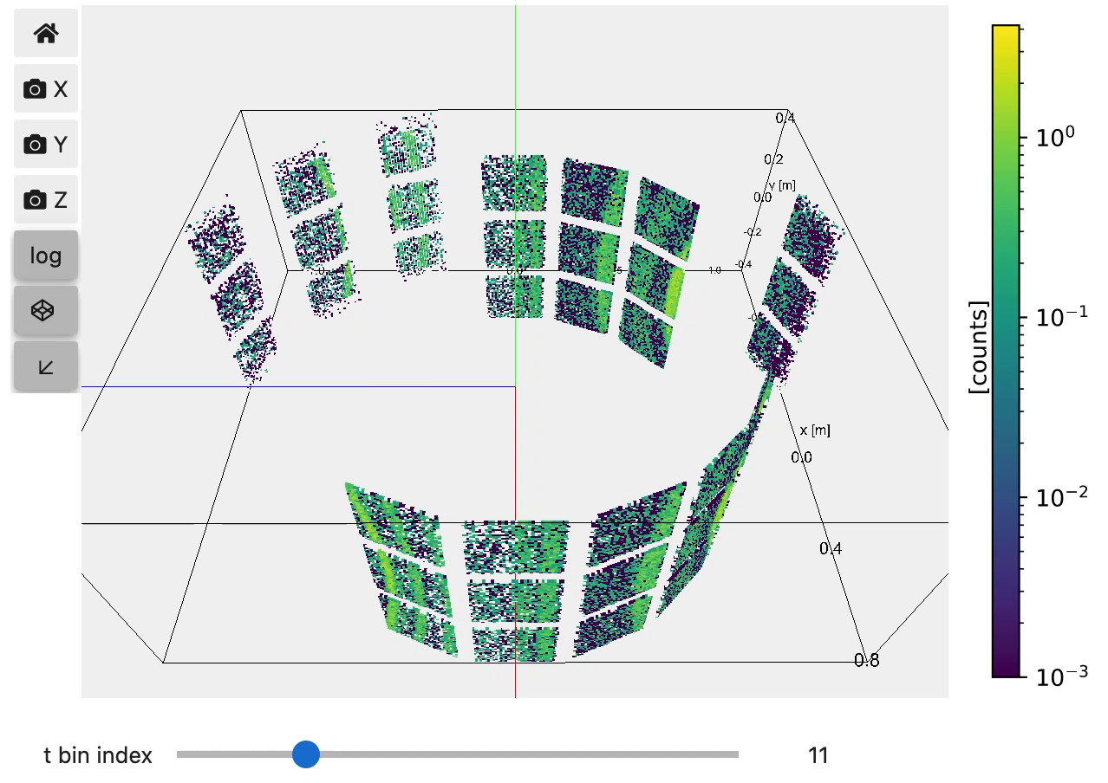
DRAM
Reduction subgroup
  Simon Heybrock
  Neil Vaytet
  Jan-Lukas Wynen
  Sunyoung Yoo
  Johannes Kasimir
  Mridul Seth

Slide 12
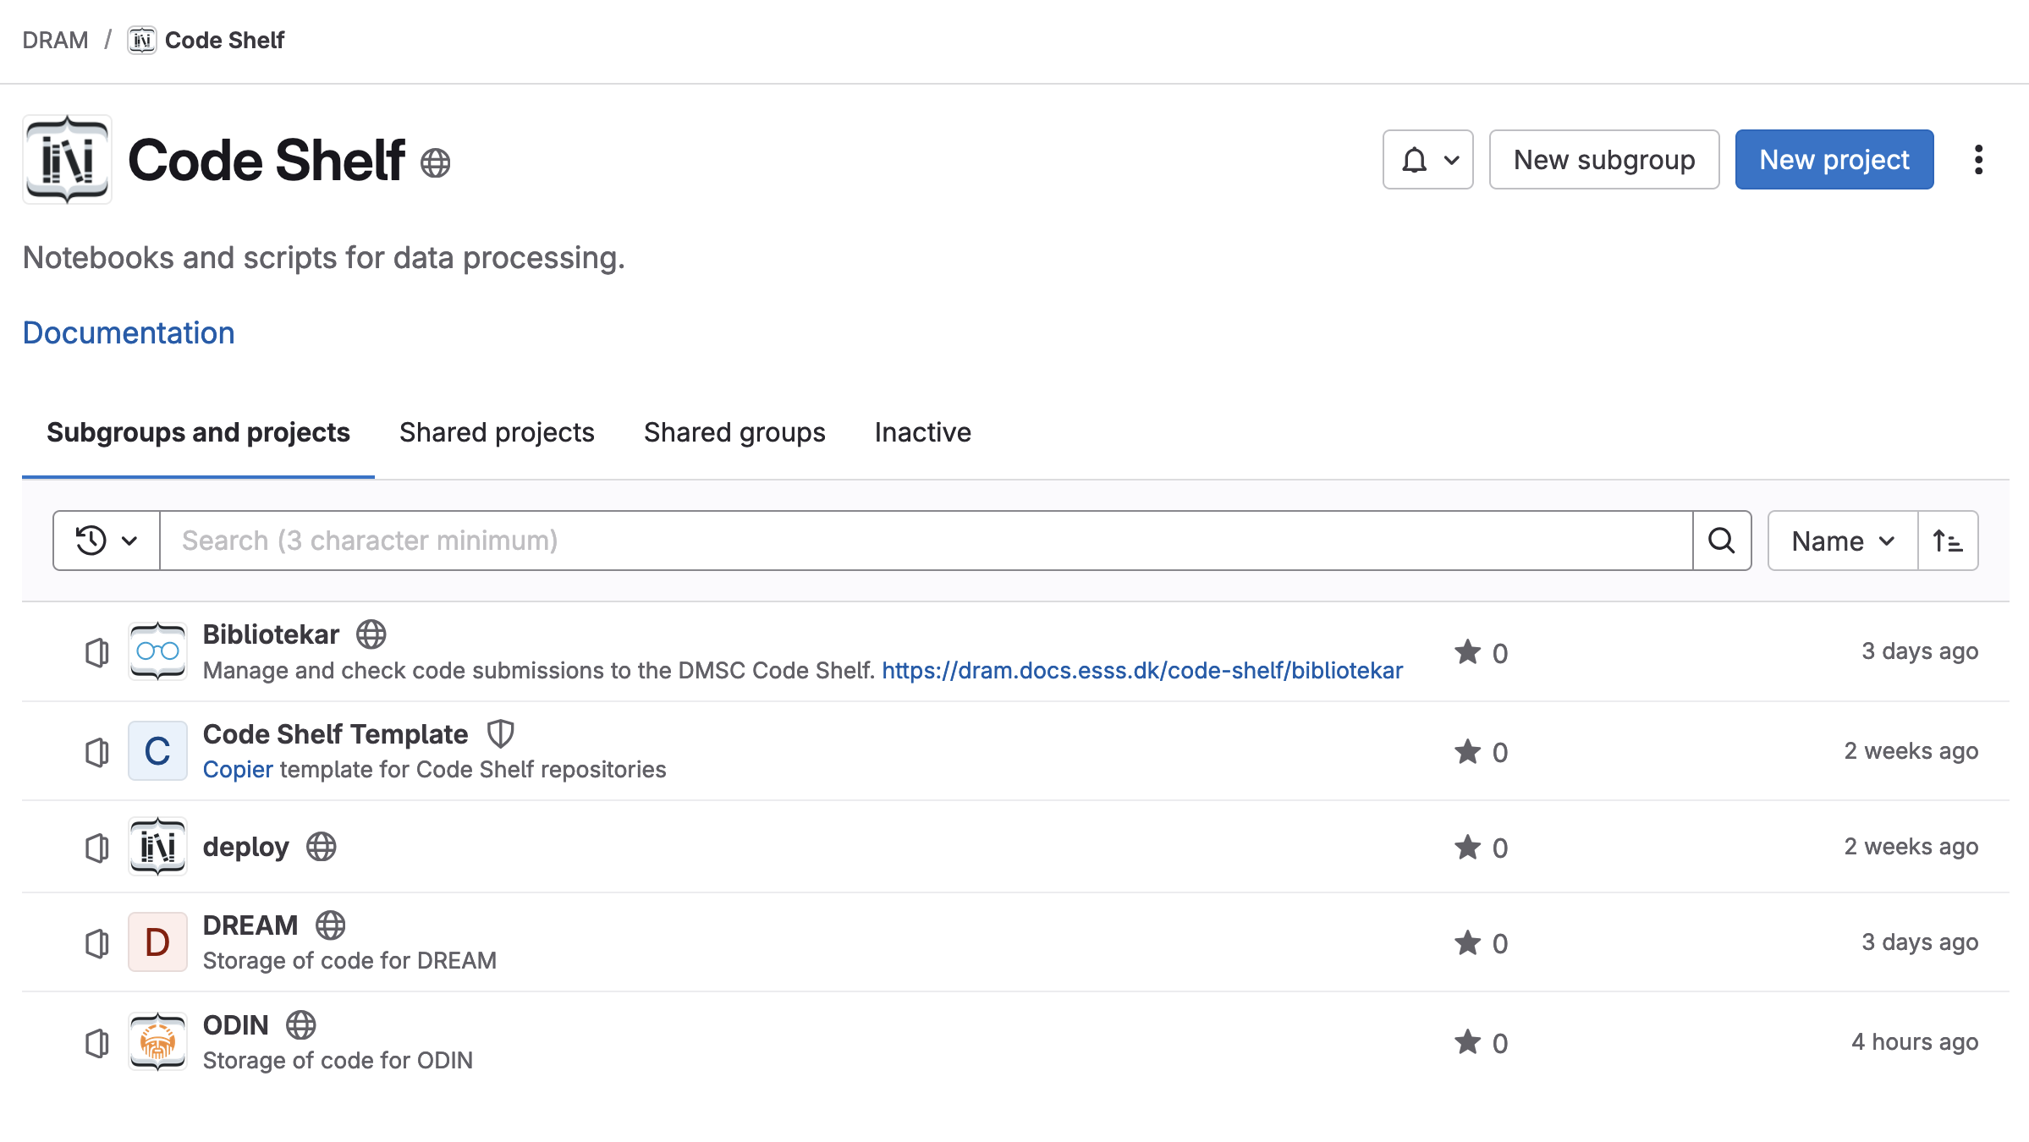
DRAM
Reduction subgroup
  Simon Heybrock
  Neil Vaytet
  Jan-Lukas Wynen
  Sunyoung Yoo
  Johannes Kasimir
  Mridul Seth

Slide 13
DRAM
Analysis subgroup
  Piotr Rozyczko
  Andrew Sazonov
  Henrik Jacobsen
  Christian Vedel
  Ales Kutsepau

Slide 14

DRAM
Analysis subgroup
  Piotr Rozyczko
  Andrew Sazonov
  Henrik Jacobsen
  Christian Vedel
  Ales Kutsepau
Analysis vary significantly across instruments
Different expectations in different fields (GUI needed?)
Not one solution
  Support some existing projects, e.g SASView
  Some created some from scratch
Technique
specific
Stream events & meta data
Data reduction & visualization
Data analysis & modelling
FAIR Data management
Experiment control
User office software (proposal)

Slide 15
DRAM
Analysis subgroup
  Piotr Rozyczko
  Andrew Sazonov
  Henrik Jacobsen
  Christian Vedel
  Ales Kutsepau
Python library
GUI
EasyScience
EasyApp
EasyCrystallography
Technique independent
EasyDiffractionLib
EasyDiffractionApp
EasyReflectometryLib
EasyReflectometryApp
EasyImagingLib
EasyImagingApp
EasyQENSLib
EasyQENSApp

Slide 16
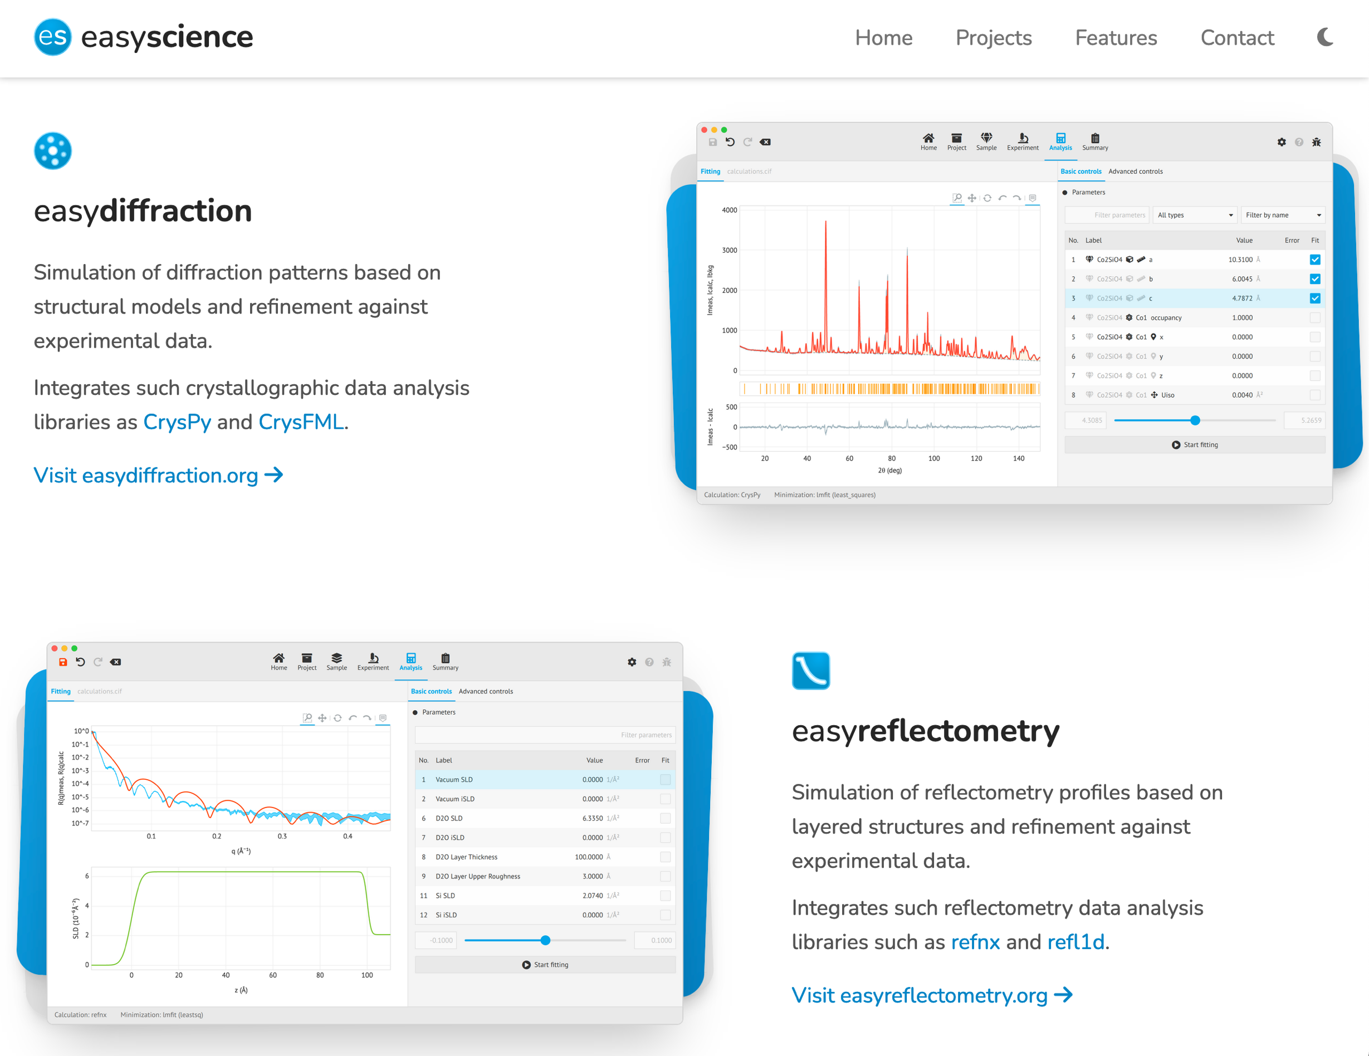
DRAM
Analysis subgroup
  Piotr Rozyczko
  Andrew Sazonov
  Henrik Jacobsen
  Christian Vedel
  Ales Kutsepau

Slide 17
DRAM
Software overview
Technique | Software | Collaborators
SANS | SasView | NIST, ISIS, ILL, DLS, SNS
Reflectometry | EasyReflectometry … | FZJ (ISIS), ORSO
Diffraction | EasyDiffraction … | ILL, LLB
Spectroscopy | EasyQENS, SpinW, PACE … | ISIS
Imaging | MuhRec, EasyImaging, GUI-RITS … | PSI, J-PARC
MX | DIALS, PHENIX | LU, STFC, DLS
Modeling | McStas, Ncrystal, DFT | DTU, ILL, KU, PSI

Slide 18


DRAM
Different ways to contact us
Slack channels (in no particular order):
# dmsc-loki
# dmsc-mnx
# dmsc-odin
# dmsc-tbl
# dmsc-estia
# dmsc-dream
# bifrost-dmsc
# scipp
# dmsc-mcstas
and much more …..
Slack
  Group messages
  Direct messages
GitHub
  Links to our documentation pages
  Add issues

Slide 19
DRAM
Conclusion
  DRAM has subgroups dealing with reduction, analysis and modelling
  Different situation in terms of match between existing software and ESS needs
  Different solutions chosen
  Hopefully covers ESS needs both in terms of ease of use, flexibility and speed!
  Modelling: McStas from 1998 and new development NCrystal
  Reduction: New developments, Scipp and packages building upon it
  Analysis: Mixed depending on situation with each type of instrument / experiment

Slide 20
Thanks for your attention

