Slide 1
User and Data Journey
JEKABS KARKLINS

Slide 2
SIMS team
Scientific Information Management Systems (SIMS)
• Fredrik Bolmsten – Group lead
• Max Novelli - Data curation scientist
• Jay Quan - Software engineer
• Yoganandan Pandiyan - Software engineer
• Janos Babik – Software engineer
• Martin Trajanovski – DAPHNE contribution
• Jekabs Karklins – Software engineer

Slide 3
Core Software We Deliver
SciCat
User Office
HAL-RIC
Opus
PAN Finder

Slide 4
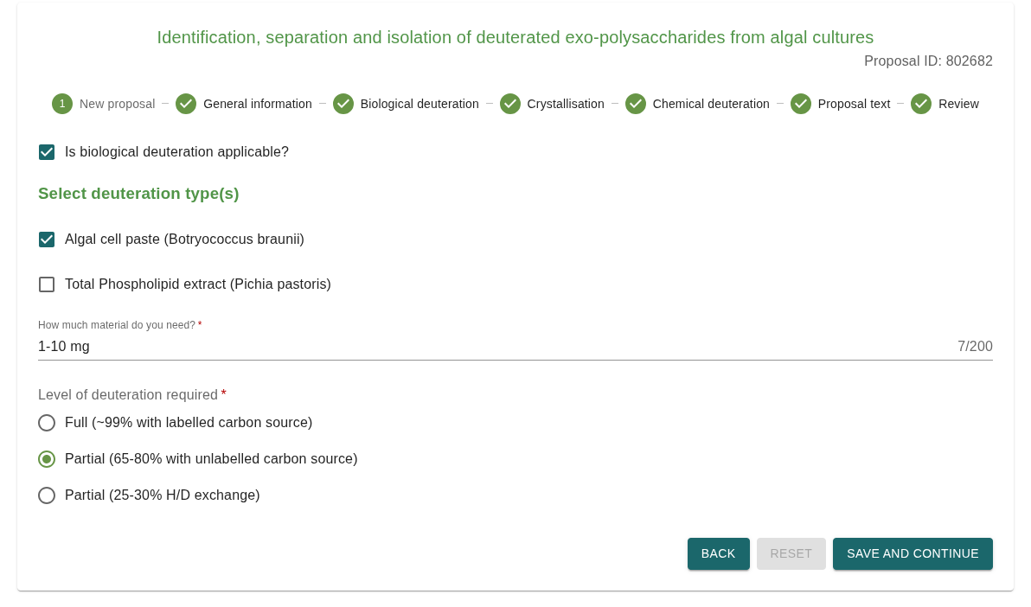
Registration
  - First point
  of contact
  - User registration
  - Submitting proposal

Slide 5
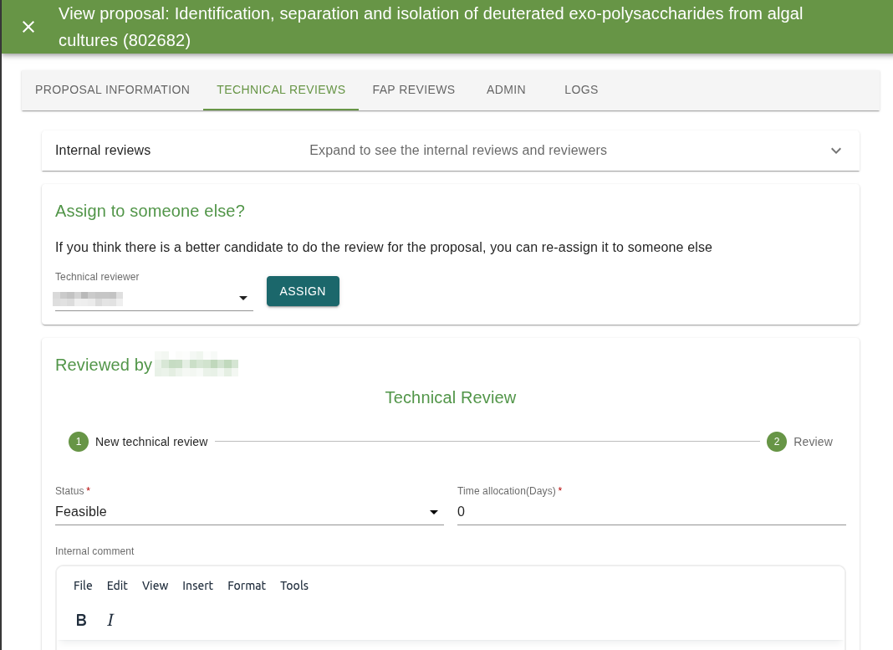
Review & time allocation
Technical review
Excellence review
Time allocation

Slide 6
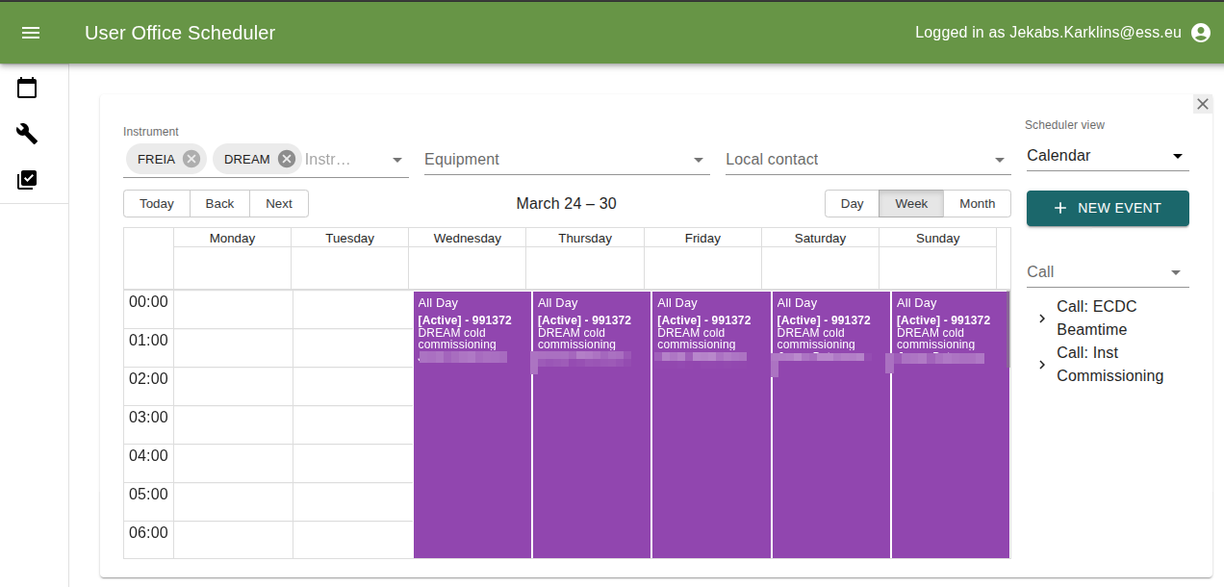
Scheduling
Resource allocation
Notify proposal members
Local contact
Integrations

Slide 7
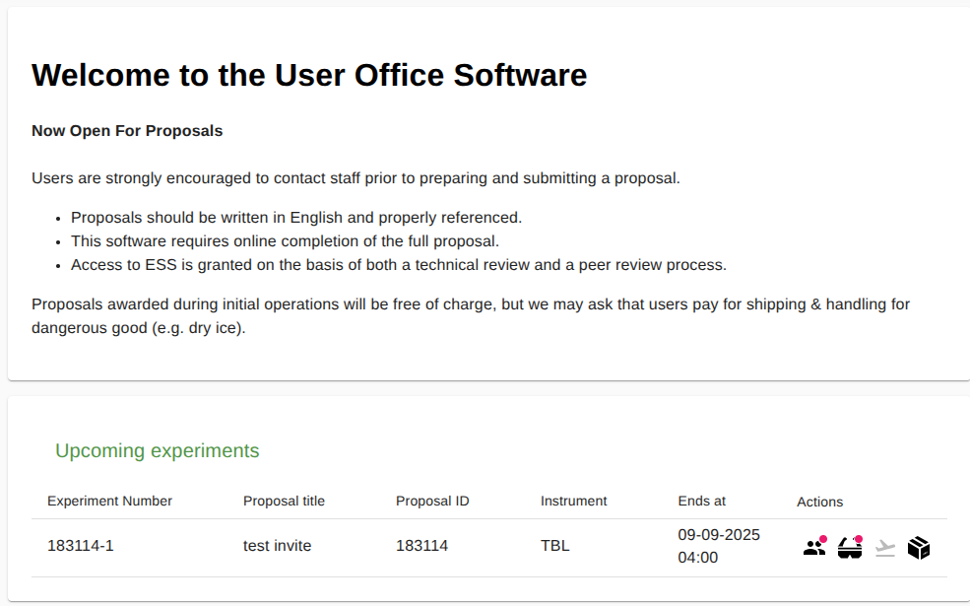
Planning
Training
In depth safety review
Sample shipping
Visit registration
Site access

Slide 8
Experiment

Slide 9
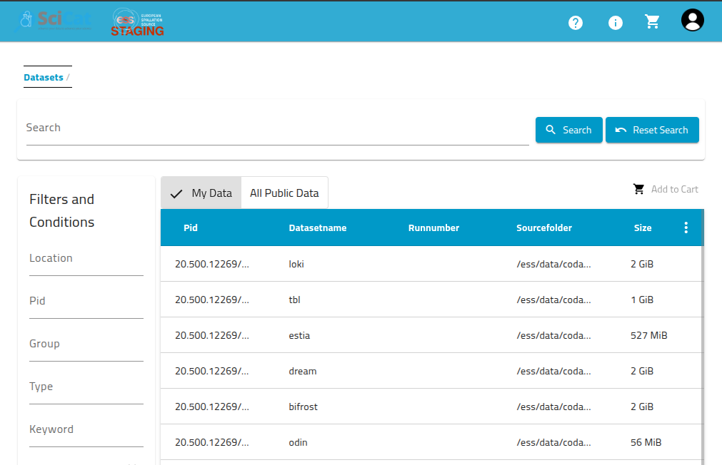
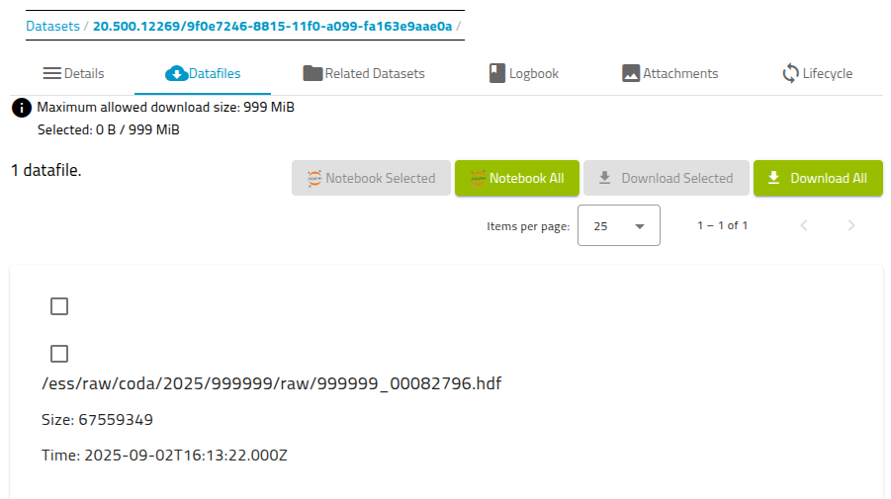
Data access
Same user login
View metadata
Access raw datasets
Use logbook

Slide 10
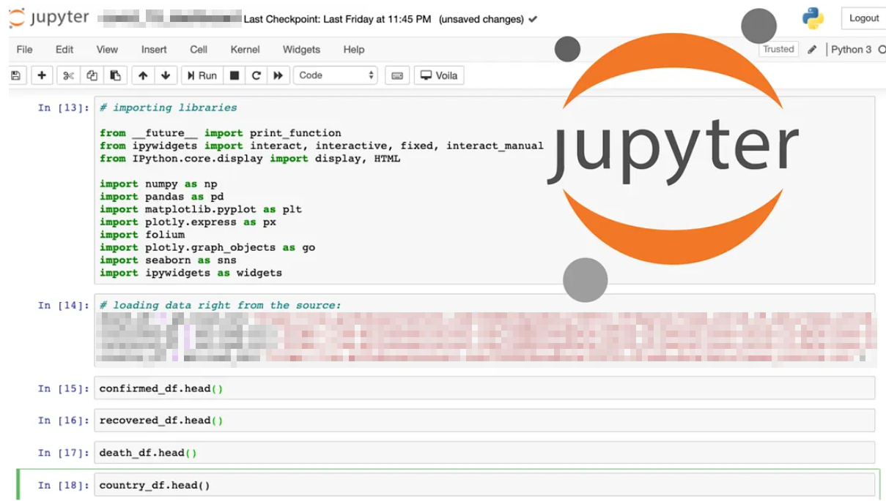
Data analysis
Integration with VISA (Jupyter)
PyScicat
Mint DOI

Slide 11
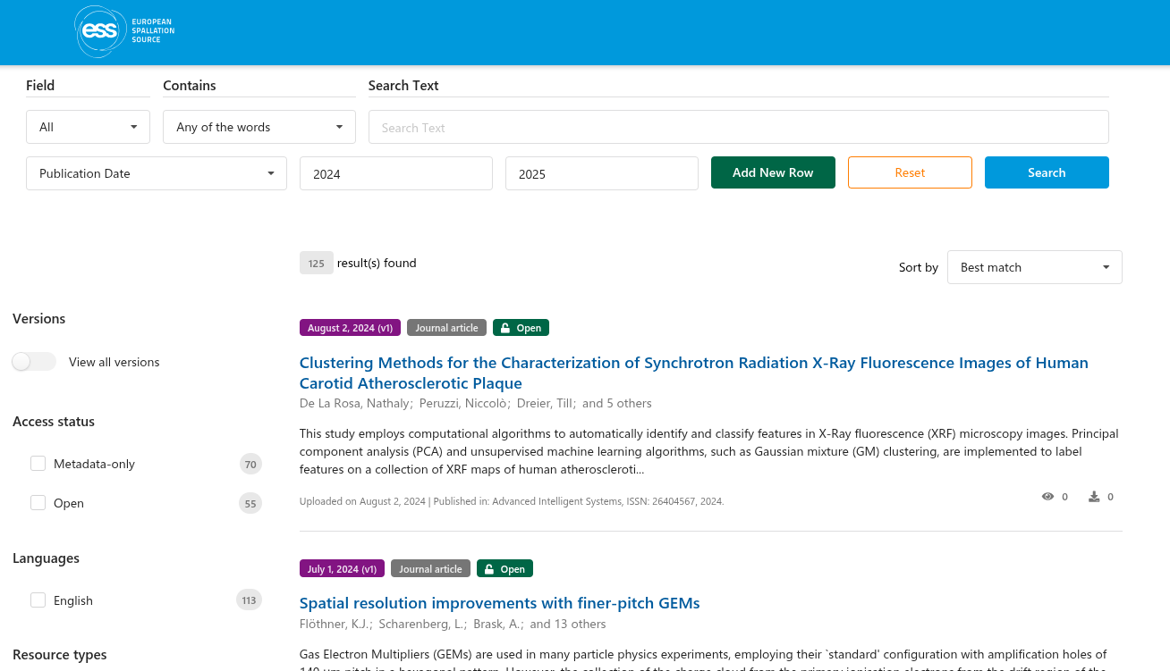
Wrap-up & harvesting
Embargo period
PAN finder
FAIR data
Publication portal

