Slide 1
Twin Peaks
Single-crystal diffractometer
Werner Schweika – Diffraction STAP meeting 22.10.2025

Slide 2

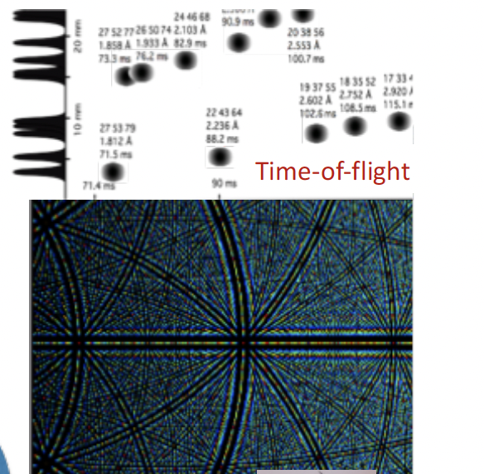
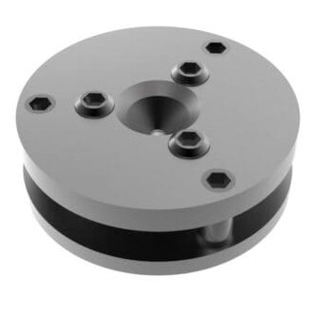
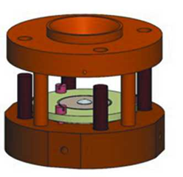
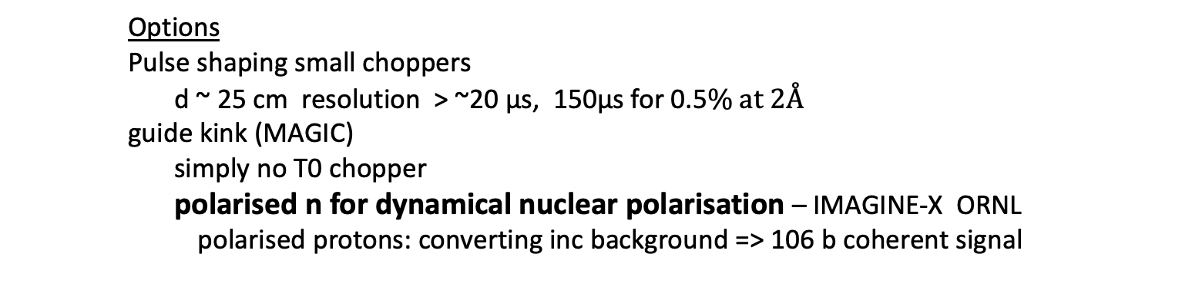
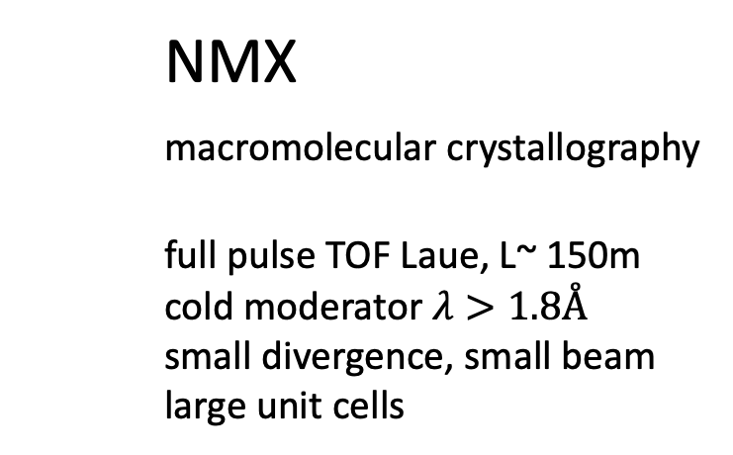
NMX
macromolecular crystallography
full pulse TOF Laue, L~ 150m
cold moderator $λ>1.8Å$
small divergence, small beam
large unit cells
Single crystal diffraction
hope for support from You, ESS, FZJ, PSI, ISIS, Bilbao, Edinburg, ….
keep it simple – high benefit/cost
similar, cold spectrum ~1.8 - 6Å
not so very large unit cells
full pulse TOF Laue, L~ 60m
very intense beam > ~ 10 x SNS, 100 x ISIS TS2
large solid angle of detection - like WISH-2
small instrument
prime application high pressure DAC from synchrotron community
bi-spectral ~0.8-5Å
we can have both instruments
at one beam port S4
probably both in total cheaper than
any other previous ESS instrument
detector pixels
courtesy of
Bianca Haberl, Univ. Canberra
Damian Paliwoda, ESS
Andrzej Grzechnik, FZ- Jülich
Options
Pulse shaping small choppers
d ~ 25 cm resolution > ~20 µs, 150µs for 0.5$\% at 2Å$
guide kink (MAGIC)
simply no T0 chopper
polarised n for dynamical nuclear polarisation – IMAGINE-X ORNL
polarised protons: converting inc background => 106 b coherent signal

Slide 3
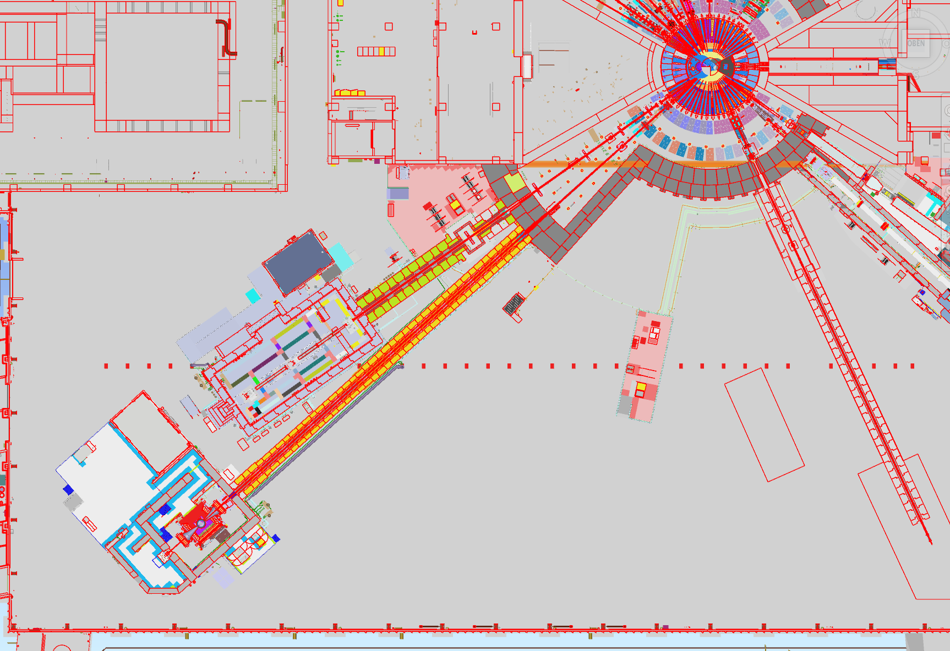
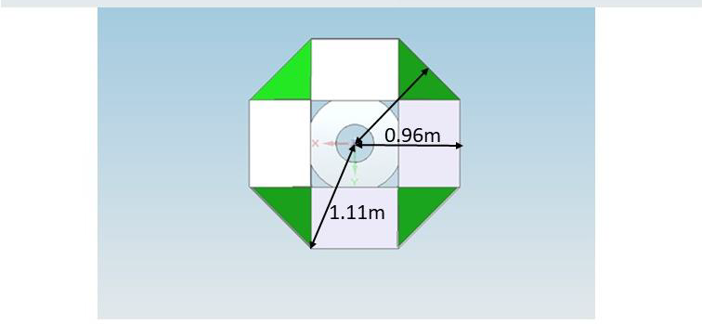

TWINS for single crystal diffraction
cold and bi-spectral at a single beam port S4
neutron time-of flight Laue diffraction
full pulse (like NMX) or with pulse shaping
=> world leading highest flux
=> high pressure DAC
S5
8 cm
S4 b
cold
beam separation 8 cm
4mx5m
chopper
at needle’s eye
straight view to cold moderator + kink
S4 a
3mx4m
at 7m / 7.5m
bi-spectral
straight view to thermal moderator + kink
~65m
S3
S2
DREAM
ODIN
small double disk chopper - simple, cheap (MAGIC)
~400 – 450 Hz fix d ~ 25 cm 3 or more sub-pulses
possible resolution > ~15µs, 3 choices
optimal resolution ~ 100µs – 200µs, or full pulse
Overlap / band selecton chopper 14 Hz, d=18 cm
opening / closing time 1.26 ms/cm
(conceptually similar to DREAM)
T0 chopper not needed with kinked guide
guide – semi elliptic - small < ~4cm
kink - could be polarising for DNP
… monitor, heavy shutter
in bunker
length 60m – 70m
bandwidth 1.8Å – 5.8Å cold spectrum
0.8 Å ~ 5 Å bispectral
collimation fix focusing 0.2$°$-0.5$°$
or change absorbing to focusing end
sample size < 8 mm (diffuse scattering) to ~ 1 mm
detector resolution < ~2mm x 2mm
~ 50 – 100 cm from sample
large solid angle
scintillation detector in vacuum
type SONDE(FZJ,SKADI) or WSF(ISIS,CDT)
WISH-II

