Slide 1
Proposal for medium performance symbiotic diffractometers
Rasmus Toft-Petersen, BIFROST

Slide 2
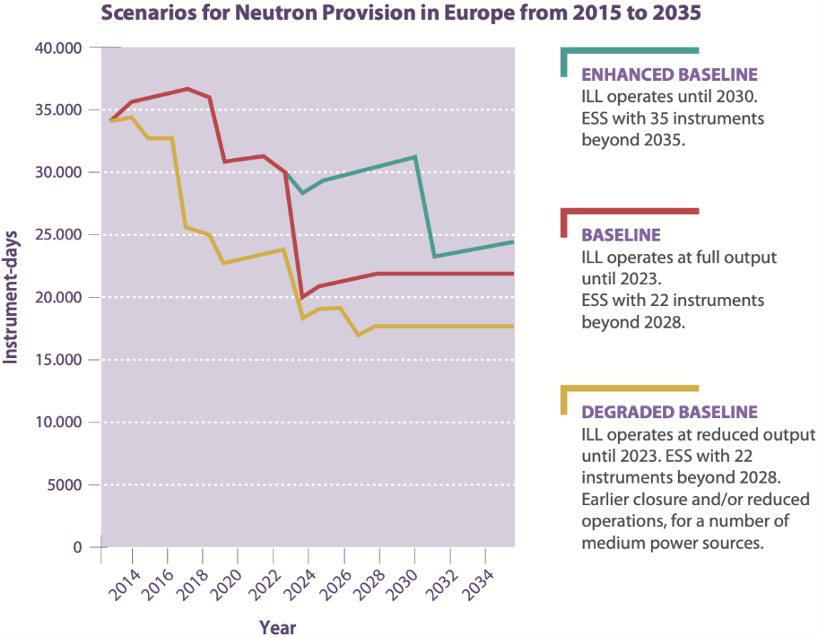
Motivation: Capacity
Local discussions:
The Danish neutron community have long discussed a Danish or Scandinavian CANS
It seems infeasible, due to the cost relative to the size of our communities. All neutron money goes to ESS, and it is hard not to understand the reluctance of funding bodies.
We have ESS right next door. The worlds brightest neutron source. The difference between CANS brilliance and ESS brilliance is so large, that if you could find a way of using neutrons otherwise wasted, even a fraction of them, you would have something decent.
Personal opinion on using ESS for capacity
ESS is built for world class science. If there is room for a world class instrument, it should be built. Capacity would be more the he role of CANS and medium flux sources.
ESS has 42 beam ports. There is no way we can fit 42 large instruments, but we could find ways of building a couple of small ones, if they are cheap
Figure 1: Instrument days available in Europe in the coming years. From [1].

Slide 3
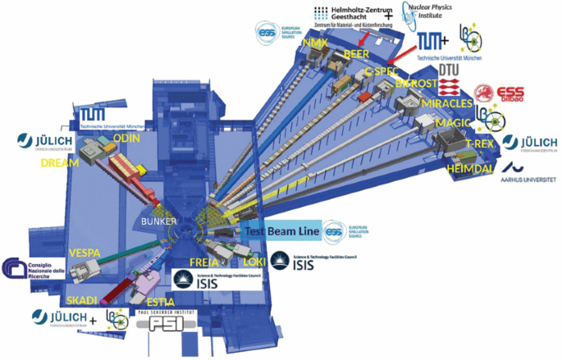
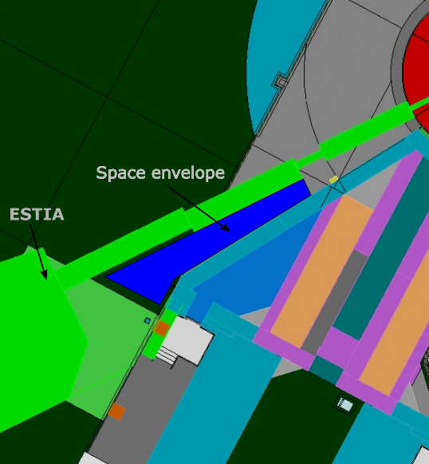
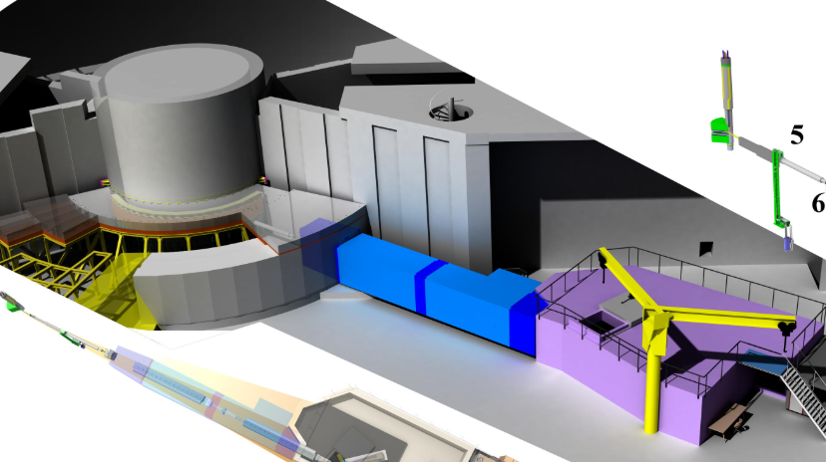
ESS outline and hidden gems
Some beam ports are squeezed between two other beamlines
Other beam ports have no space for
shielding or access on the floor

Slide 4
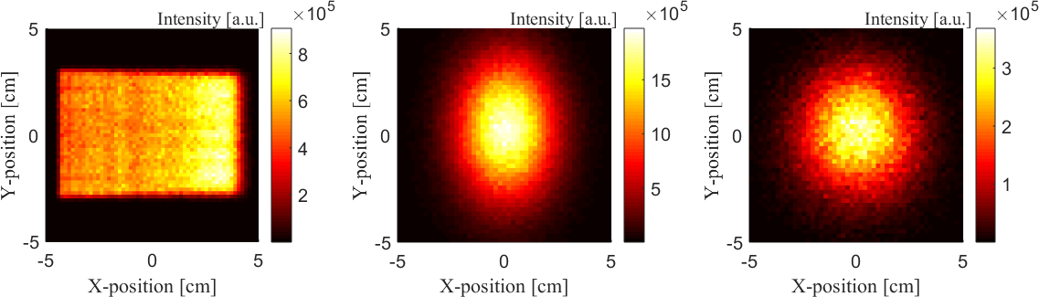
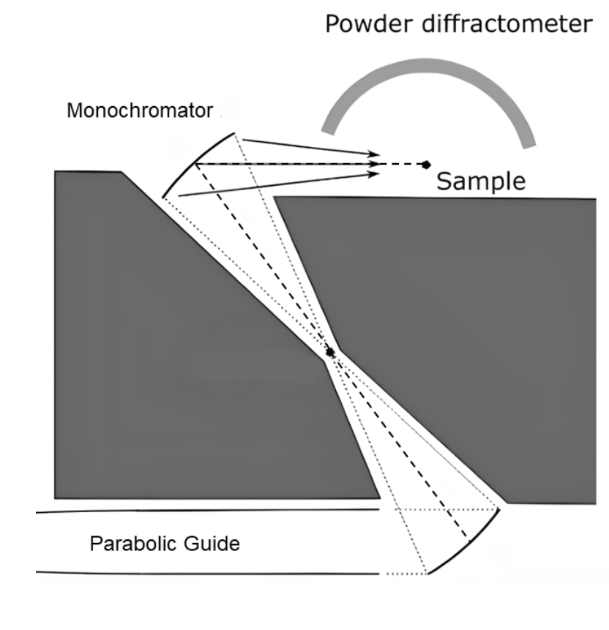
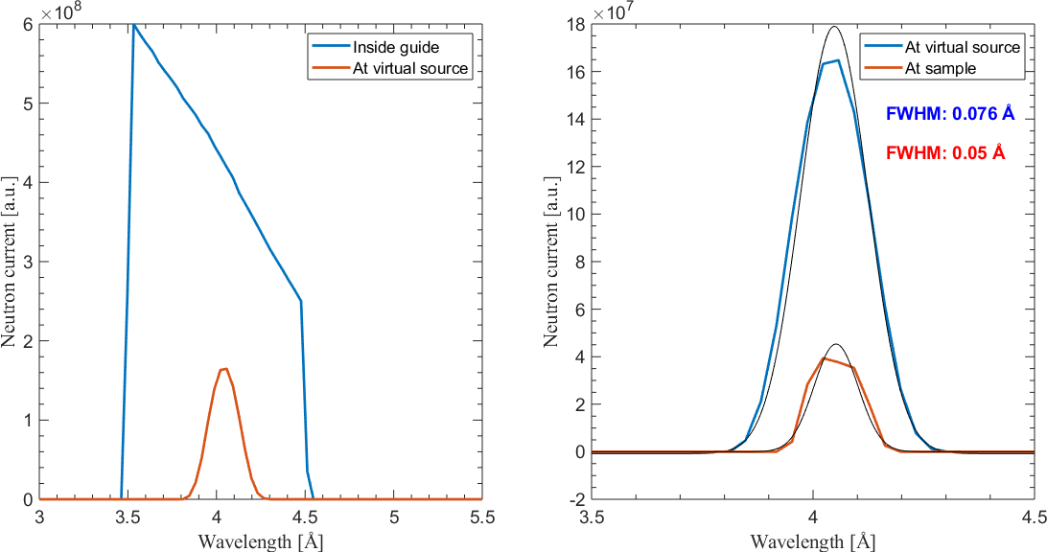
Proposal: Use virtual sources and double bounce monochromators to shift the beam 2 meters vertically

Slide 5
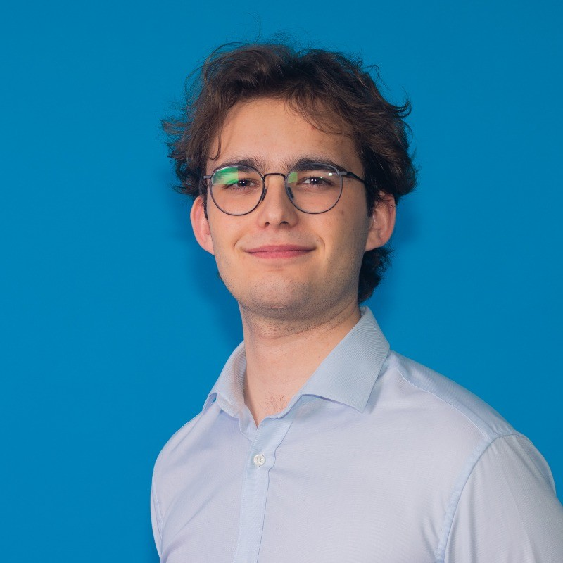
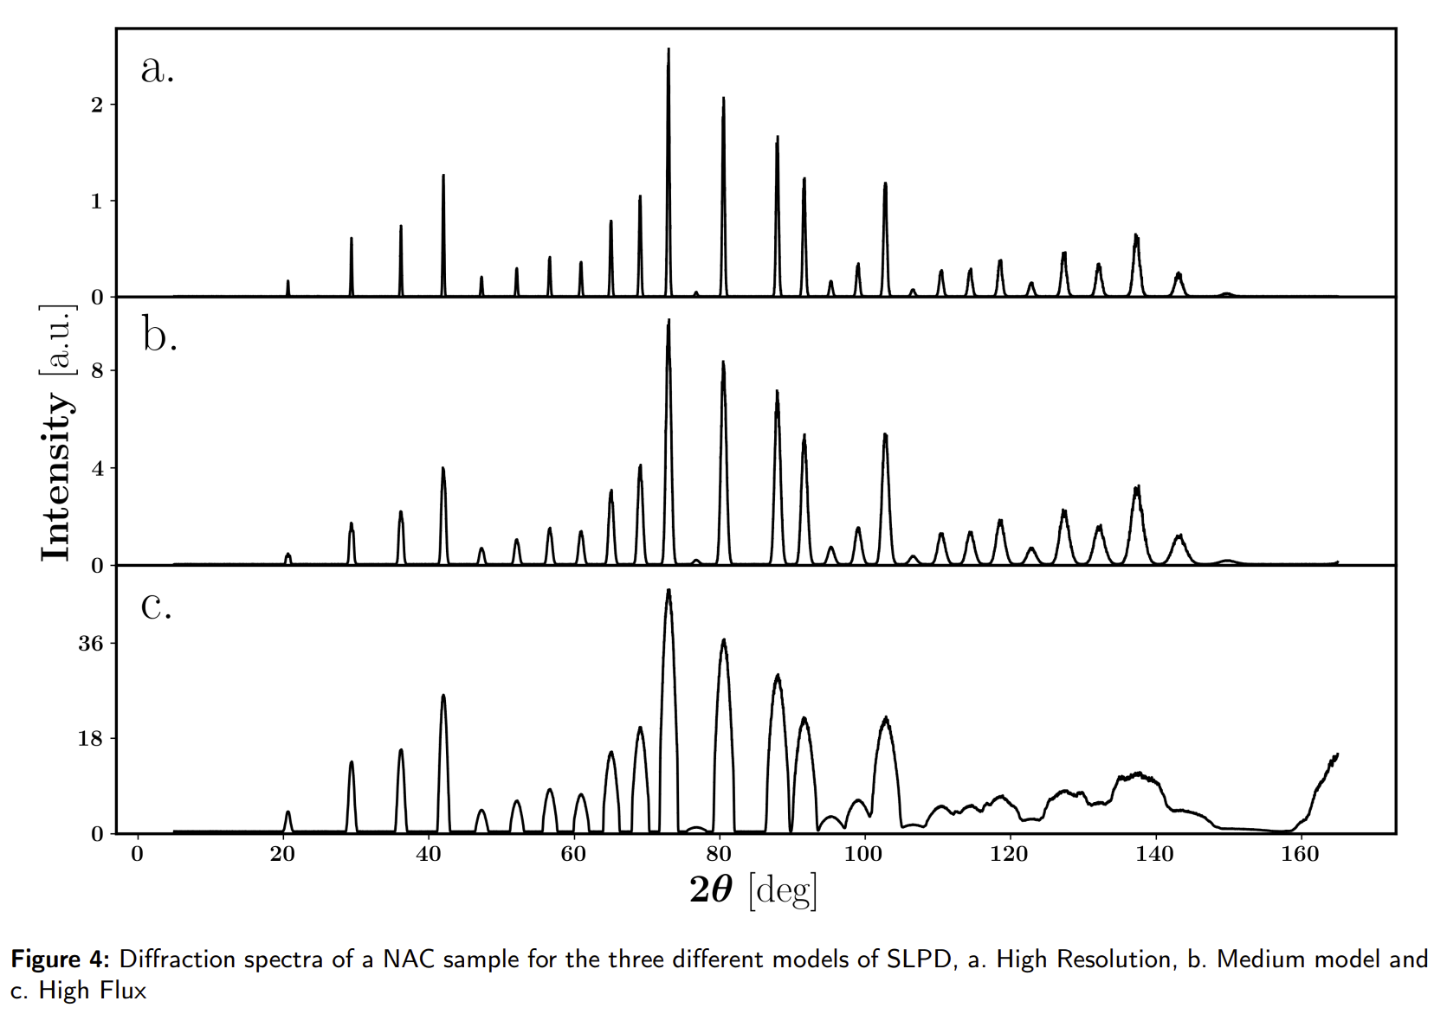
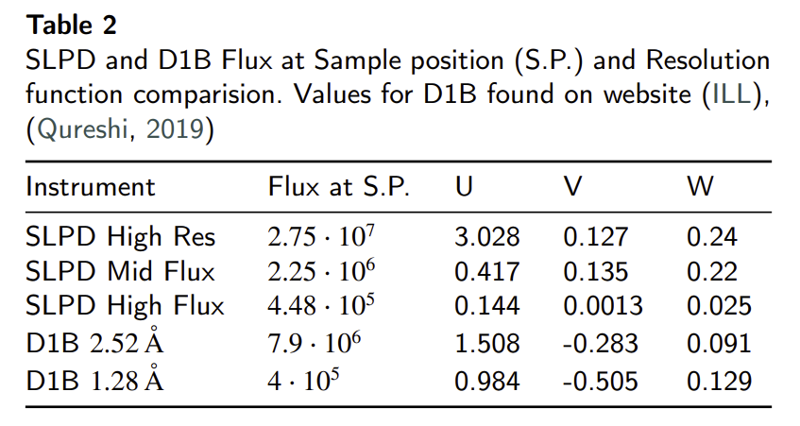
Flux reasonable
Nicolai Lindaa Amin
Masters student
Flux a factor of 4 below D1B, essentially explained by
the virtual source trick. But that is by no means a bad beam intensity, and can be used for science

Slide 6
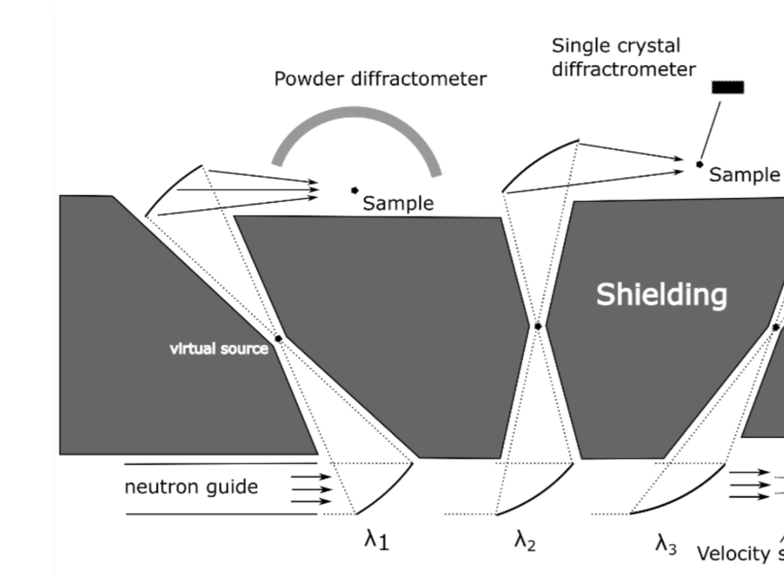
ESS plan: using the accelerator commissioning time
Postives:
If space allows, more than one
diffractometer can be built on the same guide, with some losses
No moving parts (to some extent)
very cheap instruments
CCRs and pressure cells can be used
Negatives:
A lot of optimization. Need to explore
HOPG/Si combinations (reduce flux further)
Manpower needed regardless. Needs money to operate
No magnets

Slide 7
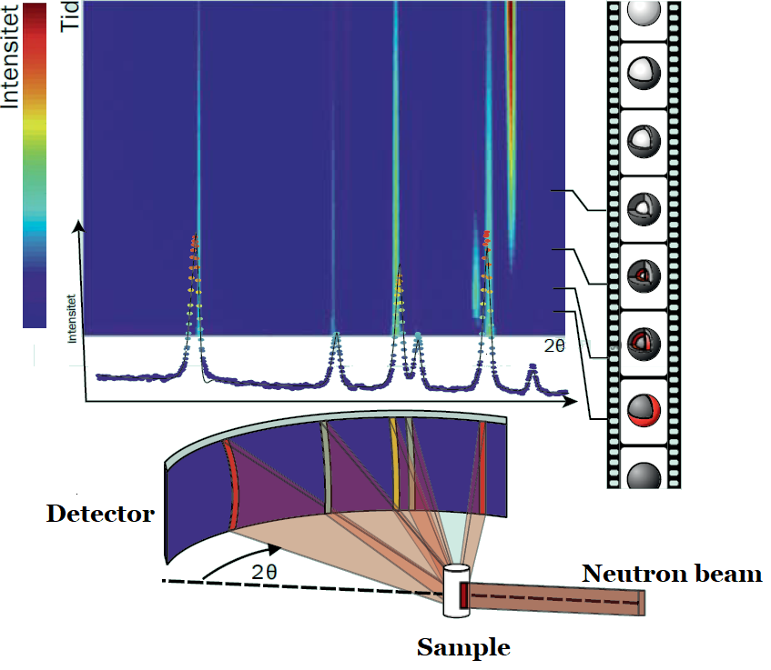
ESS plan: PSC chopper and fission monitor
PSC sets the ‘real’ T0 for the instrument and the wavelength band
Pulse timing and shaping needs experimental confirmation to make sure we understand the time delays between reference pulse, proton pulse and ‘PSC phase’
Use case
  Training
  Test measurements for DREAM/NMX/MAGIC (crystal quality, Bragg peak intensity etc)
  Bringing in students (Danish training at PSI has been extremely valuable to catch them while they are young – ESS could provide that service to the community
  Some experiments don’t need high flux.
An in-situ powder diffraction experiment, where the Bragg peaks evolve in time, as the nature of the sample changes.

Slide 8
Thank you for your attention

