Slide 1
SKADI
Progress Update
PRESENTED BY Sebastian Jaksch, Sylvain Desert, Romuald Hanslik, Tadeusz Kozielewski, Annika Stellhorn, Tamires Gallo

Slide 2
Progress since last STAP meeting
Collimation shielding finalized
Collimation tank finalized
Chopper 2 mechanically installed
Hutch installation being finalized
Polarizer assembly TG3 in production
Started compiling overall TG3 documentation (we now know what we need)
Detector tube shipped and installed
Out of bunker guides manufactured and shipped, installation imminent
Detector housing large scale components manufactured
New detector scientist started in DetGroup: Welcome Pavel
Common projects progressed towards CR stage
Some of those are culminations of several workpackes and can amount to month of work

Slide 3
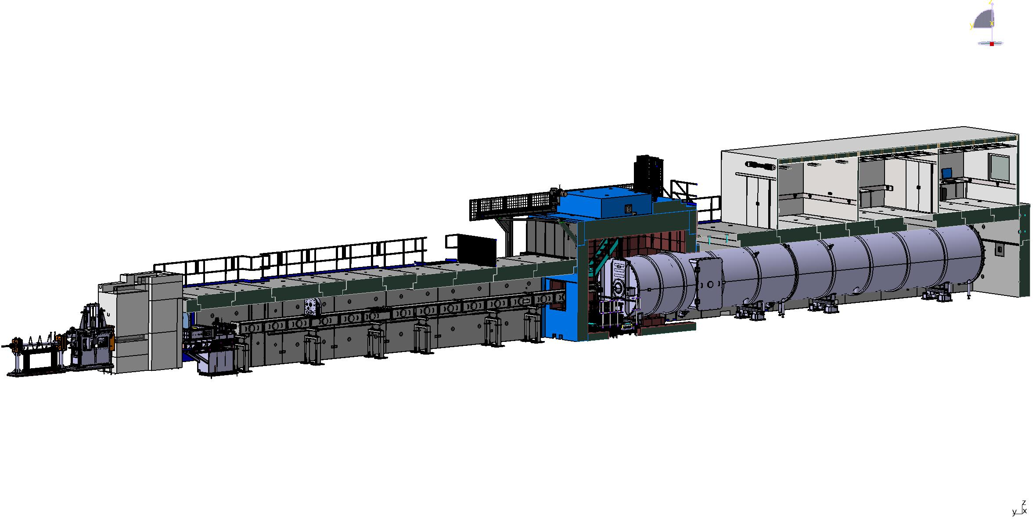
SKADI
CEP: installation ongoing
CUP: installation imminent
MCA: installation imminent
Installed,
In installation/storage,
In manufacturing
Hutch: nearly done
FZJ
Sample Exposure System
Sample area, shielding
FZJ
Beam extraction Sysystem
NBOA, BBG, Reflector
FZJ
Chopper System
FZJ
Neutron detector system
Detectortube, detector vessel, shielding
LLB
Beam geometry conditioning
Collimation and apertures +shielding
LLB
Heavy shutter
FZJ
Neutron Detector
FZJ
Housing ready Mid-2025
Installation of electronics into housing End-2025
Transfer to Lund until mid 2026
Beam filtering system
Polarizer, Spin Flipper
FZJ

Slide 4
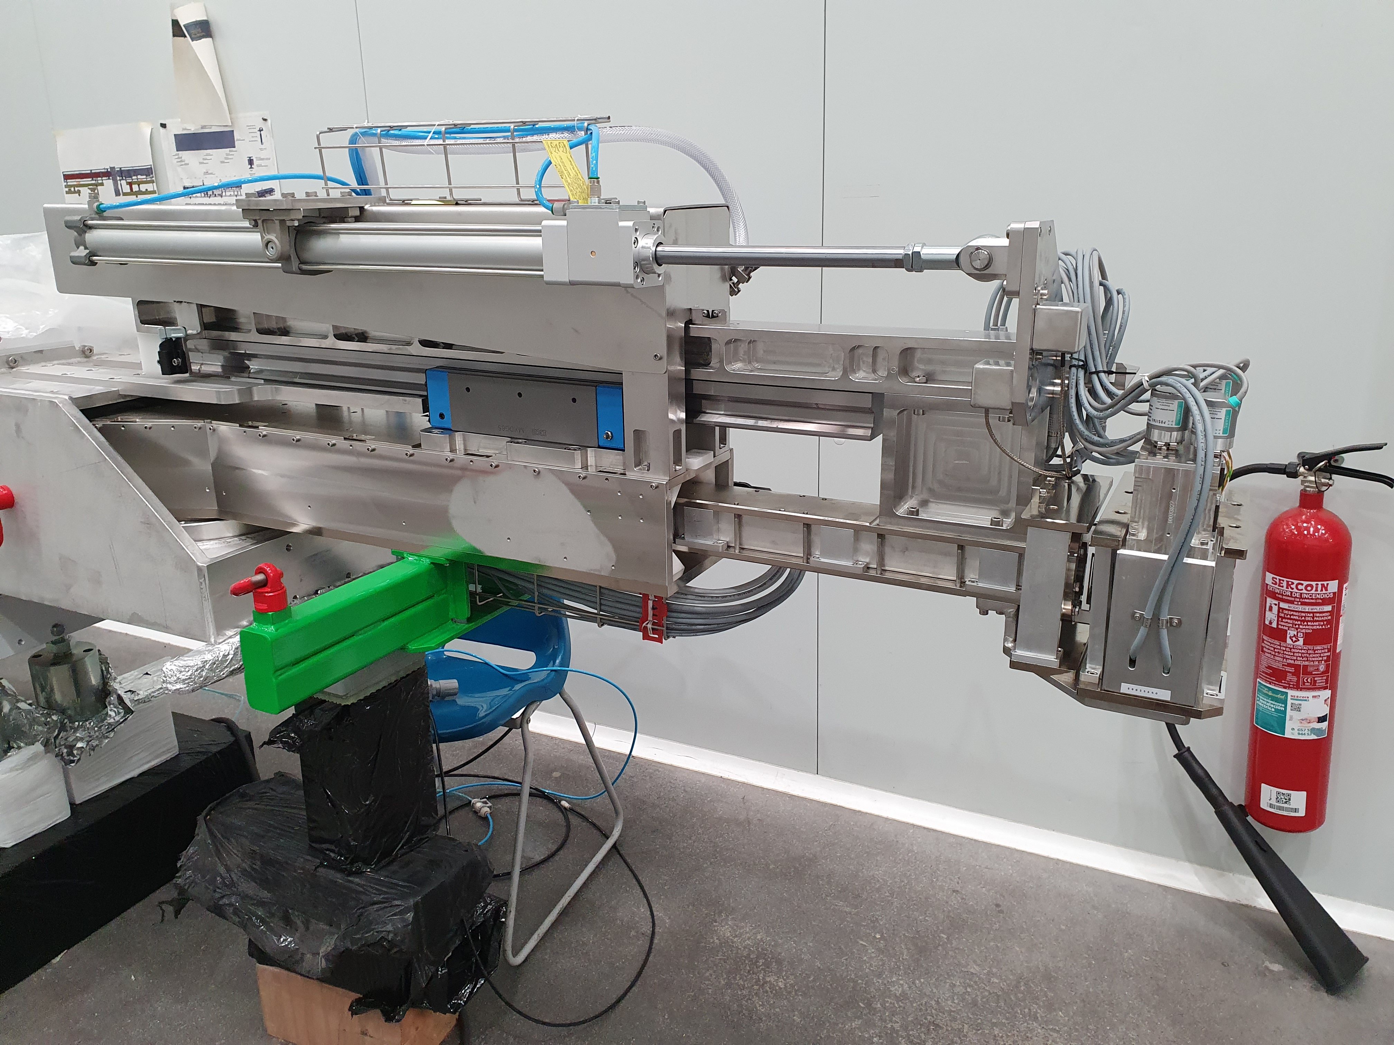
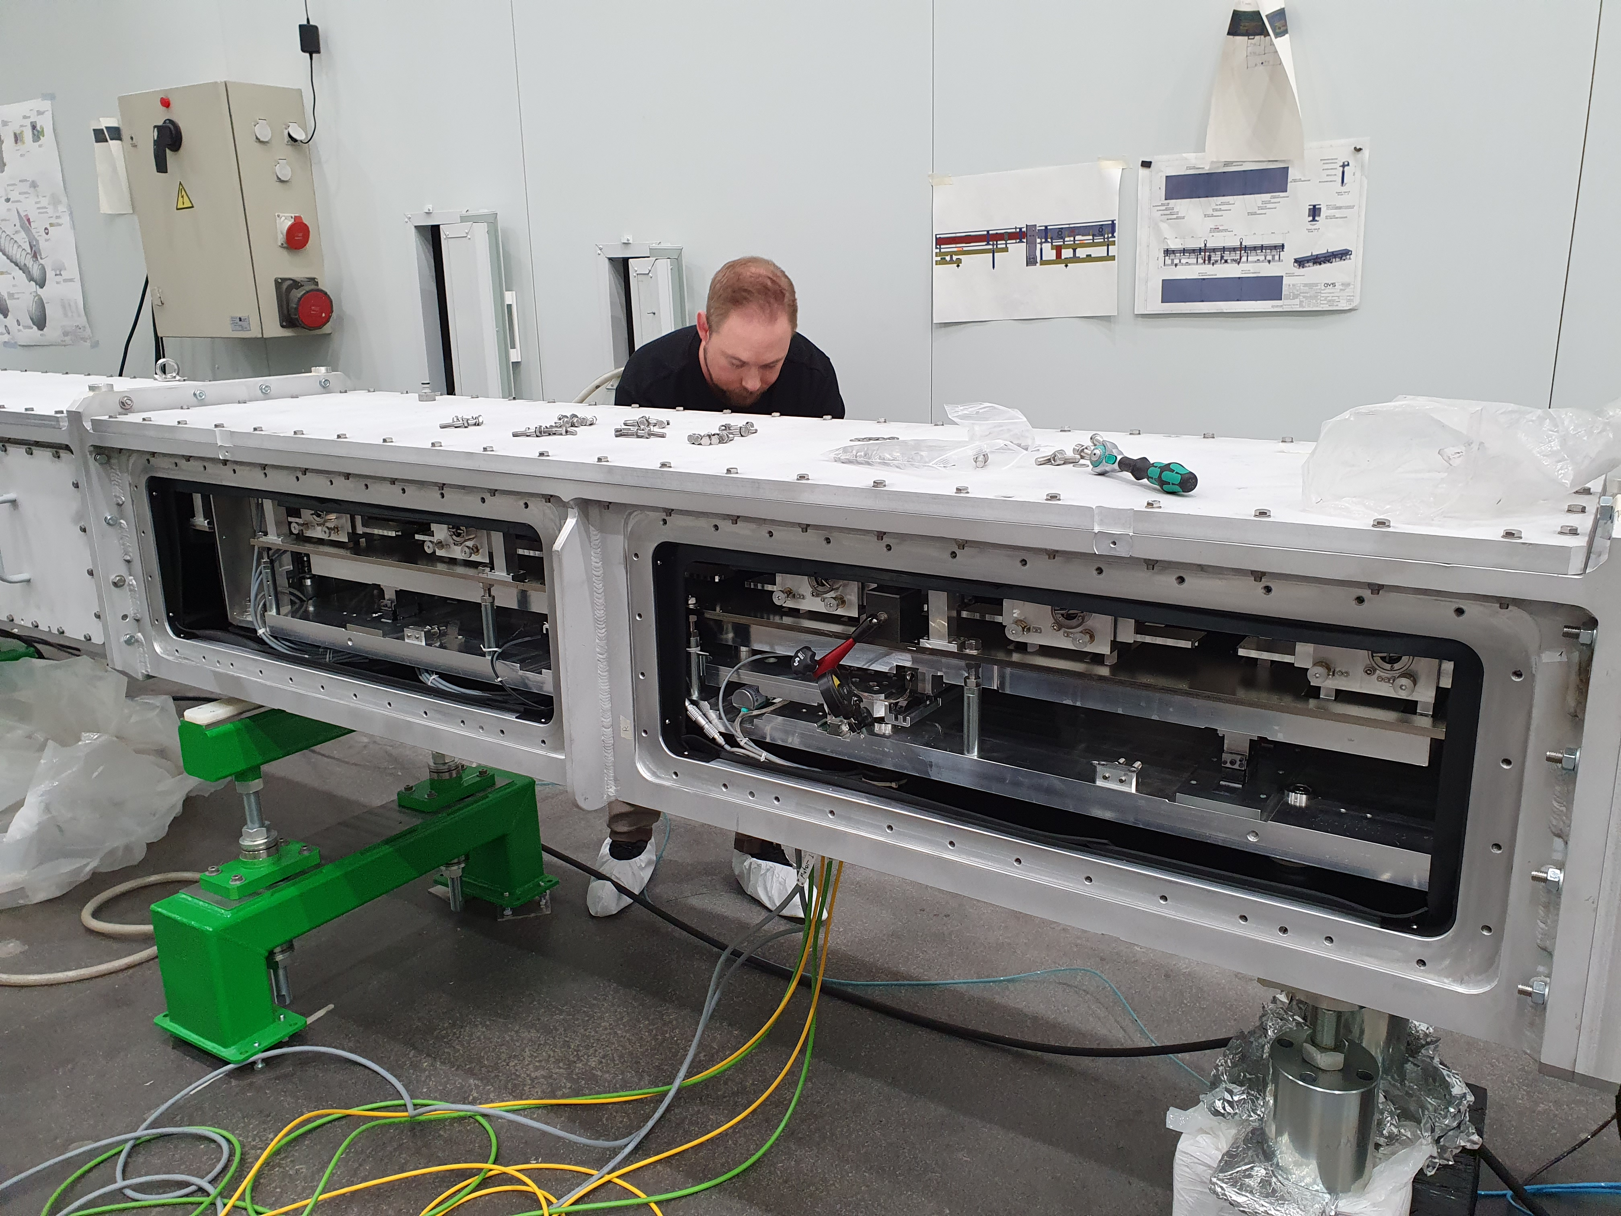
Collimation
Installation done
Took a little time: A lot of coordination between MCA and AVS
Is mechanically working (now also electrically)

Slide 5
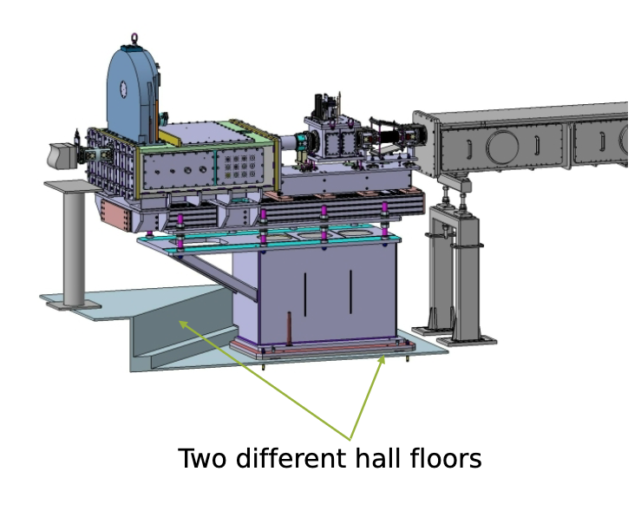
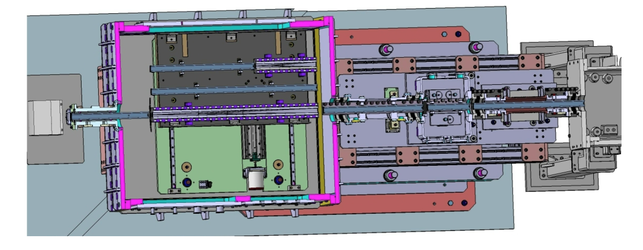
Polarizer Assembly
Now going in stepwise installation, pending workshop availability
Shutter 2 in manufacturing, base in manufacturing, flanges in manufacturing, spin flipper in manufacturing
Hammering out details about spin-flipper power supply with Hal: Issue here is that the originally planned powersupply is not manufactured anymore

Slide 6
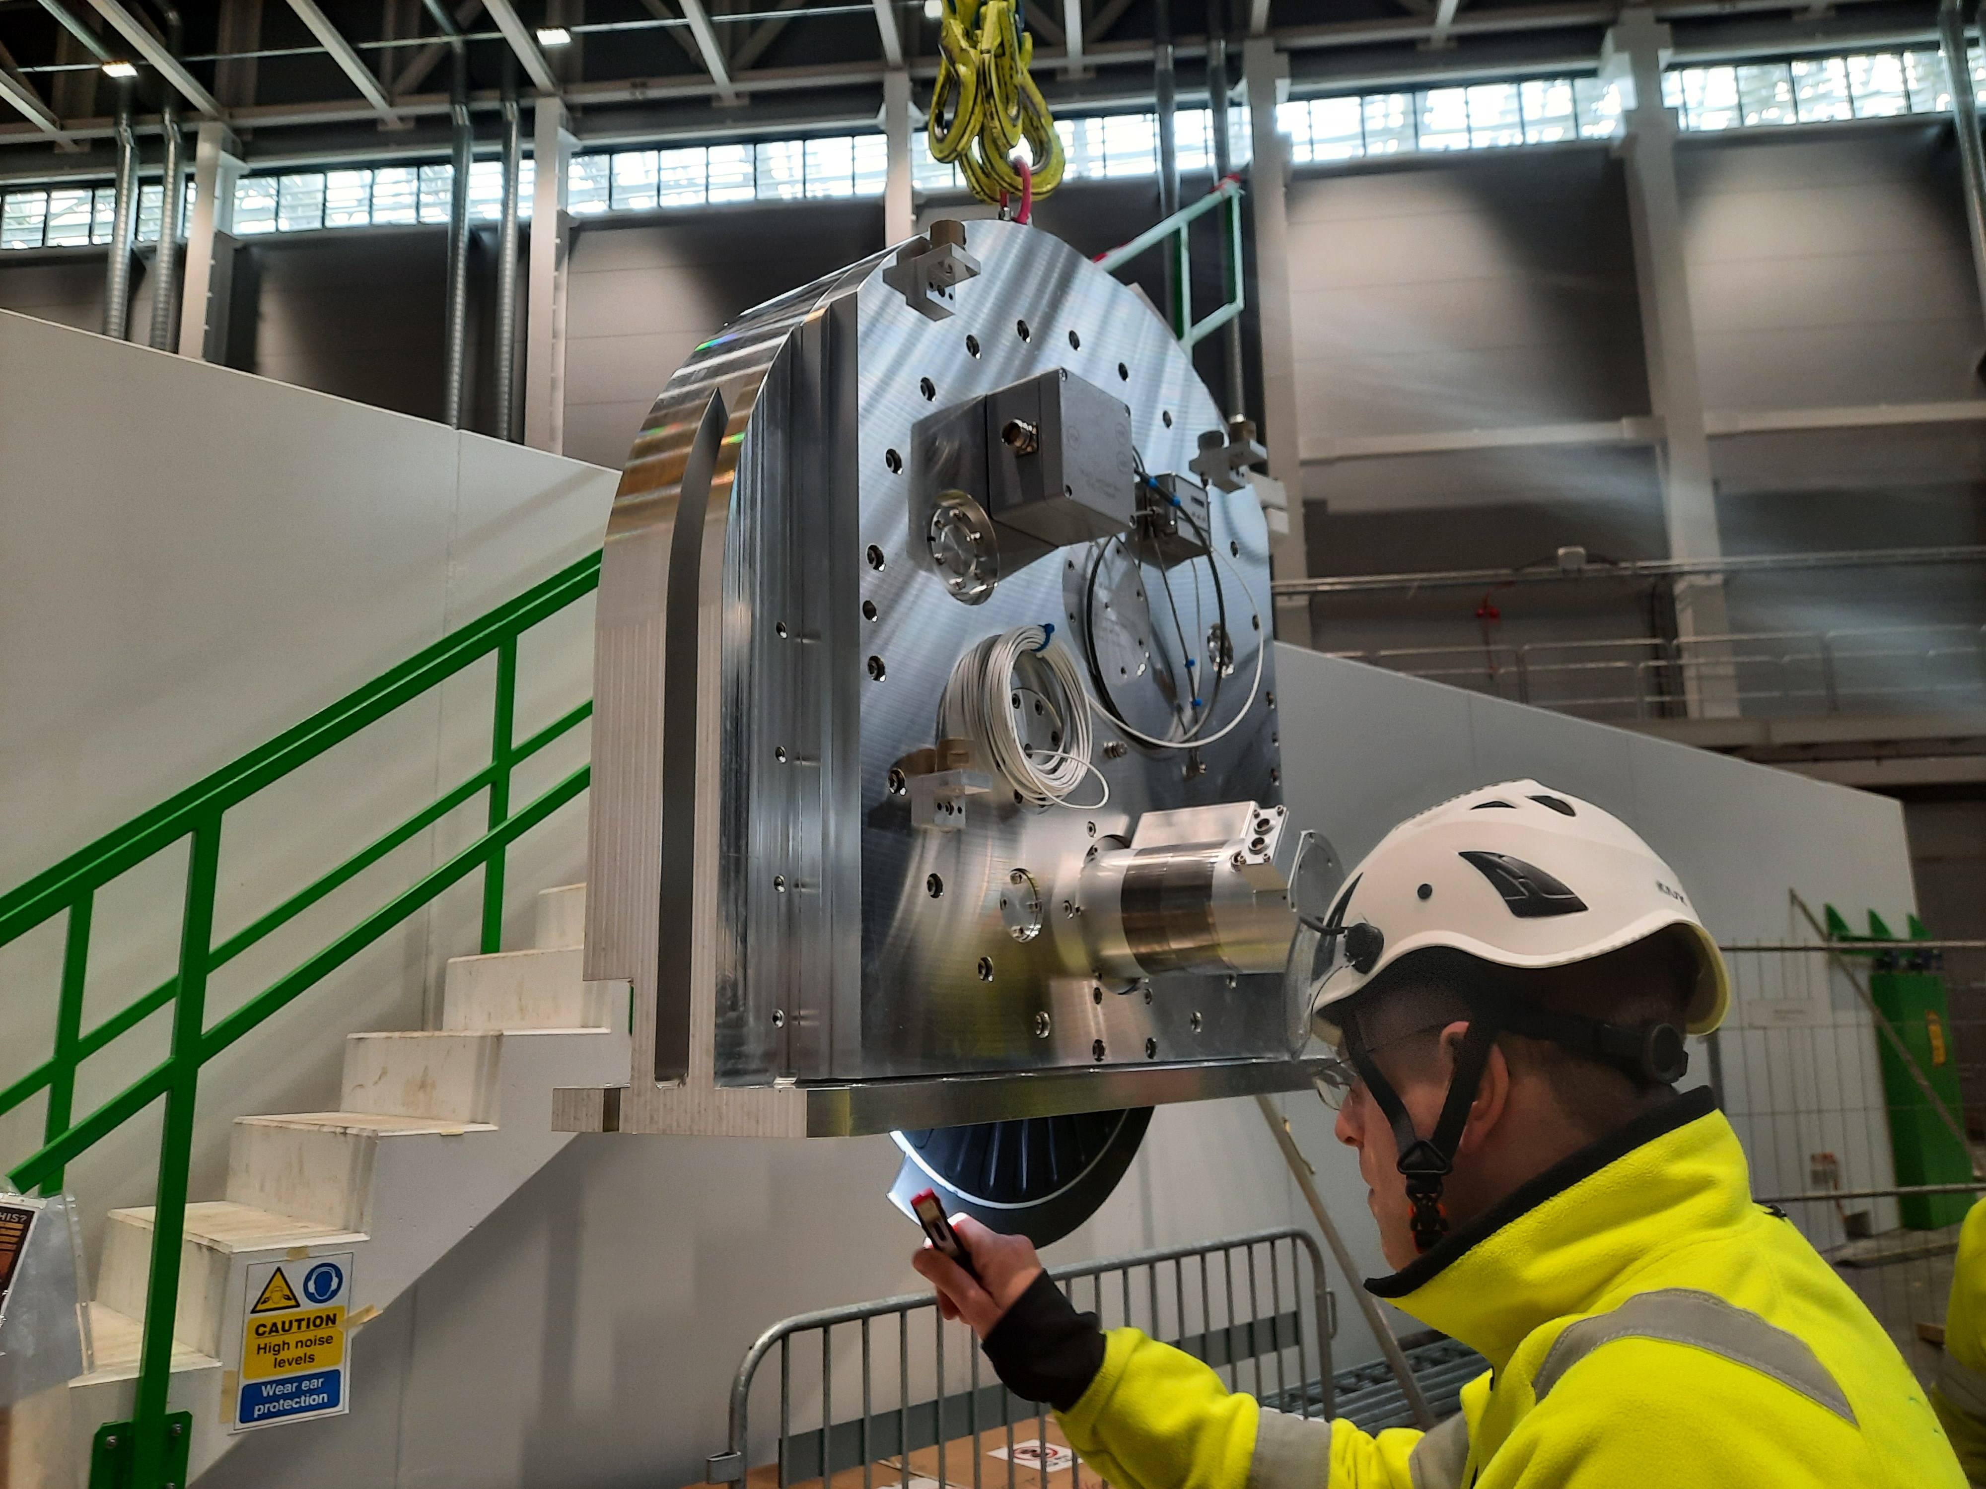
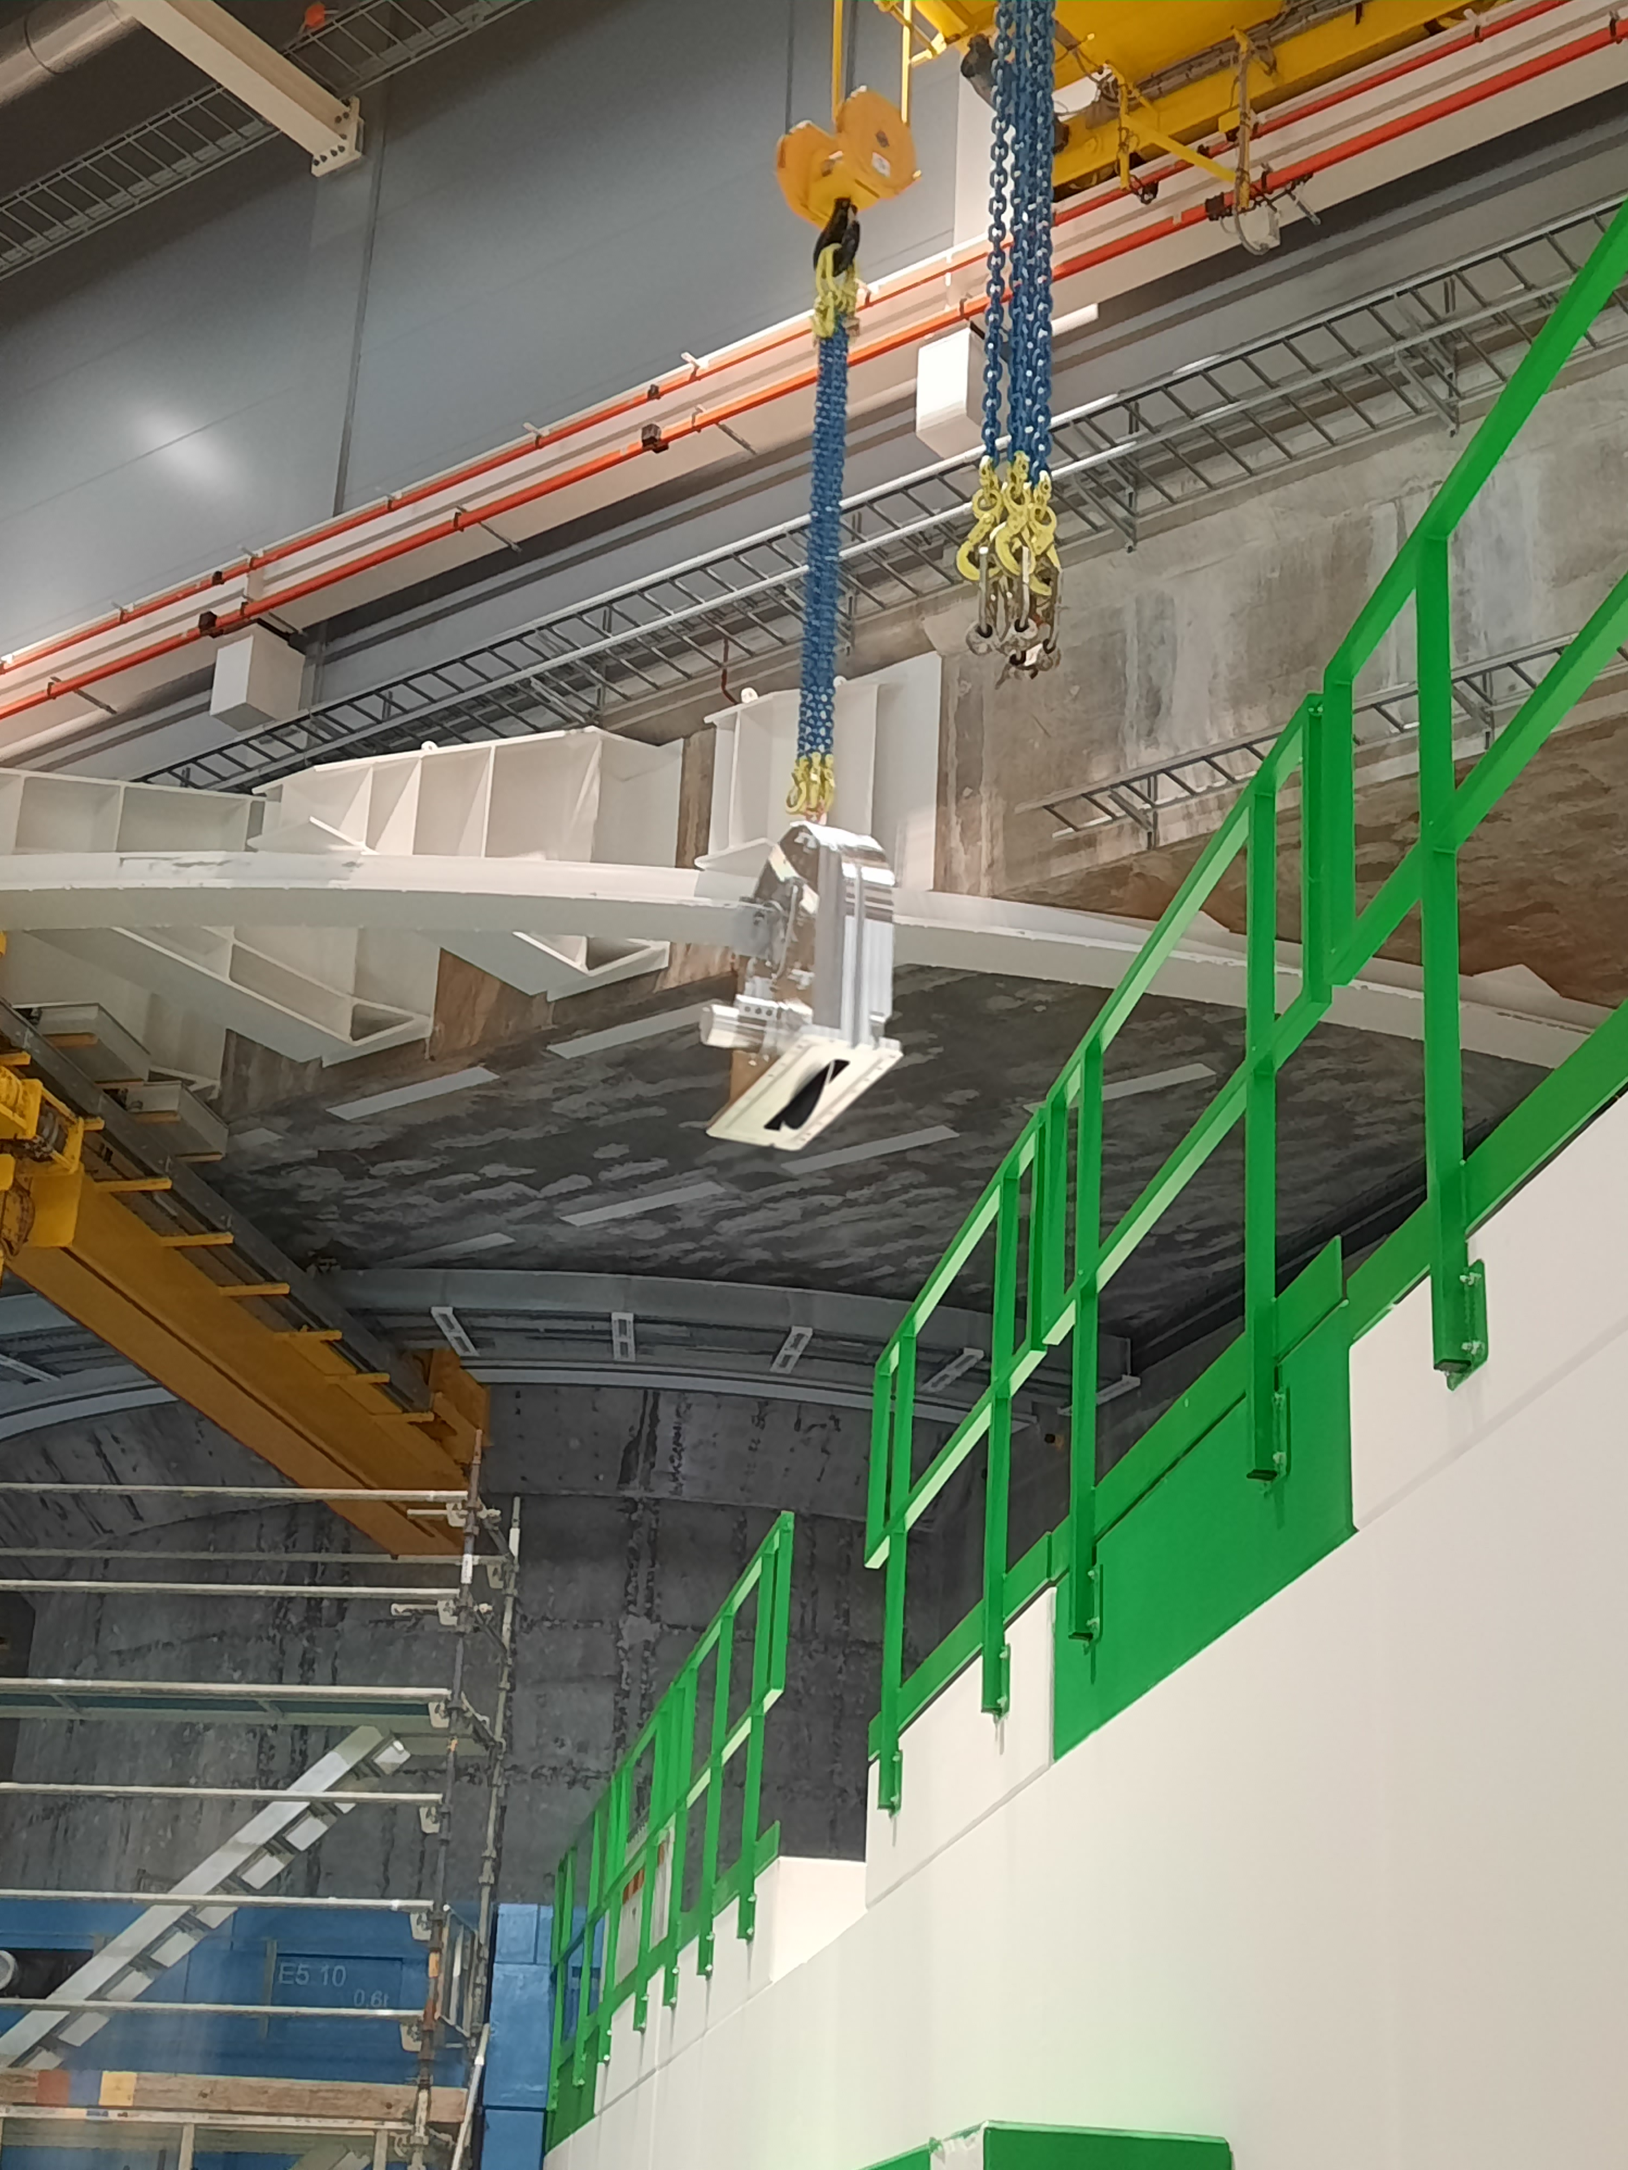
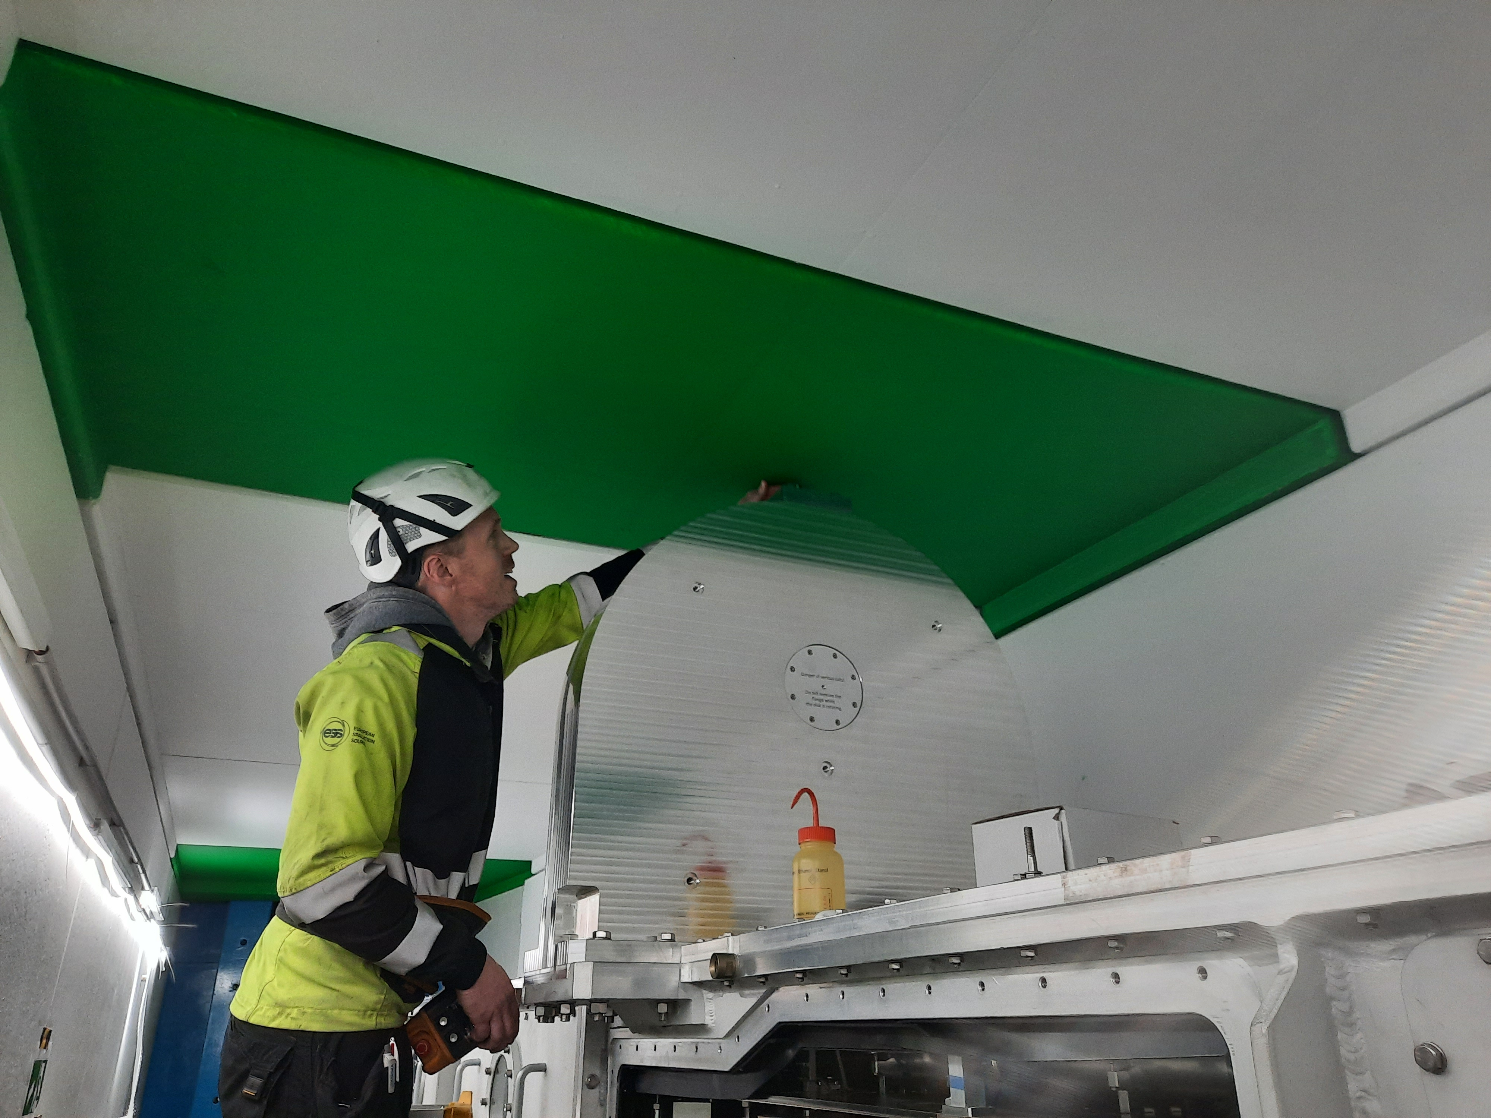
Chopper
First chopper installed earlier this year
Second chopper in storage
Electronics not installed yet (no CEP)
However, Niko does not anticipate problems, since those are identical to the DREAM slow choppers

Slide 7
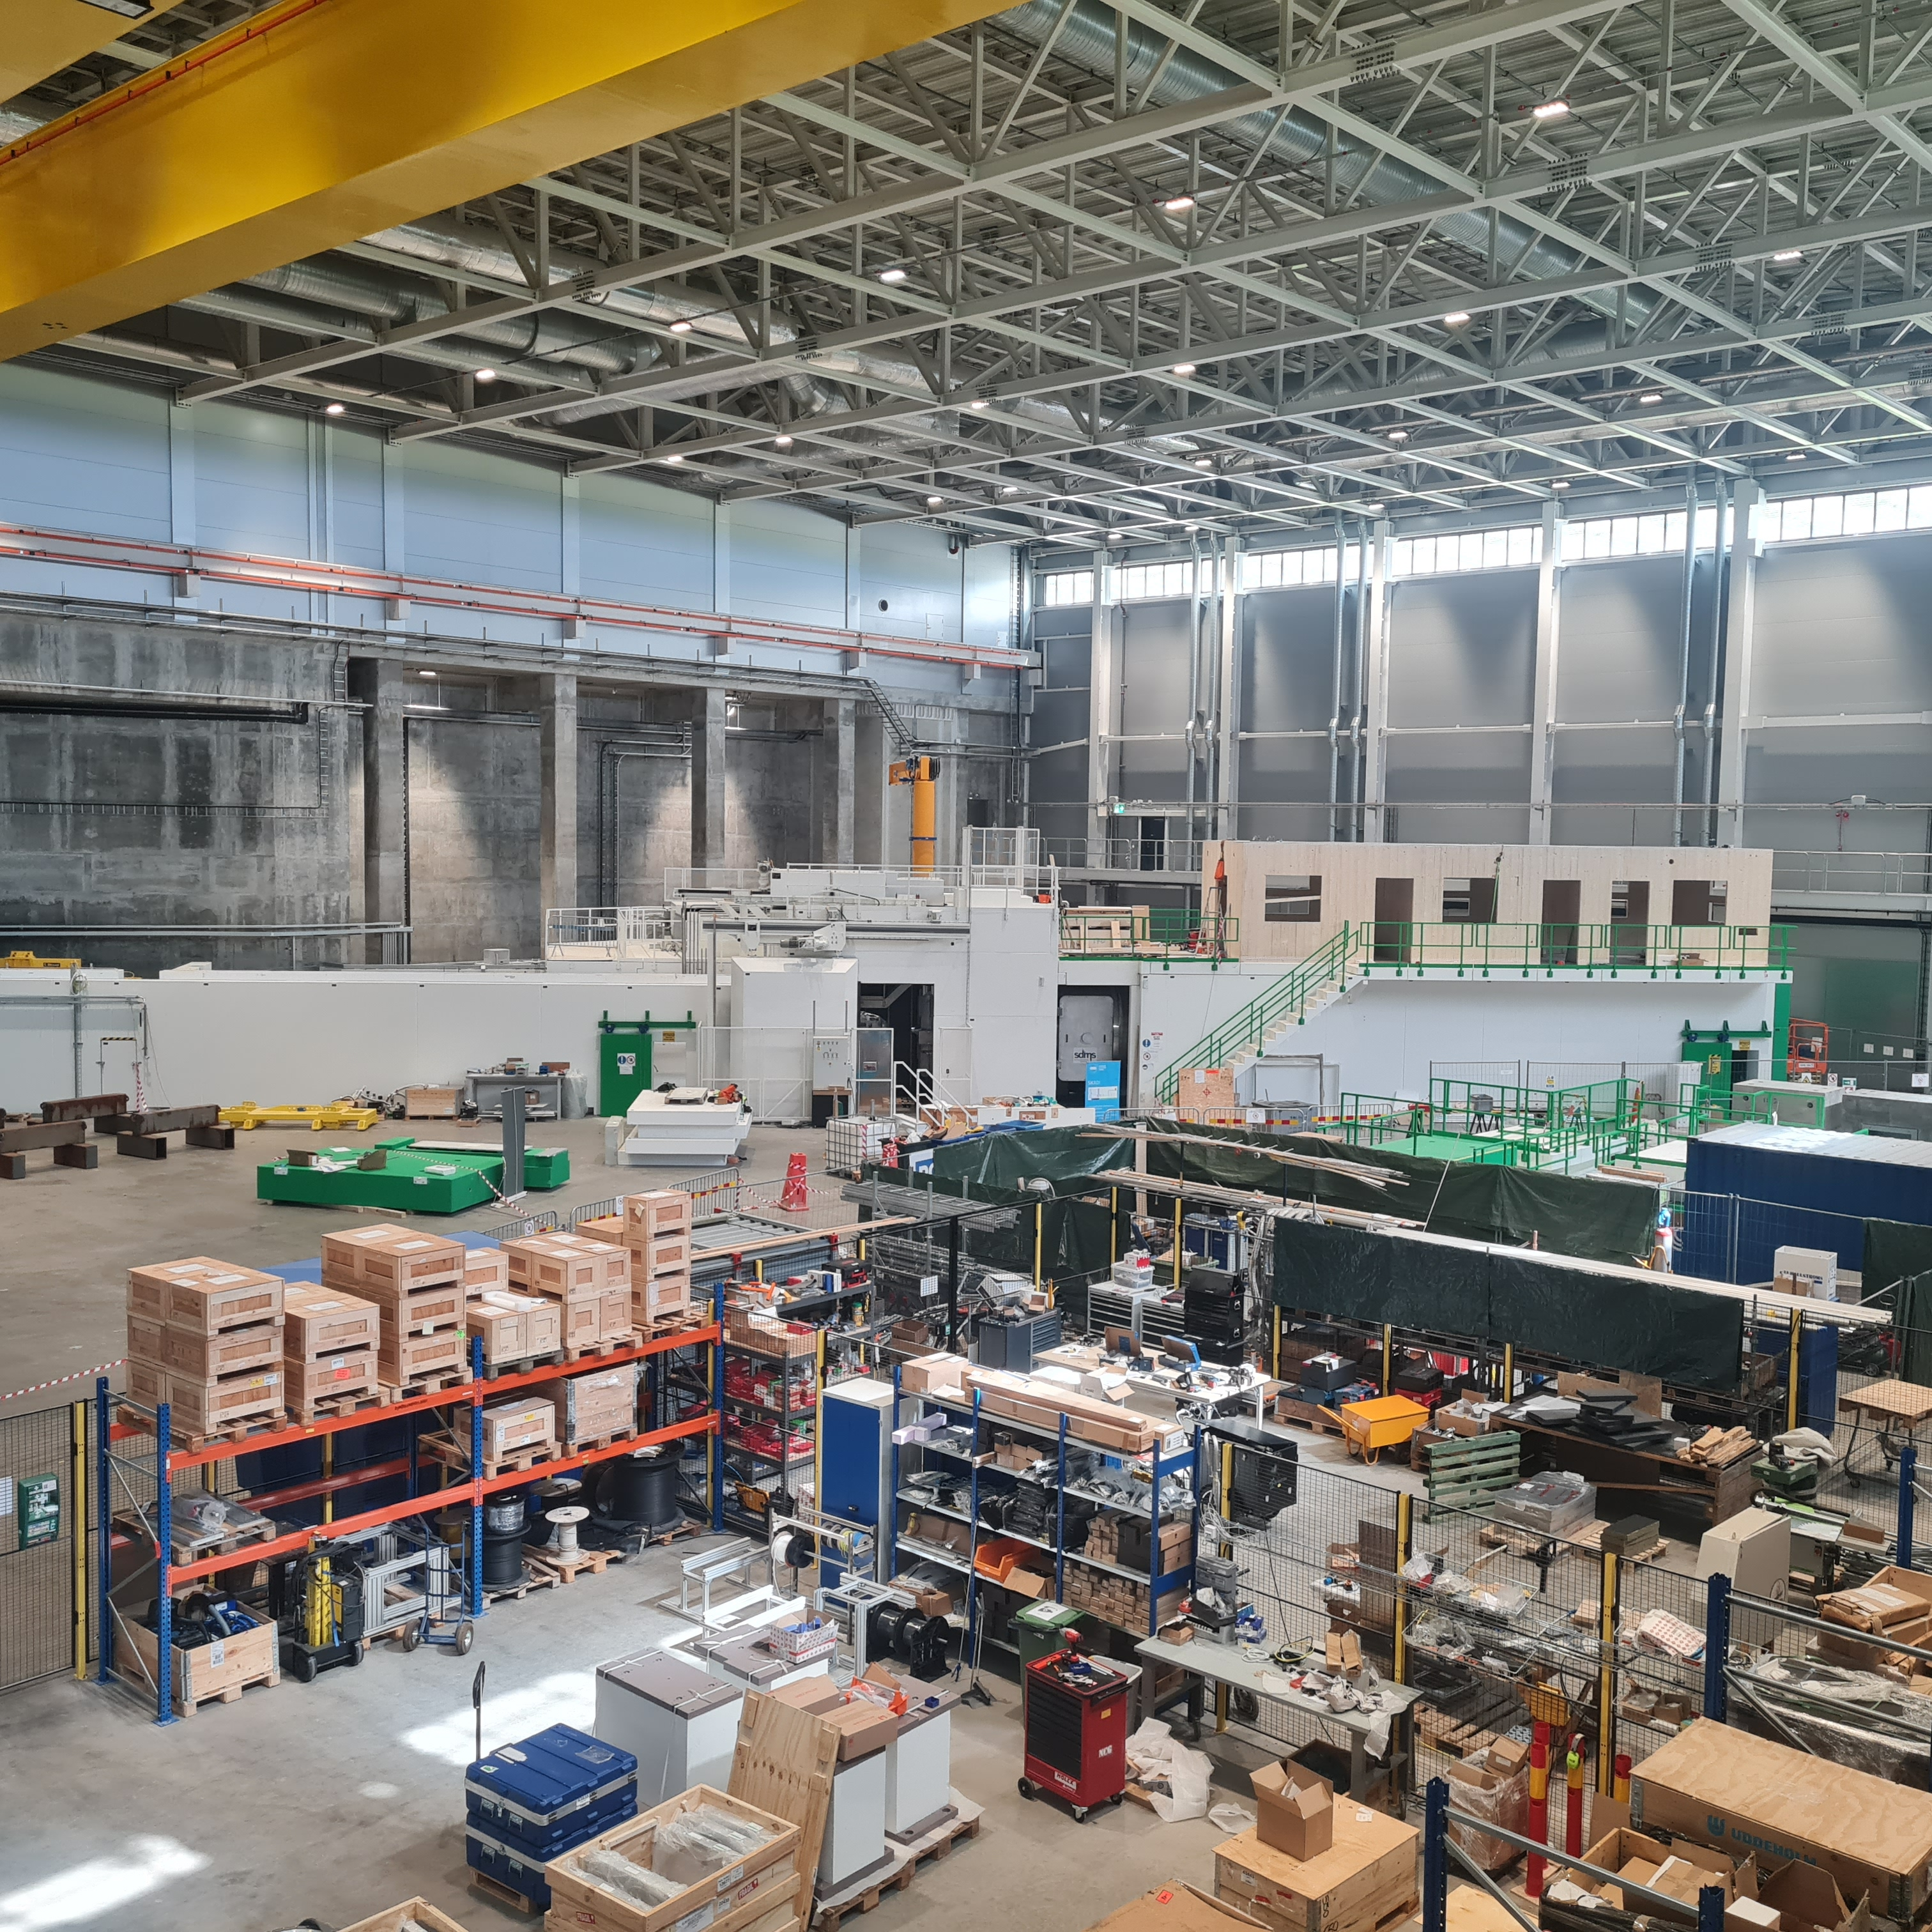
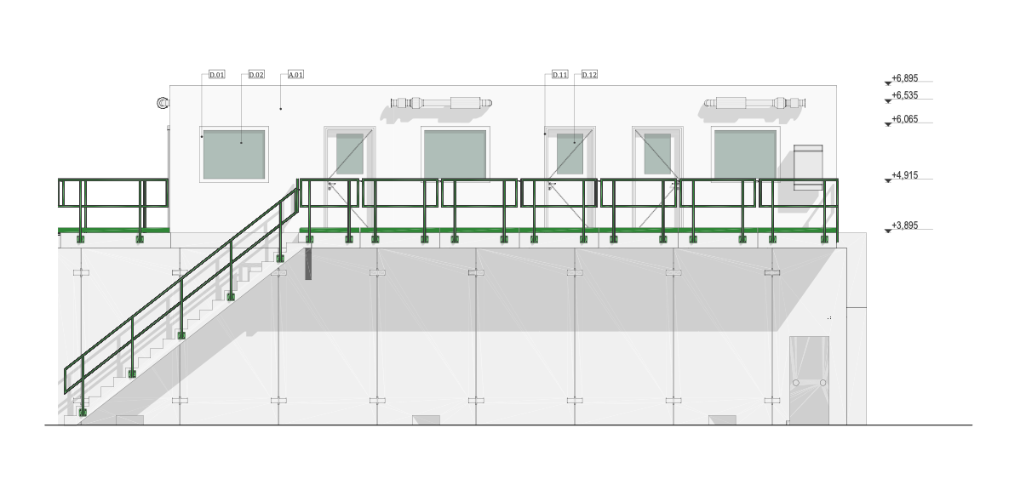
Hutch
Just now under construction
Video available
CEP will start in August → permanent energetization possible?

Slide 8
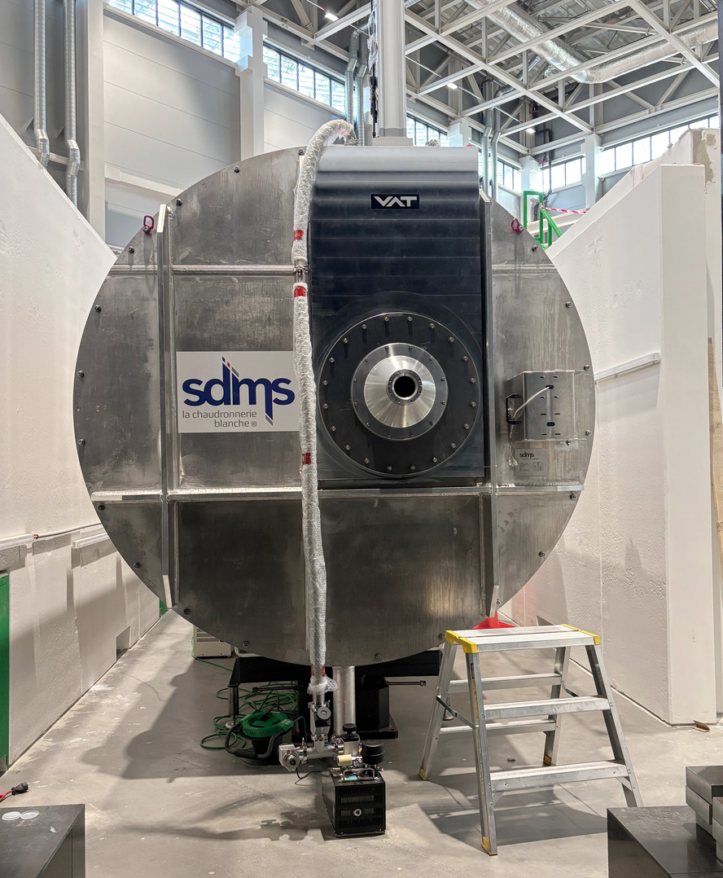
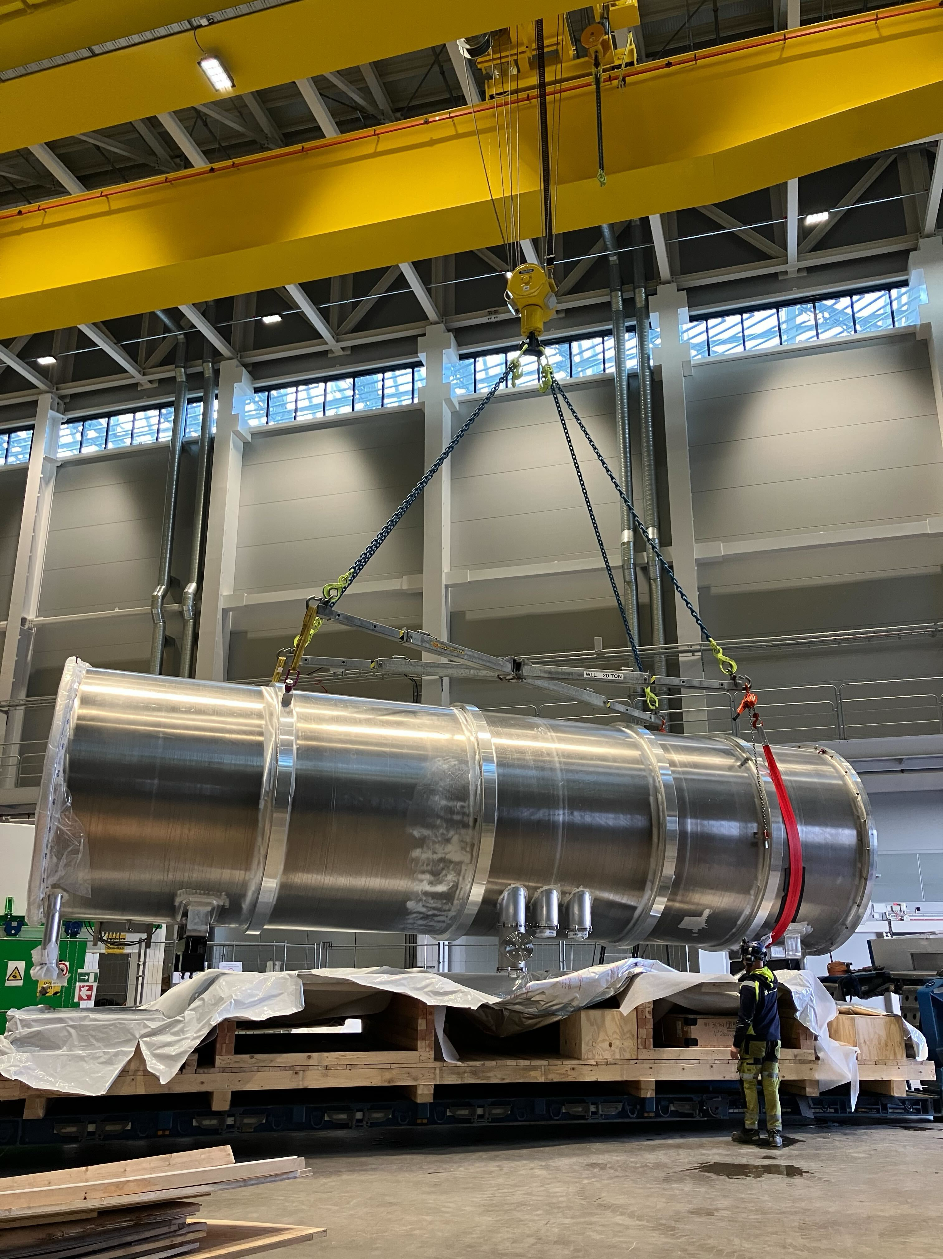
Detector Tube
Installation very impressive (video)
Vacuum excellent
Allowed for installation of hutch
Issue: Since we could not do all the MCA testing beforehand, the company handed this over, and we are now holding the risk if the inside motors do not work
Details: Complicated LLB contract with SDMS

Slide 9
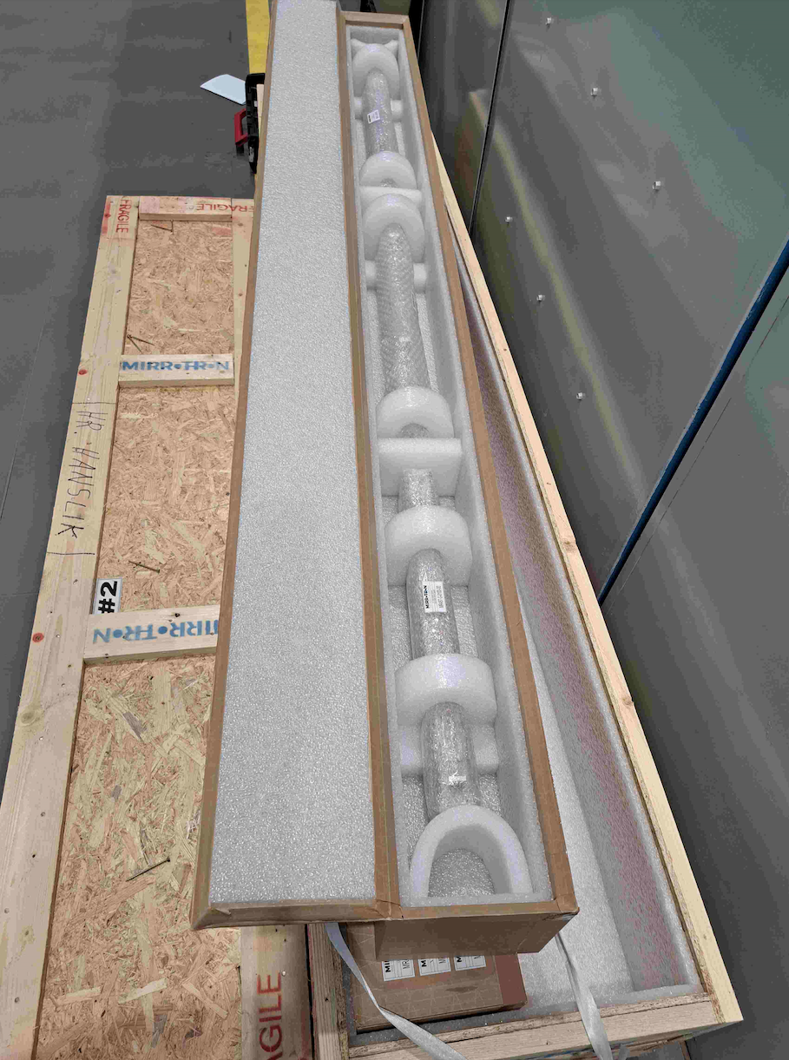
Out of bunker guides
Installed in Collimation
Polarizer optics already in Jülich
Laminar flow tent for clean install available (to be shared with other instruments)

Slide 10
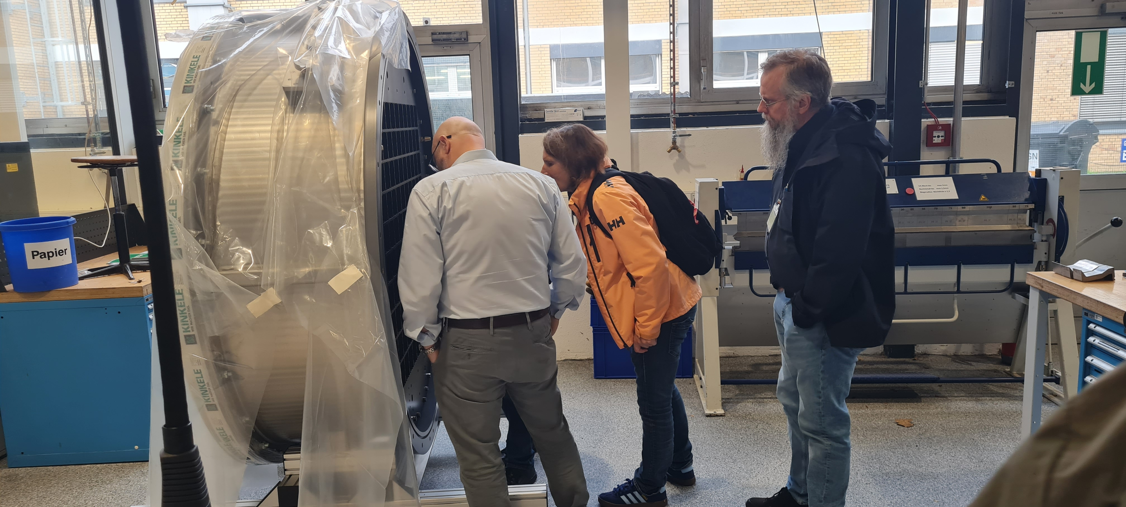
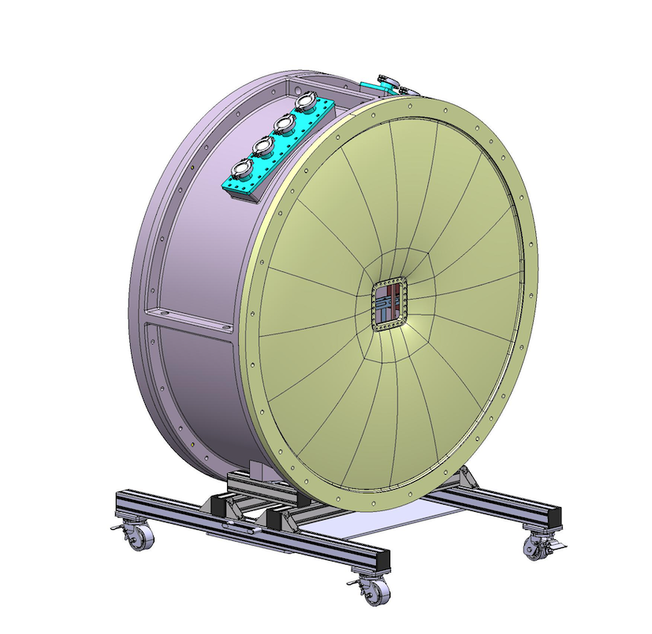
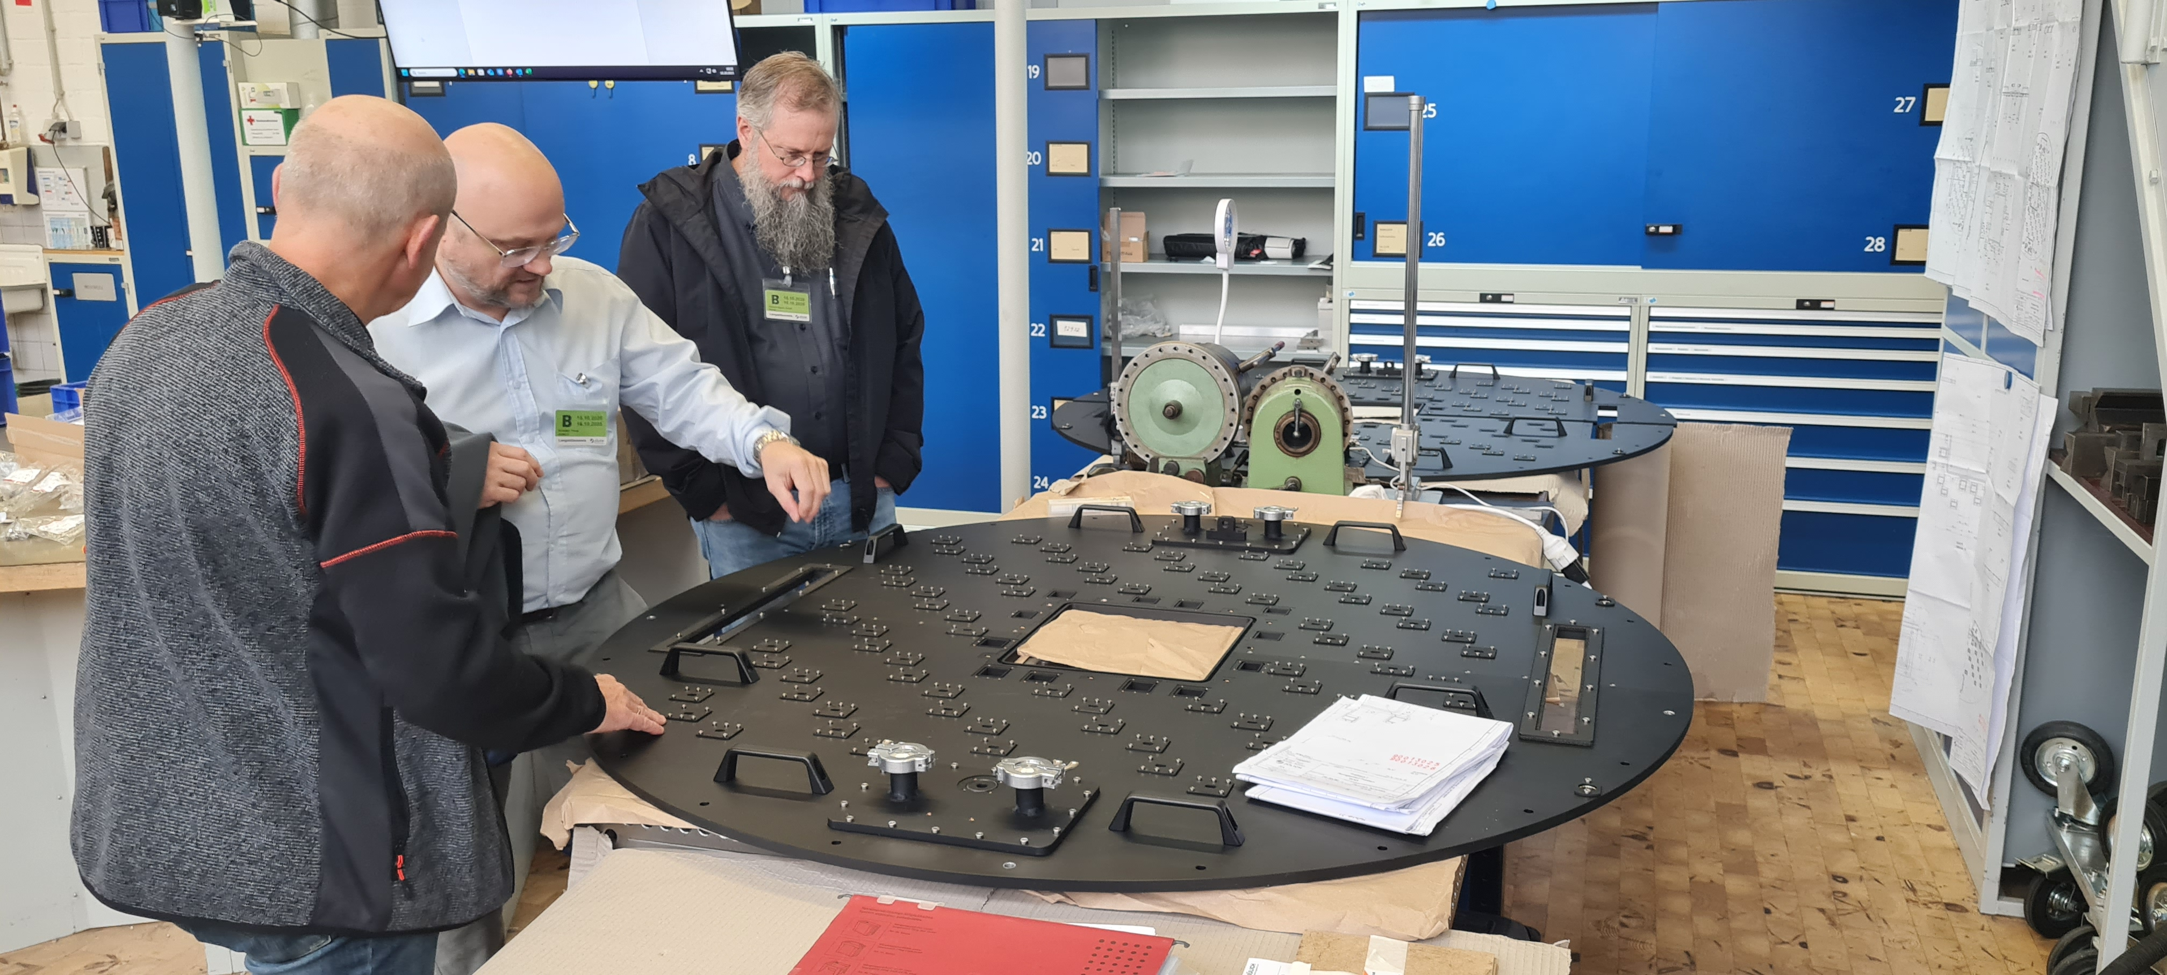
Detector
Separate Presentation

Slide 11
Common Projects
CEP
Installation started
CUP
CR done
Installation imminent
MCA
Installation scheduled early next year
Monitors
In-bunker installation done
Waiting for CR preparation
ECDC
Discussion on instrument control started
In general: Good communication
In particular: Sometimes prioritization can impact deliveries (see detector tube motors)

Slide 12
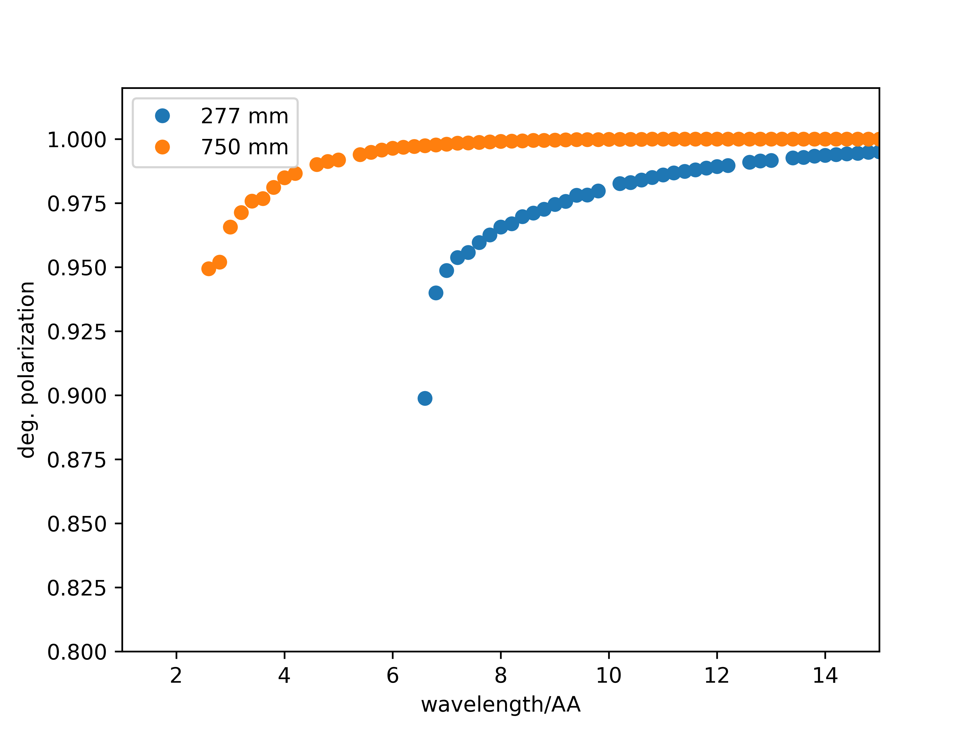
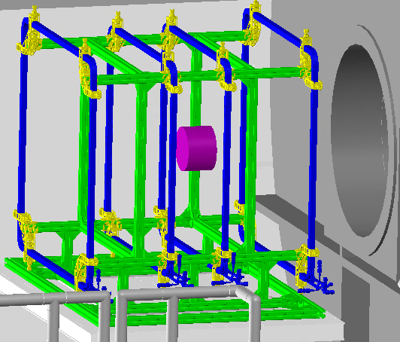
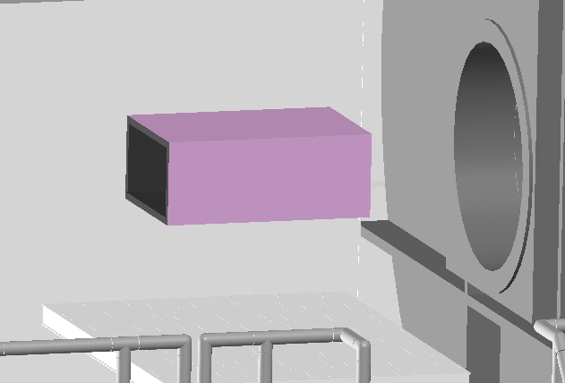
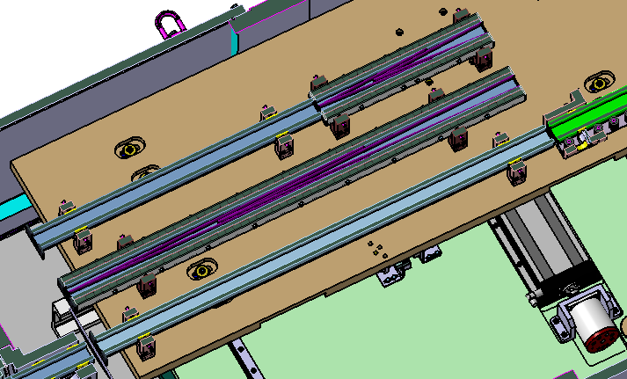
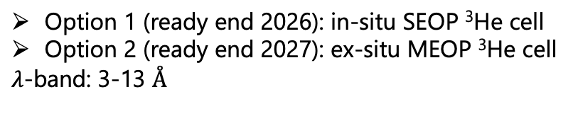

Polarization setup: Polarizer + Analyzer
Polarizer (FZJ)
Analyzer (ESS) – current setup*
Sample
³He Analyzer
Detectortube
Guide / Polarizer (FZJ)
*Changes due to different magnet options shown on next page
Pictures in courtesy of Hal Lee
Magnetostatic cavity
Q_{max}@3Å=0.11 Å ⁻¹
Uniform field coils
Q_{max}@3Å=0.74 Å ⁻¹

Slide 13
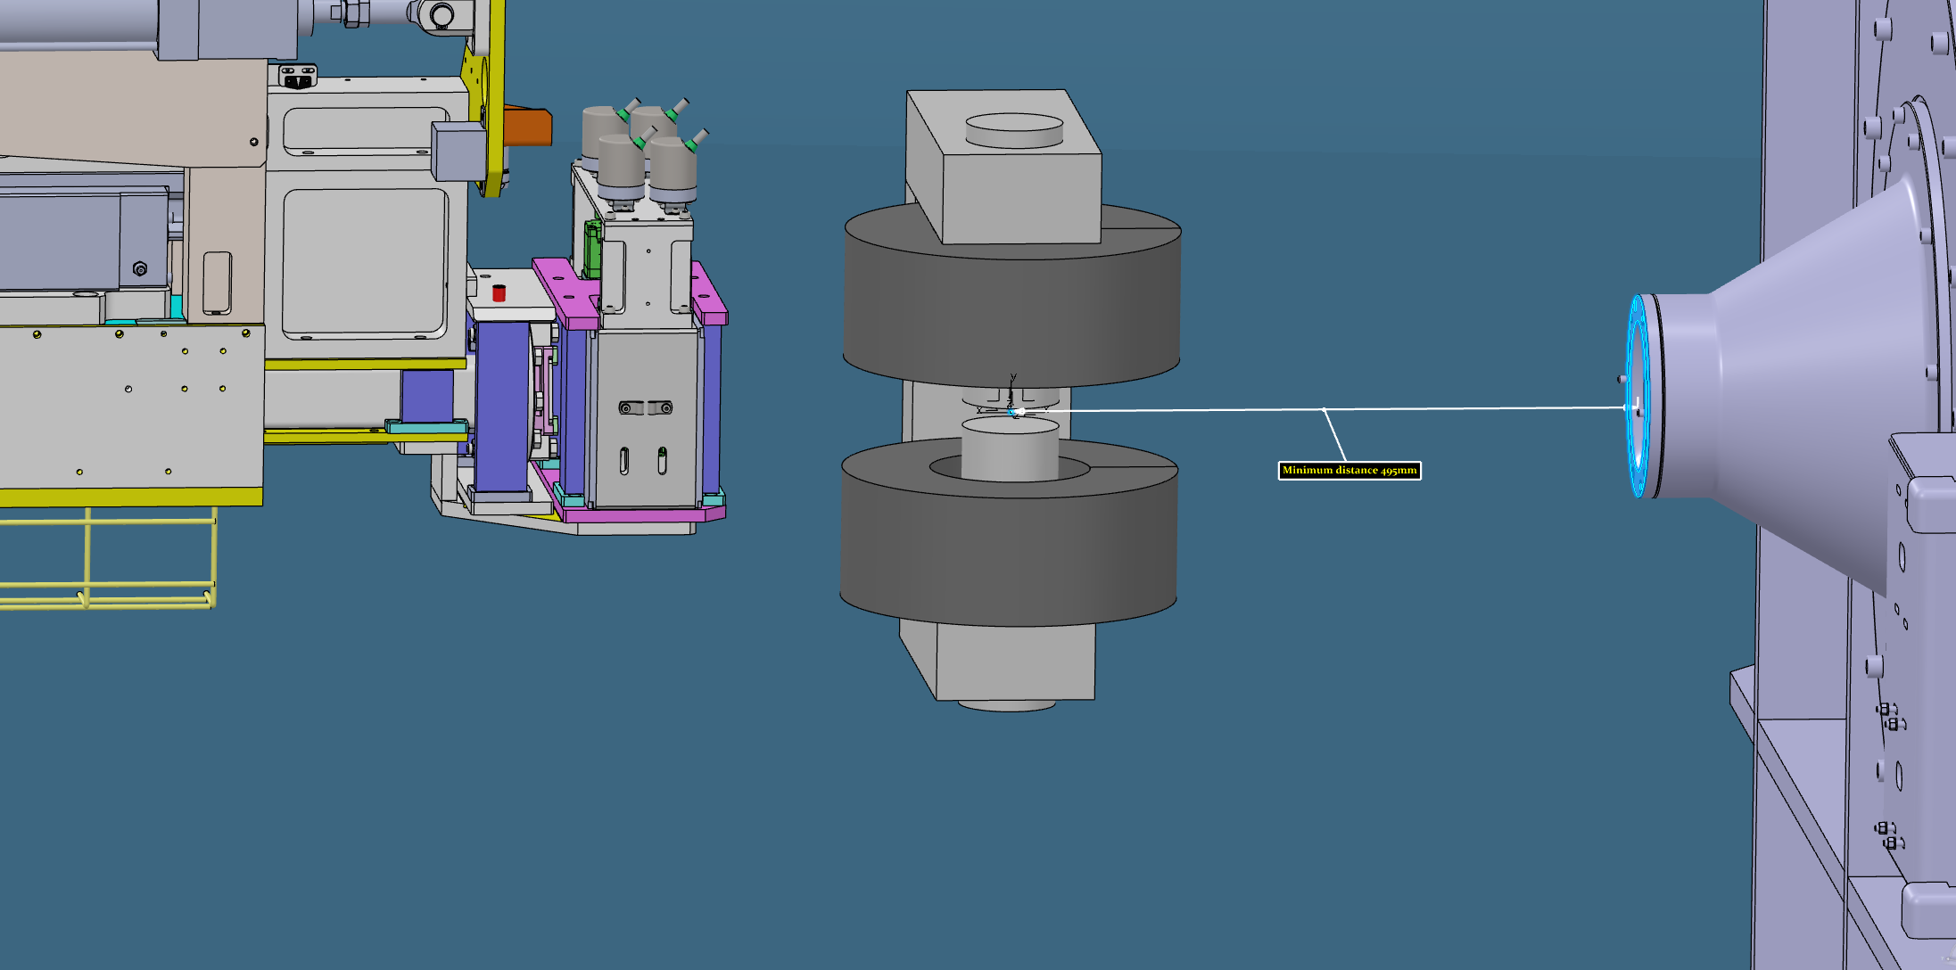
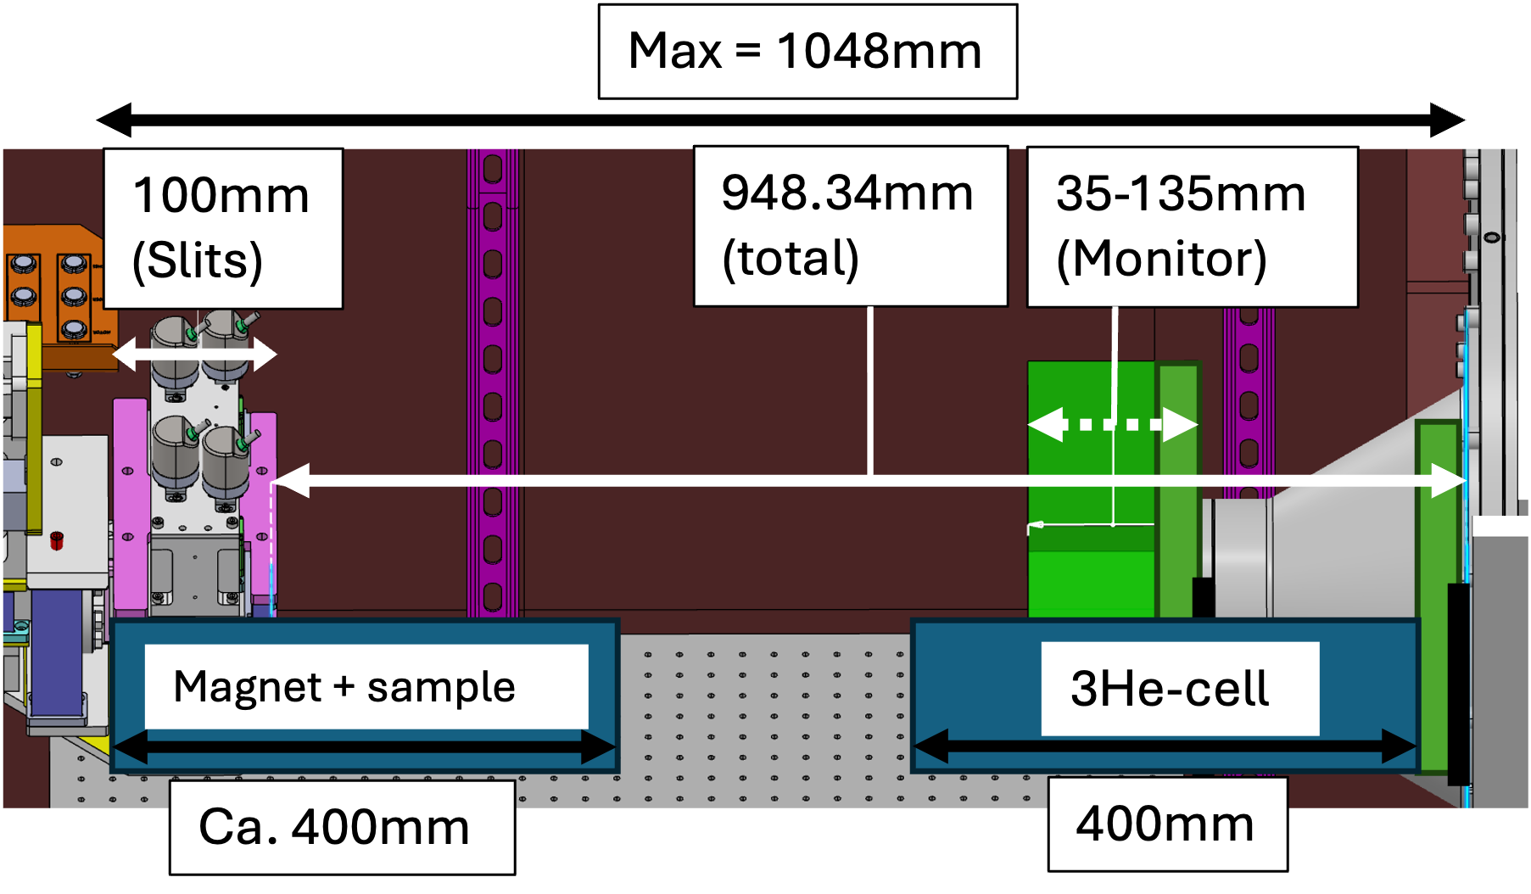
Polarization setup: Magnets
(ii) Planned to write grant proposals (such as RÅC) on:
10T, symmetric, non-shielded magnet (no PA, STAP request)
5-7T, asymmetric, shielded (full-PA)
³He analyzer between magnet-detector
Space-restrictions: remove nose + flat detector window
>7T, asymmetric, shielded (full-PA)
³He cell in detector vessel
More spatial freedom at sample position
Looking for suitable proposal partners
(i) Electromagnet (already purchased & available)
Specifications:
-2 to 2T
Field-ramp precision:
0.01mT -1mT
Depends on SE / controller
0-field precision: 0.02mT
No (half/full) PA possible

Slide 14
Jun 2026 - Oct 2026
Sep 2025 - Jan 2026
Sep 2025 - Dec 2025
Oct 2026 - Dec 2026
80 days
127 days
70 days
61 days
39 days
93 days
146 days
17 days
79 days
56 days
Mar 31
2025
Schedule
Final TG3
Start of CC
TG5/SAR approval
Today
Nov 28, 2025
Jun 17, 2026
Dec 2, 2026
2025
2026
2026
Q3
Q4
Q1
Q2
Q3
Q4
Integrated Cold Commissioning and TG5 preparations
TG5
TG5 meeting
Oct 8
TG5 Closure of open points
No. 1 - Critical Path
(0 days TF)
CEP installation
Dec 2025 - Jun 2026
MCA (including sub-systems): Installation, Energization and Commissioning phase
No. 2 - Critical Path
(5 days TF)
Detector Housing: Manufacturing and Assembly phase (FZJ)
Sep 2025 - Mar 2026
Detector Integration (FZJ & ESS)
Mar 2026 - Jun 2026
Detector: Installation and Commissioning phase (FZJ)
Sep 2025 - Dec 2025
Polarizer Housing, Spin Flipper and Fast Shutter: Procurement and Manufacturing phase (FZJ)
No. 3 - Critical Path
(20 days TF)
Dec 2025 - Mar 2026
Polarizer Housing: Assembly (with optics and chopper) phase (FZJ)*
Mar 2026 - Mar 2026
Polarizer, Spin Flipper, Fast Shutter and OoB Guides: Installation phase (FZJ, LLB & ESS)
Back into CP1 with 20 days float
Design phase ends at CDR approval
Procurement and Manufacturing phase ends at FAT closure of open points
Installation and Commissioning phase ends at SAT approval
TF: number days of total float to Instrument’s TG5
* Spin flipper and Fast shutter has 6 days float (testing in parallell to polarizer housings assembly)
Notes:
2025-09
Polarizer housing assembly delayed
2025-01
Detector housing manufacturing: moved out 2 months

Slide 15
Breakout Detector Schedule
42 | 43 | 44 | 45 | 46 | 47 | 48 | 49 | 50 | 51 | 52 | 1 | 2 | 3 | 4 | 5 | 6 | 7 | 8 | 9 | 10 | 11 | 12 | 13 | 14 | 15 | 16 | 17 | 18 | 19
Reach out to Mundi airbox and electronics separately |  |  | TG3 | Presentation for Comparison between RMM and Switch Option |  |  | Shipping of airbox to Lund |  |  |  |  |  |  | airbox installation into tube (Sylvain with Technician, Egi) |  |  |  |  |  | End of tests before delivery/Prepare shipment |  |  |  |  | Delivery | Installation
 | Sebastian prep overall TG3 |  |  |  |  |  |  | SNS data article arxiv |  |  |  | Clarify availability for Pavel visit to Jülich |  |  |  |  |  |  |  | Qgate needed - for Tile |  |  | IRR Tiles
 |  |  |  |  |  | Qgate for airbox |  | SAT/FAT protocol definition |  |  |  |  |  | IRR for airbox |  |  |  |  |  |  |  |  | BOT landing zone

Slide 16
Discussion points
Currently doing mostly installation and TG3

Slide 17
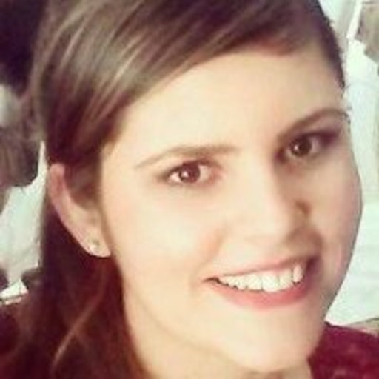
Welcome new team member
New IOE: Tamires Gallo

