Slide 1
SKADI Detector
Current status
PRESENTED BY Sebastian Jaksch, Ralf Engels, Romuald Hanslik, Tadeusz Kozielewski, Torbjörn Grahm

Slide 2
Agenda
1 Housing
2 Integration Plan
3 Testing

Slide 3
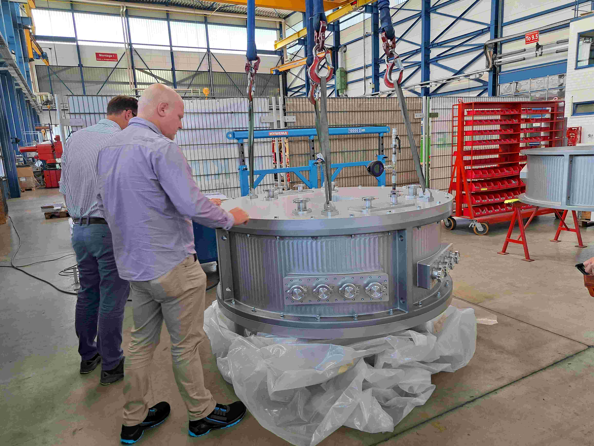
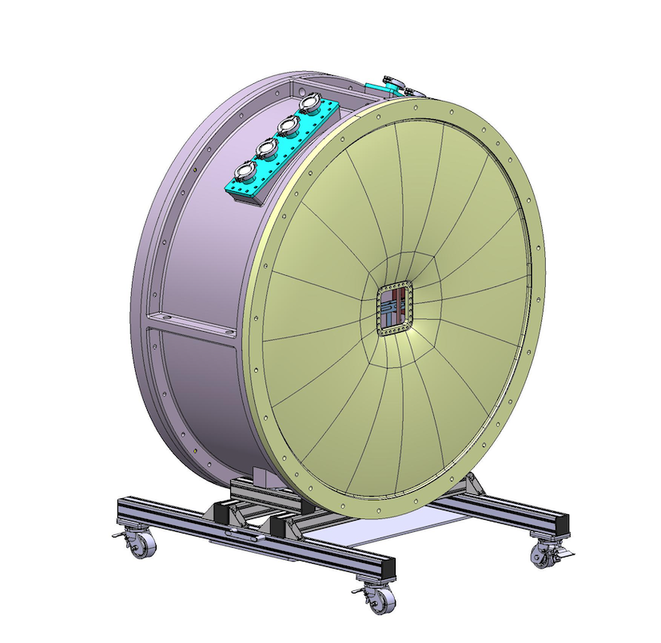
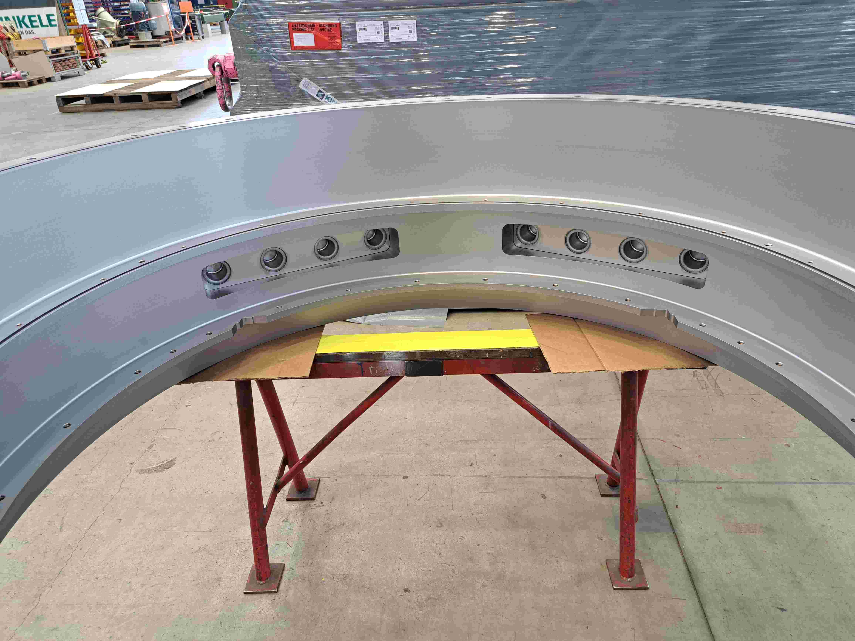
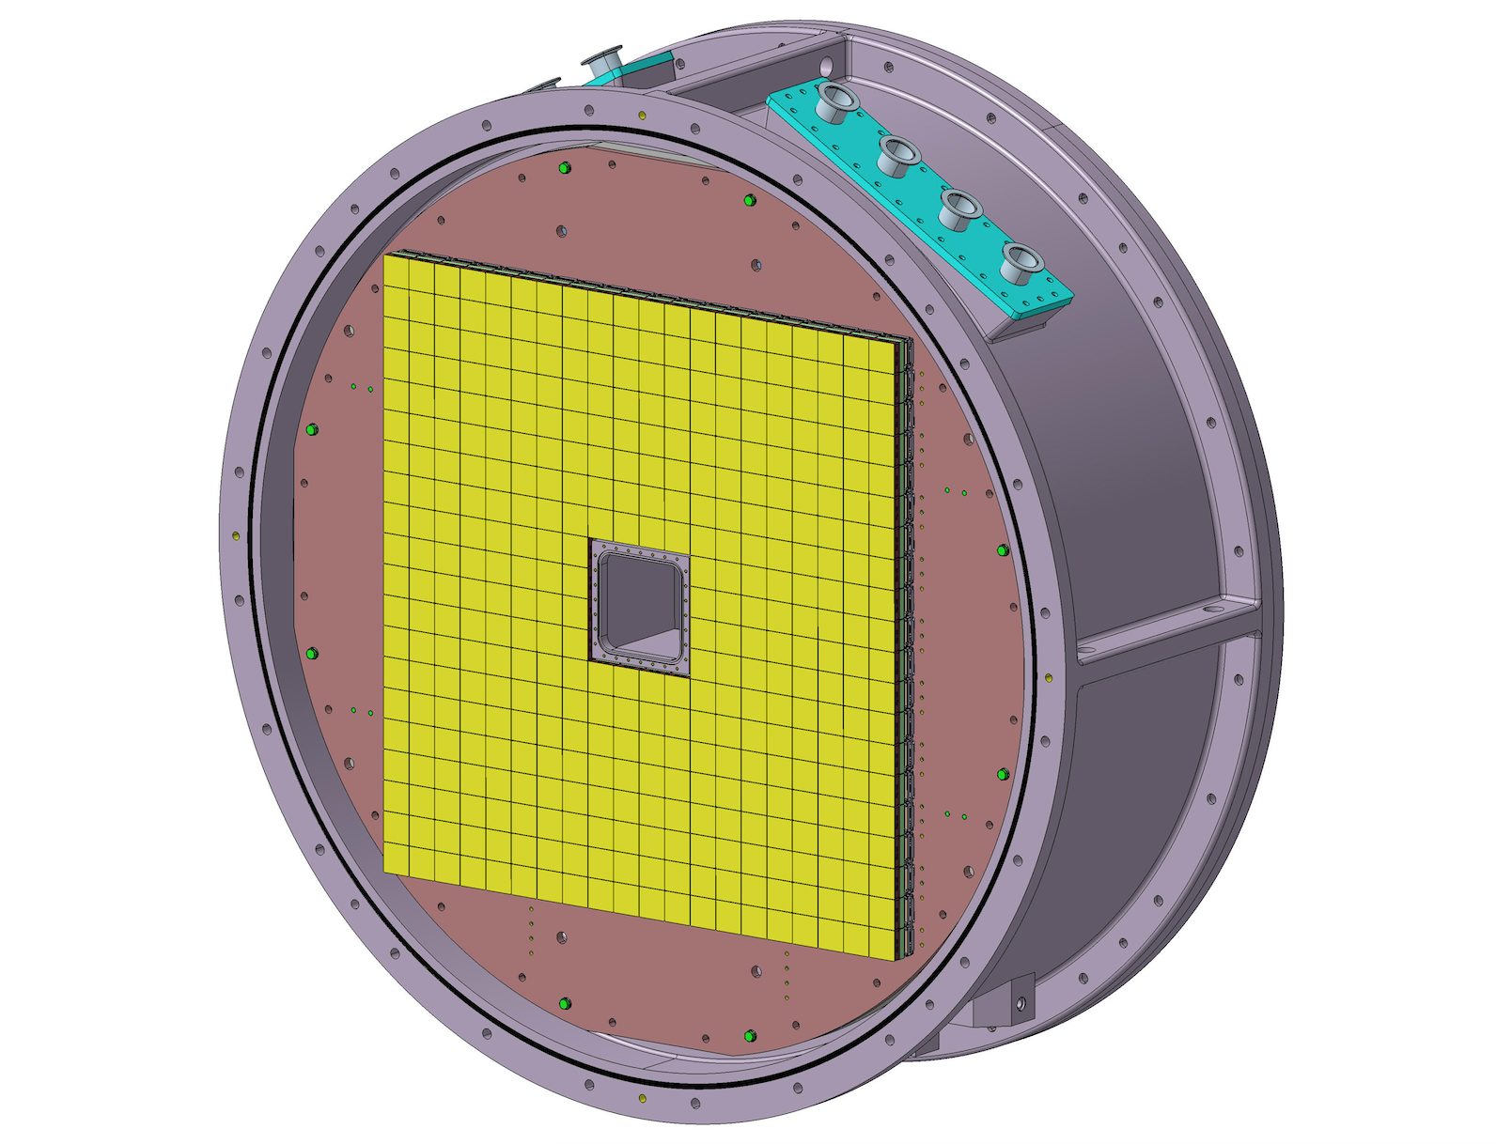
Housing
Different Components
Detectors will be housed inside the air boxes moving inside the evacuated detector tube
Detector tube:
Vacuum housing with movable box inside
Detector box:
Air-filled boxed moved back and forwards along the axis of the detector tube

Slide 4
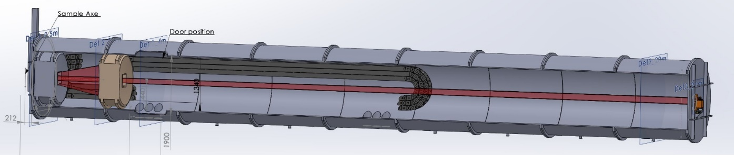
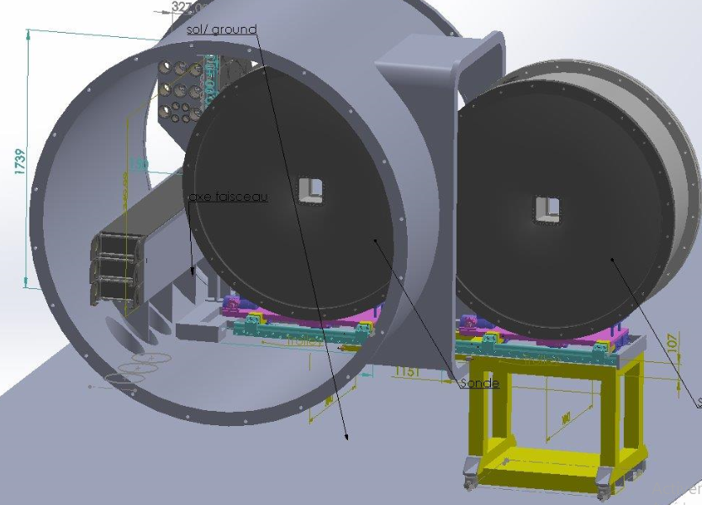
Detector tube
Has been manufactured by SDMS
Installation done
Includes the movable components for the air box (those are still awaiting MCA coordination/support)

Slide 5
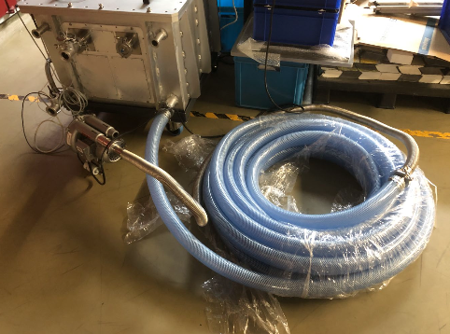
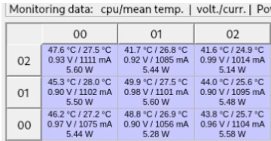
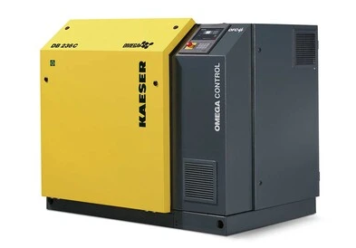
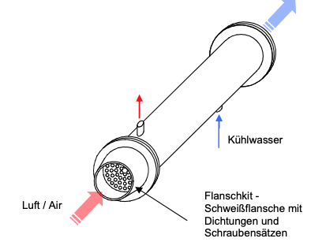
Cooling
Scale testing has been done
Complexity comes from long tubes for movable detectors
Conclusion
Less than 5000 l/min per detector box maximum → Kaeser cooling system is capable of handling that airflow
Hardware procured and delivered
@10 m/s flow rate:

Slide 6
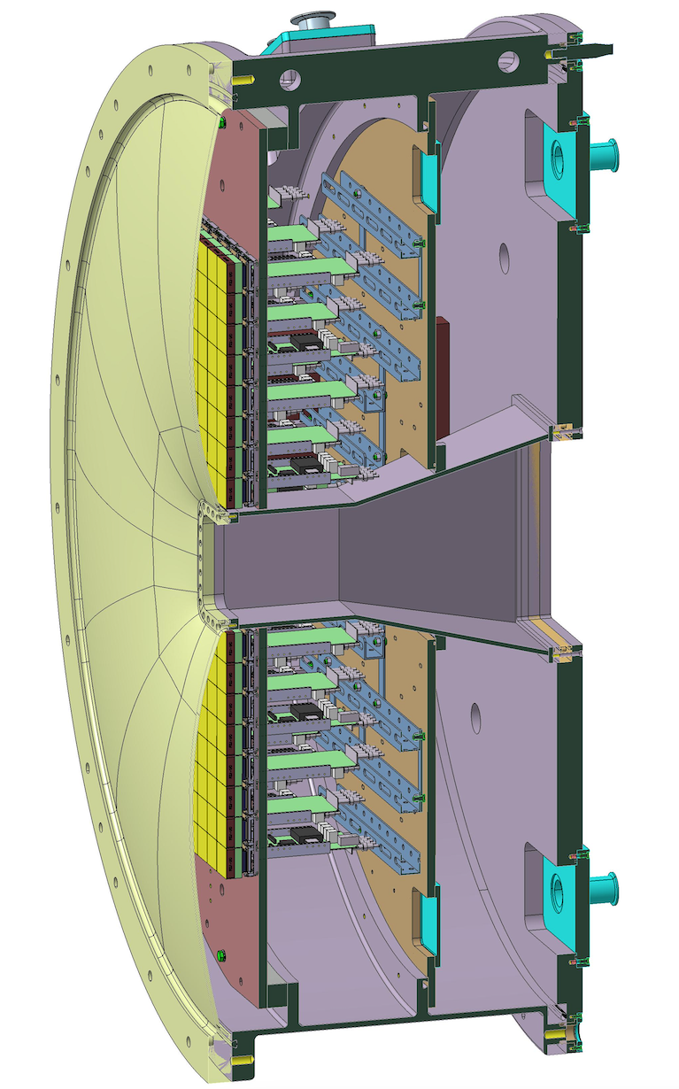
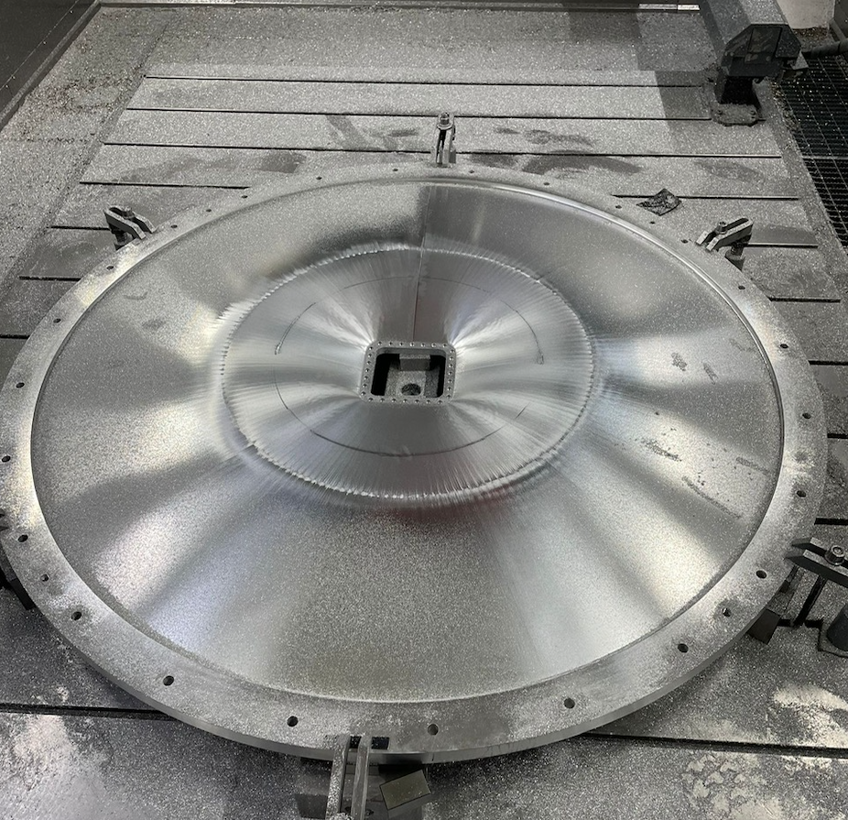
Air-Box
Necessary since detector is for operation in air only
Very thin front windows prevents using very high speed/pressures to be used for cooling
Self-contained system for the whole detector

Slide 7
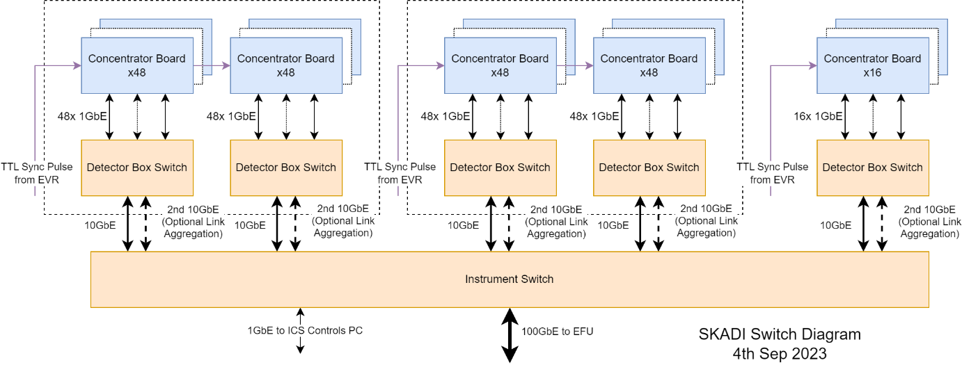
Plan for integration
Steps necessary for integration
Align firmware and ESS backend
Align time synchronization between ESS clock and detector
Create fully reduced data at the backend from neutron events at the front end
Available now
SANS images
Time synchronization in the lab with ESS timing system (single with ESS), ongoing
Time synchronization at ORNL with identical timing signal, but from different source (SNS or either pulse generator, ongoing)

Slide 8
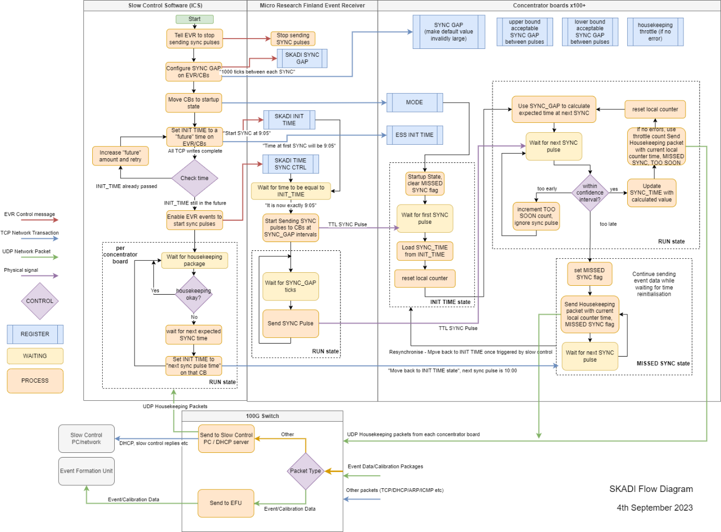
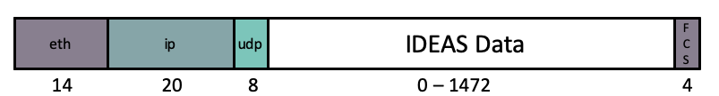
Proposed next steps
Test with new firmware: Running now
Workshop for integration of new team members as soon as possible
Improvement of firmware based on previous results
Second (final) test with firmware and full ESS stack: Based on availability late 2025

Slide 9
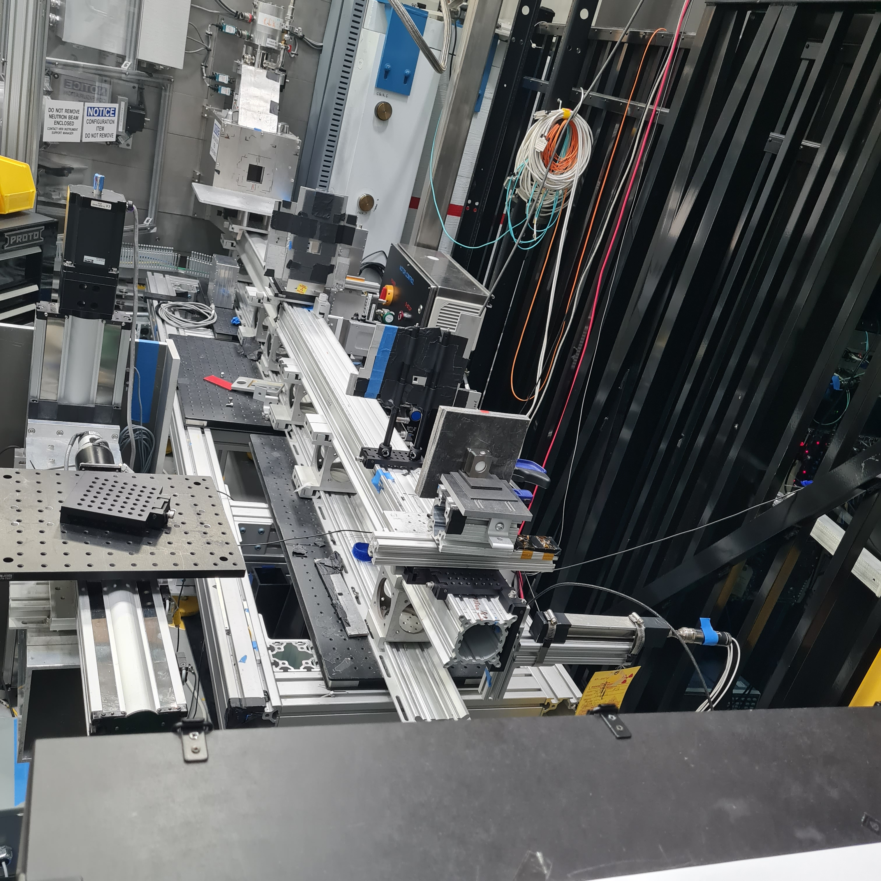
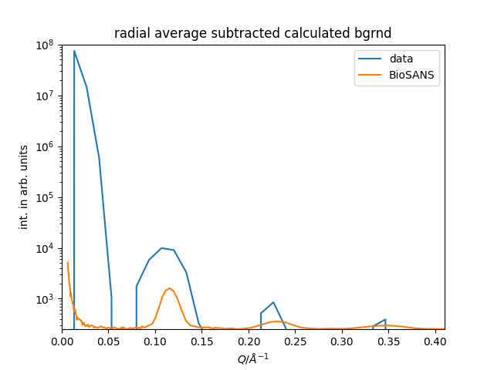
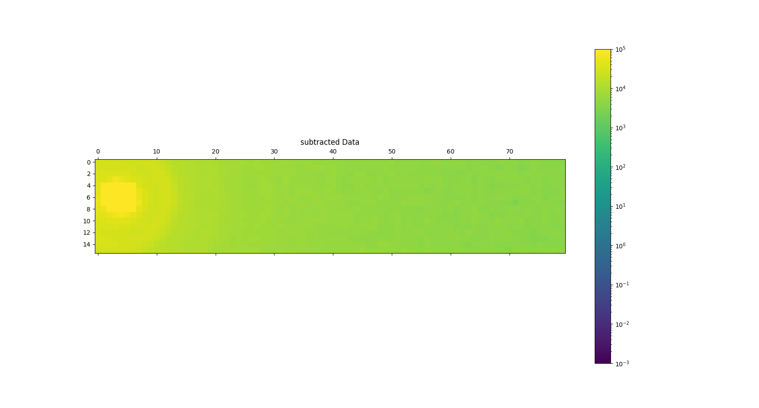
Results from tests
Goals
Create SANS images
AgBeh
Nanoparticles
Time sync with external sources for appropriate timing signal (TTL signal)
Physical setup
1x5 (10x50 cm)
Beam central on the left tile
Scattering center and scattering image recorded as one
Measured sample AgBeh
Caveats
Only rudimentary collimation
High potential background/no shielding
Very low flux

Slide 10
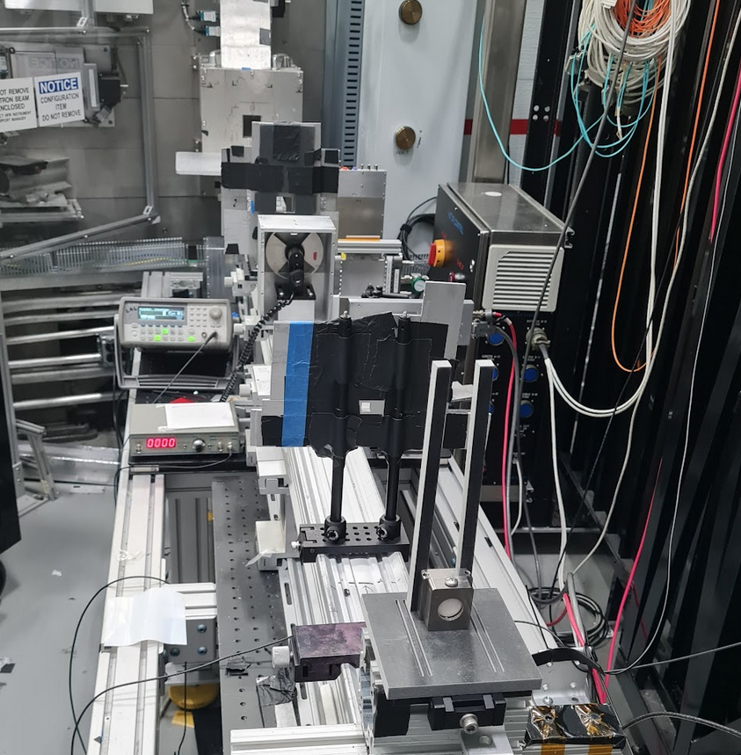
Time Synchronization: In general
General Setup
Internal clock is running on an oscillator
Whenever there is an external sync, this clock is set to zero (here pulse generator)
Real world time is calculated by adding the internal time to the external sync as an offset
Generally independent of how the external sync is created

Slide 11
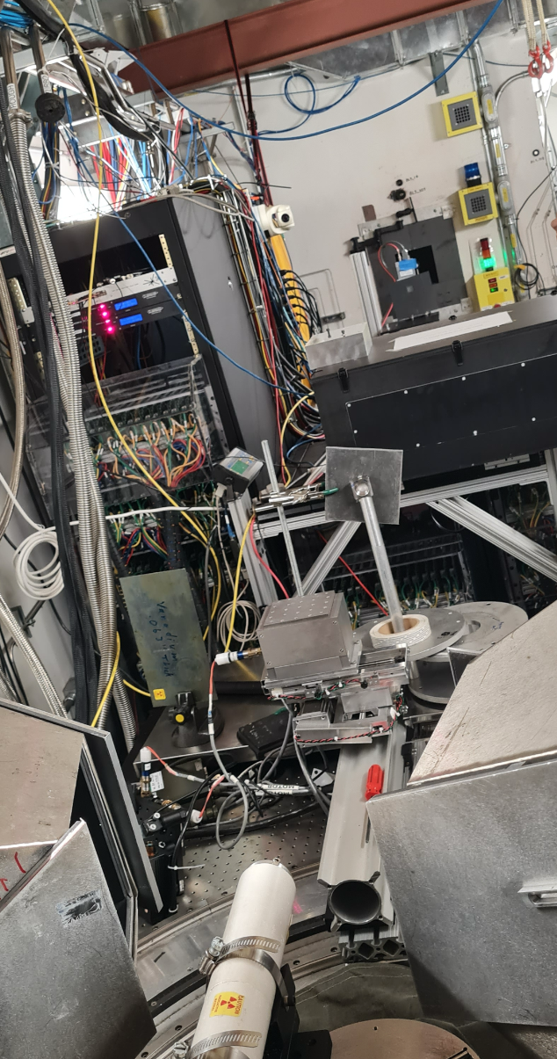
Time Synchronization: Tests
Time sync from SNS
TTL pulse delivered in sync with SNS (60 Hz)
White beam with maximum at either 2.1 Å or 6.4 Å
Exact data still under evaluation, but decay over time looks as expected for a Maxwell-Boltzmann spectrum
Data collected
Full beam
With samples
Incoherent scatterer

Slide 12
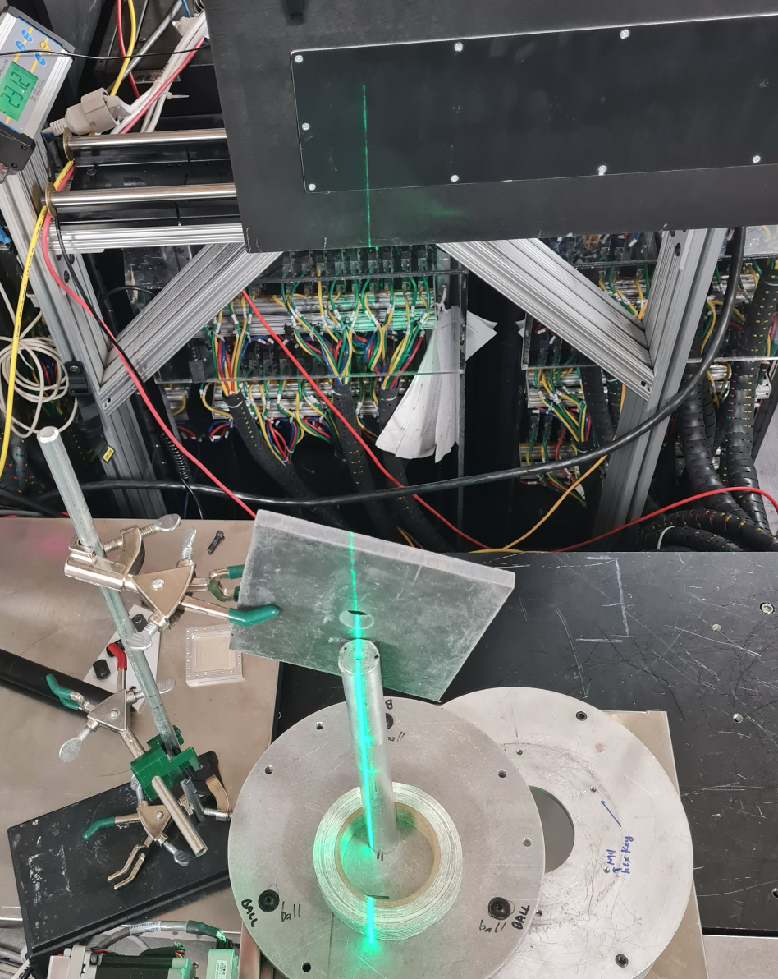
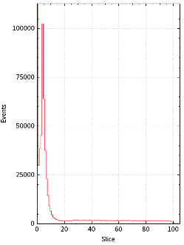
Timing Spectrum
gammas
SNS Data currently being evaluated
Software to sort time slices currently being written
Test performed at SNS
AgBeh and Nanoparticles
Direct Beam
Incoherent scatterer
Different wavelengths
Blocked beam
6.4 Å neutron +
decay

Slide 13
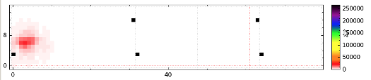
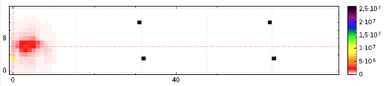
Unexpected Nuggets
With B4C
SNS allowed for a nice test for gamma sensitivity
We will use this data to estimate gamma contribution to “useful” spectrum
Here ca. 1% gammas (but still working on details)
There was a primary beam, even when beam blocked
Since B4C was only blocking neutrons there were sufficient gammas to create a primary beam shadow
Without B4C

Slide 14
Backup slides by ECDC

Slide 15
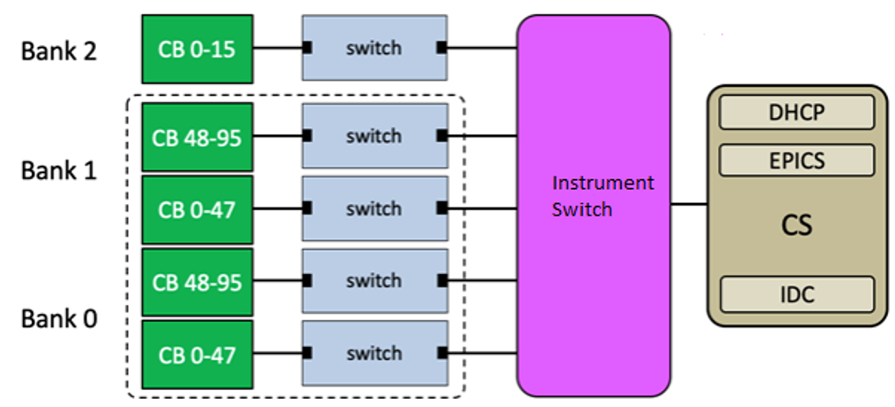
Proposed SONDE detector integration
SONDE is currently not aligned with ESS standard data chain infrastructure
The proposed SONDE detector data chain will be unique:
No Read out Master Module (RMM)
Network switches required to aggregate data
Timing synchronisation with Event Receiver- EVR (no RMM)
Individual pixel characteristics (each of 64 pixels, of each module)
Concept schematic. CB - Concentrator Boards

Slide 16
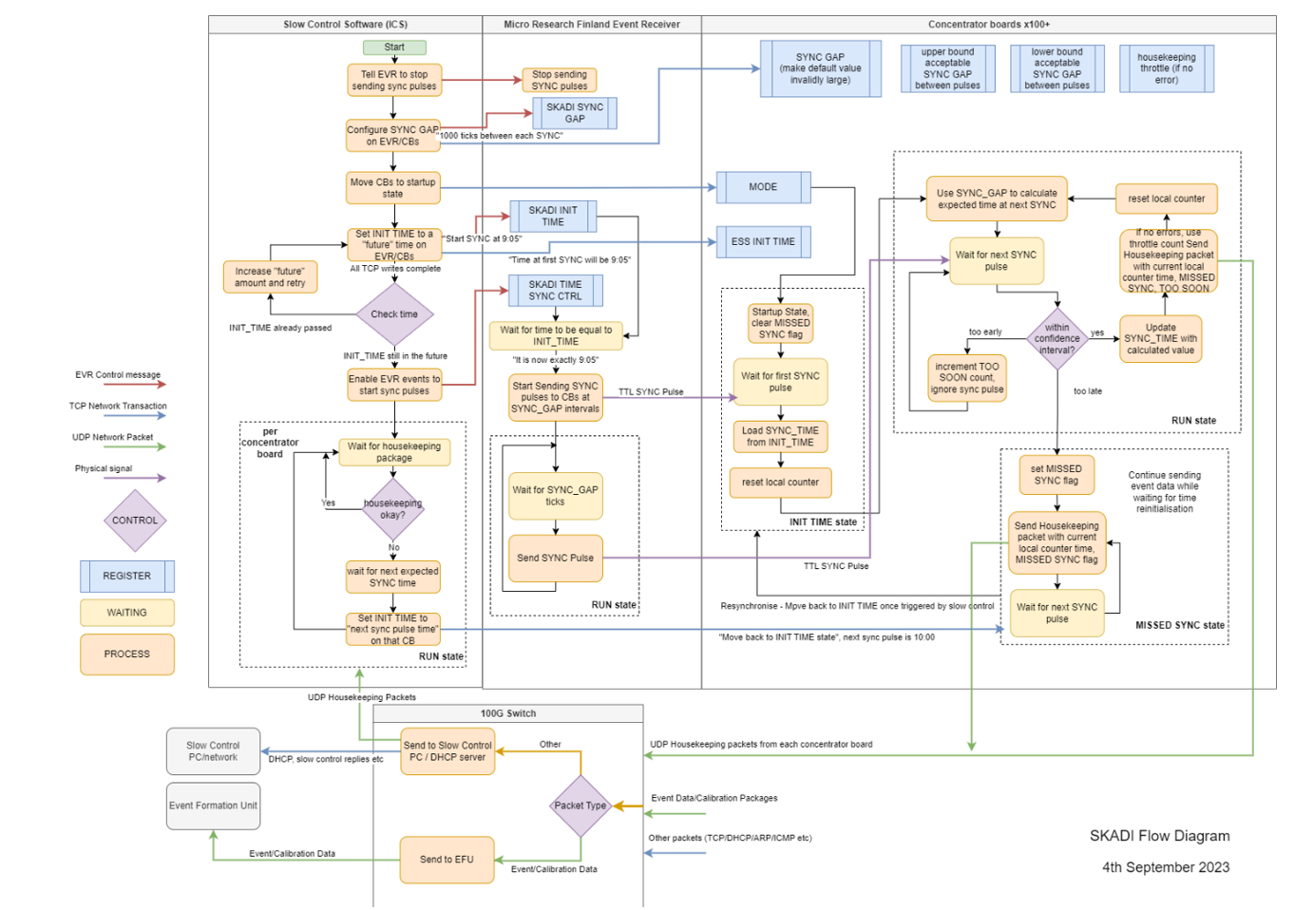
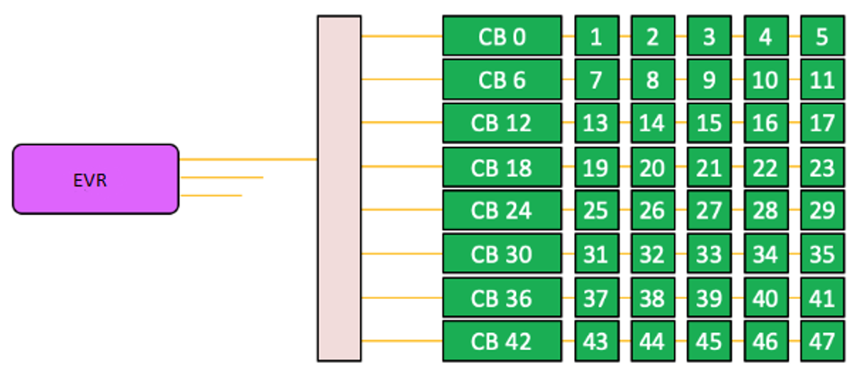
Time synchronization
A critical component
Current design synchronizes each concentrator board through a sequence (image)
Time initialization is ideally done rarely (days/ months)
Synchronization will be a 2 step process:
Configuring the time counter to the correct time on CB
Start syncing at the correct time with an electrical pulse (from EVR)
Each of the 208 CB must be synchronized, monitored and controlled individually.
Proposed schematic of time synchronisation sequence
Schematic of time synchronization pulse distribution

Slide 17
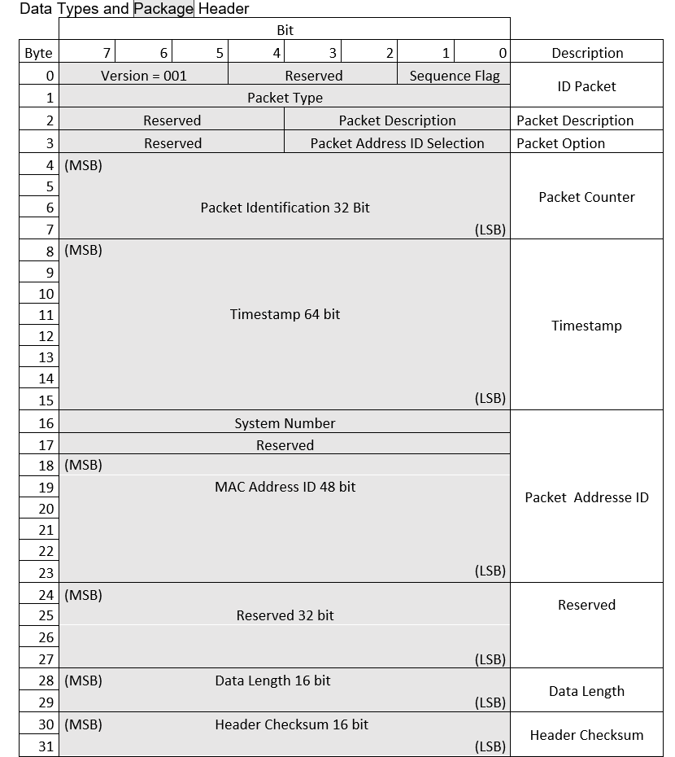
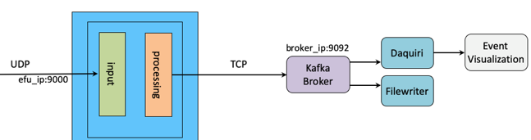
Data and data path
Everything upstream the EFU is non standard
From the EFU, the standardized ESS infrastructure can be used
CB must package and send the data and the EFU must parse the data according to the agreed format
Example of data package format
EFU
Schematic of data path. Standard ESS data path from EFU to file.

Slide 18
Project plans
A concept architecture has been documented
ECDC will provide a project leader to coordinate the integration project. The position is currently being filled
Technical resources will be identified
A project plan will be developed
Project will start as soon as feasible

Slide 19
Main challenges/design risks
Design still only theoretical
Readout chain performance
Clear requirements needed, does the system design really meet real rates?
No scale up experiments done
Stability
Timing adjustment duration (on full system)
Timing adjustment frequency (on full system)
Reliability
Missed data from PMTs or undetected drop outs
Timing accuracy (uncharacterized)
Timing could be off at times
Undetected

Slide 20
Main challenges
New control architecture
Communicating, controlling and monitoring 200+ devices(CBs) instead of one device (if RMM used)
Time synchronization sequence is complex and untested
EPICS needs to communicate with EFU
EFU application will be unique for SONDE

