Slide 1
Gas Handling and High-Pressure Sample Environment.
Chris Goodway
ISSE Sample Environment School Lund Sweden
20th January 2026

Slide 2
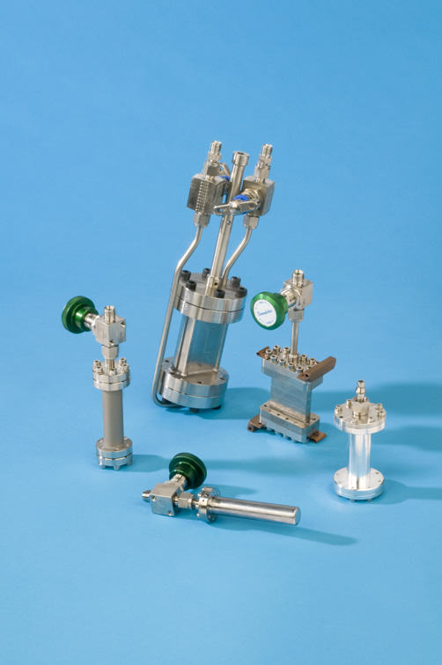
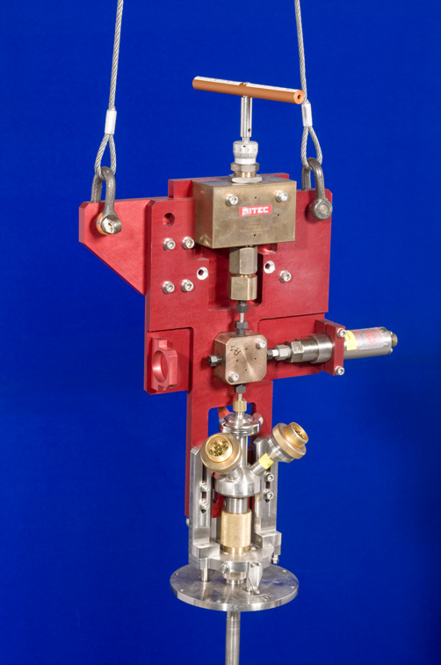
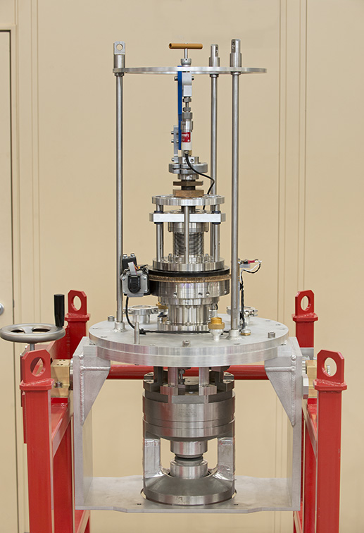
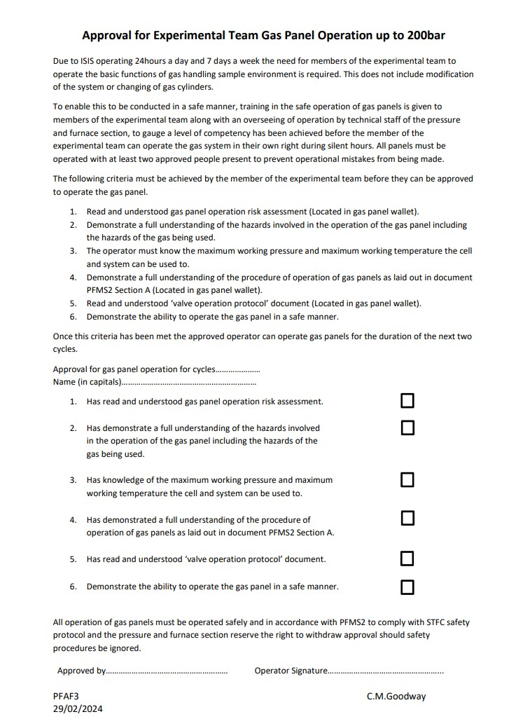
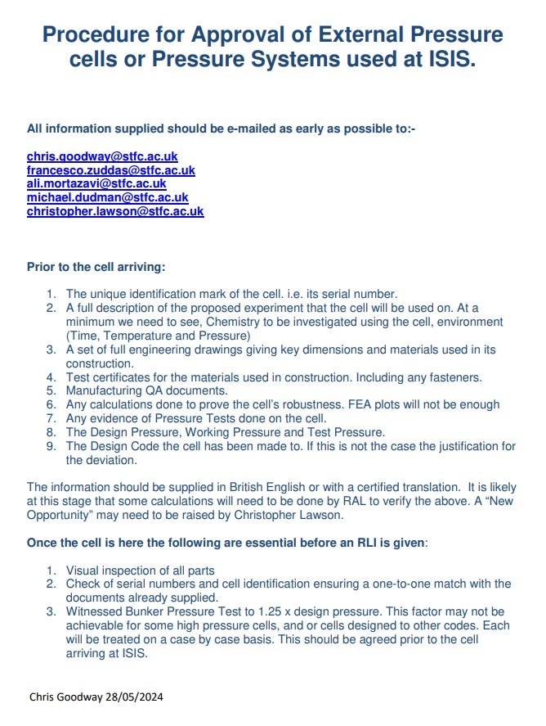
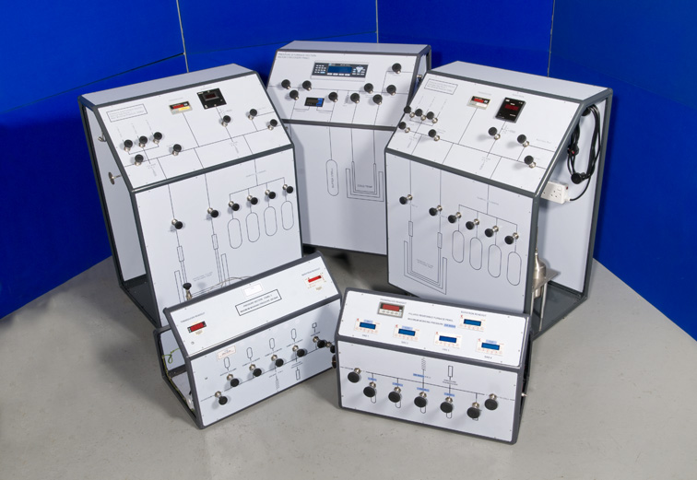
Gas Handling and High-Pressure Sample Environment.
ISIS.
Temperature and pressure ranges.
Types of cells.
Materials.
Seal types.
Gas handling systems.
High Pressure Systems.
Gas handling and High-Pressure Experiments.
Approval of pressure cells.
Safety systems and procedures.
When It Goes Wrong!

Slide 3
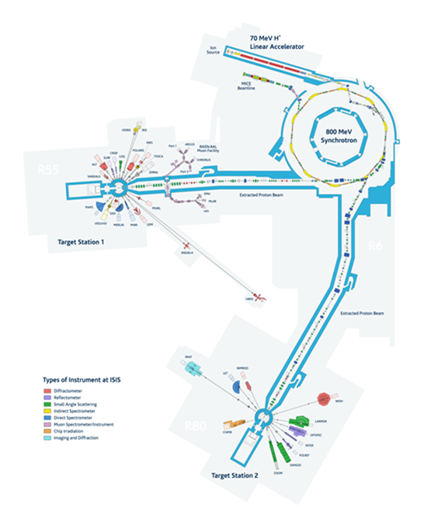
Gas Handling and High-Pressure Sample Environment.
ISIS
Neutron experiments.
18 instruments on target station 1 we support.
10 instruments on target station 2 we support.
5 Muon instruments.
Samples need to be held in a certain environment.
Temperature (hot or cold)
Pressure (high pressure to vacuum)
Magnetic field.
Polarised Neutrons.
Sample Environment Group.
Pressure & Furnace Section.
Cryogenics Section.
Soft Matter Section.
Polarised Neutrons Section.
ISIS runs five 45 day cycles a year. During each cycle
experiments are running 24hours a day 7days a week.
Each cycle pressure & furnace section would support
approximately 30 experiments involving gas handling and high-pressure.
ISIS conducts approximately 1200 experiments per year and on average 150 per year involve either gas handling or high pressure.

Slide 4
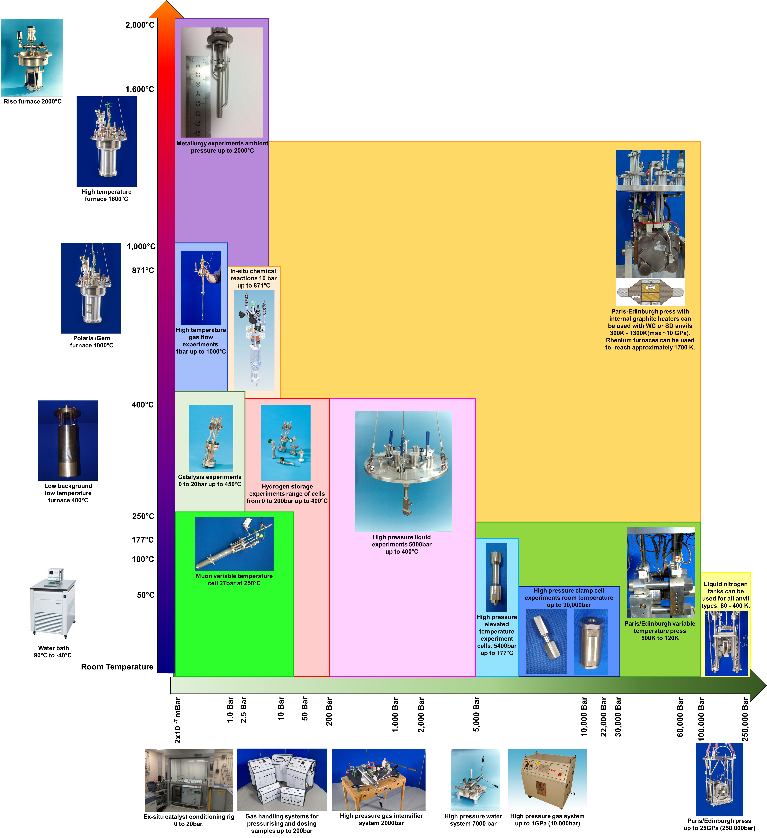
Gas Handling and High-Pressure Sample Environment.
Gas Handling and High Pressure at High Temperature.
Gas Handling
Gas handling tends to fall between vacuum and
200bar at temperature ranges from room temperature
to 1000˚C (1273K)
High pressure falls in a number of areas.
Gas cells (up to 10Kbar) room temperature.
Gas cells (up to 7Kbar) 400˚C.
Clamp cells (10 to 30Kbar) room temperature.
Paris Edinburgh presses with graphite furnace
can reach 1027˚C.
Paris Edinburgh presses with Rhenium furnace
can reach 1427˚C.

Slide 5
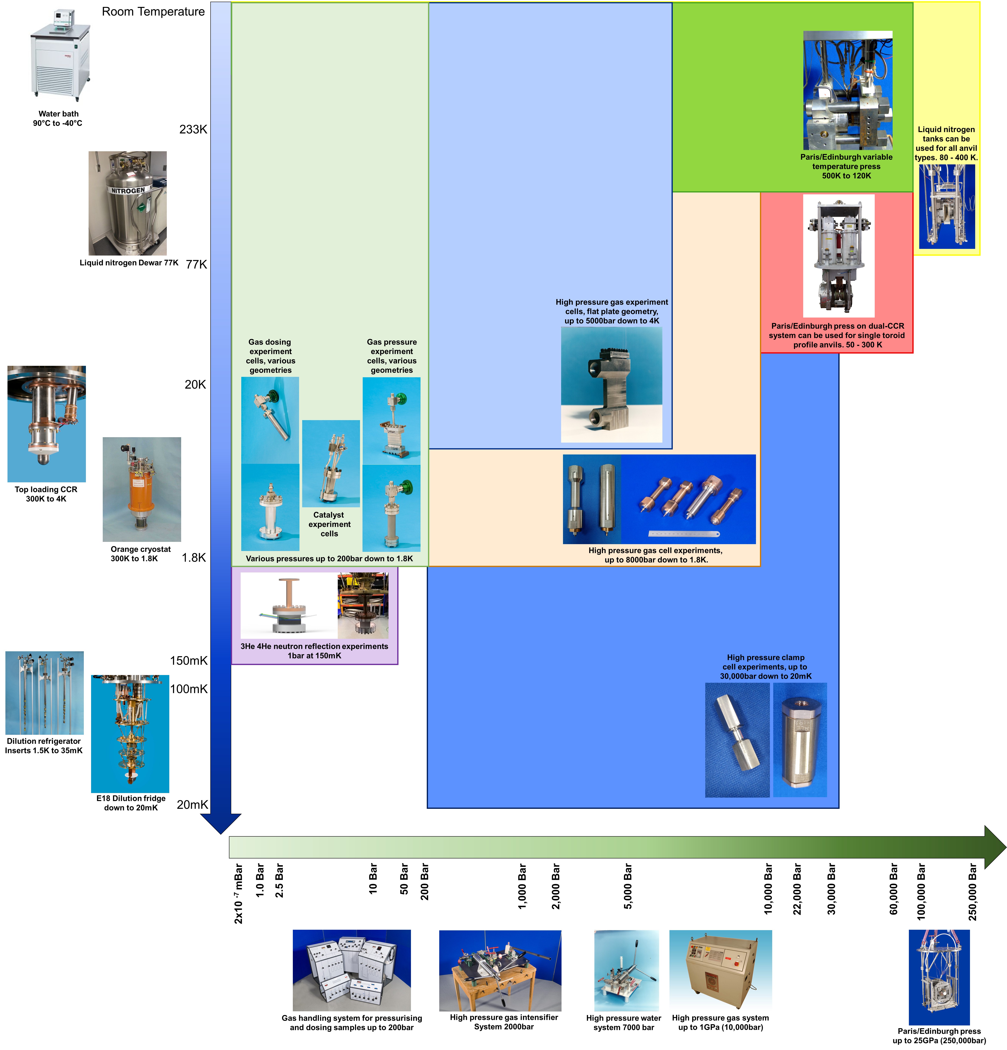
Gas Handling and High-Pressure Sample Environment.
Gas Handling and High Pressure at Low Temperature.
Gas handling
Gas handling tends to fall between vacuum and
200bar at temperature ranges from room temperature
to 1.8K but has gone as low as 150mK.
High pressure falls in a number of areas.
Gas cells (up to 10Kbar) room temperature
to 1.8K
Clamp cells (10 to 30Kbar) room temp to 20mK
Paris Edinburgh presses room temp to 30K.
Istutut Laue-Langevin (ILL) has PE press from room temp to 1.8K and below 100mK.

Slide 6
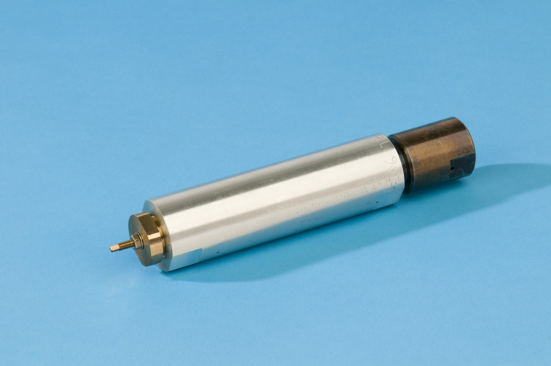
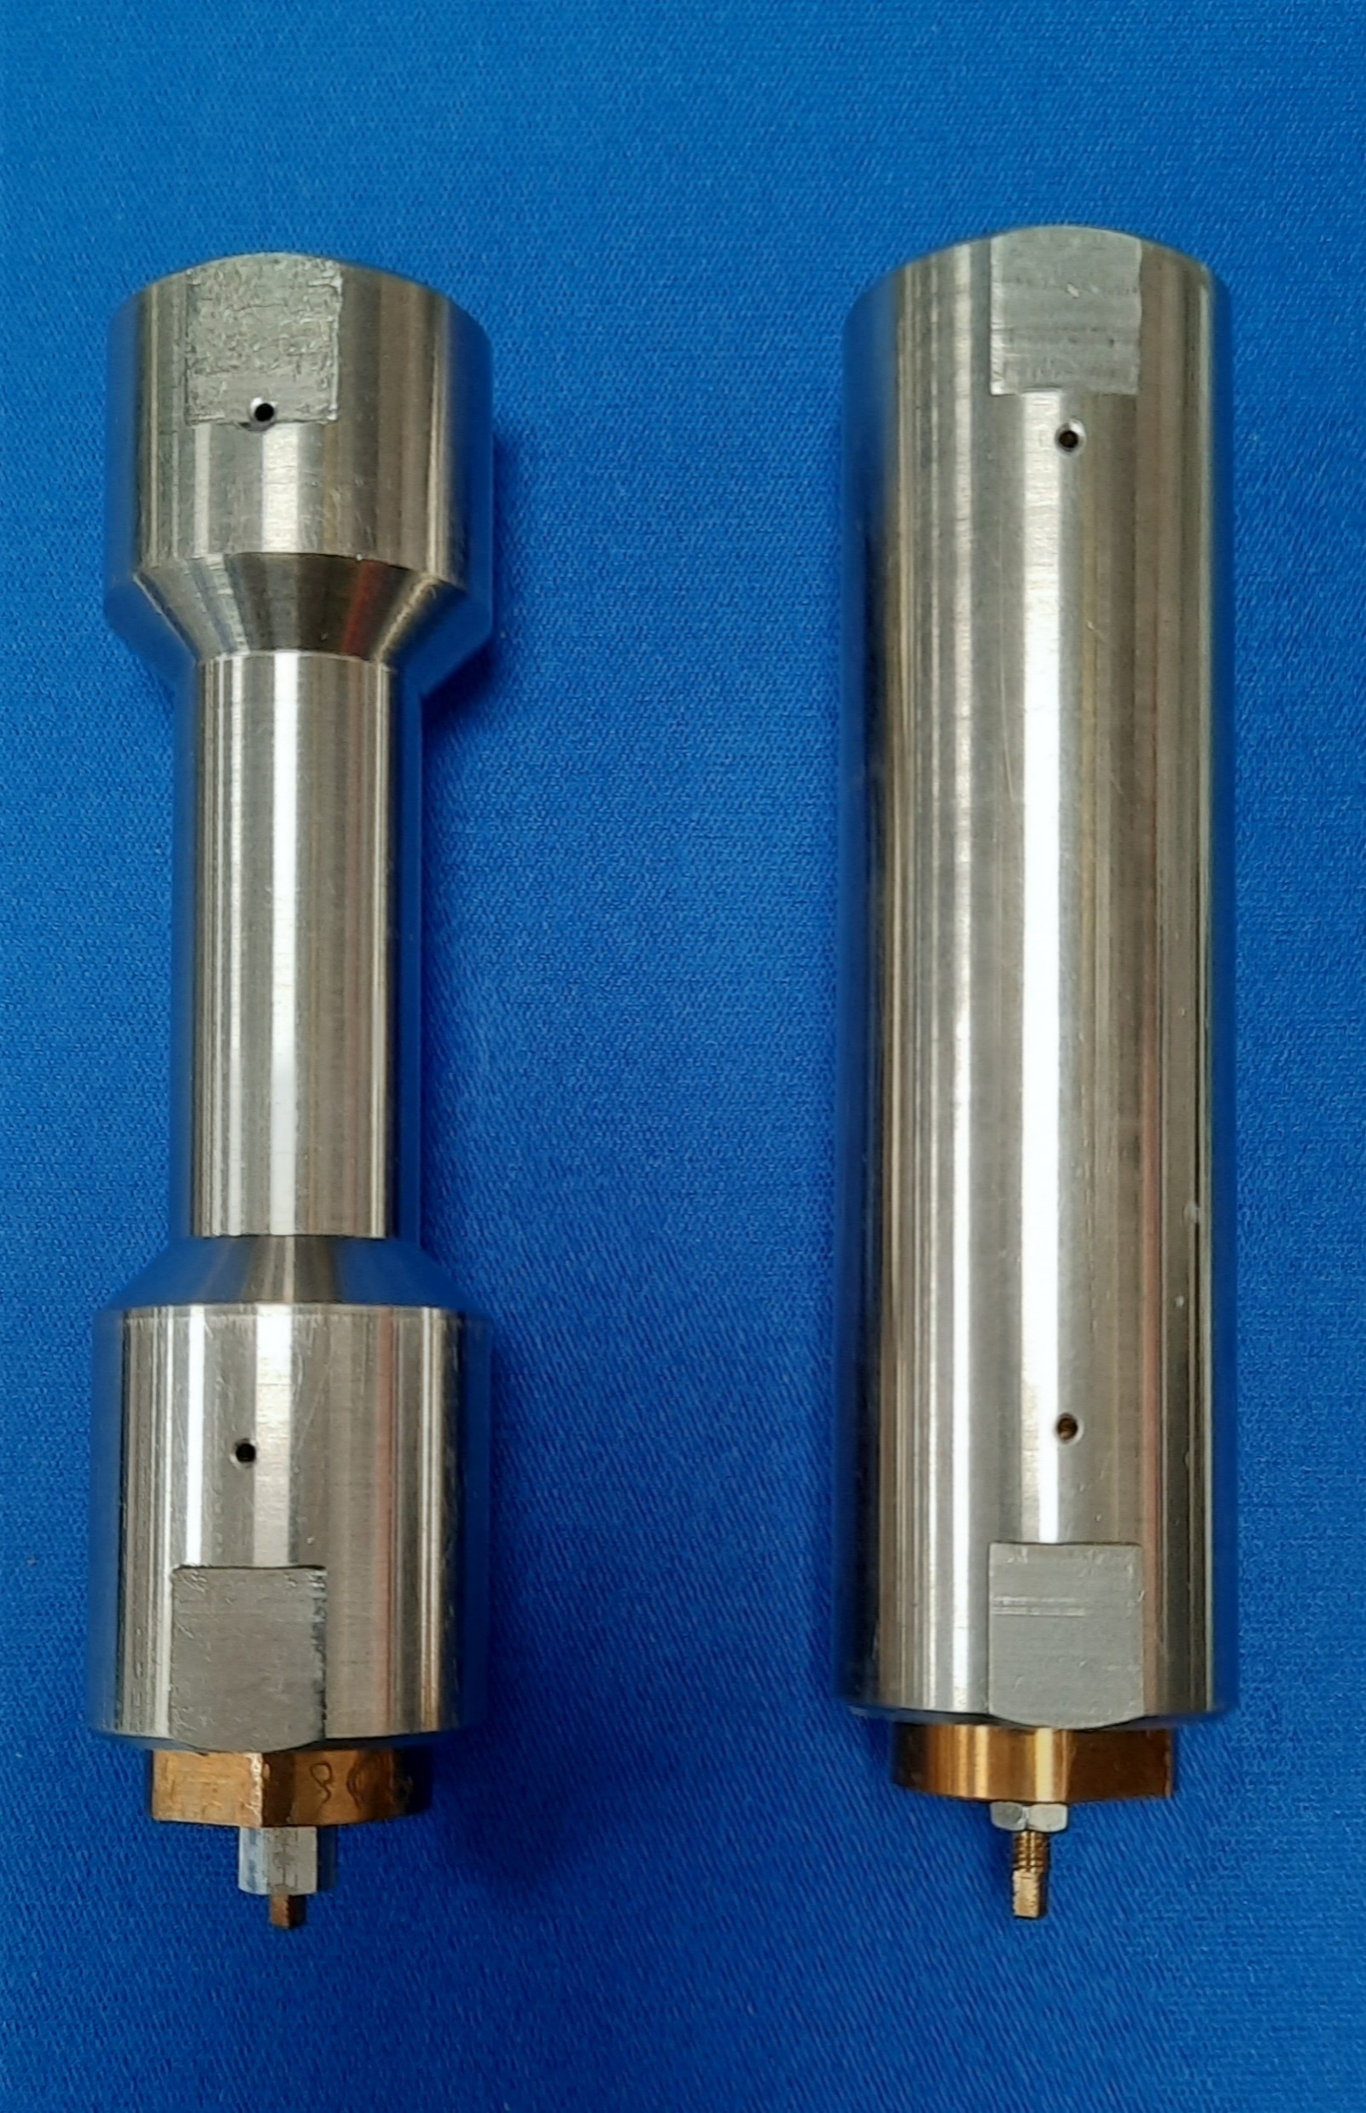
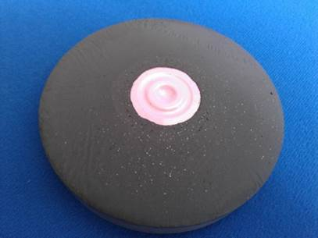
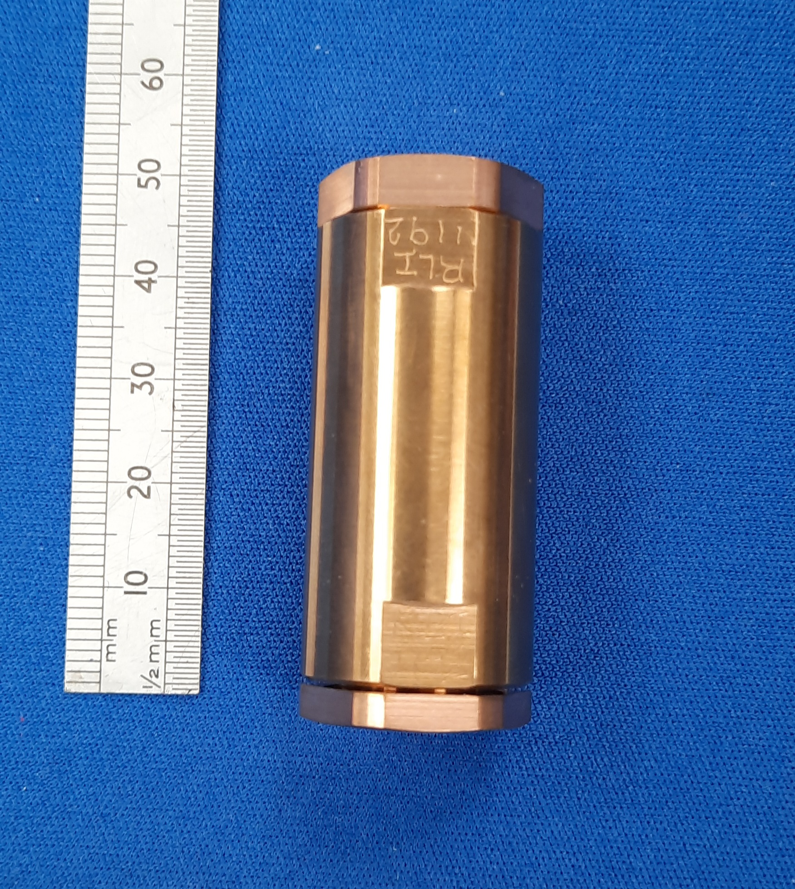
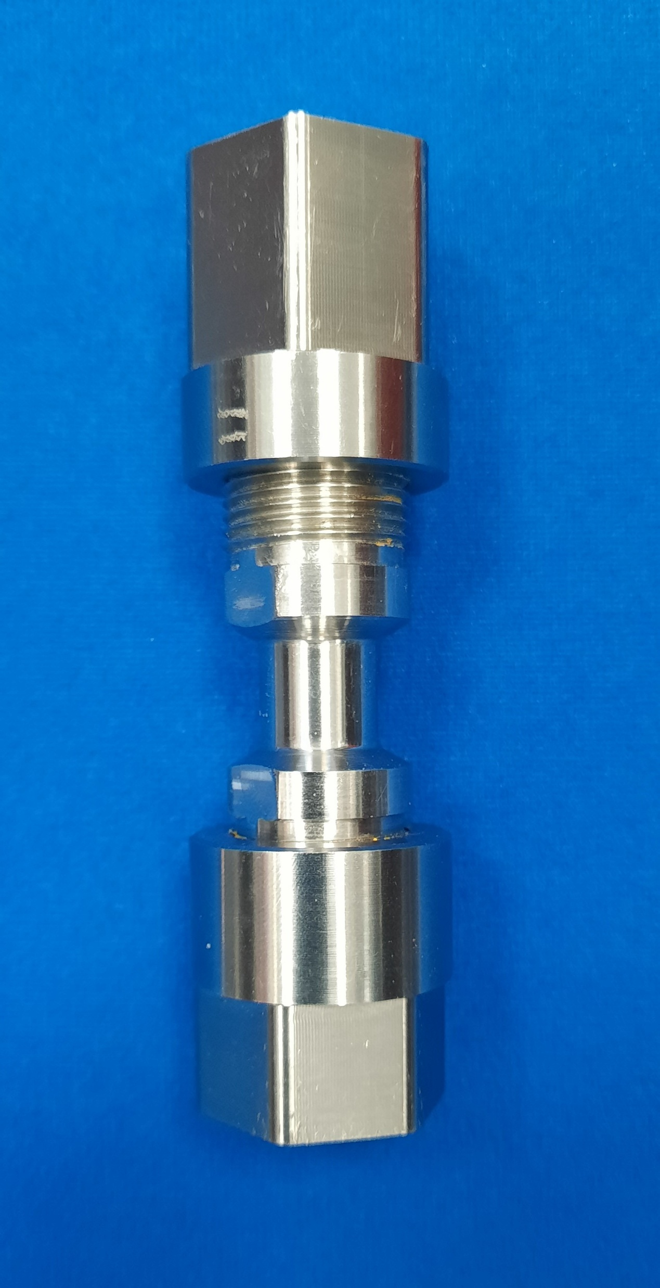
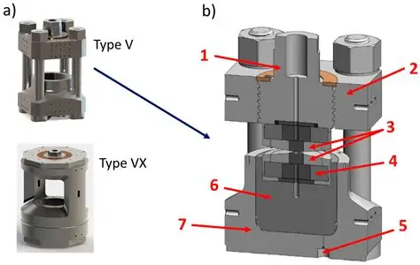
Gas Handling and High-Pressure Sample Environment.
Types of cell.
Vacuum to 200 bar (Gas cells).
Thin-walled cells for condensing gases.
Catalysis cells (elevated temperature).
High temperature and in-situ reactions.
Rated for a variety of different gases.
Vacuum to 3Kbar (Gas cells)
Hydrogen Storage.
200bar to 10Kbar. (Gas cells)
Single crystal high pressure.
Powder diffraction.
Liquid samples.
10Kbar to 30Kbar (Clamp cells)
Clamp cells for single crystals.
Clamp cells for powdered samples
10Kbar to 300Kbar (Paris/Edinburgh press)
Powder, liquid and gas samples.
Notes:
Add PE press photo and clamp cell photos

Slide 7
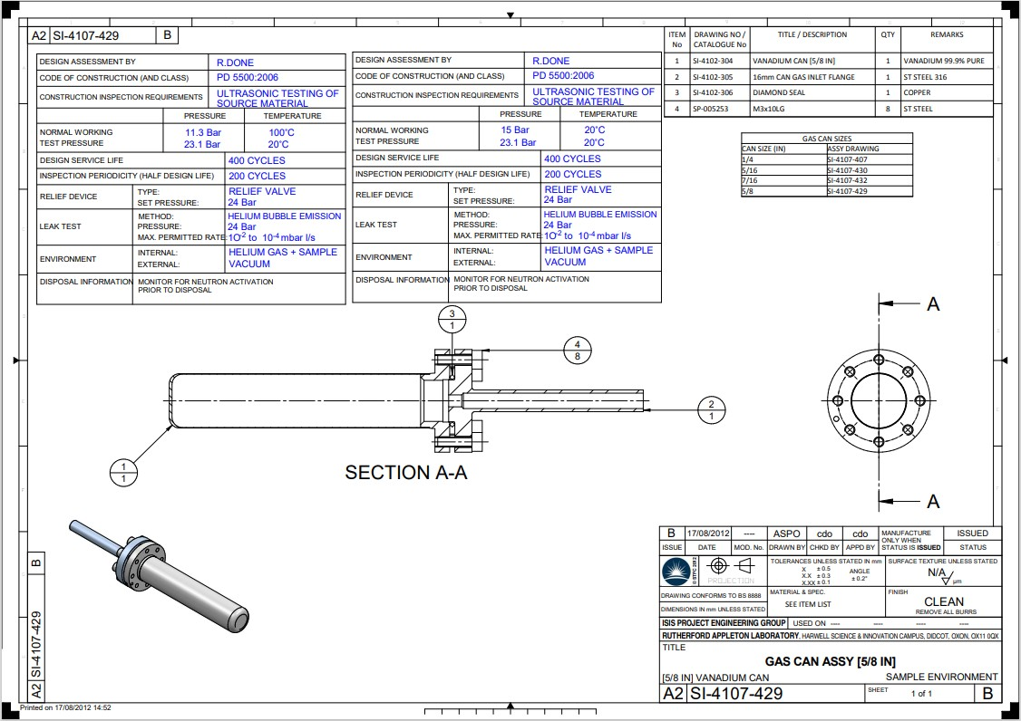
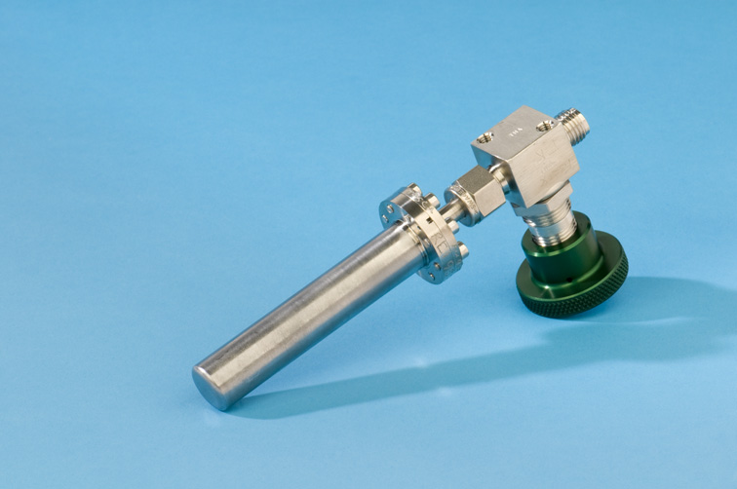
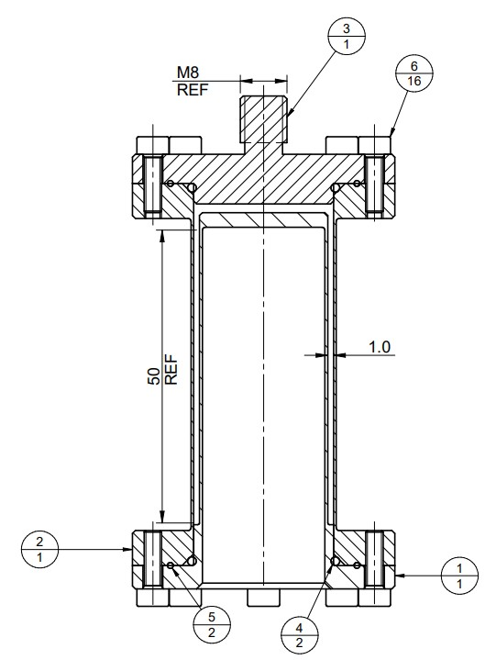
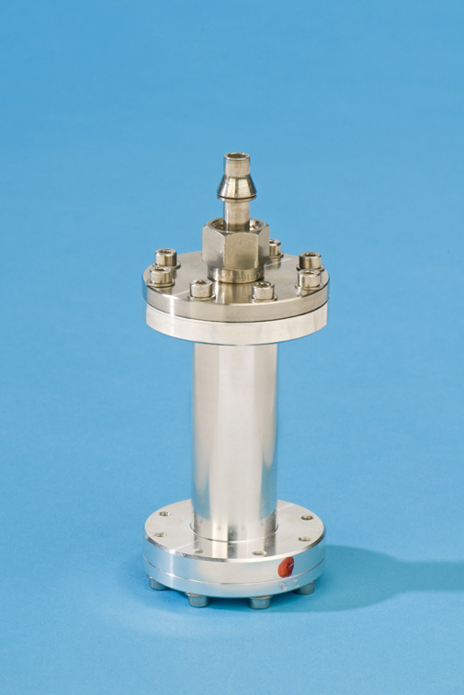
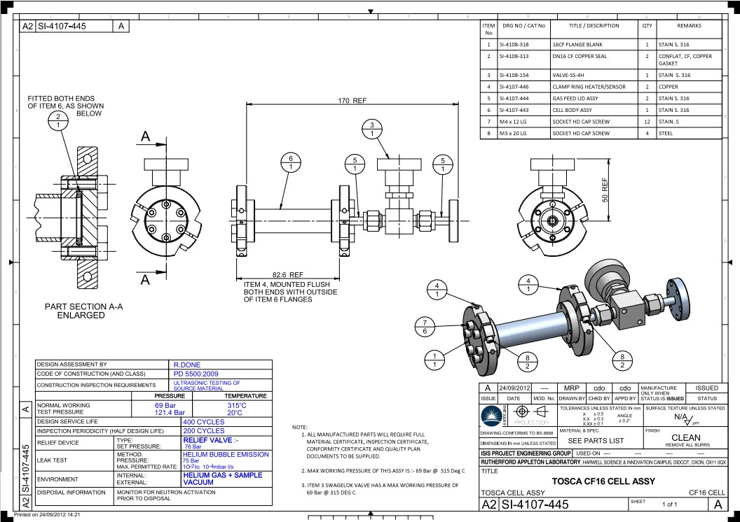
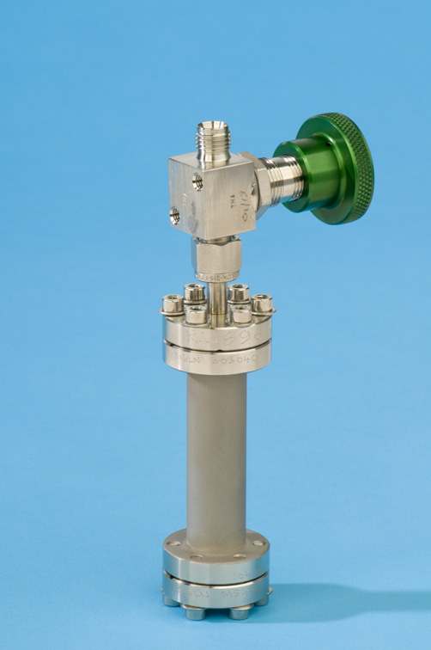
Gas Handling and High-Pressure Sample Environment.
Vacuum to 200 bar.
Thin-walled cells.
Spectroscopy
Diffraction.
Thicker-walled cells
Spectroscopy
Diffraction.
Annular sample space cells.
Spectroscopy.
Condensing gases.
liquid or powdered samples.
Sensors
Rhodium/Iron.
Platinum.
Type K thermocouple.
Heaters and sensors.
Top and bottom of cell when
possible to prevent gradients.
Twin Ferrule Swagelok connections.
Pressure rated Vanadium Cells
Annular Cells
Cylindrical Cells

Slide 8
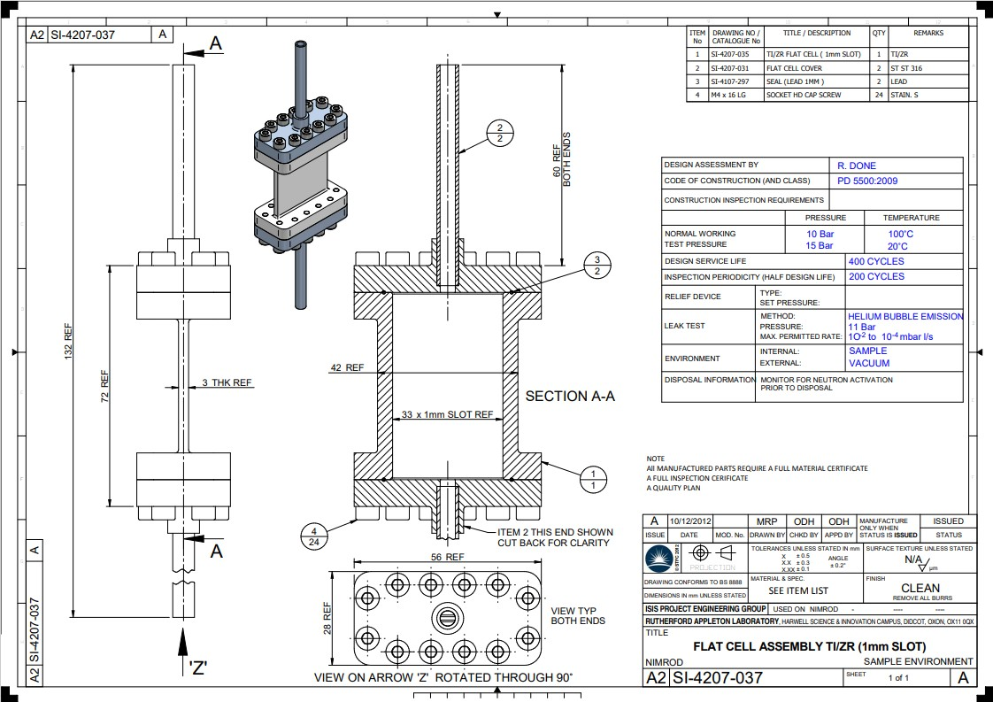
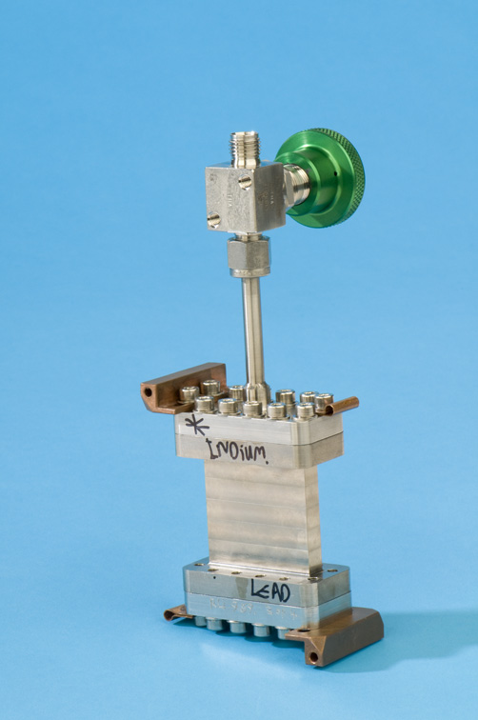
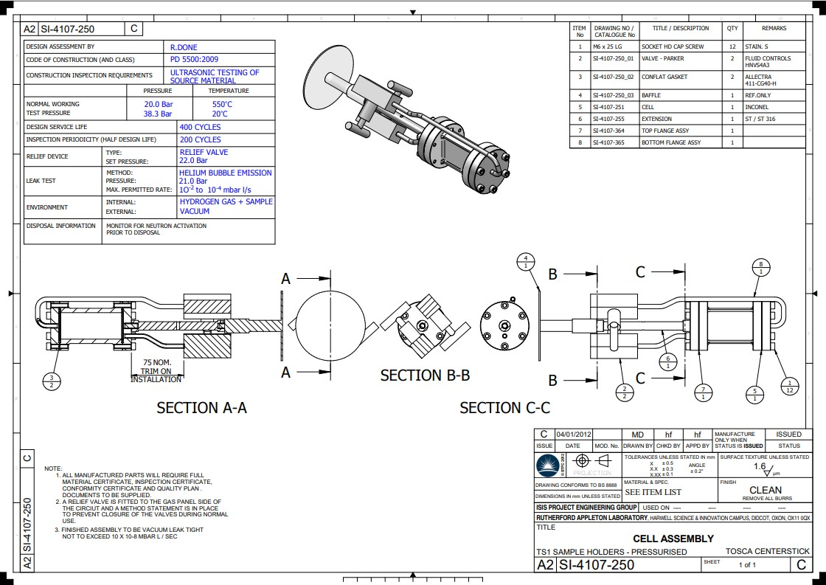
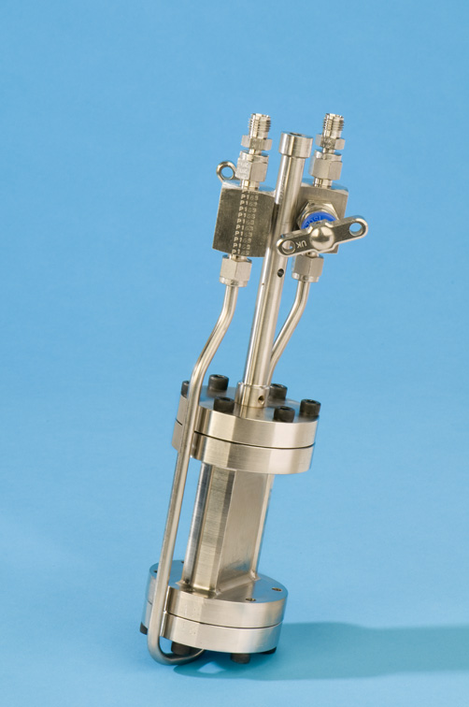
Gas Handling and High-Pressure Sample Environment.
Vacuum to 200 bar (Gas cells).
Catalysis cells.
Spectroscopy
Flat plate geometry flow cells.
Spectroscopy.
Diffraction.
Catalyst reactions both in-situ and ex-situ.
Powders, liquids and gases.
Sensors
Rhodium/Iron.
Platinum.
Type K thermocouple.
Heating and sensors.
Top and bottom of cell when
possible to prevent gradients.
Twin Ferrule Swagelok Connection.
Flat Plate Geometry Cells
Catalysis Cells

Slide 9
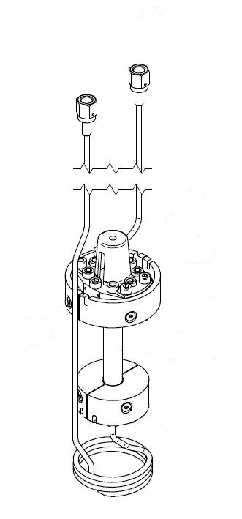
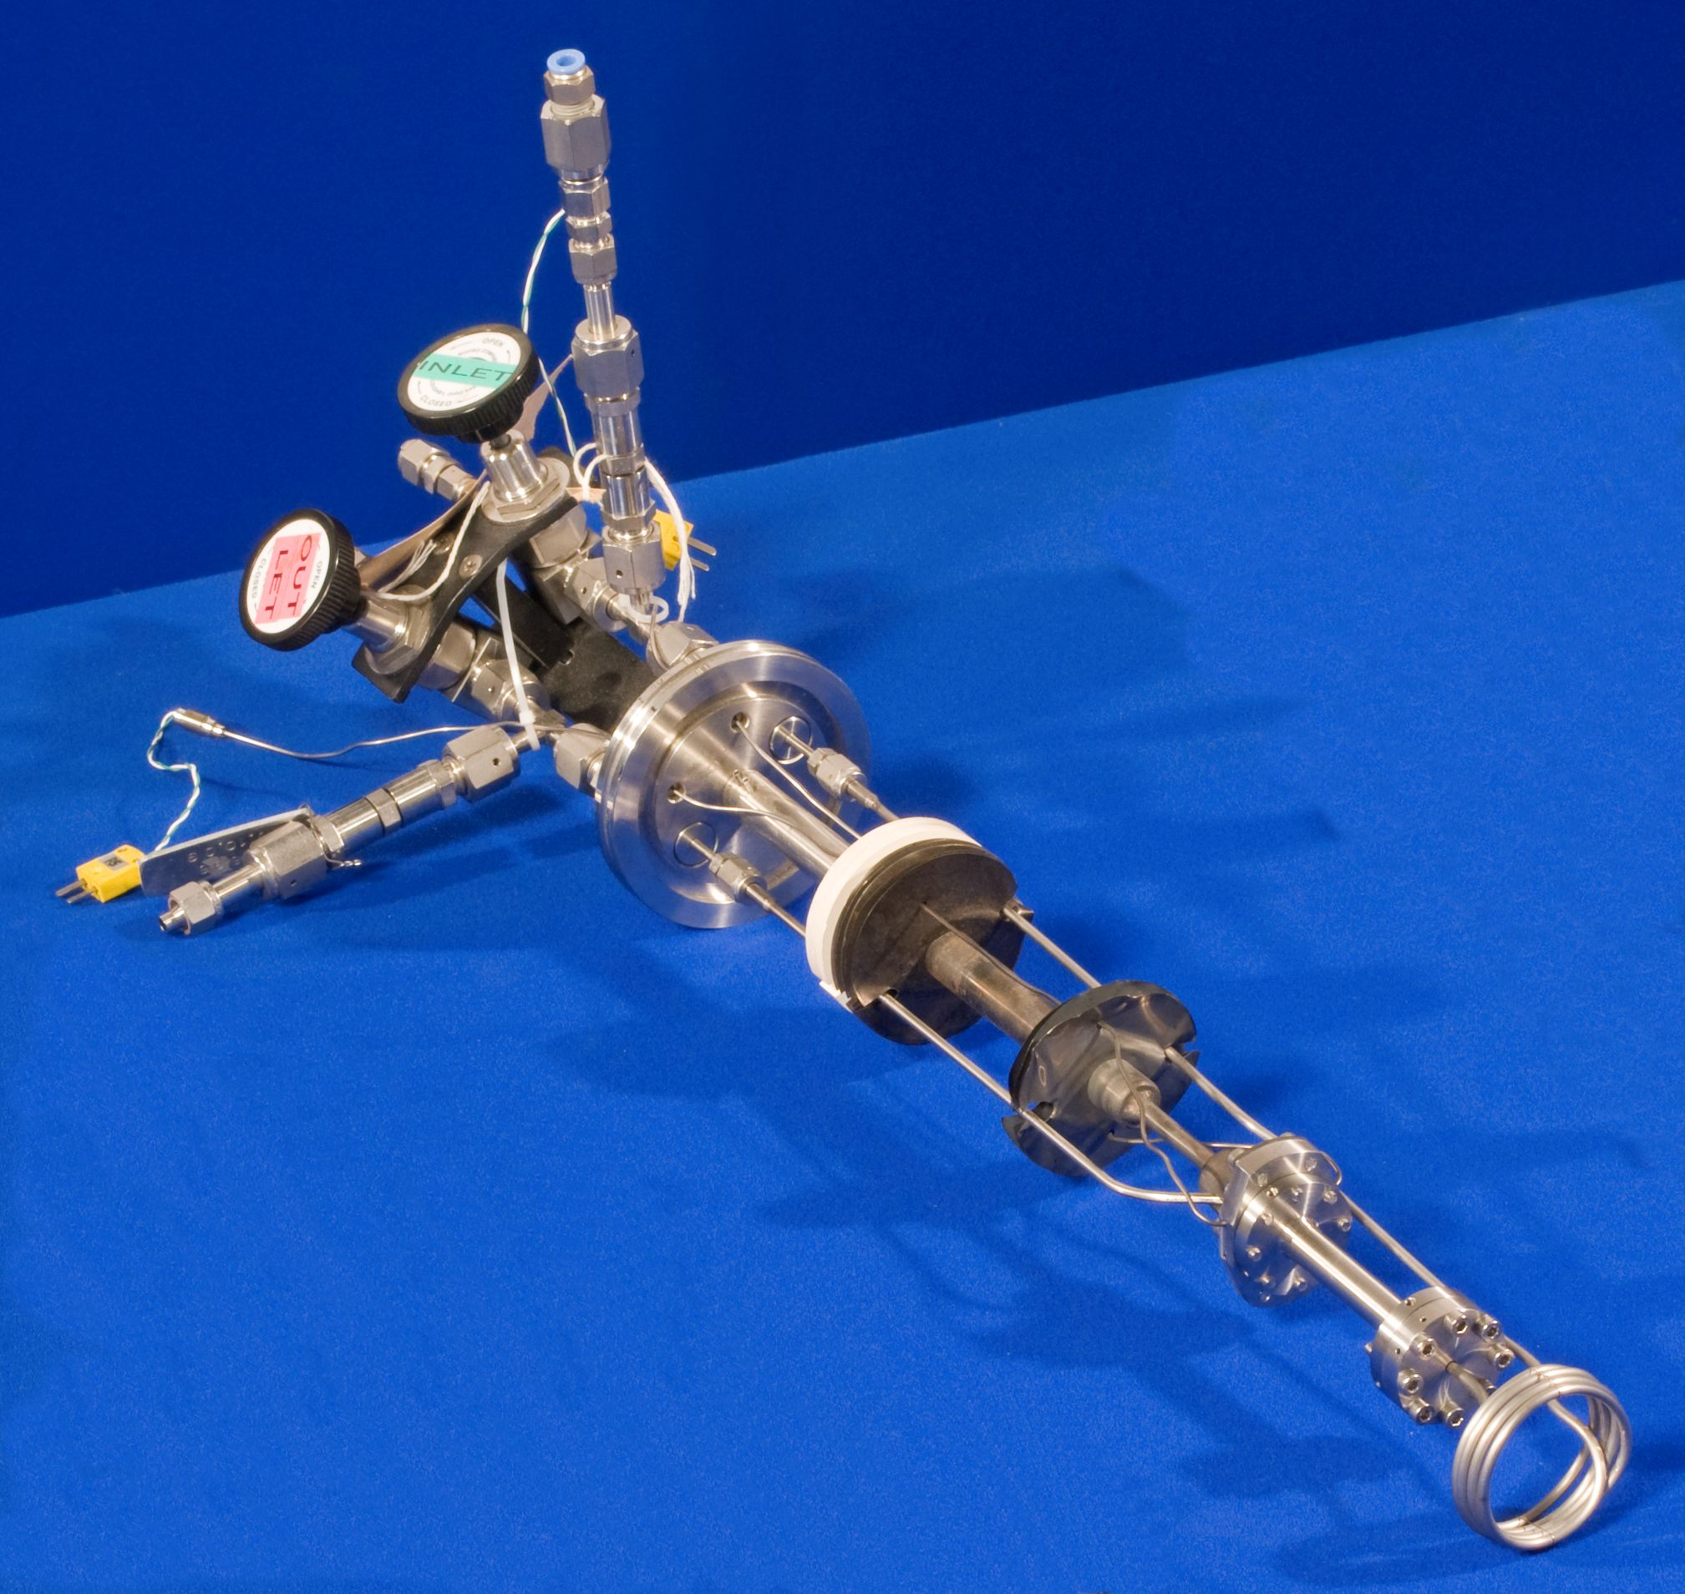
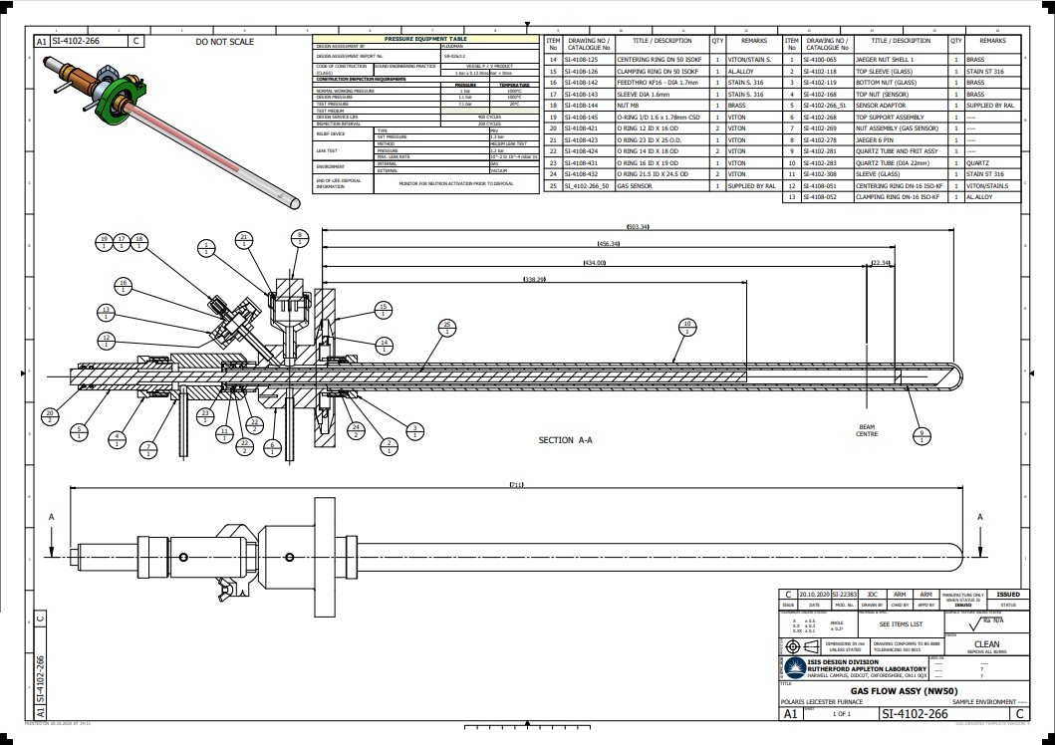
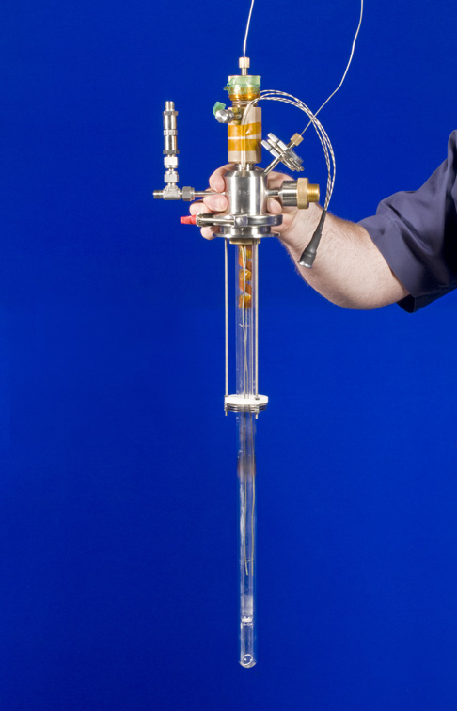
Gas Handling and High-Pressure Sample Environment.
Vacuum to 200 bar.
High temperature in-situ reactions cells.
Diffraction.
Spectroscopy.
Range of pressure and temperatures.
Special high temperature screws Wasp Alloy.
Collimation.
Sensors.
Type K
One top, one bottom.
Gas flow double quartz cells.
Diffraction.
Pressure range 1bar @ 1000˚C
Gas flows through centre tube and back up
between inner and outer tube.
Sensors
Type K thermocouples.
Two sensors one inner one outer.
Twin Ferrule Swagelok Connection.
In-situ Chemistry Cells
Double Quartz insert

Slide 10
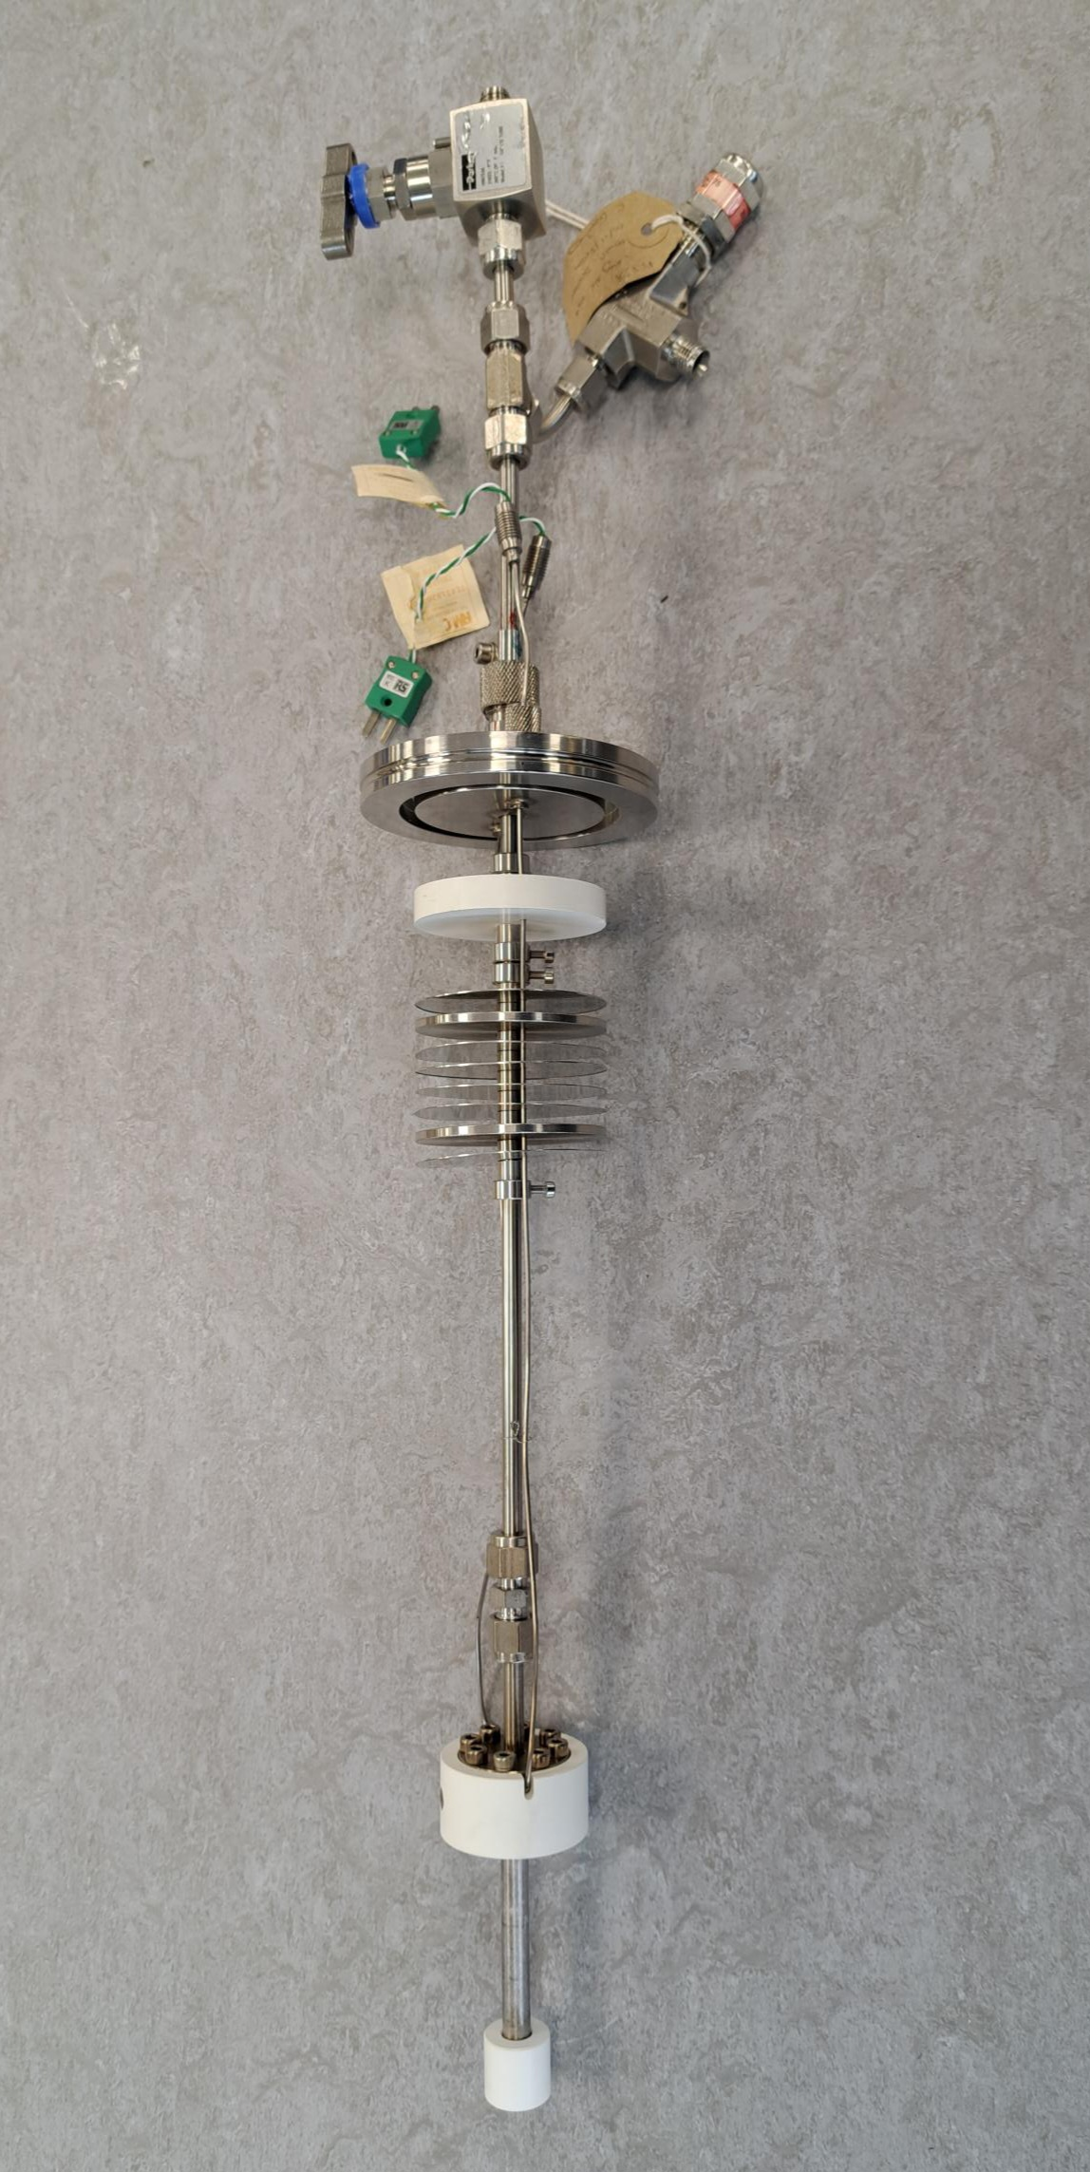
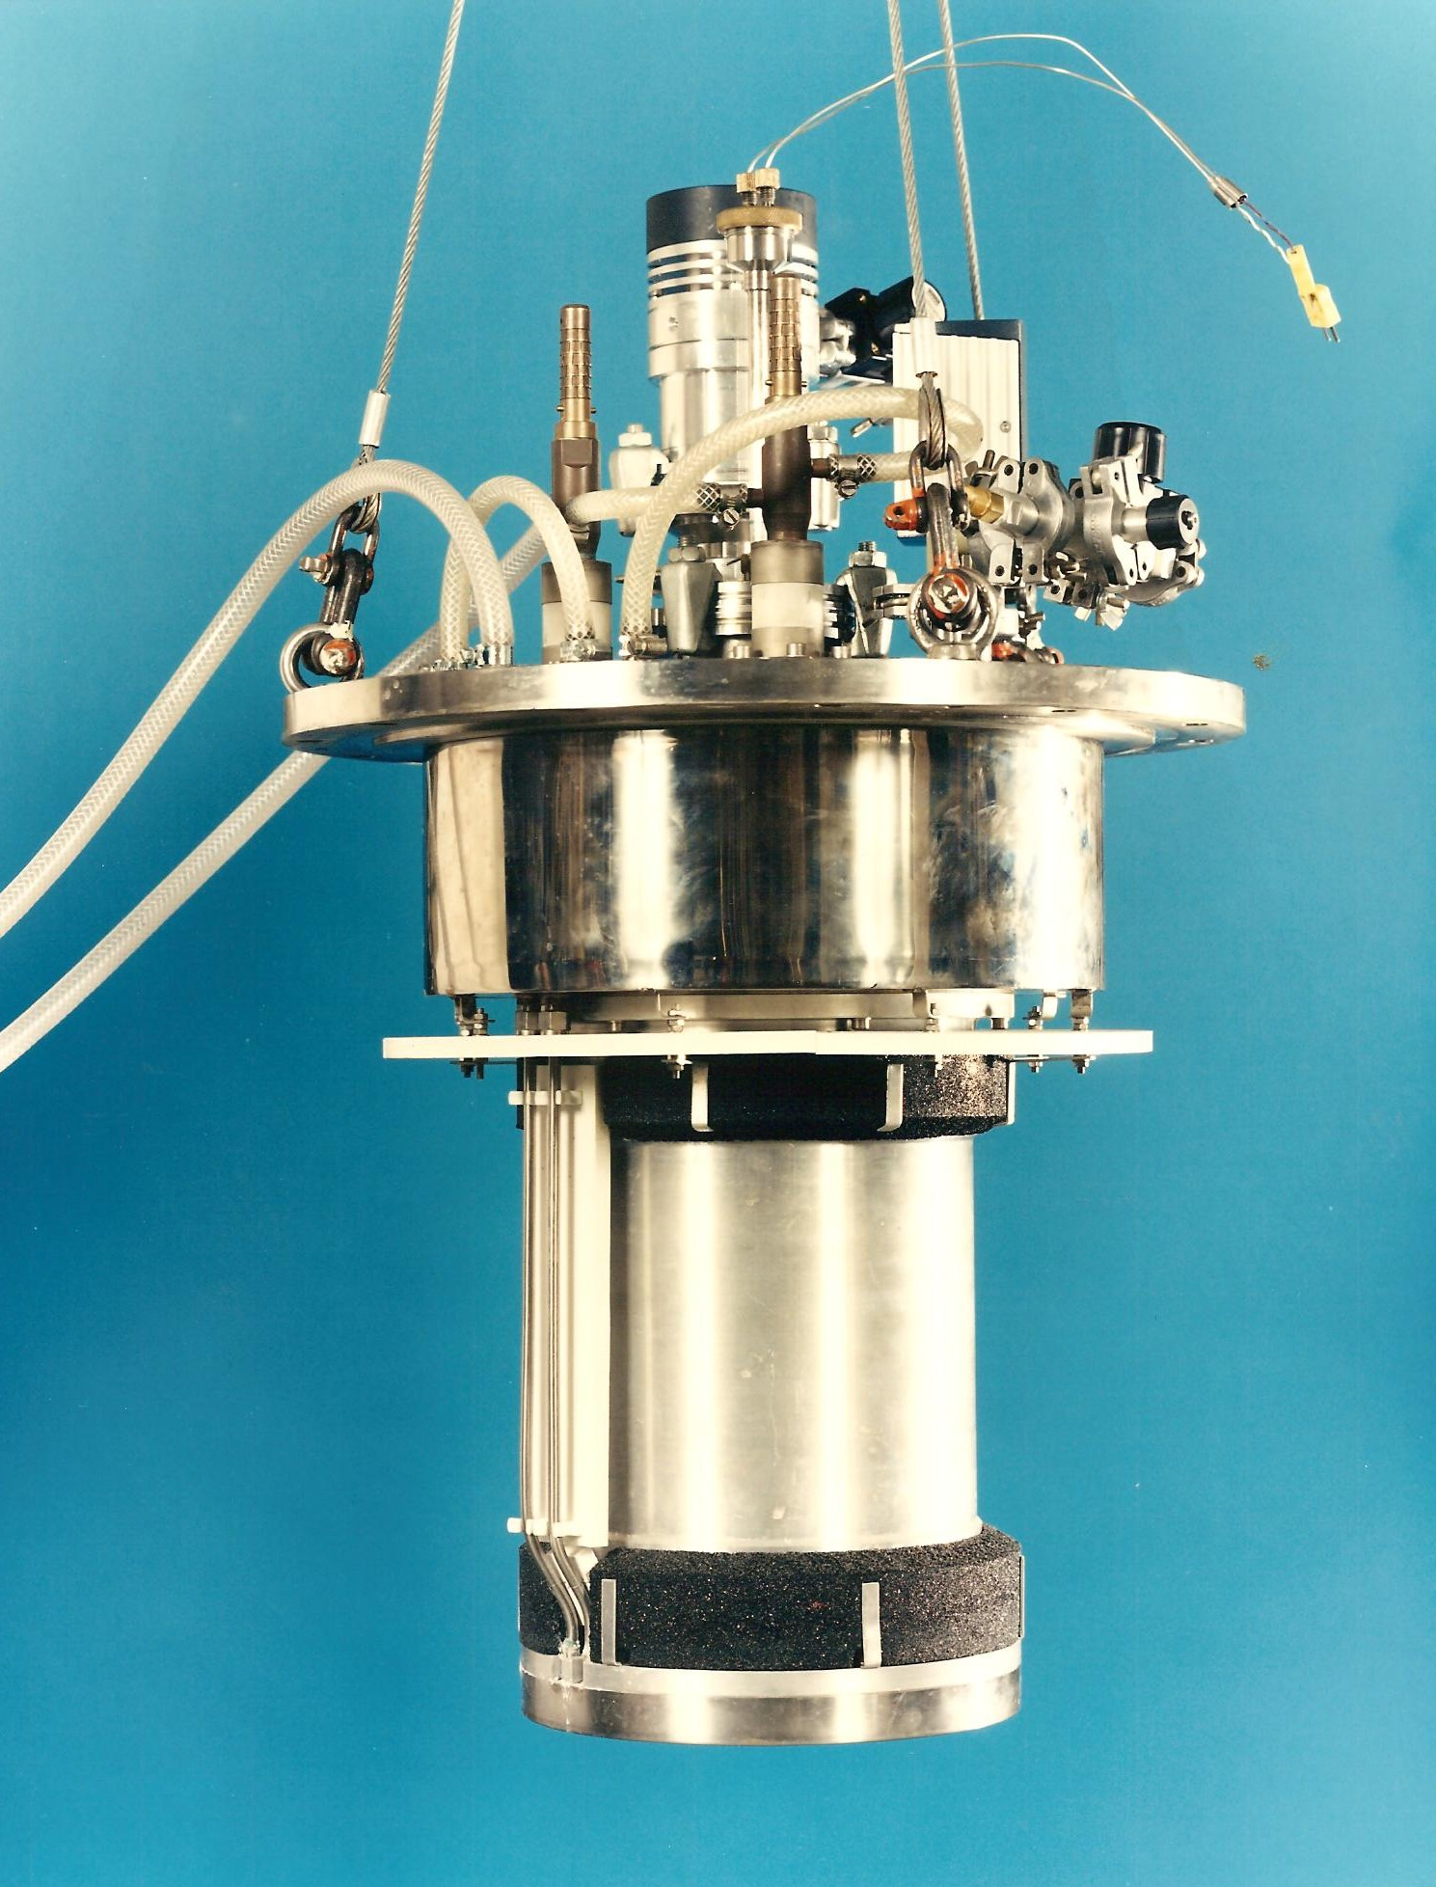
Gas Handling and High-Pressure Sample Environment.
Vacuum to 200 bar.
High temperature Hydrogen cell.
Diffraction.
Pressure rating 200bar @ 400˚C.
Cell material 316 Stainless steel
Hydrogen embrittlement.
Collimation.
Sensors
Type K
One top
Twin Ferrule Swagelok Connection.
200bar @ 400˚C 316 ST Steel Cell
1000˚C Furnace

Slide 11
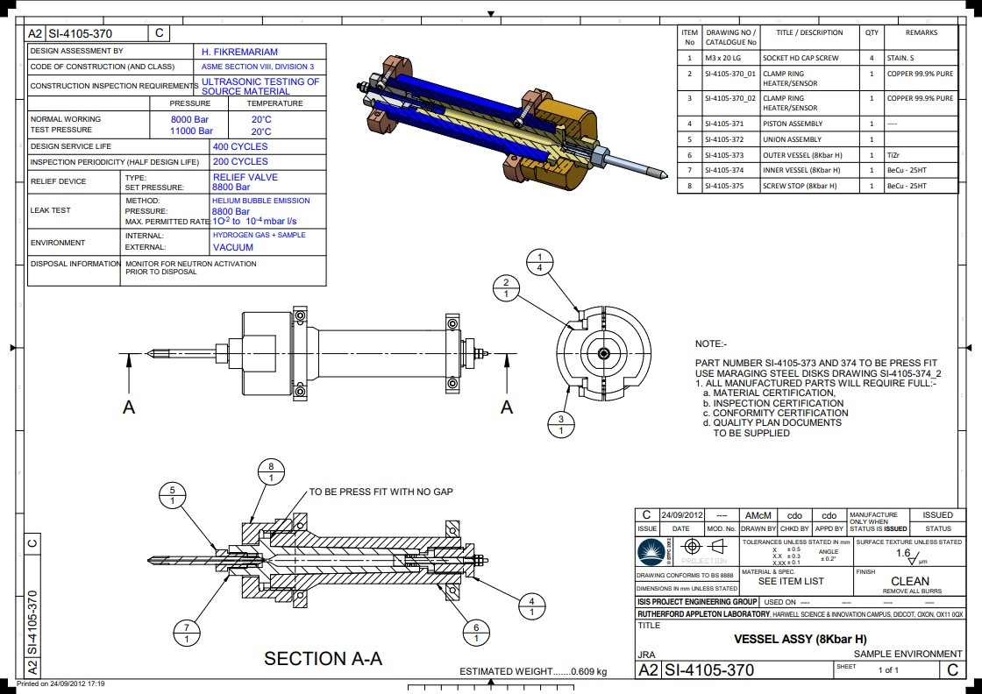
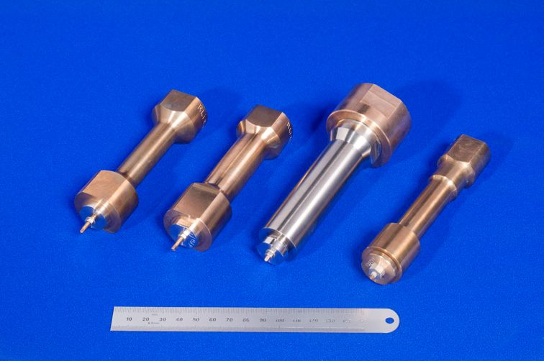
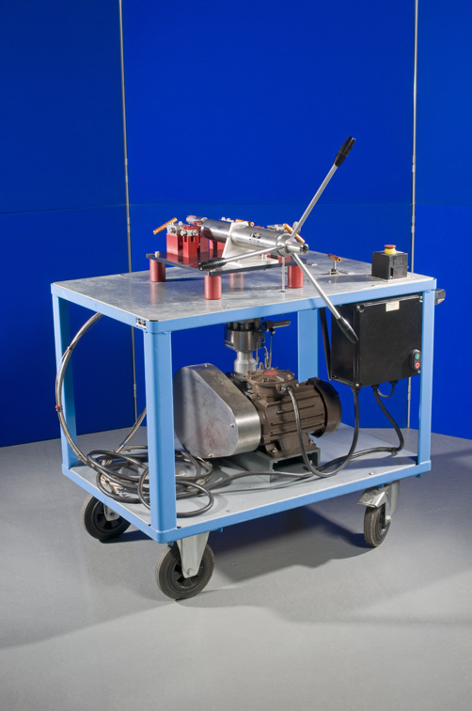
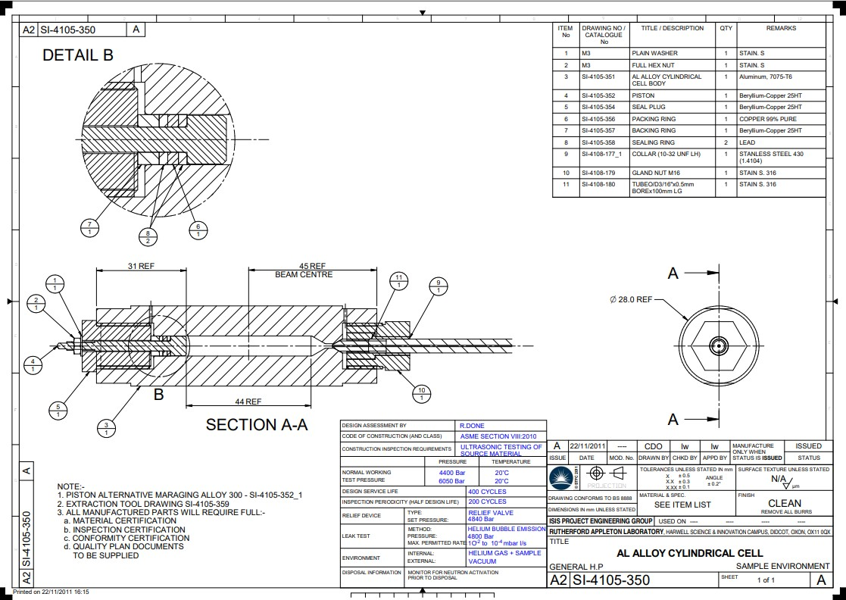
Gas Handling and High-Pressure Sample Environment.
Vacuum to 3Kbar (Hydrogen Gas Cells)
Hydrogen rated pressure systems to
generate pressure..
Diffraction.
Spectroscopy.
Hydrogen storage experiments.
Hydrogen embrittlement.
Safe working volumes.
Rupture discs, pressure relief valves vented to COSHH extract rated for flammable and explosive gases.
Sensors
Rhodium/Iron
Platinum
Type K.
Heaters and sensors top and
bottom to prevent gradients.
Collimation.
M16 high pressure 60˚cone
connection.
Bridgman seal at bottom of cell.
Beryllium/Copper Cells
Aluminium 7075 T6
ATEX rated Intensifier System

Slide 12
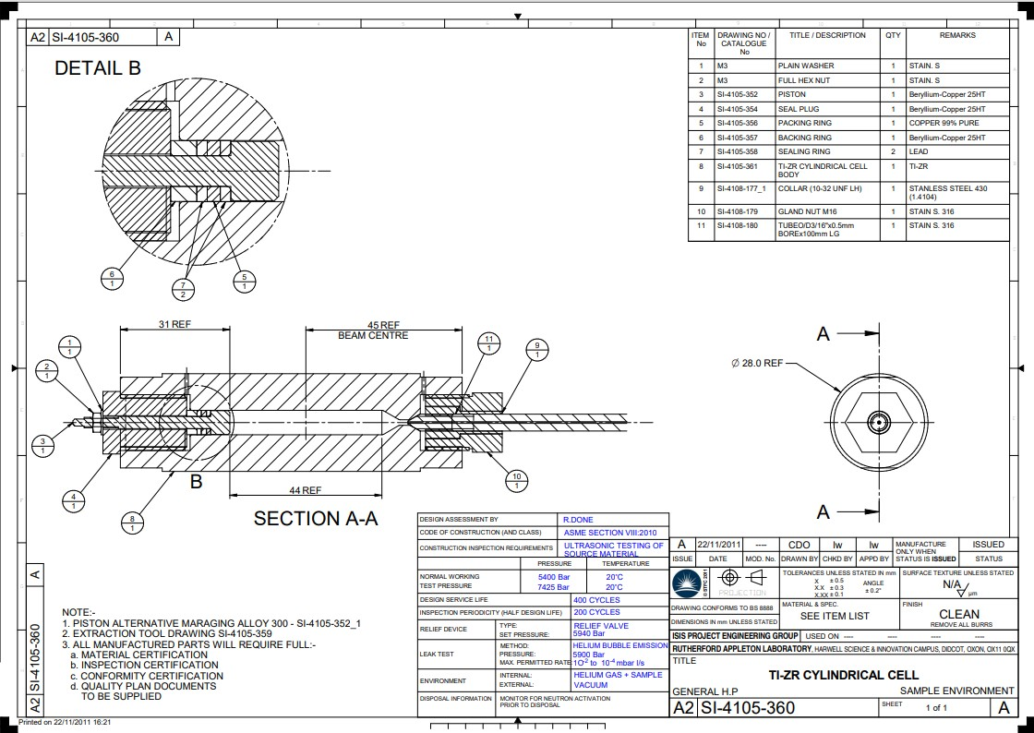
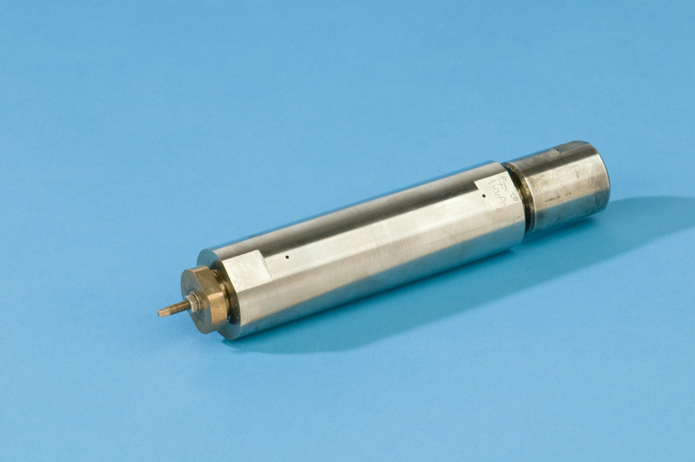
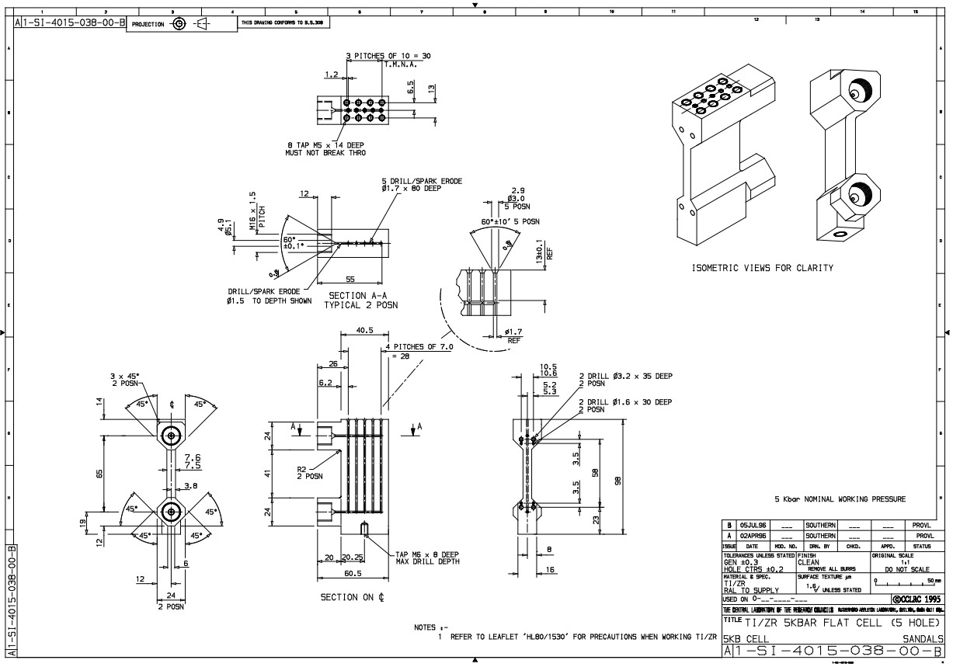
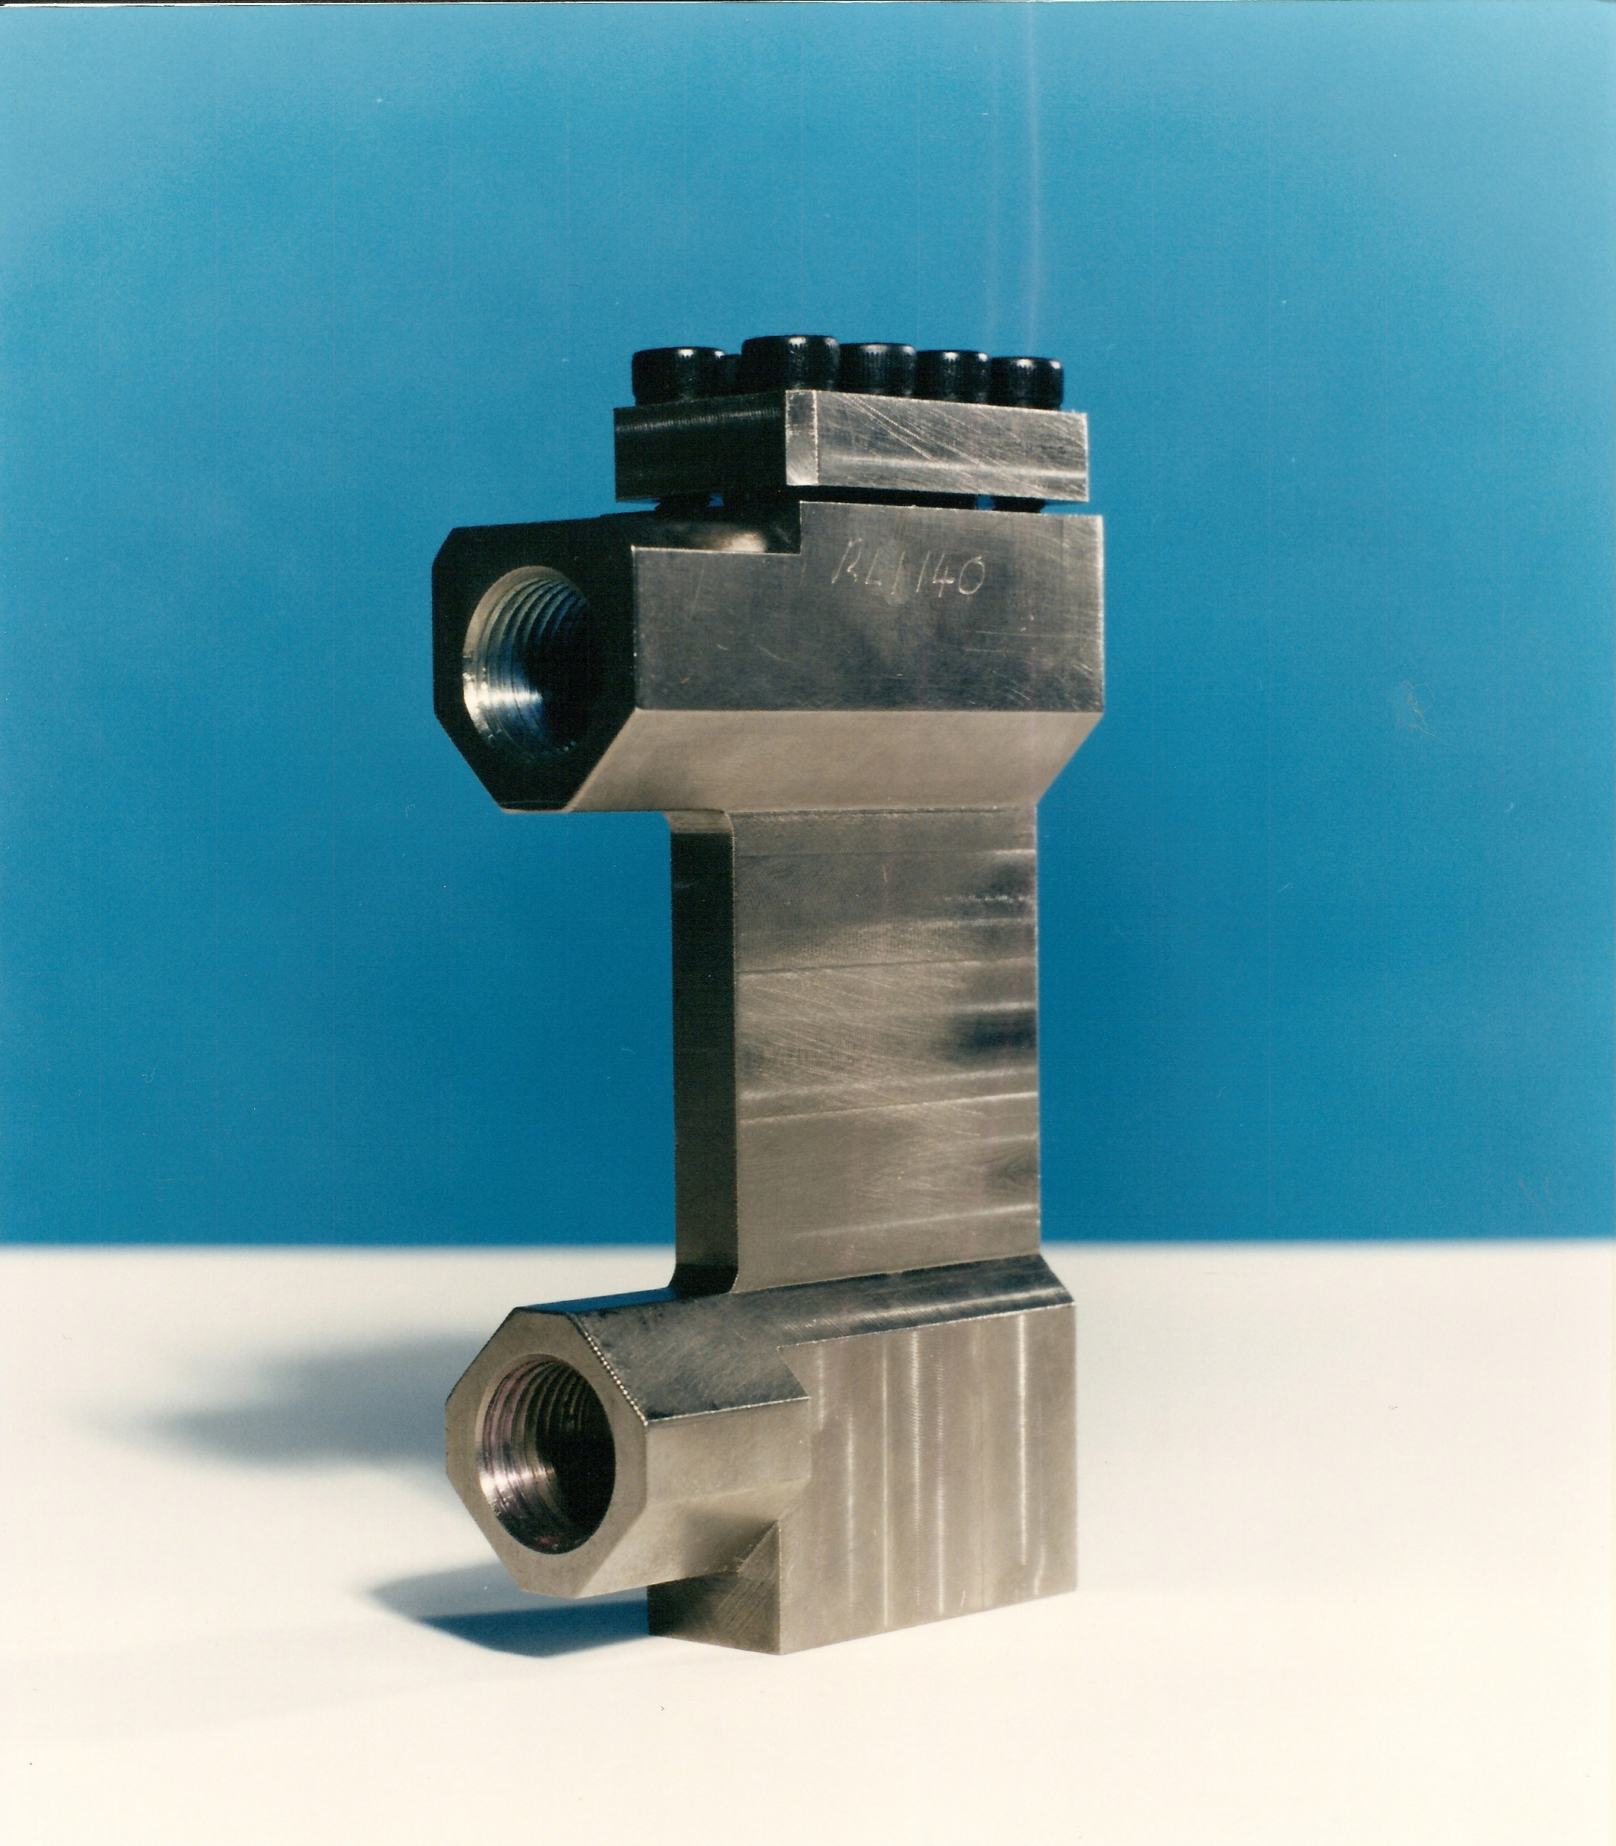
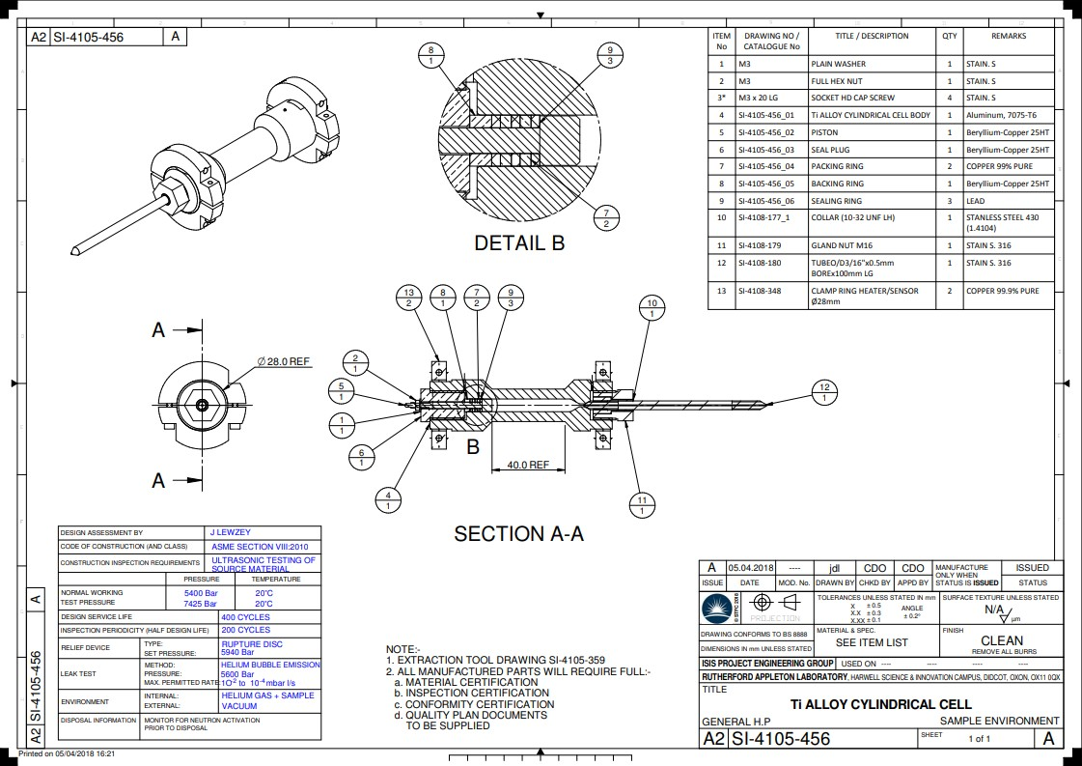
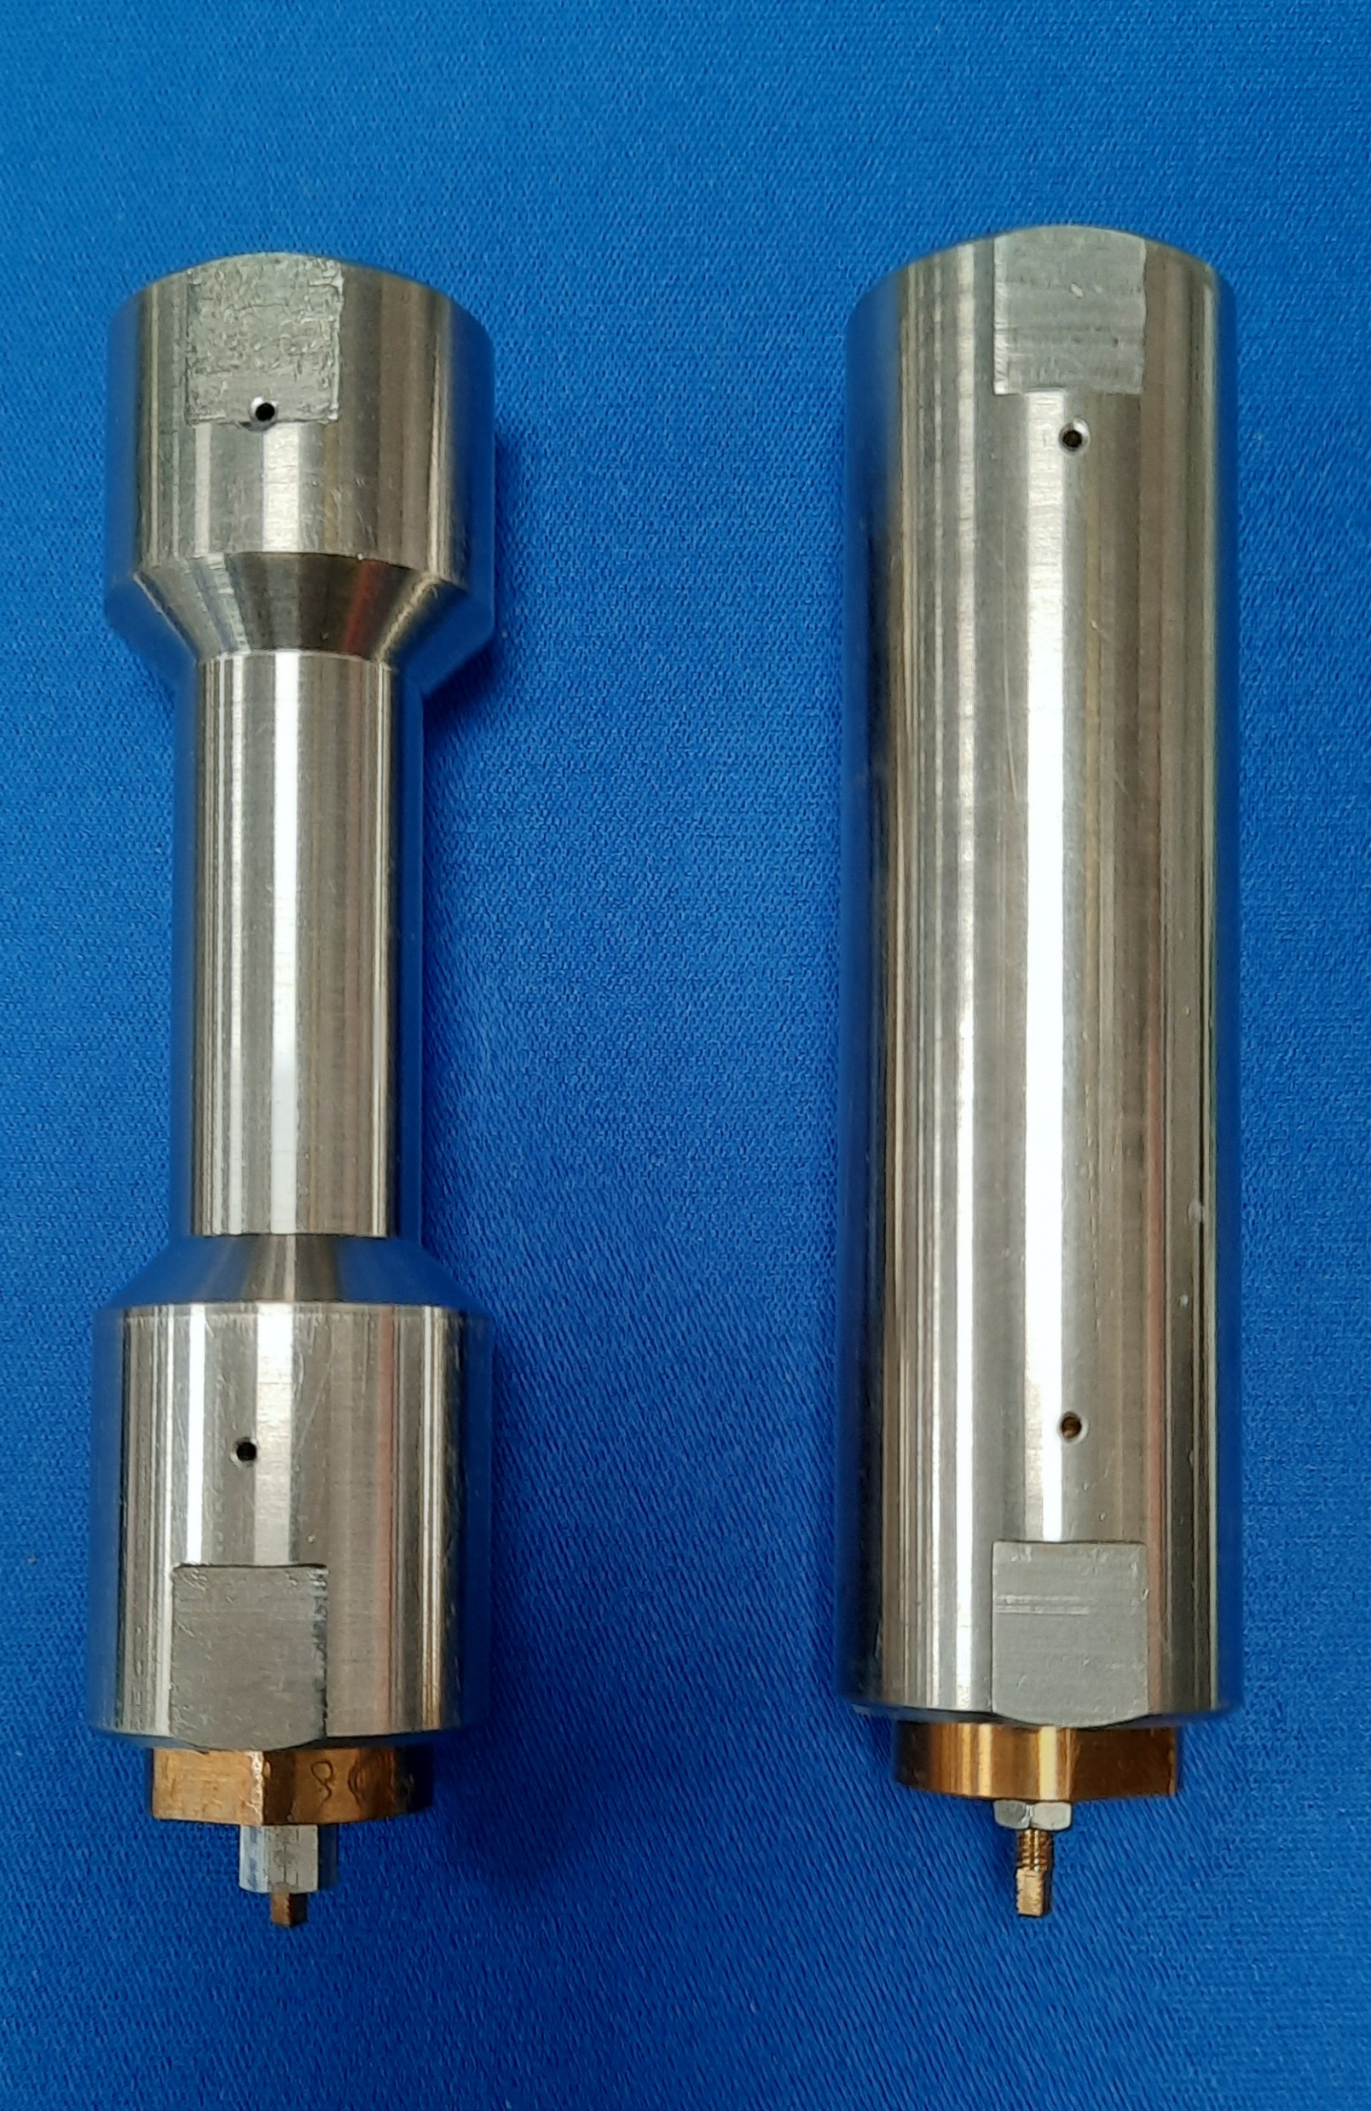
Gas Handling and High-Pressure Sample Environment.
200bar to 10Kbar.
Single crystal high pressure.
Powdered samples.
Liquid samples.
Diffraction.
Spectroscopy.
Sensors
Rhodium/Iron
Platinum
Type K.
Heaters and sensors top and
bottom to prevent gradients.
Collimation.
M16 high pressure 60˚cone
connection.
Bridgman seal at bottom
of cell.
Aluminium 7075 T6
Ti/Zr HP cell
Ti/Zr Flat Plate Cell
Beryllium/Copper Cells
TAV6 Aluminium Cell

Slide 13
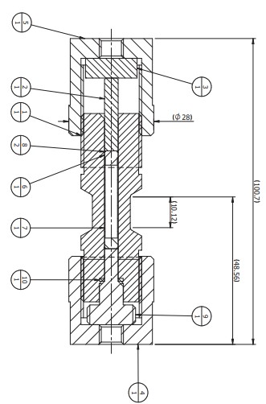
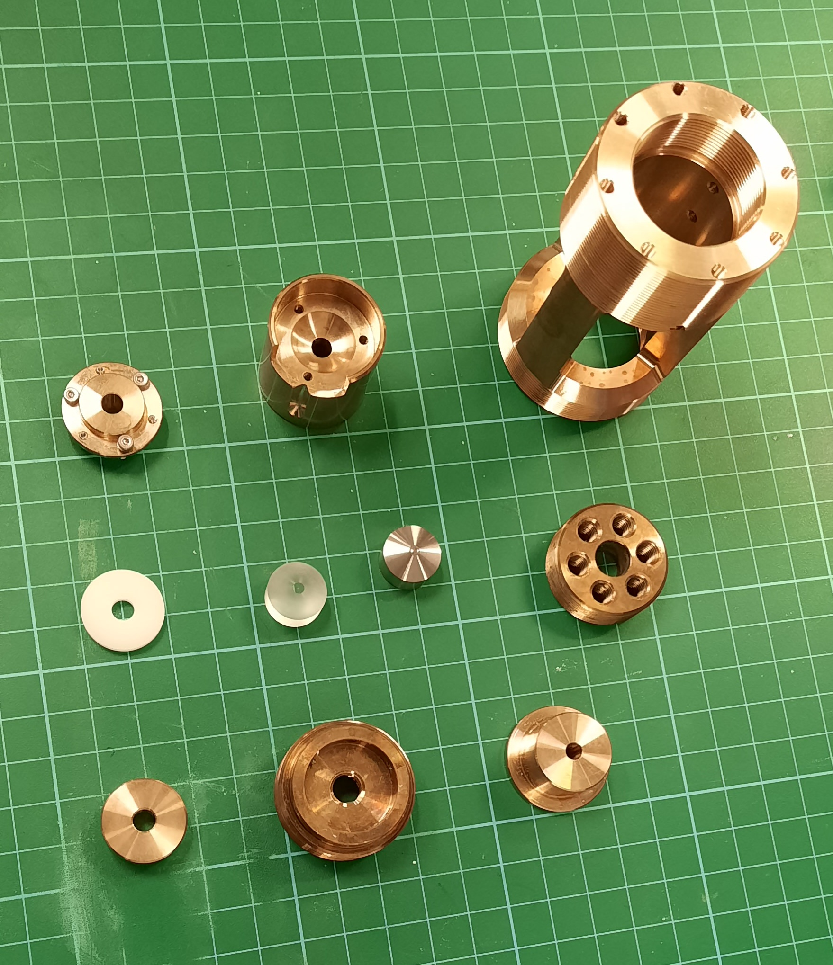
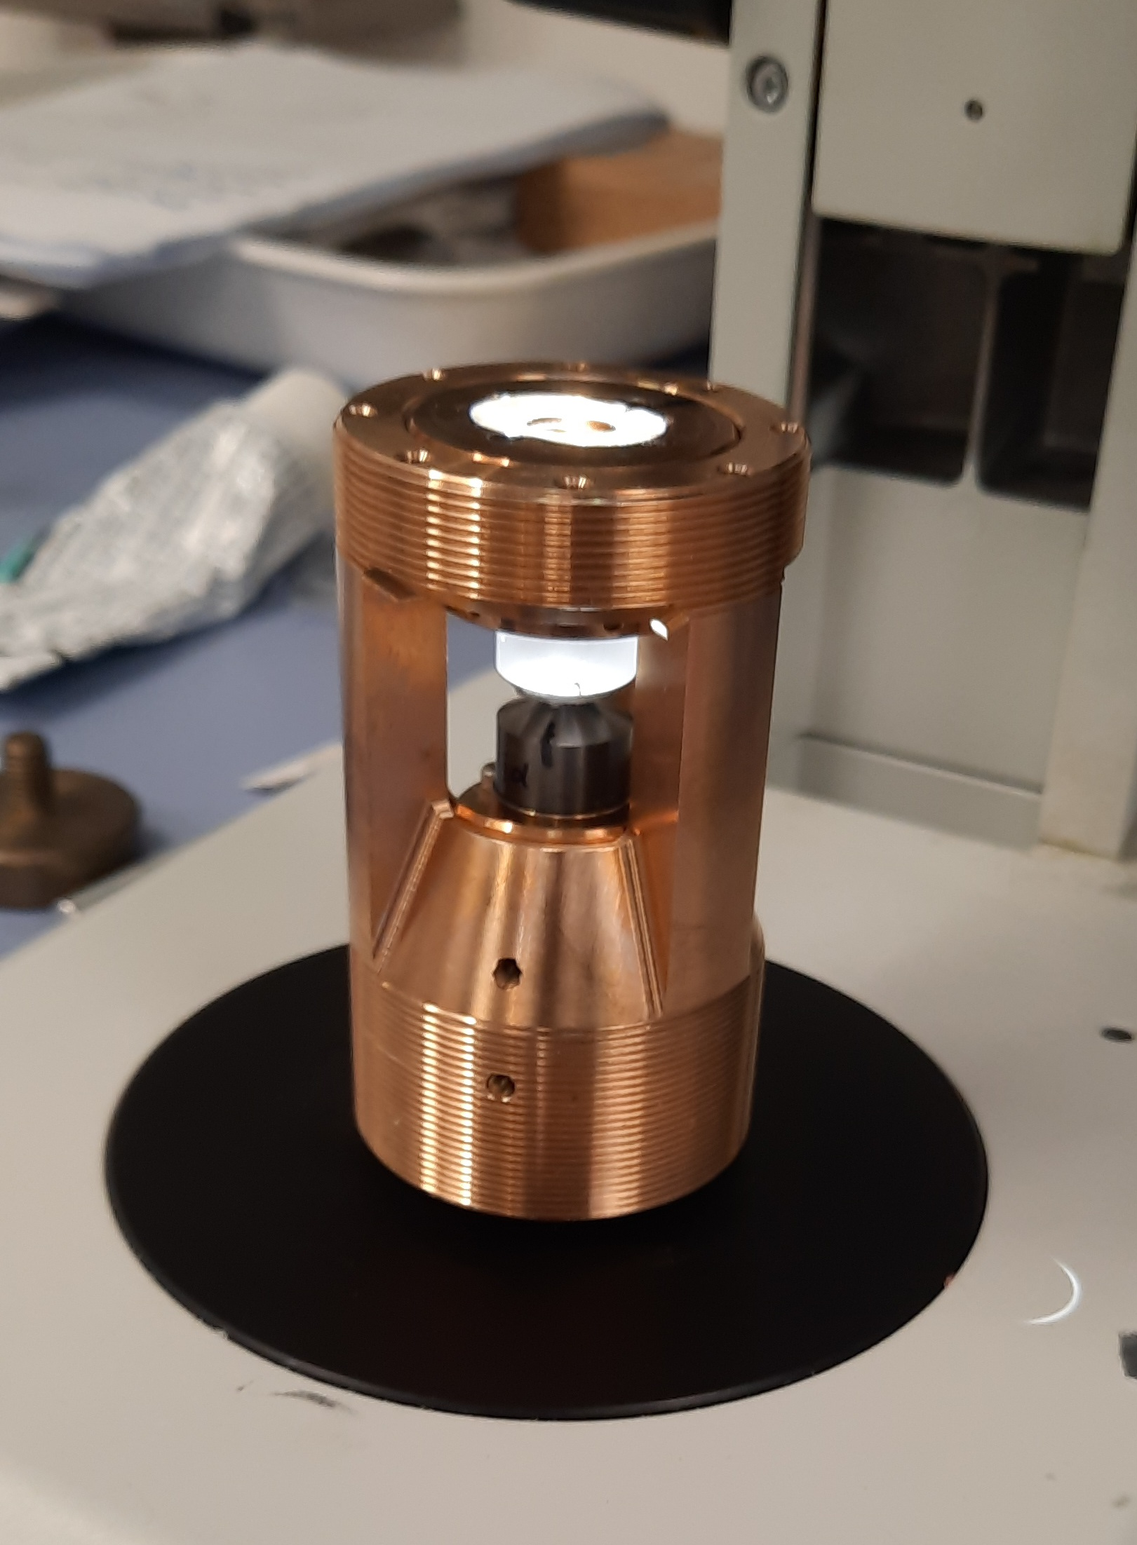
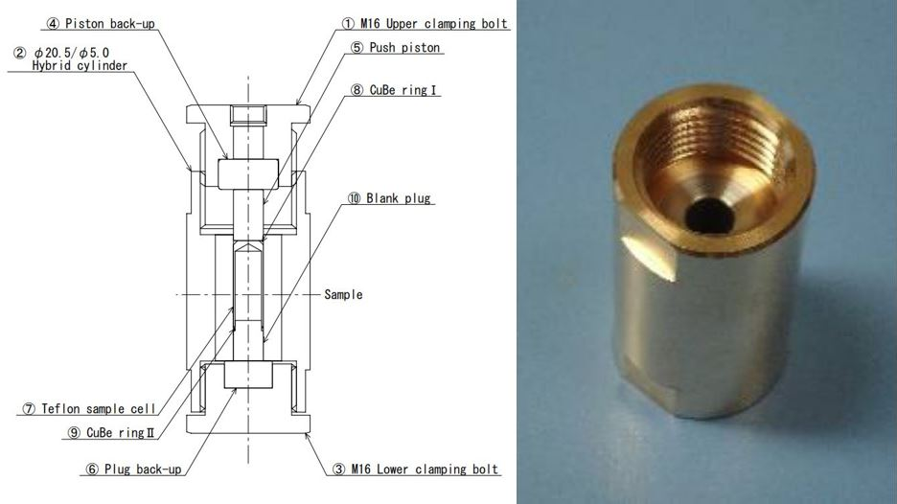
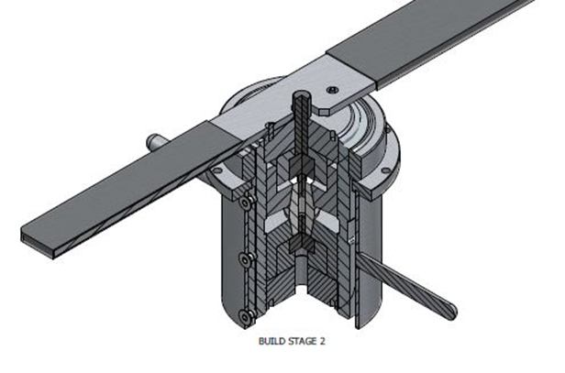
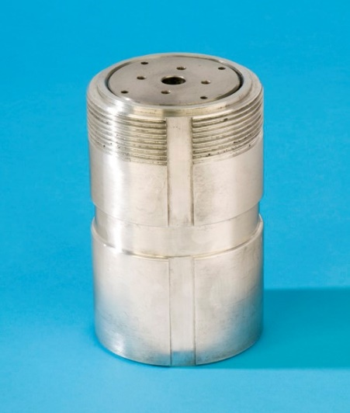
Gas Handling and High-Pressure Sample Environment.
10Kbar to 30Kbar (Clamp cells)
Clamp cells for single crystals.
Clamp cells for powdered samples
Sample size Ø4mm x 12mm to 16mm.
Up to 60Kbar
Sapphire Anvil cell.
Time consuming loading and pressurising
of the sample
Small Sample size 0.5 x 0.5 x 0.5mm.
19Kbar Ni/Cr Cell
60Kbar Saphire Anvil Cell
30Kbar BeCu/NiCr Cell
25Kbar McWhan Cell

Slide 14
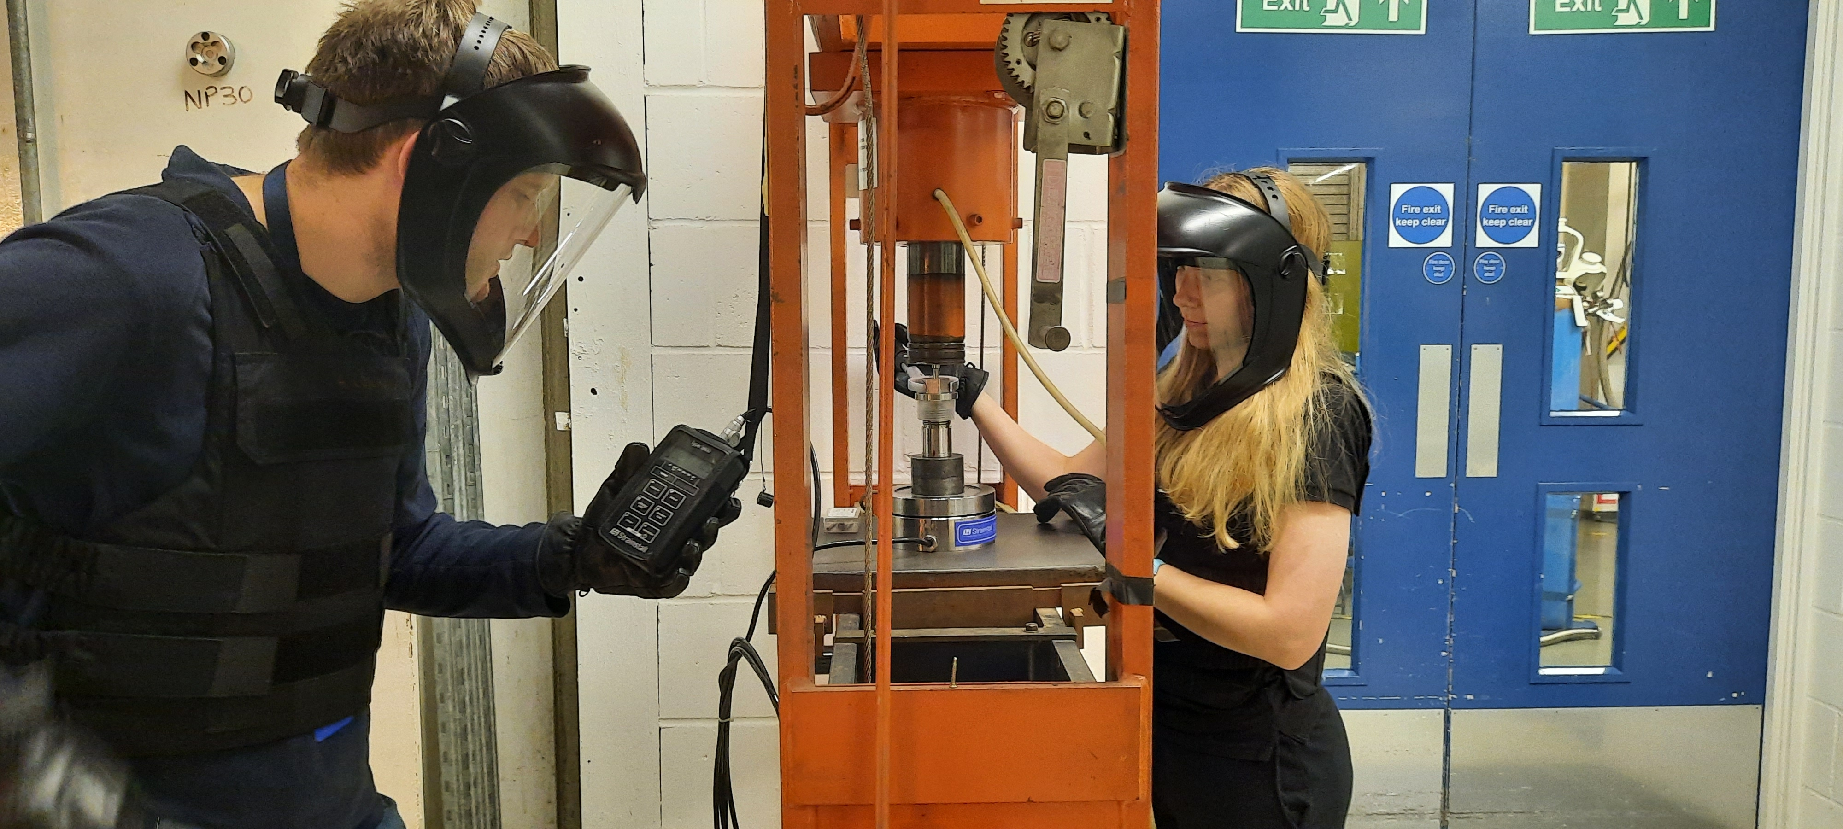
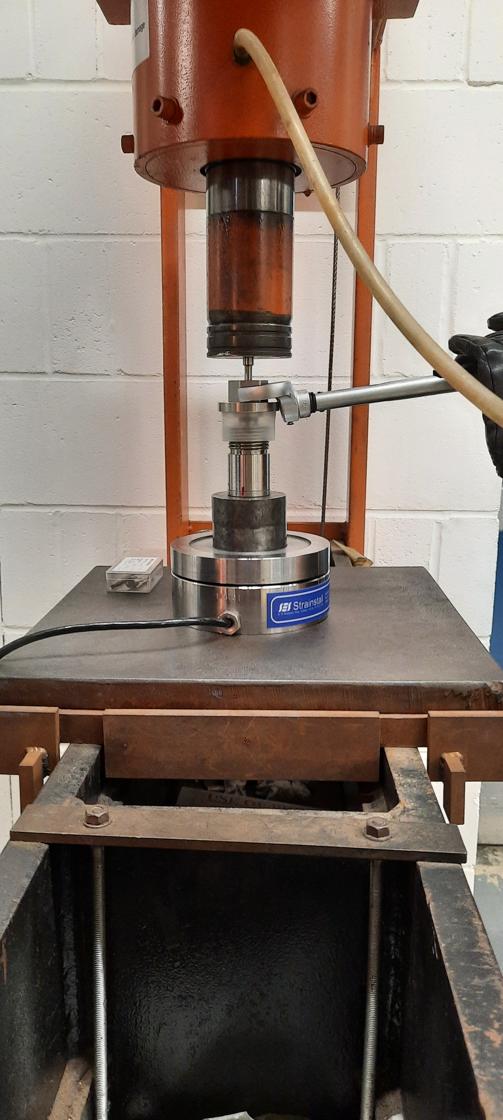
Gas Handling and High-Pressure Sample Environment.
10Kbar to 30Kbar (Clamp cells)
Loaded in hydraulic press.
Load cell for clamping force measurement (allow for friction in threads etc).
Torch wrench to produce consistent tightening of the cell under load.
Safety equipment, face mask, Kevlar jacket and gloves.

Slide 15
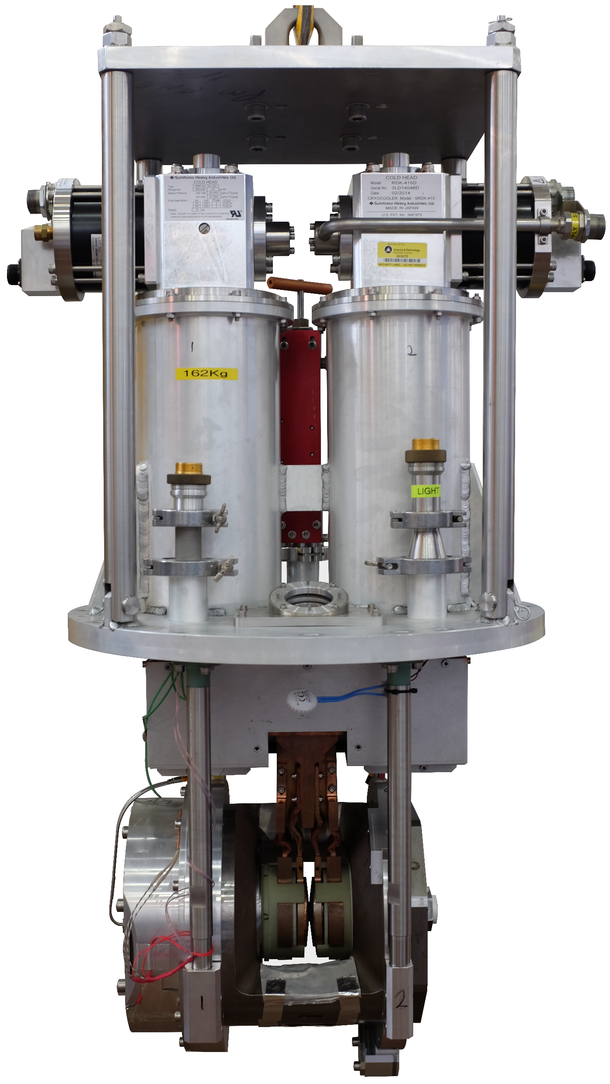
Gas Handling and High-Pressure Sample Environment.
10Kbar to 300Kbar (Paris/Edinburgh press)
Diffraction measurements.
Small sample size (66mm³).
Mainly used on Pearl instrument (dedicated instrument for PE press).
Various set ups.
Room temperature
Variable temperature set up 120 to 500K
Internal graphite heaters 300 to 1700K
Liquid Nitrogen tanks 80 to 400K
Dual-CCR system 30 to 300K
Various core types zirconia-toughened alumina (ZTA), sintered diamond (SD), tungsten carbide (WC) and cubic boron nitride (BN).
At ISIS we press in our own cores.
Various Types of PE Press
PE Press Anvil
Rotating PE Press
CCR mounted PE Press

Slide 16




Publication: Low-background materials for high pressure cells used in
inelastic neutron scattering experiments: Journal of Neutron Research
21 (2019) 105–116 DOI10.3233/JNR-190115.
Gas Handling and High-Pressure Sample Environment.
Cell Material Requirements:-
Neutron transparency/low background
Material strength
Material compatibility with sample, gas etc.
Hydrogen embrittlement.
Corrosion.
Temperature effect on material strength.
Type of instrument.
Diffraction.
Spectroscopy.
Cell Materials:-
Vanadium
Niobium
Titanium/Zirconium
Aluminium grades, 7075 T6, 6082, 5083 etc.
Titanium, aluminium, vanadium alloy (TAV6)
Inconel.
Beryllium/Copper.
Ni/Cr
Stainless steel (mainly use 316L).
Quartz.
Suprisil Quartz (low boron content).
Transmission Measurements
PE Press core materials:-
zirconia-toughened alumina (ZTA).
Sintered diamond (SD).
Tungsten carbide (WC).
Cubic boron nitride (BN).
Background Measurements
Wasp Alloy Screws, max
working temperature 870°C
Aluminium grades, 7075 T6

Slide 17









Gas Handling and High-Pressure Sample Environment.
Sealing systems.
Low pressure (up to 200 bar).
O’rings, polymers, gold, platinum,
PTFE etc.
Indium seals.
Lead seals.
Conflat.
Swagelok twin ferrule
High Pressure (up to 10Kbar).
High pressure cone seal.
Bridgman seals.
Indium Wire
Gold, Platinum &
PTFE O Rings
Lead Wire
Swagelok Twin Ferrule
High Pressure Cone Seal
PTFE & Copper
Bridgman Seal
Conflat Copper Seals
Lead & Copper
Bridgman Seal

Slide 18





Gas Handling and High-Pressure Sample Environment.
Sealing systems.
Low pressure (up to 200 bar).
O’rings, polymers, gold, platinum,
Polymers.
Clean surface is essential.
No vacuum grease (oxygen).
Flange faces parallel.
Surface blemishes (faces and seals).
Chemical compatibility.
Indium seals.
Clean surface is essential.
Good tapered overlap joint.
Flange faces parallel.
Surface blemishes (faces and seals).
Chemical compatibility.
Lead seals.
Clean surface is essential.
Good tapered overlap joint.
Flange faces parallel.
Surface blemishes (faces and seals).
Chemical compatibility.
Gold, Platinum & PTFE O Rings
Lead Wire
Indium Wire Seal
Indium Wire

Slide 19
Gas Handling and High-Pressure Sample Environment.
Sealing systems.
Low pressure (up to 200 bar).
Conflat.
Clean surface is essential.
Flange faces parallel.
Surface blemishes/damage (knife edges and seals).
Chemical compatibility.
Swagelok twin ferrule, (can go higher than 200bar).
Assembled correctly to manufacturers instructions.
Check ferrules are correct orientation.
Tightened to the correct number of turns.
Inspect when reusing fittings for wear a tare.
Chemical compatibility.
Conflat Copper Seals
Cylindrical Cells
Swagelok Twin Ferrule

Slide 20


Gas Handling and High-Pressure Sample Environment.
High Pressure (up to 10Kbar).
High pressure cone seal.
Female cone 60˚ and male cone 58˚
Retaining collar with left hand thread
Threading and coning the pipe to manufacturers
instructions.
Make sure collar is positioned correctly.
When re-using check for damage and distortion
and make sure bore of tube has not closed up.
Bridgman seals.
Piston and ring seals.
Ring seals can be lead, indium, copper,
Polymers etc.
Initial seal produced by tightening piston creating
softer seals to flow.
As pressure is applied to cell the piston is pushed
down causing the seals to flow more and creating a
better seal.
High Pressure Cone Seal
Cone Seal details.
Lead & Copper
Bridgman Seal
PTFE & Copper
Bridgman Seal
Bridgman Seal Drawing

Slide 21



Gas Handling and High-Pressure Sample Environment.
Gas handling systems:-
0 to 200 bar inert gas panels.
0 to 200 bar toxic gas panels.
Mass flow control panels (38Bar max working pressure)
Catalysis panels (ex-situ).
Panels with heated lines.
Panels with various seal materials.
High pressure inert gas systems (10Kbar)
High pressure hydrogen system (3Kbar)
High pressure water systems (7Kbar)
Gas Handling Systems additions.
Residual Gas Analysers. (Hiden)
Humidity Gas Flow System.
Separators.
O to 200bar Gas Systems.
10Kbar Automated Inert System
Humidity Gas Flow System
Hiden Residual
Gas Analyser
ATEX rated Intensifier System

Slide 22




Gas Handling and High-Pressure Sample Environment.
0 to 200bar panels.
Manual systems.
Multiple gases can be attached (up to six on some panels).
Two centre sticks can be attached at the same time to a panel.
Panels have Baratron (accurate measurement up to 1000mBar)
Panels have 200bar transducer.
Panel has pressure relief valves.
Panel has calibrated volume, some have multiple.
Panel has port to vacuum pump and ports to two centre sticks.
Some panels have a cold trap to purify gases.
Some have heated lines.
Mass flow panels have four controllers which can be set to flow for different gases (calibrated to Nitrogen).
Various seal materials.
Viton.
Buna.
EPDM.
Kalrez.
0 to 200bar Gas Panel.
0 to 100bar Gas Panel.
Mass Flow Control Gas Panel
Catalysis Gas Panel

Slide 23





Gas Handling and High-Pressure Sample Environment.
High Pressure Systems.
15Kbar Oil system for proof testing
(currently under repair).
10Kbar Inert gas automated systems.
7Kbar Water manual systems
3Kbar Hydrogen system.
2Kbar Automated Syringe Pumps.
2Kbar Automated systems for P/E
Presses
15Kbar Manual
Oil System
10Kbar Automated
Inert System
New 10Kbar Automated
Inert System.
7Kbar Water Manual
System
3Kbar ATEX rated
Intensifier System
Automated Syringe
Pumps
2Kbar Automated Oil Systems for
P/E Presses

Slide 24


Gas Handling and High-Pressure Sample Environment.
Gas Handling Systems additions.
Residual Gas Analysers. (Hiden)
Used for monitoring exhausted gas
after it has passed through sample.
Analysers measures the mass of the
gasses passing through the system.
Humidity Gas Flow System.
Consists of moisture generator,
mass flow controllers, humidity sensors.
flows a combination of dry and moist
gases to give desired humidity.
Separators.
7Kbar separator enables the pressurisation
of liquid samples where you have small quantities
such as deuterated samples.
Humidity Gas Flow System
Hiden Residual
Gas Analyser
7000bar Separator
Publication: High-pressure neutron diffraction apparatus for investigating the structure of liquids under hydrothermal conditions. High Pressure Research DOI:10.1080/08957959.2017.1391953
B.Annighöfer Et al.

Slide 25






Gas Handling and High-Pressure Sample Environment.
Gas Handling and High-Pressure Experiments.
Gas Dosing Experiments (various pressure ranges).
Multiple gases, up to six different flammable gases which can include deuterated gases.
Check suitability of materials in system, seals, cell materials etc.
Air sensitive samples.
Dosing using calibrated volumes.
Safety measures, pressure relief valves, documentation and hazard signs.
Safety training for users and instruments scientists.
Sample conditioning prior to experiment.
Sample change every day sometimes two samples.
Multiple centre sticks set up on gas panel.
Sample Changes supported by technical staff.
Hydrogen Gas Panel Used for Volumetric Measurements
Gas Handling Centre stick
Hydrogen Gas Cylinder
Vacuum Pump
Beam line Specific
Pressure cell
Or
Helium Leak Detector
Gas Cylinders
Gas panel with Multiple gas cylinders
Cryostat

Slide 26

Gas Handling and High-Pressure Sample Environment.
Gas Handling and High-Pressure Experiments.
High Pressure Experiments.
Inert gas high pressure experiments.
Up to 10Kbar.
Need to check helium solidification point.
Cryostat, CCR’s
Room temp and up to 400˚C liquid experiments.
Safety measures, rupture discs, documentation and hazard signs.
Safety training for users and instruments scientists.
Sample change every couple of days.
Sample changes support by technical staff.

Slide 27





Gas Handling and High-Pressure Sample Environment.
Gas Handling and High-Pressure Experiments.
High temperature gas handling
Covered in high temperature talk on Wednesday.
Combination of
up to 4 different
gases.
In-Situ Reaction
Centre Stick
Vacuum Pump
Mass Flow Control Panel
Moisture Generator
Residual Gas Analyser
Helium Leak Detector
Furnace

Slide 28

Gas Handling and High-Pressure Sample Environment.
Pressure cell approval.
Design and test parameters.
Process for Internal pressure cells.
Process for External pressure cells.
Record keeping
Identifying cells
Test Bunker

Slide 29
Gas Handling and High-Pressure Sample Environment.
Design and test parameters.
Equipment should be designed to a design code.
Engineering drawings.
Stress report.
Material certificates.
Working pressure.
Design pressure (safety device set at this pressure).
1.1 x working pressure.
Proof test pressure.
1.25 x design pressure.
Tested in bunker using helium, held at pressure for 30minutes.
Test conducted by technician and witnessed by designated pressure engineer or his deputy.
Tested pressure equipment given unique identifier which is etched on item and added to pressure register.
Test Bunker

Slide 30

Gas Handling and High-Pressure Sample Environment.
Process for Internal Pressure Cells.
Set up as a design project via small opportunities project.
Project run by Design group.
Design meetings
Project proposer.
Pressure Section leader.
Technicians from pressure section.
Instrument scientist.
Look experimental conditions and requirements.
Chemistry to be investigated using the cell, environment
(Time, Temperature and Pressure)
Design specification clarified.
Design review prior to manufacture.
Manufacture of cell.
Cell assembled and tested by pressure section.
Cell registration.
Design close out.
Test Bunker
Catalysis Cells

Slide 31
Gas Handling and High-Pressure Sample Environment.
Process for External Pressure Cells.
External cells designed and manufactured by user or external company.
We don’t know its history.
Letter sent to user asking for:-
The unique identification mark of the cell. i.e. its serial number.
A full description of the proposed experiment that the cell will be used on. At a minimum we need to see, Chemistry to be investigated using the cell, environment (Time, Temperature and Pressure)
A set of full engineering drawings giving key dimensions and materials used in its construction.
Test certificates for the materials used in construction. Including any fasteners.
Manufacturing QA documents.

Slide 32
Gas Handling and High-Pressure Sample Environment.
External pressure cells Cont’d.
Any calculations done to prove the cell’s robustness. FEA plots will not be enough
Any evidence of Pressure Tests done on the cell.
The Design Pressure, Working Pressure and Test Pressure.
The Design Code the cell has been made to. If this is not the case the justification for the deviation.
Once the cell is on site we will
Visual inspection of all parts
Check of serial numbers and cell identification ensuring a one-to-one match with the documents already supplied.
Witnessed Bunker Pressure Test to 1.25 x design pressure. This factor may not be achievable for some high-pressure cells, and or cells designed to other codes. Each will be treated on a case-by-case basis. This should be agreed prior to the cell arriving at ISIS.

Slide 33

Gas Handling and High-Pressure Sample Environment.
External pressure cells Cont’d.
Why do we need to approve external equipment?
This was a Microwave oven cut in half
found in one of our preparation labs which a
user had brought in to use for an experiment
They had been using it at their university
and couldn’t understand why they were not
allowed to use it at ISIS.

Slide 34

Gas Handling and High-Pressure Sample Environment.
Record keeping
All tested cells are given a unique identifier (RLI number)
RLI stands for Rutherford Laboratory ISIS.
Because ISIS require the approval of a lot of pressure cells
safety group gave ISIS the responsibility of recording and
logging their own cells.
This is one reason why ISIS has dedicated pressure engineers.
RLI register holds lots of information
Unique identifier (RLI Number)
Cell description.
Pressure and temperature parameters.
Proof test pressure.
Drawing number of general Assembly (with pressure table).
Date tested.
Expiry date / review date.
Life cycles.
Stress report number.

Slide 35



Gas Handling and High-Pressure Sample Environment.
Identifying cells
RLI number etched or engraved on to cell.
This provides quick information about the cell
via the RLI register.
Also ties all parts of the cell together.
RLI Number Etched on Cell
Pressure rated Vanadium Cell

Slide 36





Gas Handling and High-Pressure Sample Environment.
Safety Systems and Procedures.
All pressure cells and systems are set up to comply with the Pressure Systems Safety Regulations (PSSR).
Proof tested registered cells and systems.
Pressure safety devices such as pressure relief valves and rupture discs (Inspection every two years).
Calibrated transducers (every two years).
Panels serviced every two years.
Systems vacuum leak tested prior to the experiment, with additional working pressure test for flammable,
toxic, harmful gases etc.
Operating procedures, safety signs, risk assessments, sample safety sheets and training.
Transducer and Readout
PRV Setting Panel
Dead Weight Tester
Pressure Relief Valves (PRV)
Hazard Warning
Sign

Slide 37

Gas Handling and High-Pressure Sample Environment.
Pressure safety devices such as pressure relief valves (PRV) and rupture discs (Inspection every two years).
Tested and witnessed by technicians in pressure section.
Each PRV has a unique identifier.
Settings and witnessed test recorded in diary and on PRV spreadsheet.
Spreadsheet contains - PRV number, pressure set, medium used, seal material, date, who tested and witnessed it and a description of any maintenance done on the PRV.
PRV given label with details.
Pressure Relief Valves (PRV)
PRV Setting Panel
PRV Register

Slide 38

Gas Handling and High-Pressure Sample Environment.
Calibrated transducers (every two years).
Lower pressure transducers (Druck).
CCD100 digital readout.
Higher pressure transducers we use Intersonde HP28.
10-point calibration.
Transducer and readout Paired
Transducer and readout labelled with calibration date.
Calibrations logged in spreadsheet.
Transducer Calibration Register.
Deadweight Tester
Transducer and Readout

Slide 39


Gas Handling and High-Pressure Sample Environment.
Panels serviced every two years.
PRV’s maintained, lifting point re-checked and registered on the system with new label.
Transducer calibrated on deadweight tester, labels changed and spreadsheet updated.
Valves inspected, checked for passing and seals changed if required.
Panel leak tested and working pressure hold test conducted.
Gas panel maintenance register updated with all information.
Where possible in construction of the gas panels we use welded joints. These are welded using an orbital welder. This reduces possible leaks due to less compression joints.
Micro Weld Tee
Orbital Welder

Slide 40
Gas Handling and High-Pressure Sample Environment.
Systems vacuum leak tested prior to the experiment, with additional working pressure test for flammable,
toxic, harmful gases etc.
When setting an experiment up.
Details of experiment gathered.
Correct panel selected.
Pressure rating.
Number of gases required
What gases
Types of seal on panel.
Are heated lines required?
Single or multiple buffers required?
Gas from store.
Correct regulators (depending on gases and bottle connection).
Hydrogen Gas Panel Used for Volumetric Measurements
Gas Handling Centre stick
Hydrogen Gas Cylinder
Vacuum Pump
Beam line Specific
Pressure cell
Or
Helium Leak Detector
Gas Cylinders
Gas panel with Multiple gas cylinders
Cryostat

Slide 41
Gas Handling and High-Pressure Sample Environment.
When setting an experiment up Cont’d.
Cell selection
Instrument.
Detector setup.
Working temperature.
Working pressure.
Seal material.
Gases (hydrogen embrittlement, corrosion)
Connecting air sensitive samples.
Sample loaded into cell with valve in a glove box.
Cell with valve closed attached to centre stick.
Leak test down to top of valve.
Open valve and leak test cell.
All safety signs should be put in place prior to setting up system on beamline.
Connect up system and plumb all vets, relief valves and vacuum pump extract to COSHH extract.
Hydrogen Gas Panel Used for Volumetric Measurements
Gas Handling Centre stick
Hydrogen Gas Cylinder
Vacuum Pump
Beam line Specific
Pressure cell
Or
Helium Leak Detector
Gas Cylinders
Gas panel with Multiple gas cylinders
Cryostat

Slide 42




Gas Handling and High-Pressure Sample Environment.
When setting an experiment up Cont’d.
Once all connected evacuate whole system
including down to the closed gas bottle valve with
the regulators open. (We use non-self-venting regulators).
vacuum leak test (2 x 10⁻⁸ mbarl/s).
Helium working pressure hold test for Flammable, Toxic etc.
When breaking a joint in the system during
an experiment or at the end of the experiment.
Vent system down via vent line with metering
valve in a controlled manner (connected to the
COSHH Extract).
If at end of experiment vent entire system
including through the regulators up to the gas
bottle valve (gas bottle valve is closed).
COSHH Extract Arm
Metering Valve Provides
Controlled Venting.
Vacuum Pump

Slide 43

Gas Handling and High-Pressure Sample Environment.
When setting an experiment up Cont’d.
Once system is down to atmospheric pressure
slowly open the valve to the vacuum pump and
evacuate the system to 1 x 10-5mbar.
If this is done for all gases including inert,
flammable, toxic etc. it will ensure the safe removal
of the regulator from the cylinder as there will be no
risk of exposure to any trapped gas.
COSHH Extract Arm
Metering Valve Provides
Controlled Venting.
Vacuum Pump

Slide 44




Gas Handling and High-Pressure Sample Environment.
Operating procedures, safety signs, risk assessments, sample safety sheets and training.
We have a method statement for preparation and operation of our systems. This covers technicians and users.
Generic pressure systems Risk Assessment.
Experimental Risk Assessment.
Operator approval form with sign off.
Training of users and instrument scientists.
Users and instrument scientist read all documentation.
Training conducted by pressure team technicians.
Users and instrument scientist demonstrate competency.
Document signed off, user is approved for whole cycle. (some established returning users can be longer).
Sample changes and cylinder changes are only conducted by pressure team. Sample changes during working hours.
Each panel can have two centre sticks attached to aid with silent hours sample changes.
Hazard Warning Sign
Risk Assessment
Experimental Risk
Assessment
Gas Panel Procedures
Operator Authorisation

Slide 45





Gas Handling and High-Pressure Sample Environment.
When It Goes Wrong!
5.4Kbar Ti/Zr Cell.
Hi pressure cell failure.
Caused by blocked capillary.
User failed to turn on capillary heater when
Warming up cell, cell heated generating pressure.

Slide 46






Gas Handling and High Pressure Sample Environment.
When It Goes Wrong!
10Kbar Be/Cu Test Cell.
Cell used to test brigman seal at high
temperature.
Cell used for this multiple times.
Last time it was used it held pressure for test,
pressure was released and cell left to cool,
while cooling cell failed falling clean in half.
When It Goes Wrong! (intentionally)
Test conducted in fume hood.
Vanadium can (11mm) in secondary containment.
Vanadium cans exposed to hydrogen
at various temperature 50 to 300°C (50°C
steps).
Cells pressurised at the various temperatures
in steps of 2 bar, holding for 1 minute until they
reached the bursting pressure.
Helium burst - 160 to 174bar.
Hydrogen burst at various temperatures –
110 to 129bar.
Be/Cu Test Cell
Vanadium Cell

Slide 47
Gas Handling and High Pressure Sample Environment.
Thank You
Acknowledgements.
Ian Hickman - STFC ISIS Neutron and Muon Facility.
Kimberley Greenough - STFC ISIS Neutron and Muon Facility.
Paul McIntyre - STFC ISIS Neutron and Muon Facility.
Adam Sears - STFC ISIS Neutron and Muon Facility.
Mark Kibble - STFC ISIS Neutron and Muon Facility.
Christopher Lawson - STFC ISIS Neutron and Muon Facility.

