Slide 1
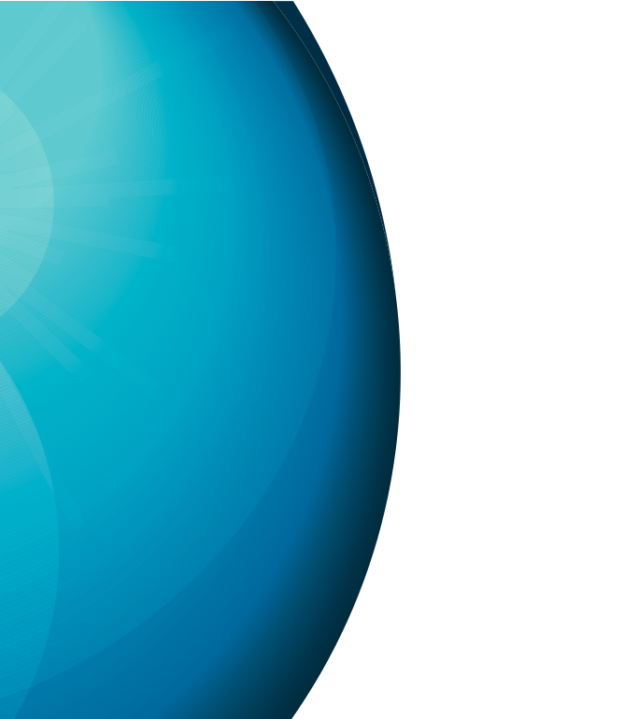
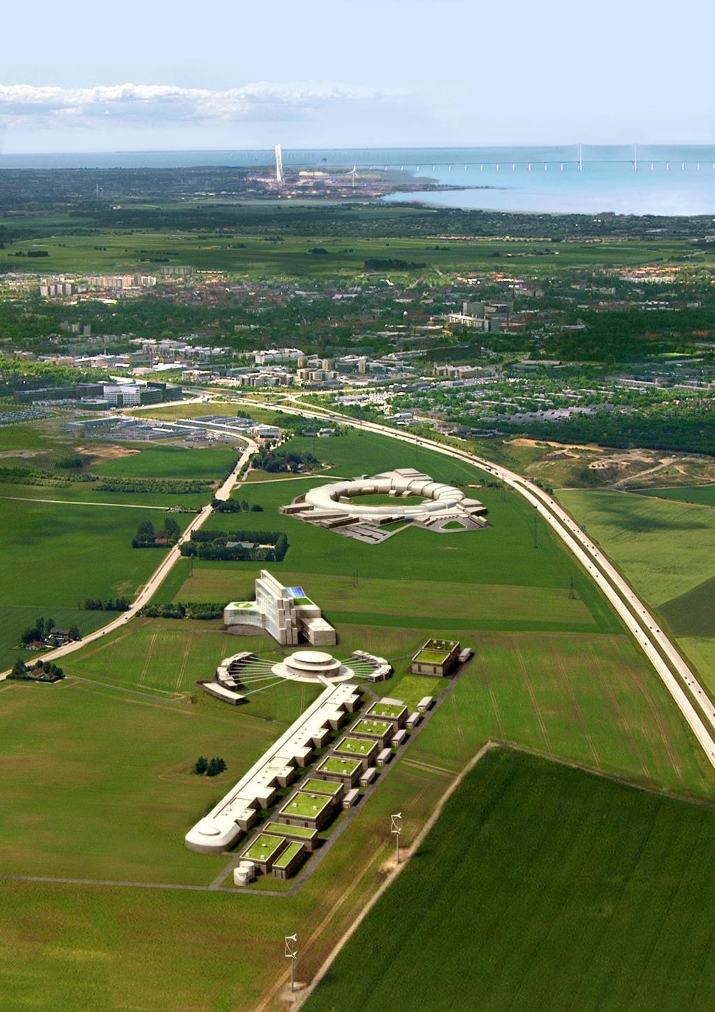



Beam Physics Design of MEBT
Ryoichi Miyamoto (ESS)
November 29th, 2012
ESS AD Retreat
On behalf of ESS AD-BPG
& ESS Bilbao

Slide 2
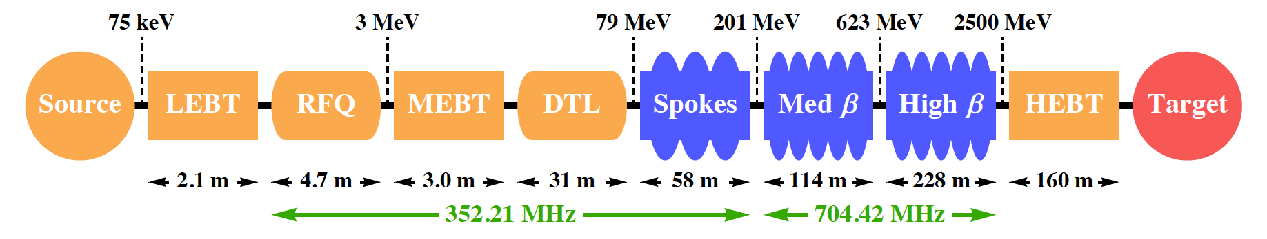
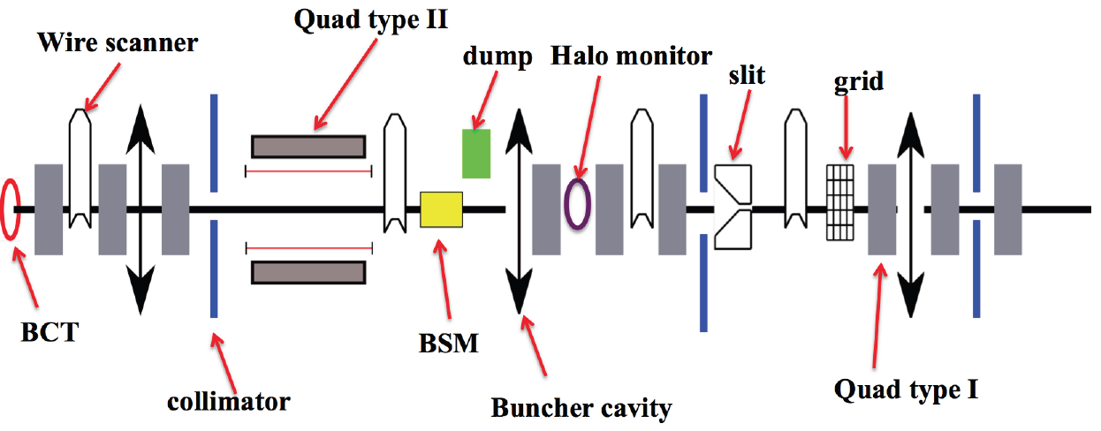
Medium Energy Beam Transport (MEBT)
Steering & Matching (adjust the beam from RFQ to DTL)
Fast chopper (remove the pulse head/tail during the source transient)
Beam instruments (measure orbit, profile, emitt, loss, …)
Collimation (remove transverse halo)
Courtesy of B. Cheymol

Slide 3
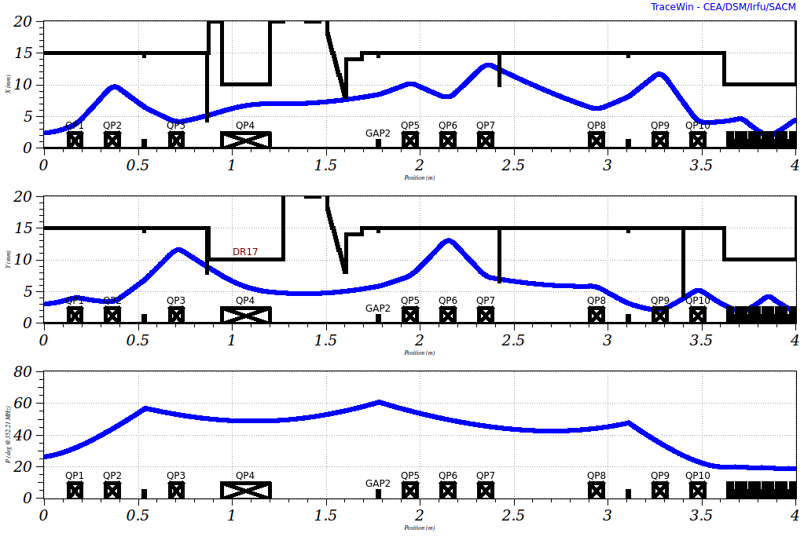
Present MEBT layout & beam envelope
x [mm]
y [mm]
phase [deg]
3 buncher cavities
9+1 quads
2 drifts: chopper & instruments
Created from the Linac4 design but revised a lot

Slide 4
MEBT is only 3-4 m but designing it isn’t so easy…
RFQ & DTL have strong focusing
➔ MEBT (relatively weaker focusing) could spoil the beam quality
➔ Could have large influence on beam quality in downstream sections
Short non-periodic lattice
➔ No “golden rules” for the design
Design is based on several guidelines with compromises.
  Match all 6 Courant-Snyder parameters at the DTL entrance (must!)
  Make the beam flat at the chopper target (chopper efficiency)
  Make the beam round at buncher cavities (avoid emittance exchange)
  Minimize losses
  Minimize emittance and halo growths (where in the linac?)
    Keep the beam as small as possible
    (fight with space-charge)
    Or, keep the beam as large as possible within the aperture
      (make piece with space charge)
  Utilize collimators
  In addition, satisfy engineering constraints

Slide 5
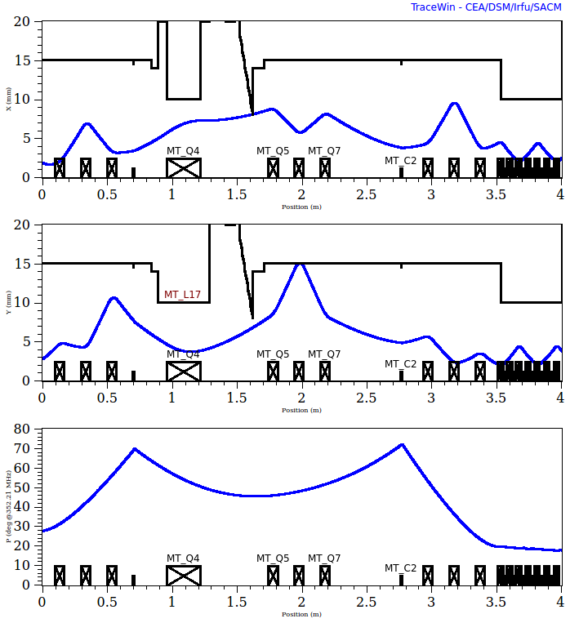
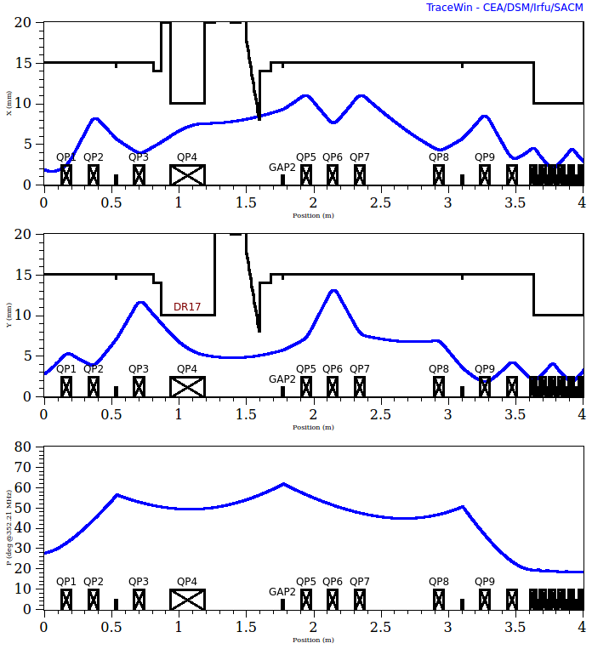
An example: modification of the May design
Old
New
x [mm]
y [mm]
phase [deg]
3σ (~full) envelopes in 3 planes

Slide 6
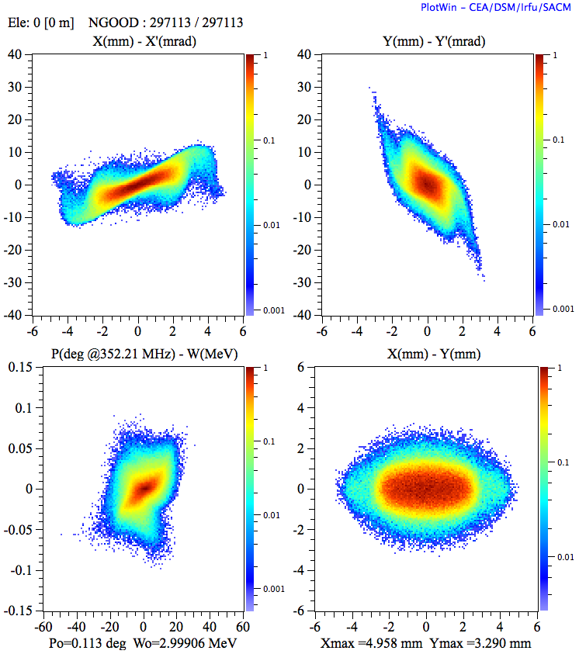
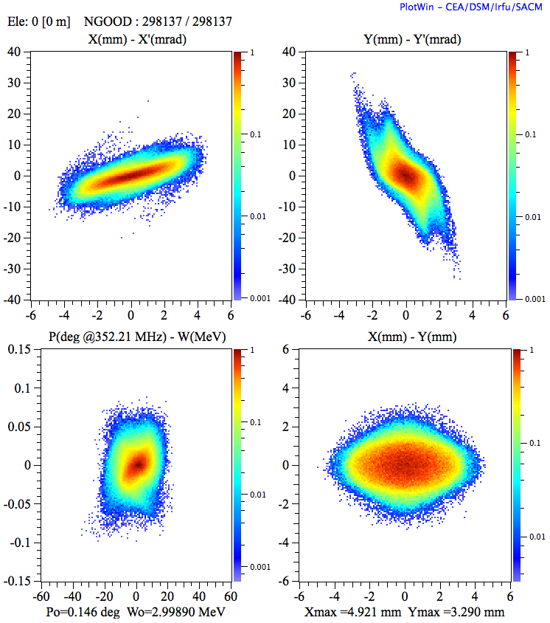
Is the beam quality really improved?
Old
New
Distributions in 3 planes at the end of the MEBT

Slide 7
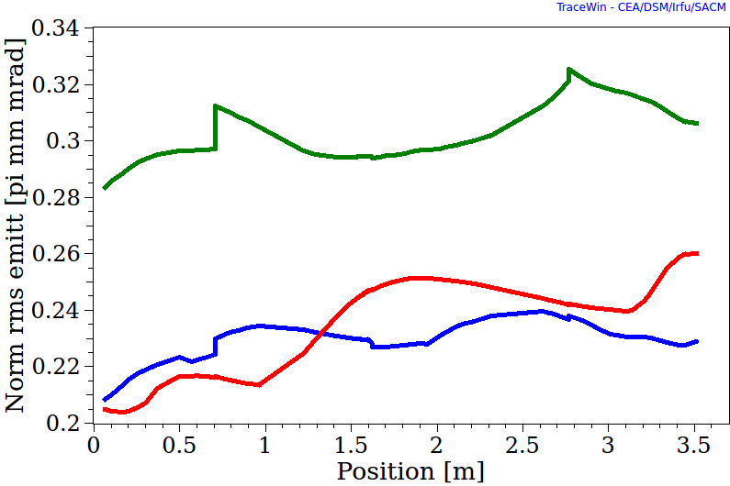
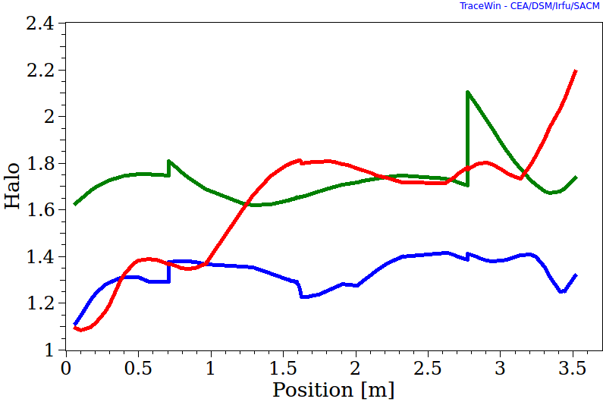
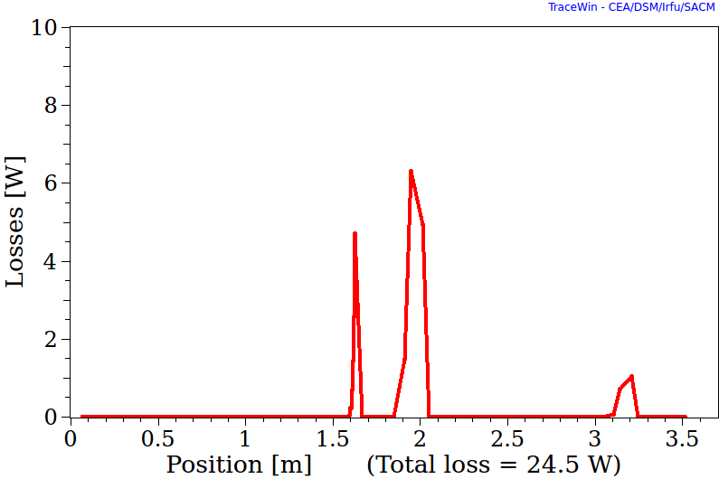
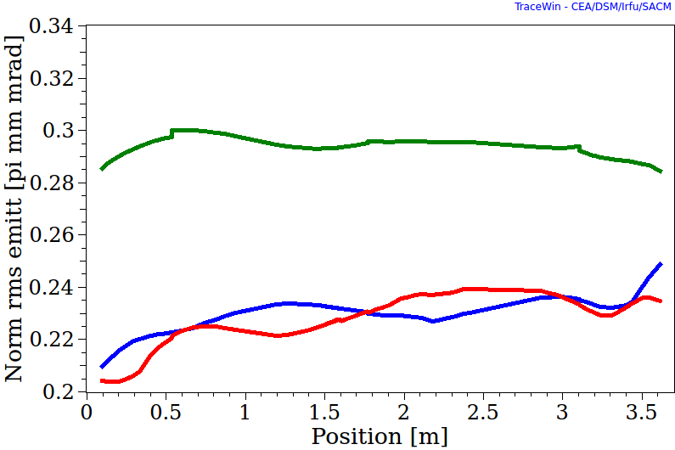
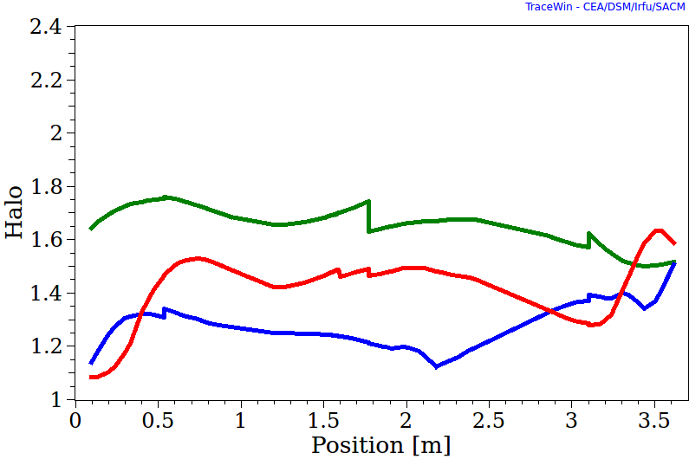
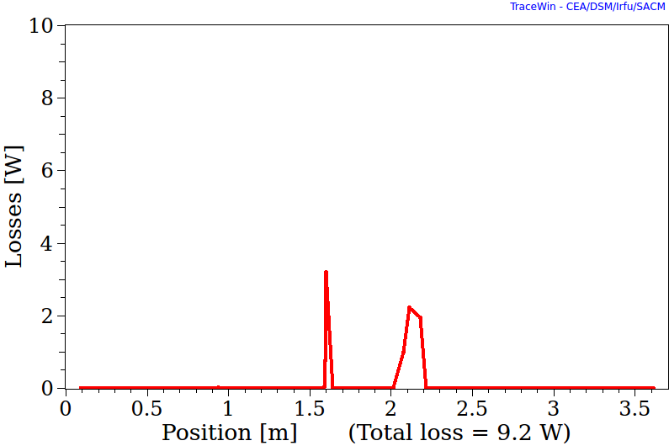
Improvement in beam parameters
Emitt
Halo
Loss
X
Y
Z
Old
New
Emittance and halo growths occur at the initial and final parts
➔ Investigating reducing quad strengths in the initial part of the DTL

Slide 8
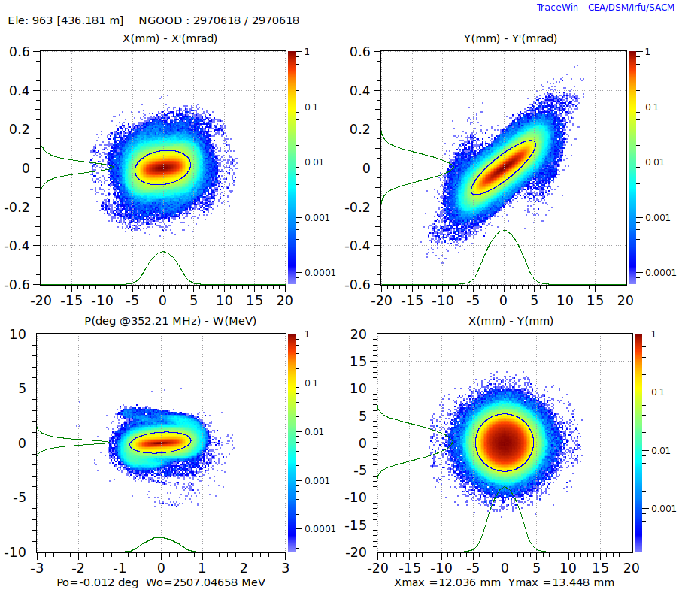
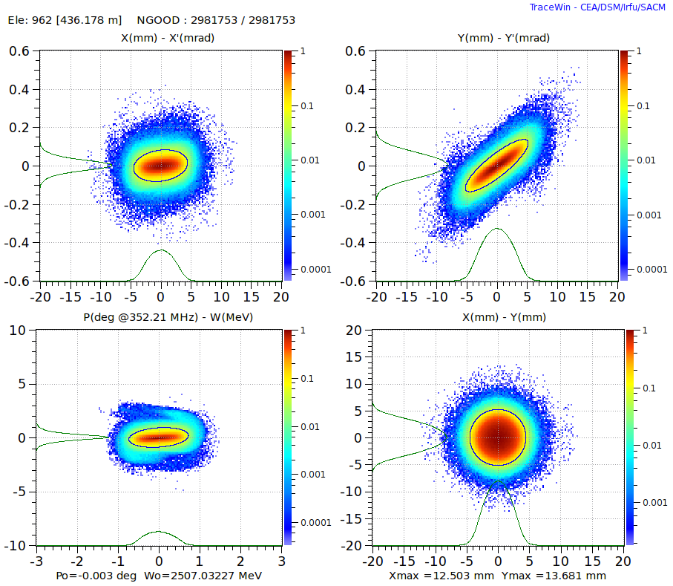
MEBT affects the beam quality in downstream sections
Old
New
Distributions in 3 planes at the end of the High-beta section
Both halo and emittance are improved. (Especially in the z plane.)
Loss in the DTL is reduced but no loss in SC sec in both cases
➔ Error study needed
3M particles tracked.

Slide 9
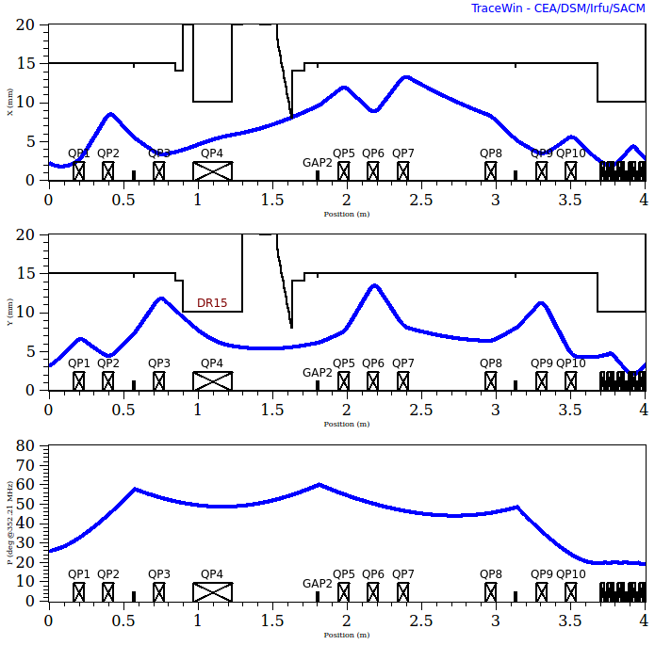
Procedure to adjust the lattice
Matching: (Q7), Q8-10, B2-3
Knobs: Q1-3, Q5-7, (Q4), B1
B1 to set the bunch lengths throughout the MEBT, B2 and B3 to match.
Q1-2 to set peaks (not too small/large).
Q2-4 to set bunch sizes inside the chopper (flat at the target for chopper efficiency, not too small, avoid loss).
Q5-7 to set peaks and sizes inside the 2nd drift (loss, emittance, halo).
Transverse match and check the result.
In reality, 1 and 5 in-betweens.
x [mm]
y [mm]
phase [deg]
JPARC adjusts only bunchers and quads are set to the design values
➔ Can we establish a beam based transverse tuning scheme?
Possible to automatize? Hard with envelop calculation. Parameter scans with tracking?

Slide 10
Procedure to adjust the lattice
Matching: (Q7), Q8-10, B2-3
Knobs: Q1-3, Q5-7, (Q4), B1
B1 to set the bunch lengths throughout the MEBT, B2 and B3 to match.
Q1-2 to set peaks (not too small/large).
Q2-4 to set bunch sizes inside the chopper (flat at the target for chopper efficiency, not too small, avoid loss).
Q5-7 to set peaks and sizes inside the 2nd drift (loss, emittance, halo).
Transverse match and check the result.
In reality, 1 and 5 in-betweens.
x [mm]
y [mm]
phase [deg]
JPARC adjusts only bunchers and quads are set to the design values
➔ Can we establish a beam based transverse tuning scheme?
Possible to automatize? Hard with envelop calculation. Parameter scans with tracking?

Slide 11
Procedure to adjust the lattice
Matching: (Q7), Q8-10, B2-3
Knobs: Q1-3, Q5-7, (Q4), B1
B1 to set the bunch lengths throughout the MEBT, B2 and B3 to match.
Q1-2 to set peaks (not too small/large).
Q2-4 to set bunch sizes inside the chopper (flat at the target for chopper efficiency, not too small, avoid loss).
Q5-7 to set peaks and sizes inside the 2nd drift (loss, emittance, halo).
Transverse match and check the result.
In reality, 1 and 5 in-betweens.
x [mm]
y [mm]
phase [deg]
JPARC adjusts only bunchers and quads are set to the design values
➔ Can we establish a beam based transverse tuning scheme?
Possible to automatize? Hard with envelop calculation. Parameter scans with tracking?

Slide 12
Procedure to adjust the lattice
Matching: (Q7), Q8-10, B2-3
Knobs: Q1-3, Q5-7, (Q4), B1
B1 to set the bunch lengths throughout the MEBT, B2 and B3 to match.
Q1-2 to set peaks (not too small/large).
Q2-4 to set bunch sizes inside the chopper (flat at the target for chopper efficiency, not too small, avoid loss).
Q5-7 to set peaks and sizes inside the 2nd drift (loss, emittance, halo).
Transverse match and check the result.
In reality, 1 and 5 in-betweens.
x [mm]
y [mm]
phase [deg]
JPARC adjusts only bunchers and quads are set to the design values
➔ Can we establish a beam based transverse tuning scheme?
Possible to automatize? Hard with envelop calculation. Parameter scans with tracking?

Slide 13
Procedure to adjust the lattice
Matching: (Q7), Q8-10, B2-3
Knobs: Q1-3, Q5-7, (Q4), B1
B1 to set the bunch lengths throughout the MEBT, B2 and B3 to match.
Q1-2 to set peaks (not too small/large).
Q2-4 to set bunch sizes inside the chopper (flat at the target for chopper efficiency, not too small, avoid loss).
Q5-7 to set peaks and sizes inside the 2nd drift (loss, emittance, halo).
Transverse match and check the result.
In reality, 1 and 5 in-betweens.
x [mm]
y [mm]
phase [deg]
JPARC adjusts only bunchers and quads are set to the design values
➔ Can we establish a beam based transverse tuning scheme?
Possible to automatize? Hard with envelop calculation. Parameter scans with tracking?

Slide 14
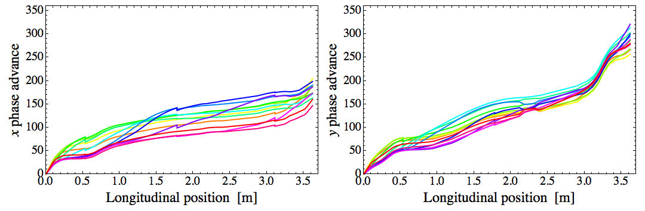
Standard collimation scheme not effective for MEBT
r = 3σ, θ = 15, 30,…, 180 deg in the norm phase space
SNS uses MEBT collimators in the operation (remove 2-3% of the beam!) but how they work hasn’t been well re-produced in simulations.
Due to space charge, phase advance of a particle depends on its initial position
➔ standard collimation schemes (3 collimators separated by 90 deg, 3 separated by 60 deg, …) are not optimum for the MEBT.
Angular distribution of halo particles is not uniform.

Slide 15
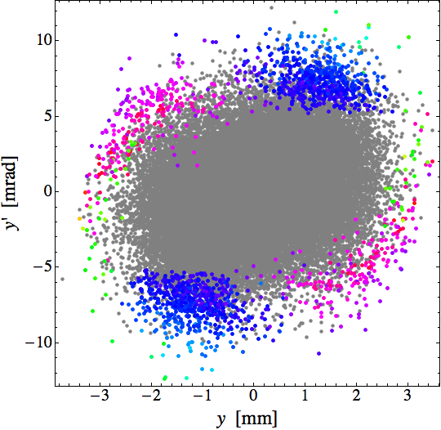
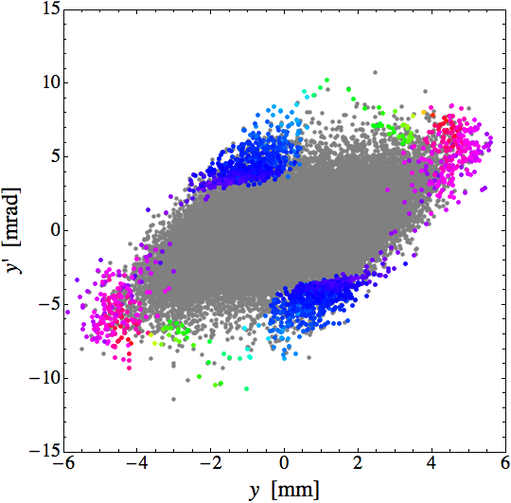
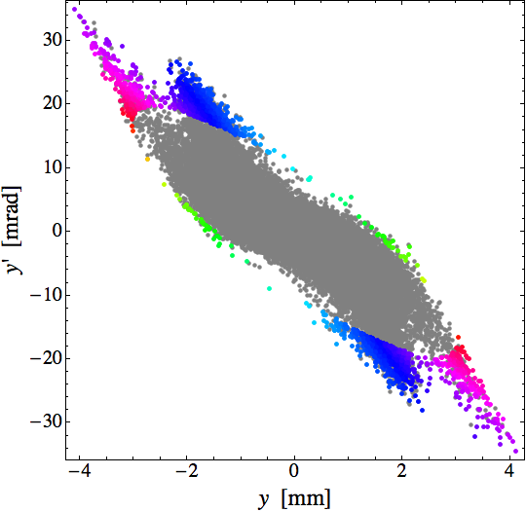
Primitive way to determine collimator locations
Entrance
s = 1.61 m
Exit
Mechanical constraints ➔ a collimator placed only between quads.
Identify halo particles (beyond 3σ) at the end of the MEBT.
Stick to ~15 W and avoid where the beam is smaller than σ_{x} ~ σ_{y} ~ 1 mm.
Trace back the distribution of the halo particles at possible collimator locations and identify the optimum set of locations.
Chaotic behavior? Also indicate collimation effective in the later part.

Slide 16
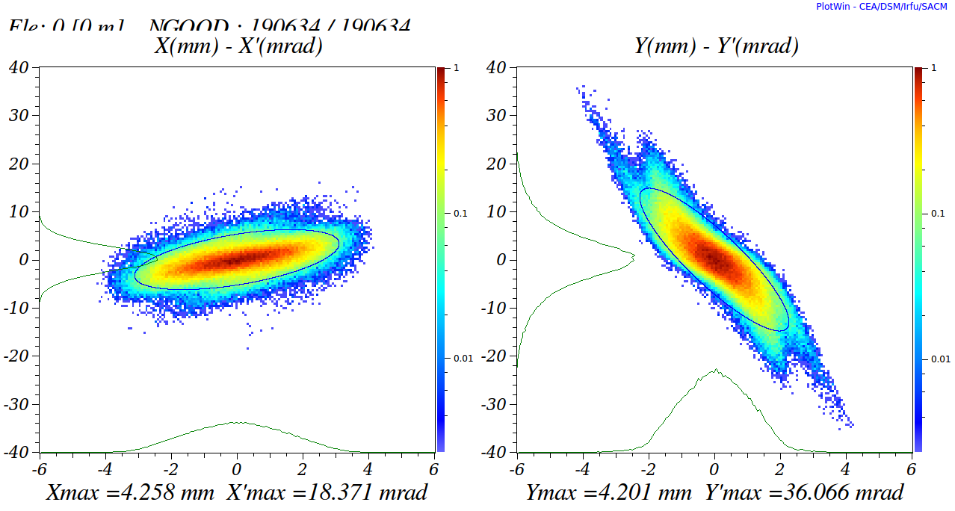
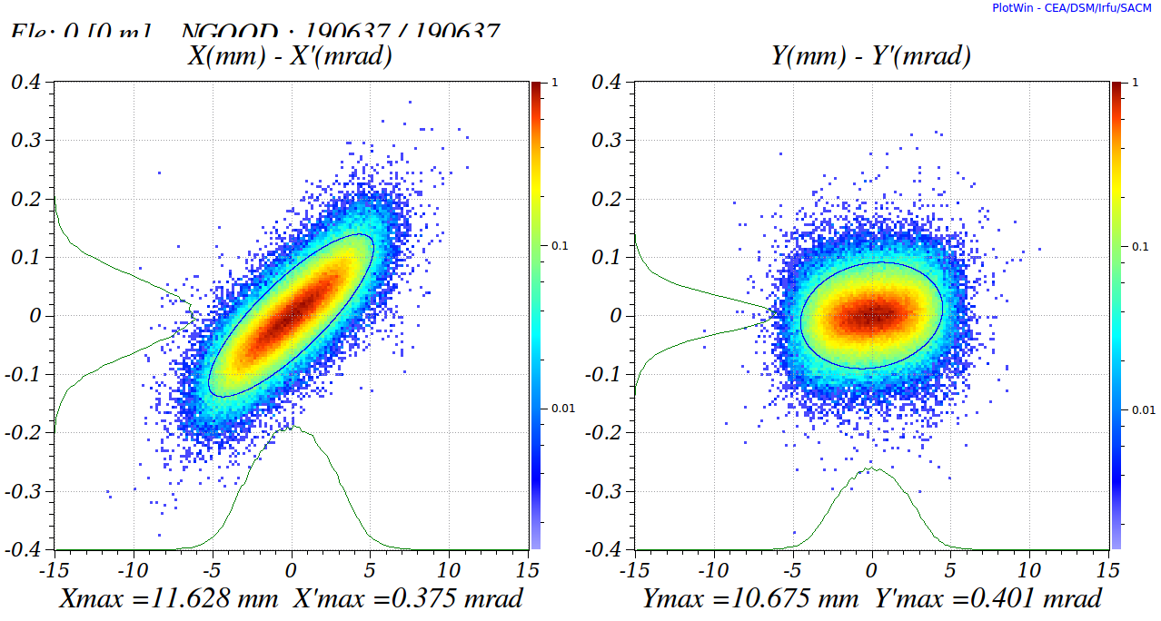
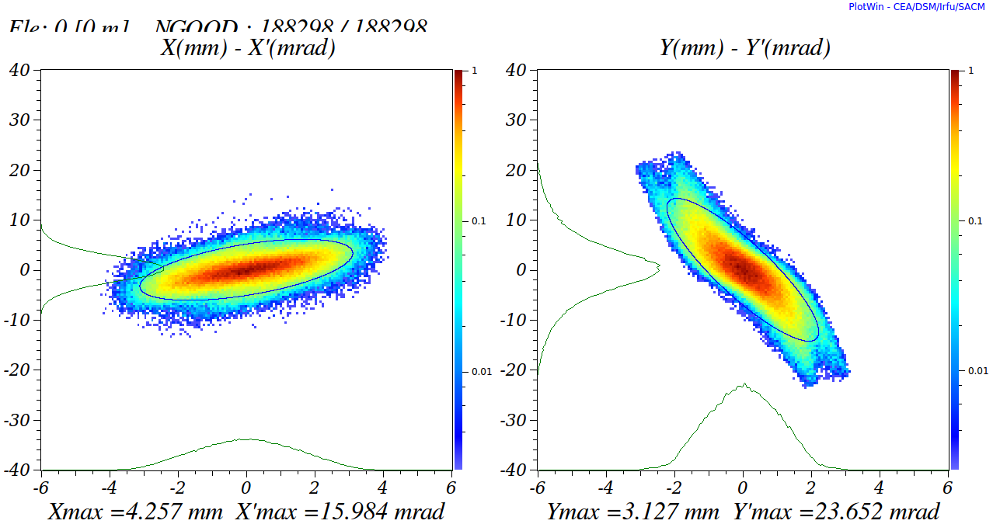
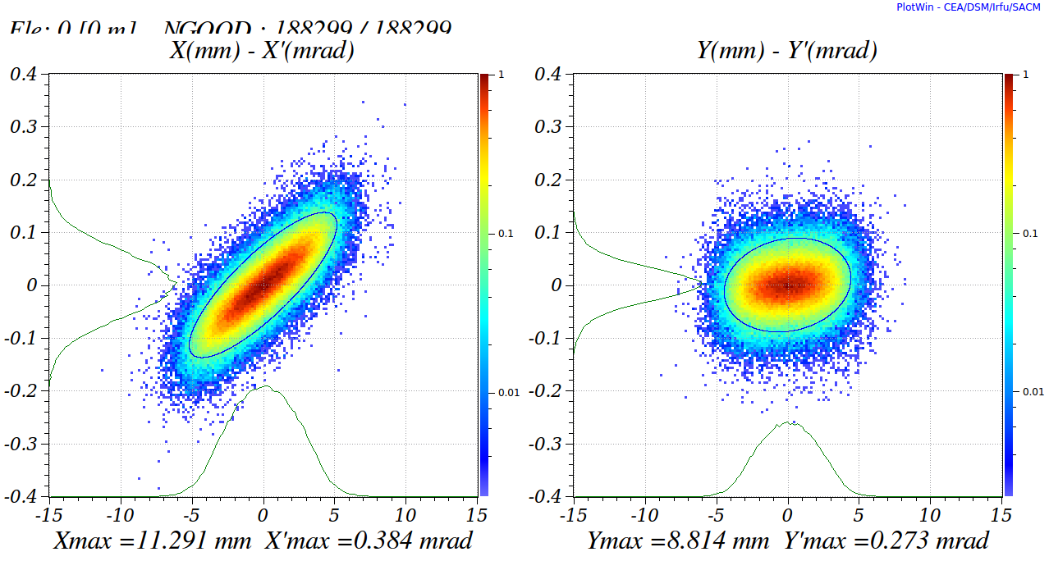
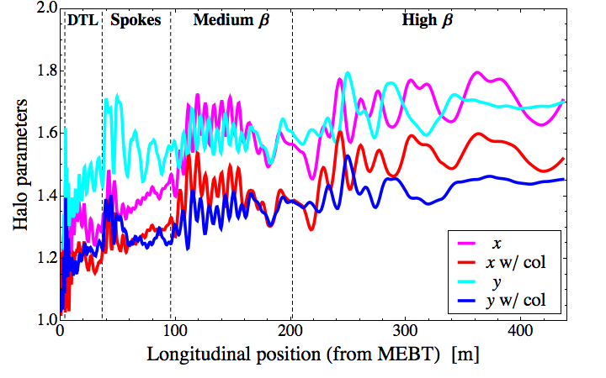
Improvement with collimators
MEBT end w/o col
Linac end w/o col
MEBT end w/ col
Linac end w/ col
The beam quality can be improved at the end of MEBT and the end of linac.
The present MEBT output is already good enough for a perfect linac. Error studies will be done.

Slide 17
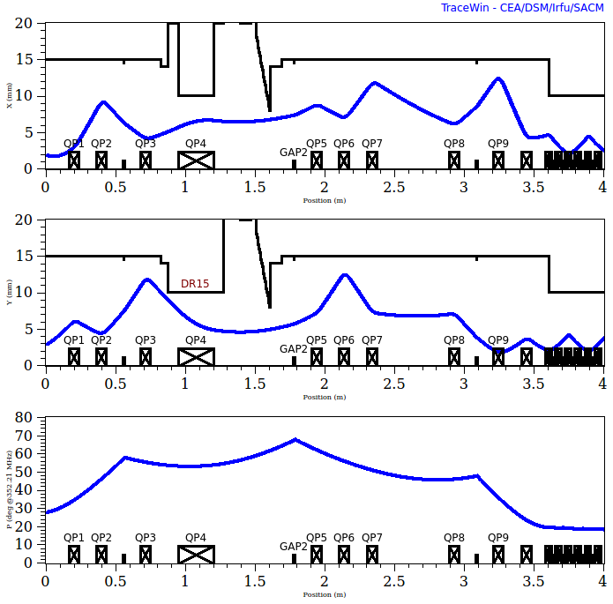
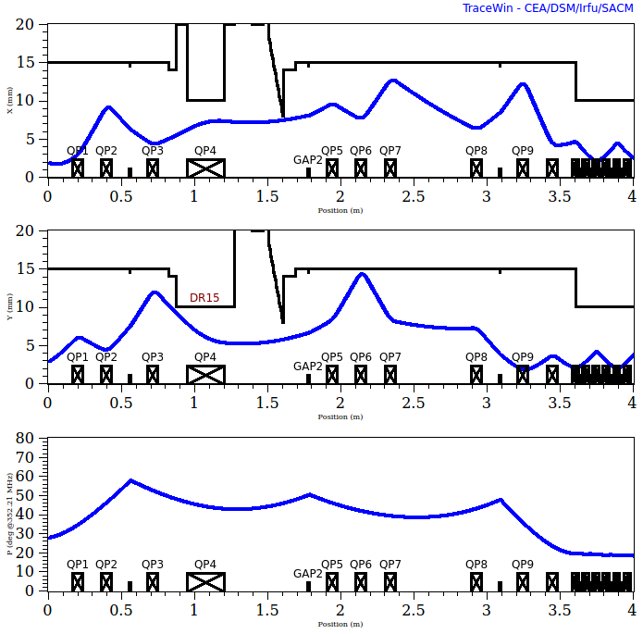
It’s not enough to look at just MEBT…
−10 kV
+10 kV
x [mm]
y [mm]
phase [deg]
As an demonstrative example, consider to change E0TL of B1 by ±10 kV (~8%)

Slide 18
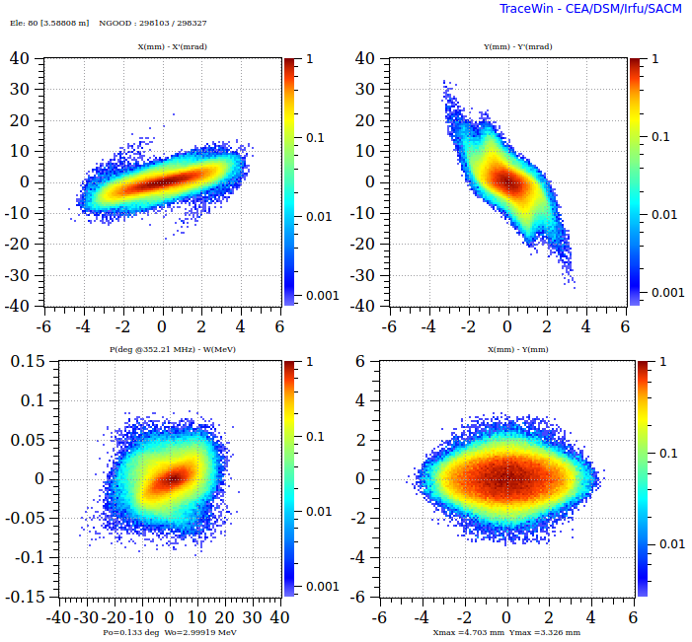
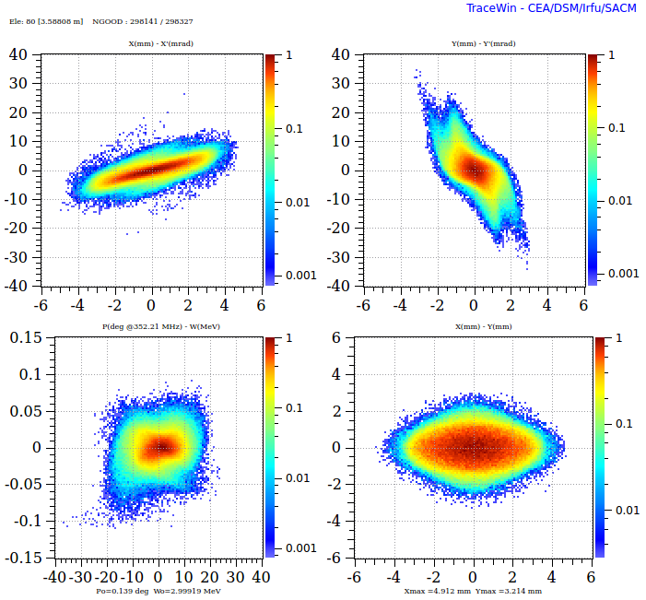
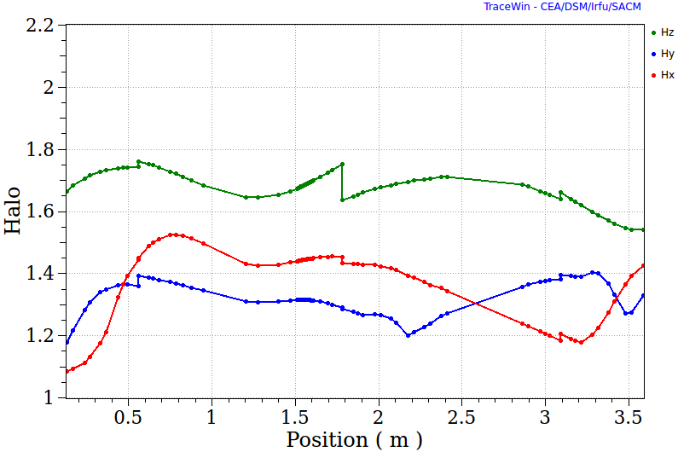
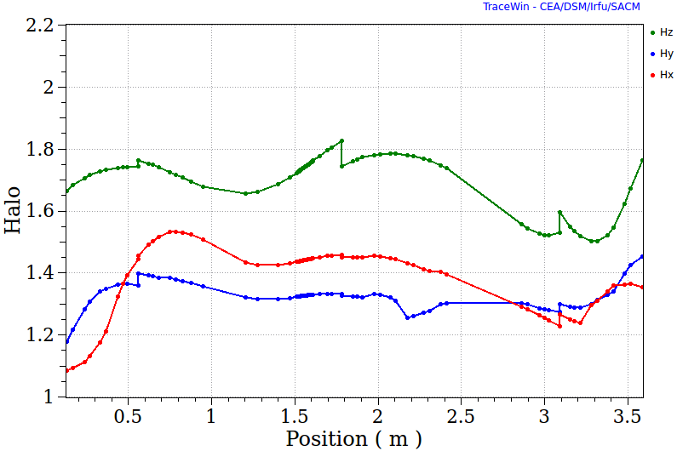
The situation at the end of the MEBT
X Y Z
−10 kV
+10 kV
Longitudinal quality visibly worse for the “tight” setting (+10 kV).
Transverse quality is about the same for both.

Slide 19
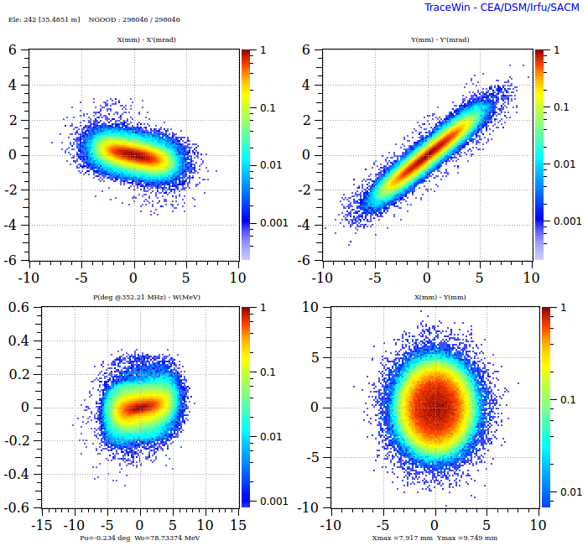
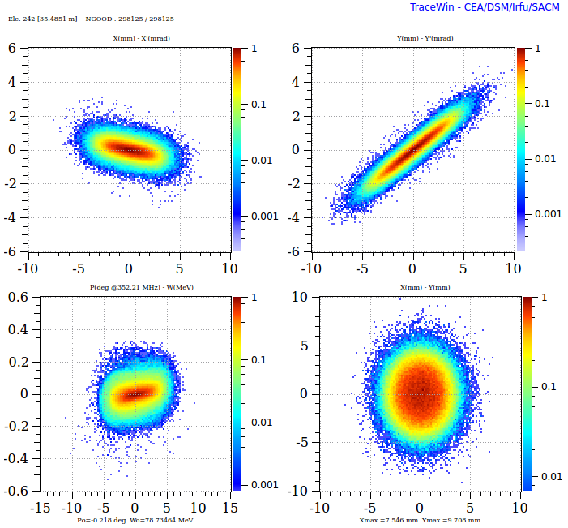
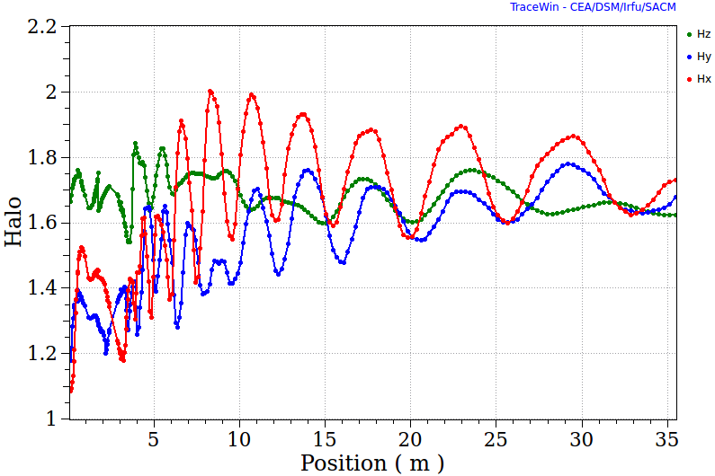
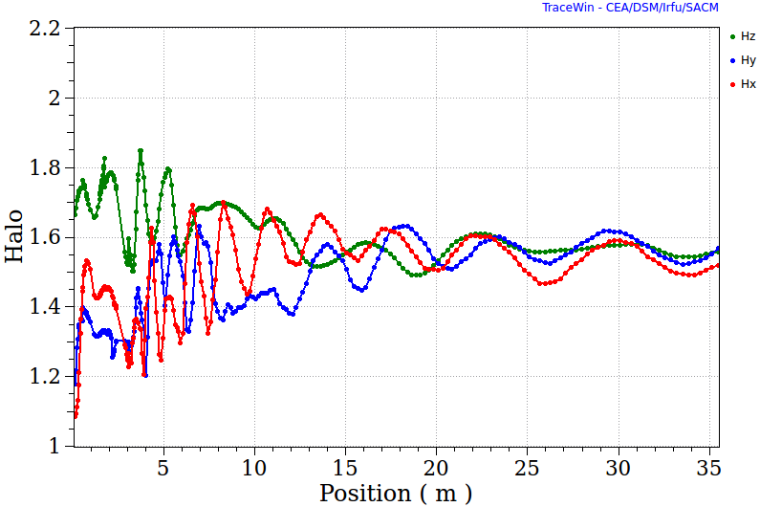
The situation at the end of the DTL
X Y Z
−10 kV
+10 kV
Now, the beam quality is better for the “tight” setting (+10 kV)! Internal Mismatch?
Loss near the end of DLT is also reduced to 1/3.
Should re-think the buncher setting? (Worth to try to weaken initial quads in DTL.)
Must consider the downstream sections!

Slide 20
Conclusions
The MEBT lattice in the May baseline has been revised based on detailed studies of influences of each component on the beam. An unsystematic procedure of lattice optimization has been established.
Schemes of collimation in the MEBT have been studied and a (manual) procedure of setting up collimators have been established.
The story is far from over as everything else with the linac. The overwhelming) list to do includes
  Error studies: input beam, lattice components
  Optimizing the interfaces, done with RFQ on some level, studying reduction of quad strengths in the initial part of DTL
  Optimization based on beam quality in downstream sections
  Establishing transverse tuning procedure
  Automatizing the optimization procedure, if possible

Slide 21
Thanks for your attention!

Slide 22
Backup Slides

Slide 23
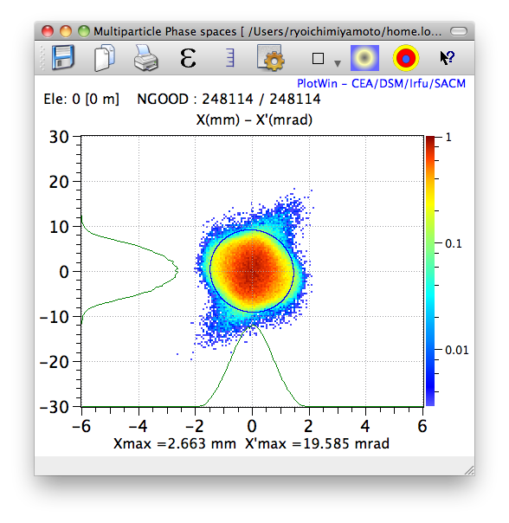
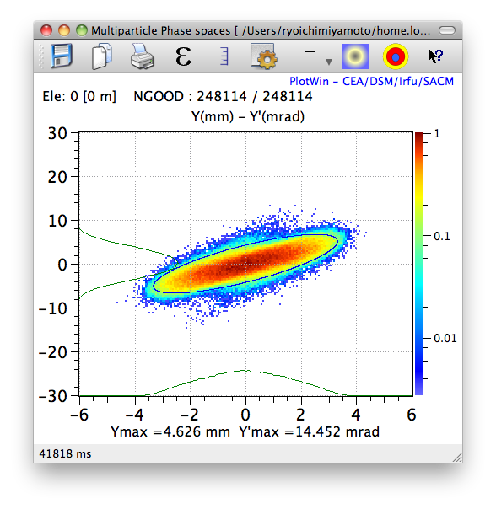
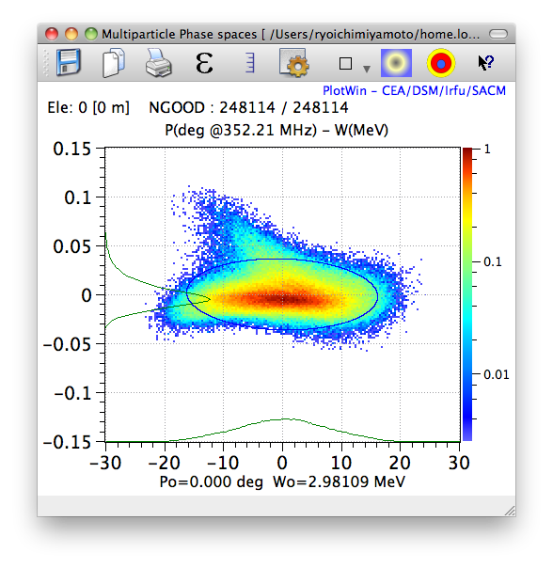
Halo definition (Wangler’s)
The spatial profile parameter (Kurtosis):
The halo intensity parameter (extension to 2D)
The normalization “2” to make the “KV” = 0 and “Gaussian” = 1.
Distribution into the DTL (from a simulation of the RFQ by A. Ponton)
23

Slide 24
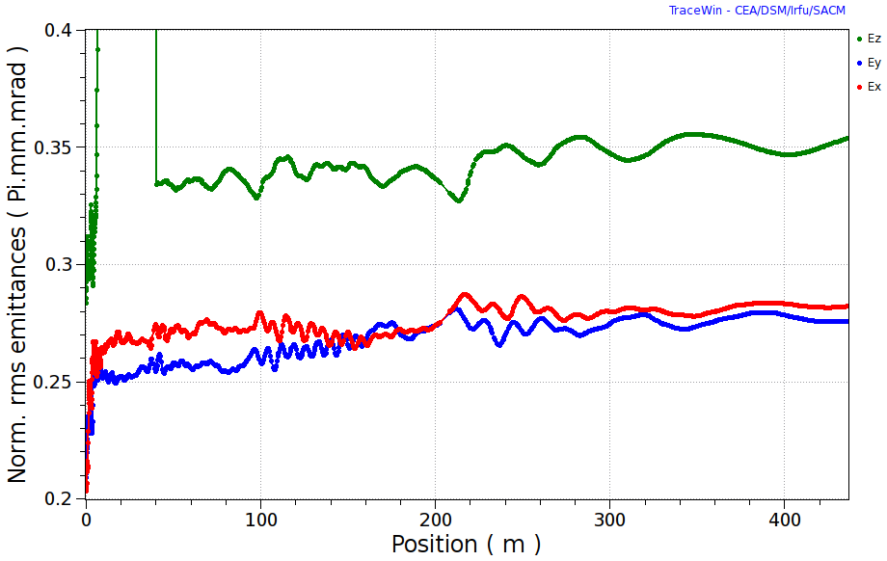
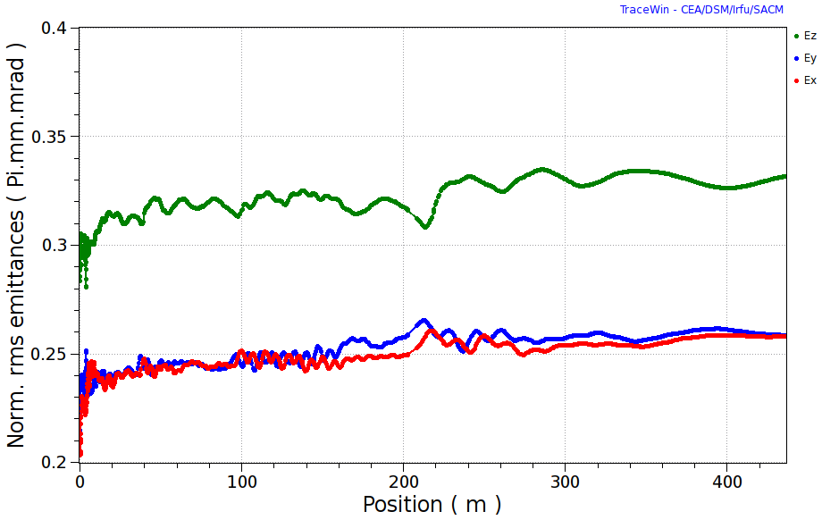
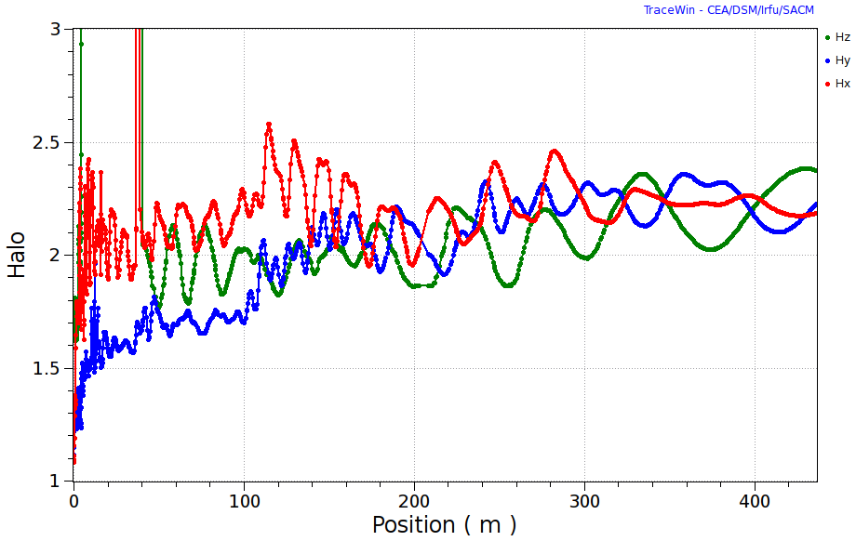
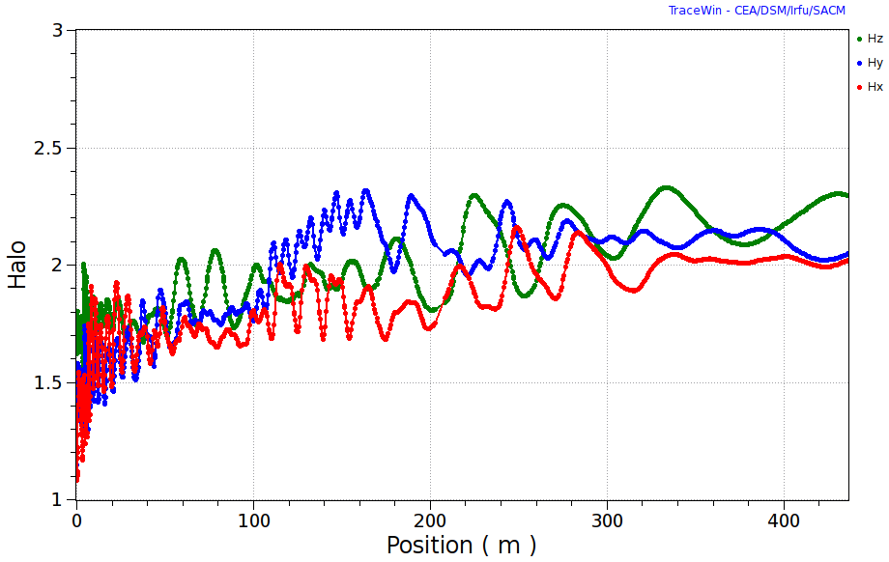
New vs. old long MEBTs: emittances and halos
Old
New
Loss in the DTL is also improved but no loss in the SC sections in both cases.

Slide 25
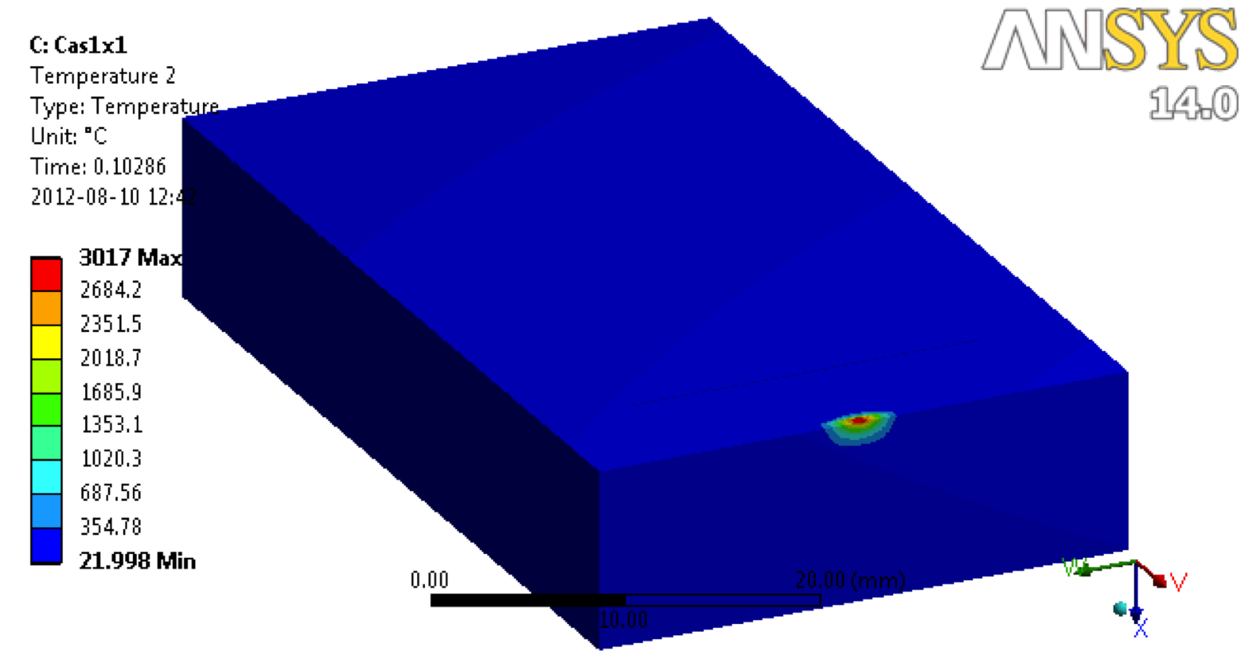
Loss limit of a MEBT collimator?
σ_{x} [mm] | σ_{y} [mm] | Temp [C°]
1 | 1 | 3017
1 | 2 | 1430
2 | 2 | 1178
Beam
Assumptions: graphite jaw, Gaussian beam, remove beyond 3σ (~0.25%, ~15 W)
Graphite may suffer mechanical damages beyond ~1500 C°.
In the simulation, stick to ~15 W and avoid where σ_{x} ~ σ_{y} ~ 1 mm.
Better to know the beam size vs. loss limit in detail.
Other materials planned to be studied.

