Slide 1


Linac – Cryogenics
Helium distribution

Slide 2
Content
Layout of the cryogenic distribution system
Parameters relevant to cryogenics
Helium flow scheme
Cryoplant and helium storage
Pressure drop analysis – cryo transfer line

Slide 3
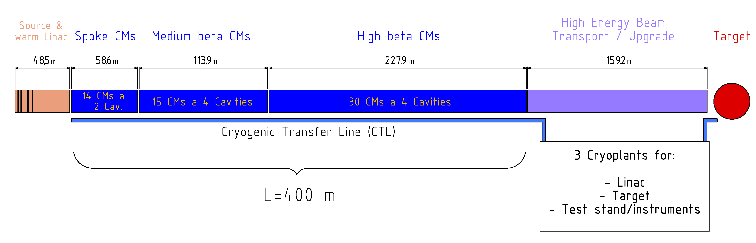
Layout of the cryogenic distribution system
Segmented Linac design with 59 individual CMs
Cavities cooled with superfluid helium to 2 K at saturation condition
SF helium conditions are generated separately at each CM (counterflow HEX)
Max. allowable working pressure: 1.5 bar(a) for cavities?
Pulsed operation at a rep. rate of: 14 Hz
Cryogenic duty cycle: 4.65 %
Major heat loads: 1.8 kW @ 2 K, 7.8 kW @ 40 K and 8 g/s PCC

Slide 4
Relevant parameters to be frozen
Circuit | Temperatures in K | Pressure in bar(a)
Thermal radiation shield | 40 – 50 | 19.5 – 19
Supercritical helium supply | 4.5 | 3
VLP helium return | 4 | 0.031
Coupler cooling | 4.6 – 150 (300) | <1.5
Gaseous helium storage | 300 | 19
Liquid helium storage | 4.5 | 1.2

Slide 5
Flow scheme
Cryogenic transfer line 400 m along Linac + 50 m connection to cryoplant
1 valve box at the end of the Cryogenic Transfer Line (CTL)
HP warm line, LP return line vacuum insulated, Purge line
Warm helium return line for coupler cooling circuit
From/to
cryoplant
Spokes cavities
CM # 01 -14
Ell. medium beta cavities
CM # 15 -29
Ell. high beta cavities
CM # 30 -59

Slide 6
HP warm line 300 K ≤ 20 bar
Purge return line 300 K ≤ 1.05 bar
LP return line 300 to 5 K - 1.05 bar
Thermal shield supply 40 K - 19.5 bar
Thermal shield return 50 K - 19 bar
SC helium supply 4.5 K - 3 bar
Helium return 8 K - 1.2 bar
Helium VLP return 4 K - 30 mbar
Valve box in CTL incl. vacuum barrier
Jumper connection
CM He II cooled cavities
Coupler cooling return 300 K - 1.05 bar

Slide 7
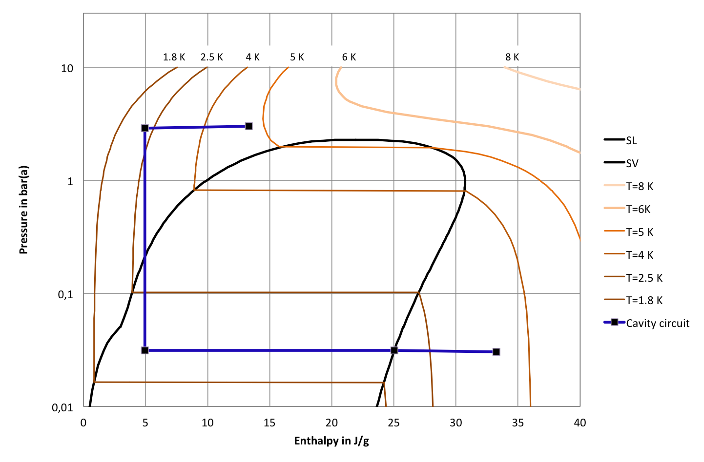
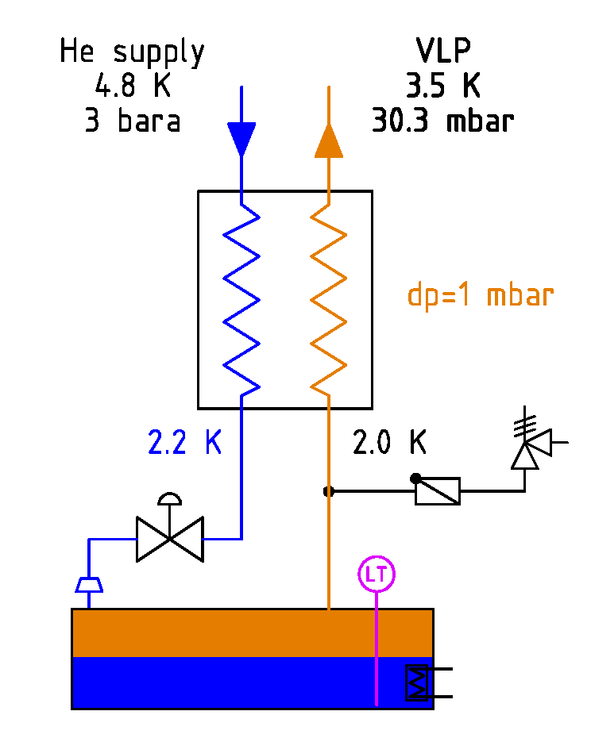
Cavity circuit in a log p-h-diagram
(a)
Δh=20 J/g
2.0 K He II bath

Slide 8
Cryoplant flow scheme
Helium inventory
of the Linac is 12 m³ liquid
LHe tank at 1.2 bar
GHe storage at 19 bar
Helium inventory storage
Cold box 1 – 4.5 K SC helium supply
Cold box 2 – Hybrid subcooling unit
Cold box 2 hosting
the sub-atmospheric
cold compressors (two)
Cold box 2 contains
the acceptance test
unit at 2.0 K and 45 K
Cold box 1
4.5 K & 40 K
supply

Slide 9
Flow scheme
Cryoplant - major components in detail

Slide 10
Pressure drop & heat load analysis
T_{bath}=2.0 K at saturation pressure of 31.3 mbar(a)
Precooling of the inlet SC-Helium flow to 2.2 K
(a)
2.0 K He II bath

Slide 11
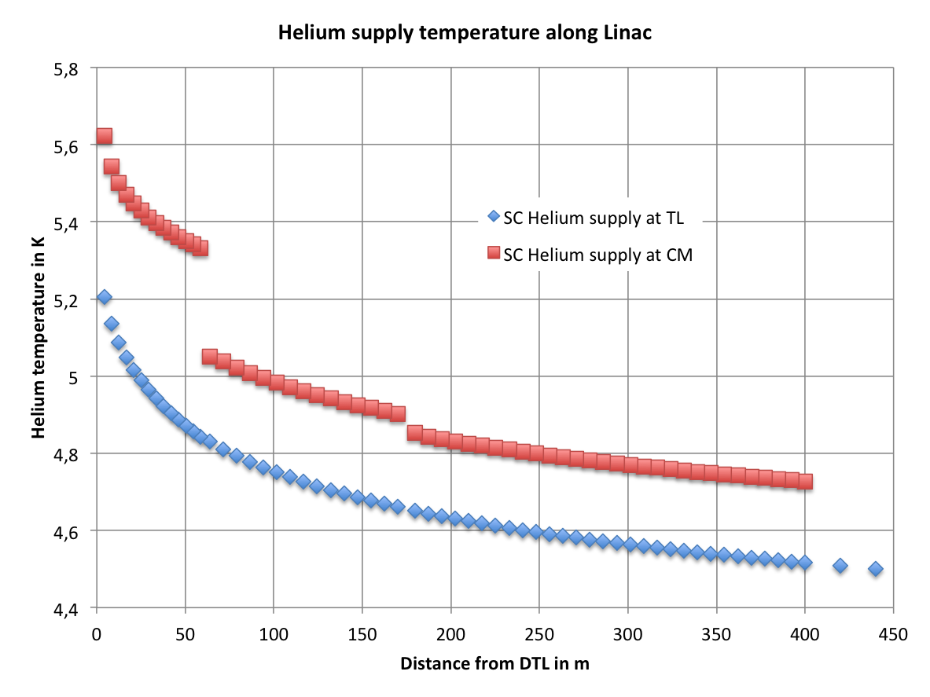
SC helium supply line – normal operation
Possible solutions:
Increase flow in SC He supply line
Integrate a phase separator/subcooler in front of the 2K HEX
d= 80 mm
Input:
q_{TL}= 0.2 W/m
q_{JC}= 0.2 W/m
L_{JC} = 4 m
Q_{valves} = 1 W
Q_{VacBar.}=1 W
Warm Linac
Spokes
Medium Beta
High Beta
CP

Slide 12
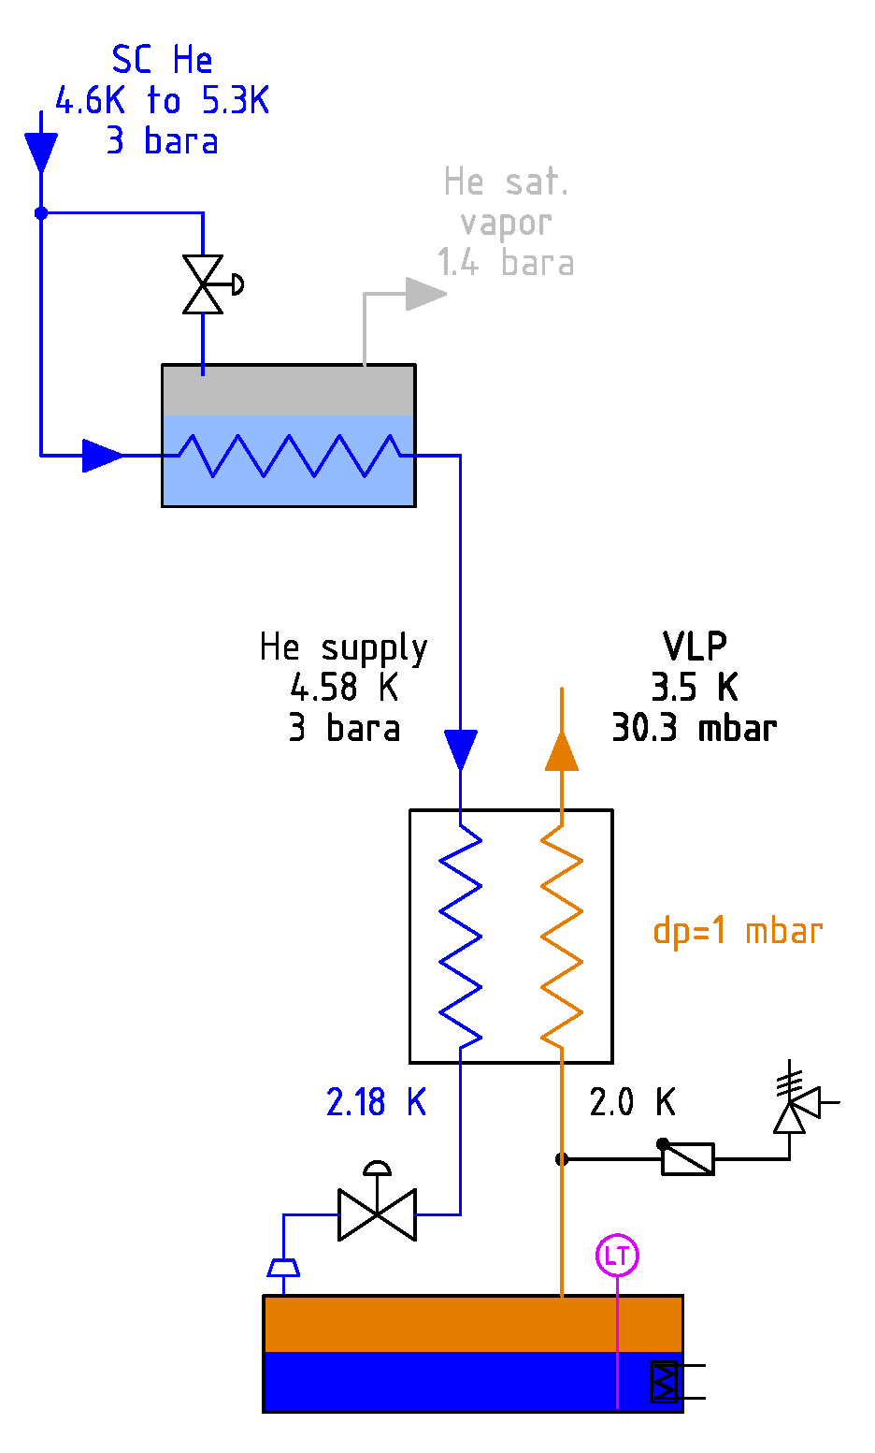
Principle proposal– Phase separator
(a)
(a)
Temperature of the incoming flow varies from 4.6 K to 5.3 K along the CTL
Subcooler e.g. to 1.4 bara saturation condition, use of the vapor to cool the couplers
(mismatch => dm/dt_{subcooler}= 2-3 * dm/dt_{coupler})

Slide 13
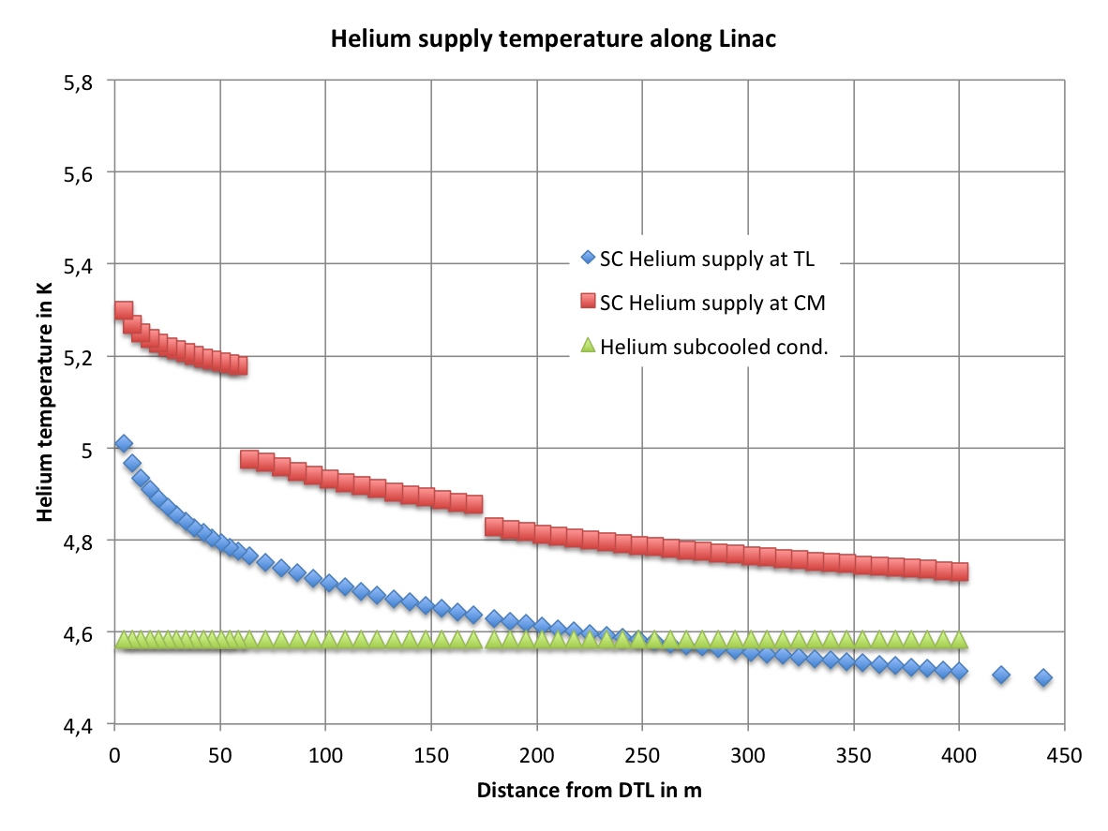
SC helium supply line option II - Subcooler
Subcooler in front of 2 K - HEX
Total=>116.5 g/s
Warm Linac
Spokes
Medium Beta
High Beta
CP

Slide 14
Pressure drop analysis
T_{bath}=2.0 K at saturation pressure of 31.3 mbar(a)
Precooling of the inlet SC-Helium flow to 2.2 K
(a)
2.0 K He II bath

Slide 15
VLP return line
d= 260 mm
Warm Linac
Spokes
Medium Beta
High Beta
CP

Slide 16
VLP return line - pipe diameter

Slide 17
Summary
Design of the Linac cryogenic transfer line => 450 m
Segmented CMs with individual jumper connection, exchangeable at cold Linac conditions
Helium circuits for cavities, thermal shield, heat intercepts and coupler cooling
Helium inventory and storage concept
Pressure drop calculations for CTL
  Question for discussion:
Phase separator => vapor flow to power couplers

Slide 18

Summary II
Stop squandering helium – Preserve it!
W. Nuttall, Nature 485, 573–575 (31 May 2012)

Slide 19
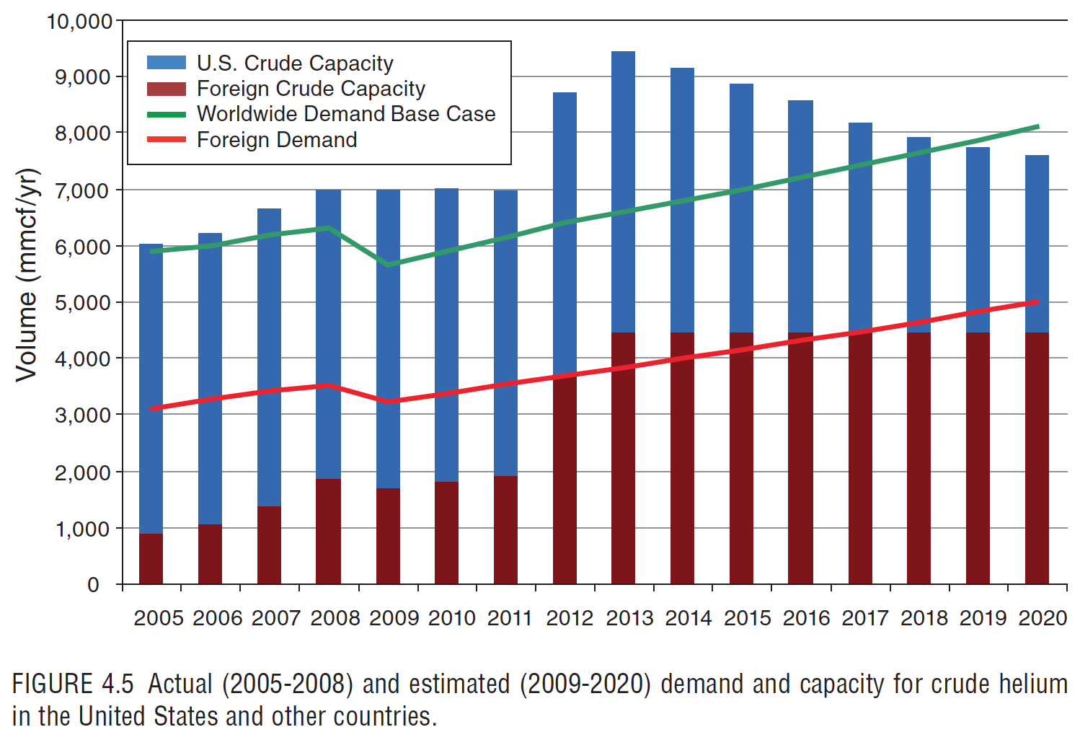
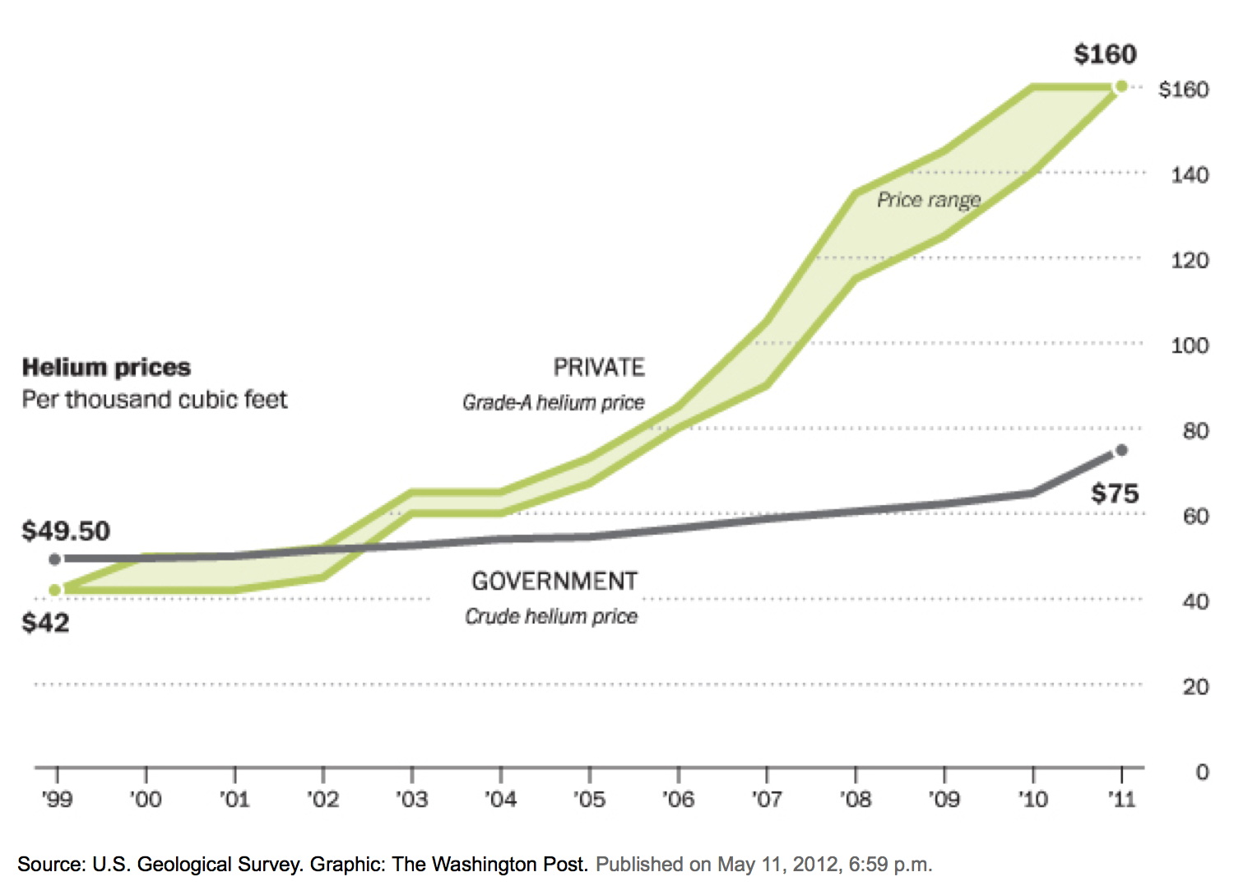
Summary II
Source: US report,
“Selling the Nation's Helium Reserve”, 2011

