Slide 1
SNS Luminescence Test Results
Beamtime 6.8-24.8.2012

Slide 2
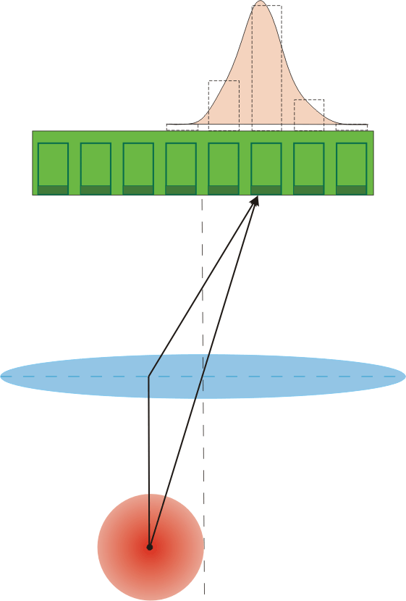
Idea
Use the photons emitted from the interaction between the beam particles and the residual gas to measure the beam profile.
Photon yield depending on
Amount of protons per time
Residual gas pressure
Specific cross section
Detector
Lens
Beam

Slide 3
Experiment Objectives
Residual gas composition measurements are not widely available, especially composition between cryostatic sections
The idea was to measure the photon yield, and estimate the gas composition from that
Due to preparation time only single photo anode Photomultiplier (PMT) were used

Slide 4
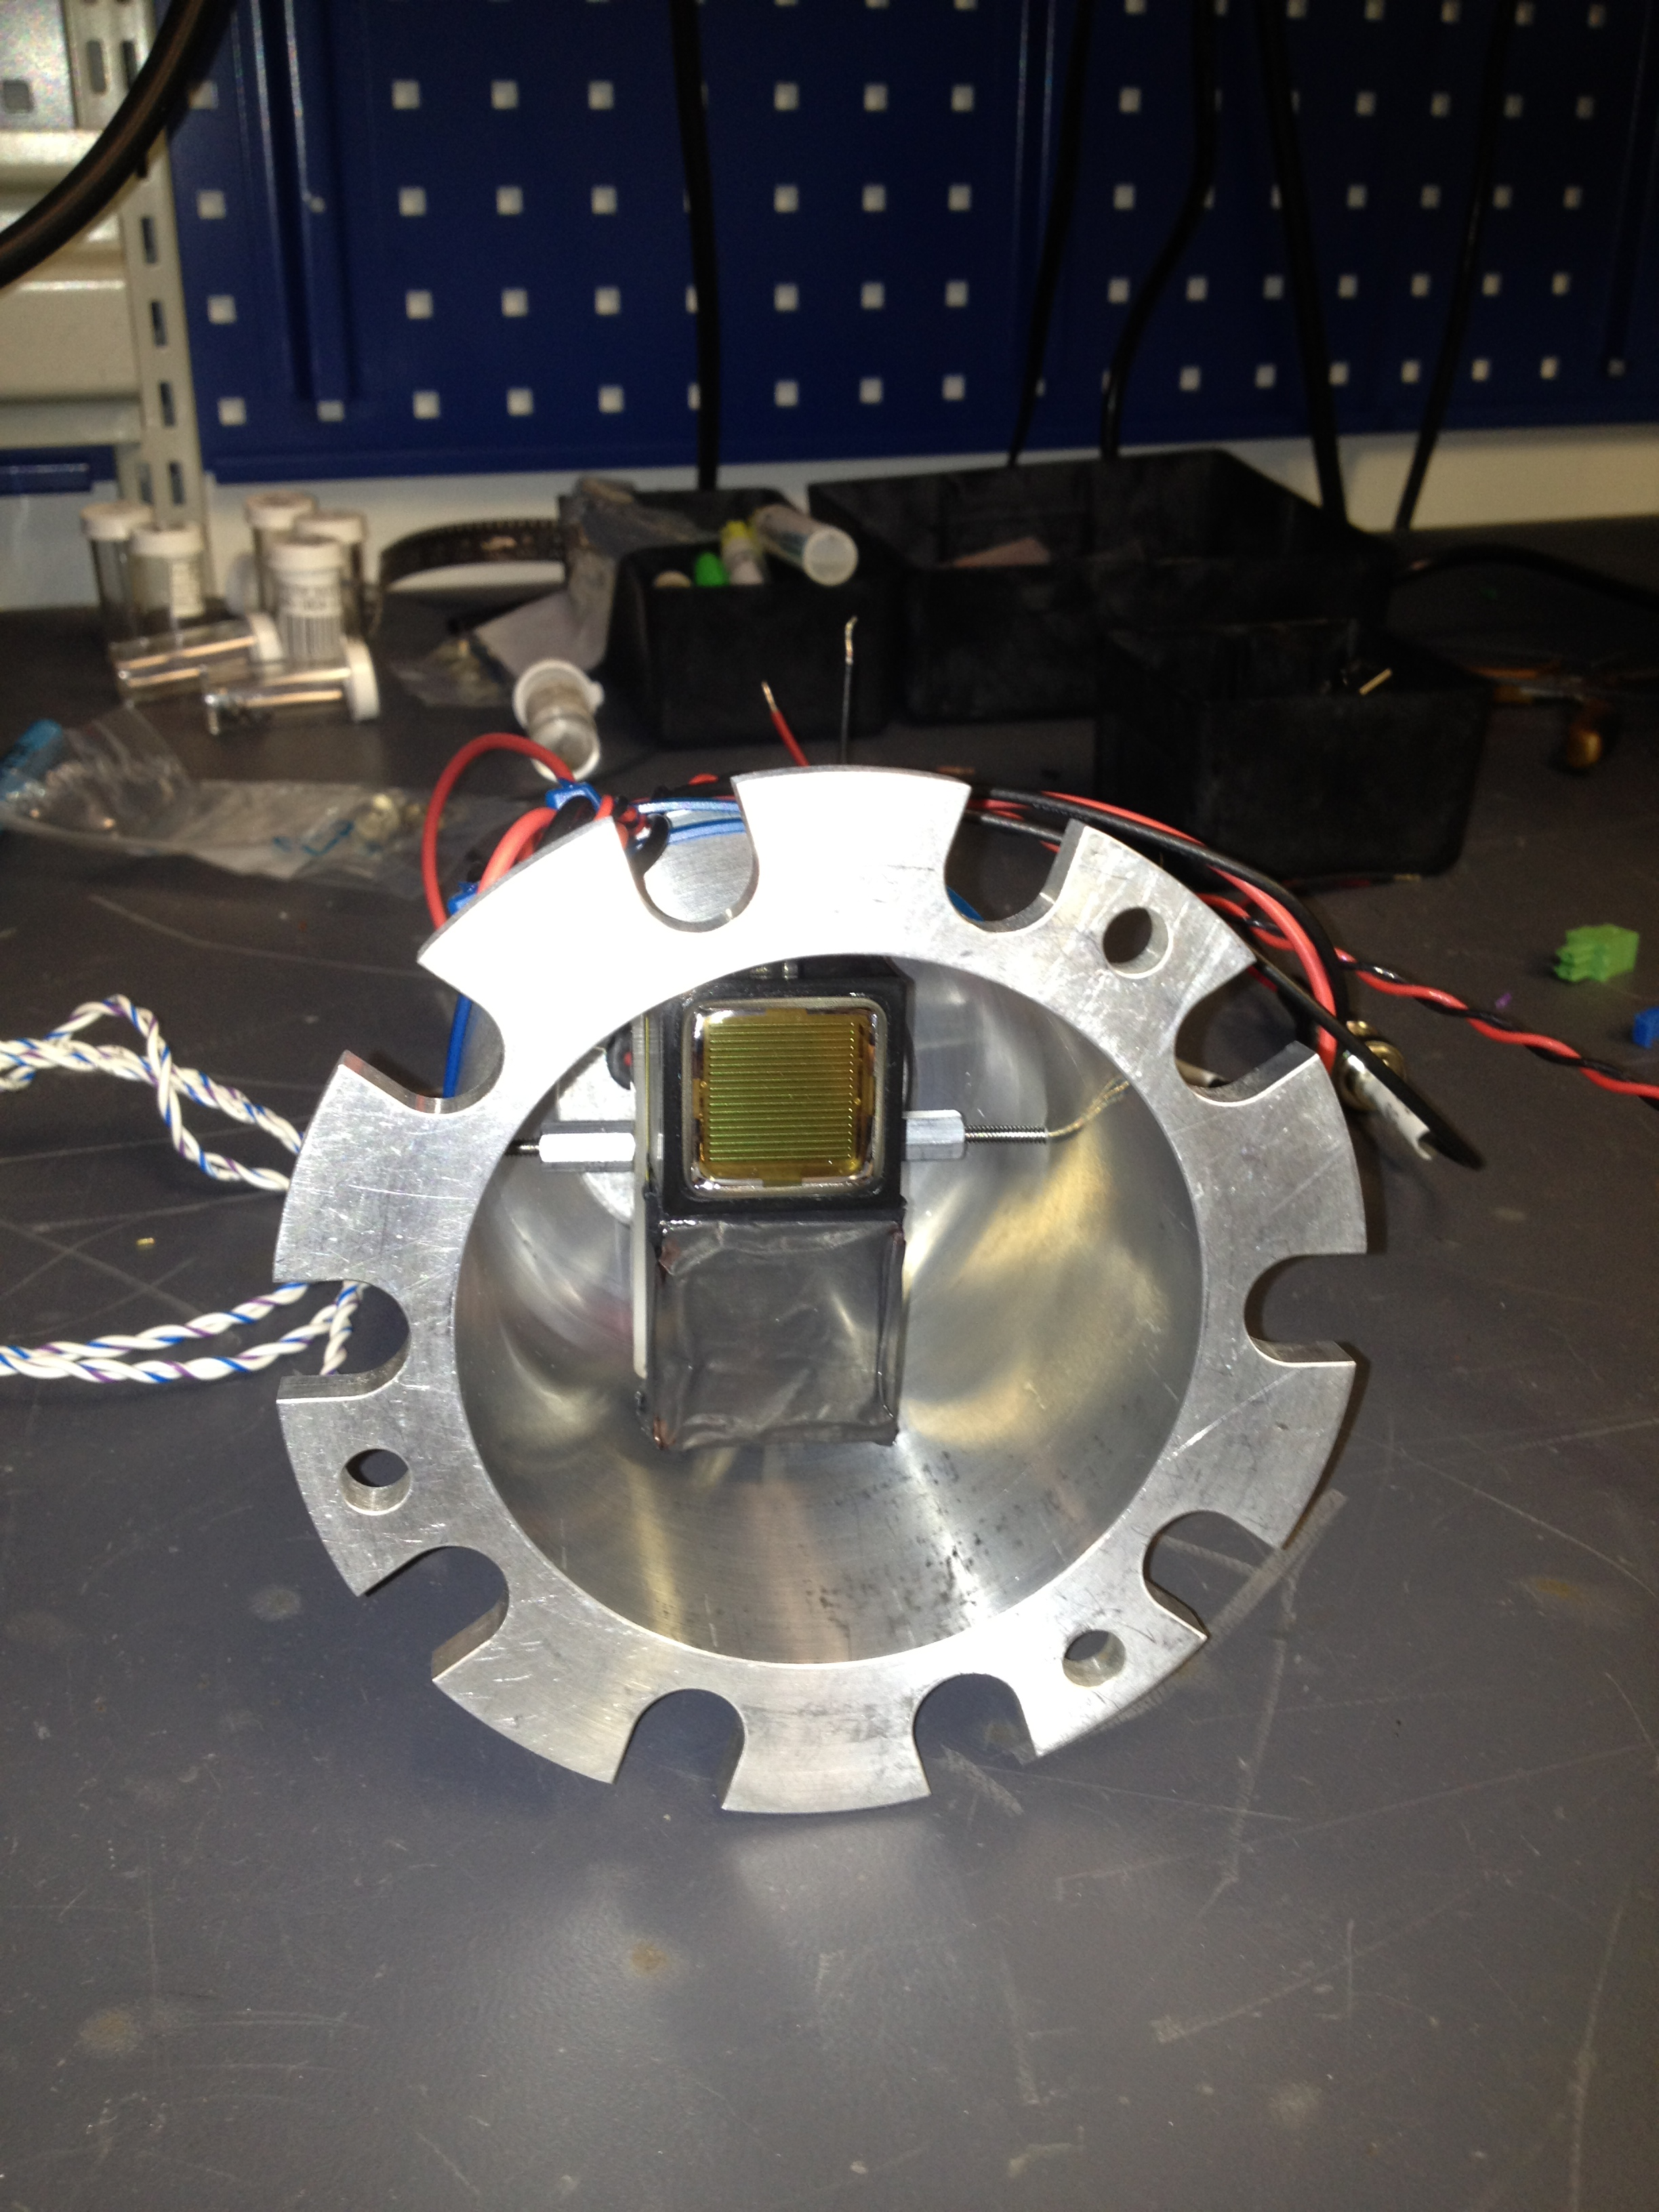
Setup
Two PMT looking into the chamber
One is blinded
This should give information about background signals

Slide 5
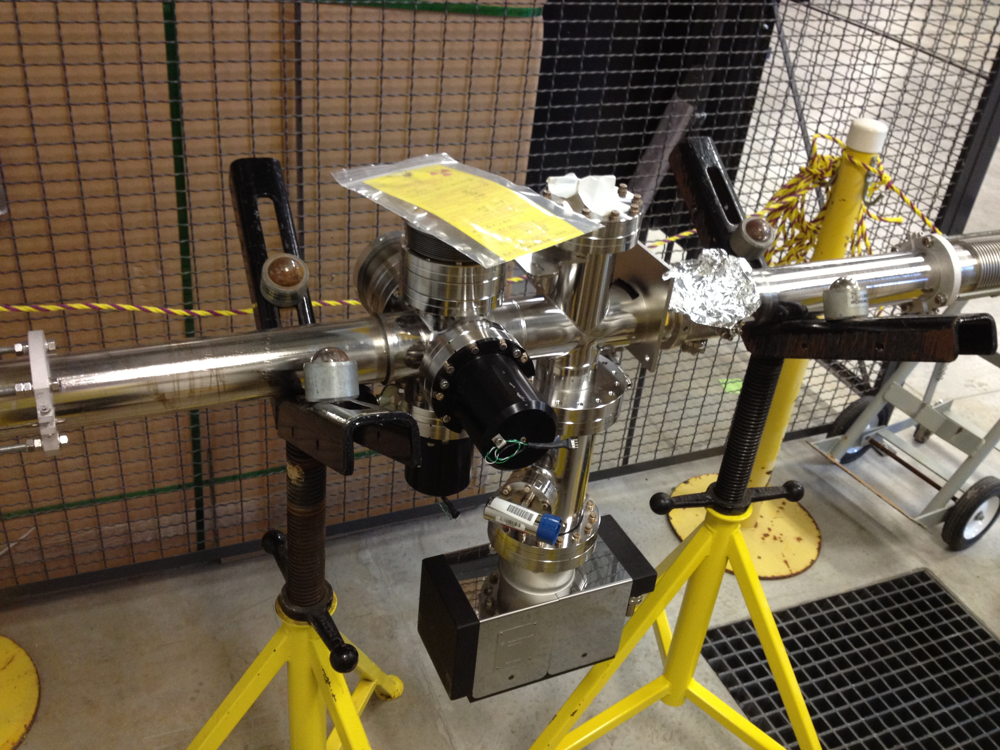
Setup II
Warm section (replace-ment), where the PMT was attached to.
PMT

Slide 6
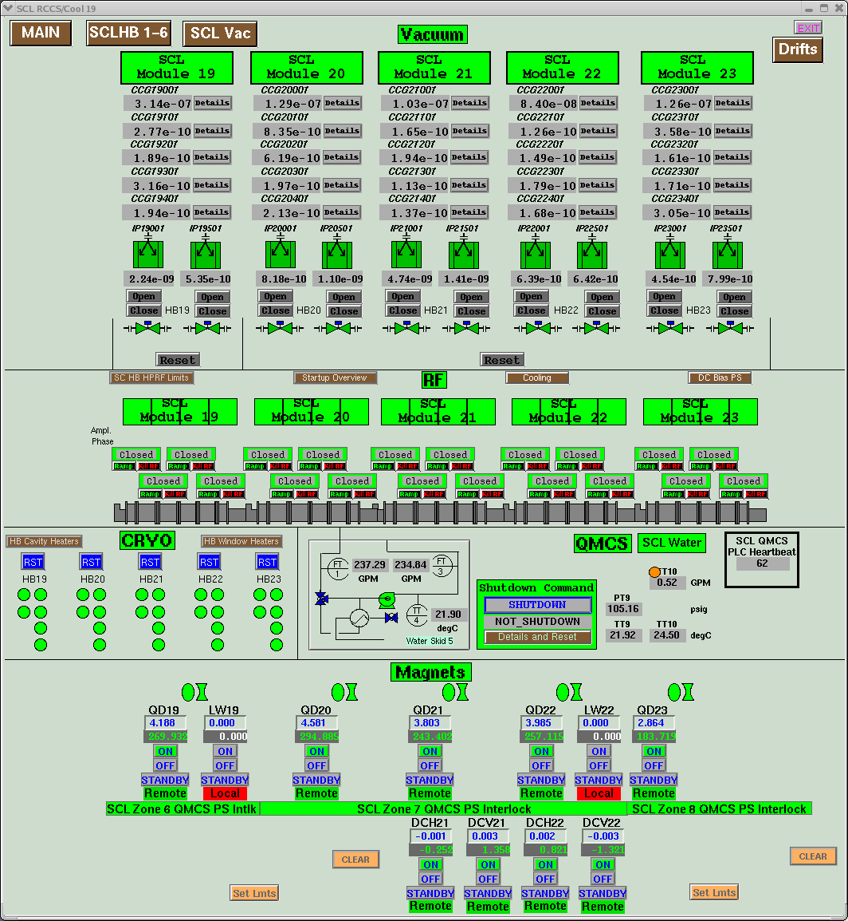
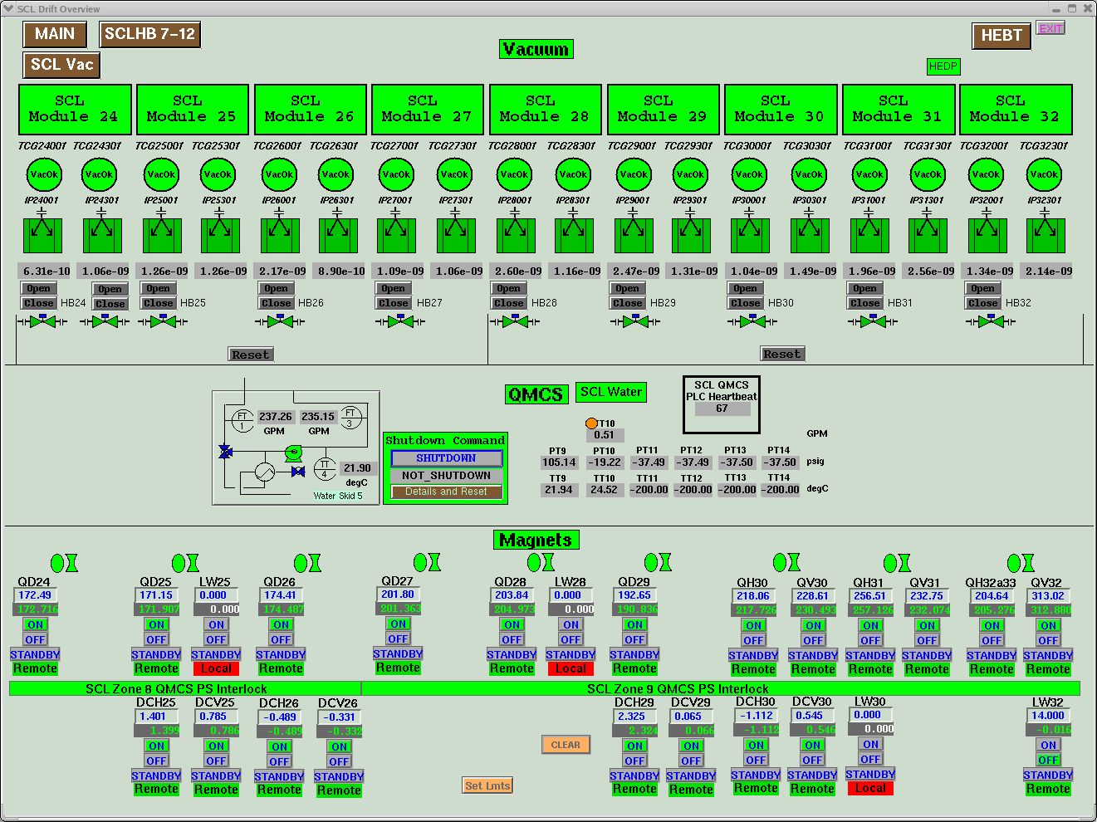
Location
Last Cryomodule installed
PMT installed
Laser Wire

Slide 7
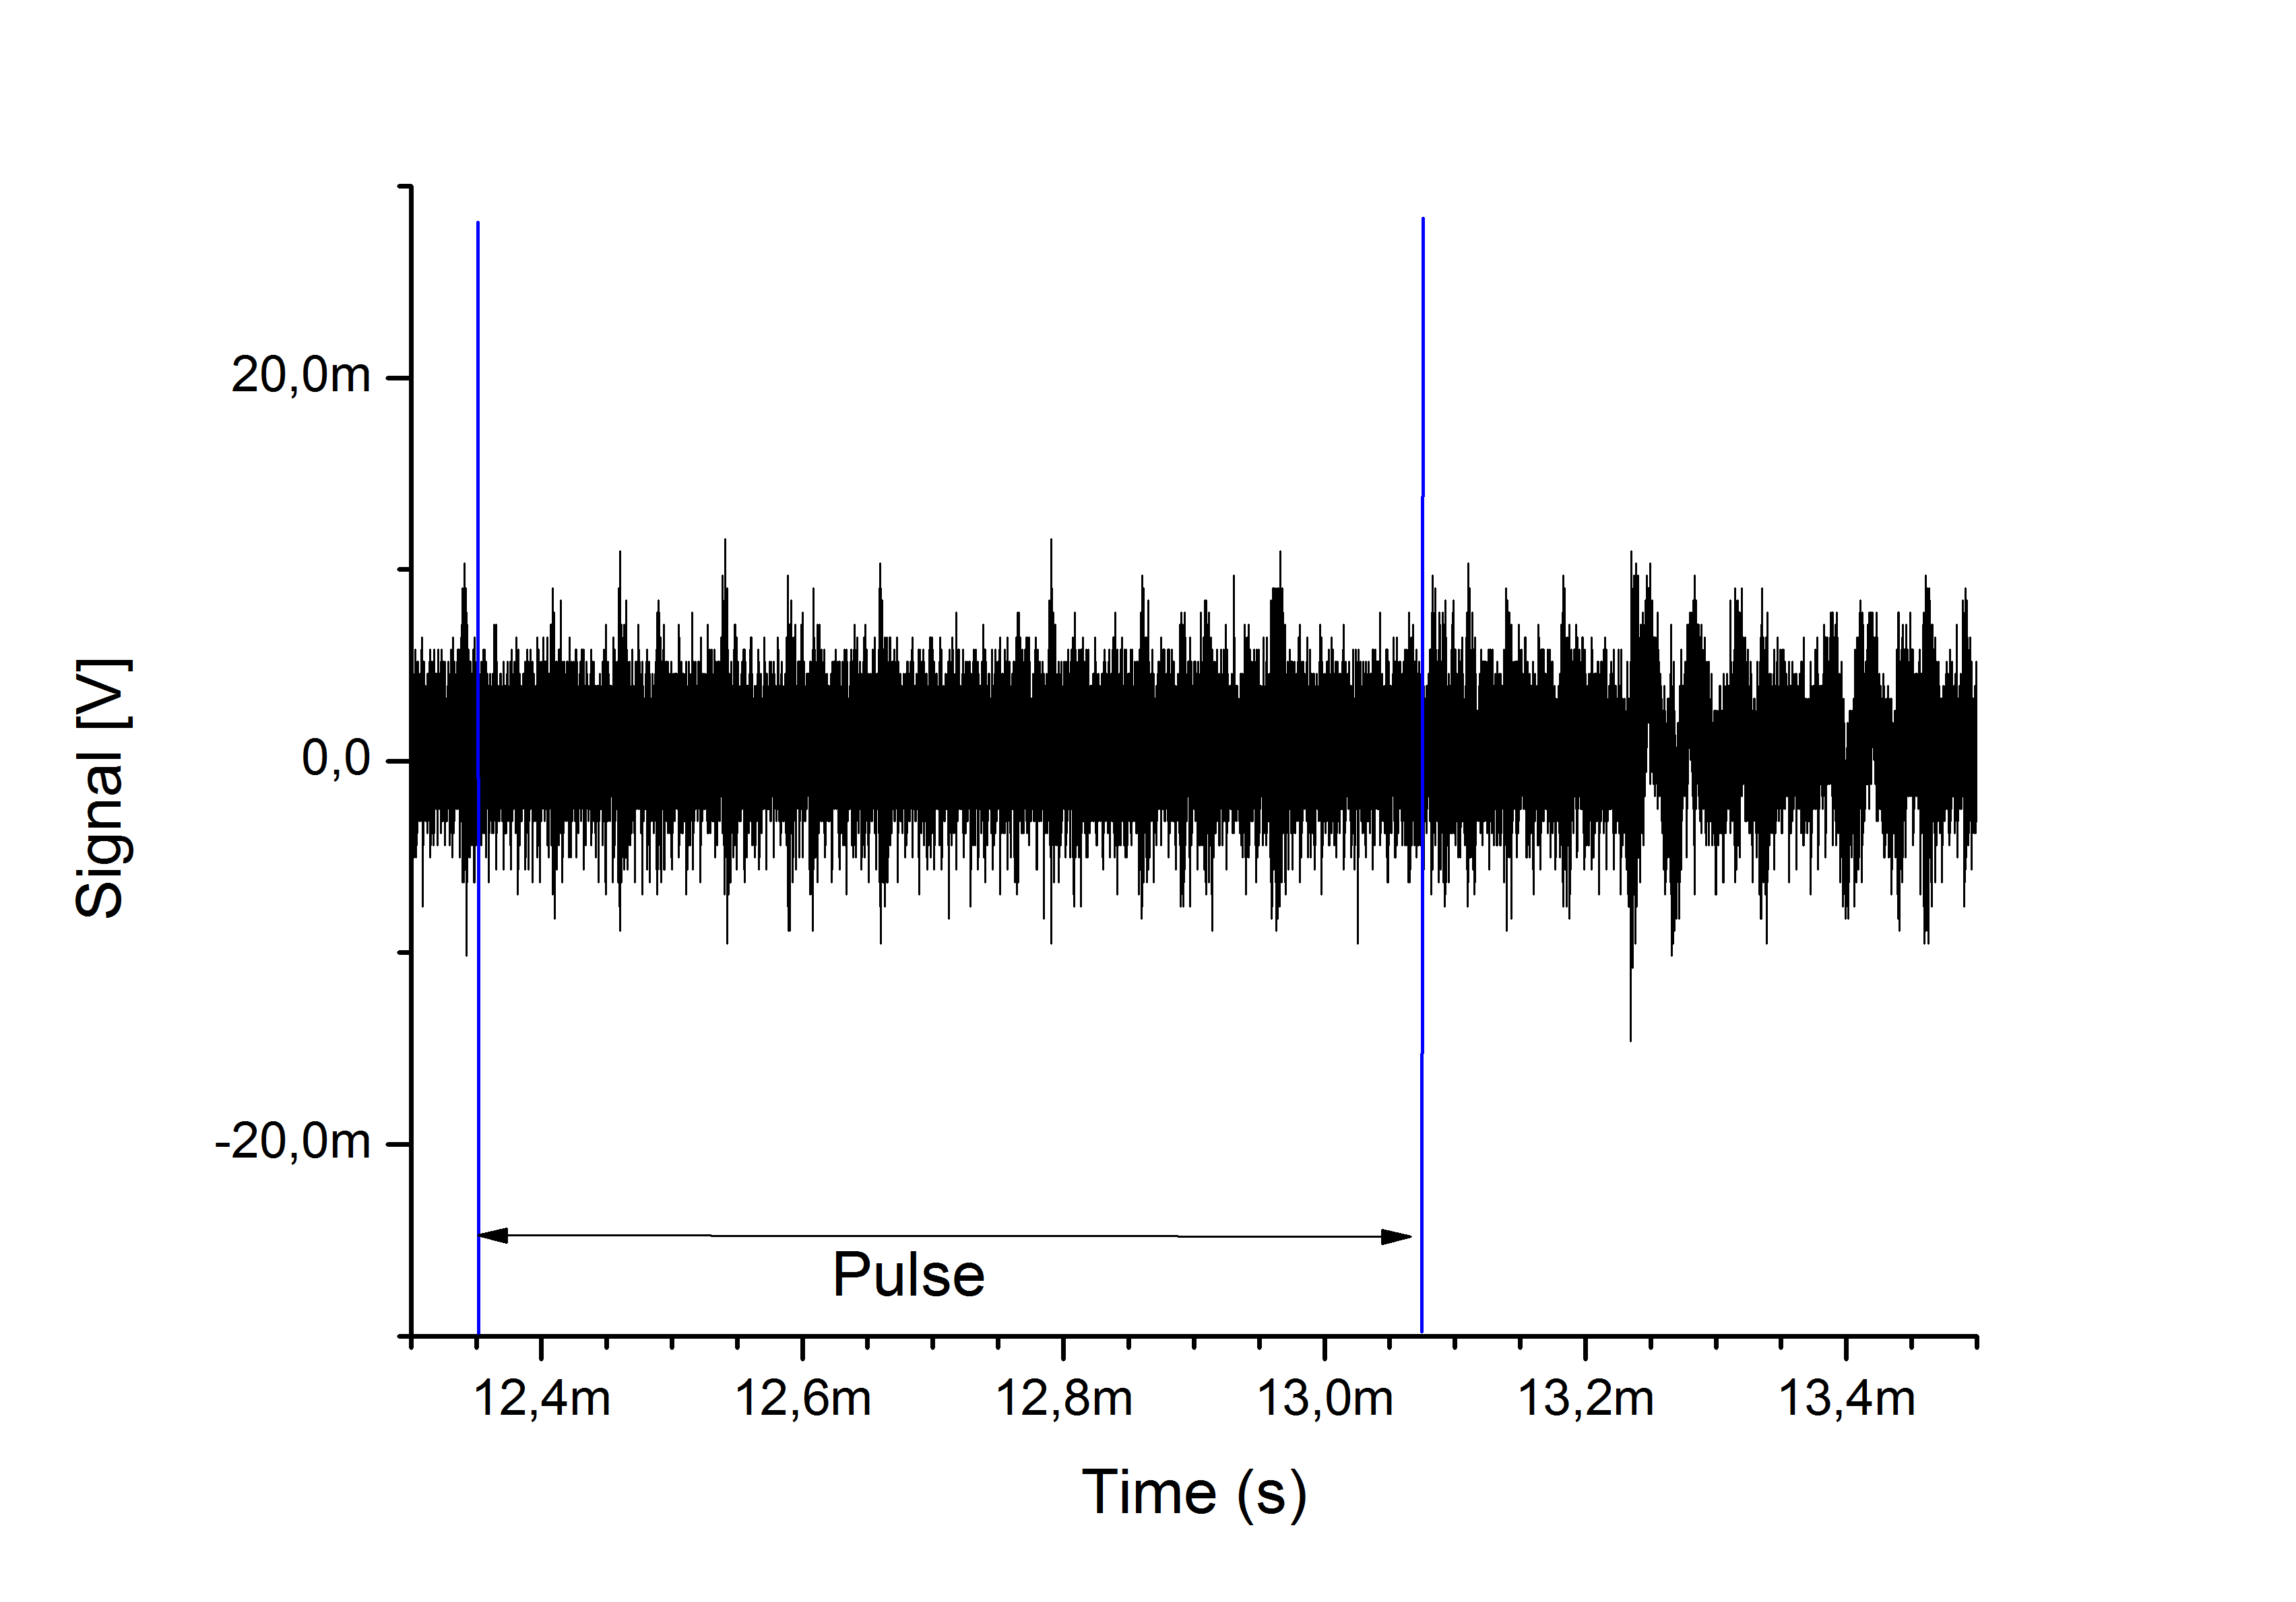
RF Influence
To calibrate the ionization chambers, every 10 s a pulse is empty (everything on, no particles)
This was captured to have a reference of RF influence
No major influence could be noticed

Slide 8
Results I
The initial idea of measure between Cryomodules could not be achieved
No information about the residual gas composition there was elsewhere available

Slide 9
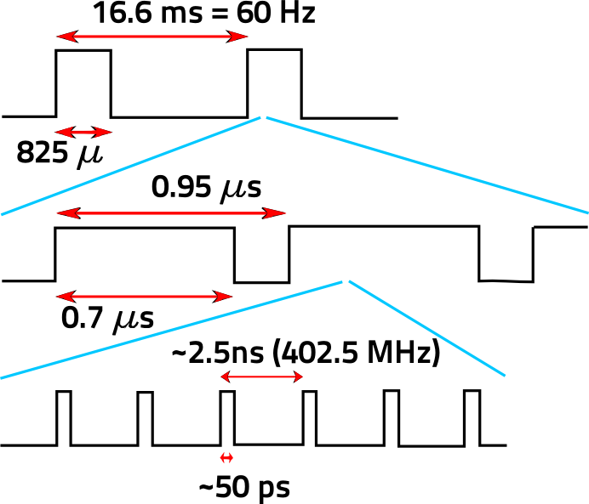
SNS Beam Structure Reminder
Macro-
Mini-
Variable
Micro-

Slide 10
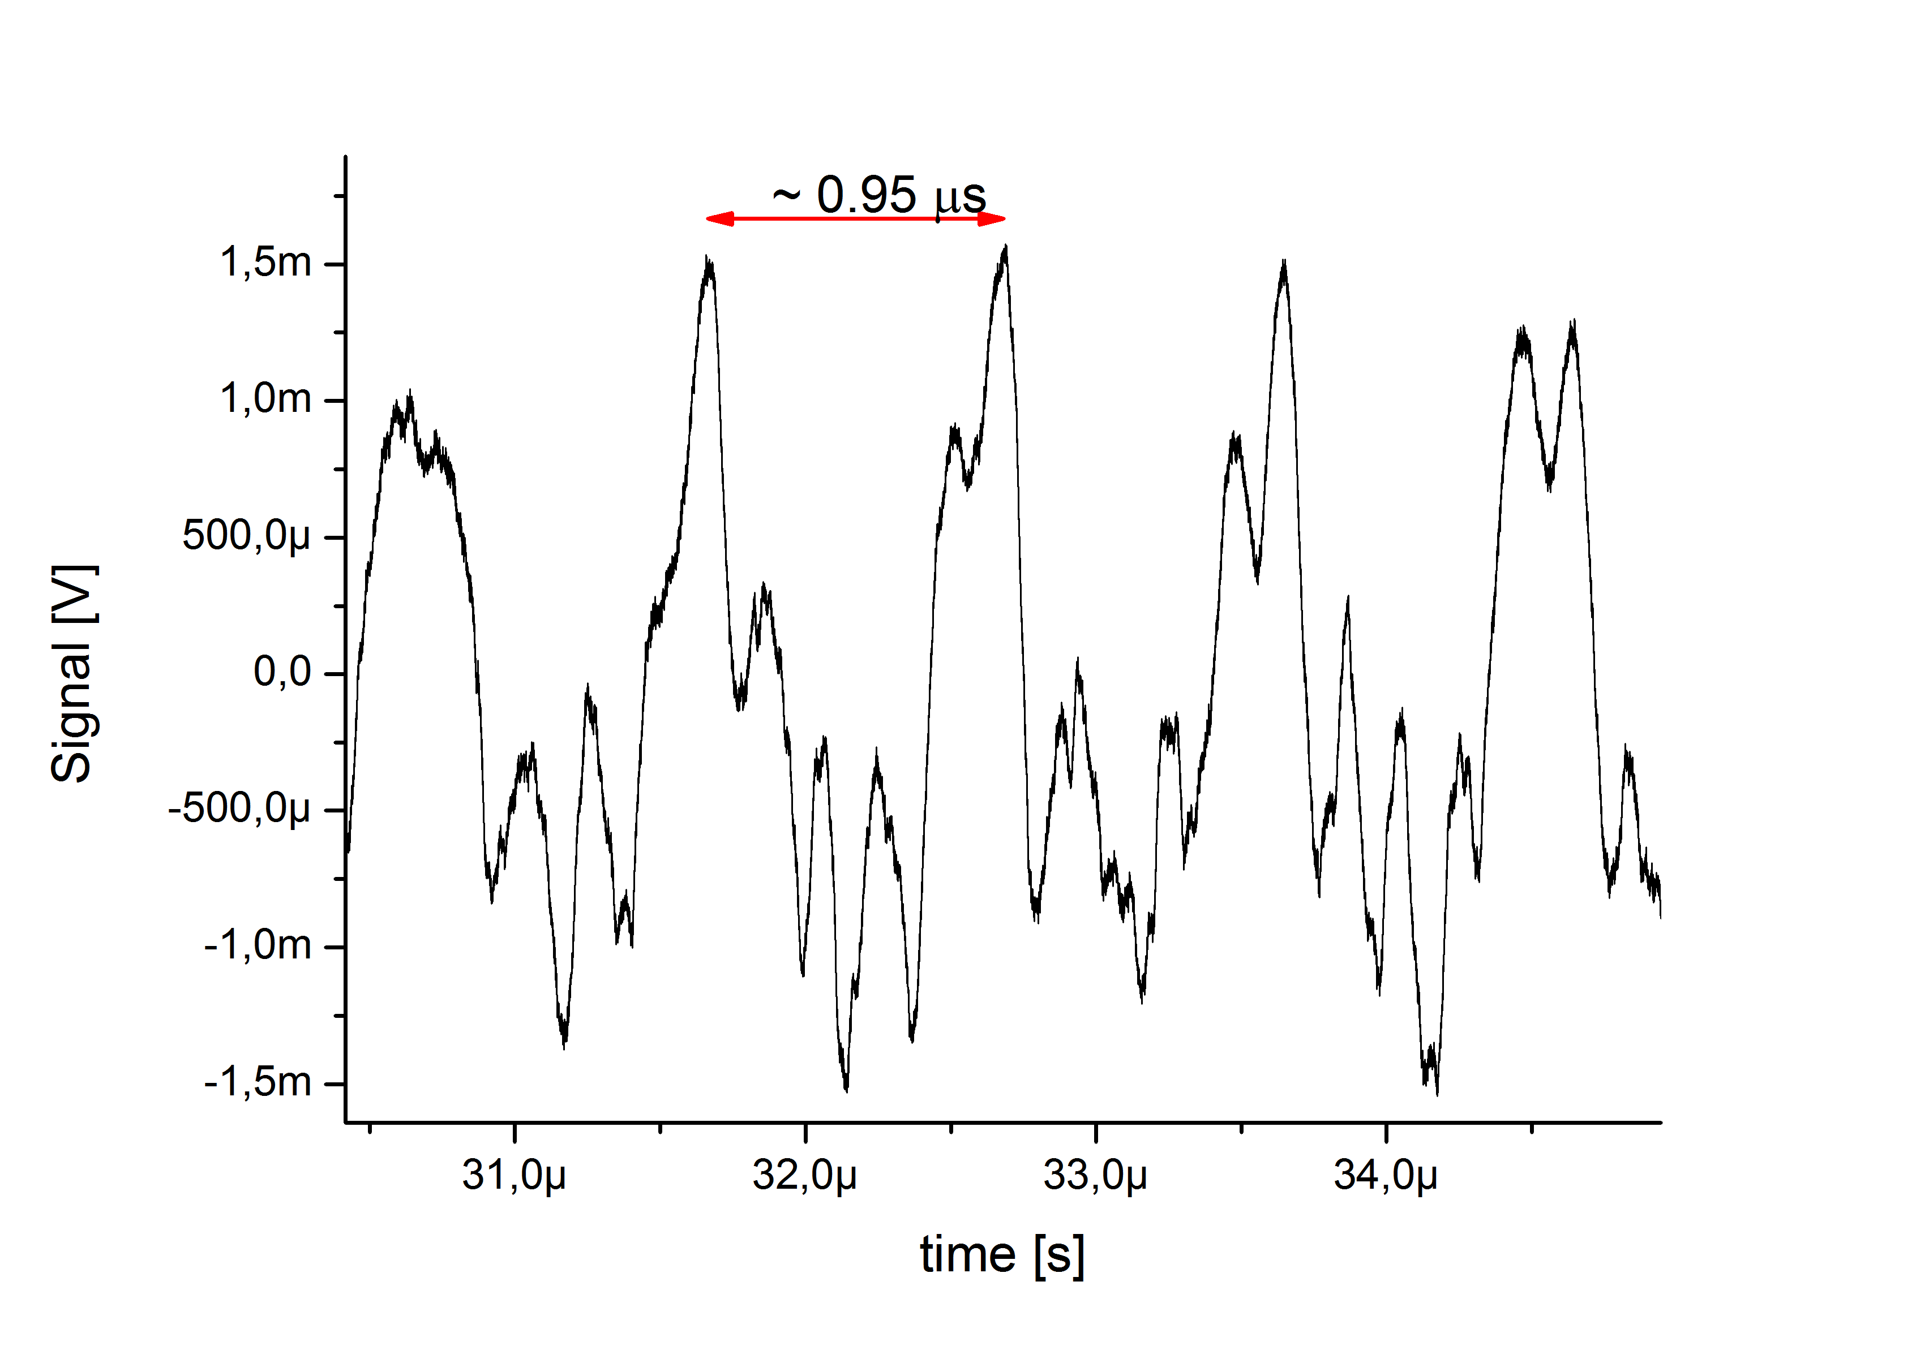
Measurement I
Use of a hybrid to analog sub-tract signals of open and closed PMT to reduce background
200 averages

Slide 11
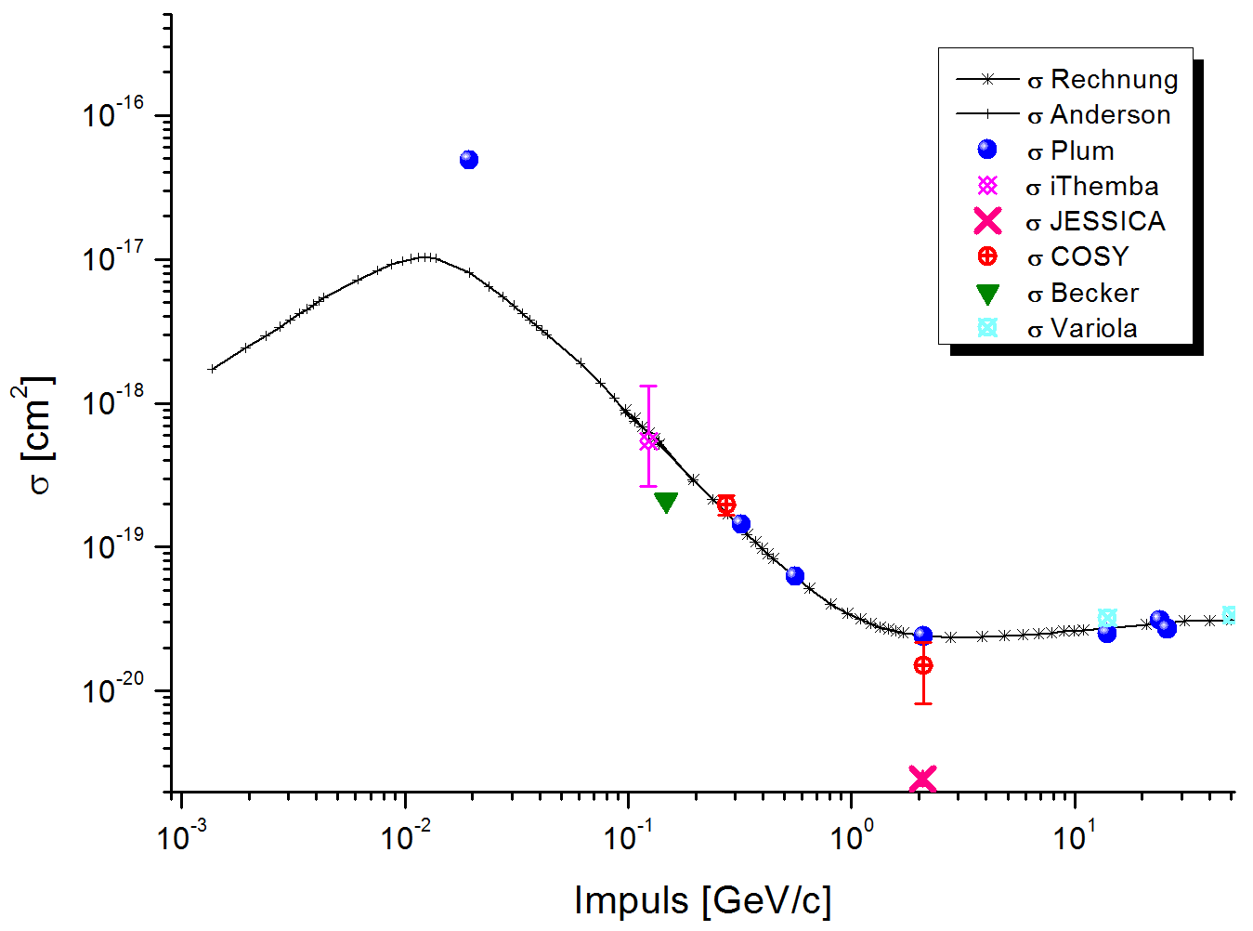
Theoretical predictions
Cross sections for proton beams measured at different labs
Calculation results in ~30 photons / 10 s for SNS
$σ= \frac{No. of photons}{No. of projectiles × No. of targets}$

Slide 12
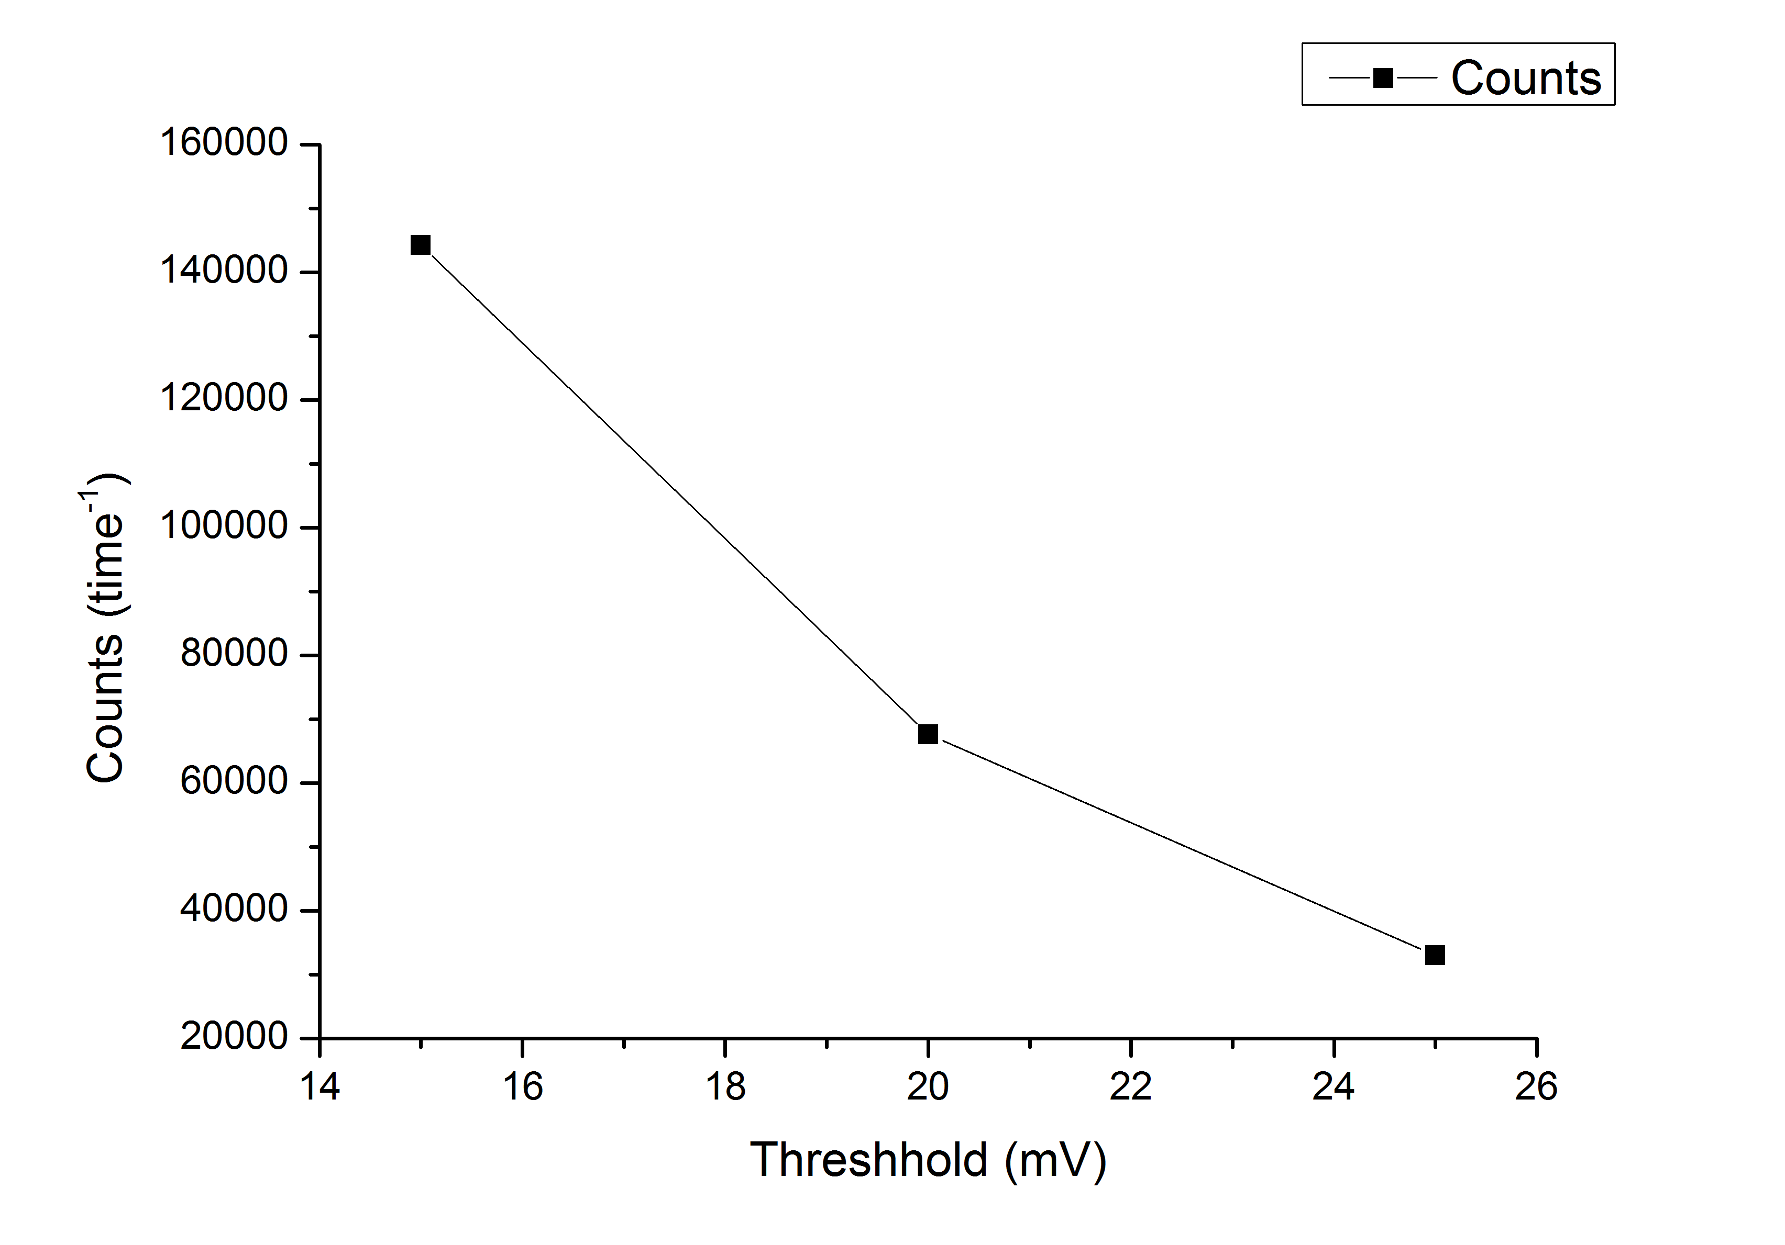
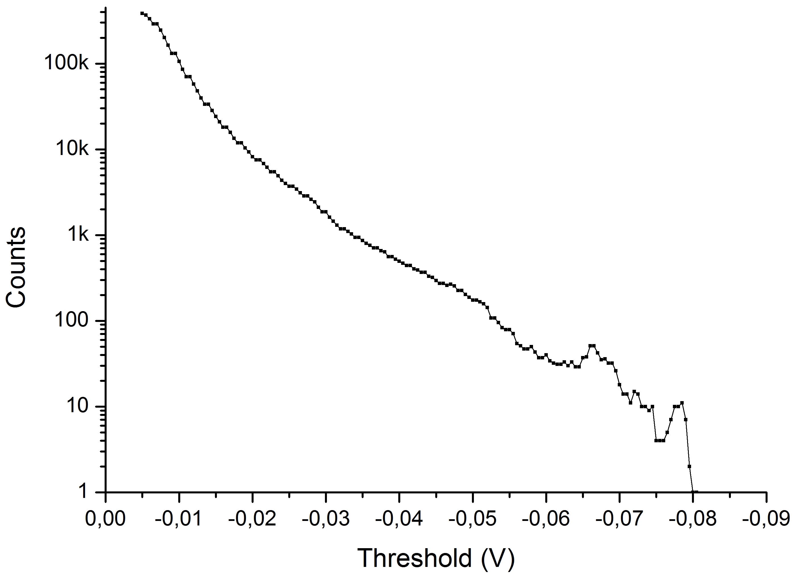
Measurements II
Using a PMT counter module to count events
Countrate dependent on discriminator threshold
Much more counts than expected (~30 in 10 sec).
10 sec (=600 pulses)
1 pulse

Slide 13
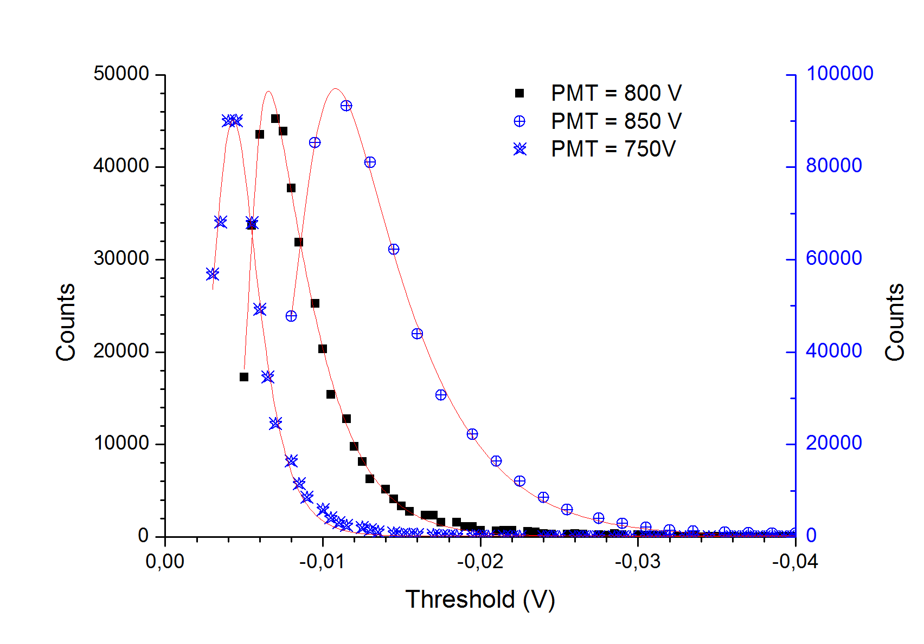
Theshold Determination
Counting behavior as expected
Threshold was chosen to high
Countrate even higher than measured

Slide 14
Results II
The ministructure of the beam could be measured
The countrates achieved were much to high compared with theoretical predictions

Slide 15
Conclusions
Countrate much higher then expected
As the empty pulse showed no significant counts, resulting assumption: Signal is beam related
Losses should be seen in blind PMT as well
Possible explanations:
Electrons accelerated by the beam (H⁻-Beam) induce additional luminescence in residual gas
Inner-beam effects (under investigation)
Losses / electrons induce luminescence elsewhere (window, residual gas)

Slide 16
Possible Next Steps
Check if losses induce scintillation in window
Setup ready, waiting for production beam
Cross-check results with proton beam
Looking for opportunity using SNS proton beam
Setup position sensitive PMT & optics at the window and measure beam / background luminescence distribution within beam pipe
Possibly cross-checking with H- / proton beam necessary

Slide 17
Special Thanks to
A. Aleksandrov
W. Blockland
V. Kamerdzhiev

Slide 18
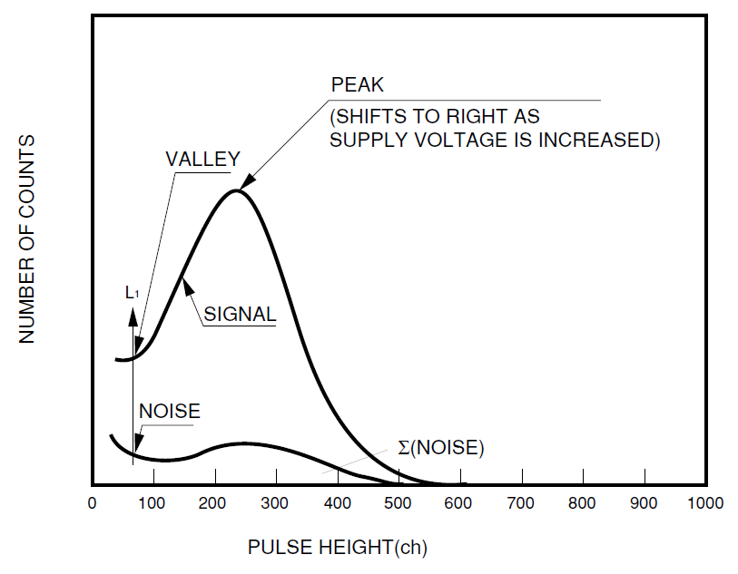

Slide 19
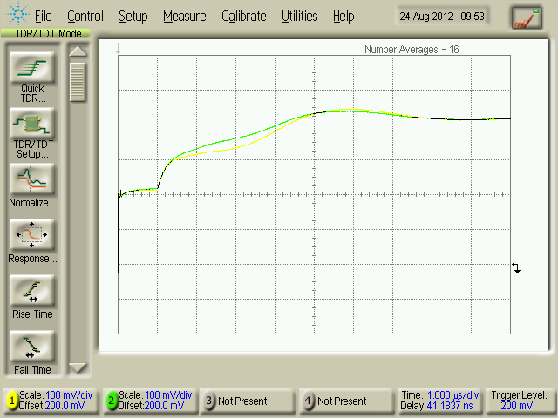
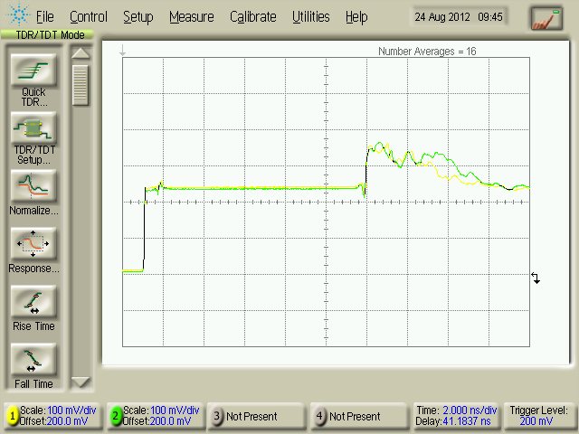
Cable Quality

Slide 20
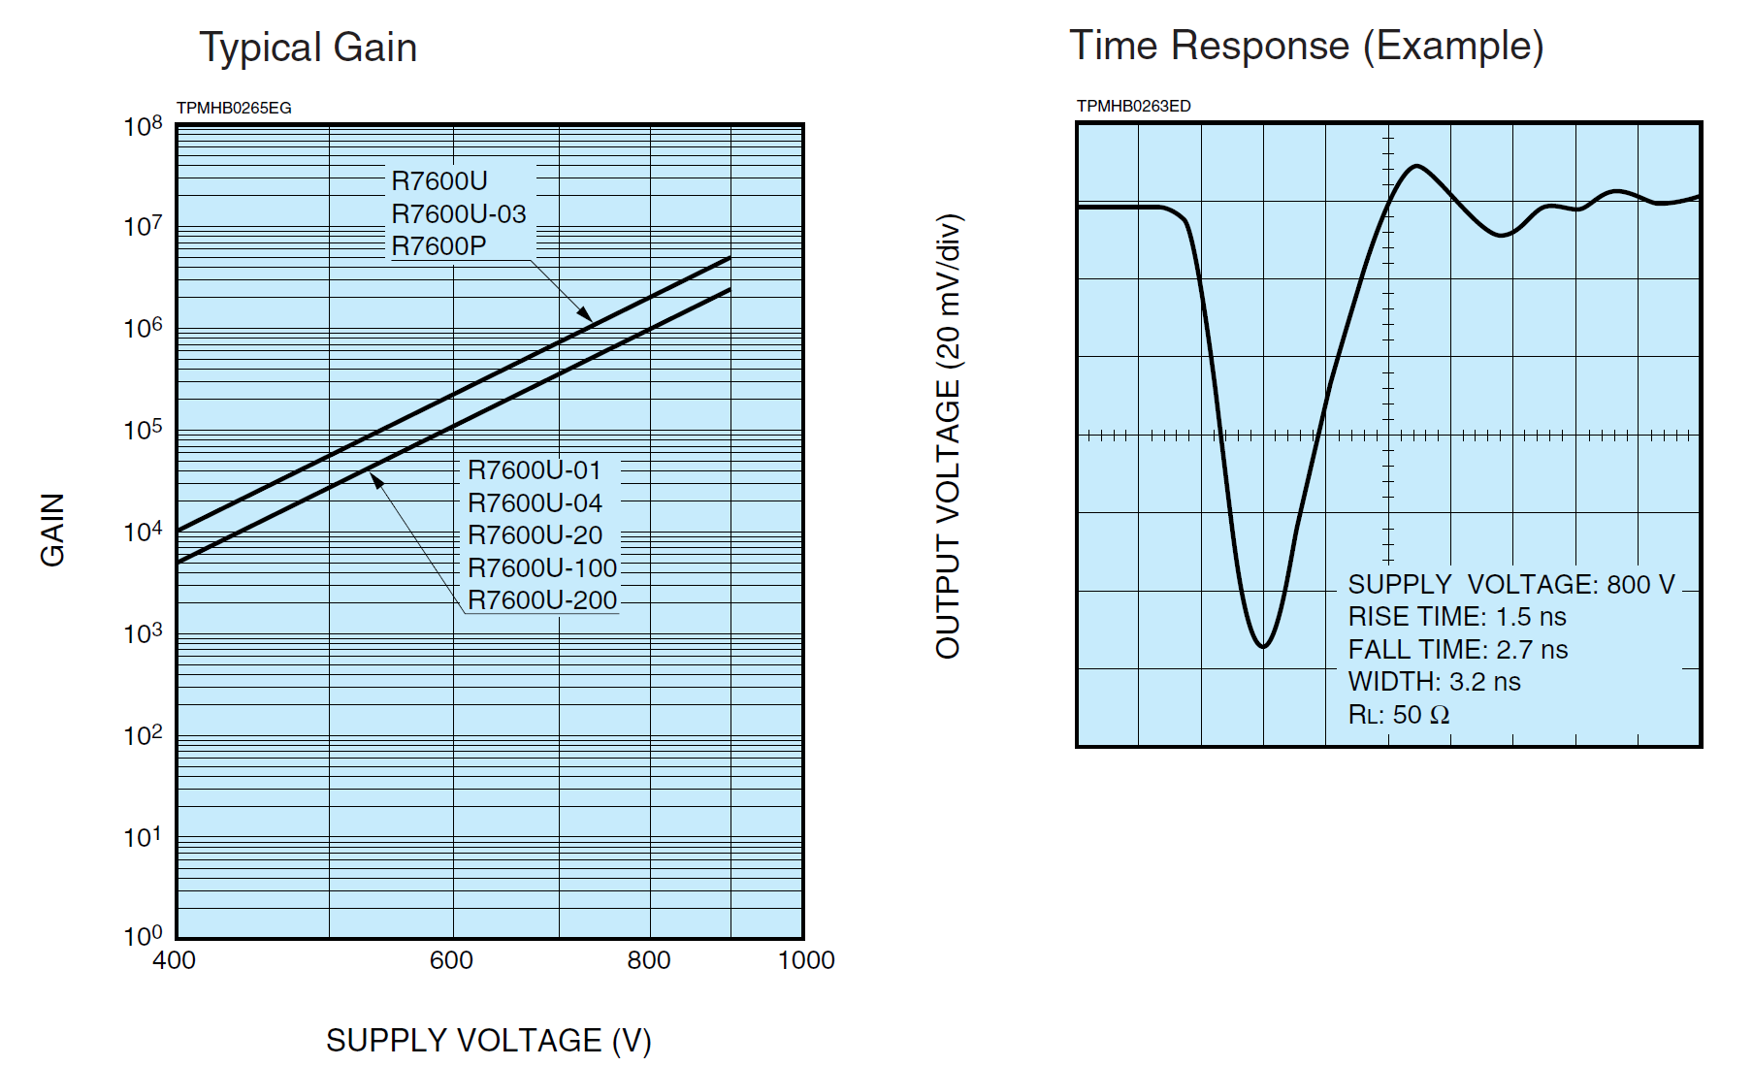
PMT

Slide 21
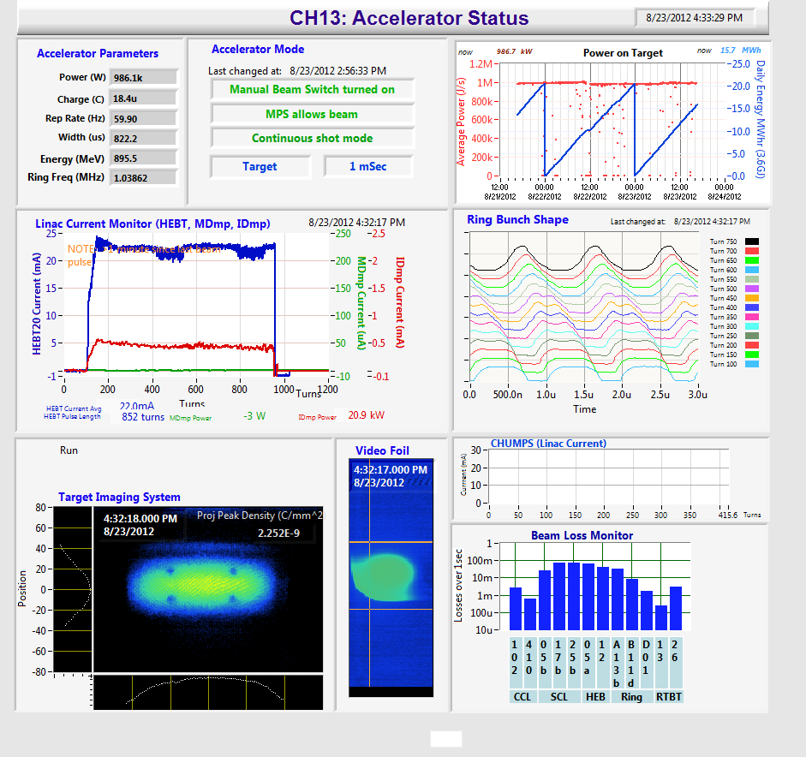

Slide 22
