Slide 1

ESS Timing System
Prototype 2012
Miha Reščič, ICS
Miha.rescic@esss.se
Miha.rescic@cosylab.com

Slide 2
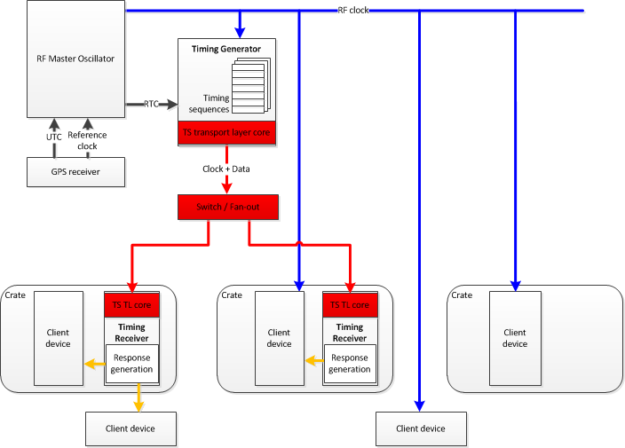
Architecture overview
Pulse
sequence
Clock, Triggers, Timestamps

Slide 3
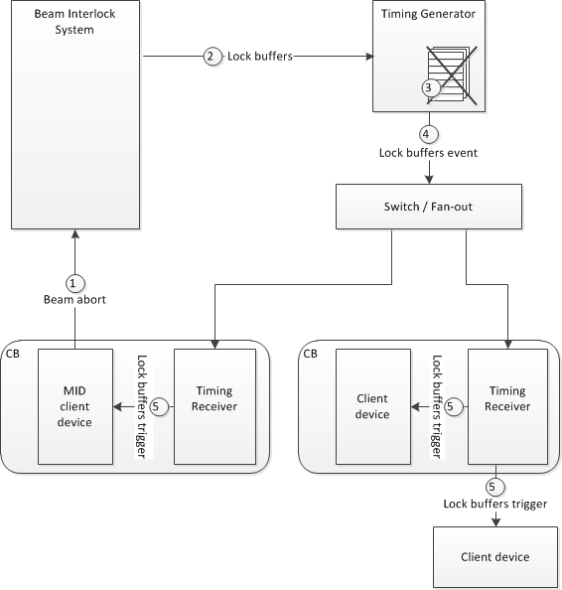
Integration with MPS

Slide 4
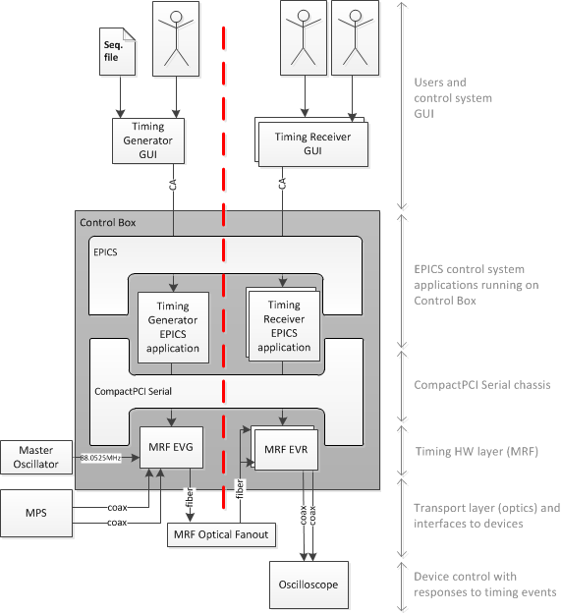
Prototype Column

Slide 5
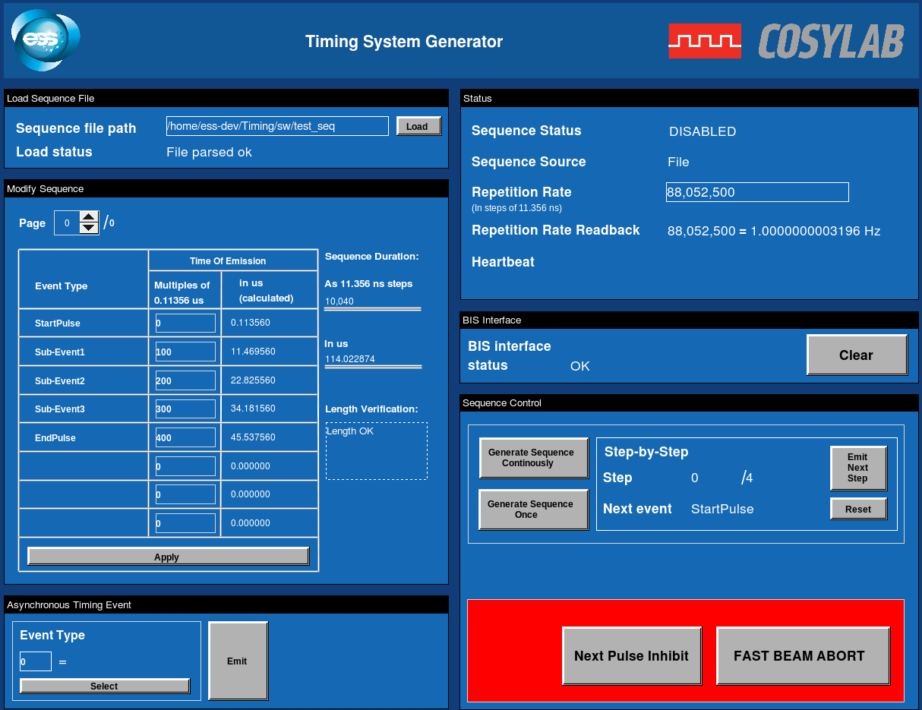
  Timing Generator
  Generator clock phase-locked to Master Oscillator (88.052500MHz)
  Generate 14Hz pulse repetition frequency
  Execute timing sequences
    Load from files, optionally modify on-the-fly in GUI
    Locked to 14Hz pulse repetition
    10*fevent event granularity (113.57ns)
      25183* 10*fevent = 2.859998ms
    repeating, once only, step-by-step

Slide 6
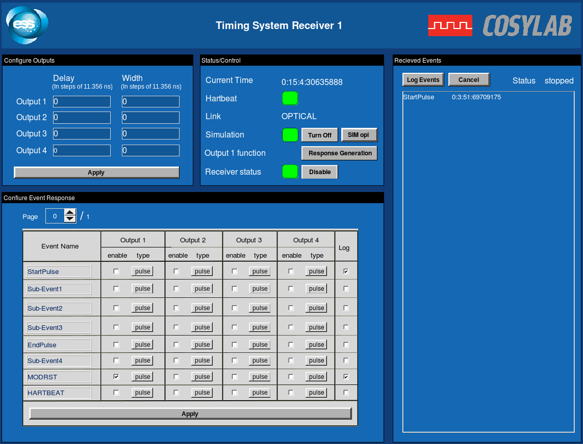
  Timing Generator
  Emit asynchronous events
  Simulate MPS beam abort to stop the generator and send lock post-mortem buffer event
    Immediately (Fast Abort) or after sequence finishes (Beam Permit)
  Distribute global time information to receivers (ns precision)

Slide 7
Timing Receiver
  Output timing clock phase-locked to Master Oscillator
  Configure triggers upon timing events
    Configurable delay and width
  Monitor status
    optical link status
    reception of heartbeat
    current time emitted by the generator (global time)
  Log events with global time with ns resolution

Slide 8
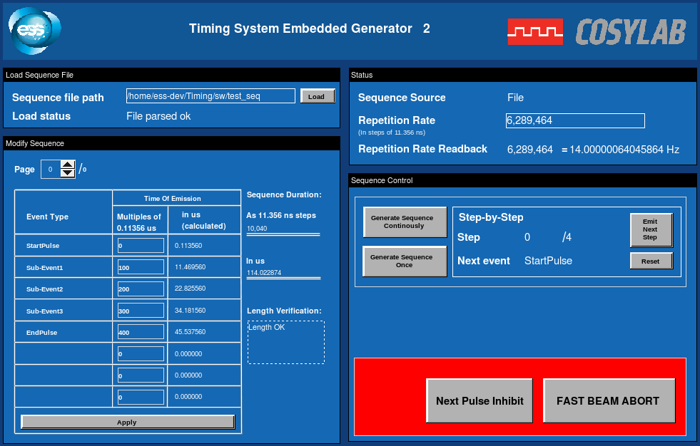
Timing Receiver
  Run timing generator on the receiver - standalone mode
    Easy development and integration without access to full timing system network

Slide 9
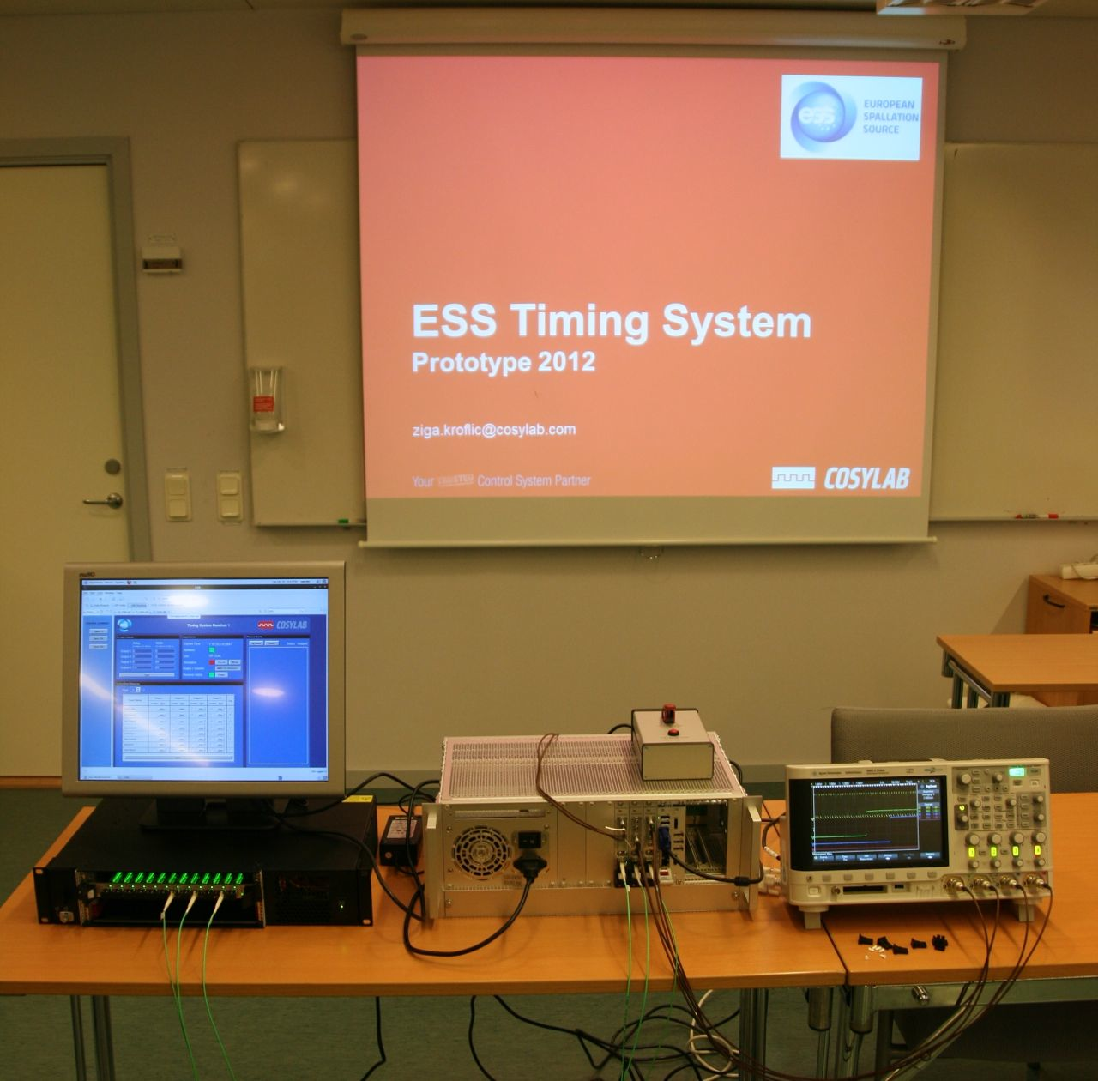
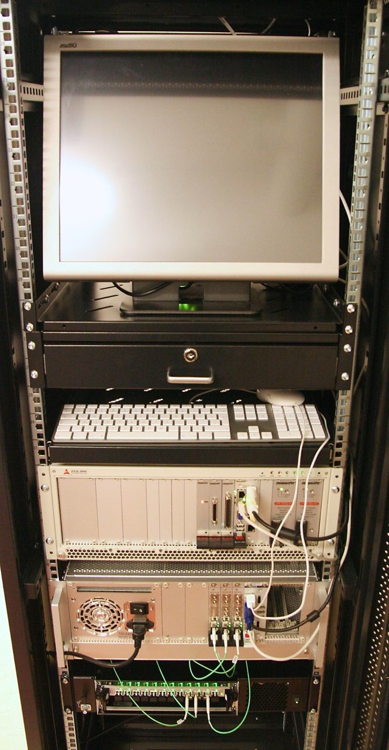
Demo

Slide 10
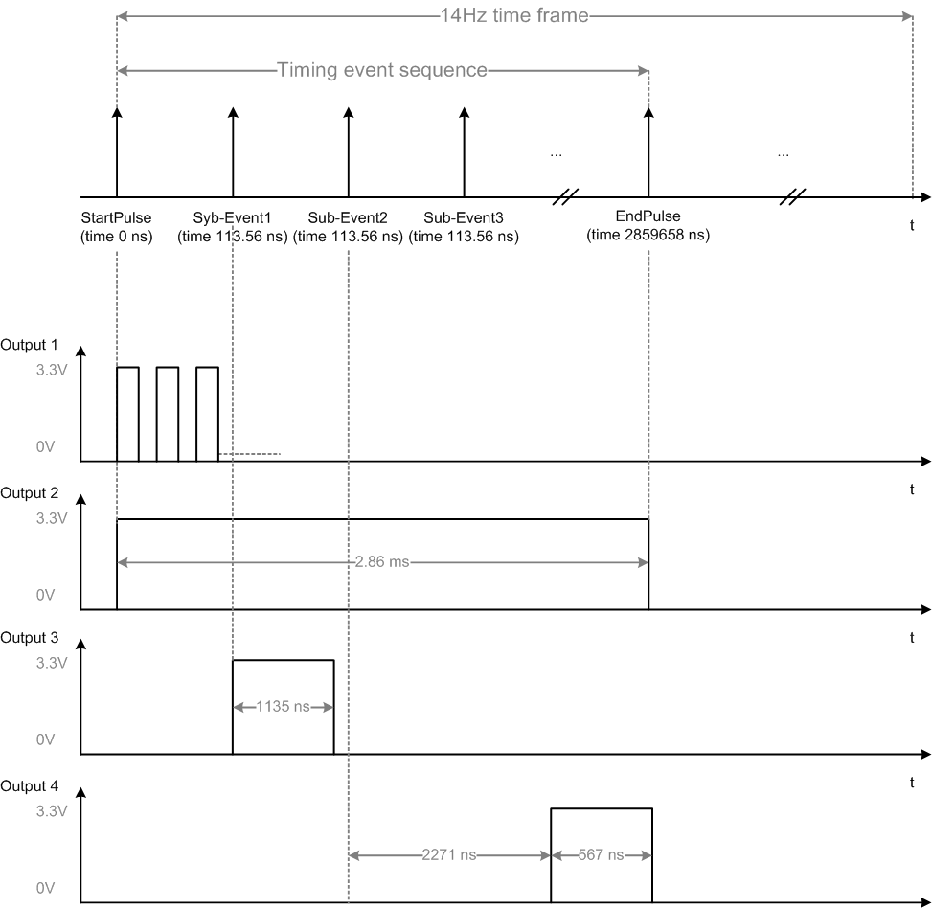
Demo

Slide 11
Thank you!

Slide 12
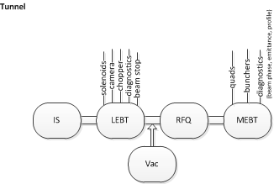
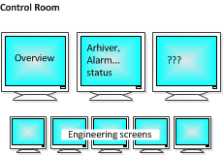
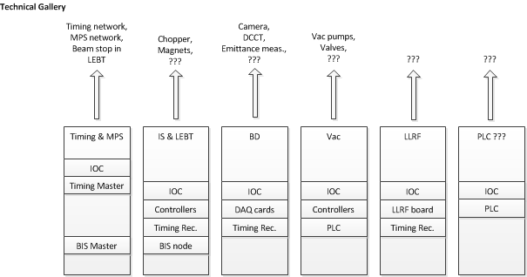


Big Picture
Timing Mast.
Timing Rec.

