Slide 2
Introduction
Welcome
DMSC Winter School 2026
❄️
❄️
❄️
❄️
❄️
❄️
❄️
❄️
❄️
❄️
❄️
❄️
❄️
❄️
❄️

Slide 3
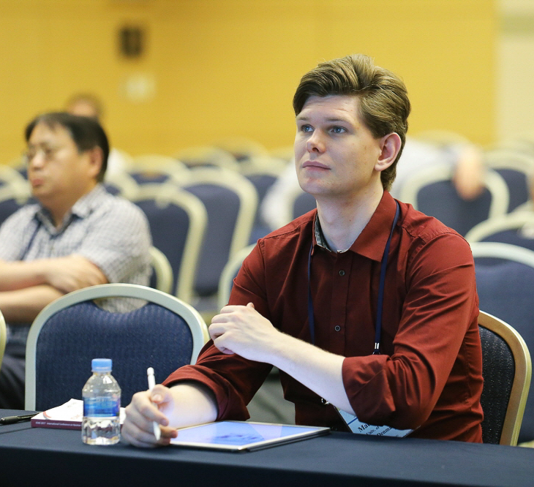

Introduction
Who am I?
Mads Bertelsen
Worked on ESS since 2011
Helped with proposals for BIFROST, HEIMDAL, MIRACLES, VESPA
PhD at University of Copenhagen with Kim Lefmann
Started at DMSC 2019
Work with instrument simulations
Lead effort of DMSC Summer School last two years

Slide 4
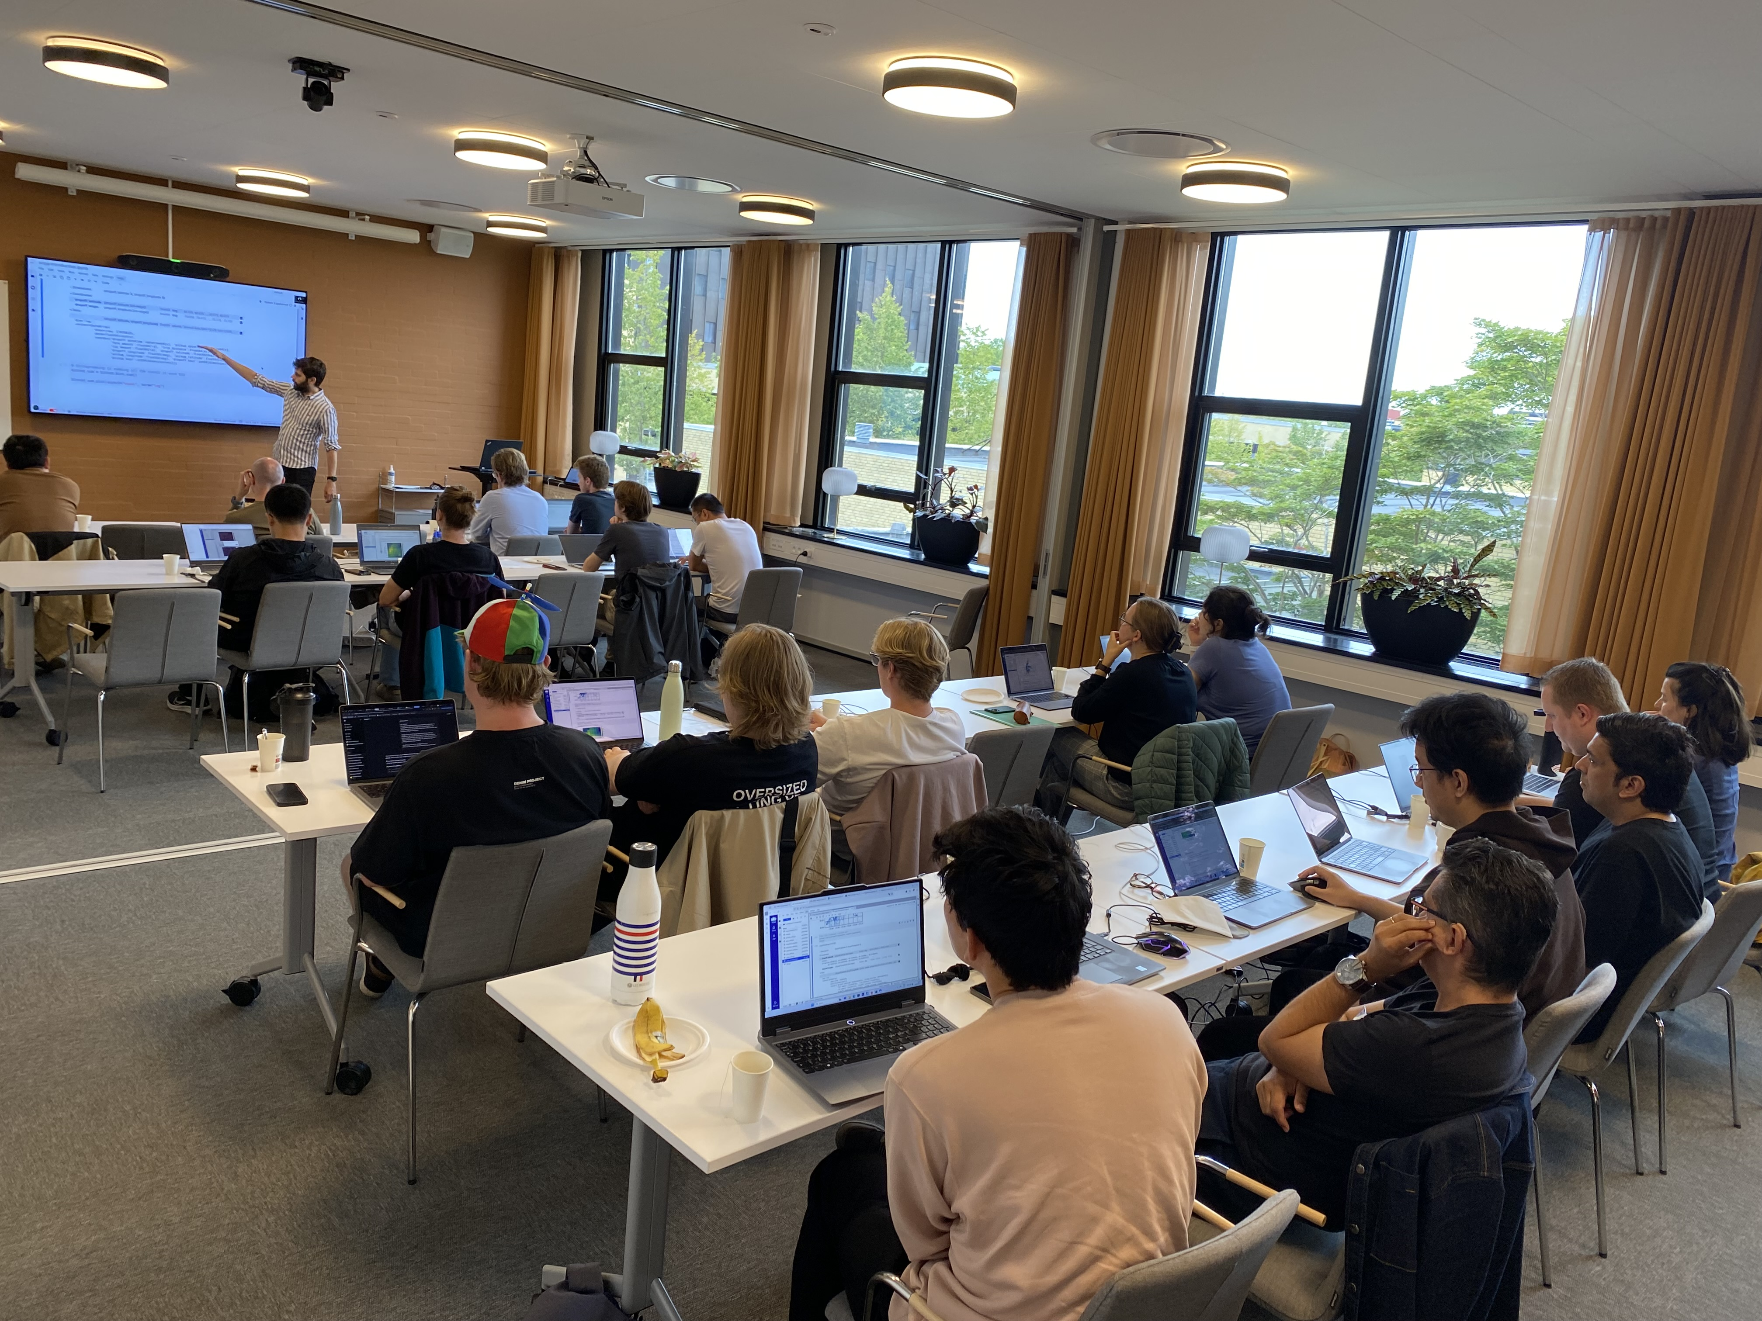
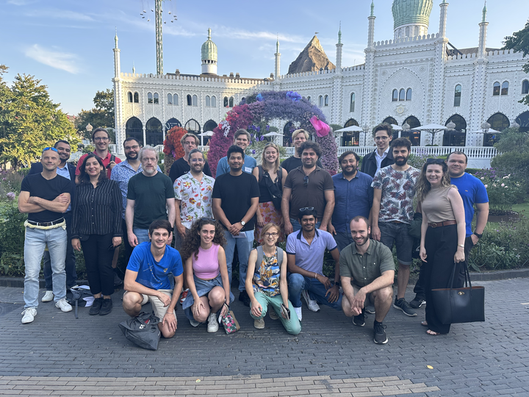
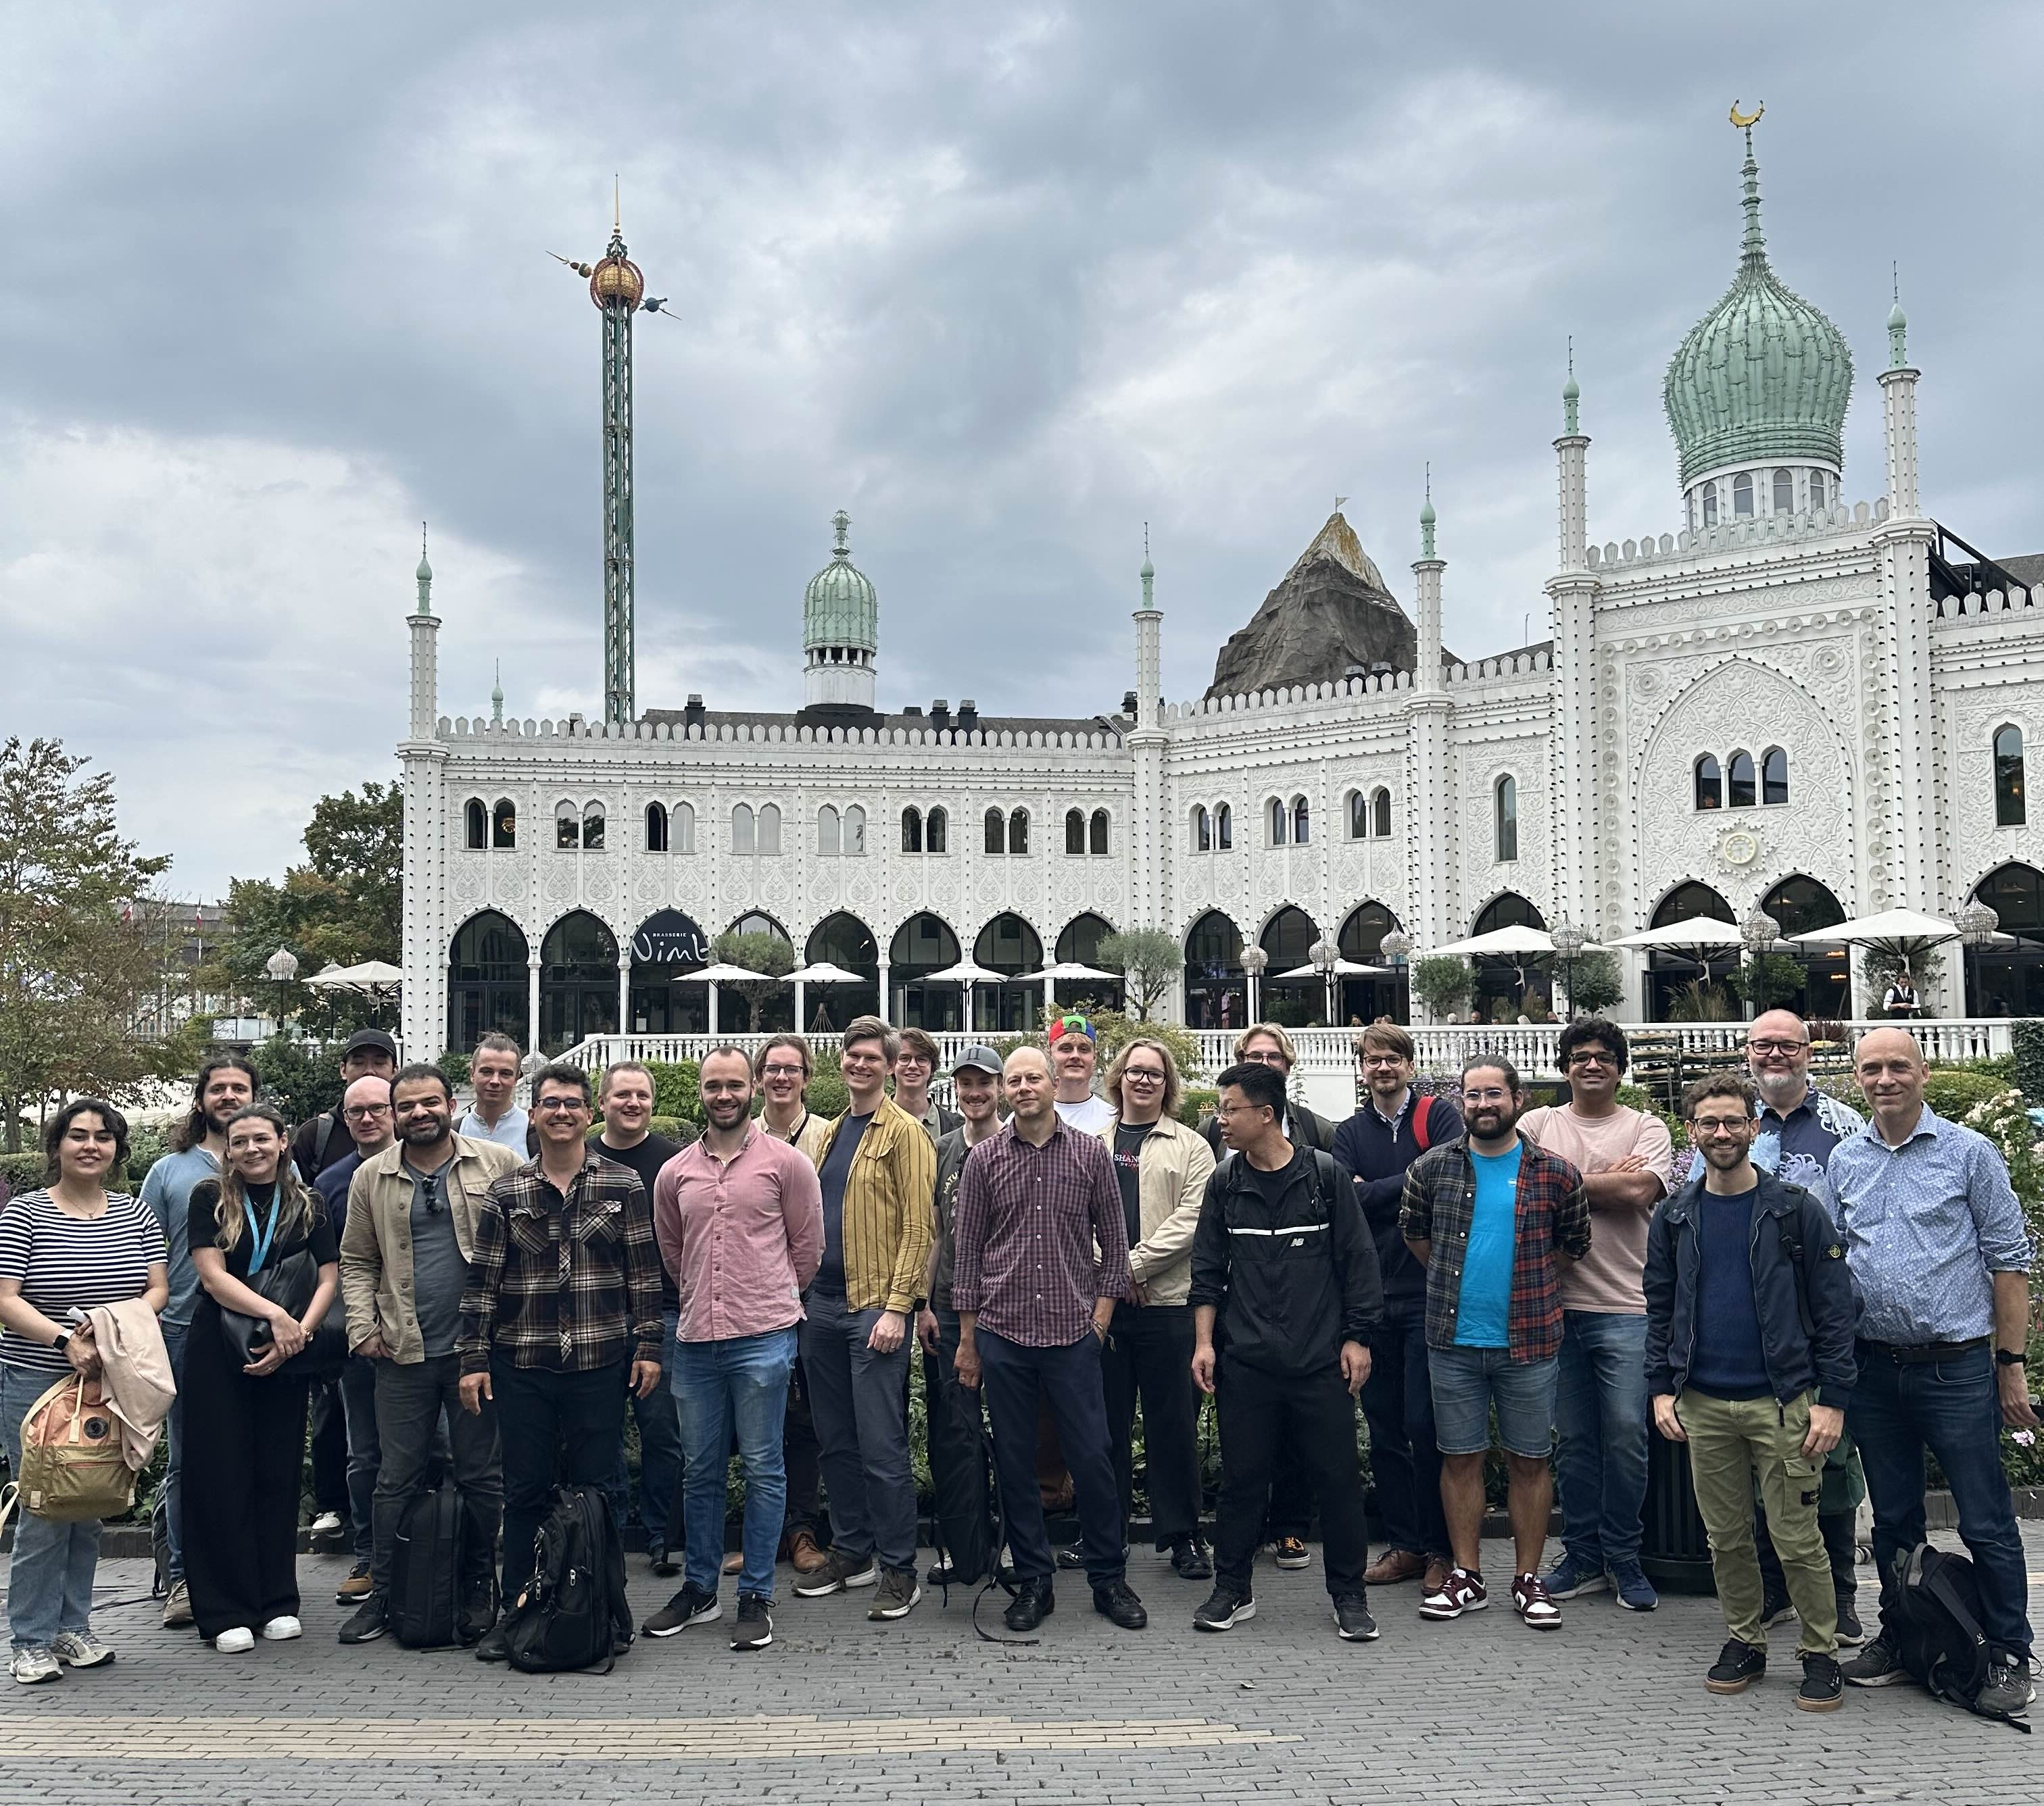




Introduction
DMSC Winter School – condensed version of DMSC Summer School
5 day schools to teach core of our software suite, ran in 2023 / 2024 / 2025
Now we are confident enough to teach you in 2 days!

Slide 5
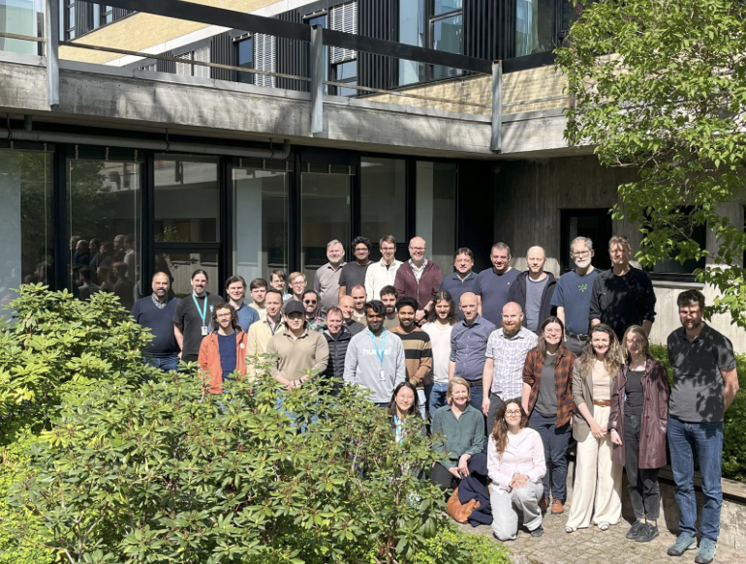
DMSC
Data Management and Scientific Computing
On Technical University of Denmark campus
Approximately 42 full time employees
Will reach over 60 in operation
Very international, 20 countries represented
Started earlier in the project than typical
A mandate to push software for neutron scattering forward

Slide 6
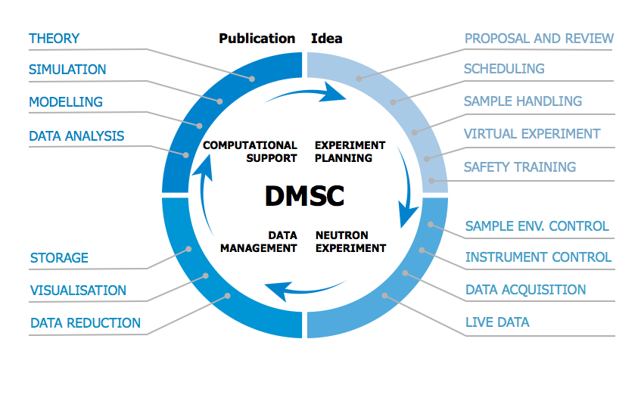
DMSC
Responsibility
Added since 2013: FAIR data management and AI
ESS Technical Design Report (2013)
Figure 2.48: IT services and infrastructure provided by the Data Management and Software Centre …

Slide 7
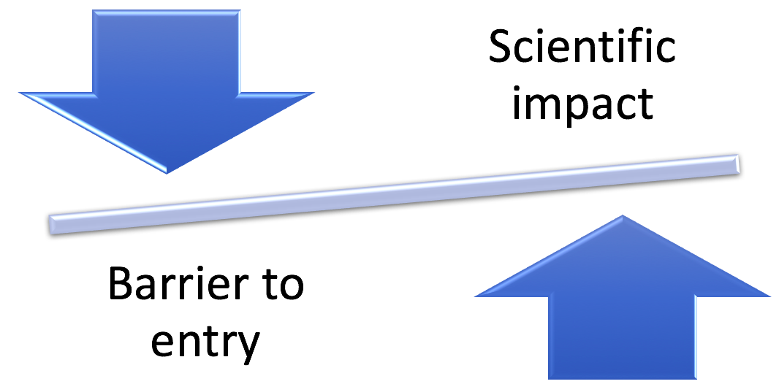
DMSC
Approach
How DMSC has chosen to lift the task
Chosen solutions must cover needs of ESS
Software should be open source
Embrace standardization
Collaboration on software development
If a satisfactory open source solution that cover ESS requirements exists, use that … ... otherwise a solution needs to be developed
In some cases we join development of open source projects to add required features

Slide 8

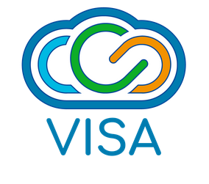
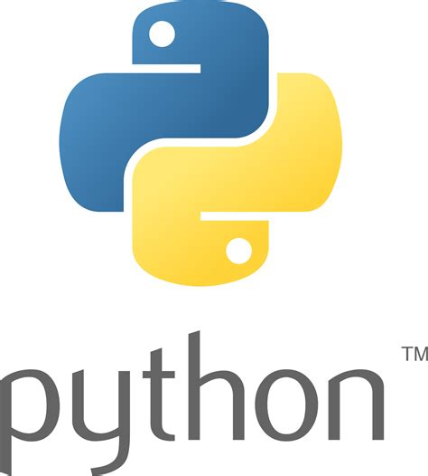
DMSC
Approach
FAIR data
Findable, Accessible, Interoperable, Reusable
Internal cloud computing
Staff and users can work on virtual computers matching their needs
Avoid need to download large datasets and installing software
One (interface) language
Can’t expect users to learn multiple languages
Currently most used language in science, large ecosystem
Many already have experience with Python
With one language, easier to use / install the tools together

Slide 9
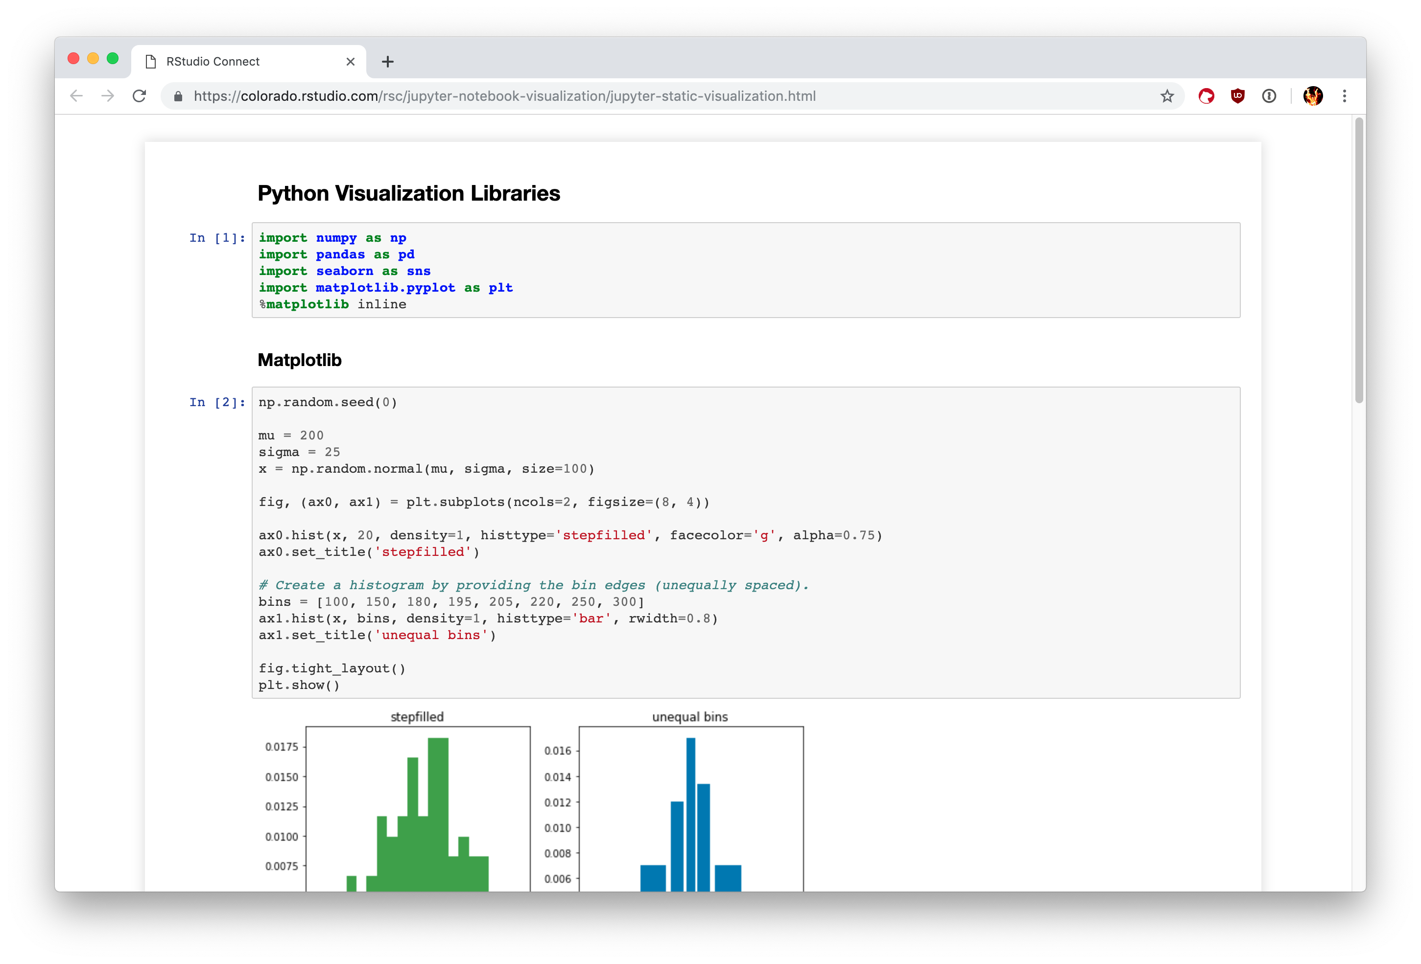

DMSC
Approach
Considering staff and users
Range of needs and capabilities
Difficult to write
Large scope
Easy to use
Limited scope
Developing bespoke Python package
Python scripts
Jupyter notebooks
Jupyter widgets
Graphical user interface

Slide 10

DMSC
Cases
Responsibility:
Instrument control
NICOS
GUI and scripting
Could be adapted to EPICS network
Open source? | ✅
Python scripting? | ✅
Covers ESS needs? | ✅
Chosen solution:
Join NICOS development

Slide 11
DMSC
Cases
Responsibility:
Instrument simulation
McStas
Already used for many ESS instruments
Open source? | ✅
Python scripting? | ❌
Covers ESS needs? | ✅
Chosen solution:
McStas continues development at DMSC, add Python scripting

Slide 12

DMSC
Cases
Responsibility:
Data reduction
Mantid
Can handle event data
Could not handle expected data rate
Open source? | ✅
Python scripting? | ✅
Covers ESS needs? | ❌
Chosen solution:
Develop reduction framework at DMSC
Scipp
Fast, C++ with Python interface
Handles units, transformations, event data, …
Open source? | ✅
Python scripting? | ✅
Covers ESS needs? | ✅

Slide 13
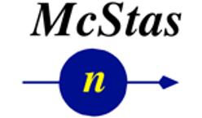

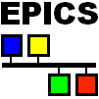





DMSC
Pipeline
Technique
specific
Modelling & simulations (planning)
Stream events & meta data
Data reduction & visualization
Data analysis & modelling
Experiment control
User office software (proposal)
Reduced data
I(q,ω)
FAIR
Raw data

Slide 14
DMSC
Educating staff and users
DMSC have chosen software solutions to cover its responsibilities
Considering staff and users experience and learning curve
Mix of solutions
Some preexisting that you may already be familiar with
Some are new developments that will require learning something new
Need to train staff everything necessary to run experiments and work with data
Instrument Data Scientists will be a crucial link

Slide 15
Winter School
Strategy and materials
To best teach this software, we start with simple cases, not the final workflows
Here focus parts that are common to all instrument types
At a later stage IDS will teach smaller groups technique specific tools
You will work on exercises in Jupyter notebooks on the VISA platform
Be aware the instances will be closed after some time, so save work you want to save

Slide 16
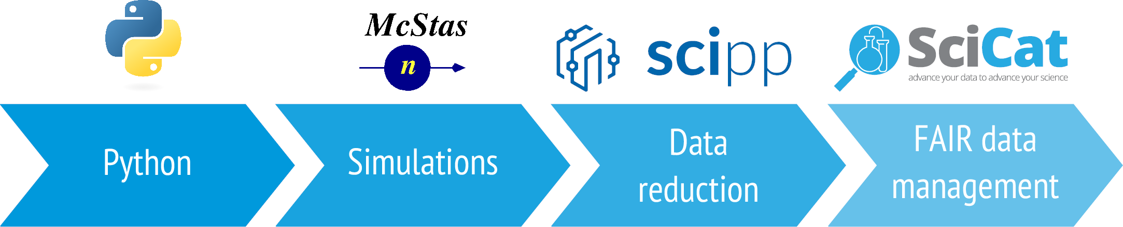
Winter School
Content
You will generate the data you work with using McStas instrument simulations, but operated through Python interface
Raw and derived data should be stored in a FAIR manner, here we will use our SciCat catalogue to demonstrate
To provide a smooth user experience, almost all our software is to be used through Python
The main topic of the school is Scipp, the data container used for reduction and handling of data

Slide 17
Winter School
Programme at a glance
Topic | Main responsible
Introduction: Workflow and tools | Mads Bertelsen
Python & McStas introduction
McStas exercises in VISA
SciCat demo
Scipp introduction | Neil Vaytet
Scipp coordinate transformation | Jan-Lukas Wynen
Scipp data reduction
Scipp’s Sciline & data reduction workflows | Johannes Kasimir
Demonstrations
Today
Tomorrow

Slide 18
Winter School
Links
Indico : https://indico.ess.eu/event/3903/
Github.io: https://ess-dmsc-dram.github.io/winter-school/intro.html
Winter school exercises: https://github.com/ess-dmsc-dram/winter-school-notebooks
Winter school repo: https://github.com/ess-dmsc-dram/winter-school
User office: https://staging.useroffice.ess.eu/
VISA: https://visa.ess.eu/home

