Slide 2
Radiation Safety Case: Context for and involvement by the Shielding&Safety Systems
PRESENTED BY Fabian lundkvist

Slide 3
Agenda
1 Background: Achieving the INP License
2 Shielding&Safety Systems: Roles in Radiation Safety
3 SAR Checklist & Rad Safety Readiness Summary
4 Questions

Slide 4
1
Background: Achieving the INP License

Slide 5
License to Operate – INP NOW
A step wise approach to routine operation license
Routine operation permit
Submission TBD
Received TBD
Trial operation permit NCL
Trial ops permit SCL
Trial ops permit BOT, NSS, H09
Submission Jul 2019
Received Oct 2020
Submission Dec 2024
Expected Oct 2025
Extension for new Instruments
Submission Oct 2023
Received May 2024
Installation permit
Installation permit NSS & H09
Submission May 2016
Received Oct 2017 excl. NSS and H09 (rad waste)
Submission Mar 2022
Received Sept 2022
Siting permit
Submission Jan 2012
Received Jun 2014
INP = Intentional Neutron Production

Slide 6
How do we get there?
Connection from engineering design to licensing
Several stages from Design to License to operate beam to Target
Engineering & Analysis
Define operations concept, systems, radiation hazards
Analyse ability to manage hazards (normal operations & accident analyses) -> define RSFs, WRSFs needed
System (SSCs): classification, design, verification/validation
Commissioning plan, OLC
Licensing
Write cSAR
PSR and ISR reviews
SSM review Trial Operations
Respond to SSM RFIs License
Acronyms:
RSF – Radiation Safety Function
WRSF – Worker (only) Radiation Safety Functions
SSC – Structure, system, component
OLC – Operating Limits and Conditions
cSAR – current Safety Analysis Report
PSR – Primary Safety Review
ISR – Independent Safety Review
SSM – Swedish nuclear regulator
RFI – Request for information
SRR – Safety Readiness Review
SRR

Slide 7
Radiation Safety Analysis Purpose
Protect ESS workers and the public from potential radiological consequences
Apply a systematic process to identify, evaluate, and control potential radiation hazards related to ESS areas.
Identify hazardous conditions and events associated with the facility processes, operations, work activities, and natural phenomena
High power beam impacting the tungsten target will create an inventory of nuclides
3000 kg of tungsten, 5 MW proton beam, 5-year target wheel lifetime
Understand potential hazardous conditions and scenarios
Define necessary prevention and mitigation measures
Input to system design requirements – Target systems, ACC systems, Instruments, Waste management, building features, shielding, HVAC, Controls, PSS, TSS
Identify need for radiation safety functions
Identify g evaluate g control these hazards (planned) and events (unplanned)

Slide 8
Achieving the Operation License
How do we do this with respect to rad safety?
Demonstrate
That we understand the radiation hazards for the facility.
That we have identified the necessary radiation safety functions to manage them.
That we have properly implemented the systems to execute those functions.
The systems meet the requirements defined by the analyses (functions, classification, reliability, quality, withstand appropriate loads, etc.).
The systems follow ESS design rules.

Slide 9
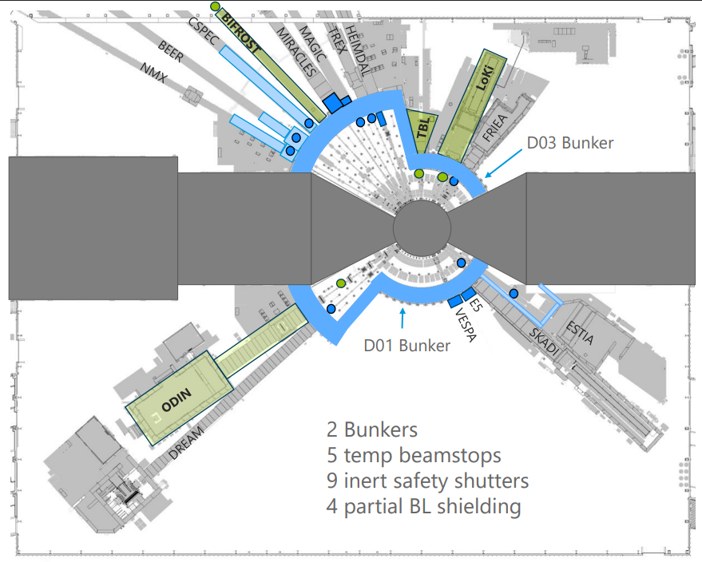
Areas involved for the Shielding&Safety systems
Areas of relevance:
D01
D03
E02

Slide 10
2
Shielding&Safety Systems: Roles in Radiation Safety

Slide 11
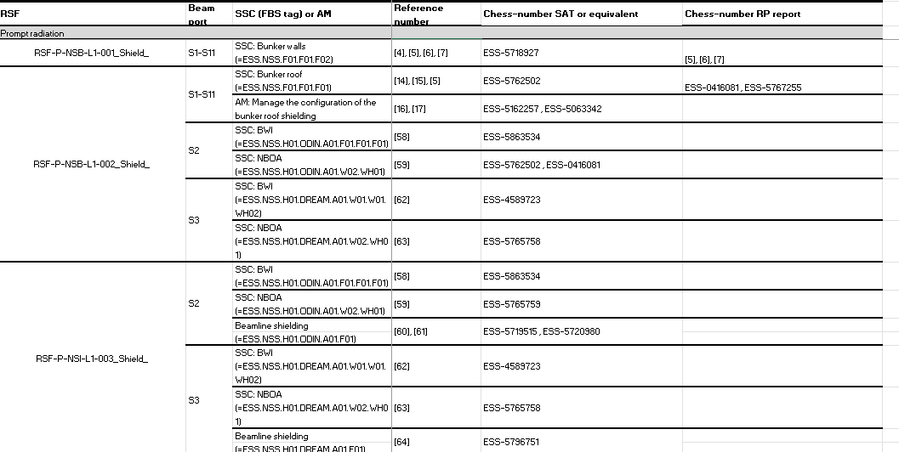
Shielding&Safety systems Safety
ESS-5912419 - Comprehensive reference list for the Shielding and Safety systems

Slide 12
S&SS Safety Case – 7-Step References
S&SS Systems
Step 1
NSS ConOps (ESS-0005817)
NSS SDD (ESS-00377817)
Step 2-3
Proposed area classifications for D, E, & G buildings (ESS-0057612)
NSS Provisions (ESS-2972939)
Provisions Utility block (ESS-2027007)
Step 4
NSS – Rationale for selection of bounding events (P/W) (ESS-0281261)
Qualitative Identification of NSS Events(ESS-4868730)
Step 4-5 (AAs)
Earthquake: NSS2P (ESS-1834687), NSS2W (ESS-3918239)
Shielding: NSS4P (ESS-1163894), NSS4W (ESS-1273763), NSS9P (ESS-3820989), NSS9W (4041791),
Human presence: NSS11W (ESS-2135635), NSS12W(ESS-5162140)
Summary of Unplanned Event assessments (ESS-5667527)
Step 6 (Classification)
ESS categorisation (ESS-3730670)
Classification report: Shutters (ESS-5033510),
Step 7 (DID):
NSS DiD (ESS-3872939)
NF DiD (ESS-0061641)

Slide 13
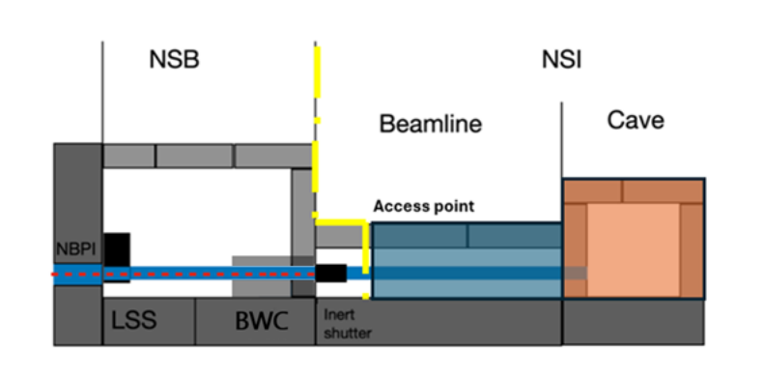
What systems?
S&SS SSCI2S (structure, system, components important to safety)
Monolith inner and outer Shielding
Beamline shielding
Up to shutter
Neutron Beam Port Plug (NBPP)
Neutron Beam Port Insert (NBPI)
Neutron Beam Optical Assembly (NBOA)*
Bunker Wall Insert (BWI)*
Collimators*
Bunker Walls / Roof
Instrument shutters (Active/Inert)
Temporary Beam stops
Light Shutter System (LSS)
Personnel Safety System (PSS) – Bunker
Boundary for the S&SS
*Not explicit SSCs – affects shielding calculations

Slide 14
S&SS in Rad Safety
Roles for SSCs in Radiation Safety
Important for public
Execute Radiation Safety Function (RSF)
Related Administrative Measure (AM)
Procedure related to system operations, maintenance, facility operations/emissions
RS Classified
EI&C, Mechanical, Civil, HVAC, lifting
Act as barriers
Involved in Operational Limits & Conditions (OLC)
operability requirements, compensatory measures, MCR-owned
Involved in Facility Safe State
Service SSC - Enables another system to maintain RSF during accidents wrt public
Important for workers (not public)
Execute Worker Radiation Safety Function (WRSF)
Worker Administrative Measure (WAM)
RS Classified
EI&C, Mechanical, Civil, HVAC, lifting

Slide 15
Systems in RS for Public
S&SS SSCs – Functional requirements
Monolith Shielding:
RSF-P-TUB-L1-003_Shield_: Shield monolith sources
RSF-R-TUB-L1-012_Shield_: Shield monolith sources
Bunker Wall/Roof:
RSF-P-NSB-L1-001_Shield_: Shielding of monolith/prompt gamma radiation/scattered radiation
RSF-P-NSB-L1-002_Shield_: Shield by movable shielding and manage shielding configuration
NBPP/NBPI:
RSF-P-NSB-L1-024_Shield_: Shield monolith components permanent shielding
BWI/Collimator/NBOA:
RSF-P-NSB-L1-002_Shield_: Shielding of monolith/prompt gamma radiation/scattered radiation
RSF-P-NSI-L1-003_Shield_: Shield by movable shielding and manage shielding configuration

Slide 16
Systems in RS for Public
S&SS SSCs – Functional requirements
Instrument shutter (Inert)
RSF-P-NSB-L1-026_Shield: Shield by movable shielding
Temporary beamstop:
RSF-P-NSB-L1-026_Shield_: Shield by movable shielding
Beamline shielding:
RSF-R-NSI-L1-009_Shield_: Shield by permanent shielding
RSF-P-NSI-L1-003_Shield_: Shield by permanent shielding

Slide 17
Systems in RS for Workers
S&SS SSCs – Functional requirements
LSS:
WRSF-R-NSB-L1-007_Stop flux_: Stop gamma flux by LSS
NBPP/NBPI:
WRSF-R-NSB-L1-025_Shield_: Shield monolith components permanent shielding
BWI/Collimator/NBOA:
WRSF-R-NSB-L1-004_Limit irradiation flux_: Limit number of particles
WRSF-R-NSI-L1-007_Limit irradiation flux_ : Stop gamma flux by LSS
Instrument shutter (active):
WRSF-P-NSI-L1-002_Shield_: Shield by movable shielding and manage shielding configuration
PSS (Bunker):
WRSF-R-NSB-L2-020_Stop flux_: Interlock LSS to ensure that gamma flux is stopped
WRSF-P-NSB-L2-021_Grant/prevent human presence_: Prevent access to Bunker
WRSF-P-NSB-L2-022_Prevent flux_: Interlock accelerator bending magnets
Notes:
Red circle: procedures are documented in the MM, but decont never trained on and full filter exchange not trained on (light version trained on).

Slide 18
AMs/WAMs for RS for S&SS
Bunker Wall/Roof (P) :
RSF-P-NSB-L1-002_Shield_: Manage the configuration of the bunker roof shielding
RSF-R-NSB-L1-006_Shield_: Manage the configuration of the bunker roof shielding
LSS (W):
WRSF-R-NSB-L2- 023_Stop flux_: Verify that the light shutters are in closed position / Isolate motion energy sources from the LSS in Maintenance mode when maintenance activities require major beamline component removal.
Notes:
Red circle: procedures are documented in the MM, but decont never trained on and full filter exchange not trained on (light version trained on).

Slide 19
Ams/WAMs for RS for S&SS
RP (W):
WRSF-R-NSB-L1-005_Optimise decay time_: RP group: access procedure to Bunker Interior
WRSF-P-NSB-L1-013_Prevent flux_: RP group: prevent neutron production during human presence in Bunker
WRSF-P-NSB-L1-014_Grant/prevent human presence_: RP group: control access to Bunker Roof
WRSF-P-NSB-L1-015_Grant/prevent human presence_: RP group: prevent access to the Bunker Interior
WRSF-R-NSB-L1-016_Grant/prevent human presence_: RP group: control access to Bunker Roof and Bunker Interior Inner and Outer Areas
WRSF-P-NSI-L1-018_Grant/prevent human presence_: RP group: precent access to beamline vicinity
WRSF-R-NSI-L1-020_Grant/prevent human presence_: RP group: control access to beamline vicinity
Other (W):
WRSF-R-NSB-L1-003_Optimise the choice of material type_: Procedures according to the ESS Materials Handbook (ESS-0028465)
WRSF-R-NSB-L1-004_Limit irradiation flux_: Boron layer included in components
WRSF-R-NSB-L1-008_Shield_: Temporary shielding
WRSF-C-NSB-L1- 012_Confine_: Stabilising surface treatment
Notes:
Red circle: procedures are documented in the MM, but decont never trained on and full filter exchange not trained on (light version trained on).

Slide 20
Procedural readiness
Procedures in the safety case – relevant for maintenance
WRSF-R-NSB-L1-005_Optimise decay time_ : RP group: access procedure to Bunker Interior
WRSF-R-NSB-L1-008_Shield_: Temporary shielding
RSF-R-NSB-L1-006_Shield_: Manage the configuration of the bunker roof shielding
Procedures described in:
ESS Procedure for Radiation Protection requirements to access the Bunker (ESS-5162257)
Bunker Access Management Working Group Report (ESS-5063342)
ESS Handbook for Radiation Protection Chapter 2. General Radiation Protection Rules (ESS-0239718)
WRSF-R-NSB-L2- 023_Stop flux_: Verify that the light shutters are in closed position / Isolate motion energy sources from the LSS in Maintenance mode when maintenance activities require major beamline component removal.
TSAR-254: Develope & validate procedure for LSS operation not yet resolved.

Slide 21
Classified S&SS SSCs
Disciplines: Mechanical, Electrical and Instrumentation & Control
SSC (FBS) | Mechanical | Electrical/ I&C | Reference
Instrument shutters (=ESS.NSS.H01.INSTR.A01.R03.R01) (P/W) | MQC4 | EIC0 | ESS-5033510
Classification -> Design, inspection, quality requirements

Slide 22
Facility Safe State (ESS-5217883)
Proton beam is switched off with no possibility of being restarted
Any residual radiation is shielded
Worker*: PSS prevents any access to the Bunker
Worker*: The LSS is closed
Checklist 6.2.3, #17: Are “Safe State” defined and corresponding procedure to reach safe state established, according to “Safe state of ESS regarding radiation hazards"?
Yes. For public.
ESS-5217883 Rev4 – released Nov2024
In INP application
Safe state for workers need to be defined.

Slide 23
3
SAR Checklist & Rad Safety Readiness Summary

Slide 24
Which SSCs finish validation after BOT?
RS classified Target Group SSCs
Checklist item #2: Do systems in the review scope that are classified as SSCI2S, have their radiation safety requirements covered by completed tests, documented and released?
See ESS-5912419 - Comprehensive reference list for the Shielding and Safety systems
Concludes that the majority of the documents are released. Completed tests are documented and also released in CHESS. The following have their documents in status preliminary:
NBOA (Beer/Miracles/Magic/T-Rex/Heimdal/Estia/Skadi/Vespa/Dream/Freia)
BWI (Miracles)
Performance of shielding can only be verified with beam on

Slide 25
Radiation Safety barriers
Target Group SSC involvement
The Barrier integrity assessment NSS (ESS-4089724, Rev4), identifies the following systems to be barriers for prompt and residual radiation:
Bunker and beamline shielding
Notes:
Barriers for contamination hazards prevent the dispersion of radioactive substances within the facility and release of radioactive substances to the surroundings

Slide 26
Facility Safe State (ESS-5217883)
S&SS SSC involvement
If there has been an accident
Safe State minimises the hazard profile of any remaining risk
Checklist #19: Are “Safe State” defined and corresponding procedure to reach safe state established, according to “Safe state of ESS regarding radiation hazards"?
Yes, for public.
ESS-5217883 Rev4 – released Nov2024
Safe state for workers needs to be defined (work in progress).
✅

Slide 27
INP OLC (ESS-0357253)
S&SS SSC involvement
Monolith shielding (Permanent&Removeable)
Temporary beamstops (This may consist of the instrument shutter (with motion disabled) or a dedicated Temporary Beamstop (TBS (=ESS.NSS.F01.F01.F07))
Beamline shielding
Bunker roof
Bunker walls
NBPI/NBPP
Checklist #18: Is Operational Limits and Conditions released in CHESS for the upcoming commissioning step released and known by relevant staff? ?
Yes
ESS-0357253, Rev19 released 19-Sept2025
Note: Rev19 in progress to address SSM-3105 for INP compl. 4 response
✅

Slide 28
JIRA tasks – radiation safety
S&SS STATUS
Issue Tracker
NIT-498 - Clarify requirements of the physical access control function of Bunker PSS areas
NIT-497 - Install radiation area signage
NIT-424 - BUNKER D03: SAT compliment
NIT-415 - BUNKER D03: Closure and Verification of shielding
NIT-413 - BUNKER D01: Closure and Verification of shielding
TSAR-254 - Develope & validate procedure for LSS operation

Slide 29
Rad Safety Readiness - Summary
What is left from a radiation safety point of view?
Before SRR5:
Any discrepancies in installation shall be addressed in ESS-5912419/ESS-5850978.
Any unreleased reports in CHESS must be released.
Finish NIT-tasks related to Rad Safety.
Before BoT:
Finish TSAR-254
NBPI/NBPP not classified – Can we update the NSS Step2-3 wrt to this?
After BoT:
Capture changes in configurations of instruments in ESS-5912419/ESS-5850978
Verify functionality of the shielding – does it perform as intended?

Slide 30
4
Questions

