Slide 1
Python & McStas introduction
PRESENTED BY Mads Bertelsen

Slide 2
Agenda
Python refresher
Instrument simulation with McStas
McStasScript Python interface
Introduction to exercises

Slide 3

Python
Overview
  High-level, general purpose programming language
  Does not need to be compiled
  Focus on readability
  Great handling of packages
    Installing packages
    Importing packages
    Uploading packages

Slide 4
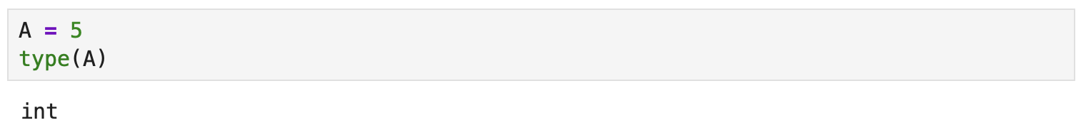
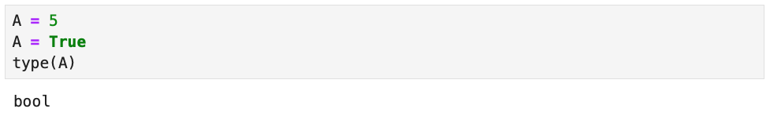
Python
Dynamically typed
  Variables do not need their type declared
  Variables can change type

Slide 5
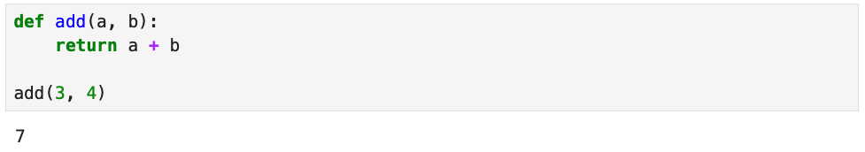
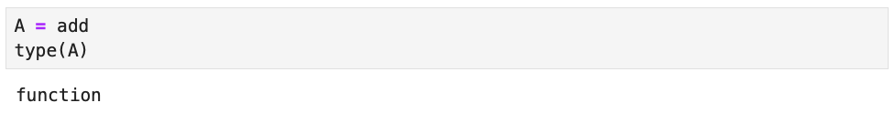
Python
Functions
  Function syntax
  Can even be stored in variables

Slide 6
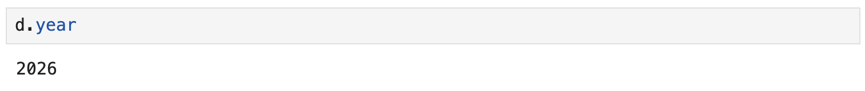
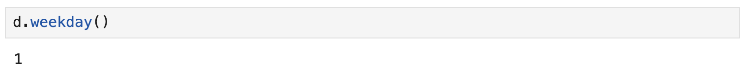
Python
Objects
  What is an object?
    Can have attributes
    Can have methods
    Can have overwritten operators

Slide 7
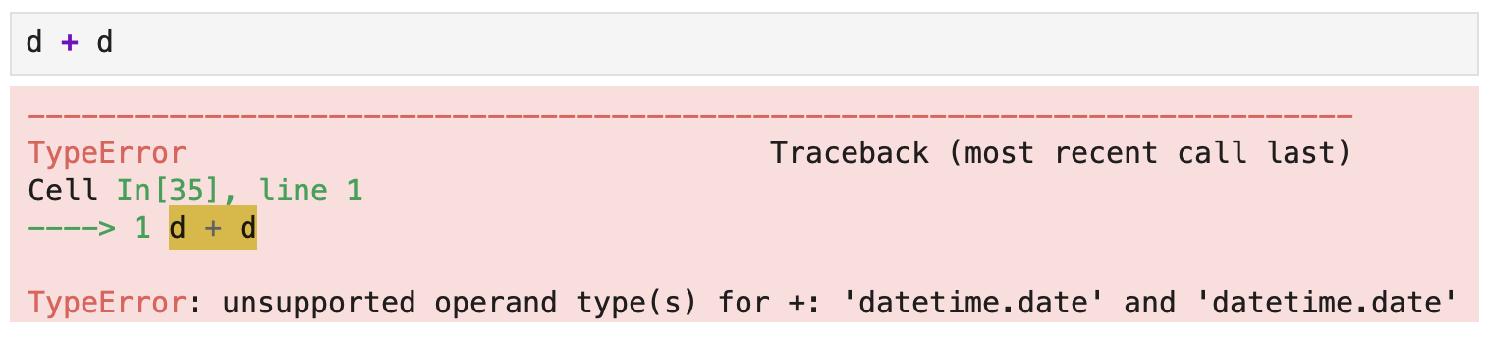
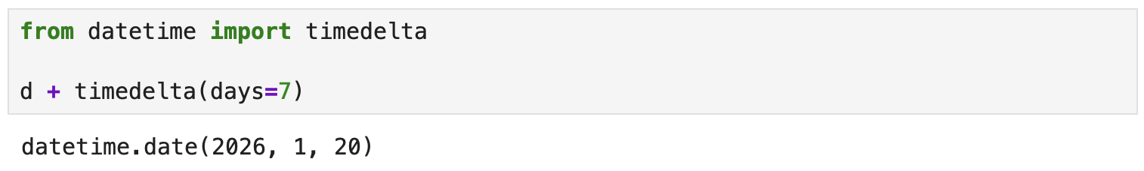
Python
Objects
  What is an object?
    Can have attributes
    Can have methods
    Can have overwritten operators

Slide 8
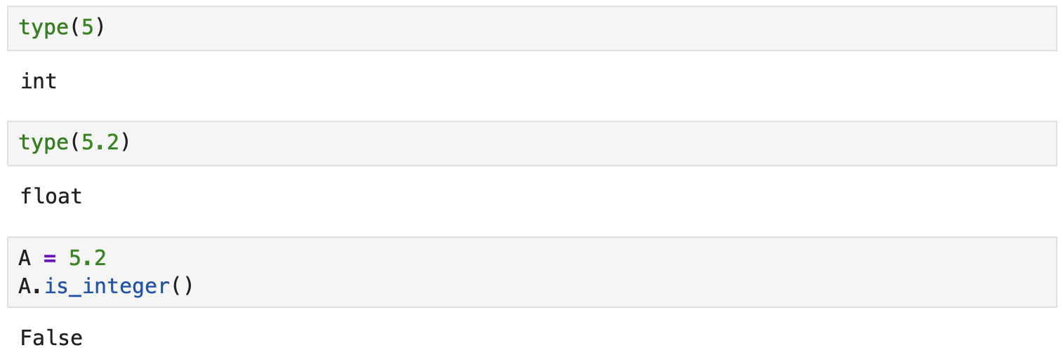
Python
Basic types
  Number

Slide 9
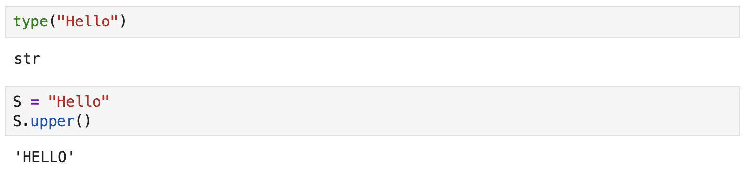
Python
Basic types
  String

Slide 10
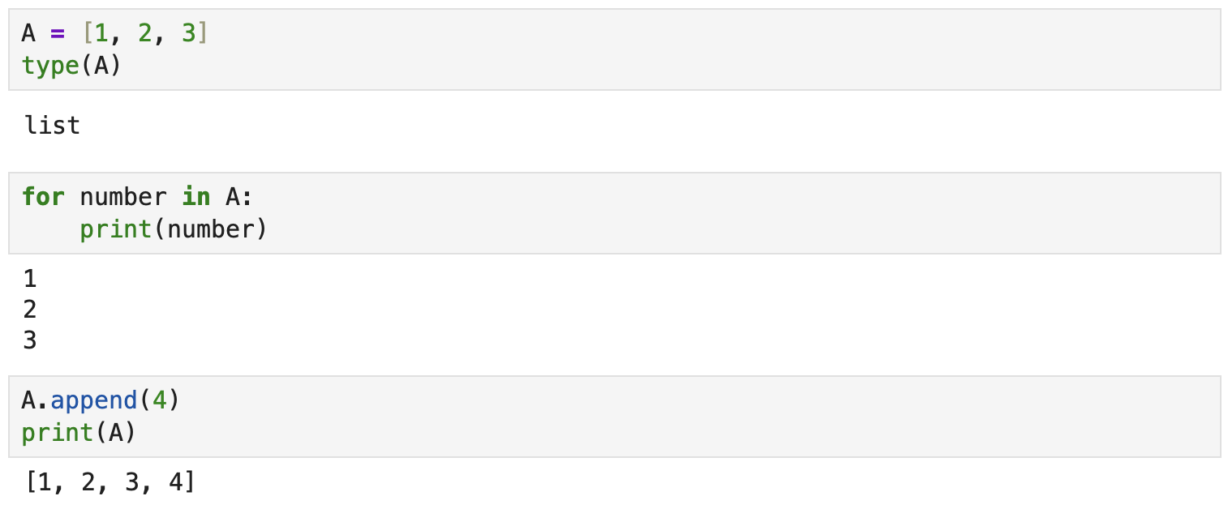
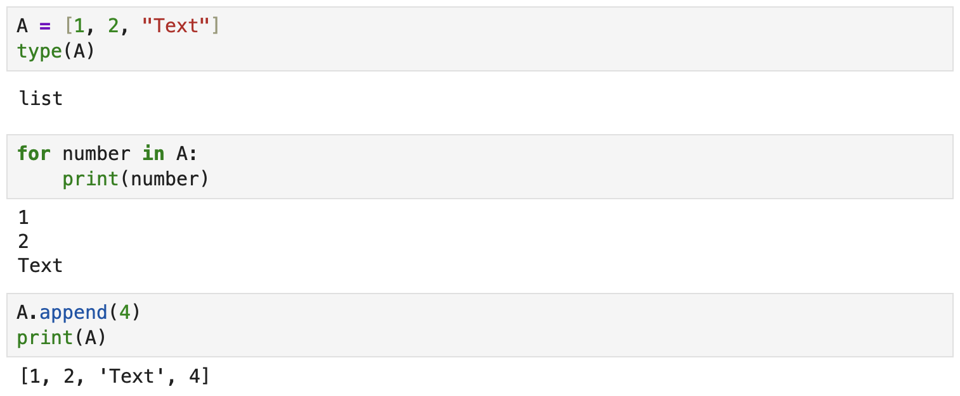
Python
Basic types
  List

Slide 11
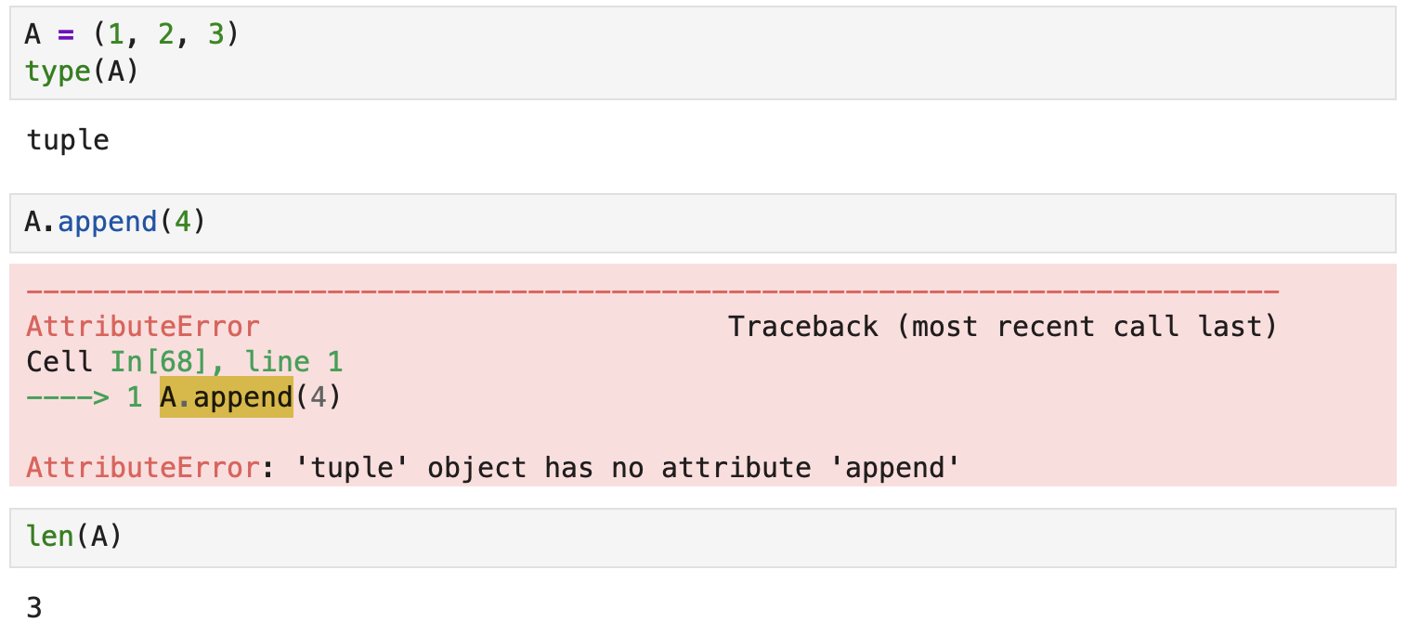
Python
Basic types
  Tuple

Slide 12
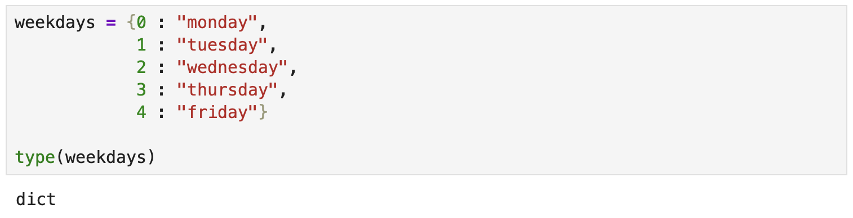
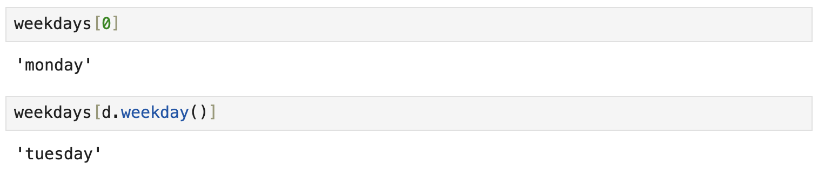
Python
key : value
Keys must be immutable
Basic types
  Dictionary

Slide 13
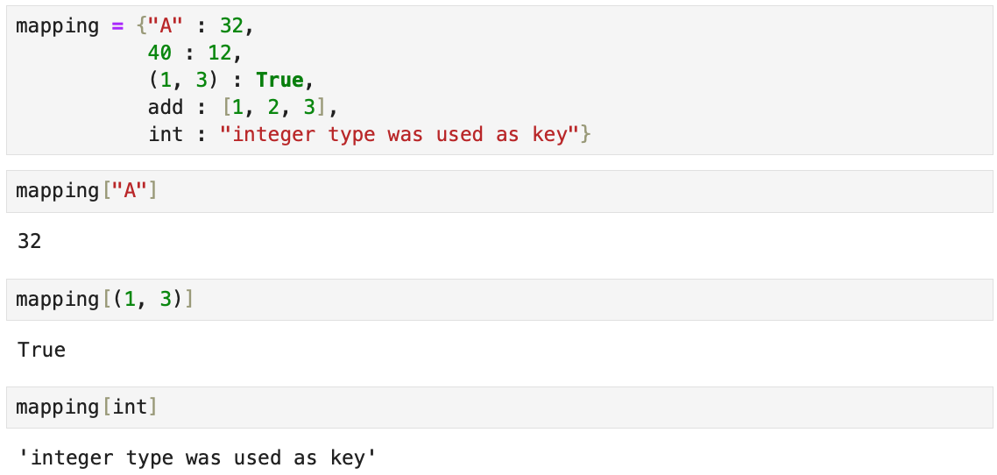
Python
key : value
Keys must be immutable
Basic types
  Dictionary

Slide 14
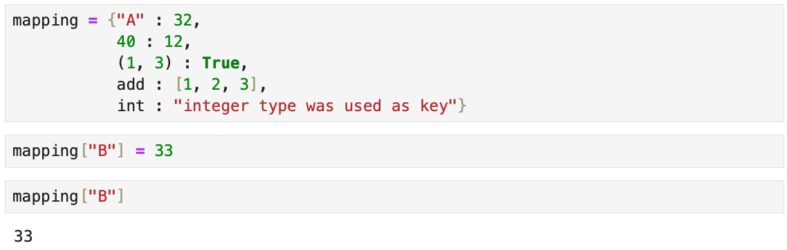
Python
key : value
Keys must be immutable
Basic types
  Dictionary
The dictionary is mutable
Can be updated after its defined

Slide 15
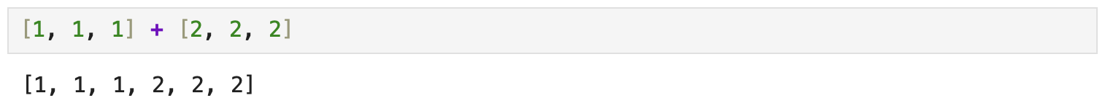
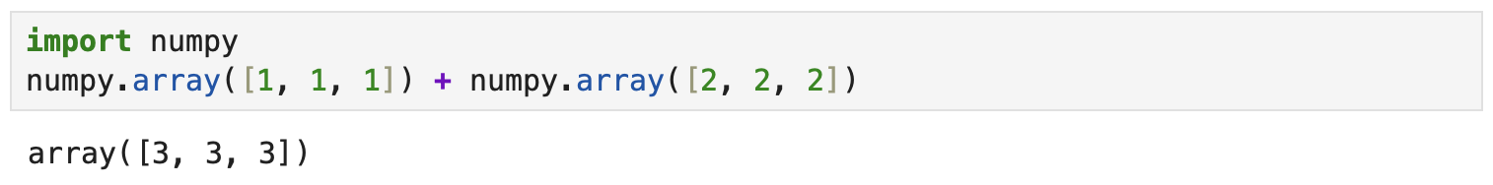
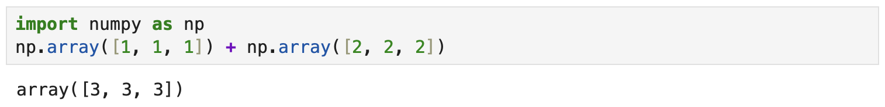
Python
Working with packages
  Want to work with vector
  Need to use numpy
  Normal to abbreviate imported packages

Slide 16

Python
Jupyter lab demo
  Quick demo of using a jupyter notebook

Slide 17
Python
Take aways
  Important to be aware of the types of objects
    Typically have helpful methods
  Use types appropriate for your problem
    Less code and typically easier to read
  Maybe an appropriate type is available in an external package
  You can also use classes to define your own types

Slide 18



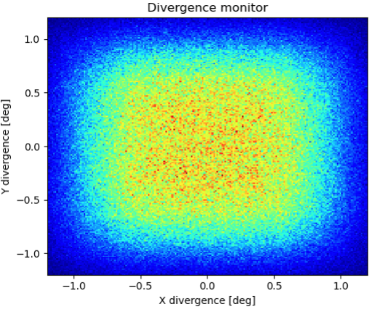
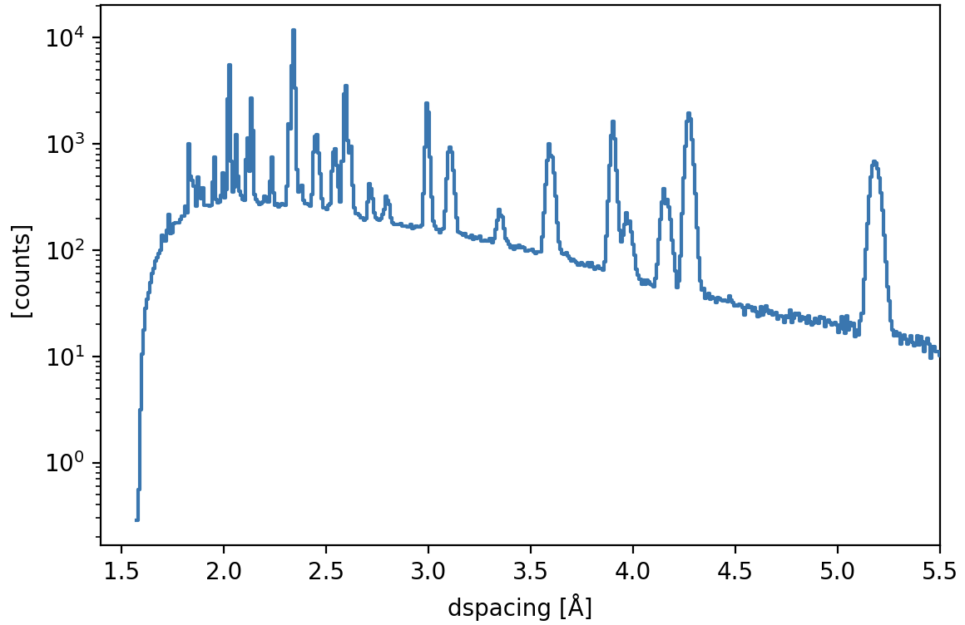
McStas
Overview
  Monte Carlo ray-tracing simulation
  Specialized for neutron scattering
  Started 1998 at RISØ, DK
  2 Full time developers at DMSC
Peter Willendrup
Mads Bertelsen

Slide 19
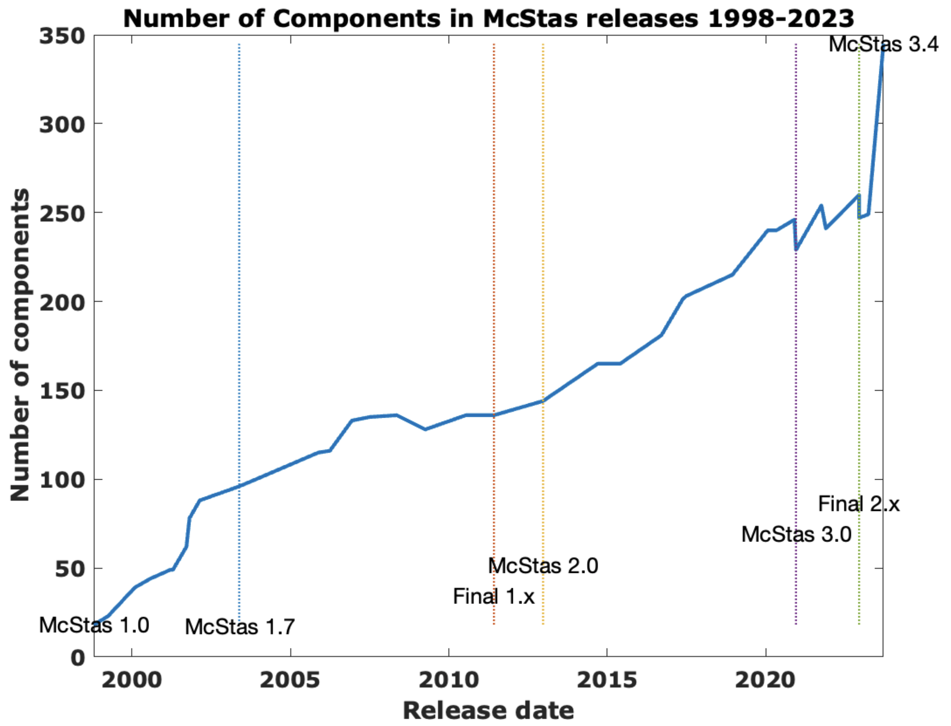
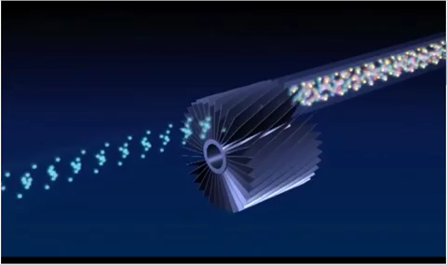
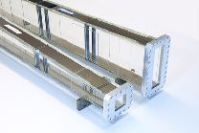
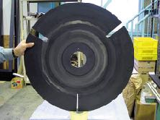
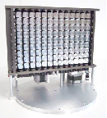
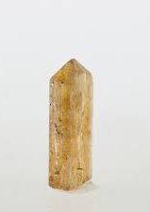
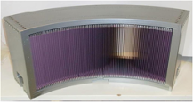
McStas
Components
  Large component library
  Beamline components / Samples / …
  McStas instruments is a sequence of components

Slide 20

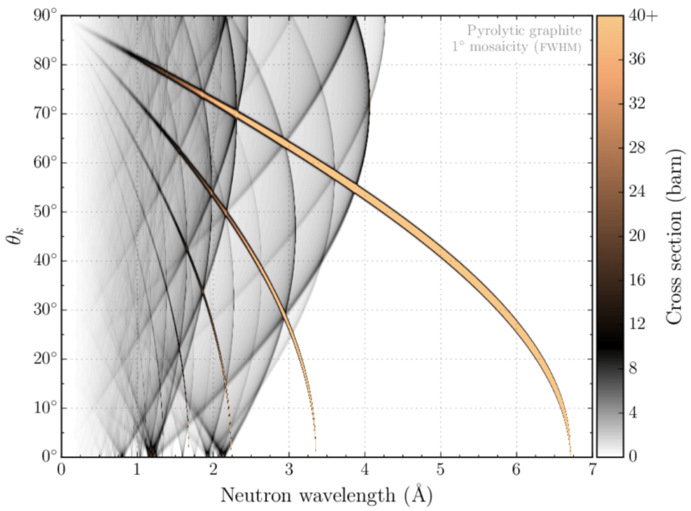

McStas
NCrystal in McStas
  NCrystal scattering kernel library
    Single crystals, powders, gasses, …
    Stand-alone or as plugin, for example GEANT-4
    Plugs into McStas as:
      Sample component / Union process
Bragg scattering in Pyrolytic graphite
Elastic neutron scattering models for Ncrystal, Thomas Kittelmann and Xiao-Xiao Cai, (2021)
Thomas Kittelmann
https://github.com/mctools/ncrystal/wiki
https://github.com/mctools/ncrystal-notebooks

Slide 21
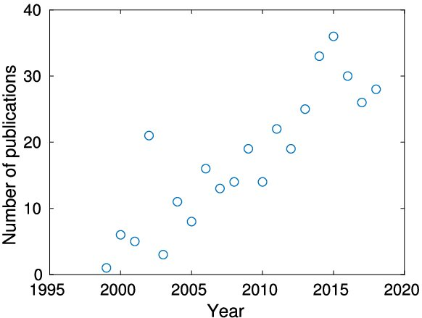
McStas
Community
  Accepted and trusted in community
  More than 400 citations of main papers
  Used to design many ESS instruments
McStas (i): Introduction, use, and basic principles for ray-tracing simulations,
P. K. Willendrup and K. Lefmann, Journal of Neutron Research (2019)

Slide 22
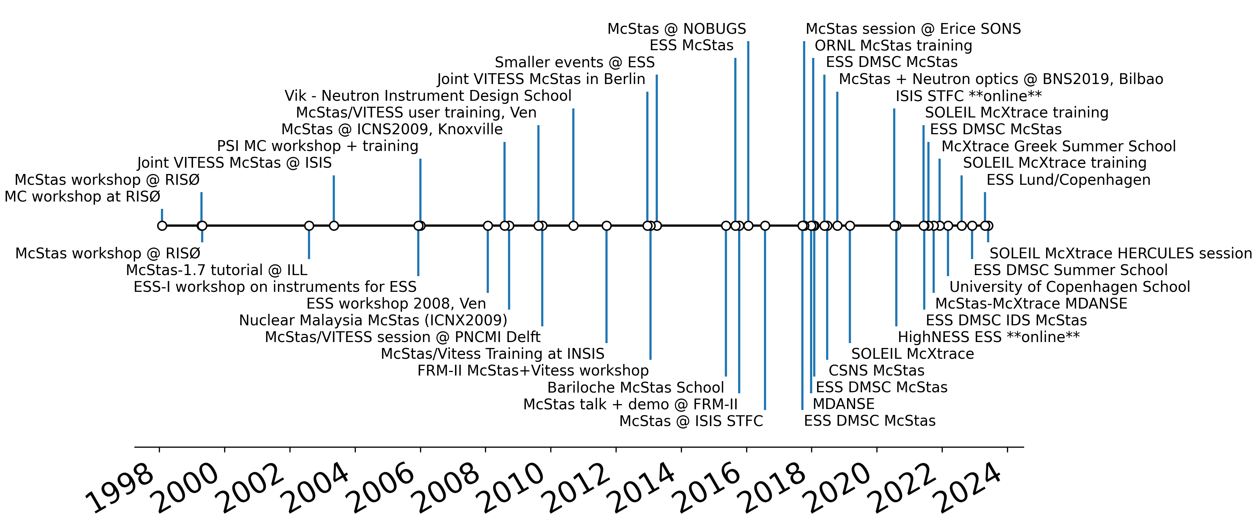
McStas
History of schools
+ e-learning + Local schools + University courses

Slide 23
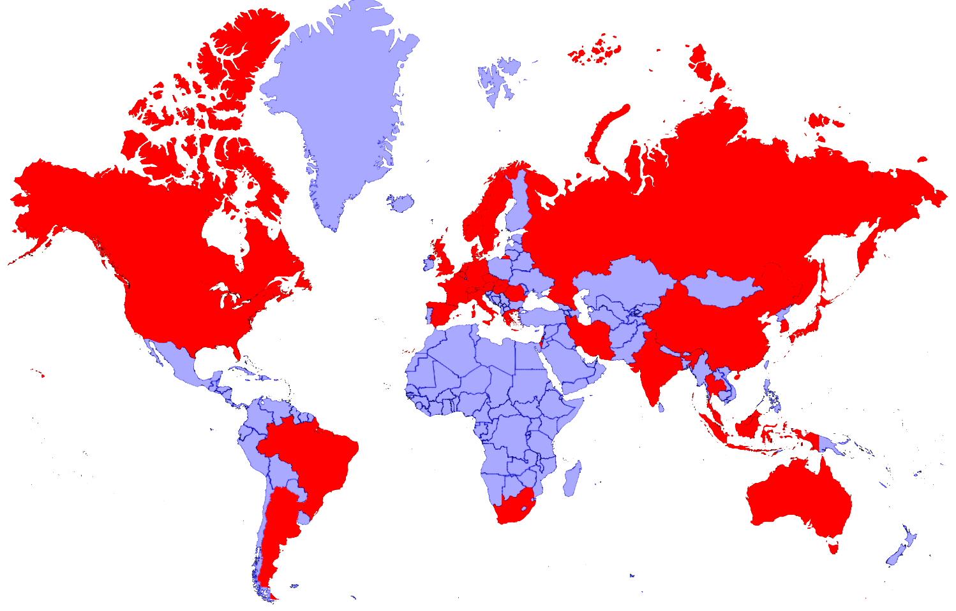


















McStas
Map of usage

Slide 24
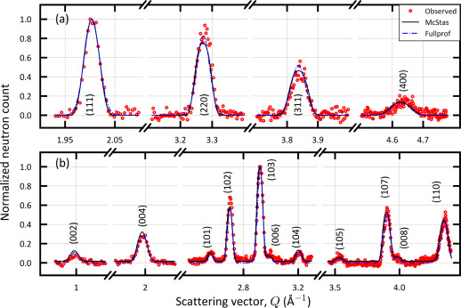
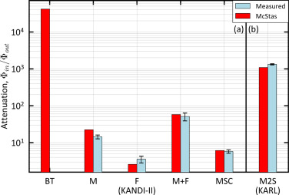
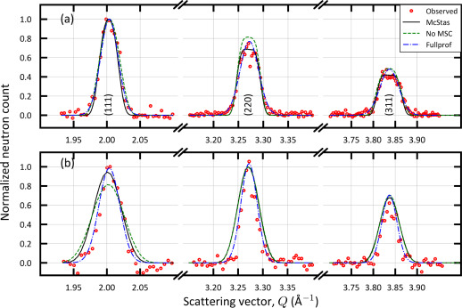
McStas
KANDI-II 2.47 Å wavelength
Si
Verification
  Can replicate real instruments well
  Powder diffractometers in Israel
Gr₂GaC
Foil intensity measurements
KARL Si sample
PG 2.421 Å
Cu 0.98 Å
Verification of the McStas code using two double axis neutron diffractometer,
D. Potashnikov, A. Pesach, O. Rivin, O. Ozeri, Z. Yungrais, M. Bertelsen and E. N. Caspi,
NIMA (2024)

Slide 25
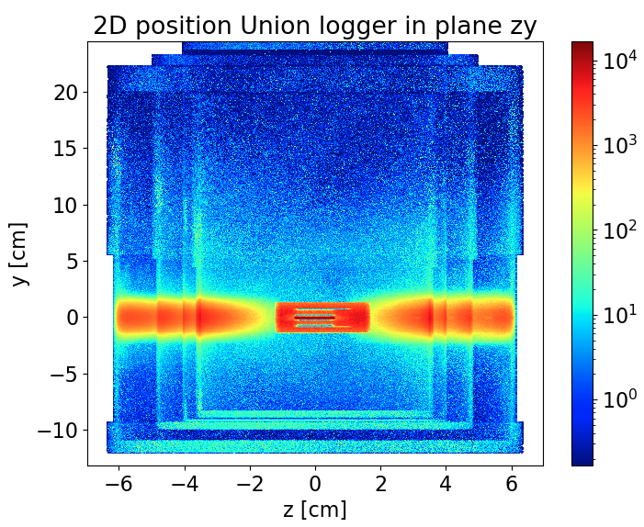
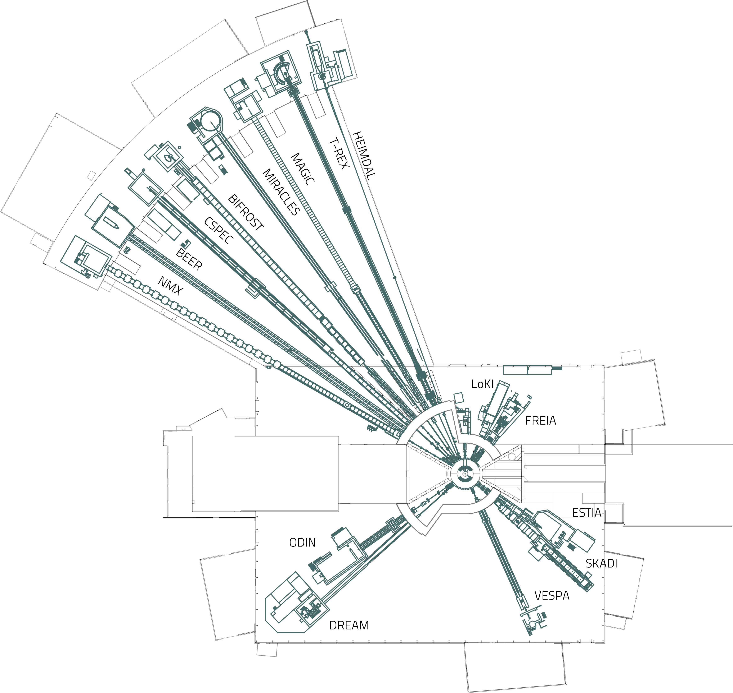
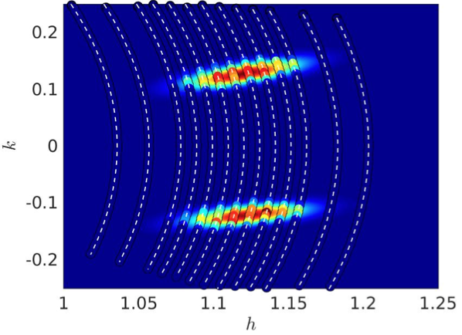

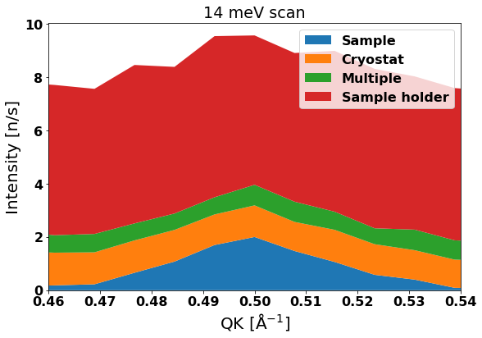
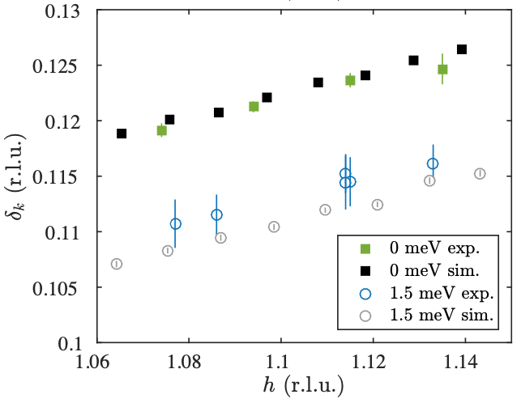
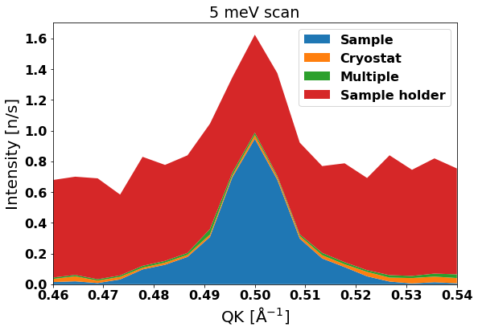
McStas
Cases
Preparation
Design
Virtual experiment
Instrument
Cryostat
Sample holder
Sample
Explanation
“For all instruments, their design has been optimised and their performance thoroughly evaluated using both analytical calculations and Monte-Carlo ray-tracing simulations …”
Investigation of instrument resolution effects on surprising result from measurements, eliminating possible explanations.
Simulated scan of double peak in q
14 meV setting
Confirmation of hypothesis, excludes resolution effects
5 meV setting
G. Simutis, J. Küspert, Q. Wang, J. Choi, D. Bucher, M. Boehm, F. Bourdarot, M. Bertelsen C. N. Wang, T. Kurosawa, N. Momono, M. Oda, M. Månsson, Y. Sassa, M. Janoschek, N. B. Christensen, J. Chang, D. G. Mazzone,
Commun Phys 5, 296 (2022)
H. Jacobsen, S. L. Holm, M.-E. Lăcătuşu, A. T. Rømer, M. Bertelsen, M. Boehm, R. Toft-Petersen, J.-C. Grivel, S. B. Emery, L. Udby, B. O. Wells, K. Lefmann,
Phys. Rev. Lett. 120, 037003 (2018)
K. H. Andersen et. al. The instrument suite of the European Spallation Source, Nucl. Instrum. Methods Phys. Res. A, vol. 957, 163402 (2020)

Slide 26
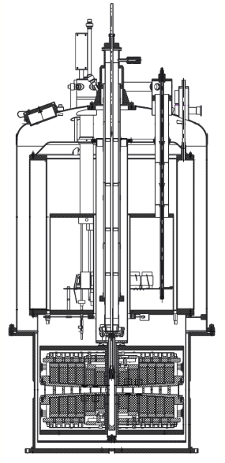
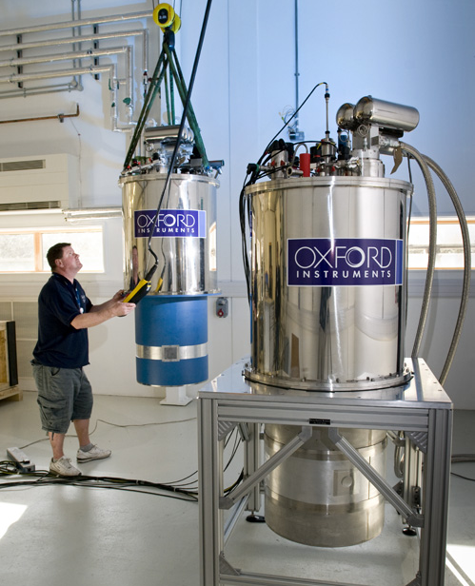
McStas
Union components
  User can assemble sample materials
  Multiple scattering in complex geometry
Incoherent_process
Al
Powder_process
Incoherent_process
Sample
Single_crystal_process
Incoherent_process
Inelastic sample
Single_crystal_process
Phonon_simple_process

Slide 27
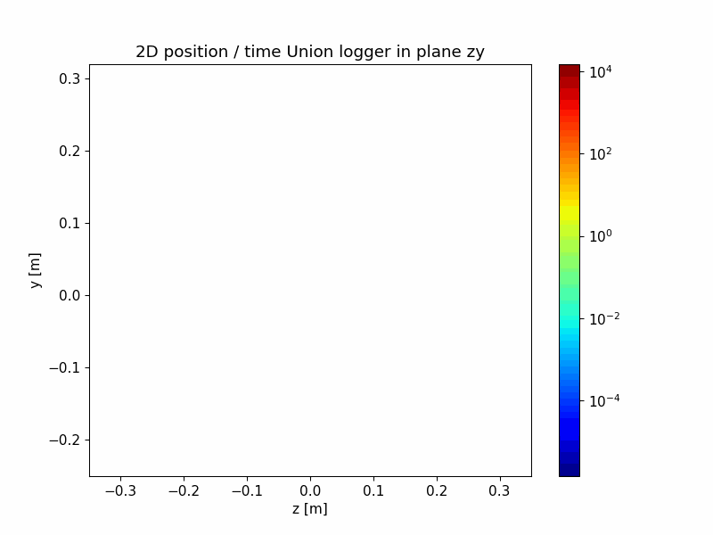
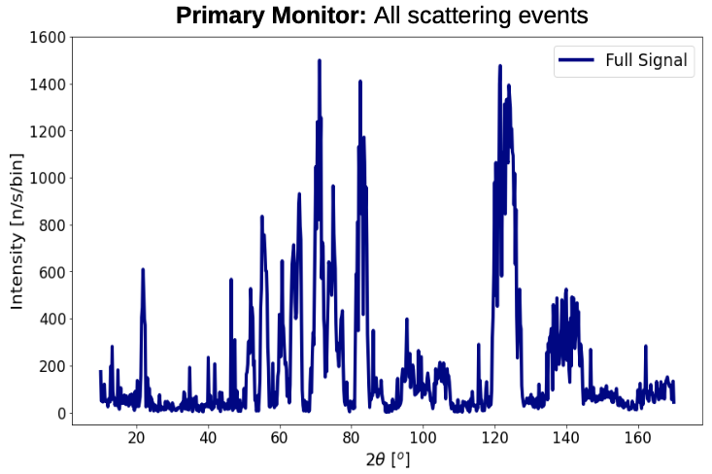
McStas
Magnet project
  Describe geometry and materials
  Good student project
Using McStas Union components to simulate a magnet sample environment and predicting background with machine learning,
Petroula Karacosta, Master thesis with Kim Lefmann, University of Copenhagen

Slide 28

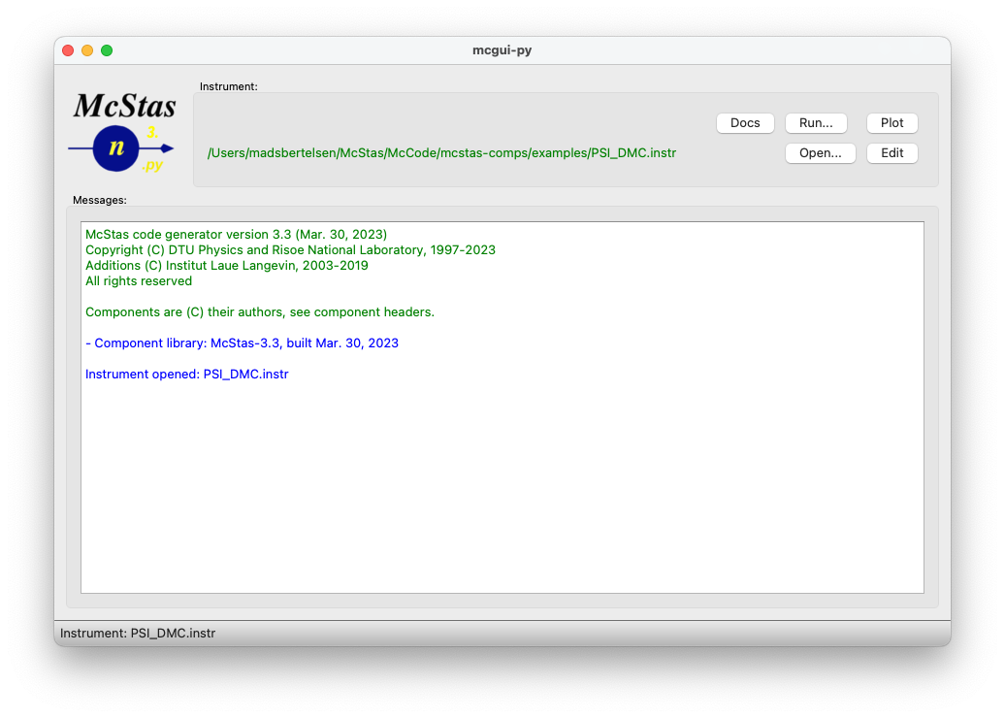

McStas
McStas instrument file
User interface
DEFINE INSTRUMENT example(theta)
DECLARE
// C-code – declare variables
double two_theta;
INITIALIZE
// C-code - perform initial calculations
two_theta = 2.0*theta;
TRACE
// McStas component sequence
Monochromator = Monochromator_flat(
yheight=0.1, zdepth=0.05, Q=1.78)
AT (0,0,2.0) RELATIVE source
ROTATED (0, theta, 0) RELATIVE source
FINALLY
// C-code – perform calculations after simulation
  C meta-language instrument file
  Help and plotting from mcgui

Slide 29
McStas
y
User interface
Instrument file
Simulated instrument
x
COMPONENT A(par=2)
AT (0, 0, 0.5)
ROTATED (-10, 0, 0)
z
COMPONENT B(width=0.3)
AT (0, 0, 4.0)
ROTATED (10, 0, 0)
COMPONENT C(length=2.5)
AT (0, 0, 11.5)
ROTATED (-12, 0, 0)

Slide 30
McStas
Execution of simulation
Simulated instrument
  Assemble from component library
  Place components in a sequence
  Place them in simulated space
  Execute through terminal or mcgui
Instrument file
c file
Executable
COMPONENT A(par=2)
AT (0, 0, 0.5)
ROTATED (10, 0, 0)
COMPONENT B(width=0.3)
AT (0, 0, 4.0)
ROTATED (-10, 0, 0)
COMPONENT C(length=2.5)
AT (0, 0, 11.5)
ROTATED (12, 0, 0)
McStas
compiler
Users
c - compiler

Slide 31
McStas
McStasScript overview
  Python McStas API
    Build instrument object
    Execute simulation
    Receive data as Python objects
  Open source
  https://github.com/PaNOSC-ViNYL/McStasScript
  Comprehensive test suite
Local components
McStasScript
Produced data
Generate instrument file
Instrument file
c file
Executable
McStas
compiler
Users
c - compiler

Slide 32

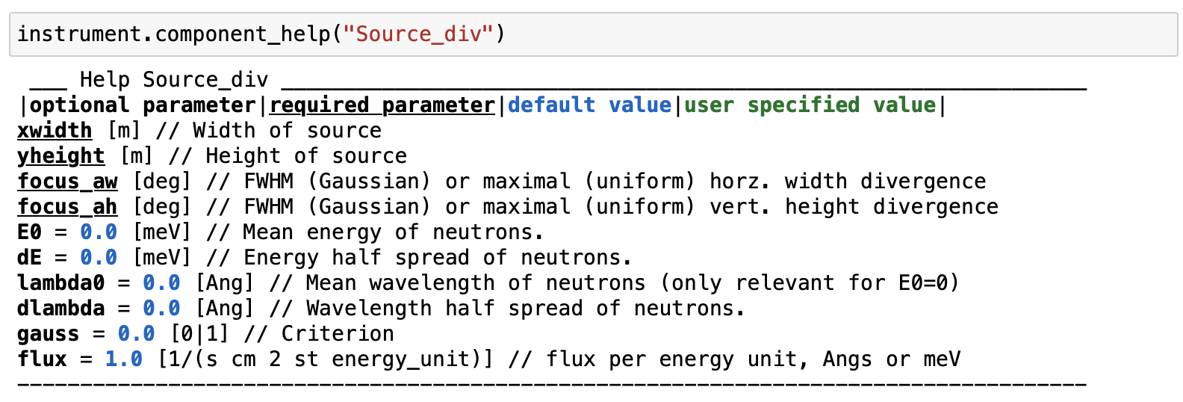
McStasScript
McStas
Demo
  Instrument object
  Knows components

Slide 33
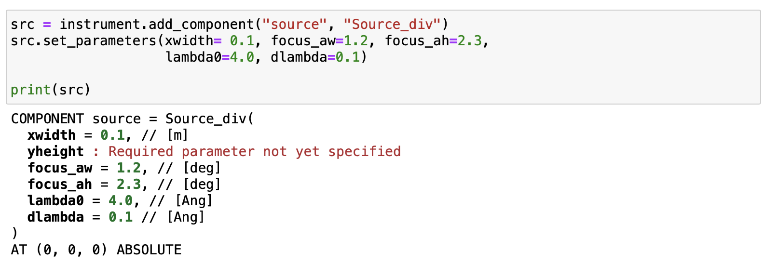
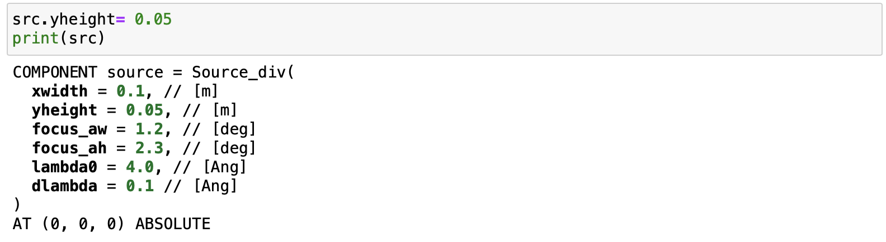
McStasScript
McStas
Demo
  Component object
  Spots errors
  Autocompletion

Slide 34

McStasScript
McStas
Demo
  Parameter objects
  Calculations
  Parameter overview

Slide 35


McStasScript
McStas
Demo
  Set position
  For-loop
  Component list

Slide 36




McStasScript
McStas
Demo
  Filename pitfall
  Diagrams

Slide 37

McStasScript
McStas
Demo
  Visualization

Slide 38

McStasScript
McStas
Demo
  Settings
  Parameters
  Run simulation
  Plot data

Slide 39


McStasScript
McStas
Demo
  Python objects
  Metadata
  Numpy arrays

Slide 40

McStasScript
Demo
  Simulation widget

Slide 41




McStasScript
McStas
Tools
  Cryostat tool
  NCrystal tool

Slide 42
McStasScript
McStas
Types
Type | Important methods | Explanation
Instrument | show_diagram show_instrument show_settings settings add_parameter show_parameters set_parameters add_component backengine | Shows diagram of instrument Shows 3D view Shows computing settings Sets computing settings Adds new instrument parameter Shows instrument parameters Sets instrument parameters Adds component to instrument, returns component Runs simulation, returns list of McStasData
Component | show_parameters set_parameters set_AT set_ROTATED | Shows component parameters Sets component parameters Sets component position Sets component rotation
McStasData | set_plot_options | Sets plot options for this data

Slide 43

McStasScript
Documentation
  Comprehensive documentation
  Descriptions of the classes
  Tutorials for
    McStasScript
    McStas features
    McStas Union components
  https://mads-bertelsen.github.io
  Workshop / School available

Slide 44
McStasScript
McStas instrument file
McStasScript
Code structure
DEFINE INSTRUMENT example(
)
DECLARE
INITIALIZE
TRACE
instr = McStas_instr(“demo”)
# Guide
# Choppers
# Sample environment
# Detectors
  Powerful Python features
    for-loops
    functions
    classes
  Chopper example
    Parameters for wavelength band
    Variables for frequency phase
    Calculations
    Component
mcstas-pygen translator

Slide 45
McStasScript
McStas
Installation
  Install from pip / conda
    pip install McStasScript
    conda install –c conda-forge mcstasscript
    Included as dependency if you install McStas, e.g.
    conda install –c conda-forge mcstas

Slide 46
McStasScript
McStas
Conclusion
  McStasScript adds a Python interface to McStas
    Build instruments
    Run simulations
    Visualize data
  Both classic user interface and McStasScript will be maintained
  In this school we will be using McStasScript to keep the focus on Python

Slide 47


Exercises
McStas
Three tracks
  Time for you to try it out!
  Get functional instrument object, though the instrument has some issue
  Run simulation and plot output
  Some quiz questions to keep you on track
  Three exercise tracks
    SANS
    Powder diffraction
    QENS

Slide 48



Exercises
McStas
VISA
  Join the slack channel #dmsc-winter-school-jan-26-27
  Instructions to start the exercises available there
Multiple choice:
Insert a string with letter
Some take the instrument object and checks it

