Slide 1
1
Radiation Safety

Slide 2
H1/H2 Scenarios
Design Basis for Radiation Safety
Summary
From simulation:
Maximum neutron current at bunker wall exit : 5.24x10¹⁰ n/s
Maximum neutron current at sample position : 1.0x10¹⁰ n/s
15 H1 events identified – 11 taken forward for analysis
7 H2 events identified – 3 taken forward for analysis
# | Cause
H1-1 | Instrument shutter is closed
H1-3 | Chopper 2 is closed
H1-4 | Collimator jaws closed in beam
H1-7 | Gd in beam at sample position
H1-8 | Water in beam at sample position
H1-9 | Fast shutter closed
H1-10 | Steel equipment in beam at sample position
H1-11 | Roof plug removed
H1-12 | Cd in beam at sample position
H1-13 | Cd in scattered beam within detector tank
H1-15 | Boron in beam within detector tank
H2-1 | Full beam on back wall of detector vessel
H2-2 | Strongly isotropic scattering sample left in beam
H2-5 | Misaligned/damaged snout

Slide 3
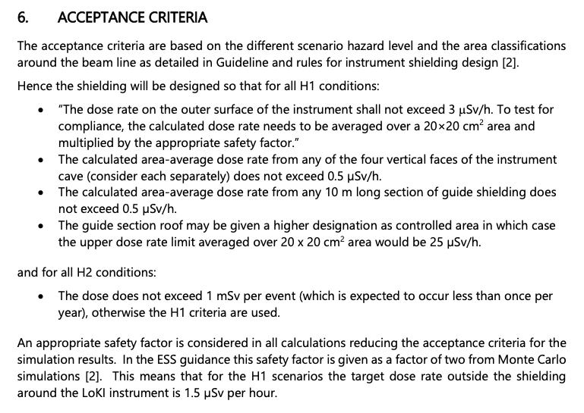
Radiation Safety Report
Shielding Analysis
Reference : ESS-0019931, “ESS Procedure for designing shielding for safety”

Slide 4
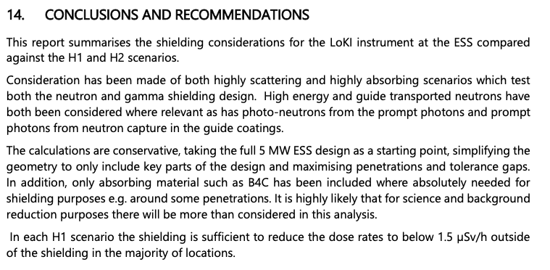
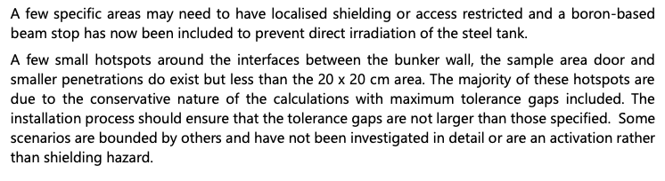
Radiation Safety Report
Shielding Analysis

Slide 5
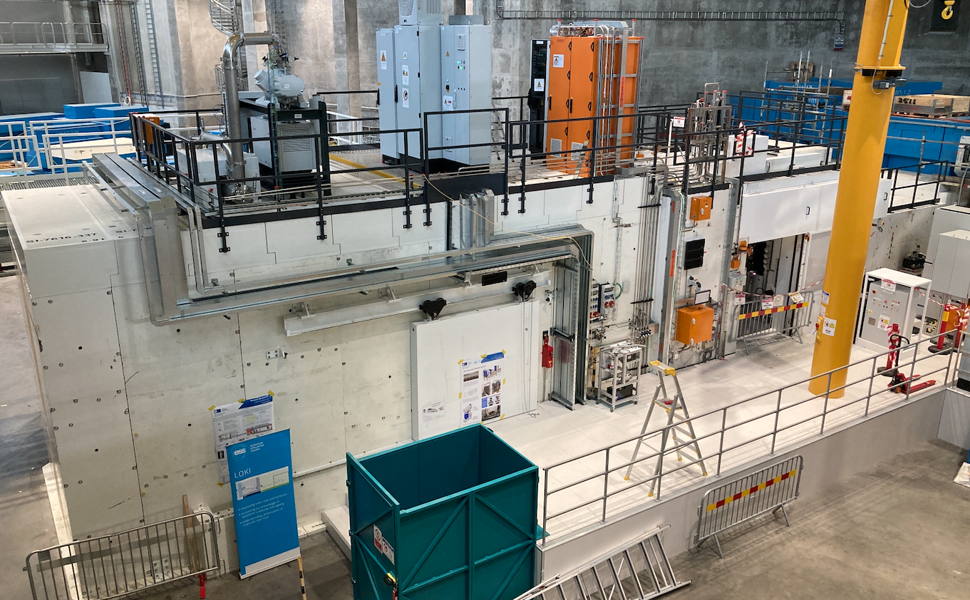
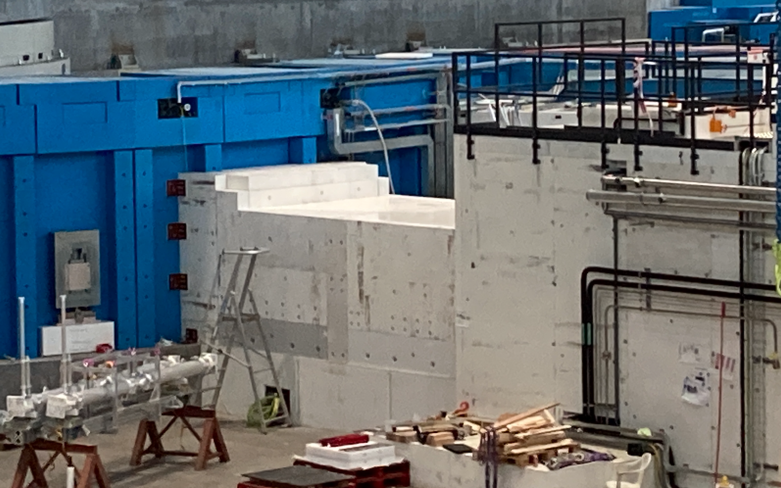
2
LoKI Shielding documentation overview

Slide 6
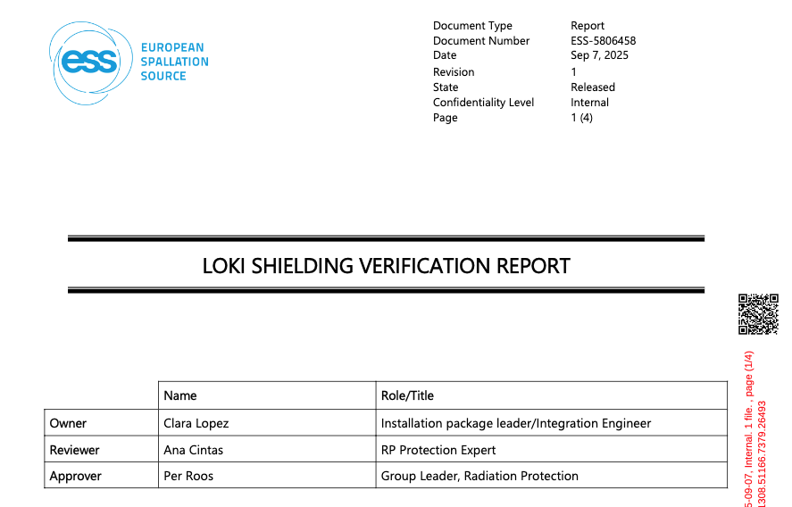
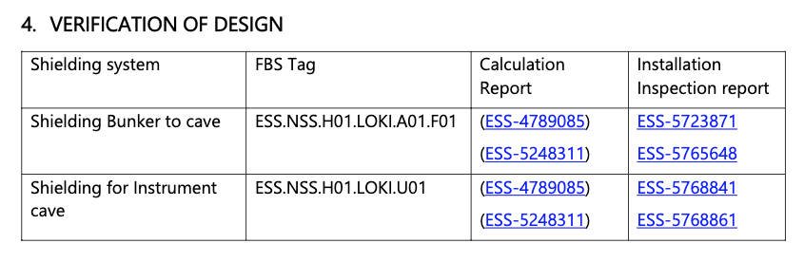
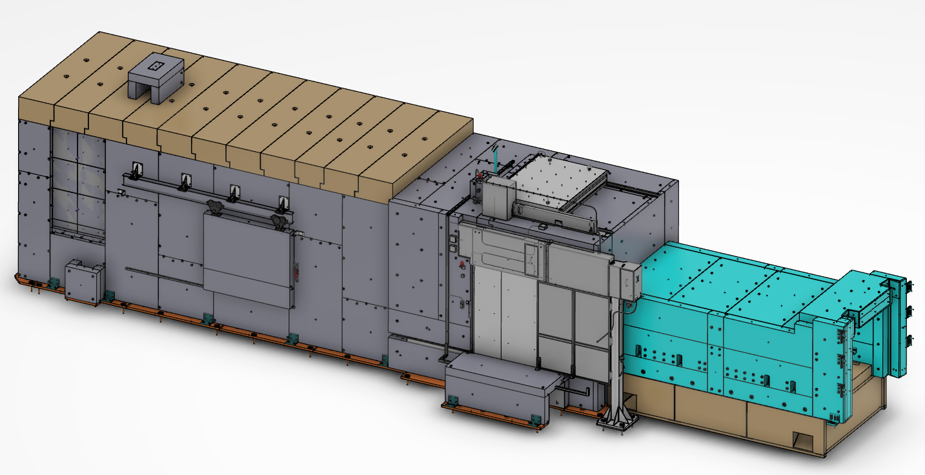
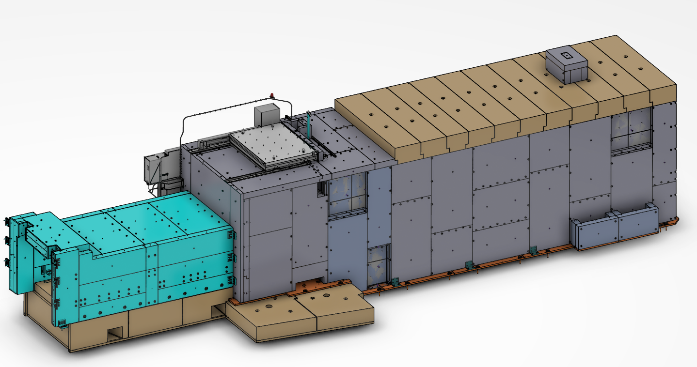
Documentation overview
LoKI Instrument
LoKI Shielding Verification report ESS-5806458
SAT based on Installation documentation
System design description
Design documentation approved in TG3
ESS-4789085 LoKI Radiation safety report
ESS-5248311 LoKI Activation Analysis Report

Slide 7
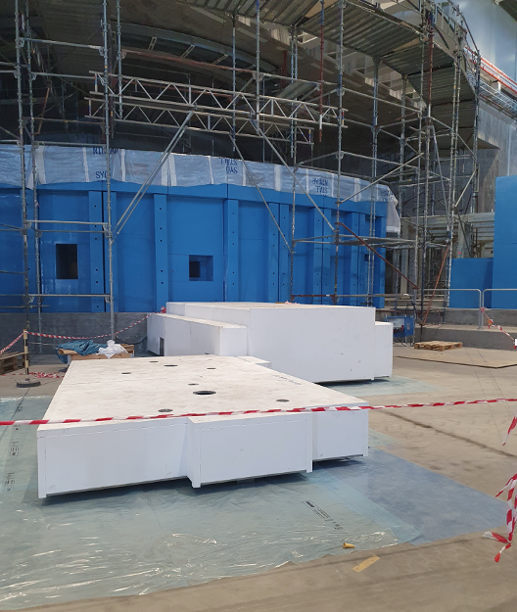
3
Bunker to cave
=ESS.NSS.H01.LOKI.A01.F01

Slide 8
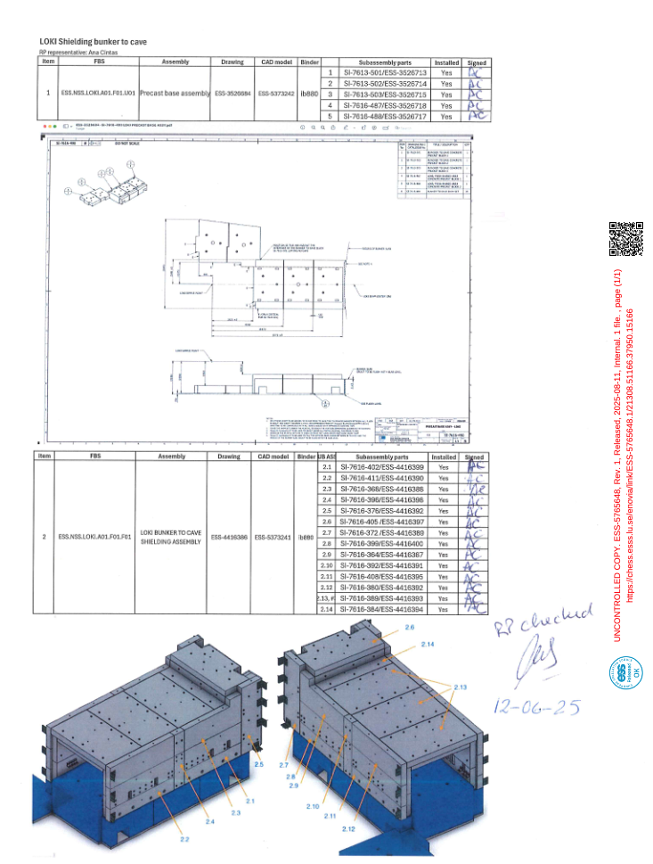
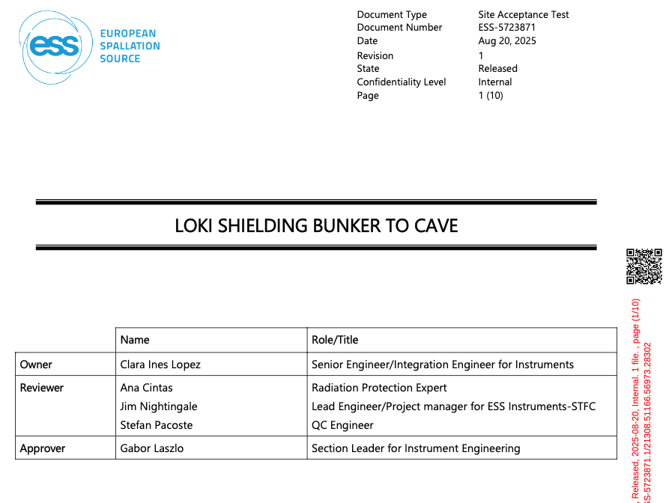
LoKI Bunker to cave shielding
LoKI Instrument
ESS-5723871 LoKI Shielding Bunker to Cave SAT
ESS-5765648 LoKI Shielding Bunker to cave location checklist
ESS-1108661 Sub System design Description for Shielding bunker to cave

Slide 9
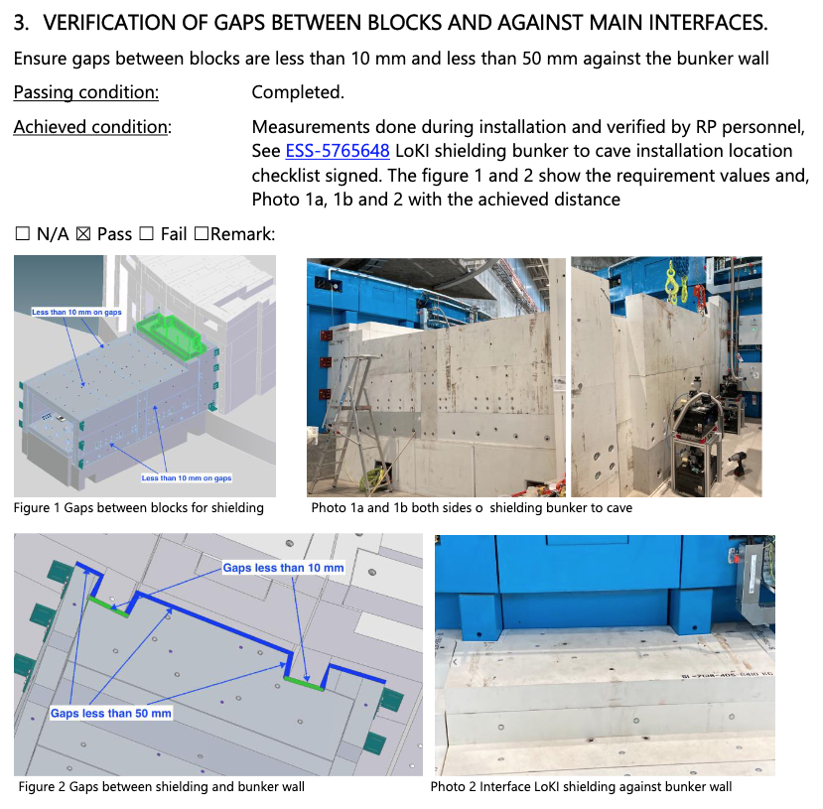
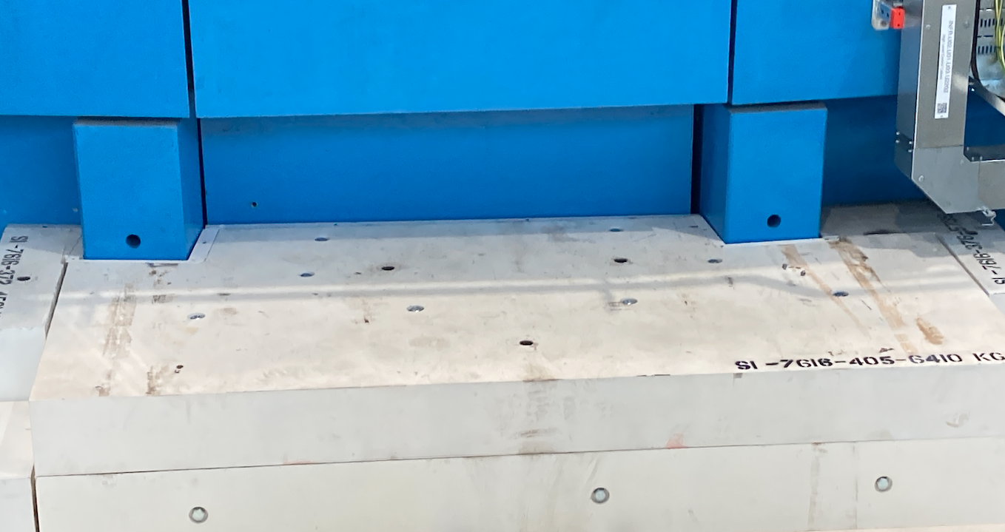
LoKI Bunker to cave shielding
LoKI Instrument
ESS-5723871 LoKI Shielding Bunker to Cave SAT

Slide 10
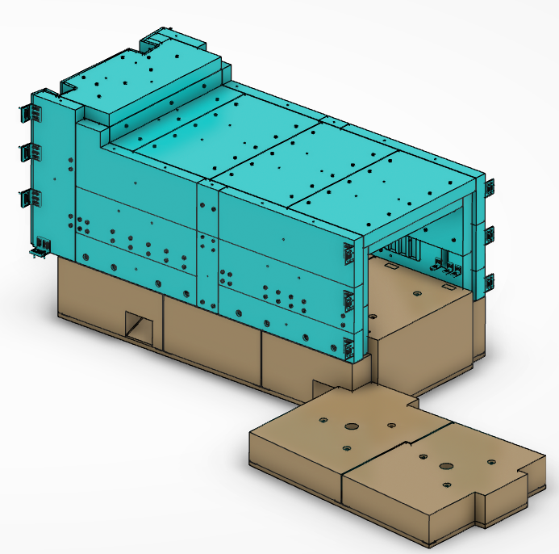
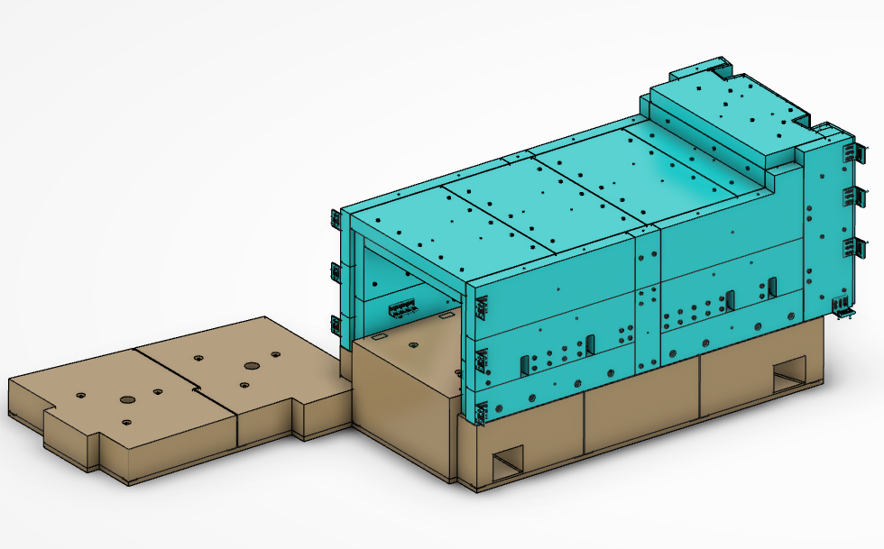
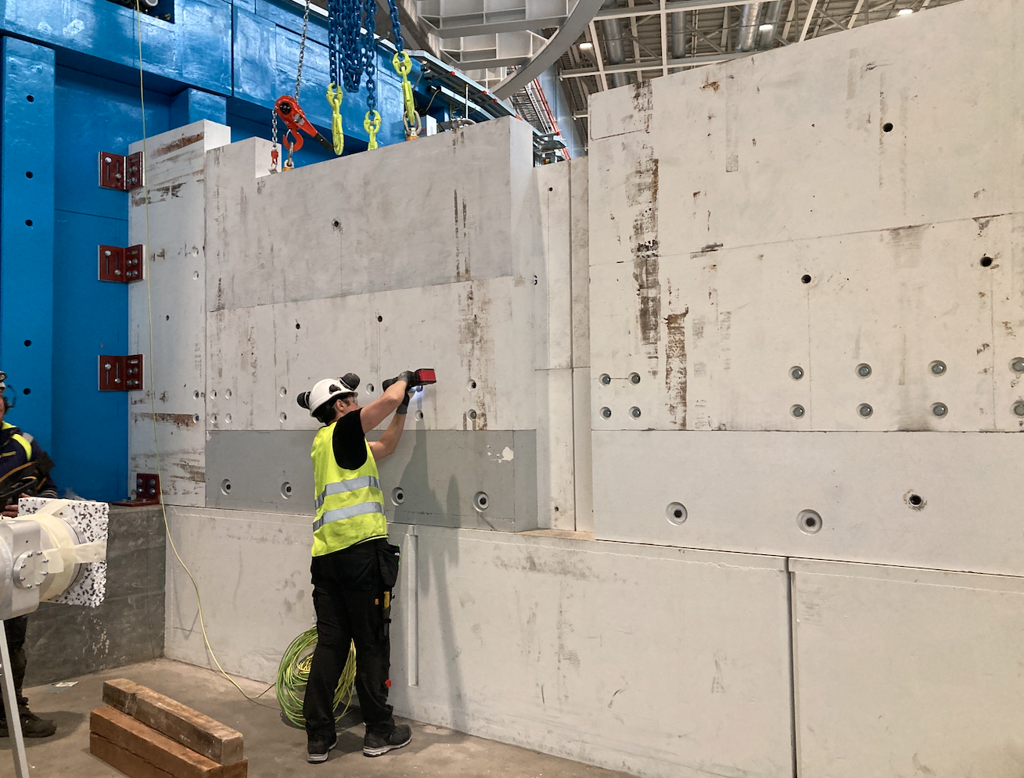
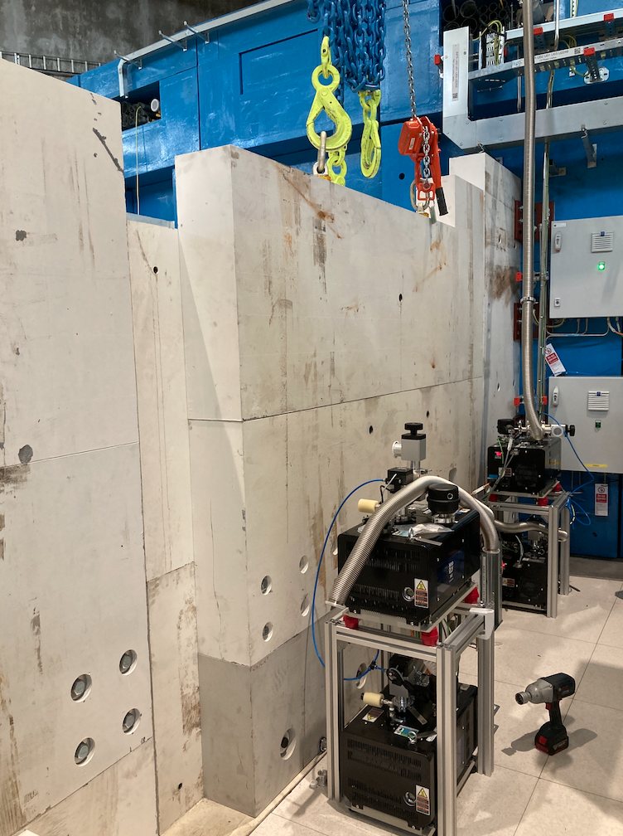
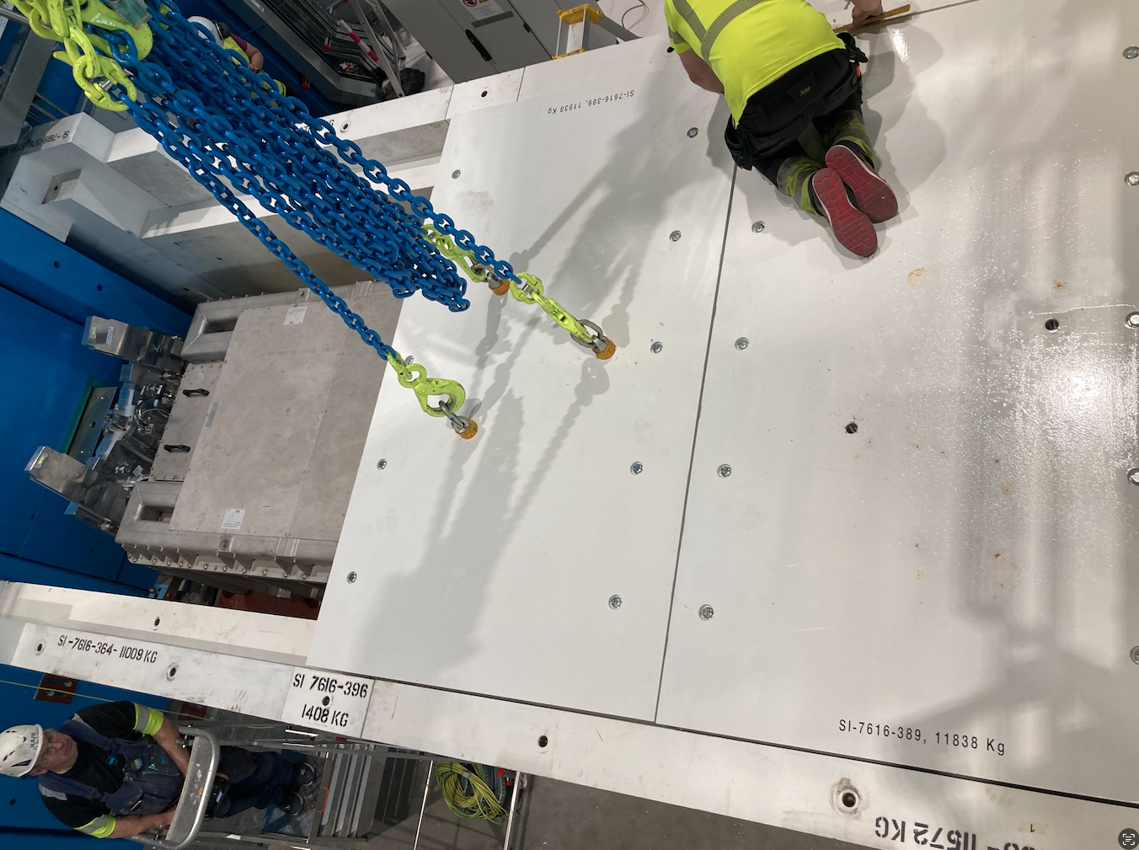
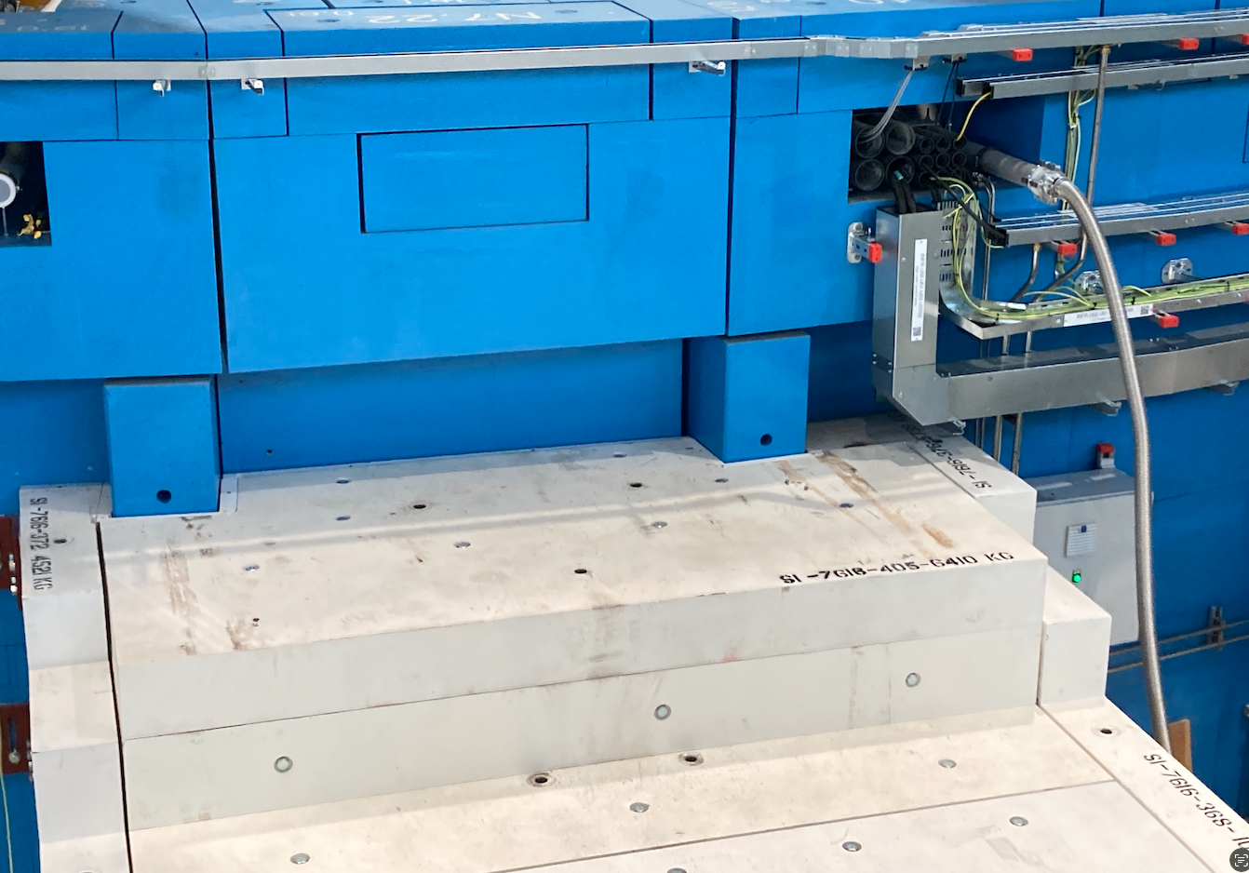
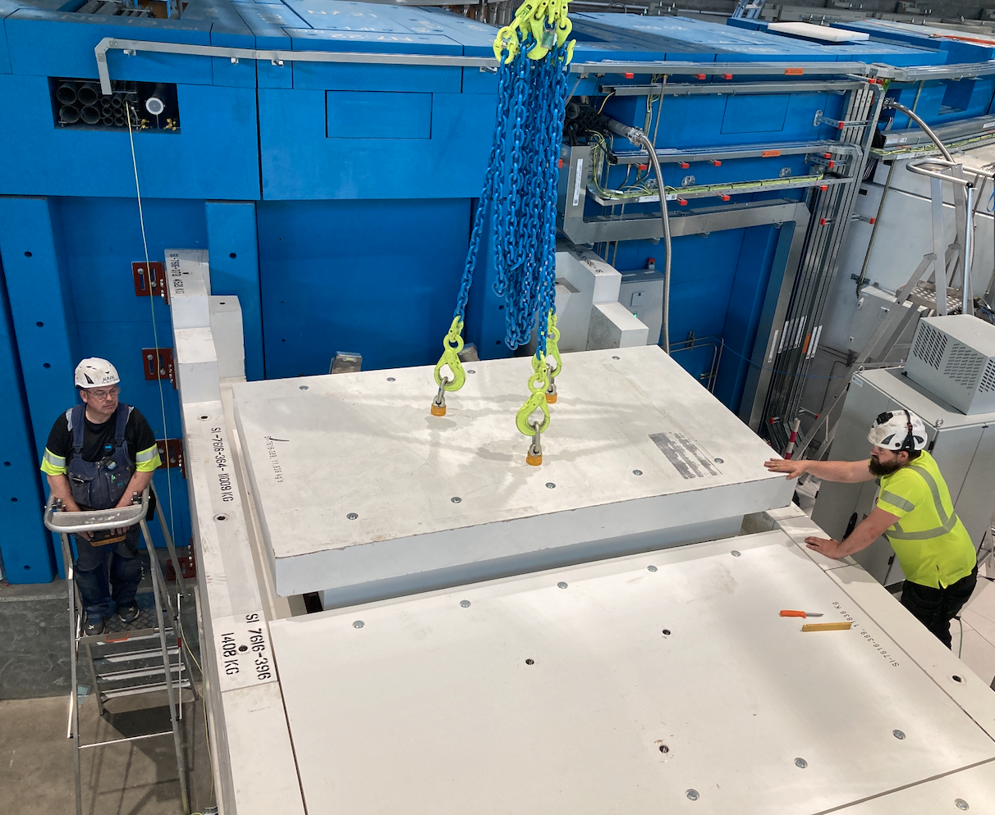
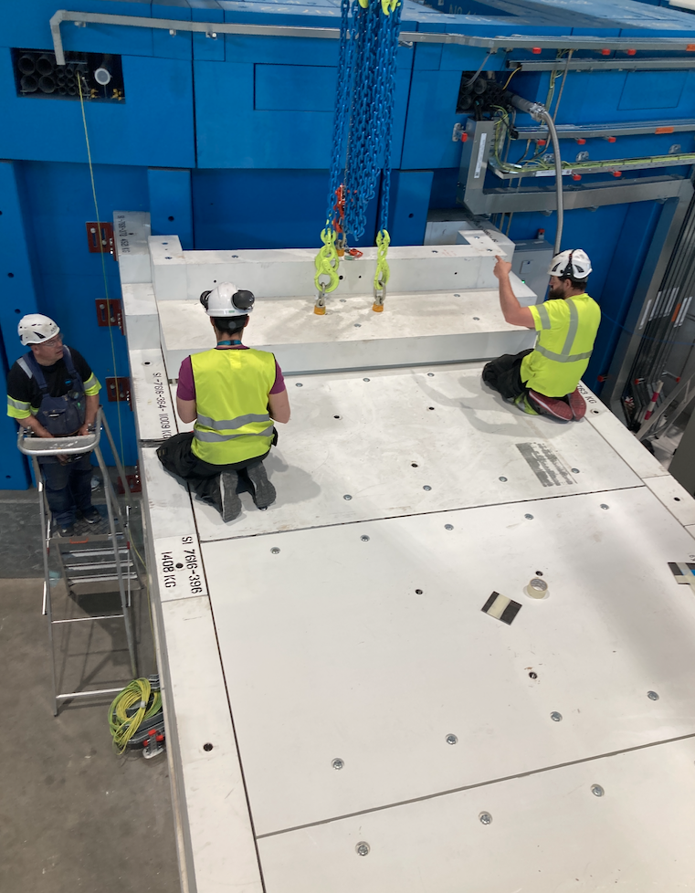
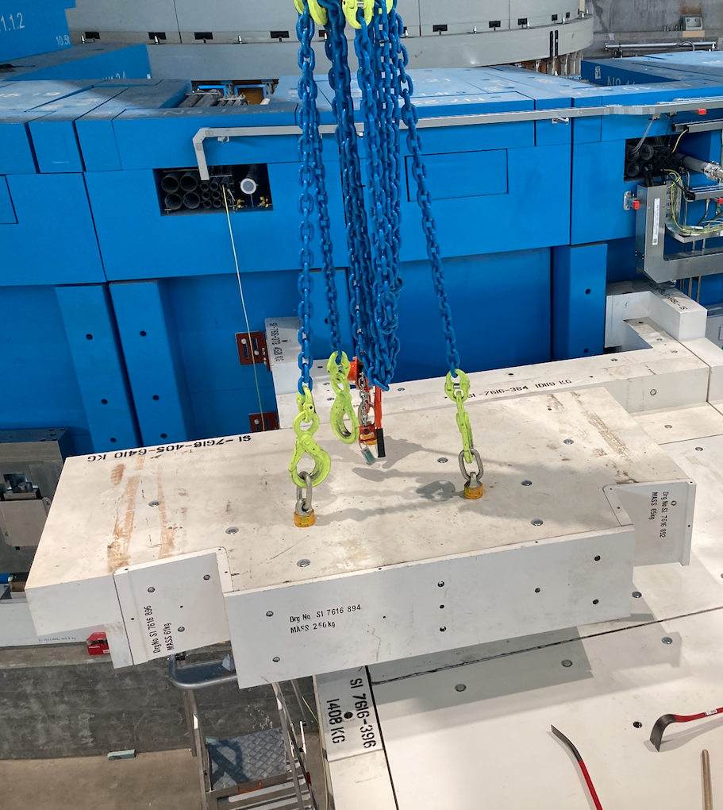
Bunker to cave Installation
LoKI Instrument

Slide 11
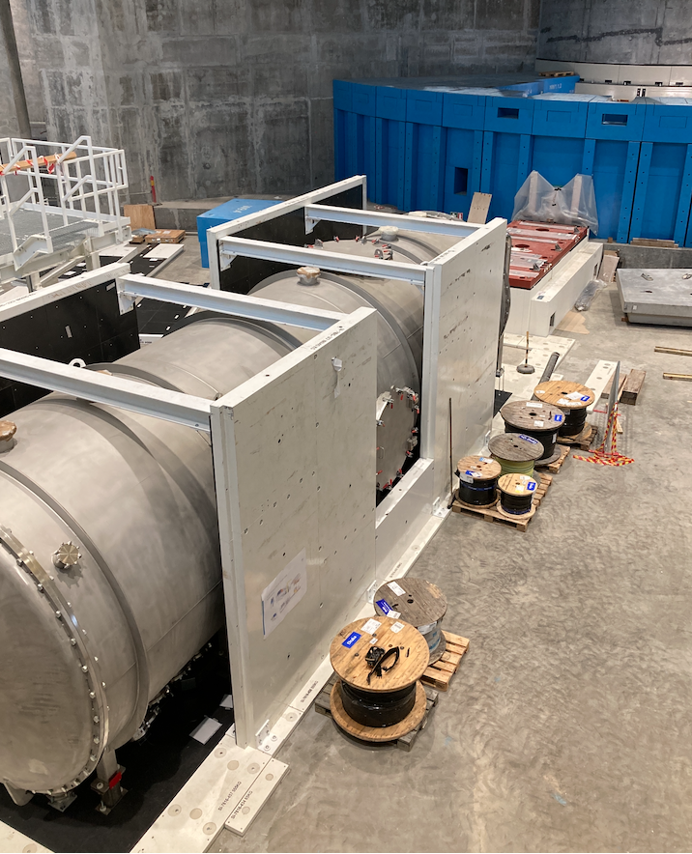
4
Shielding on cave
=ESS.NSS.H01.LOKI.U01.F01

Slide 12
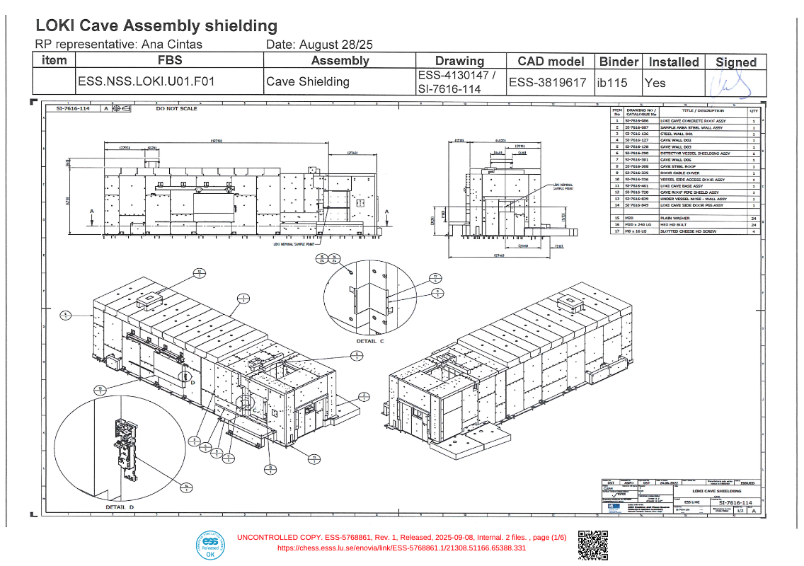
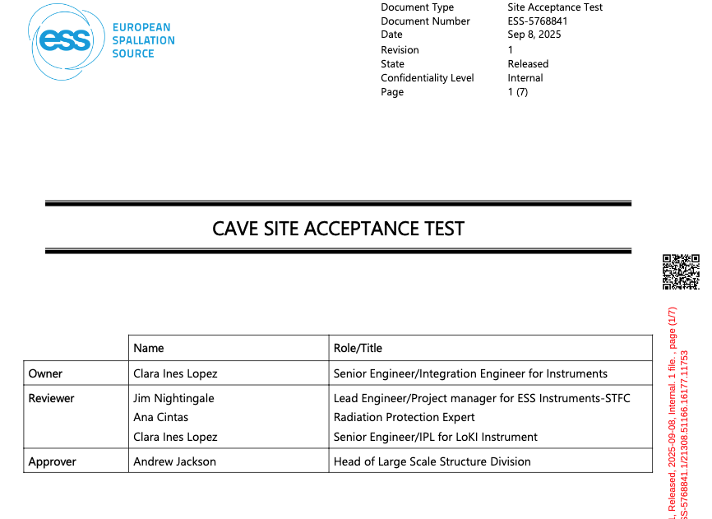
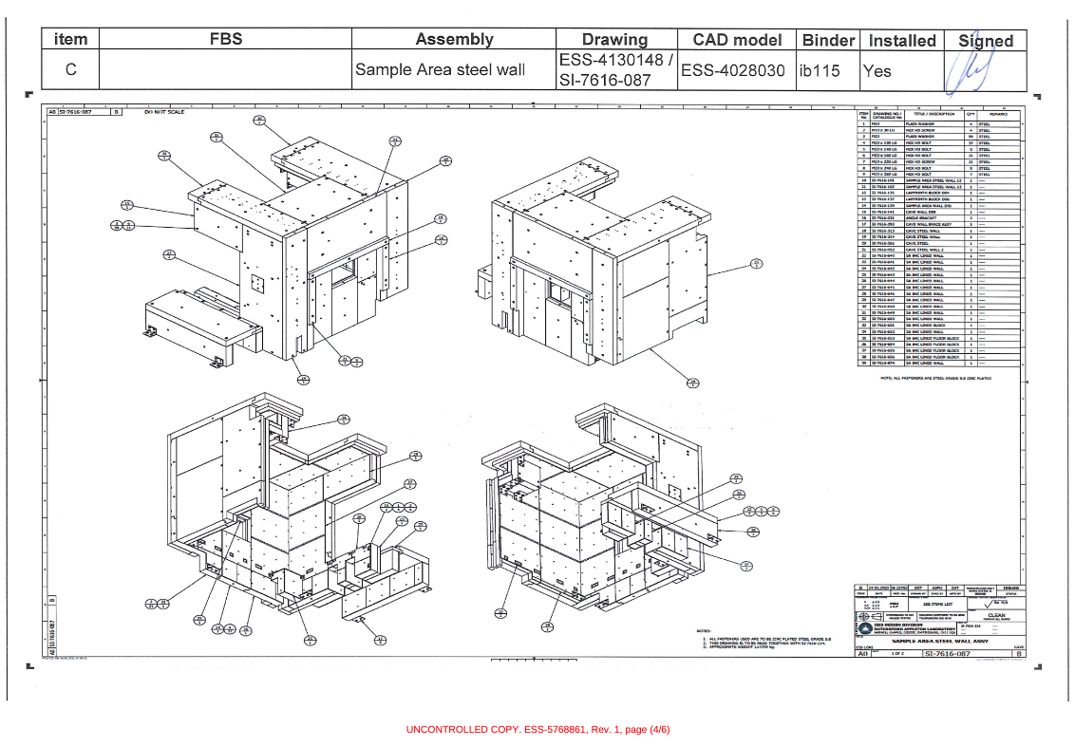
LoKI Shielding on cave
LoKI Instrument
ESS-5768841 LoKI Cave Site Acceptance Test
ESS-5768861 LoKI Cave Installation location Checklist
ESS-1108664 Sub-System design description for End Station

Slide 13
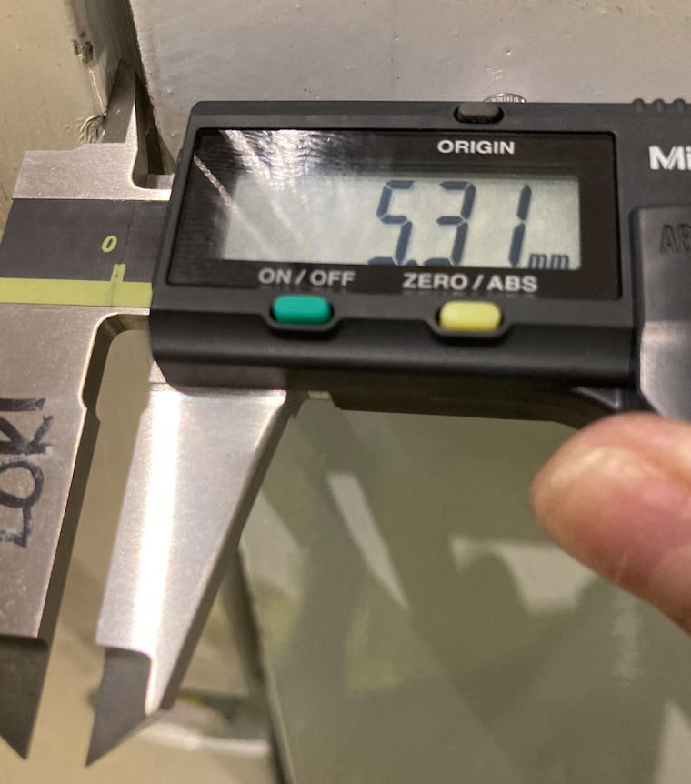
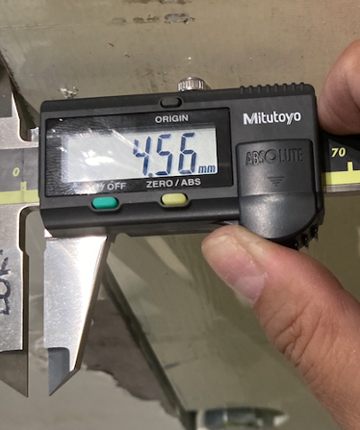
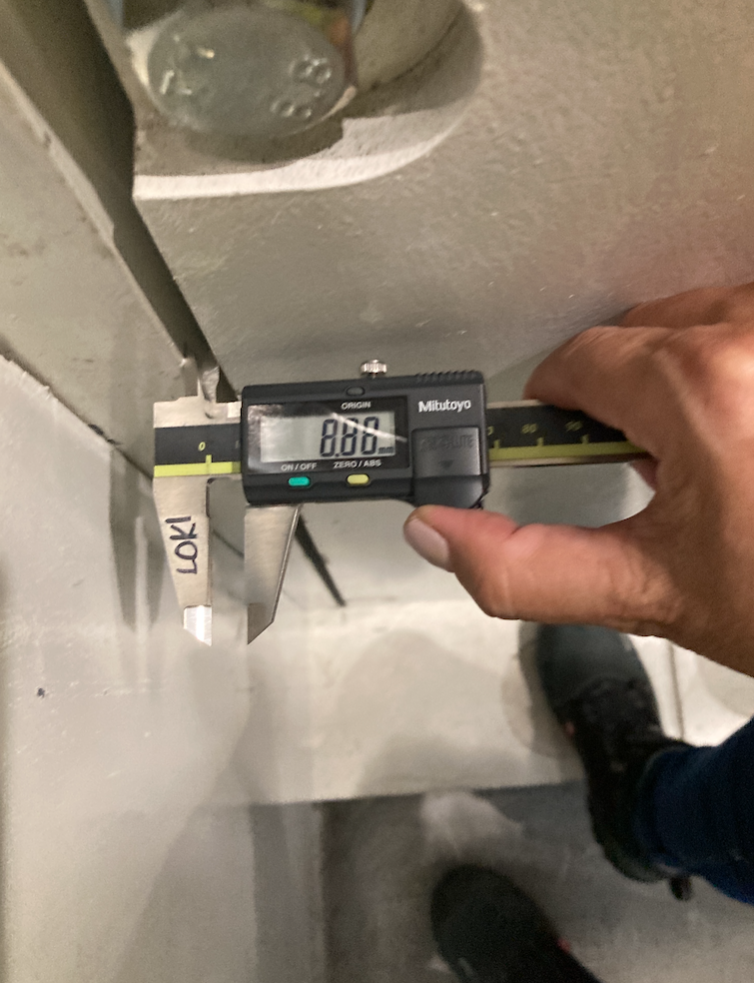
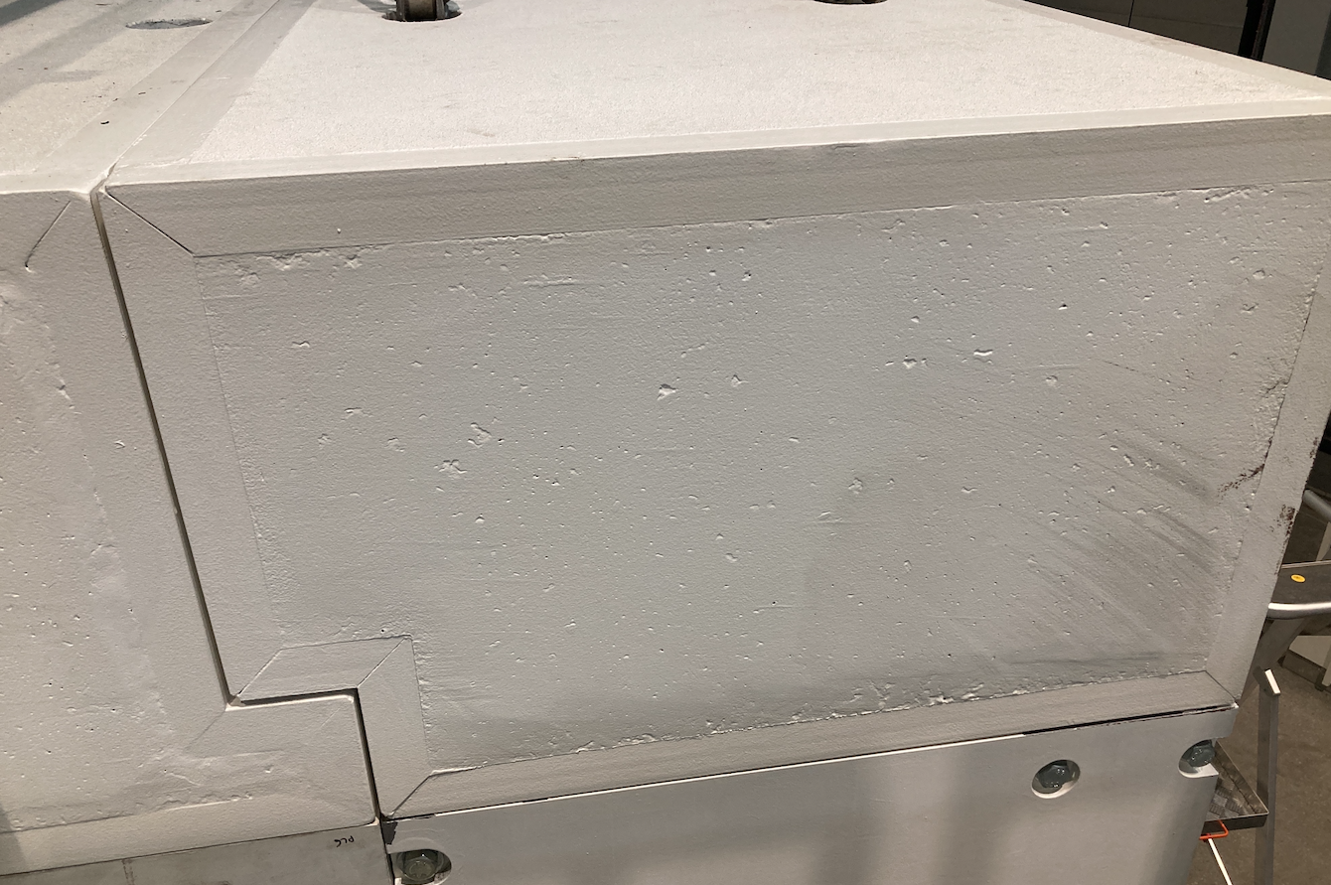
LoKI Bunker to cave shielding
LoKI Instrument
Verification of Gaps between blocks and against main interfaces
Ensure gaps between blocks are less than 10 mm.
ESS-5723871 LoKI Shielding Bunker to Cave SAT
ESS-5765648 LoKI Shielding Bunker to cave location checklist

Slide 14
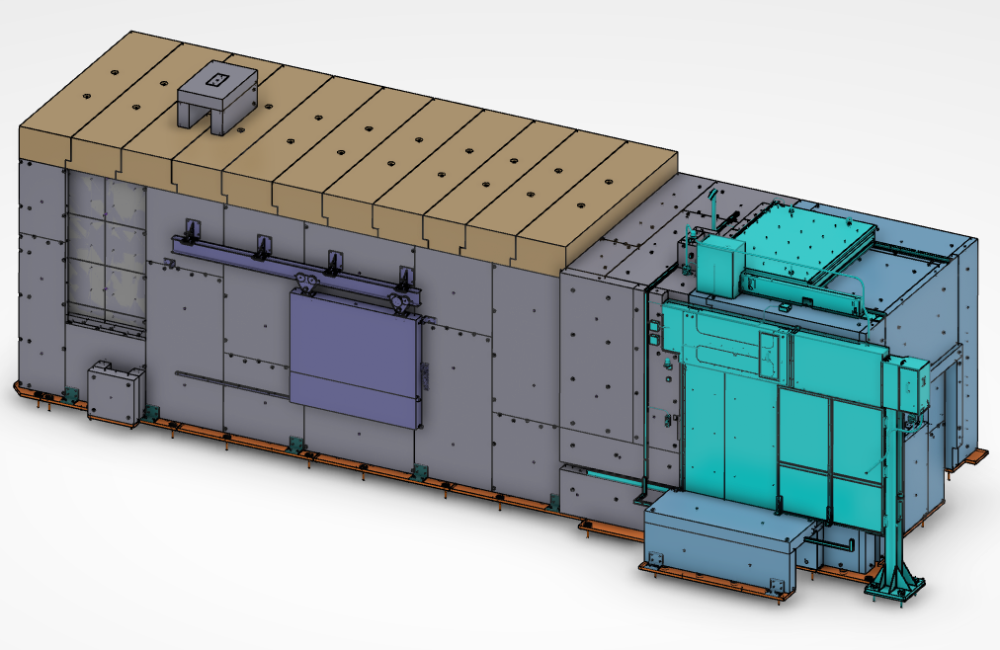
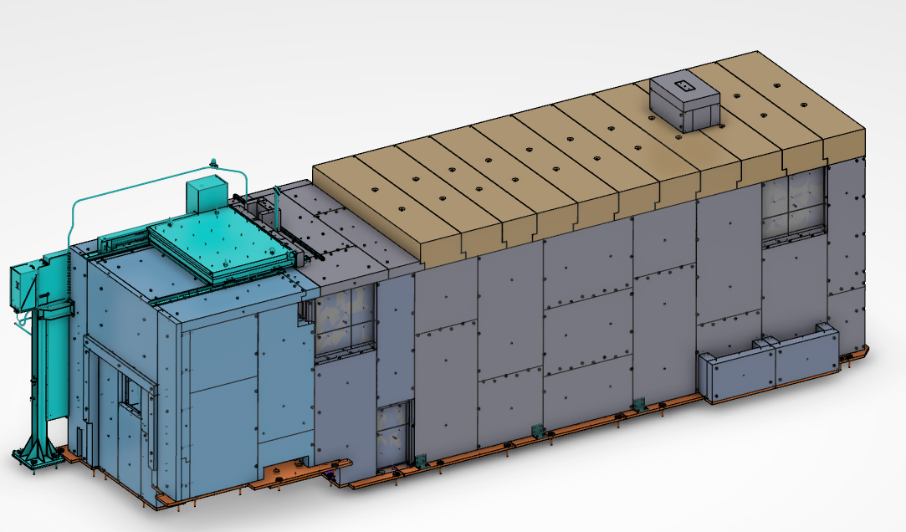
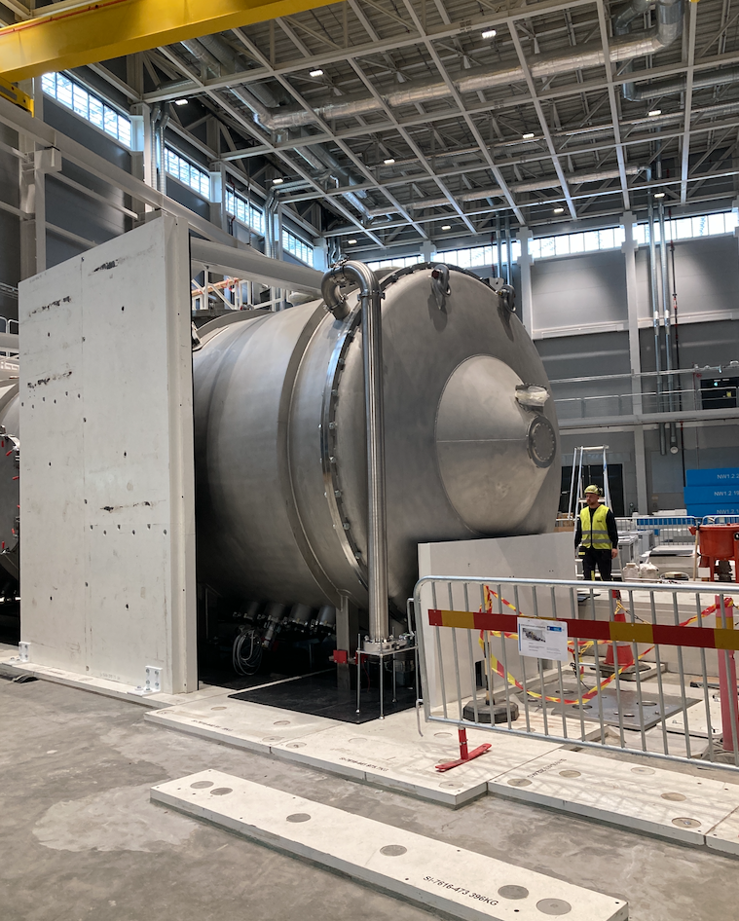
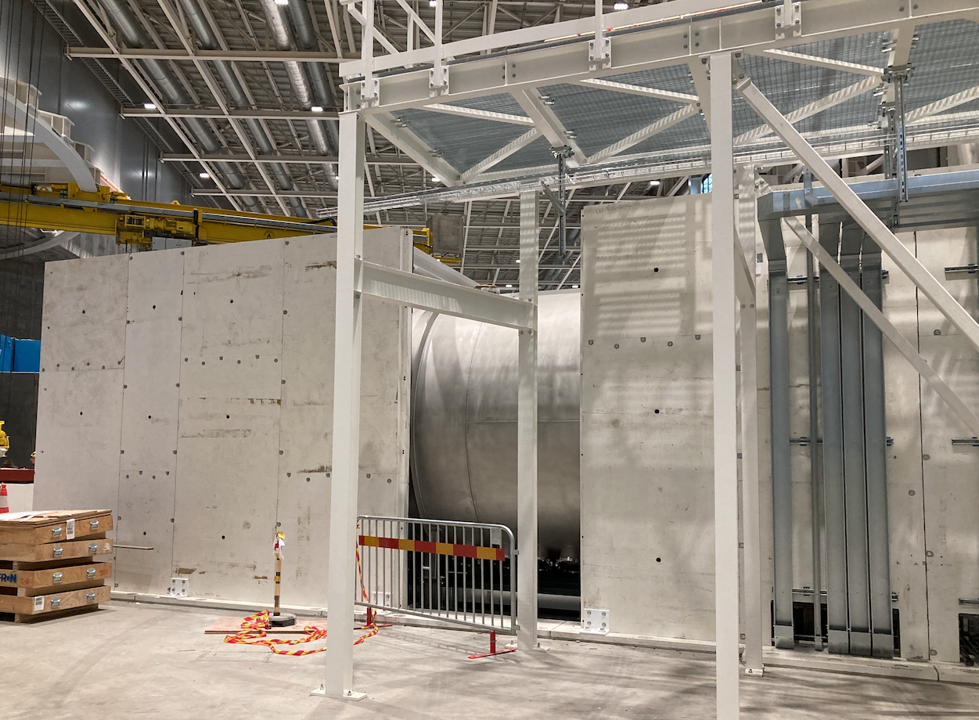
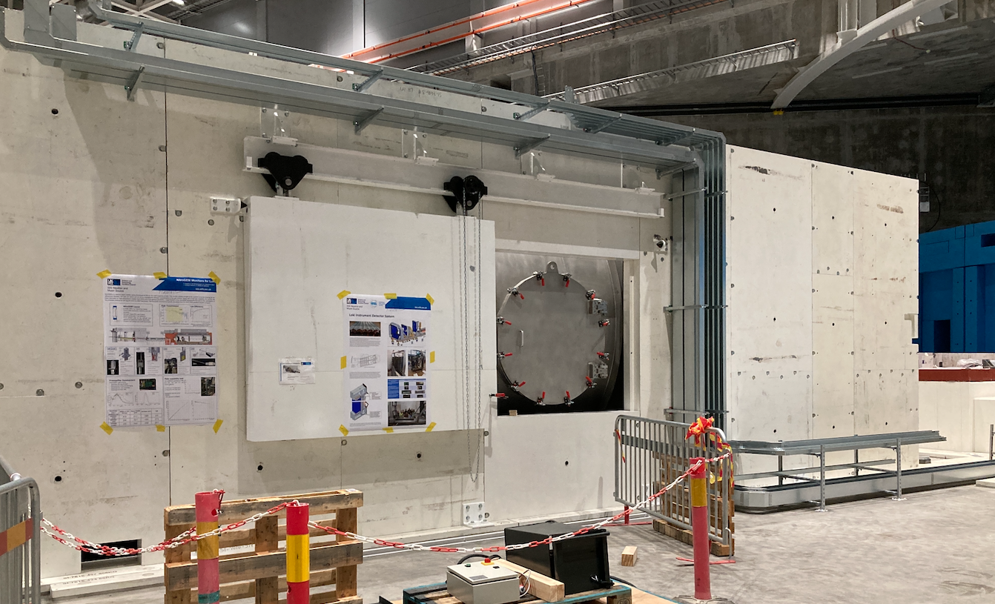
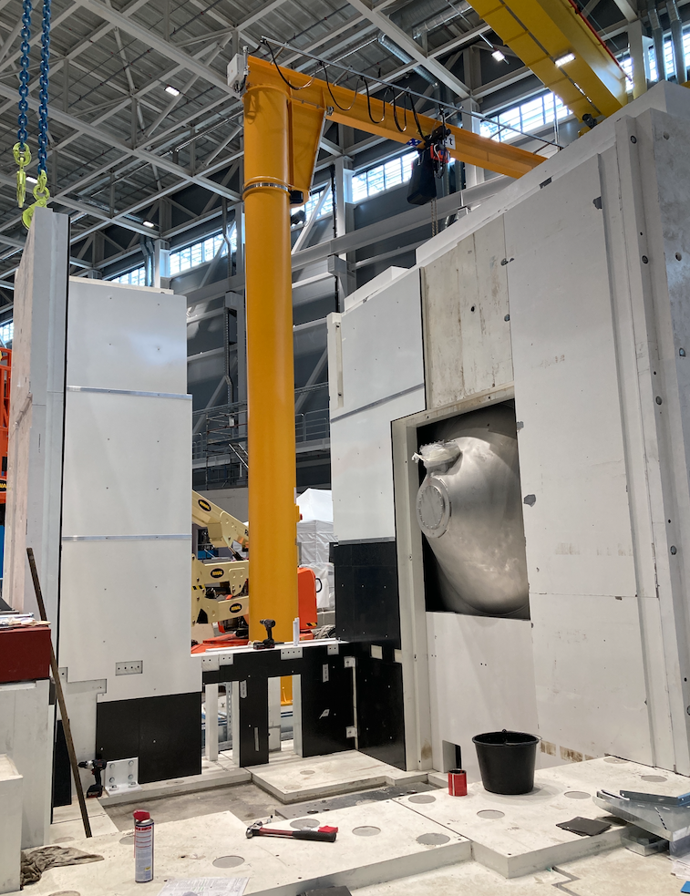
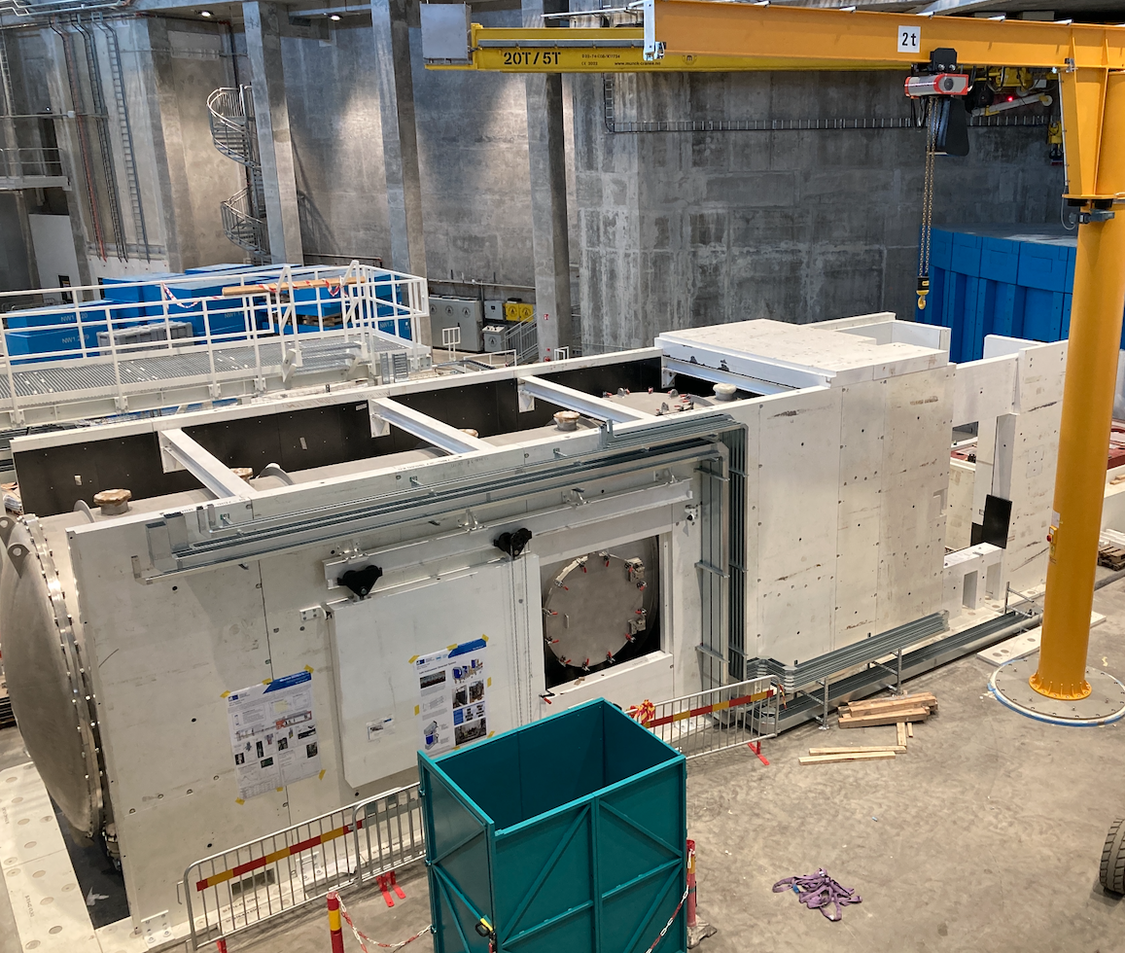
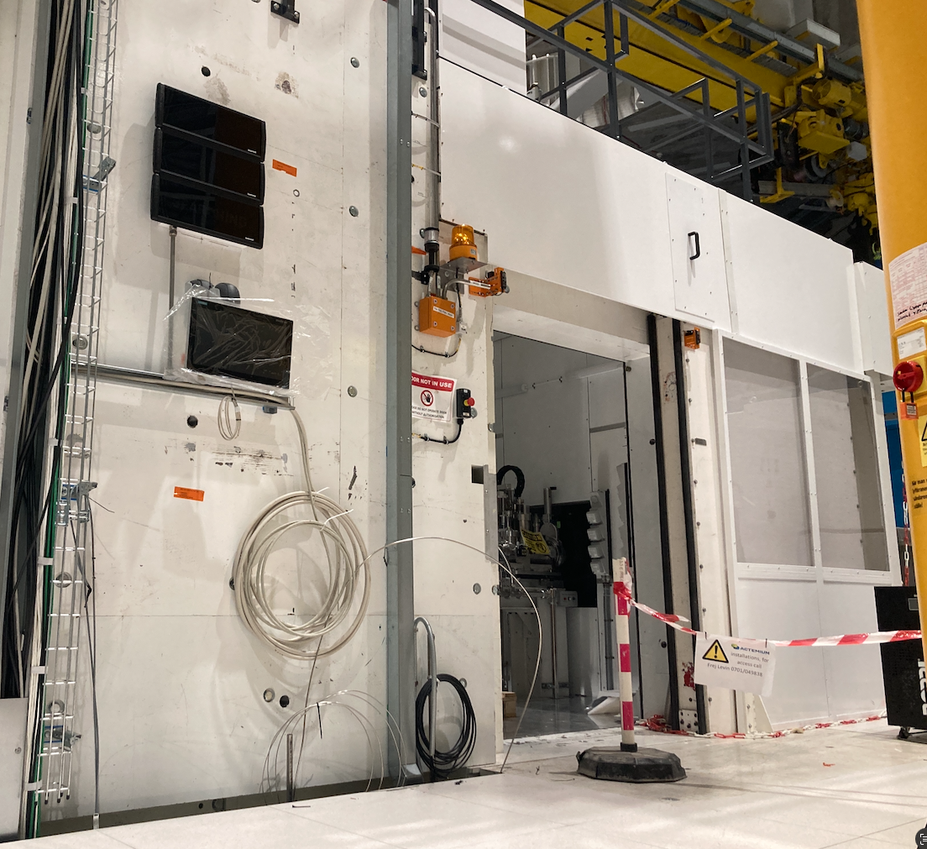
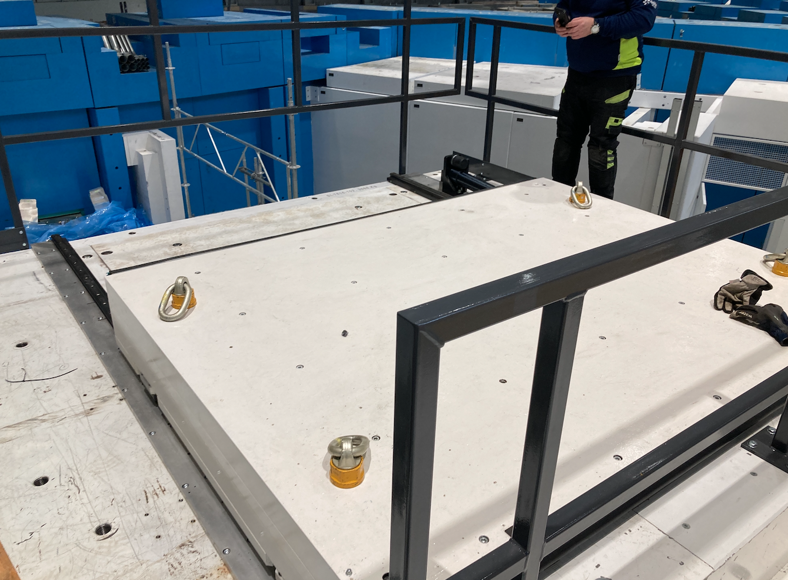
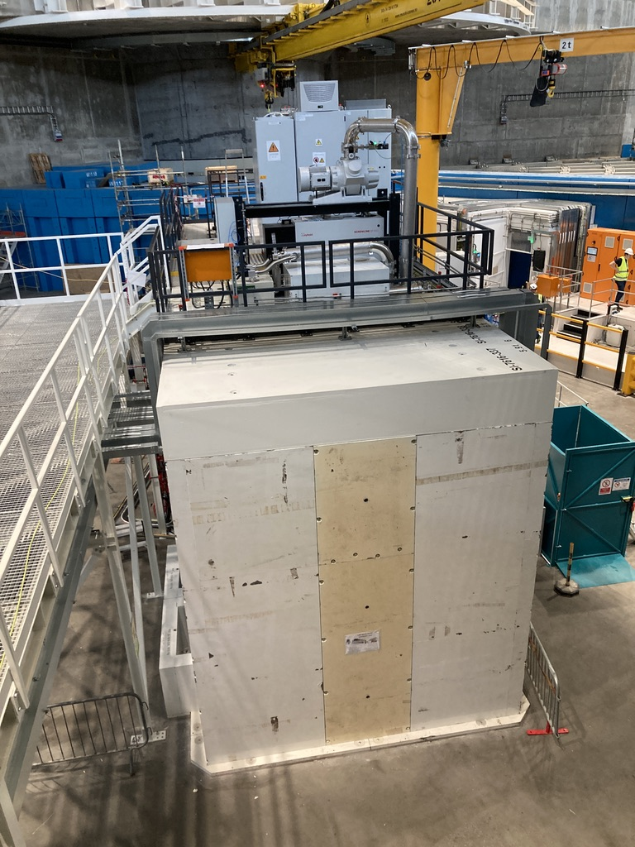
Cave Shielding installation
LoKI Instrument

Slide 15
5
Radiation Safety Assessment

Slide 16
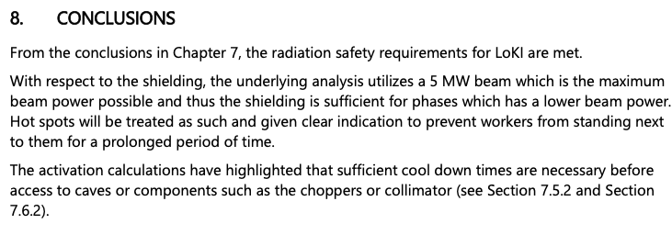
Radiation Safety Assessment
Implementation of Safety Functions
LoKI is within the radiation safety envelope of a generic instrument as defined in SSM submissions
All relevant RSFs and WRSFs are satisfied.

