Slide 1

An introduction to UX for control system interfaces
From Machine State to Human Understanding
3rd European EPICS Summer School — 17th-28th August 2026 — Balazs Nagy, Dirk Nordt
Notes:
Good morning. My name is Balazs Nagy, I am a UX designer at ESS, and I work together with Dirk on the interfaces used to operate this machine.
This week you have been learning EPICS, and you have been building OPIs. My part of the programme is about the other end of that chain: the person who has to look at your screen and decide what to do.
I have this presentation. Then Dirk and I want to hear from you, because you have all just built something, and your experience is the most interesting material in this room.
One promise before I start: I am not going to talk about making things look nice. This is about whether a person can understand a machine through a screen.

Slide 2

EPICS can expose enormous amounts of machine information.
Ultimately, a human has to interpret, decide what to do.
UI – Everything a person interacts with — buttons, screens, panels, knobs, indicators
UX – What happens in the operator's head when they use it
OPI – Operator Interface — a screen built in CS-Studio/Phoebus
HMI – Human-Machine Interface — the general industry term, screen or physical
PV - Process Variable — the fundamental unit of data in EPICS.
3rd European EPICS Summer School 17th – 28th August 202
Notes:
EPICS is extremely good at making machine information available. That is what you have been learning all week.
But at the end of that chain there is still a person. That person has to understand what is happening and decide what to do.
That is where UX comes in.
Before I go further, let me define the words, because they get used loosely.
UI, user interface. Everything a person interacts with. On a screen that is buttons, LEDs, values, layout. But it is also physical. A key switch, an emergency stop, a label on a rack. Three Mile Island, which I will come to in a minute, was a physical UI. No screens at all.
UX, user experience. Not something you draw. It is what happens when a person meets that interface. Did they find what they needed? Did they understand it? Did they make the right decision? UX is the result.
So you cannot really add UX at the end. You either designed for it or you did not.
OPI, operator interface. In our world that is a screen built in CS-Studio or Phoebus, connected to PVs. That is what you have been making this week.
HMI, human-machine interface. Same idea, older and broader term, used across industry. Refineries, power plants, manufacturing. If you read anything about ISA-101 or control room standards, they will say HMI.
One last thing worth saying out loud: UX is not visual design. Visual design is one of the tools. But a screen can be beautiful and terrible to operate, and it can be plain and work extremely well.

Slide 3
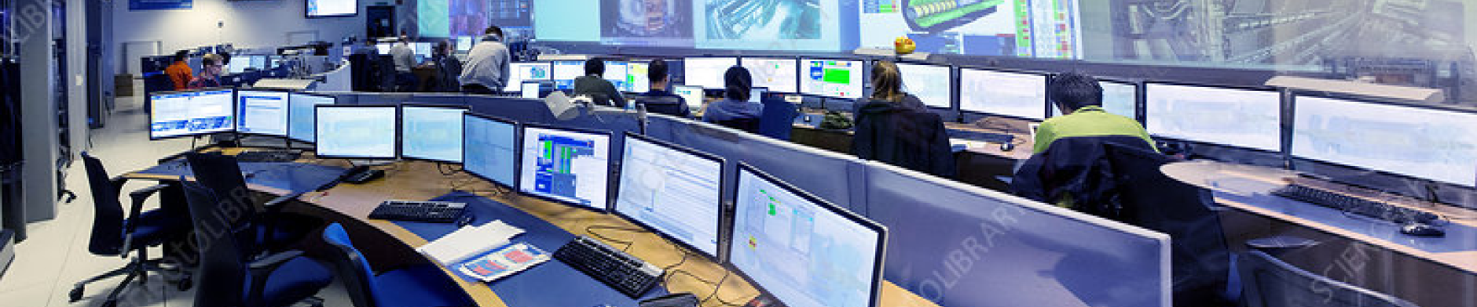
􀣌
􀣌
􀣌
􁛽
􁛽
􁛽
􁝸
􀓚
􀢹
􀣌
􀣌
􀉪
􁄠
What’s at stake
Consequences when interpretation is difficult.
Slower recognition
Misunderstanding
Higher cognitive load
Human error
Abnormal states are noticed later
Important information is missed or misinterpreted
More effort is spent interpreting the interface
The interface makes the right action harder to find
3rd European EPICS Summer School 17th – 28th August 202
Notes:
If interpretation is difficult, the consequences start small.
Something takes longer to notice.
Something is misunderstood.
More mental effort is needed.
None of that matters much when everything is normal.
But in an abnormal situation, these effects compound.
Especially under time pressure, or when all of the alarms are blaring at you.
An interface problem becomes an operational problem.
[Transition] Let me give you two examples where that happened.

Slide 4
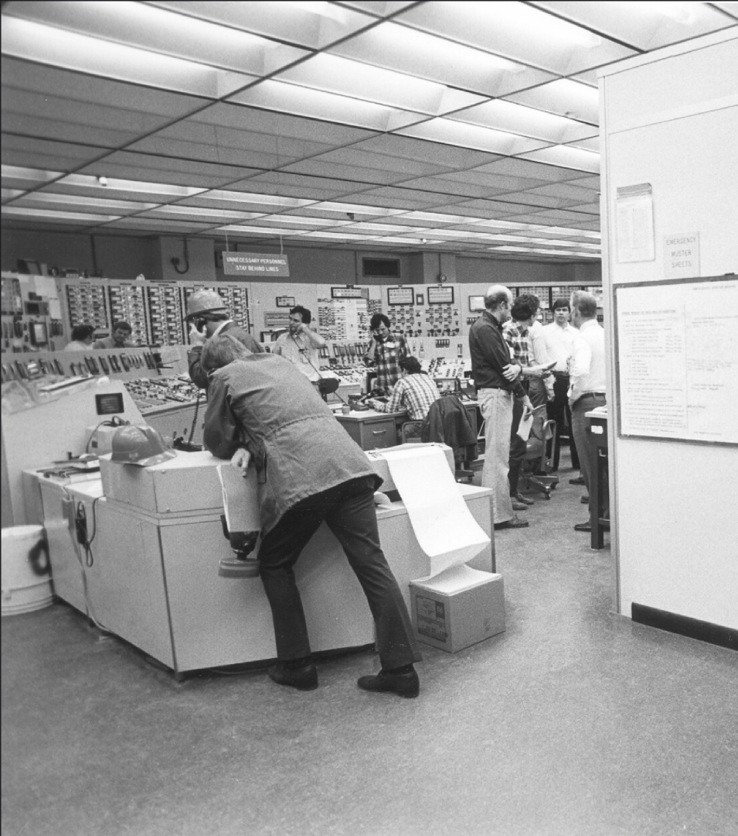
What’s at stake
Real life examples
Three Mile Island — 1979
Nuclear power plant accident.
Operators misunderstood the reactor’s condition.
What was at stake
Reactor cooling and nuclear safety
What went wrong
The indicator showed the command to close the valve — not the valve’s actual position.
Notes:
Three Mile Island is an extreme example.
A relief cooling valve was stuck open.
but the control panel made it look closed.
It showed the command, not the actual valve state.
Operators therefore had an incorrect mental picture of the system.
The important UX lesson is the difference between displayed state and actual state.
In OPI terms: don’t let a setpoint look like a readback.

Slide 5
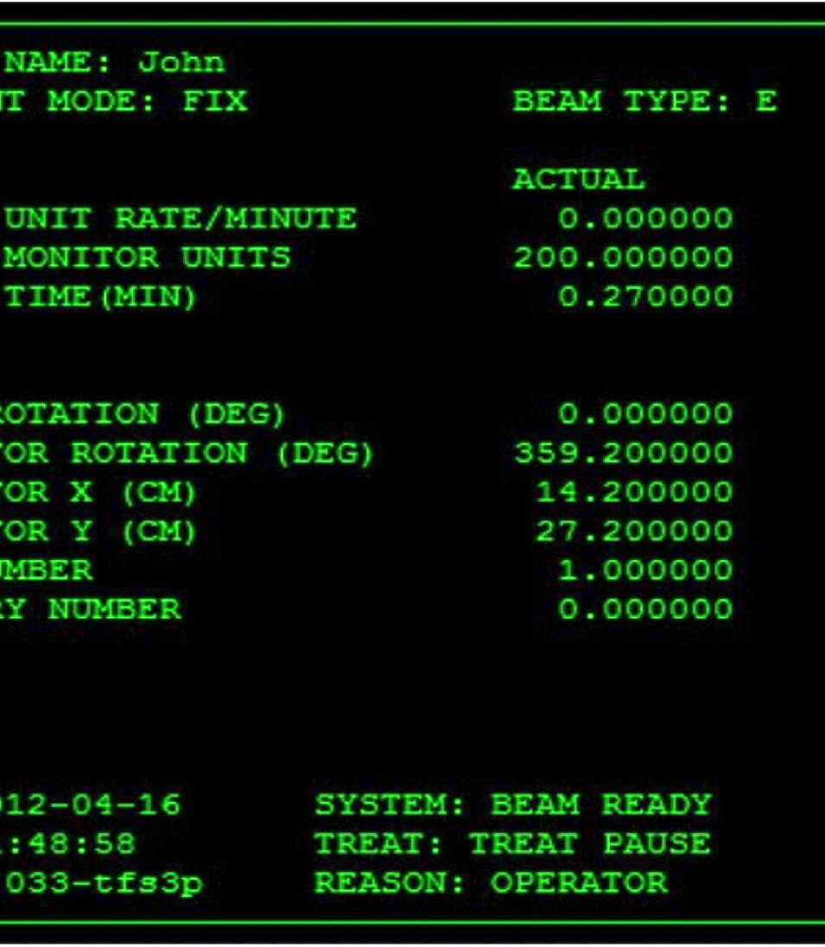
What’s at stake
Real life examples
Therac-25 — 1985–87
A computer-controlled radiation therapy machine delivered massive radiation overdoses to patients.
What was at stake
Patients’ lives
What went wrong
The interface could show corrected settings while the machine remained in an unsafe state.
Notes:
Therac-25 was a radiation therapy machine that gave massive overdoses to six patients.
The operators were faster than the machine. If they quickly corrected settings, the software could leave the machine in an unsafe state.
Then the interface simply showed “MALFUNCTION 54” — unexplained, with no indication of how dangerous it was.
The lesson: the interface must accurately communicate the machine’s state — especially when something goes wrong.
[Transition] These are extreme cases, but the underlying problem is ordinary:
the machine has a state, and the human has to understand that state through an interface.

Slide 6
Every minute an operator spends fighting the Interface
is a minute not spent on the experiment.
3rd European EPICS Summer School — 17th-28th August 2026 — Balazs Nagy, Dirk Nordt
Notes:
Both of those cases were extreme. Most of the time, the cost is not a disaster. It’s time and money.
Every minute spent figuring out the interface is time lost from the experiment. And if an OPI error causes an experiment to stop, reset, or restart, that can become a lot of lost time — and a lot of money.
That’s the everyday version of the same problem.
[Transition] So let us look at where the interface actually sits in the system.

Slide 7





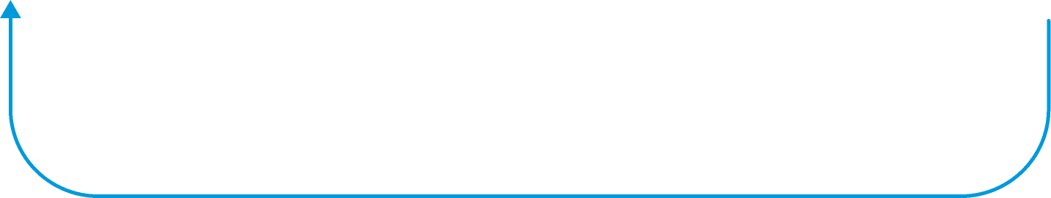
􀣌
􀣌
􀣌
􁛽
􁛽
􁛽
􁝸
􀓚
􀢹
􀣌
􀣌
􀉪
􁄠
From Machine State to Human Understanding
Where the OPI sits
Machine
PVs
OPI
Operator
Decision
The OPI is where machine state becomes human understanding.
3rd European EPICS Summer School — 17th-28th August 2026 — Balazs Nagy, Dirk Nordt
Notes:
EPICS solves communication between distributed systems extremely well.
Machine state becomes PVs.
PVs become an OPI.
And then the operator has to turn that into understanding, and into a decision, which goes back to the machine.
The OPI is not just a window onto the control system. It is part of the control loop and the basis of decisions.
And this is worth remembering: the operator in this diagram is not always at their best. They might be dealing with an alarm flood. They might be new. It might be three in the morning.
So don’t design for the person who already knows everything. Design the OPI to help the operator build the right picture of what’s happening.

Slide 8




􀣌
􀣌
􀣌
􁛽
􁛽
􁛽
􁝸
􀓚
􀢹
􀣌
􀣌
􀉪
􁄠
Situational Awareness
See what’s happening. Understand why. Anticipate what’s next.
PERCEIVE
UNDERSTAND
ANTICIPATE
What is happening?
What does it mean?
What is likely to happen next?
Values, states, and modes
Alarms and events
Trends and rate of change
Deviation from setpoint or limit
Subsystem relationships
Severity and operational impact
Trajectory of current trends
Consequences if nothing changes
Time left to act, and options
3rd European EPICS Summer School — 17th-28th August 2026 — Balazs Nagy, Dirk Nordt
Notes:
Human factors research has a name for that picture: situational awareness.
It has three levels.
Perceive: What is happening?
Can I see the state, alarms and changes?
Understand: What does it mean?
Is this normal? How are things related? How serious is it?
Anticipate: What is likely to happen next?
Where is this trend going? Do I need to act?
A good OPI should support all three.
And each level has a matching failure. Perceive fails when the signal is not visible or is buried in noise. Understand fails when you show a value with no context, no setpoint, no limit, no trend. Anticipate fails when the screen only shows now, with no rate of change and no history.
Showing the values in the OPI is only the first step.
----
Human factors research has a name for this. Situational awareness. It comes from aviation and control room research, and it has three levels.
Perceive. What is happening? Can I see the state, the alarms, the changes at all?
Understand. What does it mean? Is this normal? How do these things relate? How serious is it?
Anticipate. What is likely to happen next? Where is this trend going? Do I have time to act?
A good OPI should support all three.
And each level has a matching failure. Perceive fails when the signal is not visible or is buried in noise. Understand fails when you show a value with no context, no setpoint, no limit, no trend. Anticipate fails when the screen only shows now, with no rate of change and no history.
Showing the value is only the first level of three.

Slide 9
Designing for Understanding
Making the right information clear at the right time
Information hierarchy
What matters right now?
Consistency
Does this behave as I expect?
Color and Attention
What should I notice?
Situational
Awareness
Navigation
Where am I?
Where can I go?
State and Feedback
What is happening?
What happened after my action?
3rd European EPICS Summer School — 17th-28th August 2026 — Balazs Nagy, Dirk Nordt
Notes:
Once we look at OPIs through situational awareness w eunderstand that, none of these are aesthetic decisions. Each one answers a questions the operator is already asking.
Hierarchy. What matters right now? If everything is important, nothing is important.
Colour. What deserves attention? Contrast lets you emphasise and also lets you hide.
State and feedback. What is happening, and did my action work? The operator should never have to guess whether something took effect.
Navigation. Where am I? How did I get here, how do I get back, where do I go next?
Consistency. Can I predict how this behaves? Consistent elements let you use the tool instead of thinking about the tool.
None of these are decoration. Each one reduces the work needed to understand the machine.
[Transition] And this gets much more interesting when we stop looking at one OPI in isolation.

Slide 10













The EPICS Challenge
Many subsystems
↓
Many developers
↓
Many OPIs
↓
Many years
Each individual OPI can be technically correct...
...while the overall operator experience becomes fragmented.
Operators must learn not only the machine, but also the interfaces.
Many teams build the interfaces. One operator experiences them.
?
?
Time
Each individual OPI can be technically correct…
…while the overall operator experience becomes fragmented.
3rd European EPICS Summer School — 17th-28th August 2026 — Balazs Nagy, Dirk Nordt
Notes:
So far we’ve been talking as if we’re designing one interface.
EPICS facilities don’t work like that.
We have many subsystems.
Many developers.
Many OPIs.
And systems that evolve over many years.
Each individual OPI can be completely functional.
But the operator experiences all of them as one control environment.
If every team invents its own conventions, the operator has to learn both the machine and the interface.
People come and go, tribal knowledge can build up.
That's the scale problem.

Slide 11



Coherence at System Scale
When scaling we need rules, a system, a design guidance.
Different state representations
Different navigation
Different interaction patterns
Different visual hierarchy
More to learn and remember
Shared state representation
Shared information hierarchy
Common navigation patterns
Consistent interactions
Familiar and predictable behaviour
3rd European EPICS Summer School — 17th-28th August 2026 — Balazs Nagy, Dirk Nordt
Notes:
Consistency is not about making every screen look the same.
It is about the operator being able to transfer what they already know from one screen to the next.
Same state, same visual meaning.
Same action, same interaction.
Same component, same behaviour.
Same navigation pattern, so movement through the system is predictable.
Same alarm principles, so attention works the same way everywhere.
A design system is one way to make that consistency scalable. It is not the only way, but it is the one that survives people joining and leaving.
[Transition] Let me show you what that looks like for us in practice.

Slide 12
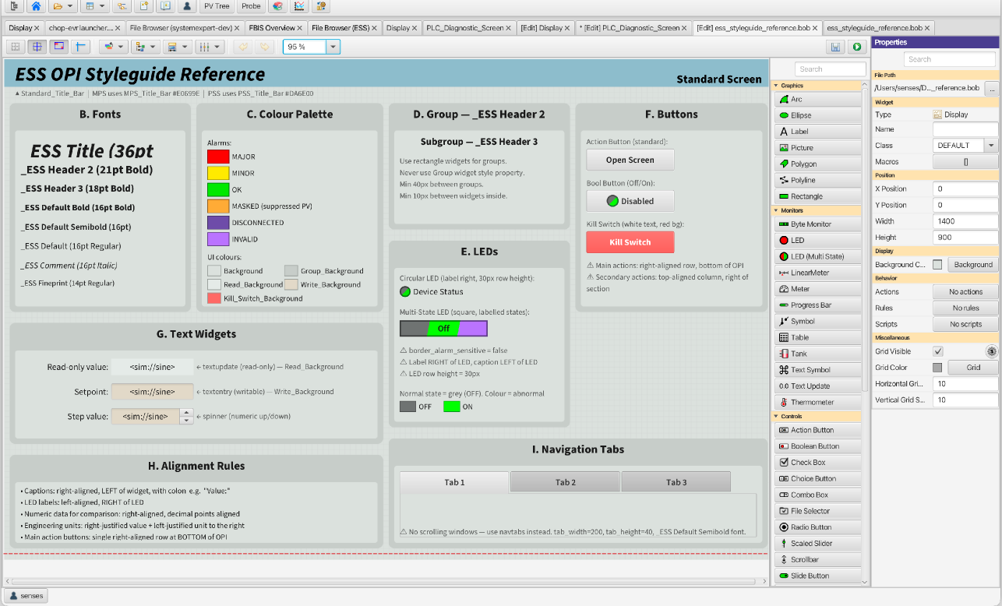
Putting It Into Practice
Creating a
Styleguide or
Design System
Notes:
We maintain a styleguide and try to hold every OPI to it. This is a rulebook that defines: typography (named roles, not sizes), colour, LED states, spacing, button placement
You can download it and learn how to use it, w also made it in different formats Figma, os a CS Studio .bob file like this
Developers can copy-paste directly from it
Important to understand that you can't thinnk of everything in advance with rules, but the basics need to be applied everywhere.

Slide 13
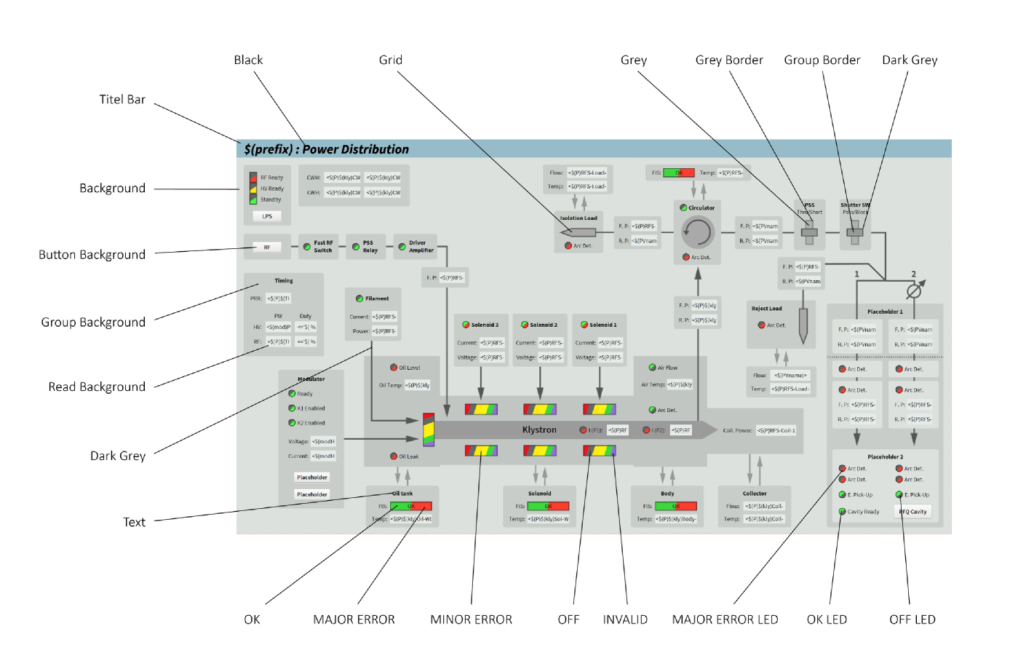
Putting It Into Practice
Creating a
Styleguide or
Design System
Notes:
This is an example of the styleguide applied in a hypothetical situation.
The styleguide doesn't tell you what to build. It eases the weight of decisions to make.
You still decide what belongs on the screen, how it's grouped, what the operator needs. That's the design work.
What you don't decide again: what red means, how big a header is, where the buttons go.
The payoff isn't on this screen. It's on the fortieth one — when an operator opens something new and already knows how to read it.
Transition: The rules are the easy part. What matters is what changes when you apply them. So — real screens from here.

Slide 14
Before & After
Not: does this look better?
But: what can the operator understand faster?
Notes:
SLOW DOWN.
We have talked about principles. Now let us look at real screens from this facility.
But I want to be clear about what question we are asking.
The question is not: does the new one look better? That is a matter of taste, and it is not interesting.
The question is: what can the operator understand faster, or more reliably, than before?
Keep that in mind for the next few slides. And if you disagree with any of the choices, say so afterwards. These are decisions, not laws.

Slide 15
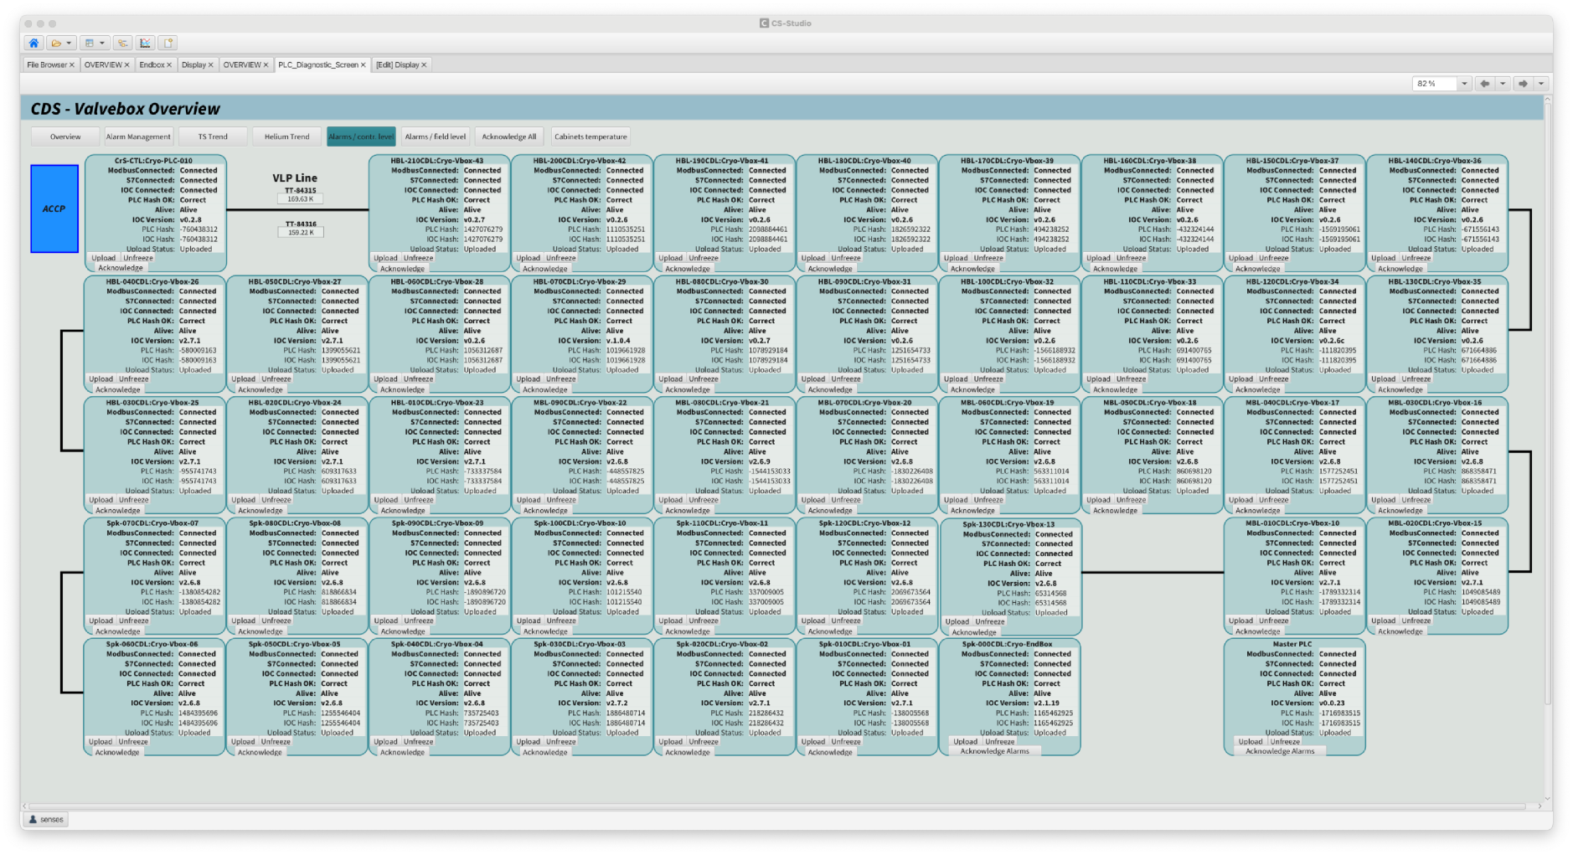
Before
Notes:
Ask the room first, then wait:
Where do you look first? Can you tell the overall state of the system? Is anything wrong here?
Information density is at maximum. Labels are duplicated everywhere
There is no hierarchy. Same size, same weight everywhere. Nothing tells your eye where to start. (You should from the bottom right and snake up to the top)
Status is buried in text. Connected, connected, connected, correct, alive. You have to read every word to know..
Colour is almost absent. The one blue box stands out immediately, which actually proves that colour works. Nothing else uses it.
So Abnormal State is invisible. If one of these boxes had a fault, you would have to scan for it.

Slide 16
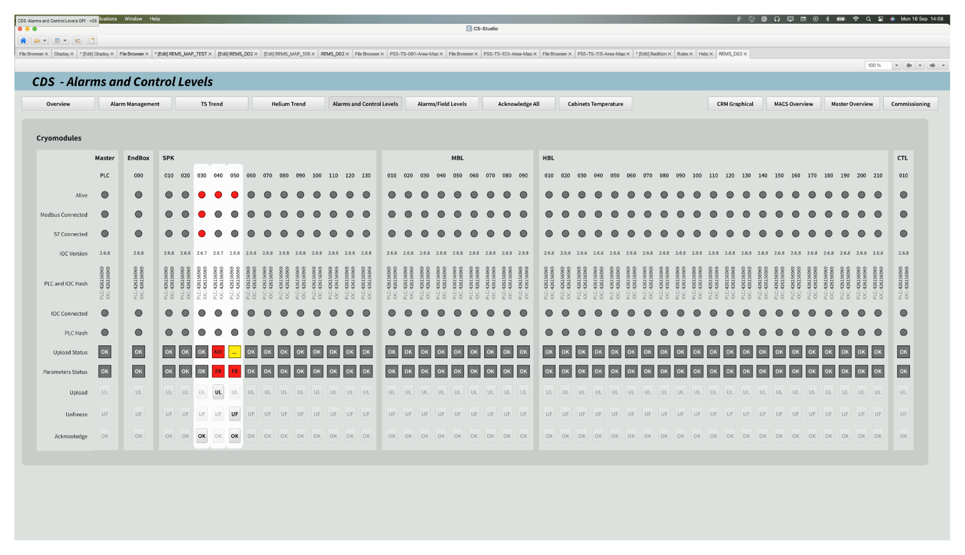
After
Notes:
It is the same information as before.
– How long does it take you to find the fault now?
It should be immediate. Three red dots, one column.
What changed, in the terms we have been using:
Perceive. Status is now visual. Grey dot, red dot. No reading. Abnormal is the only thing with colour, so it is the only thing your eye goes to.
Understand. The matrix does the interpretation work. Rows are properties, columns are Sections. You can compare across forty modules at once and see that these three are the outliers. In the previous screen every box was an island.
Hierarchy Applied
Grouping. Labelled sections instead of implied by position.
Attention. The affected column has a lighter background, so the problem reads as one cluster rather than three separate dots.
Anticipate Actions. Upload, unfreeze, acknowledge are in one consistent place at the bottom, dimmed when unavailable.
Still to improve: Density is still high but sometimes you can't decrease any more. Then comes the qustion of seperating a sceen into two for example.

Slide 17
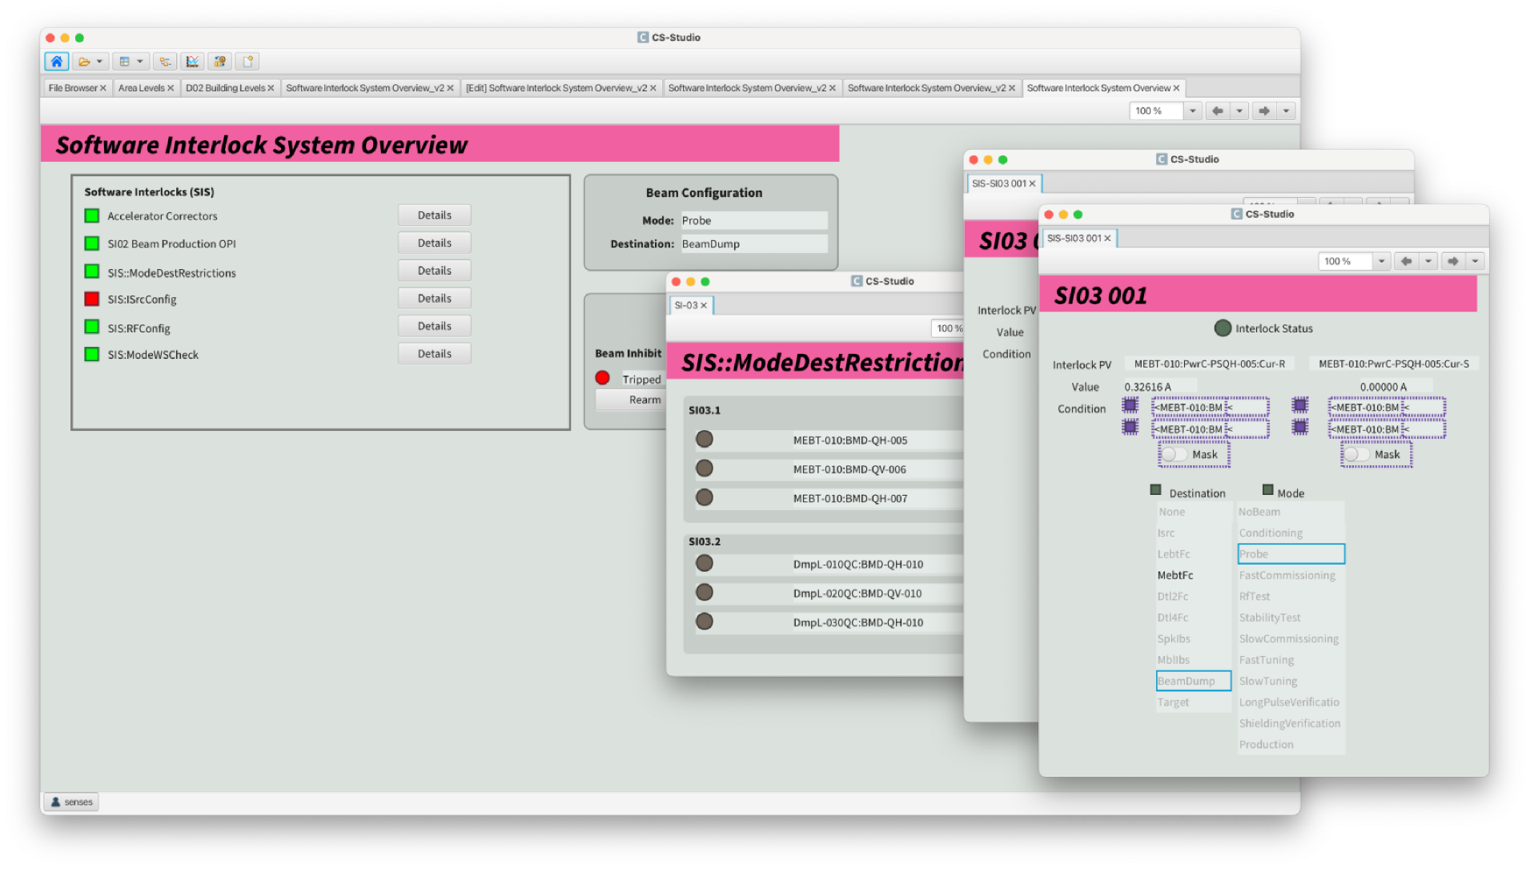
Before
Notes:
A second example, a different kind of problem. This one is about navigation rather than density.
Before: three to five clicks to reach the interlock screen, depending on where you started.
And every step opened another window. So by the time you arrive, you have a stack of windows on top of each other, and you have lost track of where you came from.
Ask them: how do you get back? Which window is the one you actually need?
This is the Navigation question from earlier. Where am I, and where can I go.

Slide 18
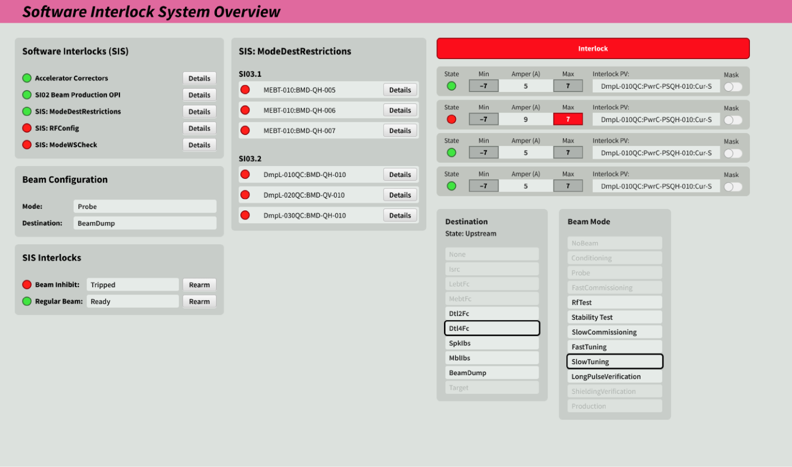
After
Notes:
After: one screen. One click.
No window clutter. Nothing stacked on top of anything else. You can see the interlocks, the restrictions and the configuration in one place.
Two things worth saying about this one:
First, nothing was removed. The same information is available. It was reorganised so that what belongs together is together.
Second, this is the cheapest kind of UX improvement there is. It cost no new PVs and no new logic. It was a decision about what belongs on one screen.
That is usually where the biggest wins are. Not in visual polish, but in deciding what belongs together.

Slide 19


Takeaway
Understanding is part of system performance
Understanding is part of system performance
Does this OPI display the right information?
↓
Does the operator understand
the right thing
at the right time?
EPICS connects machines.
OPIs connect those machines to people.
UX determines the quality of that connection.
“Does this OPI display the right information?”
“Does the operator understand the right thing at the right time?”
EPICS connects machines
OPIs connect those machines to people
UX determines the quality of that connection.
3rd European EPICS Summer School — 17th-28th August 2026 — Balazs Nagy, Dirk Nordt
Notes:
So, to close.
It is not enough to ask whether the OPI displays the right information. That question is about the machine.
The question that matters is whether the operator understands the right thing at the right time. That question is about the person.
Those are not the same question, and the second one is harder.
EPICS connects machines.
OPIs connect those machines to people.
UX is the quality of that connection.
That is my part. Now we would like to hear from you.

Slide 20
Thank you
Let’s discuss
3rd European EPICS Summer School — 17th-28th August 2026 — Balazs Nagy, Dirk Nordt
Notes:
My (Balazs) question: Why is it that UX and UI optimization in Business, like in my previous jobs, But Big science doesnt really applies these long established principles.
Hand over to Dirk here, or start it yourself if he is not ready.
Prompts to open the discussion, use whichever fits the room:
You have all built an OPI this week. What was the hardest decision you had to make about what goes on the screen?
Did you ever have to choose between showing everything and showing what matters? How did you decide?
Has anyone here used a control system screen as an operator, not as a developer? What was frustrating about it?
If you had to hand your OPI to someone who has never seen it, what would they get wrong first?
If the room is quiet: answer one of these yourself first, briefly, and then ask again. People join in once someone has gone first.
If someone challenges a point from the talk, that is a good outcome. Let it run.

