Slide 1
Phoebus (CS Studio) Training
Georg Weiss
Software Developer
European Spallation Source ERIC

Slide 2
TOC
High-level perspective of Phoebus (CS Studio).
Phoebus tools/applications:
  Display Builder
    The building blocks
    EPICS integration
    Dynamic behavior
    Best practices and OPI design guidelines
  Data Browser
  Logbook (Olog)
  Alarms
  Channel Finder
  Save&Restore
Discussions on Phoebus design and features.

Slide 3
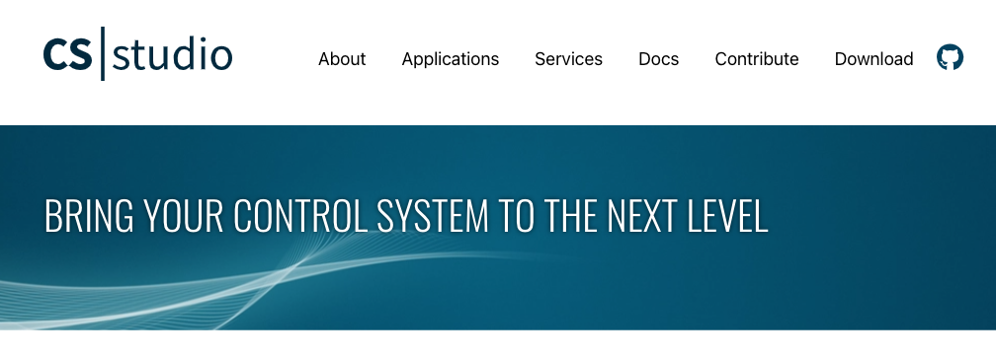
What is Phoebus (CS Studio)?
From https://phoebus.org:
CS Studio is a collection of tools and applications to monitor and operate large scale control systems, such as the ones in the accelerator community.
Phoebus is a pure java/javafx based implementation which uses java feature like SPI and modules to provide the same extensible and modular architecture. This is the current implementation of CS-Studio. The original implementation of CS-Studio is based on the Eclipse RCP framework, which provided an extensible and pluggable architecture.
The Phoebus and CS-Studio products are developed and maintained by a collaboration between many laboratories and universities.

Slide 4
What is Phoebus (CS Studio), really?
It is not a control system.
  EPICS is.
It is not an integration platform.
It is not a generic script execution environment.
It is not a data analysis tool.
It is a front-end to EPICS.
  With a number of bells and whistles…
  … but cannot be expected to support all use cases across all functions and teams at ESS.

Slide 5
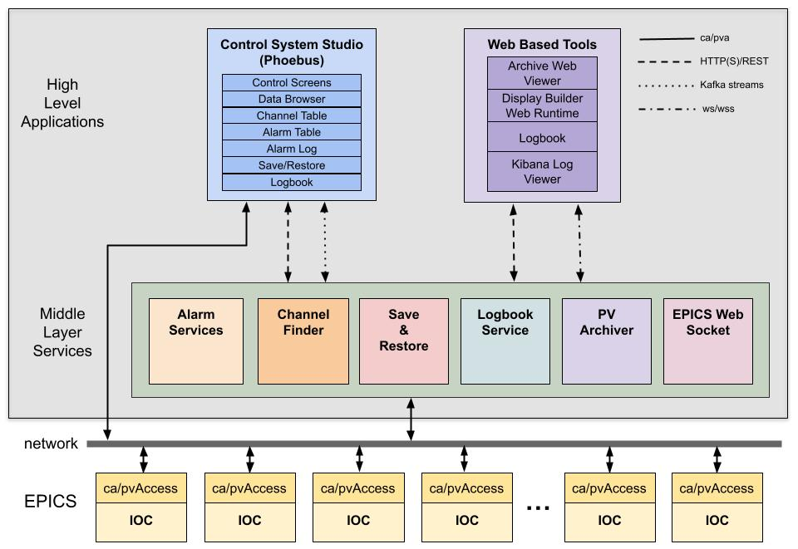



The Phoebus eco system

Slide 6
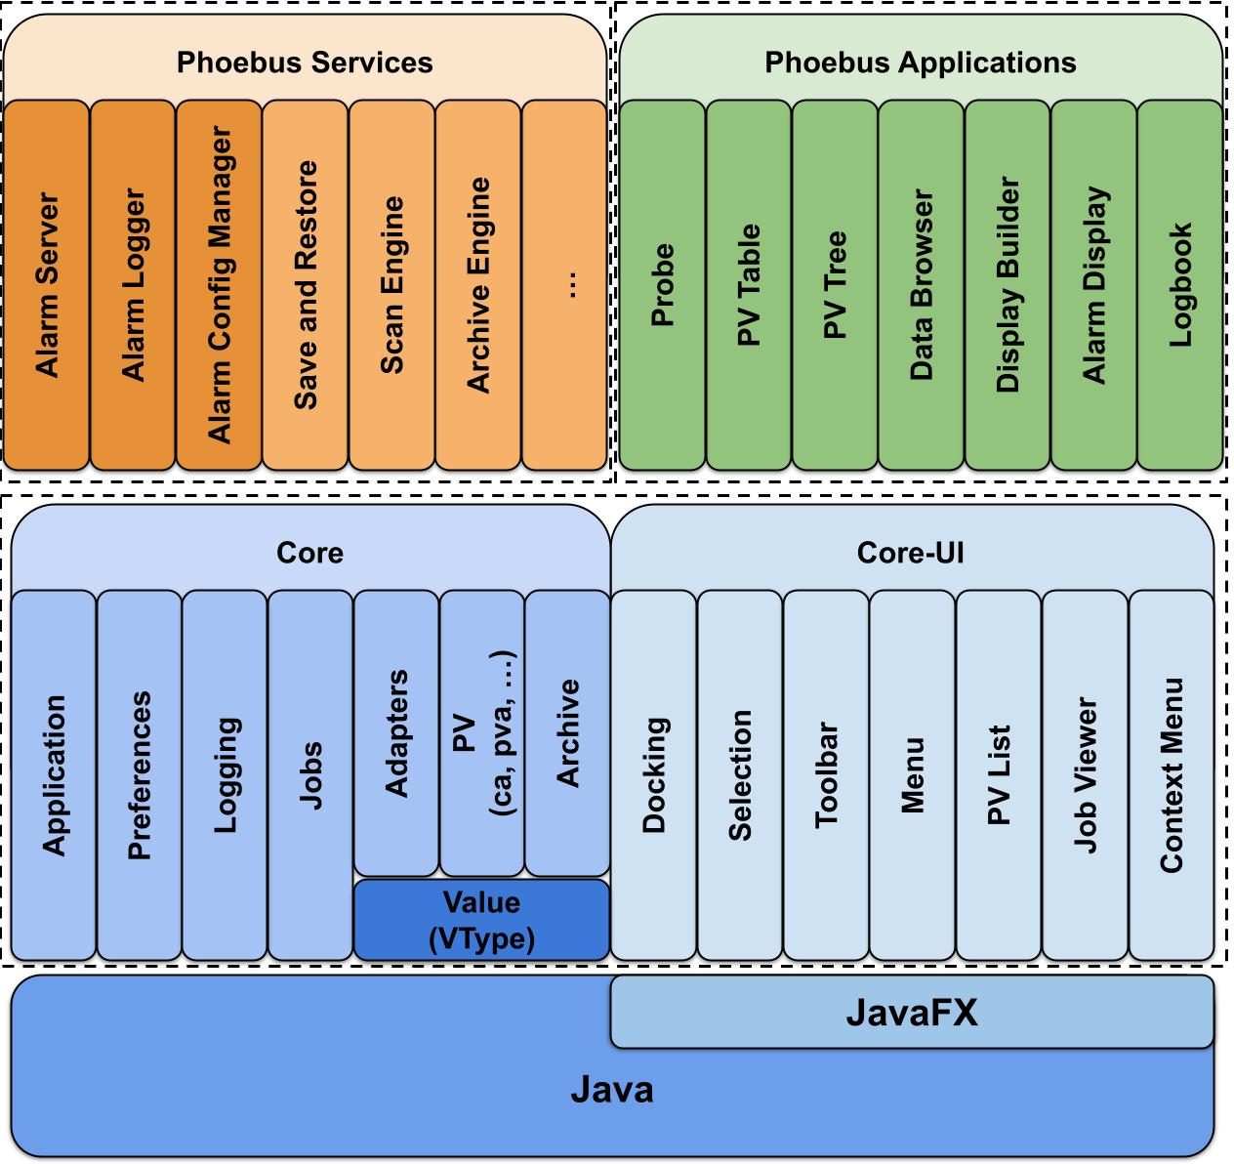
Phoebus architecture
Phoebus services manage
storage and distribution of
”data”.
Phoebus “apps” is a collection
of tools designed to work
together by sharing data.

Slide 7
Install Phoebus at ESS
Installation instructions: https://confluence.ess.eu/display/SW/CS-Studio+Phoebus%3A+install%2C+run+and+update
  Please pay close attention to information related to settings/configuration.
  Installation packages do not include settings file.
  The settings file must be named phoebus.ini and must be present in your home directory.
  Phoebus will/may not run without settings file in correct location.

Slide 8
Install Phoebus at ESS – settings for training
Make sure you have the following lines in phoebus.ini (present in template):
org.phoebus.pv/default=pva
  org.phoebus.pv.pva/epics_pva_addr_list=idmz-ro-epics-gw-tn.esss.lu.se 172.30.7.208
  org.phoebus.applications.saveandrestore.client/jmasar.service.url=http://172.30.7.208:8080/save-restore
  org.phoebus.olog.es.api/olog_url=http://172.30.7.208:18080/Olog
  org.phoebus.applications.alarm/server=172.30.7.208:9092
  org.phoebus.applications.alarm/config_name=Accelerator
  org.phoebus.applications.alarm/config_names=Accelerator

Slide 9
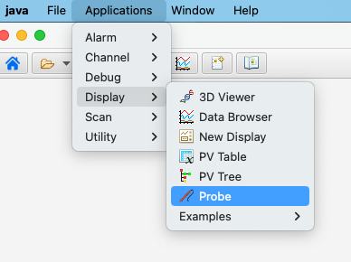
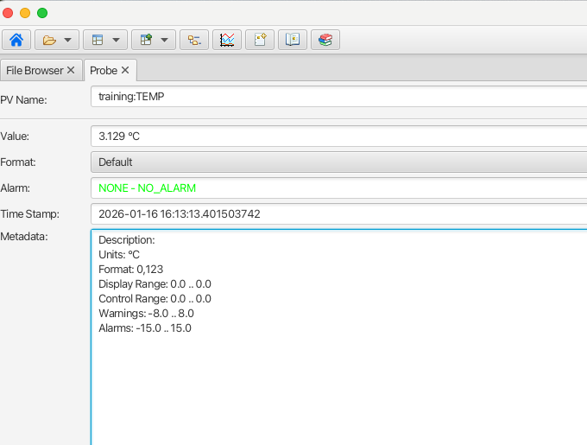
Getting your feet wet
Launch the Phoebus application.
From the menu bar, select Applications → Display → Probe
In the PV Name field type training:TEMP and press
<ENTER> key.
The Probe app is like the command line tool
pvmonitor –v training:TEMP, with a user friendly UI.

Slide 10
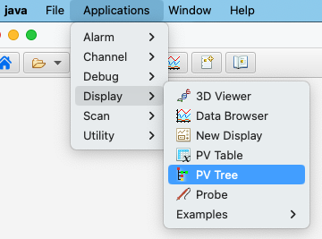
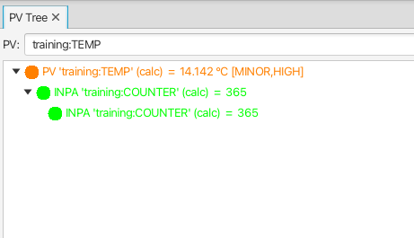
Getting your feet wet
Launch the Phoebus application.
From the menu bar, select Applications → Display → PV Tree
In the PV field type training:TEMP and press <ENTER> key.
The PV Tree app shows how a PV is setup in the IOC.

Slide 11
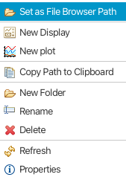
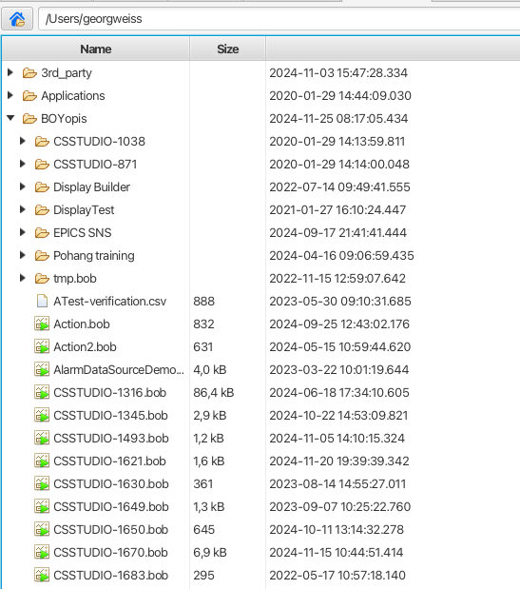
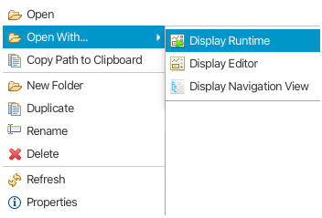
File Browser app: manage your resources
Go to user’s home directory
Default app for Phoebus file types:
.bob → Display Runtime
.plt → Data Browser
Image types → Image Viewer
Current directory
Context menu directory
Order:
Directories
Files
”Alphabetically”:
  Digits
  Upper case
  Lower case
Context menu (bob) file

Slide 12
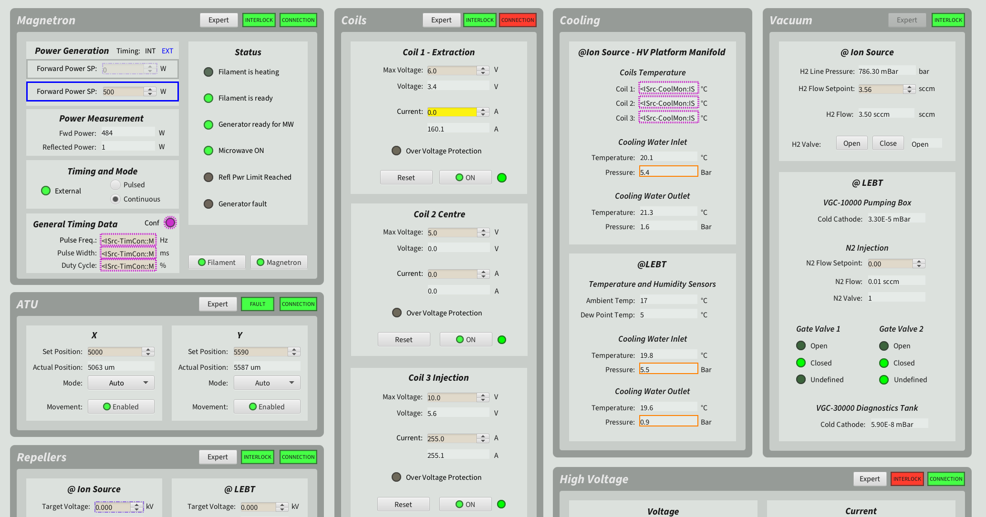
Display Builder app: build and run OPIs
The tool to build and run operator displays (OPIs).
WYSIWYG editor offering a rich palette of UI components.
  Default style and behavior of components adequate for most use cases.
Seamless integration with EPICS.
Seamless integration with other Phoebus tools/apps.

Slide 13
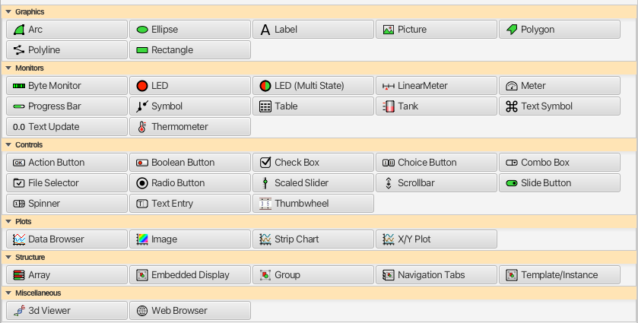
Display Builder: widget categories
Graphics: static UI elements.
Monitors: widgets showing PV values, much
much like command line tool pvmonitor
Controls: widgets to write (and show) PV
values.
Plots: self-explanatory…
Structure: used to organize set of widgets or
other displays.
Monitors, Controls and Plots are ”PV widgets”. They are designed to interact with PVs, i.e. show and/or modify values.

Slide 14
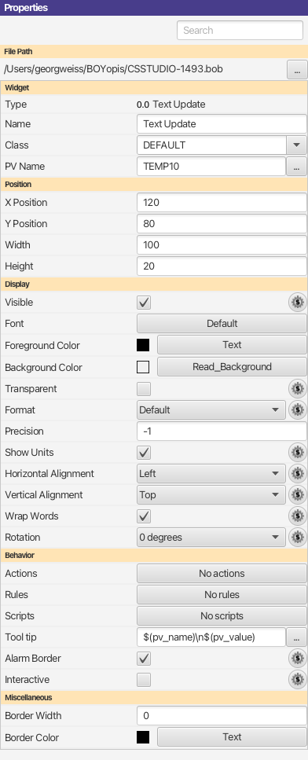
Display Builder: widget properties
Some properties common for all widgets.
Position and size absolute (no browser-like behavior).
Default appearance styled according to ESS design guidelines.
Behavior used to control properties dynamically.
PV widgets have alarm border.

Slide 15
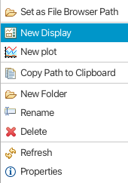
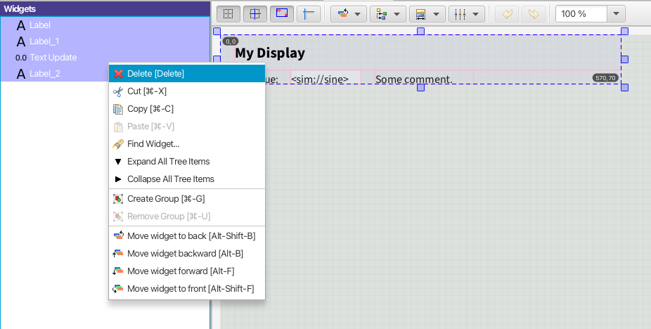
Exercise 1: basic PV aware widget
In the File Browser app, create a new display:
  Right click on a directory and select New Display.
  Specify a name. File extension .bob is added automatically.
New displays contain elements from a template.
Select all in the left-hand side widget tree and
delete from context menu.

Slide 16
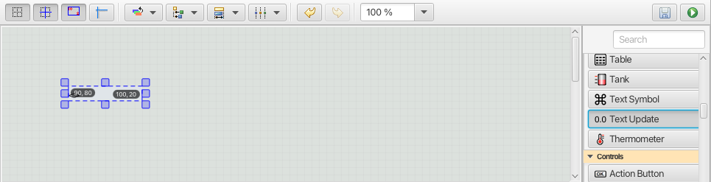
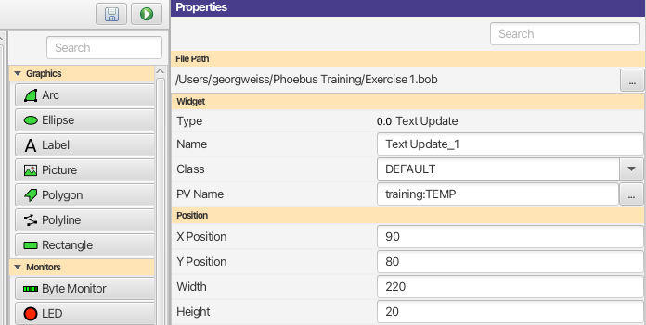
Exercise 1: basic PV aware widget
From the widget palette, select Text Update and drag-n-drop it onto the canvas:
In the widget properties, type training:TEMP for the PV Name property. Save changes.

Slide 17
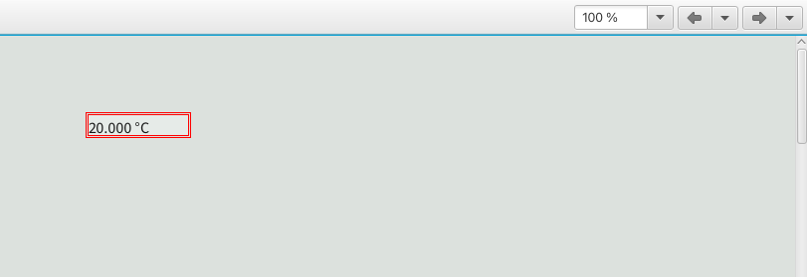
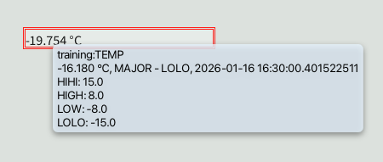
Exercise 1: basic PV aware widget
Click Play button to run display.
Widget connects to PV and shows
current value, i.e. works in a manner
similar to command line tool
pvmonitor.
By default, a border is rendered when PV indicates alarm state other than NO_ALARM.
Widget tooltip provides additional info: timestamp, alarm state and severity, alarm limits (if defined).

Slide 18



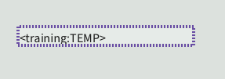

Exercise 1: basic PV widget
Widget borders and alarm severity
Alarm severity MINOR. Limits set by LOW and HIGH fields.
Alarm severity MAJOR. Limits set by LOLO and HIHI fields.
Alarm severity INVALID, record not processed (means: do not trust value!)
Alarm severity UNDEFINED, PV disconnected
OK state shall not use any “decorations”, e.g. green border or background.

Slide 19
Dynamic behavior in widgets
Rules: change a widget property based on a trigger.
  Useful, but user should be aware of pitfalls.
Actions: associate widget with some action, e.g. open other display. Invoked from widget’s context menu.
Scripts: execute python code
  Strongly discouraged! Really!
  To be used only if no other option can provide the needed functionality. Really!
  Limited to python 2.7. Currently no plan to support later versions.
  Difficult and cumbersome to maintain and debug.
  May be percieved as application (Phoebus) bugs.

Slide 20
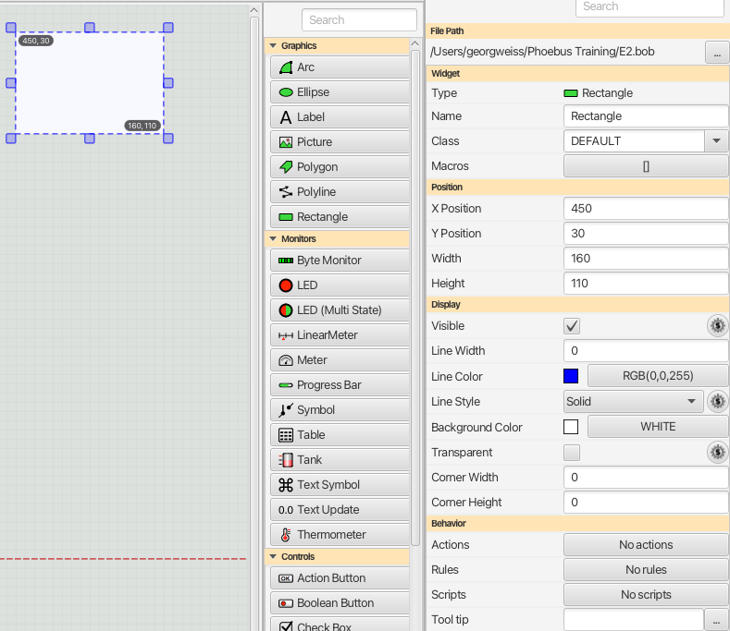
Exercise 2: Widget rules
In the File Browser, create a new display, e.g. “Exercise 2”.
From the widget palette, select “Rectangle” and drag it onto
the canvas.
In the widget properties view, set Line Width to 0
(i.e. no border*)
Change the Background color to WHITE.
Save.
* Since the Rectangle widget is not a
PV aware widget, the border is not an alarm border.

Slide 21
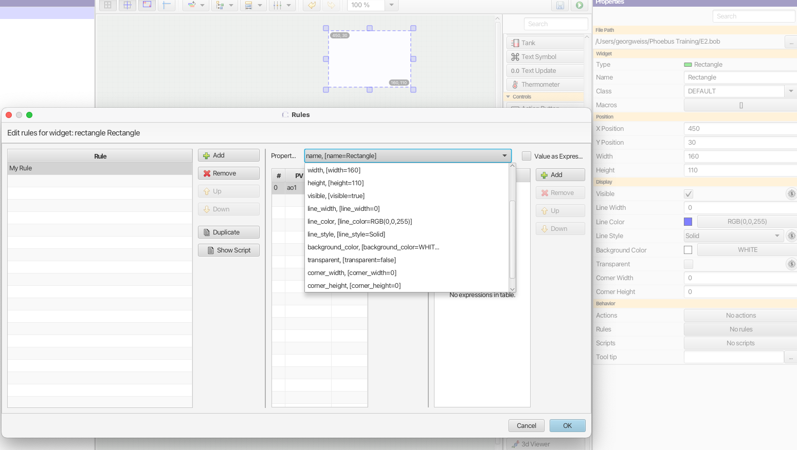
Exercise 2: Widget rules
In the display editor, click the Rules button to launch the rules editor:
Rule name
not shown
in display
Any number
of rules.
Rules control
widget properties,
e.g. Background
color

Slide 22
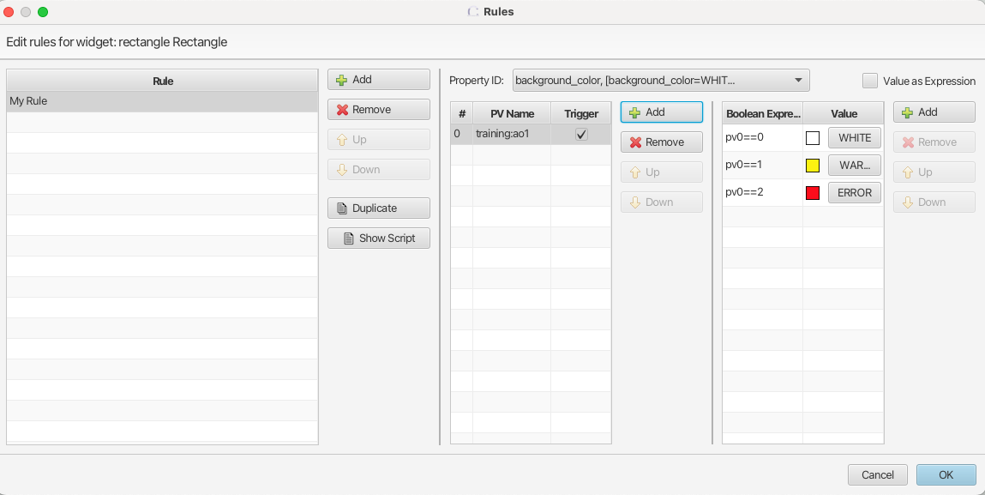
Exercise 2: Widget rules
Configure the rule to change background color based on value of a PV (ao1):
Property
controlled by the rule.
A non-PV widget
may still reference
PVs in rules. PVs act
as triggers for the rule.
Trigger is fired when
widget is first connected
to the PV, and on
each update (monitor
behavior).
Actual rule is one or
serveral boolean
expressions. They
reference PVs by index, e.g. pv0, pv1, etc.
NOTE: The boolean expressions are evaluated from top to bottom, but evaluation terminates when true is encontered.

Slide 23
Exercise 2: Widget rules - see in action
Launch the display.
In a terminal window*, set the value of the trigger PV to 1: >pvput training:ao1 1
In a terminal window*, set the value of the trigger PV to 2: >pvput training:ao1 2
In a terminal window*, set the value of the trigger PV to 1: >pvput training:ao1 3
* If you have the EPICS command line tool installed on your system

Slide 24
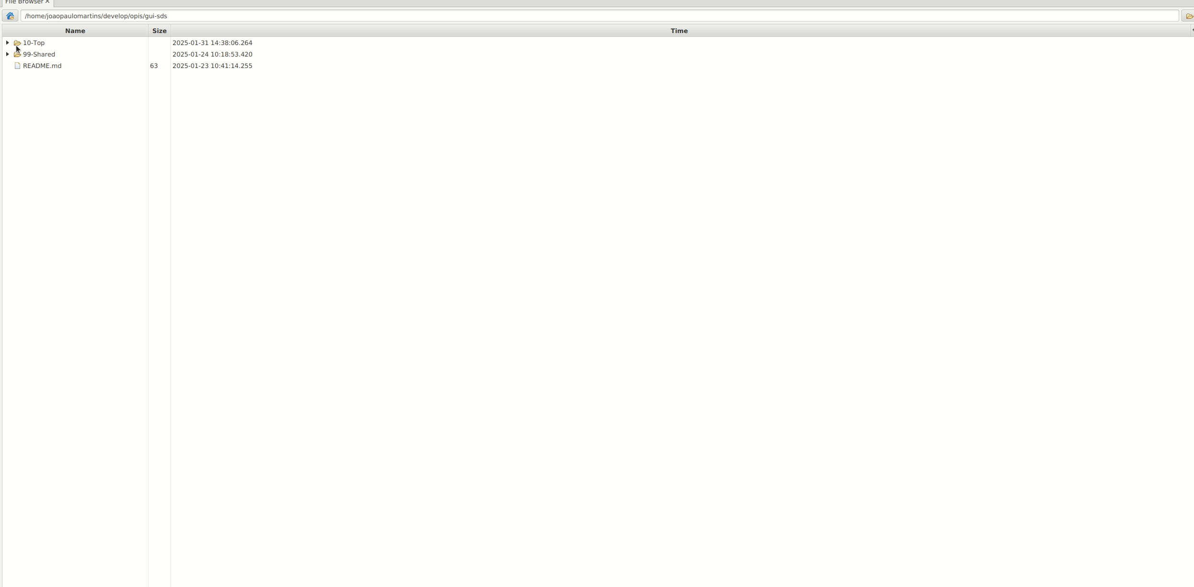
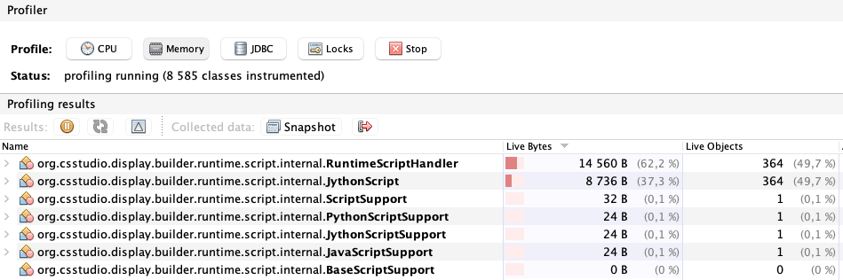
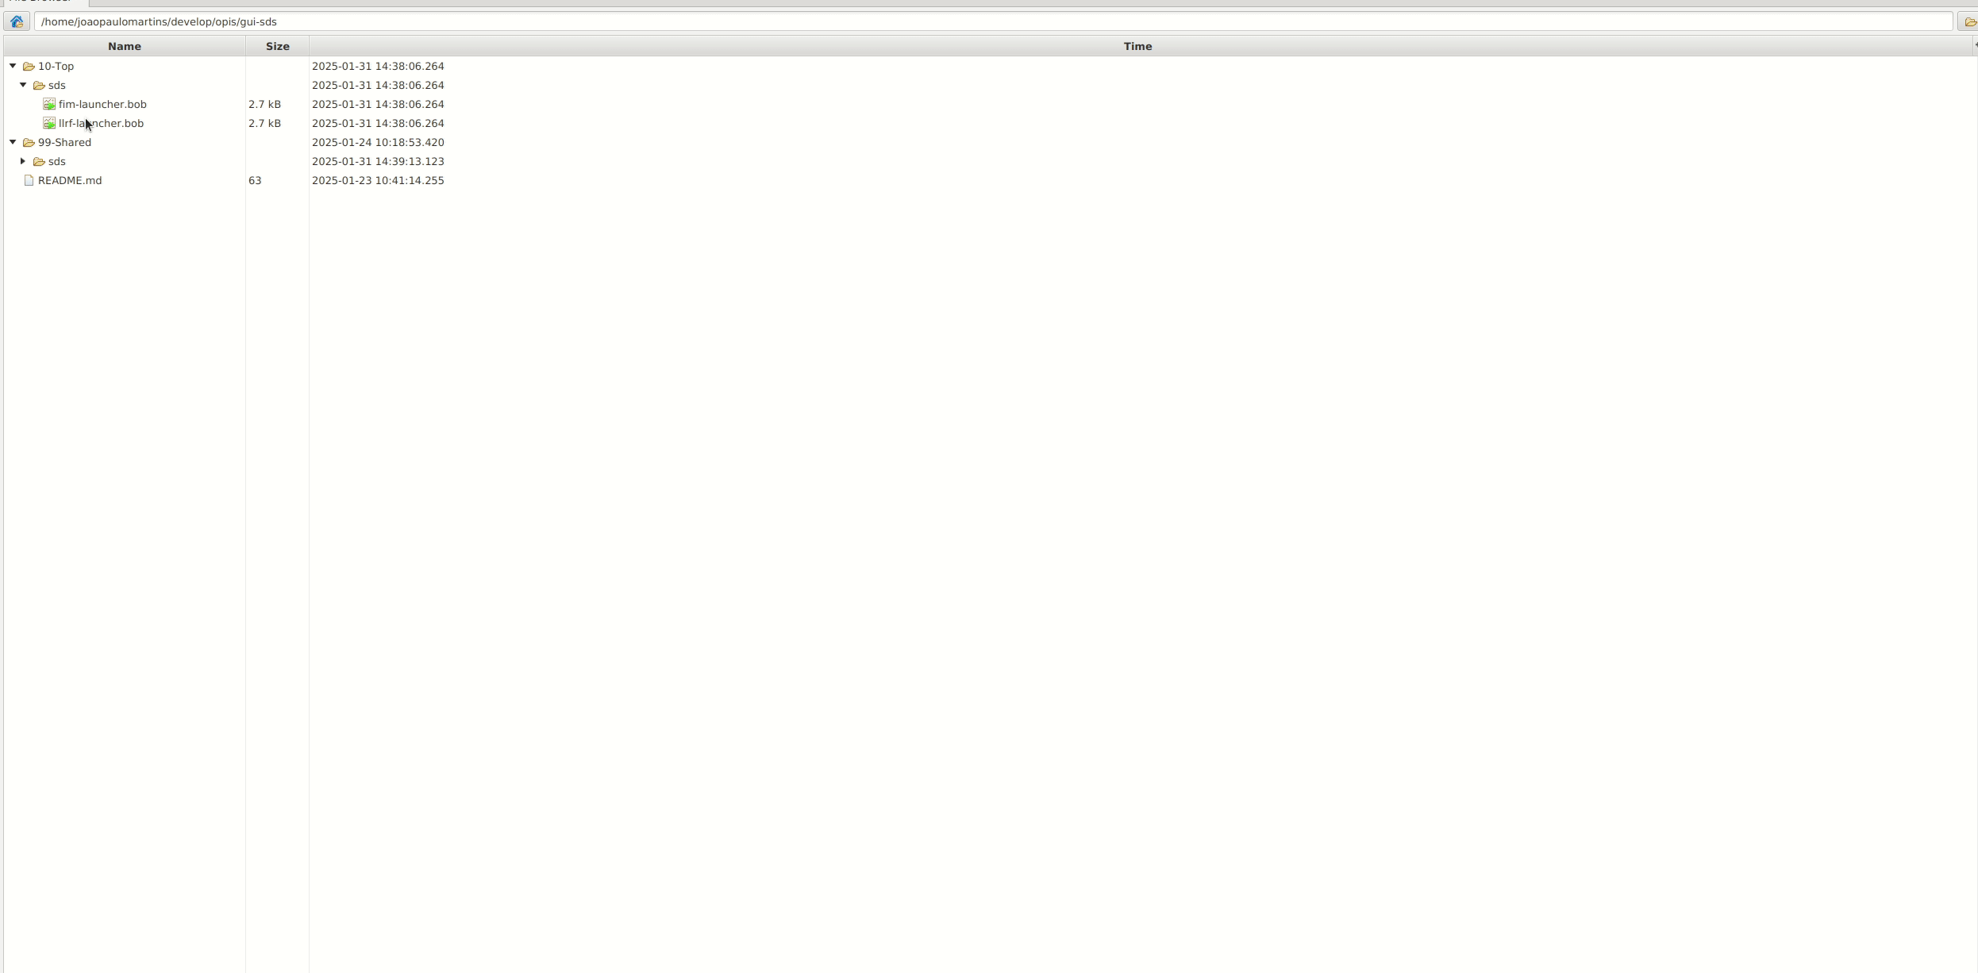
Widget rules considerations
Rules are very useful, but there is a price to pay:
OPI load time (rules are compiled Jython scripts).
Memory foot print.
CPU load.
Top OPI uses rules to set the color of a rectangular LED widget.
Bottom OPI uses “formula functions”.

Slide 25
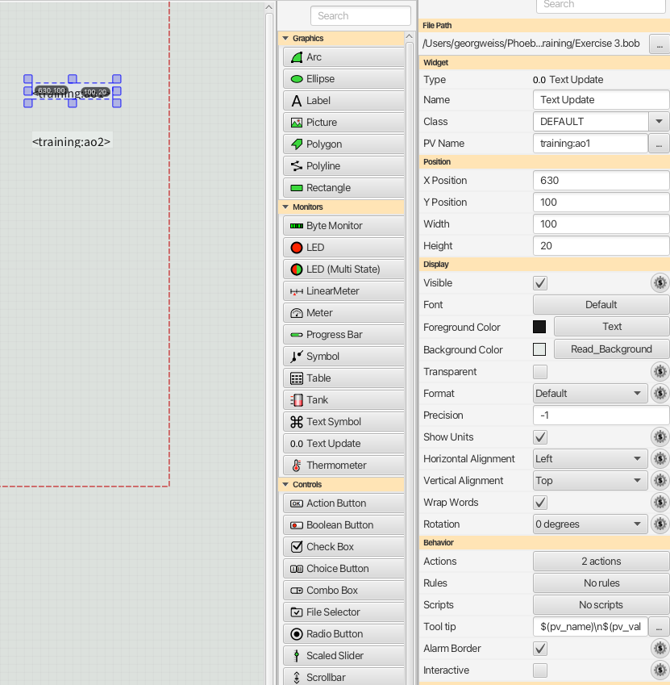
Exercise 3: Widget actions
In the File Browser, create a new display, e.g. “Exercise 3”.
From the widget palette, select “Text Update” and drag it onto
the canvas.
In the widget properties view, set the PV Name property
to training:ao1
From the widget palette, select “Text Update” and drag it onto
the canvas.
In the widget properties view, set the PV Name property
to training:ao2
Save.

Slide 26
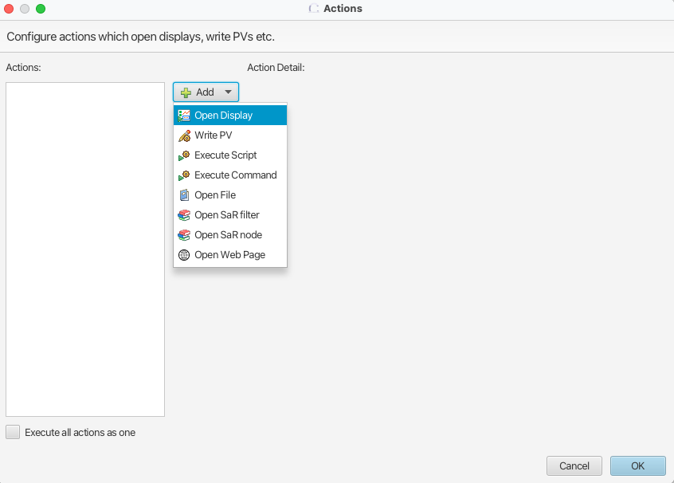
Exercise 3: Widget actions
In the display editor, click the Actions button to launch the actions editor:
Any number
of actions.
Set of available actions
is limited, but can be
extended.

Slide 27
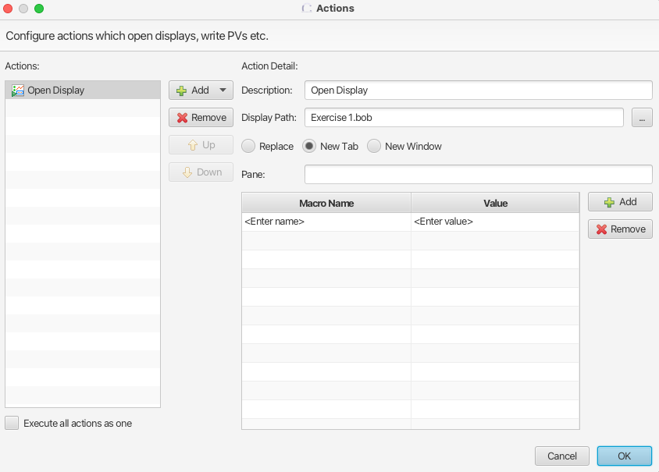
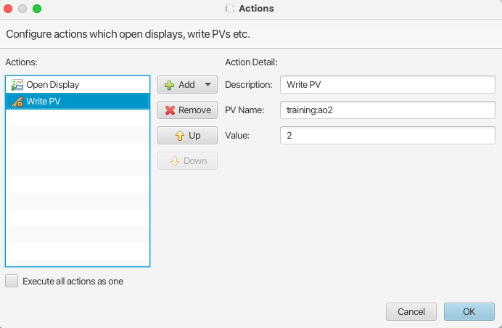
Exercise 3: Widget actions
Select Open Display from list of available
actions.
For Display Path, specify a file* from
previous exercise.
Select Write PV from list of available
actions.
For PV name, specify training:ao2.
For value, specify 2.
Save.
* Hint: avoid absolute paths, makes it difficult
to copy/move hierarchy of display files.

Slide 28
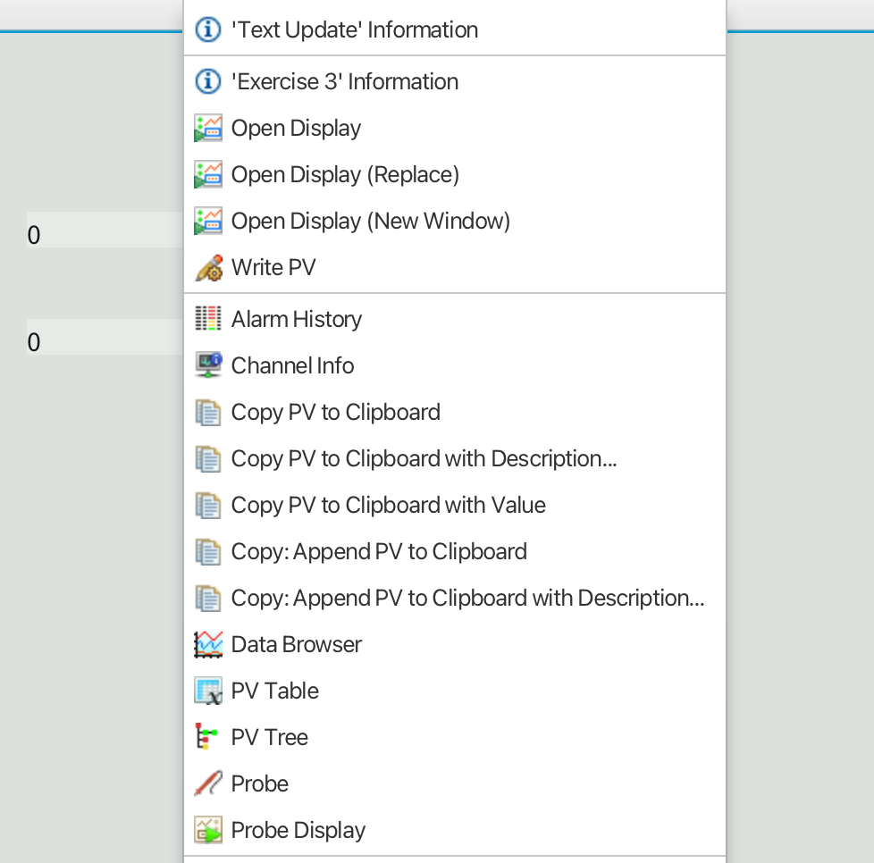
Exercise 3: Widget actions – see in action
Launch the display
Right click on upper Text Update widget to
bring up the widget’s context menu
Actions are added almost at the top of the context menu.
Open Display action adds three context menu items.

Slide 29
Widget scripts
Avoid!
Works similar to Rules, i.e. triggered by PVs.

Slide 30
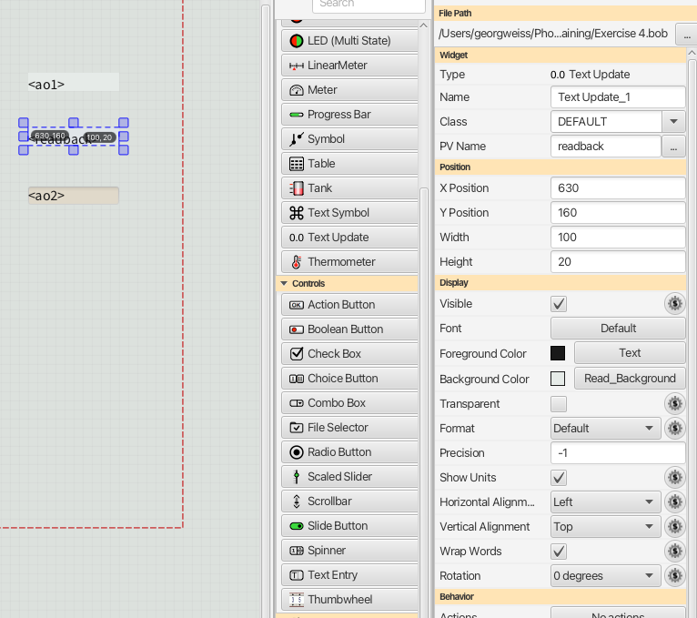
Exercise 4: Control widget
Update PV Name of second Text Update
to training:readback
Add a Text Entry widget to display from
previous exercise.
Set PV Name property to training:ao2.
Save.

Slide 31
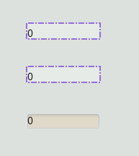
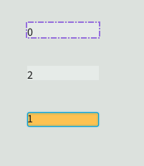
Exercise 4: Control widget
Launch display.
Initially all values 0.
Type 1 into Text Entry widget and
hit <ENTER>.
The training:readback PV is computed from
training:ao2
Text Entry widget uses special
background color during edit.
Important to distinguish between ”setpoint PV” and ”readback PV”:
Write a value to a (setpoint) PV to set (for instance) a power supply voltage.
The setpoint PV may not reflect actual voltage: power supply may need to ramp up slowly.
Actual voltage is should be provided by a (separate) readback PV.

Slide 32
Exercise 5: Control widgets and limits
Duplicate (in File Browser app) exercise 4 to exercise 5.
Launch display.
Type 100 into Text Entry widget and
hit <ENTER>.
Text Entry widget shows 60 because DRVH field is set to 60.
Default EPICS behavior is to set to DRVH if user specifies higher value.
PV may be constructed to reject a value > DRVH and
set alarm state instead of setting value to DRVH.
record(ao, ”$(P)ao2") {
field(SCAN, "Passive")
field(VAL, 0)
field(HIGH, 2)
field(HIHI, 30)
field(LOW, -20)
field(LOLO, -30)
field(HSV, 1)
field(HHSV, 2)
field(LSV, 1)
field(LLSV, 2)
field(DESC, "Analog Output 1")
field(HOPR, 50)
field(DRVH, 60)
field(LOPR, -50)
field(DRVL, -60)
field(FLNK, ”$(P)intermediate")
}

Slide 33
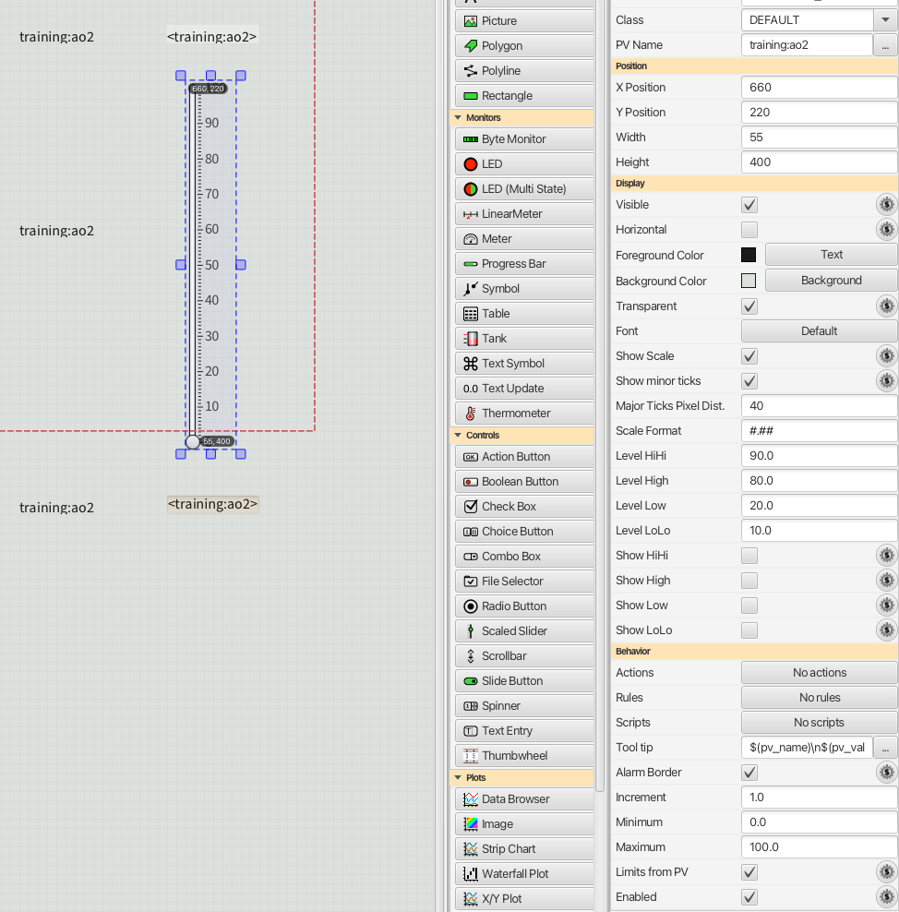
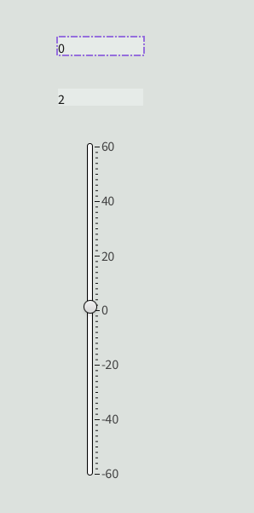
Exercise 5: Control widgets and limits
Replace Text Entry widget with a Scaled Slider.
Untick “Horizontal” and all “Show…” properties.
Note the ”Level…” properties. Untick all.
Note the “Limits from PV” property.
Save and launch the display.
Widget scale is -60 – 60, as defined in the EPICS record.

Slide 34
Visualizig alarms
Visualizing alarms on a PV can be done in several different ways:
  Alarm borders on widgets. Works out-of-the-box as it is based on EPICS PV behavior. In contrast to alarm applications, no extra configuration is needed.
  Alarm applications (Alarm Tree, Alarm Table). Provides high level view and offers interaction (acknowledge, guidance). Requires configuration: PV name must be added to an alarm configuration.
  Dedicated ”alarm widgets”, e.g. Multi-state LED widget.
Some IOCs implement separate PVs for alarms (“alarm PVs”), one for each state (LO, LOLO, HI, HIHI). This is not how EPICS works, such IOCs may need to be reworked!
Using an “alarm PV” is OK to indicate an abnormal state not associated with an analog value, e.g. lost network connection.

Slide 35
LED widget indicating alarm using rule
A LED widget can be used together with the SEVR field of a PV and a rule to indicate alarm.
The rule would change the color of the LED depending on the value of the SEVR field.
BUT:
  Rules incur an overhead when loading OPIs.
  Rules imply execution of code, sometimes even if nothing has changed.
  Rules are time consuming to maintain.
  Rules can be difficult to debug.
  This is not the recommended solution!

Slide 36
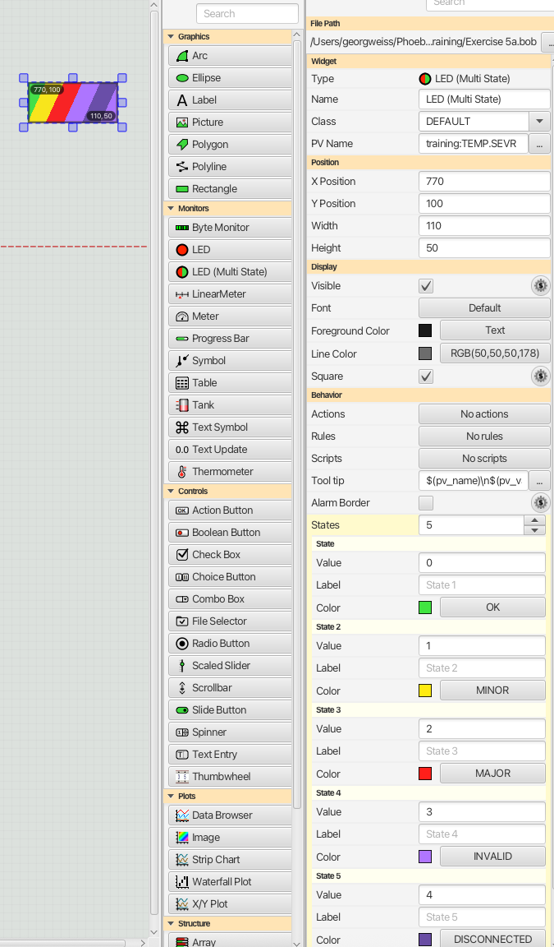
Exercise 5a – Multistate LED widget together with SEVR field
A multi-state LED widget can be used together with the SEVR
field of a PV. PV name is training:TEMP.SEVR
User must be acquainted with the enumerated values of the SEVR
field:
0 – NO_ALARM
1 – MINOR
2 – MAJOR
3 – INVALID (do not trust PV value)
4 – UNDEFINED (mostly due to disconnected PV)

Slide 37
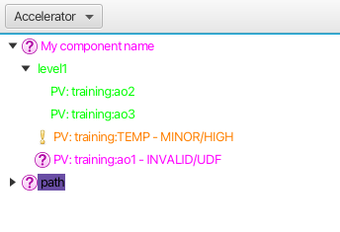
About alarm data source…
An alarm data source offers additional options for the OPI design.
  Data and functionality from the alarm system, i.e. it is built on top of EPICS alarms.
  Requires the PV to be contained in an alarm configuration.
  Example “PV name”: alarm://Accelerator/My component name/level1/training:ao2
Schema (fixed)
Alarm config name
Path in alarm config

Slide 38

Exercise 5b – Widget together with alarm data source
Create a new display and add a Text Update widget.
Specify for the PV name: alarm://Accelerator/My component name/level1/training:ao2
Save and run.
Useful?
Change the PV name to alarm://Accelerator/My component name/level1/training:ao2.state
Better?

Slide 39
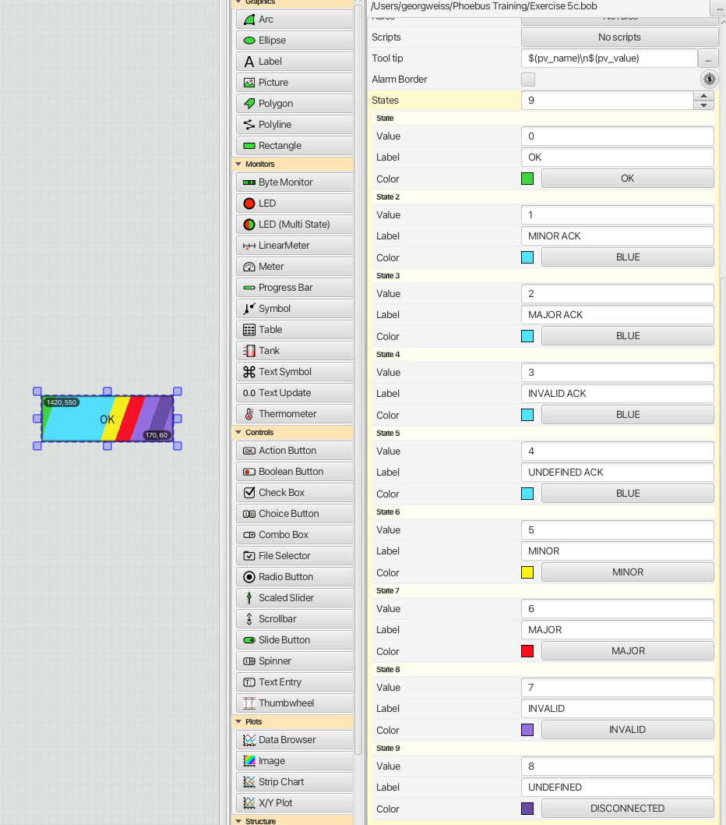
Exercise 5c – Widget together with alarm data source
Add a Multistate LED to the display.
Untick “Alarm Border”
For the PV name, specify: =indexOf(`alarm://Accelerator/My component name /level1/training:ao2.state`)
We need 9 states because of how the alarm system defines ”state”:
0 – OK
1 – MINOR ACK
2 – MAJOR ACK
3 – INVALID ACK
4 – UNDEFINED ACK
5 – MINOR
6 – MAJOR
7 – INVALID
8 – UNDEFINED

Slide 40
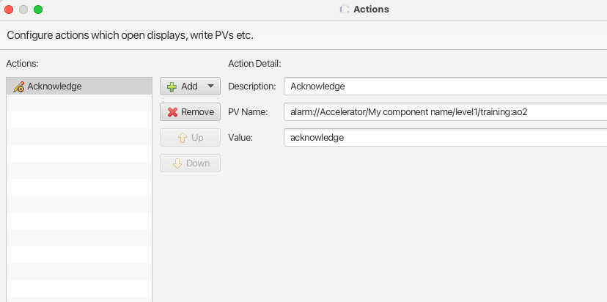
Exercise 5c – Widget together with alarm data source
Add an Action Button widget
Add an “Write PV” action to the Action Button widget:
Run the display and try out the Action Button.
Conclusion: alarms can be acknowledged from an OPI. No need to go to alarm applications.

Slide 41
Options with alarm data source
Using an alarm data source one can configure widgets to:
  Acknowledge/Unacknowledge an alarm
  Enable/Disable an alarm
  Show state or show if alarm is active/inactive
  Show if alarm is enabled/disabled
  Show alarm time

Slide 42
Data sources
A PV-aware widget connects (more specifically) to a data source.
Data sources are identified by schema, e.g. pva://myPv.
A Phoebus configuration setting defines the default schema (e.g. pva), saving user from typing pva:// in the PV name field of widgets.
Supported data sources:
  ca (EPICS channel access)
  pva (EPICS pv access)
  loc (local PV of arbitrary type, e.g. loc://x(1))
  sim (simulated PV, e.g. sim://sine(-10, 10, 1))
  aa (archiver data source: retrieve PV value at some arbitrary point in time).
  alarm
  Read more about data sources (and macros!) in Help → search for “Process Variables”

Slide 43

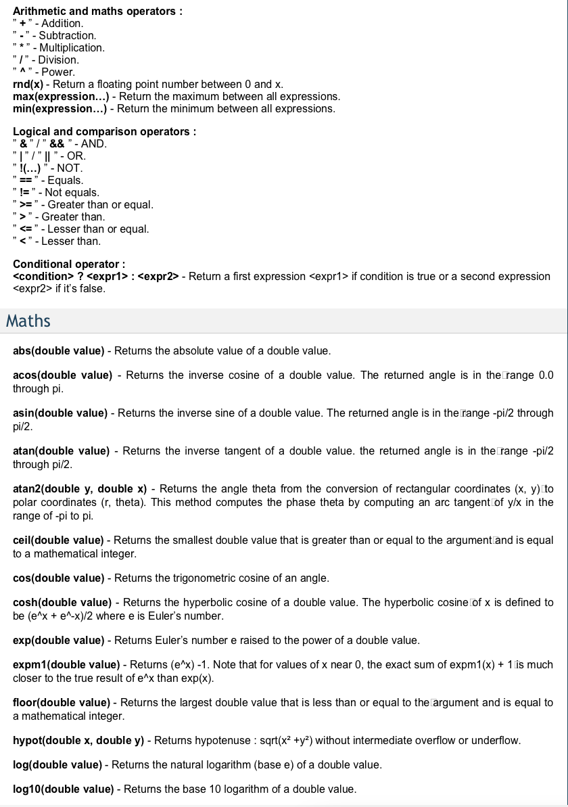
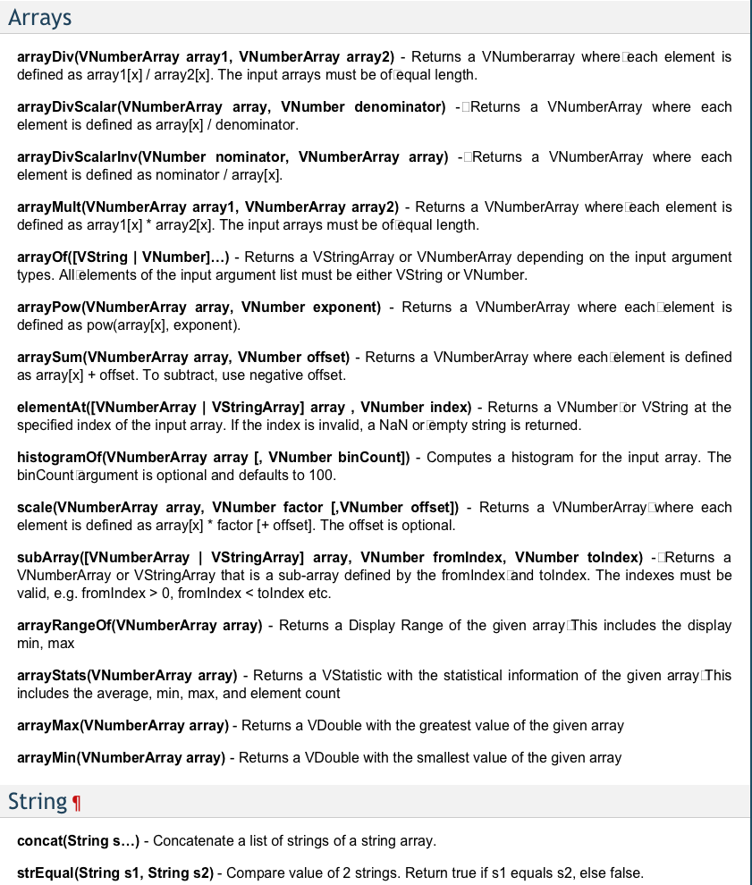
Formulas
Formulas implement an efficient way to process PV values, e.g. apply mathematical operations.
Typical use case is in the PV name field of widget or PV name in a rule.
Example: convert Celsius to Fahrenheit
Formulas are not for numerical analysis.
Formulas do not replace IOC development.
Documentation in Help → search for Formulas

Slide 44
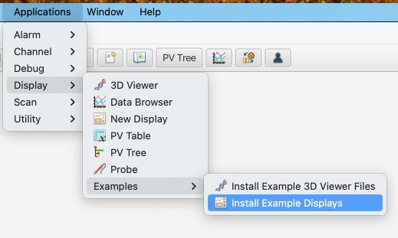
Reference: Display Builder examples
Phoebus is bundled with a rather extensive set of self-contained example displays demonstrating how widgets can/should be used.
To extract the examples from the Phoebus application image:
Starting point is “01_main.bob” in the target
directory.

Slide 45
Display Builder – best practices
Stick to default styling and behavior.
  Do not indicate OK state with colors (e.g. green background).
  Use alarm border to indicate something in need of attention, or use alarm data source with widget.
Minimize use of widget rules.
  Rules impact load time of OPIs and consume CPU cycles when triggered.
Avoid (Python) scripts at all costs! Really!
  Improvements/enhancements to Phoebus is more work, but always a better alternative.
  Use formulas where applicable
Consider update frequency of a PV consumed by OPIs.
  What is a reasonable refresh rate in the OPI?
  Each update may trigger rules, even if the rules do not change anything!
  Some widgets (e.g. Tank, Linear Meter…) are rendered in SW, each updates triggers rendering code.
Consider data decimation (EPICS side) in plot/image widgets.
  Computer monitors have resolution of at most 4k or 8k, but waveforms may be 64k.
  Phoebus is not suited for high-resolution image data at high refresh rate.

Slide 46
Display Builder – best practices
Macros are supported and widely used, but make sure you do not run into circular definitions.
  Macros is about string substitution, no more, no less.
Make sure the OPI launches “console clean”, i.e. no error printouts. Use Applications → Debug → Error log to inspect potential issues.
  Common errors:
    Unresolved macros
    Incorrect file references
    Incorrect property reference in rules (mainly a migration issue)
Treat OPIs as a piece of software.
  Errors and inadequate runtime behavior not always a Phoebus issue!

Slide 47
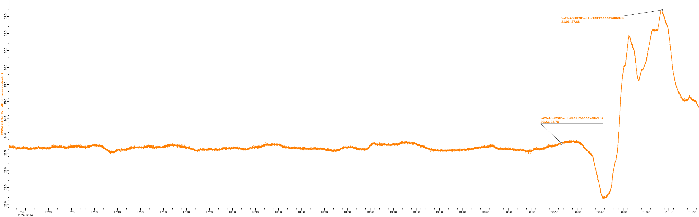
Data Browser
Use case: plot PV values over time.
Features (to mention a few):
  Annotations.
  Inspection of samples.
  Data export, e.g. for offline analysis.
Backed by the EPICS Archiver Appliance.

Slide 48
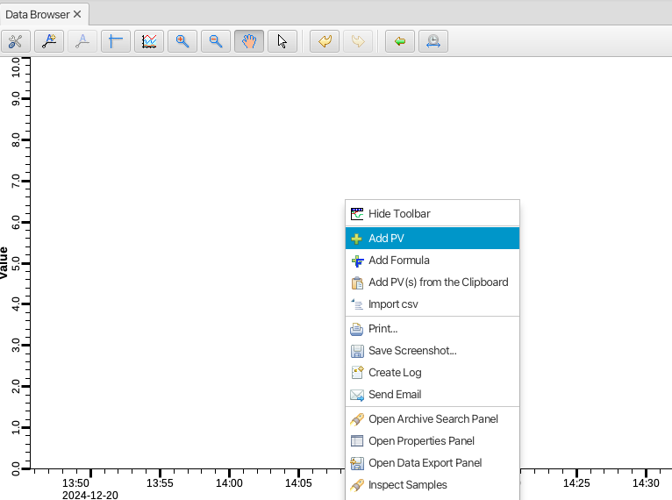
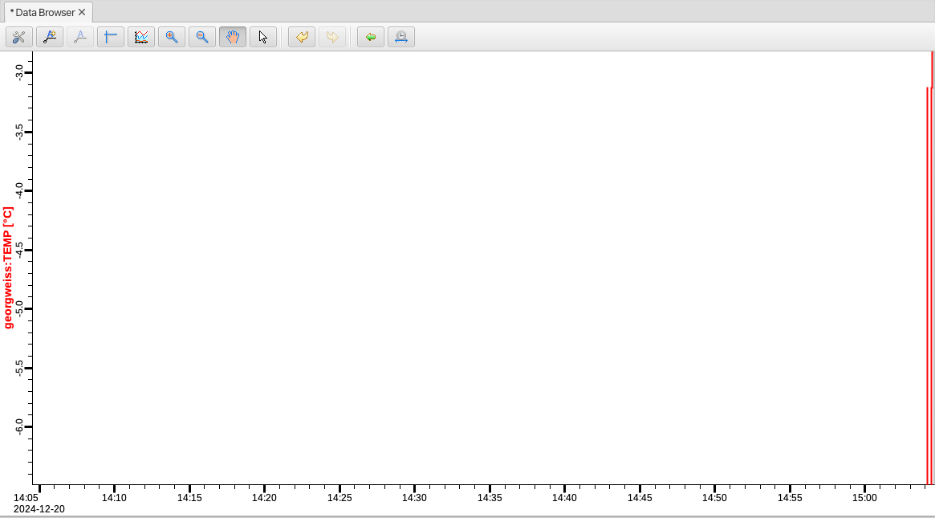
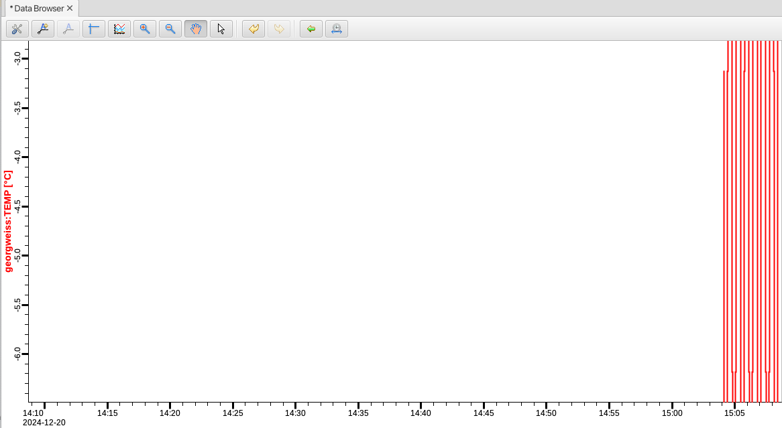
Exercise 6: create plot in Data Browser
From the Applications menu, select Display → Data Browser
Right click in the plot to bring up the Add PV dialog:
In the dialog, type training:TEMP. Close
with OK button.
Plot is fed by PV, moves as new samples are added.
Default time span is 1 hour.

Slide 49
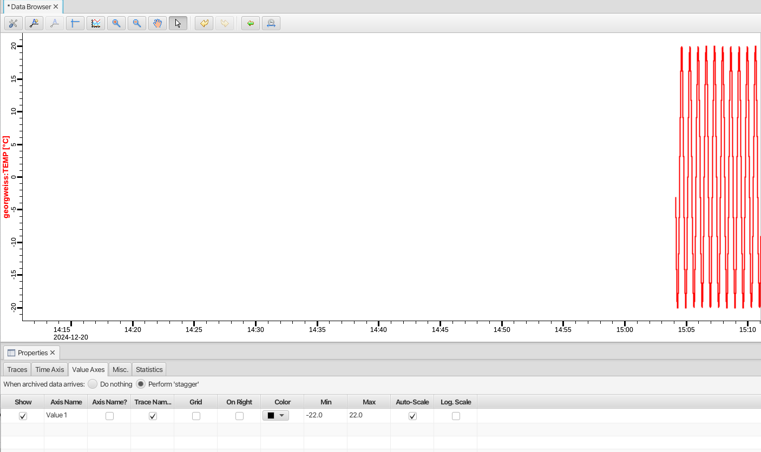
Exercise 6: Data Browser – Auto Scale
In the Properties panel below plot, select Value Axis tab.
Check Auto-Scale to see full plot.

Slide 50
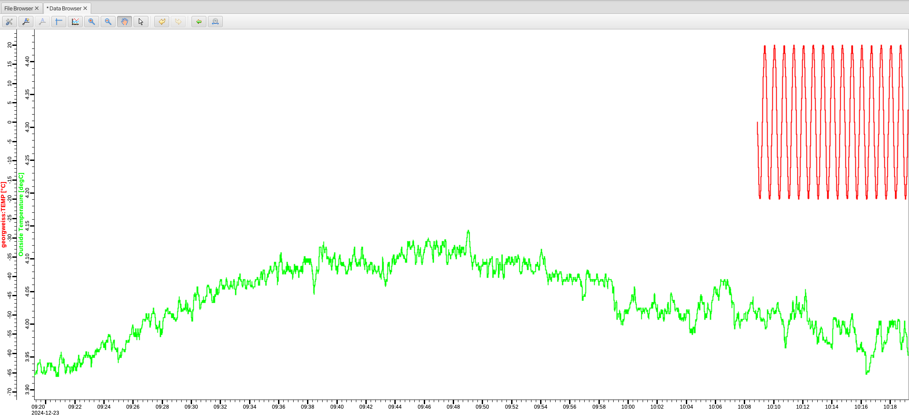
Exercise 6: add archived PV
Launch the “Add PV” dialog again and type CrS-PHS:Cryo-D-0100:AmbientTemp for the PV name.
This PV is archived, so plot will show values for entire time span.
New samples are added from live PV and merged with archived samples.

Slide 51
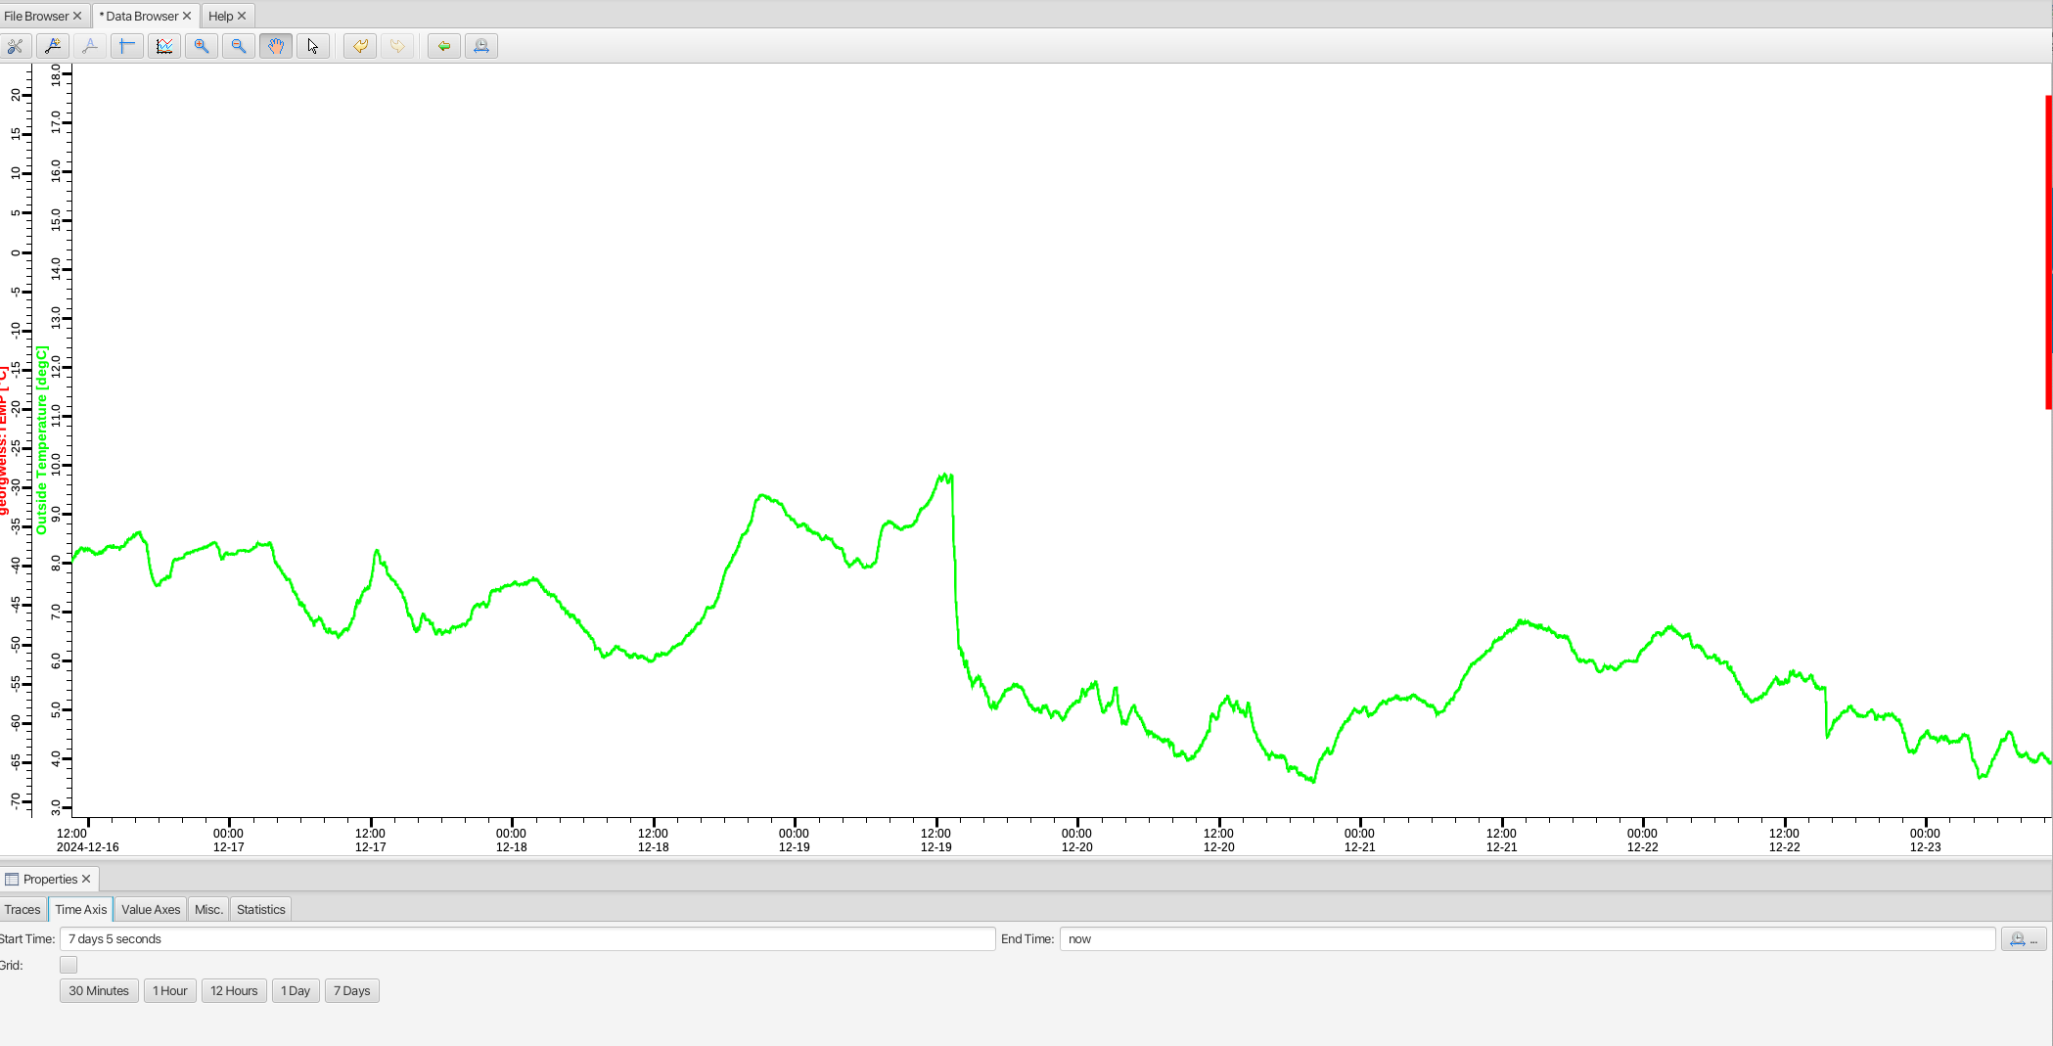
Exercise 6: archived PV
In the Properties panel, select the Time Axis tab.
Press the ”7 Days” button.

Slide 52

Data Browser – some remarks
Data Browser is an archiver client (there are others).
  PVs must be explicitly added to the Archiver Appliance service, e.g. through web application.
Data Browser plots can be saved as plt files.
  Time range included. Careful with relative time range!
Data Browser samples can be exported, csv or Matlab format.
The Data Browser widget embeds a plt file into a operator display → simplified vesion of the
Data Browser.
Data Browser has a lot of features/tools, read more in Help → Help, search for Data Browser.

Slide 53
Data Browser – best practices
Read up on how to add PVs to Archiver Appliance (AA).
  Waveform PVs are managed in a separate instance of AA.
  Consider sample rate: does it make sense to archive a PV at 10 Hz?
Data Browser sample buffer size can be changed (default 5000 per PV).
  Useful in case an non-archived PV must be monitored for a longer period of time.
  Impacts memory consumption: use with care!
AA performs compaction on older data.
  Data Browser may show average values!

Slide 54
Logbook/Olog
Olog is an electronic logbook with the purpose of replacing physical logbooks, e.g. in control room.
Organized as a central service and two clients, one integrated in Phoebus, one for web browsers.
Features:
  Efficient search on content in log entries.
  Attachments (preview of image attachments) of any type. Size limitations apply.
  Tags and properties to facilitate search queries.
  Basic support for HTML (Markdown) of log entry body.
  Integration with other Phoebus apps.
  Templates.
  Edit of existing log entries.
  REST API → easy-ish to create custom clients, e.g. for automated submission of log entries.

Slide 55

Logbook/Olog
Log entry anatomy:
Author* - based on ESS account.
Title* - plain text.
Entry Type* - fixed set.
Logbook* - at least one, fixed set.
Body – markdown, converted to HTML in viewer.
Tags – fixed set.
Attachments – can be added in different ways.
Properties - fixed set.
  A property is a named dictionary of key/value
  pairs.
* mandatory

Slide 56


Exercise 7 – create log entry
Launch editor from toolbar
Enter ESS account credentials
Enter a title
Enter some markdown body. Help available.
Attach a file, e.g. select image file from file system
NOTE: will be available to all at ESS!
Press Submit (enabled when manadatory
fields are populated).

Slide 57

Exercise 7 – view log entry
Launch logbook app from toolbar
Select your log entry: markdown is converted to HTML (supported in viewer).
Image attachments are clickable in preview pane → opens in separate tab/app.

Slide 58


Exercise 7 – integration with other apps
Launch an OPI from previous exercise.
Right click on OPI and select “Create Log”.
  Launches log entry editor.
  Screen shot automatically added as attachment
  A ”resource” property added with URL to OPI file
In the editor, enter mandatory information and submit.
Open the log entry in the logbook app and expand the Properties pane.
  The added URL is clickable, opens the OPI (not possible in web browser client, of course).
The Data Browser and alarm apps also support ”Create Log”.
  Screen shots and app specific data added automatically.

Slide 59

Exercise 7 – Olog search
Launch logbook app from toolbar
Search terms may be used for all parts of a log entry.
  start=12 week means “all log entries 12 weeks back until the most recent”.
  Empty search string means “no filter”.
The Help button launches documentation on how search works.
  Highly recommended reading!
The advanced search view can be used to construct a valid search query.
A search using the current search term is performed automatically twice per minute.

Slide 60
Logbook – expectations and use cases
Primary purpose is to replace physical logbooks.
Simplicity is a feature.
  Olog will not be the perfect tool for every use case.
The logbook is not:
  An issue ticket system (Jira is).
  A data storage area.
  A reporting authoring tool.
  A web design tool.

Slide 61

Alarm system
Alarm information from EPICS PVs is available in OPI widgets (e.g. as widget as border) and apps like the Probe.
Control room personnel need other type of views of alarm information.
Control room personnel must be able to interact with alarms, e.g. acknowledge.
  Acknowledge is not an EPICS aspect, i.e. PV does handle acknowledge information.
Alarm applications:
  Alarm Tree
  Alarm Table
  Alarm Area Panel
  Alarm Annunciator
  Alarm Log Table
The alarm applications consume (and produce!) data built on top of EPICS.
  Based on messages managed by a message broker: Kafka.

Slide 62

Alarm system – architecture
Confusion alert: ”Alarm Server” is sometimes used to refer to the “Kafka” service.

Slide 63
Alarm system – architecture
Alarms visualized in the alarm apps are managed in alarm configuration files (xml format).
  Each alarm configuration file defines a top-level alarm configuration, identified by a unique name.
Alarm configuration files organize PVs and associated data in a hierarchal structure.
Each alarm configuration corresponds to one running alarm server instance, which connects to the PVs defined in the configuration.
When the alarm state of a PV changes, the alarm server picks this up and dispatches a message to the Kafka service, which forwards it to all subscribers (e.g. Phoebus alarm apps).
One single Kafka service handles messages from all alarm server instances

Slide 64
Alarm system – example configuration
Alarm configuration files maintained here: https://gitlab.esss.lu.se/accop/beast-config/-/tree/master/alarm-01.tn.esss.lu.se
Example:
<config name=”CWS">
<component name="IAR">
<pv name="InstrA:WtrC-PT-010:Pres-R">
<description>Pressure transmitter PT-010</description>
<latching>false</latching>
<annunciating>true</annunciating>
<guidance>
<title>Guidance in case of alarm</title>
<details>Contact facility management</details>
</guidance>
</pv>
.
.
.
</component>
.
.
.
NOTE: the “latching” property is key to understand alarm apps behavior.

Slide 65

Alarm system – behavior
The Phoebus in-app help describes the principles: Help → Help → Applications → Alarms. Read carefully!
Main point: a latching alarm stays in (highest) alarm state until acknowledged by user.
Reiterating: behavior of alarm information in the alarm apps is built on top of EPICS alarms.

Slide 66


Alarm system – more on configuration
Alarm configuration may be changed in Phoebus.
  NOTE: Changes done in Phoebus are overwritten next time the alarm config file is imported.
In the Alarm Tree right click on a PV item → launch the config dialog.
Alarms can be disabled from the context menu or from config dialog.
  Disable from config dialog offers option to set a “disable until” time. Useful to avoid “forgot to enable”.
  Only affects alarm system, EPICS alarms are not affected.

Slide 67


Alarm system – guidance
Guidance texts can be added to each node in the alarm configuration structure.
Context menu provides quick access to guidance.
  Guidance context menu items are cumulative.

Slide 68

Alarm system – Alarm Logger
Alarms from all alarm configurations (~50) are logged by the Alarm Logger service.
Actions (e.g. acknowledge) and configuration changes are also logged.
The Alarm Log Table app in Phoebus is used to inspect alarm history.
In Alarm Tree (or Alarm Table) a context menu item links to the Alarm Log Table.

Slide 69


Alarm system – Alarm Logger examples
Non-latching alarm → Severity column reflects changes in alarm state
Latching alarm → Severity column reflects what user is seeing in alarm apps.
Note the acknowledge action!

Slide 70
Alarm Data Source
Alarm apps provide overviews of all alarms defined in an alarm configuration file.
  Offer interaction (e.g. acknowledge).
OPI widgets support alarm borders showing alarm state for a single PV.
  No interaction supported, i.e. not possible to acknowledge alarm through widget asspciated with a ca or pva data source.
Alarm interaction in OPIs however possible through alarm data sources.
  Alarm data sources available only for PVs listed in an alarm configuration file, i.e. not all PVs across all IOCs.
  An alarm data source can be used to:
    Show alarm state, e.g. MINOR
    Show if alarm is active/inactive
    Show if alarm is enabled/disabled
    Show the duration of the alarm
    Acknowledge/unacknowledge the alarm
    Enable/disable the alarm

Slide 71


Alarm Data Source – example and demo
Documentation in Help → search for “Alarm Datasource”

Slide 72

Alarms – best practices
Important to understand distinction between EPICS alarms and alarms as presented by alarm apps.
Alarm system (services and apps) should deal with alarms that make sense in a control room context, or for the purpose of logging/debugging (or both).
Alarm setup and configuration (e.g. EPICS alarm limits) must be carefully determined, and in many cases revisited to avoid noise:

Slide 73

Channel Finder
PV names are difficult to guess.
There are ~10 million unique PV names at ESS (Jan 2025).
Phoebus can only operate on exact (case sensitive) PV names.
Channel Finder is a directory service simplifying search for PV names.
  IOCs announce PV names to a central service/repository.
  The repository also maintains meta-data associated with PVs.
  The service supports efficient search capabilities for clients.
In Phoebus: Applications → Channel → Channel Table.

Slide 74

Channel Finder – proposal service
In the Display Builder editor, input fields for PV name
supports proposals backed by the Channel Finder search capabilities.
Other apps (e.g. Data Browser) with PV name input
fields also support proposals from the Channel Finder
service.

Slide 75
Save & Restore
Save & Restore is used to save the state of a (sub)system such that it can be restored later.
  The state is defined as a list of PV setpoint values, plus optional read-back values.
  List of PVs managed in Save & Restore configurations.
Users request Save & Restore to take a snapshots based on a configuration.
  Snapshots persisted by service.
Users request Save & Restore to restore a snapshot.
  Users’ responsibility to determine if and when to invoke a restore operation.
NOTE! Save & Restore is not a sequencer: during a restore operation, PVs are written to asynchronuously.
  Failure to write to a PV does not abort a restore operation.
The service supports a REST API.
  All operations – including create and restore snapshots – can be invoked on service by any HTTP client.
Applications → Utility → Save And Restore

Slide 76

Save & Restore – configuration editor
Data managed
as a tree structure
Data object types:
Folders
Configurations
Snapshots
Compisite
Snapshots
User specifies:
PV name
Readback PV name
(optional)
Read Only

Slide 77

Save & Restore – take snapshot
Read from archiver
will prompt for
date/time.
Live values show
what will be
stored in snapshot.

Slide 78


Save & Restore – restore snapshot
Restore operation takes stored
setpoint values and writes to PVs.
Press button to see
readback PVs
Purpose of readback PVs is to
analyze outcome of a restore
operation.
Depending on the use case,
readback PVs may not be needed.

Slide 79

Save & Restore – additional features
A composite snapshot is an aggregation of other snapshots and composite snapshots.
  Convenient way to restore multiple snapshots in a single operation.
  Unlike regular snapshots they are not associated with a configuration.
Snapshots can be tagged (free text), e.g. to clarify purpose.
  A special tag – “golden” – is used to annotate special settings.
The search & filter view is used to locate objects (configurations, snapshots…) based on a set of search criteria.

Slide 80

Layouts
Each Phoebus app runs its UI in a separate tab.
  When an app is luanched, it is rendered in a new tab in the main window.
  Some apps (e.g. Save&Restore, Display Builder OPI) support only one instance.
Control over tab arrangement is provided through:
  Possibility to split a window (left/right or top/bottom). Tabs can then be dragged/dropped onto the different parts.
  Possibility to detach a tab into a separate window.
User may save current layout to file and restore when needed.
  NOTE: When shut down, Phoebus saves the state of the UI (i.e. the layout). The state is restored when Phoebus is launched.

Slide 81
Integration between Phoebus apps
Design philosophy: app X should not implement features already available in app Y.
  Promotes simplicity → reduces code duplication and maintenance.
Integration and navigation between apps is supported by sharing data.
  Mechanism quite similar to Android and iOS.
Transition between apps happens through context menu items, or using an action associated with a widget in an OPI.
Demo of examples:
  Display Builder (OPIs)
    Probe
    Data Browser
    Logbook
    Alarm History
  Channel Table
    Create/add to Save&Restore configuration
  Data Browser, Alarm Table
    Logbook
Notes:
Display Builder → Probe, Data Browser, Logbook, Alarm History, Action Button to Save&Restore
Channel Table → Save&Restore
Data Browser / Alarm Tablr → Logbook

