Slide 1
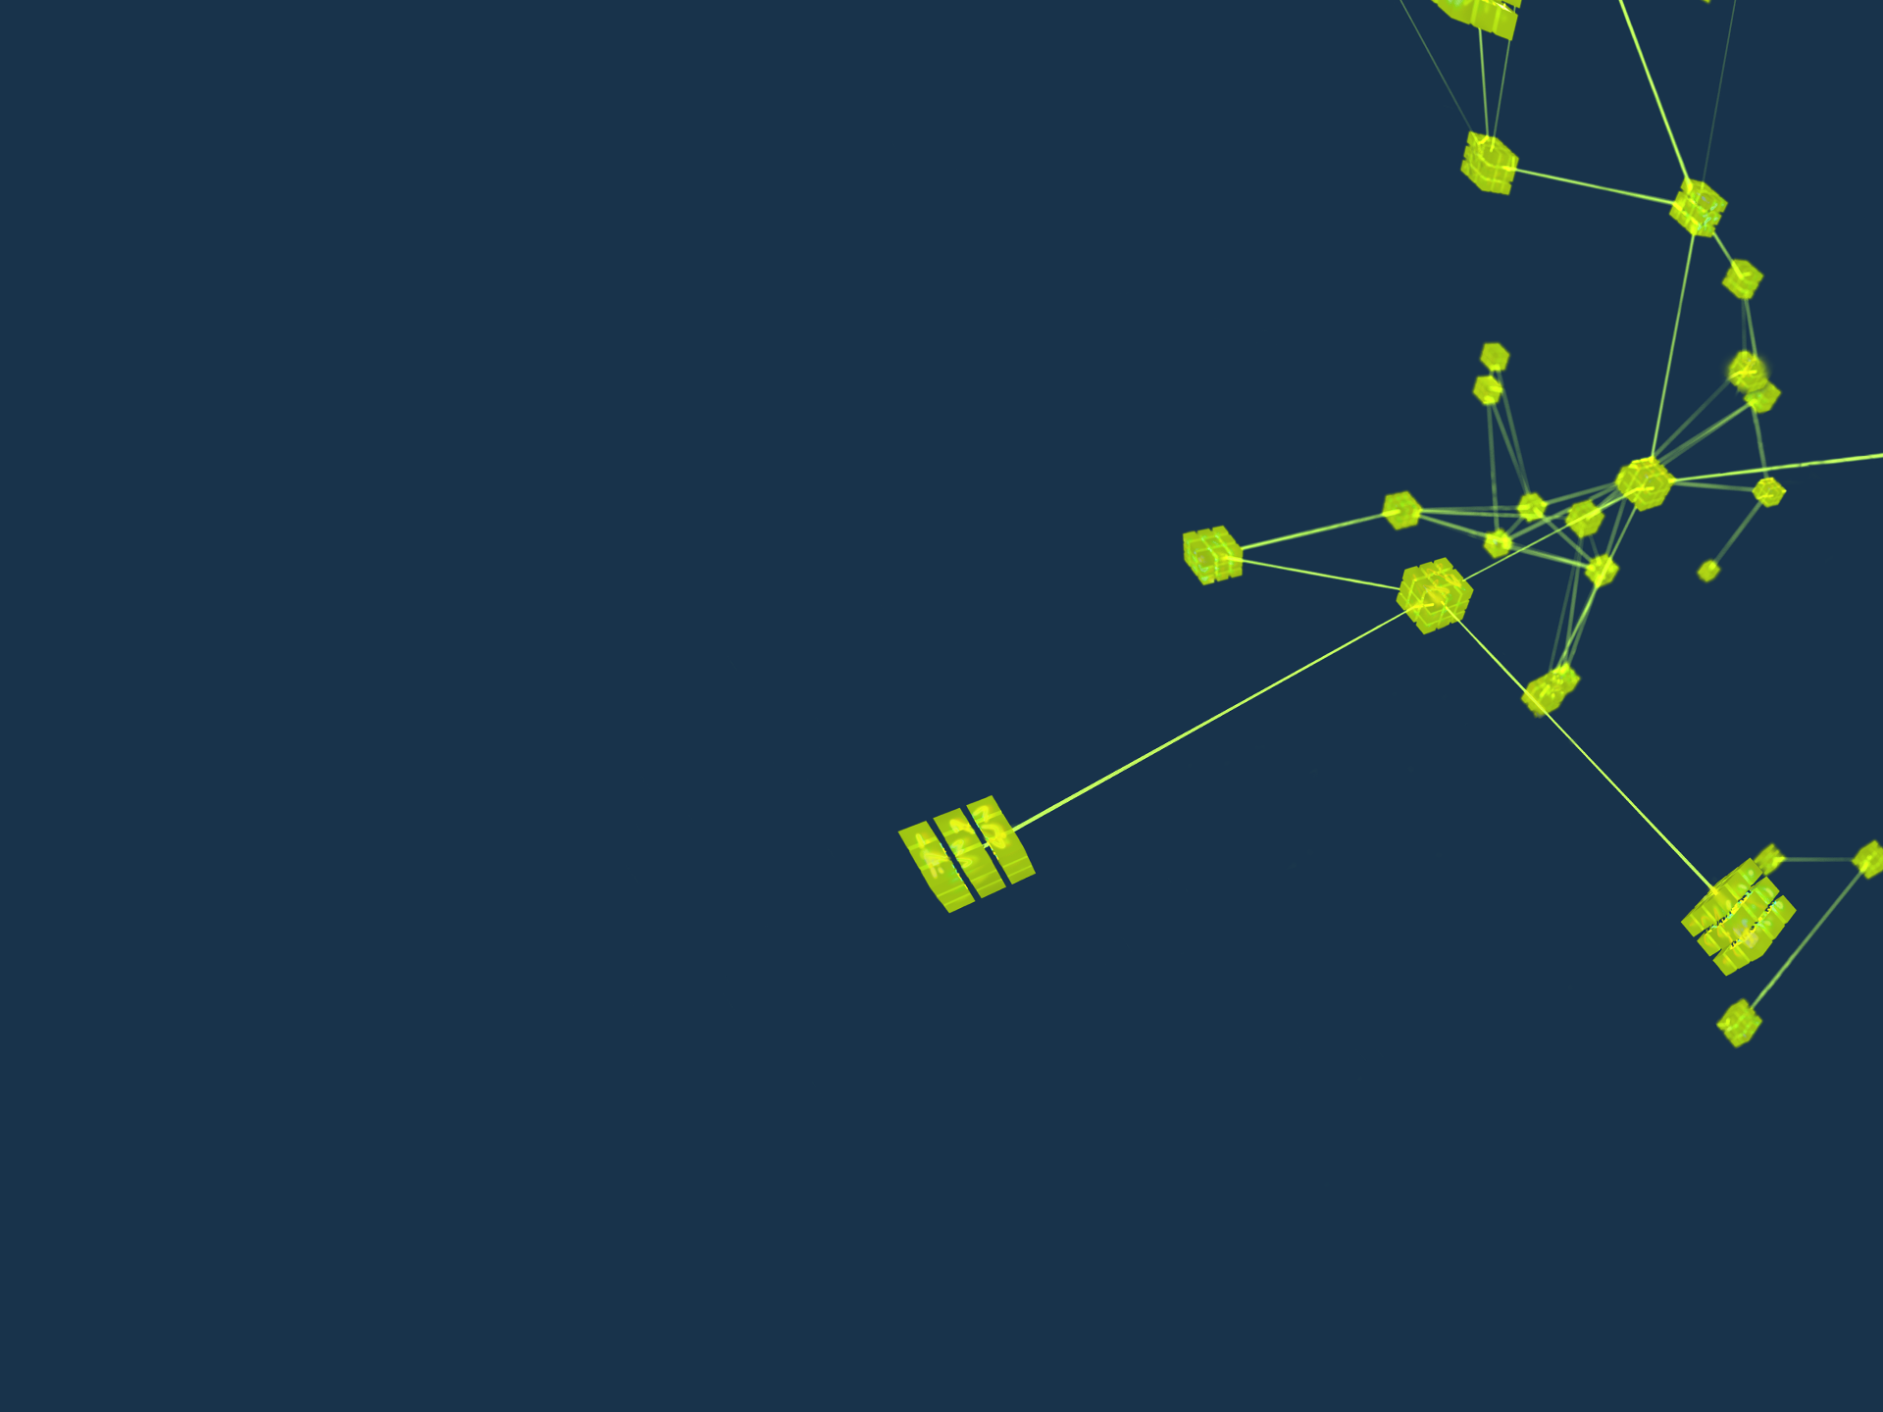

Working in the field of science -what is the role of a controls engineer?
The life and work of a control system engineer.

Slide 2

Introduction
This presentation draws from my own 30+ years-long experience from working with control and data acquisition systems. I owe the idea, as well as some material to the founder of EPICS, Bob Dalesio.
I have worked in five different accelerator projects, after doing my PhD in experimental high energy physics longer ago than I want to admit.
This presentation is intended to give an insight to working with control systems and hopefully help you to understand what it requires, as well as what it might give to you.
Working in controls has been the best career decision in my life.
Notes:
Bob’s notes:
There is a long history of learning lessons….. Highlights
Plumbing with my step father – anything worth doing, is worth doing properly (reinforced by my art teacher)
Industrial Control – you write code once – it gets run an uncountable number of times – take time to do it properly
GTACS - 100 msecs data correlation could not be done on UNIX – memory management delays
LEDA – unplugging a vacuum gauge results in a reading of very good vacuum
EPICS Collaboration – giving over control to competent people is difficult – and produced better results than predicted
SNS – time is money – money is opportunity – opportunities should not be wasted
My history on the next slide.

Slide 3
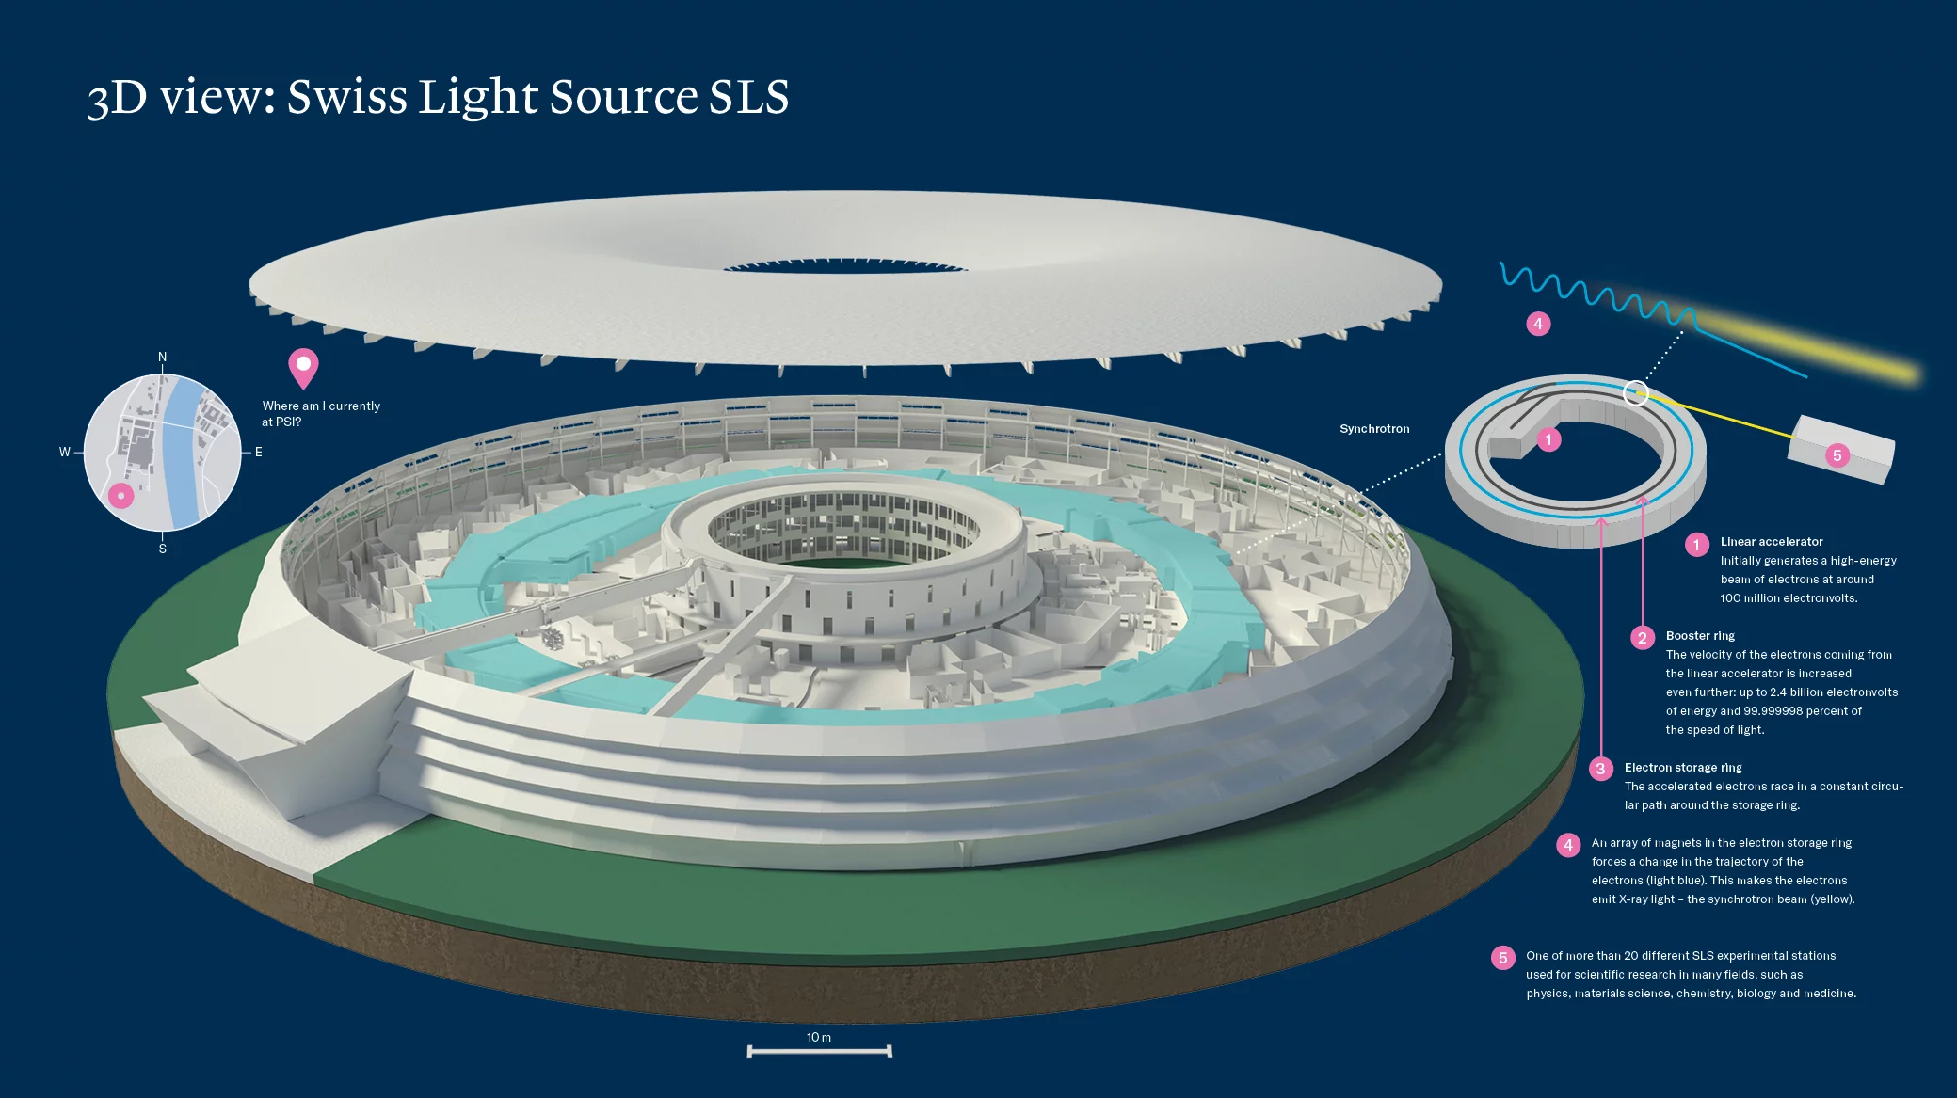
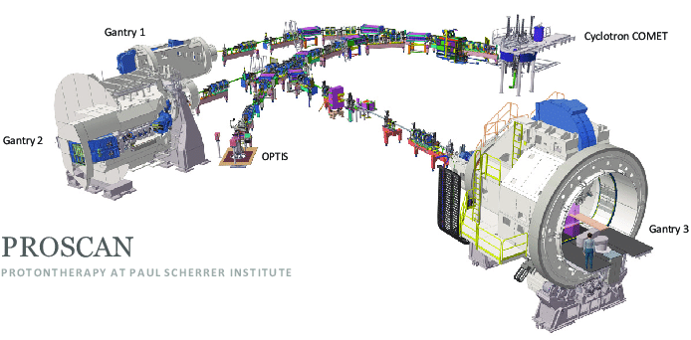
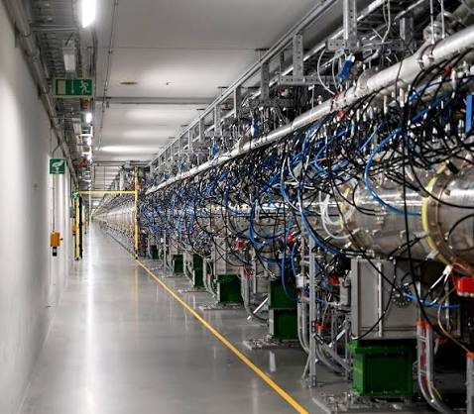
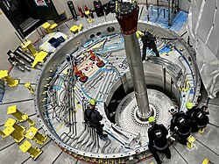
Background
With accelerators one can do a lot of different and amazing things. Building these facilities is an equally amazing process.
The projects that I have been in have had very different goals.
But working in control systems, some common patterns always appear.
Knowing these patterns helps regardless of the scale of your application or the facility you are working with.
Notes:
Swiss Light Source: short and intensive period of implementation. 2.5 years from ground breaking to first science. Went like a flash. Many things had to be improved after first implementation, but we were truly on time and on budget. We had our issues, but it was an exceptionally fun and rewarding time. Teamwork and enthusiasm takes you a long way.
Proscan: lots of new things to learn. Safety, especially safety of the patients is extremely critical. This was also a time of cultural change and clashes, but again, the excitement of the project helped us to pull through, with really nice results.
SwissFEL: I left PSI in the middle of the project, but could follow through the first phase, the injector, as well as the design of most of the subsystems. Again, a cultural change, but also a technological shift from the SLS era.
ESS: a major undertaking, and really from scratch. Not only a new machine, but a new organisation, new rules, new ways of working. Nwe project, new mistakes – even if I thought that ”this time we will do everything right”.
Organisational issues are usually lot more difficult to solve than technical ones.
EPICS, even if just one component in the mix, was a big thing that carried us through all these projects. The help of the community is priceless!

Slide 4
Things to remember
Without a control system, the best hardware is just a collection of material without life.
  Control system shall not be an afterthought.
Building scientific (and industrial) facilities is always teamwork.
  Creating mutual trust is essential for success.
Work with the system designer and end user, if possible.
  Insist on the question ”how shall this be operated”?
  You may probably will not get an answer right away.
    But getting them will profit everybody and prevent many potentially expensive mistakes.
  End users mostly come late in the play – but try to keep them in mind
Patience is a virtue. Maybe the most important one.
Notes:
Sometimes control is – or at least has been in the past – considered as something to be put on top of more important things.
That assumption is not valid anymore. Controls should be considered early on and integrated into the project.
As control system engineers, know your value. Without your success, the project will not be able to succeed in its mission.
Control system is a service – kind of. But so is almost everything else.

Slide 5
Scientific Control System Challenges
Requirements – getting performance requirements for all phases of a construction project is the most difficult part of building a scientific control facility.
Schedule – all fundamental capabilities must be identified at the start of the project and completed at least one year before the first use.
Staffing – building a team with a full compliment of skills and a critical number of experts.
Working in a very diverse environment. This is very rewarding but can also be very challenging.
Notes:
The requirements are never complete
The senior staff must cover all areas and be capable of project engineering to communicate with scientists and mentoring to train engineers that are new to the field of scientific control systems.
Leveraging off of everything

Slide 6

A top-level view
What are the expectations?
Nobody can tell you exactly…find out and use your instinct.
Key features:
  Stability
    no crashes, reliable results. Stability does not mean ”never change a running system”.
  Usability
    Think about how the system is going to be used
      On its own, and as a part of a larger entity (interfaces!)
  Longevity
    Control systems are typically meant to be used for a long time – decades!
    But they will need to be maintained, modified and enhanced.
  Performance
    Within the means that you can influence, try to select the optimal soft- and hardware solutions
Notes:
The requirements are never complete
The senior staff must cover all areas and be capable of project engineering to communicate with scientists and mentoring to train engineers that are new to the field of scientific control systems.
Leveraging off of everything

Slide 7
What are the issues?
Loosely in the context of an accelerator (project), but mostly applicable at any scale or application.
Scope: what areas does a controls engineer need to think about?
What assumptions can you make?
Requirements: what shall the system be able to do?
Interfaces: what are the surrounding systems and how do interact with them?
What are the skills that I need?
  Either to have myself, or have the skills available in some way

Slide 8
Scientific Control System – Scope
Anything that is not in a vacuum vessel:
  All electronics, hardware, firmware, software, racks, chassis, power, EMI
  All systems, industrial and beam/detector control related
  All network, computing and storage electronics
Each engineering group is responsible for all the aspects of their subsystem:
  Defining and documenting interfaces (Interface Control Documents)
  Functional specifications for each device, system and subsystem
Find – or define – the people to talk to.
  “orphaned” functions are found surprisingly often (“we did not think about that”)
Notes:
E.g., A particle accelerator project requires engineering experts for: beam instrumentation, RF power, magnets and power supplies, vacuum, cooling and facility control. Who provides the analog design of the instruments? Who provides the firmware for the instrument? Who provides the common functions in the firmware (timing, point-to-point communication, communication-to-control system)?

Slide 9
Assumptions – what can be expected?
Electrical:
  Grounding and EMI are handled
  Power is clean
Mechanical
  Vibration issues are handled
  Mechanical systems are properly designed (motion, vacuum, cooling)
Standards
  Equipment to be interfaced is defined
Safety
  Conventional and radiation safety are properly handled
  Do not expect all of these assumptions to be valid. Would be a miracle if they are.
Notes:
Grounding / Shielding at SNS caused MPS trips for the first months until an EMI expert came in and identified a long list of things that were needed. After the first 7, they could finally run long enough to start commissioning.
At ESS, grounding for the Ion Source had to be redone three times before the systems became stable. Power distribution instabilities and installation issues were recurrent during construction – and can still be risky. Keep these in mind and try to think ways to mitigate, and at least not make the problem worse.
Beamline/instrument scientists typically do not have the mindset of a controls integrator and bring in new equipment at the last minute without thinking that it takes considerable time to integrate in the control system. Especially if the interface is not following the standards that controls group has defined. This does happen in the accelerator world as well, but less often. Letting people to do their own stuff “do not worry, we will take care of everything…”. ESS modulator case: we lost everybody who was able to support the non-standard implementation, and the issue fell on us.
A mechanical design for small adjustments to the transport line were put in – the motion was in the vertical plane. The LVDT was mounted on the horizontal plane. The braces would bow and flex so the position was not repeatable.
NSLS-II case: radiation measurements were only made on a fully functioning RF system. With one of the two RF systems off, the magnets steered the beam directly into the experimental area. A temporary radiation monitor was only tested for connectivity, but saturated at the high radiation level, the operators did not see beam past the bend and attempted to find it repeatedly. Once a technician informed them of the radiation alarm sounding in the area, they called radiation physics …. And then attempted to steer the beam around the bend one more time. The facility was shutdown for nine months.

Slide 10
Requirements – What requirements?
Physicist
“All signals available at sample rate immediately now and for all time”
“I will work around whatever you give me”
Scientist
“I want everything that I had the last time. I can live with that.”
Mechanical Engineer
“Here are the manuals for our pumps, motors, magnets, etc…”
“What operational requirements are there?”
“Why did choose controllers that no one has ever heard of?”
Plant Engineer
“Here is the PI&D of the plant we are building.”
“But what does the accelerator need from the plant? Temperature control of RFQ?
Scientific control systems require expertise in many technical areas and most importantly domain knowledge of the type of facility being built and how that affects requirements.
The best sources of requirements are anyone that will answer your questions – a rare find.
Notes:
One tenets of the SCADA design for physics applications was: the requirements will show up at any time and are subject to change through to operations.
This is exactly why the integration of hardware was configured not programmed.
The risk of configuring a process database is much lower than the risk of a programmer error.

Slide 11
Accelerator Facility Requirements
Data Rates, Latency and Response Times
  Machine Protection Time Budget from event to mitigation – microseconds
  Fast Orbit Feedback time budget from measurement to control settling - msec
  Archive Data for operations, machine learning, fault studies, physics studies – GHz
Timing / Data Correlation: precision nsec, resolution nsec, drift psec
  Fast Data communication and data capture
Identify Modes of Operation from Components to Facility
  First article, installation, integration, commissioning, start up, operation, shut down and failure modes
List of application software: SCADA, Modelling, ML/AI, Fast Data Capture
Notes:
A group of engineers work with the physicists to determine the specifications for each subsystem for construction, early prototyping, development, installation, integration, commissioning and operation.
Physics operation of the machine for integration, commissioning, operations, off normal operations, physics studies.
This phase is important to solicit requirements that are most frequency ignored and occasionally lead to serious problems.
Industrial engineers expect these to be provided before they start working. In a science facility, there is no project engineer – the engineering team creates the specifications. These specifications are unique outside of scientific facilities.
E.g., sample rates at GHz rates, kHz feedback over kM, global data correlation with nsec resolution, equipment protection systems that respond in 6 µsecs. Capturing these, I frequently overlooked or mistook - “no data correlation needed” = time stamps at 35 msec resolution and “4 beam diagnostic instruments will be needed” became 21.

Slide 12
Requirements for a user facility – spectrum
  From thousands to >10 million Process Variables (PVs)
  Hundred to several hundred thousands physical IO points. Lots of metadata.
  Hundreds of device types and up to thousands instances of some types
  50% of all signals are industrial IO – 10 Hz, scalar
  30% of all signals are control hardware status signals available from instrumentation
  20% of all signals are beam-related and these require 80% of the labor
  Reliability - MTBF – MTTR: downtime from 100 to 99.97% for control systems of planned operations which can range from one week per month to 0 hours. This impacts redundancy and design of network, computer and instrument power supplies and power systems.

Slide 13
Systems and Interfaces
Physics (of the accelerator and devices therein)
Operations – the primary end users of control systems
Network is probably the most critical part of the system
Timing – almost any component will need timing, in some way.
Machine Protection should be one of the first things to think about
Fast Orbit Feedback – crucial for a light source, less so for proton machines
Beam Diagnostics – essential for success, big data producers
High Power RF – to be handled with care.
Low Level RF - is almost a science of its own.
Magnet Power Supplies – more complicated than it looks
Vacuum – looks simple but shall not be underestimated.
Cooling – looks even simpler, but can be a major source of issues
Motion Control - scales from trivial to almost impossible
Radiation monitoring – do not forget!
…
No system works in isolation.
Interfaces can be physical (cable, connector) or soft/virtual (protocol, data specification,…)
Discovering and understanding the interfaces and agreeing early on the specifications is essential.
Document the interfaces and related requirements. This serves as a contract between each side.

Slide 14
Control System – Preliminary Design
Selecting COTS and/or open-source solutions that meet your requirements:
  Identify hardware architecture
  Identify software architecture
  Identify instrumentation interfaces
Prioritize open source whenever you can.
Identify areas where there are no known solutions
Identify opportunities to apply more advanced technology
For managers: This is the only point in the project when you have time and resources to allocate: investing time and resources to meet KPPs, save money, reduce risk, and/or save schedule (especially during commissioning).
Notes:
Selecting COTS and/or Open Source solutions that meet your requirements:
Identify hardware architecture
Identify software architecture
Identify instrumentation interfaces
Open source: Sooner or later, you have to be able to fix deep issues. Open source will at least give the possibility to solve the issue if the provider cannot, does not want, wants more money than you have, or has disappeared from the business. Value of open source is not it being cheap to buy. It is in the security that it gives you. If you are unlucky with closer source products, you may end up having to replace them altogether.
Identify areas where there are no known solutions or opportunities to move ahead in technology
Developing new tools and approaches will take years and require several iterations. Does the benefit justify the cost? New developments are incentives to attract top talent.
NSLS II controls planned for major developments:
Digital power supply controllers for regulation and FOFB
Power supply was developed along with fast feedback communication and embedded timing receivers.
Open source BPMs were identified as an opportunity
BPM FOFB requirements also made it possible for a fast machine protection on beam orbit deviations w/o loss
This architecture was later adopted by ALS-U.
Relational database for equipment life cycle In the other case
We did not deliver the equipment life cycle tracking
We did deliver data domains into micro services for the PV directory, save/restore and an electronic logbook.
This is the only point in the project when you have time and resources to allocate. Investing time and resources to meet KPPs, save money, reduce risk, save schedule (especially during commissioning).
NSLS II controls planned for major developments:
Digital power supply controllers for regulation and FOFB
Power supply was developed along with fast feedback communication and embedded timing receivers.
Open source BPMs were identified as an opportunity
BPM FOFB requirements also made it possible for a fast machine protection on beam orbit deviations w/o loss
This architecture was later adopted by ALS-U.
Relational database for equipment life cycle In the other case
We did not deliver the equipment life cycle tracking
We did deliver data domains into micro services for the PV directory, save/restore and an electronic logbook.

Slide 15
Control Systems – deeper in design
Find, specify and document the interfaces of your system
Identify data storage (=archiving) needs
  Time series or events
  What is needed to understand issues after they happened
Think about problems, potential failures and hazards
  Alarms are for the operators and system owners
  Hazards require an independent protection system
Naming is important
  PV names spread all over the place! Painful to change once they are out
  Names should make sense to the users – but there will be lots of opinions
Usability makes your system shine!
  Topic of the next 1.5 hours.
Notes:
These are the most typical and fundamental issues to be thought of. Not an exhaustive list though.

Slide 16
During the design process
Regardless of the quality of your team, outside expertise is essential.
Use reviews for each subsystem as an opportunity to learn from others.
Choose experts with recent experience and solicit their criticisms.
Address all comments and corrections you receive from your reviewers.
Adjust to new information.
Notes:
To build a scientific control system – every member of the project has a critical role. It is unrealistic to have a team that has full understanding of the problem and current expertise on the state of the technology.
Create an environment for exploration.
Scientific control systems push the bounds of technical capabilities. They are an opportunity to expand your awareness of emerging technologies and growing demands. (Two years before commissioning NSLS II beamlines, the engineers at DLS exposed the requirements that our own scientists did not communicate – instead of 32 – single pixel detectors, we would have 1M pixels at 1 kHz and that our fictional 32 dimensional data was actually 2D arrays with 30 independent variables)

Slide 17
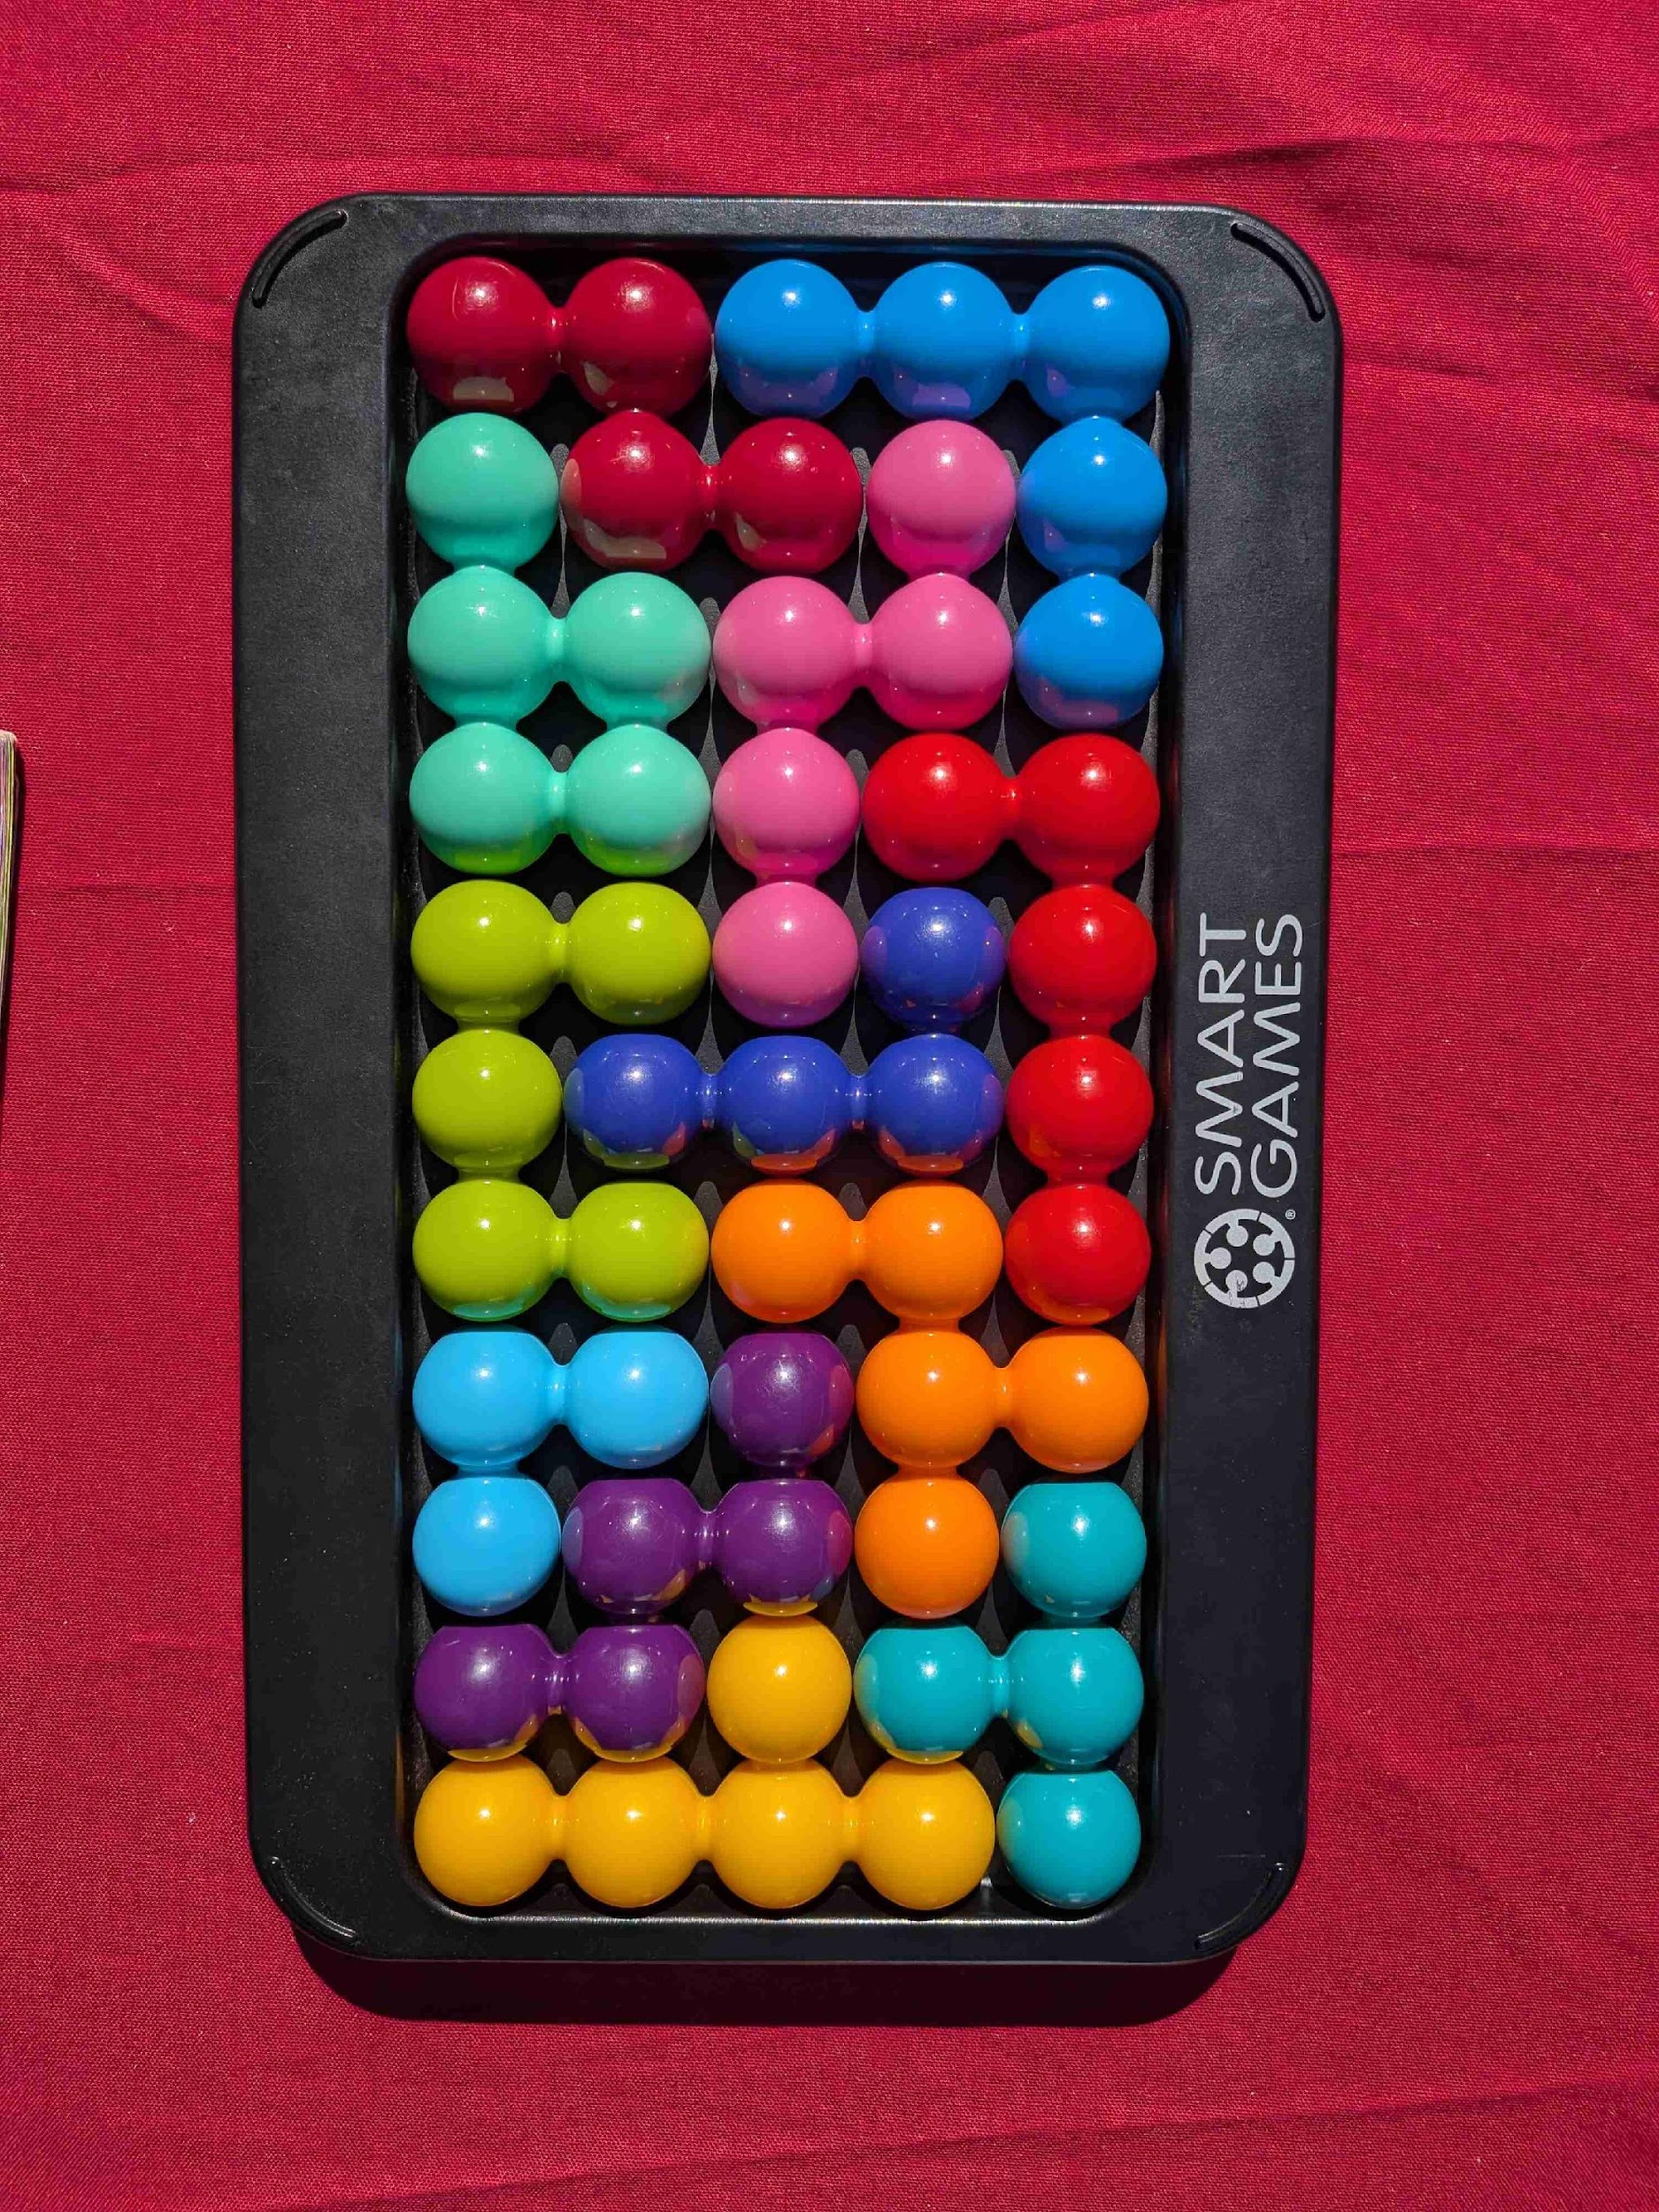
Staff skills needed for a scientific control system
[Senior] Project Engineer (Domain Knowledge/Planning)
[Senior] Network Engineer
[Senior] Beam Electronics Engineer (FPGA)
[Senior] Industrial Control Engineer (Automation)
[Senior] Software Engineer – planning all SCADA and application code
As an engineer or scientist: know who these people are. Maybe you are one of them – but hopefully not all of them.
In a management position: assign/embed an engineer with primary responsibility for each subsystem with expertise in some area.
Notes:
The first order team should be in place.
Senior Network Engineer – planning the network for the SCADA system (about 20%) and the instrumentation network (about 80%).
Ethernet is of primary importance. Most of this network is NOT a standard IT issue.
Senior Beam Electronics Engineer – planning all high-performance instrumentation both global and instrument based. This engineer is covering all subsystem meeting for the design and development of beam instrumentation. This engineer also works on the delivery of all high-performance instruments to avoid obsolescence by the time that commissioning starts.
Senior Industrial Control Engineer – planning all industrial subsystem instrumentation leading PLC selection, slow machine protection, how power control and equipment protection.
Senior Software Engineer – planning all SCADA tools selection and development. This is a UNIX and control system tool expert.
Staff grow from this point as the need arises. Have an engineer for each subsystem by the time the first article hardware evaluations start. Hiring engineers too early only funds a lot of iterations of design without meeting any projects goals.
GTA was staffed like this. For 2 years the control system was “behind schedule” meaning that we did not spend the money when we were scheduled to spend it. We were behind on staffing as the subsystem deliveries were behind schedule.

Slide 18
Range of deep knowledge is needed
Knowing the domain: accelerator, instrument, experiment. Not mandatory for everybody but helps a lot.
Control system related:
Operating Systems Design and Implementation (Threading)
Algorithms and Data Structures
Network Communication and Design
Circuit Design
FPGA Time Domains
Boolean Algebra
Instrumentation (physical principles)
Signal Analysis
Safety Systems (Validation and Verification)
Reliability - Redundancy
Machine Protection and Fail-Safe Design
And more…
You do not need to know all of them yourself – but somebody has to. But the more you know, the more you can enjoy your work and appreciate what is happening.

Slide 19
Control system engineers’ responsibilities
Uncover unstated requirements
Inquire about machine modes, interlocks, interfaces.
Inform other control system engineers of interfaces/requirements discovered
Develop a deep understanding of the domain of your responsibility
Seek the expertise of others when you need it
Share your expertise when asked

Slide 20
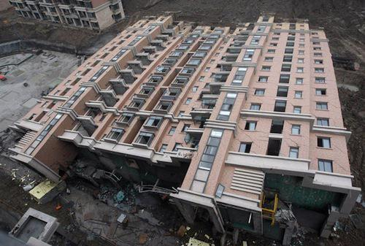
Being a bricklayer – does not make you a builder
Understanding the complexity of a scientific control system is a process
Accepting your ignorance is essential
Satisfy your curiosity to its full extent
Share your expertise
Seek expertise from others
Expect surprises at any time in the project
Notes:
The complexity of a scientific control system is compounded by the complexity of our nature. (you know – the difference between an introverted engineer and an extraverted engineer….)

Slide 21


Paint Can Make All Sorts of Pictures
What would be perfect for a physicist&scientist is everything, everywhere, all the time.
There are hard limitations with the tools we have.
Understanding these tools allows us to provide what is possible.
Using the tools properly is the best we can do.

Slide 22
Thank you for listening!
Questions, comments, opinions?

