Slide 1
EFU Tools Workshop

Slide 2
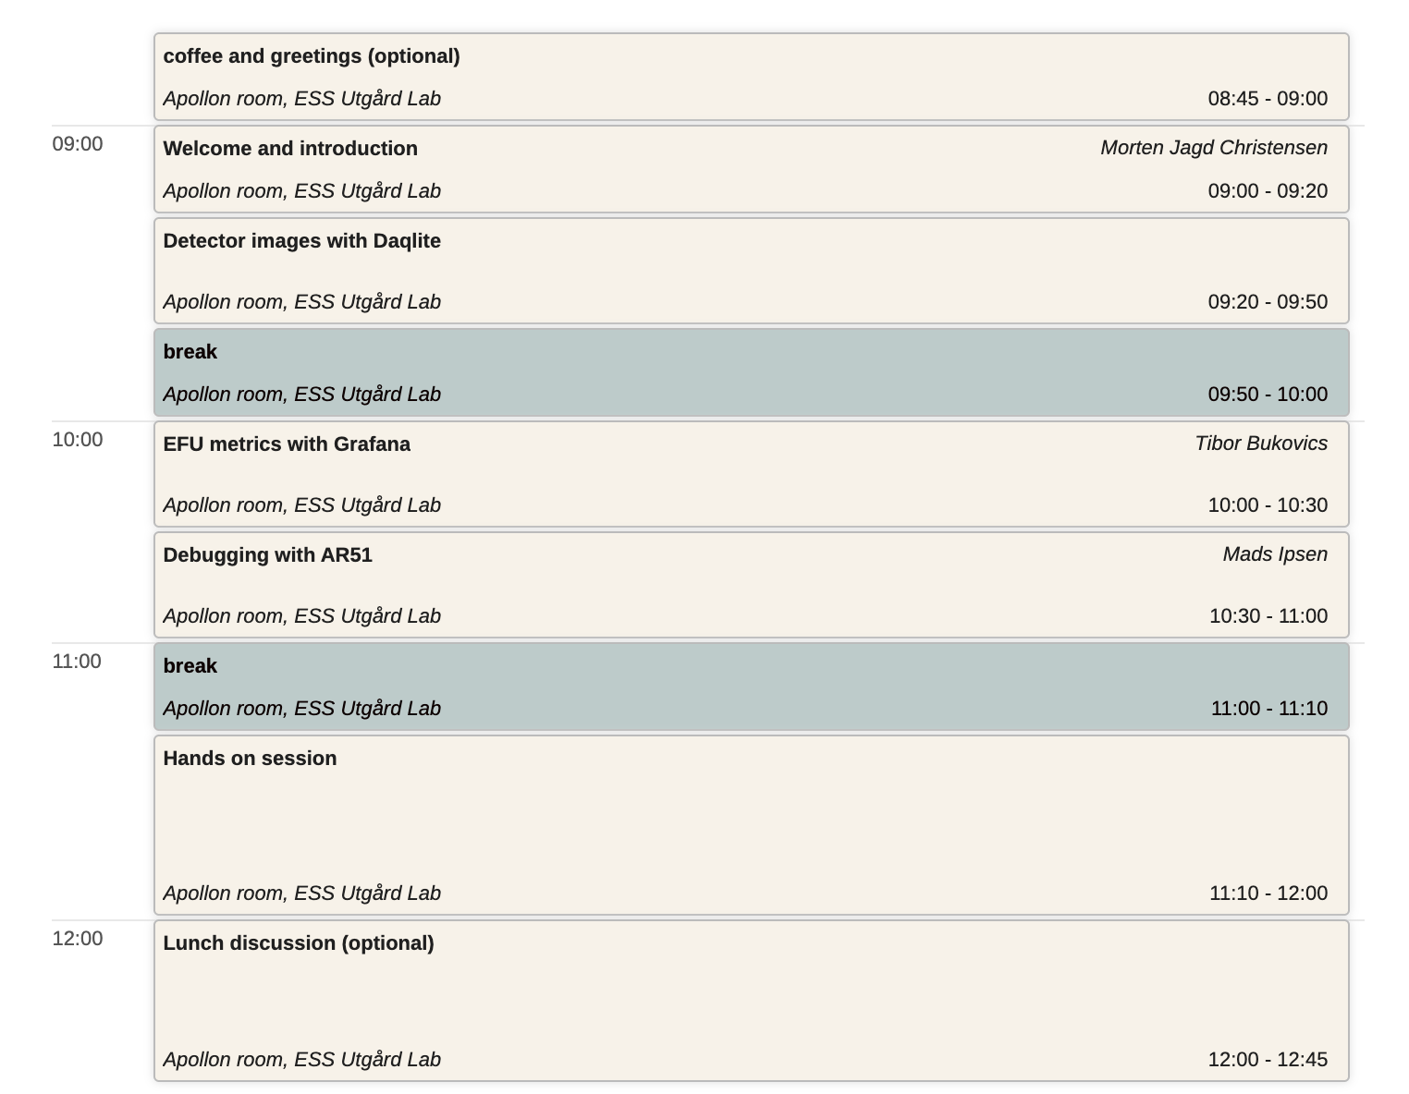
Agenda

Slide 3
Agenda
Introduction
  Background for the workshop
  EFU architecture
  Data paths
  Server dashboard
Daqlite
  What it does
  How to run it
  How to customise

Slide 4

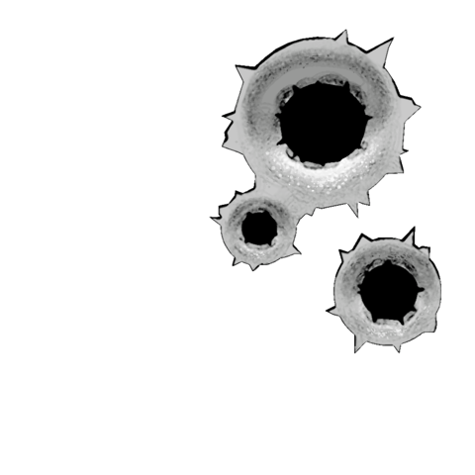

Agenda
Grafana
  efu runtime counters
  Reading Grafana dashboards
  Modifying them
AR51
  Using the detector samples topic for low level debug/diagnostics
  Customising
Try it yourself
AREA
51

Slide 5
Why?
We don't do this because we are nice,
We really don't want to help you
... if you can already help yourself that is

Slide 6
Learning points
Understanding paths data can flow
  normal operation
  calibration mode
EFU counters & Grafana relation
Checking the system status
  Server & Grafana dashboards
Validating detector data
  Daqlite images
Debugging & Troubleshooting
  efu* commands
  ar51

Slide 7
EFU Architecture

Slide 8
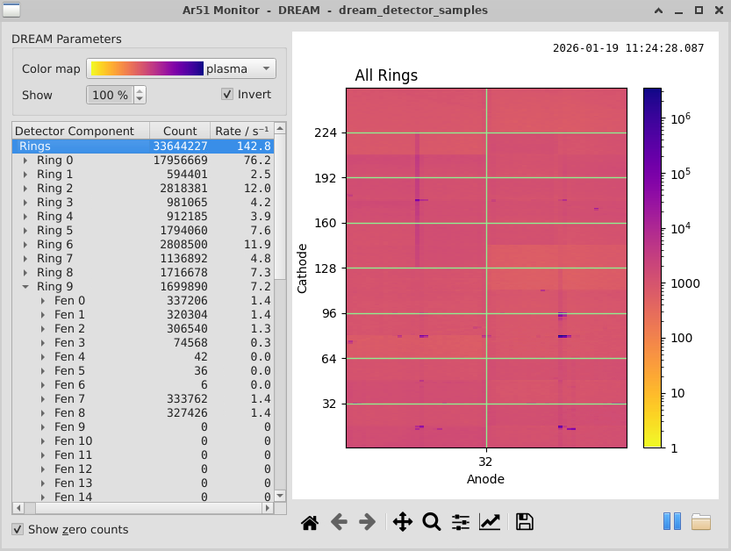
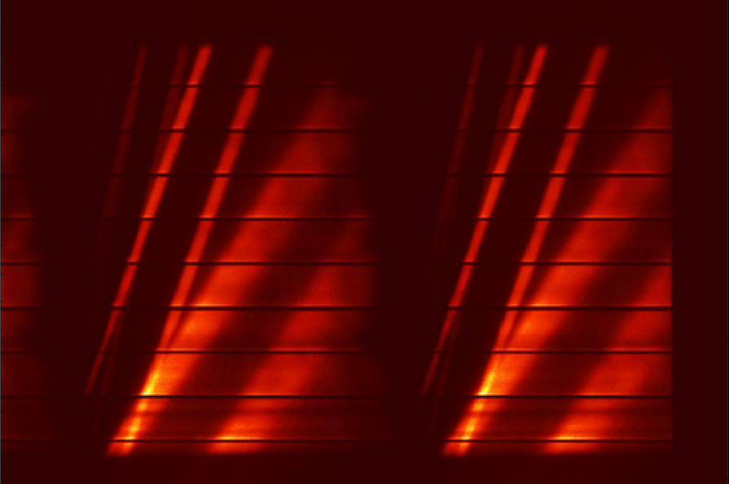




ECDC System Architecture
AREA
51
detectors
readout
event formation
filewriter
storage
'RM'
EFU

Slide 9
ECDC System Architecture
readout
AREA
51
'RM'
EFU

Slide 10
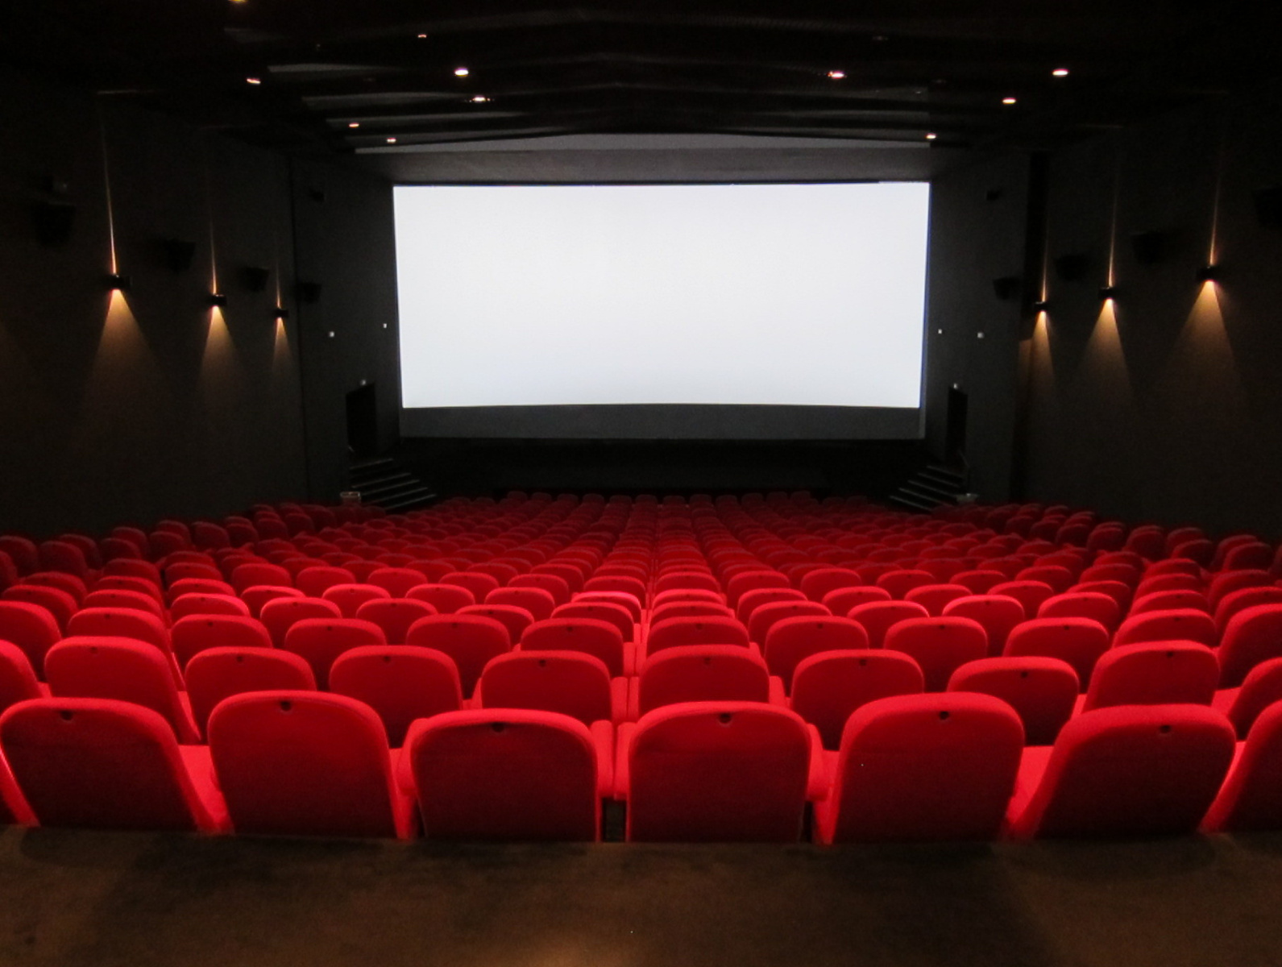
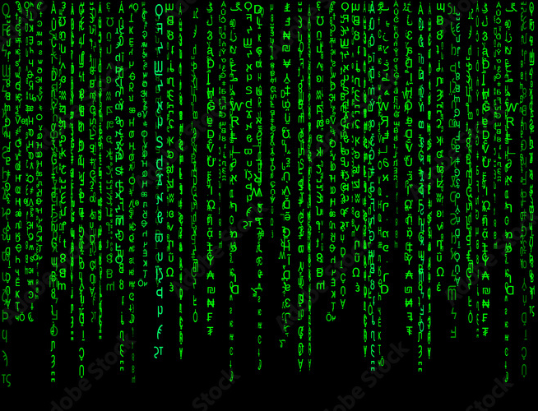
Daqlite vs AR51
Daqlite
data from detector topic
visualisation of all pixels
no energies, wavelengths
AR51
topic from detector samples
specialist visualisation
no pixel awareness

Slide 11
Normal Operation
100% events
EFU
loki_detector_bank0
...
loki_detector_bank8
loki_detector_samples
AREA
51
~1% raw data

Slide 12
Debug/Calibration mode
EFU
loki_detector_bank0
...
loki_detector_bank8
loki_detector_samples
AREA
51
100% raw data

Slide 13
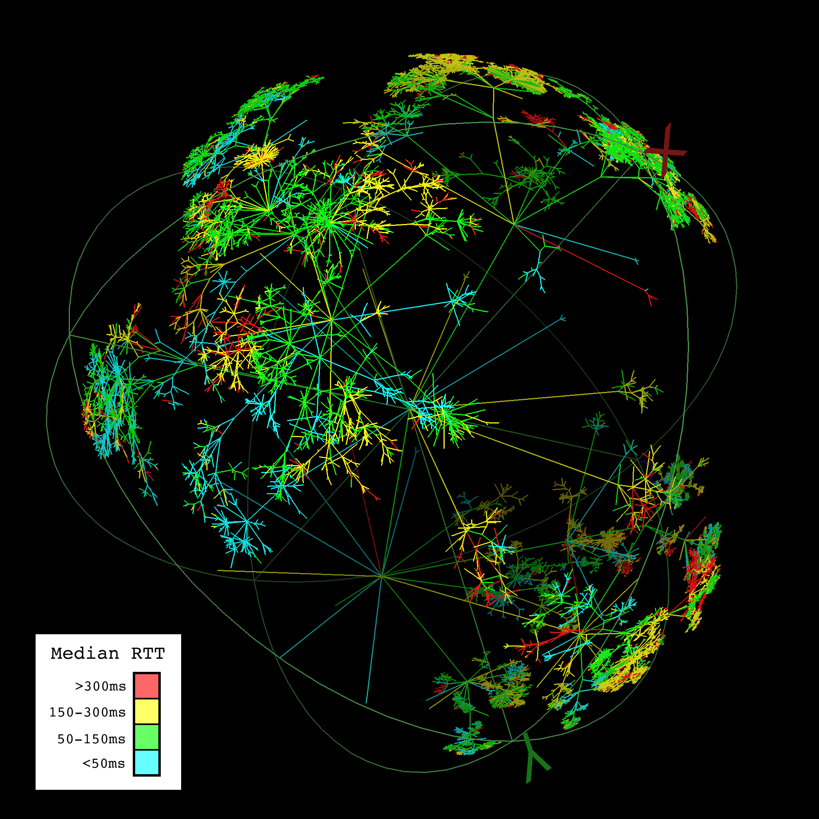

RYO
EFU
loki_detector_bank0
...
loki_detector_bank8
loki_detector_samples
100% raw data

Slide 14
Server Dashboard

Slide 15
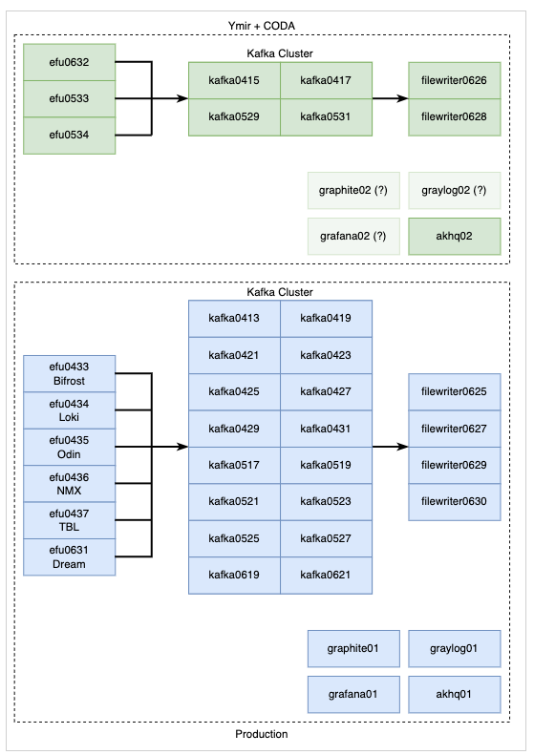
The ECDC server zoo
Nicos, File writers, Kafka and EFU servers
Grafana, Graylog, AKHQ, VNC servers
CODA and Site separation
Currently approaching 50 servers. More will come.

Slide 16
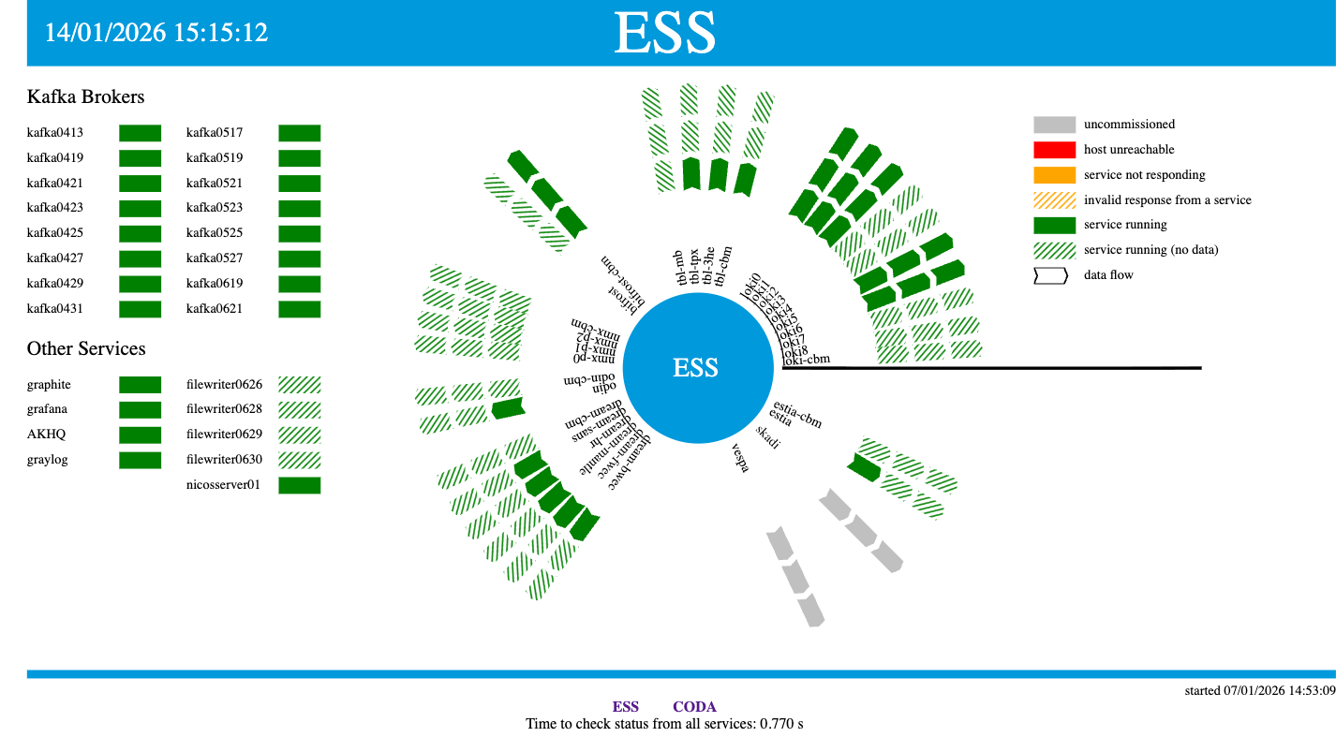
Server Dashboard - site
https://ecdcpos.esss.dk/ess

Slide 17
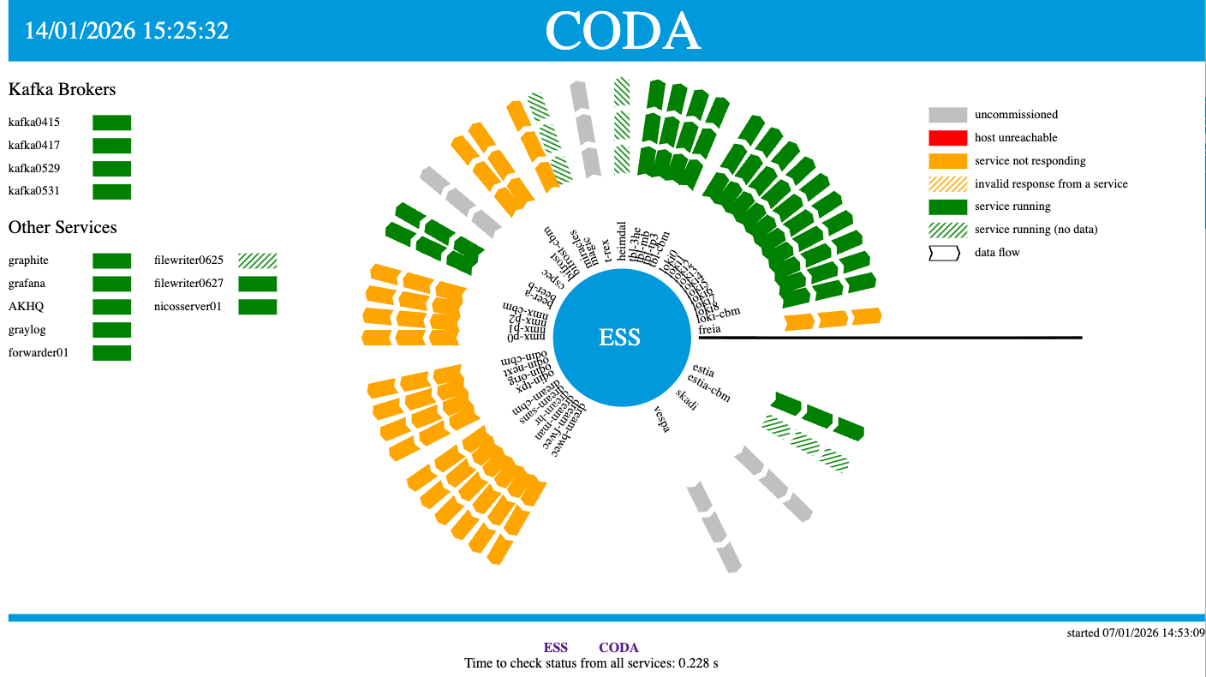
Server Dashboard - coda
https://ecdcpos.esss.dk/coda

Slide 18

Reading the dashboard
EFUs report status from three stages:
input, processing, output
Instrument is known, but uncomissioned
EFU server cannot be pinged (network issue)
Server is running but EFU is not
Service query failed
EFU is running and data flows through the stage
EFU is running but no data in the stage
shape indicates data flow direction

Slide 19
Daqlite

Slide 20
Trivia
Started as Data Acquisition project at NIST
Cloned, extended and named Daquiri at ESS
Originally intended as an internal ECDC tool, but
.. used since 2017 for detector and prototype testing
in essentially ALL ESS projects
Trimmed down to Daqlite around 2021/2022
Still being actively maintained
Daqlite uses 'logical geometry' showing detector images as 2D representation of the often more complicated 3D voxel structure.
Daqlite has no awareness of physical detector dimensions or positions

Slide 21
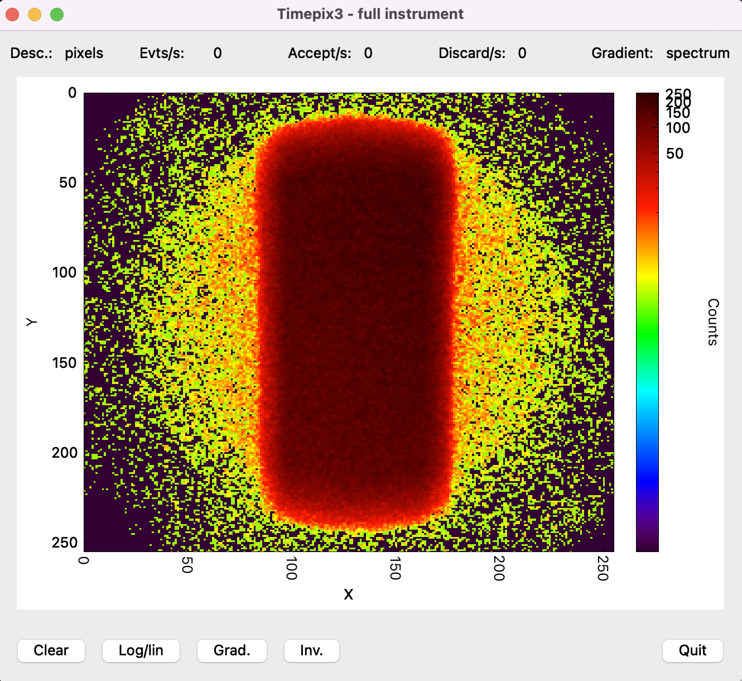
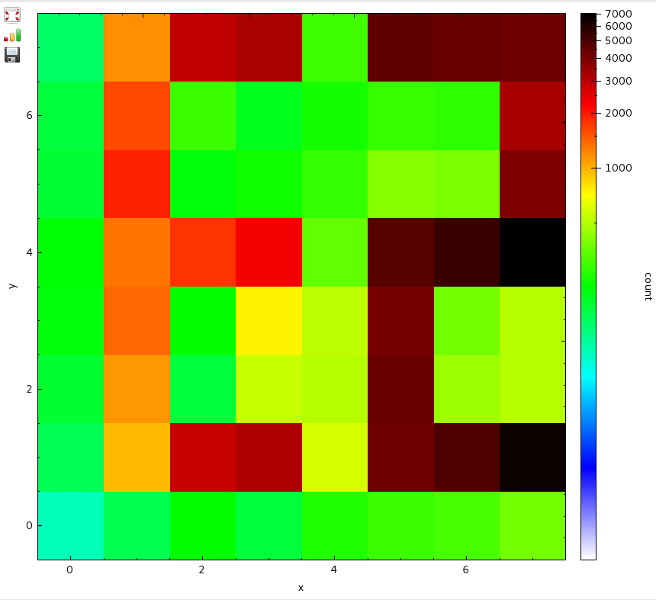
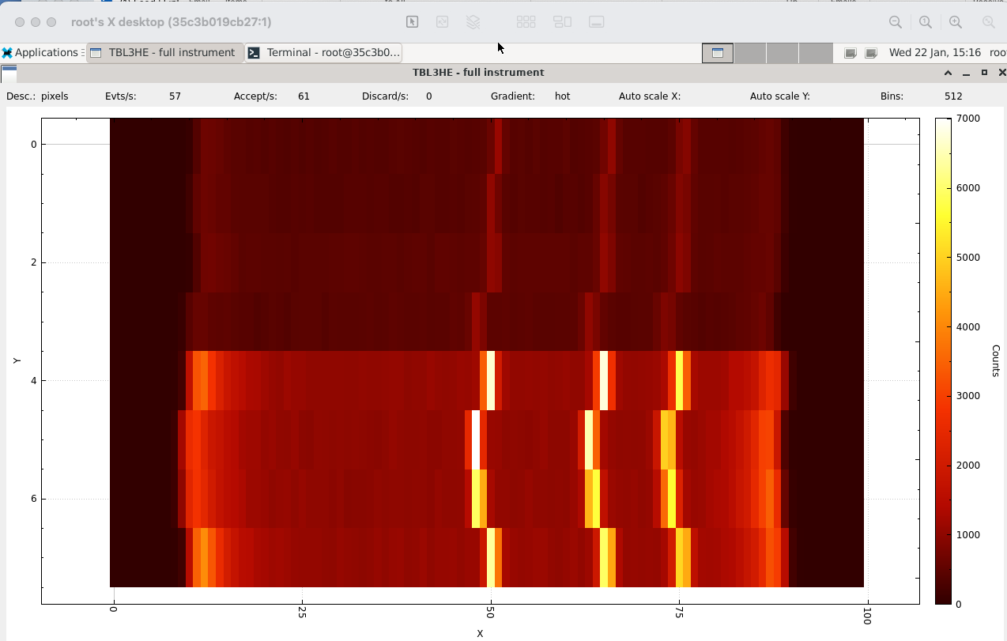
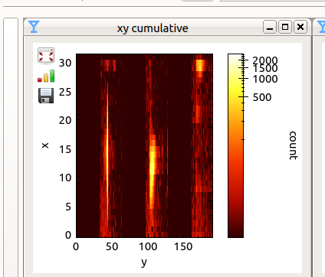
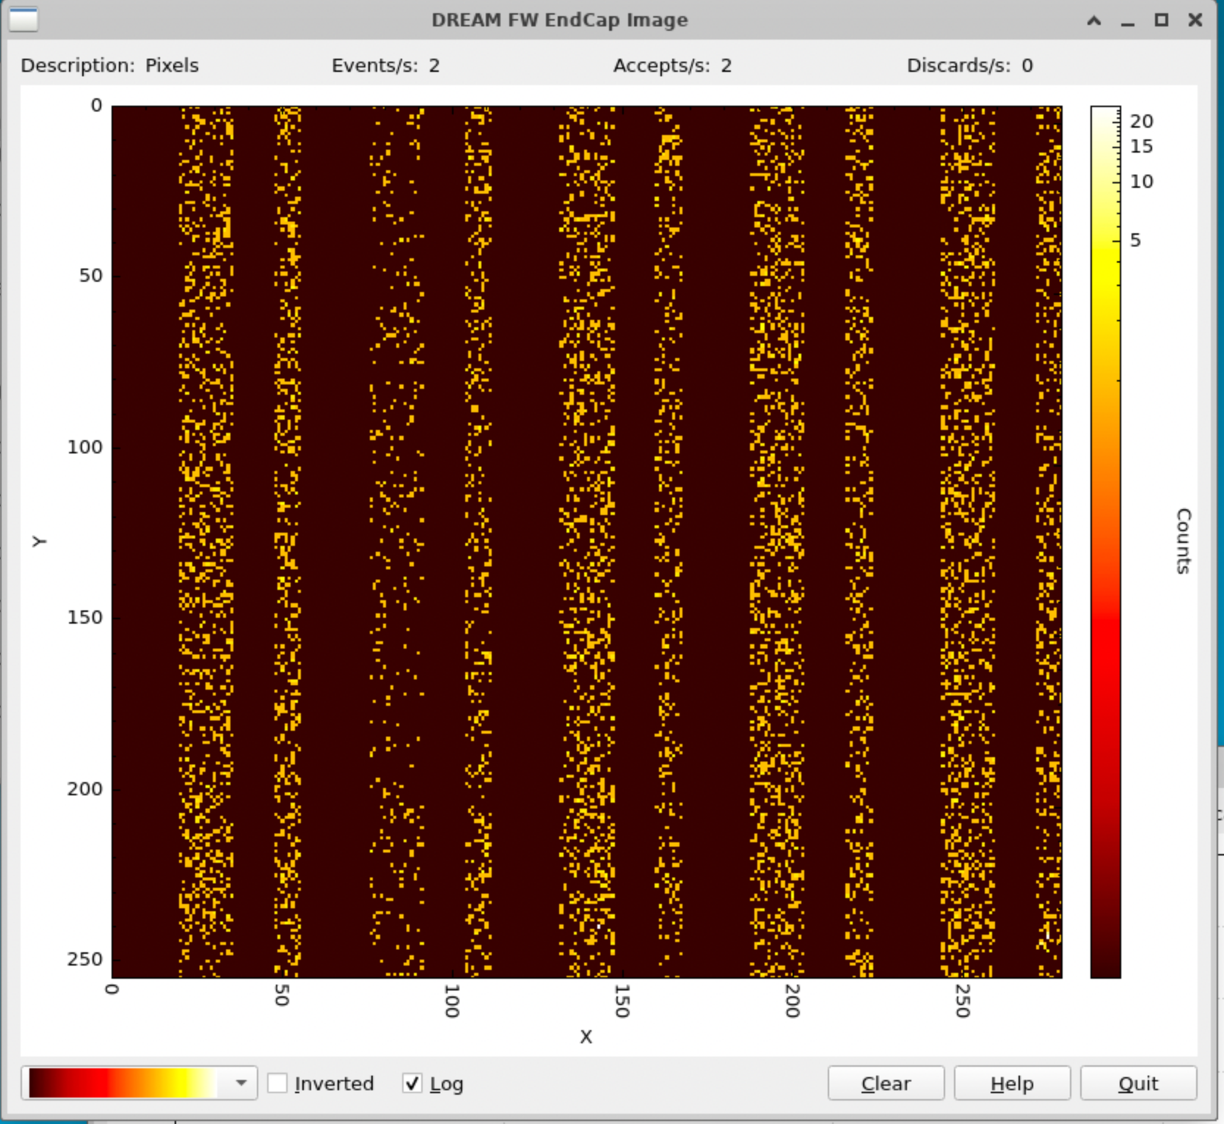
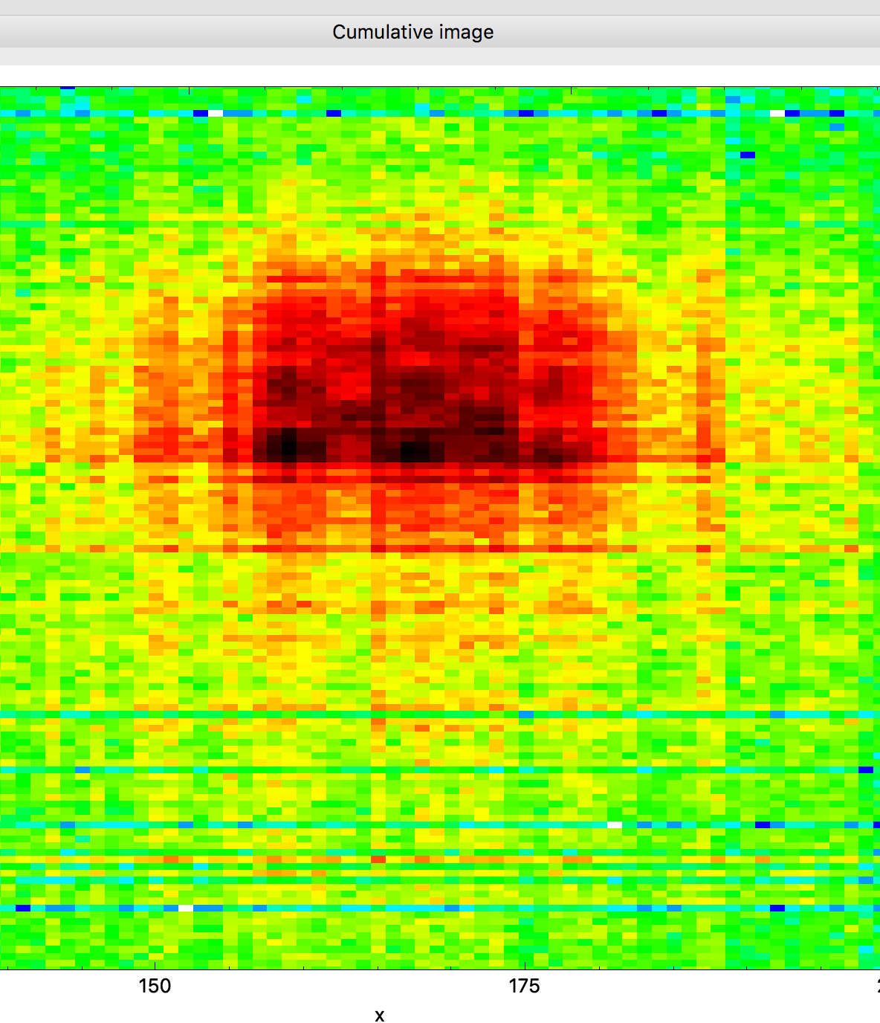
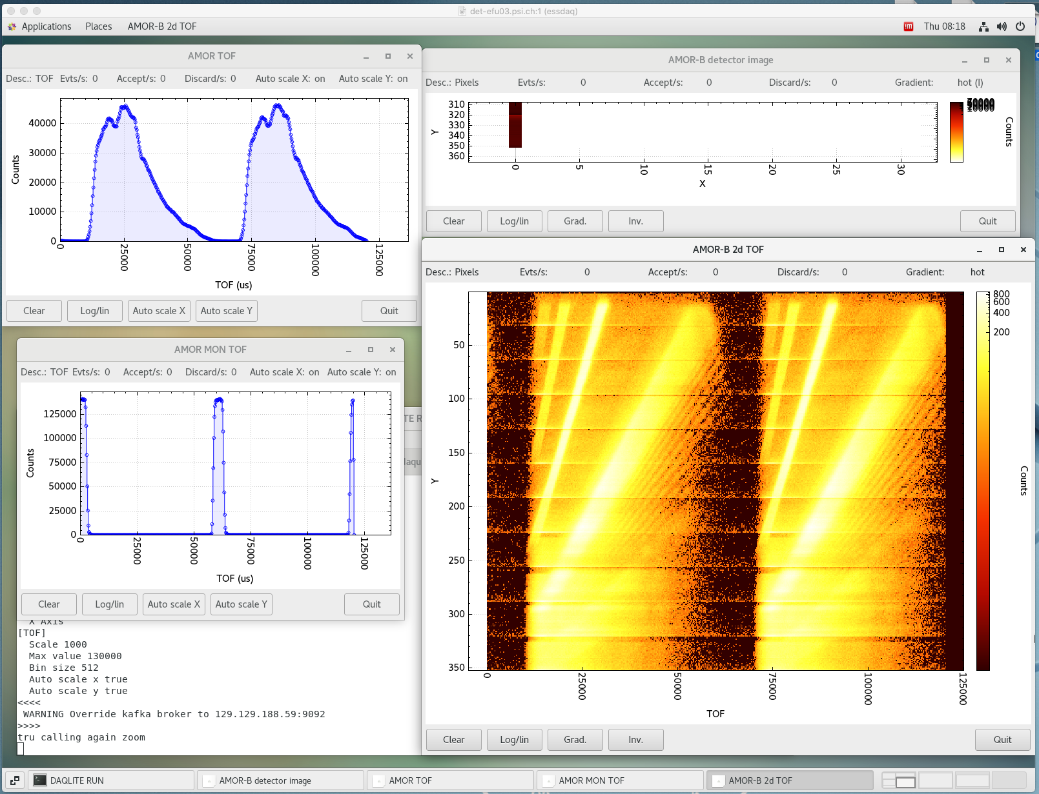
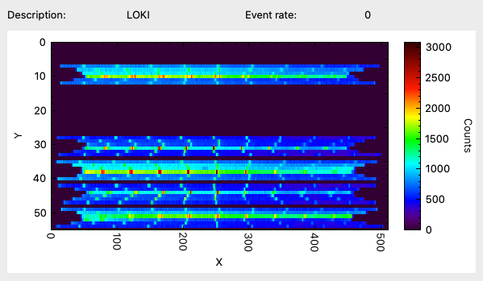
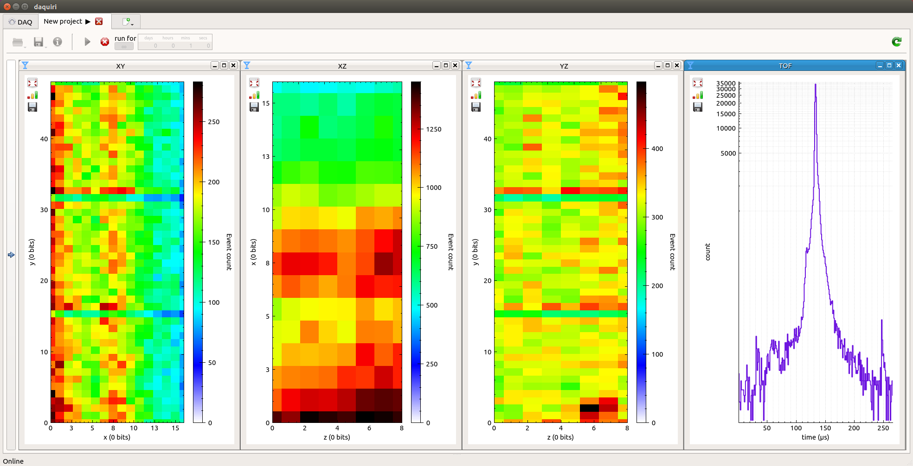
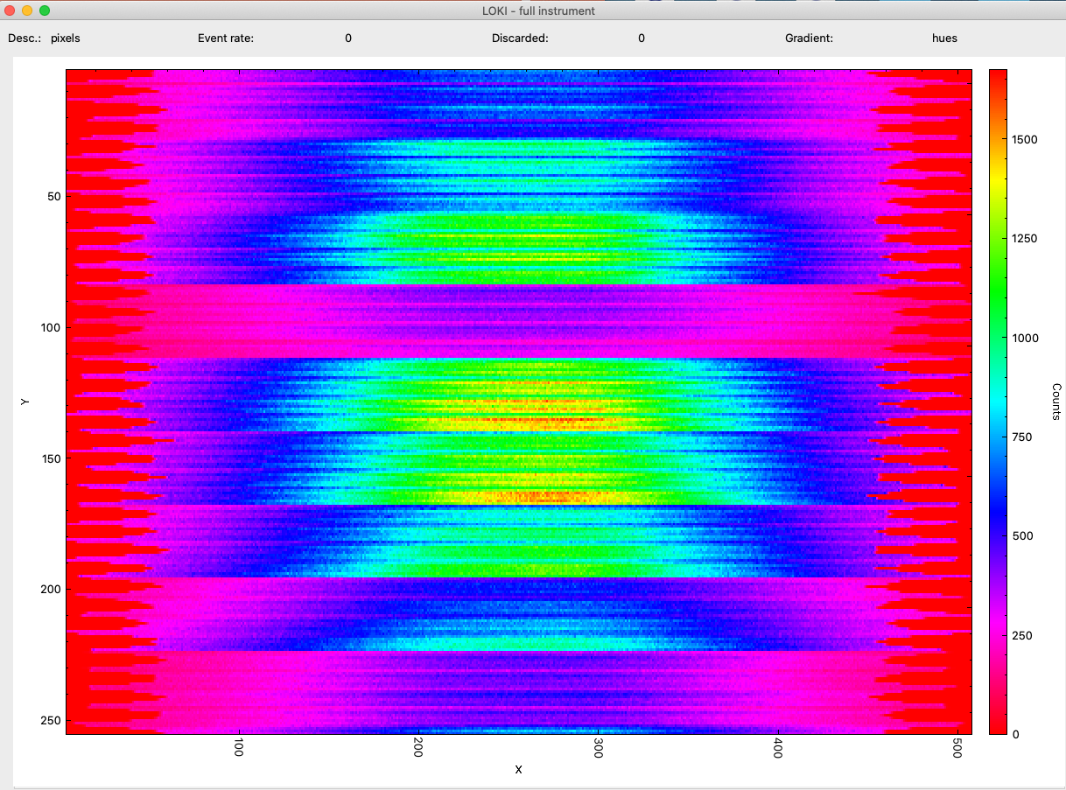
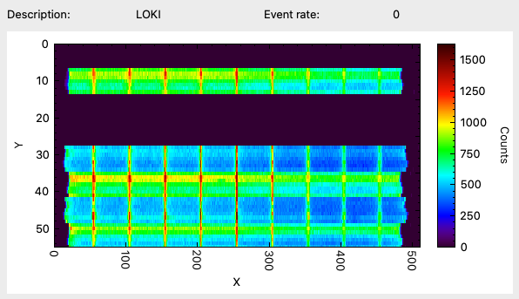
Daqlite
BIFROST
2025
MB (v1)
2018
SoNDe (SKADI)
2017
prototype
TIMEPIX
2023
DREAM
2026
prototype
AMOR(FREIA)
2022
LOKI
2021
NMX
2020
prototype
LOKI
2022
CSPEC (MG)
2017

Slide 22
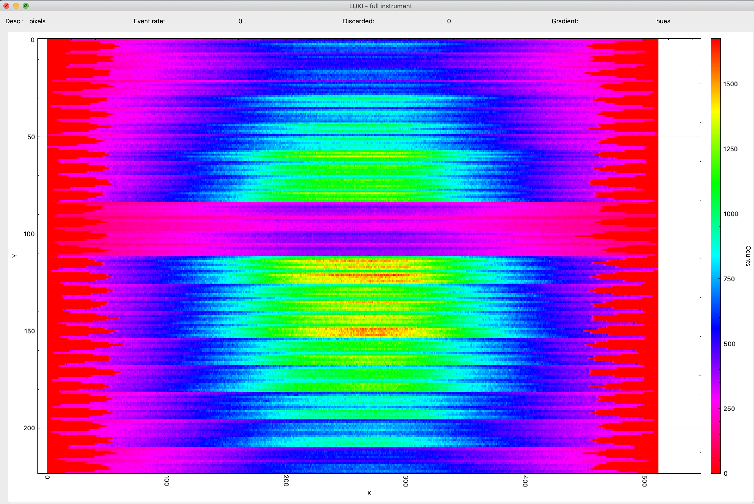
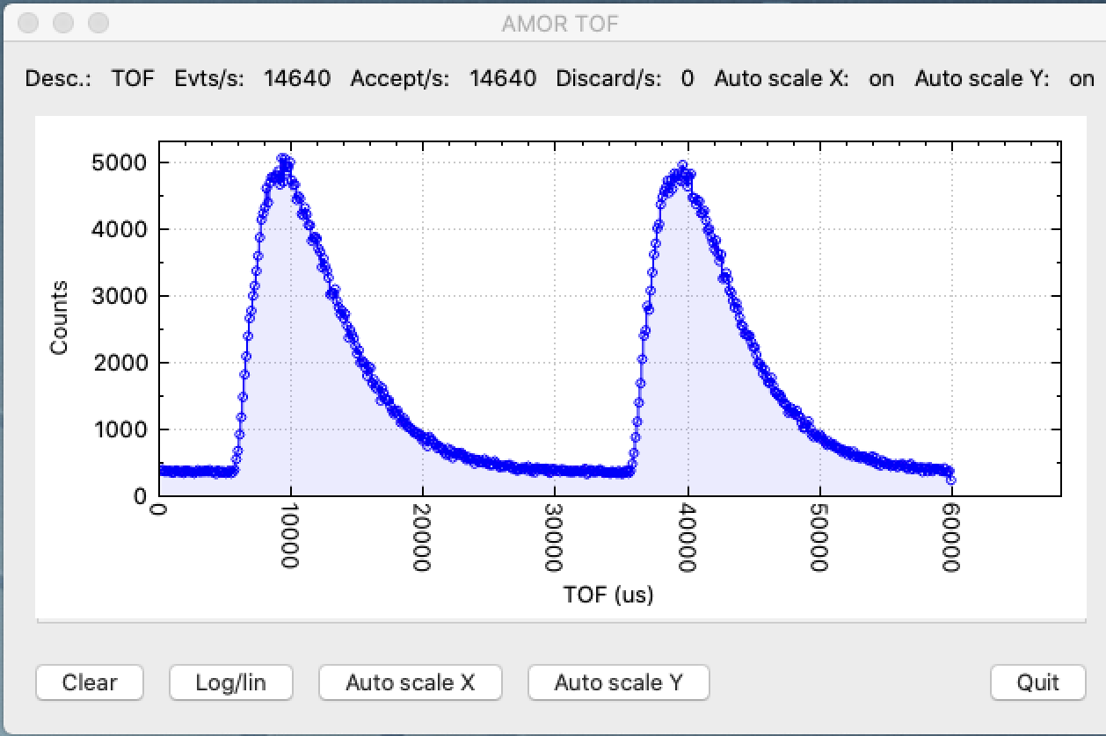
Daqlite
plots from {rToA, pixel}
normal data path
detector topic
launch
topic
broker
config
kafkacfg*

Slide 23
Demo

Slide 24
Break

