Slide 1

EFU Tools Workshop #1
Jan 20 2026

Slide 2
Monitoring Tools
https://ecdcmetrics.esss.dk
https://ecdcpos.esss.dk/ess

Slide 3
Metric system
Metric based
Based on int64 counters in applications
Events or quantitative information like incoming packets counter by the application
Counter values frequently published to metric server
Monitoring Systems
Log Based
Based on <time, text> messages.
Usually has additional information like severity to mark the seriousness
Log server can align various log events on different systems
Useful for investigation of major events
Useful to understand internal product health, operation quality and performance parameters
Text message can be precise and talkative

Slide 4
Metric system
Internal counter (EFU)
Application increase counter each time when a certain condition fulfilled in the code
Publish to metric server (EFU)
Snapshot of counter values are published to metric server with exact timestamp when the snapshot was taken
Metric server logs counter values (Graphite)
A <time, counter_value> log created by the metric server, which follows the counter status changes over time
Visualization (Grafana)
Time serialized counter values can be synthetized and visualized in various charts or further filters or mathematical methods can be applied.

Slide 5
Basic metric access
Useful commands available on EFU host machines (ssh efu0635):
efurunning: lists available efu and their ports (data and command ports)
efurates: shows the most important performance counter changes per second, like incoming data and processed events.
[tiborbukovics@efu0634 ~]$ efurunning
name pid dport cport
-----------------------------
loki 104507 9021 8021
loki 104686 9022 8022
loki 104865 9023 8023
loki 105044 9024 8024
loki 105225 9025 8025
loki 105404 9026 8026
loki 105583 9027 8027
loki 105762 9028 8028
loki 105942 9029 8029
cbm 106121 9030 8030
magic 104328 9820 8820
-----------------------------
[tiborbukovics@efu0634 ~]$ efurates -p 8021
Change per second
------------------
efu.loki.bank0.receive.packets 93.7
efu.loki.bank0.receive.bytes 839162.3
efu.loki.bank0.parser.readout.count 34840.2
efu.loki.bank0.events.count 30517.1

Slide 6
Basic metric access
Useful commands available on EFU host machines (ssh efu0635):
efustats: most basic way to get metrics, displays all internal counter at current state
[tiborbukovics@efu0634 ~]$ efustats -p 8024 | grep -v 0$
Available stats (131):
efu.loki.bank3.receive.packets 952388
efu.loki.bank3.thread.input_idle 9539707641
efu.loki.bank3.parser.essheader.version.v1 952389
efu.loki.bank3.parser.readout.header.count 354289824
efu.loki.bank3.parser.readout.count 354289824
efu.loki.bank3.events.count 354289824
efu.loki.bank3.thread.processing_idle 9872670874
efu.loki.bank3.produce.cause.timeout 10141
efu.loki.bank3.producer.event.error_events 4
efu.loki.bank3.producer.event.produce_bytes_ok 14370182536
efu.loki.bank3.producer.event.produce_calls 144709
efu.loki.bank3.producer.event.msg.num_of_msg_in_queue 1
efu.loki.bank3.producer.event.msg.bytes_in_queue 99304
efu.loki.bank3.producer.event.msg.delivery_success 144708
efu.loki.bank3.producer.event.msg.status_persisted 144708
efu.loki.bank3.producer.event.msg.msg_delivery_event 144708
efu.loki.bank3.producer.event.error.timeout 1
efu.loki.bank3.producer.event.error.transport 3
efu.loki.bank3.main.uptime 10141

Slide 7
Basic metric access
DEMO

Slide 8
Grafana
Input Counters
ESS headers
Readout
Event and Time
Producing
Packets/s
Dropped/s
V0 or V1 headers/s
Heartbeats/s
Errors/s
Readouts/s
Errors/s
rToA/s
Previous rToA/s
Produced Bytes/s
Produce calls/s
Kafka
Preserved messages
Errors/s

Slide 9
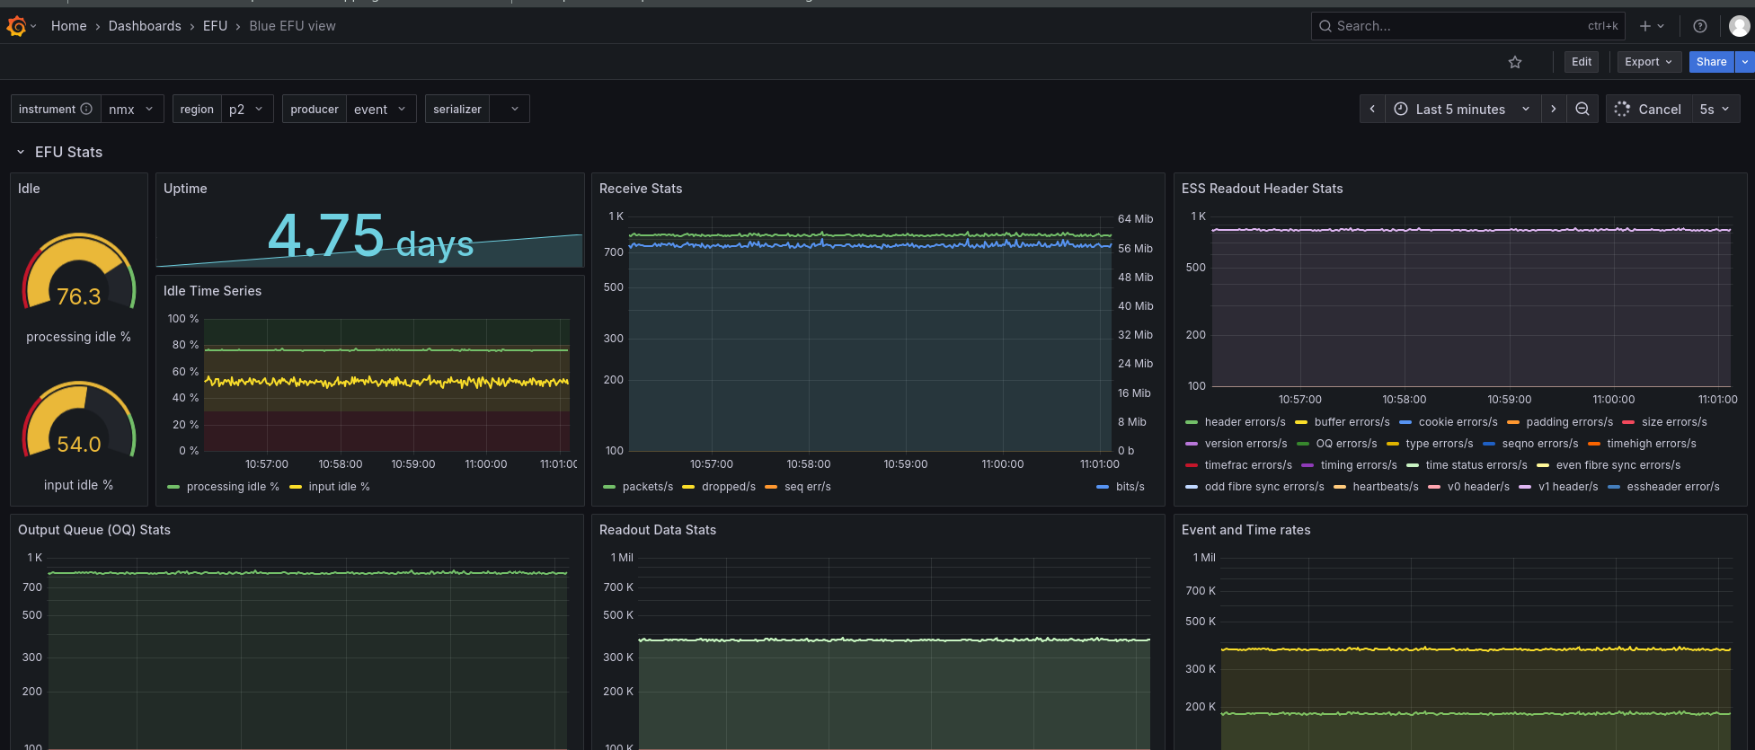
Grafana
Variable selectors left side (instrument and region), time frame and refresh rate on right side

Slide 10
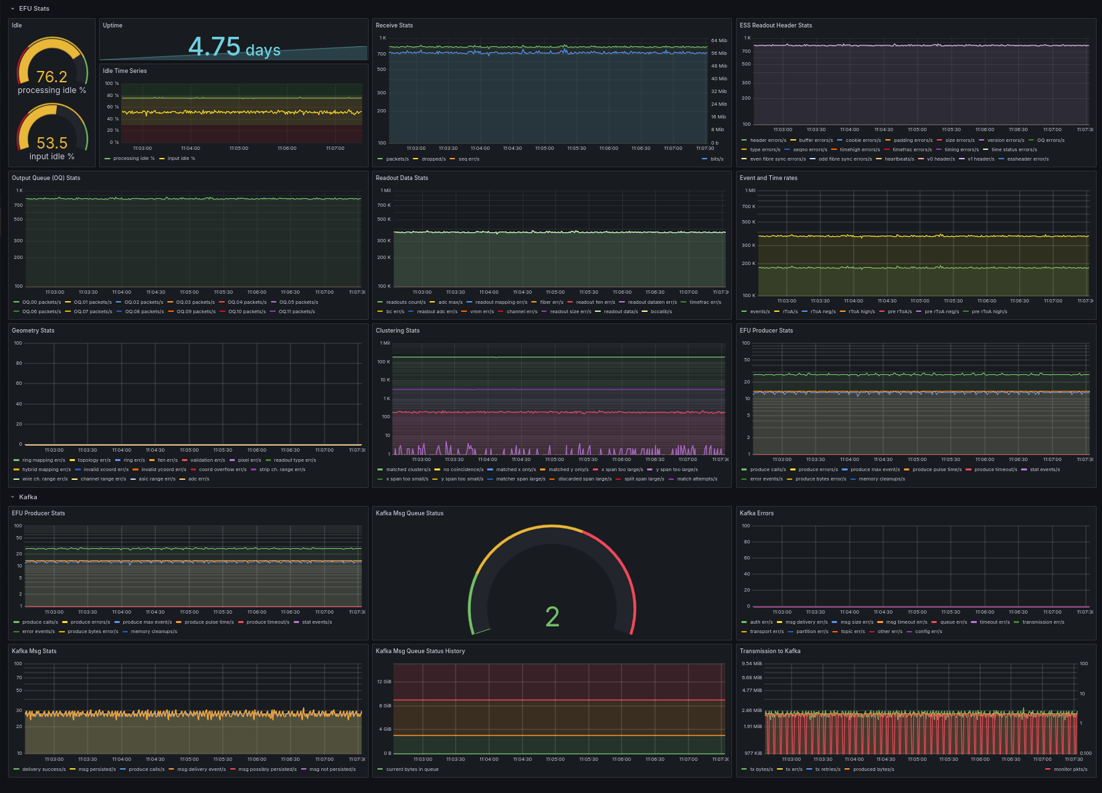
Grafana
Red section focus on EFU. Green section focus on EFU to kafka transmission

Slide 11
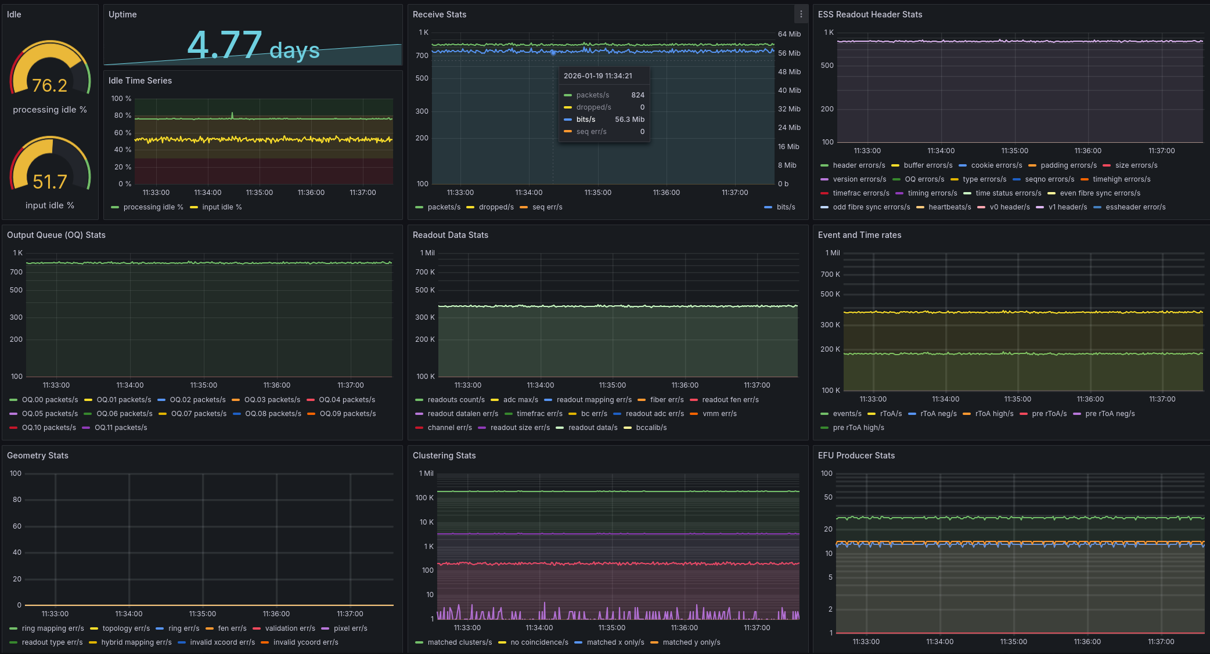
Grafana
Red section is about EFU performance and load. Yellow section is incoming ESS data packets. Purple is processing the readout data and neutron event identification. Green section is low level geometry and clustering related information.

Slide 12
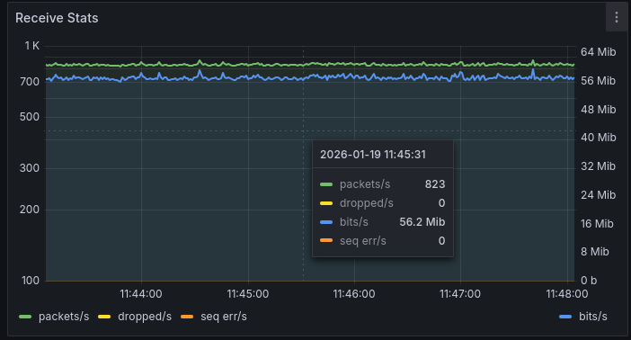
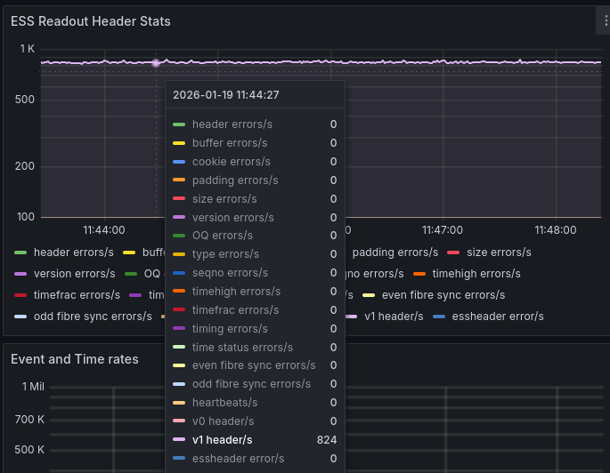
Grafana
In the receiving stats represent how much data is arriving to the EFU’s udp port. Mostly a performance indicator. Dropped packets indicate that EFU if overloaded and it’s loosing detector data.
V0 or V1 headers are indicate those data packets which are accepted by the EFU. Good if it’s equals with packets/s between the receive starts. Heartbeats/s also good status, indicate packet without data. Every other counter shows some kind of errors, and those packets and their data completely dropped.

Slide 13
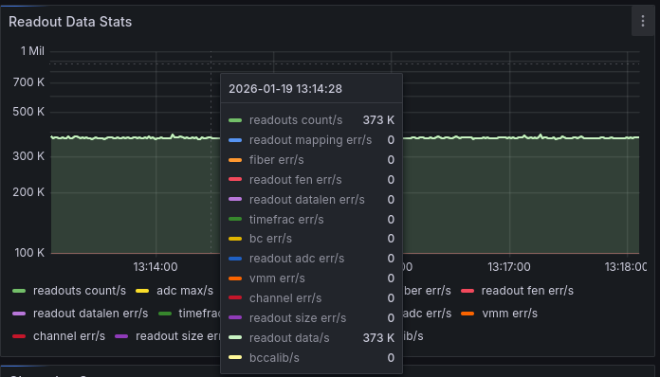
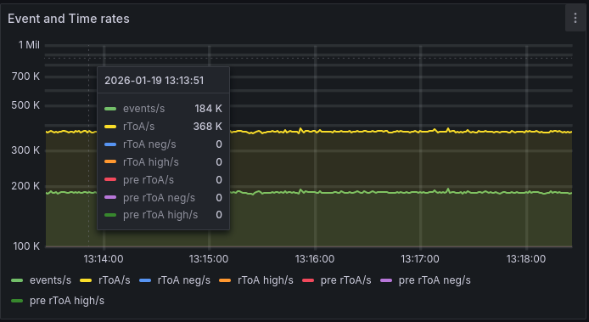
Grafana
Readouts are data segments encapsulated in the ESS packet. Readout data/s indicates the data segments received, readout count/s is the number of readout was accepted by the parser. Ideally they equal. Other fields are indicate various errors for which the readout was dropped.
Events are the final product, the identified neutron event built from one or more readout. Events/s is an important performance and quality indicator.
Each event has timestamp, rToA/s (relative time of arrival) shows perfect time matching to the pulse. Pre rToA/s indicates delayed readouts, but accepted and matched to previous pulse time. Pre rToA neg./s indicates readouts with serious delays and lost.

Slide 14
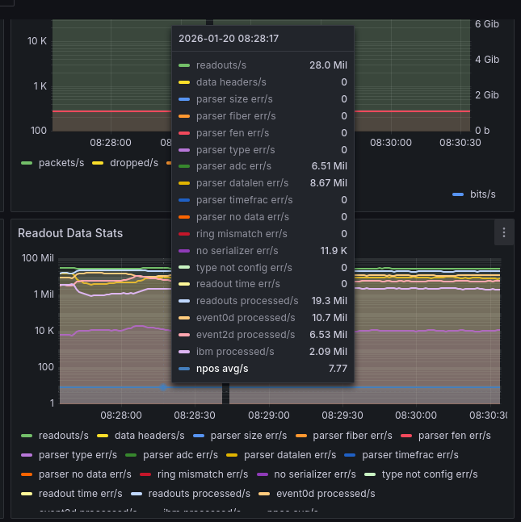
Grafana
Beam monitors have multiple serializers and different readout types depending on the data type of the monitor.
Event 0d
Event 2d
Ibm
If EFU expecting data differently as the real topology, we will see no serializer err/s

Slide 15
Grafana
DEMO

