Slide 1
AREA 51
EFU Workshop
January 2026

Slide 2
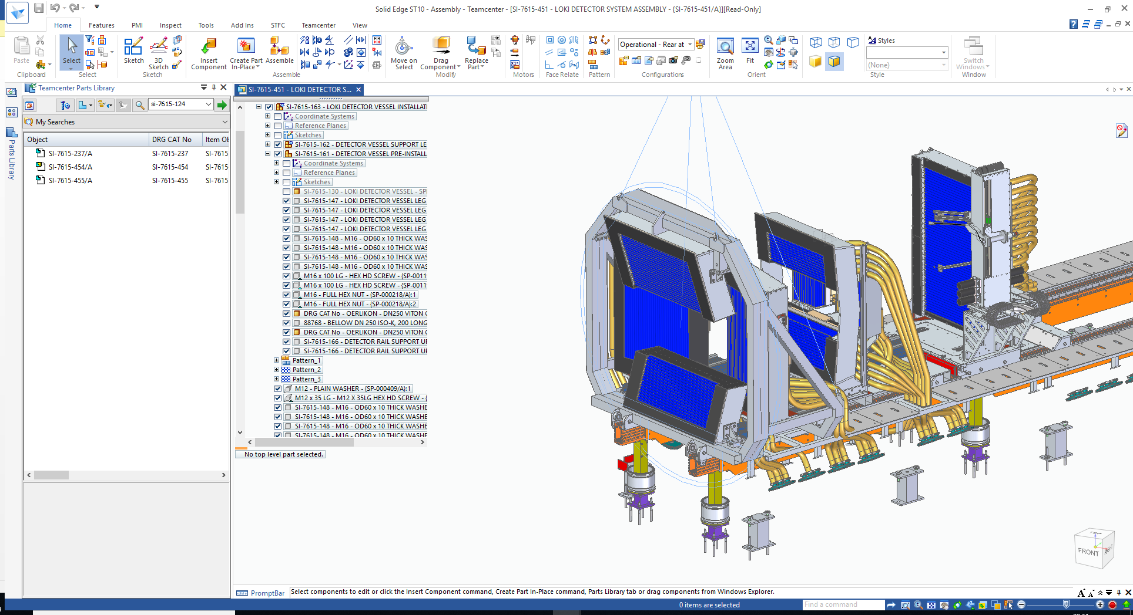
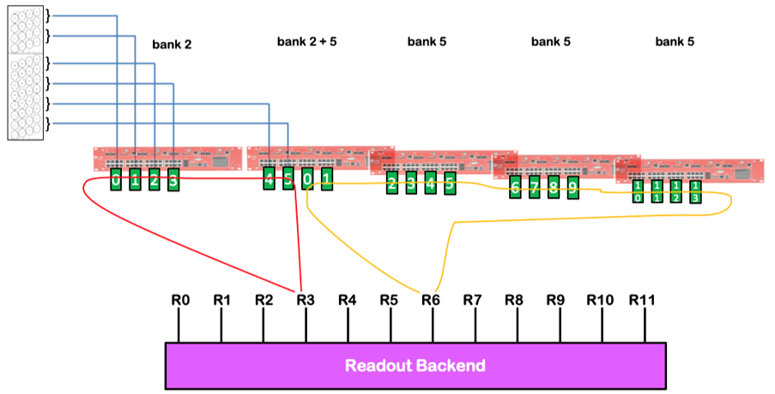
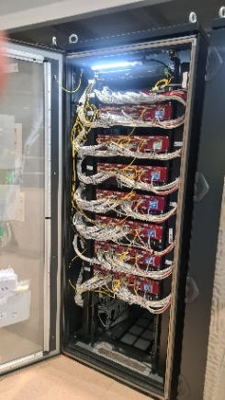
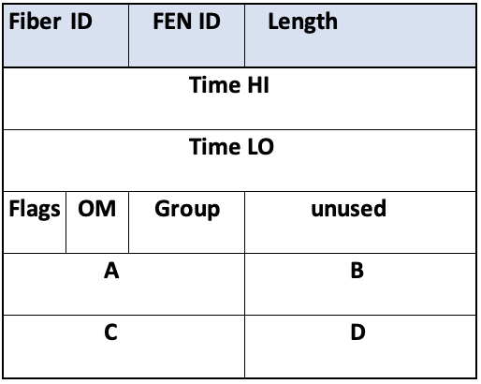
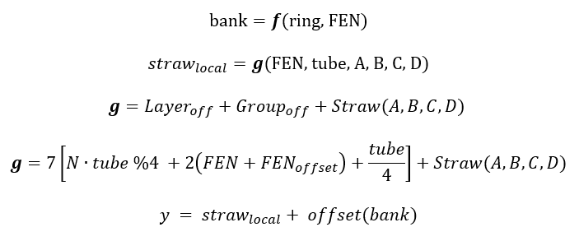
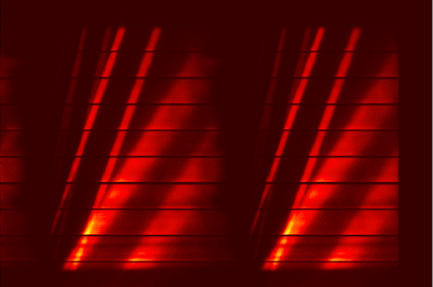
EFU – dataflow
Detector
Ring and Fens
RMM
?
Readout
Transformation
Detector

Slide 3
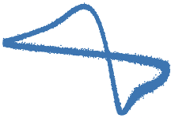

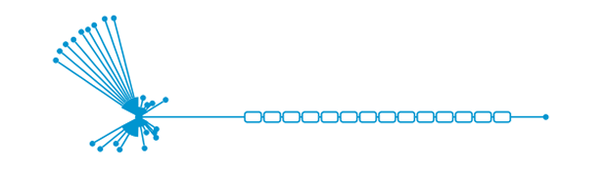


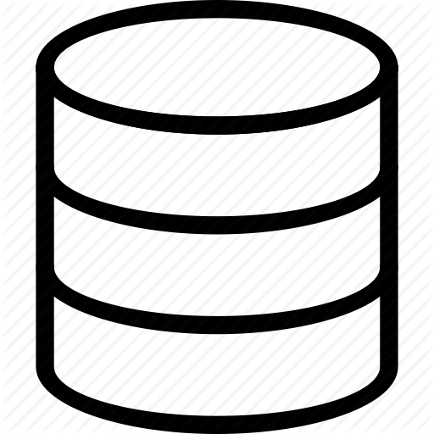


ECDC System Architecture
instrument hardware
site infrastructure
DMSC
Raw samples topic
AREA 51
detectors
readout
event formation
'RM'
EFU
filewriter
storage
data
controls
Lund - CPH
slits
'EPICS'
EPICS
FW
choppers
...
samp. env
NICOS

Slide 4
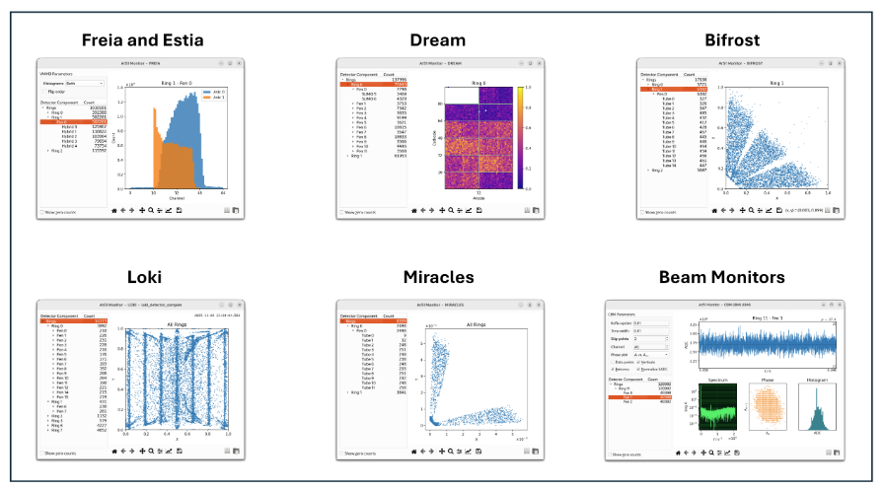
Area51 – where lost channels are found

Slide 5
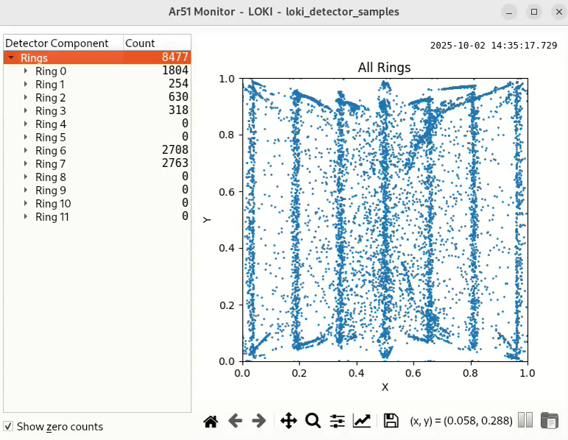
Loki – example

Slide 6
Ar51 – overview
Principle
Read raw non-processed samples topic to inspect and zoom in on specific detector quantities
Rings
Front-end-nodes (FENs)
Tubes/Hybrids/ASICs
ADC beam monitor values
Supported detectors
Loki, Bifrost, and Miracles
Estia and Freia
Dream
Beam Monitors
Skadi (coming soon)

Slide 7
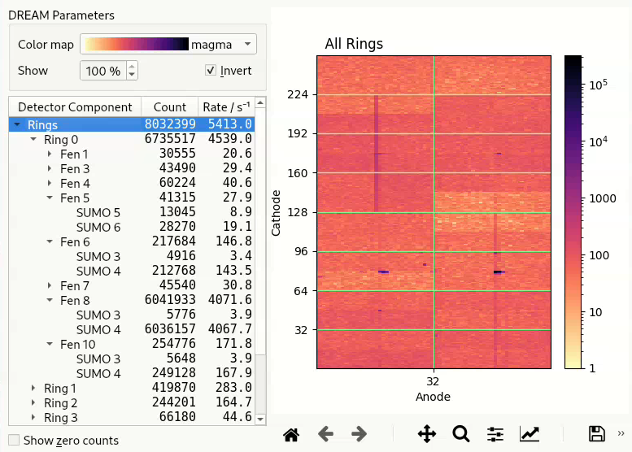
DREAM

Slide 8
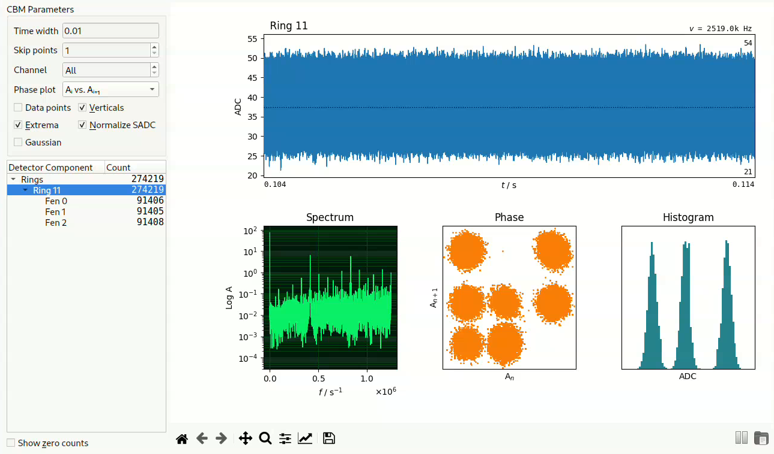
Beam Monitor – ODIN

Slide 9
Debug
...
Readout 79
-----------------
Fiber = 11
FEN = 5
Length = 16
Time high = 1764244151
Time low = 50970666
OM = 1
UId = 2
Cathode = 236
Anode = 55
Readout 80
-----------------
Fiber = 11
FEN = 5
Length = 16
Time high = 1764244151
Time low = 50970666
OM = 3
UId = 2
Cathode = 244
Anode = 4
...
--debug flag
Inspect individual readouts
Validate RMM output
python3 ar51.py -r pcap -p 9022 --debug

Slide 10
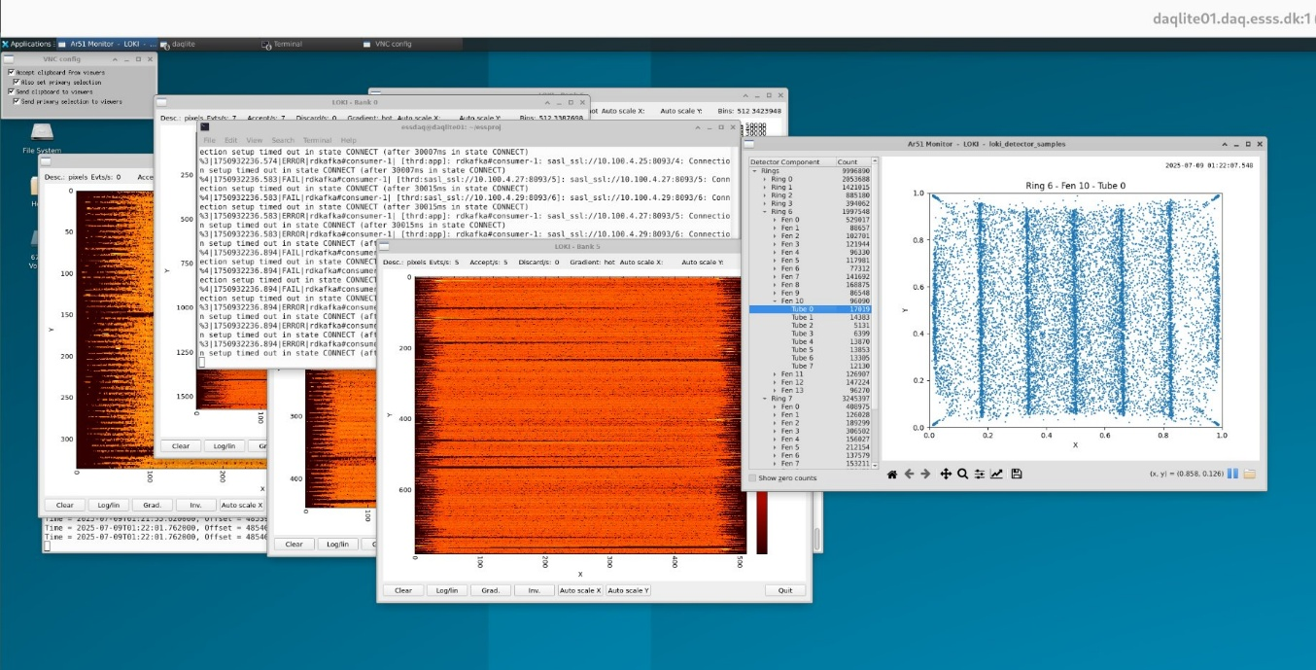
Access via VNC
Virtual Network Computing
Confluence page with setup instructions​
Individual ports for assigned users​
https://confluence.ess.eu/spaces/~michaelchristiansen/pages/806856002/EFU+Workshop

Slide 11
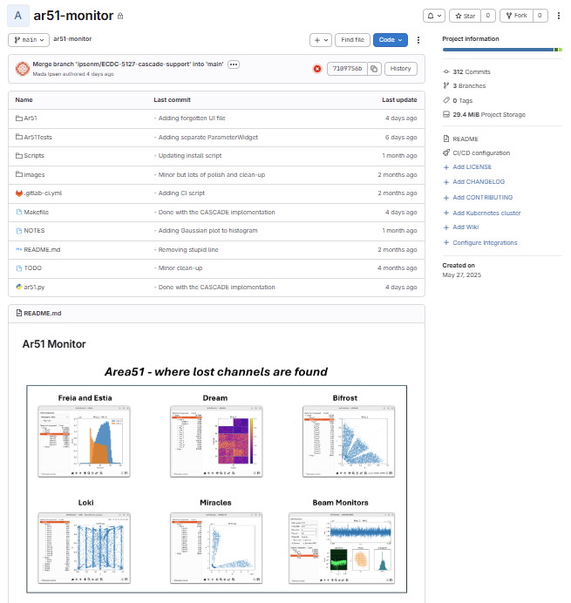
Getting the Ar51
Gitlab repo
Overview
Installation instructions
Usage examples
https://gitlab.esss.lu.se/ecdc/ess-dmsc/ar51-monitor

Slide 12
Exercises
Inspect live Loki data on daqlite01
Study different samples topics on
daqlite02
blue-daqlite
Stream and study PCAP files on blue-daqlite
Inspect data by using the --debug option

