Slide 1
Introduction to Oxygen Deficiency Hazard (ODH) Accelerator Division Retreat Duy Phan Accelerator Safety Engineer
Oxygen Deficiency Hazard: any operation which may expose personnel to an increased risk due to oxygen deficiency
November 12th

Slide 2
Definition
Oxygen Deficiency Hazard (ODH) is caused due to oxygen displacement
Two factors make ODH so dangerous...
1
The large volume ratio between a cryogenic liquid and its gaseous state at room temperature and pressure.
2
In low enough oxygen concentrations the first physiological symptoms of a problem can be unconsciousness, coma and death.

Slide 3
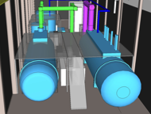
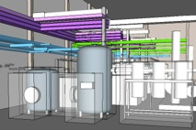
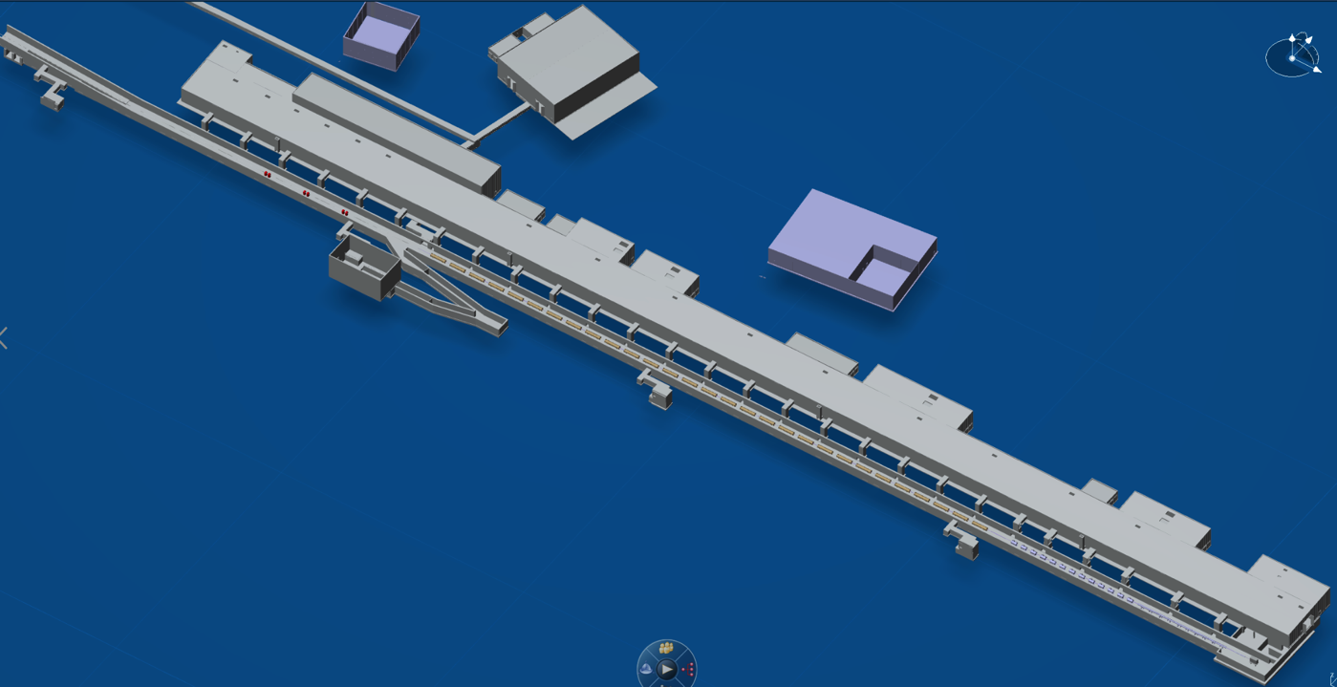
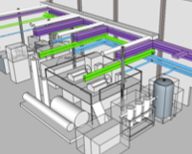
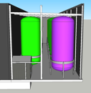
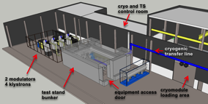
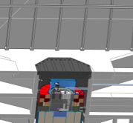
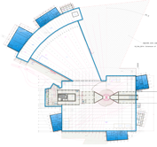
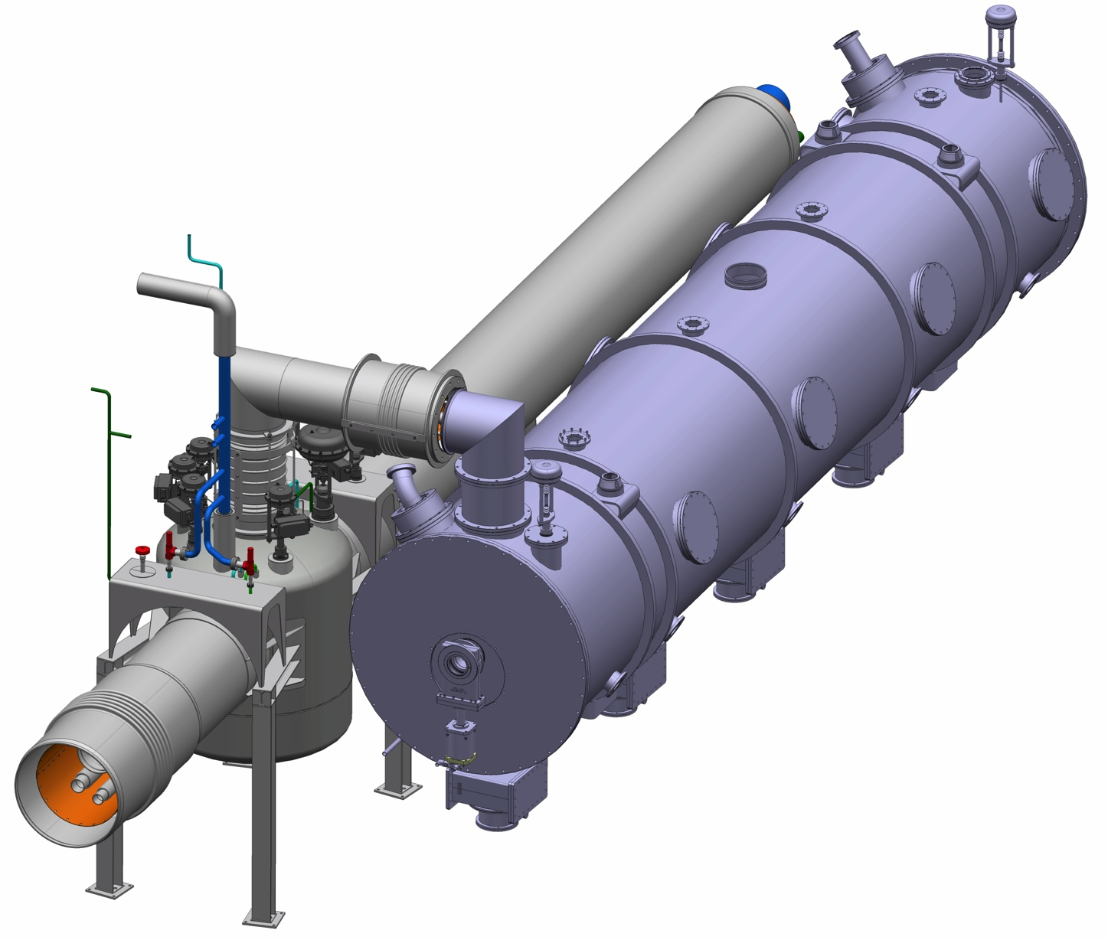
ESS’ Cryogenic inventory
Cold Box Hall
Dewar ACCP: 20 m3 Lhe
Dewar TICP: 5 m3 Lhe
Cold Box: negligible
Cold Box Hall
Compressor Bldg.
TMCP: 2 x 63,5 m3 GHe
TICP: 1 x 64 m3 GHe
ACCP: 16 x 63,5 m3 GHe
HP: 3 x 20 m3 GHe
LN2: 2 x 20 m3
ACCP
Test stand
TICP & TMCP
Gas storage
4th largest Helium inventory in Europe
But also…
Accelerator tunnel
High-β: 21 x 0,192 m3 LHe
Medium-β: 9 x 0,184 m3 LHe
Spoke: 13 x 0,120 m3 LHe
Target moderator
Science labs.
Elliptical
Spoke
Acknowledgement : N.GAZIS, X.WANG, P.ARNOLD, W.HEES (ESS)

Slide 4
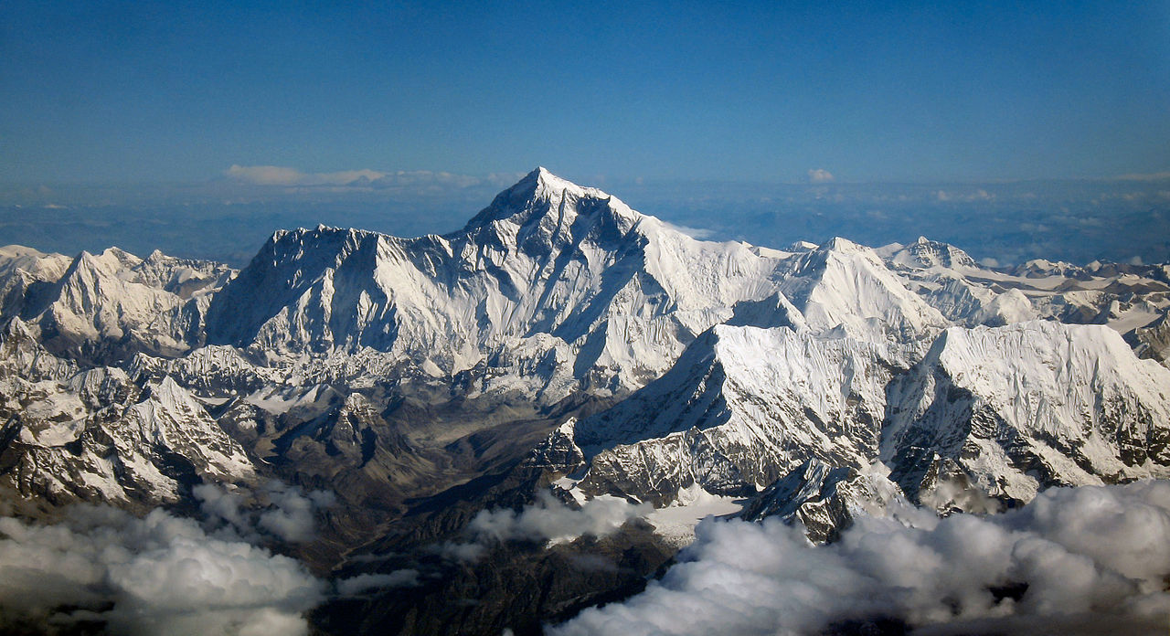
Example
Mount Everest
8840 m
Volume of the room = 175 m³
Atmosphere = 21 % O₂
→5 % O₂
Helium Gas (GHe)
20 kg TNT equivalent
132.65 m³ !!
The time between a failure and explosion may take a fraction of a second, eliminating warning signals as compensatory measures
Liquid Helium (LHe)
Pressure: 1.3 bars
Volume: 1 m³
Temperature: 4.5 K
P

Slide 5
Example of LHe spill at CERN (2014)
Acknowledgement : G.LINDELL (CERN)

Slide 6
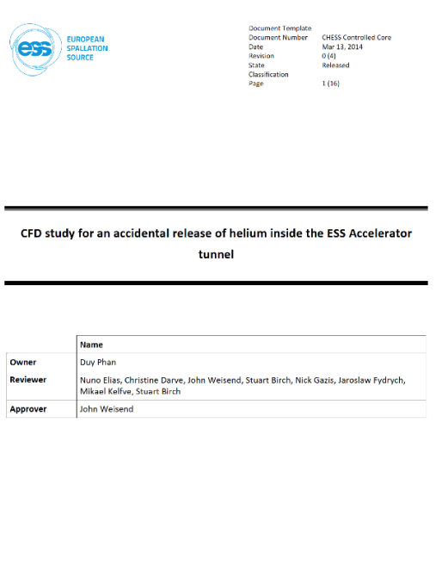
ESS Safety Policy on ODH
ESS has defined 18% O₂ as the safety threshold under which control measures shall be implemented
WHY?
1
Lessons learnt from similar Accelerator Facilities (e.g. CERN, FERMILAB)
2
Comply with the Work Environment Legislation
3
Prevent health effects

Slide 7
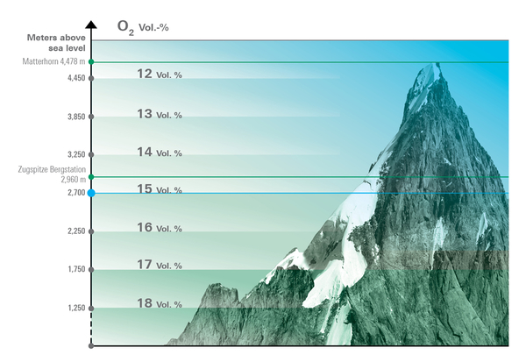
Health Effects from O₂ depletion
ESS Threshold
Previous example
Acknowledgement : FESHM Chapter 4240 – oxygen deficiency hazards (odh) (fermilab)

Slide 8
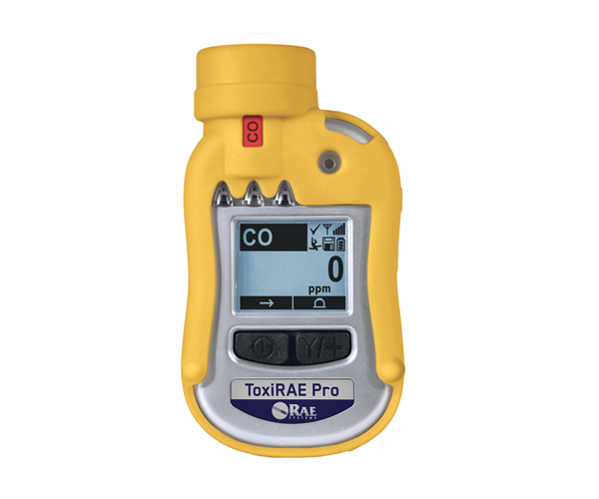
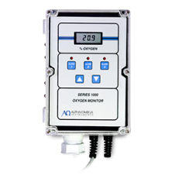
ODH Control Measures
How do we plan to mitigate ODH ESS wide?
Personal oxygen monitor
Self-rescue mask
Warning signs
Ventilation
Training
Procedures
Oxygen monitoring (fixed)
+ alarm
And what about CERN…?

Slide 9
CERN self-rescue mask
Acknowledgement : M.VIGUIER (CERN)

Slide 10
ODH in the Accelerator Tunnel
Preliminary design
Air exhaust
Air supply
O2
O2
O2
O2
Proton beam
Fire damper
O2
O₂ detector
ODH is not relevant during beam operation

Slide 11
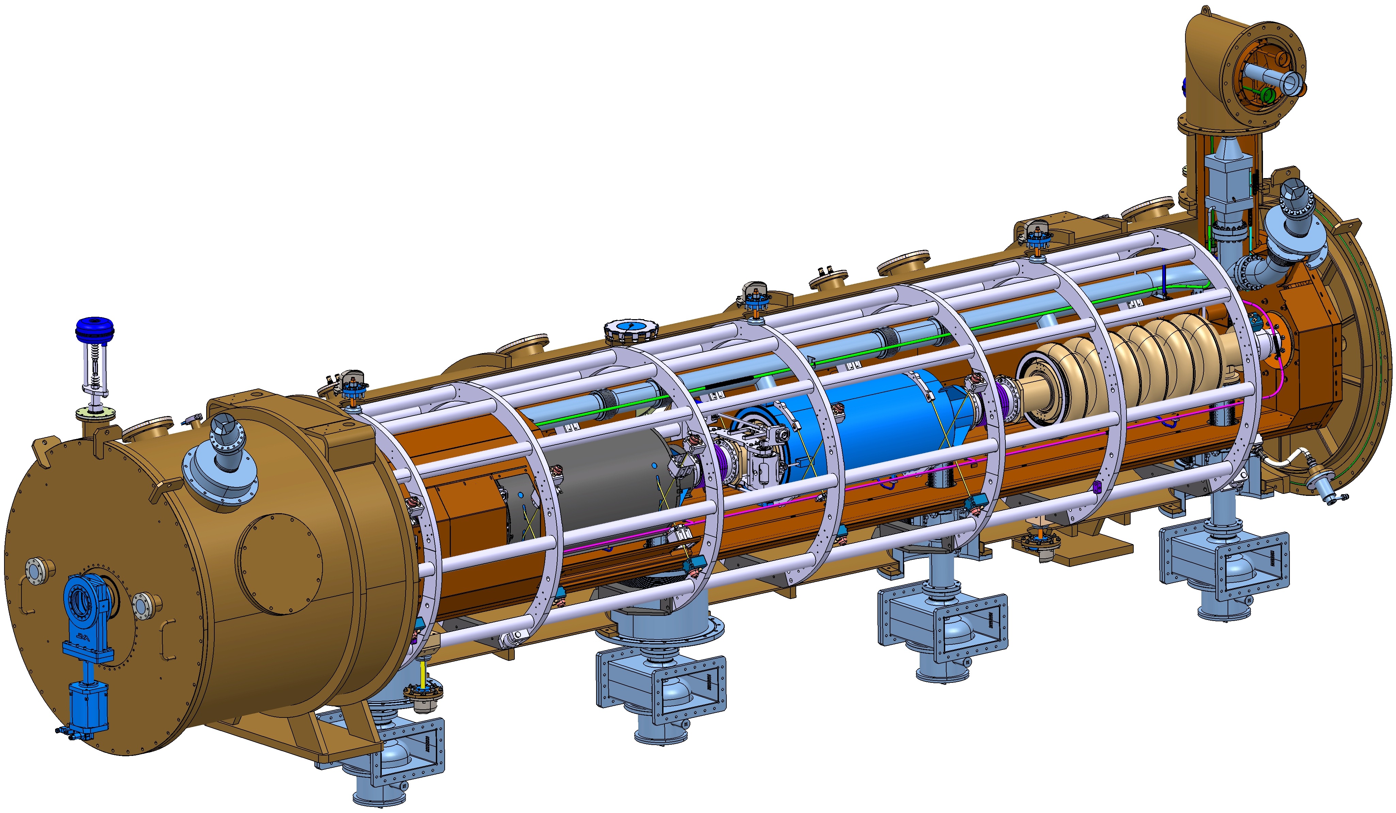
ODH in the Accelerator Tunnel
Failure scenarios (during access)
Scenario
Rupture of the power coupler’s window or beam line
Loss of the content of 1 High-Beta cryomodule (28,4 kg at 2 K and 2.04 bara)
Discharge of GHe through the 2 rupture disks located on the LHe line (2 s)
Max. mass flow rate = 15,2 kg/s
Acknowledgement : C.DARVE (ESS), J-P.THERMEAU (IPNO)

Slide 12
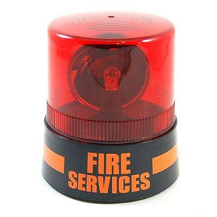
ODH in the Accelerator Tunnel
≈140 hours of maintenance/year
Air exhaust
Air supply
O2
O2
O2
O2
O2
O2
O2
O2
25 200 m3/h
25 200 m3/h
If a Helium discharge occurs, it will be partly handled by the ventilation system…
But will it be sufficient to ensure a safe evacuation of the workers?

Slide 13
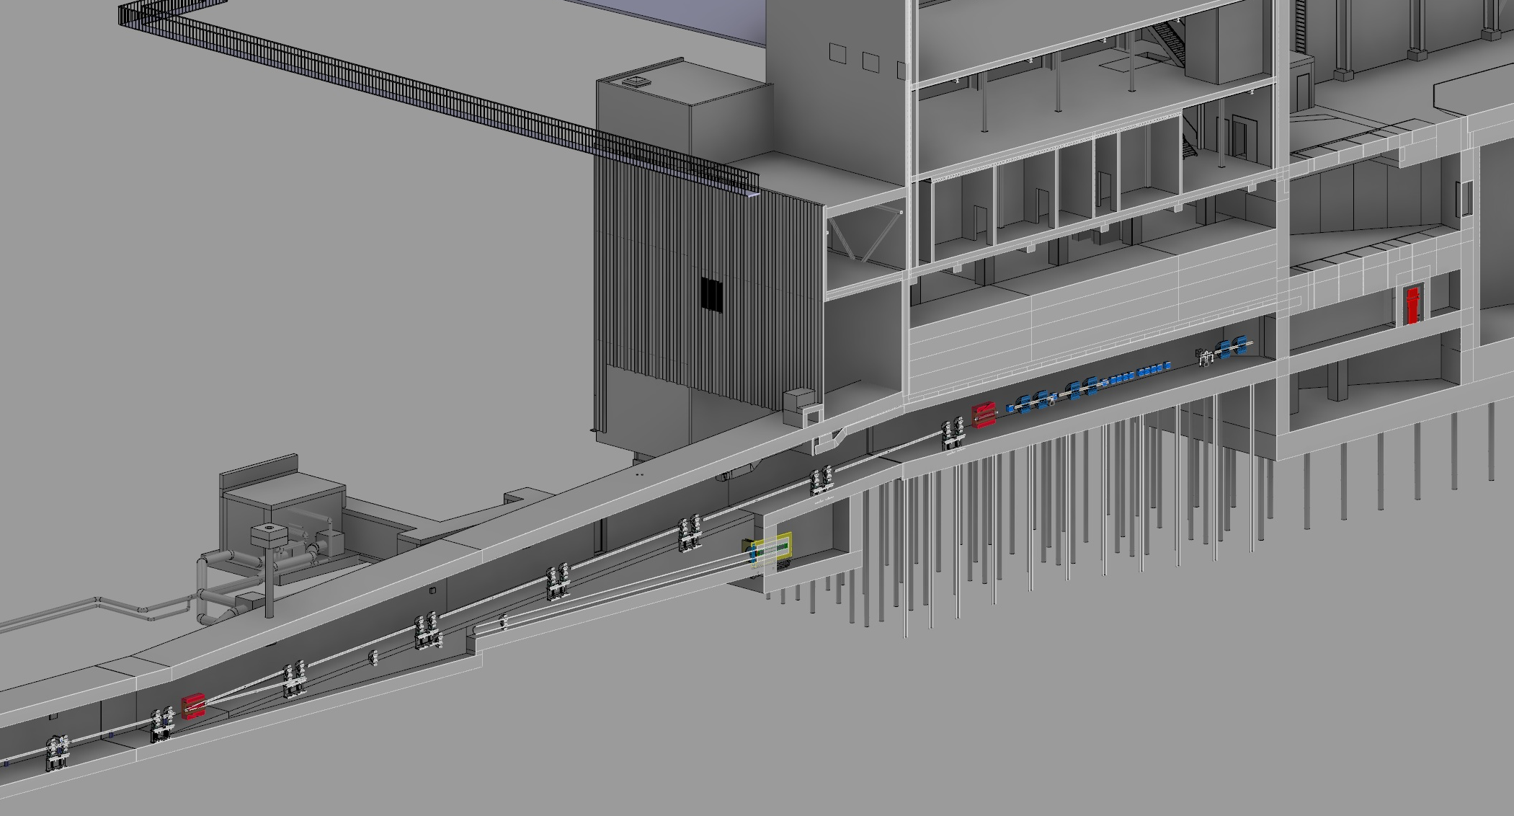
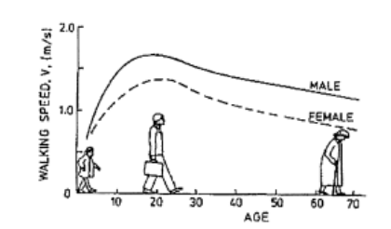
Computational Fluid Dynamics (CFD)
51 m to the nearest exit
64 seconds (30+34) to reach the nearest exit
219 m to the last cryomodule
Acknowledgement : N.GAZIS (ESS)

Slide 14
Computational Fluid Dynamics (CFD)
Near the faulty cryomodule
ESS Threshold
Accesible area
Accesible area
Acknowledgement : E.LUNDH (ESS)

Slide 15
Computational Fluid Dynamics (CFD)
At the A2T area
64 seconds (30+34) to reach the nearest exit
ESS Threshold
Acknowledgement : E.LUNDH (ESS)

Slide 16
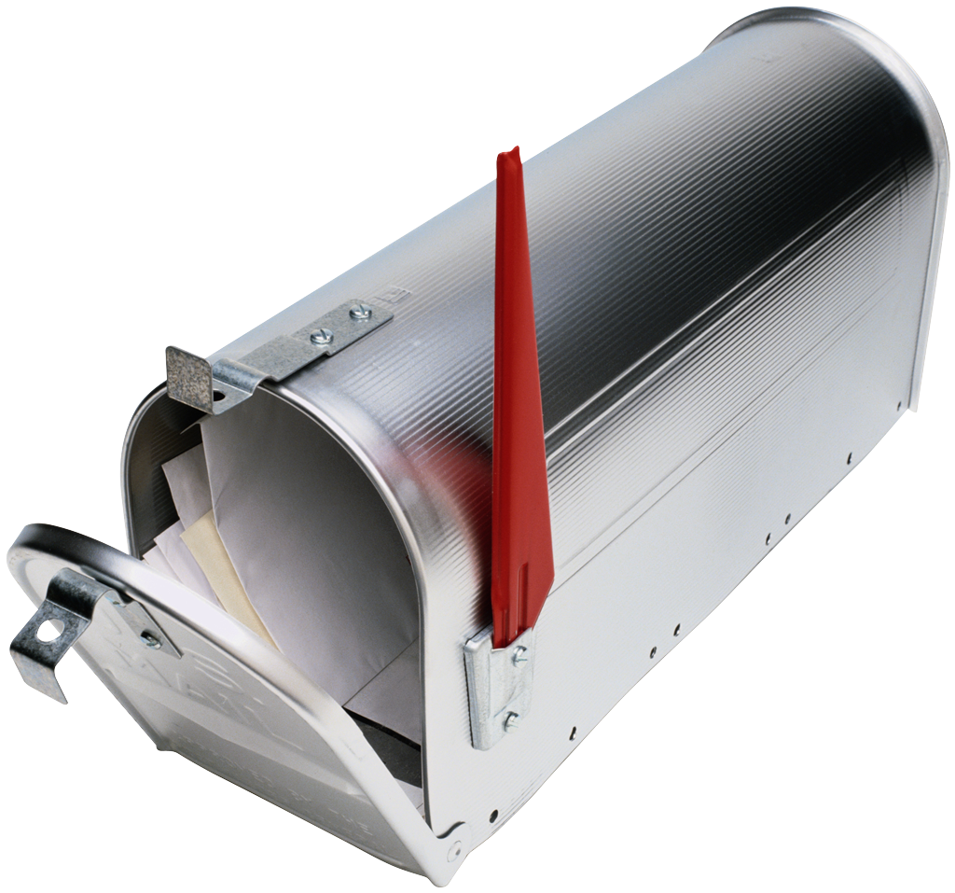
Questions
?
Any Questions
Contact: duy.phan@esss.se

