Slide 1



ESS Spoke Cryomodules:
How does it work ?
First results on prototype
On behalf of the IPN Orsay Team
Sebastien Bousson
ESS AD Retreat, Lund, 12th Nov. 2015

Slide 2
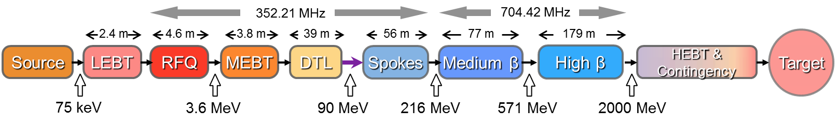
ESS Linac Overview
Warm linac
SCRF linac (T=2K)
95% of the energy gain with 146 SCRF cavities
2 types of cavities & 3 beta families
Top-level requirements
Pulse length (ms) | 2.86
Energy (GeV) | 2
Peak current (mA) | 62.5
Pulse repetition frequency (Hz) | 14
Average power (MW) | 5
Peak power (MW) | 125
ESS Linac is special and innovative:
Mainly based on SRF (Superconducting Radio Frequency ) technology
Very powerful (~4 times higher than SNS)
First accelerator to use spoke cavities
Challenging accelerating gradients

Slide 3

ESS Cryomodules
ESS Cryomodules :
3 different types (spoke, medium beta, high beta)
x13 spoke, x9 medium beta, x21 high beta
Beta (β) is the reduced particle velocity; β = v / c
=1 means that the particle has the speed of light
What is a cryomodule ?
A cryomodule is a device which gives the appropriate environment and conditions to efficiently operate the accelerating superconducting cavities (and possibly superconducting magnets)
It may group several cavities
What is an accelerating superconducting cavity ?
An accelerating cavity is the device that provide acceleration to the charged particle, by means of a voltage
Superconducting means the use of a special state of some materials, called superconductors, which below a critical temperature (Tc), exhibits extraordinary properties such as the absence of electrical resistance.

Slide 4
How does an RF accelerating cavity works ?

Slide 5
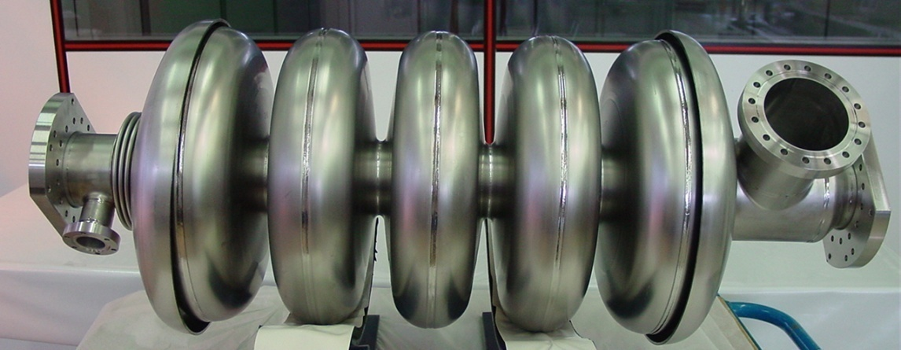
Superconducting Cavities
« CAVITY » = Electromagnetic resonant cavity
    RF fields (electric and magnetic)
    ⇒ To accelerate charged particles
Frequency f
50 MHz to 3 GHz
Size
Proportional to 1/f
Temperature T
1,5 K to 4,5 K
Accelerated particle velocity
β=v/c from 0,01 to 1
0 K ≈ - 273,15 °C
c ≈ 2,998 . 10⁸ m/s
« SUPERCONDUCTING » : very low operating temperature (Liquid Helium)
⇒ Superconducting state of the matter
Beam tube
cell
iris
equator
Power port
Incident
beam
Accelerated beam
length ∼ 1 m
Superconducting cavity (IPN Orsay) – 5 cells, 700 MHz, β=0,65

Slide 6
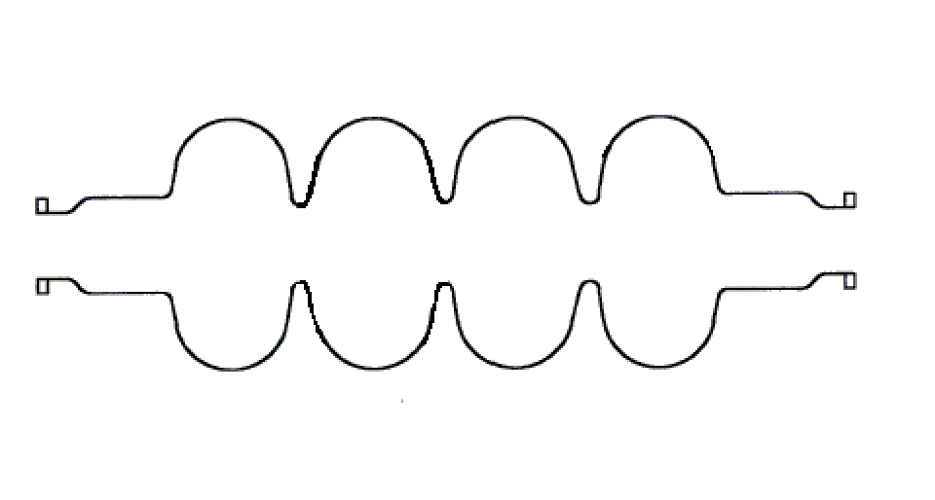
Superconducting Cavities
(1) An electric field is created on the beam axis , and is available to accelerate charged particles
PRF
Electric field E
This E field is time and space dependant
With f the cavity frequency, T = 1 / f
Ex : f = 700 MHz → T = 1,43 ns

Slide 7
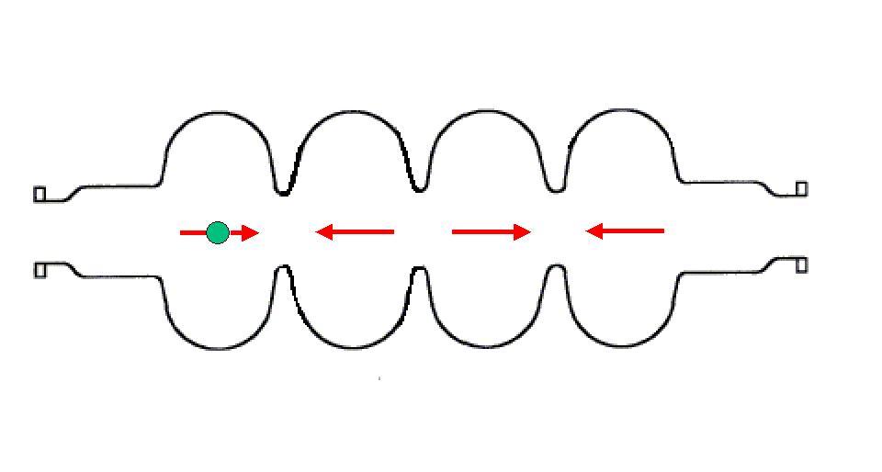
Superconducting Cavities
The charged particle enter the : for an efficient acceleration, the particle should be synchronized with the RF wave
L_{cell}
Proton case q > 0, velocity v
q
F
E
Synchronism condition :
The time for the particle to cross one cell should be T_{RF}/2 ⇔
The cell length should verify: or
The particle should arrive at the right time in the cell
The cell length should be adjusted to the particle velocity

Slide 8

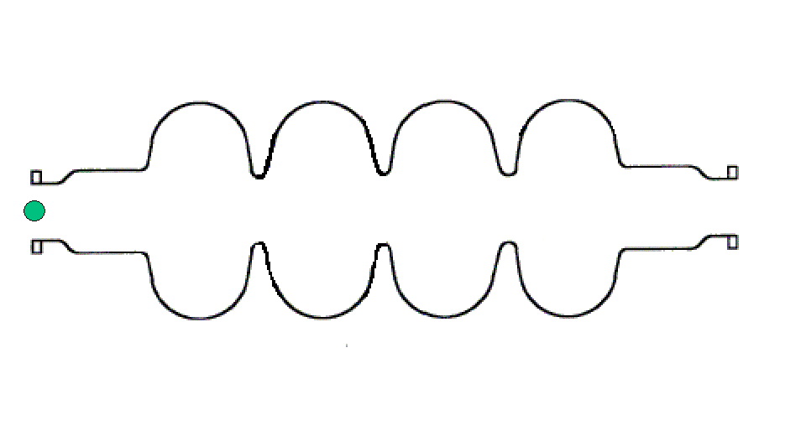
Superconducting Cavities
Proton case
q > 0, velocity v
L_{acc}=N_{cell} × L_{cell}
Energy gain :
or
E_{acc}: accelerating field of the cavity (for a given particle velocity)
L_{acc}: cavity accelerating length
ϕ : particule phase with respect to the RF wave
Ex : f = 700MHz ; 5-cell proton cavity β = 0,65 (L_{acc}=5×14cm); E_{acc}= 10MV/m ; ϕ = 0°
⇒ Energy gain : ΔU = 1eV × 10MV/m × 0,7m × 1 = 7 MeV

Slide 9
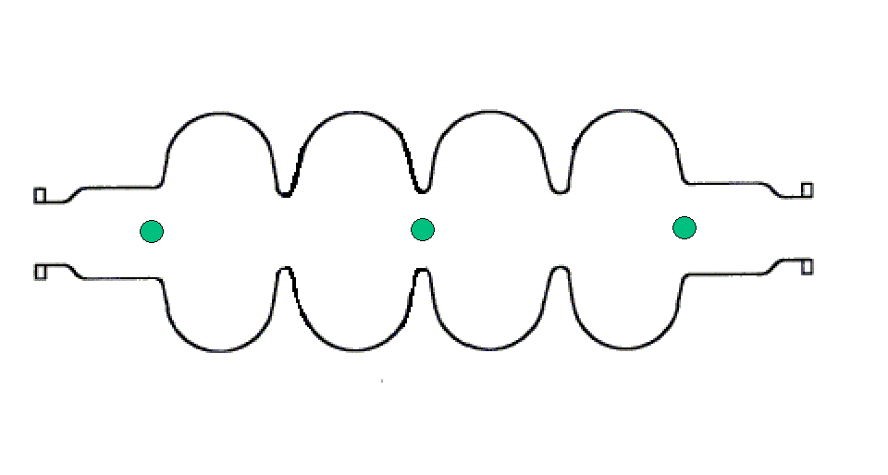
Superconducting Cavities
(3) Beam acceleration : particles should be bunched and synchronized with the electromagnetic wave
Proton case
q > 0
T_{beam} = n T_{RF} (n=1,2,3…)
« the cavity resonant frequency should be a multiple of the beam frequency that
it wants to accelerate»
Ex: if f_{beam}=350 MHz (T_{beam}=2,86ns), then the cavity should resonate at :
f = 350 MHz (T_{RF}=2,86ns), or f = 700 MHz (T_{RF}=1,43ns), or f = 1050 MHz (T_{RF}=0,95ns), etc.

Slide 10
Superconducting Cavities
RF power transmitted to the beam
P_{beam} = ΔU × I_{beam}
Dissipated RF power on
the cavity walls
P_{cavity} ∝ (E_{acc}L_{acc})² / Q₀
Q₀ : cavity « quality factor »
PRF
Pcavity
Total RF power to give to the cavity
P_{RF} = P_{beam} + P_{cavity}
Pbeam
Order of magnitude (700 MHz cavity - β = 0,65 - 5 cells- 10MV/m - ϕ=-30° - protons beam 10 mA)
SC cavity (Q₀ ∼ 10¹⁰) : P_{beam} = 6 MeV × 10 mA = 60 kW
P_{cavity} ≈ 16 W
"Warm" cavity (Q₀ ∼ 3.10⁴) : P_{beam} = 60 kW also
P_{cavity} ≈ 5,5 MW !!! ← not possible in CW !

Slide 11

Superconducting Cavities
Intrinsic advantage of cold cavities
Almost no losses on the cavity wall (thanks to superconductivity)
⇒ ∼100% of the injected RF power goes to the beam : very high efficiency !!!
Operating cost gain as compared to warm structures (which dissipate ∼10⁵ times higher)
Possibility to accelerate CW beams or beams with a high duty cycle (> 1 %) with high accelerating gradients (impossible with warm structures)
Possibility to relax the constraints on the cavity RF design: choosing larger beam port aperture is possible ⇒ reduction of the activation hazard = security gain
High potential for reliability and flexibility
Main drawback : need to be operated at cryogenic temperature

Slide 12
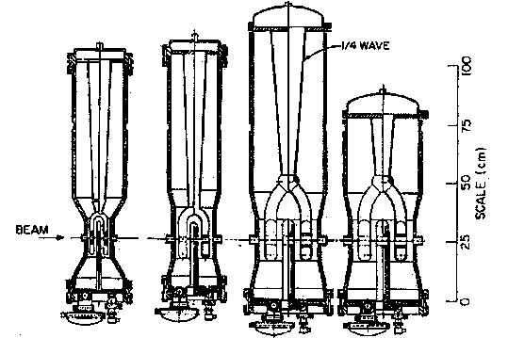
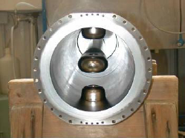
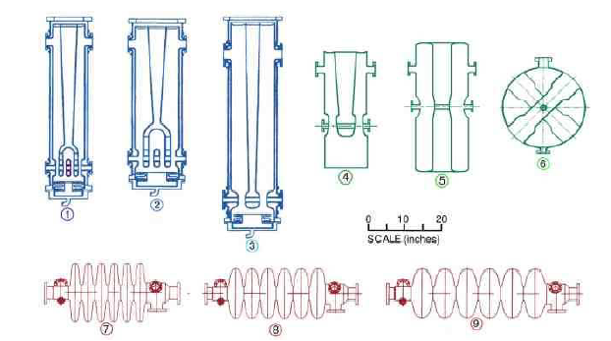
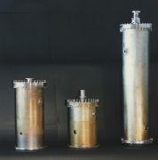
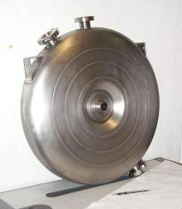
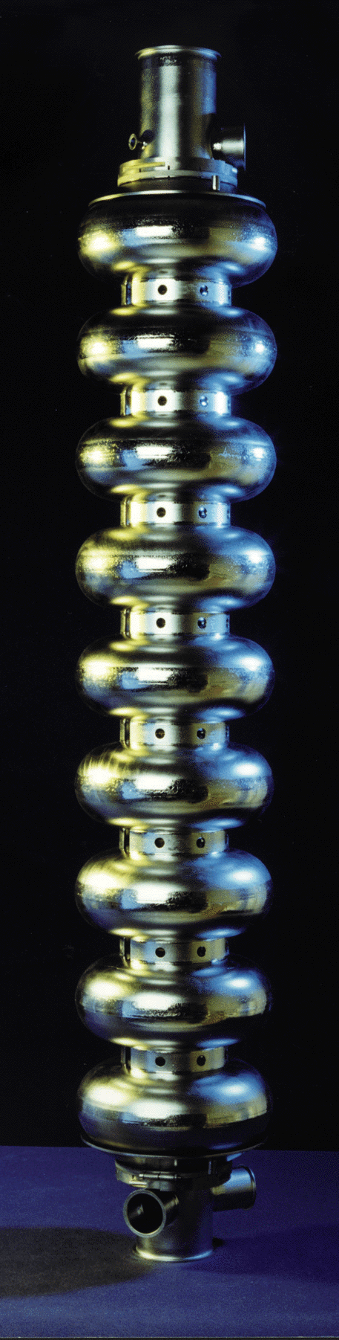
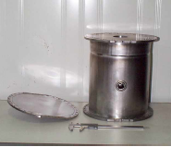
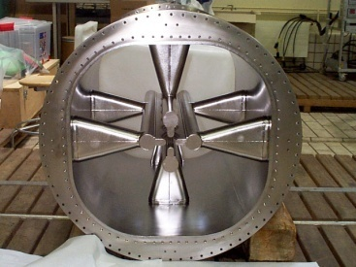
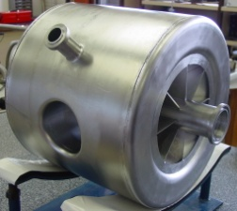
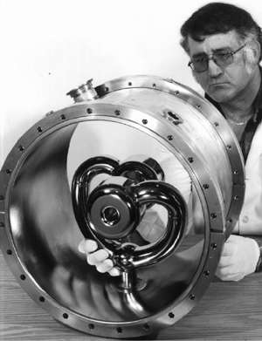
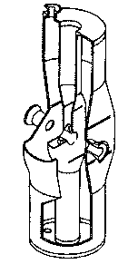
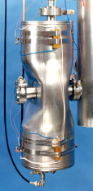
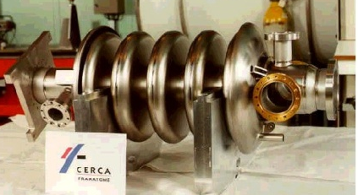
The Superconducting Cavities bestiary !
β= 0,01
β= 0,1
β= 1
Cavité ré-entrante (Legnaro)
352 MHz - β ≥ 0,1
Cavités elliptiques
350 MHz à 3 GHz - β = 0,47 à 1
Structures inter-digitales (ATLAS, Argonne)
48 et 72 MHz - β = 0,009 à 0,037
Résonateurs quart d’onde (ALPI, Legnaro)
80 à 352 MHz - β = 0,047 à 0,25
Cavité TTF
1,3 GHz - β = 1
RFQs supra (Legnaro)
80 MHz - β = 0,009 à 0,035
Cavités spoke (CNRS Orsay)
352 MHz - β = 0,15 et 0,35
Résonateurs split-ring (ATLAS, Argonne)
97 et 145 MHz - β = 0,06 à 0,16
Résonateur demi-onde (Argonne)
355 MHz - β = 0,12
Cavité APT (Los Alamos)
700 MHz - β = 0,64

Slide 13
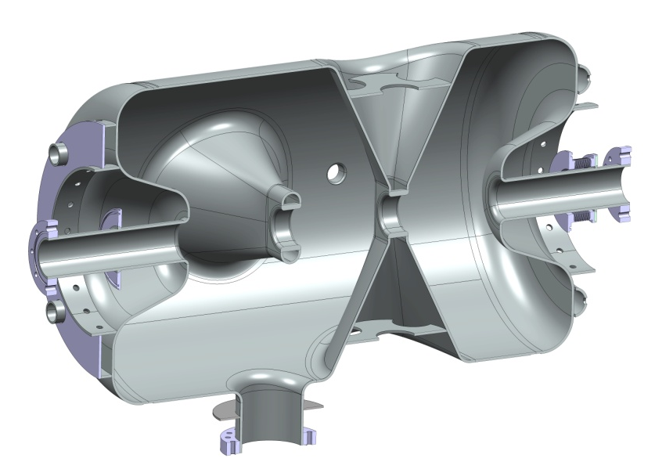
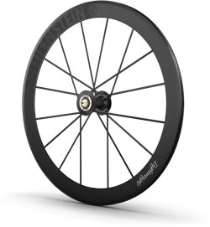
Superconducting Cavities
A spoke cavity is a superconducting RF cavity well adapted for (proton) particle acceleration between 50 MeV and 200 MeV
Has all advantages of any superconducting cavity
Is very stiff and less subjected to perturbations induced by vibrations
Can be multi-cell -> compactness
Has potential to reach high accelerating gradients
Name refers to spoke in bicycle wheels
ESS double spoke

Slide 14
How does a cryomodule works ?

Slide 15
Cryomodules
The main functions of a cryomodule
Give the cryogenic environment for the cold mass, i.e. the cavity and/or magnet (only cavity in the ESS case): perform the cryofluids distribution
  Helium (LHe) and/or Nitrogen (LN)
  Handle the liquid and vapor phase of the cryofluids
    Cavity operating temperature: 4K (atm. Pressure) or 2K (~30 mbar)
    Thermal shield could be actively cooled by cold He gaz or LN
    Power coupler might required an active cooling
Perform the thermal insulation against all heat transfer from room temperature to the cold mass:
  limit losses by conduction, convection or radiation
Supporting and positioning of the components:
  Structural support for the cold mass
  Precise alignment of the cavities with respect to the beam axis and keep the alignment over the thermal cycles
Provide magnetic shielding to the cavities

Slide 16
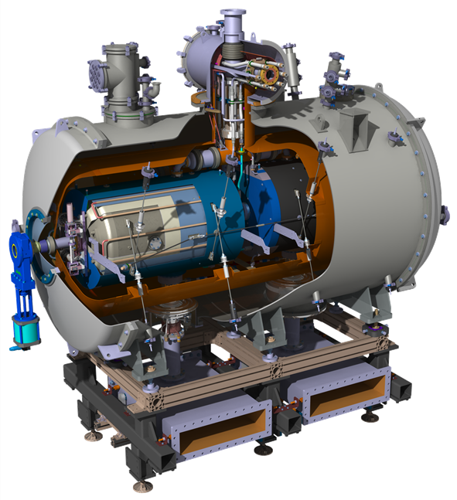
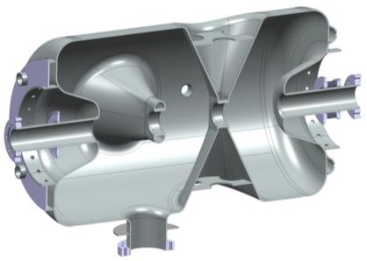
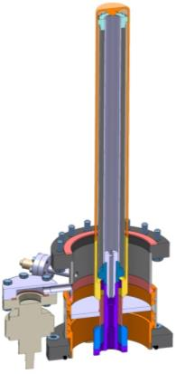
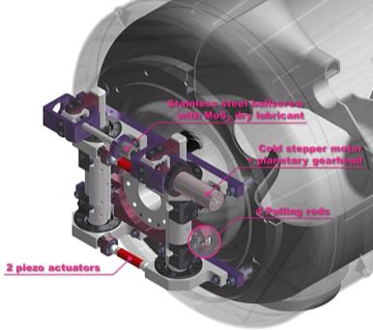
ESS spoke cryomodule: components to integrate
Double Spoke
SRF Cavities
Double spoke cavity (3-gaps), 352.2 MHz, β=0.50
Goal: Eacc = 9 MV/m [Bp= 62 mT ; Ep = 39 MV/m]
4.2 mm (nominal) Niobium thickness
Titanium Helium tank and stiffeners
Lorentz detuning coeff. : ~-5.5 Hz/(MV/m)²
Tuning sentivity Δf/Δz = 130 kHz/mm
Cold Tuning System
Slow tuning (stepper motor):
Max stroke: ~ 1.3 mm
Tuning range: ~ 170 kHz
Tuning resolution: 1.1 Hz
Fast tuning (piezo-actuator):
Applied voltage up to +/- 120V
Tuning range at 2K: 675 Hz (min)
Power Coupler
Ceramic disk, 100 mm diameter
400 kW peak power (335 kW nominal)
Antenna & window water cooling
Outer conductor cooled with SHe
Doorknob transition from coaxial
to ½ height WR2300 waveguide

Slide 17
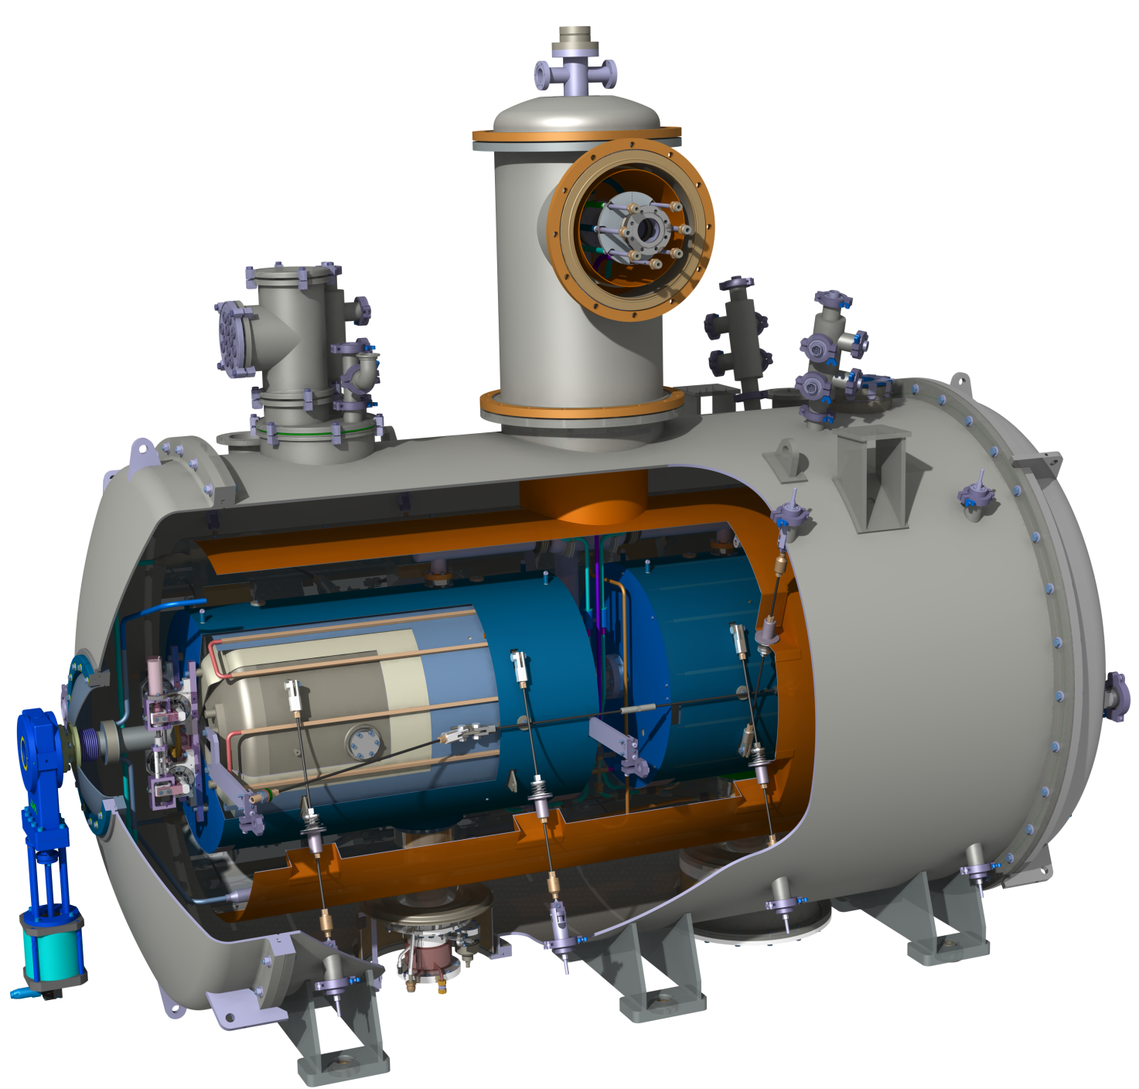
Main cryomodule components
Cold mass
(cavity, magnet)
Magnetic shielding
Thermal screen
Supporting system
Vacuum vessel
Components for Cryo distribution
(valves, tubing, heat exchanger)
ESS Spoke Cryomodule
Instrumentation (measurement of T,
P, cryo levels, vacuum)

Slide 18
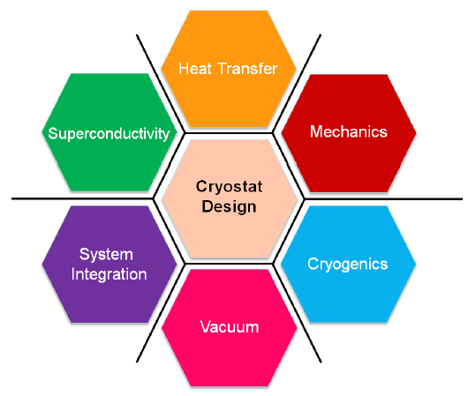
Constraints for cryomodule design

Slide 19
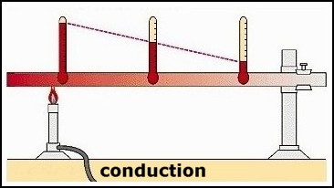
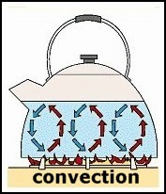

Constraints for cryomodule design
1. Limit as much as possible heat transfer
Cold mass (spoke cavities) needs to operate at 2K.
And 1 W dissipated @ 2K costs ~700 W of electrical power to maintain @ 2K !
-> optimization of running cost for the accelerator
The 3 heat transfer mechanisms:
Use of material exhibiting poor thermal conductivity
Use small sections for the interface rods
Use thermal intercepts
Operate in vacuum !
Use thermal shields at intermediate temperature
Use low emissivity materials
Use multi-layer insulation

Slide 20
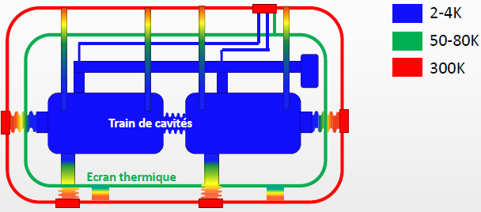
Constraints for cryomodule design
2. Mechanical constraints
Isolation vacuum:
The cryomodule external vessel has to sustain external pressure
Thermal gradients:
Thermal contractions induces mechanical constraints
Gravity: component mass
A fully equipped cavity can weight > 250 Kgs
They all have an impact on the alignment and component stability
Use material with low thermal contraction coefficient (ex: TiA6V, composite materials)
Use geometrical “tricks” to add flexibility (bellows, bended tubes,…)
Use of materials with high elastic limit to sustain the forces
Temperature map in the ESS spoke cryomodule

Slide 21
Constraints for cryomodule design
3. Assembly and maintenance constraints
The cavity string is prepared and sealed in a clean room
  Reduce as much as possible the amount of material inside clean room for improved contamination control
  Optimize the number of assembly operations inside the clean room
Design a cryomodule which can be “easily” assembled and maintained
    Optimize parts and components access
    During all assembly steps, maintain or control/monitor alignment
4. Cost constraint !
    Obvious: optimize the cryomodule component cost but also the required amount of manpower to assemble
    Also think about the cost of assembly tooling

Slide 22
ESS Spoke cryomodule status

Slide 23
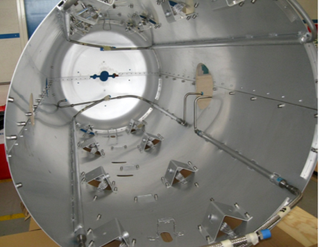
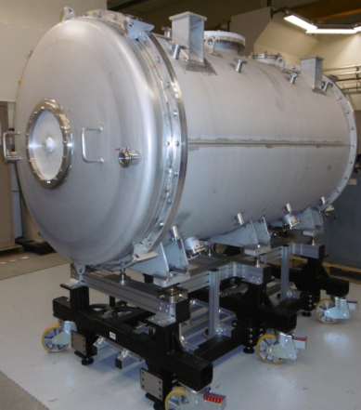
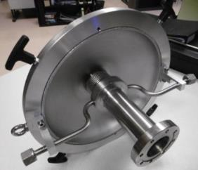
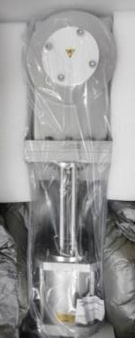
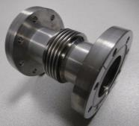
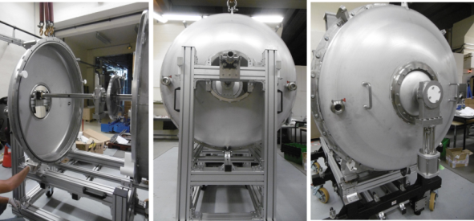
ESS spoke cryomodule status
Most of the parts are fabricated and delivered
Vacuum vessel & Mechanical support
Thermal shield
Gate valves
Cold/warm transition
First blank assembly of some parts
Inter-cavity belows

Slide 24
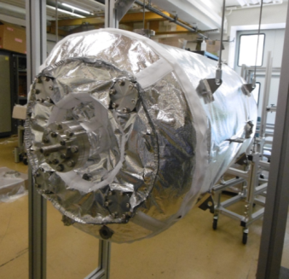
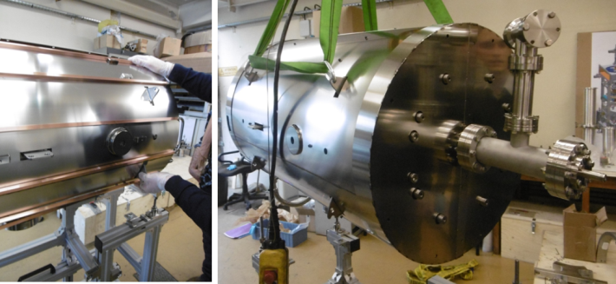
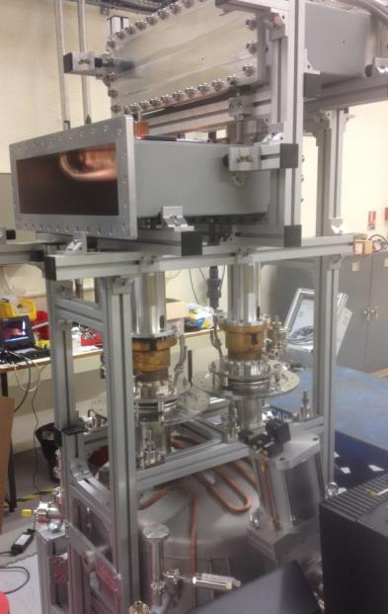
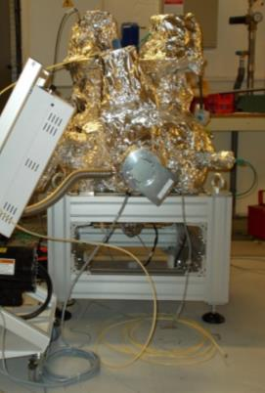
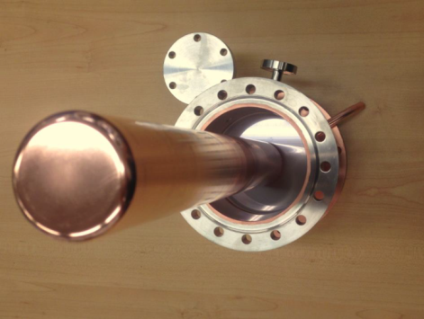
ESS spoke cryomodule status
Magnetic shield
(2-layer Cryophy, actively cooled)
MLI for the cavity
1/2 height
WR 2300
Coupler baking stand
Doorknob
Power coupler
window
Double-walled
tube
RF conditioning
Cavity with water cooling loop

Slide 25
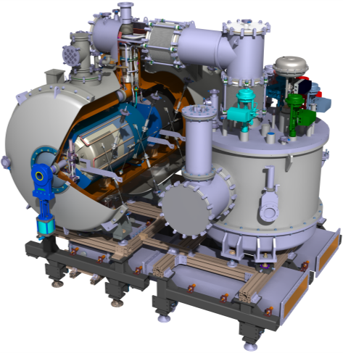
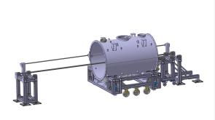
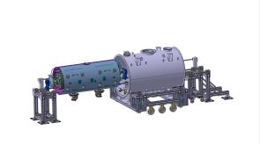
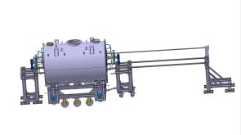
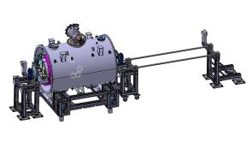
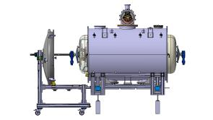
ESS spoke cryomodule status
Fabrications in progress
  Cryogenic circuits
  MLI for the thermal shield
  Valve box
Detailed studies in progress
  Tooling and assembly procedures

Slide 26
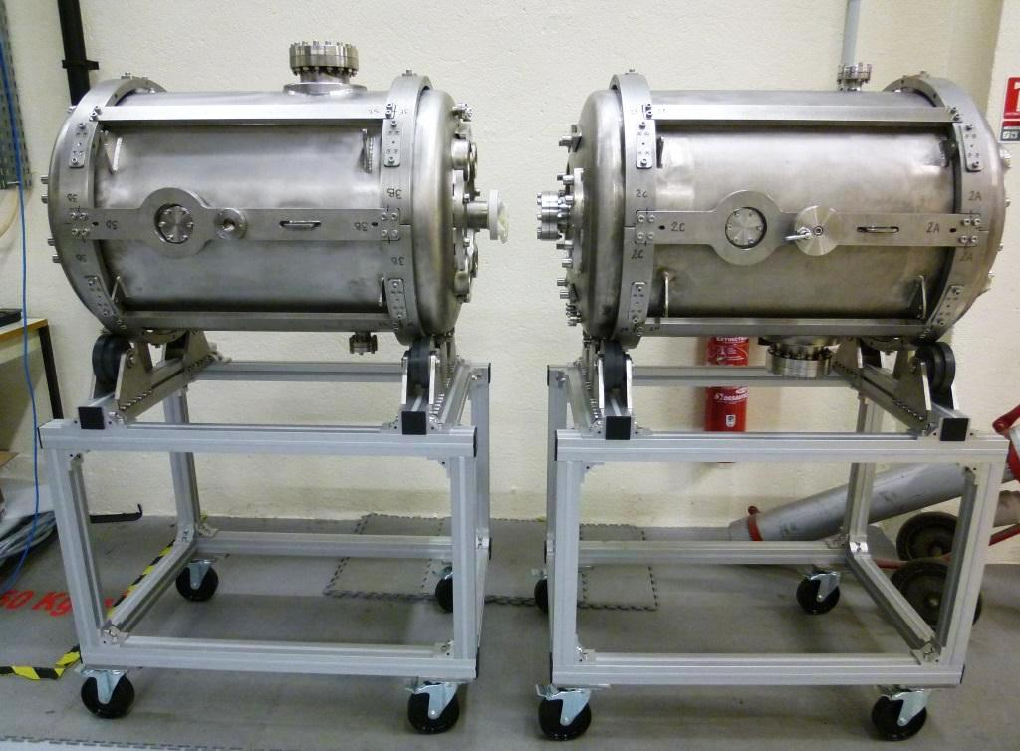
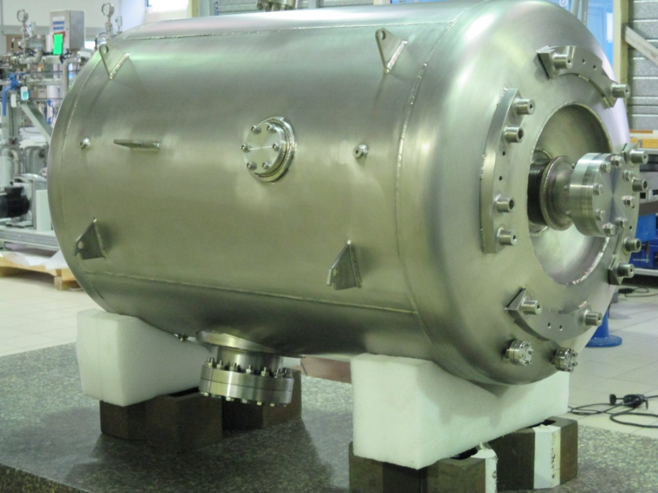
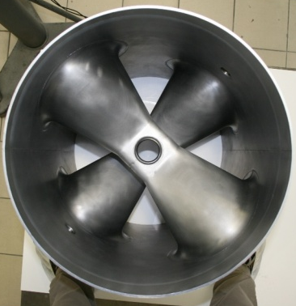
ESS spoke cryomodule status
The 3 ESS spoke prototypes
Romea
Giulietta
Germaine
View of the cavity inside: the spoke bars

Slide 27

ESS spoke cryomodule status

Slide 28
Next steps…
Prototype cryomodule test:
Conditioning of power couplers to start in end November -> first time the power coupler will be submitted to 400 kW !
Start of first assembly of the prototype cryomodule in January 2016
Cryogenic test at IPNO in february/march 2016
Full test at nominal RF power at Uppsala in Spring 2016
Series production:
Preparation of the IPNO infrastructure to handle the series production (preparation, assembly and test)
First “big market” to be released 2nd week of December for the procurement of the Niobium (4 tons !) and the 26 spoke cavities

