Slide 1
Accelerator Retreat
Mats Lindroos
Head of Accelerator
www.europeanspallationsource.se
November 2015

Slide 2
Accelerator overview
The ESS accelerator project is making progress according to plan.
26 In-kind partners have started detailed contract negotiations for >50% of the project value.
  Head of Agreement permits work to start at IK partners while contract negotiations are being completed
  Remaining possible in-kind consist of commercial procurement of components for the accelerator
The accelerator division has 61 staff members. An additional 10 engineers and 40 technicians is to be hired up to 2019 (plus 15 operators)
  The division has a management team, an integration group, an RF group, a specialized technical services group, a beam physics group and a beam instrumentation group
  The division has not organisational structure from 1st October
A major task for the division is to coordinate, integrate and install the accelerator which to a large part will be delivered as in-kind or by industry
There are technical developments e.g. RF tests, cryogenic design work, modulators, electronics and beam instrumentation design and other developments at the division
NC FE
Spoke
M-β
H-β

Slide 3
Accelerator Technical performances
Key parameters:
    -2.86 ms pulses
    -2 GeV
    -62.5 mA peak
    -14 Hz
    -Protons (H+)
    -Low losses
    -Minimize energy use
    -Flexible design for mitigation and future upgrades
Design Drivers:
High Average Beam Power
5 MW
High Peak Beam Power
125 MW
High Availability
> 95%
352.21 MHz
704.42 MHz
2.4 m
4.6 m
3.8 m
39 m
56 m
77 m
179 m
Target
Source
LEBT
RFQ
MEBT
DTL
Spokes
Medium β
High β
HEBT & Contingency
75 keV
3.6 MeV
90 MeV
216 MeV
571 MeV
2000 MeV
The scope contingency for the accelerator project consists of the RF sources and installation costs (after 2019) for the high beta-part of the linac
The fully equipped cryomdoule for the high-beta linac are IK contributions and are not part of the scope contingency. The infrastructures needed for the construction of these are only available during ESS construction.

Slide 4
High Level Master Schedule

Slide 5
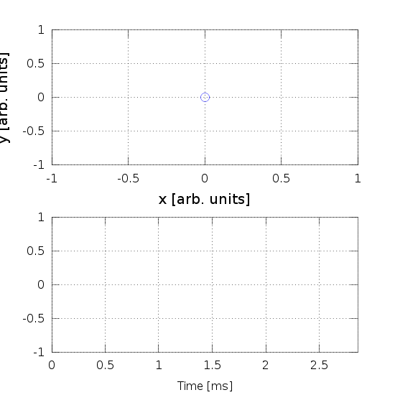
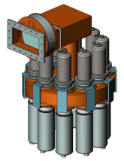
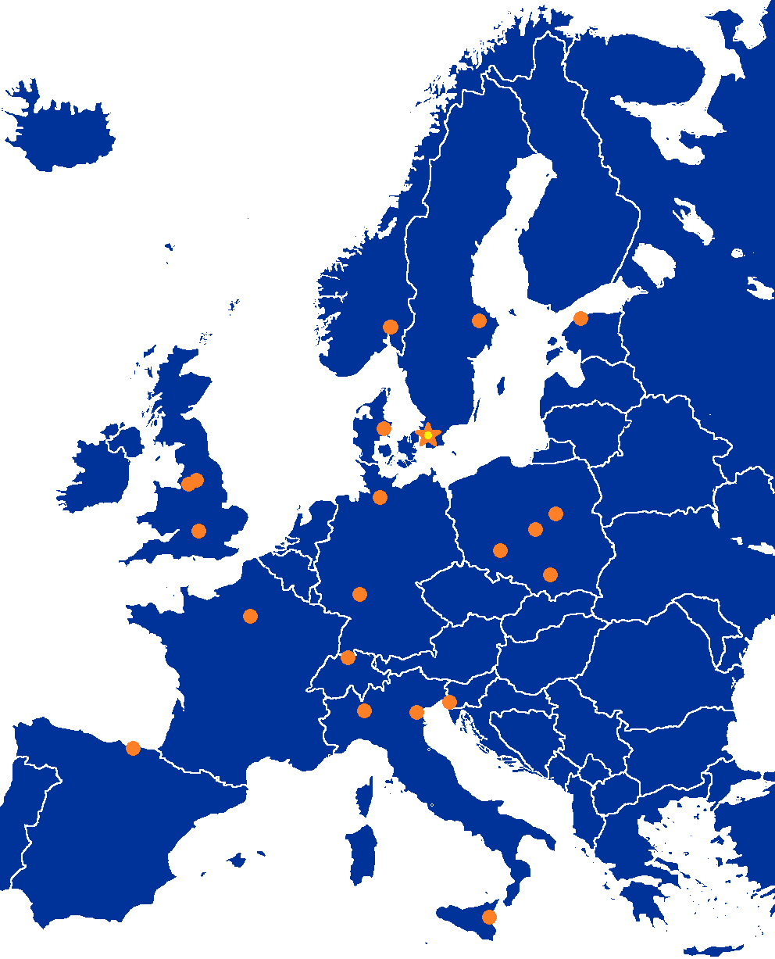
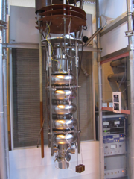
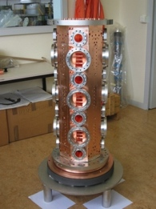
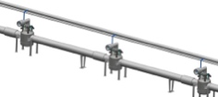
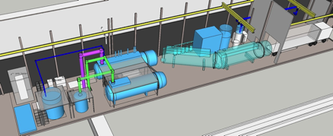
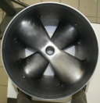
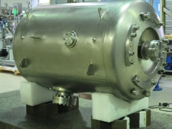
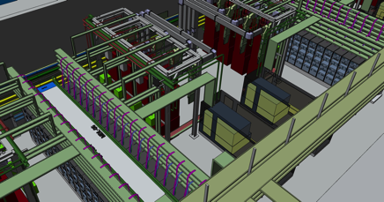
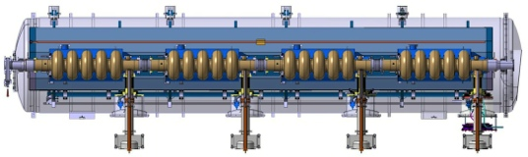
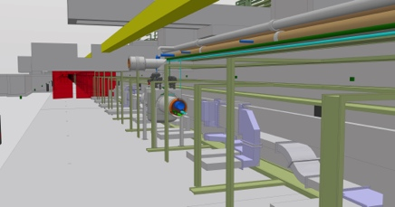
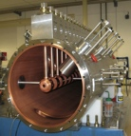
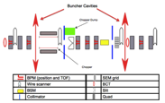
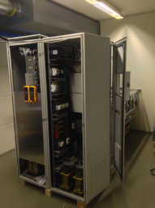
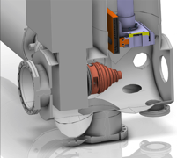
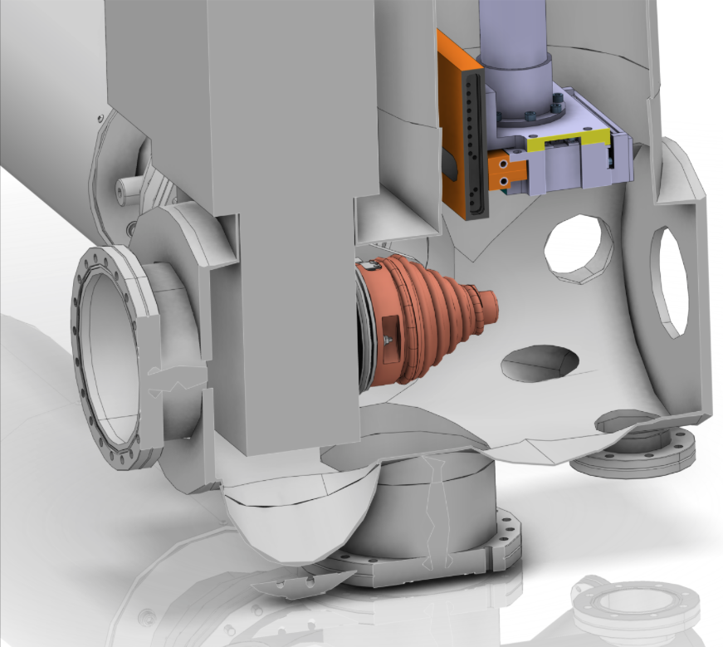
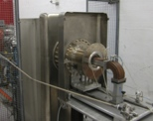
Accelerator Selected technologies
PARTNERS
ESS AD
Notes:
Explain in-kind and bilateral agreements for pre-construction phase which now are being transformed into in-kind contracts for construction

Slide 6
High level accomplishments in the last year
Organization of the project and the division at ESS
  Improved the structure of the division and project and strengthened the management of the project which includes project change control through ESS weekly meeting, Technical board and collaboration meetings
  Started the integration work at ESS
  Completed a first technical installation plan
  Planned and started technical reviews (QA/QC)
In-kind negotiations and activities:
  Prototypes for elliptical cavities and spoke cavities delivered and tested and exceeds requirements
  Design and delivery of the Ion source components in Catania and vacuum lab to ESS
  Progress on design and prototypes for parts of DTL (drift tube with PMQ) and MEBT
  Design and prototyping of many other systems such as Low Level RF, beam rastering system, medium beta elliptical cavities, warm sections, magnets with power supplies, RF sources for RFQ-DTL-Spoke sections…
  The FREIA test facility fully operational
Technical activities at AD in Lund:
  Design of RF systems
  Design and early prototyping of beam instrumentation
  Design of cryogenic systems
  Design of a 660 KVA modulator for ESS with prototyping started at ESS and LTH (LU)
  Electronics lab and modulator test lab operational. Integration test being prepared.
  Arrival and installation of vacuum lab equipment including a clean room from UK-Daresbury IK contribution
Large orders placed by ESS AD for the project:
  Placed two R&D contracts for MB IOTs and 3 contracts for klystrons prototypes for 704 MHz
  Order of a 330 KVA modulator in industry for ESS
  Order of the cryogenic plant for the accelerator

Slide 7
New AD: Groups and sections
Head of Accelerator
Admin and QA
BP, OP and BD
Andreas J
RF
Anders S
STS
John W
LINAC
Håkan D
Planning
Integration and coordination
David M
Safety
Lali T
BP
M.E.
BD
Vacant
Power
C.M.
RF sources
M.J.
Vacuum
P.L.
Cryo
P.A.
NCL
Vacant
SCL
S.M.

Slide 8
Accelerator Project organization
WP# | WP TITLE | WP LEADER | EXT. WP? | DEPUTY WP LEADERs FOR EXTERNAL WPs
WP01 | MANAGEMENT | J.G. WEISEND II | NO
WP02 | ACCELERATOR PHYSICS | M. ESHRAQI | NO
WP03 | NORMAL CONDUCTING FRONT END | S. GAMMINO | YES | W. WITTMER
WP04 | SPOKE CRYOMODULES | S. BOUSSON | YES | C. DARVE
WP05 | ELLIPTICAL CRYOMODULES | P. BOSLAND | YES | C. DARVE
WP06 | BEAM DELIVERY SYSTEMS | S. MØLLER | YES | I. ALONSO
WP07 | BEAM DIAGNOSTICS | A. JANSSON | NO
WP08 | RF SYSTEMS | A. SUNESSON | MIX | A. SUNESSON
WP99 | ACCEL INFRASTRUCTURE & INSTALLATION | D. MCGINNIS | NO
WP10 | TEST STANDS | W. HEES | MIX | W. HEES
WP11 | CRYOGENICS | P. ARNOLD | NO
WP12 | VACUUM | P. LADD | NO
WP13 | SAFETY | L. TCHELIDZE | NO
WP14 | ACCELERATOR INTEGRATION | S. MOLLOY | NO
WP15 | ELECTRICAL SUPPORT | F. JENSEN | NO
WP16 | COOLING SUPPORT | A. LUNDMARK | NO
WP17 | POWER CONVERTERS | C. MARTINS | NO
Collaboration Board:
ESS Technical Director
Project leader
Representatives of all contracted institutes (one elected as chair)
Quarterly Technical Board:
Weekly ESS management team
All WP leaders and deputies
Representatives of all contracted institutes if not already a WP leader
Weekly ESS management team:
Mats Lindroos, Project leader
John Weisend, Deputy project leader
David McGinnis, Chief engineer
Håkand Danared, In-kind manager
Lali Tchelidze, Safety including radiation safety
Anders Sunesson, RF systems
Luisella Lari, Head planner
Andreas Jansson, Beam instrumentation
Matthew Conlon, QA/QC

Slide 9
Accelerator Top Risks
The top 5 risks for ACCSYS are:
  Unidentified design faults cause failure during production
  Suppliers do not meet scope and schedule requirements
  In-kind contributors do not meet scope & schedule requirements
  Inability to deal with on-site adjustments to components
  Safety: Electrical machinery not powered down during maintenance
Treatment plans (including design reviews, close communication with IKCs and suppliers, development of onsite installation and adjustment capabilities) are underway. The last risk will be dealt with via a site wide Lock-Out-Tag-Out (LOTO) procedure.
ACCSYS is currently tracking 181 risks including many detailed technical ones

Slide 10
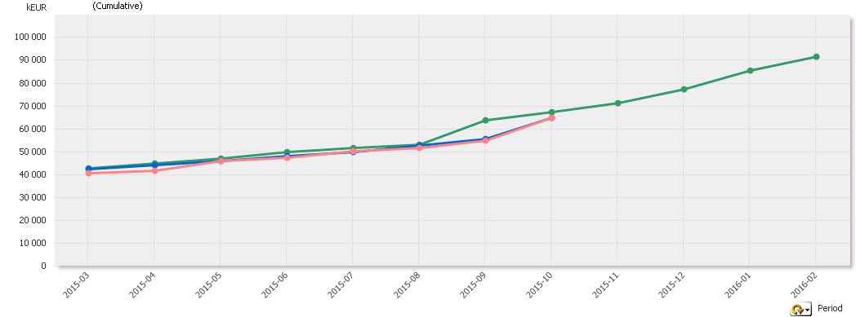
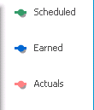
EVM Graph
September 2015
SV & CV include INK values
Current progress
Accelerator Project is Behind Schedule and almost on-budget.
However there is no impact on final delivery on-budget and on-time due to the present CV and SV values.
Notes:
Schedule variance = Earned – Schedule
Cost Variance = Actuals - Earned
SPI = Earned/Scheduled
CPI = Earned/Actuals

Slide 11
Accelerator Staff Plan

Slide 12
Staff 2016
Budget FTE’s for 2016 are forecasted by the work package managers and reflected in P6. There is no seconded staff foreseen in 2016.

Slide 13
Accelerator Budget Profile
Total budget: 504 M€

Slide 14
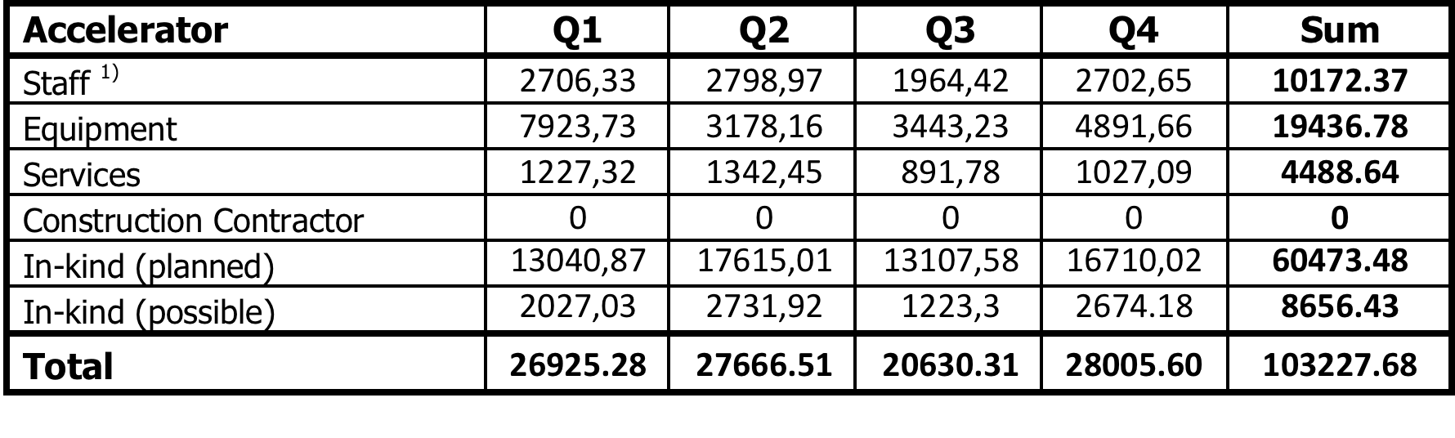
2016 budget
*
*
*
* NOT including the additional costs for racks and cable trays → on-going detail evaluation (not yet in P6)
* Including the Test & Instruments Cryoplant (“possible” in-kind) but will be ordered in November 2015
* Details in the next page.

Slide 15
A lot of change
We have managed a huge amount of work since the start of the construction project
  Some of us started already in 2009!
We have doubled in size twice since 2013
We are 30 nationalities in a division consisting of 85 staff members and consultants
  Different cultural backgrounds and different work training
  Sweden is a new experience for many of us (renewed experience for some of us!)
We just re-organized and are in the process of agreeing on group mandates

Slide 16
Some thoughts on working together and work environment
We can only achieve our common goals if we work well together and are happy to work together
We are not likely to be happy at work unless we all have a good balance between work time and free time
Open communication and transparent process builds confidence which is essential for any well functioning group
ESS has zero tolerance for any form of bullying or harassment
  Open and good communication is the best way to avoid unintentionally “hurt feelings”
  To apologize when things go wrong is important to re-build confidence
We can’t be made responsible for things we can’t influence e.g. a sub-contractors actual delivery date, a transport accident, an unexpected fault, …
We are only asked to do our best and be creative on finding better ways forward
Possibility for all through HR to get support and advice on work environment issues
The AD line and project management will work on identifying work environment issues and develop better processes to deal with these issues
We will not look for scapegoats but accept that things can go wrong and look for ways forward
We want:
  ESS to be a place at which people like to stay for a long time
  ESS to be a good and rewarding place to work

Slide 17
Accelerator Summary
You are doing a fantastic job!
The accelerator project is in a phase of intense prototyping and reviewing and will soon see most major systems in construction
  Large part of prototyping and design done by in-kind partners
  Essential to get in-kind contracts agreed and signed in 2015 to permit construction of all systems to start in earnest
  Development work and testing on the RF systems, modulators, beam instrumentation, cryogenic design and other systems done in Lund
Coordination, integration and verification represent a large part of the work done today by the accelerator division at ESS in Lund. Together with the on-going development work this represent a work burden worthy of a major accelerator laboratory
  We will continue to staff-up in 2016. Probably beyond present staff plan goals.
The goal is to build and train the accelerator division so that it can assume full responsibility for operation and maintenance of the accelerator systems in 2019

Slide 18
Reserve slides

Slide 19
Annual Review
Expedite as much as possible the formal design review process across ACCSYS: both the horizontal WP reviews and the vertical integrated system reviews. In addition, consider adding a safety and QA rep to the design review committee and tracking all actions post-review until completion. We endorse the established process of the so-called Vertical Reviews followed by Critical Design Reviews. Ultimately, the goal is to get all requirements for IK contributions established and TAs signed before the end of this year.
"Get your hands dirty!" -- the ESS/AD should start establishing some technical credibility and developing the technical workforce by getting their hands on relevant hardware systems as soon as possible. We endorse the so-called "Blinky Light Test", the rf test stand and the opportunity of early integration of the ion source, its control system and the beam diagnostics. Also, the Uppsala test stand should be used as an opportunity to train staff.
Add risk assessment and risk impact to the overall risk register. This will help focus on the high impact risks and also provide an assessment of the adequacy of the 50M€ scope contingency.
Add risks with positive impacts to the registry. For example, the new modulator topology under development may save costs. Another example is the proposed use of large-grain Niobium sheets for cavity fabrication.
Consider writing the Technical Addenda at a high level while referencing the ACCSYS DOORS requirements database.
Consider the following to optimize ACCSYS organization for executing a large science project
  Review the authority of the Work Package Leaders to ensure it is adequate to successfully execute their scope of work
  Employ centralized common project tools across ESS (Lund and in-kind partners) to minimize to the extent possible the institutional boundaries between ESS partners.
  Liberally use telecons to improve communication and coordination amongst all the ACCSYS institutional partners.
  Add a high-level ESH person to AD. The AD Head should be able to delegate some of his functions to this person. For example, procurements of hazardous materials, such as compressed gas cylinders. Also, this person would help AD Head to review and approve various AD activities, e.g. test facilities operations start.
Investigate options to improve the commissioning plan (and schedule) particularly as it applies to the low energy front end.
Review the ACCSYS spares policy and strategy. Some of the proposed spares may be spares needed for manufacturing, not for operations.
We think that they should completely separate the diagnostic and the interlock functions of the BLMs.
The hot cooling water should be seriously evaluated. It seems that this idea has many caveats, including risk for personnel accidents and shorter lifetime of expensive components, such as klystrons. We doubt that it is really environmentally friendly.

Slide 20
Accelerator Budget Profile

Slide 21
Accelerator Staff Plan at ESS

Slide 22
Accelerator Division 2015
Mats Lindroos
Head of Division
Håkan Danared – Deputy Head of Division
John Weisend II – Deputy Head of Acc Projects
David McGinnis – Chief Engineer
Lali Tchelidze – Safety
Steve Peggs (C)
BEAM PHYSICS
Håkan Danared – GL
Mohammad Eshraqi – Deputy GL
Renato De Prisco
Ryoichi Miyamoto
Marc Munoz
Christine Darve
Yngve Levinsen
SPECIALIZED TECHNICAL SERVICES
John Weisend II – GL
Wolfgang Hees - Deputy GL
Frithiof Jensen
Anton Lundmark
Evangelia Vaena
Matthew Conlon
Georg Hulla
Walter Wittmer
RF
Anders Sunesson – GL
Morten Jensen - Deputy GL
Rihua Zeng
Rafael Montano
Caroline Prabert - Personal Assistant
Gunilla Jacobsson - Divisional Planning A.
Solveig Aas - Team Assistant
BEAM INSTRUMENTATION
(Incl. Safety, 3p)
Andreas Jansson – GL
Thomas Shea - Deputy GL
Benjamin Cheymol
Irena Dolenc Kittelmann
Hooman Hassanzadegan
Lali Tchelidze
Cyrille Thomas
Hinko Kocevar
Maurizio Donna
Viatcheslav Grishin
Michal Jarosz (oPAC)
Charlotte Roose (oPAC)
Luigi Esposito
Duy Phan
INTEGRATION
David McGinnis - GL
Stephen Molloy – Deputy GL
Eugene Tanke
Nikolaos Gazis
CRYOGENICS SECTION
Philipp Arnold – SL
Xilong Wang
Jaroslaw Fydrych
John Jurns
Xiaotao Su (50%)
Ali Farsian
VACUUM SECTION
Peter Ladd – SL
Marcelo Juni Ferreira
Hilko Spoelstra
Giobatta Lanfranco
RF SOURCES SECTION
Morten Jensen – SL
Chiara Marrelli
Rutambhara Yogi
Stevo Calic
POWER CONVERTERS SECTION
Carlos de Almeida Martins – SL
Göran Göransson
ENGINEERING SECTION
Stephen Molloy – SL
Aurélien Ponton
Enric Bargalló
Edgar Sargsyan
Inigo Alonso
58 employees (2015-04-01)
New staff during 2015 in orange
3010
3010
3014
3015
3013
3012
3142
3151
3011
3121
3122
3141

Slide 23
High level 2016 Milestones
Klystron MS will be added → a major re-plan for the 3 contracts wereput in –place recently.
.
ID | Name | Planned Date | Current Forecast or Actual | Float (W.Days)
A52000 | LEVEL4.ACCSYS.WP03.Start of RFQ Machining.WP00 | 9 Feb 16 | 9 Feb 16 | 0
A47890 | LEVEL5.ACCSYS.WP10.Lund Test Stand 2 – Design complete | 29 Feb 16 | 29 Feb 16 | 0
A23060 | LEVEL5.ACCSYS.WP11.Target Cryoplant – order placed | 31 Mar 16 | 31 Mar 16 | 0
A20144120 | LEVEL5.ACCSYS.WP04.Successful test of a cavity + coupler in (HNOSS) | 1 Apr 16 | 1 Apr 16 | 0
A20860 | LEVEL4.ACCSYS.WP05. Completion of the M-ECCTD Assembly.WP08 | 17 May 16 | 17 May 16 | 0
A20410 | LEVEL4.ACCSYS.WP04.Spoke CM prototype available for Uppsala Test stand (Freia).WP10 | 24 May 16 | 24 May 16 | 0
A145610 | LEVEL5.ACCSYS.WP11.Prototype Spoke valve box design validated | 1 Jul 16 | 1 Jul 16 | 0
A46550 | LEVEL5.ACCSYS.WP05. Completion of the M-ECCTD Test in the CEA Test Station | 16 Sept 16 | 16 Sept 16 | 0
A52900 | LEVEL5.ACCSYS.WP08.L3 Contract delivery and SAT for IOT (intermediate delivery MS) | 30 Sept 16 | 30 Sept 16 | 0
A52960 | LEVEL5.ACCSYS.WP08.CPI/Thales Contract delivery and SAT (intermediate delivery MS) | 30 Sept 16 | 30 Sept 16 | 0
A20146390 | LEVEL2.2G.ACCSYS.WP08.RFI Spoke High Power Amplifier – 1 unit | 1 Nov 16 | 1 Nov 16 | 0
A47900 | LEVEL5.ACCSYS.WP10.Lund Test Stand 2 – Installation starts | 2 Nov 16 | 2 Nov 16 | 0
A20470 | LEVEL5.ACCSYS.WP10.Prototype Spoke CM report | 17 Nov 16 | 17 Nov 16 | 0
A48120 | LEVEL5.ACCSYS.WP04.Spoke CM tested | 17 Nov 16 | 17 Nov 16 | 0
A52060 | LEVEL5.ACCSYS.WP05.MB Cavity production launched | 8 Dec 16 | 8 Dec 16 | 0
A20141060 | LEVEL2.2G.ACCSYS.WP04.Spoke & MB CM production launched | 8 Dec 16 | 8 Dec 16 | 0
A20143830 | LEVEL4.ACCSYS.WP03.Start of MEBT production.WP00 | 14 Dec 16 | 14 Dec 16 | 0
A50070 | LEVEL2.2G.ACCSYS.WP08.CPI/Thales IOT prototype delivery to CERN | 20 Dec 16 | 20 Dec 16 | 0

