Slide 1
Isolator performance - a Magic or a Expected Performance ?
Rutambhara Yogi
www.europeanspallationsource.se
12 November 2015

Slide 2
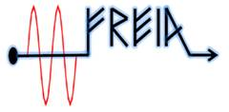
Many thanks to
Suppliers:
Colleagues:
ESS: David McGinnis, Anders Sunnesson, Morten Jensen, A. Johansson
Carlos Martins, Rihua Zeng, Rafael Montano, Chiara Marrelli,
Stevo Calic, Bruno Lagoguez, Staffan Ekström, Daniel Lundgreen, Carl Johan Hardh
FREIA: Rolf Wedberg, Lars Hermansson, Roger Ruber, Magnus Jobs & other colleagues
CERN: Eric Montesinos, Olivier Bruner
SNS: Crofford Mark

Slide 3
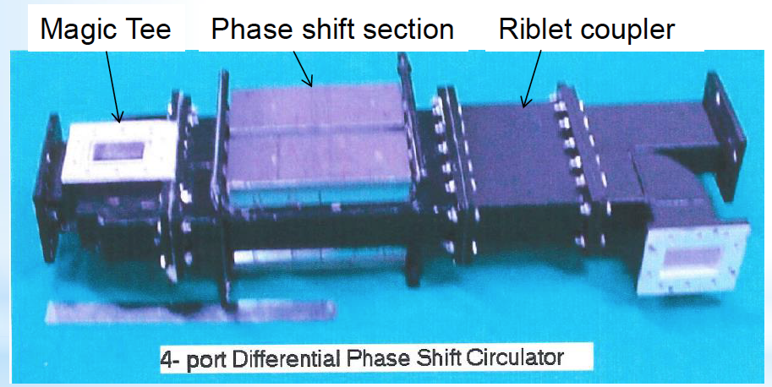
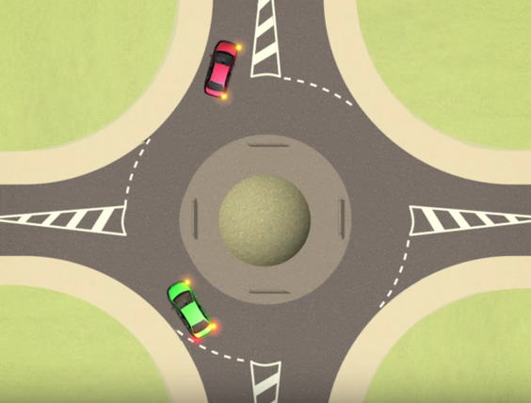
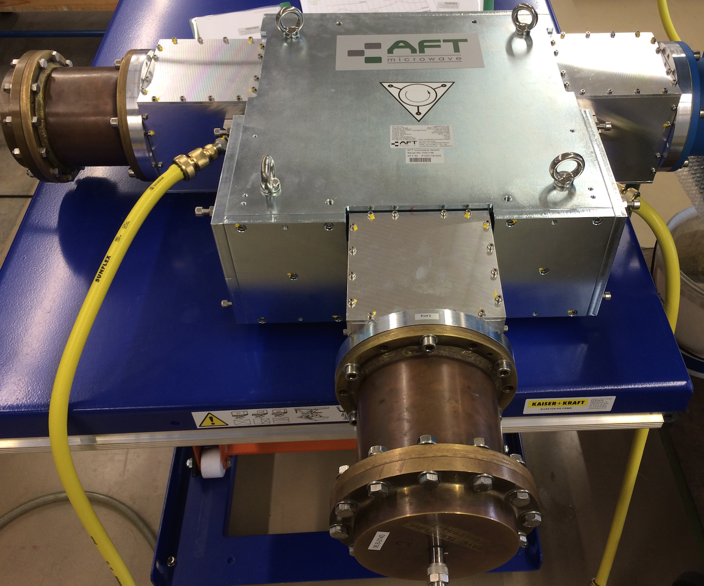
Circulator
Ideal Circulator: Like a round about
2.856 GHz
P = 6 MWp
Pavg = 25 kW
Indigenous development done in SAMEER (India) in 1999 using OFHC plates. Design, brazing, plating etc was performed in house. Installed on medical linac.
Can have either 3 ports or 4 ports
Can use coaxial line / waveguide
Direction – clockwise / anti-clockwise
352 MHz
P = 400 kWp
Pavg = 20 kW
Technology demonstrator
for ESS spoke linac (without
Pressurization)
Notes:
After lot of technical negotiations this unpressurized circulator in 6 inch coax was developed.

Slide 4
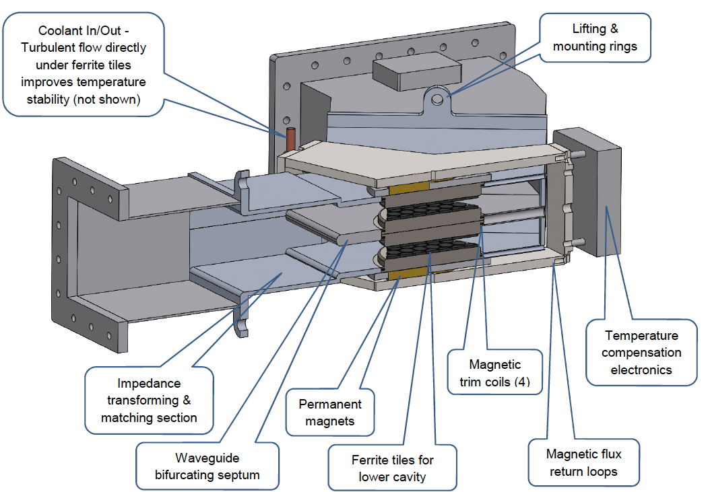
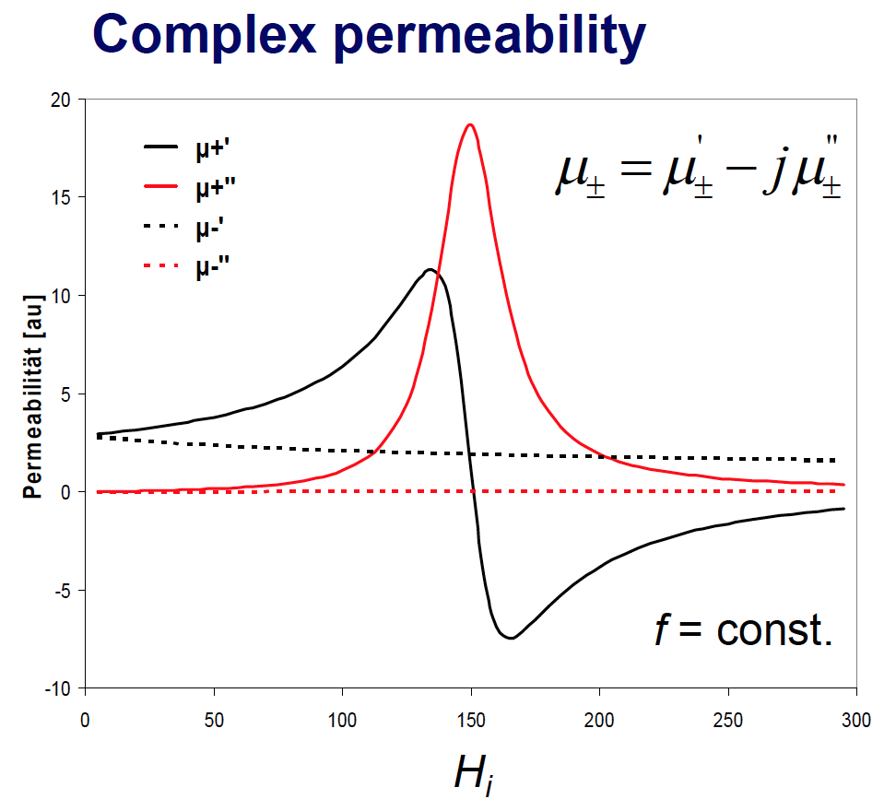
Construction of 3-port Circulator
Ferrite:

Slide 5
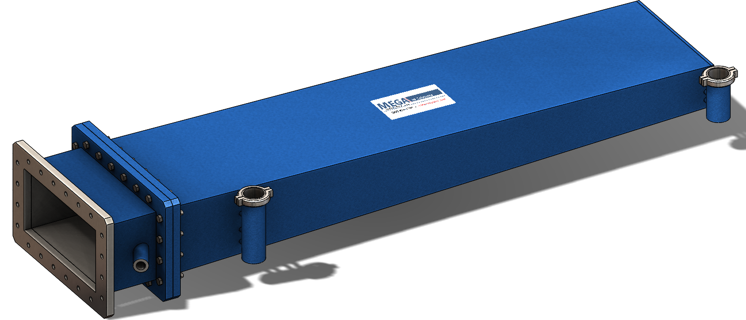
Ideal & Practical Isolator
Ideal: Infinite Isolation
Practical: Finite Isolation
2
Isolation = - 30 dB
1/1000 of
power
1
A
Isolator
3
Load
A
Input power = 400 kW
400 W will travel back
Load – Dissipate RF power from amplifier
Amplifier is completely isolated from
unwanted reflections
dB – logarithmic unit
dB = 10 log(P2/P1)

Slide 6
Practical Isolator: Is it True ?
According to specifications that we write in SoW
Isolation = - 30 dB
400 kW
400 W
Full reflection from cavity
A
1
2
Cavity
S11 = - 30 dB
400 W
3
4 W
?
4 kW
Is reflected power
804 W ?
Load
Load return loss = - 20 dB
Load Cost
α
Offered return loss
Shouldn’t care about load return loss ??

Slide 7
Worst case Reflected Power
P = V² / Zo
V_{T} = V_{i} + V_{R}
For 100% reflection, when arcing occurs or during cavity filling
where V_{i} and V_{R} add in phase, V_{T} = 2 V_{i}
P_{T} = (V_{T}²/ Z_{o}) = (2 Vi)²/ Z_{o} = 4 P_{i}
& not 2 Pi
Notes:
Circulator tender
Interetesting to think about coupler conditioning

Slide 8
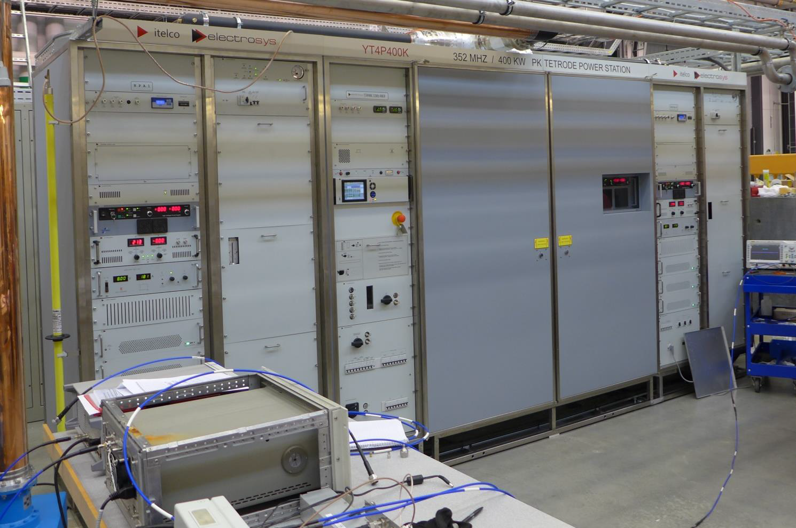
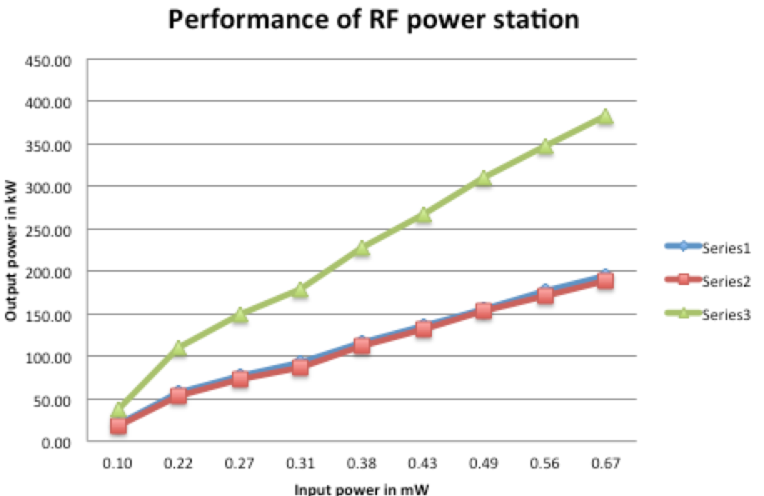
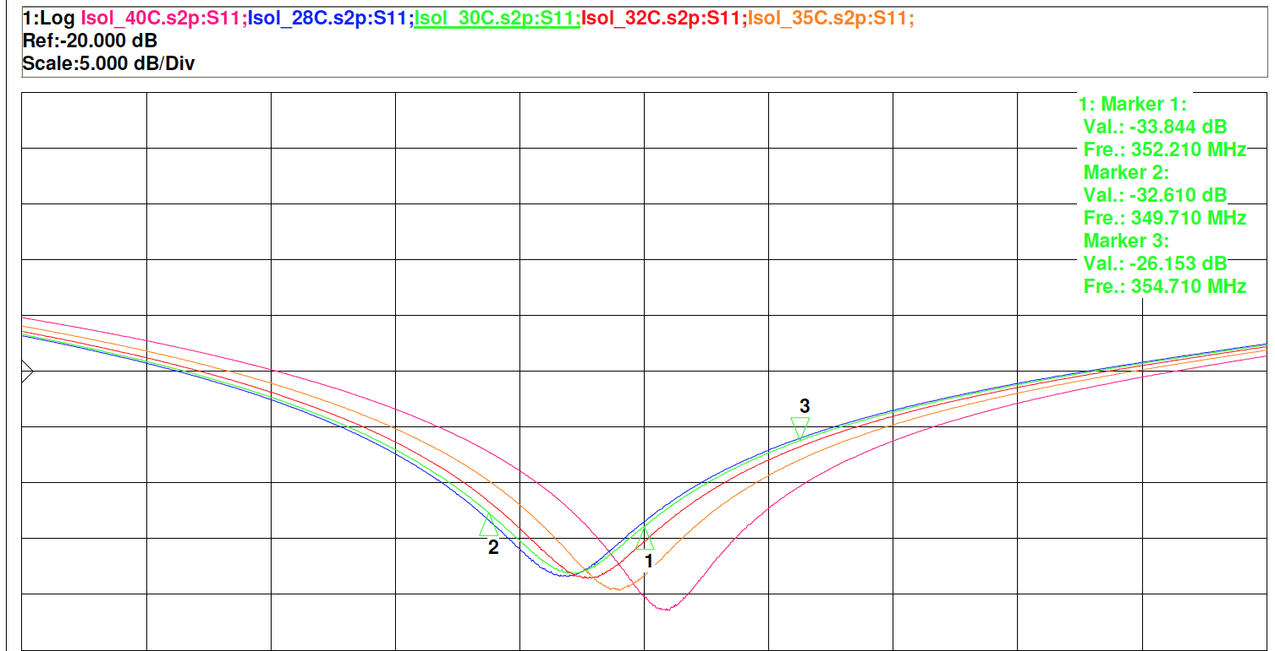
Factory Acceptance Testing
Amplifier
Isolator = Circulator + Load
Don’t have circulator,
Don’t have high power RF source. Simulation of high power test using low power.
Tin – 2 C
Tin
Tin + 2 C
Pin = 400 kW,
Pavg ≈ 20kW
Tin + 10 C
For circulator : ΔT = 2 C
For load : ΔT = 10 C
Always tested with a very good load
Load return loss > 32 dB
Return loss > 30 dB
Tetrode 1
Tetrode 2
Total power
Courtesy: Magnus Jobs at FREIA

Slide 9
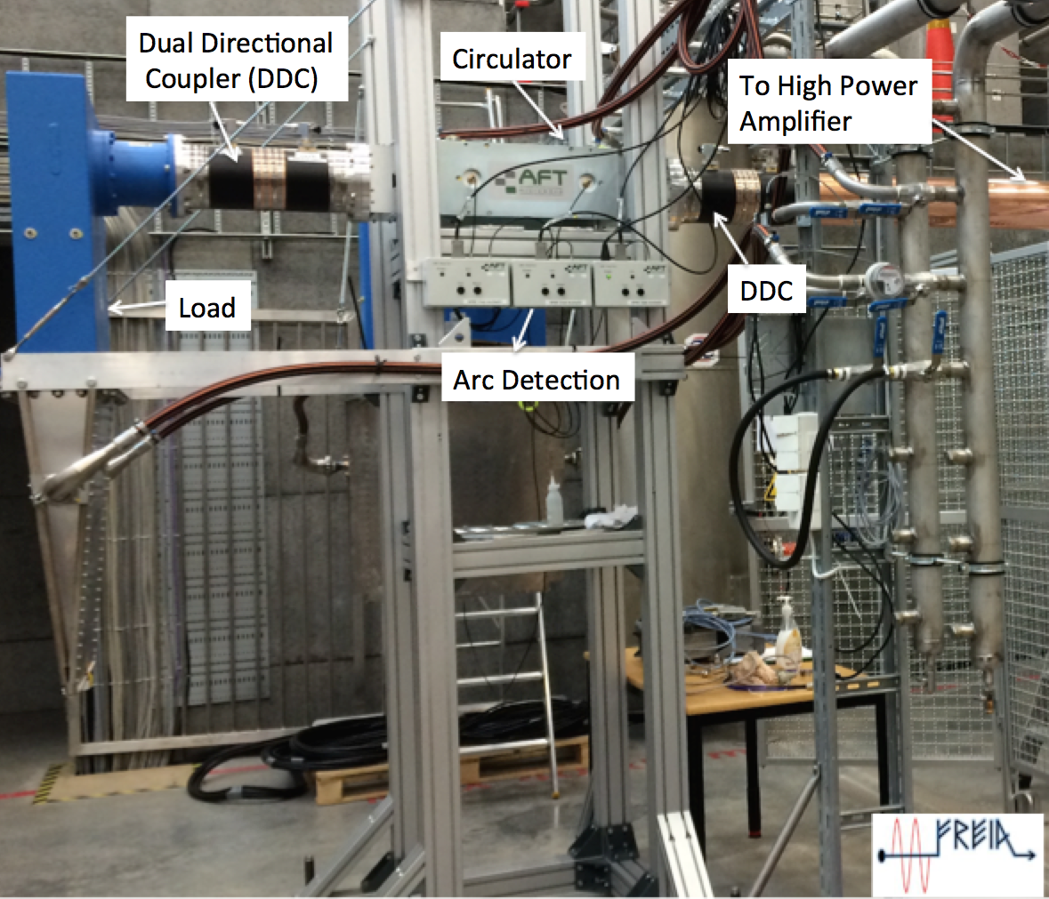
High power Test
TH595 based RF Power Station

Slide 10
Problem faced at high power
Tests on Matched load:
No problem.
Return loss was poor (about 25 dB)
Tests with variable short: Difficult test
A
1
2
Load
3
Load
Every time the Amplifier was tripping
due to high reflected power.
Trip level was set at 20 dB
Return loss of Isolator:
poor than 20 dB why ??
Difference of a factor of 10 !
A
1
2
Reflective short
to simulate worst
cavity behavior
3
Load
MAGIC ??
At some locations,
V_{T} = 2 V_{i} (depending on phase)

Slide 11
High Power Model of Isolator
(V1)
P1
Finite Isolation
A
(V2)
P2
(V3)
P3
Finite load
Return loss
Load
VT = V1 + V2 +V3
A small program is written for effective return loss calculation
(Ref: ESS-0043091)

Slide 12
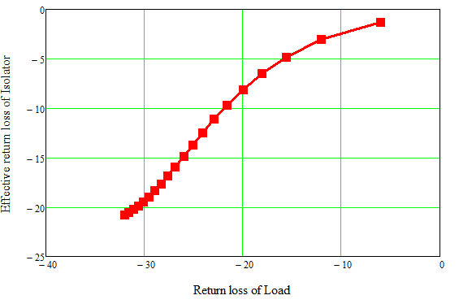
Variation of Effective return loss of Isolator with return loss of load
RF Parameters of circulator
in SoW used for simulation:
S11= 30 dB
S12 = 26 dB
S21 = 0.5 dB
NO higher order harmonics
Amplifier
Specification
We should care about load
return loss.
We need a GOOD LOAD:
Good return loss

Slide 13
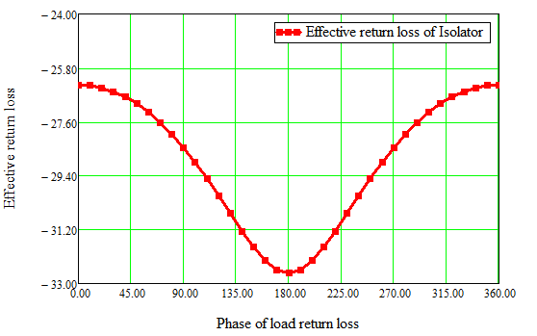
Variation of Effective return loss of Isolator with Phase of load return loss
Circulator tests at low power
S11 = 36 dB
S12 = 34 dB
S21= 0.05 dB
Load tests at low power:
S11 = 38 dB
Explains poor return loss seen
experimentally– Expected
performance
Assumptions:
Amplifier is perfectly matched.
Uncertainties in S-parameter
measurement not considered
GOOD Load:
Phase of return loss: stable

Slide 14
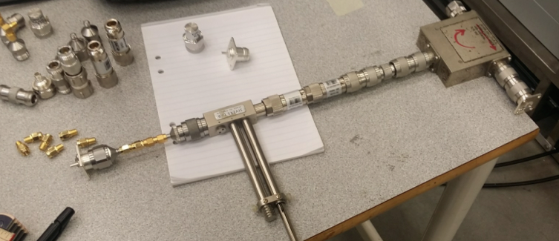
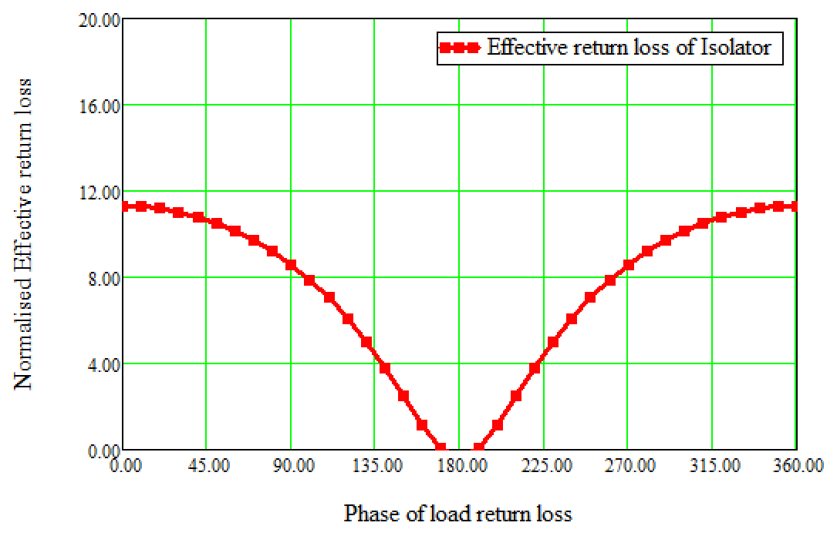
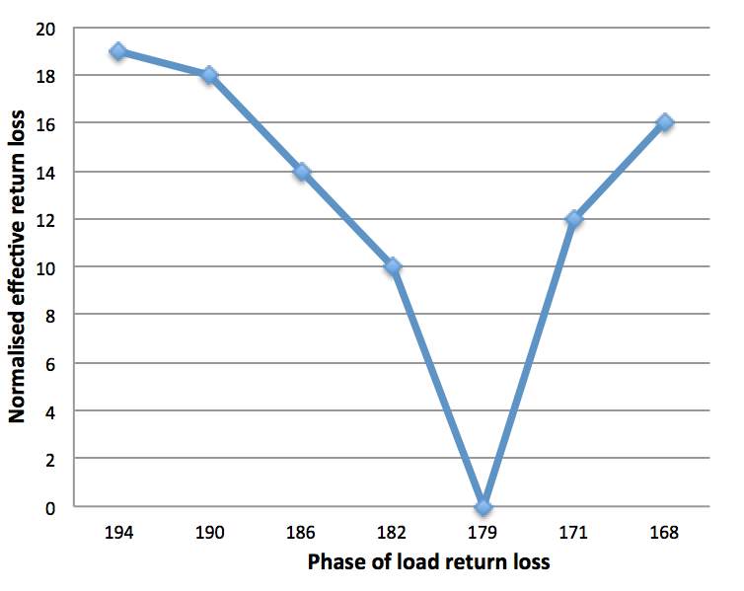
Testing of concept
Towards VNA
Load with phase of return loss
variation
Short
Experiment
Trend of both the curves is same
Good return loss when phase of load return loss
is 180 º
Further experimentation is planned with high
Circulator and load in FREIA.
Courtesy: Magnus Jobs at FREIA

Slide 15
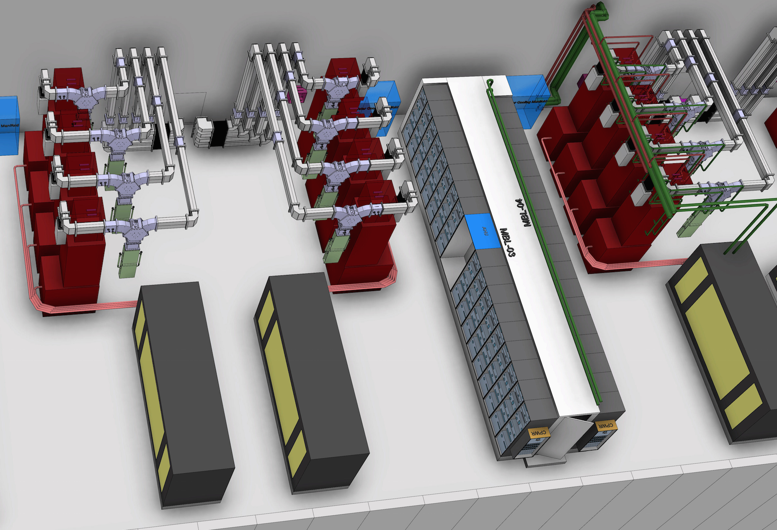
Additional Usefulness for ESS ?
Gallery layout for HB/MB
Need to install a huge
number of Systems: 155
Commissioning becomes
efficient.
Easily good
Performance can be
achieved
By adjusting phase of load return loss 180 ± X,
Adjust distance between load and circulator accordingly
Load
Circulator

Slide 16
Thank you !

