Slide 1
CERN Mechanical Measurement Laboratory
O.Sacristán

Slide 2
Outline
MML overview
Activities examples
SPL Cavities
HRMT 23

Slide 3
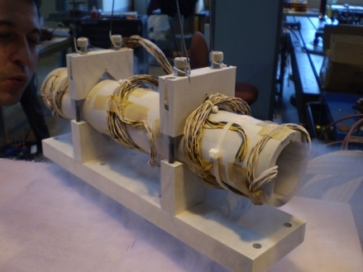
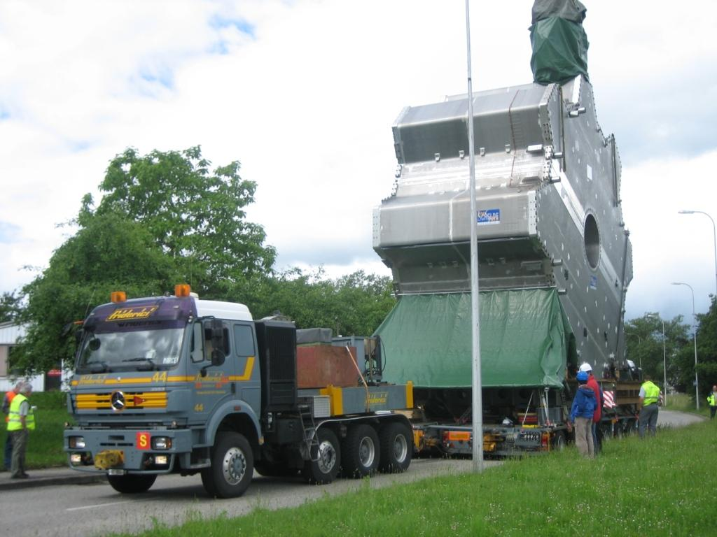
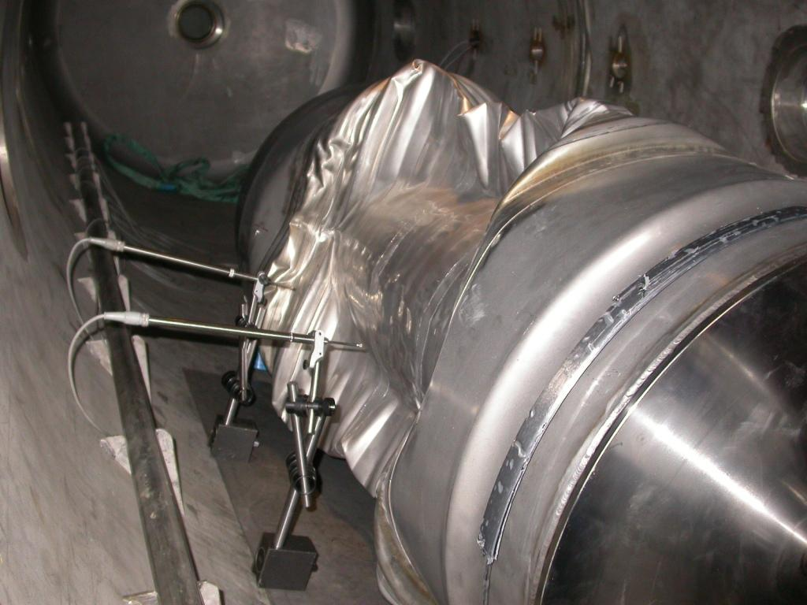
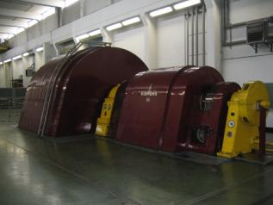
Mechanical Measurements at CERN
Input for design or simulations
Propose or validate a theory
Maintenance and safety
Why to perform mechanical measurements ?

Slide 4
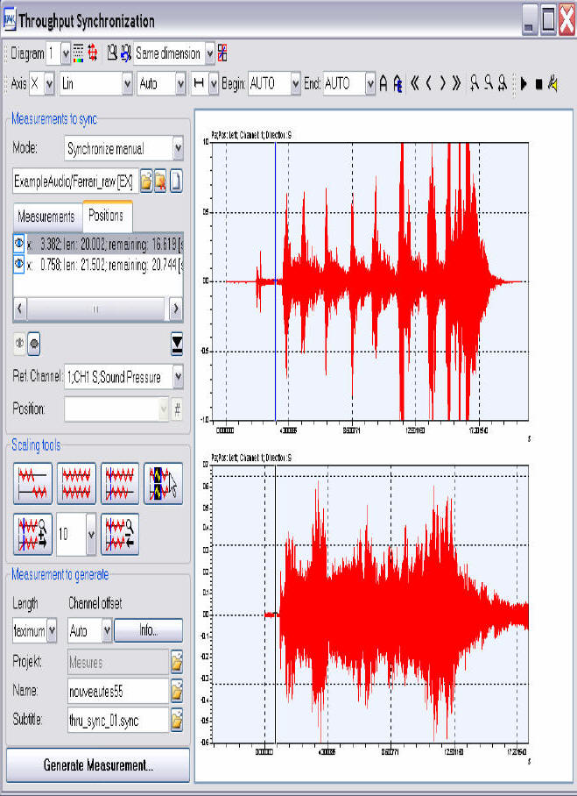
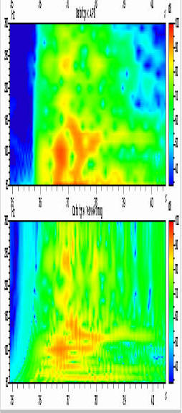
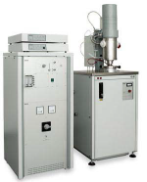
Equipment
Force and displacement transducers
Optical Vibrometers
Vibration Sensors
Optical / Electric Strain Gages
Temperature Sensors
Force
Stress
Strain
Displacement
Vibrations
Temperature
etc
Calibration Tools
Thermophysical analysis devices
Static & Dynamic acquisition system
Conductivity
Difussivity
Specific Heat
CTE
FROM RT TO 2000 ºC
Post-Processing and Analysis Tools

Slide 5
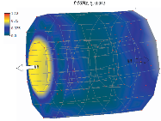
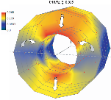
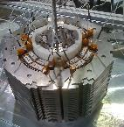
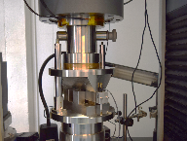
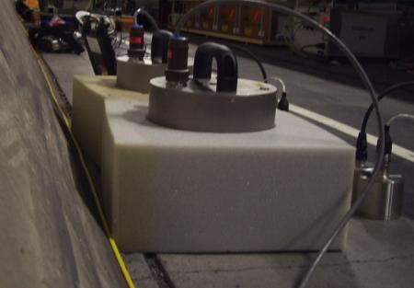
Activities
Experimental modal analysis
Mechanical instrumentation and testing
Ground motion and vibration measurements
Thermophysical analysis

Slide 6
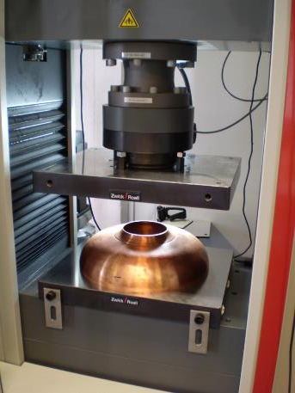
SPL Cavities – Mechanical tests
Half-Cell Compression Tests
Determination of the mechanical properties of the system
Rigidity determination
Plastification

Slide 7
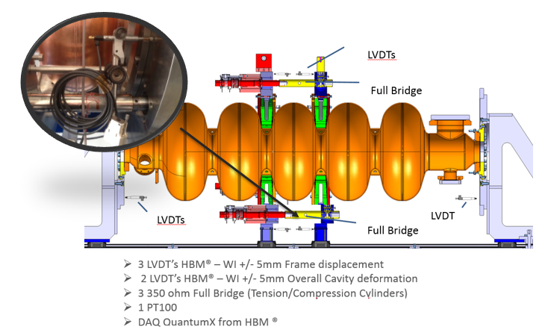
SPL Cavities – Mechanical tests
Instrumentation of a tuning machine
Determination of the forces and displacements imposed to the cavity
Deepen knowledge of mechanical vs RF properties

Slide 8
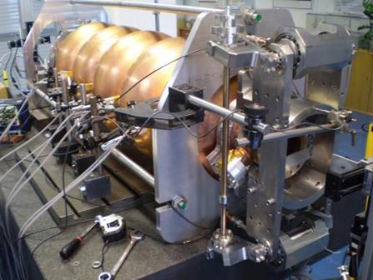
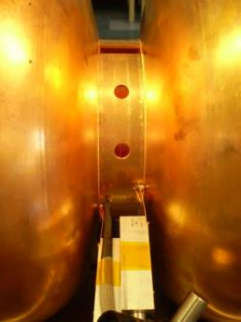
SPL Cavities – Mechanical tests
Validation of tuner
Determination of the forces and displacements imposed to the cavity
Correlation of mechanical to RF properties
Notes:
After the cavities have been tuned at warm, they will be put in service at cold, and then it will “detune” by the effect of the temperature, and then it comes the need of an “in-situ” tuning.
And this is what tuners are for, they are devices that allows to adapt the RF behavoiur of the cavities whenever they are in service at cryogenic temperatures, according to the needs of the operation of the accelerator by applying forces that deform the cavities.
Then, our job was to characterize the forces exerted over the cavity as well as deformations imposed by the tuner in order to allow the correlation of this data to the RF properties of the system.

Slide 9
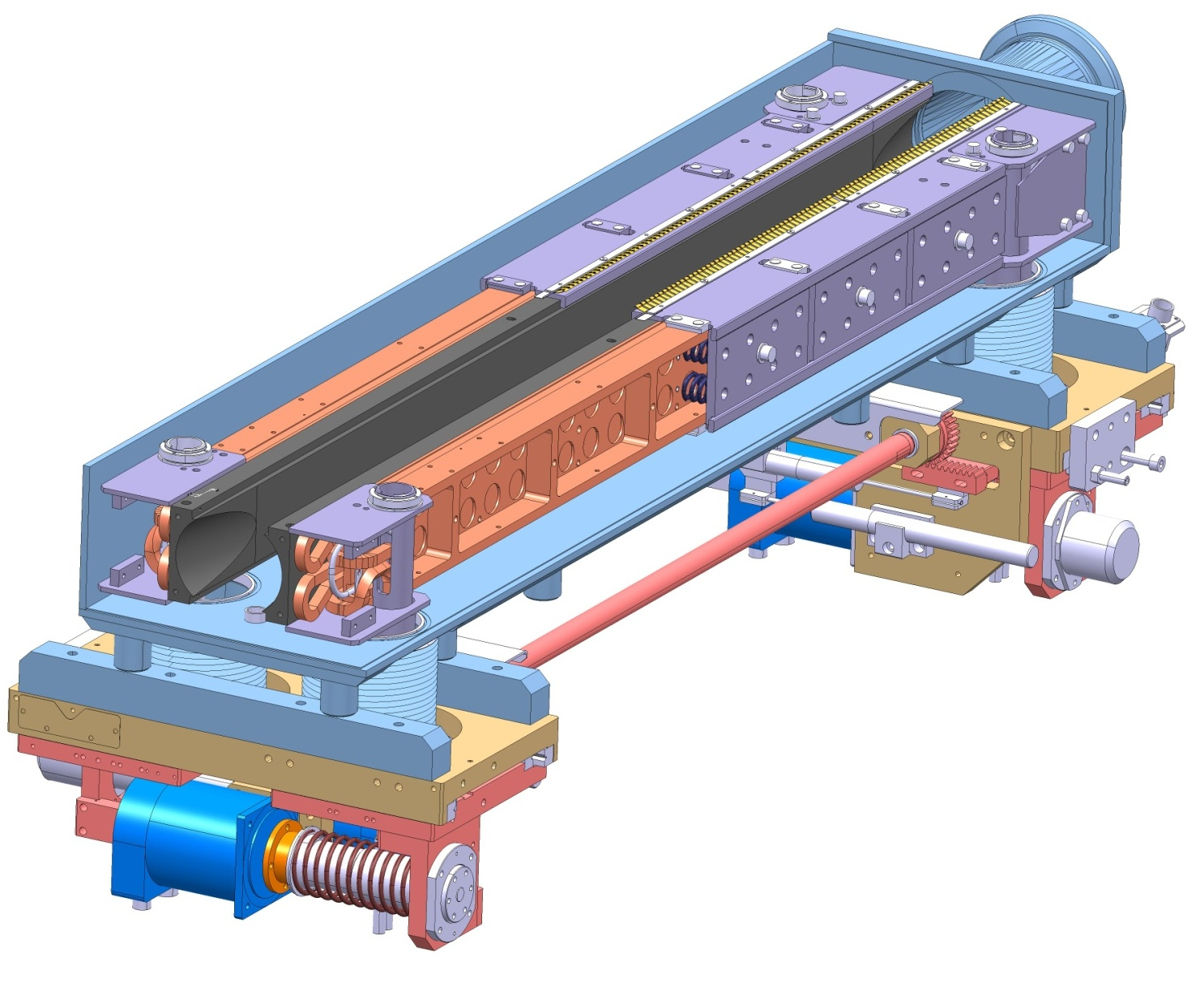
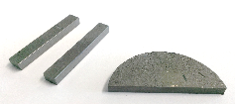
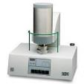
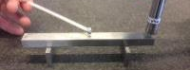
From TMA to Mech Instrumentation
Collimators Materials R&D Program
Candidate materials
Particle Beam
CuCD
Characterisation campaign
MoGr
NiGr

Slide 10
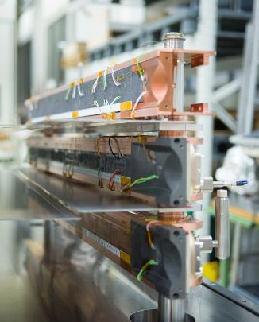
HiRadMat 23 Tests: Goals
Goals
Integrally test jaws for HL-LHC collimators
Acquire online data about response of complete jaws to beam impact
Assess impact consequences on jaws components after irradiation
Notes:
Main Goals of the Experiment
Integrally test jaws for HL-LHC collimators (simulation of ultimate HL-LHC Injection Error and Asynchronous Beam Dump)
Acquire online data about response of complete jaws to beam impact
Assess impact consequences on jaws components after irradiation
Assess impact consequences on jaws components after irradiation
HRMT-23: Test of Fully Assembled Jaws
Main Features:
Three superposed jaws in one tank.
Jaws equipped with set of strain gauges, temperature sensors, ultrasonic probes, … for online acquisition.
Special tank equipped with viewports for optical acquisition, LDV, electric connections etc. and fast dismounting system for glove box post-irradiation observations.

Slide 11
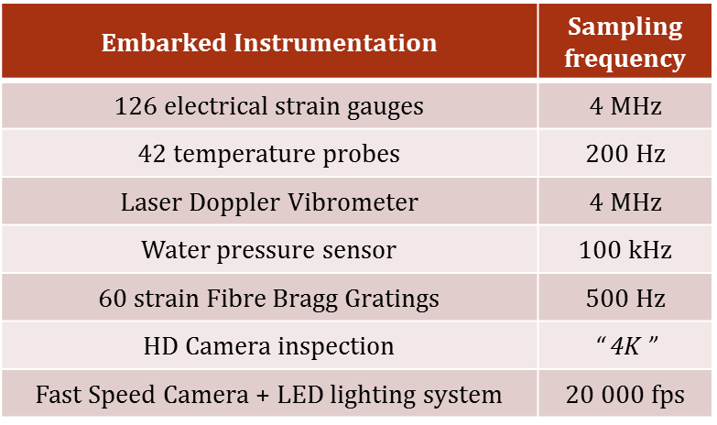
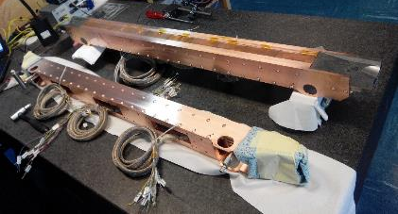
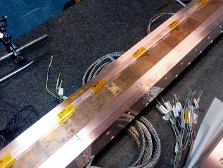
HiRadMat 23 Tests: Instrumentation

Slide 12
HiRadMat 23: Results
CuCd Jaw - 48b 6.06E+12
20000 fps
Front propagation at 200 m/s

Slide 13
Thank you for your attention
Questions?

