Slide 1
VACUUM for ESS
Simone Maria Scolari
Vacuum System Engineer
www.europeanspallationsource.se
10 November 2015

Slide 2
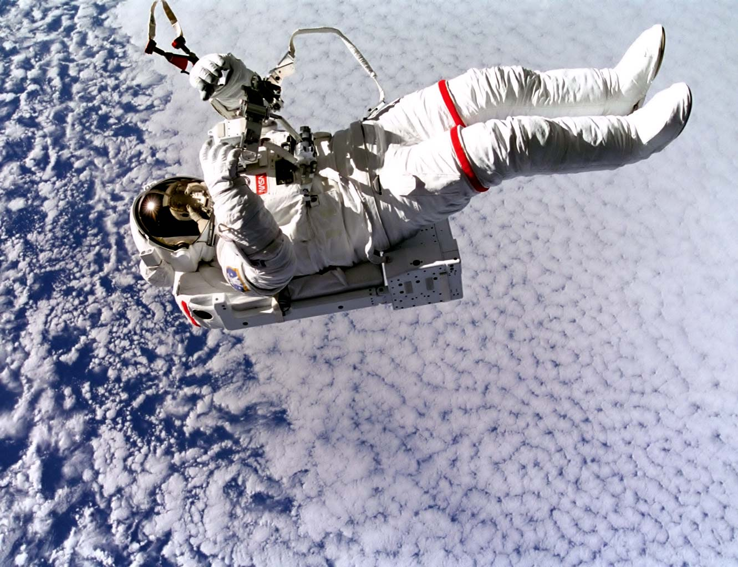
WHAT IS VACUUM
Vacuum: state of a rarefied gas or the environment corresponding to such a state, associated with a pressure or a mass density below the prevailing atmospheric level (ISO 3529).
Pressure Fractions of Atm | Pressure (Torr) | Number Density | Mean Free (cm)
1/1,000 | 0.76 | 2.7 x 10¹⁶ | 0.0065
1/10,000 | 7.6 x 10⁻² | 2.7 x 10¹⁵ | 0.065
1/100,000 | 7.6 x 10⁻³ | 2.7 x 10¹⁴ | 0.65
1/1,000,000 | 7.6 x 10⁻⁴ | 2.7 x 10¹³ | 6.5
1/10,000,000 | 7.6 x 10⁻⁵ | 2.7 x 10¹² | 65
1/100,000,000 | 7.6 x 10⁻⁶ | 2.7 x 10¹¹ | 650
Rough vacuum: 10 torr
High vacuum: 10⁻⁵ – 10⁻⁷ torr
Ultra High vacuum: lower than 10⁻⁷ torr

Slide 3
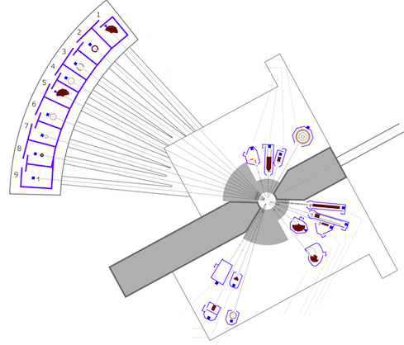
VACUUM at ESS
Target
Warm LINAC
Cold LINAC
Neutron Beam lines
10E-05 mbar
10E-07 - 10E-08 mbar
Lower than 10E-09 mbar

Slide 4
Vacuum Generation
GAS OUT: PUMPING
VACUUM
PRESSURE = GAS LOAD / PUMPING SPEED
GAS LOAD: OUTGASSING, LEAK

Slide 5
INTEGRATION CHAMBER

Slide 6
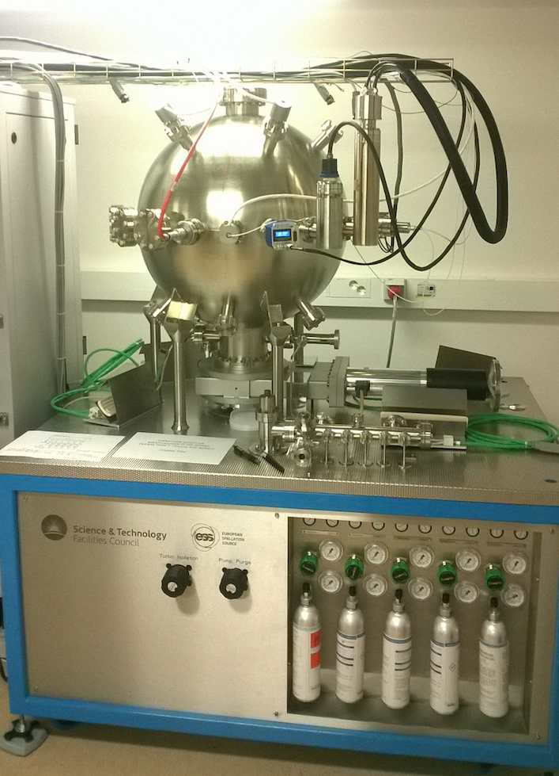
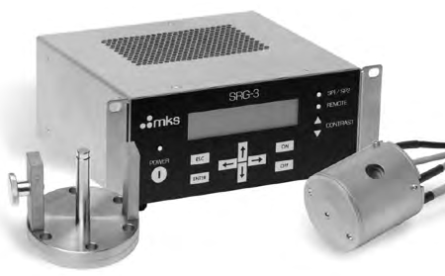
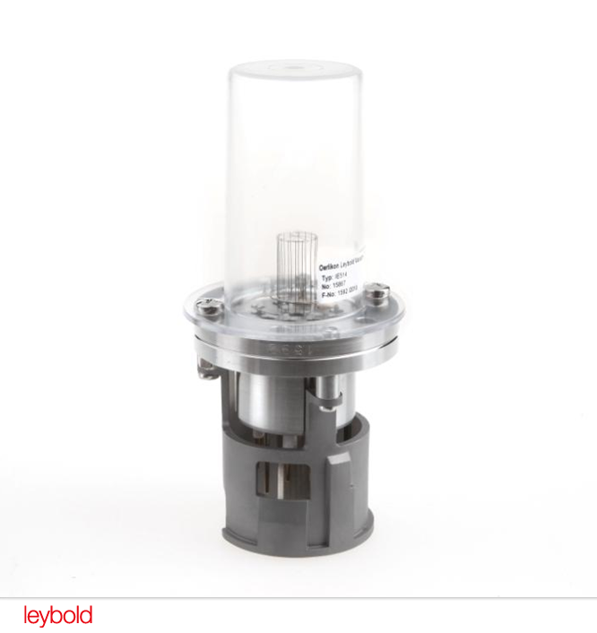
CALIBRATION CHAMBER
Spinning rotor gauge
Range: 5E-07 - 5E-05 [mbar]
Hot cathode gauge
Range: 1E-10 - 7E-05 [mbar]

Slide 7
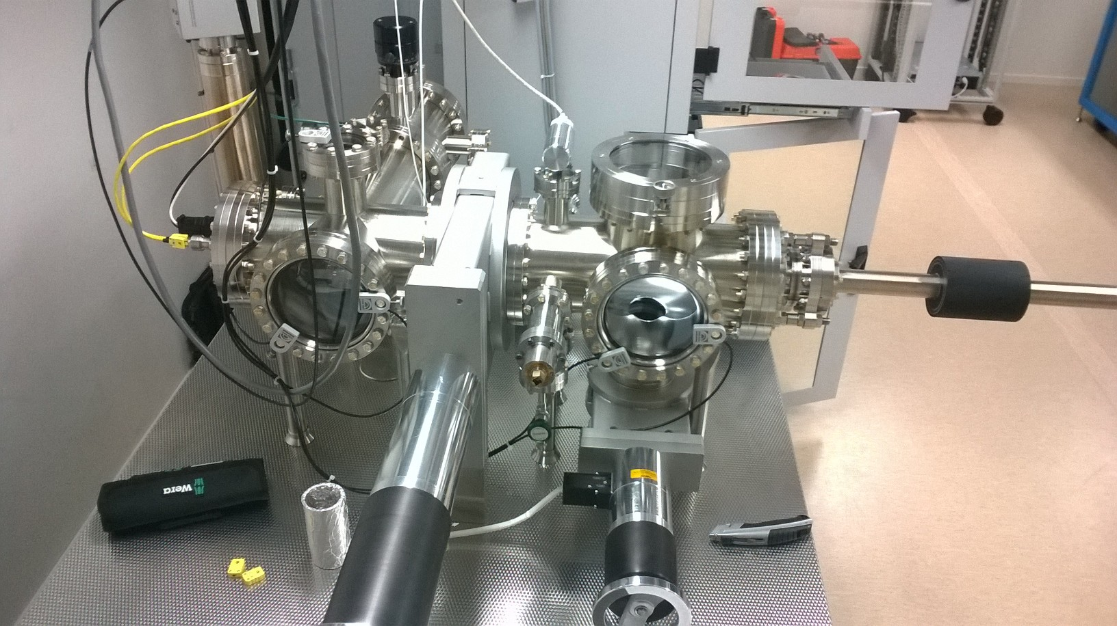
OUTGASSING CHAMBER

Slide 8
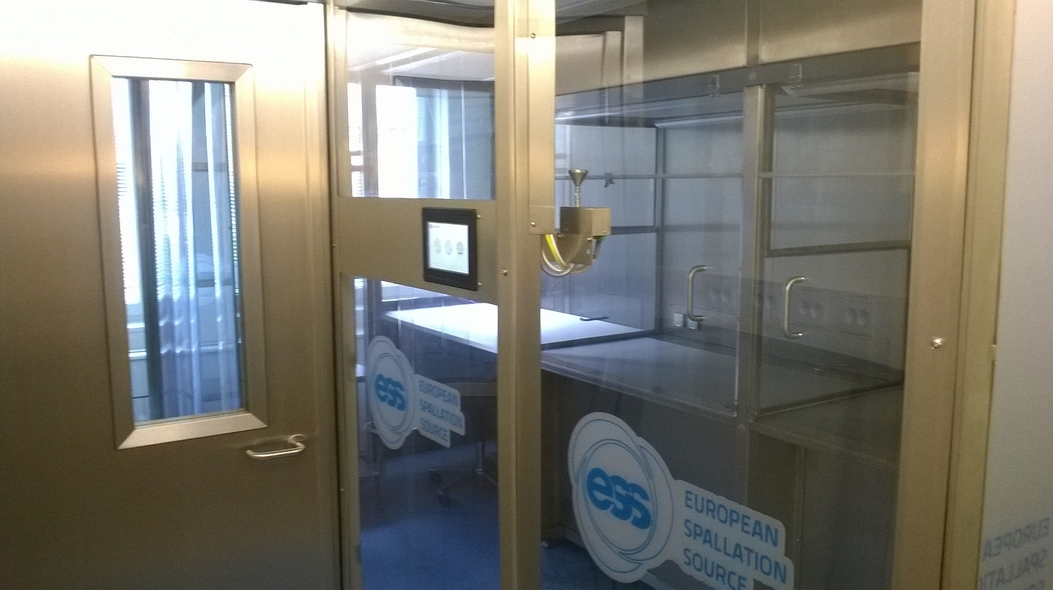
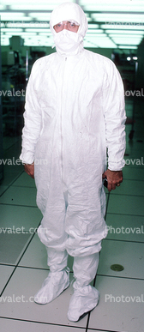
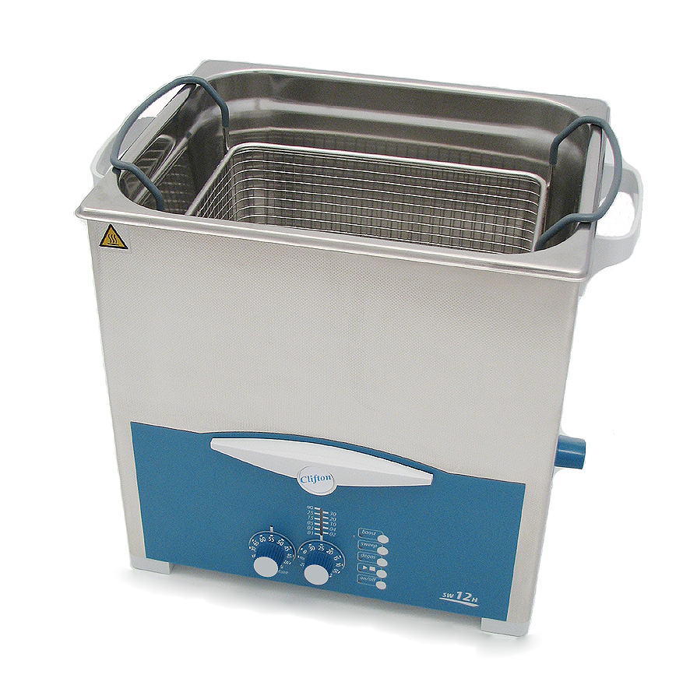
Cleanroom and Cleanliness
ESS Cleanroom
Ultrasonic bath

Slide 9
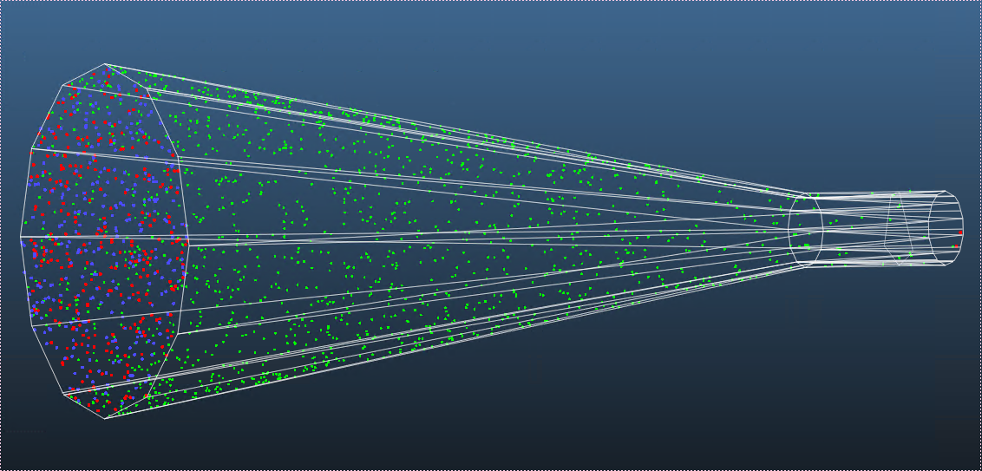
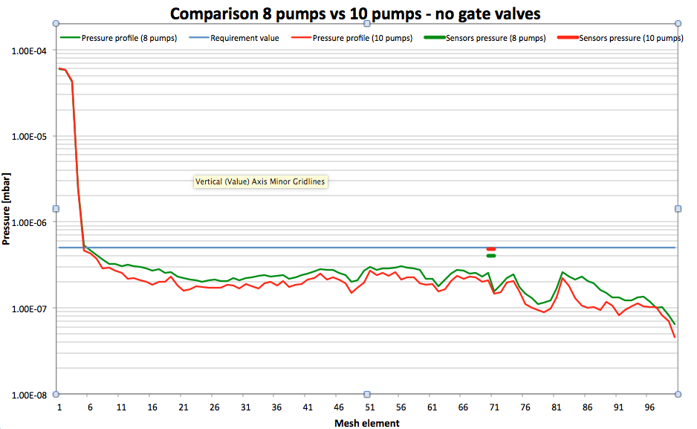
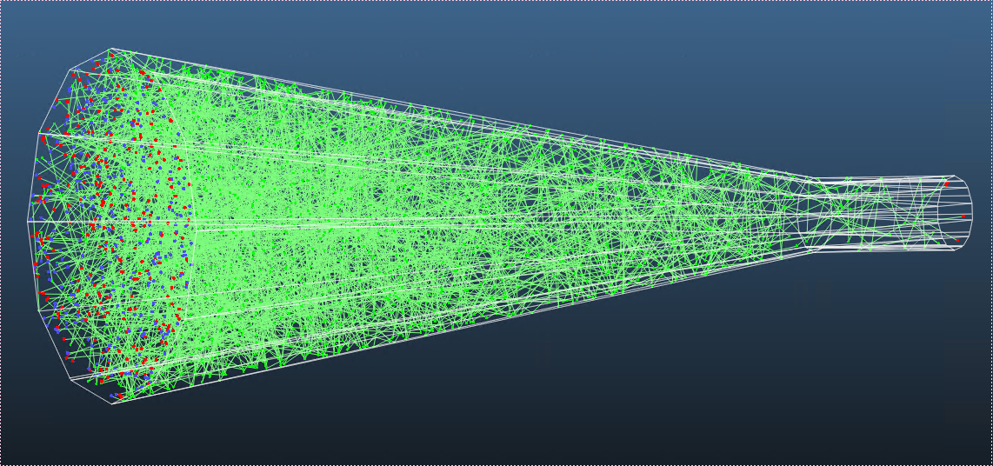
MOLFLOW Analysis
Molecules hits
RFQ pressure profile
Molecules trajectories

Slide 10
Thanks for your attention.

