Slide 2
Data Systems and Technologies (DST)
STAP presentation April 2026
PRESENTED BY Jesper Rude selknæs

Slide 3








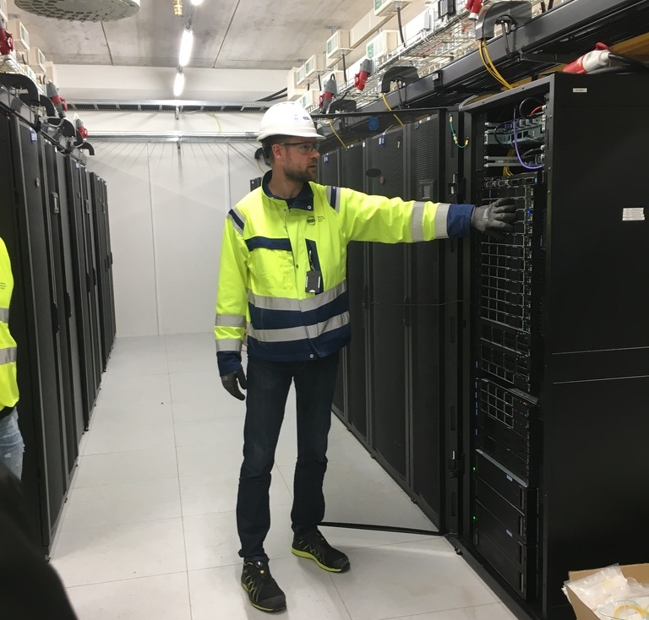
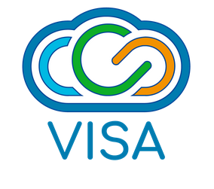

Data workflow
DMSC (+ECDC) deliverable to instruments
Technique
specific
(EasyScience)
Stream events & meta data
Data reduction & visualization
Data analysis
FAIR Data management
Experiment control
User office software
Remote access:
Data centres in Lund & Copenhagen
Notes:
*

Slide 4
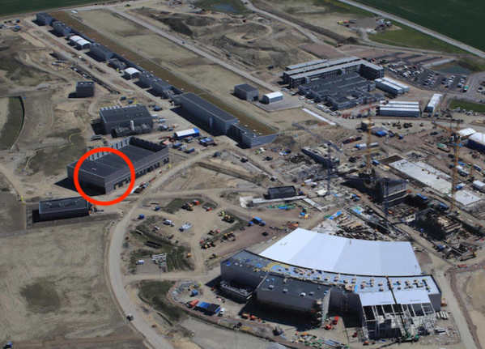
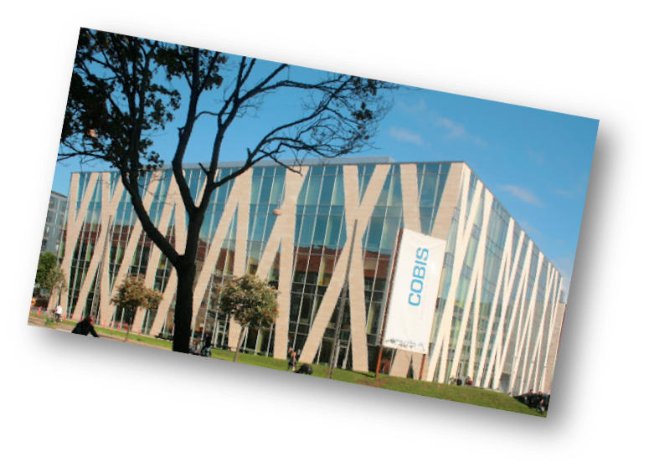
The ESS data pipeline
From detectors to publication
Site server room
Beamlines
Detector readout and EPICS Bridge
DAQ
Online Data reduction and analysis
Online storage - raw
Online storage - derived
Service Failover
External Archive
Raw data (read-only)
Derived data (read/write)
Copenhagen server room
Data Portal
Offline environment

Slide 5






DMSC data center consists of
Hardware
The Datacenter consists of:
A HPC cluster consisting of 4192 cores+ 2x Nvidia A100 GPU cards.
Storage systems:
ZFS based home directories – 80TB total
ZFS based storage for project data – 320TB total.
Lenovo based GPFS SpectrumScale 2 x 850TB
IBM based GPPS SpectrumScale 2
A 120TB ZFS based backup system at I2 (DeIC) in Lyngby DK. To be sunset in 2022.
A 3 host 1.1TB RAM virtualization system. Including 2 x 10TB SAS based storage systems
10 nodes (32 to 96 cores each) for virtualization being deployed on OpenStack in both sites.
Mac OSX servers (1 MacPro server and 10 Mac Minis)
1GBE, 10GBE and 100GBE Ethernet
QDR and HDR InfiniBand for cluster- and storage interconnect. QDR to be sunset.
Total of 50 servers in Lund for event formation, KAFKA cluster and filewriters.
10GBE MPLS based site-to-site link connecting COBIS and H01

Slide 6
DMSC data center consists of
Software and services
DST is managing the following systems and services:
Gitlab Community
Jenkins CI/CD
SLURM for cluster management
Jupyter notebooks and Jupyter hub
Mediawiki servers
NextCloud available for ESS as a whole – 17TB data
Foreman/Puppet allowing dev. Teams to spin up machines for dev and test.
VISA
Build servers for software projects
Kubernetes
Infrastructure systems:
OpenLDAP
DNS
OSSEC, Icinga, Graylog, GLPI for monitoring and asset management
Yum and apt repository servers
Etc.

Slide 7



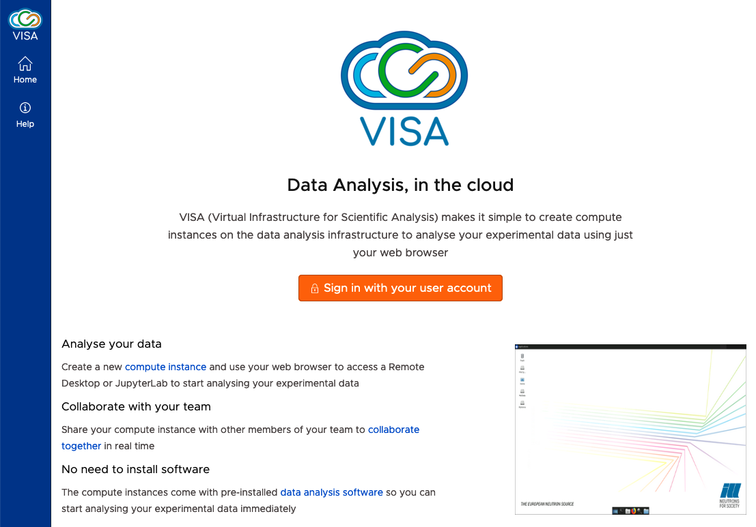

VISA
Virtual Infrastructure for Scientific Analysis
- developed at ILL – funded by PANOSC
On-demand desktop and JupyterLab environment for experiment users
Available for users both before, during and after the experiment
Sessions can be shared with collaborators (and local contacts / support)
Compute resources are allocated based on experiment and instrument
PaNOSC has received funding from the European Union’s Horizon 2020 Research and Innovation programme under grant agreement no. 823852
https://visa.ess.eu/

Slide 8

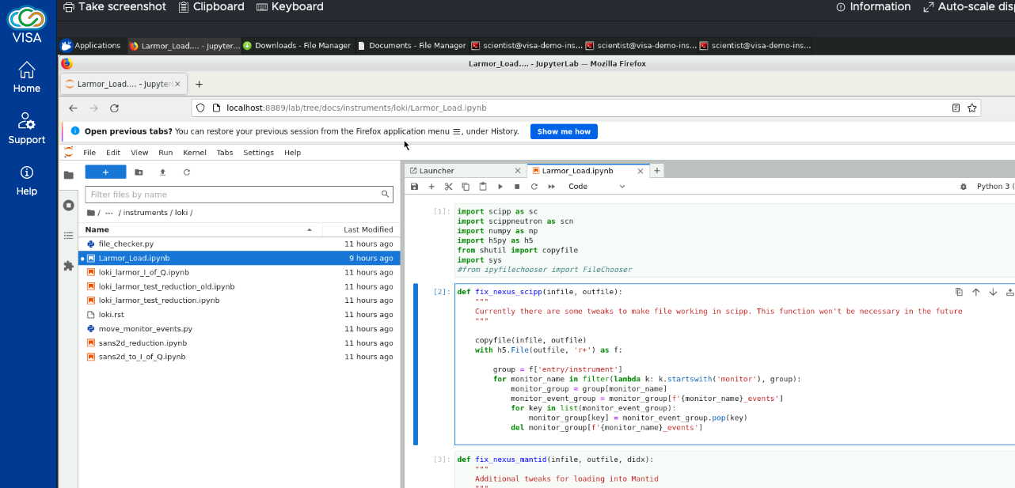
VISA at ESS
Scientific Applications
Apptainer (formerly singularity project)
- docker-like containers without (most) of the security issues of docker. Provides a self-contained environment that can run independently of the host system and environment.
Scientific applications (apps) in VISA will be made available through apptainer containers
Containers allow for each app to have its own environment (which mitigates conflicts between different apps and versions)
Live updates to apps (incl. hot-fixes in a support-situation) without the user needing to restart their instance

Slide 9
The DST team
Jesper Rude Selknæs
Alexandre Stefanov
Brian Lindgren Jensen
Farshid Farjad
Kashis Verma
Tilde Bonnevier Walstedt
Kareem Galal
Lottie Greenwood
Carl Hjort Studentworker 10h per week

Slide 10
Data systems and Technologies
Distribution of resources
Subject / Person | Jesper | Brian | Tilde | Alexandre | Farshid | Lottie | Kareem | Kashis
Network
Storage
HPC
OpenStack
VISA
Containers (AppTainer)
INFOSEC
Infrastructure services
Web services
Legacy systems

Slide 11
Data pipeline
Infrastructure requirements and status
Instrument simulation
HPC cluster, VISA for frontend, Some storage capacity
All in place and being improved continuously.
Data analysis
HPC, large VMs = OpenStack, DAQ hardware, Performant storage.
All parts in place but needs to be scaled as instruments comes online.
Data archiving
Integration between DST core infrastructure and UO, Archive storage system
All parts in place but needs to be scaled as instruments comes online.
Data reduction
HPC, large VMs = OpenStack, DAQ hardware, Performant storage.
All parts in place but needs to be scaled as instruments comes online.
Performance tuning and improved utilization of GPU resources. Also VISA will be continuously improved.
Data acquisition
All in place but needs to be scaled up and legacy hardware replaced.
Servers (EFU, Filewriters and KAFKA), storage and high-speed networks (100GBE and InfiniBand)
We are cycling old hardware, and this will be an ongoing activity from here on.

Slide 12
Risks and weak points
What keeps us awake at night
The recent developments on the IT markets for memory and GPU poses significant risk on the DST budget and ability to obtain hardware.
The potential need for on-prem AI capacity hooks into the volatile market for relevant components.
The new data hosting solution for DST comes with some level of risk even though most risks are cleared by now.
The updated schedule for BOT and HC presents some opportunities but also risk to hardware being EOL in an earlier stage of the project than expected.
INFOSEC risks remain on a high level since 2022.

Slide 13
Effect of the new ESS schedule
BOT: 27th January 2027
Pros:
More time for testing edge cases etc.
More time for the market for memory and GPU to stabilize.
The schedule for moving to new data center fits better with the plan for HC.
Cons:
Hardware procured against an earlier BOT date will be out of service in an earlier stage of the ESS project than expected.
Migration to the new data center could clash with the now very compressed got commissioning schedule.

Slide 14
Status report
What has been accomplished since the October 2025 STAP:
Team fully staffed.
Installed additional workstation in the hutches for:
LOKI
ESTIA
DREAM
ODIN
TBL
BIFROST
NMX
Installation of additional virtualization equipment in both datacenters
Pressure tests of the integration of VISA with UO and SciCat
Integration of DMSC systems with Lund based IT systems Especially the IAM system.
DST continues to move from CentOS to AlmaLinux.
Engaged in the post-PaNOSC VISA ecosystem
Continues to work with VISA and software packages for reduction and analysis
Installed and commissioned new GPFS based storage system + tape robot.
Considerable effort has gone into the future data center solution.

Slide 15
Plans for the rest of 2026
Major activities
Migration to new storage system (already in place)
Procuring, installing and deploying a new HPC queue
Upgrading and expanding VISA
Procuring, installing and commissioning an expansion of new HPC and VISA capacity
Tracking the construction project for the new hosting facility
Detailed planning of the migration of data centers.
Handing over hutch workstations to IT

Slide 16
Plans for the rest of 2026
Data center
A common solution for histing with DTU has been approved:
Joint infrastructure for power, cooling and conventional facilities with DTU and DeiC.
A modular data center has been ordered with the capacity of 1MW IT load and 30 racks.
Civil construction has started.
Risks:
We are still needing an approval from the Danish parliament sub committee for finance.
Some procurements for are still outstanding and the market for all relevant components are under a lot of pressure.
Risks concerned to civil engineering.

Slide 17
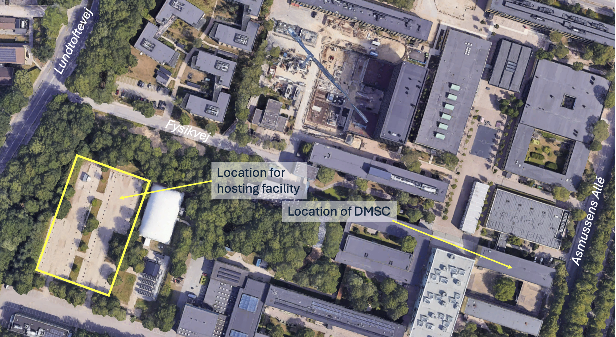
Project overview
Copenhagen data center
Common project with DTU
30 racks
Total capacity: 1MW IT load
Redundant power and cooling
Early access is October 2026
Full capacity and full redundancy is July 2027.
The project is tracked in P6
A plan for migrating the existing data center to the new one is being developed in ESS-5938067 (P)
Total cost estimated around 100MSEK
Some risk does exist on the timeline for this project. In case of significant delays, DMSC could run out of hosting space for high density systems.

Slide 18
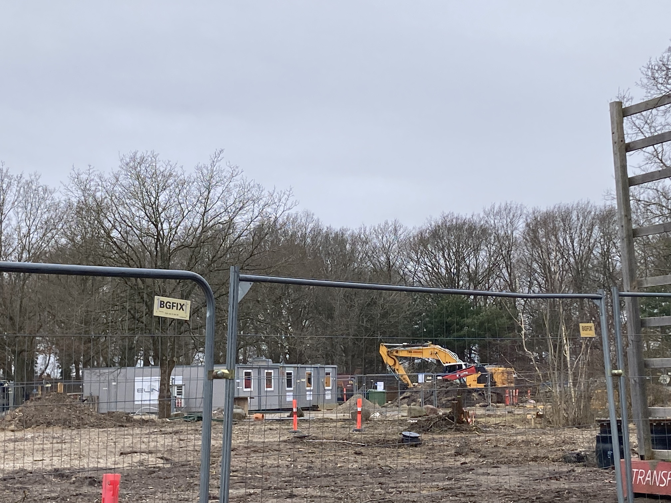
Data center project status
Work is in progress
Progress
Civil engineering has started – see picture
Tender for non-data center construction is in progress
Tender for data center modules is completed – final contract signature pending approval from Danish parliament which is delayed due to election in Denmark.
Pending work:
Final approval of the project is pending approval from the Danish Parliament – delayed due to election in Denmark.
Some re-design work is in progress due to rising prices on electrical components and steel.

Slide 19
Data center project
P6 status
P6 activity | P6 title | Due date | Status
SCI-A2146968670 | Data Center Hosting Facility | 12.10.2027 | Started
SCI-A2146968700 | Construction started | 01.06.2027 | Started
SCI-A2146968710 | Procurement of modules started | 01.10.2025 | Completed
SCI-A2146969030 | Order placed for modules | 01.06.2026 | Pending approval from parliament.
SCI-A2146969040 | Data center modules delivered | 01.10.2026 | Not started
SCI-A2146969050 | Construction completed - early access | 01.09.2026 | Not started -
SCI-A2146969180 | Full capacity of 1MW is available | 01.07.2027 | Not started

Slide 20
Advise to the DST group
Are we on the right track?
Does the data center solution looks reasonable?
Any advise on handling the volatile market situation for IT components?
Any other advice?

Slide 21
Thanks for your attention

