Slide 2
Scientific Information Management Systems
SIMS
PRESENTED BY Fredrik Bolmsten

Slide 3


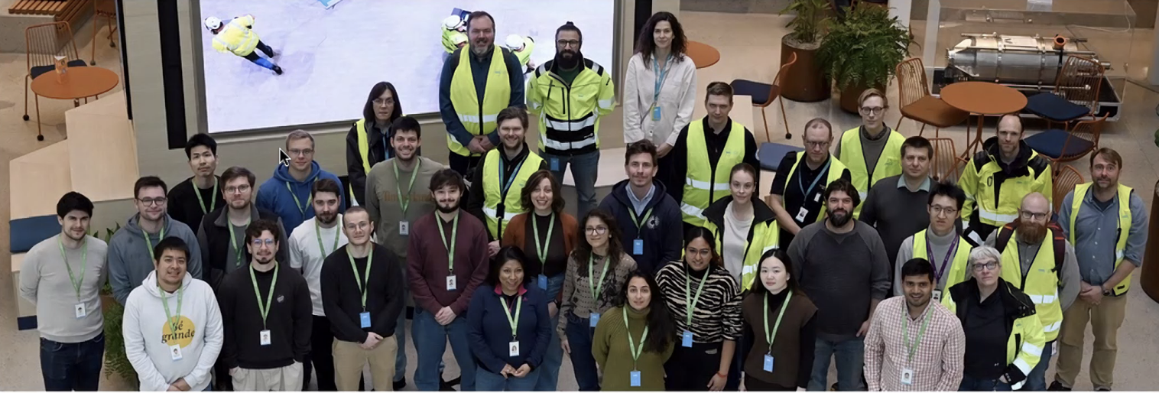
Getting ready for operations by showcasing our ability to handle the main user journey
20 Students from the Hercules school visited ESS as science users

Slide 4
Group
Staff & Scope
Fredrik Bolmsten – Group lead
Max Novelli - Data curation scientist
Jay Quan - Software engineer
Yoganandan Pandiyan - Software engineer
Janos Babik – Software engineer
Jekabs Karklins – Software engineer (Grant)
User Office:
Proposal system
Scheduling software
Statistics
Data Curation:
Metadata catalogue
Electronic logbook
Scientific data management
Miscellaneous:
E-learning platform
Publication system
AI-Platforms

Slide 5
ECDC - DK
Line Management
DMSC/Lyngby site
Morten Jagd Christensen (80%) – EFU
George ONeill – Filewriter/CODA/YMIR
Tibor Bukovics - EFU
Michael Christiansen - EFU
Andre Costa - DevOps
Milosz Novak - DevOps
Mads Ipsen(Consultant) – EFU

Slide 6
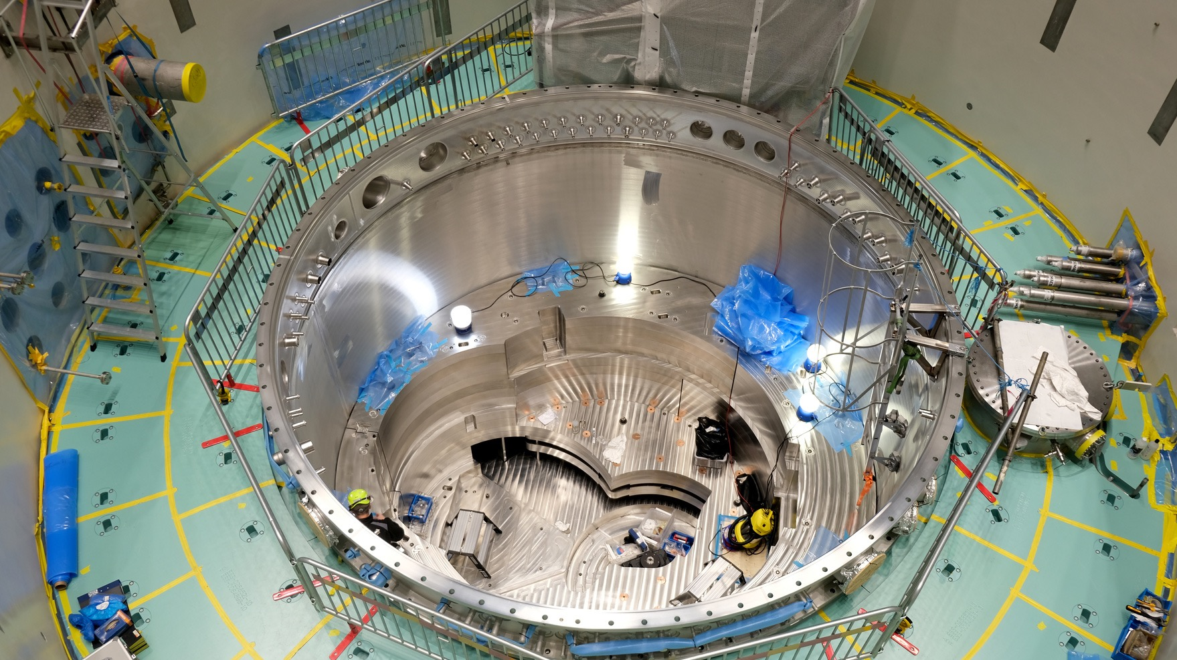

Overview

Slide 7
The User Journey
Users notify ESS of team
User training
Experiment safety review
Travel and accommodation
Ship samples
Physical Access
Dosimetry
Feedback
Experiment report
Data curation
Expenses review
Publications
KPIs
Submit proposals
Technical review
Excellence review
Result notification
Registration
Proposal
Scheduling
Planning
Performing & Analysing
Wrap-up & Harvesting
Register
Personal Data
Digital Access
Experiments
Sample environments
Local contacts
User lab facilities
Experiment notification
Data directories in place
Permissions for files
Done
Ongoing
Not started
Notes:
Purpose of slide:
Provides a high-level overview of the current status of user journey support. Items marked in green are considered ready for first science, although they may require further development for steady-state operations. For example, a basic scheduling module has been implemented to manage the initial set of experiments, while more advanced functionality will be required during full operations.
From a DMSC perspective, most aspects of the user journey are ready. Ongoing work with various ESS stakeholders focuses on completing user training, safety reviews, and accommodation planning. A minimum viable product covering all key user journey steps is expected to be in place before the start of hot commissioning. The goal is to validate the user journey by having hot commissioning users follow the same process as future science users.
of start of hot commissioning. Our aim is to test the journey by having hot commissioning users go through the same steps as future science users.

Slide 8
The Data Journey (SIMS perspective)
NICOS integration
Dataset ingestion
Pre-Exeperiment
Experiment
Post-Experiment
UOS information in SciCat
Collect Sample Information
Proposal Group
Instrument Group
Proposal DOI
Data directories in place
Permissions for files
Jupyter integration
Technique specific pages
Data Download
Embargo Period
Done
Ongoing
Not started

Slide 9
Status & Progress
User Office
Diamond onboarding started
Multiple stress tests of user onboarding
Found multiple weakpoints in IAM
Data Curation/SciCat
Customization per technique
MAX IV collaboration started for SANS/SAXS
Ingestor for tranche 1 instruments deployed
AI
OPUS
Neutro
PaN-Finder(Grant)
Tailored Abstract Translator(Grant)

Slide 10
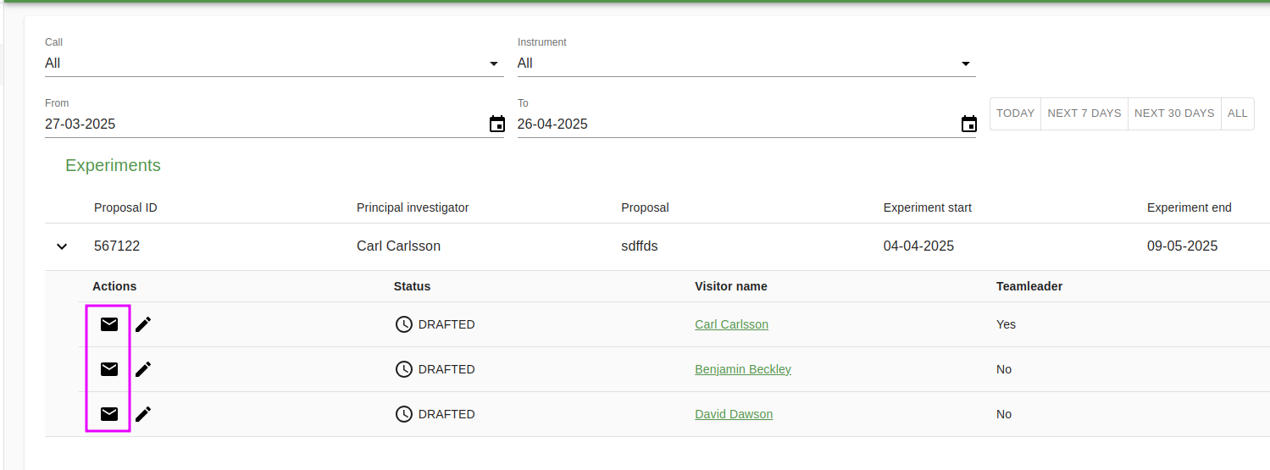
Science User Access
Science users
Todo:
Employee

Slide 11
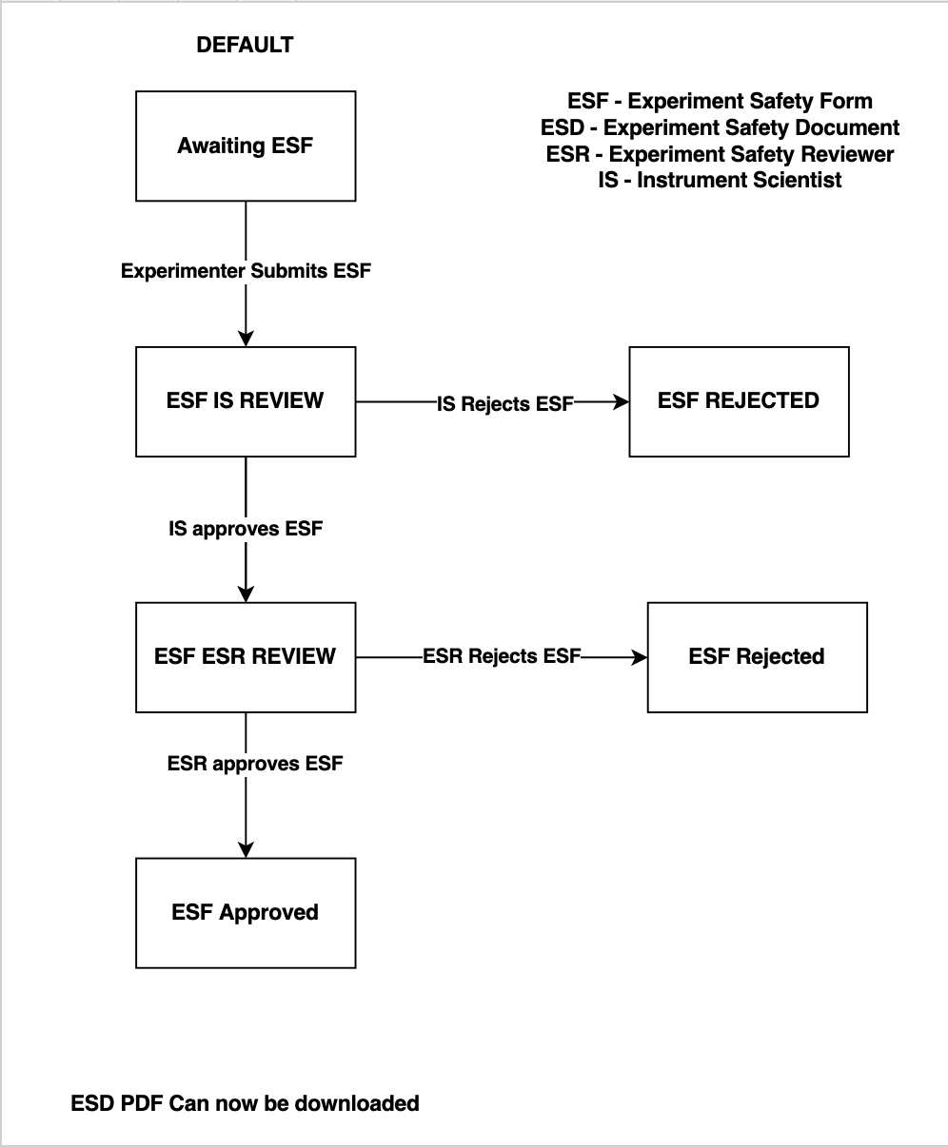
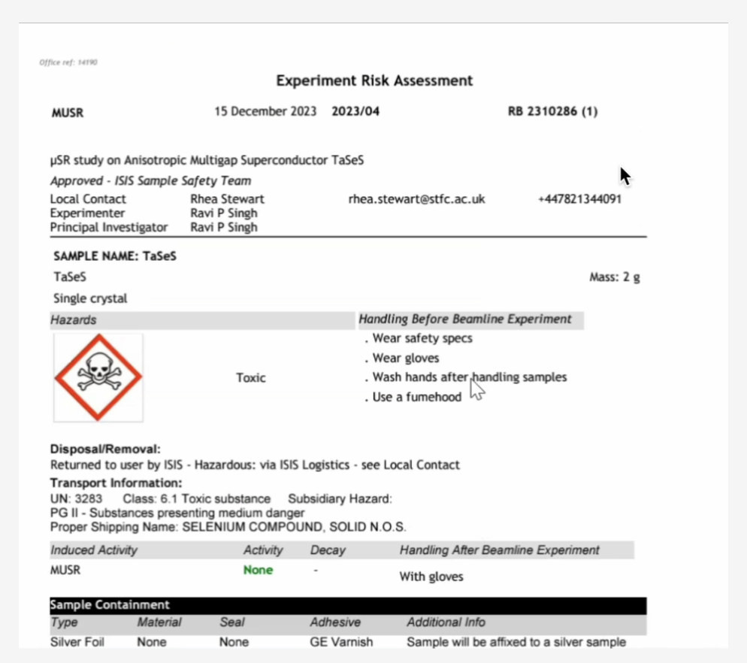
Experiment Safety Review
User Office

Slide 12

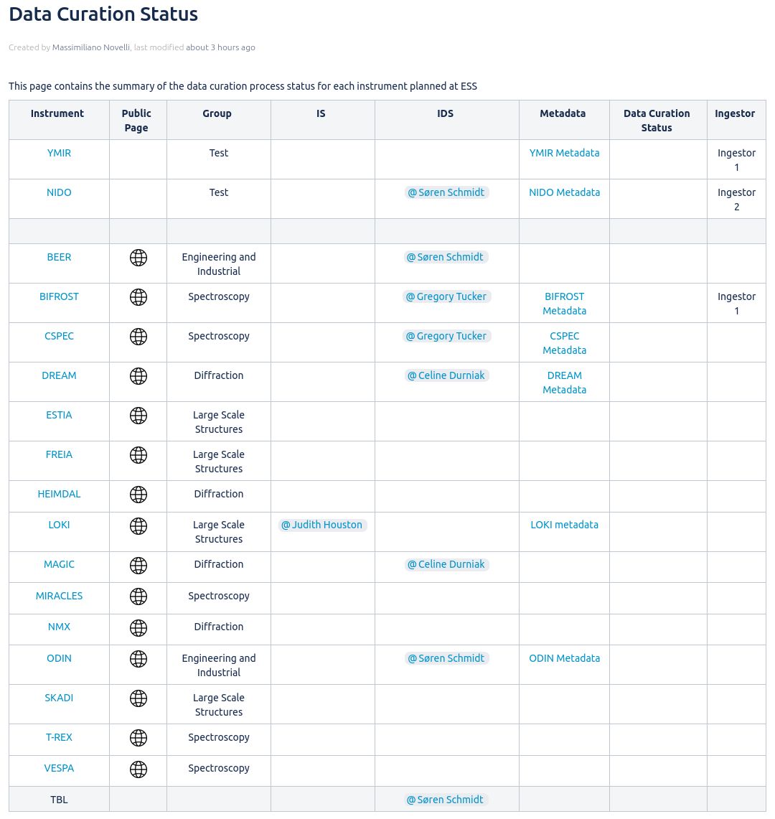
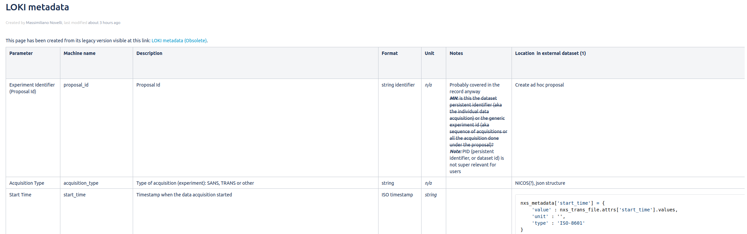
Data Curation
On-Going activities:
Documented individual instrument metadata
Instrument metadata acceptance from stakeholder
Finalize metadata configuration implementation
New dataset ingestor
Future milestones:
Technique specific dataset pages
Integration between VISA and SciCat
Technique widgets, HDF5 Viewer

Slide 13
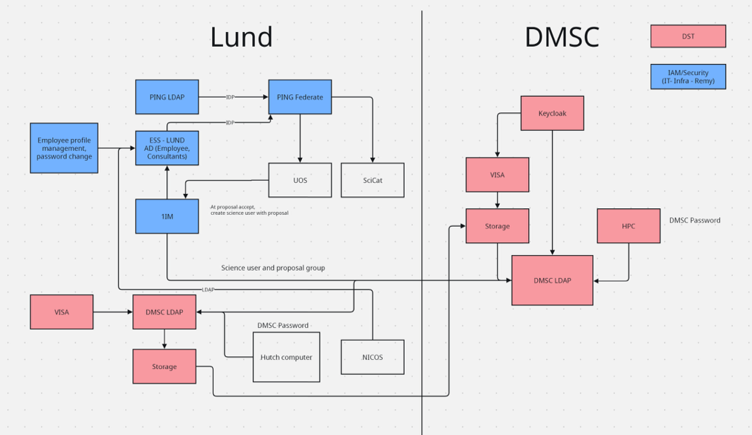
Identity Access Management
Complex structure
How to support staff wanting to do science
GDPR unresolved
Offboarding

Slide 14
Feedback
Discussion
Registration
Proposal submission
Visit declaration
Training
Reception/Guard
System access

Slide 15
Questions?

