Slide 1


Slide 2

Instrument presentation MIRACLES + CSPEC
DMSC STAP 2026
Christian Beck, Instrument Data Scientist

Slide 3
Agenda
1. MIRACLES
1.1. Instrument Description and Timeline
1.2. Current Status
1.3. Next Steps
2. CSPEC
2.1. Instrument Description and Timeline
2.2. Current Status
2.3. Next Steps

Slide 4
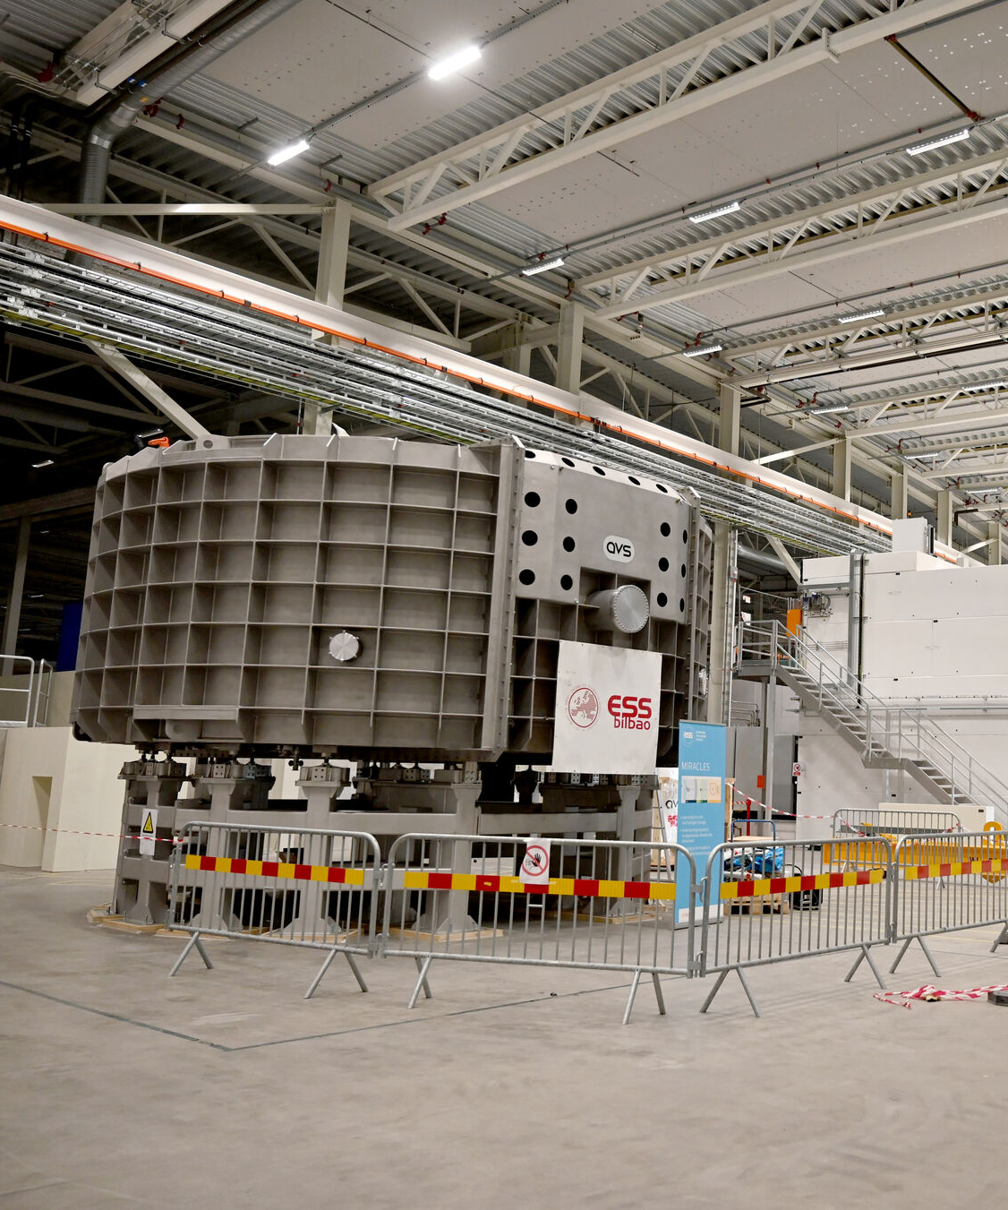
1
MIRACLES
time-of-flight backscattering spectrometer

Slide 5


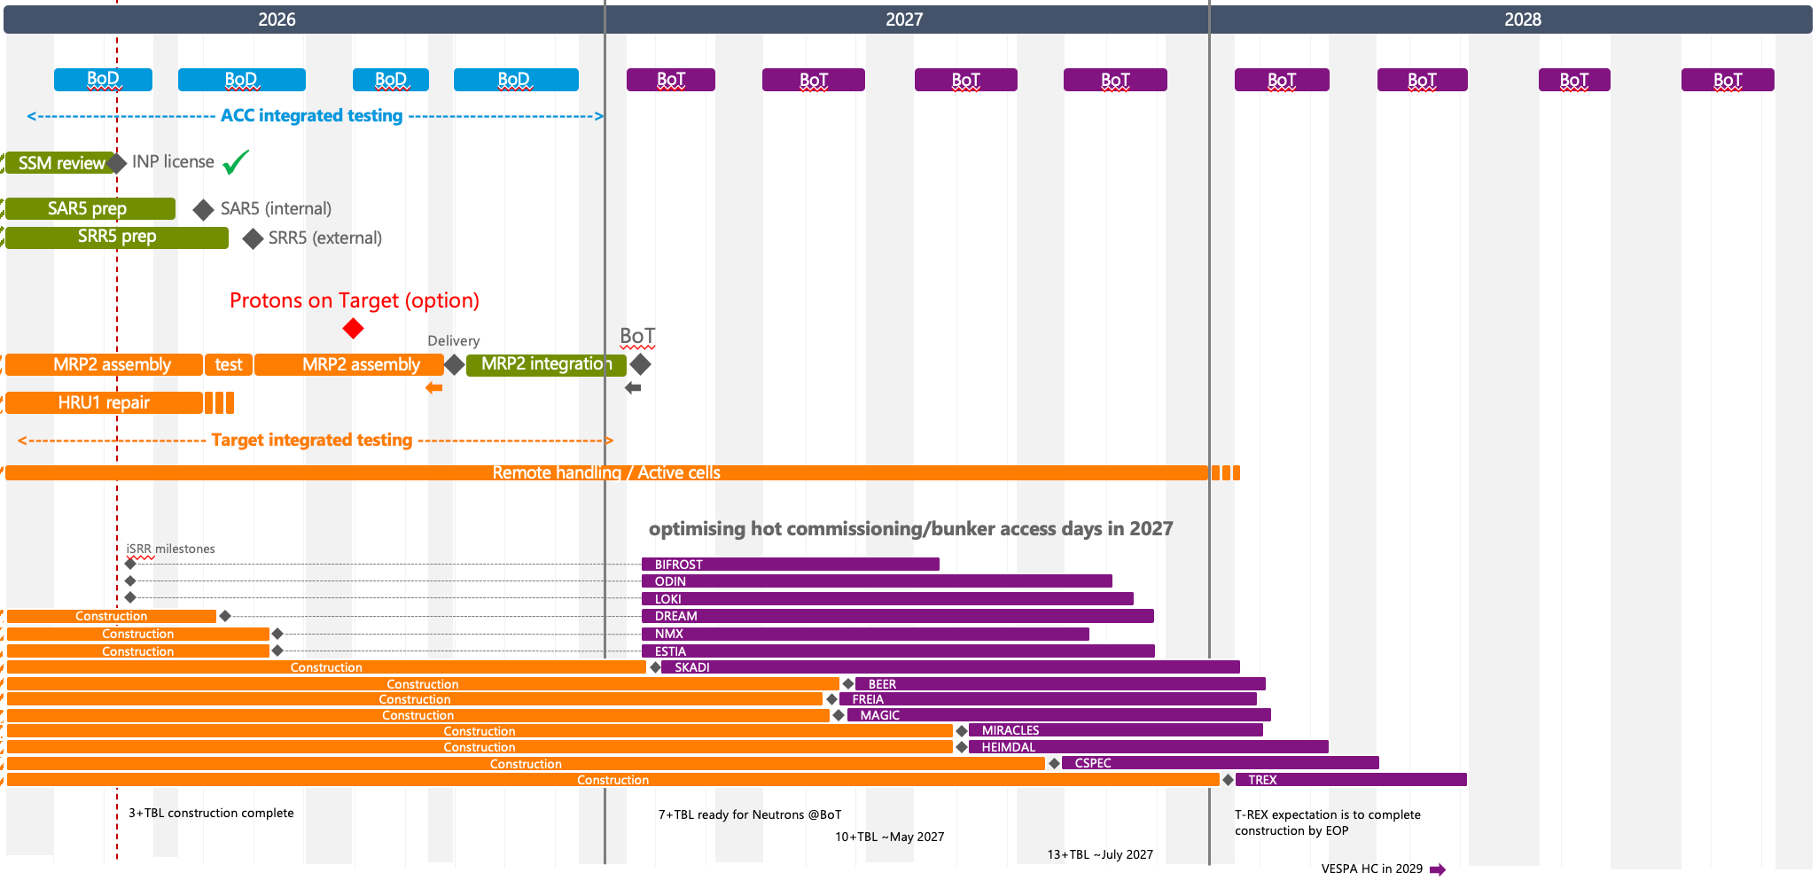
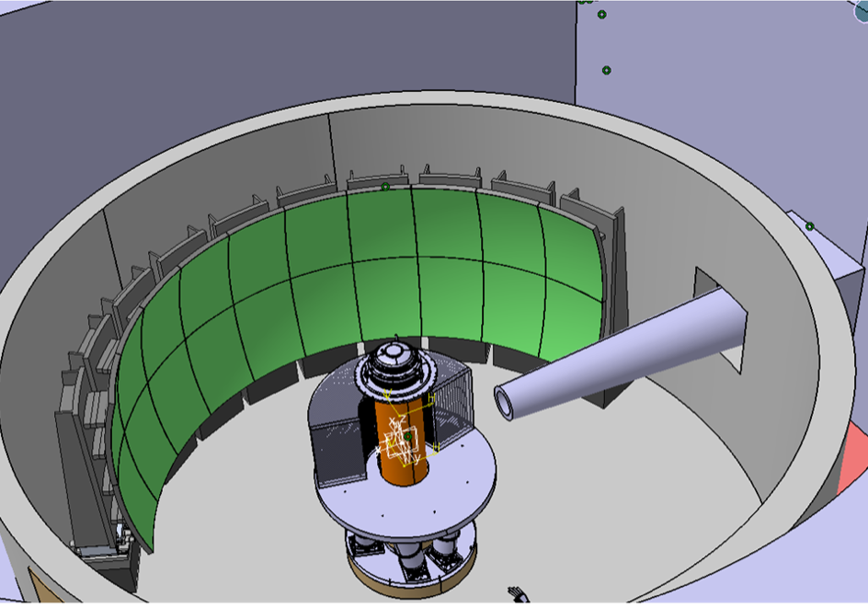
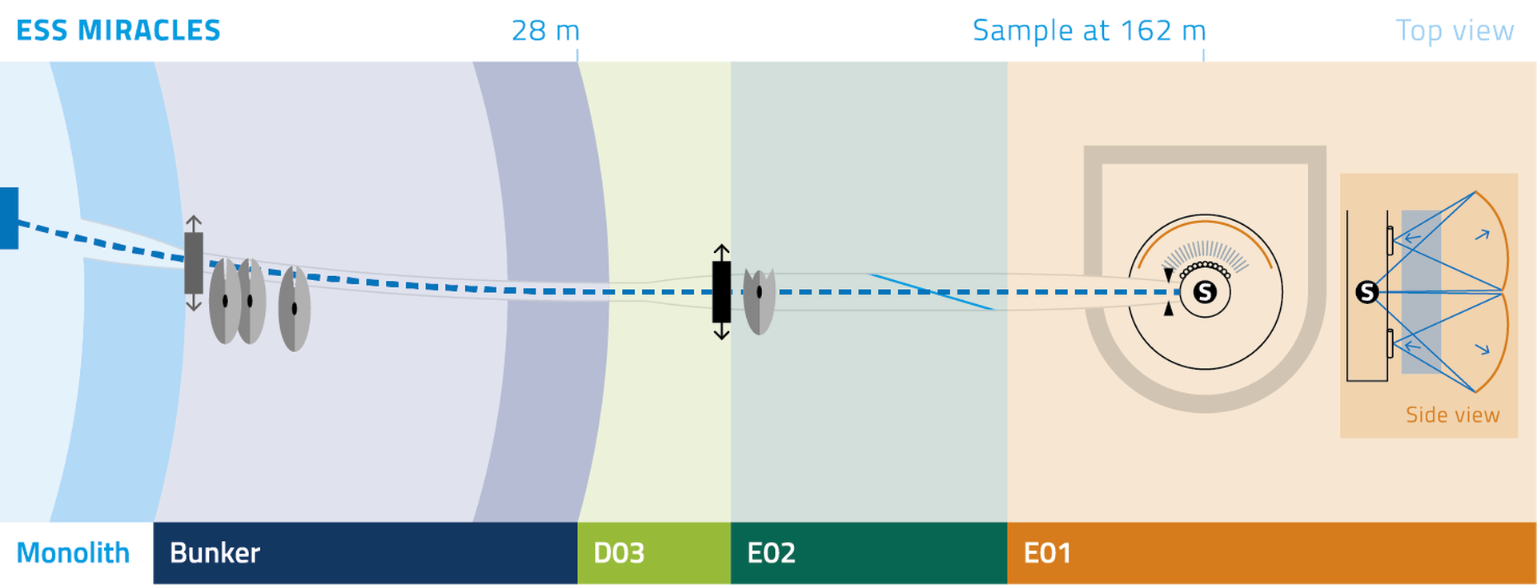
MIRACLES: Instrument Description & Timeline
Near backscattering spectrometer
Primary Spectrometer
2 Counterrotating PWD Choppers (max 308 Hz)
PS Chopper (max 42 Hz)
FO Chopper (max 98 Hz)
Secondary Spectrometer
Si111 analyzer crystals
Two detector banks
ESS Instrument with highest energy resolution δE
Wide dynamic range ΔE
Q-range dependent on analyzers (Si111: 0.2 Å⁻¹ <q<2.0 Å⁻¹)
Chopper settings allow tuning of flux, δE and ΔE to match experimental requirements.
Notes:
PWD Pulse-shaping / width definition chopper
PS Pulse-selection
FO frame overlap chopper

Slide 6
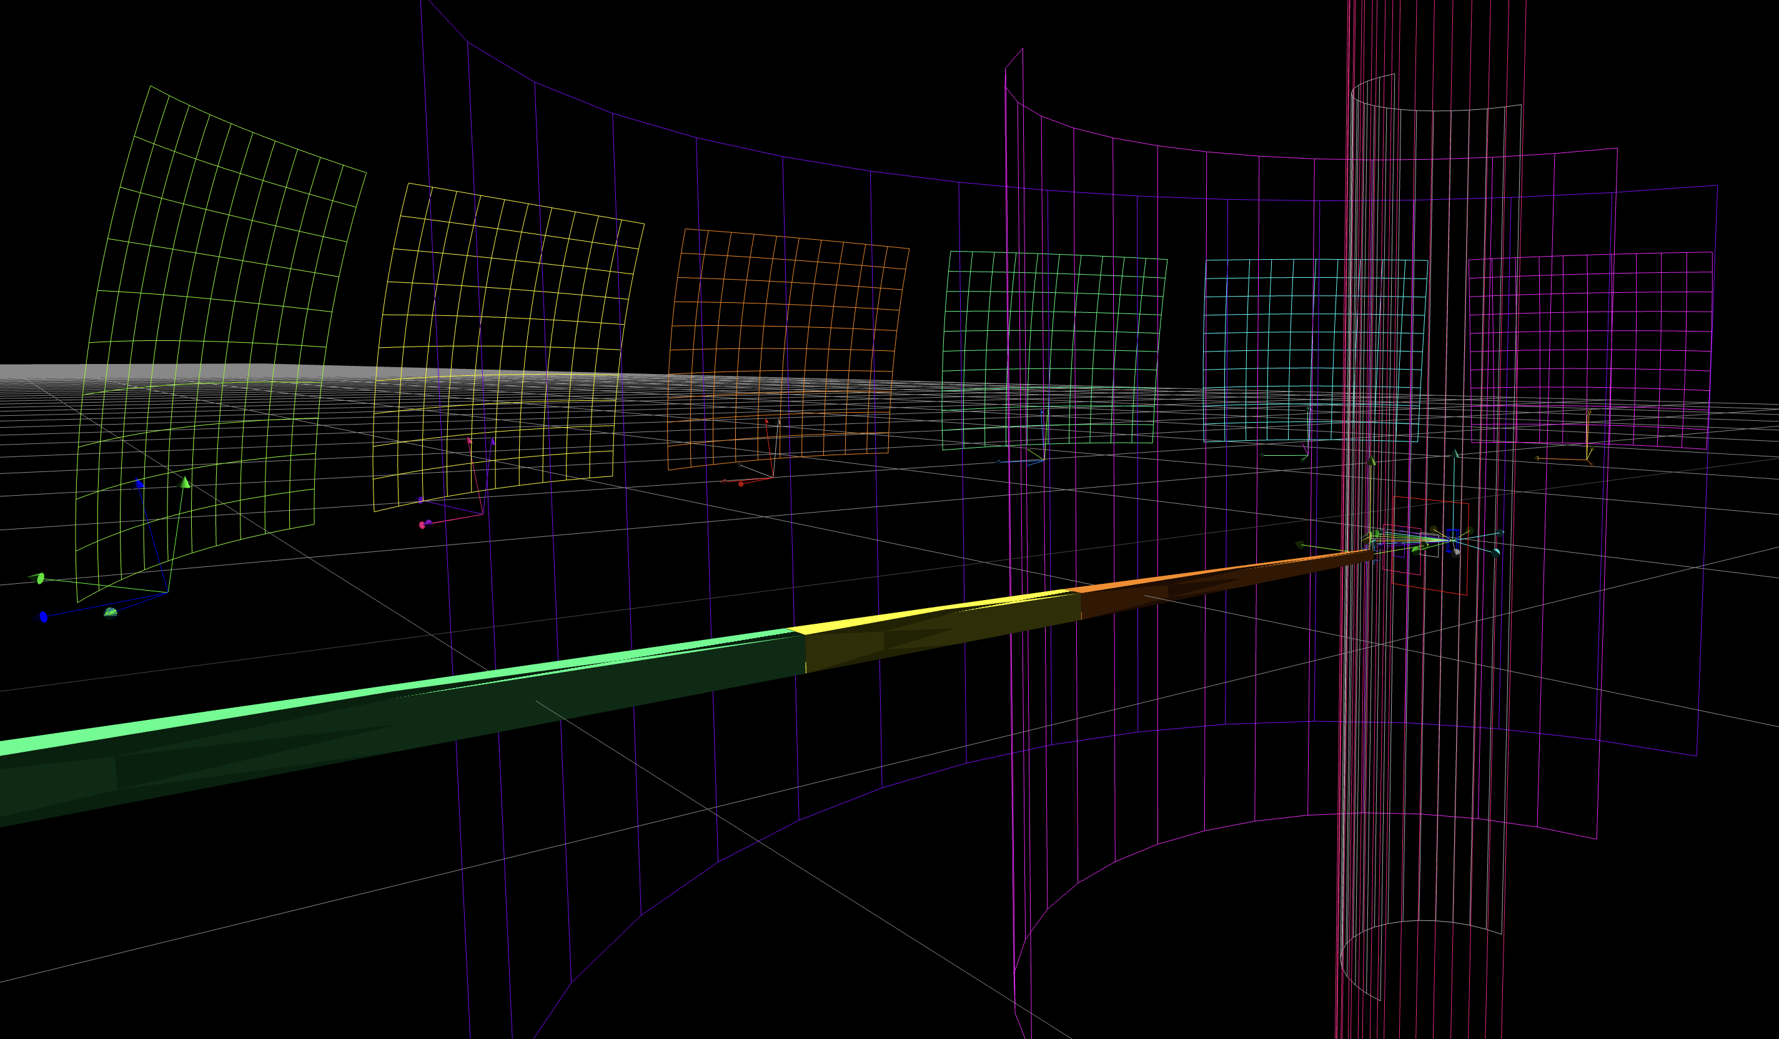
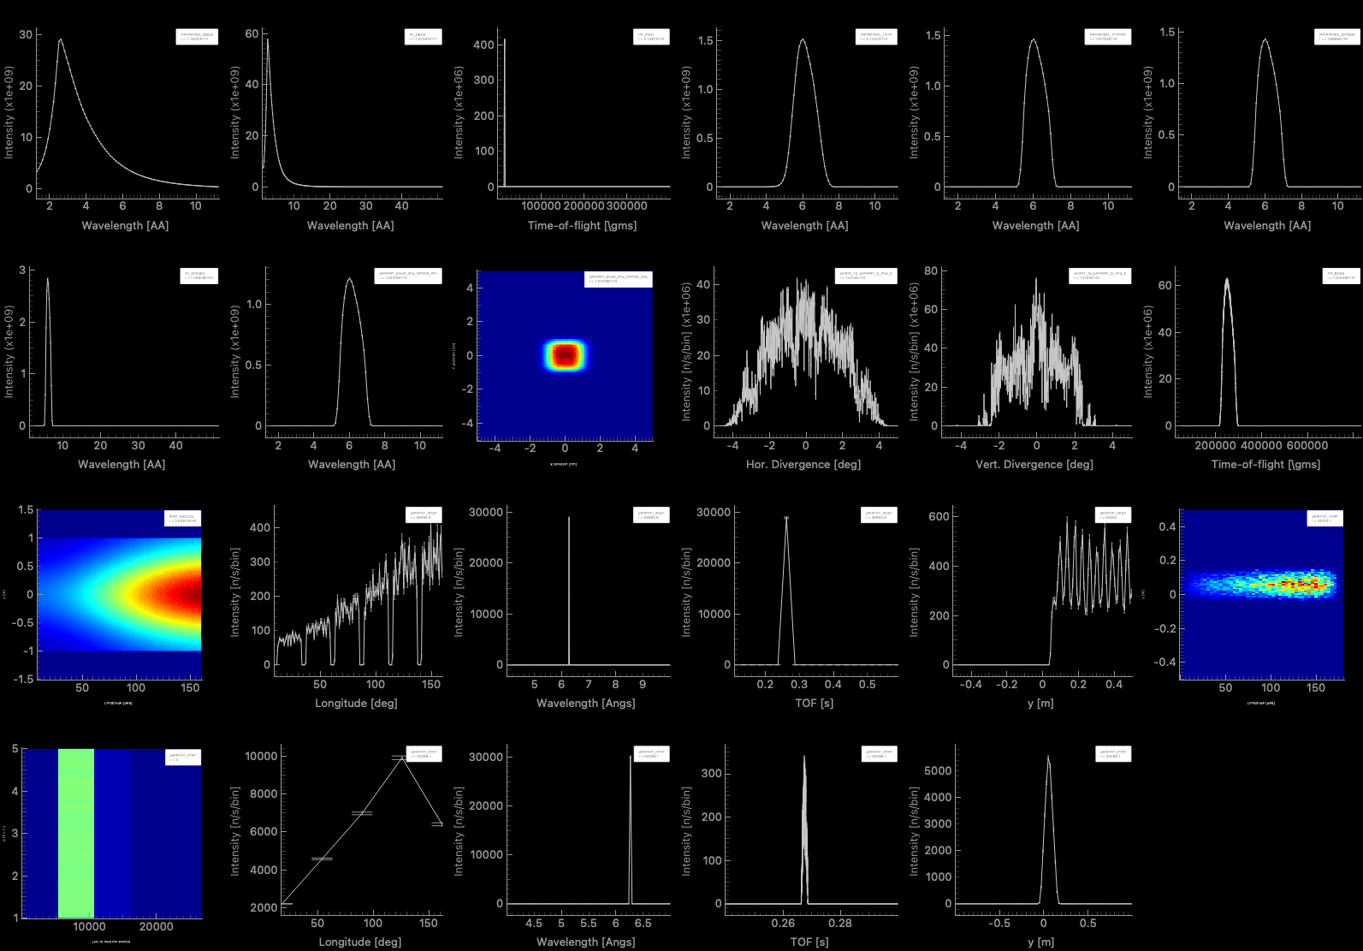
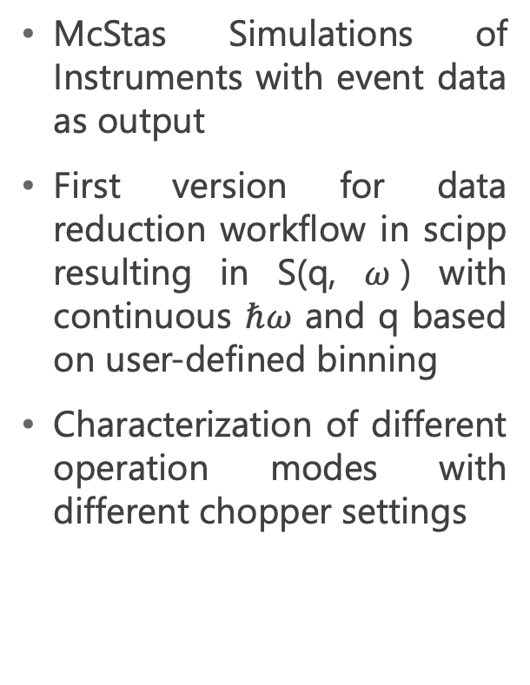
MIRACLES: Current Status
McStas Simulations of Instruments with event data as output
First version for data reduction workflow in scipp resulting in S(q, $ω$) with continuous $ℏω$ and q based on user-defined binning
Characterization of different operation modes with different chopper settings

Slide 7
MIRACLES: Next Steps
Data reduction
Normalization
Masking
Integration into essspectroscopy
Data workflow
File format
Setting up data pipeline
HC tools
Visualization of monitors
Instrument control
Possibility to easily compare to Mcstas

Slide 8
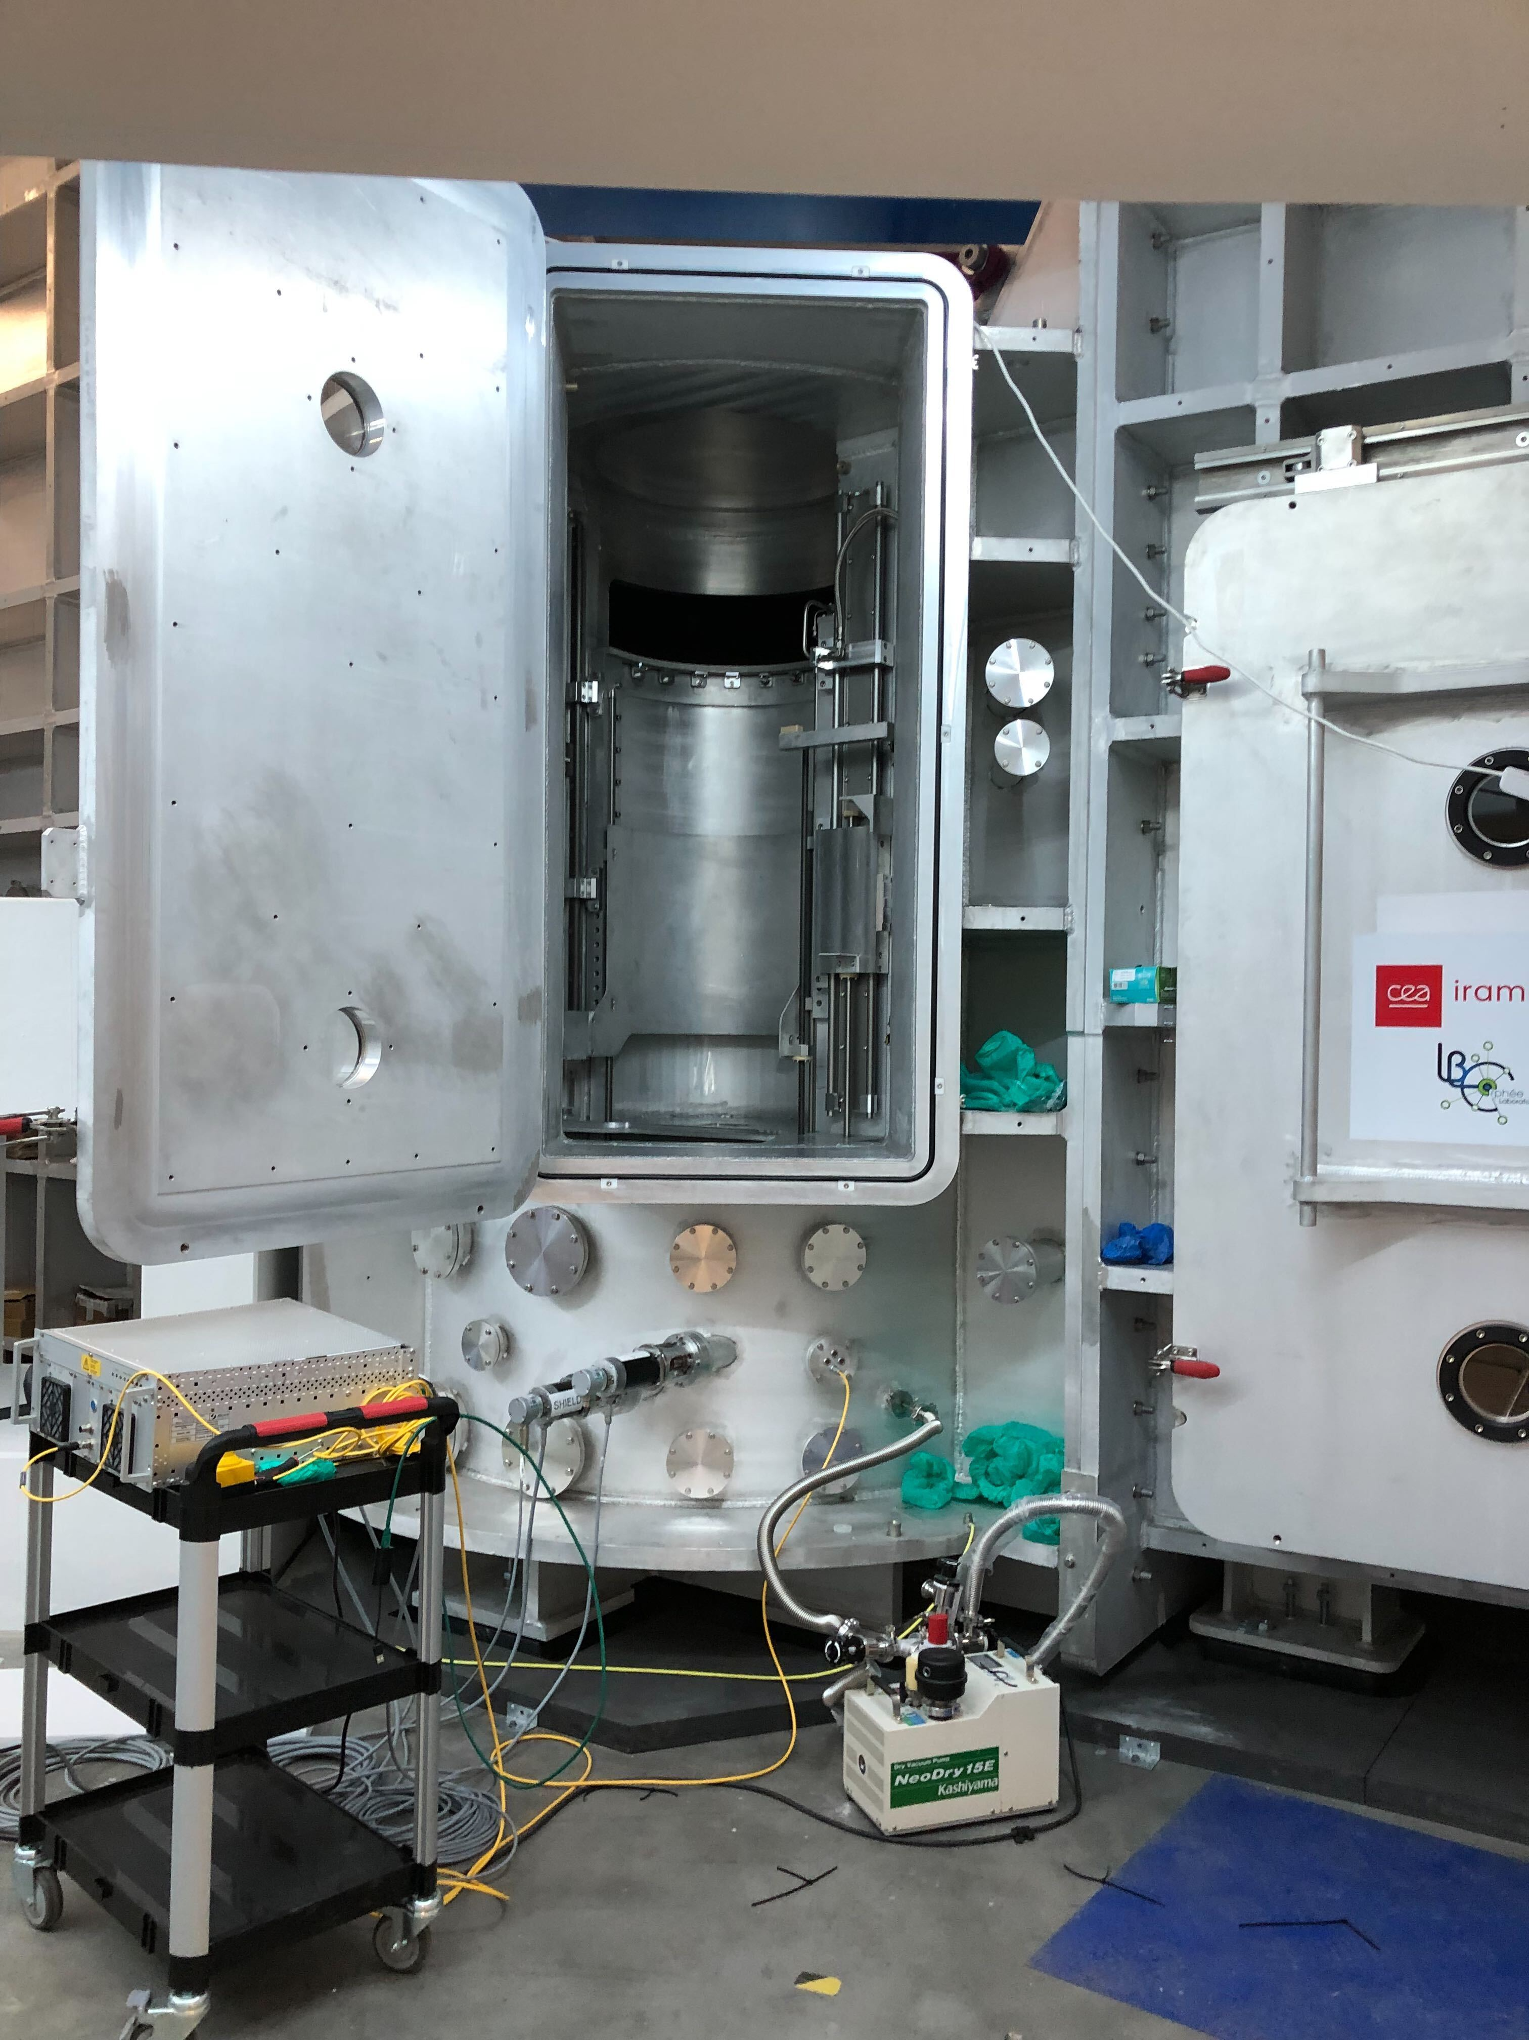
2
CSPEC
direct geometry time of flight spectrometer

Slide 9
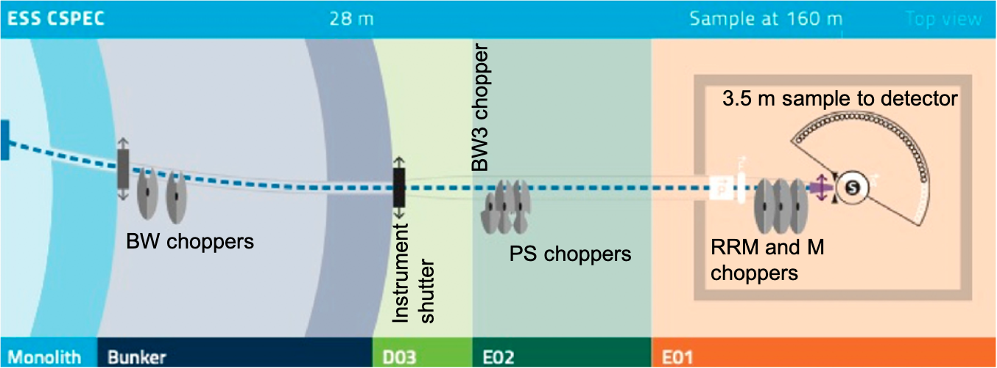


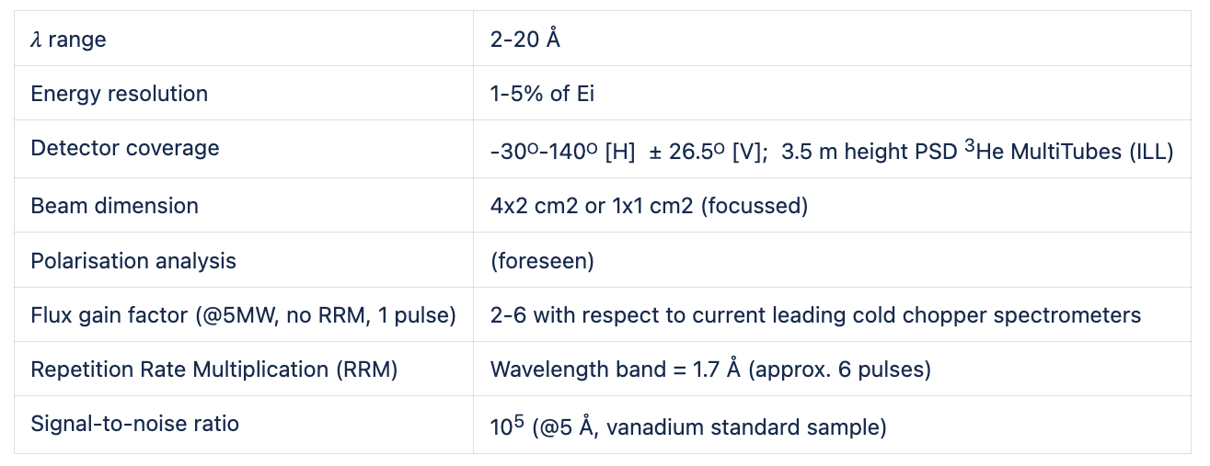
CSPEC: Instrument Description & Timeline
cold chopper spectrometer

Slide 10
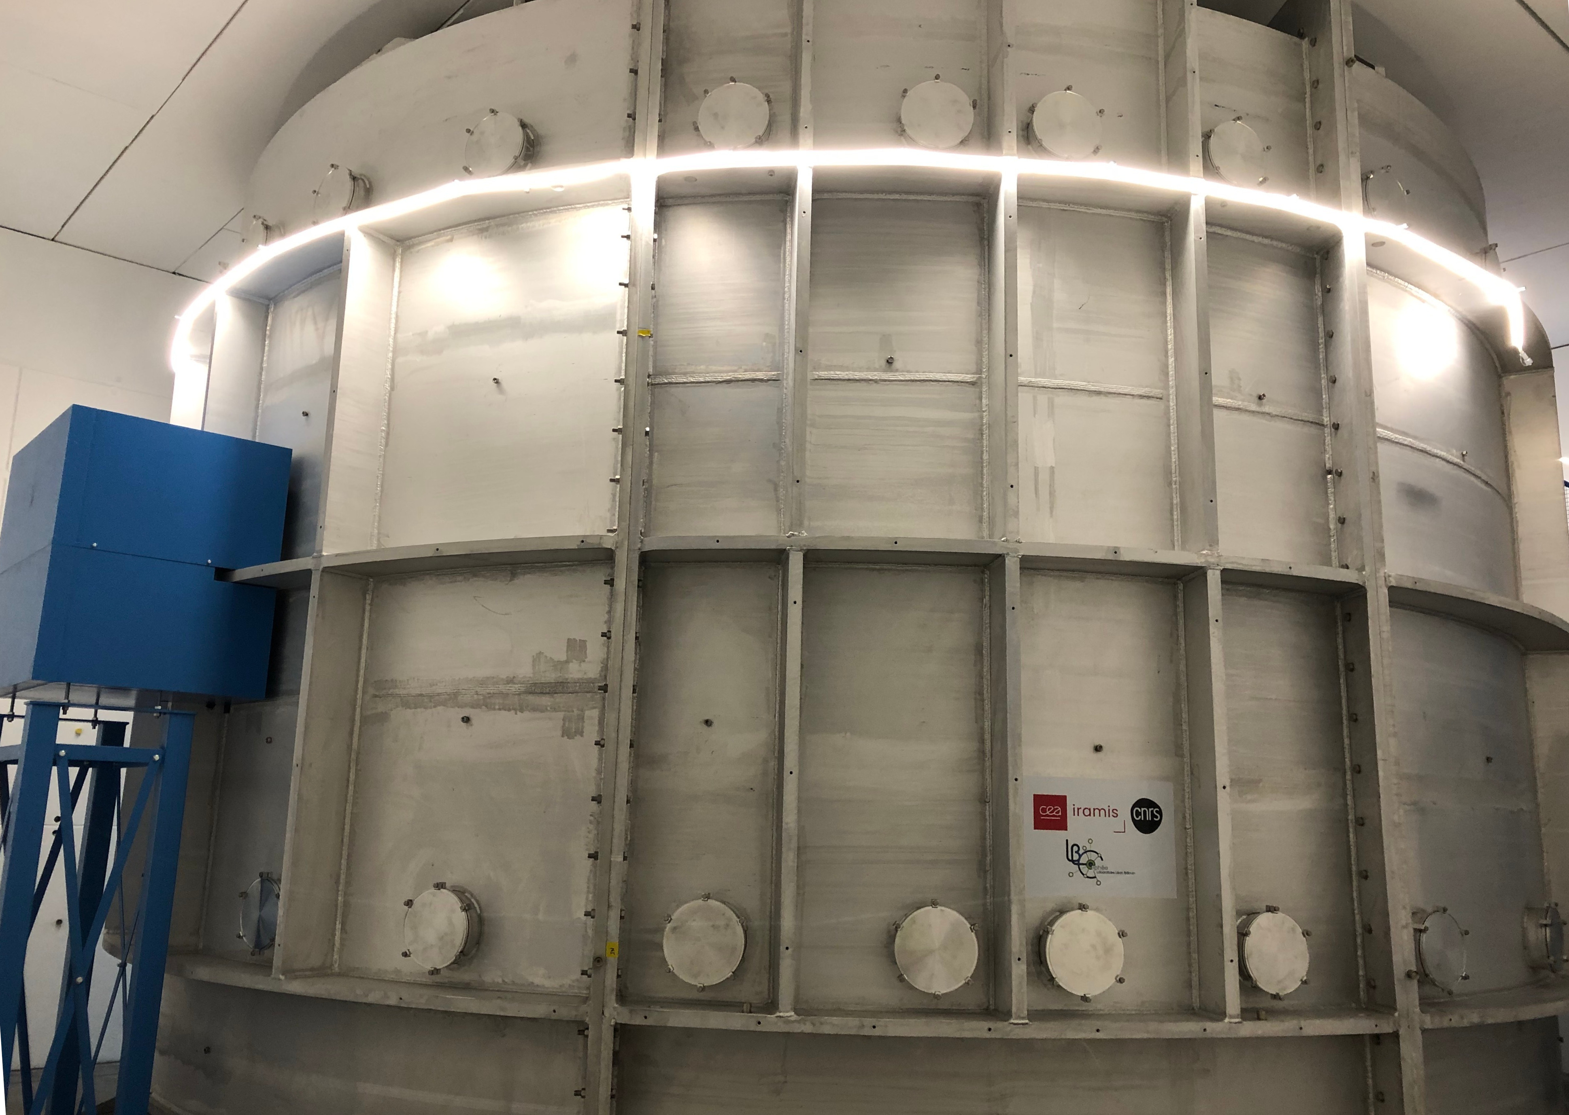
CSPEC: Current Status
Discussions started for :
McStas simulations
Data reduction workflow

Slide 11
CSPEC: Next Steps
McStas simulations
Creation of simulated data
Data reduction workflow
Define operation modes
Repetition rate multiplication (RRM)
Visualization tools
HC tools
Visualization of monitors
Instrument control
Possibility to easily compare to Mcstas

Slide 12
Thank you for your attention

Slide 13
Example with chart
Sub-headline to strengthen the headline above

Slide 14
Example with chart
Sub-headline to strengthen the headline above

Slide 15
Example with coloured table
Sub-headline to strengthen the headline above
Column A | Column B | Column C | Column D | Column E
Row 1 | Data | Data | Data | Data
Row 2 | Data | Data | Data | Data
Row 3 | Data | Data | Data | Data
Row 4 | Data | Data | Data | Data
Row 5 | Data | Data | Data | Data
Row 6 | Data | Data | Data | Data
Row 7 | Data | Data | Data | Data
Row 8 | Data | Data | Data | Data
Row 9 | Data | Data | Data | Data

