Slide 1
Update on DMSC Readiness for Hot Commissioning of T-REX
Bing Li, computational instrument scientist for T-REX (started 1 Dec. 2025)
2026-04-22

Slide 2
Contents
1 Overview of T-REX
2 Planning Tool/Prototyping
3 Data Reduction
4 Data Acquisition and Visualization
5 Data Analysis

Slide 3
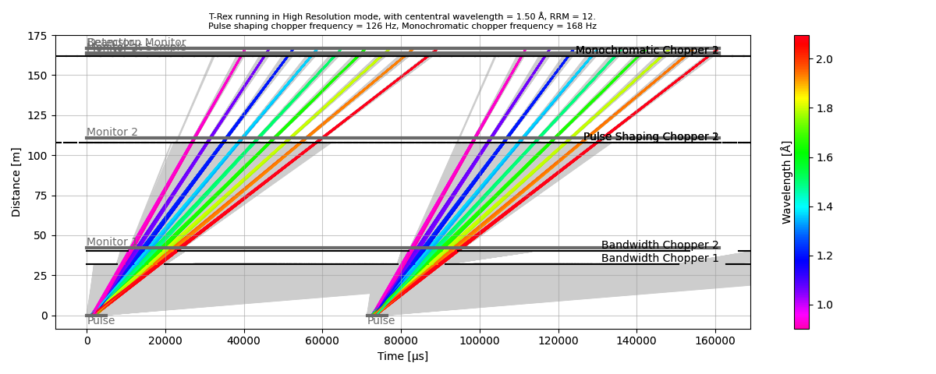
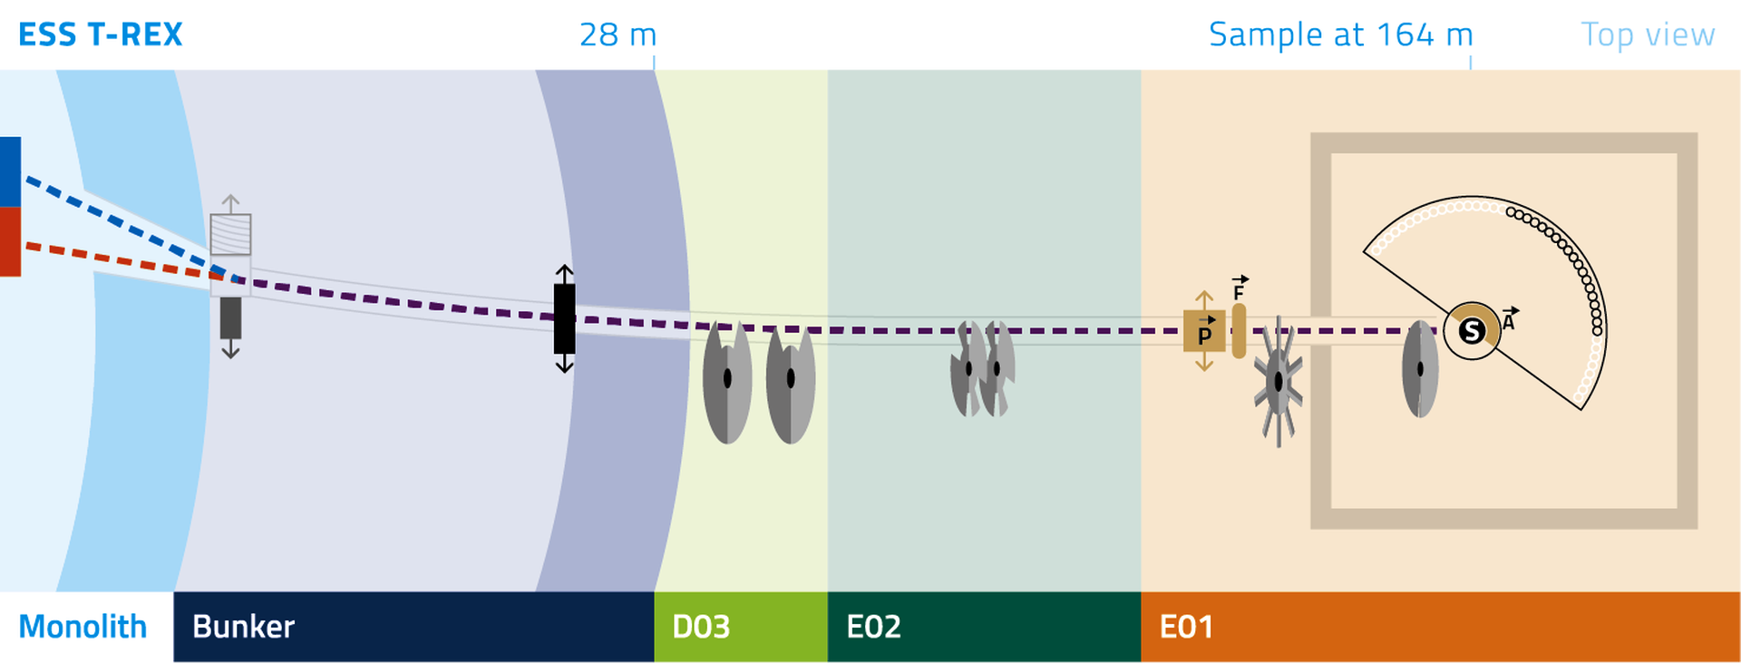
1. Overview of T-REX: Time-of-flight Reciprocal space EXplorer
Bispectral
Direct Geometry Spectrometer
Polarization Analysis
Repetition Rate Multiplication (RRM)
Fan Chopper Excluded

Slide 4
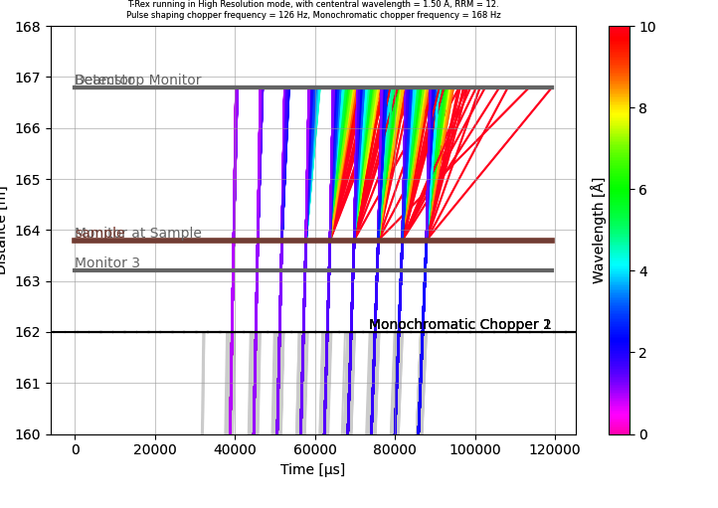
1. Overview of T-REX: Time-of-flight Reciprocal space EXplorer
Bispectral
Direct Geometry Spectrometer
Polarization Analysis
Repetition Rate Multiplication (RRM)
Fan Chopper Excluded

Slide 5
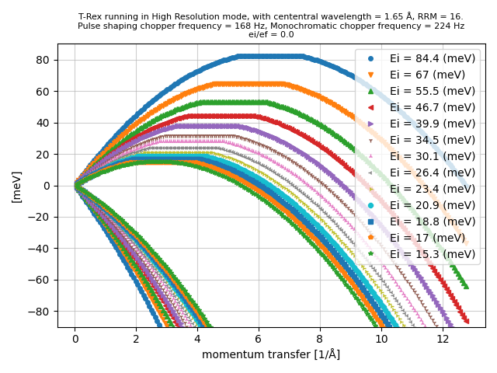
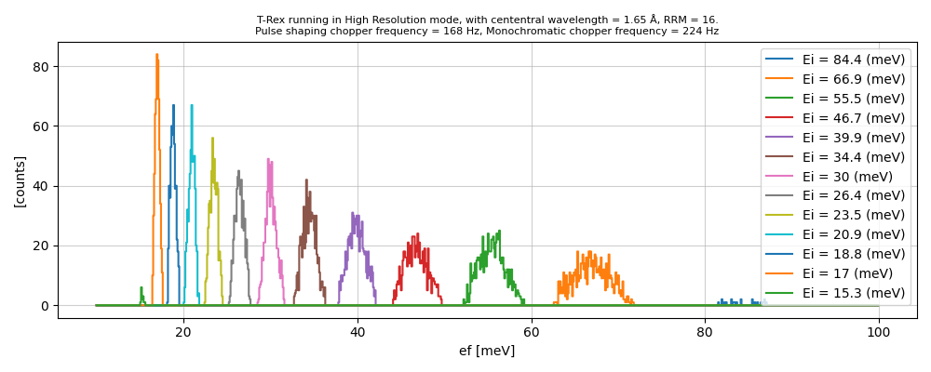
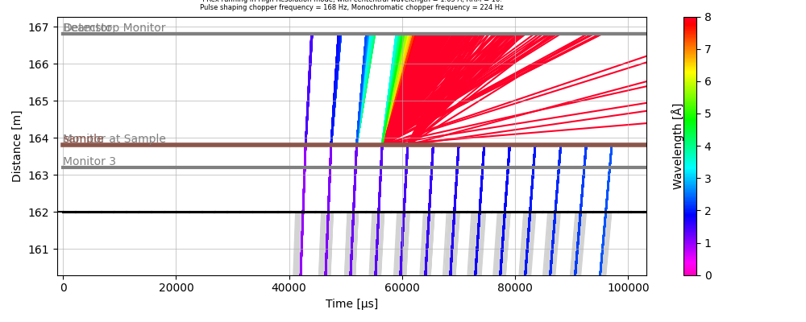
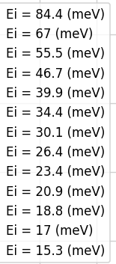
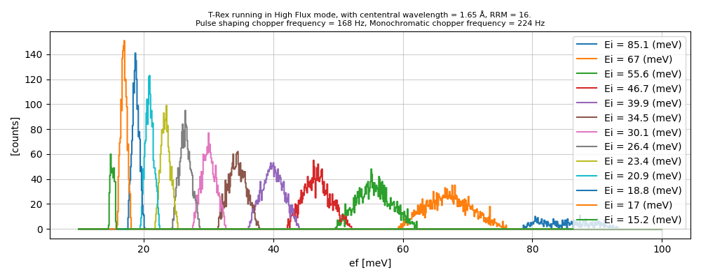
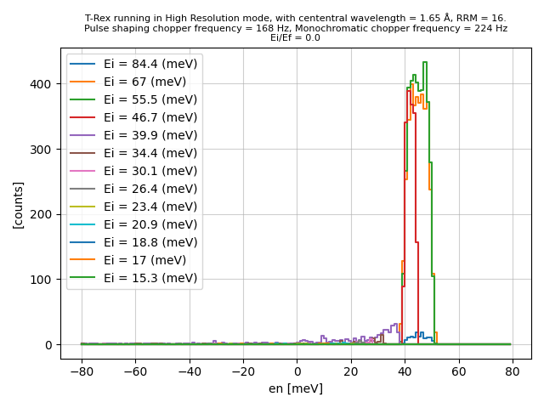
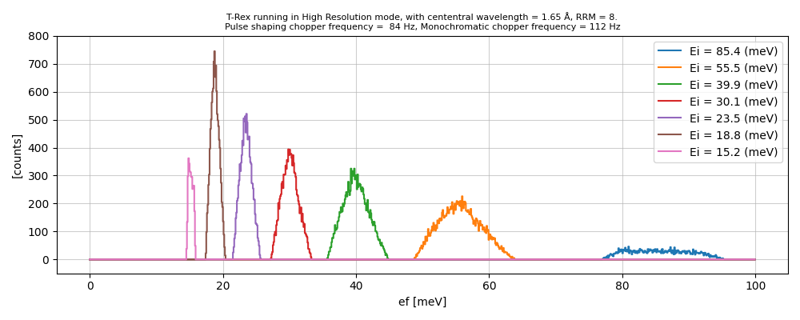
2.1. Planning Tool: drtrex (based on ToF & Scipp)
Elastic resolution & flux in different mode
Contamination due to frame overlapping
Estimation of Q,E-coverage
RRM=16, HR
RRM=16, HF
S(E)=45±5 meV
INS window
INS window
INS window
RRM=8, HR

Slide 6
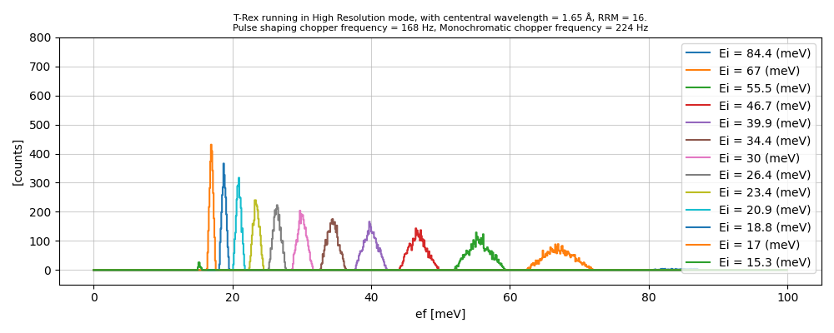
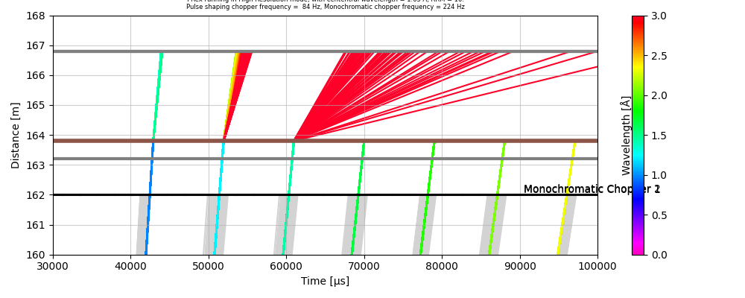
2.1. Challenges in Optimizing the Instrument Operational Parameters
High Resolution
Faster Spinning Choppers
Smaller Opening Time
Larger RRM
Low Flux
Frame-Overlap
Experimental planning tool needs to be available for instrument scientists and users to find the optimized operating parameters

Slide 7
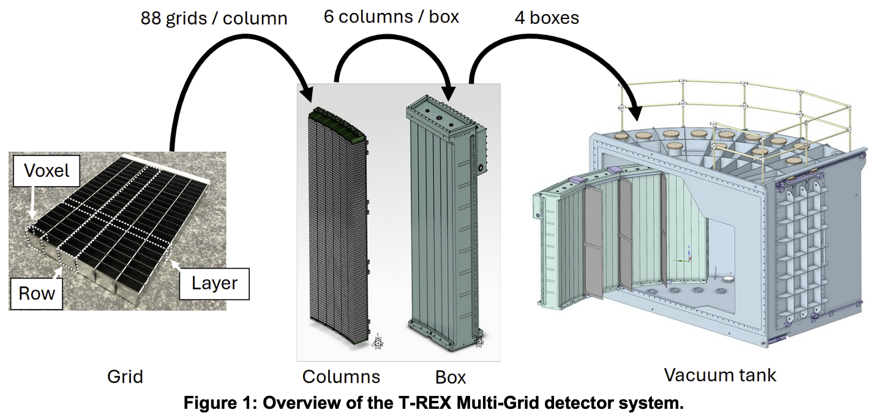
2.2. Prototyping of Multigrid Detector in McStas
6*20*88*6*4 =253,440 voxels (4 boxes) on Day One.
633,600 voxels (10 boxes) eventually.

Slide 8
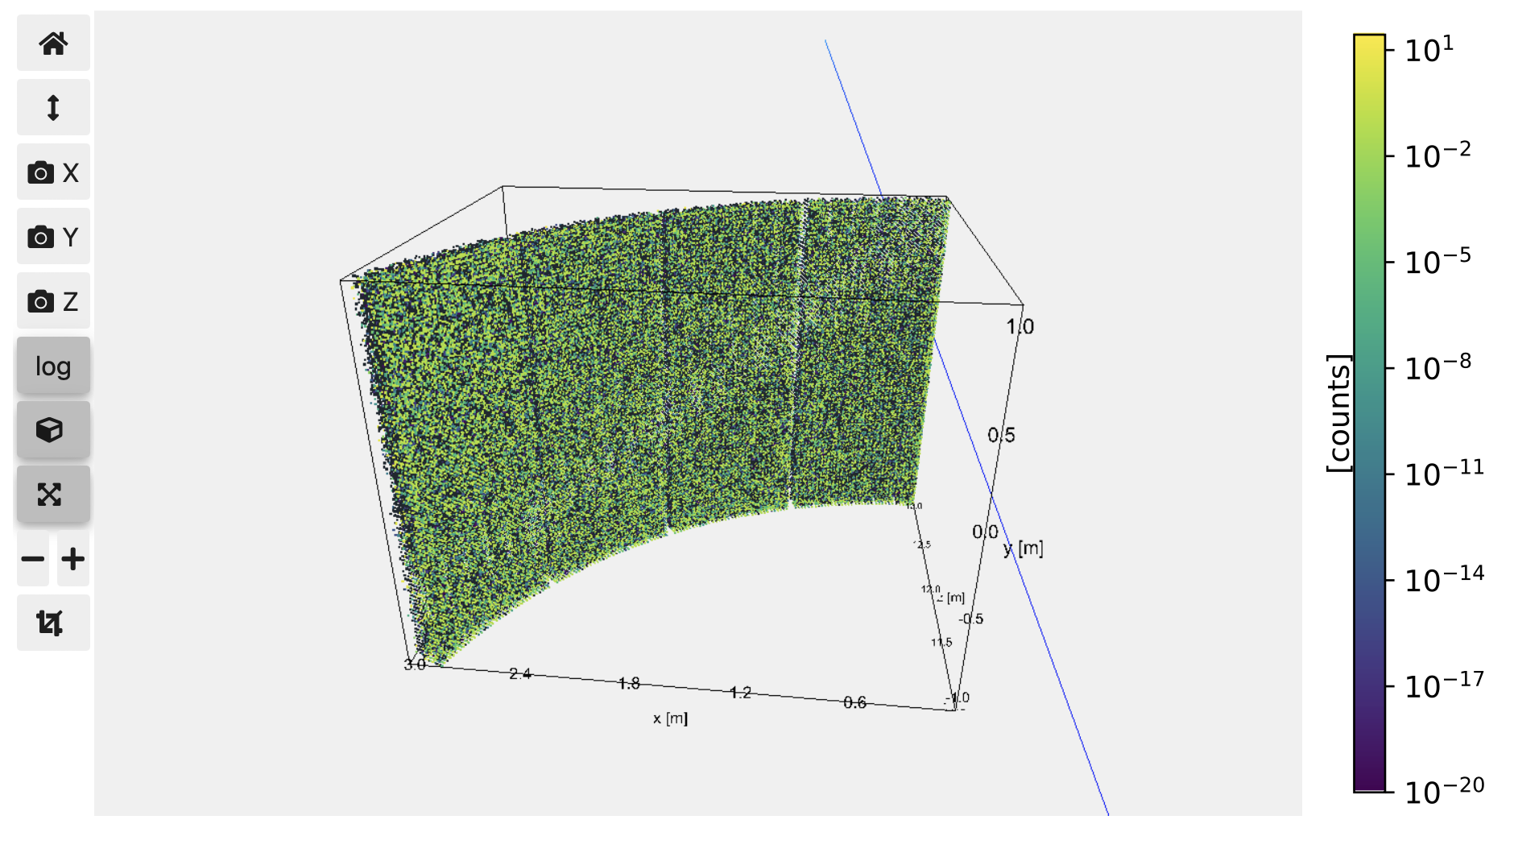
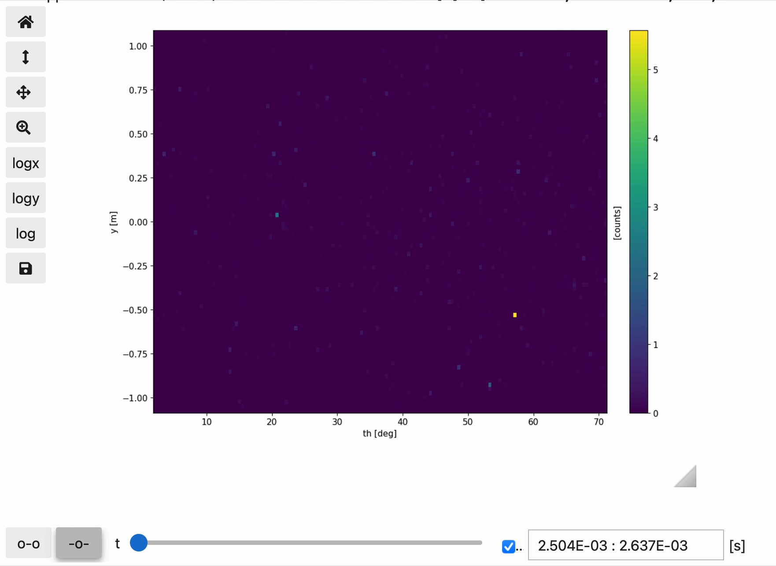
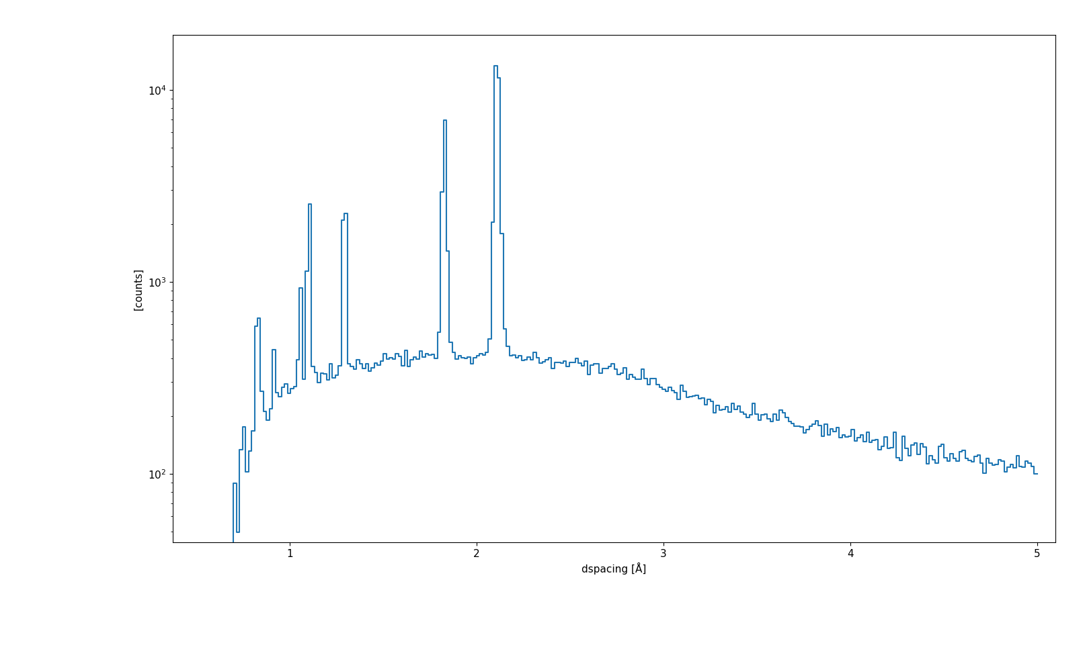
2.2. Prototyping of Multigrid Detector in McStas

Slide 9
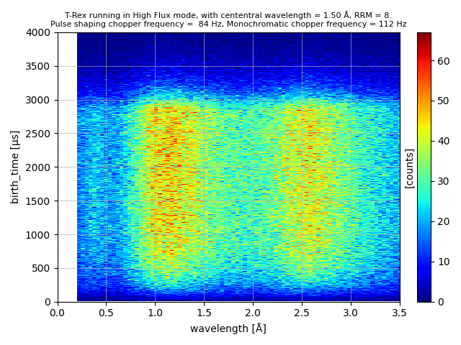
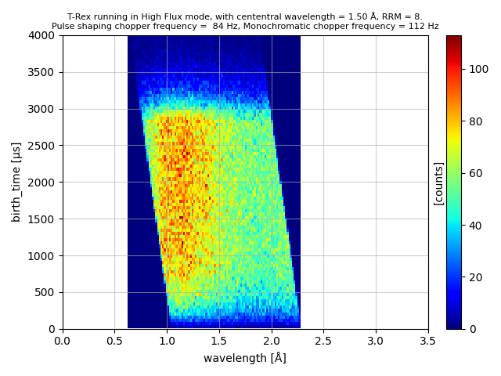
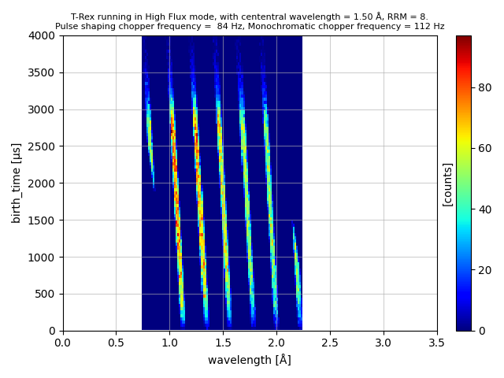
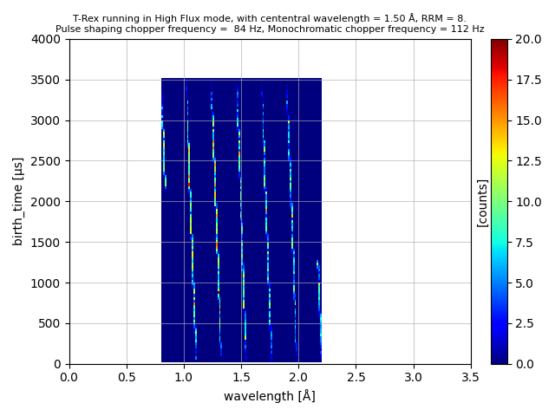
2.2. Challenges in Simulation: Low Efficiency
Faction of neutrons on sample < 0.5%
Needs optimization in sampling based on ROI

Slide 10
3. Data Reduction
Need to implement DgsReduction & MDNorm using Scipp
Tasks
Time to energy conversion
Pixel to momentum conversion & UB algorithm
Apply symmetry operations
Apply corrections, e.g. monitor efficiency
Normalization of intensity
Issues/Challenges
Are we allowed to measure Vanadium with a white beam?
How should we treat data taken with RRM?

Slide 11
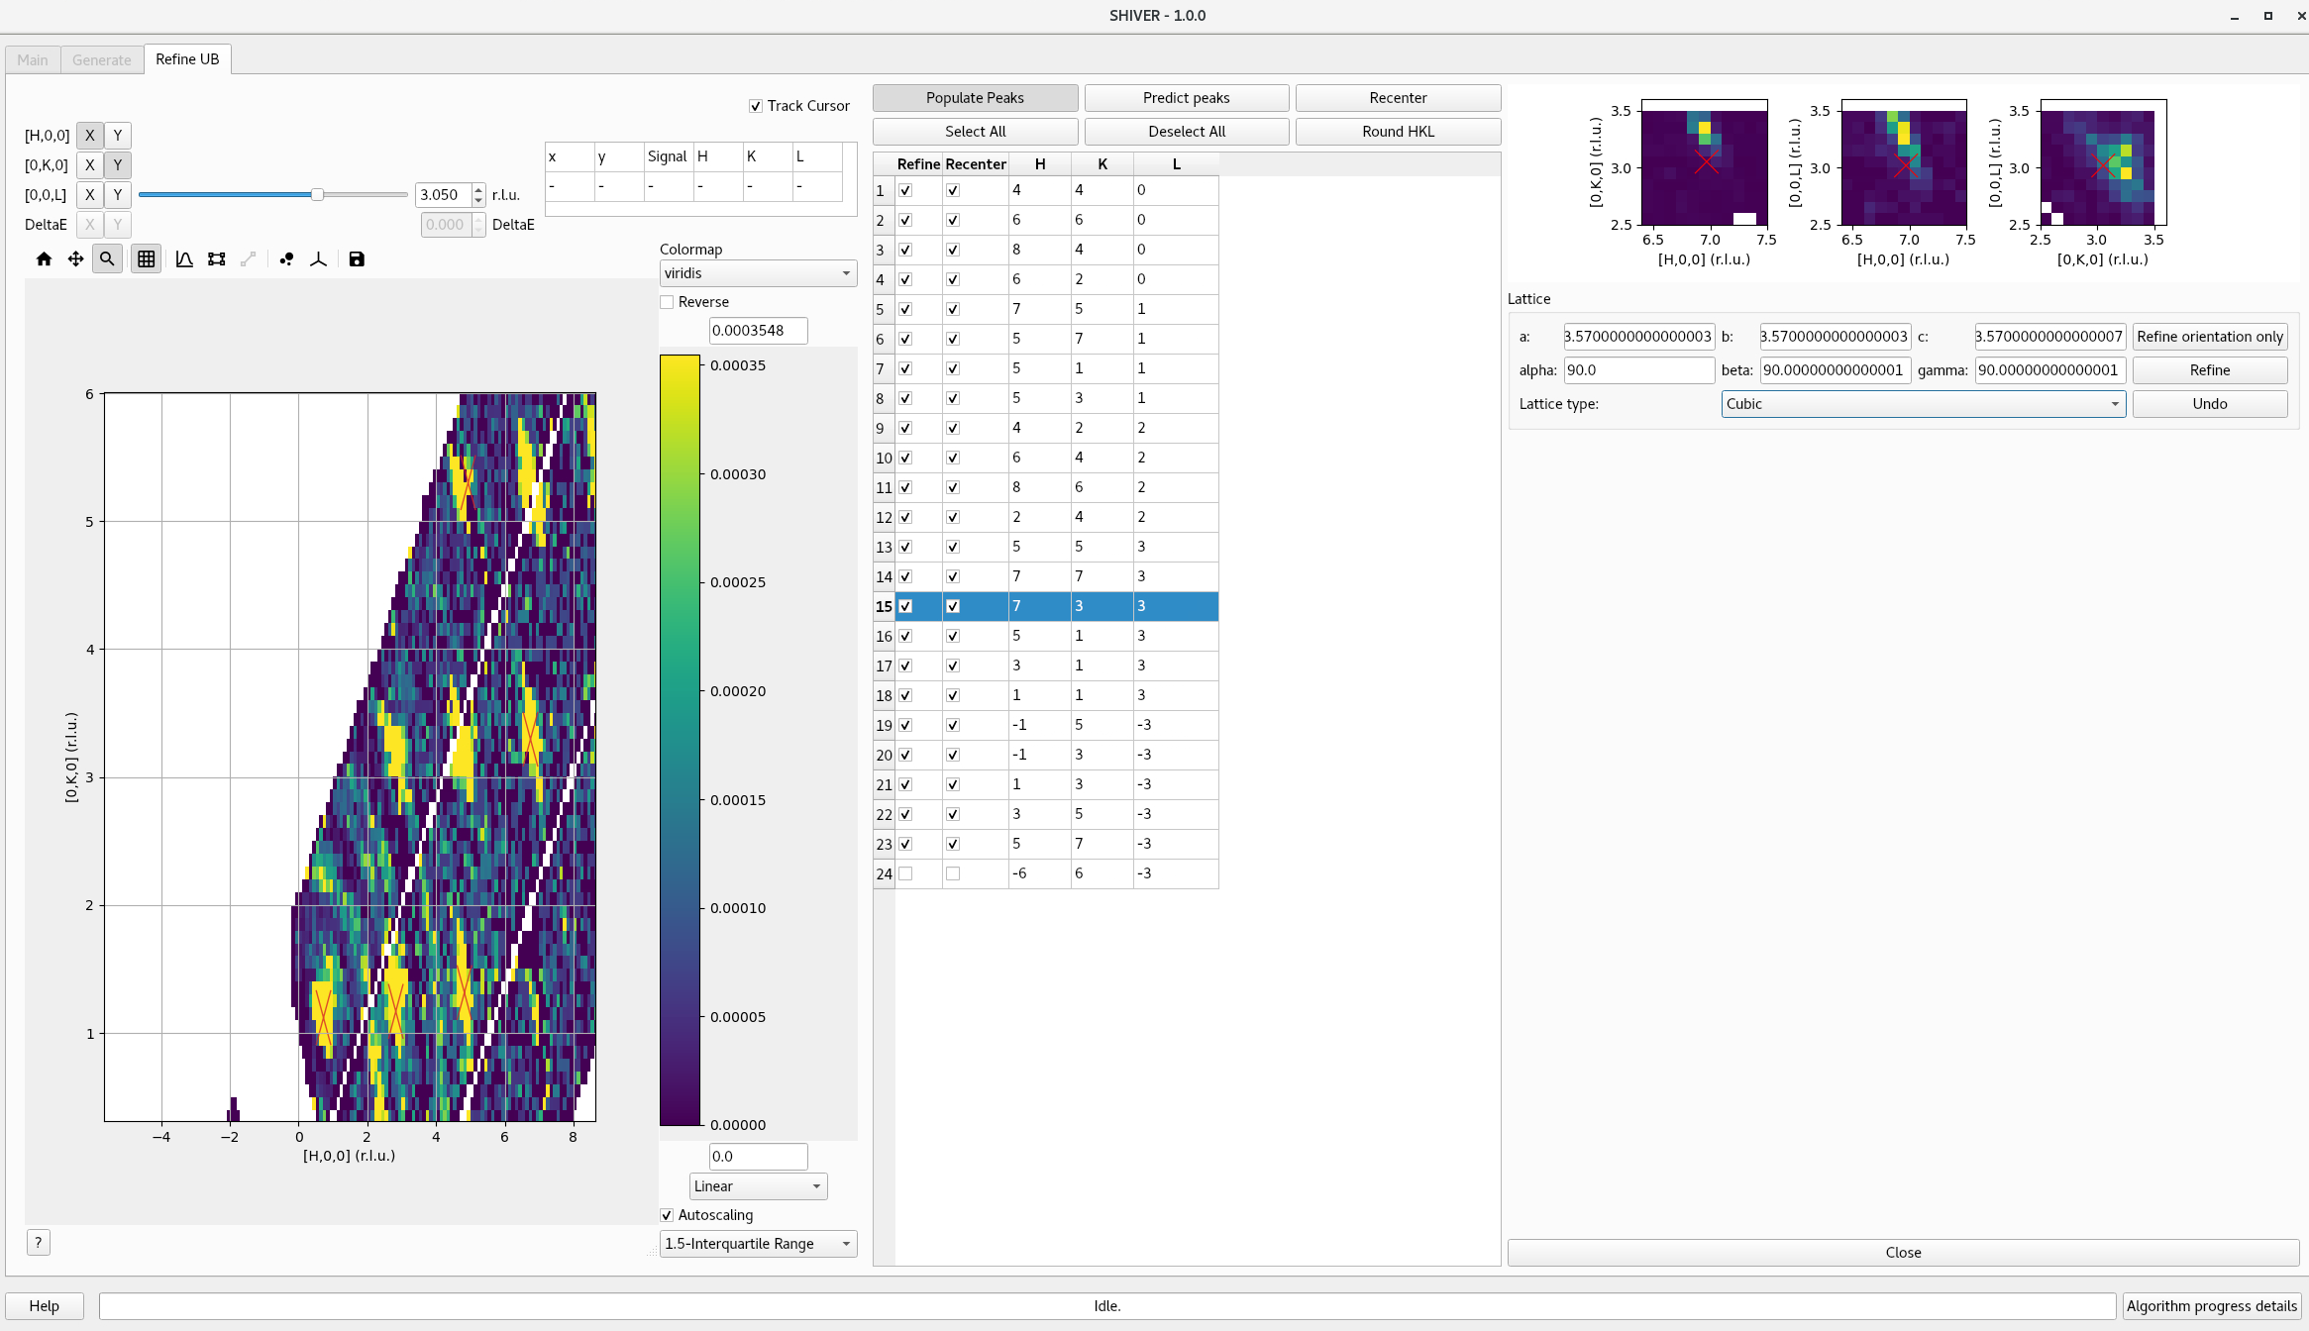
4. Data Acquisition and Visualization
Tasks:
Decision: continuous rotation vs. stop & count
Define Nexus scheme for data files
File format convertor for .nxspe, .sqw, etc.?
Live data visualization?
Issues/Challenges:
Too many pixels…
Script/JupyterNotebook/GUI?
https://neutrons.github.io/Shiver/

Slide 12
5. Data Analysis Software on VISA
Phonons
Phononpy (https://github.com/phonopy/phonopy)
Euphonic (https://github.com/pace-neutrons/euphonic)
Inspired (https://github.com/neutrons/inspired)
Magnetism
SpinW (https://github.com/spinw/spinw)
Sunny (https://github.com/SunnySuite/Sunny.jl)
PyCrysalField (https://github.com/asche1/PyCrystalField)
Utilities
FullProf (https://www.ill.eu/sites/fullprof/index.html)
Mag2Pol (https://www.ill.eu/for-ill-users/instruments/instruments-list/d3/software)
VESTA (https://jp-minerals.org/vesta/en/download.html)
ISOTROPY Suite (https://iso.byu.edu/isotropy.php)
Mantid (https://github.com/mantidproject/mantid)

Slide 13
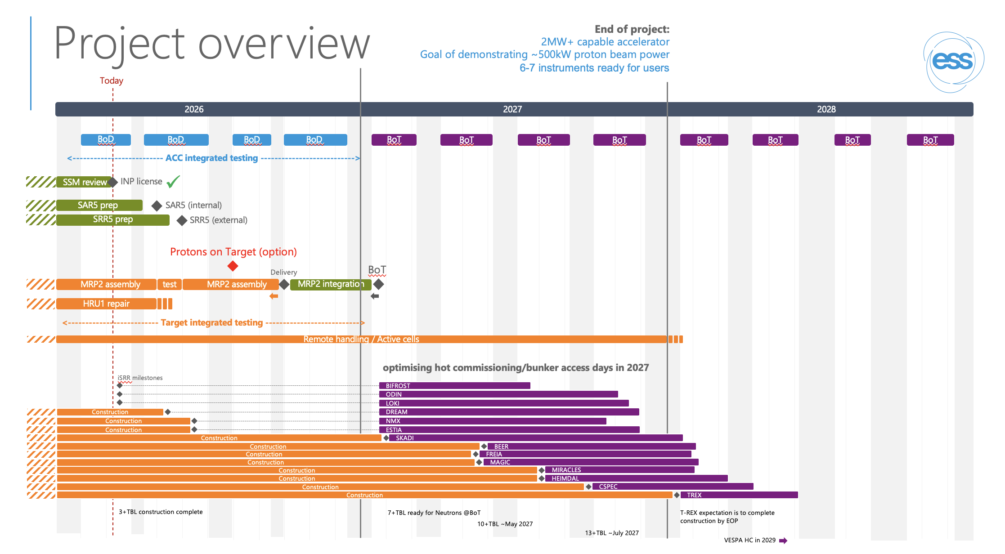
Timeline: ~20 months to make it happen

Slide 14
Thank you for your attention!

Slide 15
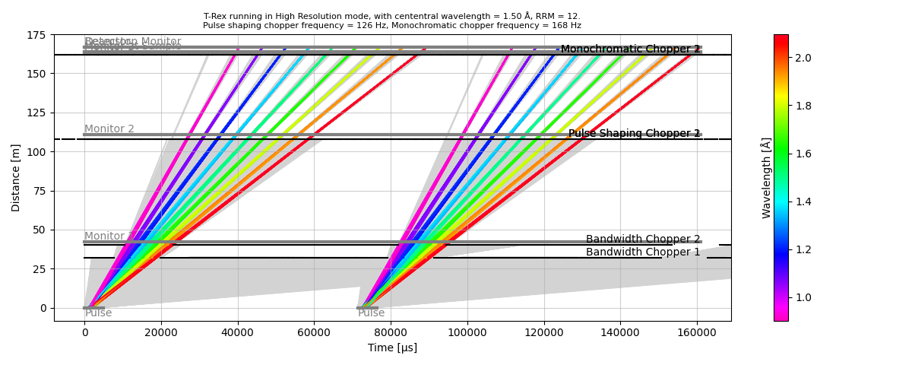
Operational Parameters
User input:
Central wavelength = 1.5 Å
RRM = 12 (getting 9 instead)
High resolution/flux mode
Chopper frequencies:
BW: 14 Hz
Mono: 14 * RRM
Pulse Shaping: 14 * RRM *3/4
RRM can to be 2N, even though the period is not 1/14 s, PS has two sets of openings

