Slide 1
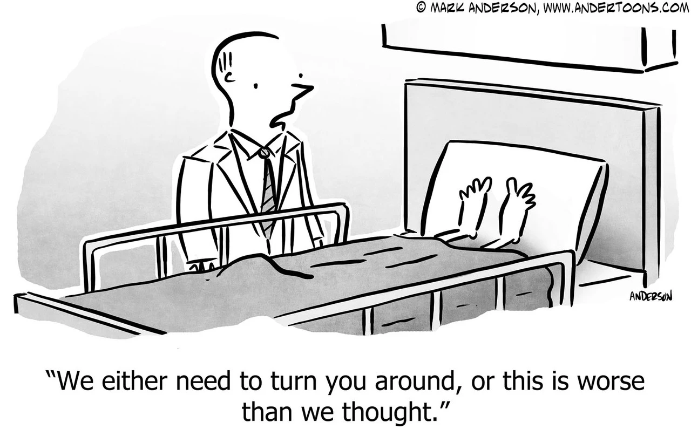

Slide 2

A reality
ESS is one of the most advanced scientific facilities ever built.
We can accelerate protons, we are designing instruments of extraordinary sophistication and we will, soon, produce neutrons.
A large start-up with the ambition to play in Champions league

Slide 3


Slide 4

Another reality

Slide 5
The daily experience…
When in doubt or disagreeing, pretend you pursue perfection, then postpone decision and action.
When something goes wrong, add a control.
When you dont want to own something, make sure it becomes someone else’s problem, then add a complicated governance.
Then springle some JIRA harassment and some CHESS sanctification!

Slide 6
ESS is a standard case of complexity management
The way organizations typically handle complexity and speed imperative
  With more governance,
  more controls,
  more rules,
  more coordination,
  more process layers.
  slower decisions,
  silos entrenched,
  reduced accountability,
  sub-optimal execution quality,
  disengagement.
Leading to
Complexity is unavoidable (multiple stakeholders, regulations, technologies, interdependencies)….
But complicatedness is self-inflicted (too many rules, approvals, interfaces, committees, reporting layers, procedures)

Slide 7
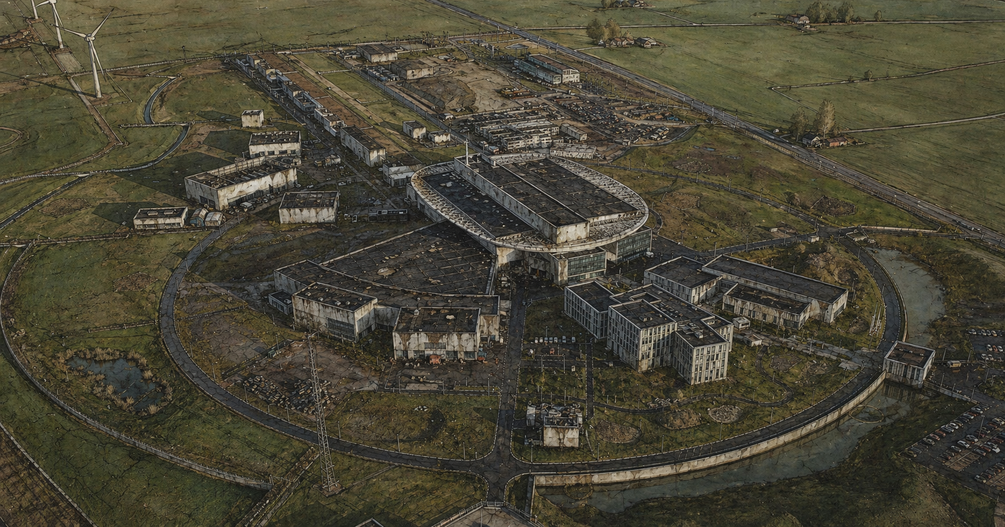

Slide 8
No magic potion – a complicated problem, multiple angles
The role of leadership and the importance of walking the talk
Shifting the ESS narrative/mindset: “Do we need this? Can we simplify it ?”
Network of “change partners”
Transformation workshops
Culture, leadership and psychological safety (assessment and action planning) Post BOT.
“It is OK to say I don’t know, I need help”

Slide 9


Slide 10
Our “tension spectrum” – understanding resistance
Structure and certainty
Perfect alignment & governance Optimal organisational sytem&response Thourough root cause analysis
Long-term problem prevention
Risk: Analysis paralysis and LT irrelevance
Equilibrium
Agility driven
Compliance driven
Speed and agility
Quick decisions
Operational agility
Optimal user response
Always on top
Risks: Long term problems
Our goals: defining the “sweet spot” for Users’ centricity in 2027 and beyond…
Our goal is not to optimize for one extreme, but to find the balance that delivers the agility needed for SSO
while maintaining sustainable and controlled operations over time.
This balance is an operational management decision. We are consulting candidly; we are not negotiating.
Every cursor position on the spectrum will come with trade-offs and risks, and we should be deliberate about these.

Slide 12



Slide 13


Slide 14
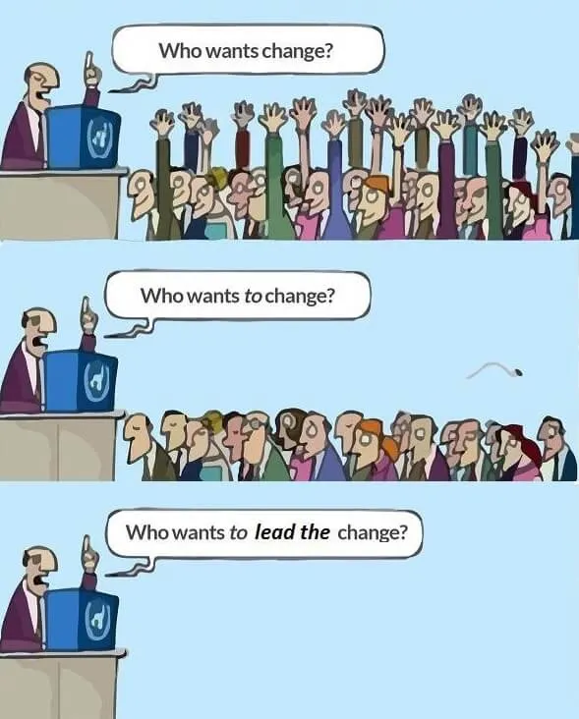
Change is attractive in the abstract…
much less attractive when it reaches us!

Slide 15
On your own
1 minute
Think of ONE behaviour at ESS that you believe needs to change.
Not a process. Not a rule or a structure. A behaviour.
e.g. Over-consulting, seeking perfection, escalating upwards, protecting resources, stone-walling, avoiding decisions and responsibilities, adding complexity….

Slide 16
Round 1: THE EASY PART
Make up a group (mix with people you don’t know)
- then for 4 minutes discuss
What behaviour do we most need to change at ESS?
Agree on one per group.

Slide 18
Round 2 : THE MIRROR
Within the same group - 5 minutes
How do WE personally contribute to keeping that behaviour alive?
Rule: No “they”. No “management”. No EB. No other directorate. Only “we, in Science” or “I”.

Slide 20
Round 3: THE TEST
At your table - 5 minutes
What would we have to do differently ourselves, in Science - even if nobody else changes first?
One concrete behaviour, not an aspiration

Slide 22
Consolidation
Bringing it all together… 5 minutes- at your table.
”We complain about _______. But we recognise that we _______.
So we could start by _______.”

Slide 23
Which crowd are you actually in?

