Slide 1
MAGIC ICEB
Critical paths, schedule adherence etc.

Slide 2
Completing design for T2T3 instruments
28 meetings held Sep 25 to Feb 26

Slide 3
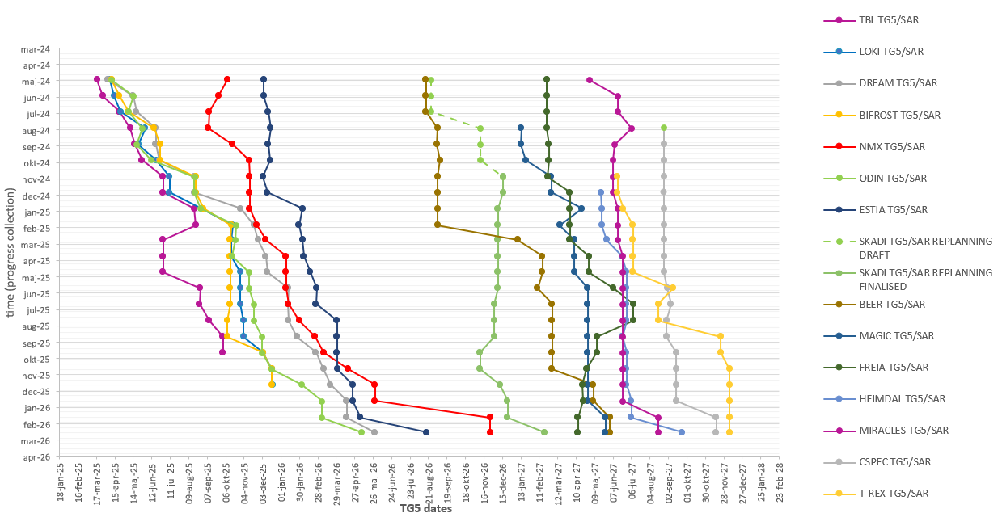
TG5 slip chart
Data from P6 MARCH 2026 lock down
TBL
LOKI,
BIFROST
TG5/SAR approved.
(iSRR held, approval pending)
,
NMX
MAGIC
BEER
SKADI
FREIA
MIRACLES,
HEIMDAL
ODIN,
CSPEC TREX
DREAM ESTIA
Note: For T2T3, tracking starts after replanning close-out. Vespa has TG5 in May 2029. Once TG5 is approved, the instrument will be removed from tracking.

Slide 4
136 days
110 days
116 days
49 days
111 days
80 days
276 days
98 days
89 days
38 days
36 days
78 days
74 days
47 days
2025
Magic Critical Paths
Data from P6 September 2025 lockdown
Final TG3
Start of CC
TG5/SAR approval
Today
Apr 21, 2026
Nov 26, 2026
Apr 28, 2027
2025
2026
2027
2027
Q3
Q4
Q1
Q2
Q3
Q4
Q1
Q2
No. 1 - Critical Path
(0 days TF)
Sep 2025 - Dec 2025
OoB VH+Supp: Design phase (LLB)
Sep 2025 - Sep 2026
OoB VH+Supp: Procurement and Manufacturing phase (LLB->ESS)
Sep 2026 - Nov 2026
OoB Guides + VH + Supp: Installation phase
Sep 2025 - Jan 2026
Oscillation of RC: Design phase (LLB)
No. 2 - Critical Path
(2 days TF)
Jan 2026 - Jul 2026
Oscillation of RC: Procurement and Manufacturing phase (LLB)
Jul 2026 - Sep 2026
RC and Oscillation (including support): Installation phase
Oct 2026 - Nov 2026
MCA (including sub-systems): Energization and Commissioning phase
No. 3 - Critical Path
(8 days TF)
Sep 2025 - Jan 2026
Support for Analyzer and Det B: Design phase (LLB)
Feb 2026 - Jul 2026
Support for Analyzer and Det B: Procurement and Manufacturing phase (LLB)
Jul 2026 - Nov 2026
Supports (Analyzer and Det B) and Analyzer seg 1: Installation and Commisioning phase (LLB)
Sep 2025 - Feb 2026
Sample Stage: Design phase (LLB)
No. 4 - Critical Path
(18 days TF)
Feb 2026 - May 2026
Sample Stage: Procurement and Manufacturing phase (LLB)
May 2026 - Jul 2026
Sample Stage: Installation phase
Jul 2026 - Oct 2026
MCA (including sub-systems): Energization and Commissioning phase
No big shift in TG5 from April to September BUT there’s a big difference in the amount of float between the different paths. Schedule has been compressed.
To note: transferring procurement from ESS to LLB for the OoB VH has been put in place as a mitigation
Design phase ends at CDR approval
Procurement and Manufacturing phase ends at FAT closure of open points
Installation and Commissioning phase ends at SAT approval
TF: number days of total float to Instrument’s TG5
Note: 2nd segment of Analyzer is part of the instrument scope but currently not linked to TG5 in P6
Notes:
2025-09
OoB VH 1 month delayed
SF 1 month delayed
Sample stage 1 month delayed
Supports RC + Det A 1 month delayed
Supports An + Det B 1 month delayed
RC 5 months delayed
Oscillation 1 month delayed
Good lift 1 month delayed
Beamstop 1 mont delayed
2025-06
OoB VH Deisgn delayed with 1 month. Manufacturing to more realistic estimates delayed with 5 months (procurement transferred to ESS, if it hadn’t been, we had seen even bigger delays)
Sample stage design delayed with 1 month.
2024-04
IB guide and VH + Support on the critical path
2025-03
Polarizer design + 2 month
Supports for RC + Det A + 1 months
2025-02
Polarizer design + 1 month
Oscillation design+ 2 months
Sample stage design+ 3 months
2024-12
LLB desinger: RF Spin flipper + OoB Vh suppoert
Mortiz + desgin pool: supports A and B
Danielle: elevated platform
LLLB 2: sample stage

Slide 5
0 days
+17 days
0 days
Mar 2026 - Aug 2026
Aug 2026 - Oct 2026
Oct 2026 - Dec 2026
Jun 2026 - Sep 2026
Sep 2026 - Jan 2027
Jul 2026 - Nov 2026
Nov 2026 - Jan 2027
Aug 2026 - Nov 2026
Nov 2026 - Dec 2026
Mar 2026 - Aug 2026
0 days
0 days
101 days
128 days
126 days
30 days
26 days
50 days
81 days
78 days
35 days
48 days
93 days
48 days
66 days
16 days
5 days
0 days
0 days
Jan 14
Jan 12
Nov 19
Dec 16
2026
Magic Critical Paths
Cold commissioning TG5 scope complete
Jan 28, 2027
Data from P6 March 2026 lockdown
Final TG3
TG5/SAR approval
Today
Oct 15, 2026
May 26, 2027
2026
2027
2027
Q1
Q2
Q3
Q4
Q1
Q2
False floor: Procurement and Installation phase
No. 1 - Critical Path
(0 days TF)
MCA & CEP: Rack installation and Energization
MCA: Local testing of sub-system
Dec 2026 - Jan 2027
Det A and Det B: Integrated testing
Jan 2027 - Jan 2027
Final Integrated testing
OoB VH+Supp: Manufacturing phase sections 1, 5 and 3 (LLB)
No. 2 - Critical Path
(5 days TF)
Polarizer: Manufacturing phase (LLB)
Polarizer: Installation and commissioning phase (LLB)
Back into CP1 with 5 days of float
No. 3 - Critical Path
(5 days TF)
OoB VH+Supp: Manufacturing phase section 4 and 2 (LLB)
OoB VH+Supp: Installation phase section 2 (LLB)
Back into CP2 with 5 days of float
Mar 2026 - May 2026
Oscillation of RC: Design phase (LLB)
No. 4 - Critical Path
(11 days TF)
May 2026 - Sep 2026
Oscillation of RC: Manufacturing phase (LLB)
Sep 2026 - Nov 2026
RC and Oscillation and Det A: Installation phase
Back into CP1 with 11 days of float
No. 5 - Critical Path
(11 days TF)
OoB VH+Supp section 3 and chopper pit: Manufacturing and Installation phase (LLB)
Local and Integrated testing of Chopper System
Design phase ends at CDR approval
Procurement and Manufacturing phase ends at FAT closure of open points
Installation and Commissioning phase ends at SAT approval
TF: number days of total float to Instrument’s TG5
Back into CP2 with 11 days of float
Note: 2nd segment of Analyzer is part of the instrument scope but currently not linked to TG5 in P6
Notes:
2026-03
MCA plan updated with links to false floor etc.
Polarizer FAT 85 days delayed
Support-RC+Det A: 26 days delayed
2026-02
OoB VH and Supports installation: 76 days delayed (some mitigations through re-prioritizing the sequence)
TG5: 18 days delayed
Sample stage: 25 days delayed
Analyzer seg 1 (128 days delayed from replanning)
2025-09
OoB VH 1 month delayed
SF 1 month delayed
Sample stage 1 month delayed
Supports RC + Det A 1 month delayed
Supports An + Det B 1 month delayed
RC 5 months delayed
Oscillation 1 month delayed
Good lift 1 month delayed
Beamstop 1 mont delayed
2025-06
OoB VH Deisgn delayed with 1 month. Manufacturing to more realistic estimates delayed with 5 months (procurement transferred to ESS, if it hadn’t been, we had seen even bigger delays)
Sample stage design delayed with 1 month.
2024-04
IB guide and VH + Support on the critical path
2025-03
Polarizer design + 2 month
Supports for RC + Det A + 1 months
2025-02
Polarizer design + 1 month
Oscillation design+ 2 months
Sample stage design+ 3 months
2024-12
LLB desinger: RF Spin flipper + OoB Vh suppoert
Mortiz + desgin pool: supports A and B
Danielle: elevated platform
LLLB 2: sample stage

Slide 6
0 days
0 days
0 days
0 days
0 days
101 days
102 days
26 days
82 days
69 days
20 days
40 days
60 days
20 days
5 days
Oct 14
Oct 1
2026
Magic Critical Paths
Data from P6 April 2026
Final TG3
Cold commissioning TG5 scope complete
TG5/SAR approval
Today
Oct 26, 2026
Mar 24, 2027
Aug 18, 2027
2026
2027
2027
Q2
Q3
Q4
Q1
Q2
Q3
Apr 2026 - Jul 2026
Sample Stage: Design and Procurement phase (LLB)
Jul 2026 - Oct 2026
Sample Stage: Manufacturing phase (LLB)
No. 1 - Critical Path
(0 days TF)
Oct 2026 - Nov 2026
Sample Stage: Installation phase
Nov 2026 - Feb 2027
MCA: Local testing of sub-system (instrument zone)
Feb 2027 - Mar 2027
Sample Stage, Rc + Oscillation, Det A, Det B: Commissioning phase
Mar 2027 - Mar 2027
Final integrated testing
Apr 2026 - Aug 2026
Support for Analyzer and Det B: Procurement and Manufacturing phase (LLB)
No. 2 - Critical Path
(30 days TF)
Aug 2026 - Oct 2026
Det B (including supports and analyzer frame): Installation and Commissioning phase (LLB & PSI)
Back into CP1 with 30 days of float
Apr 2026 - Aug 2026
False floor: Procurement and Installation phase
No. 3 - Critical Path
(39 days TF)
Aug 2026 - Oct 2026
MCA & CEP: Rack installation and Energization
Back into CP1 with 39 days of float
TG5 approval:
39 days delay in the April period
130 days delay since rebaseline
Design phase ends at CDR approval
Procurement and Manufacturing phase ends at FAT closure of open points
Installation and Commissioning phase ends at SAT approval
TF: number days of total float to Instrument’s TG5
Note: Analyzer optics is part of the instrument scope but currently not linked to TG5 in P6
Notes:
2026-04
Sample stage FAT: 37 days delayed
Support-Analyser+ DetB: 41 days delayed
False floor: 10 days delayed (+ previously missing link which now makes it more schedule critical)
OoB VH & Supp section 3: 20 days delayed
Support-RC+ DetA: 26 days delayed
2026-03
MCA plan updated with links to false floor etc.
Polarizer FAT 85 days delayed
Support-RC+Det A: 26 days delayed
2026-02
OoB VH and Supports installation: 76 days delayed (some mitigations through re-prioritizing the sequence)
TG5: 18 days delayed
Sample stage: 25 days delayed
Analyzer seg 1 (128 days delayed from replanning)
2025-09
OoB VH 1 month delayed
SF 1 month delayed
Sample stage 1 month delayed
Supports RC + Det A 1 month delayed
Supports An + Det B 1 month delayed
RC 5 months delayed
Oscillation 1 month delayed
Good lift 1 month delayed
Beamstop 1 mont delayed
2025-06
OoB VH Deisgn delayed with 1 month. Manufacturing to more realistic estimates delayed with 5 months (procurement transferred to ESS, if it hadn’t been, we had seen even bigger delays)
Sample stage design delayed with 1 month.
2024-04
IB guide and VH + Support on the critical path
2025-03
Polarizer design + 2 month
Supports for RC + Det A + 1 months
2025-02
Polarizer design + 1 month
Oscillation design+ 2 months
Sample stage design+ 3 months
2024-12
LLB desinger: RF Spin flipper + OoB Vh suppoert
Mortiz + desgin pool: supports A and B
Danielle: elevated platform
LLLB 2: sample stage

Slide 7
0 days
0 days
0 days
-39 days
0 days
Oct 22
101 days
104 days
35 days
66 days
16 days
58 days
54 days
35 days
66 days
40 days
0 days
0 days
0 days
0 days
Jan 12
Dec 16
Nov 2
2026
Magic Critical Paths
Data from P6 April 2026
Final TG3
Cold commissioning TG5 scope complete
TG5/SAR approval
Today
Oct 26, 2026
Mar 24, 2027
Aug 18, 2027
2026
2027
2027
Q2
Q3
Q4
Q1
Q2
Q3
Apr 2026 - Aug 2026
OoB VH+Supp: Manufacturing phase sections 1, 5 and 3 (LLB)
No. 4 - Critical Path
(46 days TF)
Jul 2026 - Nov 2026
OoB VH+Supp: Manufacturing phase section 4 and 2 (LLB)
Nov 2026 - Jan 2027
OoB VH+Supp: Installation and commissioning phase section 2 (LLB)
Back into CP1 with 46 days of float
From CP4
Aug 25
No. 5 - Critical Path
(55 days TF)
Aug 2026 - Nov 2026
OoB VH+Supp section 3 and chopper pit: Installation phase (LLB)
Nov 2026 - Dec 2026
Local and Integrated testing of Chopper System
Back into CP1 with 55 days of float
Apr 2026 - Jun 2026
Supports for RC and Det A: Design phase (LLB->ESS)
No. 6 - Critical Path
(70 days TF)
Jun 2026 - Sep 2026
Supports for RC and Det A: Procurement and Manufacturing phase (LLB)
Sep 2026 - Oct 2026
Det A (including supports): Installation phase (LLB)
Back into CP1 with 70 days of float
From CP4
Jun 8
No. 7 - Critical Path
(87 days TF)
Jun 2026 - Sep 2026
Polarizer: Manufacturing phase (LLB)
Sep 2026 - Nov 2026
Polarizer: Installation phase (LLB)
Back into CP1 with 87 days of float
Design phase ends at CDR approval
Procurement and Manufacturing phase ends at FAT closure of open points
Installation and Commissioning phase ends at SAT approval
TF: number days of total float to Instrument’s TG5
Note: Analyzer optics is part of the instrument scope but currently not linked to TG5 in P6
Notes:
2026-04
Sample stage FAT: 37 days delayed
Support-Analyser+ DetB: 41 days delayed
False floor: 10 days delayed (+ previously missing link which now makes it more schedule critical)
OoB VH & Supp section 3: 20 days delayed
Support-RC+ DetA: 26 days delayed
2026-03
MCA plan updated with links to false floor etc.
Polarizer FAT 85 days delayed
Support-RC+Det A: 26 days delayed
2026-02
OoB VH and Supports installation: 76 days delayed (some mitigations through re-prioritizing the sequence)
TG5: 18 days delayed
Sample stage: 25 days delayed
Analyzer seg 1 (128 days delayed from replanning)
2025-09
OoB VH 1 month delayed
SF 1 month delayed
Sample stage 1 month delayed
Supports RC + Det A 1 month delayed
Supports An + Det B 1 month delayed
RC 5 months delayed
Oscillation 1 month delayed
Good lift 1 month delayed
Beamstop 1 mont delayed
2025-06
OoB VH Deisgn delayed with 1 month. Manufacturing to more realistic estimates delayed with 5 months (procurement transferred to ESS, if it hadn’t been, we had seen even bigger delays)
Sample stage design delayed with 1 month.
2024-04
IB guide and VH + Support on the critical path
2025-03
Polarizer design + 2 month
Supports for RC + Det A + 1 months
2025-02
Polarizer design + 1 month
Oscillation design+ 2 months
Sample stage design+ 3 months
2024-12
LLB desinger: RF Spin flipper + OoB Vh suppoert
Mortiz + desgin pool: supports A and B
Danielle: elevated platform
LLLB 2: sample stage

Slide 8
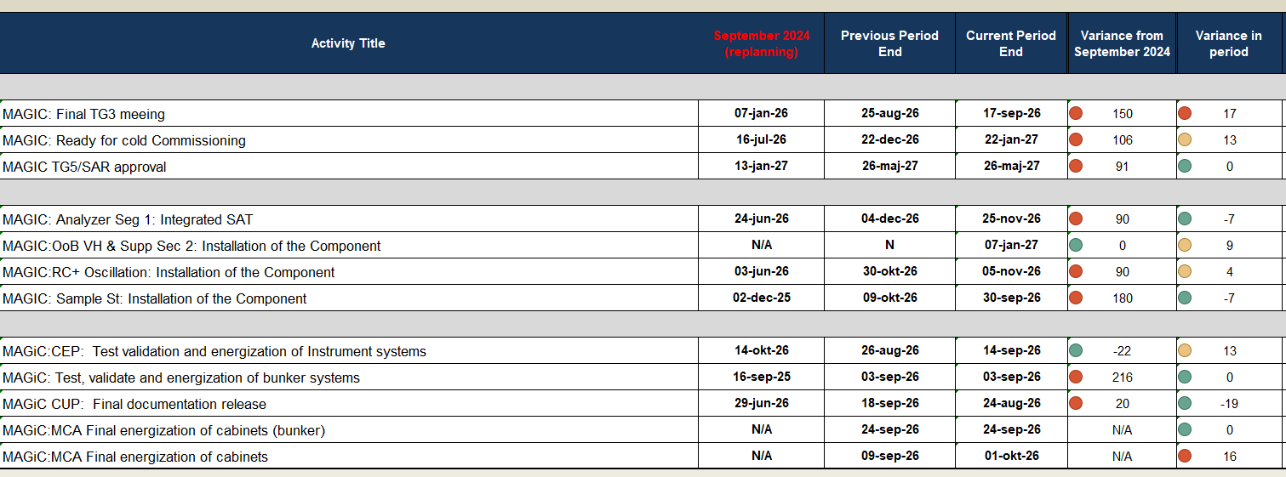
Key milestones

Slide 9
Schedule adherence
MAGIC: some good months.. And some less good
Notes:
June and july – development code, not in the NPR report

Slide 10
Lookout - future activities
There’s a lot in the pipeline..
Notes:
June and july – development code, not in the NPR report

Slide 12
Discussion points
How can we prevent further slippage of the TG5 date, and is there any opportunity to accelerate the schedule?
Are there specific mitigations or acceleration strategies we can implement?
One of the attached slides highlights milestones that have slipped by more than four months—particularly in the design phase. What actions are we taking and what more can we do to address these delays?
Can procurements be accelerated further?

Slide 13
Lookout - future activities
There’s a lot in the pipeline..
Notes:
June and july – development code, not in the NPR report

Slide 14
Key milestones > 4 months delay
Comparing September 2024 with September 2025
Activity Name | Date (Sep 24) | Date (Sep 25) | Variance date (month)
MAGIC:In-B VH+Supp:Factory Acceptance Test (FAT) | 14-mar-25 | 13-Oct-25 | -7,2
MAGIC:BWF:Factory Acceptance Test (FAT) | 25-jul-25 | 24-feb-26 | -7,1
MAGIC:OoB VH & Supp: Factory Acceptance Test (FAT) | 24-Oct-25 | 08-sep-26 | -10,55
MAGIC:Polarizer: Factory Acceptance Test (FAT) | 10-jun-25 | 08-dec-25 | -6,4
MAGIC:RF SF: CDR (meeting) | 10-feb-25 | 02-dec-25 | -9,2
MAGIC: Sample St: CDR (meeting) | 14-apr-25 | 20-jan-26 | -8,2
MAGIC:Supp-RC+Det A: CDR (meeting) | 10-jun-25 | 23-jan-26 | -6,6
MAGIC: RC: Factory Acceptance Test (FAT) | 18-jun-25 | 20-apr-26 | -10,25
MAGIC: Supp- Analzr+Det B: CDR (meeting) | 01-sep-25 | 19-jan-26 | -4,5
MAGIC: Analyzer: Seg 2: Factory Acceptance Test (FAT) | 09-apr-25 ->08-jun-26 | 03-jun-26 ->04-nov-26 | -5,3

Slide 15
Procurements
Ongoing and/or planned to start next few months
Activity Name | Activity % Complete | Start date (Sep 24) | Finish date (Sep 24) |  | Start date (Sep 25) | Finish date (Sep 25) | Variance finish date (month)
MAGIC:BWF:Procurement and tender selection | 89.06% | 04-dec-24 | 24-jul-25 |  | 15-Apr-25 A | 20-Oct-25 | -3,1
MAGIC:OoB VH & Supp : Procurement of OoB housing and supports | 20% | 26-feb-25 | 23-Oct-25 |  | 15-Sep-25 A | 05-dec-25 | -1,55
MAGIC:Polarizer: Procurement and manufacturing of the Component | 51.52% | 13-jan-25 | 09-jun-25 |  | 22-Jul-25 A | 05-dec-25 | -6,4
MAGIC:RF SF: Procurement and manufacturing of the Component | 0 % | 24-feb-25 | 08-jul-25 |  | 16-dec-25 | 07-May-26 | -10,2
MAGIC: Sample St: Procurement and manufacturing of the Component | 0 % | 30-apr-25 | 09-sep-25 |  | 03-feb-26 | 18-May-26 | -8,2
MAGIC: RC: Procurement and manufacturing of Radial Collimator | 64.11% | 16-sep-24 | 17-jun-25 |  | 16-Sep-24 A | 17-apr-26 | -9,25
MAGIC: Osc: Procurement and manufacturing of the Oscillation | 0% | 15-sep-25 | 13-mar-26 |  | 15-jan-26 | 09-jul-26 | -3,9
MAGIC: Supp- Analzr+Det B: Procurement and manufacturing of the Component | 0% | 15-sep-25 | 17-feb-26 |  | 02-feb-26 | 29-jun-26 | -4,4
MAGIC:Supp-RC+Det A: Procurement and manufacturing of the Component | 0% | 25-jun-25 | 11-nov-25 |  | 06-feb-26 | 03-jul-26 | -7,6
MAGIC: Beamstop: Procurement and manufacturing of the Component | 4% | 15-Oct-25 | 25-nov-25 |  | 29-Sep-25 A | 05-dec-25 | -0,4
MAGIC:Cave elev plat: Procurement and manufacturing | 0% | 12-nov-25 | 26-mar-26 |  | 16-dec-25 | 29-apr-26 | -1,1

Slide 16
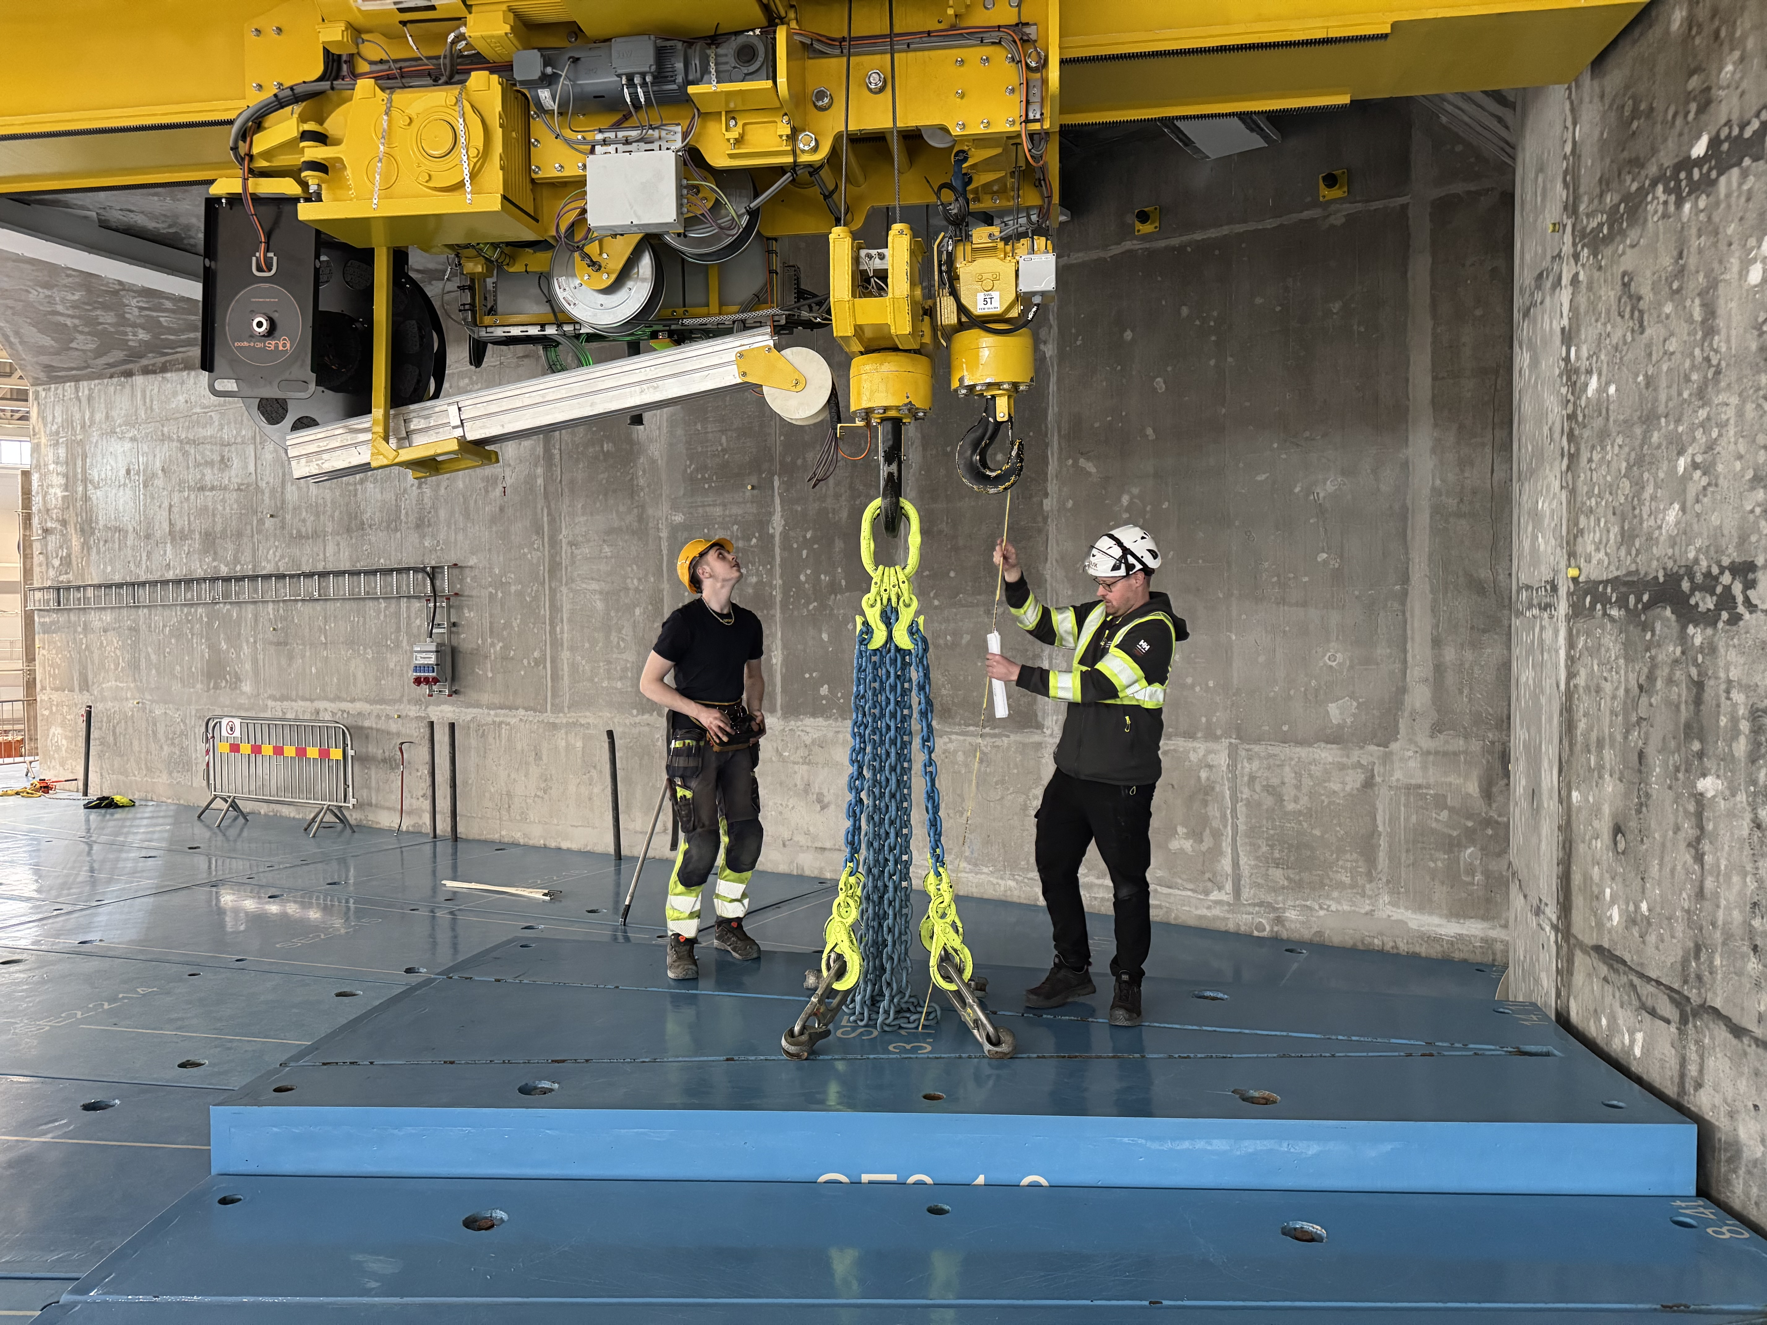
Bunker…

Slide 17
NSS Replanning Evaluation
MAGIC ICEB

Slide 18
Beer replanning finalized in June 2024
More details in P6 : TA milestones + detailed plan
We have more information in P6.
How can we use this information:
to plan/coordinate (installation, commissioning etc.)
keep track of progress (updating monthly instrument dashboards with replanning dates)
make informed decisions about priorities
MAGIC has 553 open activities in P6:
43 TA activities
510 activities from detailed plan

Slide 19
Critical paths T2T3
When a delay impacts the end date of a project
  We measure float towards the instrument’s TG5
  The first critical path has 0 float. If there’s a delay of 1 month, TG5 will shift 1 month.
  If the second critical path has 2 months float, it will push TG5 if there’s a delay of more than 2 months.
  The length of an activity reflects the start and the end of an activity, not the amount of time spent during that time period.
  The critical paths reflect the activities that are critical from a schedule perspective, not necessarily critical from a scientific or technical perspective.
  Activities on the critical paths should a priority for all of us!

Slide 20
213 days
64 days
46 days
119 days
107 days
139 days
59 days
164 days
145 days
52 days
82 days
90 days
68 days
38 days
65 days
2025
Magic Critical Paths
Final TG3
Start of CC
TG5/SAR approval
Data from P6 April 2025 lockdown
Today
Feb 23, 2026
Nov 5, 2026
Apr 7, 2027
2025
2026
2027
2027
Q2
Q3
Q4
Q1
Q2
Q3
Q4
Q1
Q2
Apr 2025 - Jun 2025
Polarizer: Detailed design (LLB)
Jun 2025 - Sep 2025
Supports for RC and Det A: Detailed design (LLB)*
No. 1 - Critical Path
(0 days TF)
Sep 2025 - Dec 2025
Oscillation of RC: Design phase (LLB)*
Dec 2025 - Jun 2026
Oscillation of RC: Procurement and Manufacturing phase (LLB)
Jun 2026 - Sep 2026
RC and Oscillation: Installation phase (LLB)
Sep 2026 - Nov 2026
MCA (including sub-systems): Energization and Commissioning phase
No. 2 - Critical Path
(40 days TF)
IB Guide+ VH+Supp: Procurement and Manufacturing phase (LLB)
Apr 2025 - Jan 2026
Jan 2026 - Sep 2026
IB Guide+ VH+Supp: Installation and commissioning phase (LLB)**
Apr 2025 - Sep 2025
Sample Stage: Design phase (LLB)*
No. 3 - Critical Path
(57 days TF)
Sep 2025 - Feb 2026
Sample Stage: Procurement and Manufacturing phase (LLB)
Feb 2026 - Apr 2026
Sample Stage: Installation phase (LLB)
Apr 2026 - Aug 2026
MCA (including sub-systems): Installation, Energization and Commissioning phase
Apr 2025 - Aug 2025
OoB VH+Supp: Design phase (LLB)
No. 4 - Critical Path
(99 days TF)
Aug 2025 - Feb 2026
OoB VH+Supp: Procurement and Manufacturing phase (LLB)
Feb 2026 - May 2026
OoB VH+Supp: Installation phase (LLB)
Design phase ends at CDR approval
Procurement and Manufacturing phase ends at FAT closure of open points
Installation and Commissioning phase ends at SAT approval
TF: number days of total float to Instrument’s TG5
*Constraints on design resources
**installation linked to first access after BOT.
Note: 2nd segment of Analyzer is part of the instrument scope but currently not linked to TG5 in P6
Notes:
2024-04
IB guide and VH + Support on the critical path
2025-03
Polarizer design + 2 month
Supports for RC + Det A + 1 months
2025-02
Polarizer design + 1 month
Oscillation design+ 2 months
Sample stage design+ 3 months
2024-12
LLB desinger: RF Spin flipper + OoB Vh suppoert
Mortiz + desgin pool: supports A and B
Danielle: elevated platform
LLLB 2: sample stage

Slide 21
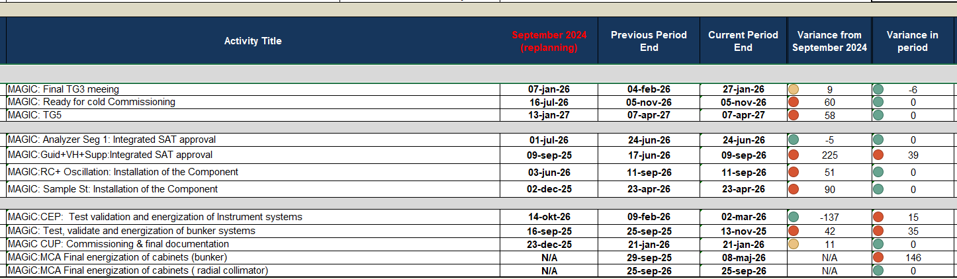
Key milestones

Slide 22
Activities with > 3 months delay
Comparing September 2024 with April 2025
Activity Name | Activity % Complete | Start date (Sep 24) | Start date (April 25) | Variance start date (month)
MAGIC: XYZ: Factory Acceptance Test (FAT) | 0% | 26-nov-24 | 20-maj-25 | -5,6
MAGIC:Polarizer: CDR (meeting) | 0% | 09-dec-24 | 04-jun-25 | -5,55
MAGIC:OoB VH & Supp Sec 1: CDR (meeting) | 0% | 05-feb-25* | 19-jun-25 | -4,5
MAGIC:RF SF: CDR (meeting) | 0% | 10-feb-25 | 02-jul-25 | -4,75
MAGIC: Good Lift: Factory Acceptance Test (FAT) | 0% | 11-mar-25 | 20-aug-25 | -5,45
MAGIC:Guid+VH+Supp (in-bunker):Factory Acceptance Test (FAT) | 0% | 14-mar-25 | 13-jan-26 | -9,9
MAGIC: Sample St: CDR (meeting) | 0% | 14-apr-25 | 01-sep-25 | -3,65
MAGIC: Det A: Factory Acceptance Test (FAT) | 0% | 12-maj-25 | 05-dec-25 | -7,25
MAGIC:Supp-RC+Det A: CDR (meeting) | 0% | 10-jun-25 | 30-sep-25 | -2,95
MAGIC:BWF:Factory Acceptance Test (FAT) | 0% | 25-jul-25 | 20-nov-25 | -4,2

Slide 23
Procurements
Ongoing and/or planned to start next four months
Activity Name | Activity % Complete | Start date (Sep 24) | Finish date (Sep 24) |  | Start date (April 25) | Finish date (April 25) | Variance finish date (month)
MAGIC: Analyzer: Seg 2: Procurement and manufacturing of the Component | 0% | 06-nov-24 | 15-apr-26 |  | 28-jul-25 | 16-apr-26 | -0,05
MAGIC:BWF:Procurement and manufacturing of the Component | 6.67% | 04-dec-24 | 24-jul-25 |  | 15-Apr-25 A | 19-nov-25 | -4,2
MAGIC:Polarizer: Procurement and manufacturing of the Component | 0% | 13-jan-25 | 09-jun-25 |  | 27-jun-25 | 13-nov-25 | -5,6
MAGIC:RF SF: Procurement and manufacturing of the Component | 0% | 24-feb-25 | 08-jul-25 |  | 16-jul-25 | 18-nov-25 | -4,75
MAGIC:OoB VH & Supp Sec 1: Procurement of OoB housing and supports | 0% | 26-feb-25 | 23-Oct-25 |  | 11-jul-25 | 30-Oct-25 | -0,25
MAGIC:OoB VH & Supp Sec 2: Procurement of OoB housing and supports | 0% |  |  |  | 15-jul-25 | 03-nov-25 | -0,4
MAGIC:OoB VH & Supp Sec 3: Procurement of OoB housing and supports | 0% |  |  |  | 18-aug-25 | 07-nov-25 | -0,4
MAGIC: Sample St: Procurement and manufacturing of the Component | 0% | 30-apr-25 | 09-sep-25 |  | 15-sep-25 | 03-feb-26 | -4,65
MAGIC: Supp- Analzr+Det B: Procurement and manufacturing of the Component | 0% | 15-sep-25 | 17-feb-26 |  | 25-jul-25 | 11-dec-25 | 1,8
MAGIC:Supp-RC+Det A: Procurement and manufacturing of the Component | 0% | 25-jun-25 | 11-nov-25 |  | 14-Oct-25 | 18-mar-26 | -3,95

Slide 24
Schedule adherence
Most months – MAGIC is below average on schedule accuracy
Notes:
June and july – development code, not in the NPR report

Slide 25
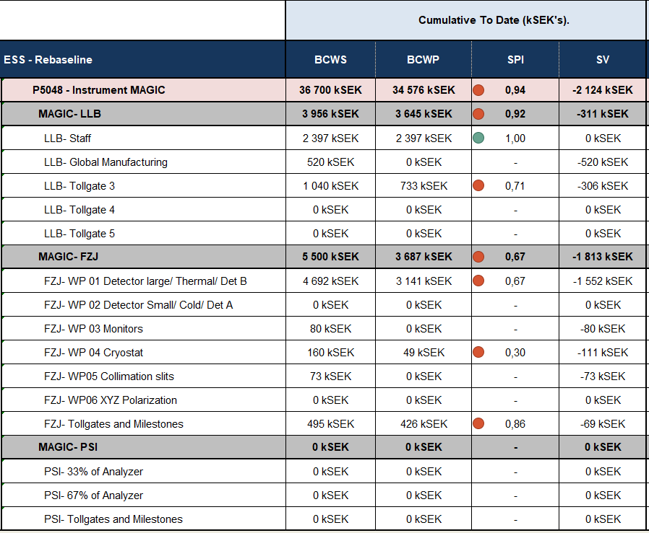
Earned value
Scheduled (in the replanning September 2024) vs. performed (April 2025)

Slide 26
Bunker next steps
  Closing roof D03 side – after summer
  West access is extended to Aug 29th,
  Roof installation starts September 1st
  Extra access before BOT currently mid Oct - mid Dec 2025.
  Under discussion.
  Post BOT access:
  First access after BOT: summer 2026
  Second access after BOT: xmas 2026
  Third access after BOT: summer 2027
Which MAGIC components
can be installed before BOT?

Slide 27
Discussion points
How can we prevent further slippage of the TG5 date, and is there any opportunity to accelerate the schedule?
Are there specific mitigations or acceleration strategies we can implement?
One of the attached slides highlights milestones that have slipped by more than three months—particularly in the design phase. What actions can we take to address these delays?
Another slide outlines upcoming procurements:
  We’d like an update from partners on their procurement plans for these components—do the current timelines still appear realistic? (More details can be found in the attached Excel sheet.)
  We’re also open to discussing how ESS might support procurement efforts, if helpful.
How can we ensure focus on the components to be installed in the bunker?
How has the MAGIC team utilised ESS resources (design/engineering, technical writer etc)? How can ESS support going forward?
How has the handover and integration of new resources gone? (this topic could preferably be included in the instrument updates in the morning)

Slide 28

Simplified view of the P6 landscape
Linking an instrument plan to common projects and technology groups
ICS – network
Output:
Installation team
Q-gate team
Controllers
….
MCA
ICS – control
CEP
ICS – PSS
Detectors
(BM, Detector integration, Detector… )
Instrument plan
CUP
Choppers
Vacuum

Slide 29
Common projects replanning T2T3
Linked to P6 instrument plans
Instrument | CEP | MCA | CUP | Choppers | Detectors | BM | ICS Network | ICS PSS
ESTIA | YES | YES | YES | YES | YES: MB | YES | YES | YES
SKADI | YES | YES* | YES | YES (Racks) | N/A | YES* | YES* | YES*
BEER | YES | YES* | YES | YES | N/A | YES* | YES* | YES*
MAGIC | YES | YES* | YES | YES | N/A |  | YES* | YES*
FREIA | YES | YES* | YES | YES (Racks) | YES: MB |  | YES* | YES*
HEIMDAL | YES | YES* | YES | YES | N/A |  | YES* | YES*
MIRACLES | YES | YES* | YES | YES (Racks) | N/A |  | YES* | YES*
CSPEC | YES | YES* | YES | N/A | YES: He3 |  | YES* | YES*
T-REX | YES | YES* | YES | YES | YES: MG |  | YES* | YES*
VESPA
Information has been sent out in the NSS Progress Report
*Draft plan in place linked to the instrument plan. Further review might be needed with wp manager and instrument teams

