Slide 1
SKADI ICEB
Critical paths, schedule adherence etc.

Slide 2
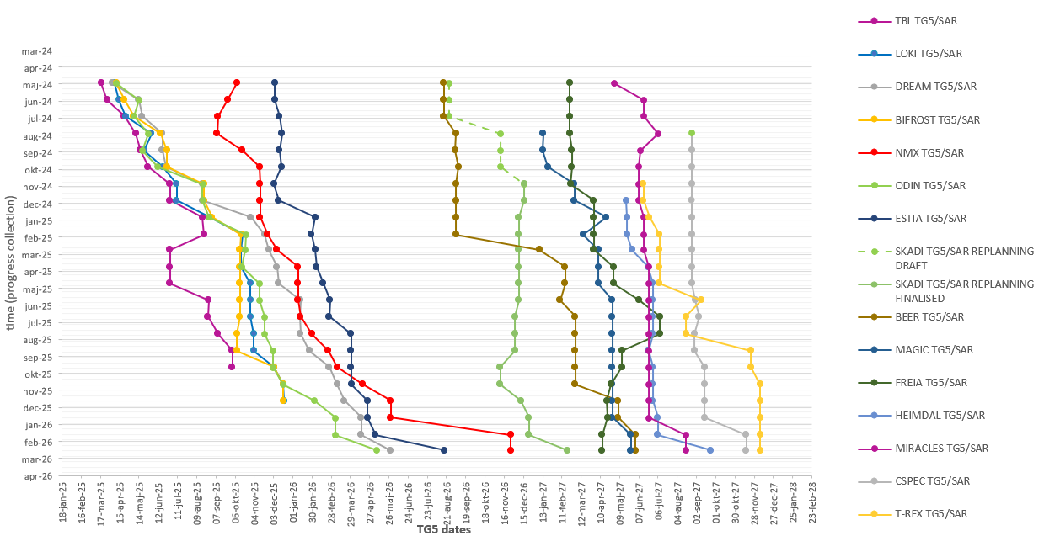
TG5 slip chart
Data from P6 MARCH 2026 lock down
TBL
LOKI,
BIFROST
TG5/SAR approved.
(iSRR held, approval pending)
,
NMX
MAGIC
BEER
SKADI
FREIA
MIRACLES,
HEIMDAL
ODIN,
CSPEC TREX
DREAM ESTIA
Note: For T2T3, tracking starts after replanning close-out. Vespa has TG5 in May 2029. Once TG5 is approved, the instrument will be removed from tracking.

Slide 3
Jun 2026 - Oct 2026
Sep 2025 - Jan 2026
Sep 2025 - Dec 2025
Oct 2026 - Dec 2026
80 days
127 days
70 days
61 days
39 days
93 days
146 days
17 days
79 days
56 days
Mar 31
2025
Skadi Critical Paths
LAST ICEB
Data from P6 September 2025 lockdown
Final TG3
Start of CC
TG5/SAR approval
Today
Nov 28, 2025
Jun 17, 2026
Dec 2, 2026
2025
2026
2026
Q3
Q4
Q1
Q2
Q3
Q4
Integrated Cold Commissioning and TG5 preparations
TG5
TG5 meeting
Oct 8
TG5 Closure of open points
No. 1 - Critical Path
(0 days TF)
CEP installation
Dec 2025 - Jun 2026
MCA (including sub-systems): Installation, Energization and Commissioning phase
No. 2 - Critical Path
(5 days TF)
Detector Housing: Manufacturing and Assembly phase (FZJ)
Sep 2025 - Mar 2026
Detector Integration (FZJ & ESS)
Mar 2026 - Jun 2026
Detector: Installation and Commissioning phase (FZJ)
Sep 2025 - Dec 2025
Polarizer Housing, Spin Flipper and Fast Shutter: Procurement and Manufacturing phase (FZJ)
No. 3 - Critical Path
(20 days TF)
Dec 2025 - Mar 2026
Polarizer Housing: Assembly (with optics and chopper) phase (FZJ)*
Mar 2026 - Mar 2026
Polarizer, Spin Flipper, Fast Shutter and OoB Guides: Installation phase (FZJ, LLB & ESS)
Back into CP1 with 20 days float
Since last ICEB…
No shift on TG5, well done!
CEP and MCA new as CP1
Some delays on deliveries on the other critical paths.
Design phase ends at CDR approval
Procurement and Manufacturing phase ends at FAT closure of open points
Installation and Commissioning phase ends at SAT approval
TF: number days of total float to Instrument’s TG5
* Spin flipper and Fast shutter has 6 days float (testing in parallell to polarizer housings assembly)
Notes:
2025-09
Polarizer housing assembly delayed
2025-01
Detector housing manufacturing: moved out 2 months

Slide 4
-6 days
0 days
0 days
Mar 2026 - Sep 2026
Mar 2026 - May 2026
Mar 2026 - Jun 2026
Jun 2026 - Jul 2026
Jul 2026 - Aug 2026
Sep 2026 - Nov 2026
Mar 2026 - Jul 2026
Jul 2026 - Aug 2026
Nov 2026 - Dec 2026
Dec 2026 - Feb 2027
0 days
0 days
0 days
May 2026 - Oct 2026
145 days
76 days
19 days
35 days
35 days
88 days
39 days
29 days
58 days
40 days
44 days
0 days
108 days
2026
Skadi Critical Paths (TG5 scope)
Cold Commissioning of TG5 scope complete
Nov 9, 2026
Data from P6 March 2026 lockdown
Final TG3 approval
TG5/SAR approval
Today
May 29, 2026
Feb 19, 2027
2026
2027
2027
Q1
Q2
Q3
Q4
Q1
TG5 preparations
TG5
TG5/SAR+ iSRR meeting
Dec 21
TG5 Closure of open points
No. 1 - Critical Path
(0 days TF)
Detector: Manufacturing phase bank 2 (FZJ)
Detector: Installation and Commissioning phase (FZJ)
Polarizer Housing: Manufacturing phase (FZJ)
No. 2 - Critical Path
(5 days TF)
Polarizer, SF and FS: Assembly (with optics and chopper) phase and FAT (FZJ)*
Polarizer, SF, FS and chopper: Installation phase
Aug 2026 - Oct 2026
Commissioning phase
Back into CP01 with 5 days float
Oct 23
No. 3 - Critical Path
(8 days TF)
Detector tool: Manufacturing phase (FZJ)
Detector housing (including bank 0 and bank 1): Installation phase (FZJ)
Back into CP01 with 8 days float
Aug 25
No. 4 - Critical Path
(9 days TF)
BMs: Design phase
BM: Installation and Commissioning phase
Back into CP01 with 9 days float
Oct 19
iSRR scope:
PSS Skadi Complete – 18th of December
Motion Safety testing and validation complete – 10th of November
iSRR approval – 1st of March
Design phase ends at CDR approval
Procurement and Manufacturing phase ends at FAT closure of open points
Installation and Commissioning phase ends at SAT approval
TF: number days of total float to Instrument’s TG5
Notes:
2026-03
Spin flipper manufacturing: 59 days delayed
Detector installation (due to detector installation tool): 65 days delayed
2026-01
Polarizer housing: 48 days delayed
Skadi Det: 20 days delayed
2025-10
Polarizer housing: one month delayed
CEP accelerated their schedule
2025-09
Polarizer housing assembly delayed
2025-01
Detector housing manufacturing: moved out 2 months

Slide 5
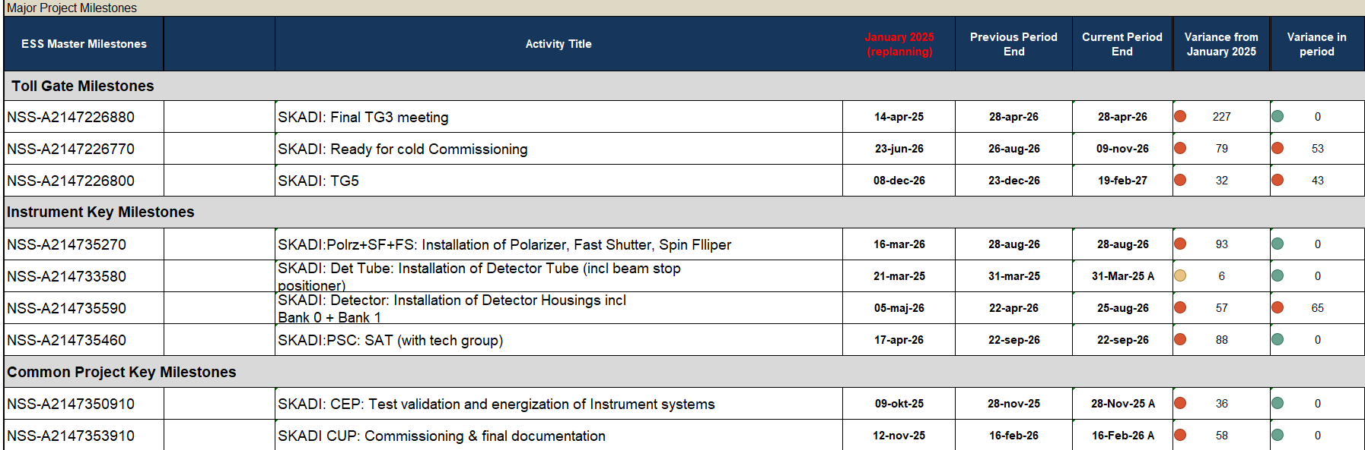
Key milestones
MARCH lockdown

Slide 6
Schedule adherence

Slide 7
Lookout - future activities
Component deliveries and dependencies are missing from the plan, creating a false impression that completion can be achieved earlier than is realistically feasible (e.g. M3 beam positioner still in design)
There’s a lot in the pipeline.. But maybe not enough?

Slide 9
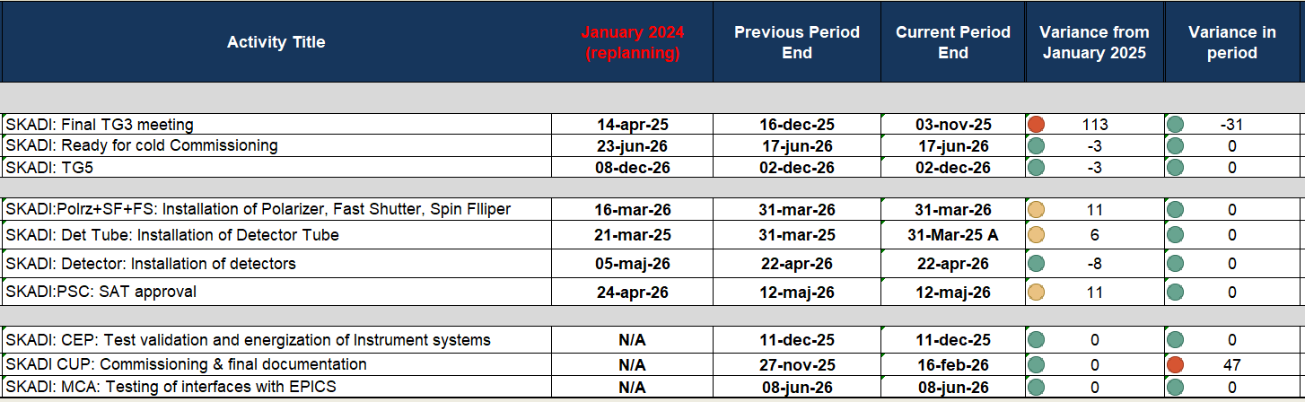
Key milestones
TG3 has been delayed, no other big shifts on other key milestones

Slide 10
Schedule adherence
Most months – SKADI is above average on schedule accuracy

Slide 11
Lookout - future activities
There’s a lot in the pipeline..

