Slide 1

SKADI detector status
Nicholai Mauritzon, Detector Scientist, DetG
ICEB Meeting, April 28-29th, 2026

Slide 2
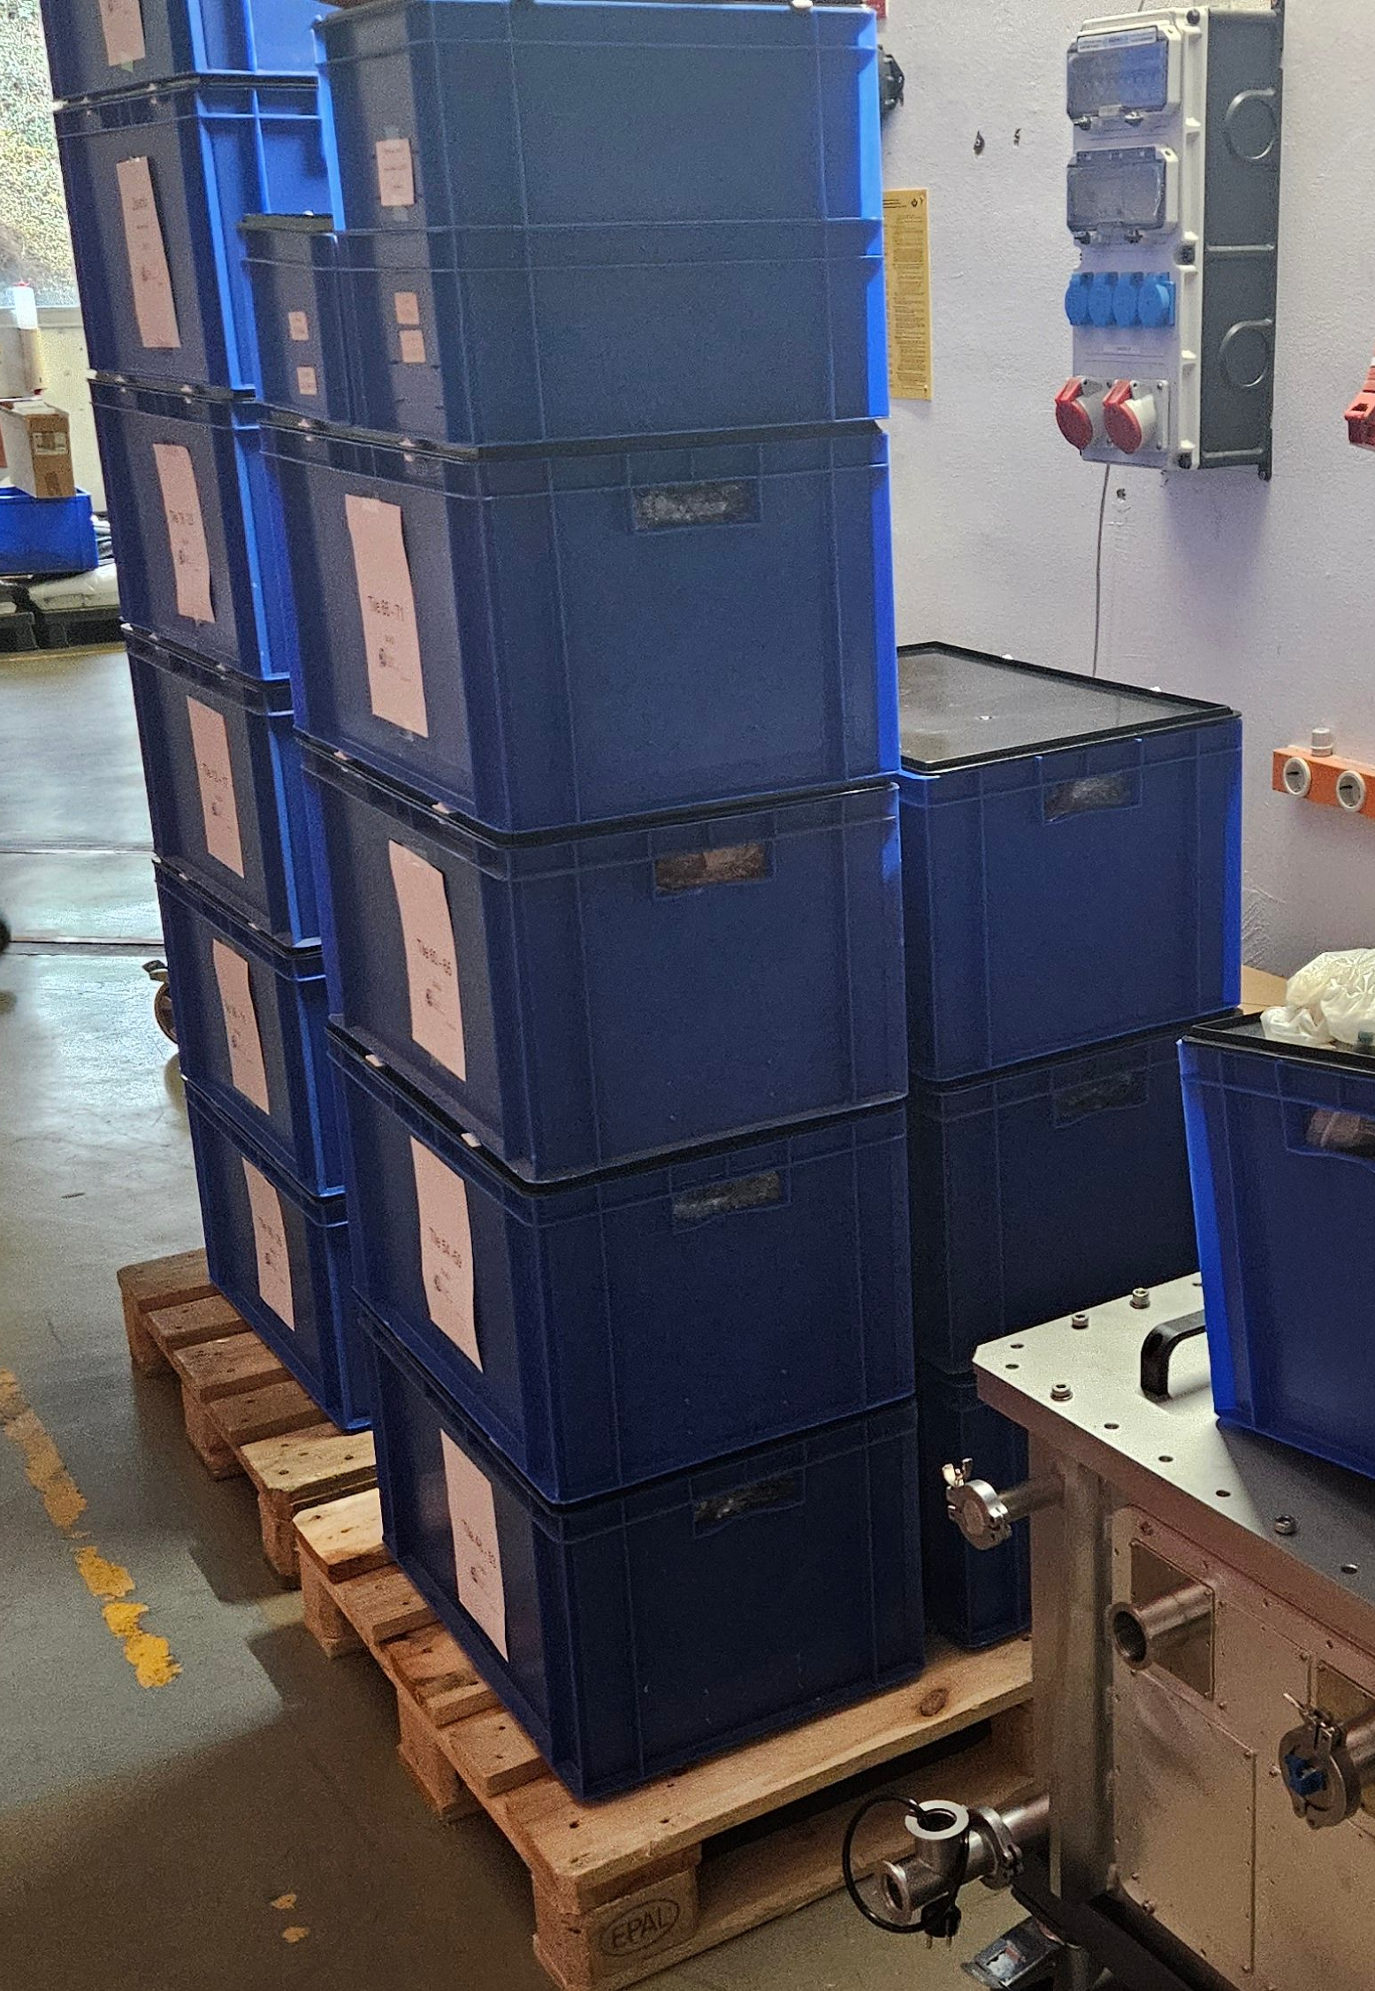
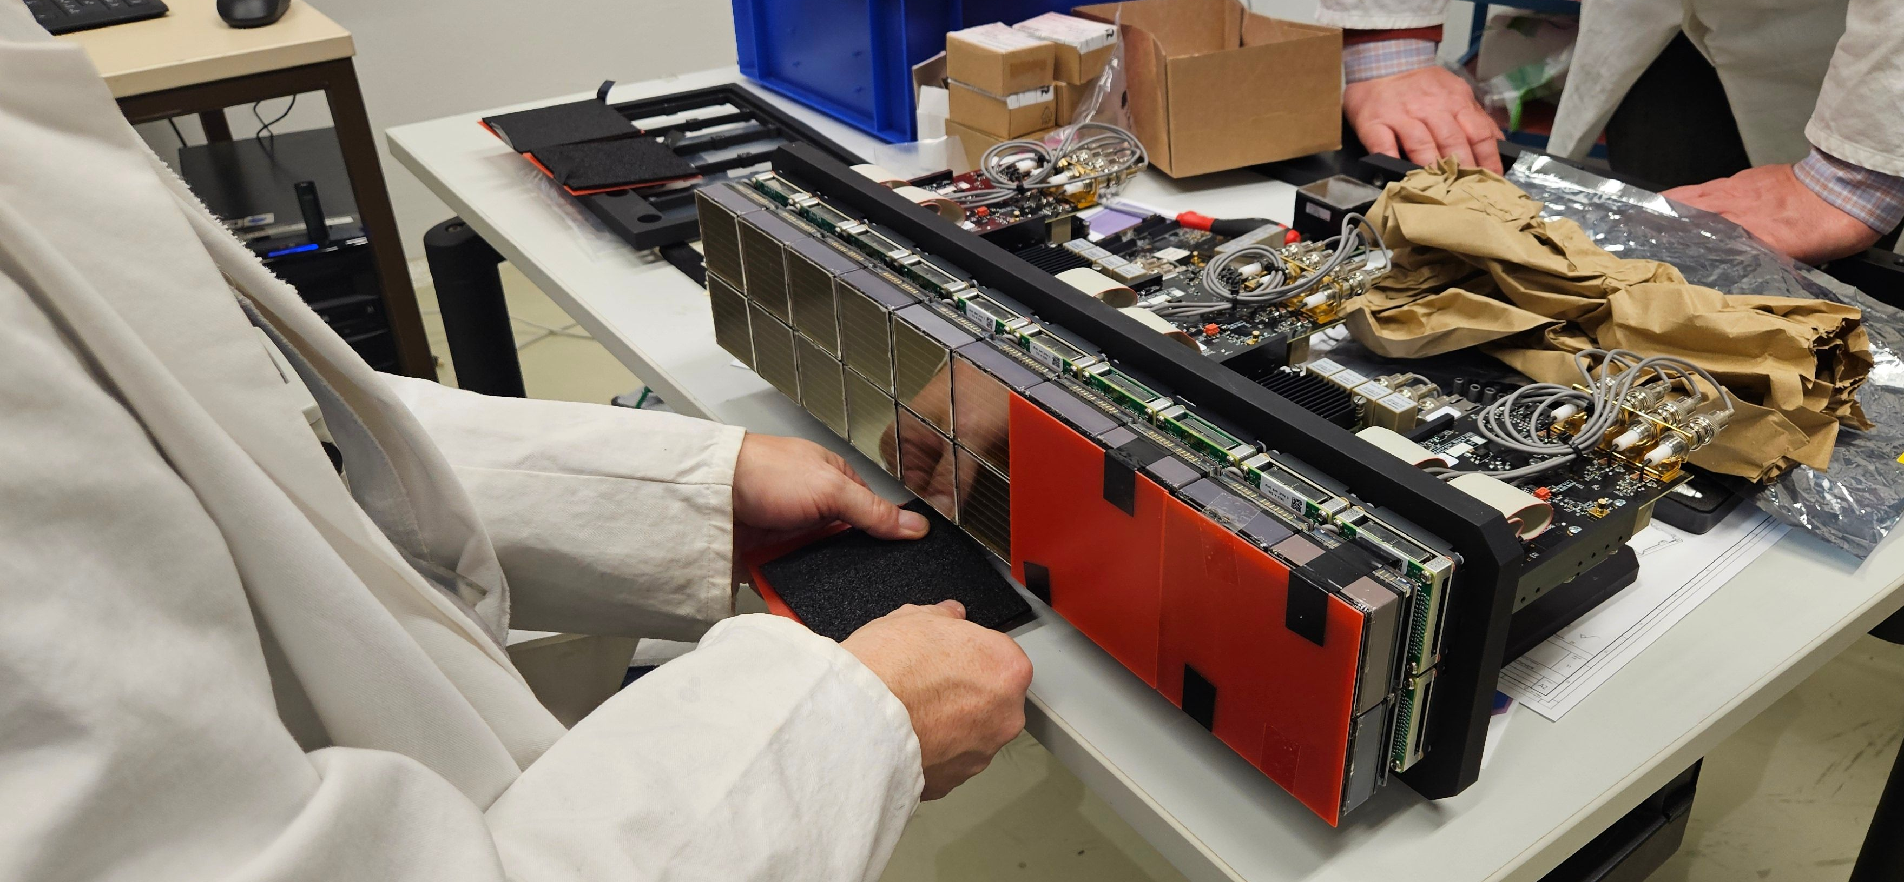
SKADI Detector System – Current Status
ESS visit to Jülich (week 11)
Demonstration
Knowledge transfer

Slide 3
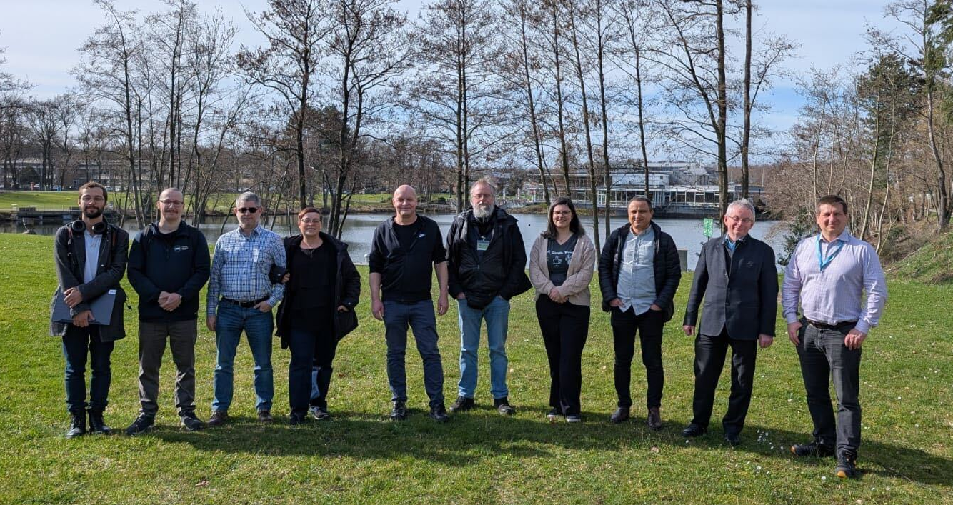
SKADI Detector System – Current Status
Thank you!

Slide 4
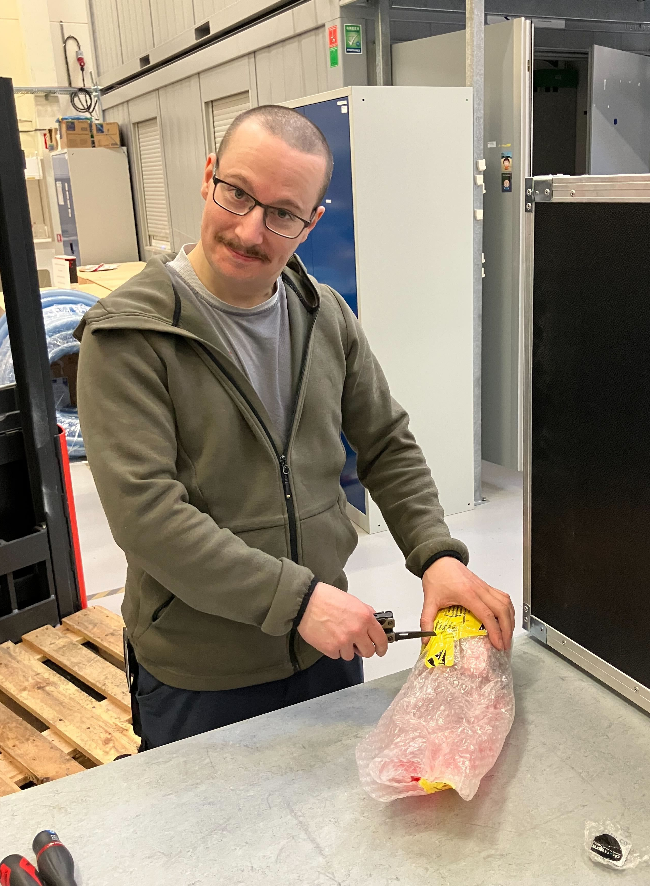

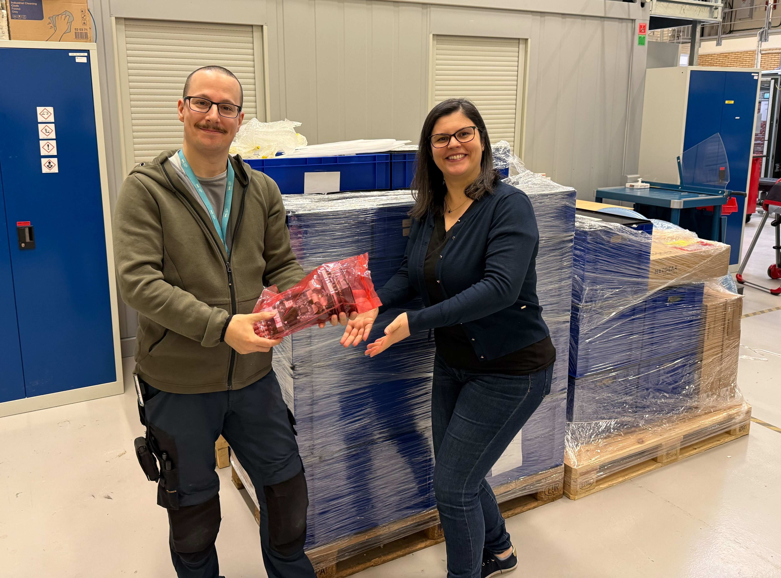
SKADI Detector System – Current Status
Receiving Bank 0 and 1 at Utgård
No observable damage
Welcome home!

Slide 5
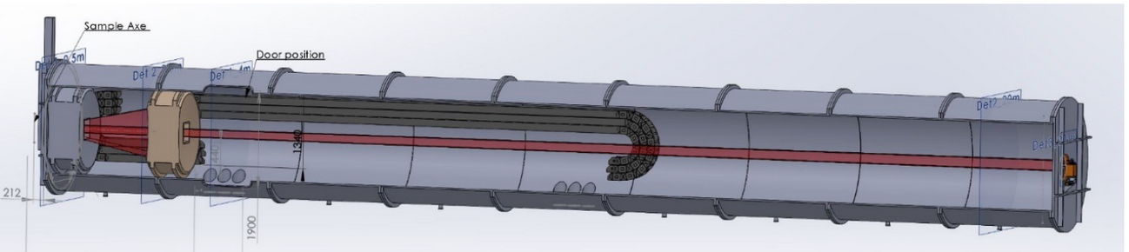
Jülich Detector Deliverables Overview
96 Tiles for Detector Banks 0 and 1
Detector bank switches
Fine mechanics
Cooling pipes
Spare mechanical components and scintillators for full-scope

Slide 6
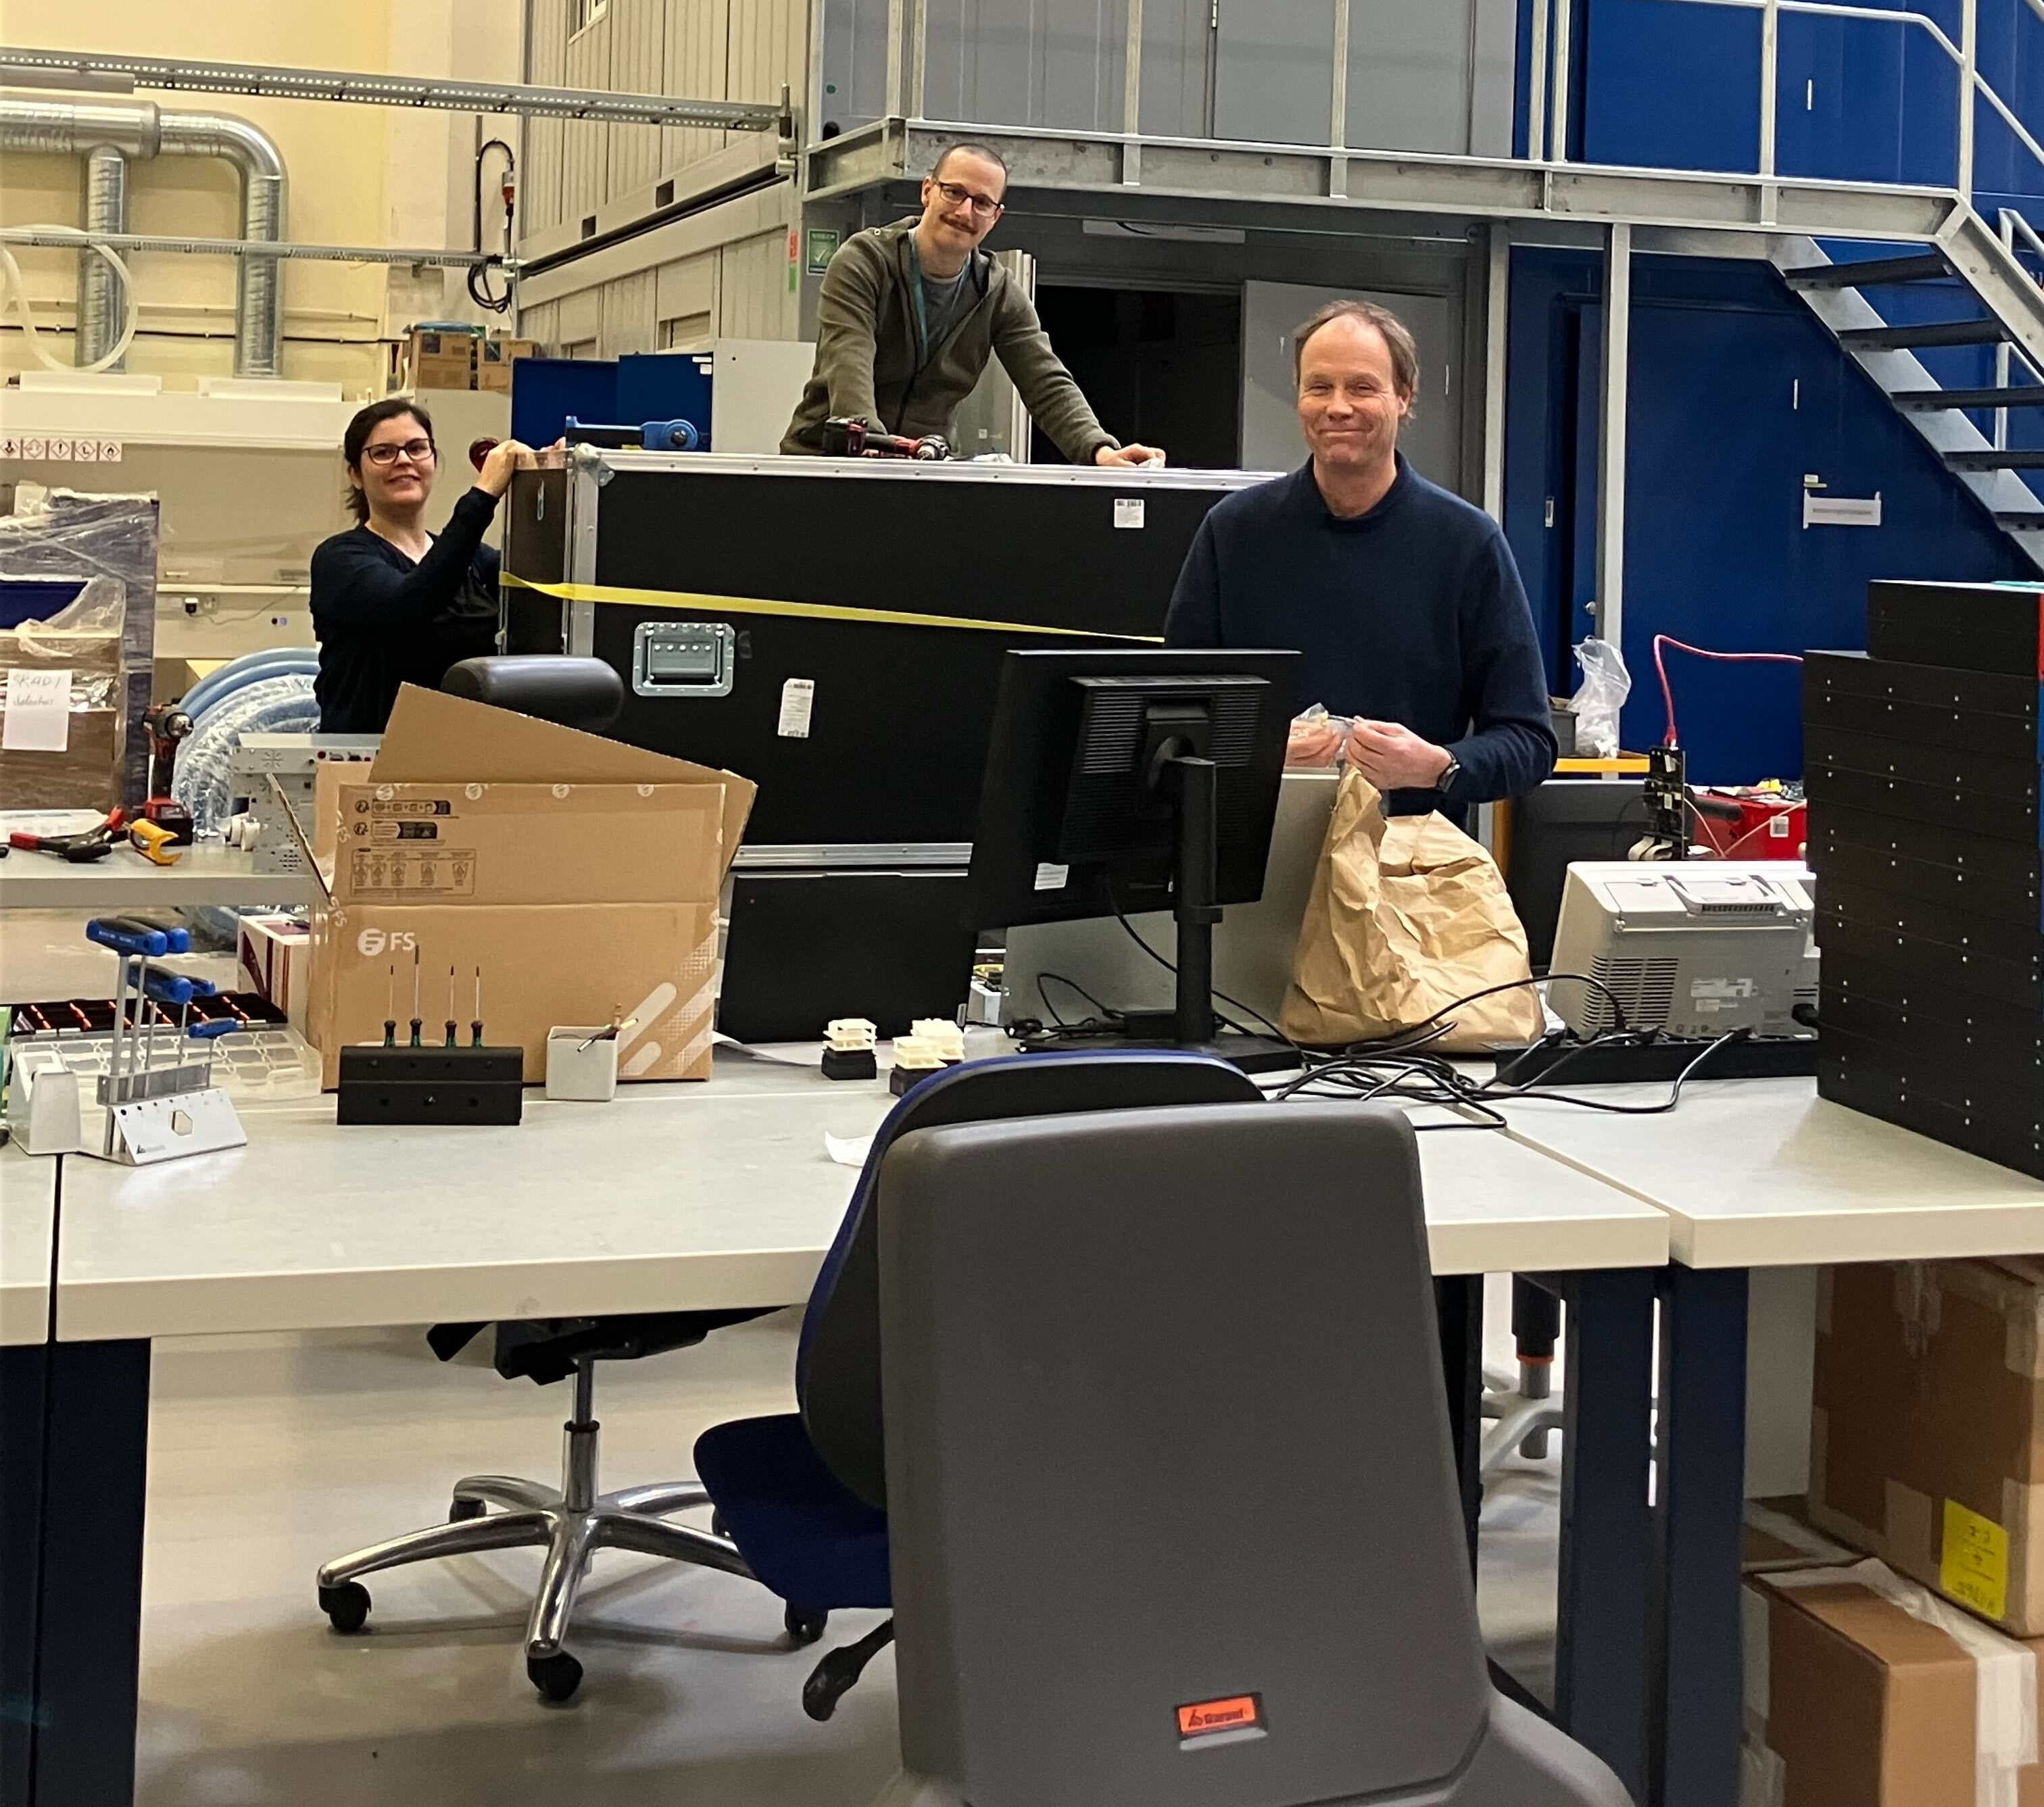
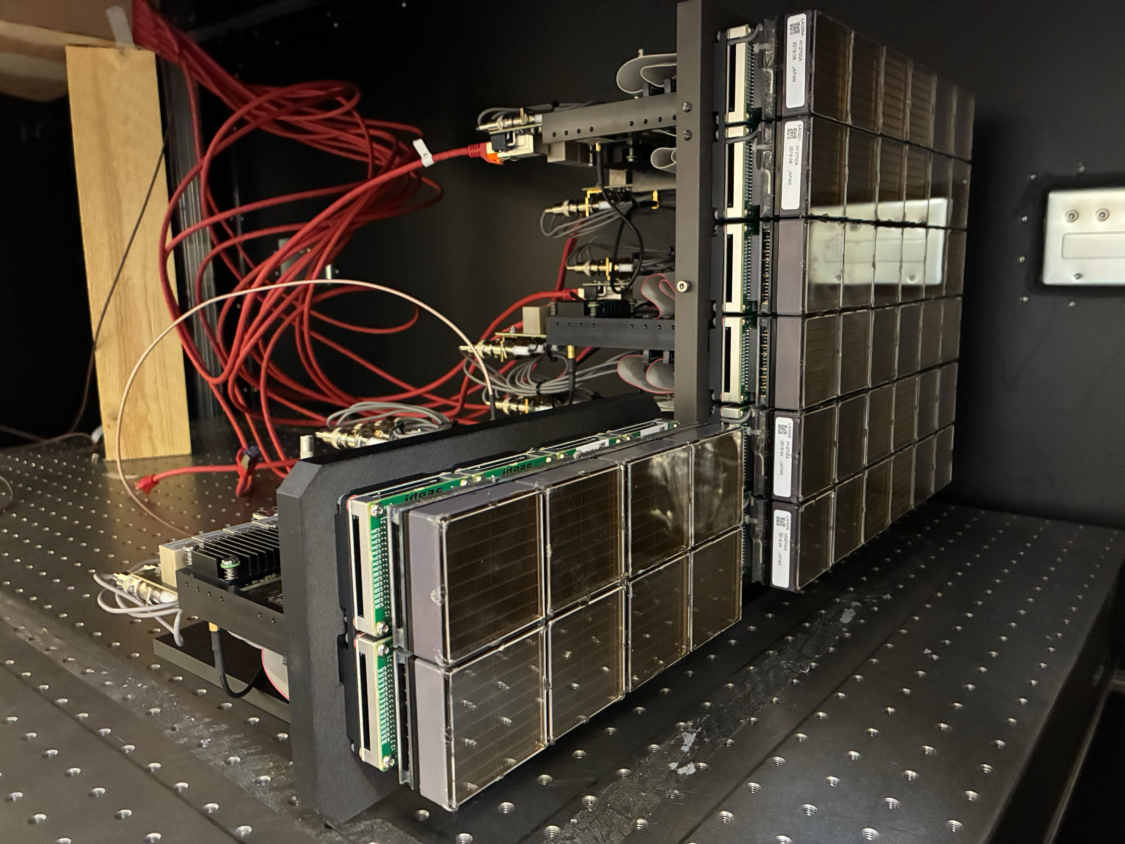
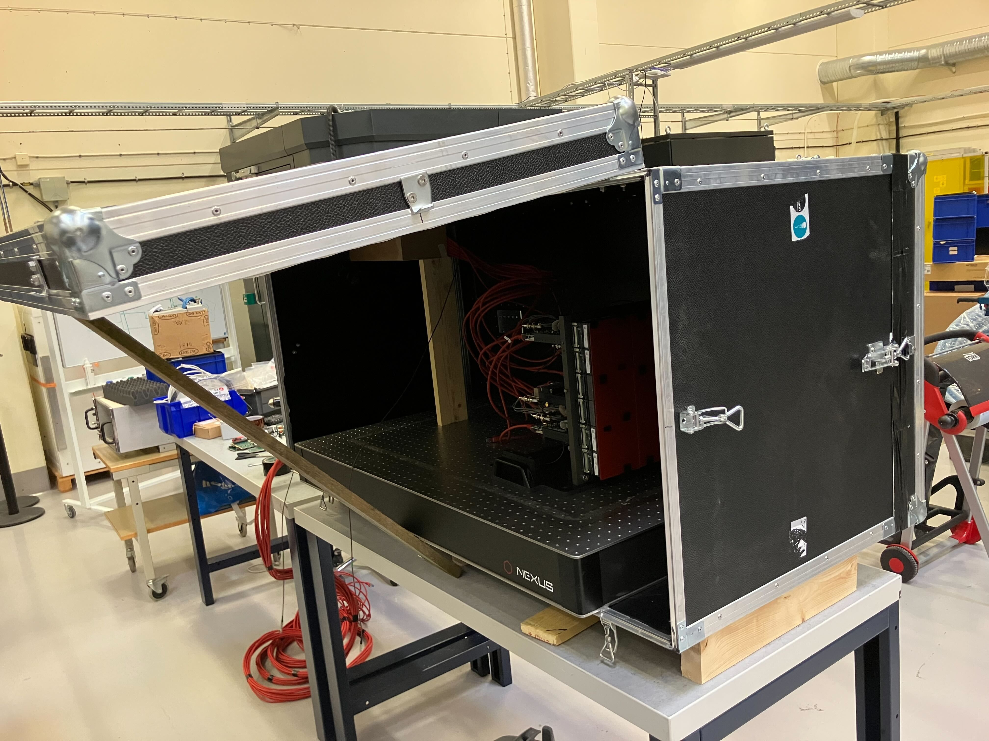
Testing and Validation at Utgård
Post-Transport Validation of Tiles has comenced

Slide 7
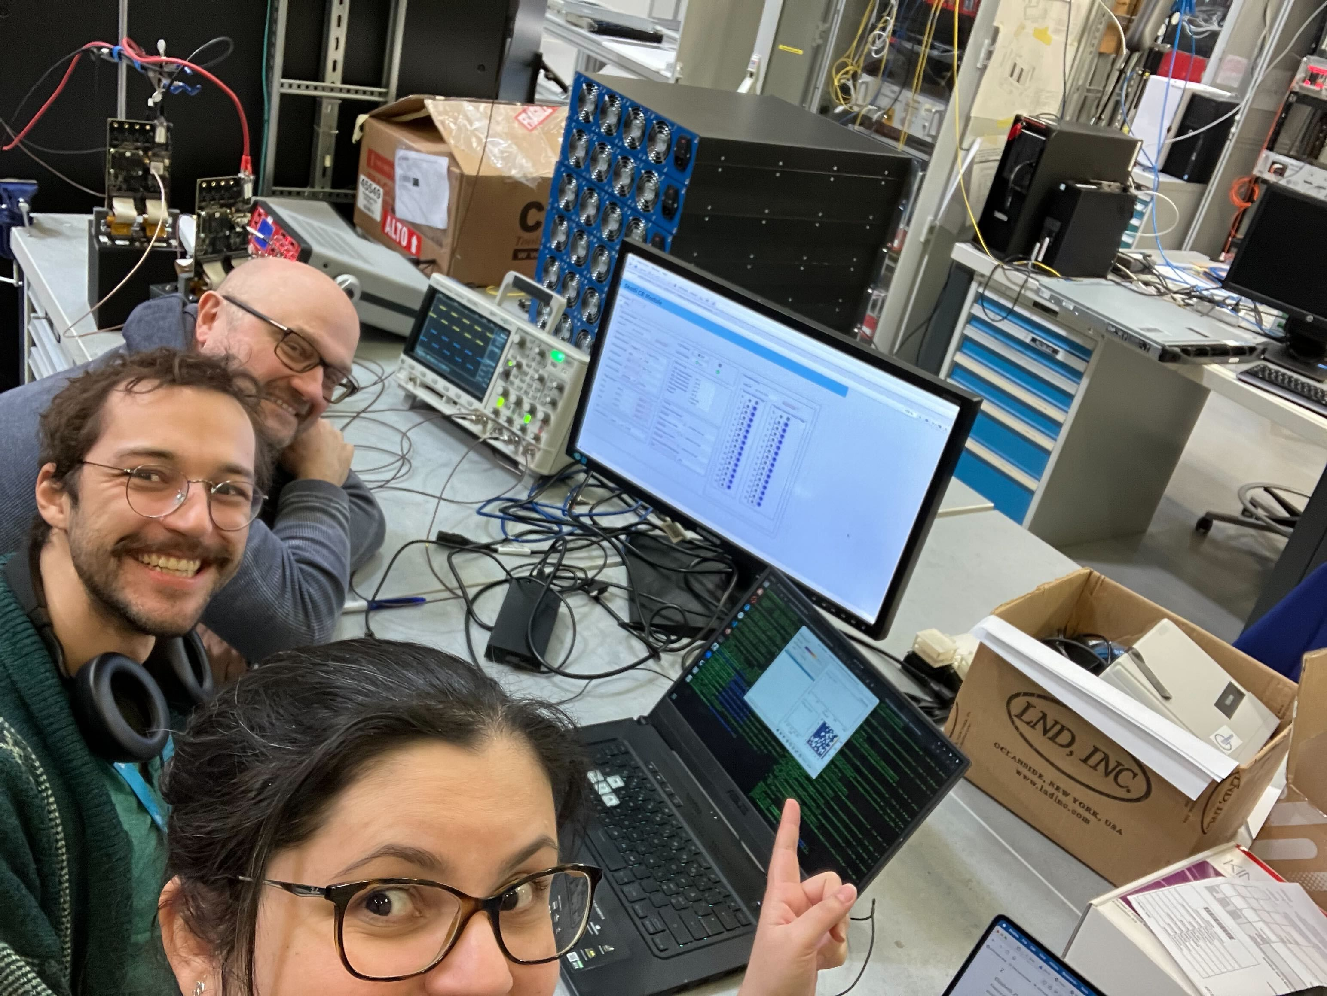
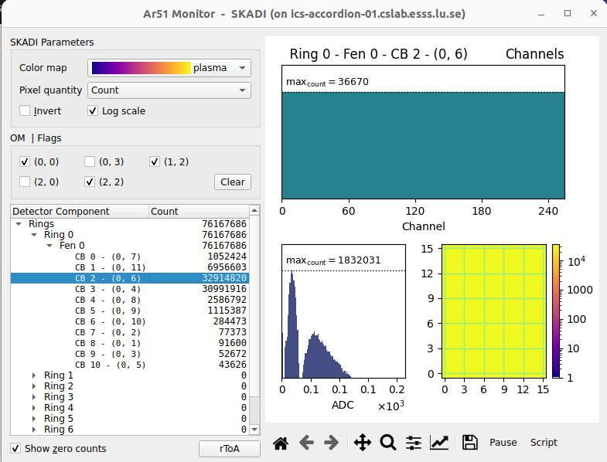
Testing and Validation at Utgård
Post-Transport Validation of Tiles has comenced
11-Tile Readout Chain Validated End-to-End, Ready for Day-0

Slide 8
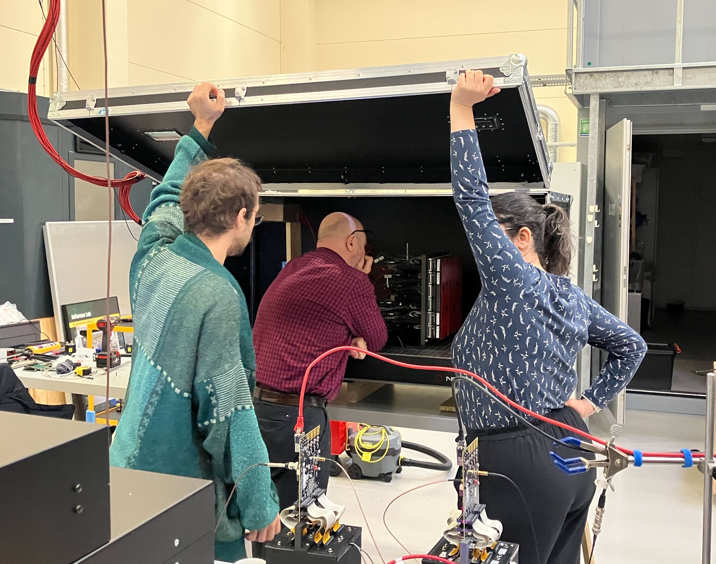
Testing and Validation at Utgård
Post-Transport Validation of Tiles has comenced
11-Tile Readout Chain Validated End-to-End, Ready for Day-0
Risks mitigated:
  key issues identified and tracked
  only validated, fully functional tiles
  included in first site delivery

Slide 9
Firmware Status Overview
IDEAS firmware (CBs): 6 issues pending incl. 1 showstopper. Additional realase needed from IDEAS.
ESS firmware (FEA/KC705): Done!
ESS timing system validated
Slow control progress is good. Final tuning and feature implementation ongoing.
Detector calibration (HV/thr) procedure is under development

Slide 10
Q-gate status
Preparation ongoing
Pre-meetings held:
  Electrical Safety
  Radiation Safety
Integration into ESS documentation structure in progress
XRF study of detector Tile pending
Awaiting feedback from Electrical safety
  Target: readiness for installation by end of June

Slide 11
Outlook and conclusions
First end-to-end SKADI data at ESS!
63 Tiles validated, 8 with issues found (detailed investigation pending)
Slow control development in mature state
Q-gate feedback pending from electrical safety
End-to-End Validation of KC705: 12 FEAs configured with one Tile each
Bank 1 assembly planned for June at site followed by SAT

Slide 12
Questions?

Slide 13
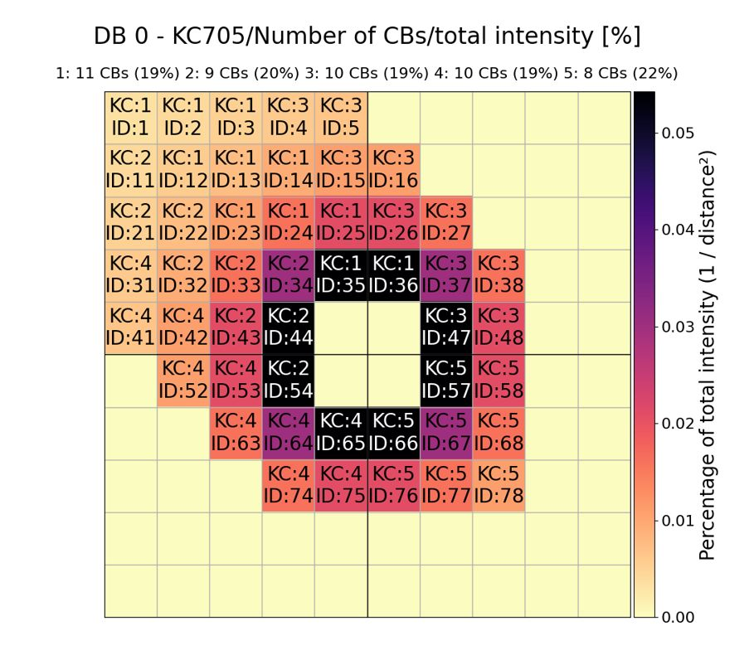
backup

Slide 14
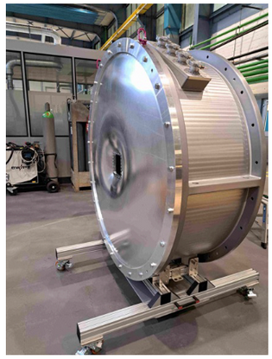
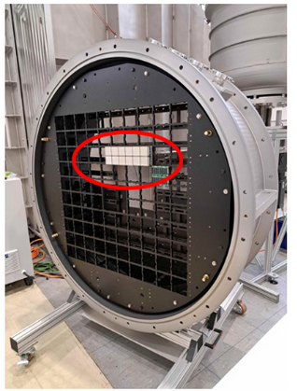
backup

