Slide 1
TREX ICEB
Critical paths, schedule adherence etc.

Slide 2
Completing design for T2T3 instruments
28 meetings held Sep 25 to Feb 26
As shown at ICB

Slide 3
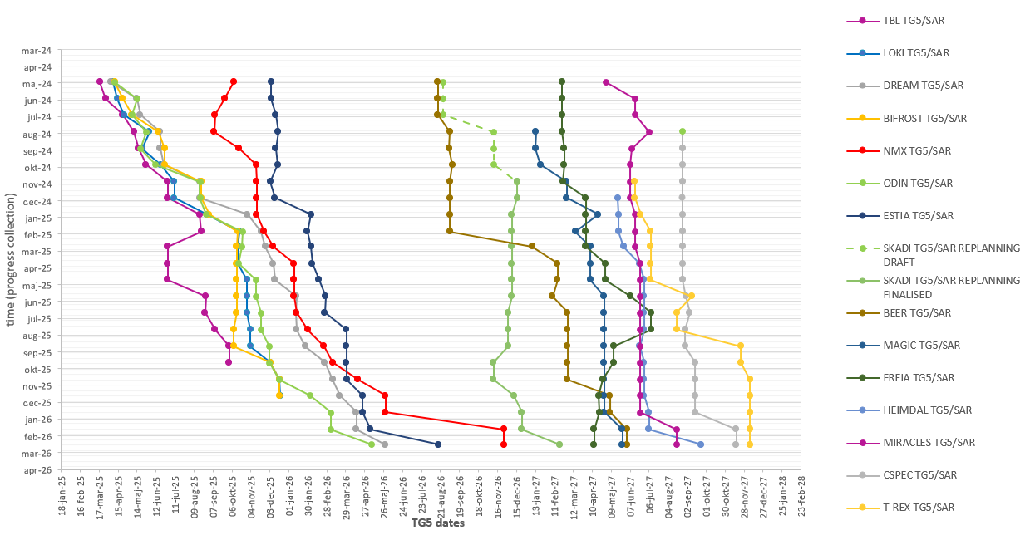
TG5 slip chart
Data from P6 MARCH 2026 lock down
TBL
LOKI,
BIFROST
TG5/SAR approved.
(iSRR held, approval pending)
,
NMX
MAGIC
BEER
SKADI
FREIA
MIRACLES,
HEIMDAL
ODIN,
CSPEC TREX
DREAM ESTIA
Note: For T2T3, tracking starts after replanning close-out. Vespa has TG5 in May 2029. Once TG5 is approved, the instrument will be removed from tracking.

Slide 4
Mar 2026 - Apr 2026
0 days
Mar 2026 - Feb 2027
Mar 2026 - Oct 2026
Mar 2026 - Jun 2026
0 days
0 days
0 days
0 days
252 days
167 days
107 days
125 days
134 days
44 days
198 days
40 days
67 days
78 days
52 days
37 days
89 days
0 days
2026
TREX Critical Paths
Cold Commissioning TG5 scope complete
Aug 17, 2027
Final TG3
TG5/SAR approval
Data from P6 March 2026 lockdown
Today
Nov 2, 2026
Dec 7, 2027
2026
2027
2027
Q1
Q2
Q3
Q4
Q1
Q2
Q3
Q4
No. 1 - Critical Path M Chopper
(0 days TF)
M Chopper: Manufacturing phase (FZJ)
Feb 2027 - Jun 2027
M Chopper : Installation and Commissioning phase (FZJ)
Jun 2027 - Aug 2027
Integrated Cold Commissioning
CEP: Requirement and Desigh phase (ESS)
No. 2 - Critical Path
(0 days TF)
Oct 2026 - Mar 2027
CEP and ICS: Installation and Energization (ESS)
Mar 2027 - Jun 2027
Detector and Vessel: Commissioning phase (FZJ & ESS)
Back into CP01 with 0 days float
Jun 21
Transl Table: Design phase (FZJ)
No. 3 - Trans Table & Cold Polariz
(4 days TF)
Jun 2026 - Dec 2026
Transl Table: Manufacturing phase (FZJ)
Dec 2026 - Jun 2027
Transl Table & Therm Polariz: Installation and Commissioning phase (FZJ)
Back into CP01 with 4 days float
Jun 15
Primary Coll & Slits Design phase (CNR)
No. 4 - Critical Path Primary Coll & Slits
(9 days TF)
May 2026 - Feb 2027
Primary Coll & Slits: Procurement and Manufacturing phase (CNR)
Feb 2027 - Apr 2027
Primary Coll & Slits: Installation phase (CNR)
Apr 2027 - Jun 2027
MCA, Translation Table, Secondary RC, Primary Coll & Slits Commissioning phase
Back into CP01 with 9 days float
Jun 8
Design phase ends at CDR approval
Procurement and Manufacturing phase ends at FAT closure of open points
Installation and Commissioning phase ends at SAT approval
TF: number days of total float to Instrument’s TG5
Note: MG detector boxes 2-4 (including 18 modules) is part of the instrument scope but currently not linked to TG5 in P6. Tentatively planned to be completed in Q2-2028
Notes:
2026-03
Translation table design: 17 days delayed
Primary coll & slits design: 31 days delayed
Polarization alanyser design: 16 days delayed
Secondary RC FAT: 37 days delaed
2026-01
Primary Coll & slits 30 days delayed
Polarization Analyser: 29 days delayed
Translation table: 14 days delayed (sixth CP)
2025-09
OoB Guides 43 days delayed
M-chopper FAT delayd 139 days
P-chopper Fat delayed 45 dyas
Fan chopper 33 days delayed
OoB Guides 33 days delayed
2025-09
Delay to M chopper
2025-05
P-chopper manufacturing delayed 8 months
OoB Guides (design, procurement and manufacturing) is 1 month delayed
2025-04
CP3 new: Translation table delayed 1 month
OoB Guide delayed 1 month

Slide 5
0 days
0 days
0 days
0 days
0 days
0 days
119 days
91 days
120 days
235 days
125 days
65 days
40 days
87 days
77 days
77 days
20 days
93 days
10 days
0 days
Mar 23
2026
TREX Critical Paths
Cold Commissioning TG5 scope complete
Aug 17, 2027
Final TG3
TG5/SAR approval
Data from P6 March 2026 lockdown
Today
Nov 2, 2026
Dec 7, 2027
2026
2027
2027
No. 1 - Critical Path M Chopper
(0 days TF)
Q1
Q2
Q3
Q4
Q1
Q2
Q3
Q4
Jun 2027 - Aug 2027
Integrated Cold Commissioning
No. 5 - Critical Path Pol. Analyser
(11 days TF)
Mar 2026 - Jul 2026
Polarization Analyser: Design phase (FZJ)
Jul 2026 - Dec 2026
Polarization Analyser: Manufacturing phase (FZJ)
Dec 2026 - Jun 2027
Polarization Analyser: Installation and Commissioning phase (FZJ)
Back into CP01 with 11 days float
Jun 4
No. 6 - Critical Path P Chopper
(13 days TF)
Mar 2026 - Jan 2027
P Chopper: Manufacturing phase (FZJ)
Jan 2027 - Jun 2027
P Chopper : Installation and Commissioning phase (FZJ)
Back into CP01 with 13 days float
Jun 4
No. 7 - Critical Path OoB guides
(30 days TF)
Mar 2026 - Aug 2026
OoB guides: Design phase (FZJ)
Aug 2026 - Dec 2026
OoB guides: Manufacturing phase (FZJ)
Dec 2026 - Mar 2027
OoB guides : Installation preparation phase (FZJ)
Back into CP1 with 30 days of float
Mar 2026 - Jun 2026
Secondary RC: Manufacturing and Integration phase (FZJ)
No. 8 - Critical Path Vessel and cave
(30 days TF)
Jun 2026 - Oct 2026
Detector Vessel: Rework, testing and shipping phase (FZJ)
Oct 2026 - Oct 2026
Detector Vessel: Installation phase (FZJ)
Oct 2026 - Nov 2026
Cave: Installation (last wall) phase (CNR)
Back into CP02 with 30 days float
Nov 12
Design phase ends at CDR approval
Procurement and Manufacturing phase ends at FAT closure of open points
Installation and Commissioning phase ends at SAT approval
TF: number days of total float to Instrument’s TG5
Notes:
2026-03
Translation table design: 17 days delayed
Primary coll & slits design: 31 days delayed
Polarization alanyser design: 16 days delayed
Secondary RC FAT: 37 days delayed
2026-01
Primary Coll & slits 30 days delayed
Polarization Analyser: 29 days delayed
Translation table: 14 days delayed (sixth CP)
2025-09
OoB Guides 43 days delayed
M-chopper FAT delayd 139 days
P-chopper Fat delayed 45 dyas
Fan chopper 33 days delayed
OoB Guides 33 days delayed
2025-09
Delay to M chopper
2025-05
P-chopper manufacturing delayed 8 months
OoB Guides (design, procurement and manufacturing) is 1 month delayed
2025-04
CP3 new: Translation table delayed 1 month
OoB Guide delayed 1 month

Slide 6
Sep 2025 - Nov 2026
Sep 2025 - Jul 2026
Nov 2026 - Feb 2027
Sep 2025 - Jan 2027
Sep 2025 - Jan 2026
Sep 2025 - Jan 2026
Sep 2025 - Jan 2027
367 days
354 days
101 days
195 days
138 days
103 days
167 days
148 days
218 days
307 days
70 days
99 days
94 days
Feb 9
2025
TREX Critical Paths
As shown at last ICEB
Data from P6 September 2025 lockdown
Final TG3
Start of CC
TG5/SAR approval
Today
Oct 7, 2026
Jun 8, 2027
Nov 23, 2027
2025
2026
2027
2027
Q3
Q4
Q1
Q2
Q3
Q4
Q1
Q2
Q3
Q4
No. 1 - Critical Path M Chopper
(0 days TF)
M Chopper: Manufacturing phase (FZJ)
Jan 2027 - Jun 2027
M Chopper : Installation and Commissioning phase (FZJ)
No. 2 - Critical Path P Chopper
(8 days TF)
P Chopper: Manufacturing phase (FZJ)
Jan 2027 - May 2027
P Chopper : Installation and Commissioning phase (FZJ)
No. 3 - Critical Path Fan Chopper
(20 days TF)
Fan Chopper: Design phase (FZJ)
Jan 2026 - Oct 2026
Fan Chopper: Procurement and Manufacturing phase (FZJ)
Oct 2026 - Apr 2027
Fan Chopper : Installation and Commissioning phase (FZJ)
Primary Coll & Slits: Design phase (CNR/INFN)
No. 4 - Primary Coll & Slit
(41 days TF)
Jan 2026 - Sep 2026
Primary Coll & Slits: Procurement and Manufacturing phase (CNR/INFN)
Sep 2026 - Apr 2027
Primary Coll & Slits and MCA: Installation and Commissioning phase (CNR/INFN)
OoB Optics: Design phase (FZJ)
No. 5 - Out of bunker optics
(45 days TF)
OoB Optics: Procurement and Manufacturing (FZJ)
OoB Optics: Installation preparations (FZJ)
Since last ICEB…
Shift on TG5
Cave no longer on top critical path
3 new deliverables on top critical paths (M chopper, P chopper and primary collimator & slits
Go back to CP 1 (45 days of float)
Design phase ends at CDR approval
Procurement and Manufacturing phase ends at FAT closure of open points
Installation and Commissioning phase ends at SAT approval
TF: number days of total float to Instrument’s TG5
Cave has 6 months of float and is no longer top 5 CP
Note: MG detector boxes 2-4 (including 18 modules) is part of the instrument scope but currently not linked to TG5 in P6
Notes:
2025-09
OoB Guides 43 days delayed
M-chopper FAT delayd 139 days
P-chopper Fat delayed 45 dyas
Fan chopper 33 days delayed
OoB Guides 33 days delayed
2025-09
Delay to M chopper
2025-05
P-chopper manufacturing delayed 8 months
OoB Guides (design, procurement and manufacturing) is 1 month delayed
2025-04
CP3 new: Translation table delayed 1 month
OoB Guide delayed 1 month

Slide 7
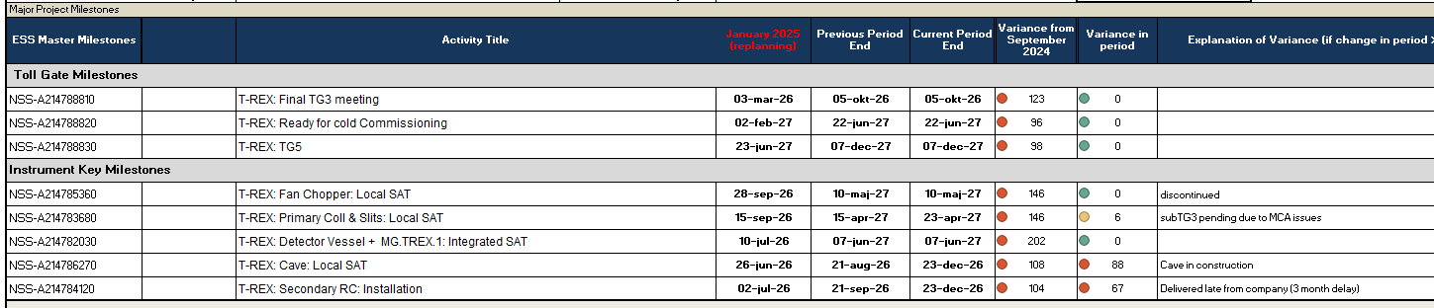
Key milestones (as shown in dashboard)
Delays on all key milestones since the replanning

Slide 8
Schedule adherence
Most months – T-REX is above average on schedule accuracy

Slide 9
Lookout - future activities
There’s a lot in the pipeline..

Slide 11
NSS Replanning Evaluation
TREX ICEB

Slide 12
Sep 2025 - Nov 2026
Sep 2025 - Jul 2026
Nov 2026 - Feb 2027
Sep 2025 - Jan 2027
Sep 2025 - Jan 2026
Sep 2025 - Jan 2026
Sep 2025 - Jan 2027
367 days
354 days
101 days
195 days
138 days
103 days
167 days
148 days
218 days
307 days
70 days
99 days
94 days
Feb 9
2025
TREX Critical Paths
Data from P6 September 2025 lockdown
Final TG3
Start of CC
TG5/SAR approval
Today
Oct 7, 2026
Jun 8, 2027
Nov 23, 2027
2025
2026
2027
2027
Q3
Q4
Q1
Q2
Q3
Q4
Q1
Q2
Q3
Q4
No. 1 - Critical Path M Chopper
(0 days TF)
M Chopper: Manufacturing phase (FZJ)
Jan 2027 - Jun 2027
M Chopper : Installation and Commissioning phase (FZJ)
No. 2 - Critical Path P Chopper
(8 days TF)
P Chopper: Manufacturing phase (FZJ)
Jan 2027 - May 2027
P Chopper : Installation and Commissioning phase (FZJ)
No. 3 - Critical Path Fan Chopper
(20 days TF)
Fan Chopper: Design phase (FZJ)
Jan 2026 - Oct 2026
Fan Chopper: Procurement and Manufacturing phase (FZJ)
Oct 2026 - Apr 2027
Fan Chopper : Installation and Commissioning phase (FZJ)
Primary Coll & Slits: Design phase (CNR/INFN)
No. 4 - Primary Coll & Slit
(41 days TF)
Jan 2026 - Sep 2026
Primary Coll & Slits: Procurement and Manufacturing phase (CNR/INFN)
Sep 2026 - Apr 2027
Primary Coll & Slits and MCA: Installation and Commissioning phase (CNR/INFN)
OoB Optics: Design phase (FZJ)
No. 5 - Out of bunker optics
(45 days TF)
OoB Optics: Procurement and Manufacturing (FZJ)
OoB Optics: Installation preparations (FZJ)
Since last ICEB…
Shift on TG5
Cave no longer on top critical path
3 new deliverables on top critical paths (M chopper, P chopper and primary collimator & slits
Go back to CP 1 (45 days of float)
Design phase ends at CDR approval
Procurement and Manufacturing phase ends at FAT closure of open points
Installation and Commissioning phase ends at SAT approval
TF: number days of total float to Instrument’s TG5
Cave has 6 months of float and is no longer top 5 CP
Note: MG detector boxes 2-4 (including 18 modules) is part of the instrument scope but currently not linked to TG5 in P6
Notes:
2025-09
OoB Guides 43 days delayed
M-chopper FAT delayd 139 days
P-chopper Fat delayed 45 dyas
Fan chopper 33 days delayed
OoB Guides 33 days delayed
2025-09
Delay to M chopper
2025-05
P-chopper manufacturing delayed 8 months
OoB Guides (design, procurement and manufacturing) is 1 month delayed
2025-04
CP3 new: Translation table delayed 1 month
OoB Guide delayed 1 month

Slide 13
Apr 2025 - Jan 2026
Apr 2025 - Sep 2025
Apr 2025 - Dec 2025
Apr 2025 - Feb 2026
Apr 2025 - Jun 2026
229 days
140 days
188 days
140 days
218 days
150 days
324 days
208 days
181 days
121 days
54 days
45 days
145 days
2025
TREX Critical Paths
Data from P6 April 2025 Lockdown
Final TG3
Start of CC
TG5/SAR approval
Today
Apr 29, 2026
Feb 15, 2027
Jul 8, 2027
2025
2026
2027
2027
Q2
Q3
Q4
Q1
Q2
Q3
Q4
Q1
Q2
Q3
Cave: Procurement and Manufacturing phase (CNR)
No. 1 - Critical Path Cave
(0 days TF)
Jan 2026 - Sep 2026
Cave and Vessel: Installation phase (CNR & FZJ)
Sep 2026 - Dec 2026
CEP and ICS: Installation and Energization (ESS)
Energization instrument zone complete
Dec 11
Dec 2026 - Feb 2027
MCA: Commissioning phase for sub-system
No. 2 - Critical Path Fan Chopper
(5 days TF)
Fan Chopper: Design phase (FZJ)
Sep 2025 - Jul 2026
Fan Chopper: Procurement and Manufacturing phase (FZJ)
Jul 2026 - Feb 2027
Fan, P and M Chopper : Installation and Commissioning phase (FZJ)
No. 3 - Out of bunker optics
(11 days TF)
Thermal Polarization and Translation Table: Design phase (FZJ)
Dec 2025 - Jul 2026
Translation Table: Procurement and Manufacturing phase (FZJ)
Jul 2026 - Jan 2027
Translation Table and Cold Polarization: Installation phase (FZJ)
No. 4 - Out of bunker optics
(25 days TF)
OoB Optics: Design phase (FZJ)
OoB Optics: Procurement and Manufacturing (FZJ)
Jun 2026 - Jan 2027
OoB Optics and Polarization Flipper: Installation and Commissioning phase (FZJ)
Design phase ends at CDR approval
Procurement and Manufacturing phase ends at FAT closure of open points
Installation and Commissioning phase ends at SAT approval
TF: number days of total float to Instrument’s TG5
Note: MG detector boxes 2-4 (including 18 modules) is part of the instrument scope but currently not linked to TG5 in P6. MG Detector box 1 (including 6 modules) has 91 days of float
Notes:
2025-04
CP3 new: Translation table delayed 1 month
OoB Guide delayed 1 month

Slide 14
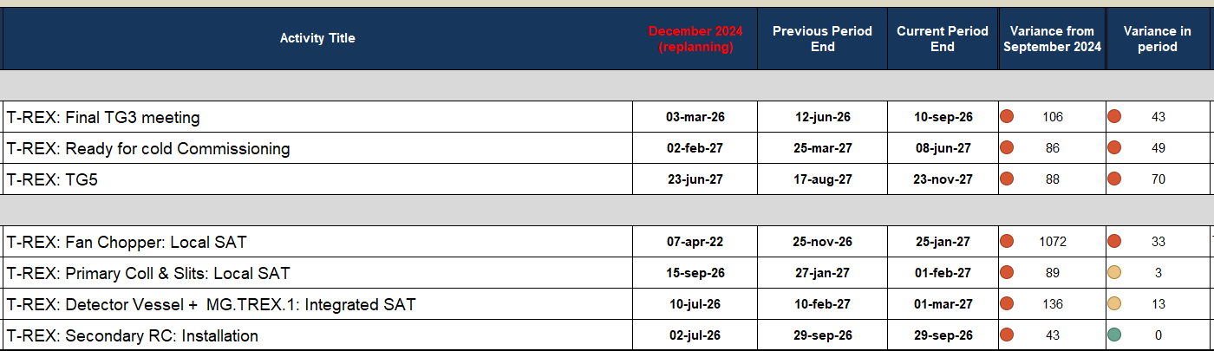
Key milestones (as shown in dashboard)
Delays on all key milestones since the replanning

Slide 15
Key milestones > 4 months delay
Comparing January 2025 with September 2025
Activity Name | Date (Jan 25) | Date (Sep 25) | Variance date (month)
T-REX:OoB Guide (96-151.5): CDR/subTG3 (meeting) | 02-jun-25 | 11-dec-25 | -5,8
T-REX:OoB Guide (151.5-163.1): IRR/subTG4 (meeting) | 15-sep-26 | 03-feb-27 | -4,55
T-REX: P- Fast Chopper: Factory Acceptance Test (FAT) | 23-sep-25 | 23-nov-26 | -13,4
T-REX: M- Fast Chopper: Factory Acceptance Test (FAT) | 19-dec-25 | 06-nov-26 | -9,7
T-REX: Fan Chopper:CDR/subTG3 (meeting) | 14-apr-25 | 16-dec-25 | -7,45
T-REX: BG Chopper (Disk & Housing): CDR/subTG3 (meeting) | 01-apr-25 | 25-nov-25 | -7,15
T-REX: Thermal Polarization: CDR/subTG3 (meeting) | 30-apr-25 | 24-nov-25 | -6,15
T-REX: Polarization Analyser: CDR/subTG3 (meeting) | 06-May-25 | 19-dec-25 | -6,95
T-REX: Polarization Flipper: CDR/subTG3 (meeting) | 07-May-25 | 15-dec-25 | -6,7
T-REX: Cd Shielding: Factory Acceptance Test (FAT) | 01-dec-25 | 29-apr-26 | -4,75
T-REX: Primary Coll & Slits: CDR/subTG3 (meeting) | 26-jun-25 | 08-jan-26 | -5,5
T-REX: Beamstop: CDR/subTG3 (meeting) | 27-May-25 | 14-jan-26 | -6,6
T-REX: Det boxes 2-4: Factory Acceptance Test (FAT) | 31-aug-26 | 10-feb-27 | -5,35

Slide 16
Completing design for T2T3 instruments
30 meetings held this year from Jan 25 to mid-Sep 25
As shown at ICB

Slide 17
The path to TG3
Planned CDR meetings
Activity Name | Date (Sep 25)
T-REX: Control Hutch: CDR/subTG3 (meeting) | 17-okt-25
T-REX: Thermal Polarization: CDR/subTG3 (meeting) | 24-nov-25
T-REX: BG Chopper (Disk & Housing): CDR/subTG3 (meeting) | 25-nov-25
T-REX:OoB Guide (96-151.5): CDR/subTG3 (meeting) | 11-dec-25
T-REX: Translation Table: CDR/subTG3 (meeting) | 15-dec-25
T-REX: Polarization Flipper: CDR/subTG3 (meeting) | 15-dec-25
T-REX: Fan Chopper:CDR/subTG3 (meeting) | 16-dec-25
T-REX: Polarization Analyser: CDR/subTG3 (meeting) | 19-dec-25
T-REX: Primary Coll & Slits: CDR/subTG3 (meeting) | 08-jan-26
T-REX: Beamstop: CDR/subTG3 (meeting) | 14-jan-26
T-REX: Sample Environment: CDR/subTG3 (meeting) | 14-jan-26
T-REX:OoB Guide (151.5-163.1): CDR/subTG3 (meeting) | 11-jun-26

Slide 18
Schedule adherence
Most months – T-REX is above average on schedule accuracy - improvement form last period!

Slide 19
Lookout - future activities
There’s a lot in the pipeline..

