Slide 1
TREX ACCELERATIONS

Slide 2
Objective
    Protect or advance the TG5 date
    Remove remaining blockers and reduce schedule risk
    Common understanding on the challenges and priorities going forward
    Evaluate potential TG5 deferrals and their impact on hot commissioning
    Agree on clear actions and next steps

Slide 3
Agenda
Recap of previous decisions/meetings
Review of critical path
Acceleration options. You’ve been asked to come prepared with concrete acceleration proposals, including:
      Estimated schedule gain (weeks)
      Required additional resources
      Associated risks
TG5 scope and deferral strategy. Evaluation of deferral candidates:
      Some of the beam monitors
      Pol analyser
      Commissioning of polariser
      MG boxes 2+
      Any other candidates?

Slide 4
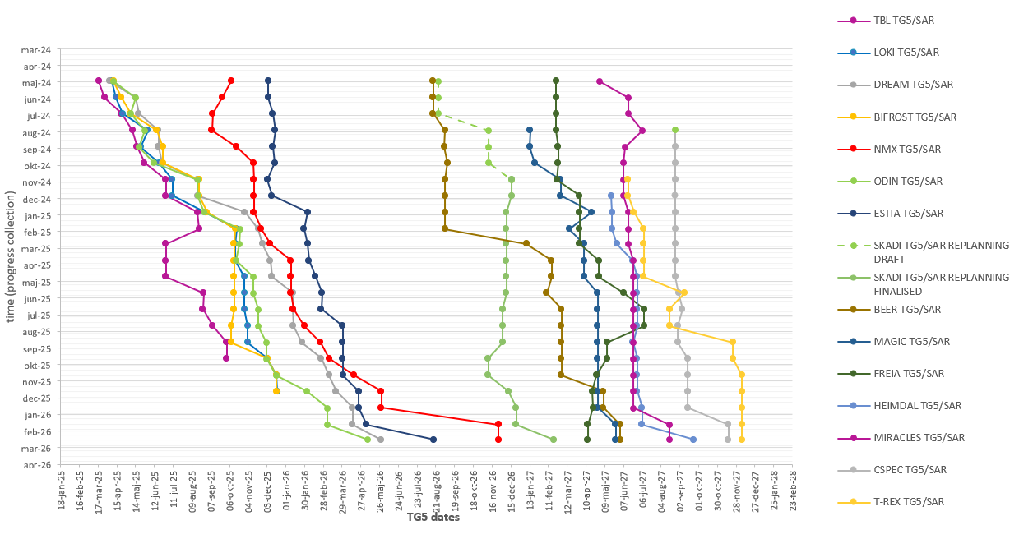
TG5 slip chart
Data from P6 MARCH 2026 lock down
TBL
LOKI,
BIFROST
TG5/SAR approved.
(iSRR held, approval pending)
,
NMX
MAGIC
BEER
SKADI
FREIA
MIRACLES,
HEIMDAL
ODIN,
CSPEC TREX
DREAM ESTIA
Note: For T2T3, tracking starts after replanning close-out. Vespa has TG5 in May 2029. Once TG5 is approved, the instrument will be removed from tracking.

Slide 5
Sep 2025 - Jul 2026
Sep 2025 - Jan 2027
Sep 2025 - Jan 2026
Sep 2025 - Jan 2026
Sep 2025 - Jan 2027
367 days
354 days
101 days
195 days
138 days
103 days
167 days
148 days
218 days
307 days
70 days
99 days
94 days
Feb 9
2025
TREX Critical Paths
As viewed at the last ICEB
Data from P6 September 2025 lockdown
Final TG3
Start of CC
TG5/SAR approval
Today
Oct 7, 2026
Jun 8, 2027
Nov 23, 2027
2025
2026
2027
2027
Q3
Q4
Q1
Q2
Q3
Q4
Q1
Q2
Q3
Q4
No. 1 - Critical Path M Chopper
(0 days TF)
M Chopper: Manufacturing phase (FZJ)
Jan 2027 - Jun 2027
M Chopper : Installation and Commissioning phase (FZJ)
No. 2 - Critical Path P Chopper
(8 days TF)
P Chopper: Manufacturing phase (FZJ)
Jan 2027 - May 2027
P Chopper : Installation and Commissioning phase (FZJ)
No. 3 - Critical Path Fan Chopper
(20 days TF)
Fan Chopper: Design phase (FZJ)
Jan 2026 - Oct 2026
Fan Chopper: Procurement and Manufacturing phase (FZJ)
Oct 2026 - Apr 2027
Fan Chopper : Installation and Commissioning phase (FZJ)
Primary Coll & Slits: Design phase (CNR/INFN)
No. 4 - Primary Coll & Slit
(41 days TF)
Jan 2026 - Sep 2026
Primary Coll & Slits: Procurement and Manufacturing phase (CNR/INFN)
Sep 2026 - Apr 2027
Primary Coll & Slits and MCA: Installation and Commissioning phase (CNR/INFN)
OoB Optics: Design phase (FZJ)
No. 5 - Out of bunker optics
(45 days TF)
Sep 2025 - Nov 2026
OoB Optics: Procurement and Manufacturing (FZJ)
Nov 2026 - Feb 2027
OoB Optics: Installation preparations (FZJ)
Go back to CP 1 (45 days of float)
Design phase ends at CDR approval
Procurement and Manufacturing phase ends at FAT closure of open points
Installation and Commissioning phase ends at SAT approval
TF: number days of total float to Instrument’s TG5
Cave has 6 months of float and is no longer top 5 CP
Note: MG detector boxes 2-4 (including 18 modules) is part of the instrument scope but currently not linked to TG5 in P6
Notes:
2025-09
OoB Guides 43 days delayed
M-chopper FAT delayd 139 days
P-chopper Fat delayed 45 dyas
Fan chopper 33 days delayed
OoB Guides 33 days delayed
2025-09
Delay to M chopper
2025-05
P-chopper manufacturing delayed 8 months
OoB Guides (design, procurement and manufacturing) is 1 month delayed
2025-04
CP3 new: Translation table delayed 1 month
OoB Guide delayed 1 month

Slide 6
Mar 2026 - Apr 2026
0 days
Mar 2026 - Feb 2027
Mar 2026 - Oct 2026
Mar 2026 - Jun 2026
0 days
0 days
0 days
0 days
252 days
167 days
107 days
125 days
134 days
44 days
198 days
40 days
67 days
78 days
52 days
37 days
89 days
0 days
2026
TREX Critical Paths
Cold Commissioning TG5 scope complete
Aug 17, 2027
Final TG3
TG5/SAR approval
Data from P6 March 2026 lockdown
Today
Nov 2, 2026
Dec 7, 2027
2026
2027
2027
Q1
Q2
Q3
Q4
Q1
Q2
Q3
Q4
No. 1 - Critical Path M Chopper
(0 days TF)
M Chopper: Manufacturing phase (FZJ)
Feb 2027 - Jun 2027
M Chopper : Installation and Commissioning phase (FZJ)
Jun 2027 - Aug 2027
Integrated Cold Commissioning
CEP: Requirement and Desigh phase (ESS)
No. 2 - Critical Path
(0 days TF)
Oct 2026 - Mar 2027
CEP and ICS: Installation and Energization (ESS)
Mar 2027 - Jun 2027
Detector and Vessel: Commissioning phase (FZJ & ESS)
Back into CP01 with 0 days float
Jun 21
Transl Table: Design phase (FZJ)
No. 3 - Trans Table & Cold Polariz
(4 days TF)
Jun 2026 - Dec 2026
Transl Table: Manufacturing phase (FZJ)
Dec 2026 - Jun 2027
Transl Table & Therm Polariz: Installation and Commissioning phase (FZJ)
Back into CP01 with 4 days float
Jun 15
Primary Coll & Slits Design phase (CNR)
No. 4 - Critical Path Primary Coll & Slits
(9 days TF)
May 2026 - Feb 2027
Primary Coll & Slits: Procurement and Manufacturing phase (CNR)
Feb 2027 - Apr 2027
Primary Coll & Slits: Installation phase (CNR)
Apr 2027 - Jun 2027
MCA, Translation Table, Secondary RC, Primary Coll & Slits Commissioning phase
Back into CP01 with 9 days float
Jun 8
Design phase ends at CDR approval
Procurement and Manufacturing phase ends at FAT closure of open points
Installation and Commissioning phase ends at SAT approval
TF: number days of total float to Instrument’s TG5
Notes:
2026-03
Translation table design: 17 days delayed
Primary coll & slits design: 31 days delayed
Polarization alanyser design: 16 days delayed
Secondary RC FAT: 37 days delaed
2026-01
Primary Coll & slits 30 days delayed
Polarization Analyser: 29 days delayed
Translation table: 14 days delayed (sixth CP)
2025-09
OoB Guides 43 days delayed
M-chopper FAT delayd 139 days
P-chopper Fat delayed 45 dyas
Fan chopper 33 days delayed
OoB Guides 33 days delayed
2025-09
Delay to M chopper
2025-05
P-chopper manufacturing delayed 8 months
OoB Guides (design, procurement and manufacturing) is 1 month delayed
2025-04
CP3 new: Translation table delayed 1 month
OoB Guide delayed 1 month

Slide 7
0 days
0 days
0 days
0 days
0 days
0 days
119 days
91 days
120 days
235 days
125 days
65 days
40 days
87 days
77 days
77 days
20 days
93 days
10 days
0 days
Mar 23
2026
TREX Critical Paths
Cold Commissioning TG5 scope complete
Aug 17, 2027
Final TG3
TG5/SAR approval
Data from P6 March 2026 lockdown
Today
Nov 2, 2026
Dec 7, 2027
2026
2027
2027
No. 1 - Critical Path M Chopper
(0 days TF)
Q1
Q2
Q3
Q4
Q1
Q2
Q3
Q4
Jun 2027 - Aug 2027
Integrated Cold Commissioning
No. 5 - Critical Path Pol. Analyser
(11 days TF)
Mar 2026 - Jul 2026
Polarization Analyser: Design phase (FZJ)
Jul 2026 - Dec 2026
Polarization Analyser: Manufacturing phase (FZJ)
Dec 2026 - Jun 2027
Polarization Analyser: Installation and Commissioning phase (FZJ)
Back into CP01 with 11 days float
Jun 4
No. 6 - Critical Path P Chopper
(13 days TF)
Mar 2026 - Jan 2027
P Chopper: Manufacturing phase (FZJ)
Jan 2027 - Jun 2027
P Chopper : Installation and Commissioning phase (FZJ)
Back into CP01 with 13 days float
Jun 4
No. 7 - Critical Path OoB guides
(30 days TF)
Mar 2026 - Aug 2026
OoB guides: Design phase (FZJ)
Aug 2026 - Dec 2026
OoB guides: Manufacturing phase (FZJ)
Dec 2026 - Mar 2027
OoB guides : Installation preparation phase (FZJ)
Back into CP1 with 30 days of float
Mar 2026 - Jun 2026
Secondary RC: Manufacturing and Integration phase (FZJ)
No. 8 - Critical Path Vessel and cave
(30 days TF)
Jun 2026 - Oct 2026
Detector Vessel: Rework, testing and shipping phase (FZJ)
Oct 2026 - Oct 2026
Detector Vessel: Installation phase (FZJ)
Oct 2026 - Nov 2026
Cave: Installation (last wall) phase (CNR)
Back into CP02 with 30 days float
Nov 12
Design phase ends at CDR approval
Procurement and Manufacturing phase ends at FAT closure of open points
Installation and Commissioning phase ends at SAT approval
TF: number days of total float to Instrument’s TG5
Notes:
2026-03
Translation table design: 17 days delayed
Primary coll & slits design: 31 days delayed
Polarization alanyser design: 16 days delayed
Secondary RC FAT: 37 days delayed
2026-01
Primary Coll & slits 30 days delayed
Polarization Analyser: 29 days delayed
Translation table: 14 days delayed (sixth CP)
2025-09
OoB Guides 43 days delayed
M-chopper FAT delayd 139 days
P-chopper Fat delayed 45 dyas
Fan chopper 33 days delayed
OoB Guides 33 days delayed
2025-09
Delay to M chopper
2025-05
P-chopper manufacturing delayed 8 months
OoB Guides (design, procurement and manufacturing) is 1 month delayed
2025-04
CP3 new: Translation table delayed 1 month
OoB Guide delayed 1 month

Slide 8
Evaluation of TG5 deferral candidates
      Some of the beam monitors
      Pol analyser
      Commissioning of polariser
      MG boxes 2+
      Any other candidates?

