Slide 1
BEER ICEB
CRITICAL PATHS, SCHEDULE ETC

Slide 2
Schedule adherence
ICEB in May-25
Most months – BEER is above average on schedule accuracy
Notes:
June and july – development code, not in the NPR report

Slide 3
Schedule adherence
Lower than before
Notes:
June and july – development code, not in the NPR report

Slide 4
Lookout - future activities
There’s a lot in the pipeline..

Slide 5
TG5 Approval dates
PAC.17
Tranche 2 and 3 - Since the replanning
Instrument | Replanning close-out | March 26 lockdown | Slip (months)
BEER | 05-aug-26 | 02-jun-27 | -10,3
ESTIA | 05-dec-25 | 18-aug-26* | -7,35
TREX | 23-jun-27 | 07-dec-27 | -4,9
MAGIC | 13-jan-27 | 26-May-27 | -4,55
HEIMDAL | 20-May-27 | 24-sep-27 | -3,55
CSPEC | 26-aug-27 | 16-nov-27 | -2,9
SKADI | 07-dec-26 | 19-feb-27 | -2,2
FREIA | 23-feb-27 | 13-apr-27 | -1,65
MIRACLES | 11-jun-27 | 17-aug-27 | -1,35
This table shows the TG5 date from the replanning. All instruments have had their TG5 date slip. Additionally, we have seen schedule compression and several milestones slipping.
For several instrument, one partner scope is driving the completion of the instrument project.
*combined TG5/SAR and iSRR meeting
Notes:
In two years, Beer has moved 10 months.
Activity Name
New schedule baseline
TG5 (Replanning)
TG5 PMB (Baseline)
ESTIA: Final TG5 Jun 2024
2025-12-05
2024-05-02
BEER: Final TG5 Jun 2024
2026-08-17
2024-03-28
FREIA: Final TG5 Jun 2024
2027-02-23
2025-12-08
MIRACLES: Final TG5 Jun 2024
2027-06-14
2025-12-16
MAGIC: Final TG5 Sep 2024
2027-01-13
2025-03-17
CSPEC: Final TG5 Sep 2024
2027-08-26
2026-04-02
SKADI: Final TG5 Jan 2025
2026-12-16
2025-08-18
T-REX: Final TG5 Jan 2025
2027-06-14
2026-06-30
HEIMDAL: Final TG5 Jan 2025
2027-05-20
2026-02-02

Slide 6
Aug 2025 - Nov 2025
Aug 2025 - Oct 2025
Aug 2025 - Apr 2026
Aug 2025 - Nov 2025
Jan 2026 - Jul 2026
66 days
85 days
81 days
77 days
81 days
83 days
133 days
185 days
201 days
96 days
43 days
49 days
50 days
50 days
2025
Beer Critical Paths
Last ICEB
Data from P6 August 2025 lockdown
Final TG3
Start of CC
TG5/SAR approval
Today
Feb 13, 2026
Oct 1, 2026
Mar 3, 2027
2025
2026
2027
2027
Q3
Q4
Q1
Q2
Q3
Q4
Q1
Sample Tower Support: Design phase (Hereon)
No. 1 - Critical Path
(0 days TF)
Nov 2025 - Mar 2026
Sample Tower Support: Procurement and Manufacturing phase (Hereon)
Mar 2026 - May 2026
Sample Tower Support, Hexapod and Rotary Stage: Installation phase (Hereon)
May 2026 - Sep 2026
MCA: Energization and Commissioning phase for sub-systems (Hereon)
No. 2 - Critical Path
(19 days TF)
Supports for guides and choppers: Design phase (Hereon)
Aug 2025 - Nov 2025
Supports for guides and choppers: Procurement and Manufacturing phase (Hereon)
Nov 2025 - Sep 2026
bunker closed
In-bunker choppers, bispectral switch and heavy shutter : Installation and commissioning phase (Hereon)*
No. 3 - Critical Path
(21 days TF)
RCM: Manufacturing phase (Hereon)
Apr 2026 - Jun 2026
RCM, Detector and BM: Installation phase (Hereon)
Jun 2026 - Sep 2026
MCA: Energization and Commissioning phase for sub-systems (Hereon)
No. 4 - Critical Path
(36 days TF)
Detector Support: Design phase (Hereon)
Nov 2025 - Mar 2026
Detector Support: Procurement and Manufacturing phase (Hereon)
Mar 2026 - May 2026
Detector Support: Installation phase (Hereon)
Design phase ends at CDR approval
Procurement and Manufacturing phase ends at FAT closure of open points
Installation and Commissioning phase ends at SAT approval
TF: number days of total float to Instrument’s TG5
*Dependant on pre-alignement of chopper support before bunker closing in 2025. Chopper installation completed in first bunker opening after BOT.
Notes:
2025-07
TG5 delayed 1 month
Sample tower design delayed 2 months
RCM manufacturing delayed 1 month
Detector Support design delayed 2 months
2025-06
Delay on design for supports for guide and choppers 1,5 months.
2025-04
All design are delayed
CEP - Start installation beginning of Nov - > to be finalized in February
2025-03
Linked to bunker opening. Chopper supports delayed
Sample tower supports 3 months delay
2024-10
MCA, CEP and ICS has been added
The cave is no longer the 1st CP. Sample tower and detector support is now driving

Slide 7
0 days
0 days
0 days
0 days
0 days
0 days
97 days
97 days
81 days
65 days
63 days
50 days
48 days
68 days
10 days
30 days
15 days
5 days
2026
Beer Critical Paths
Cold Commissioning of TG5 scope complete
Feb 26, 2027
Data from P6 May 2026
Final TG3
TG5/SAR approval
Today
Nov 24, 2026
Jul 8, 2027
2026
2027
2027
Q2
Q3
Q4
Q1
Q2
Q3
May 2026 - Sep 2026
Detector Support: Design phase (Hereon)
No. 1 - Critical Path
(0 days TF)
Aug 2026 - Nov 2026
Detector Support: Procurement and Manufacturing phase (Hereon)
Nov 2026 - Feb 2027
Detector (incl. supports) and RCM: Installation and commissioning phase (Hereon & ESS)
Feb 2027 - Feb 2027
Final integrated testing
May 2026 - Jul 2026
Supports for guides and choppers (array 1): Procurement and Manufacturing phase (Hereon)
No. 2 - Critical Path
(45 days TF)
Jul 2026 - Oct 2026
In-bunker choppers, bispectral switch and MCA : Installation phase (Hereon)
Oct 2026 - Oct 2026
MCA: Commissioning phase for sub-systems
Oct 2026 - Dec 2026
Chopper: Commissioning phase
Back into CP01 with 45 days float
Dec 1
May 2026 - Aug 2026
Sample Tower Support: Procurement and Manufacturing phase (Hereon)
No. 3 - Critical Path
(56 days TF)
Aug 2026 - Sep 2026
Sample Tower Support, Hexapod and Rotary Stage: Installation phase (Hereon)
Sep 2026 - Nov 2026
MCA: Commissioning phase for sub-systems (Hereon)
Back into CP01 with 56 days float
Nov 18
No. 4 - Critical Path
(67 days TF)
May 2026 - Sep 2026
Detector+ BM: Manufacturing phase incl. delivery (Hereon)
Back into CP01 with 67 days float
Sep 14
Design phase ends at CDR approval
Procurement and Manufacturing phase ends at FAT closure of open points
Installation and Commissioning phase ends at SAT approval
TF: number days of total float to Instrument’s TG5
Notes:
2026-05
Det support: 25 days delayed
2026-02
Det support: 40 days delayed
Supports for guides and choppers: 39 days delayed
TG5: 18 days delayed
2026-01
Sample tower 40 days delay (in December period)
Detector support: 17 days delay in the period (55days in the last couple of months)
Chopper supports: 10 days delay in the period
Detector: 60 days delay (in December period)
2025-10
Sample tower design delayed 2 months
Sample tower manufacturing delayed 1 months
Detector support design delayed 3 months
Detector support manufacturing delayed 1,5 months
Final TG3 delayed 3 months
2025-07
TG5 delayed 1 month
Sample tower design delayed 2 months
RCM manufacturing delayed 1 month
Detector Support design delayed 2 months
2025-06
Delay on design for supports for guide and choppers 1,5 months.
2025-04
All design are delayed
CEP - Start installation beginning of Nov - > to be finalized in February
2025-03
Linked to bunker opening. Chopper supports delayed
Sample tower supports 3 months delay
2024-10
MCA, CEP and ICS has been added
The cave is no longer the 1st CP. Sample tower and detector support is now driving

Slide 8
Estimated TG5/SAR approval dates
0 days
0 days
0 days
Dec 2029
Dec 2029
Dec 2029
Dec 2029
Dec 2029
Dec 2029
0 days
0 days
0 days
0 days
0 days
0 days
0 days
2026
2029
2026
Today
2027
2028
2029
Q3
Q4
Q1
Q2
Q3
Q4
Q1
Q2
Q3
Q4
Q1
Q2
Q3
Q4
June 2024 (Replanning close out)
Aug 2026
BeerTG5/SAR approval
.
April 2026 lockdown
Jun 2027
BeerTG5/SAR approval
Note, tentative date (from progress meetings in May): 8th of July
.
Extrapolated (using average slip rate*)
Oct 2027
BeerTG5/SAR approval
.
.
Extrapolated (using each instruments own slip rate**)
May 2028
BeerTG5/SAR approval
.
.
*5 working days (T2T3 instrument average slip per month)
**9 working days (Beer average slip per month)

Slide 9
NSS Replanning Evaluation
BEER ICEB – Follow up

Slide 10
Activities with > ≈4 months delay
Comparing June 2024 with April 2025 and August 2025
Activity Name | Start date (Aug 25) | Finish date (Aug 25) | Start date (April 25) | Finish date (April 25) | Start date (June 24) | Finish date (June 24) | Variance finish date (month)
BEER: In-Bunker Guides Chopper section: CDR/TG3 Closure of open points and approval | 27-Jun-25 | 11-July-25 | 26-May-25 | 11-jun-25 | 04-sep-24 | 17-sep-24 | - 10,7
BEER: Supports for Guides and Choppers: CDR/TG3 Closure of open points and approval | 13-Sep-24 A | 31-Oct-25 | 13-Sep-24 A | 18-jul-25 | 09-sep-24 | 20-sep-24 | - 14,55
BEER: Supports for Guides and Choppers: Factory Acceptance Test (FAT) | 17-Nov-25 | 27-Nov-25 | 27-Oct-25 | 31-Oct-25 | 25-mar-25 | 31-mar-25 | - 8,7
BEER: Cave: FAT closure of open pts and approval | 17-Sep-25 | 30-Sep-25 | 03-sep-25 | 16-sep-25 | 14-feb-25 | 27-feb-25 | - 7,7
BEER: RCM: Factory Acceptance Test (FAT) | 04-Mar-26 | 24-Mar-26 | 24-nov-25 | 15-dec-25 | 29-jan-25 | 19-feb-25 | - 14,25
BEER: Sample Tower Support: CDR/TG3 Closure of open points and approval | 10-Nov-25 | 21-Nov-25 | 09-sep-25 | 22-sep-25 | 24-apr-25 | 08-May-25 | - 7,1
** Support plan has been updated into 3 sections and the presented date is the latest section, First Array

Slide 11
Dates keep on moving to the right…

Slide 12
Aug 2025 - Nov 2025
Aug 2025 - Oct 2025
Aug 2025 - Apr 2026
Aug 2025 - Nov 2025
Jan 2026 - Jul 2026
66 days
85 days
81 days
77 days
81 days
83 days
133 days
185 days
201 days
96 days
43 days
49 days
50 days
50 days
2025
Beer Critical Paths
Data from P6 August 2025 lockdown
Final TG3
Start of CC
TG5/SAR approval
Today
Feb 13, 2026
Oct 1, 2026
Mar 3, 2027
2025
2026
2027
2027
Q3
Q4
Q1
Q2
Q3
Q4
Q1
Sample Tower Support: Design phase (Hereon)
No. 1 - Critical Path
(0 days TF)
Nov 2025 - Mar 2026
Sample Tower Support: Procurement and Manufacturing phase (Hereon)
Mar 2026 - May 2026
Sample Tower Support, Hexapod and Rotary Stage: Installation phase (Hereon)
May 2026 - Sep 2026
MCA: Energization and Commissioning phase for sub-systems (Hereon)
No. 2 - Critical Path
(19 days TF)
Supports for guides and choppers: Design phase (Hereon)
Aug 2025 - Nov 2025
Supports for guides and choppers: Procurement and Manufacturing phase (Hereon)
Nov 2025 - Sep 2026
bunker closed
In-bunker choppers, bispectral switch and heavy shutter : Installation and commissioning phase (Hereon)*
No. 3 - Critical Path
(21 days TF)
RCM: Manufacturing phase (Hereon)
Apr 2026 - Jun 2026
RCM, Detector and BM: Installation phase (Hereon)
Jun 2026 - Sep 2026
MCA: Energization and Commissioning phase for sub-systems (Hereon)
No. 4 - Critical Path
(36 days TF)
Detector Support: Design phase (Hereon)
Nov 2025 - Mar 2026
Detector Support: Procurement and Manufacturing phase (Hereon)
Mar 2026 - May 2026
Detector Support: Installation phase (Hereon)
Design phase ends at CDR approval
Procurement and Manufacturing phase ends at FAT closure of open points
Installation and Commissioning phase ends at SAT approval
TF: number days of total float to Instrument’s TG5
*Dependant on pre-alignement of chopper support before bunker closing in 2025. Chopper installation completed in first bunker opening after BOT.
Notes:
2025-07
TG5 delayed 1 month
Sample tower design delayed 2 months
RCM manufacturing delayed 1 month
Detector Support design delayed 2 months
2025-06
Delay on design for supports for guide and choppers 1,5 months.
2025-04
All design are delayed
CEP - Start installation beginning of Nov - > to be finalized in February
2025-03
Linked to bunker opening. Chopper supports delayed
Sample tower supports 3 months delay
2024-10
MCA, CEP and ICS has been added
The cave is no longer the 1st CP. Sample tower and detector support is now driving

Slide 13
Agenda
BEER replanning evaluation
Replanning recap and updates
Replanning evaluation
Schedule adherence
Earned value
Critical paths
Bunker access

Slide 14
Beer replanning finalized in June 2024
More details in P6 : TA milestones + detailed plan
We have more information in P6.
How can we use this information:
to plan/coordinate (installation, commissioning etc.)
keep track of progress (updating monthly instrument dashboards with replanning dates)
make informed decisions about priorities
BEER has 312 open activities in P6:
70 TA activities
242 activities from detailed plan

Slide 15

Simplified view of the P6 landscape
Linking an instrument plan to common projects and technology groups
ICS – network
Output:
Installation team
Q-gate team
Controllers
….
MCA
ICS – control
CEP
ICS – PSS
Detectors
(BM, Detector integration, Detector… )
Instrument plan
CUP
Choppers
Vacuum

Slide 16
Common projects replanning T2T3
Linked to P6 instrument plans
Instrument | CEP | MCA | CUP | Choppers | Detectors | BM | ICS Network | ICS PSS
ESTIA | YES | YES | YES | YES | YES: MB | YES | YES | YES
SKADI | YES | YES* | YES | YES (Racks) | N/A | YES* | YES* | YES*
BEER | YES | YES* | YES | YES | N/A | YES* | YES* | YES*
MAGIC | YES | YES* | YES | YES | N/A |  | YES* | YES*
FREIA | YES | YES* | YES | YES (Racks) | YES: MB |  | YES* | YES*
HEIMDAL | YES | YES* | YES | YES | N/A |  | YES* | YES*
MIRACLES | YES | YES* | YES | YES (Racks) | N/A |  | YES* | YES*
CSPEC | YES | YES* | YES | N/A | YES: He3 |  | YES* | YES*
T-REX | YES | YES* | YES | YES | YES: MG |  | YES* | YES*
VESPA
Information has been sent out in the NSS Progress Report
*Draft plan in place linked to the instrument plan. Further review might be needed with wp manager and instrument teams

Slide 17
Schedule adherence
Most months – BEER is above average on schedule accuracy
Notes:
June and july – development code, not in the NPR report

Slide 18
Critical paths T2T3
When a delay impacts the end date of a project
  We measure float towards the instrument’s TG5
  The first critical path has 0 float. If there’s a delay of 1 month, TG5 will shift 1 month.
  If the second critical path has 2 months float, it will push TG5 if there’s a delay of more than 2 months.
  The length of an activity reflects the start and the end of an activity, not the amount of time spent during that time period.
  The critical paths reflect the activities that are critical from a schedule perspective, not necessarily critical from a scientific or technical perspective.
  Activities on the critical paths should a priority for all of us!

Slide 19
Apr 2025 - Jul 2025
Apr 2025 - Sep 2025
Apr 2025 - Sep 2025
125 days
129 days
79 days
88 days
125 days
93 days
101 days
121 days
105 days
213 days
45 days
43 days
41 days
91 days
2025
Beer Critical Paths
Data from P6 April 2025 lockdown
Final TG3
Start of CC
TG5/SAR approval
Today
Dec 1, 2025
Sep 15, 2026
Feb 16, 2027
2025
2026
2027
2027
Q2
Q3
Q4
Q1
Q2
Q3
Q4
Q1
No. 1 - Critical Path
(0 days TF)
Supports for guides and choppers: Design phase (Hereon)
Jul 2025 - Nov 2025
Supports for guides and choppers: Procurement and Manufacturing phase (Hereon)
Nov 2025 - Sep 2026
In-bunker choppers, bispectral switch and heavy shutter : Installation and commissioning phase (Hereon)*
Sample Tower Support: Design phase (Hereon)
No. 2 - Critical Path
(16 days TF)
Sep 2025 - Jan 2026
Sample Tower Support: Procurement and Manufacturing phase (Hereon)
Jan 2026 - Apr 2026
Sample Tower Support, Hexapod and Rotary Stage: Installation phase (Hereon)
Apr 2026 - Aug 2026
MCA: Energization and Commissioning phase for sub-systems (Hereon)
Detector Support: Design phase (Hereon)
No. 3 - Critical Path
(20 days TF)
Sep 2025 - Mar 2026
Detector Support: Procurement and Manufacturing phase (Hereon)
Mar 2026 - May 2026
Detector Support: Installation and Commissioning phase (Hereon)
May 2026 - Jul 2026
Detector, BM, RC** and MCA: Installation and Commissioning phase (Hereon)
Apr 2025 - Sep 2025
Cave: Manufacturing phase (NPI)
No. 4 - Critical Path
(120 days TF)
May 2025 - Oct 2025
Cave: Installation phase (NPI)
Oct 2025 - Feb 2026
CEP, CUP and ICS: Installation and Energization (ESS)
Design phase ends at CDR approval
Procurement and Manufacturing phase ends at FAT closure of open points
Installation and Commissioning phase ends at SAT approval
TF: number days of total float to Instrument’s TG5
*Dependant on pre-alignement of chopper support before bunker closing in 2025. Chopper installation completed in June 2026 (first bunker opening after BOT)
**RCM manufacturing has 13 days float
Notes:
2025-04
All design are delayed
CEP - Start installation beginning of Nov - > to be finalized in February
2025-03
Linked to bunker opening. Chopper supports delayed
Sample tower supports 3 months delay
2024-10
MCA, CEP and ICS has been added
The cave is no longer the 1st CP. Sample tower and detector support is now driving

Slide 20
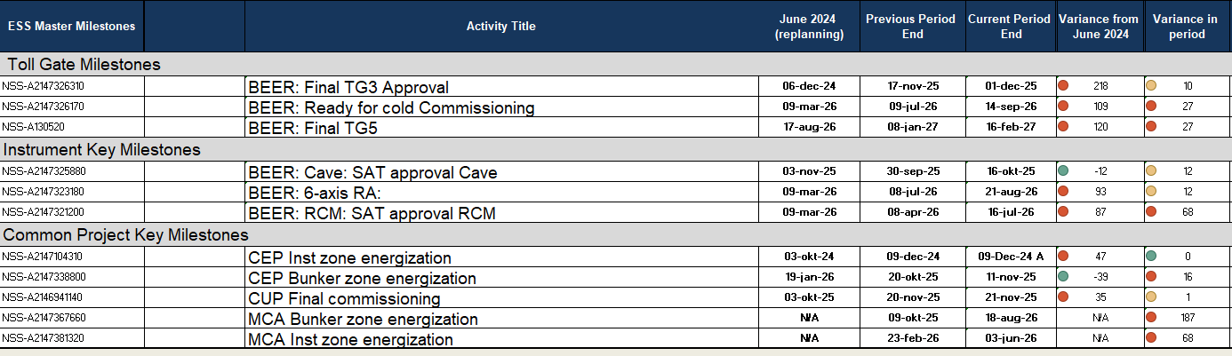
Key milestones

Slide 21
Activities with > ≈4 months delay
Comparing June 2024 with April 2025
Activity Name | Start date (April 25) | Finish date (April 25) | Start date (June 24) | Finish date (June 24) | Variance finish date (month)
BEER: In-Bunker Guides Chopper section: CDR/TG3 Closure of open points and approval | 26-May-25 | 11-jun-25 | 04-sep-24 | 17-sep-24 | -8,7
BEER: Supports for Guides and Choppers: CDR/TG3 Closure of open points and approval | 13-Sep-24 A | 18-jul-25 | 09-sep-24 | 20-sep-24 | -9,85
BEER: Supports for Guides and Choppers: Factory Acceptance Test (FAT) | 27-Oct-25 | 31-Oct-25 | 25-mar-25 | 31-mar-25 | -6,35
BEER: Cave: FAT closure of open pts and approval | 03-sep-25 | 16-sep-25 | 14-feb-25 | 27-feb-25 | -6,8
BEER: RCM: Factory Acceptance Test (FAT) | 24-nov-25 | 15-dec-25 | 29-jan-25 | 19-feb-25 | -9,3
BEER: Sample Tower Support: CDR/TG3 Closure of open points and approval | 09-sep-25 | 22-sep-25 | 24-apr-25 | 08-May-25 | -3,65

Slide 22
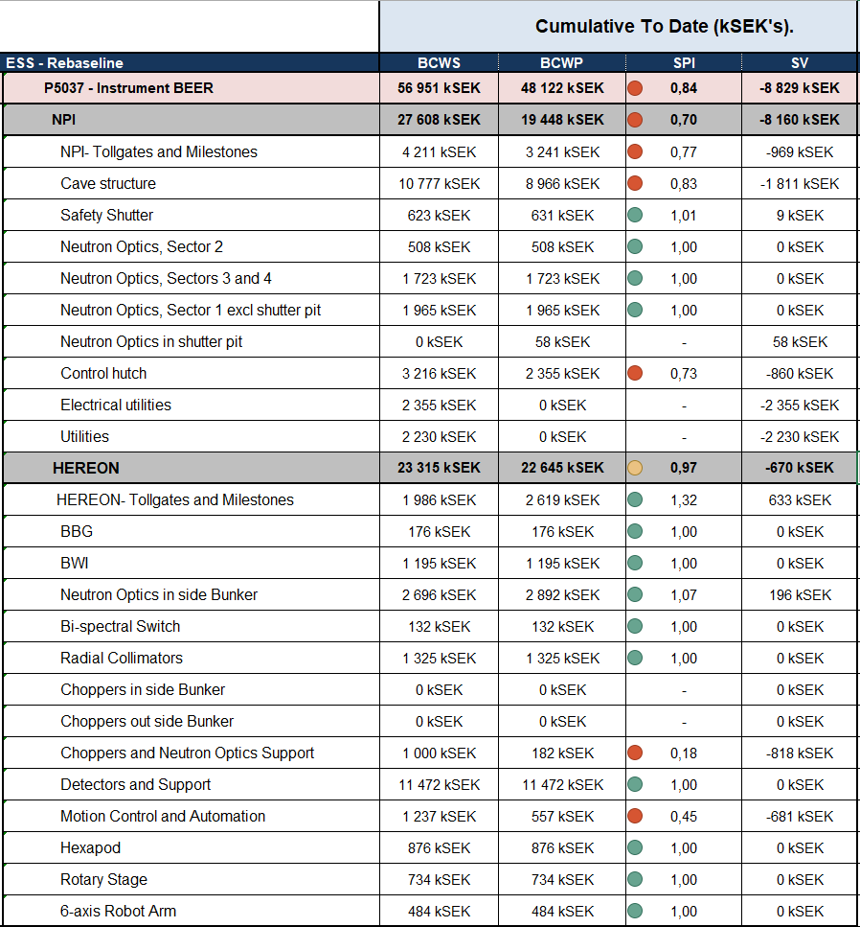
Earned value
Scheduled (in the replanning June 2024) vs. performed (April 2025)
NPI: Cave, hutch behind schedule, but progressing well
Hereon: Choppers and Neutron Optic support behind schedule
Budget for CEP, CUP and MCA to be transferred when CR:s have been agreed.
To note: Some budget holder for Hereon “Tollgates and milestones” were missing links in the replanning and were planned for June/Oct 25 and started in 2024 (TG3.3 Detectors and Support plus Radial Collimators & TG4.7 BBG, BWI, Choppers and Neutron optics in bunker and support)

Slide 23
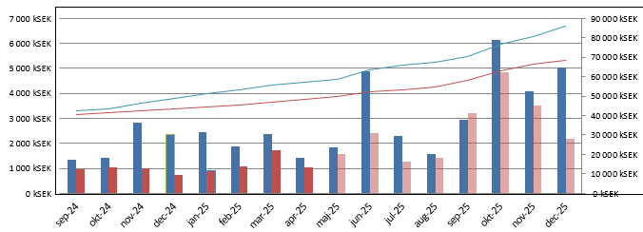
Earned value
Scheduled in replanning (blue) vs. performed (red)
vs.

Slide 24
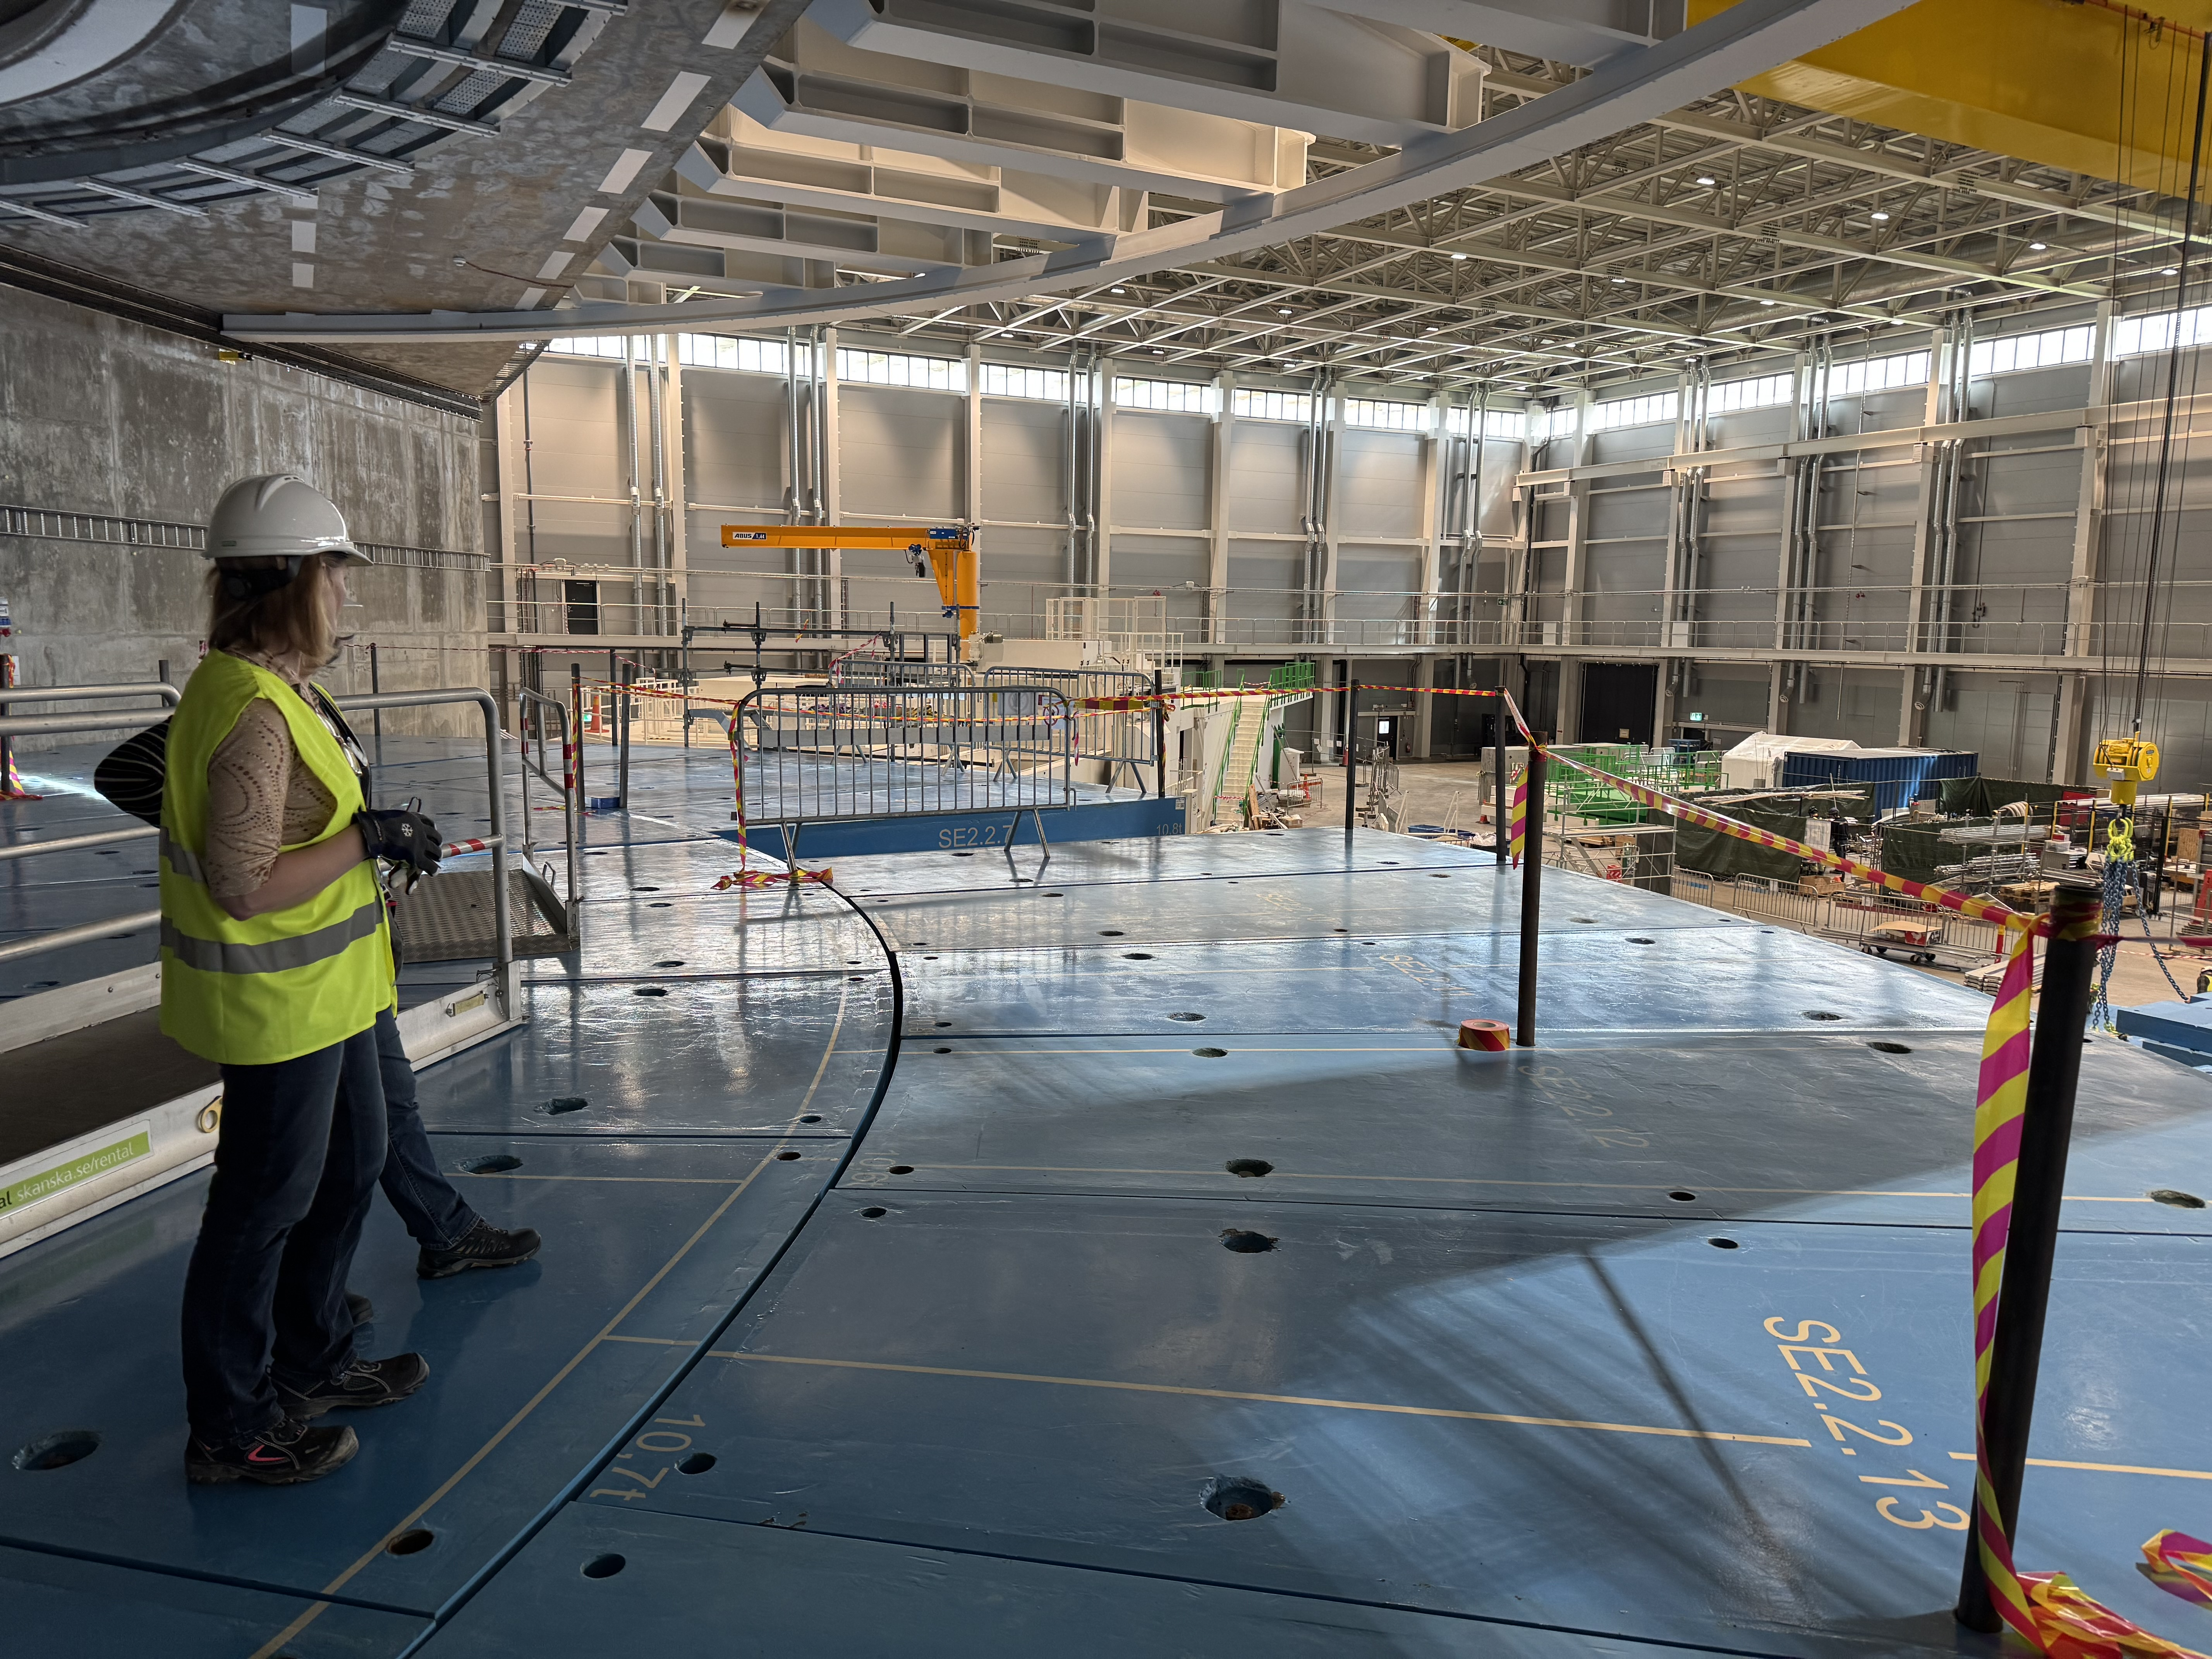
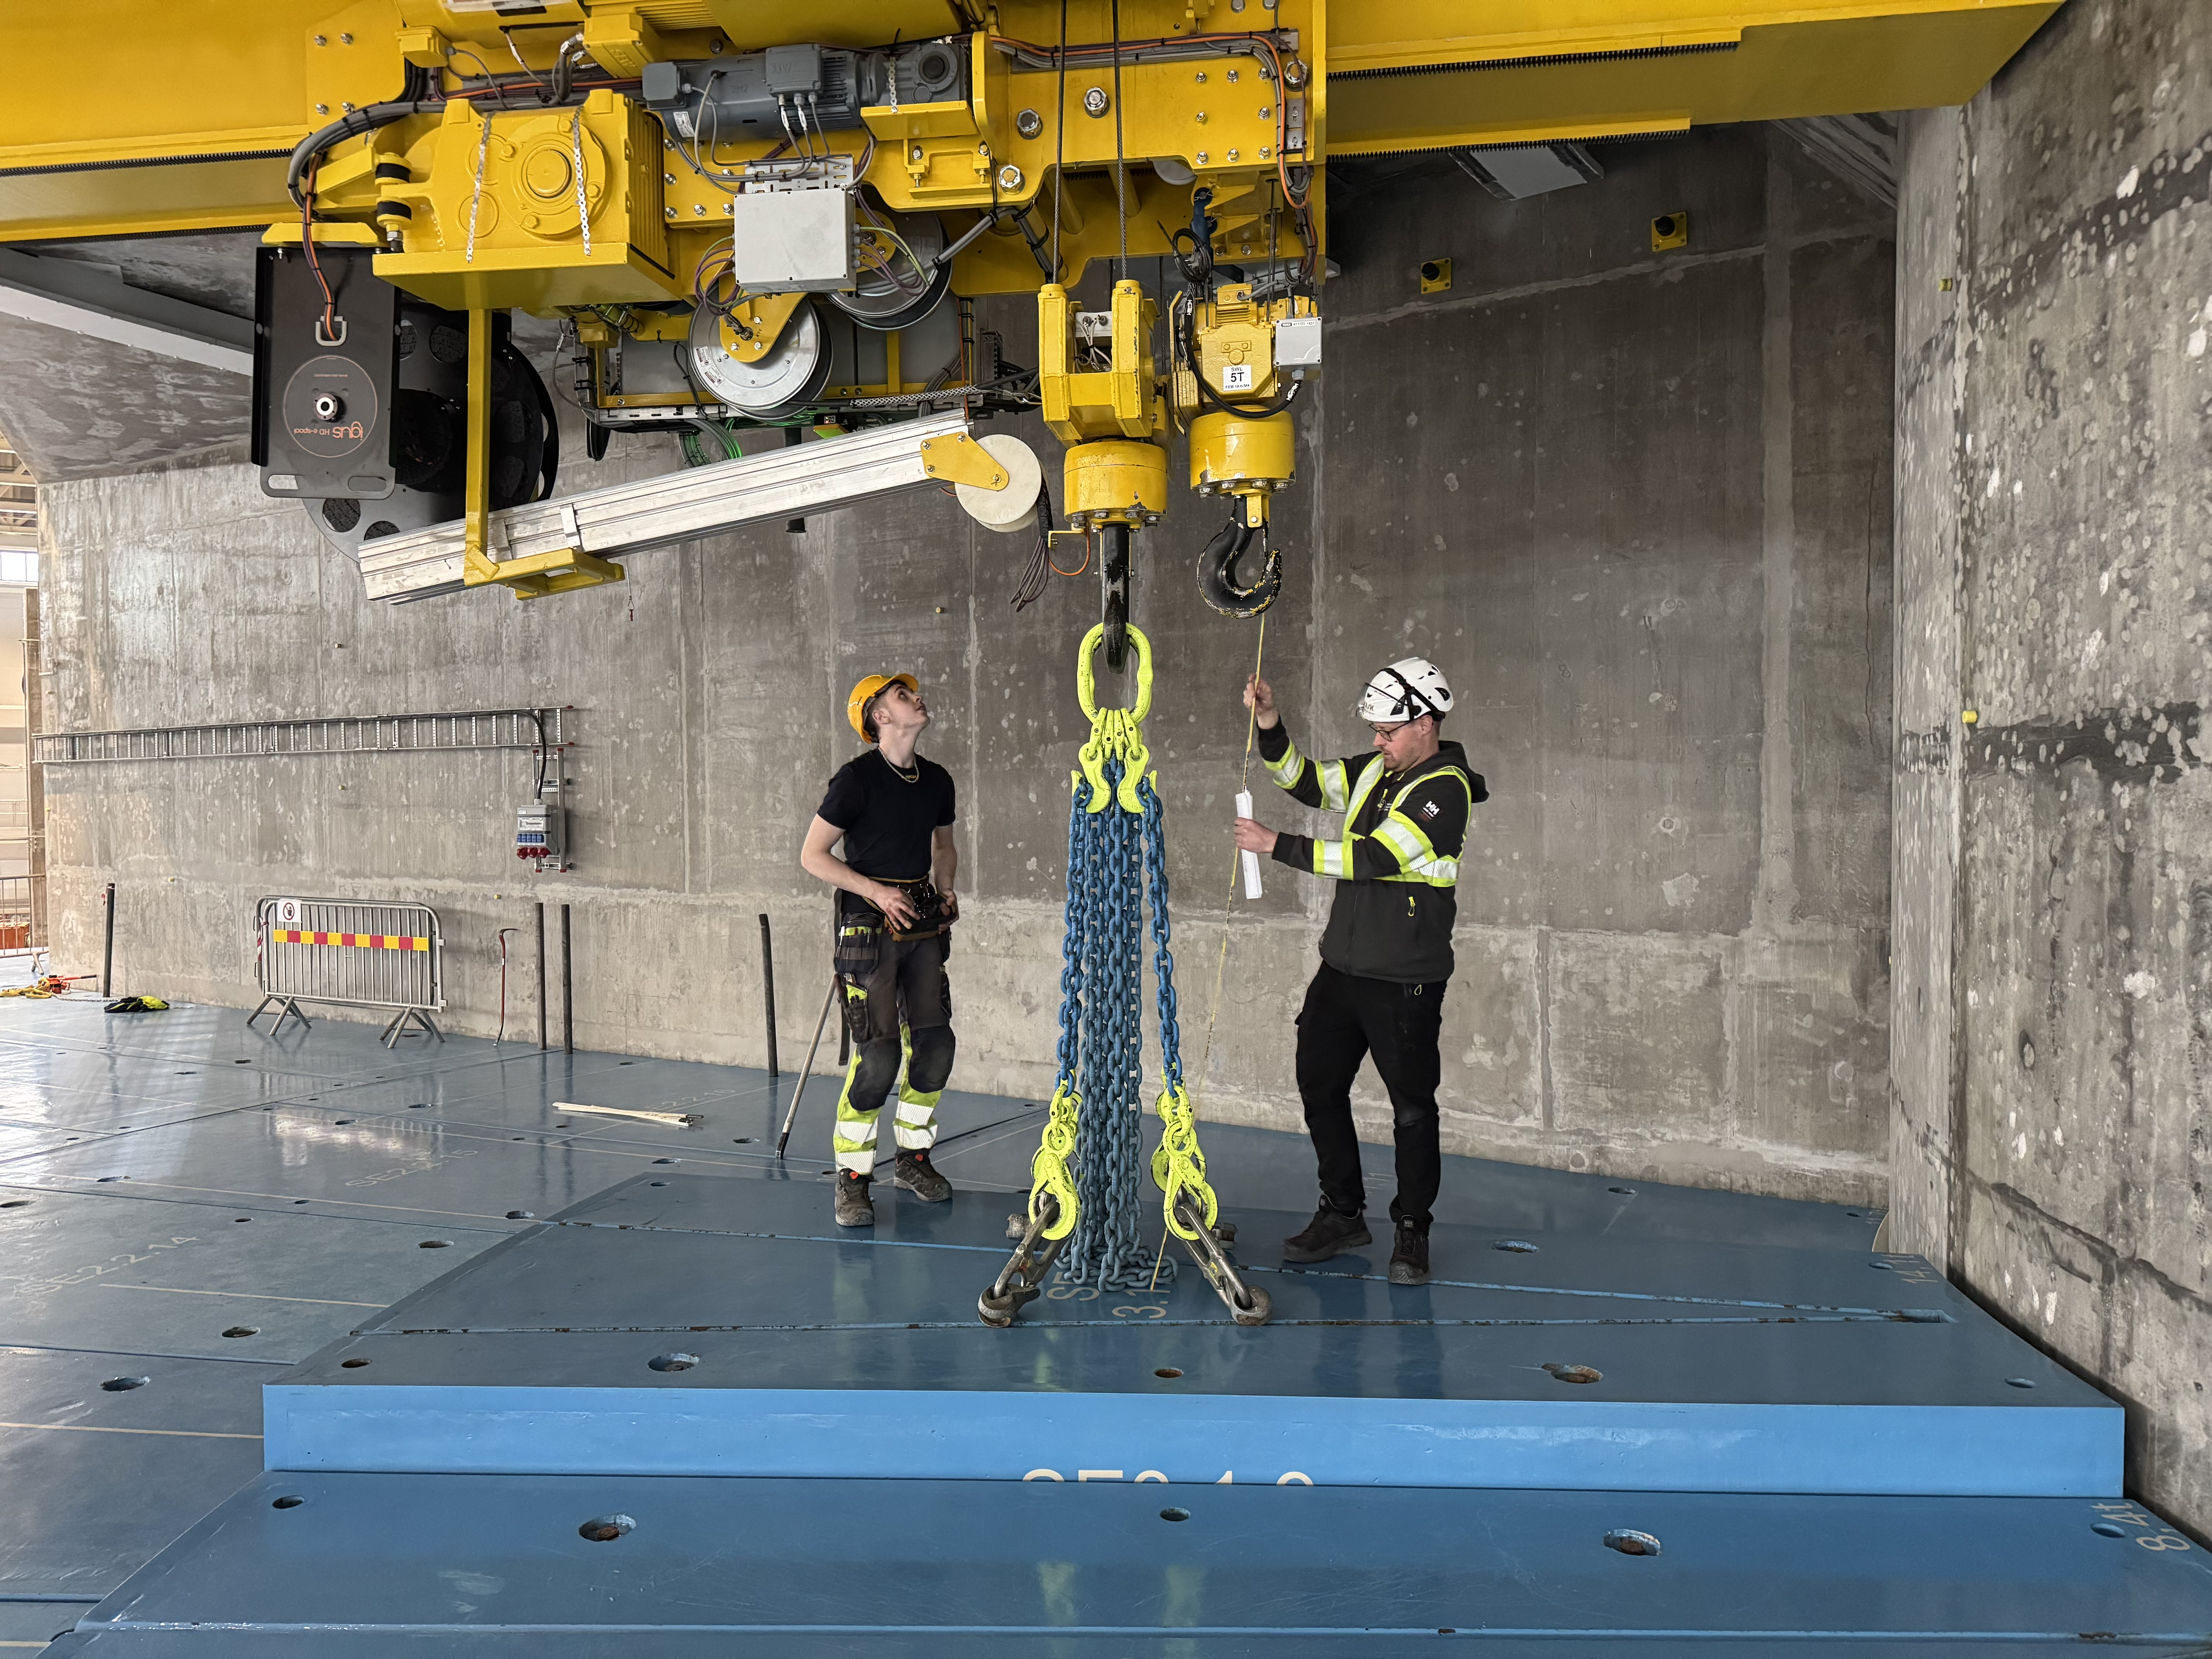
Bunker next steps
  Closing roof D03 side – after summer
  West access is extended to Aug 29th,
  Roof installation starts September 1st
  Extra access before BOT currently mid Oct - mid Dec 2025.
  Under discussion.
  Post BOT access:
  First access after BOT: summer 2026
  Second access after BOT: xmas 2026
  Third access after BOT: summer 2027

