Slide 1
LLRF Control Simulations for SPL Cavities
Simulink Model for SPL Extension to LINAC4 at CERN from RF Point of View
Matias Hernandez
Acknowledgements:
CEA team, in particular O. Piquet (simulink model)
W. Hofle, J. Tuckmantel, D. Valuch, G. Kotzian, P. A. Posocco

Slide 2
Presentation Overview
SPL Characteristics
Single Cavity/Klystron Model and Simulation Results
Double Cavity/Klystron Model and Simulation Results
Full Accelerator Analysis

Slide 3

Current SPL Accelerator Design Parameters
SPL is meant to accelerate H⁻ ions from 160 MeV up to 5 GeV.
Resonant frequency of RF system was set at 704.4 MHz to minimize SPL length and allow easy interface with re-commissioned 352.2 MHz LEP equipment used in LINAC4.
2 sections: 54 β=0.65 cavities, 200 β=1 cavities.
Vacc from 3 MV up to 26.6MV, max E field of 19.3 MV/m and 25 MV/m for each cavity type.
Synchronous angle range from 17 ̊ to 13 ̊ to minimize longitudinal emittance.
160 MeV to 5 GeV
β=0.51 to β = 0.99
5-cell elliptical SC cavities tested at CEA Saclay and INFN

Slide 4

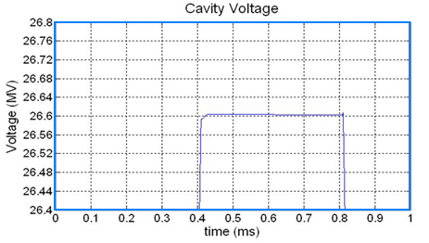
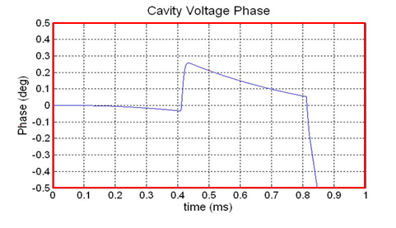
SPL Accelerator Design Parameters (3)
Hydrogen ion source is designed for flexibility and high-power for different end-user requirements in terms of average pulse current and time structure of the beam.
For 5 GeV injection acceptance tolerance (PS2, neutrinos), the control of the cavities’ accelerating voltages during beam pulse is tightly constrained.
0.4 ms pulses of 40mA (high current) beam at 50 Hz repetition rate
0.8 ms pulses of 20mA (low current) beam at 50 Hz repetition rate
max +- 0.5%
|V| nominal
max +- 0.5 ̊ V phase

Slide 5
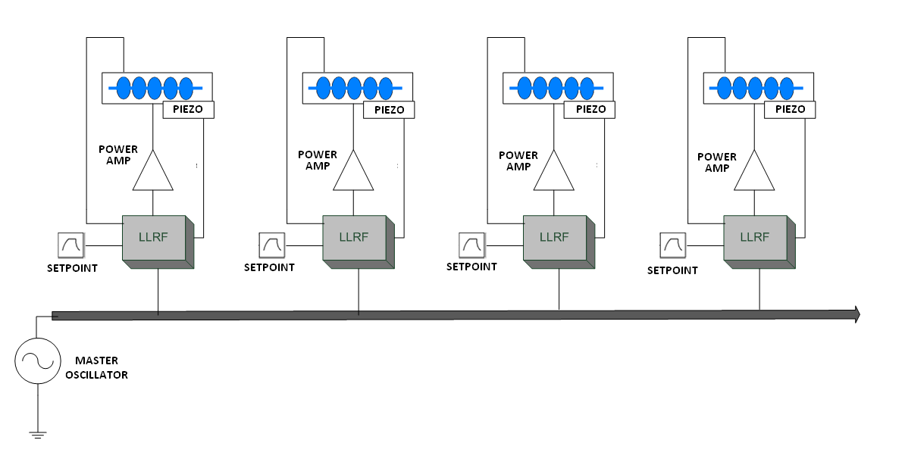
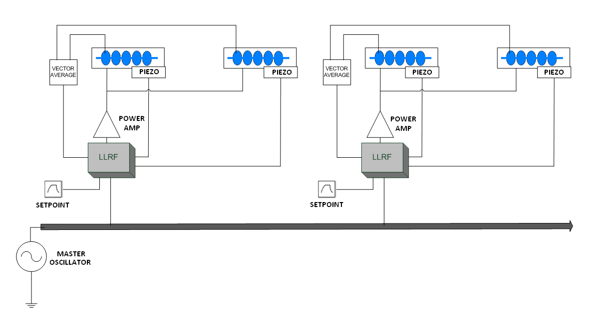
Cavity Voltage Control
Possible operation using 1 or 2 cavities controlled via a single feedback loop
1 cavity per klystron
Feedback loop acts on cavity voltage pickup vector average for dual case
2 cavities per klystron

Slide 6
High-Level Diagram of Single Cavity + Control System

Slide 7
RF Drive and Generator Model
A-A
A-P
The specifications for the Klystron and modulator ordered for CERN test stand were taken into account.
Curves were fitted for amplitude-amplitude and amplitude-phase transfer characteristics, modulator effects also included.

Slide 8
RF Drive and Generator Model Diagram
1 MHz BW

Slide 9
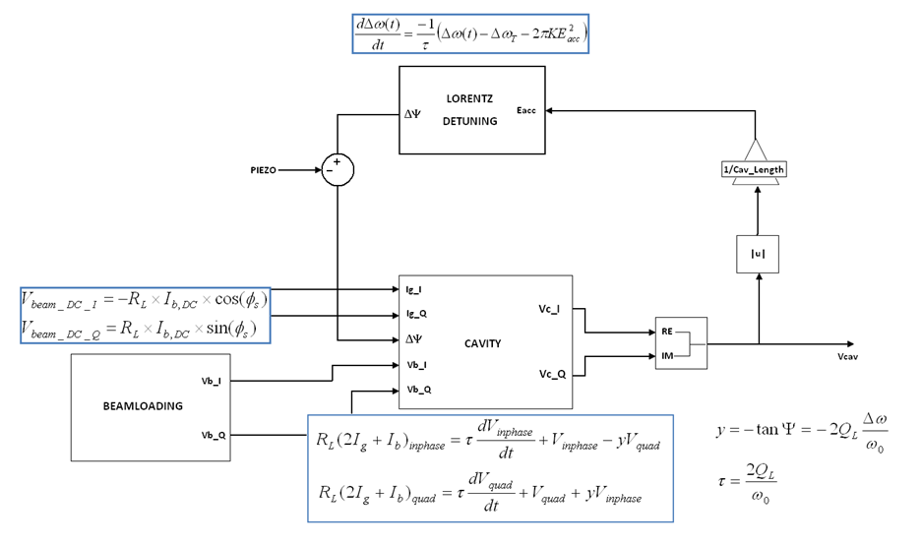
Cavity Model
Simplified Diagram
Cavity differential equations, generator plus beam loading DC voltage drop result in output curve for cavity voltage.

Slide 10
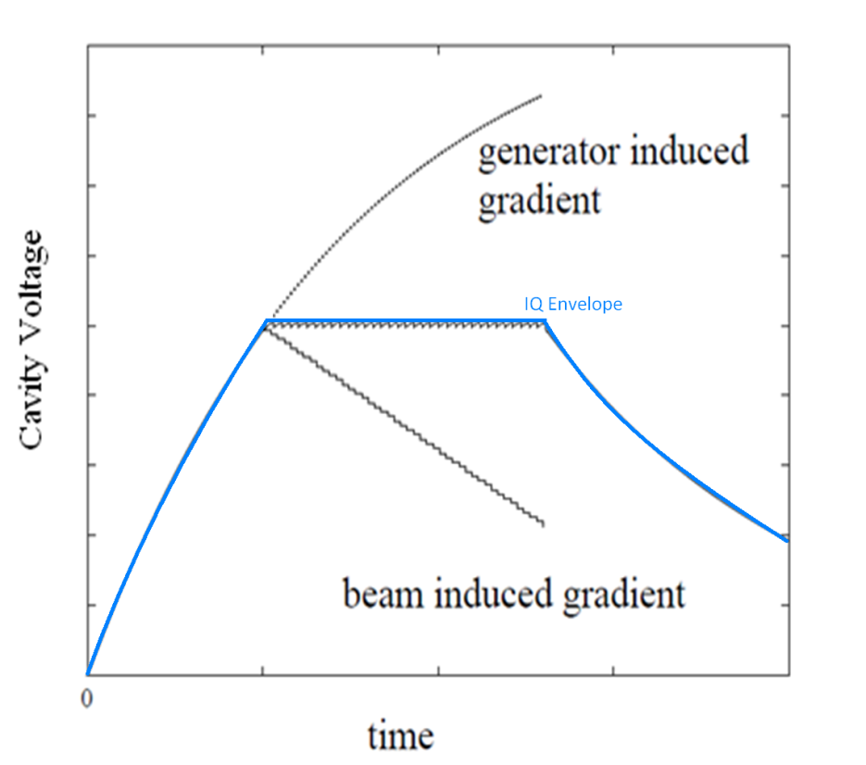
Beam Loading
Infinitely narrow bunches induce instant voltage drops in cavity
Voltage drop is equal to generator induced voltage between bunches creating flattop operation
Envelope of RF signal in I/Q

Slide 11
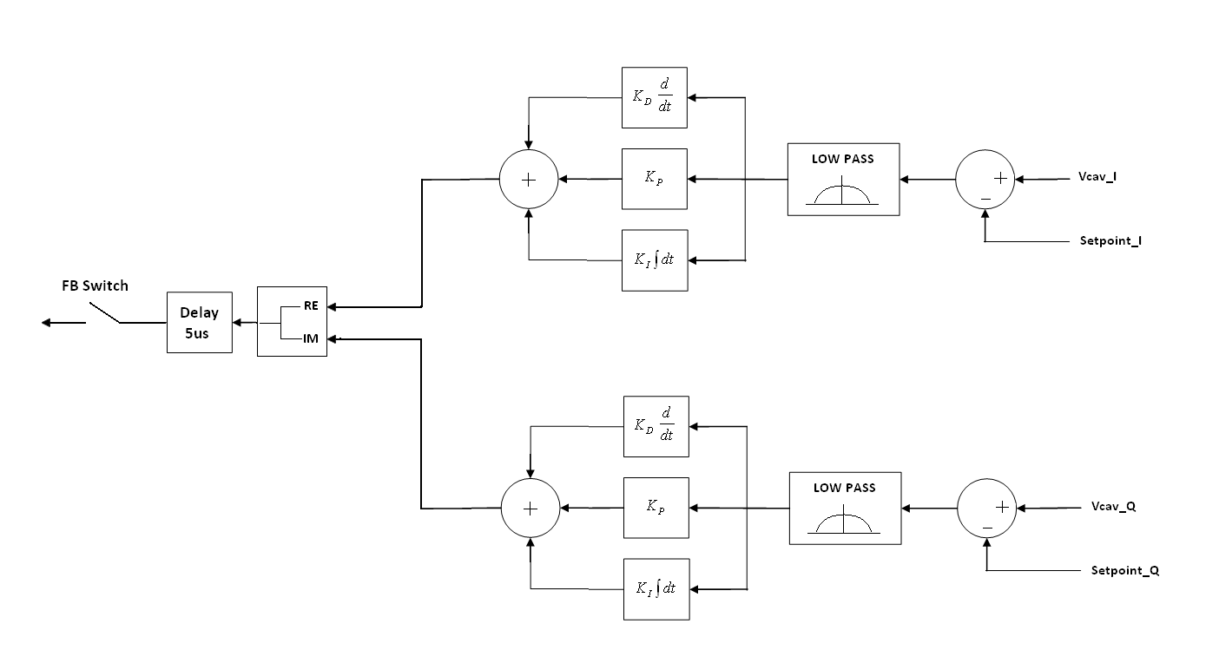
RF Feedback
PID controller
Limit bandwidth in feedback loop to 100 kHz
(Klystron bandwidth is 1 MHz)

Slide 12
Feed-Forward
System impulse response is pre-calculated and its inverse is stored in the feed-forward controller in matrix form.
The output error is calculated during the beam pulse in normal operation and the feed-forward signal is fed to the system during the next beam pulse.
IMPULSE RESPONSE

Slide 13
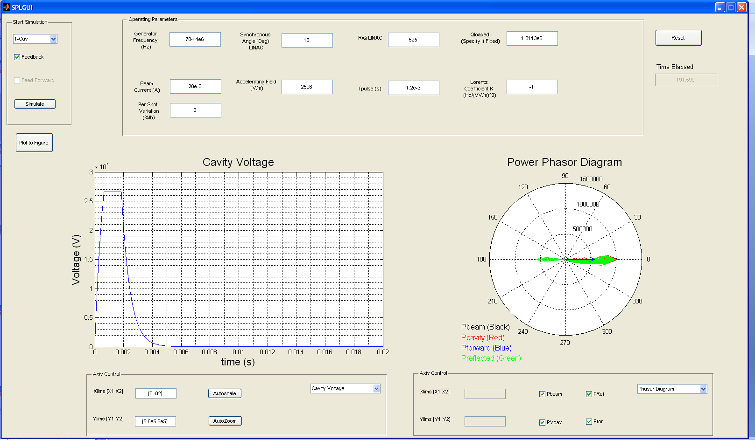
Graphical User Interface

Slide 14
Results
Cavity Voltage Amplitude and Phase
Forward and Reflected Power
Additional Power for Feedback Transients and Control
Klystron Modulator Ripple Effects and Feed-Forward Compensation
Effects of Beam Relativistic Beta Factor on Cavity Voltage During Beamloading

Slide 15
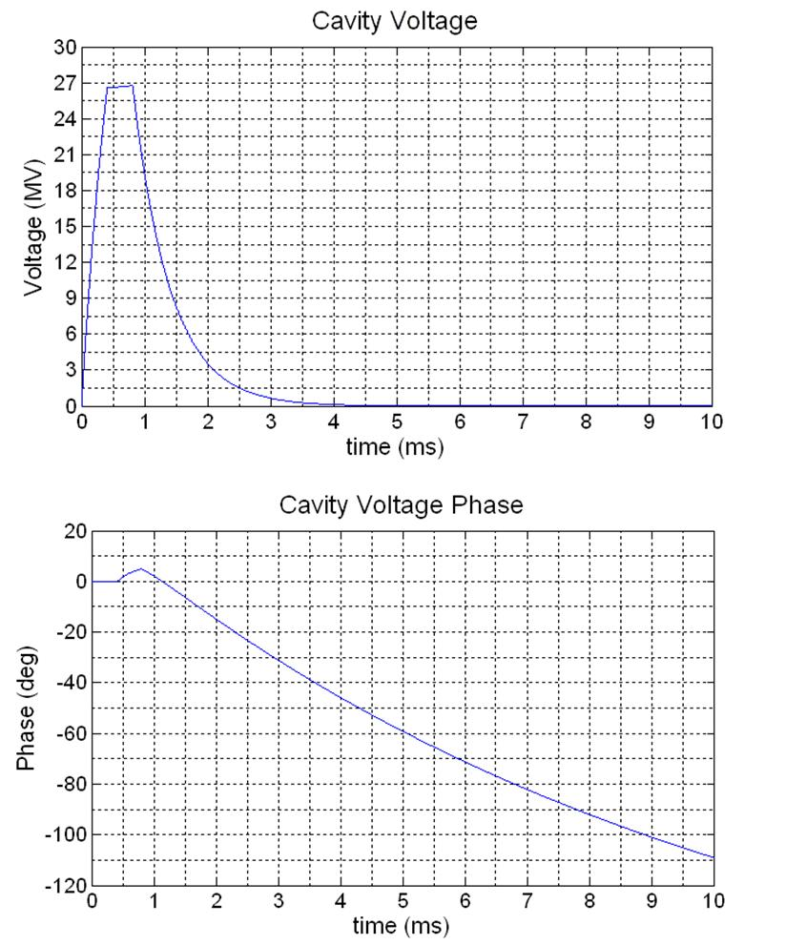
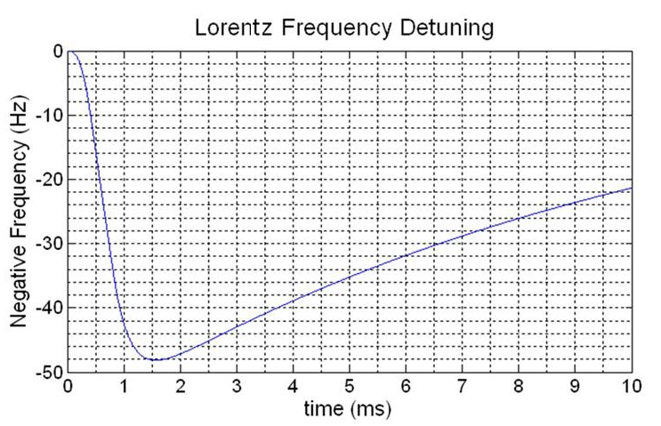
Cavity Voltage Magnitude and Phase with Lorentz Detuning (Open Loop)
Lorentz detuning coefficient K=-1 Hz/(MV/m)²
Linear phase shift for undriven cavity

Slide 16
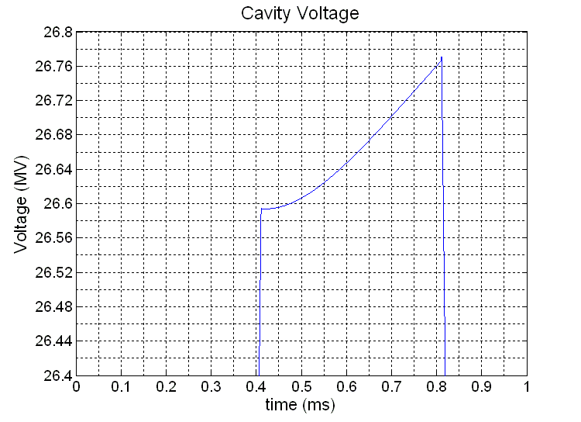
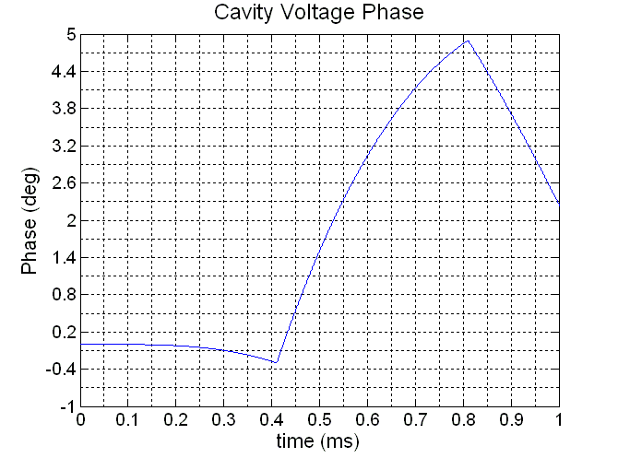
Cavity Voltage Magnitude and Phase
(Open Loop Close-Up)
Negative Lorentz detuning factor has opposite effect on cavity voltage magnitude with respect to synchronous angle effects.
Injection time
Injection time
Negative Lorentz detuning factor has opposite effect on phase with respect to synchronous angle effects.

Slide 17
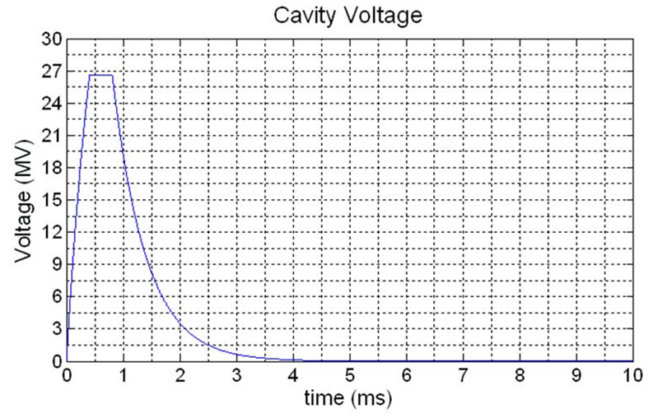
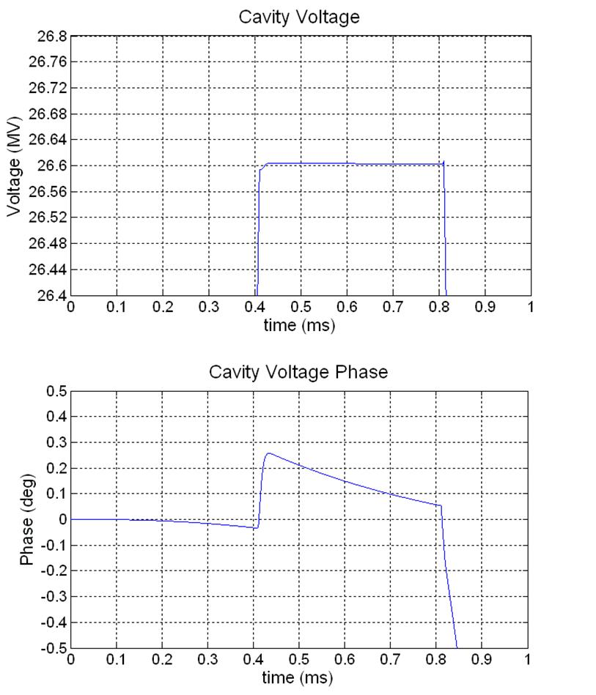
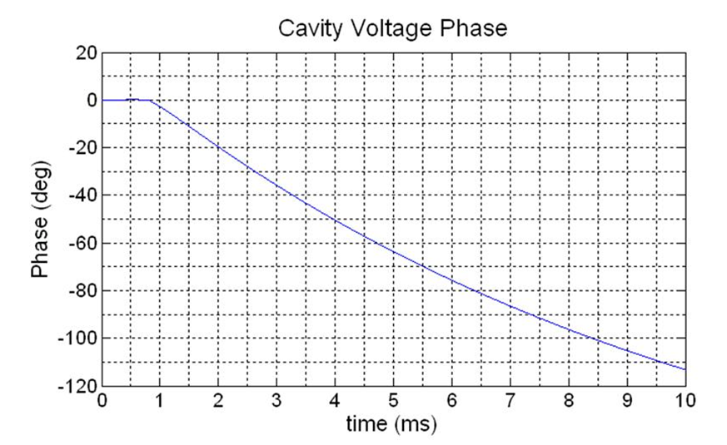
Cavity Voltage Magnitude and Phase
(Closed Loop)
Injection time

Slide 18
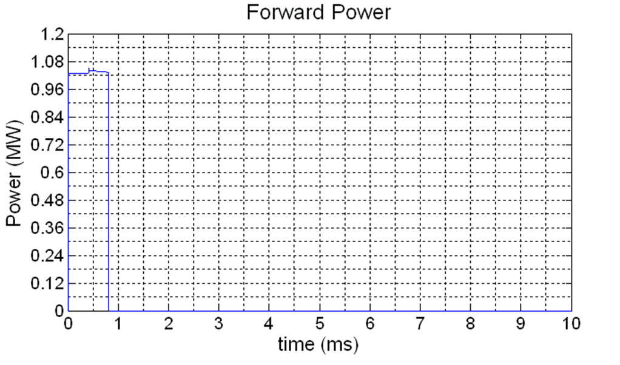
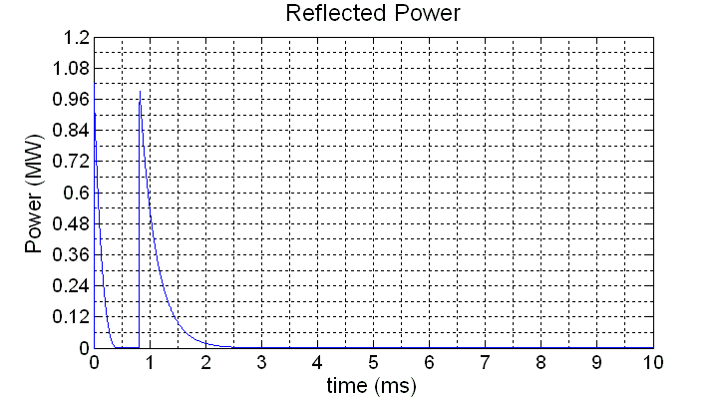
Forward and Reflected Power with Lorentz Force detuning
Less power is necessary to maintain cavity voltage due to opposing effects of synchronous angle and Lorentz detuning
Oscillations due to transients during FB loop ON and beam loading.
Feedback loop is closed 10 us after generator pulse and open 10 us after end of beam loading.
Injection time

Slide 19
High Voltage Modulator Ripple
Injection time
Variations in the high voltage supply from the modulator to the Klystron cathode have noticeable effects on the output magnitude and phase of the Klystron.
A worst case scenario of 0.2 dB/% in magnitude and 15°/kV in phase are specified.

Slide 20
Feed-Forward Effects
Feed-forward recursively corrects the residual error in the cavity voltage from pulse to pulse. After a few pulses, the correction minimizes the modulator ripple effects and the initial transients at beam injection on the cavity voltage waveform.
Injection time
Even with feedback ON, the cavity voltage phase is not ideal during beam loading, thus an extra correction must be applied.
Injection time

Slide 21
Transit Time Factor Variation with Relativistic Beta
(SPL beta=1 cavities)
The shunt impedance relates the voltage in the cavity gap to the power dissipated in the cavity walls.
The “effective” shunt impedance relates the accelerating voltage in the cavity to the power dissipated. This quantity describes the voltage that a particle travelling at a certain speed will “see” when traversing the cavity.
The “correction” applied is known as the “Transit Time Factor”.
uncorrected for beam speed

Slide 22
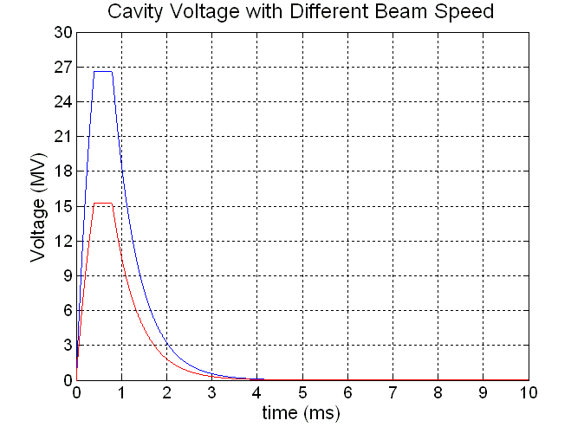
Transit Time Factor Variation with Relativistic Beta
(SPL beta=1 cavities)
Until now, the cavity dynamics have been modeled from the point of view of a beam travelling at the speed of light (β=1), the voltage seen by a β=x beam is simply a scaled version of the cavity waveforms we have already seen.
If beam loading occurs with a slower beam than
that of design (in terms of generator power and
loaded quality factor), however, the cavity
voltage will tend towards a new equilibrium
during the beam pulse.
This new equilibrium is a result of the beam
absorbing dramatically lower amounts of power
as it travels through the cavity.
β =1
β =0.85

Slide 23
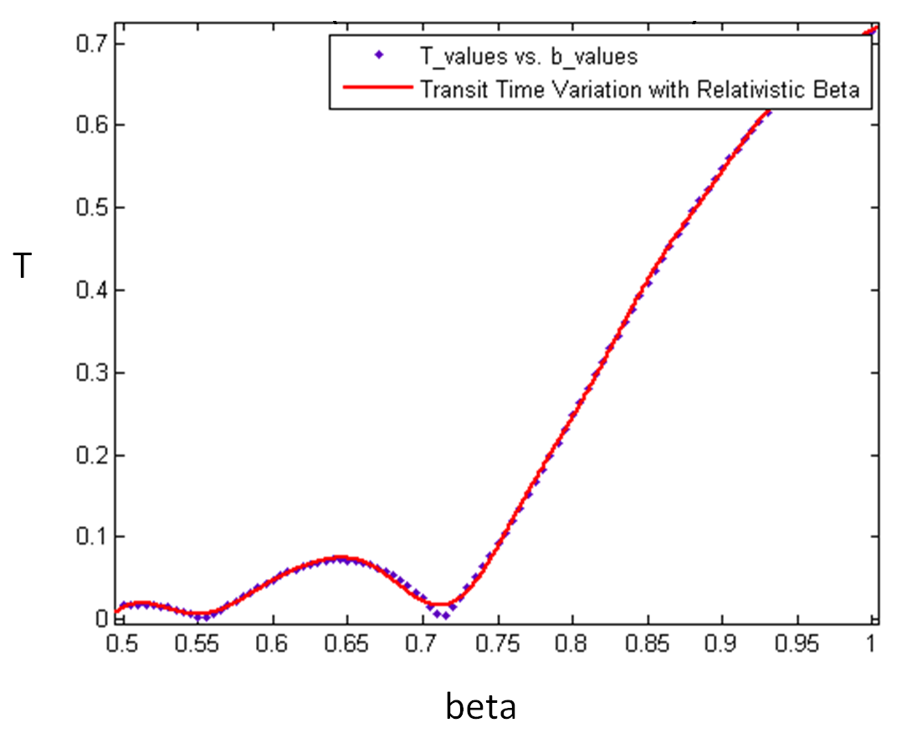
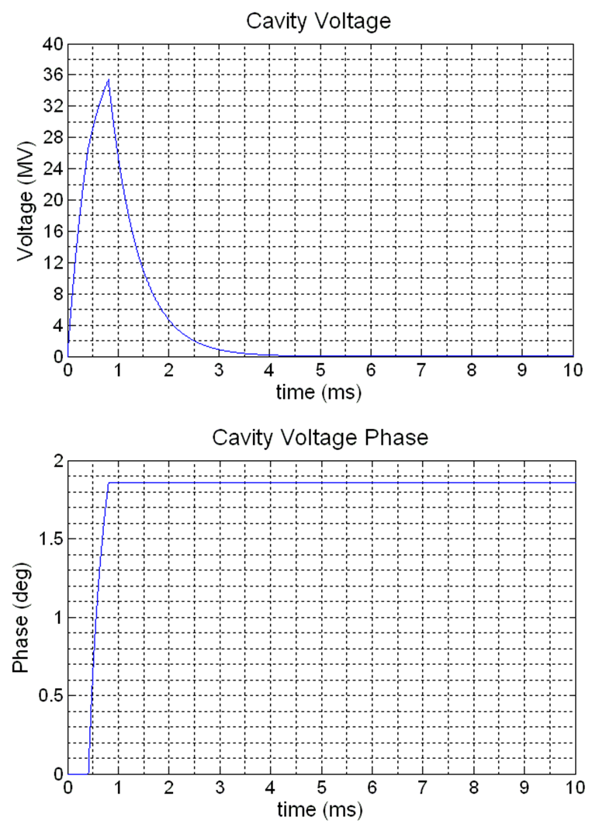
Transit Time Factor Variation with Relativistic Beta
(SPL beta=1 cavities, open loop simulation)
Beamloading
Values obtained from SUPERFISH simulations by Marcel Schuh (CERN)
Beamloading
Weaker beam loading results in a higher flattop equilibrium and less phase shift of the cavity voltage.
Beta value taken from beam energy at beginning of SPL high beta section (farthest from beta=1).

Slide 24
Transit Time Correction
The solution is to lower the forward power to the cavity during beam loading to maintain the voltage flattop.
To do this we find the power required for the equilibrium voltage of the new beam (β=x) to match that of the relativistic beam (β=1).
If where is a known constant,
then for a fixed loaded quality factor we need to find the (virtual) generator current such that
, therefore

Slide 25
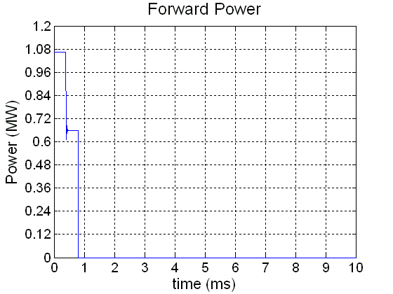
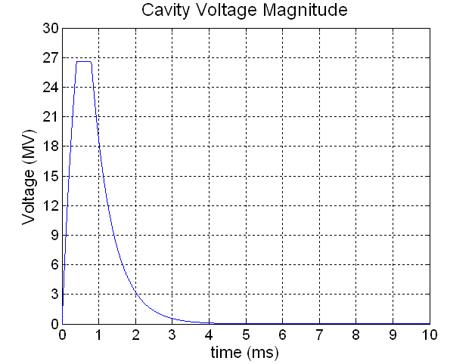
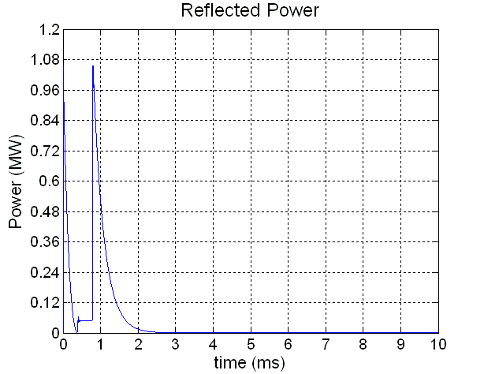
Transit Time Correction (2)
Forward power drop at injection time results in flat-top operation
Loaded quality factor mismatch during beam loading

Slide 26
High Level Diagram for Dual Cavity + Control System

Slide 27
High Level Diagram for Piezo Controller
Similarly to the feed-forward controller design, the piezo algorithm optimizes the mechanical correction pulse by pulse.
The algorithm uses information from the forward and cavity waveforms, as well as the previously known characteristics of the beam

Slide 28
Results
Cavity Phase Variation Without Compensation
Effects of Adaptive Piezo Compensation
Effects of Loaded Quality Factor Variation

Slide 29
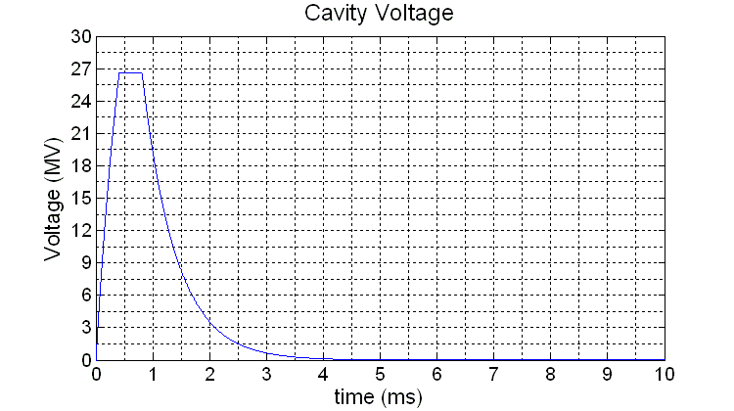
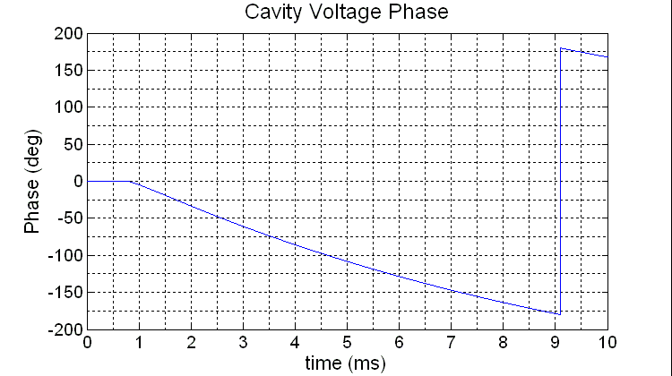
Vcav Magnitude and Phase for Dual Cavity Case
(K=-1 and -0.5 Hz/(MV/m)²)
While the voltage magnitude and phase of the vector average stays within specifications, it is possible that each cavity controlled by the single feedback loop deviates in opposite directions.
Due to these effects, it is necessary to manipulate each cavity separately with the piezo controllers to ensure acceptable beam loading

Slide 30
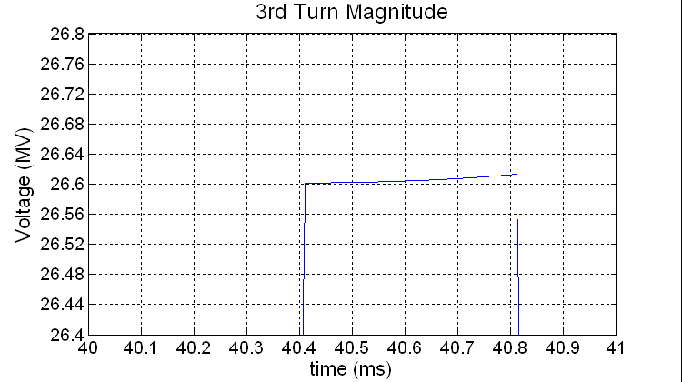
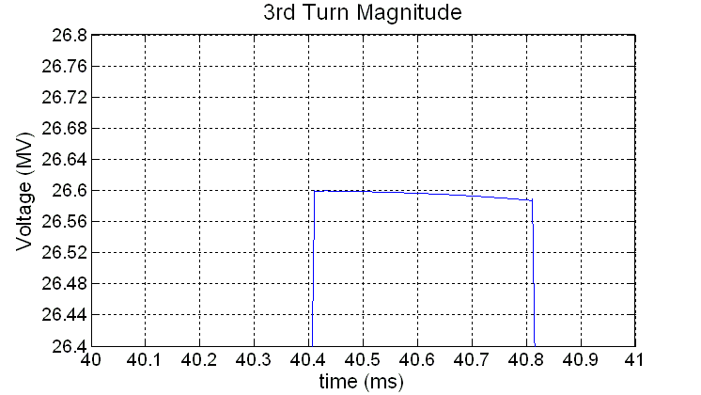
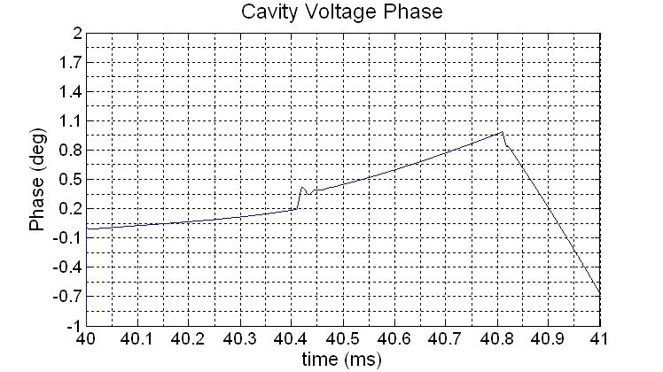
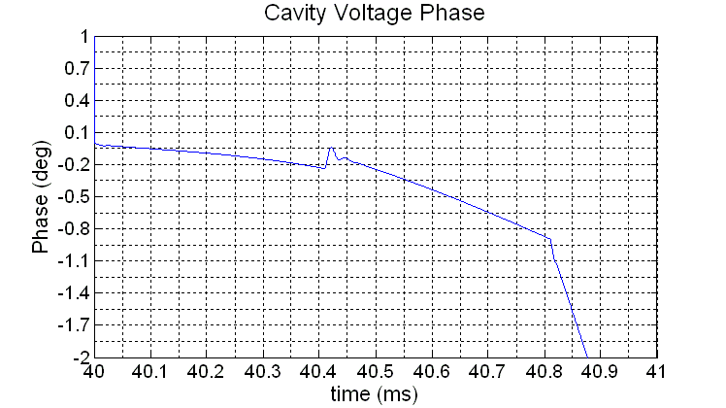
Voltage Magnitude and Phase for Dual Cavity Case
(Without Piezo-Compensation)
K=-0.5
K=-1

Slide 31
Vcav Magnitude and Phase for Dual Cavity Case
(With Piezo Compensation)
The piezo system can correct the issues due to mismatches in the Lorentz detuning factor of individual cavities.
Here the cavity voltage phase of both cavities controlled by a single feedback/feed-forward loop are shown.
The Klystron is modeled taking into account the effects of the modulator ripple.
Cavity 1
(K=-1 Hz/(MV/m)²)
Cavity 2
(K=-0.5 Hz/(MV/m)²)

Slide 32
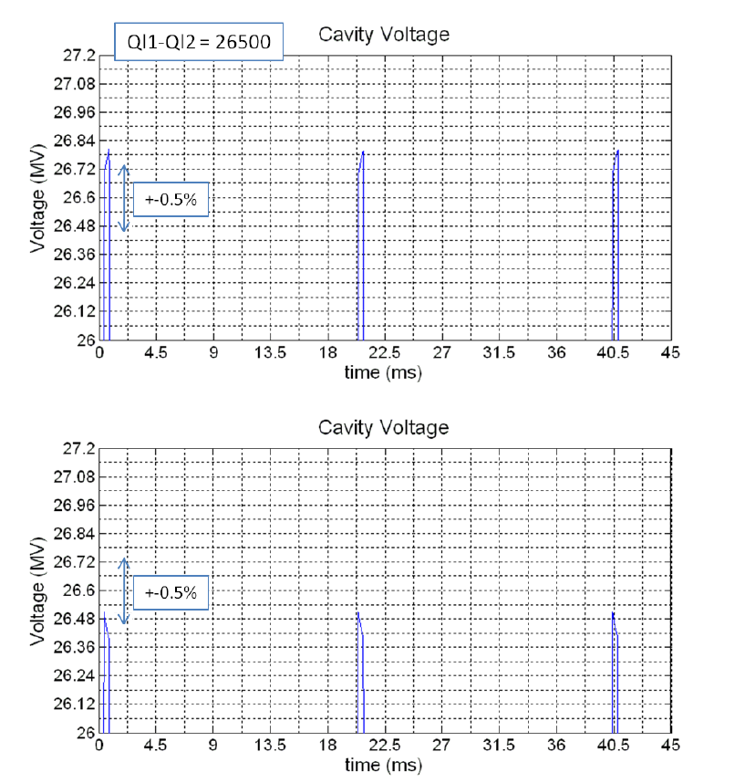
Loaded Quality Factor Fluctuation Effects on Cavity Voltage Magnitude
Variation of 2.2% in loaded quality factors of each cavity from the nominal can be enough to push the cavity voltage magnitudes beyond the 0.5% limit.
This is, however, a coupled effect. It is interesting, therefore, to investigate the effect of adjacent deviations from the nominal accelerating voltage on the quality of the beam after passing though the whole SPL.

Slide 33
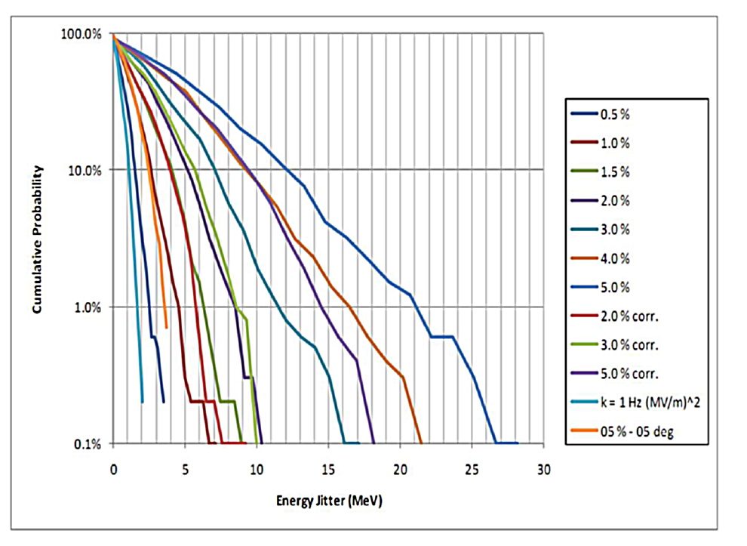
Loaded Quality Factor Fluctuation Effects on Cavity Voltage Magnitude (2)
Simulations and figures by Piero Antonio Posocco at CERN
Full simulations show that for an output jitter of 0.1% of the SPL beam kinetic energy (≈5MeV), if we take a 99% bound for beam within specifications, we can see that the maximum deviation from the nominal accelerating voltage for coupled cavities is of around 1%. This translates to about 4 % difference in loaded quality factor for two cavities controlled via a single feedback loop acting on their vector average.
The curves labeled 2% to 5% corr. are simulated with an equal correction applied to each cavity after the theoretical extraction points to ISOLDE (1.4GeV) and EURISOL (2.5GeV). The phase of each cavity after these points is shifted by the measured cumulative phase change of the beam pulse. This results in double the flexibility in terms of loaded quality factor.
The quality factor difference between 2 cavities controlled by a single feedback loop can be very restrictive.

Slide 34
Full SPL Effects Analysis
Investigated small errors in cavity magnitude and phase and their cumulative effects on beam quality.
The worst case scenario of repetitive errors on all 254 SPL cavities extrapolated from single cavity simulations was scrutinized.

Slide 35
Cumulative Error Along Full SPL due to Feedback Loop Transient (1)
254 cavities
Injection Time
(start of beam pulse)
Power Gain Along SPL
power (kW)
cavity number

Slide 36
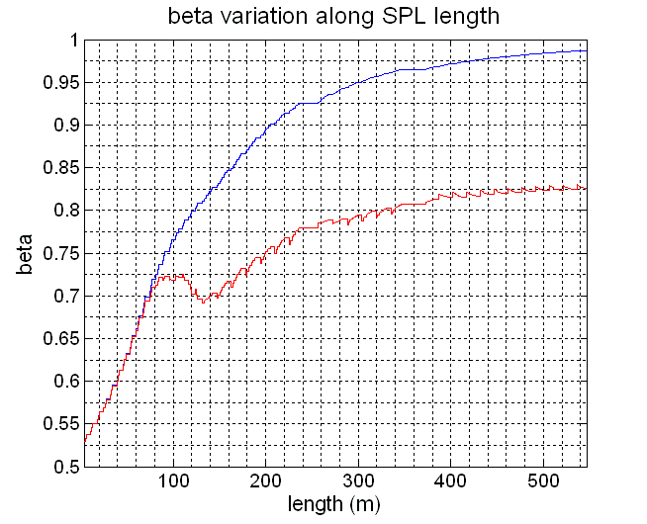
Cumulative Error Along Full SPL due to Feedback Loop Transient (2)
The SPL is comprised of 254 cavities with RF phases that are designed to fit the acceleration of the hydrogen ion beam as it traverses its length.
The cumulative effect of a 0.3 degree phase deviation on each cavity at beam arrival can result in merging of beam bunches and a deterioration in the output energy of particles.
The difference in “time of flight” (ToF) for a single charge that receives full acceleration as opposed to that which experiences a 0.3 degree deviation at arrival on each SPL cavity, is two orders of magnitude higher than the bunch separation.
The kinetic energy variation from nominal at SPL output is higher than 0.1%
ToF0 = 2137.8 ns E0 = 4935 MeV
ToF0.3 = 2438.4ns E0.3 = 724 MeV
TRF = 1.4 ns
ToF0.3 - ToF0 >> TRF
dE0.3deg >> 0.1% Eo

Slide 37
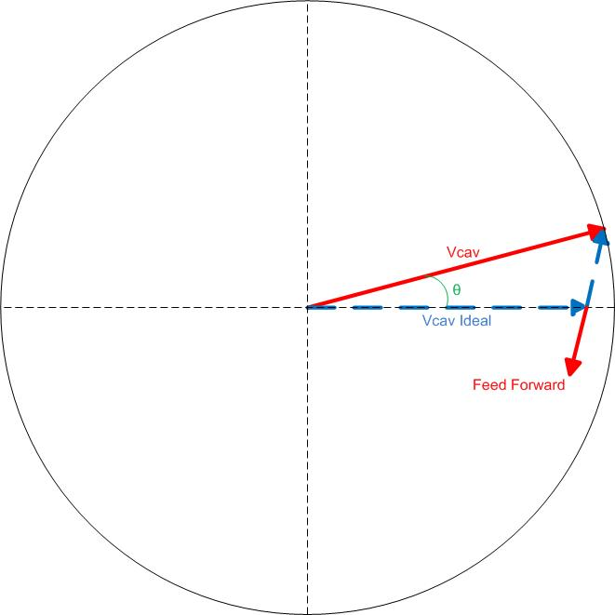
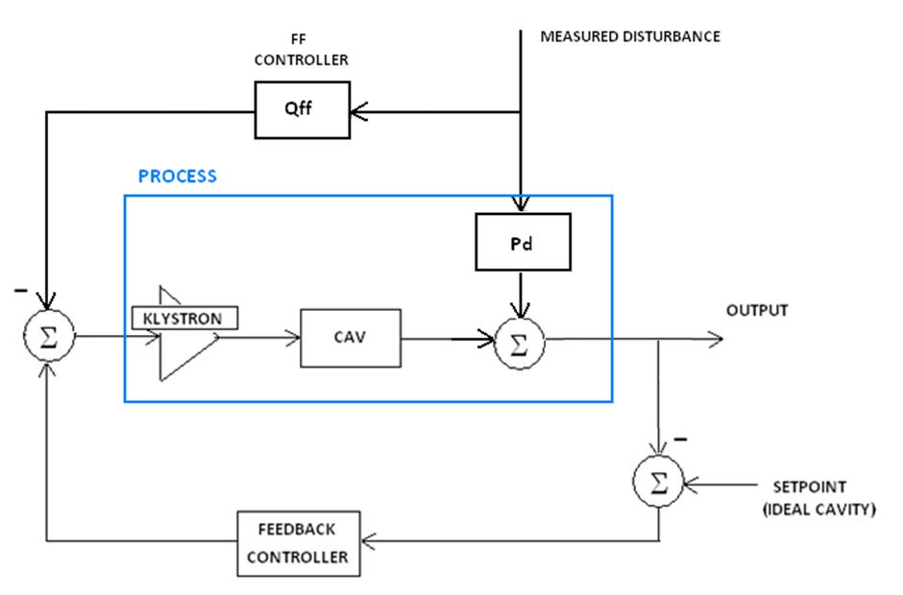
Feed Forward Correction for Cumulative Error along
SPL (1)
We measure the vector deviation of the cavity voltage from its ideal and add an excitation to the power source feeding the cavity that nullifies it.
The excitation to the power source (generator current) is dependent on the transient relationship between cavity and generator.

Slide 38
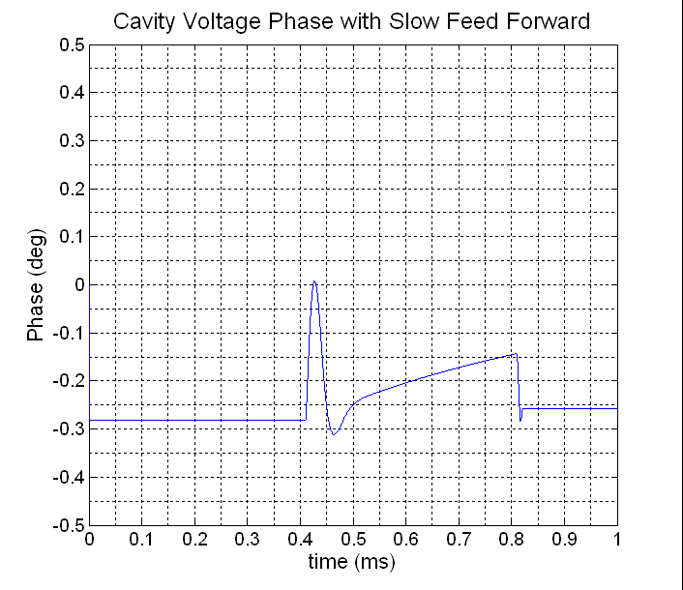
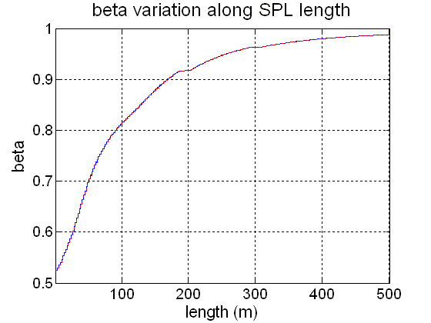
Feed Forward Correction for Cumulative Error along
SPL (2)
Easiest solution is to intersperse slow feed-forward so that each SPL cavity will have the opposite error from the preceding one along the accelerator, “randomizing” the error.
In this way, particles travelling along the LINAC will not experience an accumulated deviation.
injection
Feed forward ON before injection
ToF0.3 - ToF0 < TRF
dE < 0.1% Eo

Slide 39
In Summary…
In order to cater for the needs of project specifications in constant need of revision, a high flexibility simulation model developed, with a GUI for data processing.
Flexible graphical user interface allows for efficient handling of simulation data
1 and 2 cavities per Klystron schemes can be observed from RF point of view under a wide set of circumstances
Can estimate practical issues that can arise during development of a real LLRF system in terms of power, stability of accelerating field and technology necessary for operation

Slide 40
Next Step
Characterize a Klystron polar loop to deal with modulator ripple and
non-linearities
Develop DSP/FPGA hardware to implement the control loops simulated
Investigate feed-forward schemes using system identification algorithms in order to update the feed-forward controller during normal SPL operation (using random signals)

