Slide 1
Fabrication of SPL β=1 cavities at CERN
N. Valverde
Lund, 5 Dec 2011

Slide 2
Introduction
Niobium cavity
  Cavity design
    Interfaces between cavity and tank
    Brazing test
    Welding requirements
    Niobium procurement
    Anodizing test
      Copper cavity fabrication
    Shaping of half-cells and extremities
    Welding tests
    Extrusion of extremities
    RF measurements
    Shape accuracy by CMM vs. RF
      R&D
        Cold gas dynamic spray
        Interfaces
  Conclusion
N. Valverde / EN-MME

Slide 3
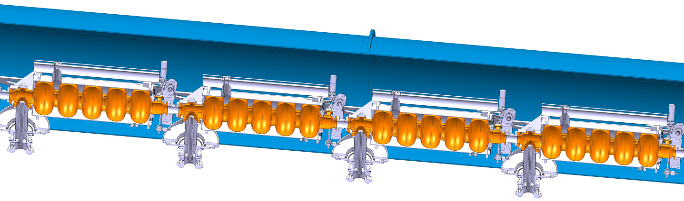
A string of 4 equipped β=1 bulk niobium cavities to be tested into a short cryo-module by 2013.
N. Valverde / EN-MME

Slide 4
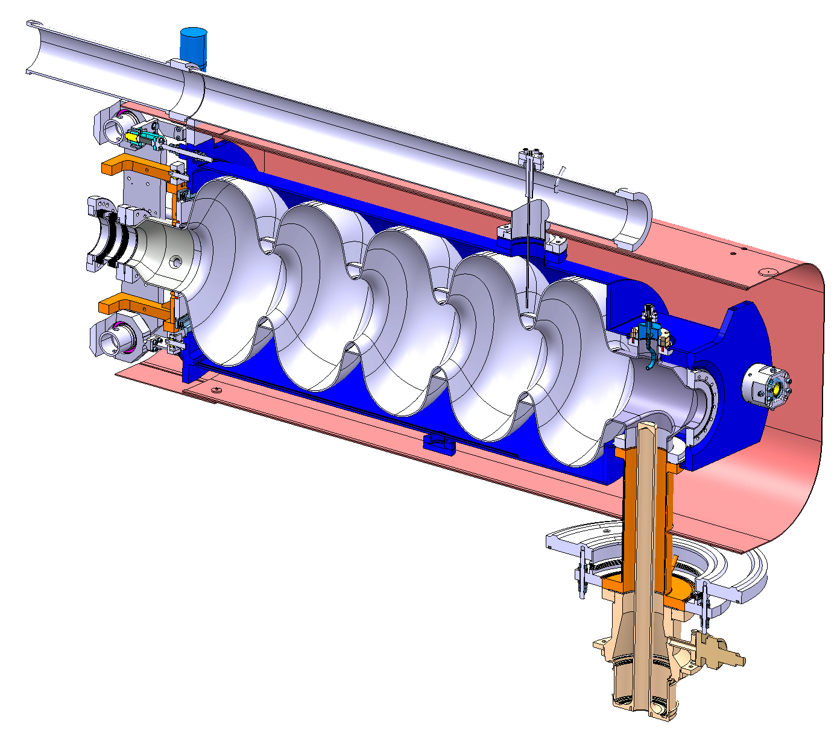
Four bulk niobium β=1 equipped cavities to be fabricated
Helium tube
Helium Tank
Bellows
Tuner
Bulk Niobium 5Cells cavity
Magnetic shielding
Hom Coupler
Interface tank
N. Valverde / EN-MME
Power Coupler

Slide 5
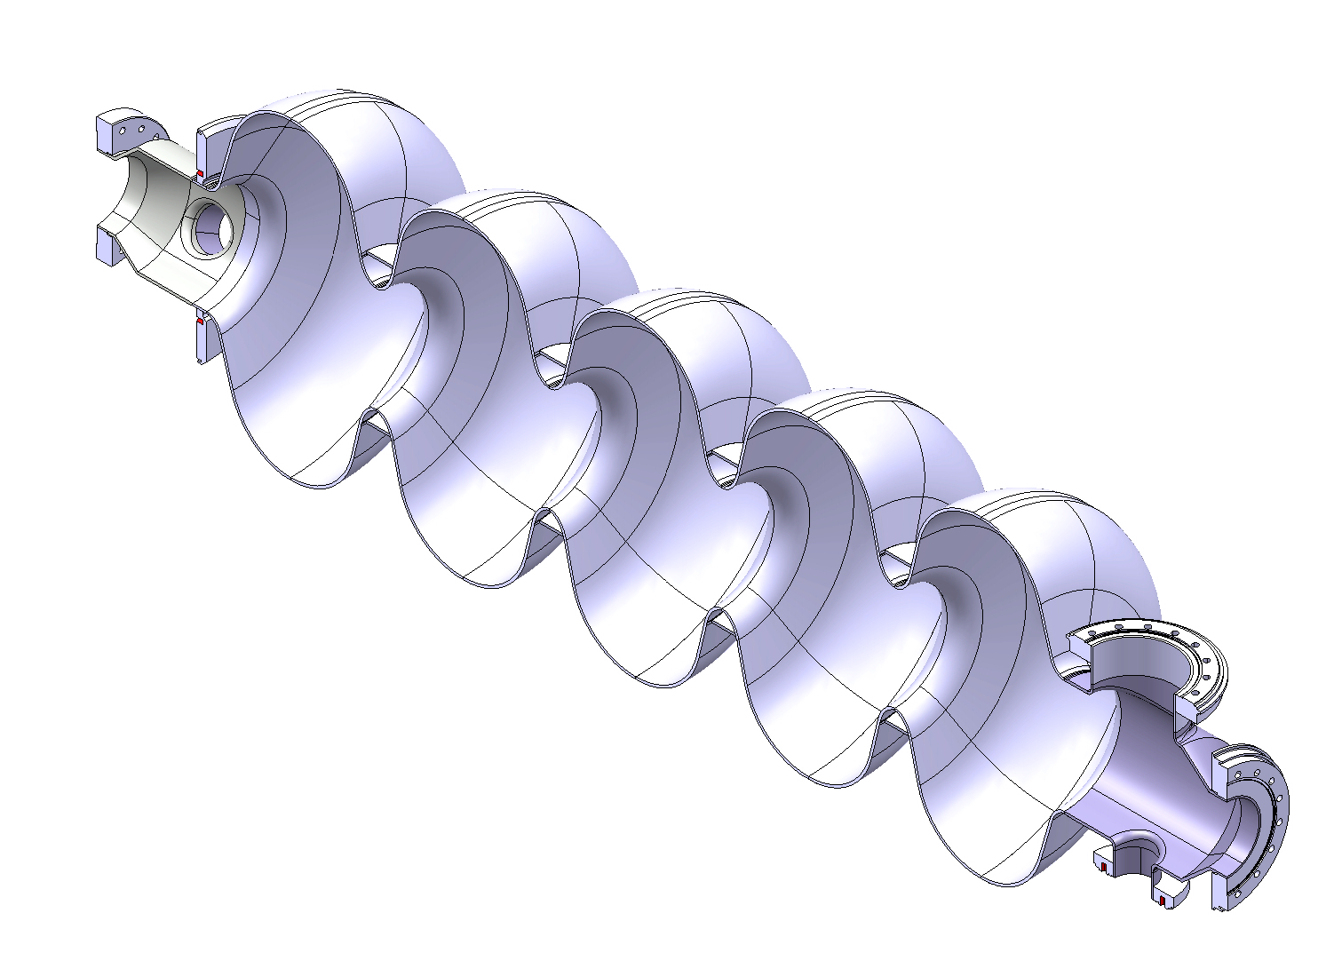
Cavity Design
5-cell cavity
Material: Bulk Niobium
Flanges: 316LN
Frequency: 704.4 MHz
Quality factor: 10¹⁰
Nominal gradient E_{acc}= 25 MV/m
1397.3 mm
79.7
106.6
381.7
100
Min Thck= 3mm
Dimensions at warm temperature
79.7
45
Half-cells fabricated by spinning and welded by EB welding.
N. Valverde / EN-MME

Slide 6
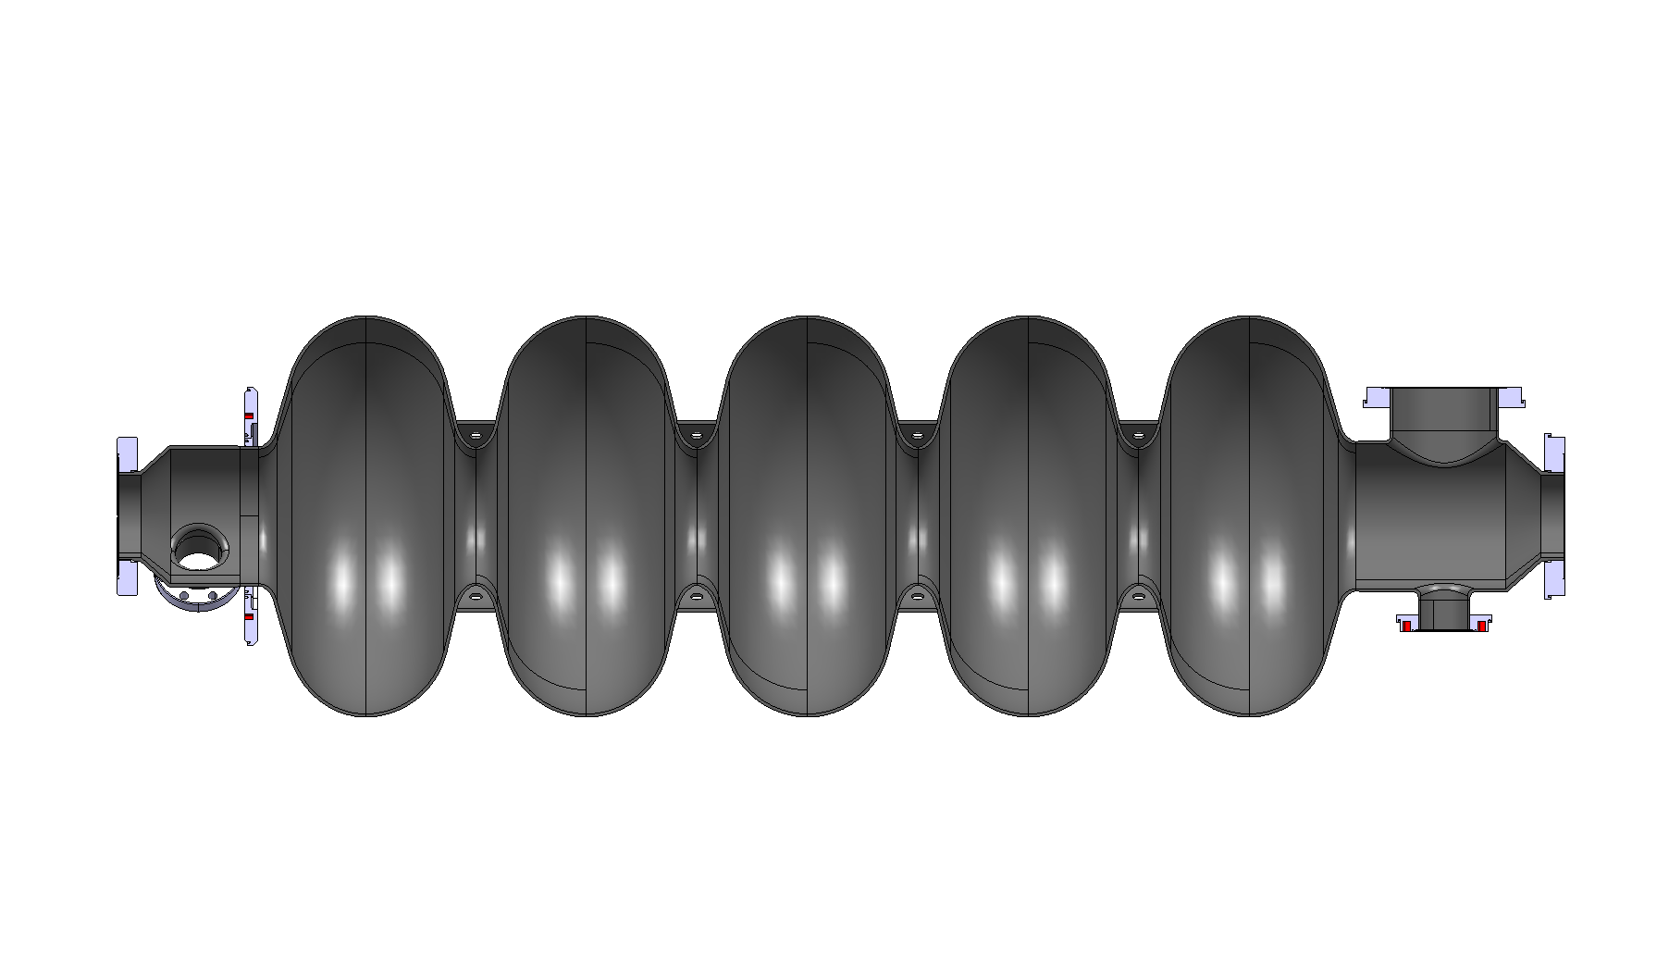
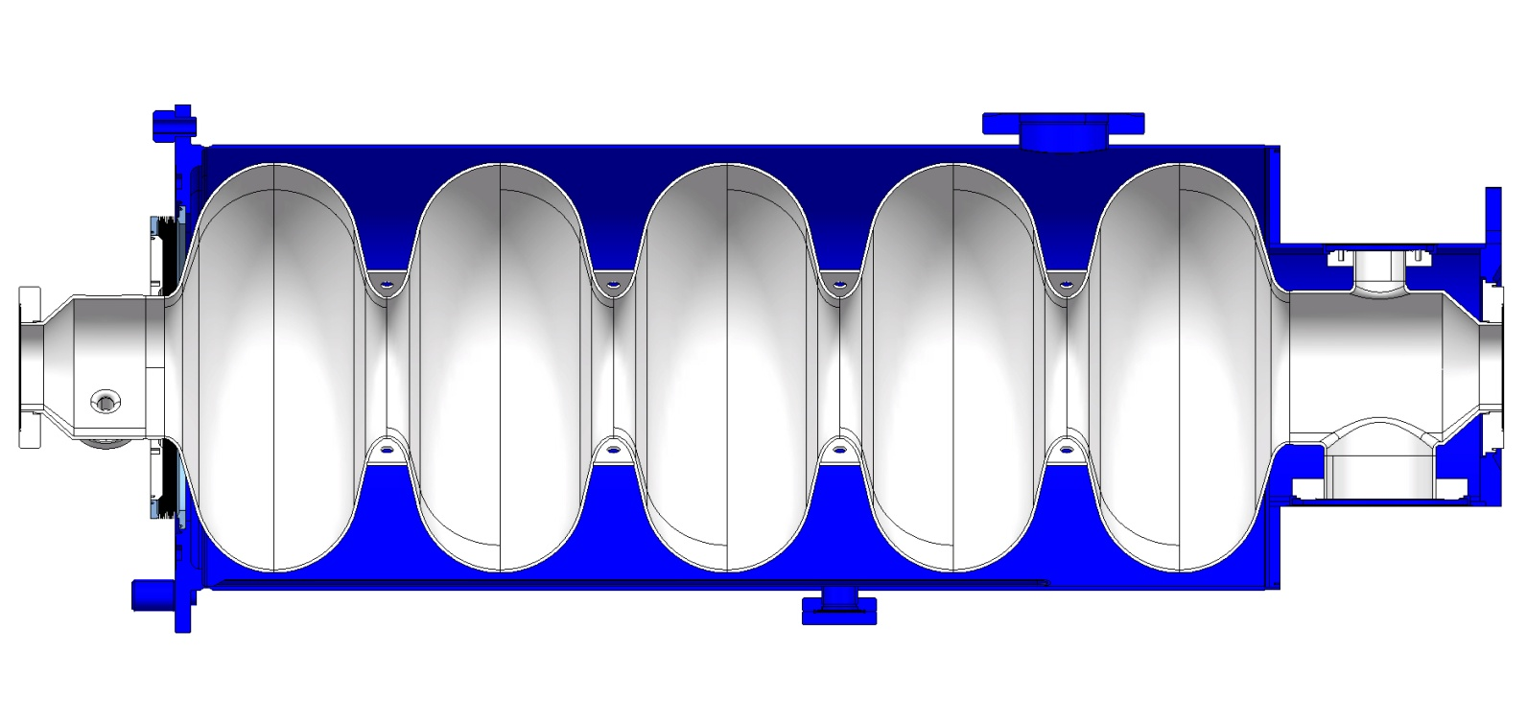
Interfaces between cavity and tank
Niobium cavity for SS tank
SS flanges
N. Valverde / EN-MME

Slide 7
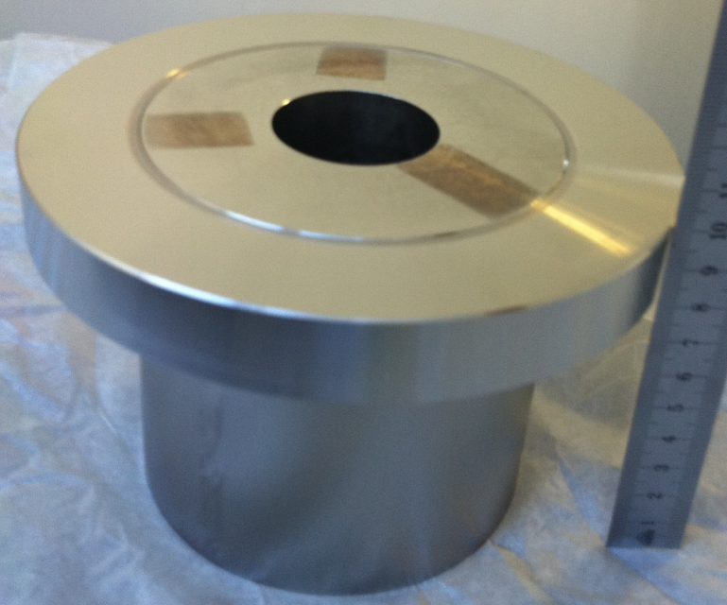
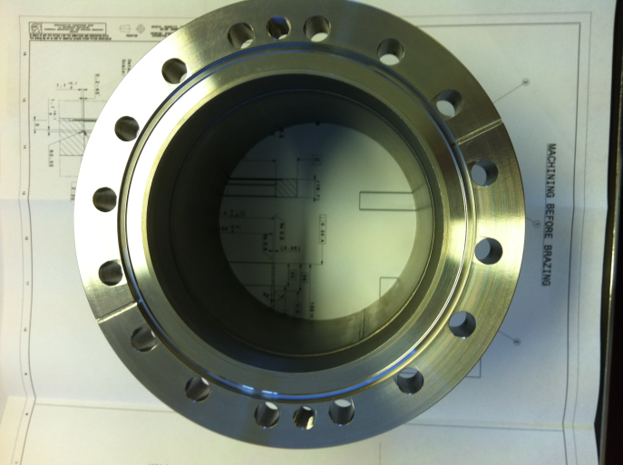
Brazing test
Brazing Nb / SS 316 LN is a key technology
Developed at CERN in 1987
Difference in thermal expansion of Nb/SS
Nb tube fitted to SS flange
Clearance ≤ 20 µm
SS plug to expand the Nb
Pure Cu filler metal
Brazing temperature 1100°C, ∆_{time} <<
P< 10⁻⁵ mbar
Nb tube
SS plug
SS flange
Flange after machining the SS plug
N. Valverde / EN-MME

Slide 8

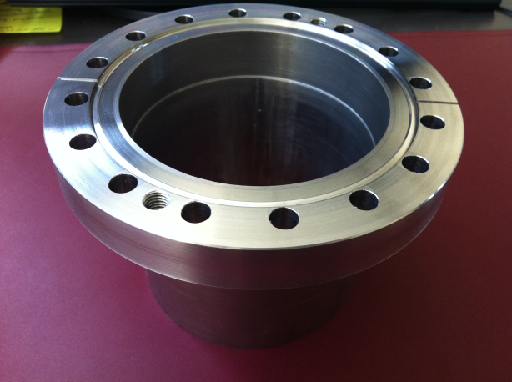
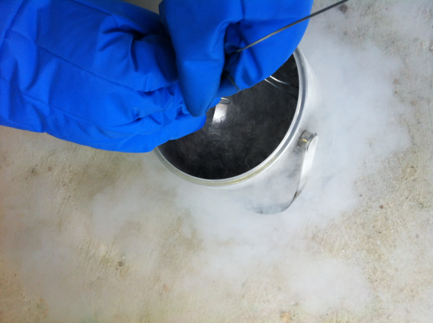
Brazing test
Ultrasonic examination
Leak test
Thermal shock liquid N₂ (x5)
Ultrasonic examination
Leak test
Electropolishing
HT ( 600°C/24h)
Electropolishing
Leak test
Ultrasonic examination
Thermal shock liquid N₂ (x5)
Ultrasonic examination
Leak test
Shear test
Leak test
Ultrasonic examination
Assembly test
Macroscopic examination
SEM assesment
2 brazing samples tested
Thermal shock liquid N2 (x5)
Ultrasonic examination of the brazing area
N. Valverde / EN-MME

Slide 9
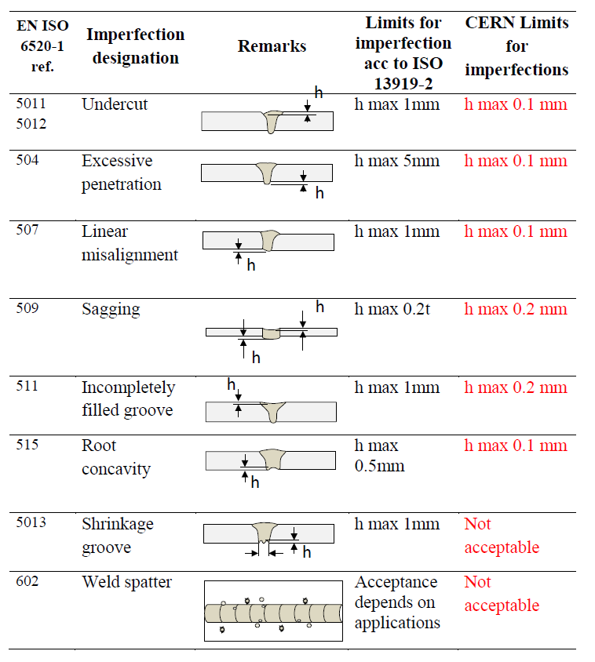
Welding requirements
Evaluation according to EN ISO 13919-2. Welding Electron and laser beam welded joints. Guidance on quality levels for imperfection. Part 2: Aluminium and its weldable alloys.
Evaluation according to group B and Cern requirements.
P < 5.10⁻⁵ mbar
N. Valverde / EN-MME

Slide 10
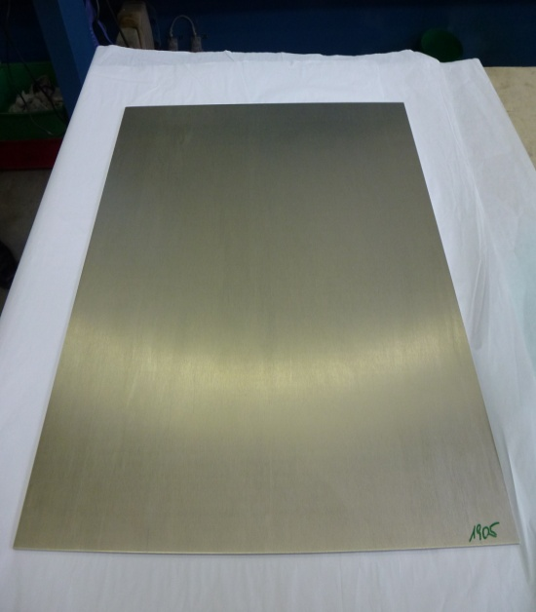
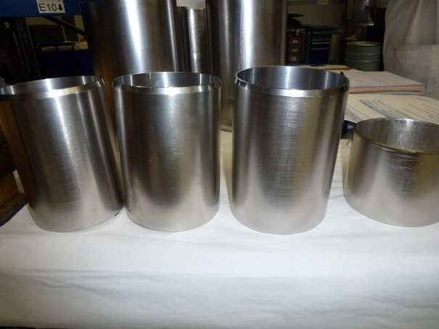
Niobium procurement
Niobium material – Plansee (Austria)
Five visits to Plansee to follow the fabrication.
Almost one year delay !!!- All sheets delivered but not tubes
Total weight: 556 kg Price: 300 k€
520 x 520 x 3.6 mm RRR 300 sheets (60)
180 x 240 x 3.2 mm RRR 300 sheets (12)
700 x 1000 x 3 mm RRR 40 sheet (1)
Seamless tubes 3.2 mm thick RRR 300
Ø 139.8 mm
Ø129.8 mm
Ø 99.7 mm
Ø 79.7 mm
Ø 16 mm
N. Valverde / EN-MME

Slide 11
Niobium procurement
Maximum limits for main impurities content in weight- percent
Material properties
RRR value
  > 300
Ta
0.05
Grain size (ASTM)
>6 (Local grains size 4 are acceptable)
W
0.007
Yield strength min/max
>50/100 N/mm²
Mo
0.005
Tensile strength
>140 N/mm²
0.005
Ti
Elongation
>30%
H
0.0002
Vickers hardness HV 10
≤60
O
0.001
Roughness (Rt) on the RF side
<15μm
N
0.001
C
0.001
Other metallic impurities
0.003
N. Valverde / EN-MME

Slide 12
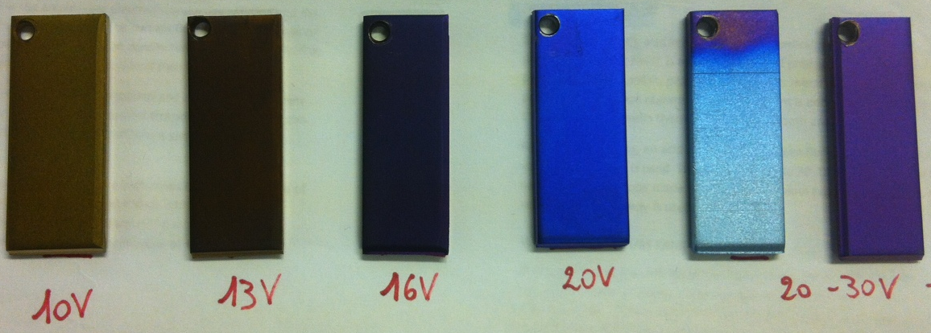
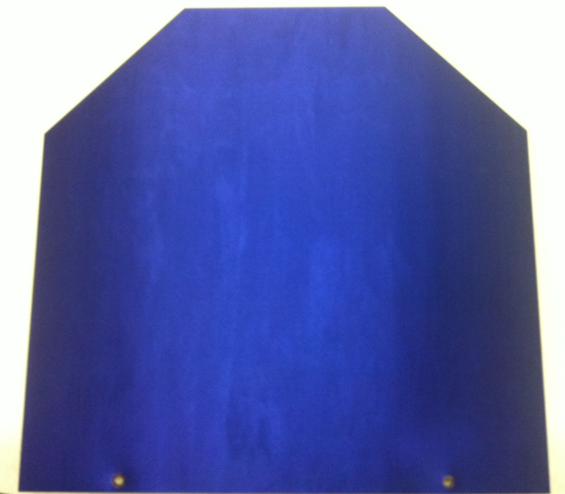
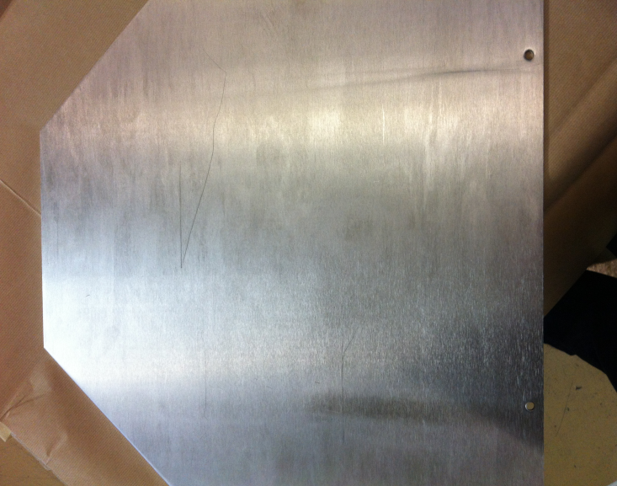
Anodizing
Checking the suitability of anodizing to detect defects and inclusions of foreign material
Anodizing of Nb samples at different voltages
N. Valverde / EN-MME
Niobium before anodizing
Niobium after anodizing

Slide 13
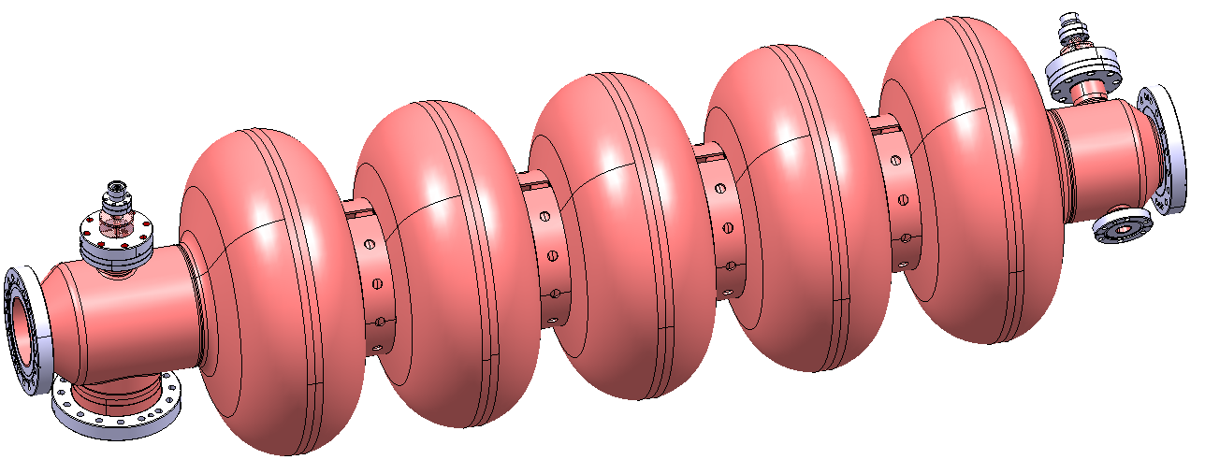
Copper cavity
Two copper cavities(mock-up) are under fabrication
To learn during the fabrication process
To carry out RF measurements of the dumb-bells and complete cavity with the HOM.
For surface treatment purposes
N. Valverde / EN-MME

Slide 14
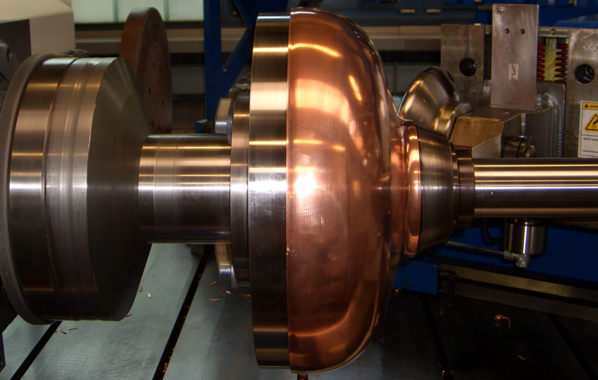
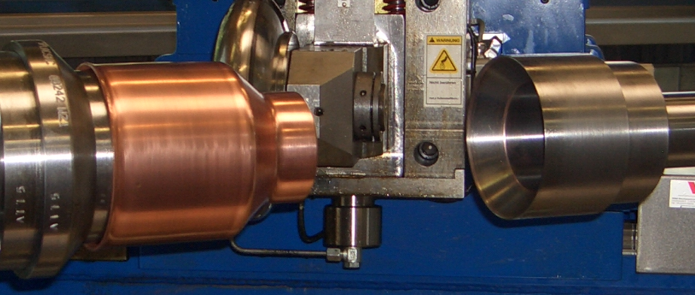
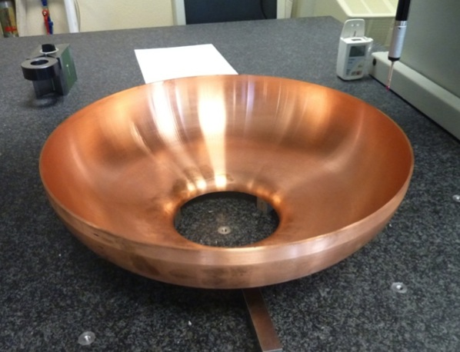
Shaping of half-cells
Fabrication of half-cells and extremities by spinning. Subcontracted to Heggli
Dimensional control by CMM
Dimensional control
The average shape accuracy achieved is ± 0.150 mm
The average shape accuracy achieved is ± 0.150 mm
The best half cell: shape accuracy ± 0.119 mm
N. Valverde / EN-MME

Slide 15
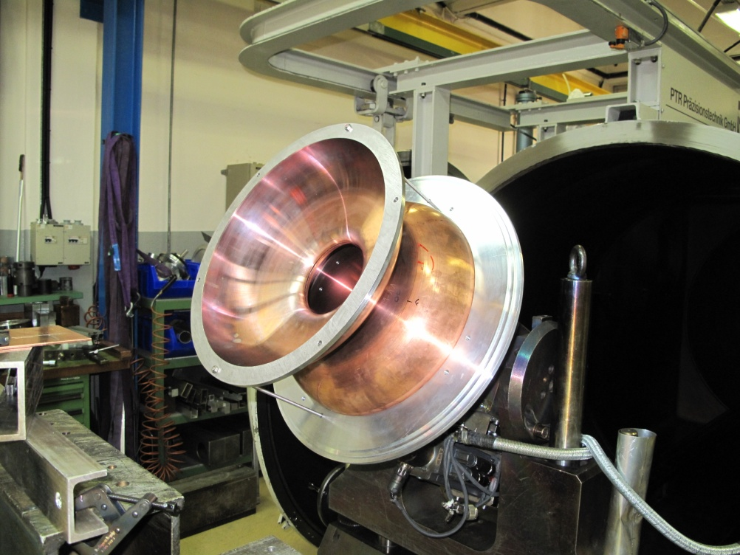
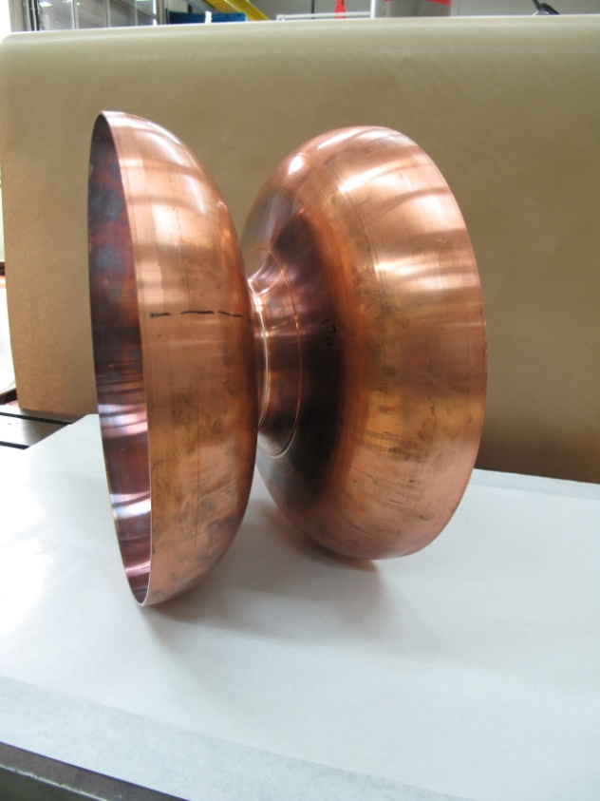
Welding test
EB welding of two half-cells to study the welding parameters and the shrinkage of the iris weld.
N. Valverde / EN-MME

Slide 16
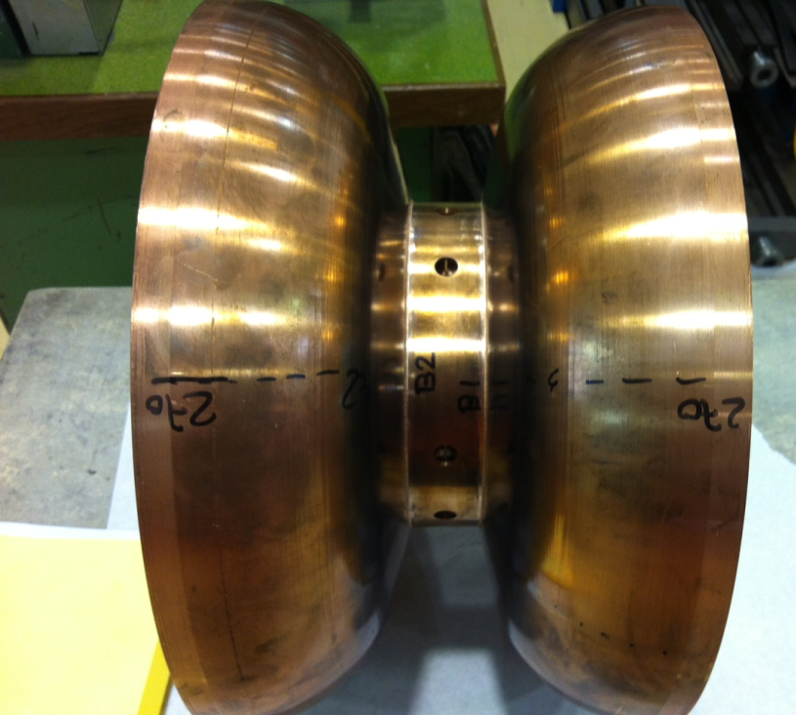
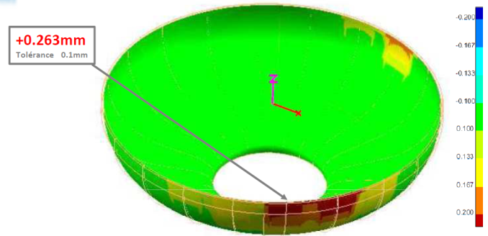
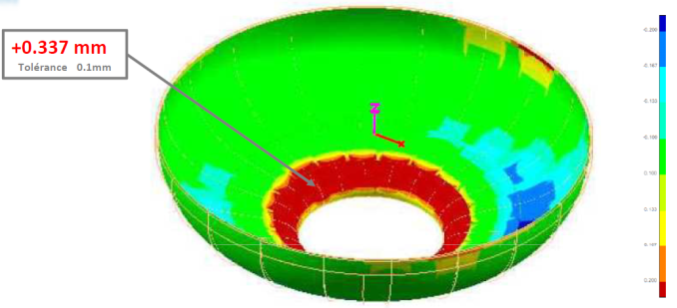

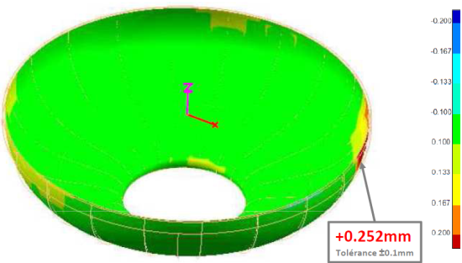
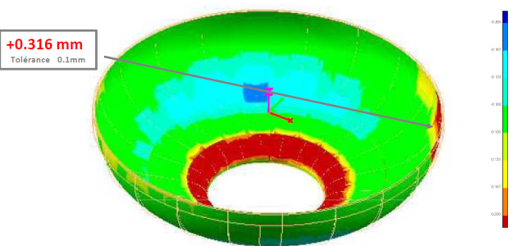
Welding test II
EB welding of stiffening ring to dumb-bell to study the welding parameters and the welding shrinkage.
Before welding
After welding
Next step is to weld two dumb-bells by the equator
N. Valverde / EN-MME

Slide 17
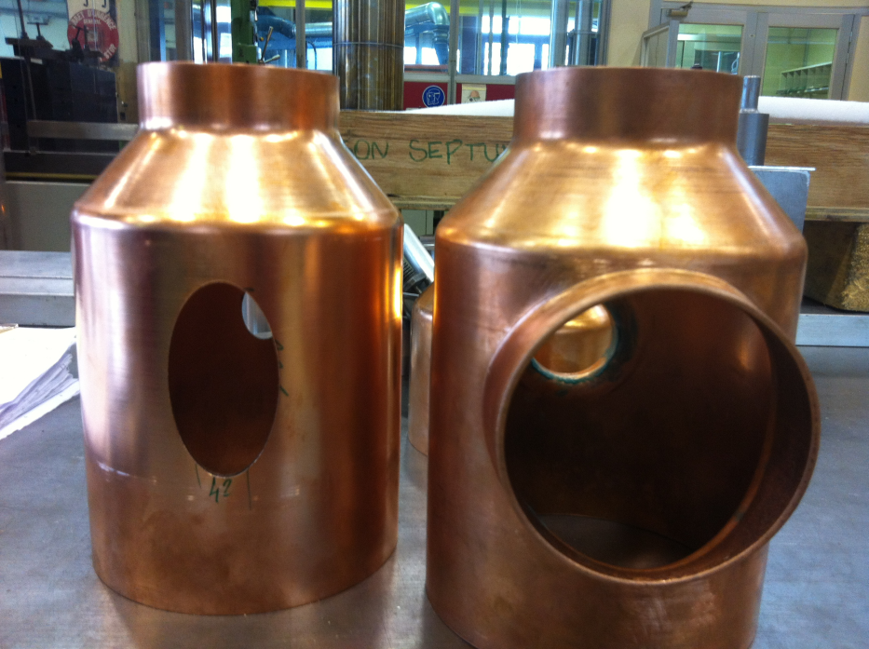
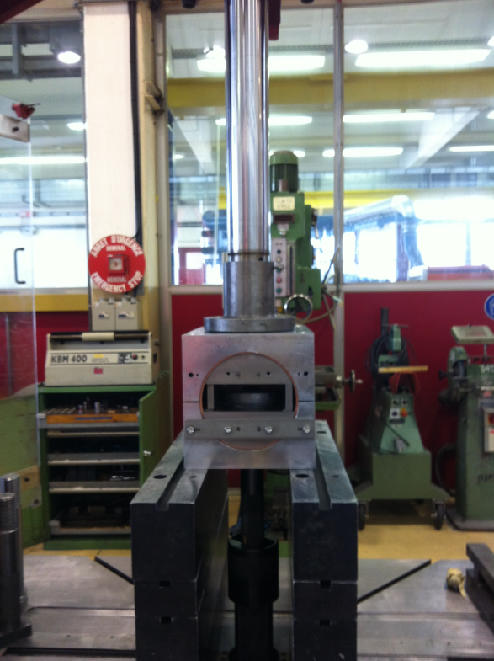
Extrusion of extremities
Extremities fabricated in one piece by spinning and nozzle necks made by extrusion to avoid welding on the RF surface, minimize the welding distortions and achieve the required tolerances.
N. Valverde / EN-MME

Slide 18
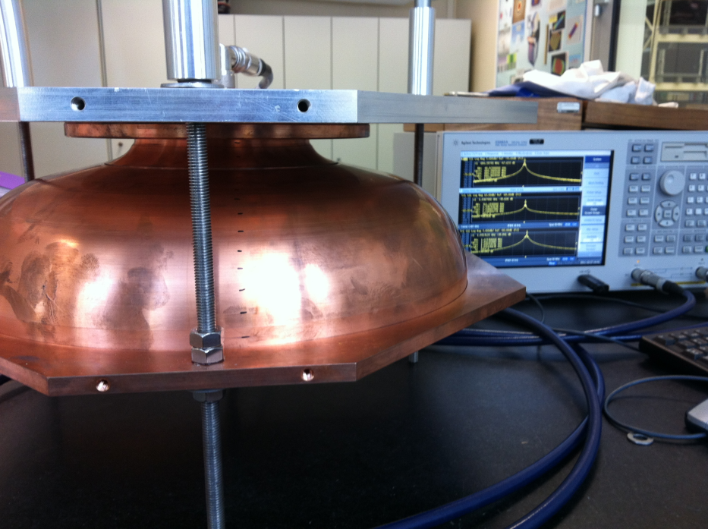
Rf measurements
Measurement setup
N. Valverde / EN-MME

Slide 19
RF measurements
1.3 MHz
CST : 684.496 MHz
SUPERFISH: 684.48 MHz
Rf measurements of the middle half-cells
N. Valverde / EN-MME
Notes:
Numerical simulations

Slide 20
RF measurements
0.53 MHz
CST : 688.293 MHz
SUPERFISH: 688.287 MHz
Rf measurements of the extremity half-cells diam 139
1 MHz
CST : 690 MHz
SUPERFISH: 689.99 MHz
Rf measurements of the extremity half-cells diam 129
N. Valverde / EN-MME

Slide 21
Shape accuracy by CMM vs RF
Shape accuracy by CMM
Shape accuracy by RF
Shape accuracy mm
Frequency deviation MHz
Shape accuracy of middle half-cells
N. Valverde / EN-MME

Slide 22
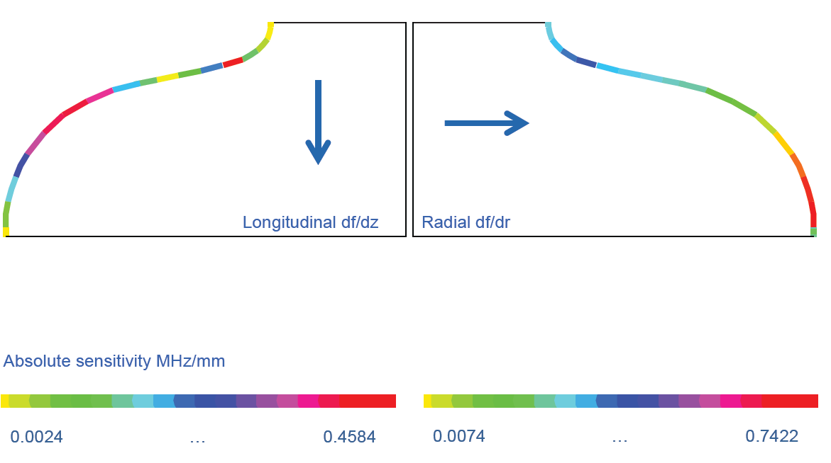
RF measurements
SENSITIVITY
Courtesy of S. Mikulas & N. Schwerg (CERN)
N. Valverde / EN-MME

Slide 23
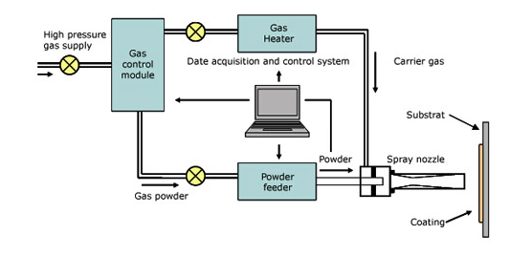
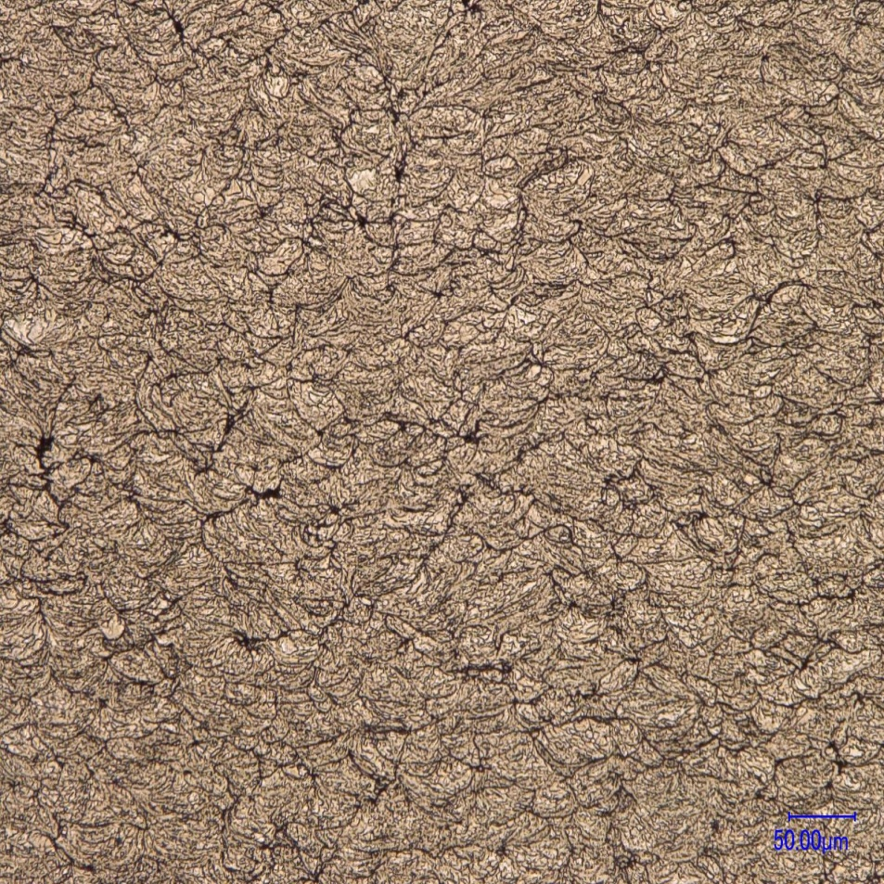
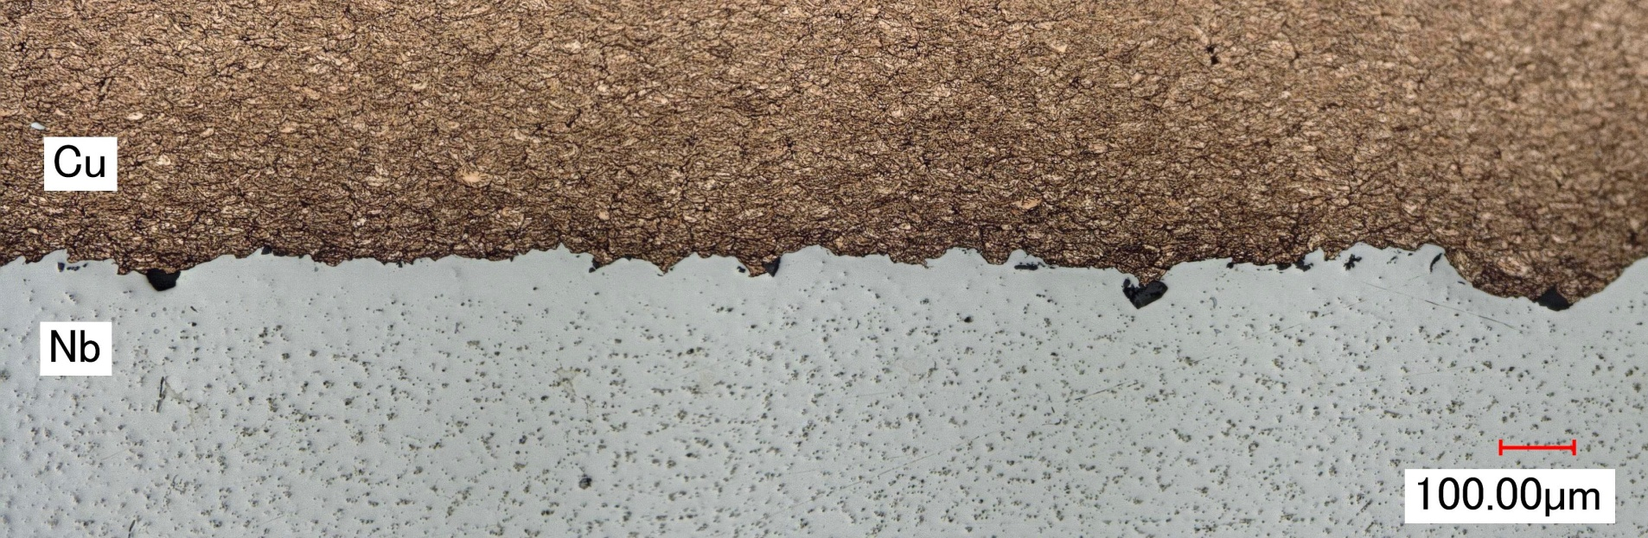
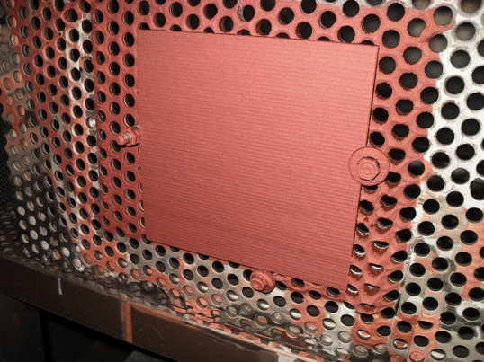
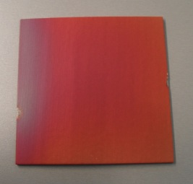
Cold gas dynamic spray
Solid-state coating deposition method
a supersonic gas (N2) jet that propel fine
coating powder particles ( 1-50 μm) at
very high velocities (500-1200 m/s).
Advantages:
powders are not melted
almost absence of oxidation during the process
allows materials to be constructed layer upon layer

Slide 24
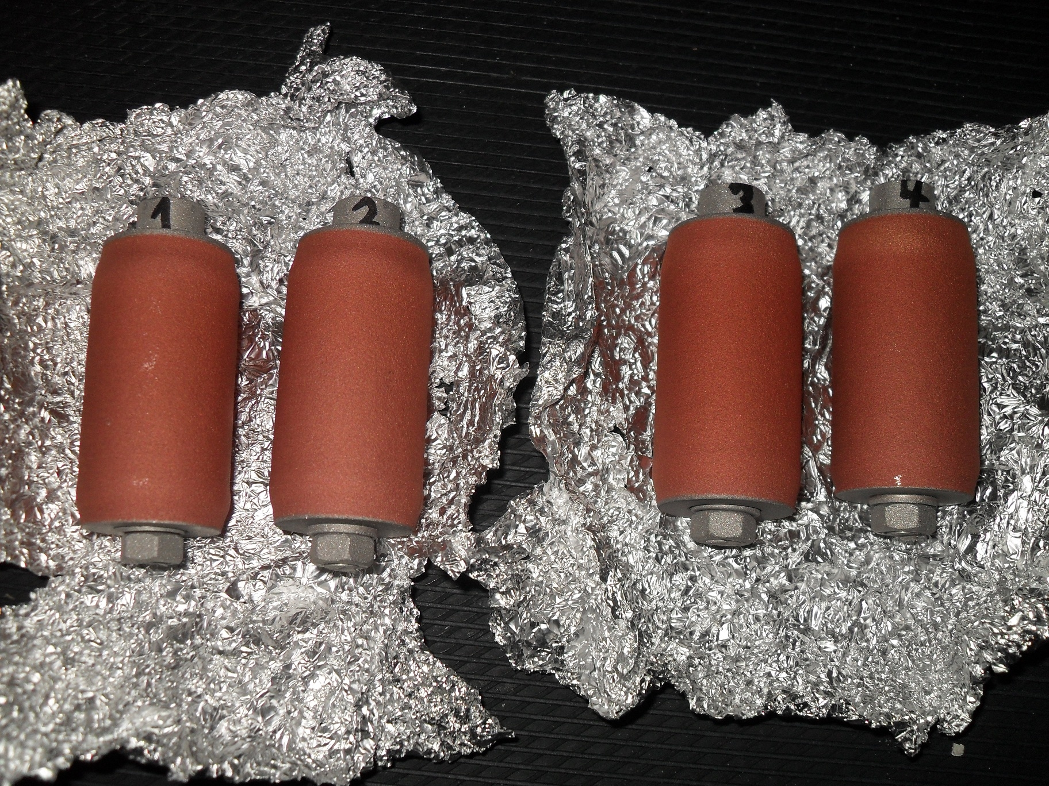
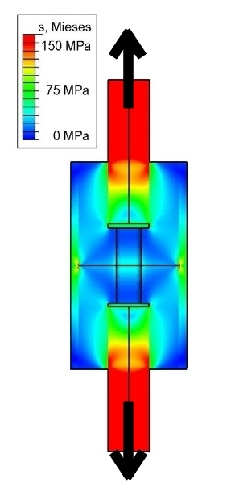
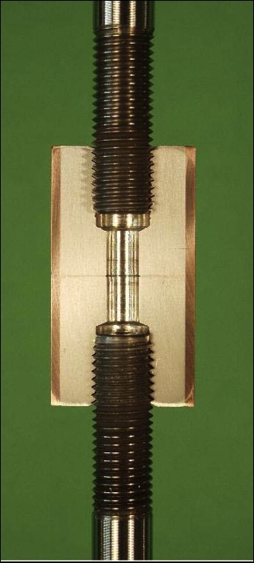
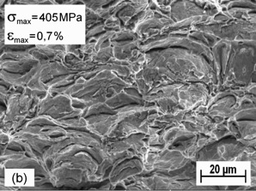
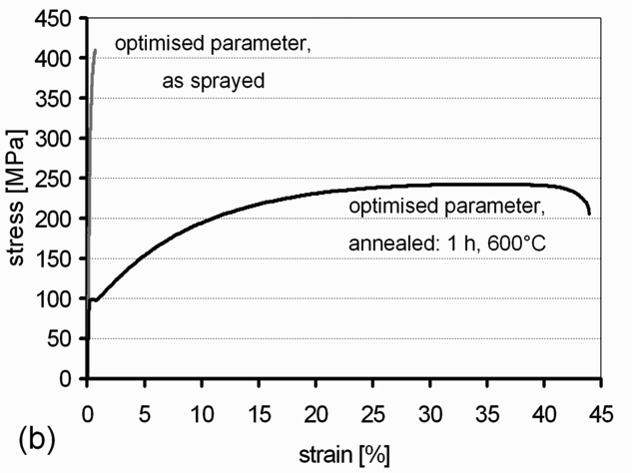
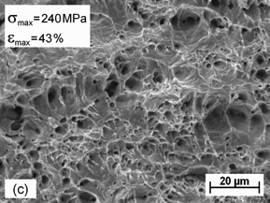
Cold gas dynamic spray
Tubular Coating Tensile Test (TCT-Test)
Micro Flat Tensile Test (MFT-test)
Metallurgical characterization

Slide 25
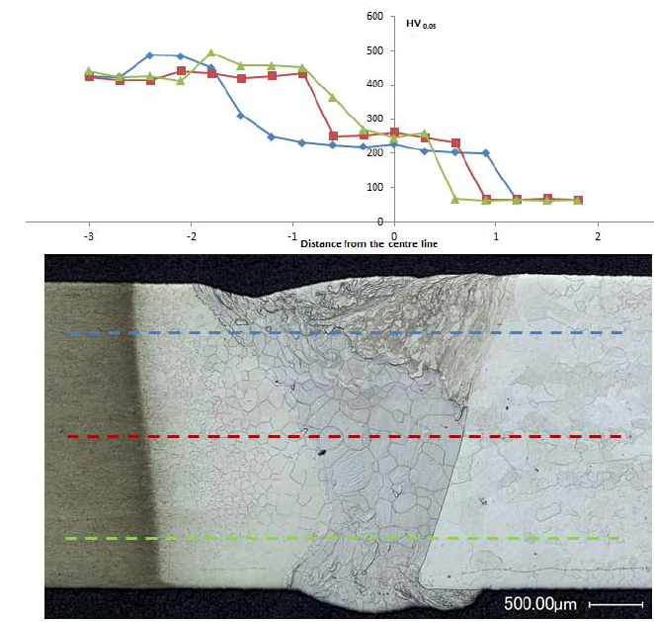
Interfaces
Niobium to titanium grade 5 (Ti6Al4V)
EB welding successfully tested before and after heat treatment at 800 °C
Ti6Al4V
Nb
 | Nb | Ti (grade 5)
ρ (Kg/m³) | 8600 – 8700 (+48%) | 4410 – 4450 (-48%)
T_{m} (ºC) | 2460 – 2470 (+830) | 1610 – 1660 (-830)
K (W/m ºC) | 54 – 57 (x 7.7) | 7.1 – 7.3 (/ 7.7)

Slide 26
Conclusion
Two copper cavities under fabrication.
We learn from the fabrication of copper cavities.
Many fabrication steps will be retained for the fabrication of the niobium cavity.
Assembly tooling of copper has been validated and it will be used for the niobium as well.
One copper mono-cell β=0.65 to be fabricated next year.
Four niobium cavities have been subcontracted. First cavity will be delivered mid 2012 and last cavity beginning 2013.
It is under review if one niobium cavity will be fabricated in house.
N. Valverde / EN-MME

Slide 27
Thanks for your attention!!

