Slide 1
Accelerator Division Retreat Mtg
Programme Office & Costing 2011/2012
Johan Brisfors
Programme Office Manager
Accelerator Division Retreat
Mtg, Dec 2011

Slide 2
ESS Organigram
Director
Director’s Services
Machines Directorate
Programme Directorate
Science Directorate
Administration Department
Accelerator
Target
Conventional Facilities
Energy
Design Office
Instruments and Neutron Beams
Neutron Science
Instrument Support
Data Management Centre
Procurement
Human Resources
Information Technology
Finance
Office Management
Steering Committee
ESS Board
Safety, Health & Environment
Administration & Finance Committee
Science Advisory Committee
Technical Advisory Committee
Legal
Programme Office

Slide 3
Organigram Programme Directorate
Programme Director
Kjell Möller
Conventional facilities
Kent Hedin
Design office
Peter Rådahl
Safety, Health & Environment
Peter Jacobsson
Energy
Thomas Parker
Senior Advisor Conventional Facilities
Örjan Larsson
Senior Advisor – Programme
Staffan Näsström
Senior Advisor - Programme
Billy Fredriksson
Deputy Programme Director
Johan Lehander
Programme Directors
Programme
Office
Johan Brisfors
Programme Controller
Planning Manager
Semcon Consultant
Planning Manager
Semcon Consultant
Team Assistant
Inger Persson
Planning Manager
Starts 1 Jan, 2012
Costing Manager
Vacant
Planning Manager
Epsilon Consultant

Slide 4
Programme Office
Programme Office is a support function for all ESS projects and departments
The function will provide support in the following major areas
  Planning
  Costing
  Risk Management
The function is under establishment (since Aug 2011)

Slide 5
Costing & Planning 2011

Slide 6
Deliverables from Pre-construction phase
CDR
  Status ok: ready December 2011
TDR
  Work will start after CDR
Programme Plan
  Status ok: 1st issue September, next issue December 2011
Project specification
  Status ?
Cost report
  Status ok: 1st iteration December 2011, 2nd iteration June 2012
Risk Management Plan
  Status ok: 1st round ready mid December, 2nd round during 2012.

Slide 7
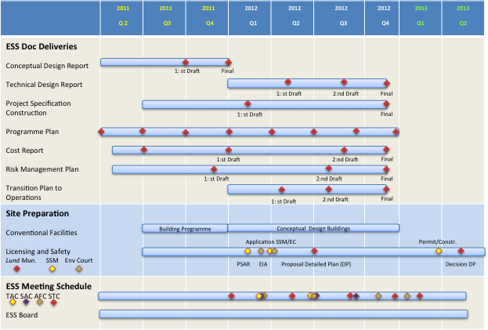
Pre-construction deliverables (documentation)
Programme Plan
Project Specifications
Technical Design Report
Cost Report
Risk Management Plan
ESS Pre-Construction Master Plan

Slide 8
To do 2011
WBS for each project
WBS descriptions down to level three for each project
Equipment list (“top 10 items”) for each project
Successive planning for schedule, 2nd – 4th November
Summing up after the Successive planning, 15th November
Perform planning to WBS level three for each project
Estimate cost to WBS level three for each project
Successive planning for cost, 7th – 9th December
Perform risk analysis for the WBS packages and deliverables

Slide 9
Costing & Planning 2011
Aug
Sep
Oct
Nov
Dec
Successive Planning workshop: Schedule
Schedule & cost down to WBS level 3 (1st draft)
1st draft Equipment list
Joint Planning workshop in Ystad. Focus WBS & Milestones
WBS descriptions (level 3)
Successive Planning workshop: Cost

Slide 10
Short introduction Successive Principle (1/3)
What is the Successive Principle?
A method for overall assessment of a project
Focusing on schedule and cost
Both opportunities and risks are evaluated, including the surrounding environment
Enables the participants to get a joint perception and understanding of prevailing conditions

Slide 11
Short introduction Successive Principle (2/3)
The four cornerstones of the Successive Principle
Top down
Acceptance of uncertainties
Method for assessment
General conditions
Three-point estimates
M= [A+(3*B)+C] / 5
A=min B=most likely C=max
+
Monte Carlo Simulation

Slide 12
Short introduction Successive Principle (3/3)
A broad analysis group is the key for good analysis

Slide 13
What need to be done (in short)
☑
Overall WBS
  Ready and agreed
WBS descriptions
  Ok
Estimate schedule for each WBS (level 3)
  In progress
Estimate resource per WBS
  In progress
Estimate cost (equipment, services etc.)
  In progress
☑
☐
☐
☐

Slide 14
WBS for Construction Phase
ESS
Construction Project
Supporting Activities

Slide 15
Construction Project WBS
Construction Project
Project Administration
Accelerator System
Target
System
Instrument Systems
Conventional Facilities
Integrated Control System
Pre-
Operations

Slide 16
WBS Accelerator
Accelerator
Work Package:
ACCELERATOR PHYSICS
Work Package:
NORMAL CONDUCTING FRONT END
Work Package:
SPOKE SCRF INCL. CRYOMODULE
Work Package:
ELLIPTICAL CAVITY SCRF INCL. CYROMODULES
Work Package:
HEBT, MAGNETS, POWER SUPPLIES, BEAM DUMPS AND COLLIMATORS
Work Package:
BEAM INSTRUMENTATION
Work Package:
RF SYSTEMS
WBS level 3

Slide 17
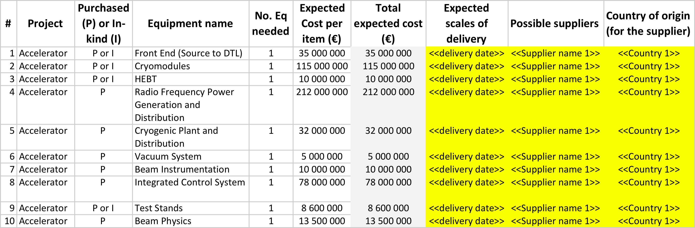
Accelerator Equipment list

Slide 18
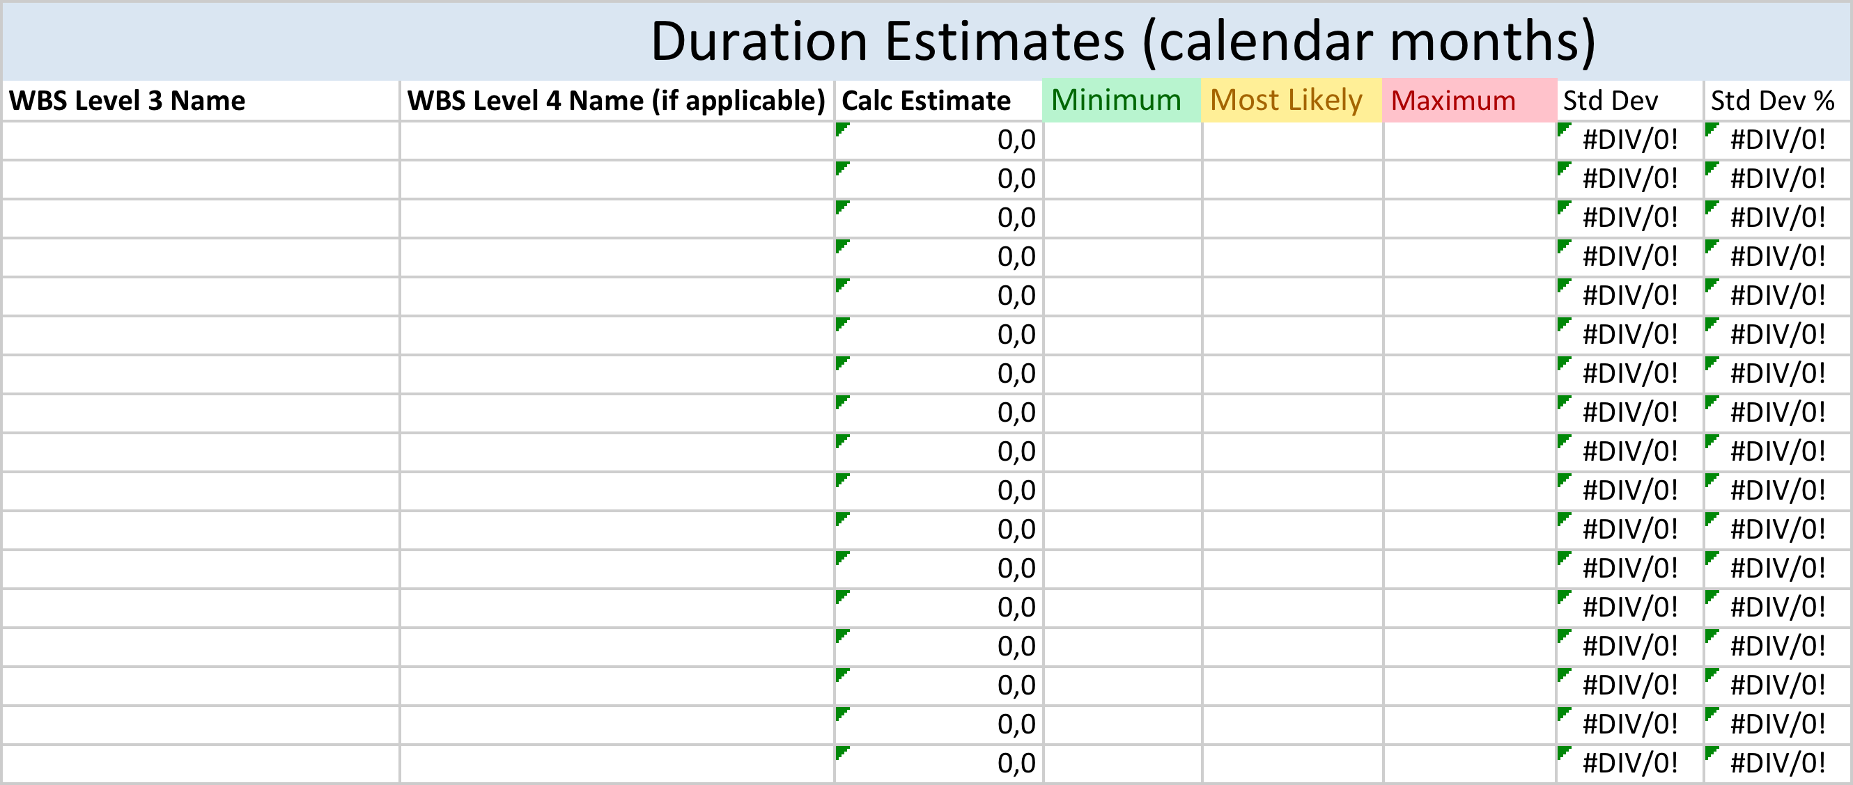
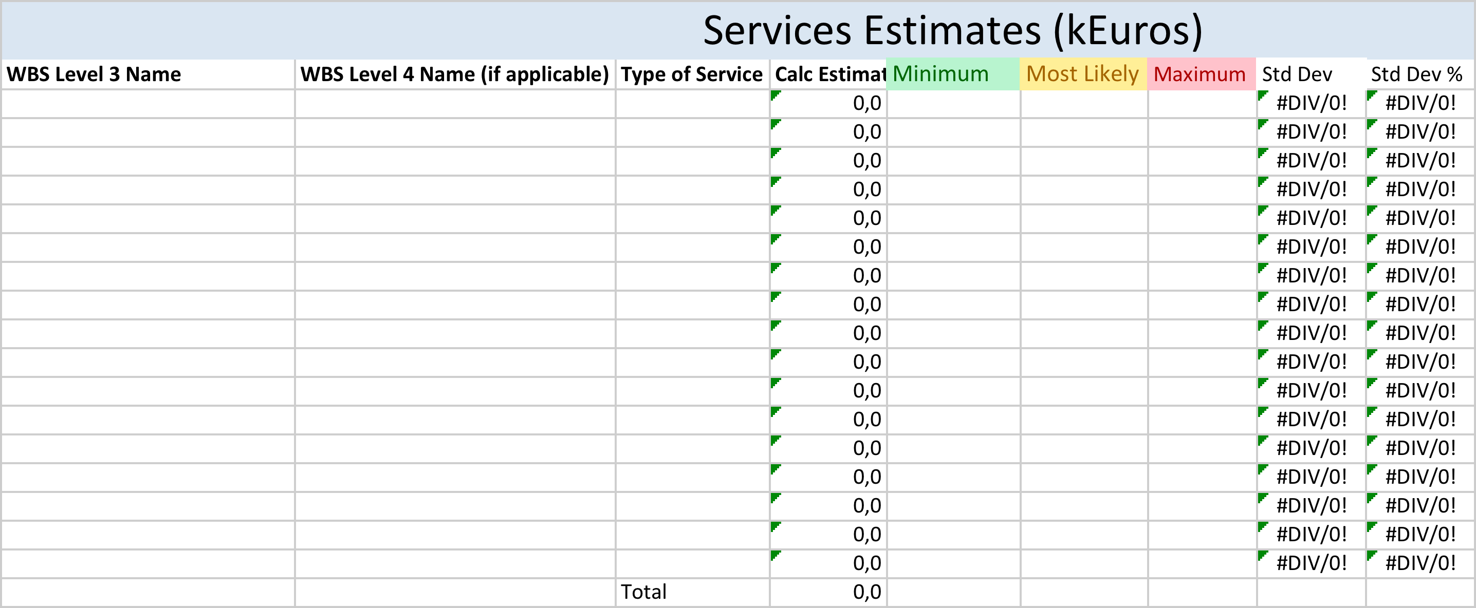
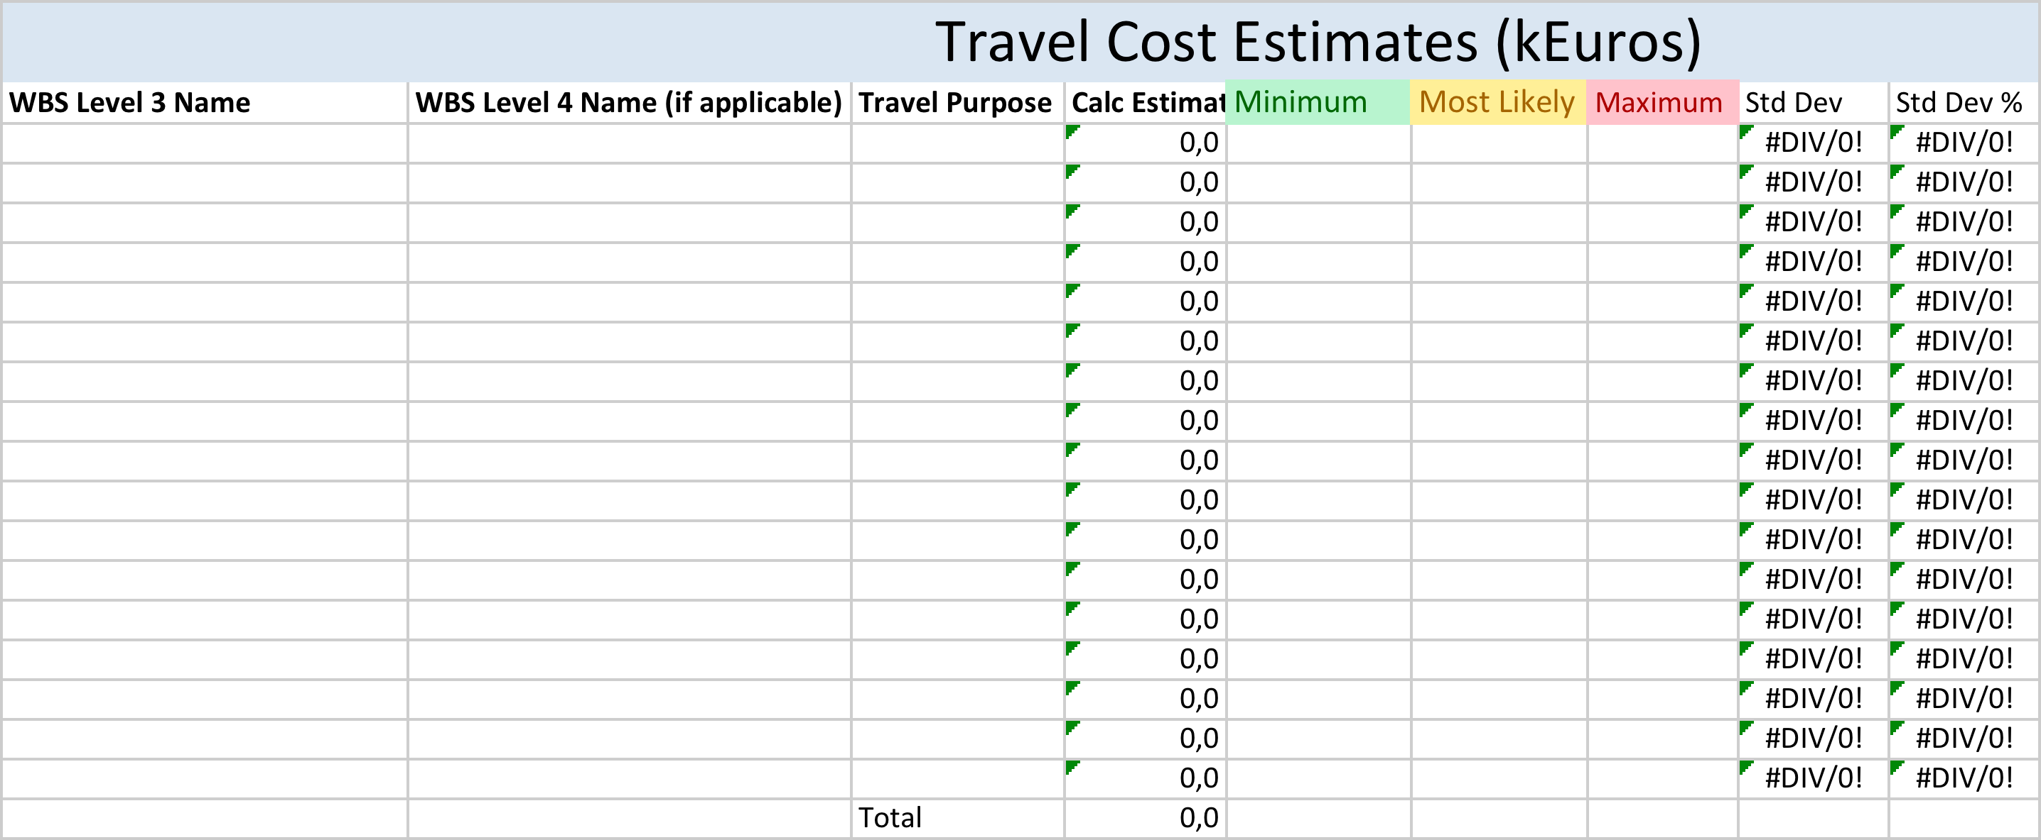
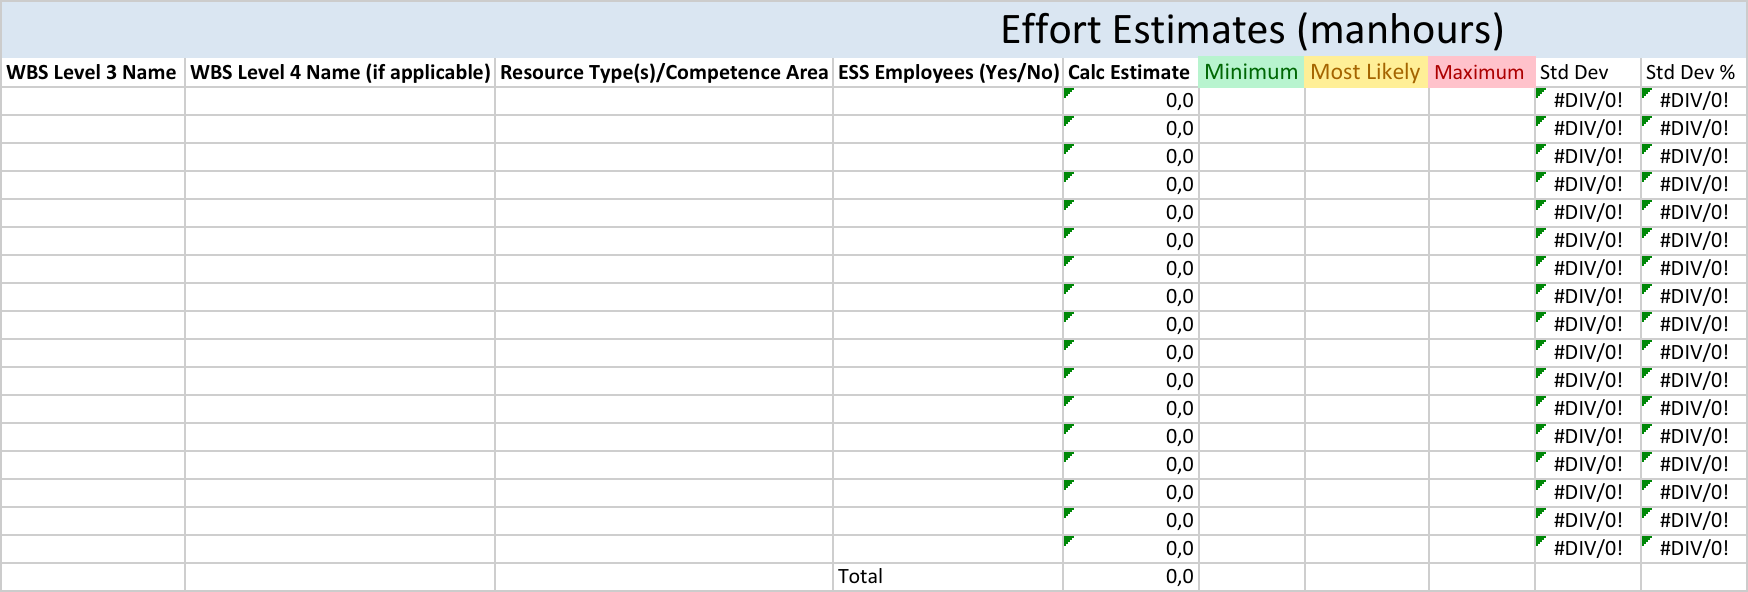
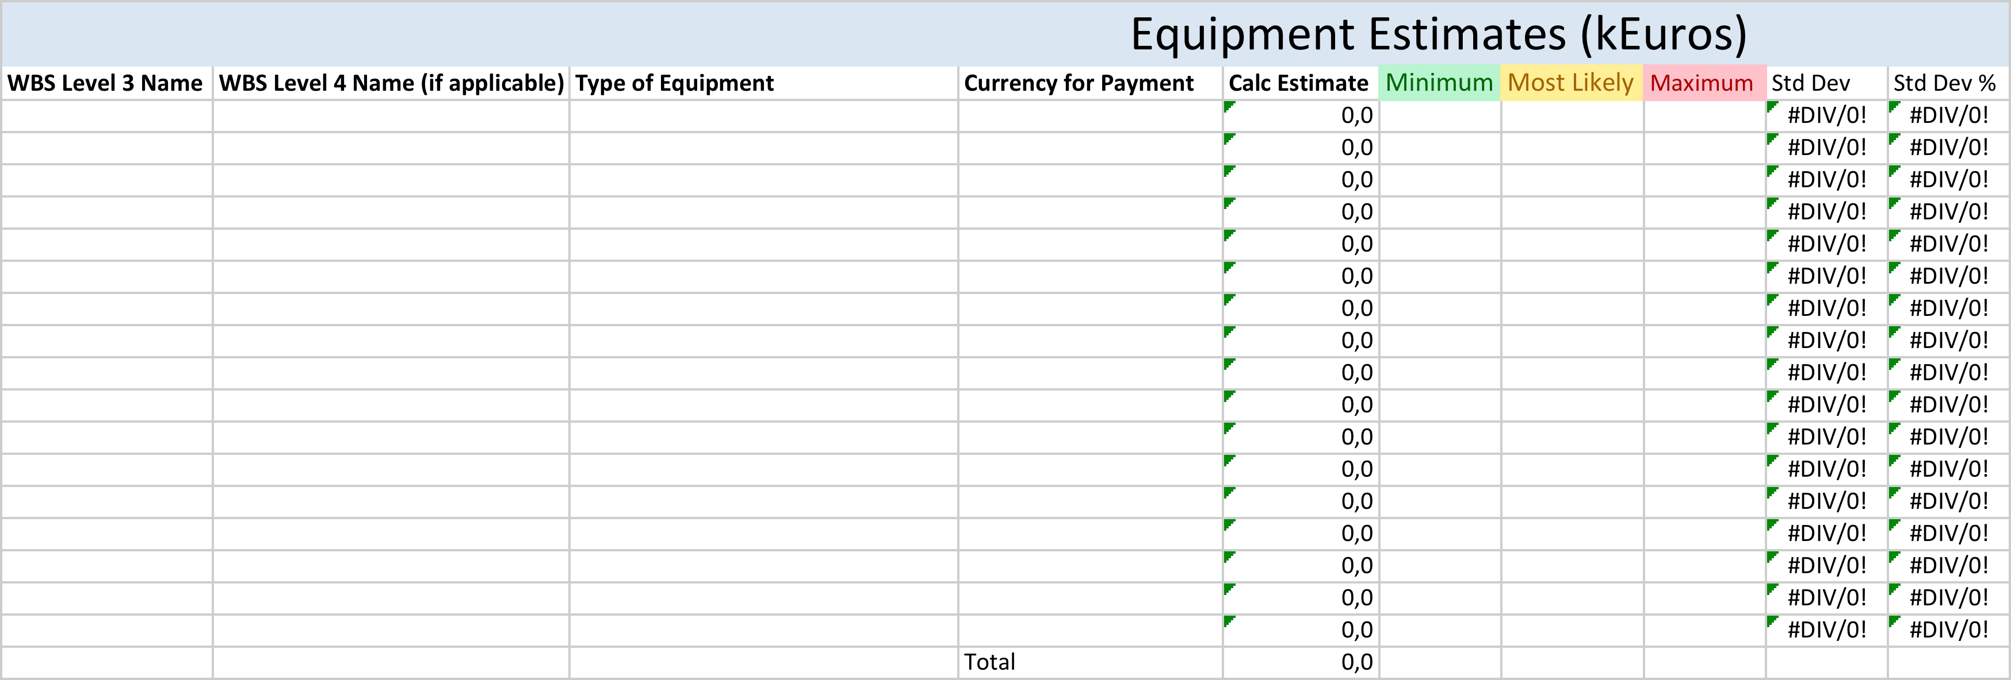
Tools
Template for estimating WP/WU level
Min/Most likely/Max

Slide 19
Template for summary
Templates for summary of WP/WU level

Slide 20
Summary and comments
If uncertain if its In-kind or cash?
If uncertain of which currency?
Use the support from PMO
  Mikael Klein-Velderman
  Ann Stenberg
  Johan Brisfors
Count it as Cash
Count it as EURO

Slide 21
Costing & Planning 2012

Slide 22
Scope for 2012 Planning & Costing
  Reflecting the current ESS design (CDR/TDR)
  Including commissioning, installation etc.
  Detailed planning for each project down to appropriate WP level
  WBS level 5/6/7 ??
  Size of Work Package/Work Unit 5 days – 5 weeks
  Resource allocation plan for each WP/WU
  Risk management plan for each Work Package
  Including active measurements - not a paper product!

Slide 23
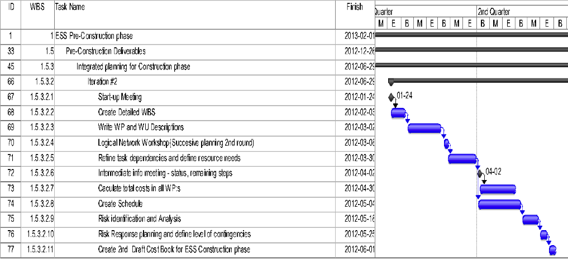
Schedule for 2012

Slide 24
QUESTIONS ?

