Slide 1
Status of the SPL cryomodule study
Rossana Bonomi
Lund, 6th Dec. 2011

Slide 2
Outline
SPL project
Thermal performance RF coupler
Test of mock-ups

Slide 3
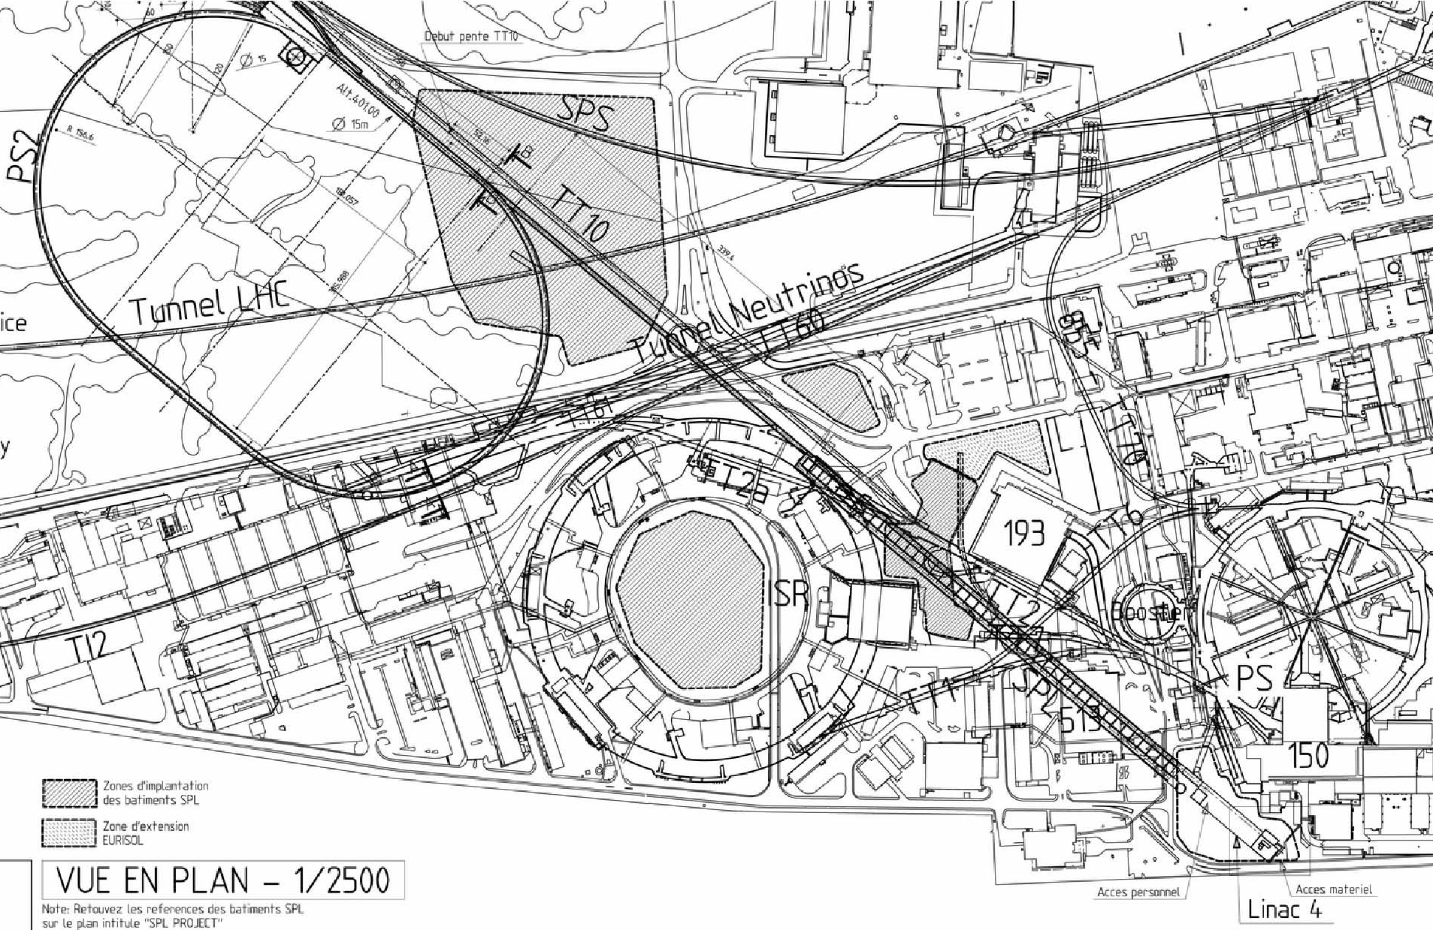
SPL: 1st proposal
Superconducting Proton Linac
High power beam multi purpose machine as injector for LHC and others
SPS
PS2
ISOLDE
PS
SPL
Courtesy of V. Parma
LINAC4

Slide 4
SPL: new orientation (2010)
R&D of key technologies for the high intensity proton source
Development, manufacture, test of SHORT CRYOMODULE in machine-type config.
Housed in He vessel
Equipped with tuners
Powered by RF couplers
Low thermal loads
Cavity positioning

Slide 5
SPL machine
warm quads
β = 1 cryomodule
(8 cavities)
β = 0.65 cryomodule
(3 cavities)
SHORT CRYOMODULE
“Segmented”
Warm quadrupoles
Courtesy of V. Parma

Slide 6
SPL Short Cryomodule
Courtesy of P. Duthil
To many extents, compatible with full-size CM
Four 5-cells cavities @ 704 MHz
high-gradient (25 MV/m), relativistic (β = 1)
Conceptual design reviewed last November!

Slide 7
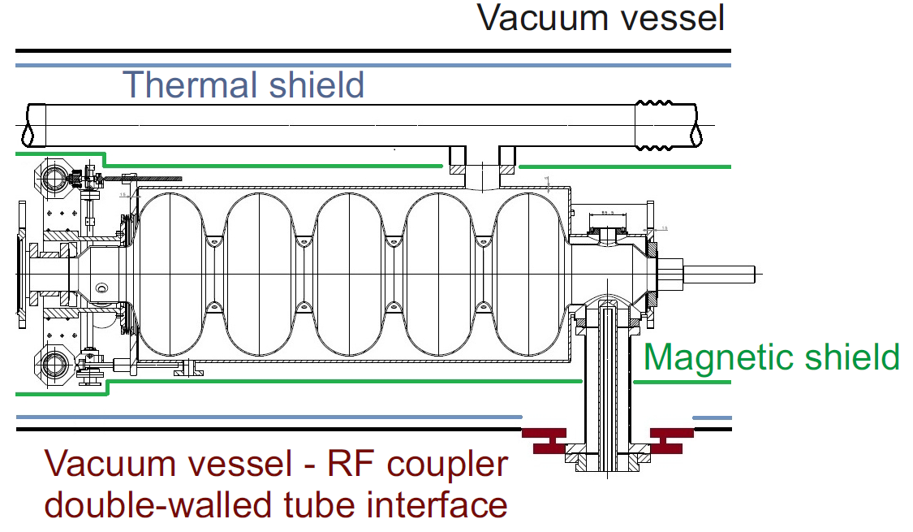
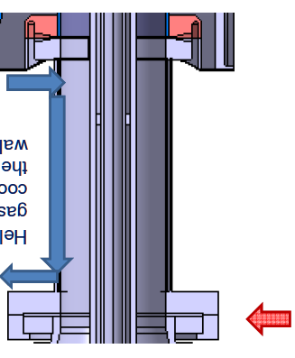
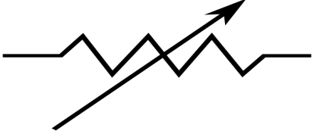
Current work
RF Coupler functions:
Feeding the cavity with RF power
Supporting the cavity
RF power
Conduction
Courtesy of P. Coelho
Active cooling
with He gas
Heater
Courtesy of O. Capatina

Slide 8
Semi-analytical analysis
x
Wall, int
RT
(300 K)
Gas
BATH
(2 K)
Wall, ext
n=0
n=1
n=2
n=N-1
n=N
n=N+1
RF power dissipation
Radiation with antenna
Boundary conditions
T wall (0) | 300 K
T wall (N+1) | 2 K
T gas (N) | 5 K

Slide 9
Some results: no cooling
11 W_{th} to bath !!
RF power OFF
RF power ON

Slide 10
Cooling with 40 mg/s, 10 W/m²/K
0.3 W_{th} to bath
Refrigerator power required
(0.3 W_{th} to bath):
< 100 W_{el}
η_C = 17*10-3
η _tech = 0.20

Slide 11
To do..
Completion of thermo-mechanical performances of RF coupler
Transient-state analysis of RF coupler
Overall thermal budget of CM
..

Slide 12
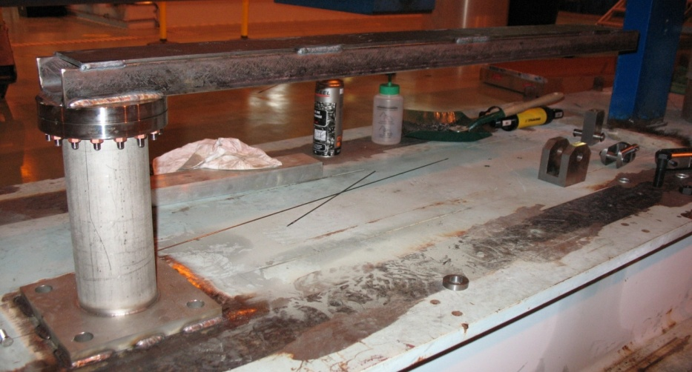
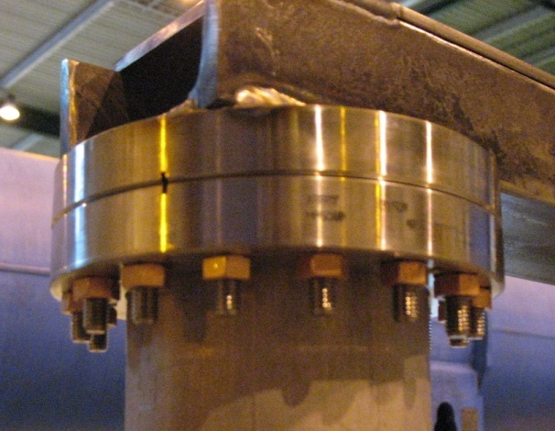
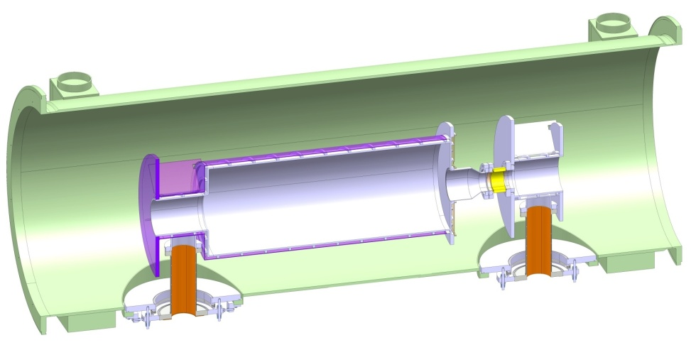
Mock-ups
Mock-up | Motivation | Today | Future
Interface cavity to RF coupler | Warm test of the mech. behaviour | Successfully tested in cantilever: it can stand the bending moments during transport loads | Test on optimal torque for bolts Test on seals for reproducibility
Overall supporting scheme | Cold test of thermo-mech. behaviour of whole assembly | Finalization of design | Test on alignment procedure Test on thermal transient
Courtesy of A. Vande Craen

Slide 13
References
V. Parma, The short cryomodule: requirements (http://indico.cern.ch/getFile.py/access?contribId=1&resId=1&materialId=slides&confId=154284)
O. Capatina, SPL power coupler double-walled tube thermo-mechanical studies (http://indico.cern.ch/getFile.py/access?contribId=3&resId=1&materialId=slides&confId=86123)
E. Montesinos, SPL power coupler I (http://indico.cern.ch/getFile.py/access?contribId=1&resId=1&materialId=slides&onfId=86123)
E. Montesinos, SPL power coupler II (http://indico.cern.ch/getFile.py/access?contribId=6&resId=1&materialId=slides&confId=86123)
A. Vande Craen, SPL intercavity support (http://indico.cern.ch/getFile.py/access?contribId=6&resId=15&materialId=slides&confId=154284)
A. Vande Craen, SPL test mock-ups (http://indico.cern.ch/getFile.py/access?contribId=6&resId=11&materialId=slides&confId=154284)
P. Azevedo, Cavity supporting scheme (http://indico.cern.ch/getFile.py/access?contribId=6&resId=13&materialId=slides&confId=154284)

Slide 14
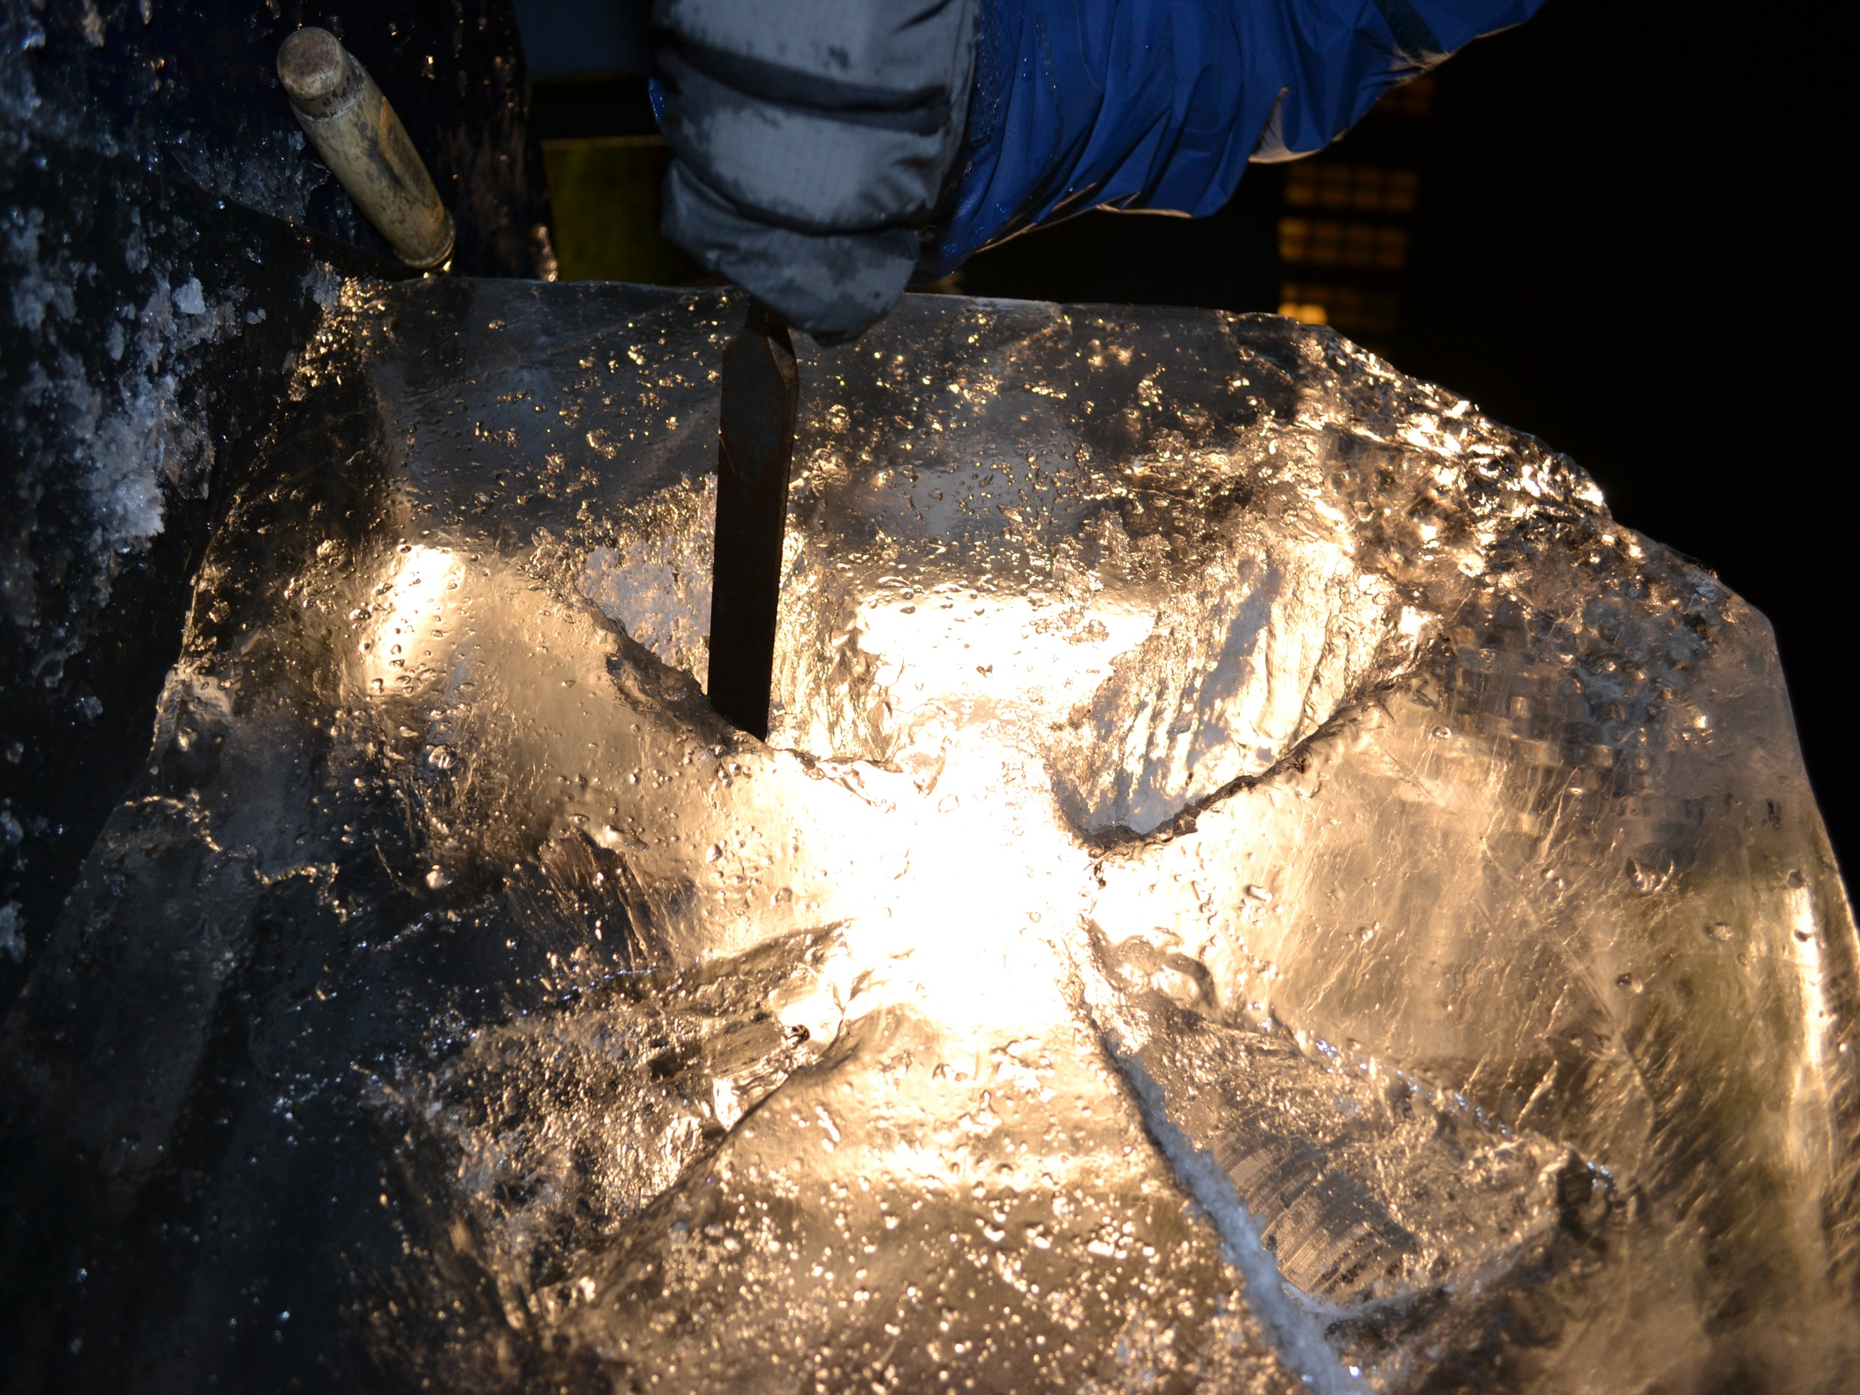
Thanks for your attention! Tack för din uppmärksamhet !
Participants to the collaboration effort:
System/Activity | Responsible/member | Lab
Cryo-module coordination | V.Parma | CERN
Cryo-module conceptual design | V.Parma Team: R. Bonomi, P.Coelho, O.Capatina, D.Caparros, Th.Renaglia, A.Vande Craen | CERN
Cryo-module detailed design & Integration CNRS | P.Duthil (P.Duchesne) + CNRS Team | CNRS/IPNO-Orsay
Cryostat assembly tooling | P.Duthil (P.Duchesne) | CNRS/IPNO-Orsay
Cavities/He vessel/tuner, RF coupler) | W.Weingarten, O.Brunner/O.Capatina/S.Chel | CERN/CEA-Saclay
RF Coupler | E.Montesinos/S.Chel | CERN/CEA Saclay
Vacuum systems | S.Calatroni, G.Vandoni | CERN
Cryogenics | U.Wagner | CERN
Survey and alignment | D.Missiaen | CERN
SPL Machine architecture | F.Gerigk | CERN
ESS cryo-module requirements | W.Hees | ESS Lund (Sweden)

Slide 15
Extra slides
Rossana Bonomi
Lund, 6th Dec. 2011

Slide 16
40 mg/s, 10 W/m2/K

