Slide 1
Welcome
Mats Lindroos
Head of the ESS Accelerator Division
EPG 5/12/2011

Slide 2
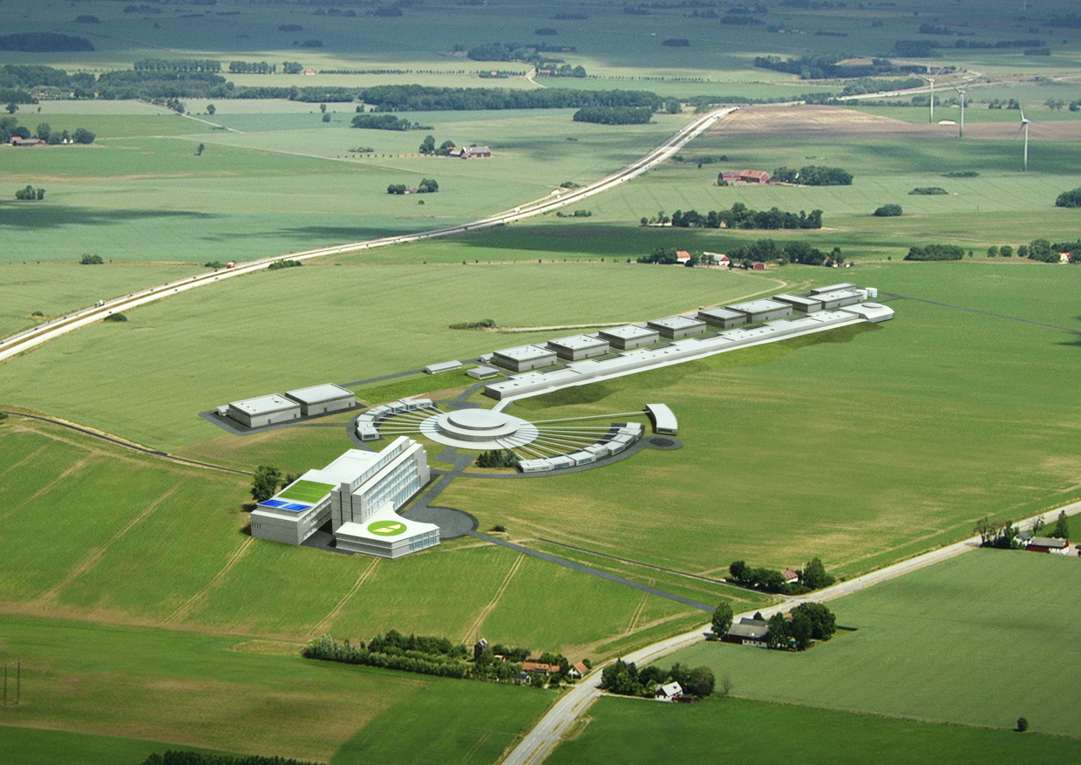
ESS accelerator design High level objectives
ESS accelerator high-level technical objectives:
5 MW long pulse source
-2.86 ms pulses
-14 Hz
-Protons (H+)
-Low losses
-High reliability, >95%
-Cryostats for minimum
Energy consumption
-Flexible design for
a future power upgrade

Slide 3
LINAC layout
 | Length (m) | Input Energy (MeV) | Frequency (MHz) | Geometric β | # of Sections | Temp (K)
RFQ | 4.7 | 75 × 10⁻³ | 352.2 | -- | 1 | ≈ 300
DTL | 19 | 3 | 352.2 | -- | 3 | ≈ 300
Spoke | 58 | 50 | 352.2 | 0.57 | 14 (2c) | ≈ 2
Low Beta | 108 | 188 | 704.4 | 0.70 | 16 (4c) | ≈ 2
High Beta | 196 | 606 | 704.4 | 0.90 | 15 (8c) | ≈ 2
HEBT | 100 | 2500 | -- | -- | -- | --
H. Danared, M. Eshraqi, A. Ponton, ESS
3

Slide 4
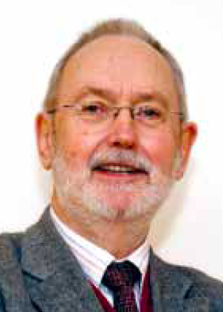
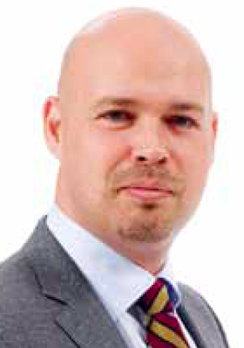
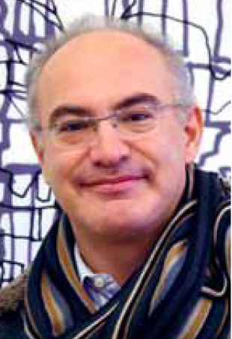
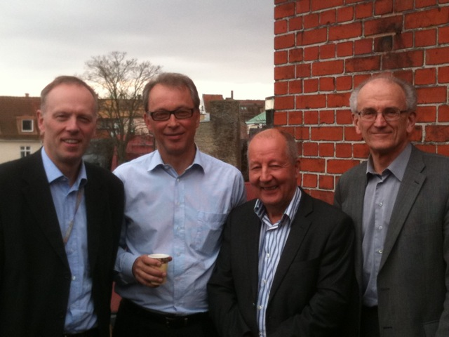
ESS Programme Organisation
ESS AB Board
Steering Comm (STC)
Adm Financial Comm
CEO
C. Carlile
Administration
Director
Collaboration Partners
Programme Director
Machine Director
Science
Director
Technology Adv. Comm
Science Adv. Comm
Programmme Office
Accelerator
Target
Conventional Facilities
Instruments
Neutron Science
Data Management
Preconstruction
Construction
Operation Phase

Slide 5
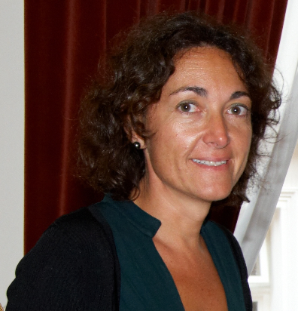
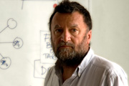
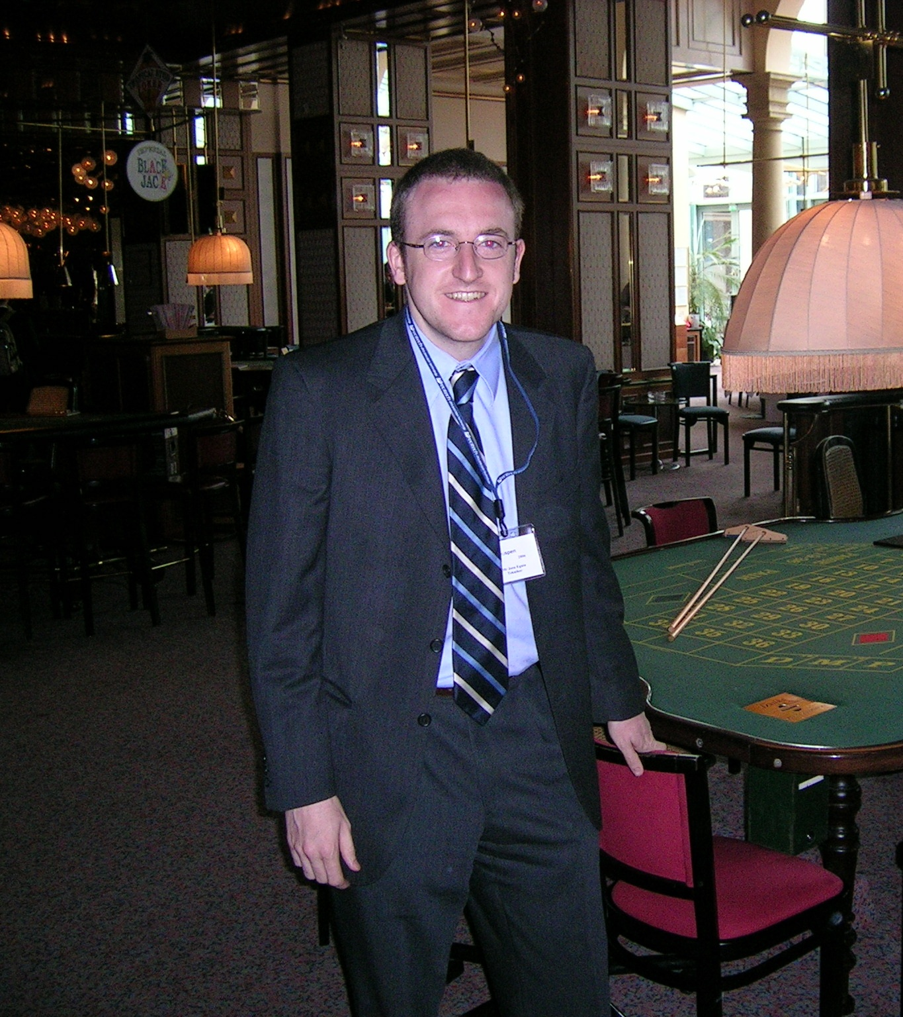
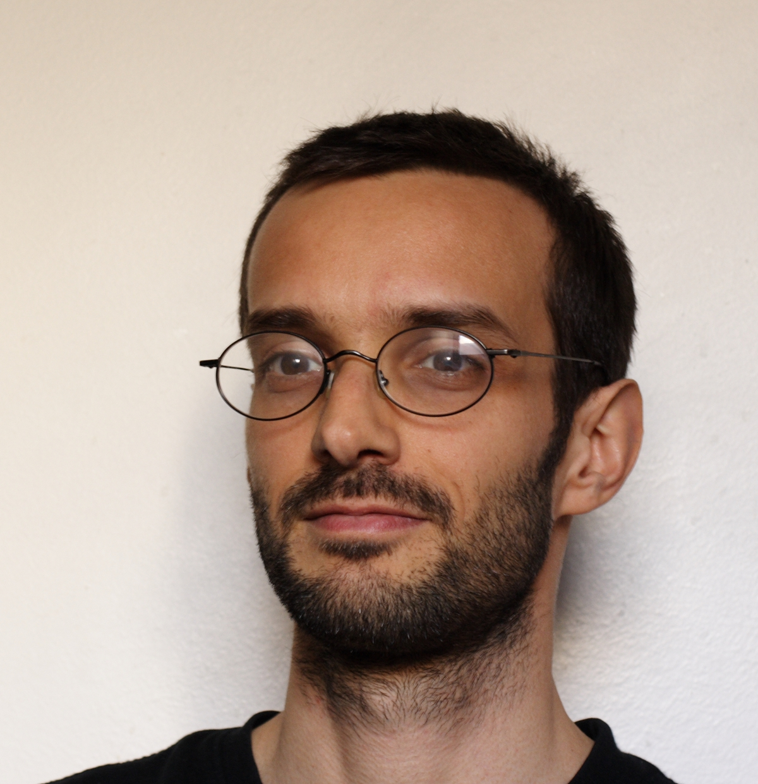
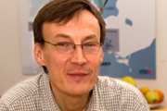
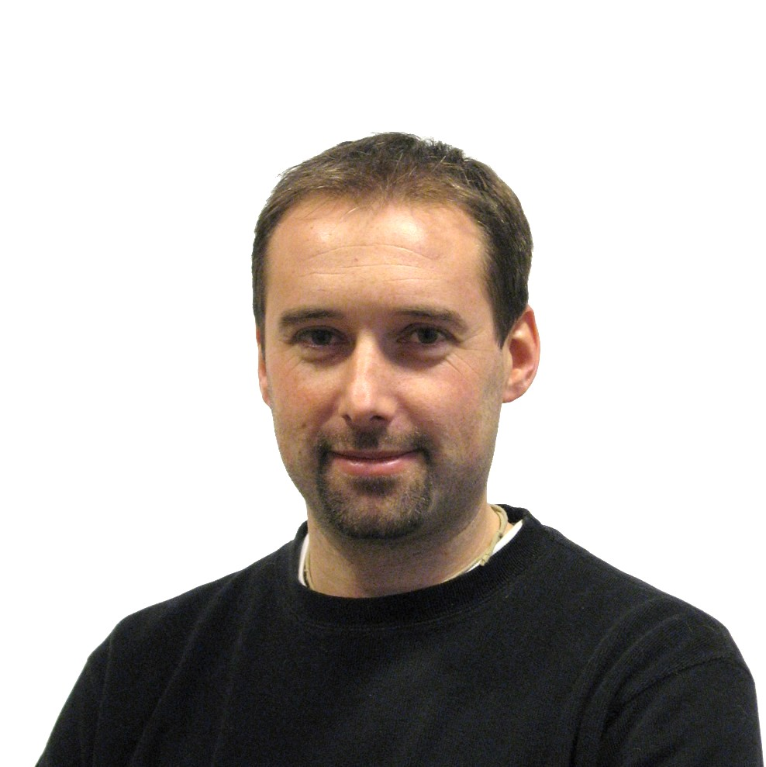
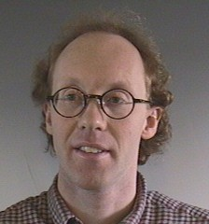
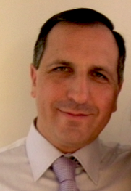
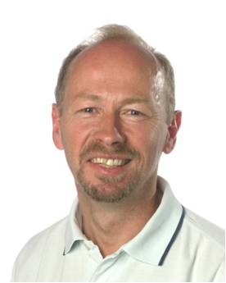
Accelerator Design Update
Steve Peggs
Cristina Oyon
Work Package (work areas)
1. Management Coordination – ESS (Mats Lindroos)
2. Accelerator Science – ESS (Steve Peggs)
3. Infrastructure Services – Tekniker, Bilbao (Josu Eguia)
4. SCRF Spoke cavities – IPN, Orsay (Sebastien Bousson)
5. SCRF Elliptical cavities – CEA, Saclay (Guillaume Devanz)
6. Front End and NC linac – INFN, Catania (Santo Gammino)
7. Beam transport, NC magnets and Power Supplies – Århus University (Søren Pape-Møller)
8. RF Systems – Uppsala university (Roger Ruber)
Josu Eguia
Romuald Duperrier (30 years ago)
Guillaume Devanz
Mats Lindroos
Sebastien Bousson
Roger Ruber
Søren Pape Møller
Santo Gammino

Slide 6
Some of the committees…
EMT: ESS management team which consists of the ESS CEO, the thre directors and the head of administration
EPG: ESS Project management group which consists of EMT, AD head, TD head and ID head
CCB-M and CCB-F: Change control and coordination of machine and facilities

Slide 7
ESS Master Programme Schedule
 | 2009 | 2010 | 2011 | 2012 | 2013 | 2014 | 2015 | 2016 | 2017 | 2018 | 2019 | 2020 | 2021 | 2022 | 2023 | 2024 | 2025
ESS Program Phases, Gates and Milestones Program level
Accelerator
Target
Instruments
Conventional Facilities
PG 1
PG 2
PG 3
PG 4
Program Initiation
Program Set-up
losure
Delivery of Contsruction phase
Pre-construction phase
First Neutrons
to Instruments
Full beam power on target
Construction
Technical Design Report
Operations
Pre Construction Report
Design Update
Prepare to Build
Installation
Construction
Design Update
Prepare to Build
Installation
Construction
Concepual Design
# 7
List
Design and Manufacturing 22 instruments
Ground Break
Installation 1-22
Design Update
First Building
Site preparation
Construction

Slide 8
Progress in 2011
Recruitment of staff in Lund, we are now 25!
Experts present in Lund for shorter and longer periods to support AD and ADU project
Kick-off of ADU project
Regular TB meetings for change control and coordination
Work has started in all WPs
First revision of Parameter lists, available at AD homepage in PDF form
Collaboration board had its first meeting
Conceptual Design Report in V1 (going to V2)
Modulator ordered for CERN test stand
Project support in Lund at AD for ADU and P2B
Reporting fully operational and first project review passed
Alfresco, please use it!
Suzanne Gysin, what a star!
The project office in Lund
CCB and EPG meetings for chnage and configuration control, project reviews and coordination
More from Johan Brisfors

Slide 9
Some on-going work…
Strategy for Elliptical cavitiy cryomdoule prototyping
Several visit to potential partners and one workshop in Lund
To be presented to ESS senior management in the end of February
Strategy for modulator prototypes
Discussions between Uppsala University, Lunds university and ESS on how to optmize existing reources and assure a coherent plan and division of responsibilities
To be presented to senior management in February for decision
New baseline to be “downloaded” in January and April 2012
Issues: Hybrid or not, MEBT design, DTL length, transition energies, RFQ length,…
Beam physics is the integrating cavity for any accelerator project
CDR to become a living document which will progress to TDR under change control
Steve is the chief Editor and CCB and EPG manages change control
Internal reviews for all ADU activities and future P2B and construction activities
Suzanne will present next steps at TB meeting
Planning, re-planning and launching of ADU and P2B Wus and WPs
Launched as we are ready to go: CM prototyping, Uppsala test stand, Infrastructure and services
Planning for construction project under PMO
WBS to level 3, schedule and costing to enable us to enter into construction in 2013

Slide 10
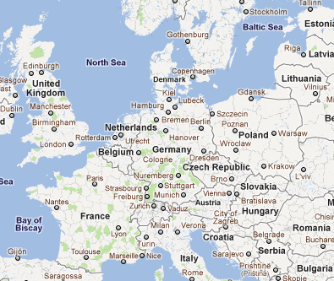
First thoughts -
CM production line (XFEL)
Other Manufacturer
SDMS, ZANON, RI, …

Slide 11
Upgrade options
Increase the repetition rate
Requires new RF sources
Not favored for operation with operation at a single target station as it would require moving the instruments
Increase the beam current
Requires additional RF sources and/or additional cryomdoules and that linac and shielding is design for higher currents (with some additional cost)
Favored from instrument study (power upgrade with preserved time structure improves almost all instrument performance almost linearly)
Increase the pulse length
Will require new RF sources
Not all instruments would benefit
Add a second target station
Could be combined with increased repetition rate
Short pulse operation with H- and ring
Can be combined with H+ operation but would require new RF sources and a new front-end
Increase beam energy
Only moderate beam energy increase can be handled by the target and moderators
EPG adopted guidelines for upgrade studies:
Beam current limitation at 90-100 mA with a single front-end
Beam energy limitation at 3.5 GeV set by shielding and target

Slide 12
Upgrades
The mandate is to build a 5 MW accelerator!
The presently favored upgrade scenario is a power upgrade to higher power with maintained time structure
Present understanding at AD is that this best is achieved with a higher beam current or/and a moderate beam energy increase
We will study how this can be prepared within the present 5 MW baseline
The additional cost should be understood and made apparent in the costing of the 5 MW baseline
First technical studies and financial estimates for the upgrade itself should be done as part of the ADU project

Slide 13
Headlines
We are designing the ESS accelerator
Good progress in all areas
Many thanks for your contribution
We should plan for entering construction in 2013
Will require that we deliver in time on all deliverables and that we that we launch key P2B activities in 2012
Will require that we deliver on construction project planning to PMO
Will require that we prepare through internal reviews with external experts for a comprehensive technical review of the ESS accelerator construction project
None of this would be possible without you and your collaborators at our partner institutes and labs.

Slide 14
Greetings from Bejing

Slide 15
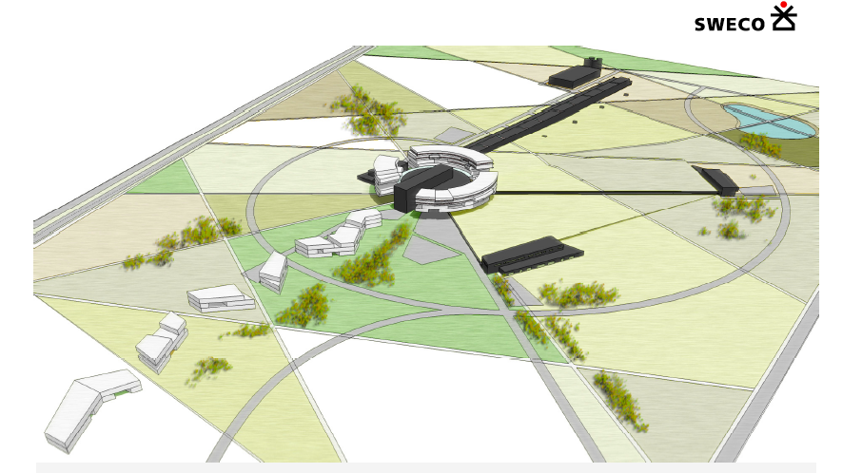
Thank you for your attention!

