Slide 1
ESS AD RETREAT
5th December 2011, Lund
“A walk down the Linac”
SPOKES
Sébastien Bousson
IPN Orsay

Slide 2
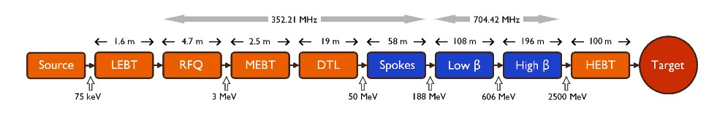
The ESS Spoke linac
After 50 m walking down the linac, you will experience a sharp transition from room temperature to -271°C.
The Spoke section of the linac is:
  ~ 60 m long
  composed of 28 cavities hosted in 14 cryomodules
  increasing the beam power from 50 MeV to 188 MeV

Slide 3
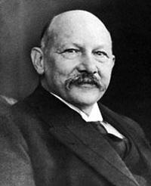
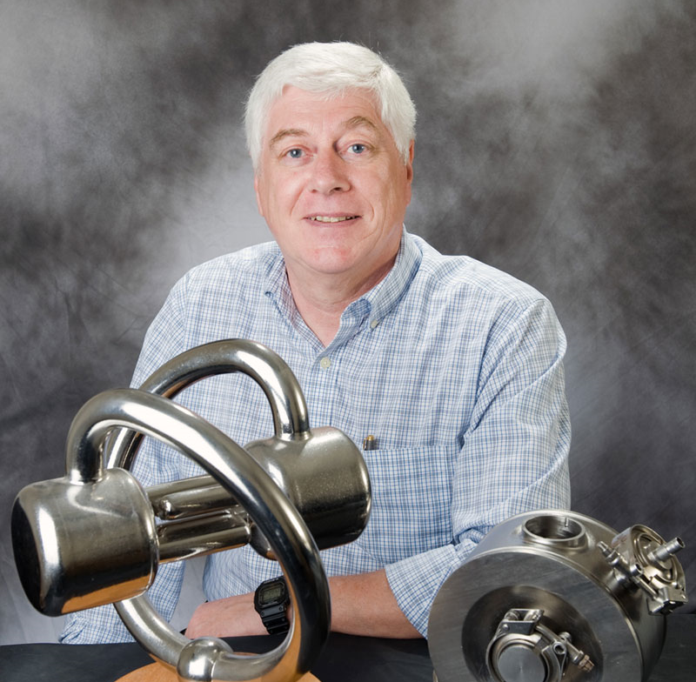
What you said ? Spoke ???
Trivia: Let us solve the following equation
+
=
?

Slide 4

What you said ? Spoke ???
Trivia: Let us solve the following equation
+
Heike Kamerlingh Onnes
Discovery of superconductivity
100 years ago
Nobel prize
Jean Delayen (ODU / JLAB)
Inventor of spoke geometry
Late 1980s

Slide 5
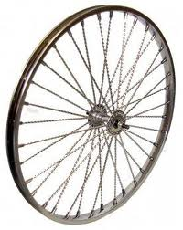
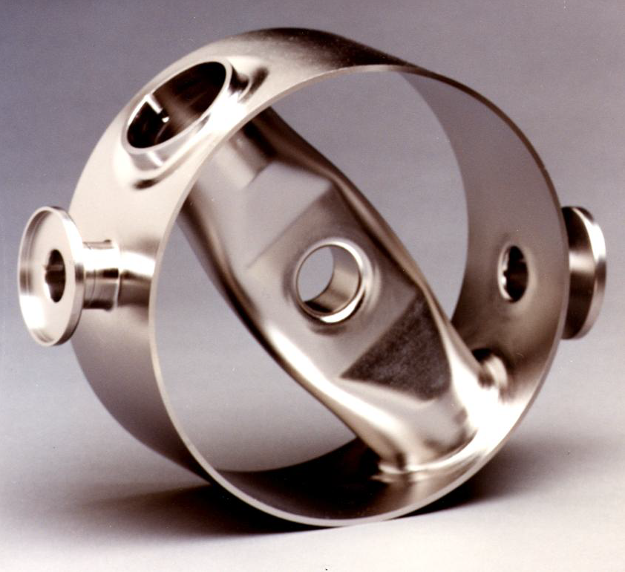
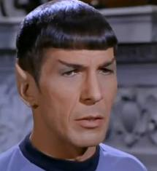
What you said ? Spoke ???
Trivia: Let us solve the following equation
+
=
?

Slide 6
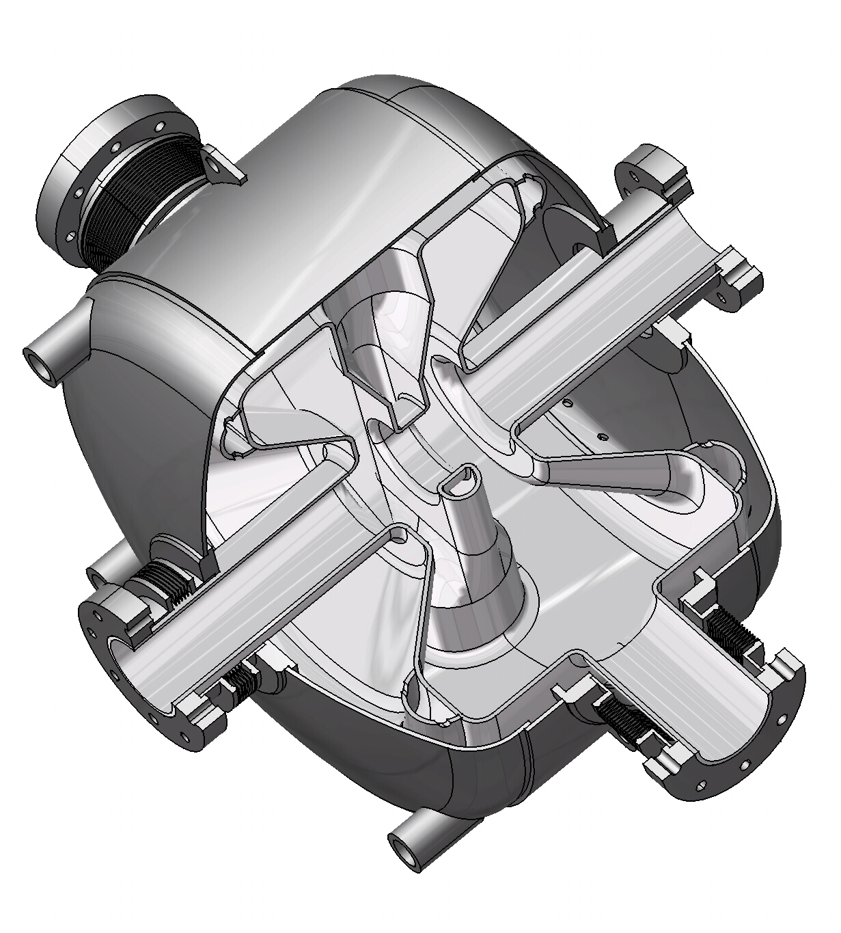
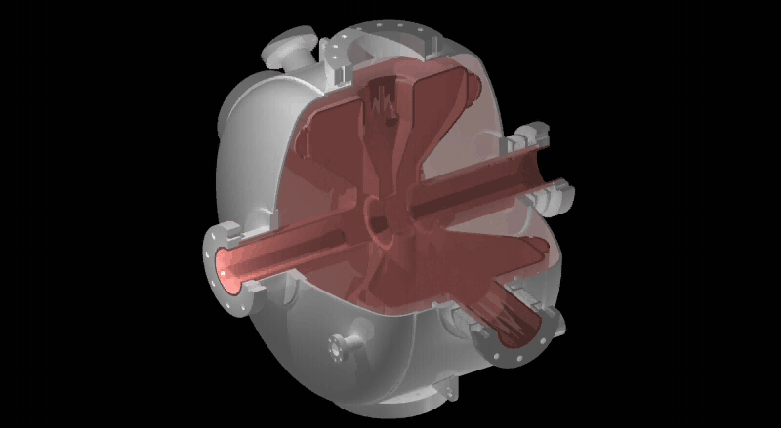
Spoke cavities
Spoke cavity: a superconducting resonator of a complex 3D geometry, well suited to accelerate beam of medium energy (and potentially more…)

Slide 7

Advantages of Superconducting Cavities
Almost no losses on the cavity wall (thanks to superconductivity)
⇒ ∼100% of the injected RF power goes to the beam : very high efficiency !!!
Operating cost gain as compared to warm structures (which dissipate ∼10⁵ times higher)
Possibility to accelerate CW beams or beams with a high duty cycle (> 1 %) with high accelerating gradients (impossible with warm structures)
Possibility to relax the constraints on the cavity RF design: choosing larger beam port aperture is possible ⇒ reduction of the activation hazard = security gain
High potential for reliability and flexibility
Main drawback : need to be operated at cryogenic temperature

Slide 8
Specific Advantages of Spoke Cavities
Spoke cavities have all advantages of Superconducting structures
AND
• Potential for very high accelerating gradients
• They are compact and naturally stiff, making them less sensitive to static or dynamic vibration (important for a pulsed machine)
• Multi-gap capability -> increased real-estate gradients
• High cell to cell coupling => no need for field flatness
• Less sensitive to HOM or trapped modes
• No dipole steering effect
• Wide β range accessible

Slide 9
Spoke in ESS : a world premiere !
About 15 spoke resonators prototypes (SSR, DSR, TSR) have been constructed and tested worldwide. None have accelerated beam until now ! ESS linac will be the first accelerator to operate spoke cavities.
T=4 K
IPN Orsay Triple 352 0.3 4.1 9.1

Slide 10
ESS Spoke cavities ongoing work
Developping spoke cavities: Scope of Work
Address the engineering design of the complete spoke cryomodules composing the intermediate energy section of the ESS SC Linac.
WP4 | Spoke SC linac
WU 4.1 | Management and TDR contribution
WU 4.2 | Spoke cavities
WU 4.3 | Cold tuning system
WU 4.4 | Power coupler
WU 4.5 | Cryomodule
WU 4.6 | Superconducting magnets integration
WU 4.7 | Prototypes and tests
Cover the energy range: ~ 50 MeV to ~ 190 MeV
Spoke cavity type : Double spoke (DSR), @ 8 MV/m
One family : β_{g} = 0.50
About 28 cavities and 14 cryomodules operating at 2K

Slide 11
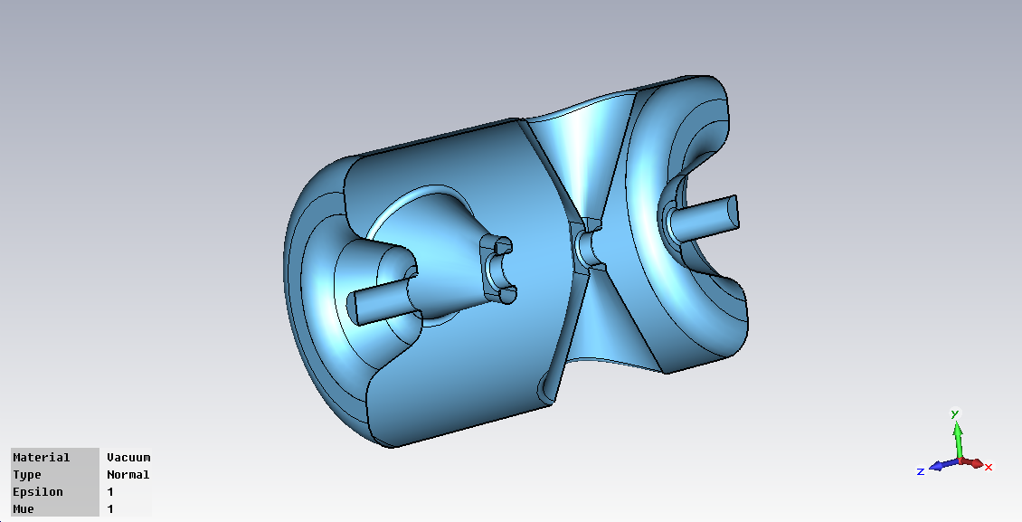
RF Design of Spokes
Overall dimension of the cavity
Cavity β | 0.50
Cavity length | 780 mm
Cavity diameter | 480 mm
frequency | 351.8 MHz

Slide 12
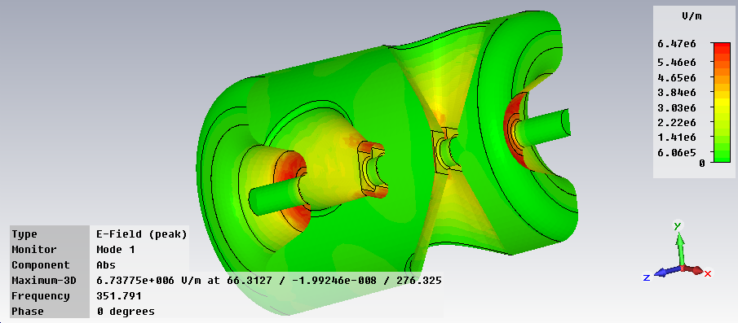
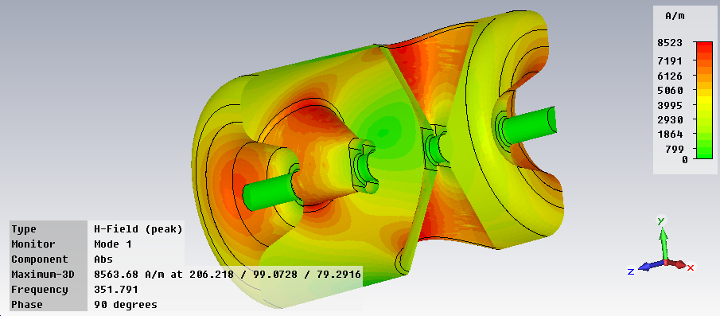
RF Design of Spokes
Cavity RF parameters
R/Q | 426 Ω
G | 130 Ω
Q_{o} at 4K (with R_{res} = 10 nΩ) | 2.6 10⁹
Q_{o} at 2K (with R_{res} = 10 nΩ) | 1.2 10¹⁰
E_{pk} / E_{acc} | 4.43
B_{pk} / E_{acc} | 7.08 mT/(MV/m)
Peak fields @
Eacc =8 MV/M
E_{pk} = 35 MV/m
B_{pk} = 57 mT
Electric surface field
Magnetic surface field

Slide 13
RF Design of Spokes
Electrical field along beam axis
( Definition of Lacc = 3/2.beta.c/f )

Slide 14
RF Design of Spokes
Cavity RF parameters
R/Q | 426 Ω
G | 130 Ω
Q_{o} at 4K (with R_{res} = 10 nΩ) | 2.6 10⁹
Q_{o} at 2K (with R_{res} = 10 nΩ) | 1.2 10¹⁰
E_{pk} / E_{acc} | 4.43
B_{pk} / E_{acc} | 7.08 mT/(MV/m)
Peak fields @
Eacc =8 MV/M
E_{pk} = 35 MV/m
B_{pk} = 57 mT
What does all these parameters mean ?
Here is the ESS spoke cavity talk:
“Give me 15 Watt of RF power, provide me with T=2 K fluids, and I’ll pay you back with 8 000 000 volts/meter.”
“Give me 250 kW more, and I’ll transfer it to your tiny charged particles without charging you a single Watt of it for my personal use !”

Slide 15
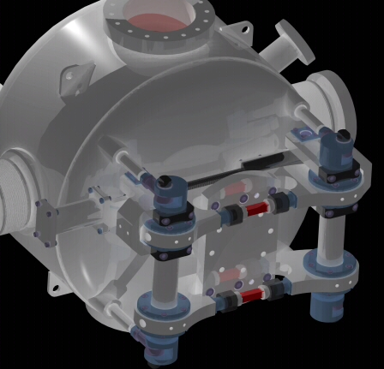
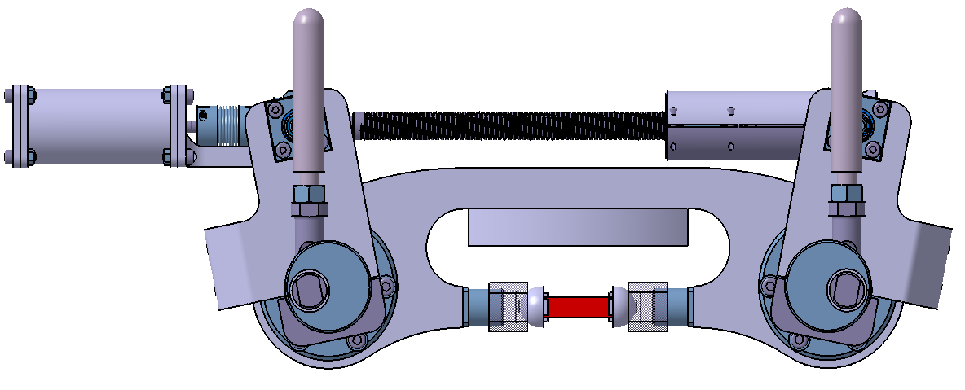
Cold tuning system for Spokes: option 1
Parameters for the cold tuning system (slow tuning)
  Stiffness (CATIA calculations): 162 kN/mm
  96% of the tuner excursion transferred to the cavity
  Theoretical resolution 2 nm/motor step
  Sensitivity: ~2 Hz/motor step ⬄ ~80 kHz/turn
  Tuner excursion: 4 mm max (i.e. 4 MHz of tuning range)

Slide 16
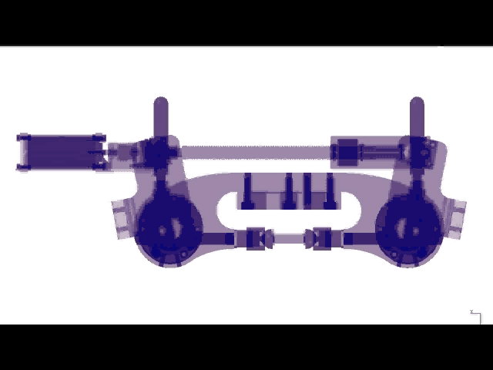
Cold tuning system for Spokes: option 1

Slide 17
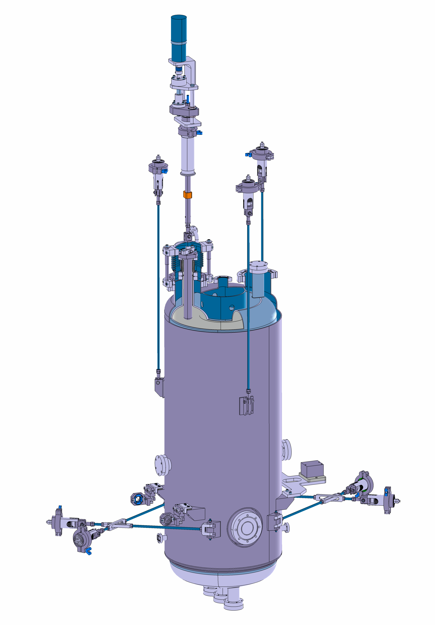
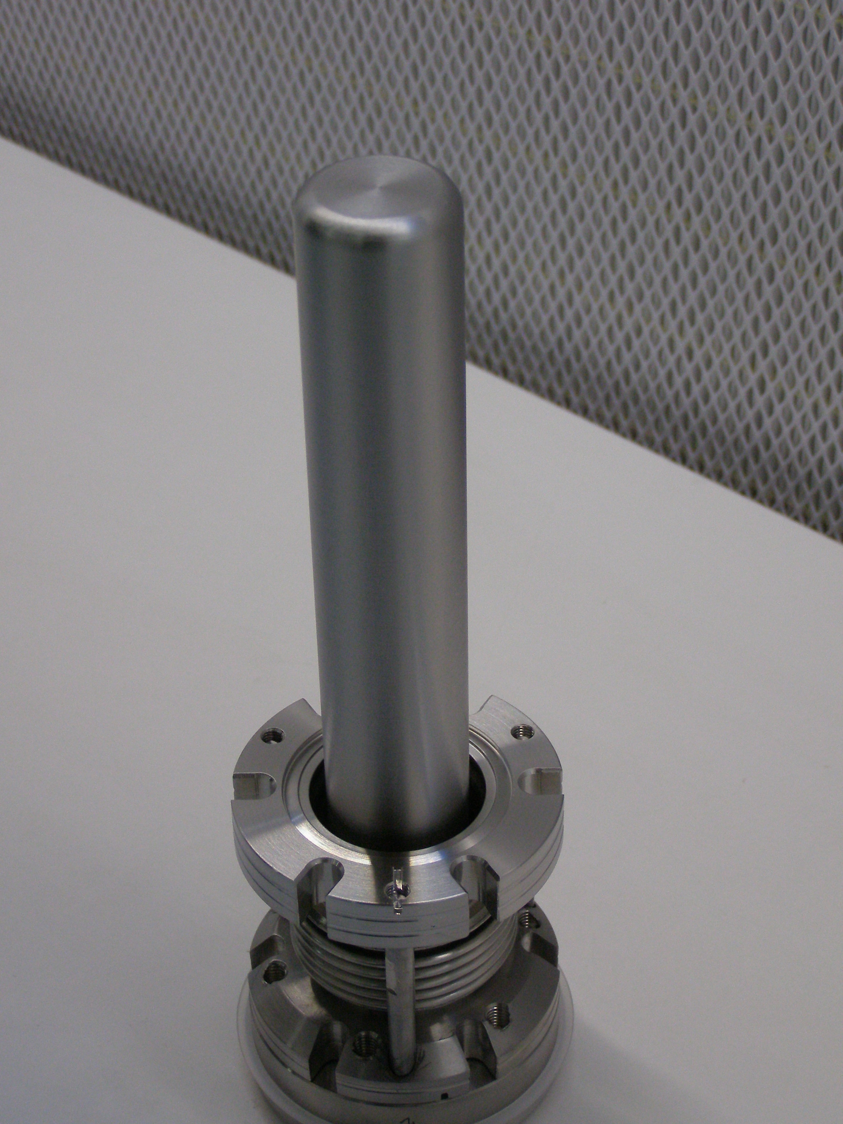
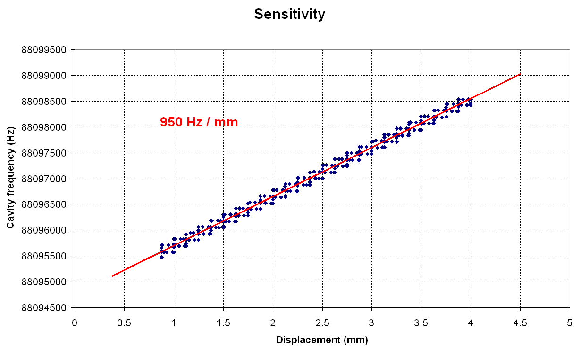
Cold tuning system for Spokes: option 2
Second option for the cold tuning system: Nb plunger inside the cavity
Recently developed by IPN Orsay for Spiral2
Niobium plunger (1) :
    Length : ~200 mm
    Diameter : 30 mm
    Thickness : 3 mm
Length inside the cavity :
    50 mm for moving plunger
    100 mm for fixed plunger

Slide 18
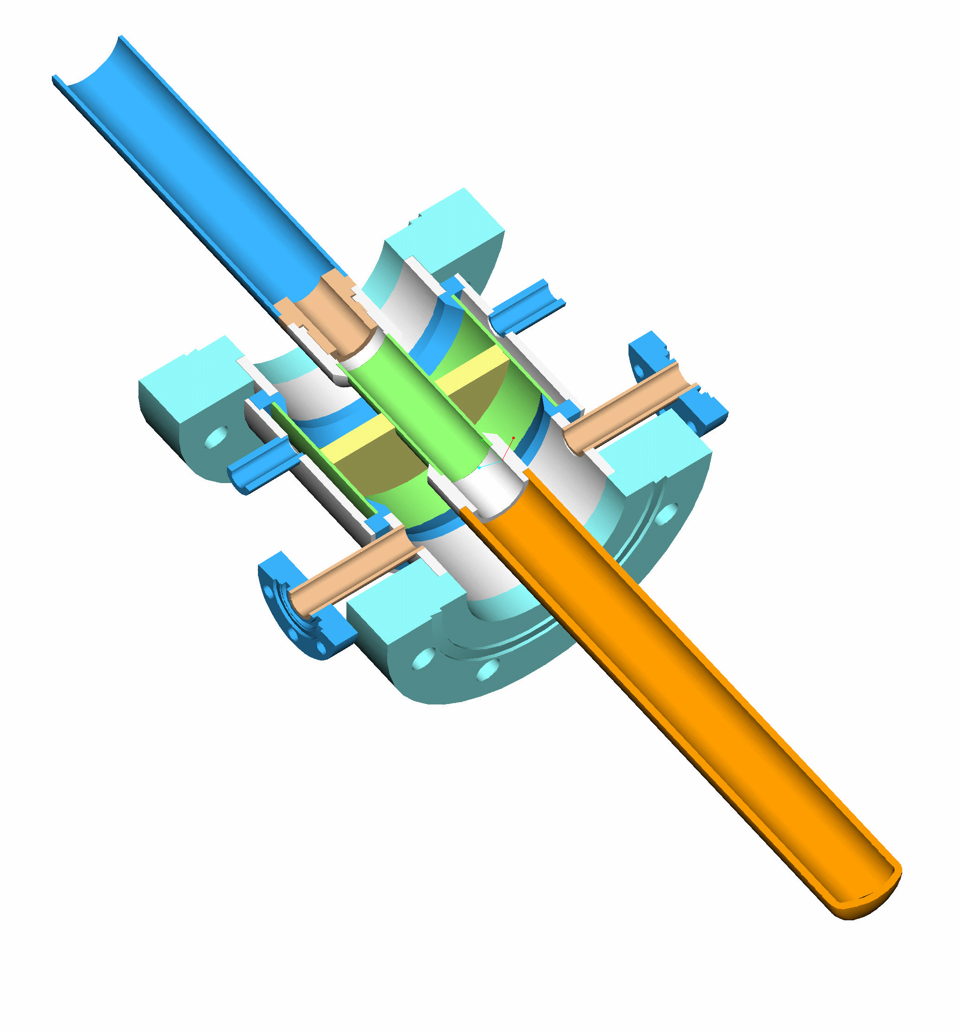
Spoke power couplers
  Operation frequency : 352.2 MHz
  Nominal power : 250 kW (upgrade to 400 kW ?)
  Capacitive coupling
  Maximum reflection coefficient : S₁₁ < -30 dB
  Window cooling capabilities
  Relatively simple design for reliability and cost reasons
  Max outer diameter : 100 mm
Upgrade of the Eurisol spoke power coupler to ESS requirements:
* Different peak power : pulsed, 250 kW (instead of 20 kW CW for Eurisol)
* same magnitude of average power (~ 20 kW): no additional cooling required
* adapt the length and diameter to the ESS requirements

Slide 19
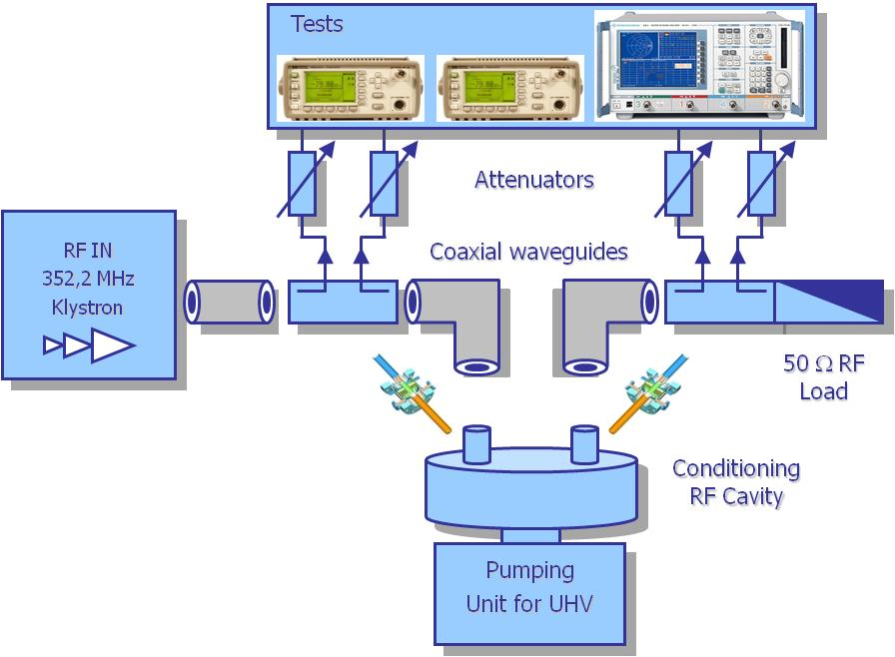
Spoke power couplers test bench
Spoke power couplers will be first tested at room temperature at full power (and even 2 or 3 times more) in a test bench operated by IPNO at CEA Saclay’s premises.

Slide 20
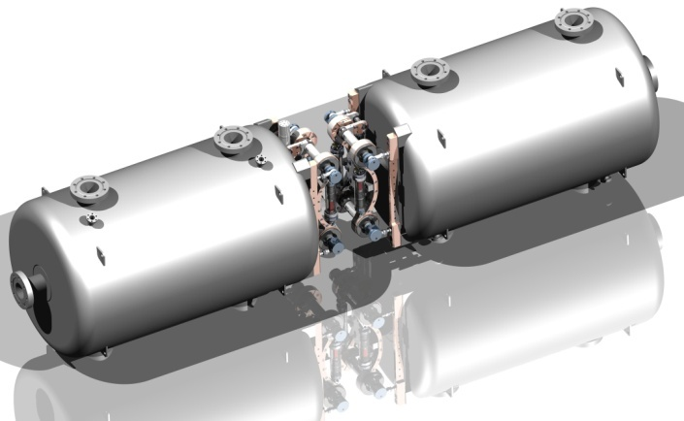
Spoke cryomodule
The cryomodule provides the necessary vacuum, cryogenic and mechanical environment to the superconducting cavities (and magnet in case of cold focusing) to properly operate at the required accelerating voltage (magnetic field), within an appropriate mechanical environment for installation, alignment and operation of the cavities.
3 main cryomodule options are envisaged:
Segmented design
Continuous design
Hybrid design
Main parameter for decision: comparisons on total heat load, reliability, installation cost…

Slide 21
Prototyping: “Dry run” on the Eurisol TSR
Prototyping Strategy
Early Prototypes (early 2013, ADU + P2B phase)
2 spoke cavities - tested in vertical cryostat (IPNO)
2 spoke cavities /w alternative options (ESS Bilbao)
2 power couplers - RF tests at low power (IPNO)
Late Prototypes (end 2014, P2B phase)
A complete spoke cryomodule (2 cavities) constructed, assembled and tested with:
at least: low RF power on cavities (IPNO)
later on: nominal RF power on one cavity at a time (?)
finally: nominal RF power on the 2 cavities (?)

Slide 22
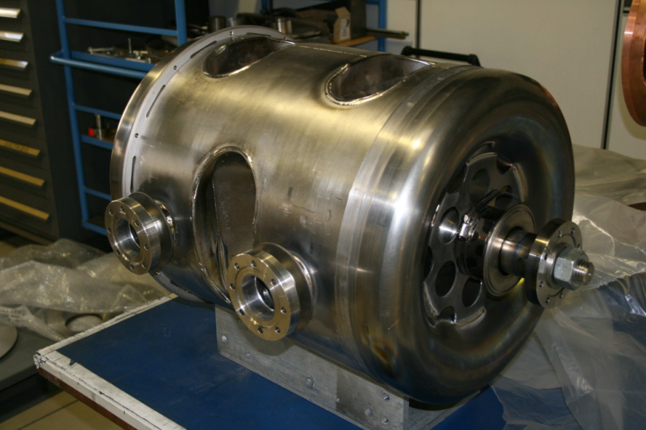
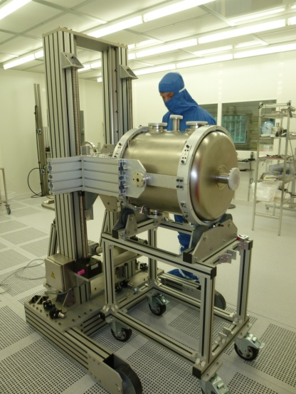
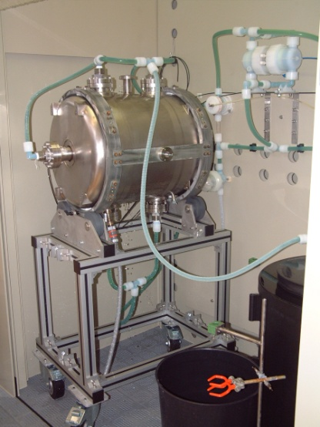
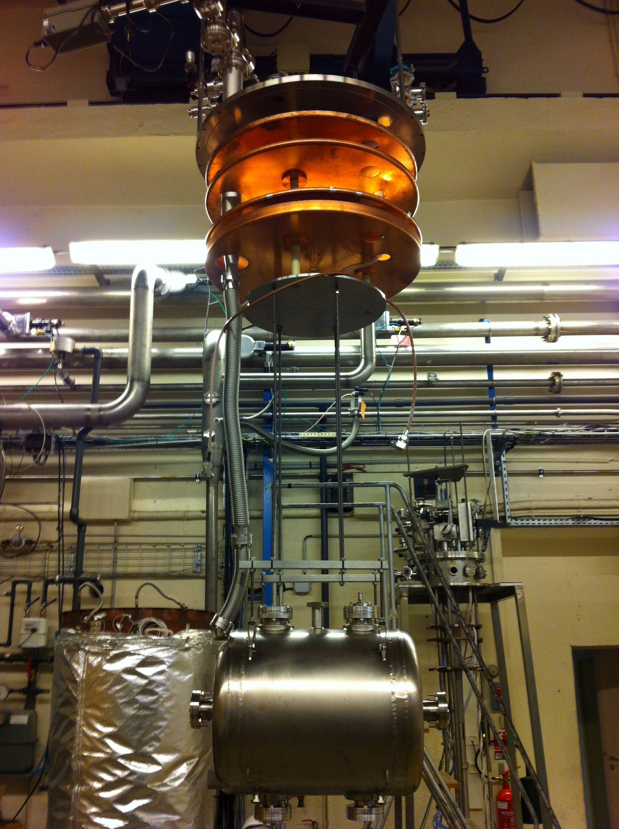
Prototyping: “Dry run” on the Eurisol TSR
Eurisol Triple Spoke
Clean room assembly
Preparation for cold test
Chemical etching

Slide 23
So…
Let’s do it !

